Slide 1
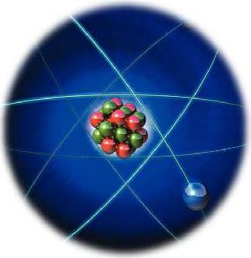


Selected Topics in Nuclear Physics
Lecturer: Hans-Jürgen Wollersheim
e-mail: h.j.wollersheim@gsi.de
web-page: https://web-docs.gsi.de/~wolle/ and click on

Slide 2
Selected Topics in Nuclear Physics
Lectures: Hans-Jürgen Wollersheim
e-mail: h.j.wollersheim@gsi.de
web-page: https://web-docs.gsi.de/~wolle/ and click on
1. Nuclear properties (K. Hyde)
2. Liquid drop model (K. Hyde)
3. Types of nuclear reactions
4. Counting statistics and error propagation (G. F. Knoll)
5. Properties of radiation detectors(efficiency especially) (G. F. Knoll)
6. Nuclear Shell model(K. Hyde)
7. Nuclear physics at extremes of stability : Exotic nuclei (Isomers especially) (K. Hyde)

Slide 3
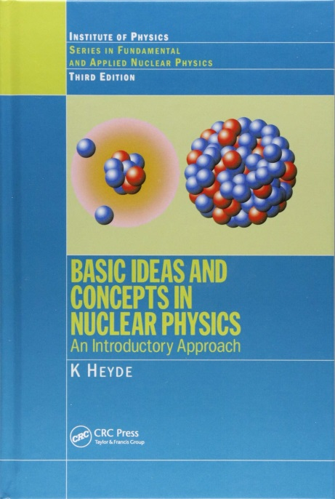
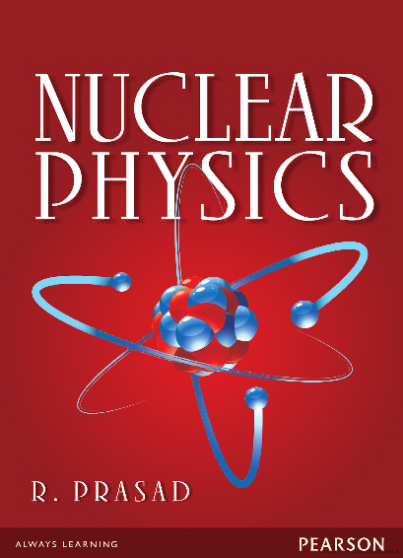
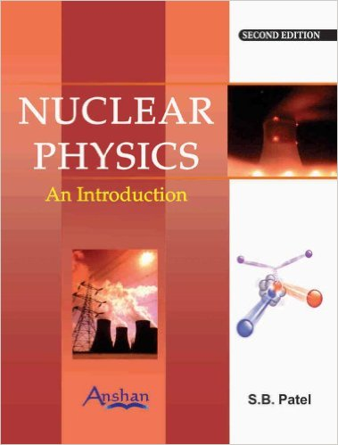
Literature
Recommended Textbook
Supplemental Textbook
www.bookzz.org

Slide 4
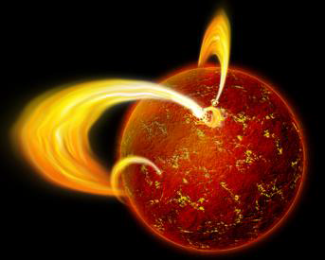
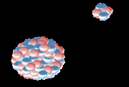
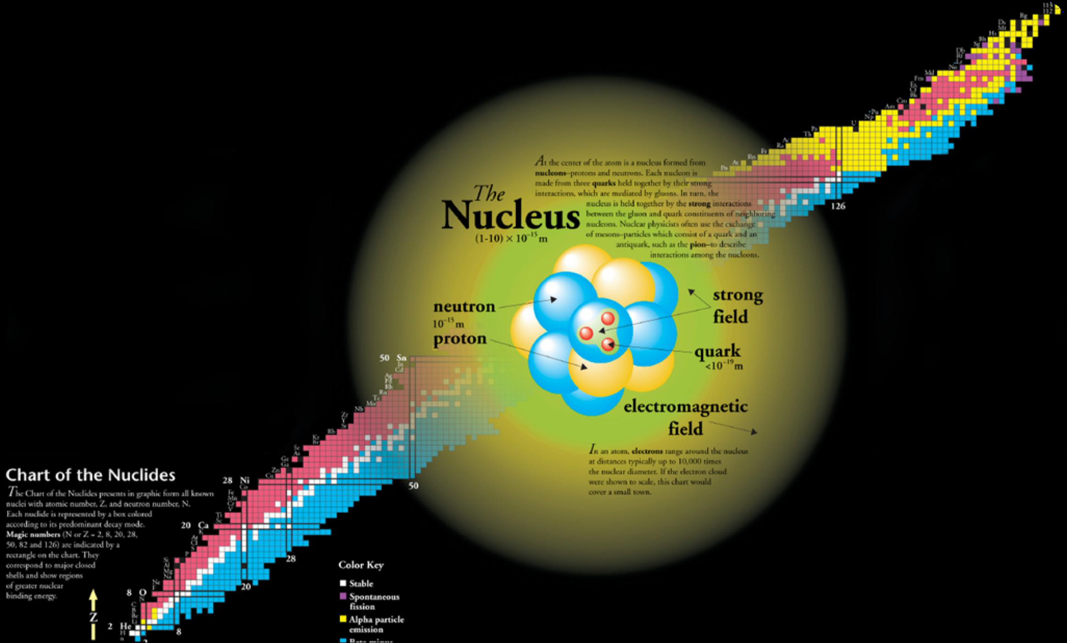
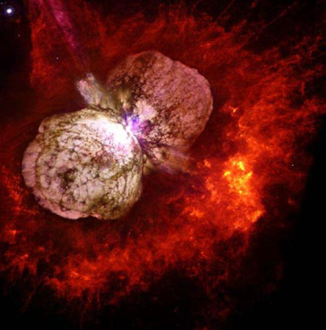
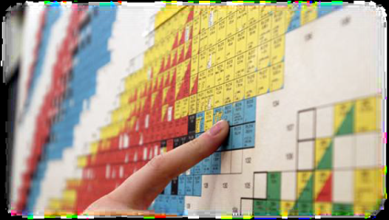
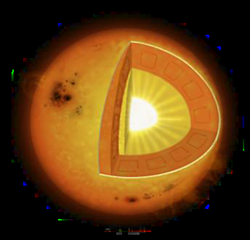
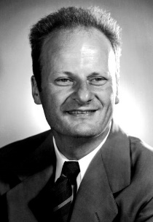

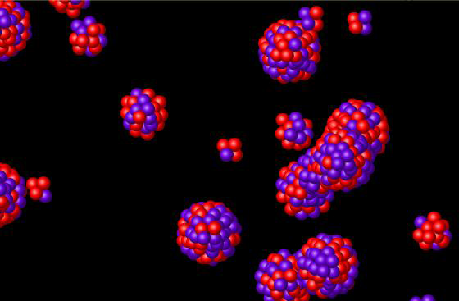
neutron star
unstable nuclei
supernovae
sun
heavy ion
nuclear reactions

Slide 5




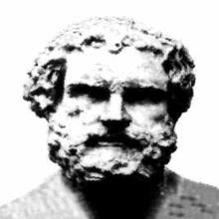
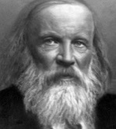
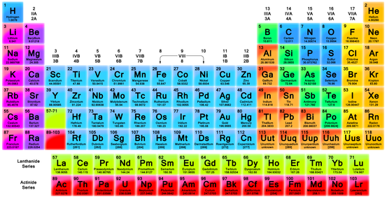
Brief historical overview in search of the building blocks of the universe ...
Greek philosophers
4 building blocks
earth
air
5th BC - Democritus
atomic hypothesis
water
fire
18th – 19th century Lavoisier, Dalton, ...
put atomic hypothesis on firm basis
distinction between compounds and pure elements
1896 Dmitri Mendeleev
92 building blocks
(chemical elements)
₁H, ₂He, ... ₉₂U

Slide 6
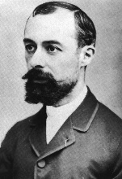
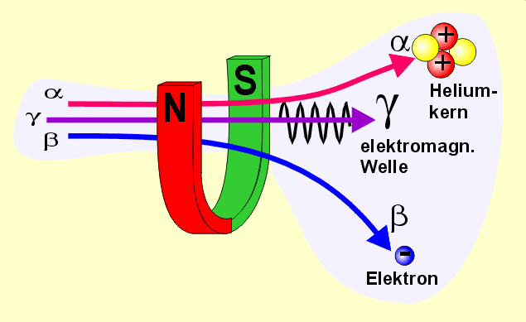
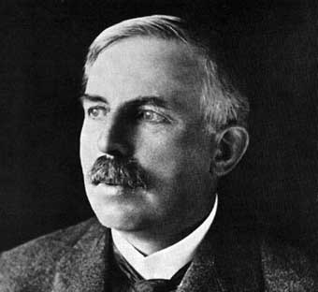

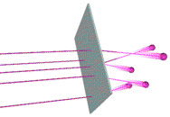
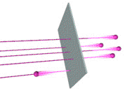
Brief historical overview in search of the building blocks of the universe ...
1896 Henri Becquerel
discovers radioactivity
Helium
nucleus
emission of radiation from atoms
3 types observed: α, β and γ
α and β deflected in opposite direction opposite charges
α deflected less than β α must have larger mass
γ not deflected uncharged
electromagnetic wave
electron
~1900 Ernest Rutherford
investigates new radiation
“... it was as incredible as if you had fired a 15-inch shell at a piece of tissue paper and it came back and hit you”
α and β emissions change nature of element
α‘s charge = +2e α‘s mass ~ 4H
β radiation = electrons
γ = electromagnetic radiation (photons)
expected
α’s (₂He) pushed a little to the side by charges of atom (₇₉Au)
observed
some α’s deflected backwards to 180⁰!!
1911 Ernest Rutherford tests Thomson’s model of the atom
N electrons (-e·N) embedded in (+e·N) charge uniformly distributed over atomic volume
“plum pudding model”

Slide 7
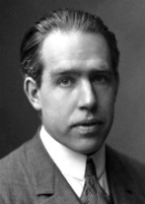
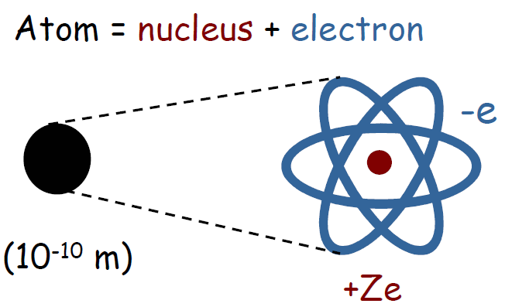
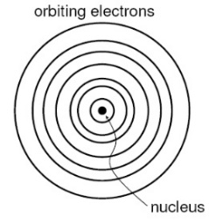
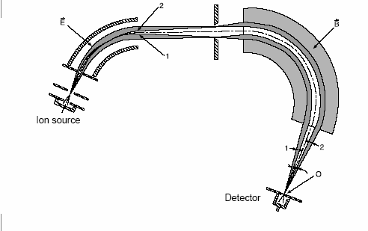
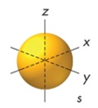
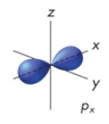
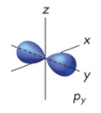
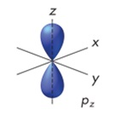
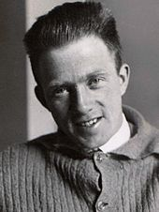
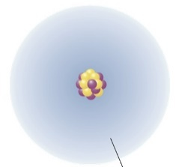
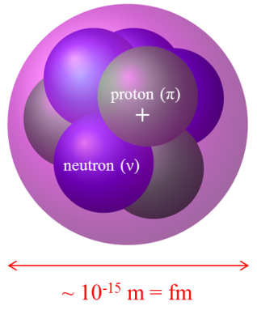
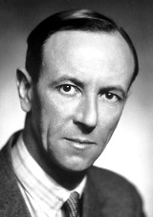


Brief historical overview in search of the building blocks of the universe
1913 Niels Bohr
planetary model of atom
all positive charges (and ~ all mass) concentrated in tiny region at the center
classical physics: electron should fall into the nucleus
New mechanism is needed
1920 Francis William Aston mass spectrograph
mass | charge
He ~ 4 H | He = 2 H
C ~ 12 H | C = 6 H
O ~ 16 H | O = 8 H
$$\vec{E}$$
$$\vec{B}$$
measures masses of atoms
hypothesis of neutral particle in nucleus with m ~ m_{p}
1925 Werner Heisenberg
quantum mechanics
simplest atom = H
its nucleus = proton
electron cloud
1932 James Chadwick
discovers the neutron
3 building blocks
electron + proton + neutron
NUCLEAR PHYSICS

Slide 8
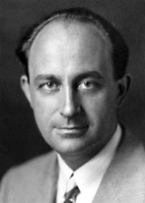
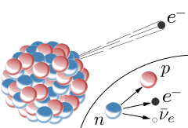
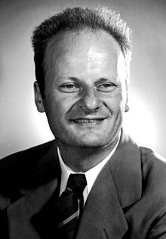
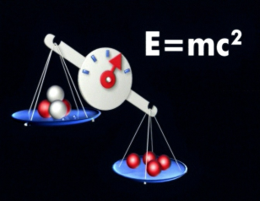
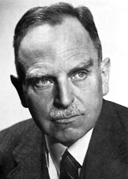

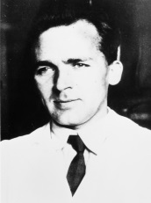
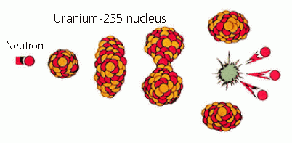
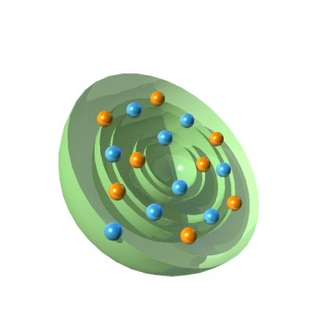
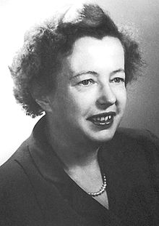
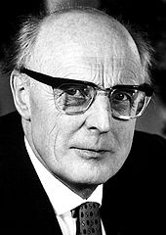

Brief historical overview in search of the building blocks of the universe
1932 Enrico Fermi
developed the theory of β-decay
1934 Irene Joliot-Curie & Frederic Joliot
artificial radioactivity
$${}_{13}^{27}{Al}+{}_{2}^{4}{He}→{{}_{15}^{30}P}^{∗}+1n$$
1934 Hans Bethe
liquid drop model and mass formula
1938 Otto Hahn, Lise Meitner & Fritz Strassmann
discover nuclear fission
1948 Maria Goeppert-Mayer & J. Hans D. Jensen
develop the nuclear shell model

Slide 9
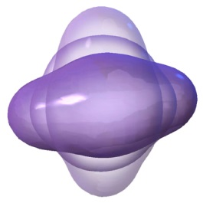
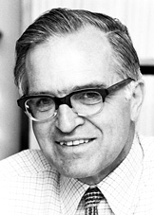
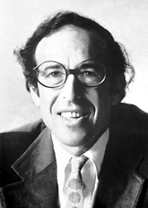
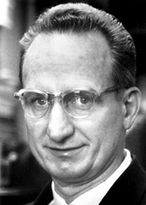
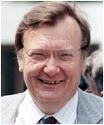
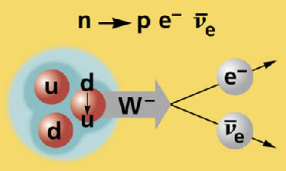
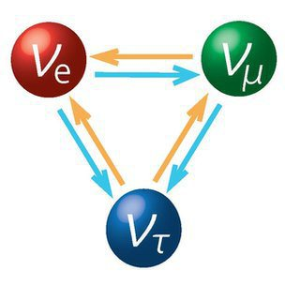


Brief historical overview in search of the building blocks of the universe
1953 Aage Niels Bohr, Ben Roy Mottelson, Leo James Rainwater
developed the collective nuclear model
1956 Frederick Reines & Clyde L. Cowan
discovery of the neutrino
1983 Carlo Rubbia
discovery of the W and Z Boson
1998 Takaaki Kajita & Arthur B. McDonald
discovery of neutrino oscillations neutrinos must have some mass

Slide 10
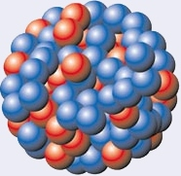


The Nobel Prizes in Physics (Chemistry) in the 20 and 21 centuries
1903: Radioactivity (Henri Becquerel, Marie & Pierre Curie)
1906: Discovery of electron (J. J. Thompson)
1908: Disintegration of the elements (Ernest Rutherford)
1922: Structure of atoms (Niels Bohr)
1929: Wave nature of electrons (Prince Louis-Victor Pierre Raymond de Broglie)
1935: Discovery of neutron (James Chadwick)
1936: Discovery of positron (Carl David Anderson)
1938: New radioactive elements produced by neutron irradiation (Enrico Fermi)
1939: Cyclotron (Ernest O. Lawrence)
1949: Theoretical work on nuclear forces (Hideki Yukawa)
1951: Transmutation of atomic nuclei (John Douglas Cockcroft & Ernest Thomas Sinton Walton)
1952: Nuclear Magnetic Resonance (Felix Bloch & Edward Mills Purcell)
1957: Parity violation (Chen Ning Yang & Tsung-Dao Lee)
1959: Discovery of antiproton (Emilio Gino Segre & Owen Chamberlain)
1961: Electron scattering and resonance absorption (Robert Hofstadter & Rudolf Ludwig Mössbauer)
1963: Nuclear shell model (Maria Goeppert-Mayer & J. Hans D. Jensen)
1967: Nuclear reactions and energy production in stars (Hans Albrecht Bethe)
1969: Quarks (Murray Gell-Mann)
1975: Collective and particle motion (Aage Niels Bohr, Ben Roy Mottelson & Leo James Rainwater)
1984: Discovery of W and Z bosons (Carlo Rubia & Simon van der Meer)
1989: Development of ion trap technique (Hans G. Dehmelt & Wolfgang Paul)
1992: Multi Wire Proportional Chamber (Georges Charpak)
1995: Discovery of tau and detection of neutrino (Martin L. Perl & Frederick Reines)
2008: CKM matrix element (Makoto Kobayashi & Toshihide Masukawa)
2013: Theoretical work on origin of mass of subatomic particles (Francois Englert & Peter W. Higgs)
2015: Discovery of neutrino oscillations (Takaaki Kajita & Arthur B. McDonald)
Henri Becquerel
1852-1908
Nobel price 1903
Marie Curie (1867-1934)
Piere Curie (1859-1906)
Nobel price 1903

Slide 11
Discovery timeline
1896: Henri Becquerel discovers radioactivity in Uranium salt
1898: Marie & Pierre Curie discover Polonium and Radium (new elements)
1907: Ernest Rutherford classified α-, β-, γ-radiation (α ≡ ⁴He nucleus)
1911: Rutherford, Geiger and Marsden discovered the atomic nucleus
1913: Bohr model of the hydrogen atom
1919: first nuclear reaction by Rutherford ¹⁴N + α → ¹⁷O + p
1930: Ernest O. Lawrence invented the cyclotron
1932: Enrico Fermi developed the theory of β-decay
1935: Hideki Yukawa postulates the theory of strong interaction (pion)
Bethe-Weizäcker mass formula & liquid drop model
1938: Hans Bethe postulates CNO fusion reaction for stellar energy
1939: O. Hahn, F. Straßmann and L. Meitner discover nuclear fission
1946: F. Bloch and E. Purcell improve NMR technique
1949: M. Goeppert-Mayer proposed the nuclear shell model
1957: beginning of nuclear astrophysics (Burbidge², Fowler, Hoyle-article to nucleosynthesis)
1967: J. Bell and A. Hewish discover pulsars (neutron stars)
1986: first observation of double-β decay 2νββ (rarest decay)
2006: production of the so far heaviest element (element Z = 118)
Henri Becquerel
1852-1908
Nobel price 1903
Marie Curie (1867-1934)
Piere Curie (1859-1906)
Nobel price 1903

Slide 12

Scales in the Universe
So ... Where Do We Start?
We need a point of reference to start discussing nuclear physics.
crystal molecule atom nucleus proton quark

Slide 13


The atom
atom is a neutral system
atomic excitations
~ 1-10⁵ eV
caused by transitions
between electronic states
~ 10⁻¹⁰ m

Slide 14


Bohr atomic model absorption spectrum
Hydrogen gas
Hydrogen
absorption
spectrum

Slide 15

Bohr atomic model emission spectrum
Helium
emission
spectrum

Slide 16


The atomic nucleus
nuclear excitations
~ 10⁵-10⁸ eV
caused by transitions
between nuclear states
proton (π)
+
neutron (ν)
~ 10⁻¹⁵ m = fm
excitations can be caused
by individual nucleons or
as a collective motion of the nucleus
nuclear shell model

Slide 17


Inside the atomic nucleus
positive charge
neutral charge
+
proton
neutron
protons and neutrons are very similar, they can be classified as the same object: the nucleon
Nucleons are quantum mechanical objects:
They are spin ½ Fermions
Radius: r ~ 1·10⁻¹⁵ m, or 1 fm (fermi)
Charge: p → + e
n → 0
Mass: p → 938.27 MeV/c²
n → 939.56 MeV/c²
Isospin: |p > = | -1/2 >
|n > = | +1/2 >

Slide 18

Structure of nucleons
particle excitations
> 10⁹ eV
“Up” (u)
m = 2.4 MeV/c²
q = +2/3
“Down” (d)
m = 4.8 MeV/c²
q = -1/3
proton
u, u, d
neutron
u, d, d

Slide 19

Elementary particles of the standard model

Slide 20



Terminology
A – mass number gives the number of nucleons in the nucleus
Z – number of protons in the nucleus (atomic number)
N – number of neutrons in the nucleus
A = Z + N
In nuclear physics, nucleus is denoted as ${}_{Z}^{A}X$ , where X is the chemical element
e.g. ${}_{1}^{1}H$ - hydrogen, ${}_{6}^{12}C$ - carbon, ${}_{79}^{197}{Au}$ - gold.
Different combinations of Z and N (or Z and A) are called nuclides
nuclides with the same mass number A are called isobars
nuclides with the same atomic number Z are called isotopes
nuclides with the same neutron number N are called isotones
nuclides with equal proton number and equal mass number,
but different excited states are called nuclear isomers
$${}_{7}^{17}N, {}_{8}^{17}O, {}_{9}^{17}F$$
$${}_{6}^{12}C, {}_{6}^{13}{C, {}_{6}^{14}C }$$
${}_{6}^{13}C, {}_{7}^{14}N$
$${}_{73}^{180}{Ta}, {}_{73}^{180m}{Ta}$$
The most long-lived non-ground state nuclear isomer is tantalum-180m, which has a half-life in excess of 1000 trillion years

Slide 21

The Chart of Nuclides
- the “Playground” for Nuclear Physics
chart of nuclides:
representation of isotopes in the Z-N plane
isotope: atom (nucleus) of an element with
different number of neutrons
proton number Z
black: stable isotope
red: β⁺-unstable isotope
blue: β⁻-unstable isotope
yellow: α-instable isotope
green: spontaneous fission
neutron number N

Slide 22

The Chart of Nuclides
- the “Playground” for Nuclear Physics
chart of nuclides:
representation of isotopes in the Z-N plane
isotope: atom (nucleus) of an element with
different number of neutrons
different modes of
radioactive decay
proton number Z
neutron number N

Slide 23

The Chart of Nuclides
- the “Playground” for Nuclear Physics
chart of nuclides:
representation of isotopes in the Z-N plane
isotope: atom (nucleus) of an element with
different number of neutrons
proton number Z
neutron number N

Slide 24

Questions: Chart of Nuclides
How are the isotopes of an element arranged on the chart?
Nuclides with the same number of neutrons are called isotones. How are they arranged on the chart?
Nuclides with the same mass number are called isobars. What would be the orientation of a line connecting an isobaric series?
Begin with the following radioactive parent nuclei, ²³⁵U, ²³⁸U, ²⁴⁴Pu, trace their decay processes and depict the mode and direction of each decay process on the chart. What are the final stable nuclei?
http://people.physics.anu.edu.au/~ecs103/chart/index.php

Slide 25



Applications: Solar Abundances of Elements
Solar abundance (Si²⁸ = 10⁶)
Big Bang
fusion reactions
neutron reactions
open questions:
Why is Fe more common
than Au ?
Why do the heavy elements
exist and how are they
produced?
Can we explain the solar
abundances of the elements?
Mass number

Slide 26

Shell evolution, Nucleosynthesis (r-process)
r-process abundances
exp.
pronounced shell gap
shell structure quenched
mass number A
Assumption of N=82 and N=126 shell quenching leads to a considerable
improvement in the global abundance fit in r-process calculations

Slide 27

Applications: Nuclear Astrophysics

Slide 28

Nuclear Fission: Energy and Engineering

Slide 29



Nuclear matter has exotic properties
Nuclear matter is extremely heavy 2.3·10¹⁷ kg/m³
for comparison:
sea water: 1.0·10³ kg/m³
tin oxide: 1.6·10³ kg/m³
steel: 1.1·10⁴ kg/m³
lead: 2.5·10⁴ kg/m³
core of the sun: 1.5·10⁵ kg/m³
Although we know nuclear matter only in small portions inside atoms, it exists in nature also in big portions:
Neutron Stars have a diameter of typically 10 km
Nuclear structure physics investigates the response of the nucleus as a function of:
$$ρ=\frac{Am_{p}}{4/3π∙R^{3}}=\frac{m_{p}}{4/3π∙r_{0}^{3}}=\frac{1.66∙{10}^{−27}kg}{4/3π∙{\left(1.2∙{10}^{−15}m\right)}^{3}}$$

Slide 30





Properties of stable nuclei
Radius & shape
size: nuclear radius (R = 1.2·A^{1/3} fm)
shape: spherical / deformed (prolate / oblate)
Density & mass
constant nuclear density (ρ = 10¹⁷ kg/m³)
nuclear mass & valley of stability
Nuclear states
quantum numbers spin S, parity P, magnetic moments
shell structure: valence-nucleons, collective excitations
Nuclear reactions
binding energy: fusion & fission, nuclear astrophysics
special reactions: exchange / transfer

Slide 31


Long Standing Questions of Nuclear Structure Physics
What are the limits for existence of nuclei?
  Where are the proton and neutron drip lines situated?
  Where does the nuclear chart end?
How does the nuclear force depend on varying proton-to-neutron ratios?
  What is the isospin dependence of the spin-orbit force?
  How does shell structure change far away from stability?
How to explain collective phenomena from individual motion?
  What are the phases, relevant degrees of freedom, and symmetries of the nuclear many-body system?
How are complex nuclei built from their basic constituents?
  What is the effective nucleon-nucleon interaction?
  How does QCD constrain its parameters?
Which are the nuclei relevant for astrophysical processes
and what are their properties?
  What is the origin of the heavy elements?
p-dripline
n-dripline

Slide 32


Eleven Science Questions for the 21st century
What is dark matter?
What is dark energy?
The expansion of the universe is speeding up rather than slowing down
How were the heavy elements from iron to uranium made?
The production of elements up to iron in stars and supernovae is fairly understood.
The precise origin of heavier elements remains a mystery.
Do neutrinos have mass?
The experimental discovery of neutrino oscillation implies that
the neutrino has a non-zero mass.
Where do ultrahigh-energy particles come from?
Colliding galaxies produce extremely high energy cosmic rays
which exceeds any energy produced on Earth.
Is a new theory of light and matter needed to explain what happens at very high energies and temperatures?
Matter and radiation appears to be well described by quantum mechanics and electromagnetism.
(neutron stars, gamma-ray bursts)
Are there new states of matter at ultrahigh temperatures and densities?
At extremely high densities and temperatures, protons an neutrons may “dissolve”
into a undifferential “soup” of quarks and gluons.
Are protons unstable?
The tiny imbalance between matter and antimatter at the early universe may be tied to a
hypothesized instability of protons.
What is gravity?
Black holes are ubiquitous in the universe, and their intense gravity can be explored.
Are there additional dimensions?
To understand the quantum nature of gravity, one has posited the existence of space-time dimensions
beyond those that we know.
How did the Universe begin?
There is evidence that during its earliest moments the universe underwent a tremendous burst of additional expansion (mystery)

Slide 33






Nuclear units and physical constants
Nuclear units
length unit:
Fermi = femtometer = fm = 10⁻¹⁵ [m]
energy unit:
MeV = 10⁶ eV = 10⁶·1.602·10⁻¹⁹ CV = 1.602·10⁻¹³ [J]
mass unit:
1 u = 1/12·m[¹²C] = 931.49432 MeV/c² = 1.66054·10⁻²⁷ [kg]
time unit:
[s] or [fm/c] ≈ 3·10⁻²⁴ [s]
Albert Einstein
1879-1955
Nobel price 1921
$$E=m∙c^{2}$$
Constant of nature relevant to nuclear physics
speed of light in vacuum, c = 2.99792458·10⁸ [m/s]
Planck’s constant / 2π = ħ = 6.58211889·10⁻²² [MeV s] = 1.054·10-34 [J s]
ħc = 197.3269602 [MeV fm]
fine structure constant (dimensionless), α = e²/(ħc) = 1/137.0359976
→ e² = α·ħc = 1.4399643929 [MeV fm]
elementary charge, e = 1.602·10⁻¹⁹ [C] or e = 1.1999851636 $\left[\sqrt{MeV fm}\right]$
rest energy of proton, m_{p}c² = 938.27231 [MeV]
rest energy of neutron, m_{n}c² = 939.56563 [MeV]
rest energy of electron, m_{e}c² = 0.51099906 [MeV]
Avogadro’s number, N_{A} = 6.0221367·10²³ /mol
E – p relationship:
Kinetic energy:
$$E^{2}=p^{2}c^{2}+{m_{0}}^{2}c^{4}$$
$$T=E−m_{0}c^{2}=m_{0}c^{2}\left(γ−1\right)$$

