Slide 1
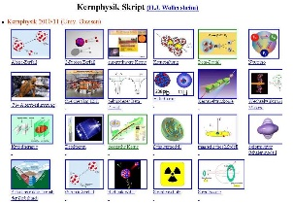
Outline: Interacting Boson Model
Lecturer: Hans-Jürgen Wollersheim
e-mail: h.j.wollersheim@gsi.de
web-page: https://web-docs.gsi.de/~wolle/ and click on
particle classification
parameters in IBM Hamiltonian
vibrational limit U(5)
rotational limit SU(3)
extension of IBM

Slide 2
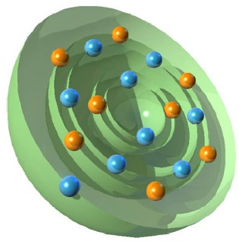
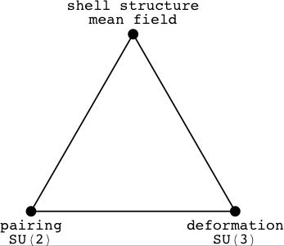
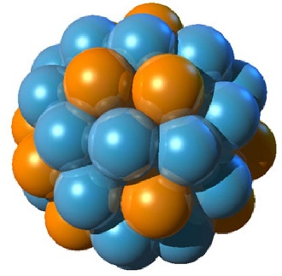
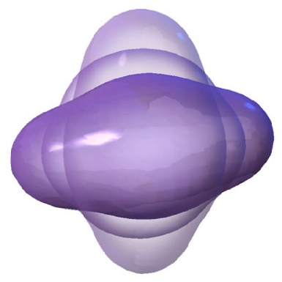
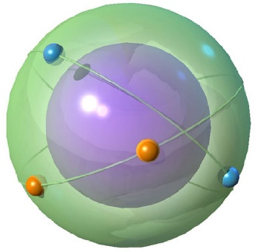
The three faces of the shell model

Slide 3
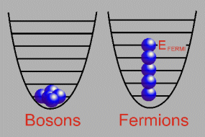
Particle classification
Fermions:
  Spin 1/2 particles
  Obey Pauli Exclusion Principle
    No more than one fermion can occupy the same quantum state
  Antisymmetric wave functions
  Two classifications
    Hadrons - interact via strong nuclear force; composed of quarks; neutrons, protons, etc.
    Leptons - fundamental particles, ie no substructure; electron, muon, tau, neutrino.
Bosons:
  Integer spins
  Obey Bose-Einstein Statistics
    Any number of bosons can share the same quantum state
  Symmetric wave functions
  Force mediators- Photons, gluons, etc.

Slide 4
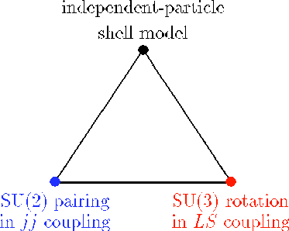
Symmetries of the shell model
Three bench-mark solutions;
  no residual interaction → IP shell model
  pairing (in jj coupling) → Racah’s SU(2)
  quadrupole (in LS coupling) → Elliott’s SU(3)
Symmetry triangle:

Slide 5

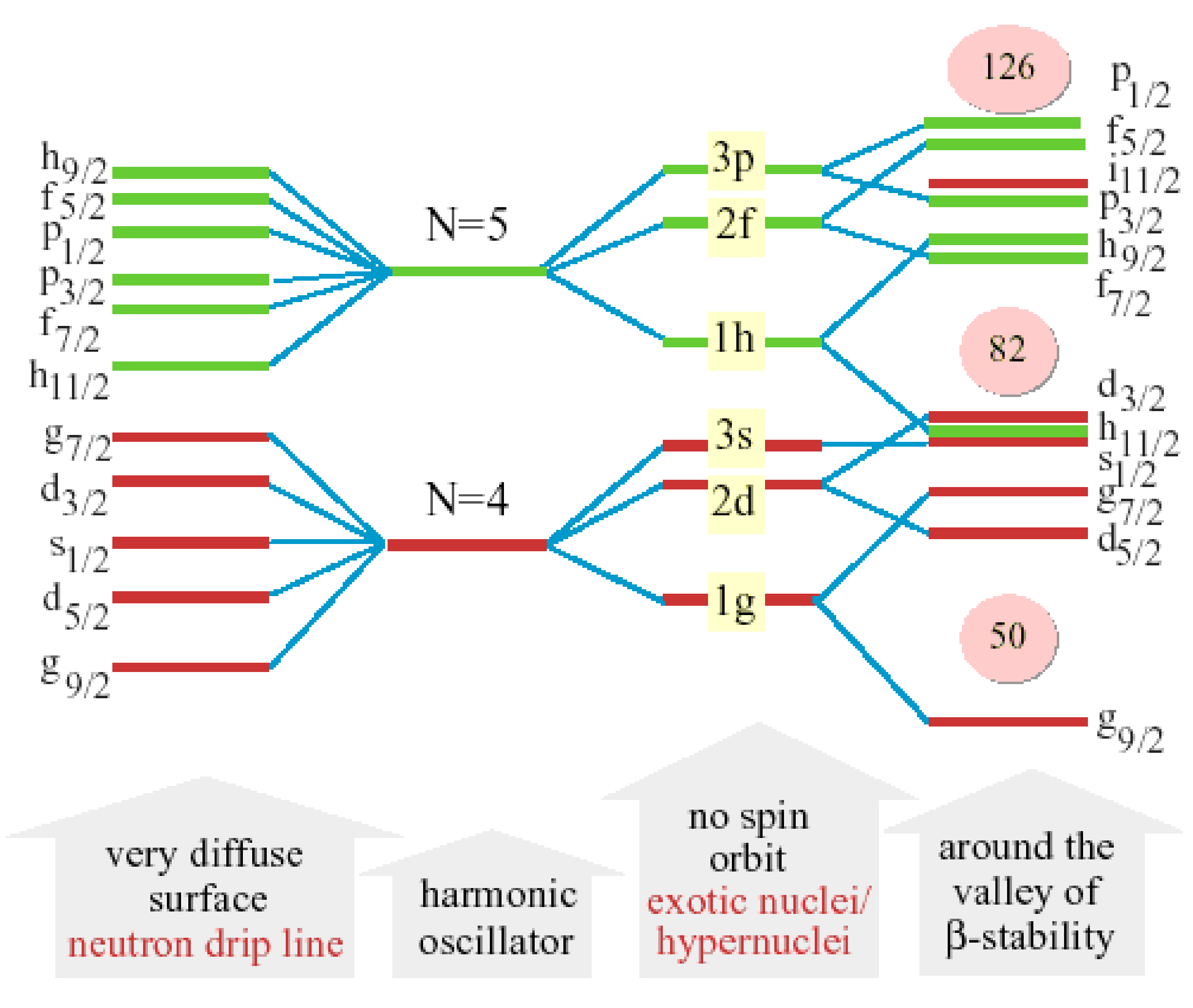
Evidence for shell structure
Evidence for shell structure from
  2⁺ energies in even-even nuclei [E_{x}, B(E2)]
  nucleon separation energies & nuclear masses
  nuclear level densities
  reaction cross sections
Is nuclear shell structure modified
away from the line of stability?

Slide 6
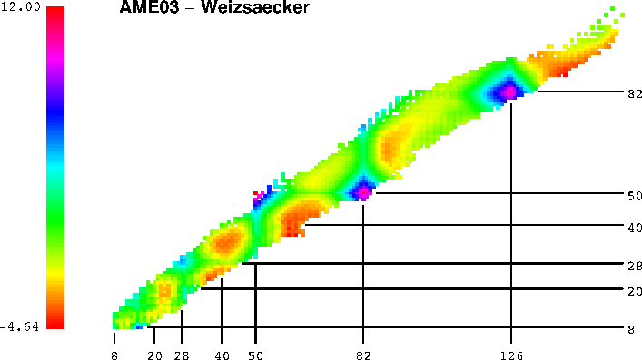
Shell structure from masses
Deviations from Weizsäcker mass formula:

Slide 7
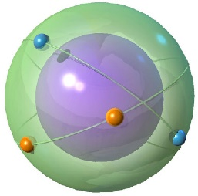
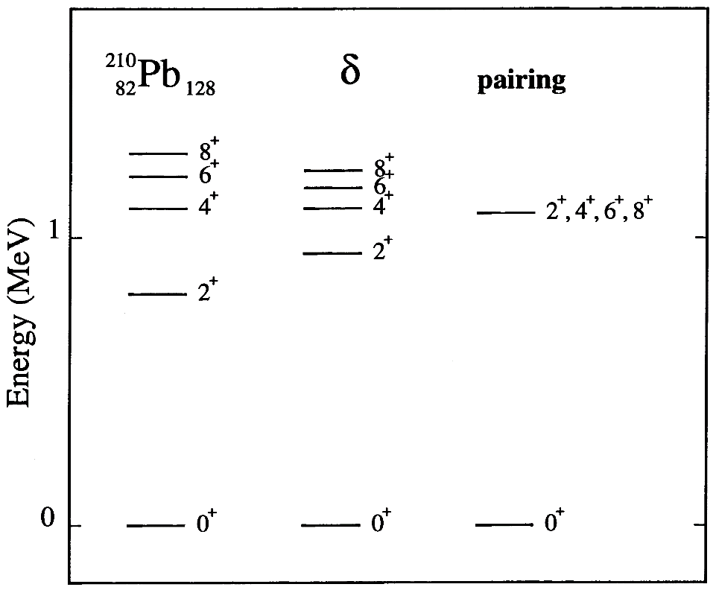
Racah’s SU(2) pairing model
Assume large spin-orbit splitting which implies a jj-coupling scheme
Assume pairing interaction in a single-j shell
Spectrum of ²¹⁰Pb:

Slide 8

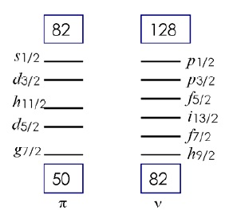


Modeling a nucleus
$${}_{66}^{162}{{Dy}_{96}}$$
shell model
~ 7·10¹⁹ 2⁺ states
one needs a truncation
Interacting Boson Model
assumptions:
only valence nucleons
Fermions → Bosons
J = 0 (s bosons)
J = 2 (d bosons)
30 basic states 2⁺ states
${}_{50}^{132}{{Sn}_{82}}$inert core

Slide 9
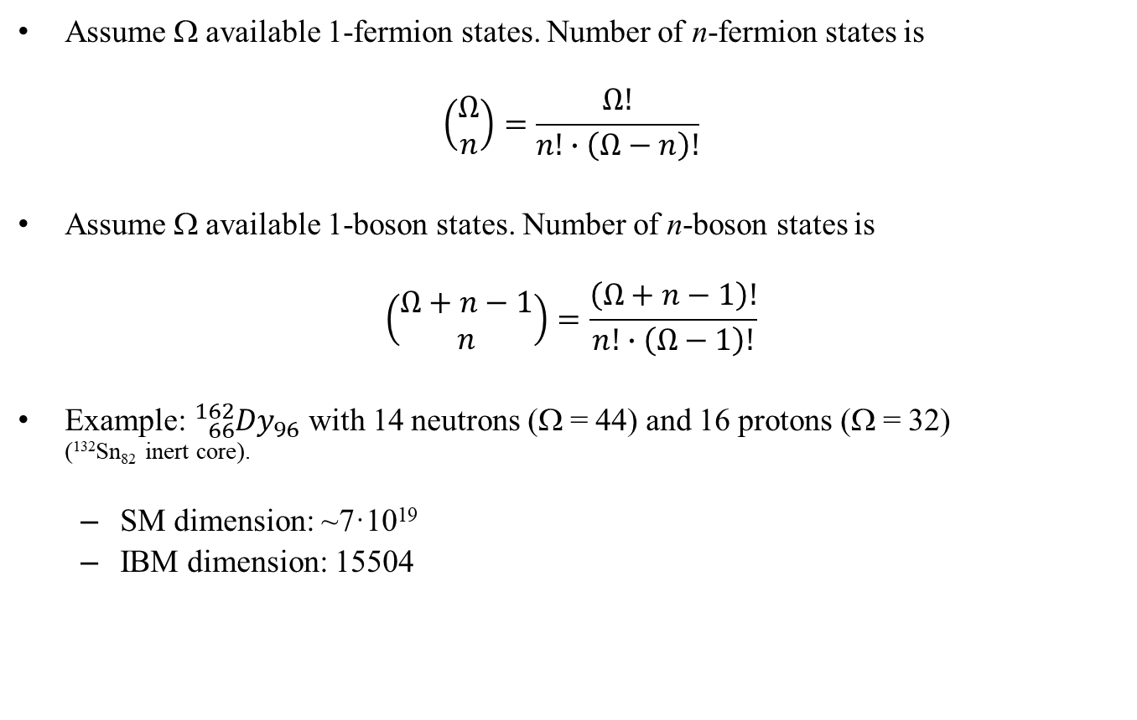
Dimensions
Assume Ω available 1-fermion states. Number of n-fermion states is
$$\left(\begin{matrix}Ω \\ n\end{matrix}\right)=\frac{Ω!}{n!∙\left(Ω−n\right)!}$$
Assume Ω available 1-boson states. Number of n-boson states is
$$\left(\begin{matrix}Ω+n−1 \\ n\end{matrix}\right)=\frac{\left(Ω+n−1\right)!}{n!∙\left(Ω−1\right)!}$$
Example: ${}_{66}^{162}{{Dy}_{96}}$ with 14 neutrons (Ω = 44) and 16 protons (Ω = 32) (¹³²Sn₈₂ inert core).
  SM dimension: ~7·10¹⁹
  IBM dimension: 15504

Slide 10
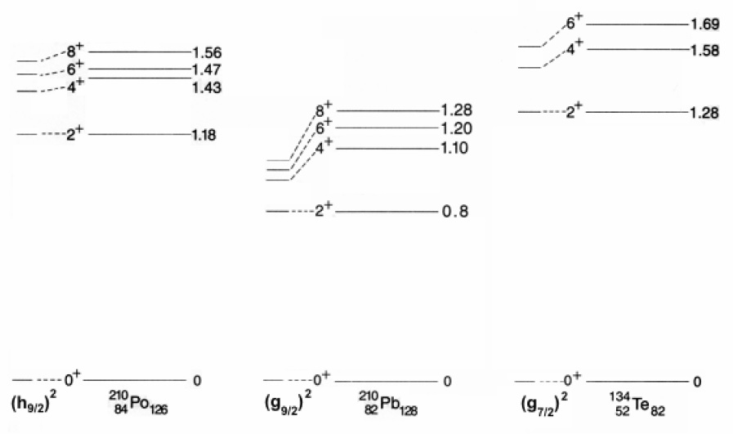
Why s- and d-bosons?
s-boson lowest state of all even-even nuclei is 0⁺.
δ-force gives 0⁺ ground state
d-boson first excited state in non-magic even-even nuclei almost always 2⁺
δ-force gives 2⁺ (occupation μ=-2,-1,0,1,2) next above 0⁺

Slide 11
Interacting boson model
F. Iachello, A Arima (1975)
s-bosons (l=0)
  Interpretation:
  “nucleon pairs with l = 0, 2”
  “quanta of collective excitations”
d-bosons (l=2)
Dynamical algebra: U(6)
…generators:
…conserves:
Subalgebras: U(5), O(6), O(5), O(3), SU(3), [O(6), SU(3)]
Dynamical symmetries (extension of standard, invariant symmetries):
U(5)
O(6)
SU(3)
[O(6), SU(3)]
See eg.: F.Iachello, A. Arima : The Interacting Boson Model, Cambridge University Press, 1987

Slide 12
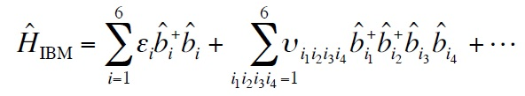

Interacting boson model
Describe the nucleus as a system of N interacting s and d bosons. Hamiltonian:
Since boson number is conserved for a given nucleus, H can only contain “bilinear” terms: 36 of them.
group theoretical classification of Hamiltonian
U(6)
$$s^{+}s, s^{+}d_{m}, d_{m}^{+}s, d_{m}^{+}d_{m′}$$
Justification from
  Shell model: s and d bosons are associated with S and D fermion (Cooper) pairs.
  Geometric model: for large boson number the IBM reduces to a liquid-drop Hamiltonian.

Slide 13
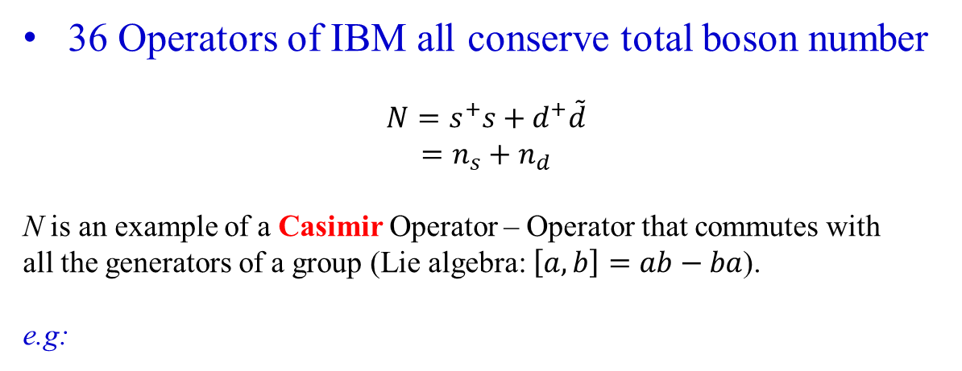



Group theory Casimir operator
36 Operators of IBM all conserve total boson number
$$N=s^{+}s+d^{+}\tilde{d}$$
$$=n_{s}+n_{d}$$
N is an example of a Casimir Operator – Operator that commutes with
all the generators of a group (Lie algebra: $\left[a,b\right]=ab−ba$).
e.g:
$$\left[N,s^{+}\tilde{d}\right]Ψ=\left[N\left(s^{+}\tilde{d}\right)−s^{+}\tilde{d}N\right]Ψ$$
$$=Ns^{+}\tilde{d}Ψ−s^{+}\tilde{d}NΨ$$
$$=Ns^{+}\tilde{d}Ψ−Ns^{+}\tilde{d}Ψ=0$$
Set of states of the IBA with given N are an irreducible representation of the group U(6) spanned by these 36 operators

Slide 14
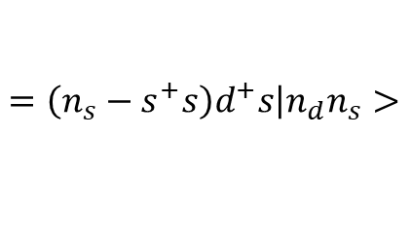
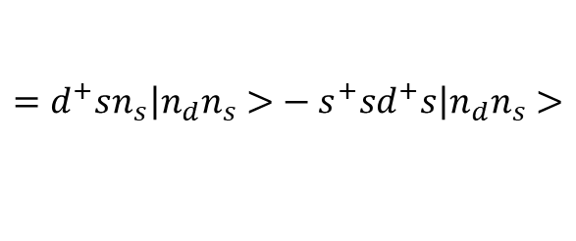
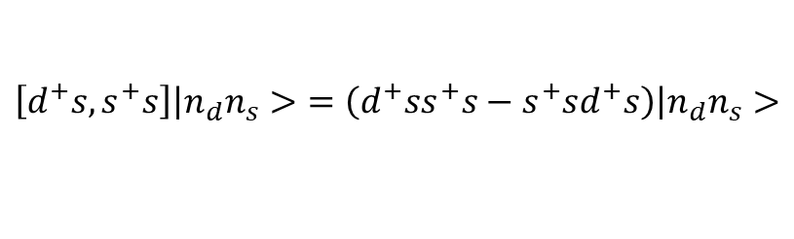
Concept of group theory
For IBA, the 36 operators $s^{+}s, d^{+}s, s^{+}d, d^{+}d$ are generators of the group U(6)
$$\left[d^{+}s,s^{+}s\right]\left|n_{d}n_{s}>\right.=\left(d^{+}ss^{+}s−s^{+}sd^{+}s\right)\left|n_{d}n_{s}>\right.$$
$$=d^{+}sn_{s}\left|n_{d}n_{s}>\right.−s^{+}sd^{+}s\left|n_{d}n_{s}>\right.$$
$$=\left(n_{s}−s^{+}s\right)d^{+}s\left|n_{d}n_{s}>\right.$$
Subsets of generators that commute among themselves.
e.g: d⁺d 25 generators—span U(5)
They conserve n_{d} (# d bosons)
Set of states with same n_{d} are the representations of the group U(5)

Slide 15
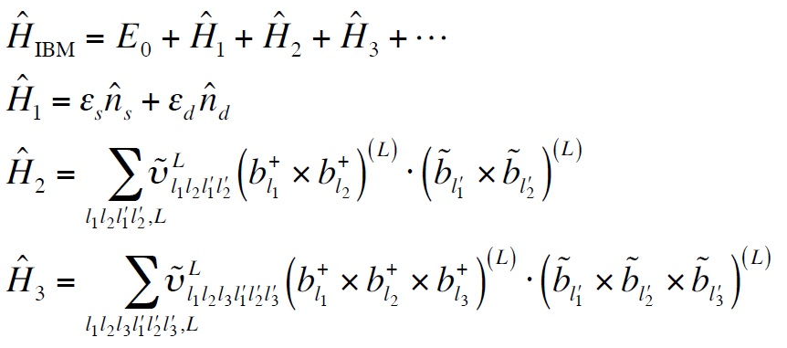
General IBM Hamiltonian
Most general rotationally invariant IBM Hamiltonian:

Slide 16
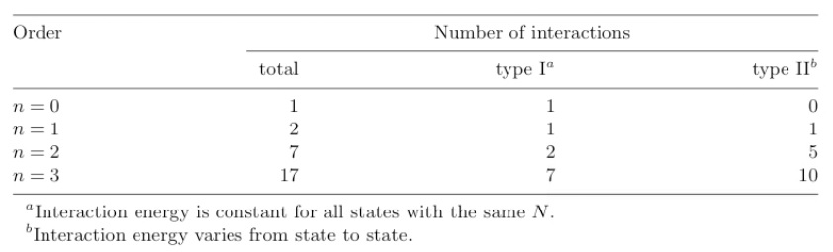
Parameters in the IBM Hamiltonian
Spectrum of a single nucleus: 0+1+5+10 parameters.
Overall binding energy: 1+1+2+7 parameters.
⇒ A total of 27 parameters if all interactions up to three-body are included (cfr. 63 2-body sd-shell model matrix elements).

Slide 17

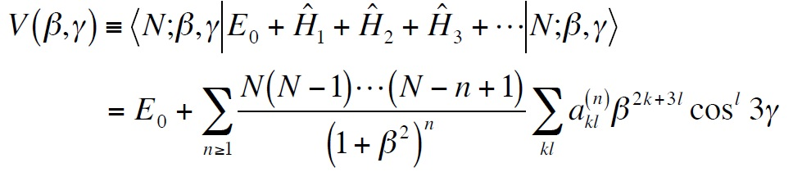
Classical limit
Coherent state:
Generic form of the potential:
β is elongation of nuclear ellipsoidal shape – related to ratio of major and minor axes.
γ is the deviation from axial symmetry along the major axis. It is measured as an angle from 0 to 30 degrees.

Slide 18
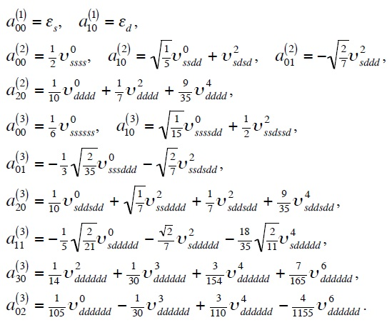
Coefficients up to third order

Slide 19
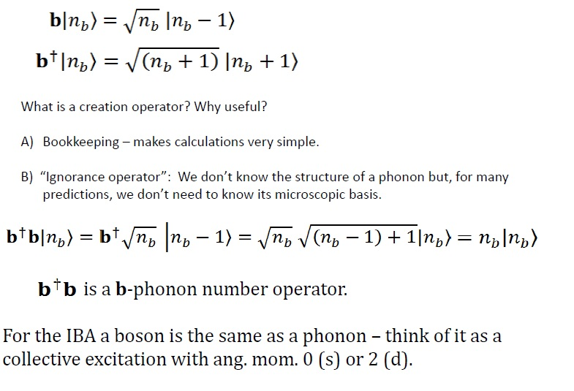
Review of phonon creation and annihilation operators

Slide 20
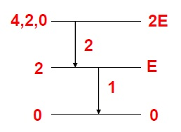
Why are creation and annihilation operators useful?
Example: Consider a vibrational nucleus with quadrupole phonon excitations, with angular momentum 2. These are vibrational excitations with energy E.
Therefore, the lowest energy state will have N=0 of these vibrations. The lowest excited state will have one of them and excitation energy 1 E.
$$B\left(E2;4→2\right)=2∙B\left(E2;2→0\right)$$

Slide 21
The solvable IBM Hamiltonians Dynamical symmetries
U(5) Vibrator
SU(3) Axial Rotator
O(6) Axially asymmetric Rotor (“gamma-soft”)

Slide 22
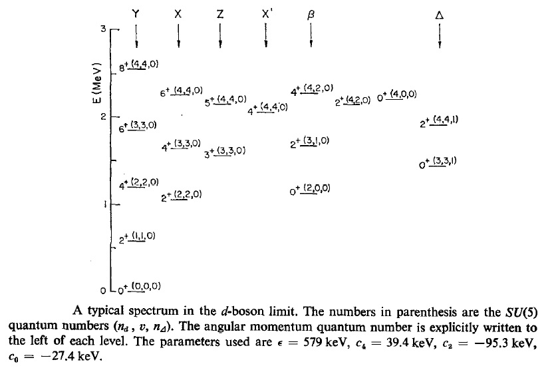
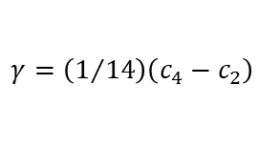
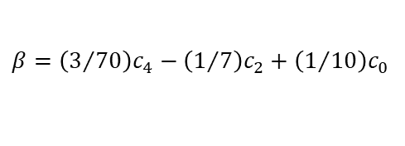
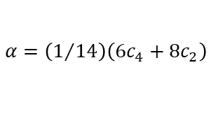
Application to U(5)-like nuclei 4 + 4 parameters
$$E\left(n_{d},ν,n_{Δ},L,M\right)=ε∙n_{d}+\frac{α}{2}∙n_{d}\left(n_{d}−1\right)+β\left(n_{d}−ν\right)\left(n_{d}+ν+3\right)+γ∙\left[L\left(L+1\right)−6n_{d}\right]$$
eigenvalues do not depend on n_{Δ} and M.
The parameters α, β, γ can be related to c₀, c₂, c₄ by considering states wit n_{d} = 2.
$$α=\left(1/{14}\right)\left(6c_{4}+8c_{2}\right)$$
$$β=\left(3/{70}\right)c_{4}−\left(1/7\right)c_{2}+\left(1/{10}\right)c_{0}$$
$$γ=\left(1/{14}\right)\left(c_{4}−c_{2}\right)$$
ν = n_{d} – 2n_{β} boson seniority number
F.Iachello, A. Arima ; Ann. Phys. 99 (1976) 253

Slide 23
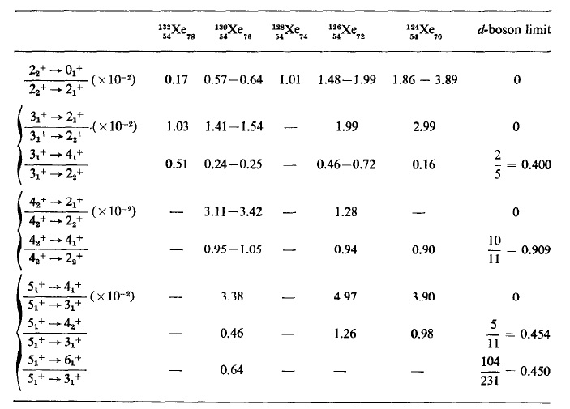
Application to U(5)-like nuclei 4 + parameters
B(E2) branching ratios in the Xe-isotopes
F.Iachello, A. Arima ; Ann. Phys. 99 (1976) 253

Slide 24

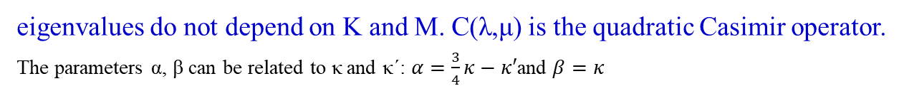
Application to SU(3)-like nuclei 2 + parameters
$E\left(\left[N\right]\left(λ,μ\right)KLM\right)=α∙L\left(L+1\right)−β∙C\left(λ,μ\right)$ with $C\left(λ,μ\right)=λ^{2}+μ^{2}+λμ+3\left(λ+μ\right)$
eigenvalues do not depend on K and M. C(λ,μ) is the quadratic Casimir operator.
The parameters α, β can be related to κ and κ´: $α=\frac{3}{4}κ−κ′$and $β=κ$
$${}_{64}^{156}{{Gd}_{92}}$$
The energy difference between the lowest (2N,0) and the next lowest (2N-4,2) representation is in units of κ, 12N-6
F.Iachello, A. Arima ; Ann. Phys. 111 (1978) 201

Slide 25
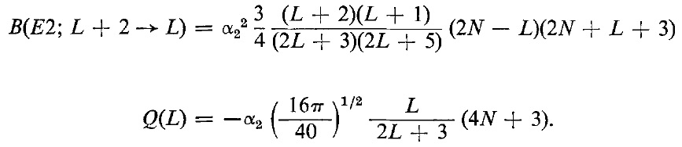
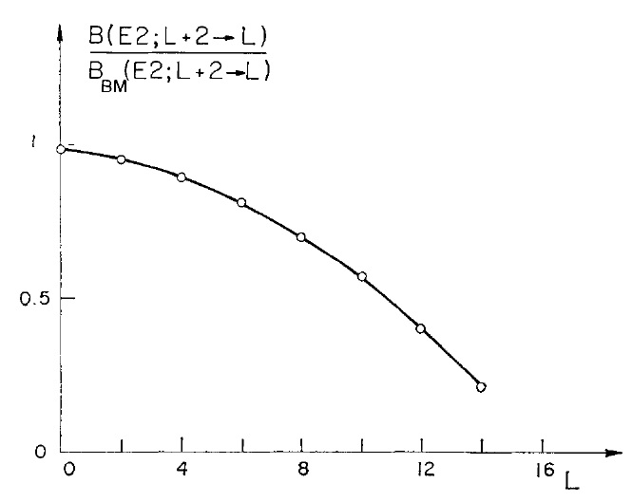
Application to SU(3)-like nuclei 2 + 3 parameters
N=8
F.Iachello, A. Arima ; Ann. Phys. 111 (1978) 201

Slide 26
Application to SO(6) γ-unstable nuclei 2 + parameters
Rotation-vibration spectrum of a γ-unstable body.
Conserved quantum numbers: σ, υ, L.
F.Iachello, A. Arima ; Ann. Phys. 123 (1979) 468

Slide 27
Synopsis of IBM symmetries
Symmetry triangle of the IBM:
  Three standard solutions: U(5), SU(3), SO(6).
  SU(1,1) analytic solution for U(5) → SO(6).
  Hidden symmetries (parameter transformations).
  Deformed-spherical coexistent phase.
  Partial dynamical symmetries.
  Critical-point symmetries?

Slide 28
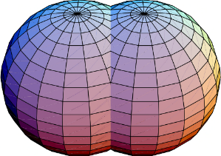
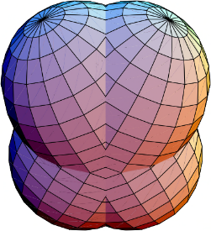




Extension of IBM
Neutron and proton degrees freedom (IBM-2):
  F-spin multiplets (N_{ν}+N_{π}=constant)
  Scissors excitations
Fermion degrees of freedom (IBFM):
  Odd-mass nuclei
  Supersymmetry (doublets & quartets)
Other boson degrees of freedom:
  Isospin T=0 & T=1 pairs (IBM-3 & IBM-4)
  Higher multipole (g,…) pairs
$${}_{78}^{194}{{Pt}_{116}}$$
$${}_{78}^{195}{{Pt}_{117}}$$
$${}_{79}^{195}{{Au}_{116}}$$
$${}_{79}^{196}{{Au}_{117}}$$

Slide 29

Scissors excitations
Collective displacement modes between neutrons and protons:
  Linear displacement (giant dipole resonance): $R_{ν}−R_{π}⇒E1 excitation$.
  Angular displacement (scissor resonance): $L_{ν}−L_{π}⇒M1 excitation$

Slide 30

Supersymmetry
A simultaneous description of even- and odd- mass nuclei (doublets) or of even-even, even-odd, odd-even and odd-odd nuclei (quartets).
Example of ${}_{78}^{194}{{Pt}_{116}}$, ${}_{78}^{195}{{Pt}_{117}}$, ${}_{79}^{195}{{Au}_{116}}$ & ${}_{79}^{196}{{Au}_{117}}$

Slide 31
Comments on the use of NNDC
Nuclear spectra:
  Systematic use of band-plotting option in NuDat
⇒ important for identification of collective bands.
  Occasional problems:
    Gamma-band structure in ¹⁶⁰Dy and ¹⁷⁰Yb??
    Gamma band cut in two in ¹⁸⁰W??
    2⁺ @ 691 keV in ¹⁷⁴Os should be in beta band??
    Beta band cut in two in ¹⁸⁰Os??
  In general: confusion concerning beta band in deformed nuclei.
  What are the correct criteria to label a K^{π} = 0⁺ band as
  collective beta band?

