Slide 1

Outline: Nuclear surface vibration
Lecturer: Hans-Jürgen Wollersheim
e-mail: h.j.wollersheim@gsi.de
web-page: https://web-docs.gsi.de/~wolle/ and click on
2⁺, 4⁺ systematics
collective vibration
second quantization
reduced transition probabilities

Slide 2
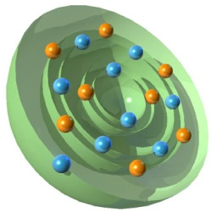
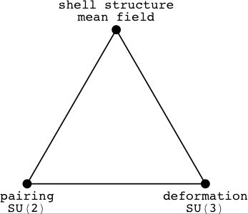
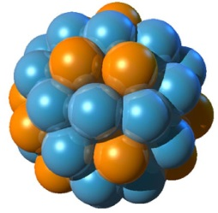
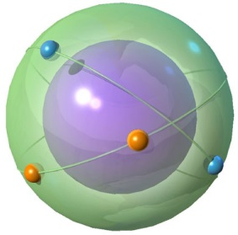
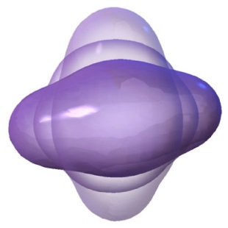
Nuclear surface vibration

Slide 3
2⁺ Systematics
Excitation energy (keV)
2⁺
0⁺
ground state configuration
spin/parity I^{π}=0⁺ ; E_{x} = 0 keV

Slide 4
4⁺/2⁺ energy ratio: mirrors 2⁺ systematics
Excitation energy (keV)
4⁺
2⁺
0⁺
ground state configuration
spin/parity I^{π}=0⁺ ; E_{x} = 0 keV

Slide 5
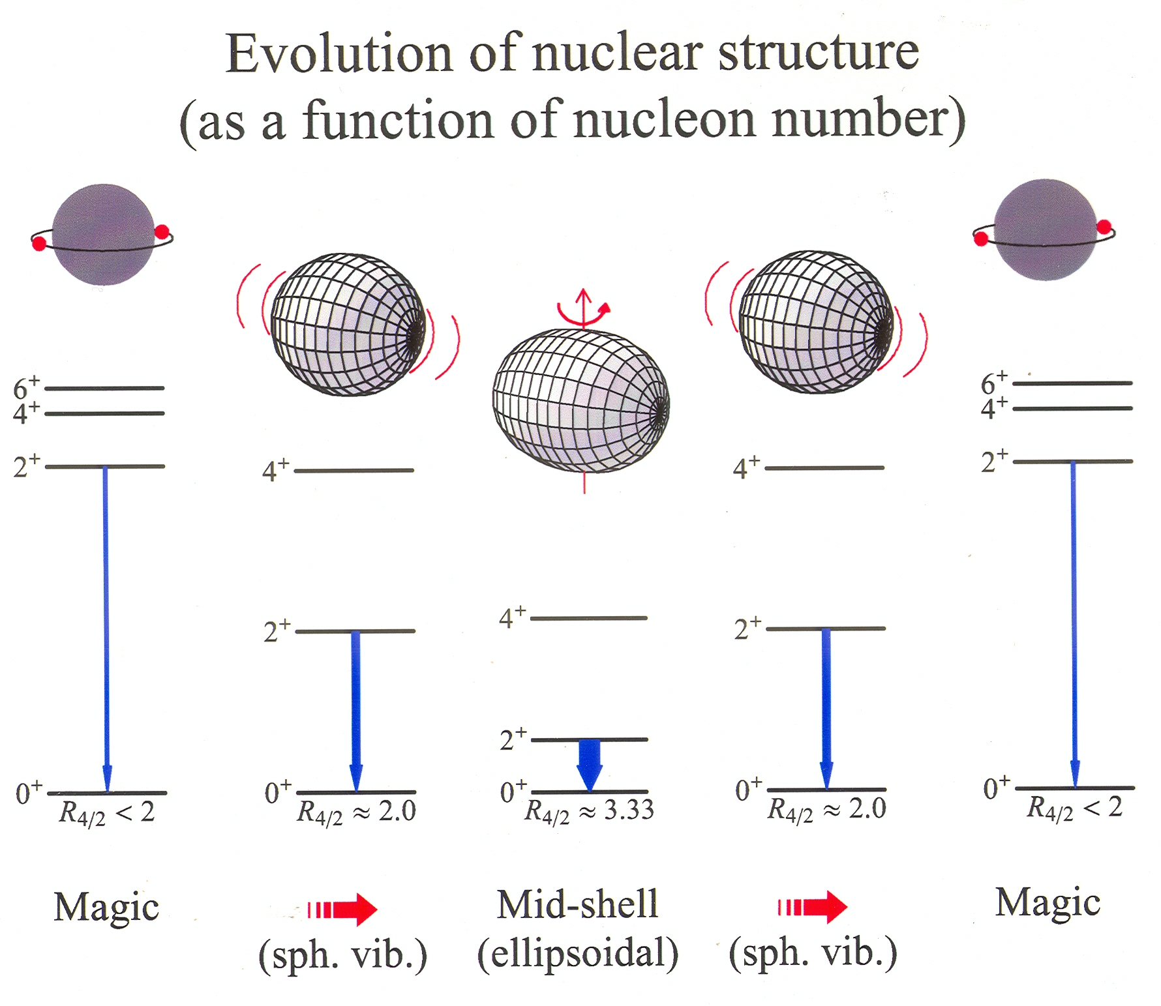
Evolution of nuclear structure as a function of nucleon number

Slide 6



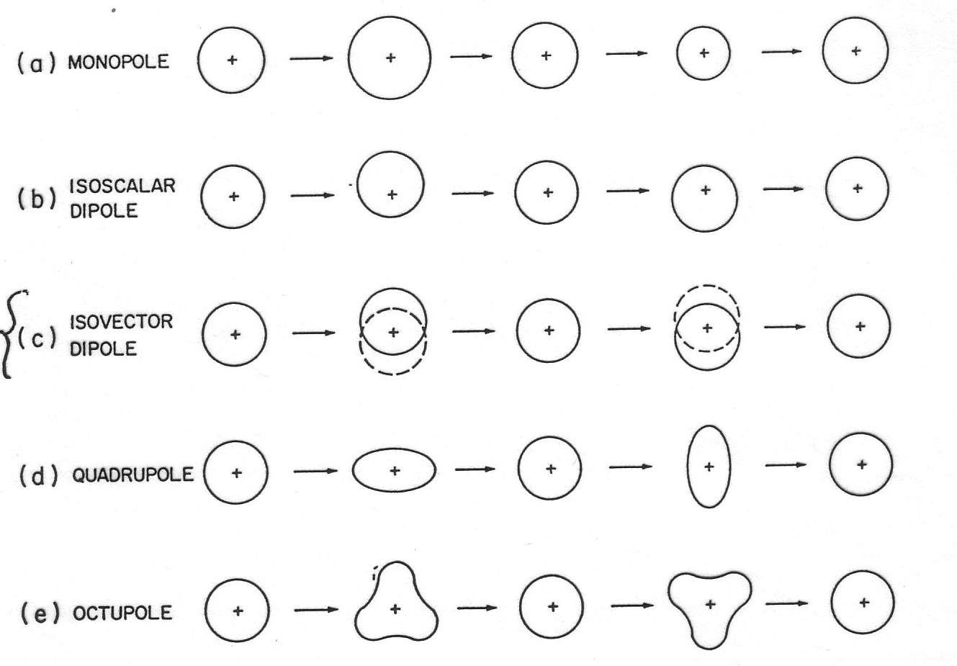
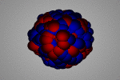


Collective vibration
In general,
$$,t$$
$$\left(t\right)$$
forbidden – density change!
λ=0
forbidden – CM moves!
λ=1
time
OK...
λ=2
λ=3

Slide 7
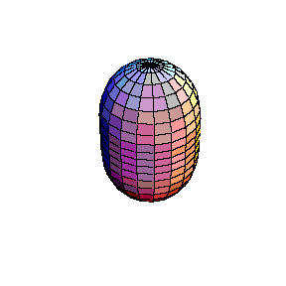
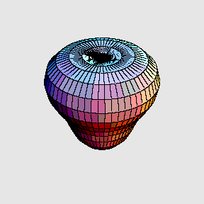
Collective vibration
In general,
$$,t$$
$$\left(t\right)$$
harmonic vibration
λ=2: quadrupole vibration
λ=3: octupole vibration

Slide 8
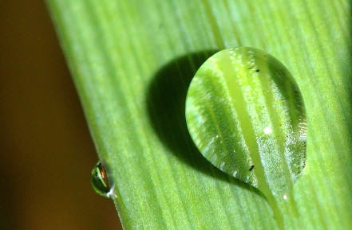
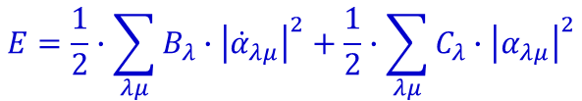
Collective vibration
classical Hamiltonian
$$E=\frac{1}{2}∙\sum_{λμ}{B_{λ}∙{\left|{\dot{α}}_{λμ}\right|}^{2}}+\frac{1}{2}∙\sum_{λμ}{C_{λ}∙{\left|α_{λμ}\right|}^{2}}$$
constants:
Binding energy of a nucleus:
a_{V} = 15.560 MeV a_{S} = 17.230MeV a_{C} = 0.6970 MeV a_{A} = 23.385 MeV a_{P} = 12.000 MeV

Slide 9





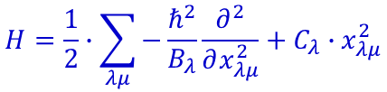
Collective vibration
classical Hamiltonian
$$E=\frac{1}{2}∙\sum_{λμ}{B_{λ}∙{\left|{\dot{α}}_{λμ}\right|}^{2}}+\frac{1}{2}∙\sum_{λμ}{C_{λ}∙{\left|α_{λμ}\right|}^{2}}$$
quantization
$$\left[π_{α_{λμ}},α_{λ´μ´}\right]=−i∙ℏ∙δ_{λλ´}∙δ_{μμ´}$$
$$H=\frac{1}{2}∙\sum_{λμ}{−\frac{ℏ^{2}}{B_{λ}}\frac{∂^{2}}{∂x_{λμ}^{2}}+C_{λ}∙x_{λμ}^{2}}$$
energy eigenvalue
$$E=\sum_{λμ}{ℏ∙ω_{λ}∙\left(n_{λμ}+\frac{1}{2}\right)}$$
$$2ℏω_{2}$$
$$1ℏω_{2}$$
wave function
0
Hermite polynomials

Slide 10

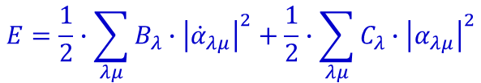
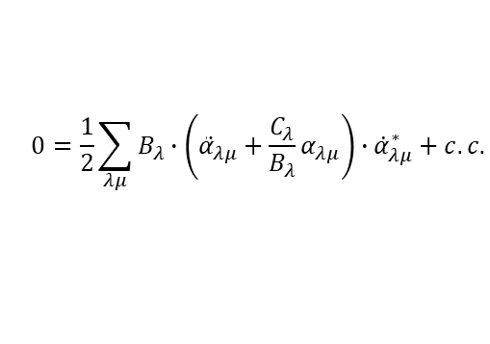
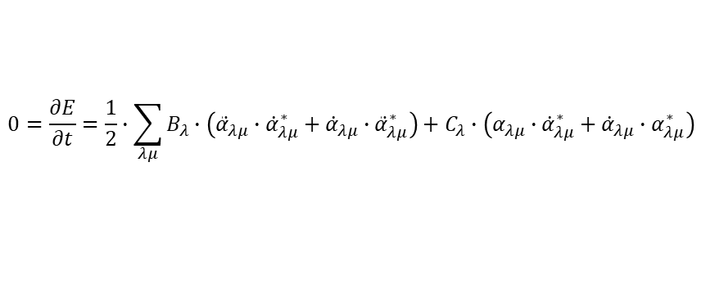
Collective vibration
classical Hamiltonian
$$E=\frac{1}{2}∙\sum_{λμ}{B_{λ}∙{\left|{\dot{α}}_{λμ}\right|}^{2}}+\frac{1}{2}∙\sum_{λμ}{C_{λ}∙{\left|α_{λμ}\right|}^{2}}$$
differential equation
$$0=\frac{∂E}{∂t}=\frac{1}{2}∙\sum_{λμ}{B_{λ}∙\left({\ddot{α}}_{λμ}∙{\dot{α}}_{λμ}^{∗}+{\dot{α}}_{λμ}∙{\ddot{α}}_{λμ}^{∗}\right)}+C_{λ}∙\left(α_{λμ}∙{\dot{α}}_{λμ}^{∗}+{\dot{α}}_{λμ}∙α_{λμ}^{∗}\right)$$
$$0=\frac{1}{2}\sum_{λμ}{B_{λ}∙\left({\ddot{α}}_{λμ}+\frac{C_{λ}}{B_{λ}}α_{λμ}\right)∙{\dot{α}}_{λμ}^{∗}+c.c.}$$
$$0={\ddot{α}}_{λμ}+ω_{λ}^{2}∙α_{λμ} ω_{λ}^{2}=\frac{C_{λ}}{B_{λ}}$$

Slide 11
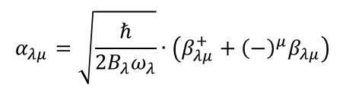
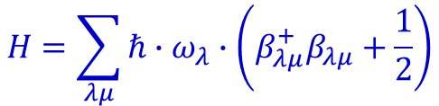
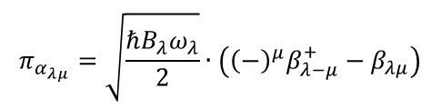
Second quantization
Hamilton operator
$$H=\sum_{λμ}{ℏ∙ω_{λ}∙\left(β_{λμ}^{+}β_{λμ}+\frac{1}{2}\right)}$$
$$α_{λμ}=\sqrt{\frac{ℏ}{2B_{λ}ω_{λ}}}∙\left(β_{λμ}^{+}+{\left(−\right)}^{μ}β_{λμ}\right)$$
$$π_{α_{λμ}}=\sqrt{\frac{ℏB_{λ}ω_{λ}}{2}}∙\left({{\left(−\right)}^{μ}β}_{λ−μ}^{+}−β_{λμ}\right)$$
rule for boson operators:

Slide 12
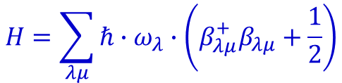
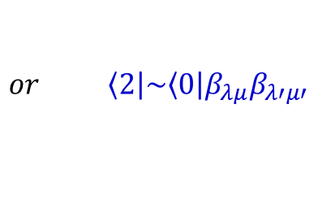
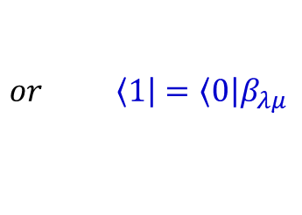
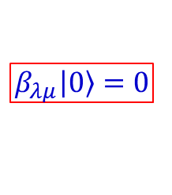
Second quantization
Hamilton operator
$$H=\sum_{λμ}{ℏ∙ω_{λ}∙\left(β_{λμ}^{+}β_{λμ}+\frac{1}{2}\right)}$$
rule for boson operators:
creation & annihilation operators
increase or decrease the number of phonons in a wave function
ground state (vacuum)
1-phonon state
2-phonon state
$$\left.or \left\langle 1\right.\right|=\left.\left\langle 0\right.\right|β_{λμ}$$
$$\left.or \left\langle 2\right.\right|\sim \left.\left\langle 0\right.\right|β_{λμ}β_{λ′μ′}$$
Remember for the following calculations:
$$β_{λμ}\left|\left.0\right\rangle \right.=0$$

Slide 13





Second quantization
Hamilton operator
$$H=\sum_{λμ}{ℏ∙ω_{λ}∙\left(β_{λμ}^{+}β_{λμ}+\frac{1}{2}\right)}$$
rule for boson operators:
1-phonon energy:
$$ℏ$$
$$ℏ$$
$$ℏ$$
$$ℏ$$
$$ℏ$$

Slide 14



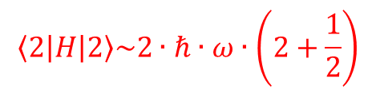
Second quantization
Hamilton operator
$$H=\sum_{λμ}{ℏ∙ω_{λ}∙\left(β_{λμ}^{+}β_{λμ}+\frac{1}{2}\right)}$$
rule for boson operators:
2-phonon energy:
$$ℏ$$
$$ℏ$$
$$ℏ$$
etc.
$$\left\langle 2 | H | 2\right\rangle \sim 2∙ℏ∙ω∙\left(2+\frac{1}{2}\right)$$
normalization of wave function !!!

Slide 15
Second quantization
Hamilton operator
$$H=\sum_{λμ}{ℏ∙ω_{λ}∙\left(β_{λμ}^{+}β_{λμ}+\frac{1}{2}\right)}$$
rule for boson operators:
2-phonon state:
normalization (approximation):

Slide 16
Second quantization
Hamilton operator
$$H=\sum_{λμ}{ℏ∙ω_{λ}∙\left(β_{λμ}^{+}β_{λμ}+\frac{1}{2}\right)}$$
rule for boson operators:
2-phonon state:
normalization:

Slide 17
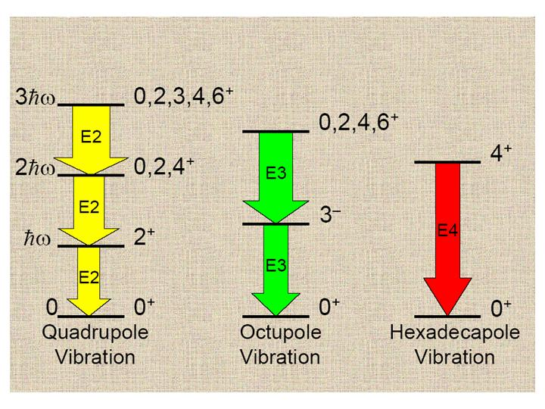
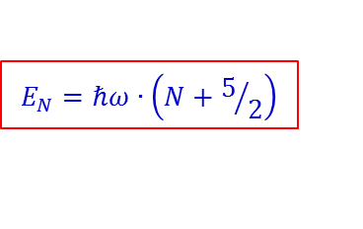
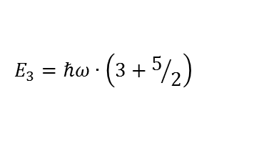
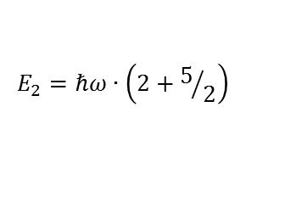
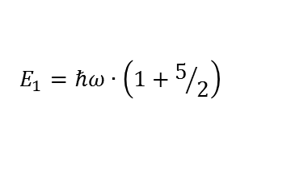
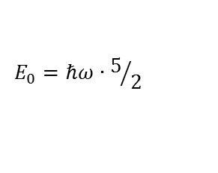
Collective vibration
$$E_{N}=ℏω∙\left(N+5/2\right)$$
$$E_{3}=ℏω∙\left(3+5/2\right)$$
$$E_{2}=ℏω∙\left(2+5/2\right)$$
$$E_{1}=ℏω∙\left(1+5/2\right)$$
$$E_{0}=ℏω∙5/2$$

Slide 18
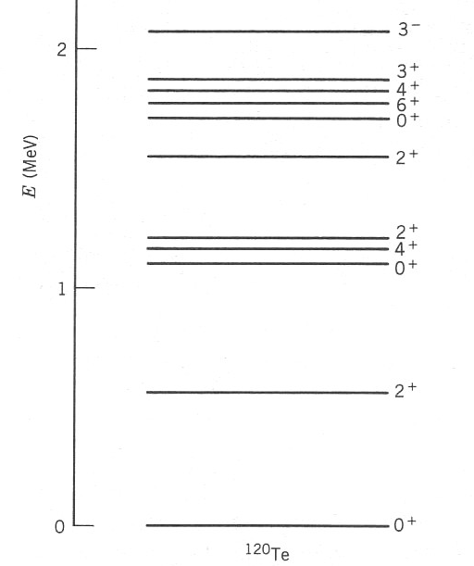
Example of vibrational excitations
3⁻ state?
3ħω₂
multiple λ = 2 phonon
states, ideally degenerate
n = 2, λ = 2, J^{π} = 0+, 2+, 4+
2ħω₂
ħω₂
n=1, λ = 2, 2+ phonon
(E-E ground state)

Slide 19
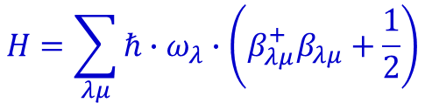

Second quantization
$$H=\sum_{λμ}{ℏ∙ω_{λ}∙\left(β_{λμ}^{+}β_{λμ}+\frac{1}{2}\right)}$$
Hamilton operator
rule for boson operators:
2-phonon state:
reduced transition probability:
$$ℏ$$

Slide 20

Reduced transition probabilities
2-phonon state
3-phonon state
$$ℏ$$

Slide 21

Appendix: Reduced transition probabilities
1-phonon state
2-phonon state
3-phonon state
$$ℏ$$

Slide 22
Reduced transition probabilities
The figure shows the experimental energy levels for the nucleus ¹⁰⁶Pd. Find the energy of the first excited 2⁺ state.
Level energy (vibrator model):
Ground state level:
First excited 2⁺ level (N=1, J^{π}=2⁺):
Second excited 2⁺ level (N=2, J^{π}=2⁺):
→ Energy of the second exited 2⁺ state
→ Energy of the first exited 2⁺ state

