Slide 1

Outline: Nuclear rotation of odd-even nuclei
Lecturer: Hans-Jürgen Wollersheim
e-mail: h.j.wollersheim@gsi.de
web-page: https://web-docs.gsi.de/~wolle/ and click on
particle-rotor model
Euler angles
Example: ¹⁸¹Ta
reduced transition probabilities

Slide 2
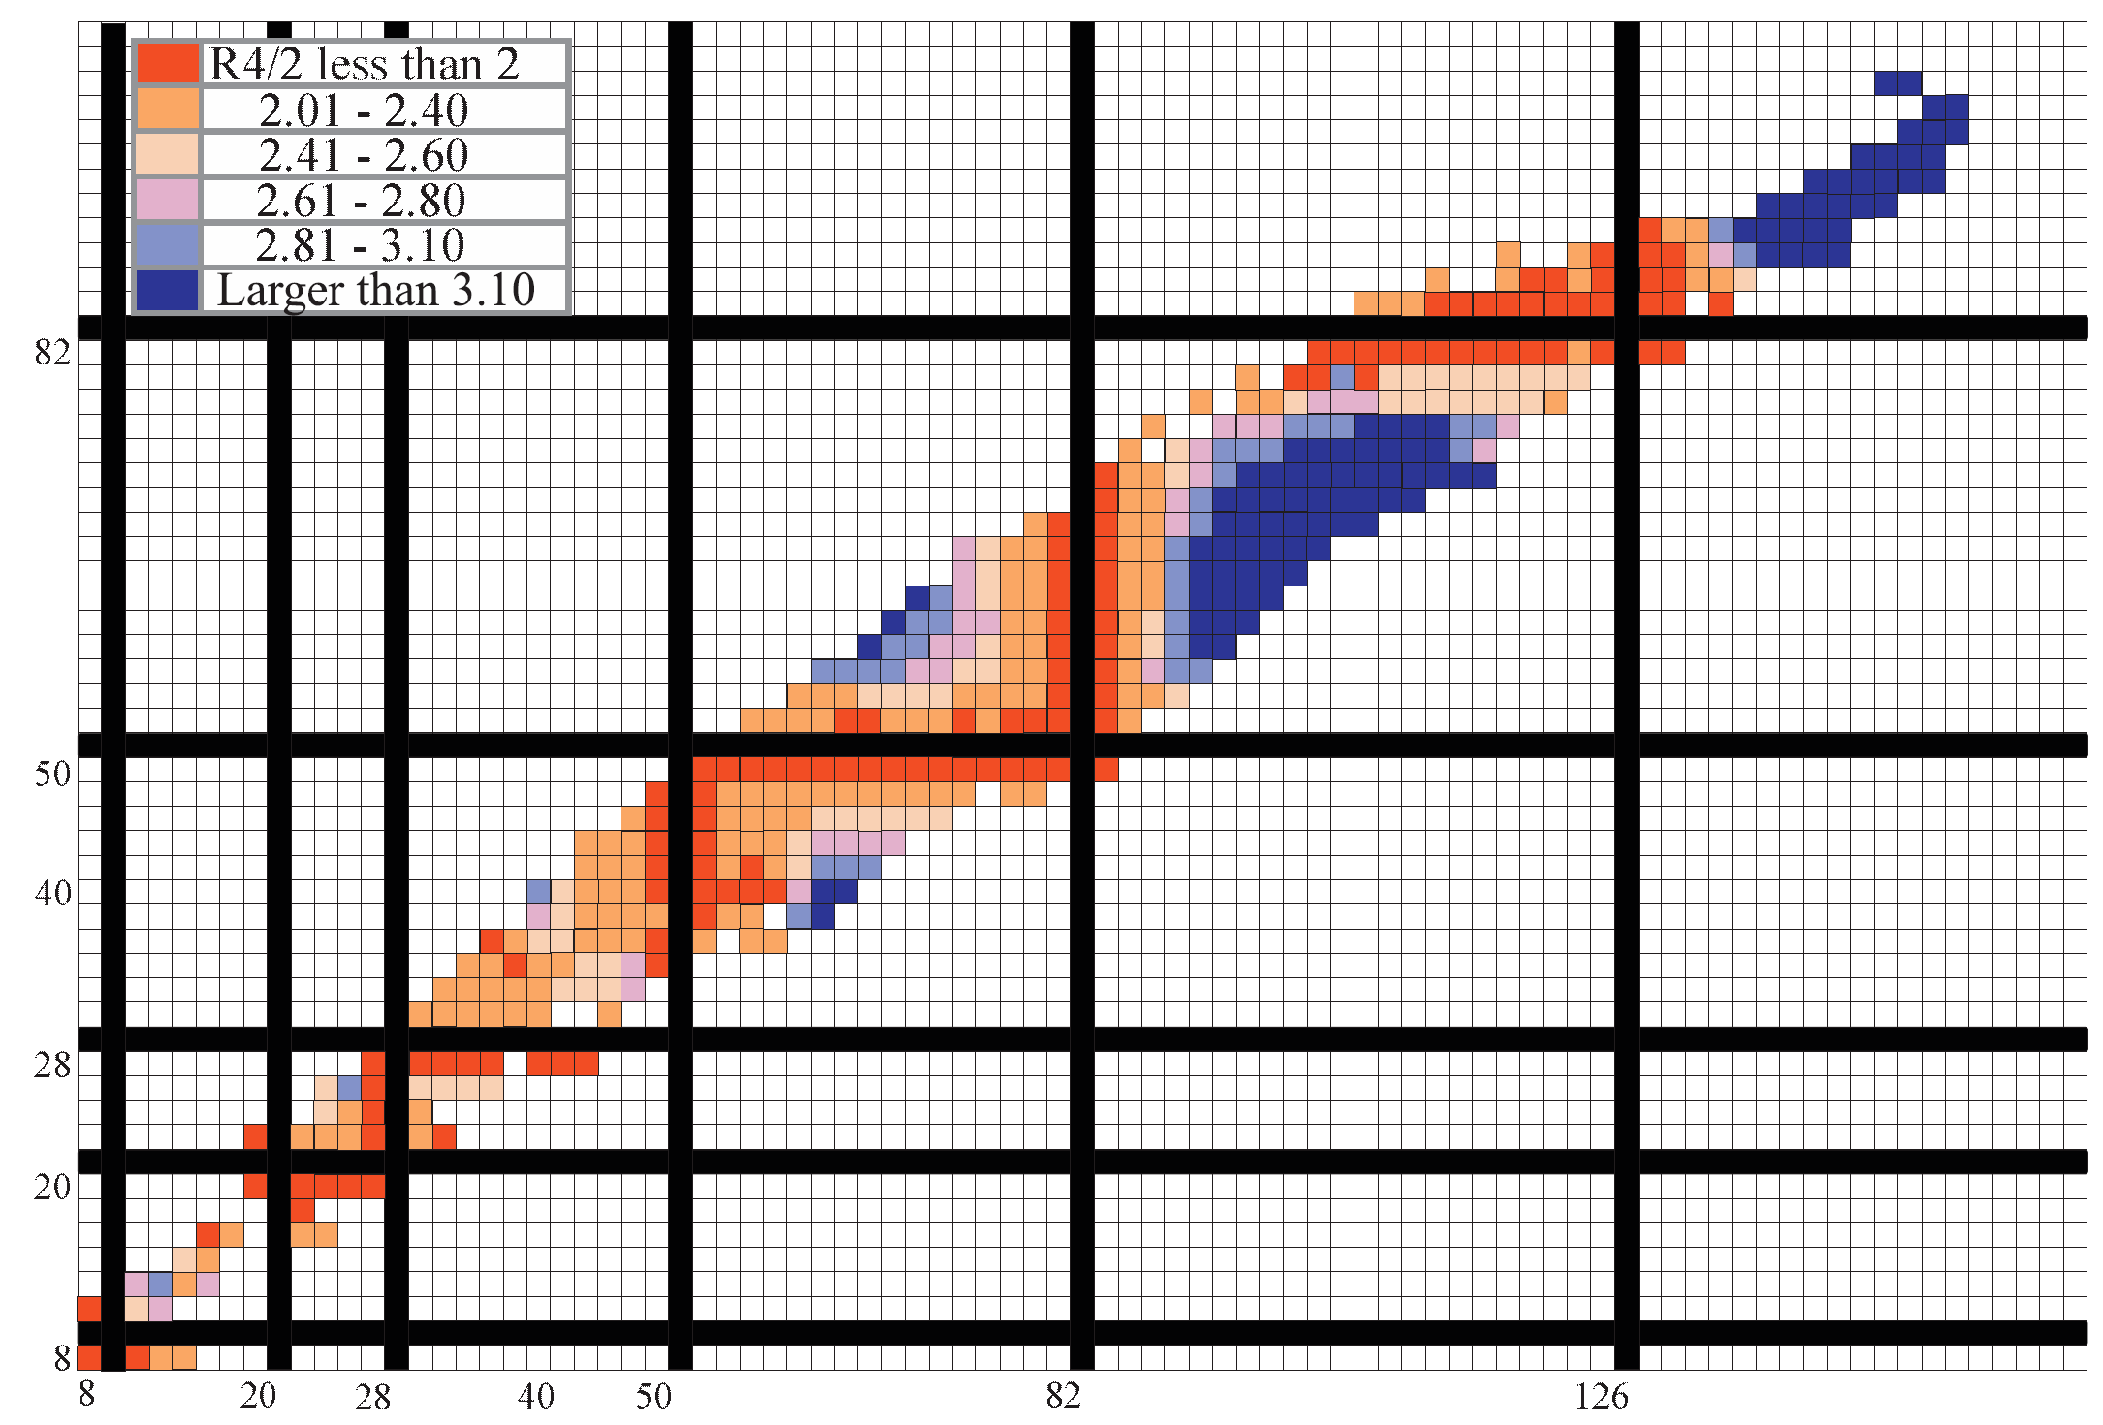
J
Broad perspective on structural evolution:
3
proton number
neutron number
for even-even nuclei

Slide 3

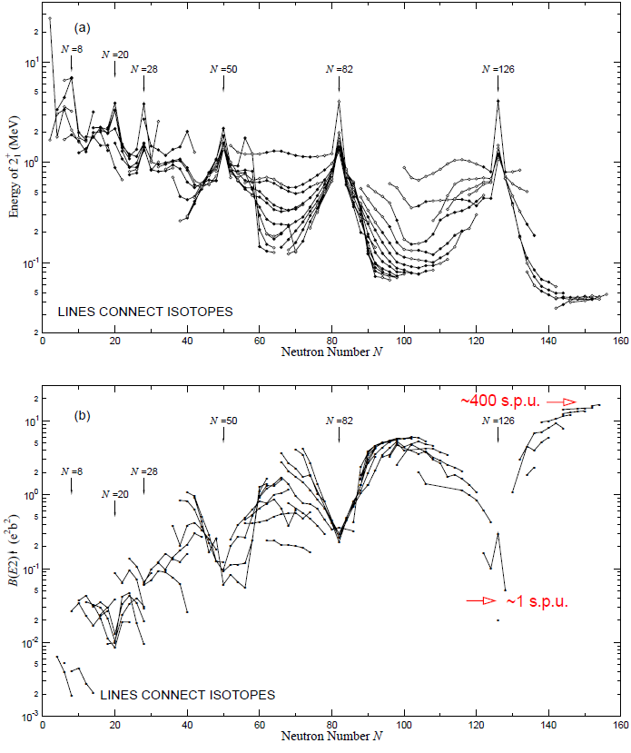
Collective rotation
S. Raman et al., Atomic Data & Nuclear Data Tables 78, 1

Slide 4

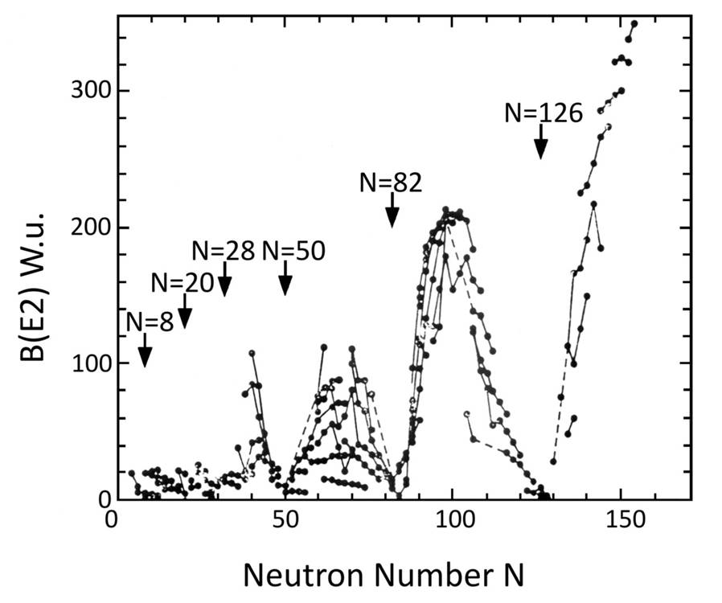

Reduced transition probability
Transition probability:
half-life:
Weisskopf estimate:

Slide 5
The Euler angles
It is important to recognize that for nuclei the intrinsic reference frame can
have any orientation with respect to the lab reference frame as we can hardly
control orientation of nuclei (although it is possible in some cases).
One way to specify the mutual orientation of two reference frames of the
common origin is to use Euler angles.
(x, y, z) axes of lab frame (red)
(x´,y´,z´) axes of intrinsic frame (blue)
Rotation by angle α about the z´axis,
β about the x´axis and γ about the
new z´axis brings the intrinsic frame
onto the lab frame

Slide 6
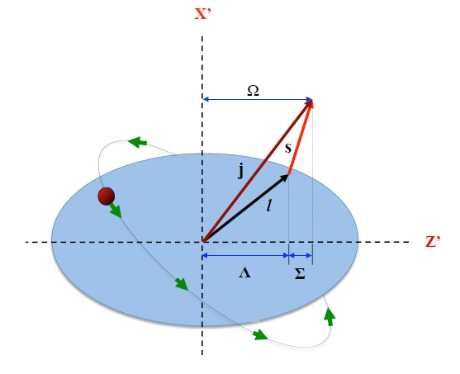
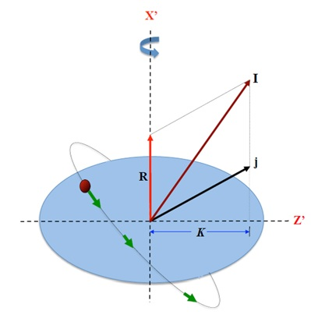
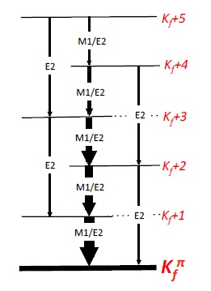
Odd-Even nuclei
1
3
1
3

Slide 7
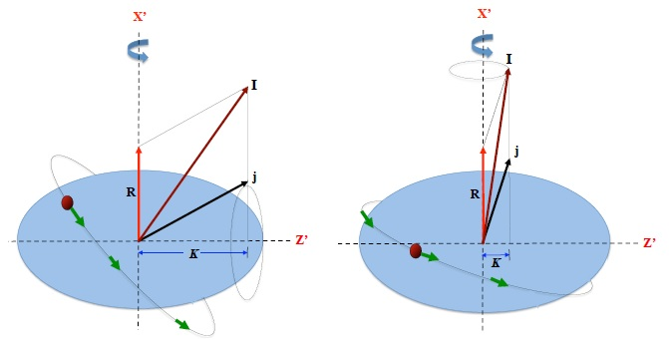
Odd-Even nuclei: Coriolis coupling
1
1
3
3
strong coupling
weak coupling
rotational alignment

Slide 8
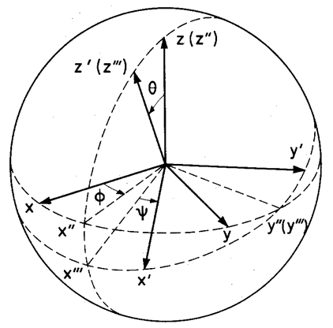
The Euler angles
It is important to recognize that for nuclei the intrinsic reference frame can
have any orientation with respect to the lab reference frame as we can hardly
control orientation of nuclei (although it is possible in some cases).
One way to specify the mutual orientation of two reference frames of the
common origin is to use Euler angles.
(x, y, z) axes of lab frame
(1,2,3) axes of intrinsic frame
The rotation from (x,y,z) to (x´,y´,z´)
can be decomposed into three parts:
a rotation by about the z axis to
, a rotation of θ about the
new y axis to , and
finally a rotation of ψ about the new
z axis .

Slide 9






Quantization
$$\left[J_{x},J_{y}\right]=i∙ℏ∙J_{z}$$
$$J_{z}⟶ℏ∙M$$
$$J^{2}⟶ ℏ^{2}∙I\left(I+1\right)$$
$$\left[J_{1},J_{2}\right]=i∙ℏ∙J_{3}$$
$$J_{3}⟶ℏ∙K$$
$$J^{2}⟶ ℏ^{2}∙I\left(I+1\right)$$

Slide 10
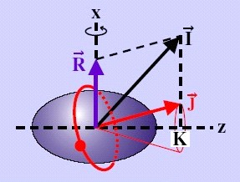
Quantization
z
3

Slide 11
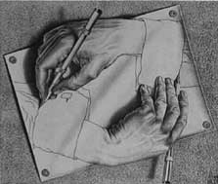
Rotational motion of a deformed nucleus
z
The nucleus does not have an orientation degree of freedom with respect to the symmetry axis
3
States with projections K and –K are degenerated

Slide 12
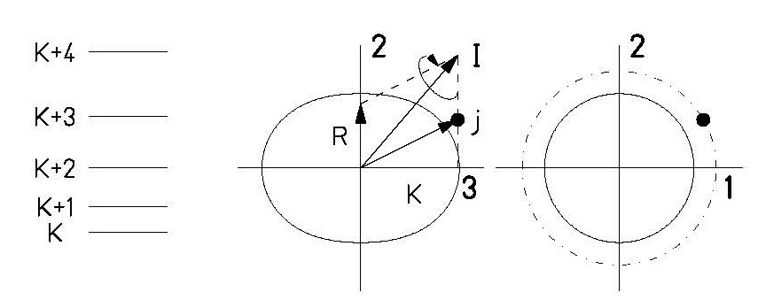




Particle-rotor model
The nucleus does not have an orientation degree of freedom with respect to the symmetry axis
with
$$\vec{R}=\vec{I}−\vec{j}$$
$$H_{rot}=\frac{ℏ^{2}}{2ℑ_{0}}\left\{{\left(I_{1}−j_{1}\right)}^{2}+{\left(I_{2}−j_{2}\right)}^{2}\right\}$$
$$H_{rot}=\frac{ℏ^{2}}{2ℑ_{0}}\left(I^{2}−I_{3}^{2}\right)+\frac{ℏ^{2}}{2ℑ_{0}}\left(j_{1}^{2}+j_{2}^{2}−j_{3}^{2}\right)−\frac{ℏ^{2}}{2ℑ_{0}}\left(j_{+}I_{−}+j_{−}I_{+}\right)$$
$$I_{±}=I_{1}±i{∙I}_{2}$$
$$j_{±}=j_{1}±i∙j_{2}$$
$$E_{K}\left(I\right)=ε_{K}+\frac{ℏ^{2}}{2ℑ}\left[I\left(I+1\right)−K^{2}+δ_{K,1/2}∙a∙{\left(−1\right)}^{I+1/2}\left(I+1/2\right)\right]$$
where a is the so-called decoupling parameter

Slide 13


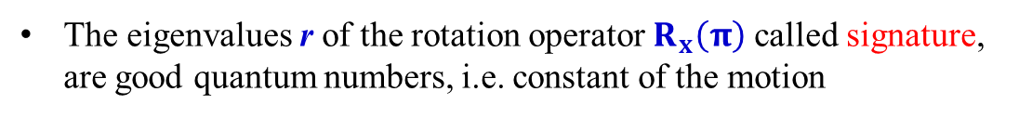
Symmetries of rotating nuclei: Signature Quantum Number
A rotation of 2π leaves the wave function unchanged, except for a possible phase factor (±1), i.e.
z
$R_{x}^{2}\left(π\right)Ψ=r^{2}Ψ={\left(−1\right)}^{A}Ψ$ with $r^{2}=±1$
3
The eigenvalues r of the rotation operator $R_{x}\left(π\right)$ called signature, are good quantum numbers, i.e. constant of the motion
The signature exponent quantum number α is defined:
$$r=exp\left(−iπα\right)$$

Slide 14
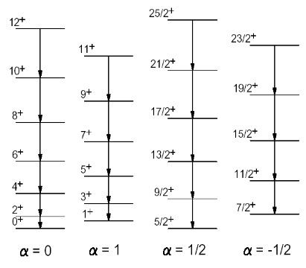
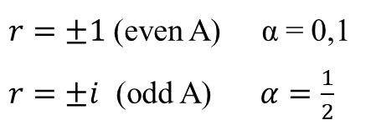
Signature Quantum Numbers
The signature is:
$r=±1$ (even A) α = 0,1
$r=±i$ (odd A) $α=\frac{1}{2}$
Only good quantum numbers: π and α

Slide 15
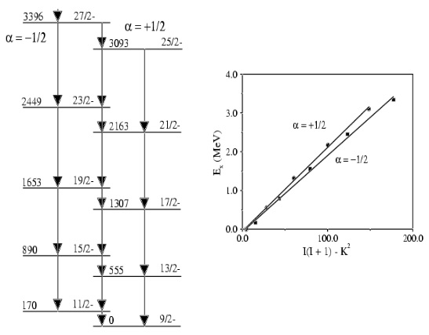
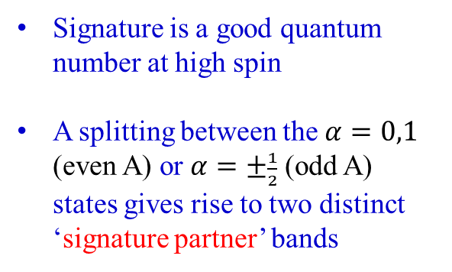
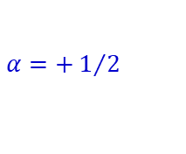
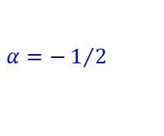
Signature Partners
$$α=−1/2$$
$$α=+1/2$$
Signature is a good quantum number at high spin
A splitting between the $α=0,1$ (even A) or $α=±\frac{1}{2}$ (odd A) states gives rise to two distinct ‘signature partner’ bands

Slide 16
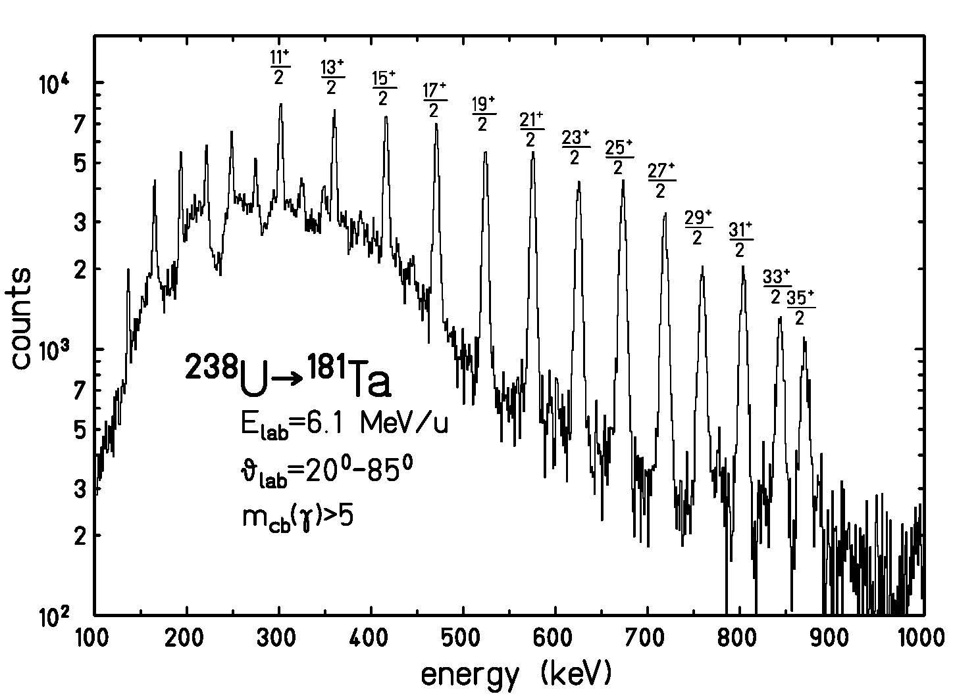
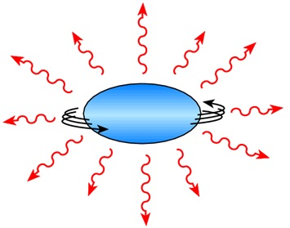
γ-rays from a deformed band in ¹⁸¹Ta
I → I-2
I → I-1

Slide 17
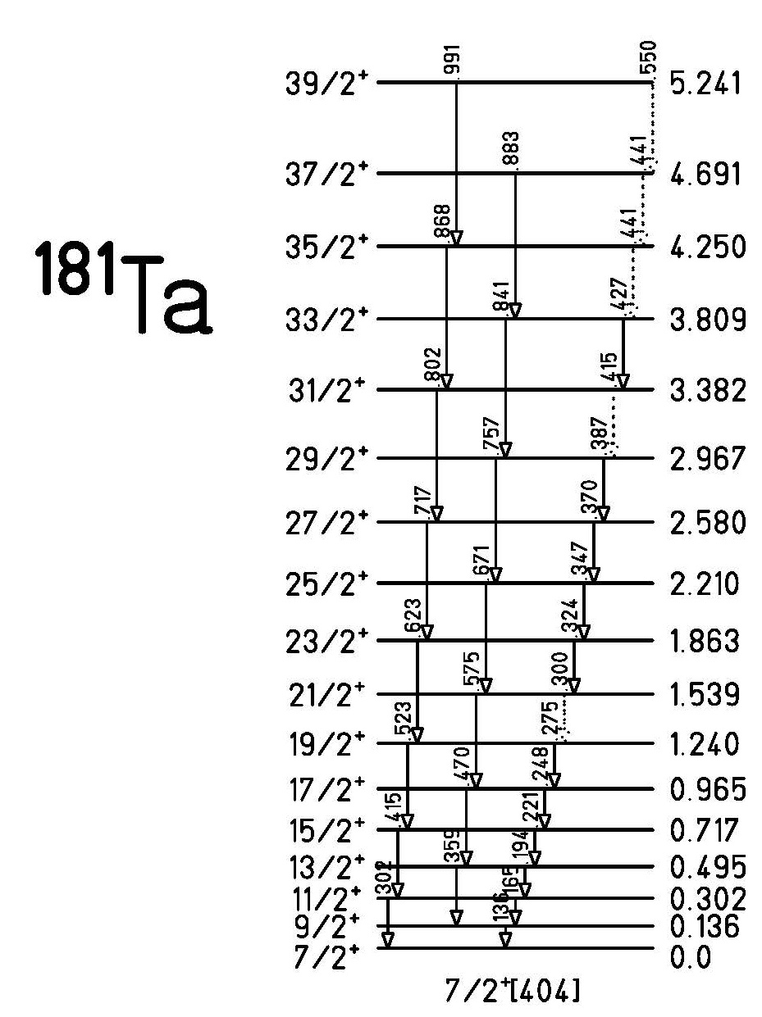
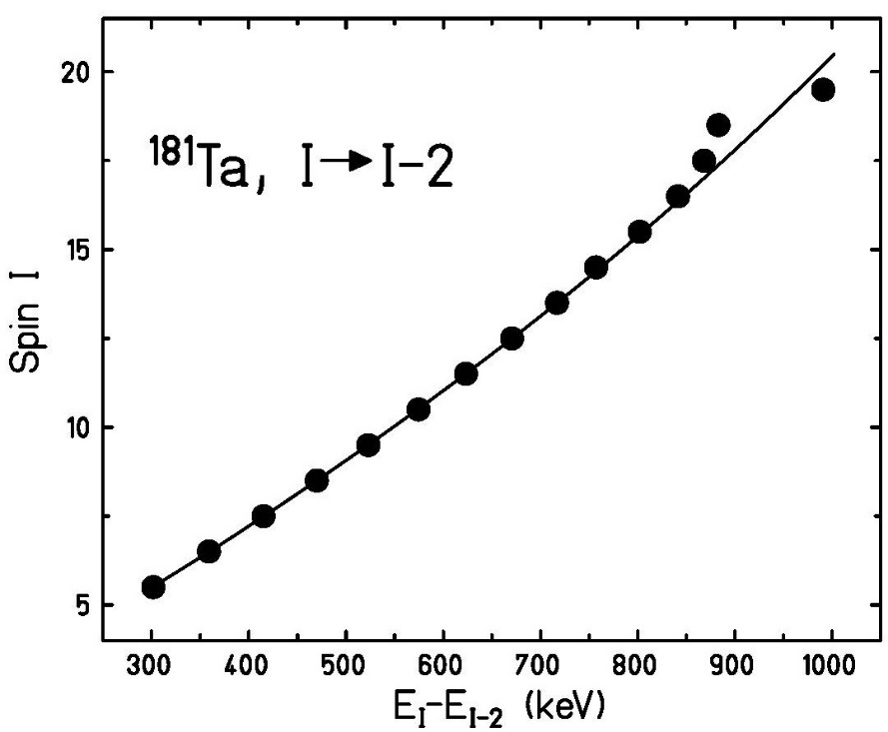
Nuclear level scheme of ¹⁸¹Ta

Slide 18
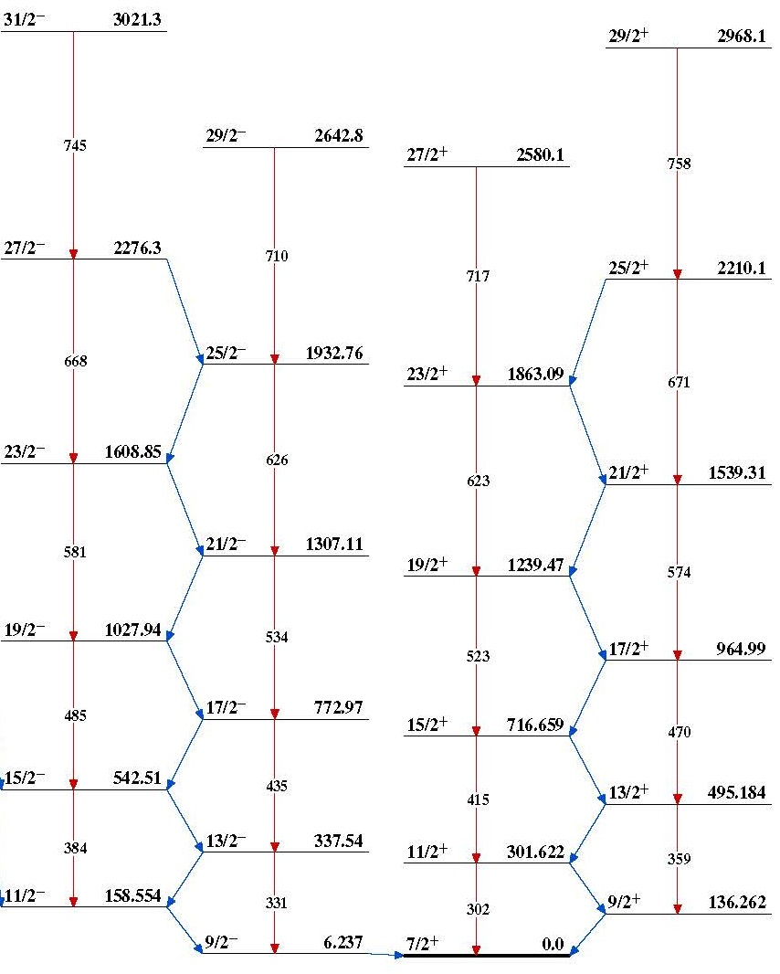
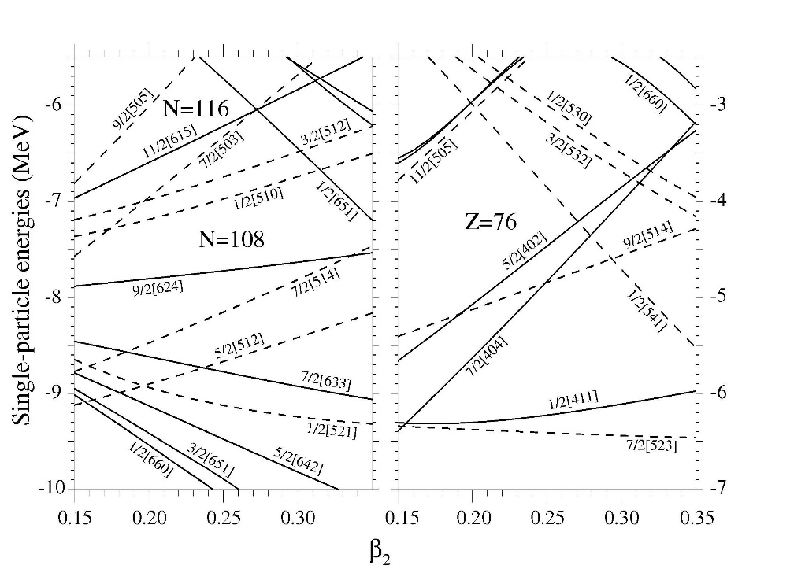
Nilsson diagram of ¹⁸¹Ta
N=108
73
9/2⁻[514]
7/2⁺[404]

Slide 19

Nilsson diagram of ¹⁷⁸Hf
106
72
F.R. Xu et al., Phys. Lett. B435 (1998) 257]

Slide 20
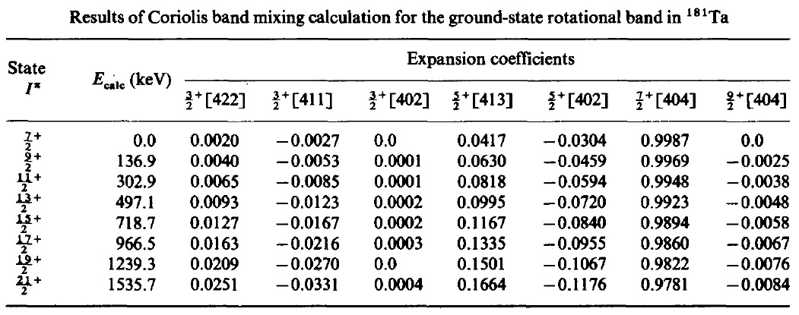

Coriolis band mixing calculation for the 7/2⁺[404] band in ¹⁸¹Ta
The Hamiltonian H_{rot} is the diagonal part of the rotational Hamiltonian. The eigenvalues are assumed to be given by
$$E_{K}\left(I\right)=ε_{K}+\frac{ℏ^{2}}{2ℑ}\left[I\left(I+1\right)−K^{2}+δ_{K,1/2}∙a∙{\left(−1\right)}^{I+1/2}\left(I+1/2\right)\right]$$
Off-diagonal terms are given by the Coriolis matrix elements
$$V_{K+1,K}=−\frac{ℏ^{2}}{2ℑ}\sqrt{\left(I−K\right)\left(I+K+1\right)}∙\left\langle K+1 | j_{+} | K\right\rangle$$
T. Inamura et al., Nucl. Phys. A270 (1976) 255

Slide 21
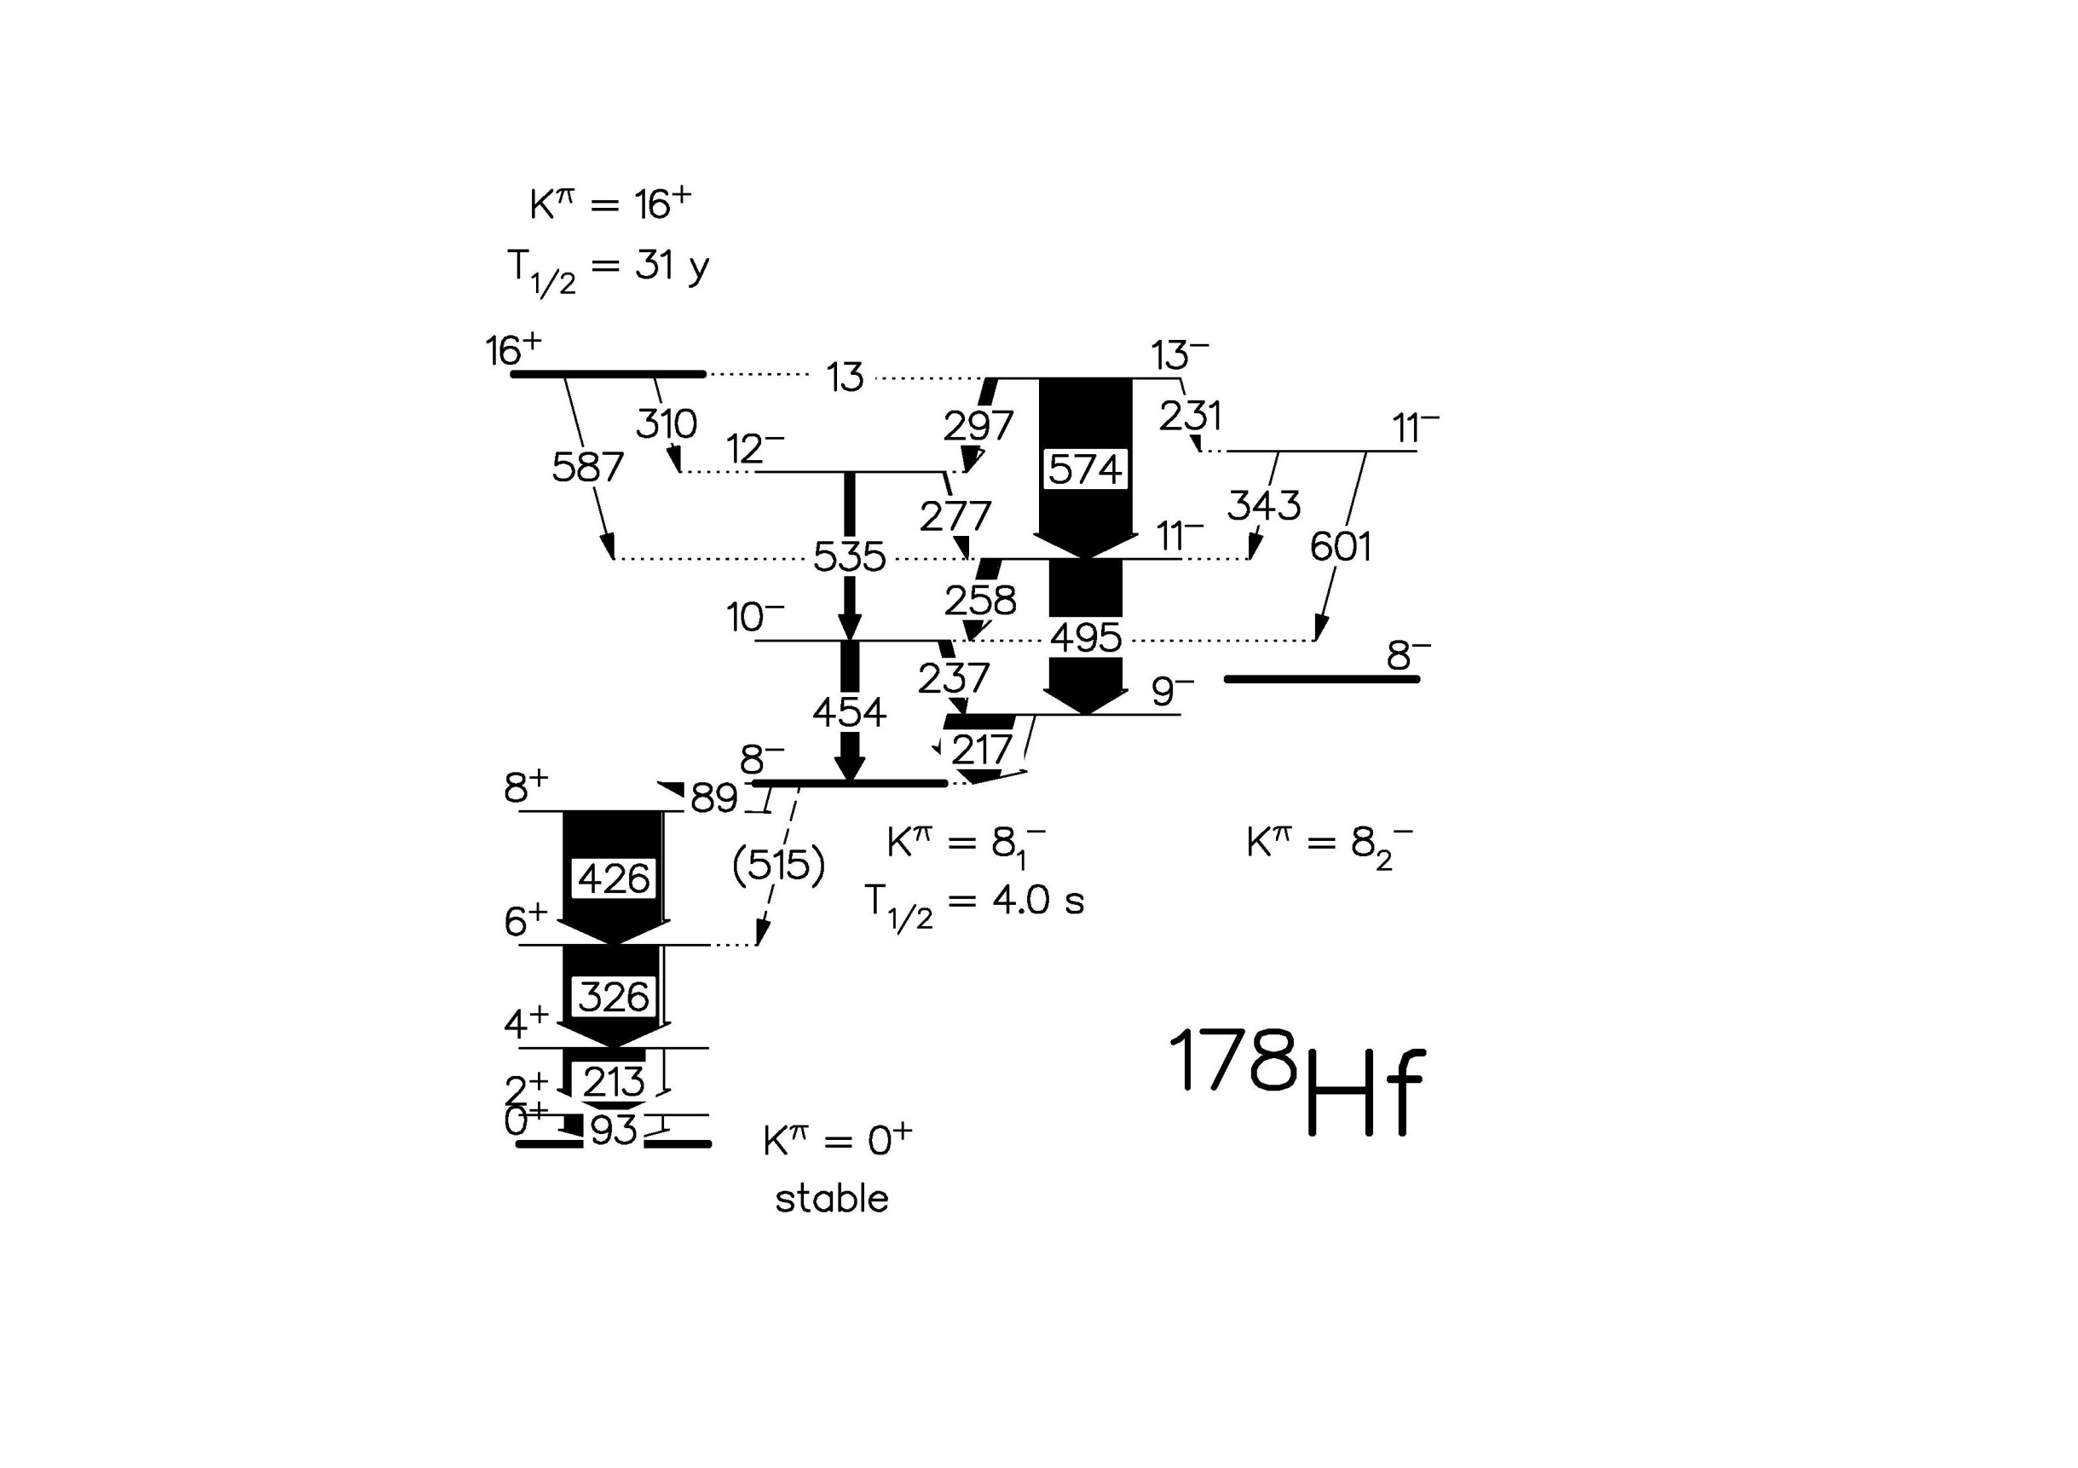
Level scheme of ¹⁷⁸Hf
Hf-178 new level scheme
4-quasiparticle isomer at 2.4 MeV
~2Δ
2-quasiparticle isomer
at 1.1 MeV
~2Δ
72
106
Smith et al., Phys. Rev. C68 (2003) 031302(R)

Slide 22
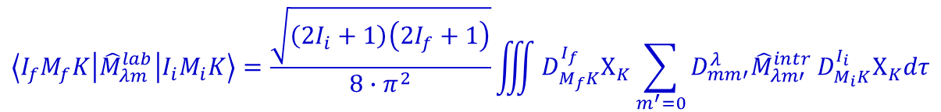
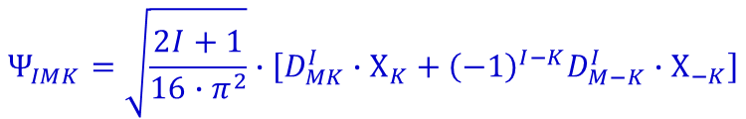
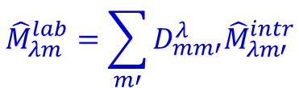
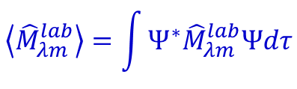
Reduced transition probability
$$\left\langle {\hat{M}}_{λm}^{lab}\right\rangle =\int{Ψ^{∗}{\hat{M}}_{λm}^{lab}Ψdτ}$$
expectation value
$${\hat{M}}_{λm}^{lab}=\sum_{m′}{D_{mm′}^{λ}{\hat{M}}_{λm′}^{intr}}$$
$$Ψ_{IMK}=\sqrt{\frac{2I+1}{16∙π^{2}}}∙\left[D_{MK}^{I}∙Χ_{K}+{\left(−1\right)}^{I−K}D_{M−K}^{I}∙Χ_{−K}\right]$$
wave function
$$\left\langle I_{f}M_{f}K | {\hat{M}}_{λm}^{lab} | I_{i}M_{i}K\right\rangle =\frac{\sqrt{\left(2I_{i}+1\right)\left(2I_{f}+1\right)}}{8∙π^{2}}\iiint{D_{M_{f}K}^{I_{f}}Χ_{K}\sum_{m^{′}=0}{D_{mm′}^{λ}{\hat{M}}_{λm′}^{intr}}D_{M_{i}K}^{I_{i}}Χ_{K}dτ}$$
$$\left\langle I_{f}M_{f}K | {\hat{M}}_{λm}^{lab} | I_{i}M_{i}K\right\rangle =\sqrt{\frac{2I_{i}+1}{2I_{f}+1}}∙\left(I_{i}λM_{i}\left(M_{f}−M_{i}\right) | I_{f}M_{f}\right)∙\left(I_{i}λK0 | I_{f}K\right)∙\left\langle Χ_{K} | {\hat{M}}_{λ0}^{intr} | Χ_{K}\right\rangle$$

Slide 23

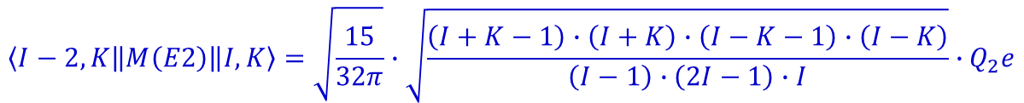
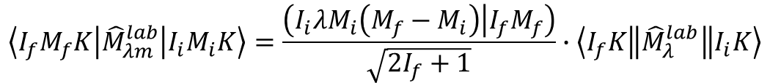
Reduced transition probability
$$\left\langle I_{f}M_{f}K | {\hat{M}}_{λm}^{lab} | I_{i}M_{i}K\right\rangle =\sqrt{\frac{2I_{i}+1}{2I_{f}+1}}∙\left(I_{i}λM_{i}\left(M_{f}−M_{i}\right) | I_{f}M_{f}\right)∙\left(I_{i}λK0 | I_{f}K\right)∙\left\langle Χ_{K} | {\hat{M}}_{λ0}^{intr} | Χ_{K}\right\rangle$$
Wigner-Eckart-Theorem (reduction of an expectation value):
$$\left\langle I_{f}M_{f}K | {\hat{M}}_{λm}^{lab} | I_{i}M_{i}K\right\rangle =\frac{\left(I_{i}λM_{i}\left(M_{f}−M_{i}\right) | I_{f}M_{f}\right)}{\sqrt{2I_{f}+1}}∙\left\langle I_{f}K\left\|{\hat{M}}_{λ}^{lab}\right\|I_{i}K\right\rangle$$
$$\left\langle I_{f}K\left\|M\left(Eλ\right)\right\|I_{i}K\right\rangle =\sqrt{2I_{i}+1}\left(I_{i}λK0 | I_{f}K\right)∙\left\langle Χ_{K} | {\hat{M}}_{λ0}^{intr} | Χ_{K}\right\rangle$$
special case: E2 (λ=2) transition I→I-2
$$\left\langle I−2,K\left\|M\left(E2\right)\right\|I,K\right\rangle =\sqrt{\frac{15}{32π}}∙\sqrt{\frac{\left(I+K−1\right)∙\left(I+K\right)∙\left(I−K−1\right)∙\left(I−K\right)}{\left(I−1\right)∙\left(2I−1\right)∙I}}∙Q_{2}e$$
reduced transition probability:
$$B\left(E2;I_{i}→I_{f}\right)=\frac{1}{2I_{i}+1}{\left|\left\langle I_{f}K\left\|M\left(E2\right)\right\|I_{i}K\right\rangle \right|}^{2}$$

Slide 24
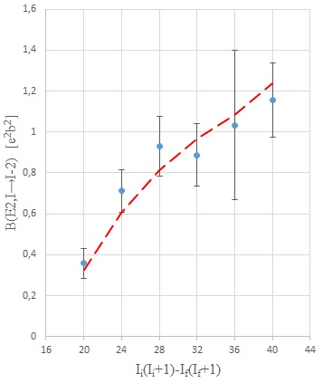
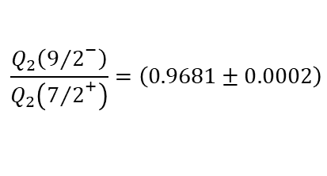

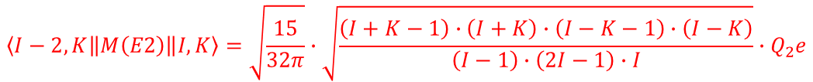
Odd-even nucleus: ¹⁸¹Ta
special case: E2 transition I→I-2
$$\left\langle I−2,K\left\|M\left(E2\right)\right\|I,K\right\rangle =\sqrt{\frac{15}{32π}}∙\sqrt{\frac{\left(I+K−1\right)∙\left(I+K\right)∙\left(I−K−1\right)∙\left(I−K\right)}{\left(I−1\right)∙\left(2I−1\right)∙I}}∙Q_{2}e$$
reduced transition probability:
$$B\left(E2;I_{i}→I_{f}\right)=\frac{1}{2I_{i}+1}{\left|\left\langle I_{f}K\left\|M\left(E2\right)\right\|I_{i}K\right\rangle \right|}^{2}$$
$$\frac{Q_{2}\left({9/2}^{−}\right)}{Q_{2}\left({7/2}^{+}\right)}=\left(0.9681±0.0002\right)$$
Q₂ = 6.71(8) [b]
M. Loewe; dissertation

Slide 25
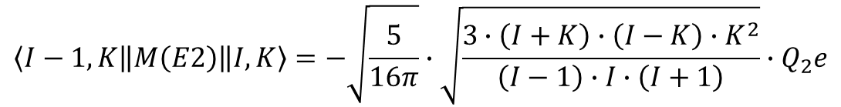
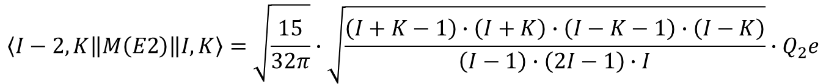
Matrix elements
$$\left\langle I−2,K\left\|M\left(E2\right)\right\|I,K\right\rangle =\sqrt{\frac{15}{32π}}∙\sqrt{\frac{\left(I+K−1\right)∙\left(I+K\right)∙\left(I−K−1\right)∙\left(I−K\right)}{\left(I−1\right)∙\left(2I−1\right)∙I}}∙Q_{2}e$$
$$\left\langle I−1,K\left\|M\left(E2\right)\right\|I,K\right\rangle =−\sqrt{\frac{5}{16π}}∙\sqrt{\frac{3∙\left(I+K\right)∙\left(I−K\right)∙K^{2}}{\left(I−1\right)∙I∙\left(I+1\right)}}∙Q_{2}e$$
$$\left\langle I,K\left\|M\left(E2\right)\right\|I,K\right\rangle =−\sqrt{\frac{5}{16π}}∙\sqrt{\frac{2I+1}{\left(2I−1\right)∙I∙\left(I+1\right)∙\left(2I+3\right)}}∙{\left(I^{2}−3K^{2}+I\right)∙Q}_{2}e$$

Slide 26
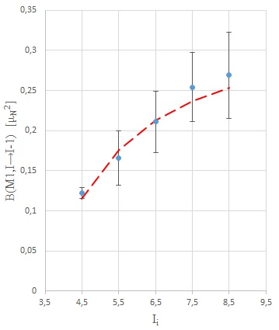
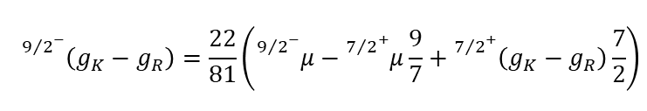
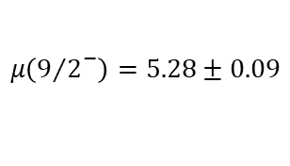

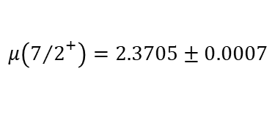
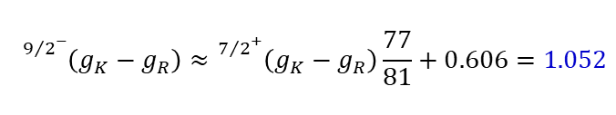
Odd-even nucleus: ¹⁸¹Ta
$$\left\langle I−1,K\left\|M\left(M1\right)\right\|I,K\right\rangle =−\sqrt{\frac{3}{4π}}\sqrt{\frac{\left(I+K\right)\left(I−K\right)}{I}}∙K∙\left(g_{K}−g_{R}\right)\left[1+δ_{K,1/2}{\left(−1\right)}^{I+1/2}b_{0}\right]μ_{N}$$
The quantity b₀ depends on the magnetic decoupling parameter
$$μ\left({7/2}^{+}\right)=2.3705±0.0007$$
$$μ=\frac{K}{I+1}∙\left(g_{K}−g_{R}\right)∙K+g_{R}∙I$$
g_{R} = 0.313(5)
g_{K} = 0.782(2)
$$μ\left({9/2}^{−}\right)=5.28±0.09$$
g_{K} –g_{R} = 0.469(6)
$${}_{}^{{9/2}^{−}}{\left(g_{K}−g_{R}\right)}=\frac{22}{81}\left({}_{}^{{9/2}^{−}}μ−{}_{}^{{7/2}^{+}}μ\frac{9}{7}+{}_{}^{{7/2}^{+}}{\left(g_{K}−g_{R}\right)}\frac{7}{2}\right)$$
$${}_{}^{{9/2}^{−}}{\left(g_{K}−g_{R}\right)}≈{}_{}^{{7/2}^{+}}{\left(g_{K}−g_{R}\right)}\frac{77}{81}+0.606=1.052$$
M. Loewe; dissertation

Slide 27
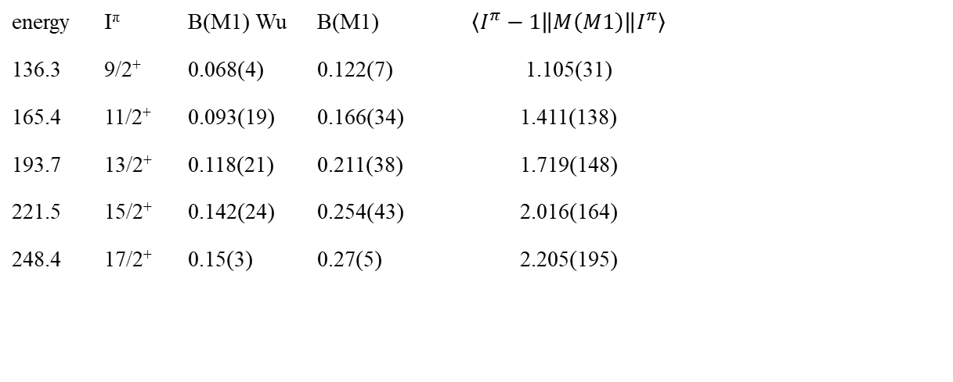
Matrix elements
$$\left\langle I−1,K\left\|M\left(M1\right)\right\|I,K\right\rangle =−\sqrt{\frac{3}{4π}}\sqrt{\frac{\left(I+K\right)\left(I−K\right)}{I}}∙K∙\left(g_{K}−g_{R}\right)\left[1+δ_{K,1/2}{\left(−1\right)}^{I+1/2}b_{0}\right]μ_{N}$$
The quantity b₀ depends on the magnetic decoupling parameter
energy | I^{π} | B(M1) Wu | B(M1) | $$\left\langle I^{π}−1\left\|M\left(M1\right)\right\|I^{π}\right\rangle$$
136.3 | 9/2⁺ | 0.068(4) | 0.122(7) | 1.105(31)
165.4 | 11/2⁺ | 0.093(19) | 0.166(34) | 1.411(138)
193.7 | 13/2⁺ | 0.118(21) | 0.211(38) | 1.719(148)
221.5 | 15/2⁺ | 0.142(24) | 0.254(43) | 2.016(164)
248.4 | 17/2⁺ | 0.15(3) | 0.27(5) | 2.205(195)

Slide 28

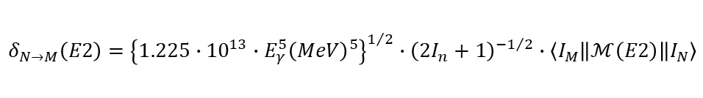
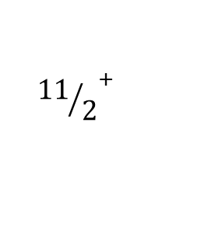

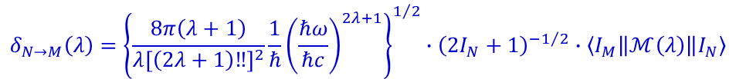




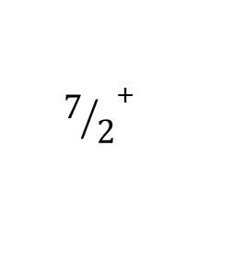

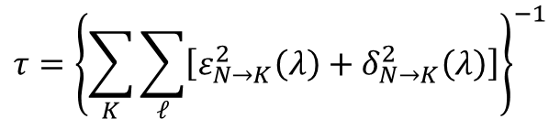
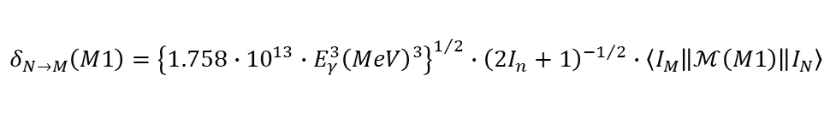
Odd-even nucleus: ¹⁸¹Ta
$$τ={\left\{\sum_{K}{\sum_{ℓ}{\left[ε_{N→K}^{2}\left(λ\right)+δ_{N→K}^{2}\left(λ\right)\right]}}\right\}}^{−1}$$
$${{13}/2}^{+}$$
0.495
$$τ=9.1±1.2 ps$$
$${{11}/2}^{+}$$
0.302
$$τ=23.1±4.3 ps$$
$$τ={T_{1/2}}/{ln2}$$
E2 + M1
E2
$${9/2}^{+}$$
0.136
$$τ=57.0±2.3 ps$$
E2 + M1
$${7/2}^{+}$$
0.0
¹⁸¹Ta
$$δ_{N→M}\left(λ\right)={\left\{\frac{8π\left(λ+1\right)}{λ{\left[\left(2λ+1\right)‼\right]}^{2}}\frac{1}{ℏ}{\left(\frac{ℏω}{ℏc}\right)}^{2λ+1}\right\}}^{1/2}∙{\left(2I_{N}+1\right)}^{−1/2}∙\left\langle I_{M}\left\|ℳ\left(λ\right)\right\|I_{N}\right\rangle$$
$$δ_{N→M}\left(E2\right)={\left\{1.225∙{10}^{13}∙E_{γ}^{5}{\left(MeV\right)}^{5}\right\}}^{1/2}∙{\left(2I_{n}+1\right)}^{−1/2}∙\left\langle I_{M}\left\|ℳ\left(E2\right)\right\|I_{N}\right\rangle$$
$$δ_{N→M}\left(M1\right)={\left\{1.758∙{10}^{13}∙E_{γ}^{3}{\left(MeV\right)}^{3}\right\}}^{1/2}∙{\left(2I_{n}+1\right)}^{−1/2}∙\left\langle I_{M}\left\|ℳ\left(M1\right)\right\|I_{N}\right\rangle$$
T. Inamura et al., Nucl. Phys. A270 (1976) 255
$$ε_{N→M}^{2}\left(ℓ\right)=δ_{N→M}^{2}\left(ℓ\right)∙α_{N→M}\left(ℓ\right)$$
conversion coefficient.: bricc.anu.edu.au

Slide 29

Odd-even nucleus: ¹⁸¹Ta
$$τ={\left\{\sum_{K}{\sum_{ℓ}{\left[ε_{N→K}^{2}\left(λ\right)+δ_{N→K}^{2}\left(λ\right)\right]}}\right\}}^{−1}$$
$${{13}/2}^{+}$$
0.495
$$τ=9.1±1.2 ps$$
$${{11}/2}^{+}$$
0.302
$$τ=23.1±4.3 ps$$
$$τ={T_{1/2}}/{ln2}$$
E2 + M1
E2
$${9/2}^{+}$$
0.136
$$τ=57.0±2.3 ps$$
E2 + M1
$${7/2}^{+}$$
0.0
¹⁸¹Ta
Spin I | E_{γ} (MeV) | (2I+1)^{-1/2} | <I-1//M()//I> | delta | α_{T} | ε² | τ (ps)
9/2 | 0.1365 | 0.3162 | -3.899 (E2) | -29594. | 1.1 | 9.98·10⁸ | 533
 |  |  | 1.103 (M1) | 73591 | 1.8 | 9.75·10⁹ | 58.7
11/2 | 0.1654 | 0.2887 | -4.291 (E2) | -48238 | 0.6 | 1.33·10⁹ | 274
 |  |  | 1.413 (M1) | 115044 | 1.0 | 1.38·10¹⁰ | 32.6
11/2 | 0.3017 | 0.2887 | 1.977 (E2) | 99868 | 0.1 | 8.08·10⁸ | 24.1
T. Inamura et al., Nucl. Phys. A270 (1976) 255

Slide 30
Oddproton-evenneutron nuclei
 |  | μ | (g_{K}-g_{R}) | B(M1)W.u. | (g_{K}-g_{R})
¹⁵³Eu | 5/2⁺ | +1.5324(3) | 0.551 | 0.00608(28) | 0.185
¹⁵⁹Tb | 3/2⁺ | +2.014(4) | 1.556 | 0.173(8) | 1.471
¹⁶⁵Ho | 7/2⁻ | +4.177(5) | 1.012 | 0.275(14) | 0.973
¹⁶⁹Tm | 1/2⁺ | -0.2316(15) |  | 0.0342(8)
¹⁷⁵Lu | 7/2⁺ | +2.2327(11) | 0.298 | 0.0354(14) | 0.349
¹⁸¹Ta | 7/2⁺ | +2.3705(7) | 0.352 | 0.068(4) | 0.484
¹⁸⁵Re | 5/2⁺ | +3.1871(3) | 1.217 | 0.28(5) | 1.252
¹⁸⁷Re | 5/2⁺ | +3.2197(3) | 1.242 | 0.260(18) | 1.206

Slide 31
Oddneutron-evenproton nuclei
 |  | μ | (g_{K}-g_{R}) | B(M1)W.u. | (g_{K}-g_{R})
¹⁵³Eu | 5/2⁺ | +1.5324(3)
¹⁵⁵Gd | 3/2⁻ | -0.2574(4) | -0.974 | 0.0493(39) | 0.783
¹⁵⁷Gd | 3/2⁻ | -0.3398(7) | -1.057 | 0.077(6) | 0.981
¹⁶¹Dy | 5/2⁺ | -0.4803(25) | -0.843 | 0.028(4) | 0.395
¹⁶³Dy | 5/2⁻ | +0.6726(35) | -0.190 | 0.00081(8) | 0.066
¹⁶⁷Er | 7/2⁺ | -0.56385(12) | -0.731 | 0.048(4) | 0.406
¹⁷⁷Hf | 7/2⁻ | +0.7935(6) | -0.232 | 0.00037(3) | 0.036
¹⁷⁹Hf | 9/2⁺ | -0.6409(13) | -0.666 | 0.094(8) | 0.479

Slide 32
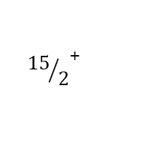





















Ta-nuclei: level schemes
$${{25}/2}^{−}$$
1.933
$${{23}/2}^{+}$$
1.863
ΔK=8
1.778
9/2⁻[514]
$${{23}/2}^{−}$$
1.609
1.586
$${{21}/2}^{+}$$
1.539
9/2⁻[514]
$${{19}/2}^{+}$$
$${{21}/2}^{−}$$
1.307
9/2⁻[514]
1.259
1.287
1.239
1.130
$${{19}/2}^{−}$$
1.028
1.054
$${{17}/2}^{+}$$
0.965
0.993
7/2⁺[404]
0.868
$${{17}/2}^{−}$$
0.773
0.750
0.747
0.802
$${{15}/2}^{+}$$
0.717
0.629
0.596
$${{13}/2}^{+}$$
0.495
$${{15}/2}^{−}$$
0.543
0.520
0.529
0.417
0.404
$${{11}/2}^{+}$$
0.302
$${{13}/2}^{−}$$
0.338
0.317
7/2⁺[404]
0.337
0.231
$$τ≤7 ns$$
7/2⁺[404]
0.245
$${9/2}^{+}$$
0.136
$${{11}/2}^{−}$$
0.159
0.143
0.164
0.175
0.155
$$τ=153 ns$$
$$τ=8.7 μs$$
0.073
$${7/2}^{+}$$
0.0
$${9/2}^{−}$$
0.006
0.0
0.0
0.0
¹⁸¹Ta
¹⁸³Ta
¹⁸⁵Ta
¹⁸⁷Ta
$$y=−6.5∗x+17$$

Slide 33






















¹⁸⁷Ta level scheme
expected lifetimes
$$I→I−1$$
$$I→I−2$$
ΔK=8
$$\left({{25}/2}^{−}\right)$$
1.778
$$τ=10.5(13) s$$
9/2⁻[514]
$$\left({{21}/2}^{−}\right)$$
1.586
$$τ=0.6 ps$$
$$\left({{19}/2}^{−}\right)$$
1.287
$$τ=1.1 ps$$
Sum of γγ-coincidence energy spectra
$$\left({{17}/2}^{−}\right)$$
1.054
$$τ=1.1 ps$$
$$\left({{15}/2}^{−}\right)$$
0.802
$$τ=2.2 ps$$
$$\left({{13}/2}^{−}\right)$$
0.596
$$τ=3.4 ps$$
$$\left({{11}/2}^{−}\right)$$
0.404
$$τ=7.9 ps$$
7/2⁺[404]
$$\left({9/2}^{−}\right)$$
0.245
$$τ \sim 40 ns$$
$$\left({9/2}^{+}\right)$$
0.155
$$\left({7/2}^{+}\right)$$
0.0
¹⁸⁷Ta
Signature splitting versus angular momentum
P.M. Walker; Phys. Rev. Lett. 125 192505
$$y=−6.5∗x+17$$

Slide 34







Experimental information on ¹⁸⁹Ta
²⁰⁸Pb primary beam
K_{α}
PhD-thesis: Steven John Steer

Slide 35

Experimental information on ¹⁸⁹Ta
E_{γ} (keV) | intensity
153.9 | 100(19)
283.7 | 73(17)
342.5 | 47(13)
388.7 | 80(19)
481.6 | 97(21)
PhD-thesis: Steven John Steer

Slide 36


Experimental information on ¹⁸⁹Ta
E_{γ} | ΔE_{γ} | γ-intensity |  | α_{tot} | intensity | S.J. Steer | T_{1/2} (μs)
154 | 3.2 | 149.5±14.1 | 100% | 0.734 | E1:119/E2:173 | 100% | 1.09(4)
199 | 4.2 | 67.1±9.0 | 44.9±7.4 | 0.303 | 58.5±9.6
198 | 2.5 | 32.3±9.6 | 21.6±6.7 | 0.308 | 28.3±8.8
200.5 | 2.5 | 31.1±9.6 | 20.8±6.7 | 0.295 | 26.9±8.7
247.2 | 1.8 | 36.9±7.1 | 24.7±5.3 | 0.149 | 28.4±6.1
284.6 | 2.4 | 37.5±8.3 | 25.5±6.0 | 0.025 | E1:26.1±6.2 | 73±22 | 1.16(7)
342.7 | 2.6 | 29.4±7.0 | 19.7±5.0 | 0.056 | 20.8±5.3 | 47±16
389.3 | 2.5 | 110.5±10.9 | 73.9±10.1 | 0.039 | 76.8±10.4 | 80±24 | 1.08(6)
481 | 3.2 | 131.6±12.5 | 88.0±11.8 | 0.022 | 90±12 | 97±28 | 1.12(7)
83 |  |  |  |  |  |  | 0.202(12)
134 |  |  |  |  |  |  | 0.284(11)
gate
481 |  | 154 |  |  |  |  | 284 | 389 |  | -
389 |  | 154 |  |  |  |  | 284 | - |  | 481
284 |  | 154 |  |  |  |  | - | 389 |  | 481
343 |  | 154 | 199 | 246 | -
246 |  | 154 | 199 | - | 343 | 370 |  |  | 453 | 481
199 |  | 154 | - |  |  |  |  | 389 |  | 481
154 | 134 | 154 |  | 246 | 343 |  | 284 | 389 |  | 481
134
PhD-thesis: Sultan Alhomaidhi
$$y=−6.5∗x+17$$

Slide 37









Experimental information on ¹⁸⁹Ta
9/2⁻[514]
$$α=+1/2$$
$$α=−1/2$$
$$\left({{23}/2}^{−}\right)$$
1.463
0.154
$$\left({{19}/2}^{−}\right)$$
1.309
0.481
$$\left({{15}/2}^{−}\right)$$
0.828
gate
0.389
481 |  | 154 |  |  |  |  | 284 | 389 |  | -
389 |  | 154 |  |  |  |  | 284 | - |  | 481
284 |  | 154 |  |  |  |  | - | 389 |  | 481
343 |  | 154 | 199 | 246 | -
246 |  | 154 | 199 | - | 343 | 370 |  |  | 453 | 481
199 |  | 154 | - |  |  |  |  | 389 |  | 481
154 | 134 | 154 |  | 246 | 343 |  | 284 | 389 |  | 481
134
$$\left({{11}/2}^{−}\right)$$
0.439
7/2⁺[404]
0.284
$$\left({9/2}^{+}\right)$$
0.154
$$\left({7/2}^{+}\right)$$
0.0
¹⁸⁹Ta
PhD-thesis: Sultan Alhomaidhi
$$y=−6.5∗x+16.6$$

Slide 38




Experimental information on ¹⁸⁹Ta
9/2⁻[514]
$$α=+1/2$$
$$α=−1/2$$
$$\left({{23}/2}^{−}\right)$$
1.308
0.154
$$\left({{19}/2}^{−}\right)$$
1.154
0.481
gate
$$\left({{15}/2}^{−}\right)$$
0.673
481 |  | 154 |  |  |  |  | 284 | 389 |  | -
389 |  | 154 |  |  |  |  | 284 | - |  | 481
284 |  | 154 |  |  |  |  | - | 389 |  | 481
343 |  | 154 | 199 | 246 | -
246 |  | 154 | 199 | - | 343 | 370 |  |  | 453 | 481
199 |  | 154 | - |  |  |  |  | 389 |  | 481
154 | 134 | 154 |  | 246 | 343 |  | 284 | 389 |  | 481
134
0.389
7/2⁺[404]
$$\left({{11}/2}^{−}\right)$$
0.284
$$\left({9/2}^{+}\right)$$
0.154
0.284
$$\left({7/2}^{+}\right)$$
0.0
¹⁸⁹Ta
PhD-thesis: Sultan Alhomaidhi
$$y=−6.5∗x+17$$

Slide 39




Experimental information on ¹⁸⁹Ta
9/2⁻[514]
$$α=+1/2$$
$$α=−1/2$$
$$\left({{23}/2}^{−}\right)$$
1.463
0.154
$$\left({{19}/2}^{−}\right)$$
1.309
1.042
0.481
$$\left({{17}/2}^{−}\right)$$
0.453
$$\left({{15}/2}^{−}\right)$$
0.828
gate
0.389
481 |  | 154 |  |  |  |  | 284 | 389 |  | -
389 |  | 154 |  |  |  |  | 284 | - |  | 481
284 |  | 154 |  |  |  |  | - | 389 |  | 481
343 |  | 154 | 199 | 246 | -
246 |  | 154 | 199 | - | 343 | 370 |  |  | 453 | 481
199 |  | 154 | - |  |  |  |  | 389 |  | 481
154 | 134 | 154 |  | 246 | 343 |  | 284 | 389 |  | 481
134
$$\left({{13}/2}^{−}\right)$$
0.589
0.343
$$\left({{11}/2}^{−}\right)$$
0.439
7/2⁺[404]
0.193
0.284
$$\left({9/2}^{−}\right)$$
0.246
$$\left({9/2}^{+}\right)$$
0.154
0.246
$$\left({7/2}^{+}\right)$$
0.0
¹⁸⁹Ta
PhD-thesis: Sultan Alhomaidhi
$$y=−6.5∗x+16.6$$

Slide 40




Experimental information on ¹⁸⁹Ta
9/2⁻[514]
$$α=+1/2$$
$$α=−1/2$$
$$\left({{23}/2}^{−}\right)$$
1.308
$$\left({{21}/2}^{−}\right)$$
1.271
0.154
$$\left({{19}/2}^{−}\right)$$
1.154
0.453
0.481
$$\left({{17}/2}^{−}\right)$$
0.818
gate
0.343
$$\left({{15}/2}^{−}\right)$$
0.673
481 |  | 154 |  |  |  |  | 284 | 389 |  | -
389 |  | 154 |  |  |  |  | 284 | - |  | 481
284 |  | 154 |  |  |  |  | - | 389 |  | 481
343 |  | 154 | 199 | 246 | -
246 |  | 154 | 199 | - | 343 | 370 |  |  | 453 | 481
199 |  | 154 | - |  |  |  |  | 389 |  | 481
154 | 134 | 154 |  | 246 | 343 |  | 284 | 389 |  | 481
134
0.198
$$\left({{13}/2}^{−}\right)$$
0.475
0.389
0.246
0.191
7/2⁺[404]
$$\left({{11}/2}^{−}\right)$$
0.284
$$\left({9/2}^{−}\right)$$
0.229
$$\left({9/2}^{+}\right)$$
0.154
0.284
$$\left({7/2}^{+}\right)$$
0.0
¹⁸⁹Ta
PhD-thesis: Sultan Alhomaidhi
$$y=−6.5∗x+17$$

Slide 41
Experimental information on ¹⁸⁹Ta
9/2⁻[514]
$$α=+1/2$$
$$α=−1/2$$
$$\left({{23}/2}^{−}\right)$$
1.308
$$\left({{21}/2}^{−}\right)$$
1.271
0.154
$$\left({{19}/2}^{−}\right)$$
1.154
0.453
0.481
$$\left({{17}/2}^{−}\right)$$
0.818
gate
0.343
$$\left({{15}/2}^{−}\right)$$
0.673
481 |  | 154 |  |  |  |  | 284 | 389 |  | -
389 |  | 154 |  |  |  |  | 284 | - |  | 481
284 |  | 154 |  |  |  |  | - | 389 |  | 481
343 |  | 154 | 199 | 246 | -
246 |  | 154 | 199 | - | 343 | 370 |  |  | 453 | 481
199 |  | 154 | - |  |  |  |  | 389 |  | 481
154 | 134 | 154 |  | 246 | 343 |  | 284 | 389 |  | 481
134
0.198
$$\left({{13}/2}^{−}\right)$$
0.475
0.389
0.246
0.191
7/2⁺[404]
$$\left({{11}/2}^{−}\right)$$
0.284
$$\left({9/2}^{−}\right)$$
0.229
$$\left({9/2}^{+}\right)$$
0.154
0.284
$$\left({7/2}^{+}\right)$$
0.0
¹⁸⁹Ta
PhD-thesis: Sultan Alhomaidhi
$$y=−6.5∗x+17$$

Slide 42







Ta-nuclei: level schemes (1. solution)
$$\frac{ℏ^{2}}{2ℑ}=14.1$$
$$\frac{ℏ^{2}}{2ℑ}=13.8$$
9/2⁻[514]
$$α=+1/2$$
$$α=−1/2$$
$$\frac{ℏ^{2}}{2ℑ}=14.3$$
$$\frac{ℏ^{2}}{2ℑ}=13.6$$
$$\left({{23}/2}^{−}\right)$$
1.463
0.154
$$\left({{19}/2}^{−}\right)$$
1.309
1.042
0.481
$$\left({{17}/2}^{−}\right)$$
0.453
$$\left({{15}/2}^{−}\right)$$
0.828
0.389
$$\left({{13}/2}^{−}\right)$$
0.589
0.343
$$\left({{11}/2}^{−}\right)$$
0.439
7/2⁺[404]
0.193
0.284
$$\left({9/2}^{−}\right)$$
0.246
$$\left({9/2}^{+}\right)$$
0.154
0.246
$$\left({7/2}^{+}\right)$$
0.0
¹⁸⁹Ta
¹⁸⁷Ta
$$y=−6.5∗x+17$$

Slide 43













Ta-nuclei: level schemes (2. solution)
½⁺[411]
$$\frac{ℏ^{2}}{2ℑ}=12.6, a=−0.4$$
$$\frac{ℏ^{2}}{2ℑ}=12,8, a=−0.4$$
$$α=+1/2$$
$$α=−1/2$$
$$\frac{ℏ^{2}}{2ℑ}=14.3, a=−0.2$$
$$\frac{ℏ^{2}}{2ℑ}=14.0$$
$$\left({{23}/2}^{−}\right)$$
1.463
0.154
$$\left({{19}/2}^{+}\right)$$
1.309
1.042
0.481
$$\left({{17}/2}^{+}\right)$$
0.453
$$\left({{15}/2}^{+}\right)$$
0.828
0.389
$$\left({{13}/2}^{+}\right)$$
0.589
0.343
$$\left({{11}/2}^{+}\right)$$
0.439
7/2⁺[404]
0.193
0.284
$$\left({9/2}^{+}\right)$$
0.246
$$\left({7/2}^{+}\right)$$
0.154
0.246
$$\left({5/2}^{+}\right)$$
$$\left({3/2}^{+}\right)$$
0.0
¹⁶⁹Lu
¹⁸⁹Ta
$$y=−6.5∗x+17$$

Slide 44










¹⁸⁹Ta level scheme
9/2⁻[514]
$$α=+1/2$$
$$α=−1/2$$
$$\left({{23}/2}^{−}\right)$$
1.308
$$\left({{21}/2}^{−}\right)$$
1.271
0.154
$$\left({{19}/2}^{−}\right)$$
1.154
0.453
0.481
$$\left({{17}/2}^{−}\right)$$
0.818
0.343
$$\left({{15}/2}^{−}\right)$$
0.673
0.198
0.389
$$\left({{13}/2}^{−}\right)$$
0.475
0.246
0.191
7/2⁺[404]
$$\left({{11}/2}^{−}\right)$$
0.284
$$\left({9/2}^{−}\right)$$
0.229
$$\left({9/2}^{+}\right)$$
0.154
0.284
$$\left({7/2}^{+}\right)$$
0.0
¹⁸⁹Ta
Signature splitting versus angular momentum
$$y=−6.5∗x+17$$

Slide 45











Ta-nuclei: level schemes
9/2⁻[514]
$$α=+1/2$$
$$α=−1/2$$
$$\left({{21}/2}^{−}\right)$$
1.554
0.284
$$\left({{19}/2}^{−}\right)$$
1.270
$$\left({{17}/2}^{−}\right)$$
0.481
$$\left({{15}/2}^{−}\right)$$
0.789
0.198
$$\left({{13}/2}^{−}\right)$$
0.591
0.389
0.191
0.343
$$\left({{11}/2}^{−}\right)$$
0.400
7/2⁺[404]
0.153
$$\left({9/2}^{−}\right)$$
0.247
$$\left({9/2}^{+}\right)$$
0.154
0.246
$$\left({7/2}^{+}\right)$$
0.0
¹⁸⁷Ta
¹⁸⁹Ta
$$y=−6.5∗x+17$$

Slide 46
Experimental information on ¹⁸⁹Ta
9/2⁻[514]
$$α=+1/2$$
$$α=−1/2$$
$$\left({{23}/2}^{−}\right)$$
1.308
$$\left({{21}/2}^{−}\right)$$
1.271
0.154
$$\left({{19}/2}^{−}\right)$$
1.154
0.453
0.481
$$\left({{17}/2}^{−}\right)$$
0.818
gate
0.343
$$\left({{15}/2}^{−}\right)$$
0.673
481 |  | 154 |  |  |  |  | 284 | 389 |  | -
389 |  | 154 |  |  |  |  | 284 | - |  | 481
284 |  | 154 |  |  |  |  | - | 389 |  | 481
343 |  | 154 | 199 | 246 | -
246 |  | 154 | 199 | - | 343 | 370 |  |  | 453 | 481
199 |  | 154 | - |  |  |  |  | 389 |  | 481
154 | 134 | 154 |  | 246 | 343 |  | 284 | 389 |  | 481
134
0.198
$$\left({{13}/2}^{−}\right)$$
0.475
0.389
0.246
0.191
7/2⁺[404]
$$\left({{11}/2}^{−}\right)$$
0.284
$$\left({9/2}^{−}\right)$$
0.229
$$\left({9/2}^{+}\right)$$
0.154
0.284
$$\left({7/2}^{+}\right)$$
0.0
¹⁸⁹Ta
$$y=−6.5∗x+17$$

Slide 47
Experimental information on ¹⁸⁹Ta
9/2⁻[514]
$$α=+1/2$$
$$α=−1/2$$
$$\left({{21}/2}^{−}\right)$$
1.554
0.284
$$\left({{19}/2}^{−}\right)$$
1.270
$$\left({{17}/2}^{−}\right)$$
0.481
gate
$$\left({{15}/2}^{−}\right)$$
0.789
481 |  | 154 |  |  |  |  | 284 | 389 |  | -
389 |  | 154 |  |  |  |  | 284 | - |  | 481
284 |  | 154 |  |  |  |  | - | 389 |  | 481
343 |  | 154 | 199 | 246 | -
246 |  | 154 | 199 | - | 343 | 370 |  |  | 453 | 481
199 |  | 154 | - |  |  |  |  | 389 |  | 481
154 | 134 | 154 |  | 246 | 343 |  | 284 | 389 |  | 481
134
0.198
$$\left({{13}/2}^{−}\right)$$
0.591
0.389
0.343
0.191
$$\left({{11}/2}^{−}\right)$$
0.400
7/2⁺[404]
0.153
$$\left({9/2}^{−}\right)$$
0.247
$$\left({9/2}^{+}\right)$$
0.154
0.246
$$\left({7/2}^{+}\right)$$
0.0
¹⁸⁹Ta
$$y=−6.5∗x+17$$

Slide 48

DESPEC setup

Slide 49











Ta-nuclei: level schemes
expected lifetimes
ΔK=8
$$\left({{25}/2}^{−}\right)$$
1.778
$$τ=10.5(13) s$$
9/2⁻[514]
$$\left({{21}/2}^{−}\right)$$
1.586
$$τ=0.6 ps$$
$$\left({{21}/2}^{−}\right)$$
1.554
0.284
$$\left({{19}/2}^{−}\right)$$
1.287
$$τ=1.1 ps$$
$$\left({{19}/2}^{−}\right)$$
1.270
$$\left({{17}/2}^{−}\right)$$
1.054
$$τ=1.1 ps$$
$$\left({{17}/2}^{−}\right)$$
0.481
$$\left({{15}/2}^{−}\right)$$
0.802
$$τ=2.2 ps$$
$$\left({{15}/2}^{−}\right)$$
0.789
0.198
$$\left({{13}/2}^{−}\right)$$
0.596
$$τ=3.4 ps$$
$$\left({{13}/2}^{−}\right)$$
0.591
0.389
0.191
$$\left({{11}/2}^{−}\right)$$
0.404
$$τ=7.9 ps$$
0.343
$$\left({{11}/2}^{−}\right)$$
0.400
7/2⁺[404]
7/2⁺[404]
0.153
$$\left({9/2}^{−}\right)$$
0.245
$$τ \sim 40 ns$$
$$\left({9/2}^{−}\right)$$
0.247
$$\left({9/2}^{+}\right)$$
0.155
$$\left({9/2}^{+}\right)$$
0.154
0.246
$$\left({7/2}^{+}\right)$$
0.0
$$\left({7/2}^{+}\right)$$
0.0
¹⁸⁷Ta
¹⁸⁹Ta
Acta Phys.Pol. B40, 875 (2009)
$$y=−6.5∗x+17$$

Slide 50

Ta-nuclei: level schemes
$$\left({{21}/2}^{−}\right)$$
0.284
$$\left({{19}/2}^{−}\right)$$
1.270
$$\left({{17}/2}^{−}\right)$$
0.481
$$\left({{15}/2}^{−}\right)$$
0.789
$$\left({{13}/2}^{−}\right)$$
0.580
0.389
0.343
$$\left({{11}/2}^{−}\right)$$
0.400
7/2⁺[404]
$$\left({9/2}^{−}\right)$$
0.237
$$\left({9/2}^{+}\right)$$
0.154
0.083
0.246
$$\left({7/2}^{+}\right)$$
0.0
¹⁸⁹Ta
Acta Phys.Pol. B40, 875 (2009)
$$y=−6.5∗x+17$$

Slide 51
Ta-nuclei: level schemes
ΔK=8
$$\left({{25}/2}^{−}\right)$$
1.778
¹⁸⁷Ta |  | ¹⁸⁹Ta
532.6 | 299.4 |  | 284
484.9 | 233.2 | 481
458.3 | 251.7 |  | 246
398.3 | 206.6 | 389 | 199
(350) | 191.7 | 343 | 154
 | 158.6 |  | 134
 |  |  | 83
 |  |  | 58
9/2⁻[514]
$$\left({{21}/2}^{−}\right)$$
1.586
$$\left({{19}/2}^{−}\right)$$
1.287
$$\left({{17}/2}^{−}\right)$$
1.054
$$\left({{15}/2}^{−}\right)$$
0.802
$$\left({{13}/2}^{−}\right)$$
0.596
$$\left({{11}/2}^{−}\right)$$
0.404
7/2⁺[404]
$$\left({9/2}^{−}\right)$$
0.245
$$\left({9/2}^{+}\right)$$
0.155
$$\left({7/2}^{+}\right)$$
0.0
¹⁸⁷Ta
Acta Phys.Pol. B40, 875 (2009)
$$y=−6.5∗x+17$$

Slide 52

Matrix elements
$$\left\langle I−1,K\left\|M\left(M1\right)\right\|I,K\right\rangle =−\sqrt{\frac{3}{4π}}\sqrt{\frac{\left(I+K\right)\left(I−K\right)}{I}}∙K∙\left(g_{K}−g_{R}\right)\left[1+δ_{K,1/2}{\left(−1\right)}^{I+1/2}b_{0}\right]μ_{N}$$
The quantity b₀ depends on the magnetic decoupling parameter
energy | I^{π} | B(M1) Wu | B(M1) | $$\left\langle I^{π}−1\left\|M\left(M1\right)\right\|I^{π}\right\rangle$$
158.6 | 11/2⁻ |  | 0.811 | 3.119
191.7 | 13/2⁻ |  | 1.293 | 4.255
206.6 | 15/2⁻ |  | 1.605 | 5.068
251.7 | 17/2⁻ |  | 1.817 | 5.721
233.2 | 19/2⁻ |  | 1.971 | 6.279
299.4 | 21/2⁻ |  | 2.085 | 6.772

Slide 53


Prolate-oblate shape transition critical point N=116
isotope | β | γ
¹⁸²W | 0.274 | 11.4⁰
¹⁸⁴W | 0.258 | 13.8⁰
¹⁸⁶W | 0.223 | 15.9⁰
¹⁸⁶Os | 0.196 | 16.5⁰
¹⁸⁸Os | 0.185 | 19.2⁰
¹⁹⁰Os | 0.184 | 22.3⁰
¹⁹²Os | 0.168 | 25.2⁰
¹⁹²Pt | 0.146 | -
¹⁹⁴Pt | 0.134 | -
¹⁹⁶Pt | 0.135 | -
¹⁹⁸Hg | 0.106 | 36.3⁰
²⁰⁰Hg | 0.098 | 39.1⁰
²⁰²Hg | 0.082 | 33.4⁰
²⁰⁴Hg | 0.068 | 31.5⁰

Slide 54




Prolate-oblate shape transition
n-rich hafnium ground states
critical point
N = 116
60
γ
30
0
Robledo et al., J. Phys. G: Nucl. Part. Phys. 36, 115104 (2009).

Slide 55




Band crossing prediction in ¹⁸⁰Hf
oblate
prolate
T. Inamura et al., Nucl. Phys. A270 (1976) 255
HFB calculations
Phys. Rev. Lett. 43 (1979) 1979

Slide 56
¹⁸⁰Hf oblate band?
three 20⁺ states
pre-Gammasphere
high-K yrast isomers:
d'Alarcao et al., Phys. Rev. C59 (1999) 1227(R)
Tandel et al.,
Phys. Rev. Lett. 101 (2008) 182503
with Gammasphere
3600

Slide 57

¹⁹⁰Hf TRS oblate rotor beyond the critical point
ħω = 0 MeV
ħω = 0.15 MeV
prolate
oblate
ħω = 0.3 MeV
ħω = 0.45 MeV
I=32
Xu et al., unpublished

Slide 58

Hf prolate vs oblate
¹⁸²Hf
¹⁸⁶Hf
oblate
prolate
oblate
mqp
prolate
prolate
Xu et al., Phys. Rev. C62 (2000) 014301

Slide 59


Nilsson single-particle diagram N = 116 (¹⁸⁸Hf, ¹⁹⁰W, ¹⁹²Os)
oblate
prolate

Slide 60



Decay spectroscopy
delayed gamma rays from ²⁰⁸Pb fragmentation at 1 GeV per nucleon
~1 ms
¹⁹⁰W
a critical point nucleus

Slide 61


Isomer energies in keV & potential energy surfaces
Walker and Xu, PLB636 (2006) 286
¹⁹⁰W: prolate
2360±25
(exp)
ground state PES
~1ms
2015 6s
1705 10m
1920
10⁻
10⁻
(calc)
1700
1633
10⁻ isomer PES
0⁺
¹⁹⁰Os₁₁₄ ¹⁹²Os₁₁₆ ¹⁹⁰W₁₁₆

Slide 62
¹⁹⁰W with Gammasphere
Lane et al.,
Phys. Rev. C82 (2010) 051304

Slide 63
¹⁹⁰W with Gammasphere
Lane et al.,
Phys. Rev. C82 (2010) 051304
10⁻ isomer at 1839 keV

Slide 64
Isomer energies in keV & potential energy surfaces
Walker and Xu, PLB636 (2006) 286
¹⁹⁰W: prolate
2360±25
(exp)
ground state PES
~1ms
2015 6s
1920
1839 240µs
1705 10m
10⁻
10⁻
(calc)
1700
1633
10⁻ isomer PES
0⁺
¹⁹⁰Os₁₁₄ ¹⁹²Os₁₁₆ ¹⁹⁰W₁₁₆

Slide 65
¹⁹⁰W with Gammasphere
Lane et al.,
Phys. Rev. C82 (2010) 051304
That was the
high-K isomer.
What about the
oblate rotation?

Slide 66
¹⁹⁰W with Gammasphere
(12⁺) yrast at 2653 keV
Lane et al.,
Phys. Rev. C82 (2010) 051304
That was the
high-K isomer.
What about the
oblate rotation?

Slide 67






¹⁹⁰W TRS: prolate to oblate
rotation alignment of 2 i_{13/2} neutrons with oblate shape
ħω = 0.200 MeV
ħω = 0.216 MeV
γ=0º
I = 4
prolate
I = 14
oblate
γ=-60º
Walker and Xu, PLB636 (2006) 286

Slide 68

Projected shell model angular momentum basis
Sun et al., PLB659 (2008) 165

Slide 69
Reduced transition probability
Transition probability:
half-life:
Weisskopf estimate:

Slide 70



Appendix: Odd-even nuclei
$$\left\langle I−2,K\left\|M\left(E2\right)\right\|I,K\right\rangle =\sqrt{\frac{15}{32π}}∙\sqrt{\frac{\left(I+K−1\right)∙\left(I+K\right)∙\left(I−K−1\right)∙\left(I−K\right)}{\left(I−1\right)∙\left(2I−1\right)∙I}}∙Q_{2}e$$
 | $$<I_{f}\left\|M\left(E2\right)\right\|I_{i}>$$ | Q₂ (b)
¹⁶²Dy | 2.32±0.02 eb | 7.36±0.03
¹⁶³Dy | 2.31±0.02 eb | 7.29±0.12
¹⁶⁴Dy | 2.38±0.01 eb | 7.54±0.04
¹⁶⁶Er | 2.42±0.01 eb | 7.67±0.03
¹⁶⁷Er | 2.24±0.01 eb | 7.60±0.10
¹⁶⁸Er | 2.40±0.02 eb | 7.61±0.06

Slide 71



Appendix: Odd-even nuclei
$$\left\langle I−2,K\left\|M\left(E2\right)\right\|I,K\right\rangle =\sqrt{\frac{15}{32π}}∙\sqrt{\frac{\left(I+K−1\right)∙\left(I+K\right)∙\left(I−K−1\right)∙\left(I−K\right)}{\left(I−1\right)∙\left(2I−1\right)∙I}}∙Q_{2}e$$
$$\left\langle I−1,K\left\|M\left(E2\right)\right\|I,K\right\rangle =−\sqrt{\frac{5}{16π}}∙\sqrt{\frac{3∙\left(I+K\right)∙\left(I−K\right)∙K^{2}}{\left(I−1\right)∙I∙\left(I+1\right)}}∙Q_{2}e$$
¹⁶³Dy:
$$\frac{B\left(E2;5/2→7/2\right)}{B\left(E2;5/2→9/2\right)}=2.76±0.14 \left({2.86}_{theo}\right)$$
¹⁶⁷Er:
$$\frac{B\left(E2;7/2→9/2\right)}{B\left(E2;7/2→{11}/2\right)}=3.81±0.15 \left({3.89}_{theo}\right)$$

Slide 72









Appendix: Odd-even nuclei
$$τ={\left\{\sum_{K}{\sum_{ℓ}{\left[ε_{N→K}^{2}\left(ℓ\right)+δ_{N→K}^{2}\left(ℓ\right)\right]}}\right\}}^{−1}$$
$${{11}/2}^{−}$$
0.282
$$τ=0.38±0.07 ns$$
$${9/2}^{−}$$
0.167
$$τ=0.49±0.09 ns$$
$${7/2}^{−}$$
0.073
$$τ=2.18±0.07 ns$$
$${5/2}^{−}$$
0.0
¹⁶³Dy
$$δ_{N→M}\left(ℓ\right)={\left\{\frac{8π\left(ℓ+1\right)}{ℓ{\left[\left(2ℓ+1\right)‼\right]}^{2}}\frac{1}{ℏ}{\left(\frac{ℏω}{ℏc}\right)}^{2ℓ+1}\right\}}^{1/2}∙{\left(2I_{N}+1\right)}^{−1/2}∙\left\langle I_{M}\left\|ℳ\left(ℓ\right)\right\|I_{N}\right\rangle$$
$$δ_{N→M}\left(E2\right)={\left\{1.225∙{10}^{13}∙E_{γ}^{5}{\left(MeV\right)}^{5}\right\}}^{1/2}∙{\left(2I_{n}+1\right)}^{−1/2}∙\left\langle I_{M}\left\|ℳ\left(E2\right)\right\|I_{N}\right\rangle$$
$$δ_{N→M}\left(M1\right)={\left\{1.758∙{10}^{13}∙E_{γ}^{3}{\left(MeV\right)}^{3}\right\}}^{1/2}∙{\left(2I_{n}+1\right)}^{−1/2}∙\left\langle I_{M}\left\|ℳ\left(M1\right)\right\|I_{N}\right\rangle$$
$$ε_{N→M}^{2}\left(ℓ\right)=δ_{N→M}^{2}\left(ℓ\right)∙α_{N→M}\left(ℓ\right)$$
conversion coefficient.: bricc.anu.edu.au

Slide 73
Appendix: Odd-even nuclei
$$τ={\left\{\sum_{K}{\sum_{ℓ}{\left[ε_{N→K}^{2}\left(ℓ\right)+δ_{N→K}^{2}\left(ℓ\right)\right]}}\right\}}^{−1}$$
$${{11}/2}^{−}$$
0.282
$${9/2}^{−}$$
0.167
$$τ=0.49±0.09 ns$$
$${7/2}^{−}$$
0.073
$$τ=2.18±0.07 ns$$
$${5/2}^{−}$$
0.0
¹⁶³Dy

Slide 74
Appendix: Odd-even nuclei
$$τ={\left\{\sum_{K}{\sum_{ℓ}{\left[ε_{N→K}^{2}\left(ℓ\right)+δ_{N→K}^{2}\left(ℓ\right)\right]}}\right\}}^{−1}$$
$${{13}/2}^{+}$$
0.295
$$τ=0.38±0.07 ns$$
$${{11}/2}^{+}$$
0.178
$$τ=0.49±0.09 ns$$
$${9/2}^{+}$$
0.079
$$τ=2.18±0.07 ns$$
$${7/2}^{+}$$
0.0
¹⁶⁷Er
Spin I | E_{γ} (MeV) | (2I+1)^{-1/2} | <I-1//M()//I> | delta | α_{T} | ε² | τ (ns)
7/2 | 0.0734 | 0.3536 | -3.886 (E2) | -7019.1 | 8.9 | 4.38·10⁸ | 2.05
 |  |  | 0.108 (M1) | 3183.7 | 5.7 | 5.78·10⁷ | 1.80
9/2 | 0.0939 | 0.3162 | -4.002 (E2) | -11968 | 3.4 | 4.87·10⁸ | 1.59
 |  |  | 0.153 (M1) | 5837.1 | 2.9 | 9.88·10⁷ | 1.31
 | 0.167 | 0.3162 | 2.299 (E2) | 29133 | 0.4 | 3.65·10⁸ | 0.51

Slide 75


Appendix: Spherical harmonics

Slide 76

Show that the experimental excitation spectrum of the deformed nucleus ¹⁸⁰Hf follows the rotational band.
Level energy (rotational model):
¹⁸⁰Hf is an even-even nucleus → J=0, 2, 4,…
→ The ratio of the levels should be:
= 2(2+1) : 4(4+1) : 6(6+1) : 8(8+1) = 6 : 20 : 42 : 72
From experiment:
93 : 307 : 637 : 1079 = 6 : 19.8 : 41.1 : 69.6
→ follows the rotational band
E (keV) J^{π}

