Slide 1

Outline: Rotational Spectroscopy
Lecturer: Hans-Jürgen Wollersheim
e-mail: h.j.wollersheim@gsi.de
web-page: https://web-docs.gsi.de/~wolle/ and click on
rotational bands
band crossings
backbending
rotational alignment

Slide 2
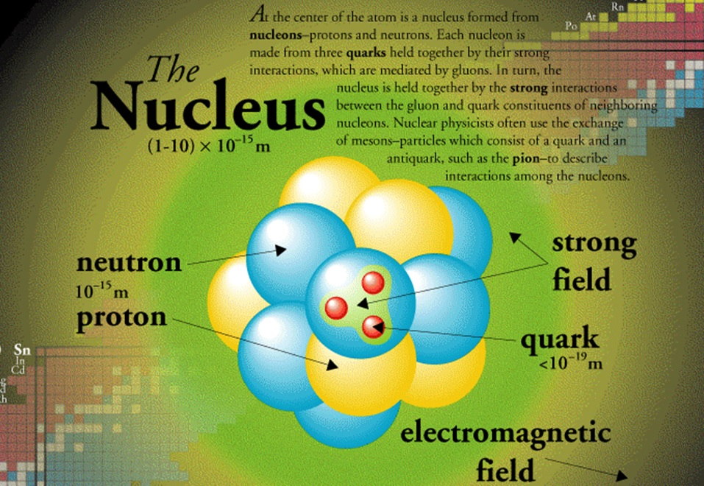
The nucleus

Slide 3
Why study nuclear structure?
Studying exotic nuclei extends the range over which
theories can be tested
Goal: Establish the physical
properties of exotic nuclei and
their interactions (reactions) to
constrain theory and improve
predictive power
Theory
Physical properties
Mass, decay lifetime, production cross-section, electric
and magnetic moments, excited state properties
(moments, energies, lifetimes), etc…
Note → the observables in an experiment may or may not
require interpretation to relate to physical properties

Slide 4
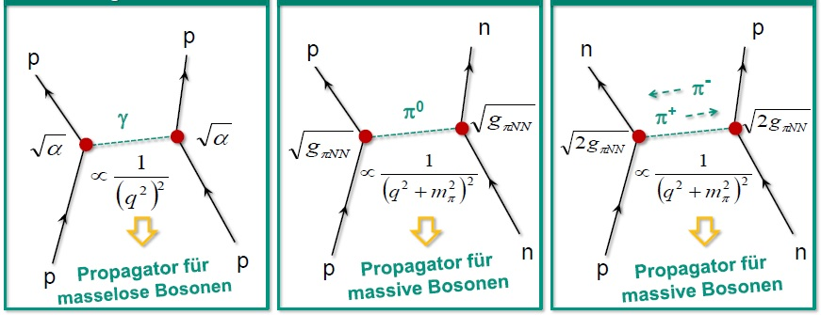
Feynman diagrams
electromagnetic repulsion of protons
strong interaction of a proton and a neutron
strong interaction of a proton and a neutron
propagator for massless bosons
propagator for massive boson
propagator for massive bosons

Slide 5
Level schemes – collective versus single particle
Collective Rotation
Single Particle Alignment

Slide 6
Rotational bands: sequences of excited states

Slide 7
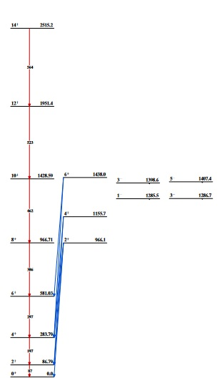
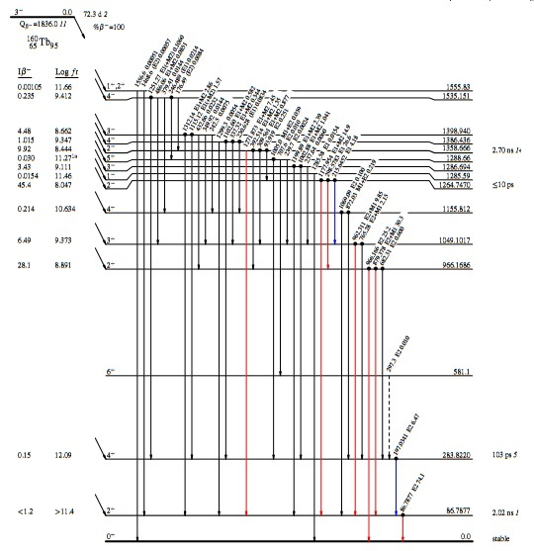

Rotational bands in ¹⁶⁰Dy: sequences of excited states
14⁺
Coulomb excitation
β⁻ decay
12⁺
3⁻ 0.0
$${}_{65}^{160}{{Tb}_{95}}$$
10⁺
6⁺
3⁻
5⁻
1⁻
3⁻
4⁺
4⁺
3⁺
8⁺
2⁺
2⁺
6⁺
6⁺
4⁺
4⁺
2⁺
2⁺
0⁺
0⁺

Slide 8
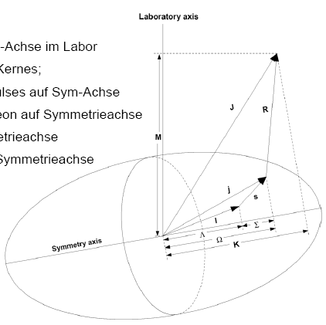
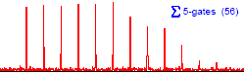
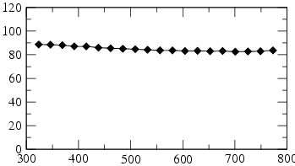
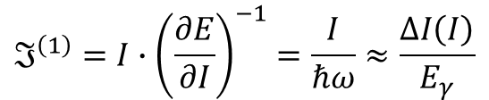




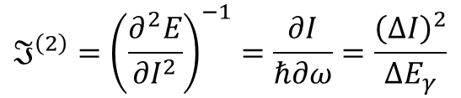
Rotation of deformed nuclei
rotational axis $⊥$ symmetry axis
z
I+14
$$E\left(I\right)=\frac{ℏ^{2}}{2ℑ}\left[I\left(I+1\right)−K^{2}\right]$$
M
R
I
kinematic moment of inertia
I+12
j
ρ
$$ℑ^{\left(1\right)}=I∙{\left(\frac{∂E}{∂I}\right)}^{−1}=\frac{I}{ℏω}≈\frac{ΔI\left(I\right)}{E_{γ}}$$
Ω
K
dynamic moment of inertia
I+10
$$ℑ^{\left(2\right)}={\left(\frac{∂^{2}E}{∂I^{2}}\right)}^{−1}=\frac{∂I}{ℏ∂ω}=\frac{{\left(ΔI\right)}^{2}}{ΔE_{γ}}$$
I+8
rigid rotor: $ℑ^{\left(2\right)}=ℑ^{\left(1\right)}$
I+6
I+4
Eγ
rotational frequency
I+2
I
$$ℏω=\frac{∂E}{∂I}≈\frac{E}{∆I}$$
J ⁽²⁾ [ħ²MeV⁻¹]
superdeformed ¹⁵²Dy
ħω [keV]

Slide 9
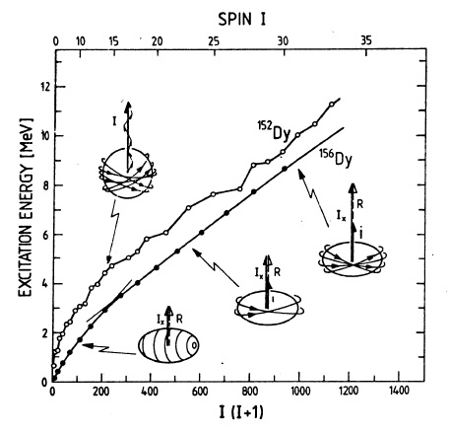
Rotational bands: sequences of excited states

Slide 10
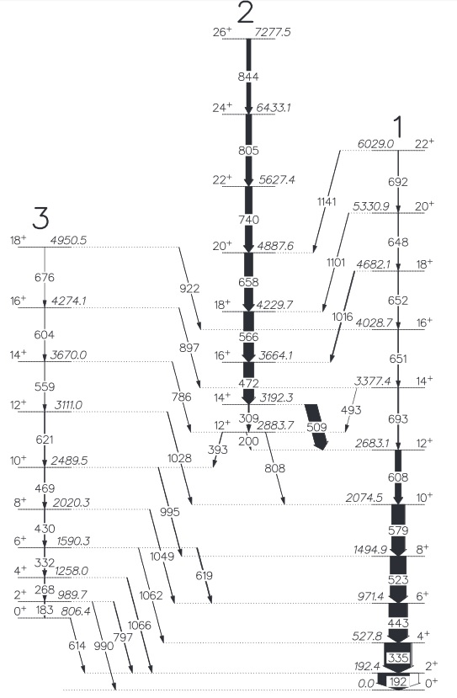
Rotational bands: band crossing
Rotational bands
Rotation can exist on top of other excitations
As such, a nucleus can have several different
rotational bands and the moment of inertia ℑ
is often different for different bands
The different ℑ lead to different energy spacings for the different bands
¹⁵⁸Er

Slide 11





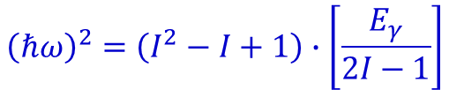
Rotational bands
Rotational bands: Backbending
The different ℑ for different rotational bands creates the so-called “backbend”
This is when we follow the lowest-energy state for a given spin-parity (“yrast” state) belonging to a given rotational band and plot the moment of inertia and square of the rotational frequency
$$ℑ=ℑ_{rig}$$
excited state band
at high spin → break up of J=0 pair, reduction of the moment of inertia
$$\frac{2ℑ}{ℏ^{2}}=\frac{4I−2}{E_{γ}}$$
$${\left(ℏω\right)}^{2}=\left(I^{2}−I+1\right)∙\left[\frac{E_{γ}}{2I−1}\right]$$
$$ℏω≅\frac{E_{γ}}{2}$$
ground state band
$$E_{rot}=\frac{ℏ^{2}}{2ℑ}I\left(I+1\right)=\frac{1}{2}ℑω^{2}$$
$$E_{γ}=E\left(I\right)−E\left(I−2\right)$$

Slide 12
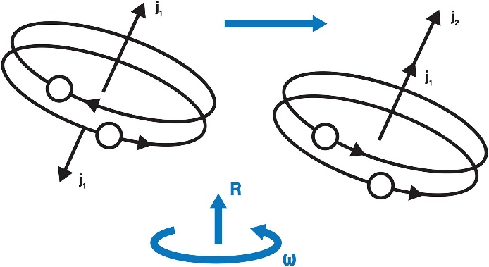
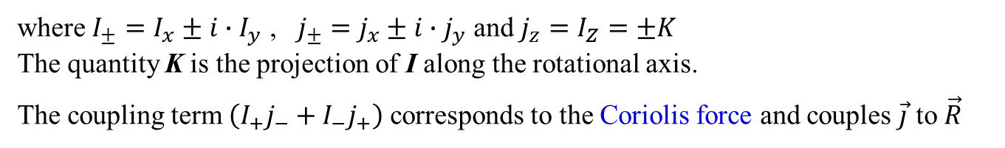



Rotational alignment: Coriolis coupling
at high spin → break up of J=0 pair, reduction of the moment of inertia
$$H_{rot}=\frac{ℏ^{2}}{2ℑ}∙{\vec{R}}^{2}=\frac{ℏ^{2}}{2ℑ}{\left(\vec{I}−\vec{j}\right)}^{2}$$
Illustration of the “rotational alignment” effect where a pair of high-j quasi-particles in time-reversed orbits at a critical rotational frequency are broken and align themselves with the collective rotation, R, of the nucleus as a whole leading to the “backbending” effect in nuclei
$${\vec{R}}^{2}={\left(\vec{I}−\vec{j}\right)}^{2}={\vec{I}}^{2}−2∙\vec{I∙}\vec{j}+{\vec{j}}^{2}$$
$$=I^{2}+j^{2}−2K^{2}−\left(I_{+}j_{−}+I_{−}j_{+}\right)$$
where $I_{±}=I_{x}±i∙I_{y}$ , $j_{±}=j_{x}±i∙j_{y}$ and $j_{z}=I_{Z}=±K$
The quantity K is the projection of I along the rotational axis.
The coupling term $\left(I_{+}j_{−}+I_{−}j_{+}\right)$ corresponds to the Coriolis force and couples $\vec{j}$ to $\vec{R}$

Slide 13
Rotational alignment: Coriolis coupling
Panel (a) shows the deformation aligned coupling scheme (DAL), where the
angular momentum ~I has the maximum projection K along the symmetry axis. Panel (b)
shows the rotation aligned coupling scheme (RAL), where the angular momentum ~j has
the maximum projection j_{x} along the rotation axis. ~R is the collective angular momentum
and ~j is a single particle angular momentum.

Slide 14
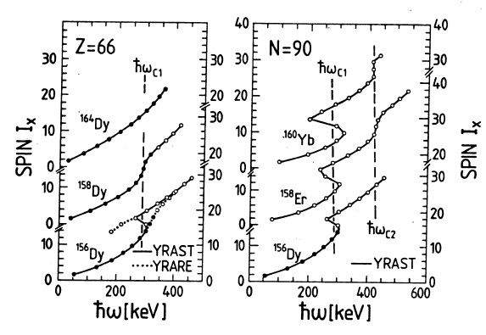
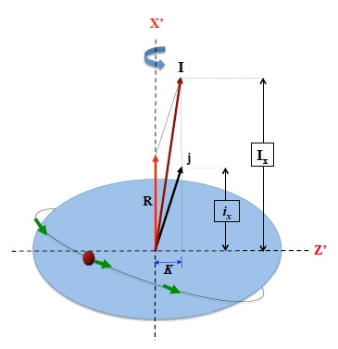




Rotational alignment
1
3
$$I_{x}\left(I\right)=\sqrt{I\left(I+1\right)}≈I+0.5$$
$$I_{x}\left(I\right)=R\left(ω\left(I\right)\right)+i$$
$$=ℑ∙ω+i$$
$$ℏω\left(I_{x}\left(I−1\right)\right)=\frac{∆E\left(I→I−2\right)}{I_{x}\left(I\right)−I_{x}\left(I−2\right)}≈\frac{1}{2}∆E\left(I→I−2\right)$$

Slide 15
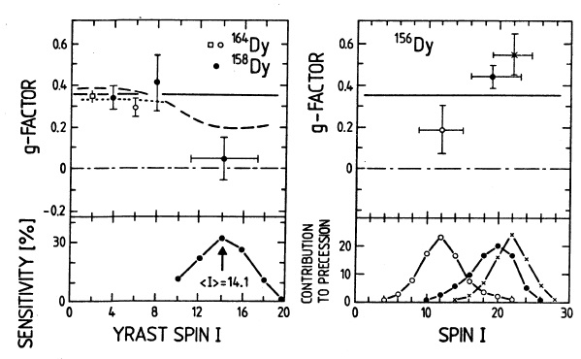




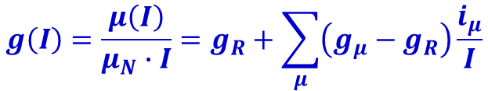
Rotational alignment: g-factor
$$g\left(I\right)=\frac{μ\left(I\right)}{μ_{N}∙I}=g_{R}+\sum_{μ}{\left(g_{μ}−g_{R}\right)\frac{i_{μ}}{I}}$$
$$g_{R}=\frac{Z}{A}$$
$$g_{μ}≈−0.15$$
$$g_{μ}≈+1.2$$
$$i_{μ}=10$$

Slide 16
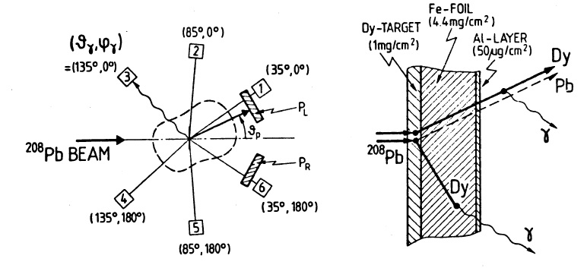
Rotational alignment: g-factor

Slide 17
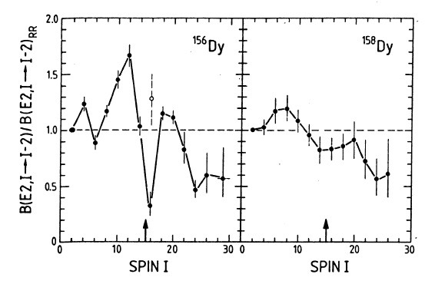





Rotational alignment: B(E2)-values
$$B\left(E2,I→I−2\right)=\frac{5}{16π}\frac{3I\left(I−1\right)}{2\left(4I^{2}−1\right)}Q_{t}^{2}$$
$$Q\left(I\right)=−\frac{I}{2I+3}Q_{d}$$
$$Q_{t}=Q_{0}\frac{2}{\sqrt{3}}cos\left({30}^{0}−γ\right)$$
$$Q_{d}=Q_{0}∙2∙sin\left({30}^{0}−γ\right)$$
$$Q_{0}=\frac{3}{\sqrt{5π}}ZeR_{0}^{2}β$$

Slide 18
Rotational alignment: B(E2)-values

Slide 19
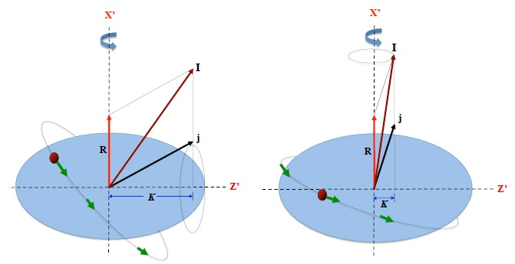
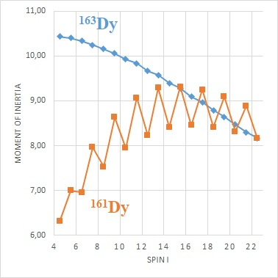
Rotational alignment: Coriolis coupling
1
1
¹⁶¹Dy: 5/2[642] (i_{13/2})
¹⁶³Dy: 5/2[523] (f_{7/2})
3
3
strong coupling
weak coupling
rotational alignment

Slide 20
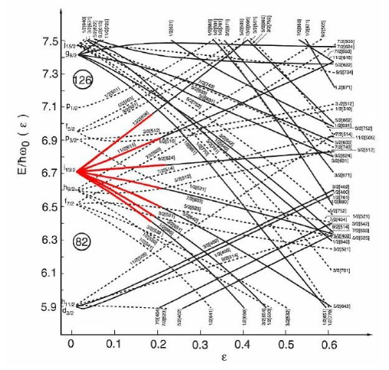
Nilsson diagram

Slide 21
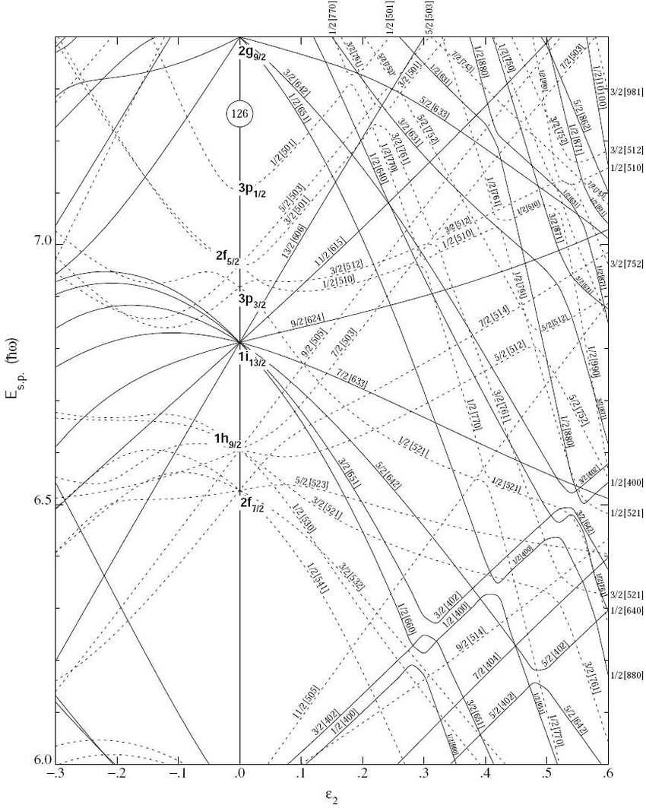
Nilsson diagram

