Slide 1

Outline: Nuclear rotation
Lecturer: Hans-Jürgen Wollersheim
e-mail: h.j.wollersheim@gsi.de
web-page: https://web-docs.gsi.de/~wolle/ and click on
collective rotation
oblate and prolate quadrupole deformation
Euler angles
reduced transition probabilities

Slide 2

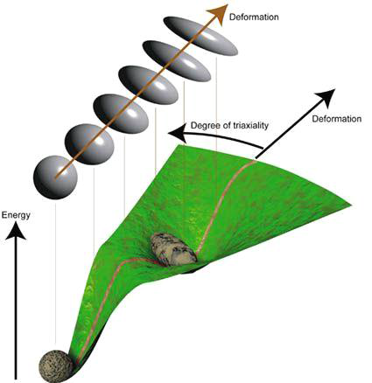
Nuclear rotation

Slide 3

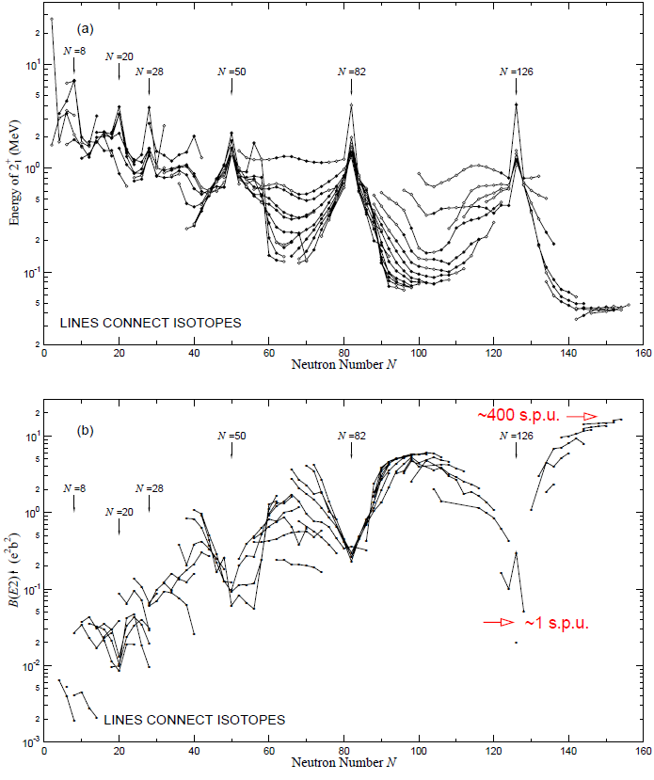
Collective rotation
S. Raman et al., Atomic Data & Nuclear Data Tables 78, 1

Slide 4
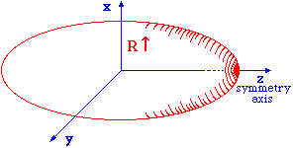
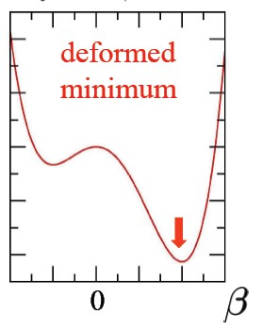
How do nuclei rotate?
1
3
symmetry axis
2
energy spheroid
The nucleus rotates as a whole.
(collective degrees of freedom)
The nucleons move independently
inside deformed potential (intrinsic degrees of freedom)
The nucleonic motion is much faster
than the rotation (adiabatic approximation)

Slide 5
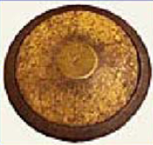
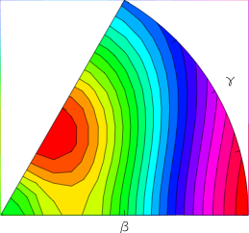
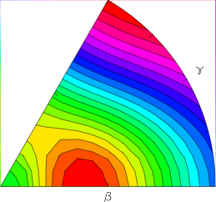


Oblate and prolate quadrupole deformation
Choosing the vertical axis as the 3-axis one obtains the oblate by R₁ = R₂ > R₃ and the prolate by R₁ = R₂ < R₃ axially-symmetric quadrupole deformations
$$α_{20}=β∙cosγ$$
$$α_{22}=α_{2−2}=\frac{1}{\sqrt{2}}∙β∙sinγ$$
oblate deformation (β<0)
prolate deformation (β>0)
Hill – Wheeler introduced the (β, γ) - parameters

Slide 6
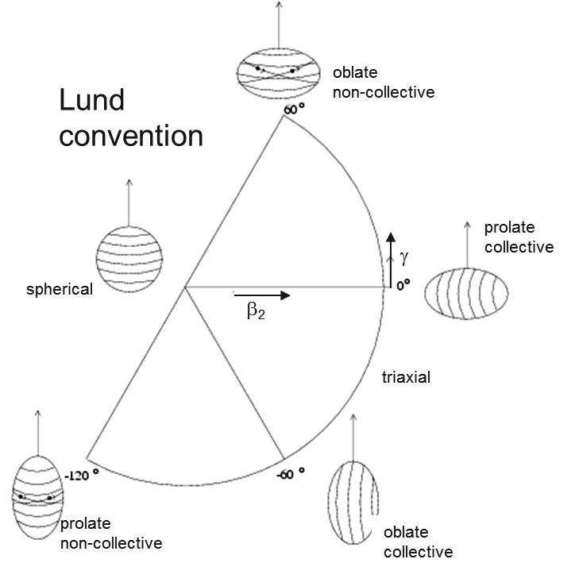
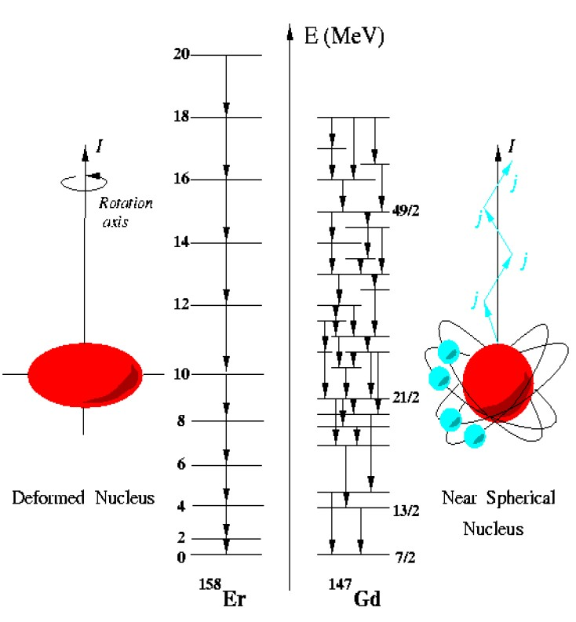


Nuclear deformation
$$α_{20}=β∙cosγ$$
$$α_{22}=α_{2−2}=\frac{1}{\sqrt{2}}∙β∙sinγ$$

Slide 7
The Euler angles
It is important to recognize that for nuclei the intrinsic reference frame can
have any orientation with respect to the lab reference frame as we can hardly
control orientation of nuclei (although it is possible in some cases).
One way to specify the mutual orientation of two reference frames of the
common origin is to use Euler angles.
(x, y, z) axes of lab frame (red)
(x´,y´,z´) axes of intrinsic frame (blue)
Rotation by angle α about the z´axis,
β about the x´axis and γ about the
new z´axis brings the intrinsic frame
onto the lab frame

Slide 8
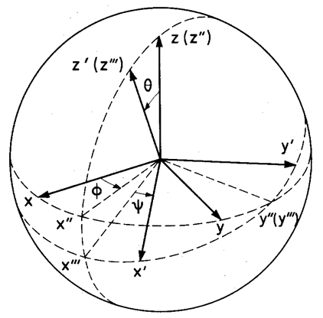
The Euler angles
It is important to recognize that for nuclei the intrinsic reference frame can
have any orientation with respect to the lab reference frame as we can hardly
control orientation of nuclei (although it is possible in some cases).
One way to specify the mutual orientation of two reference frames of the
common origin is to use Euler angles.
(x, y, z) axes of lab frame
(1,2,3) axes of intrinsic frame
The rotation from (x,y,z) to (x´,y´,z´)
can be decomposed into three parts:
a rotation by about the z axis to
, a rotation of θ about the
new y axis to , and
finally a rotation of ψ about the new
z axis .

Slide 9






Quantization
$$\left[J_{x},J_{y}\right]=i∙ℏ∙J_{z}$$
$$J_{z}⟶ℏ∙M$$
$$J^{2}⟶ ℏ^{2}∙I\left(I+1\right)$$
$$\left[J_{1},J_{2}\right]=i∙ℏ∙J_{3}$$
$$J_{3}⟶ℏ∙K$$
$$J^{2}⟶ ℏ^{2}∙I\left(I+1\right)$$

Slide 10
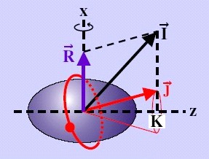
Quantization
z
3

Slide 11
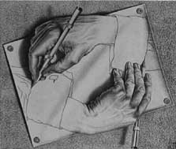

Rotational motion of a deformed nucleus
z
The nucleus does not have an orientation degree of freedom with respect to the symmetry axis
3
States with projections K and –K are degenerated
J
3
If the total angular momentum results only from the rotation (J = R), one obtains for the rotational energy of an axially symmetric nucleus by
$$ℏ^{2}$$

Slide 12
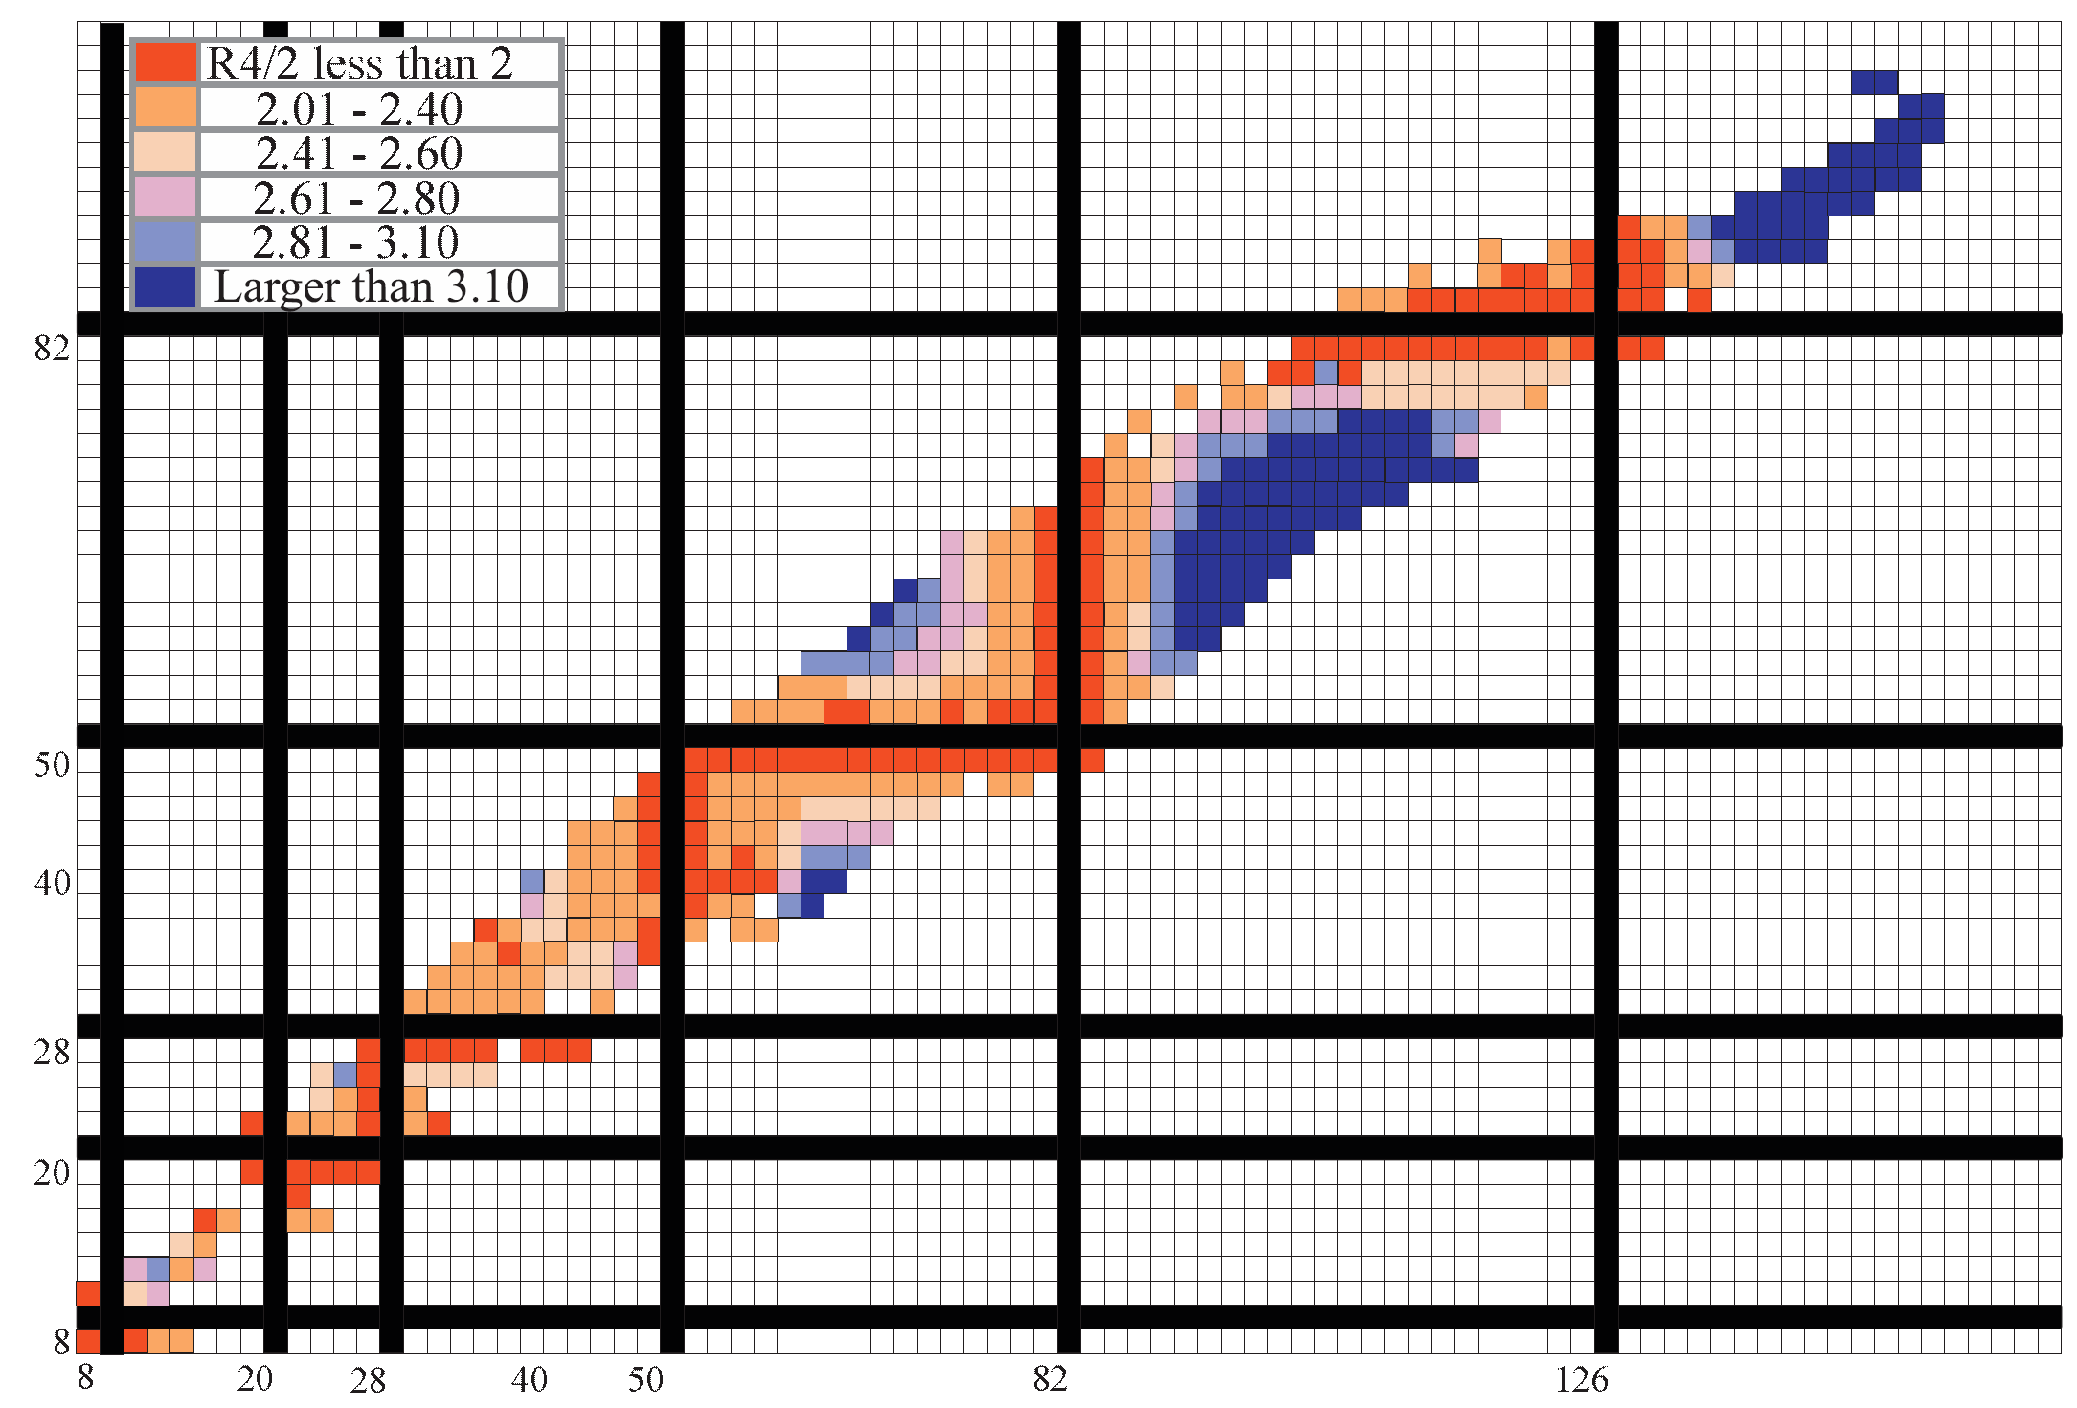
Broad perspective on structural evolution:
proton number
neutron number
Note the characteristic, repeated patterns

Slide 13
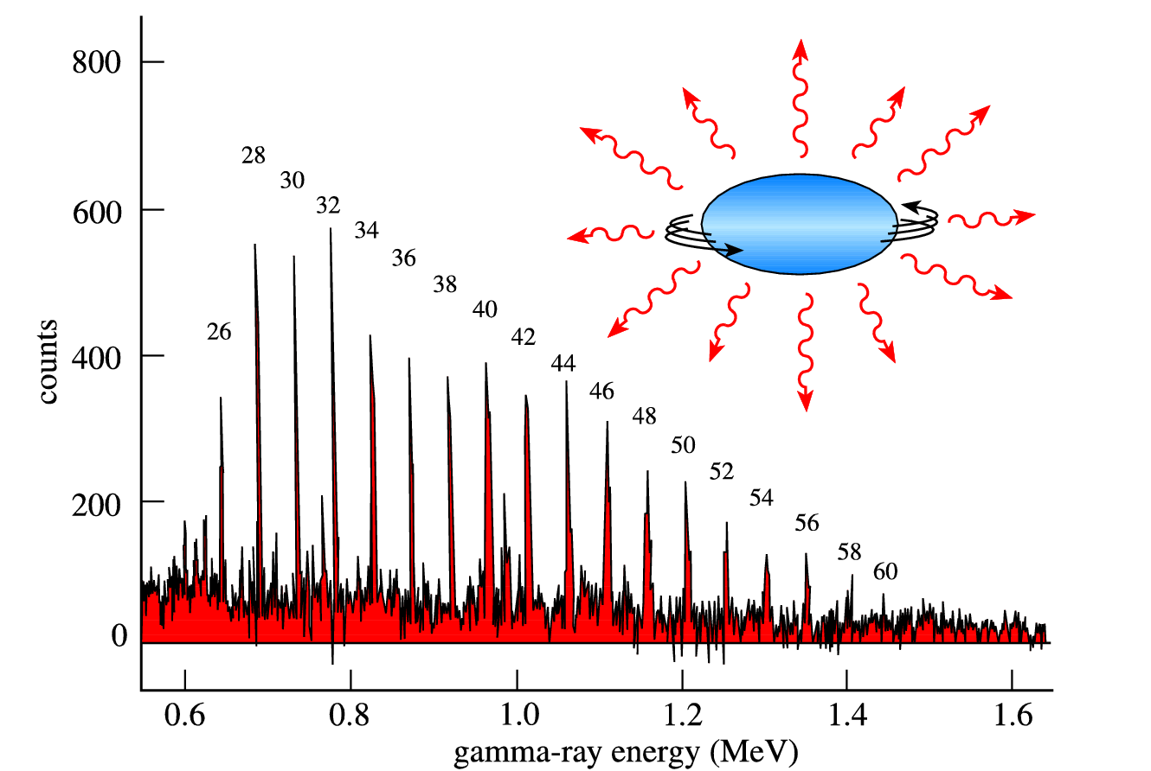
γ-rays from a superdeformed band in ¹⁵²Dy

Slide 14
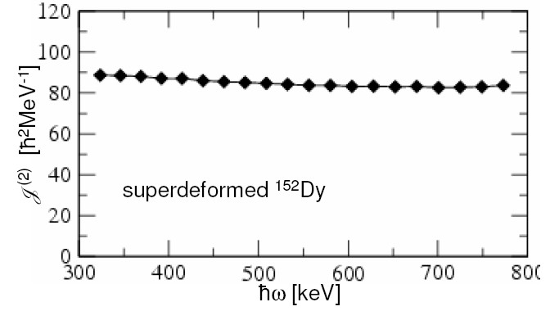




Rotational motion of a deformed nucleus
z
$$ℏ^{2}$$
3
kinematic moment of inertia
$$ℏ^{2}$$
dynamic moment of inertia
$$ℏ^{2}$$
rotational frequency
$$ℏω$$

Slide 15






Rotational frequency
$$ℏ^{2}$$
$$ℏ^{2}$$
$$ℏ^{2}$$
$$ℏ$$
?
$$ℏ^{2}$$
$$ℏ^{3}$$
E_{γ}

Slide 16
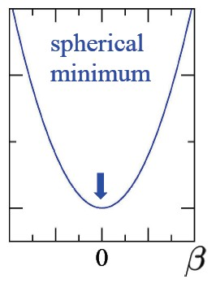
Moment of inertia
z
θ
R(θ)
Rigid body moment of inertia:
Irrotational flow moment of inertia:

Slide 17
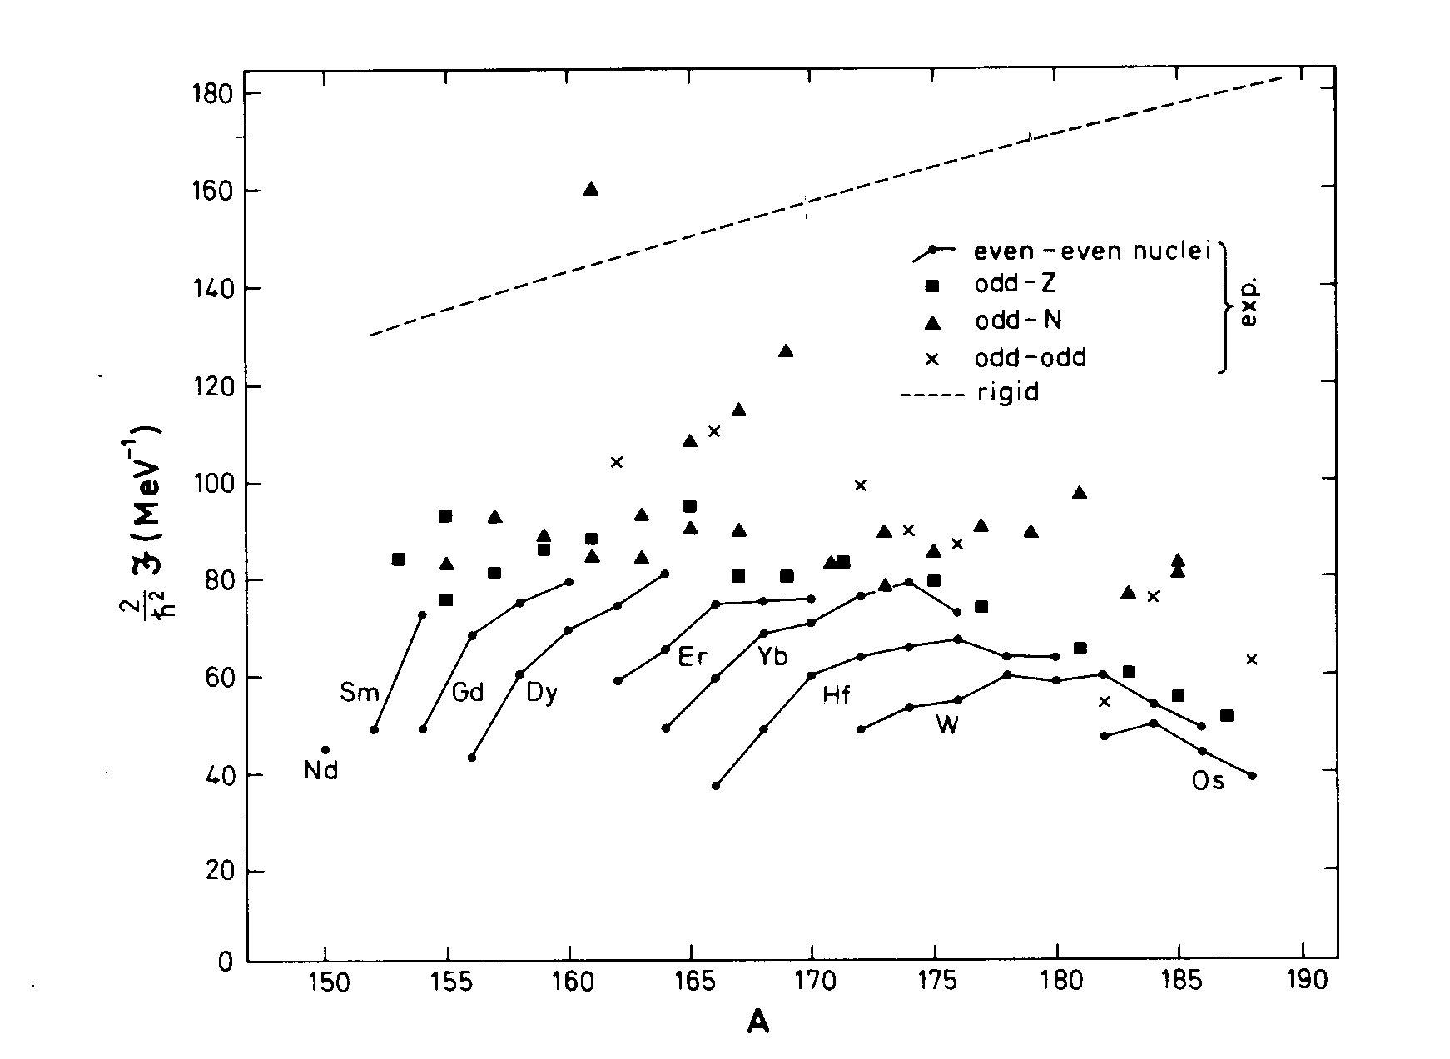
Moment of inertia
rigid
irrotational

Slide 18
Reduced transition probability
expectation value
wave function

Slide 19
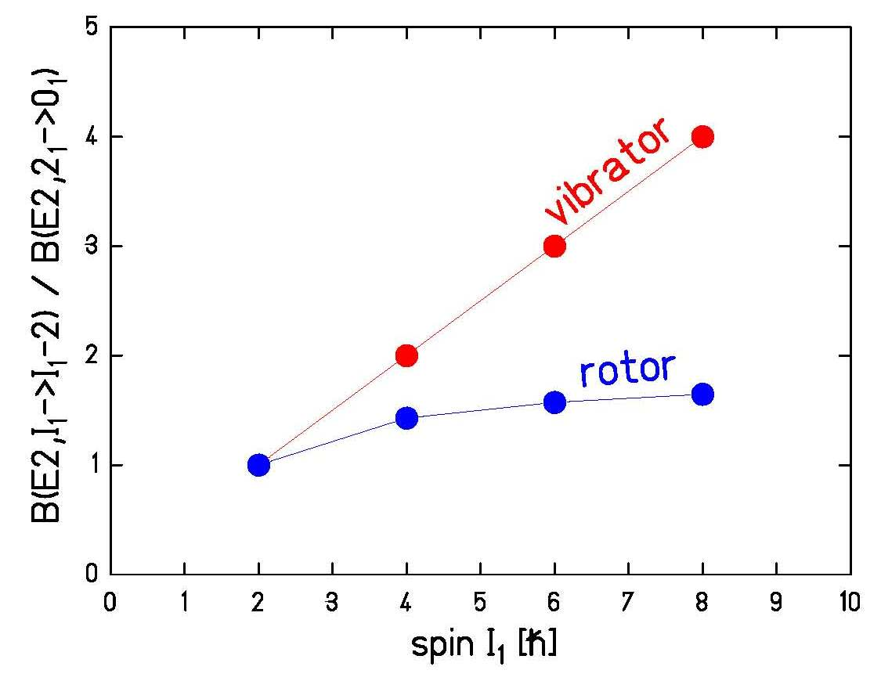


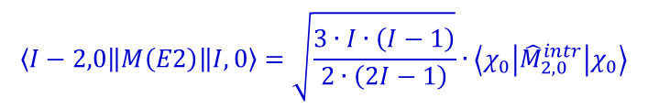
Reduced transition probability
Wigner-Eckart-Theorem (reduction of an expectation value):
$$\left\langle I_{f}0\left\|M\left(Eℓ\right)\right\|I_{i}0\right\rangle =\sqrt{2I_{i}+1}∙\left(I_{i}ℓ00 | I_{f}0\right)∙\left\langle χ_{0}\left|{\hat{M}}_{ℓ0}^{intr}\right|χ_{0}\right\rangle$$
special case: E2 transition I→I-2
$$\left\langle I−2,0\left\|M\left(E2\right)\right\|I,0\right\rangle =\sqrt{\frac{3∙I∙\left(I−1\right)}{2∙\left(2I−1\right)}}∙\left\langle χ_{0}\left|{\hat{M}}_{2,0}^{intr}\right|χ_{0}\right\rangle$$
reduced transition probability:
$$B\left(Eℓ;I_{i}→I_{f}\right)=\frac{1}{2I_{i}+1}{\left|\left\langle I_{f}0\left\|M\left(Eℓ\right)\right\|I_{i}0\right\rangle \right|}^{2}$$
$$B\left(E2;I→I−2\right)=\frac{3∙I∙\left(I−1\right)}{\left(2I+1\right)∙2∙\left(2I−1\right)}∙{\left|\left\langle χ_{0}\left|{\hat{M}}_{2,0}^{intr}\right|χ_{0}\right\rangle \right|}^{2}$$

Slide 20

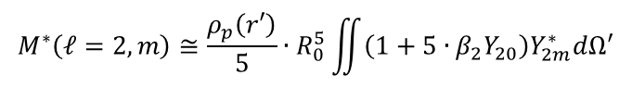
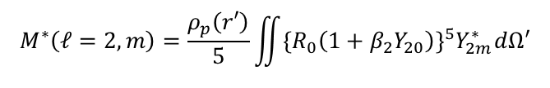
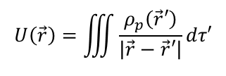
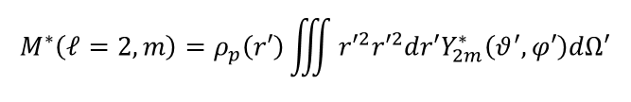
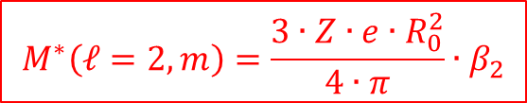
Electric fields of multipoles
In general the electric potential due to
an arbitrary charge distribution is
$$U\left(\vec{r}\right)=\iiint{\frac{ρ_{p}\left(\vec{r}′\right)}{\left|\vec{r}−\vec{r}′\right|}}dτ′$$
$$ρ_{p}\left(\vec{r}′\right)=\frac{3∙Z∙e}{4∙π∙R_{0}^{3}}$$
expansion
multipole moments
$$M^{∗}\left(ℓ=2,m\right)=ρ_{p}\left(r′\right)\iiint{{r′}^{2}{r′}^{2}dr′Y_{2m}^{∗}\left(θ^{′},φ′\right)dΩ′}$$
special case: electric quadrupole matrixelement
$$M^{∗}\left(ℓ=2,m\right)=\frac{ρ_{p}\left(r′\right)}{5}\iint{{\left\{R_{0}\left(1+β_{2}Y_{20}\right)\right\}}^{5}Y_{2m}^{∗}dΩ′}$$
$$M^{∗}\left(ℓ=2,m\right)≅\frac{ρ_{p}\left(r′\right)}{5}∙R_{0}^{5}\iint{\left(1+5∙β_{2}Y_{20}\right)Y_{2m}^{∗}dΩ′}$$
$$M^{∗}\left(ℓ=2,m\right)=\frac{3∙Z∙e∙R_{0}^{2}}{4∙π}∙β_{2}$$

Slide 21

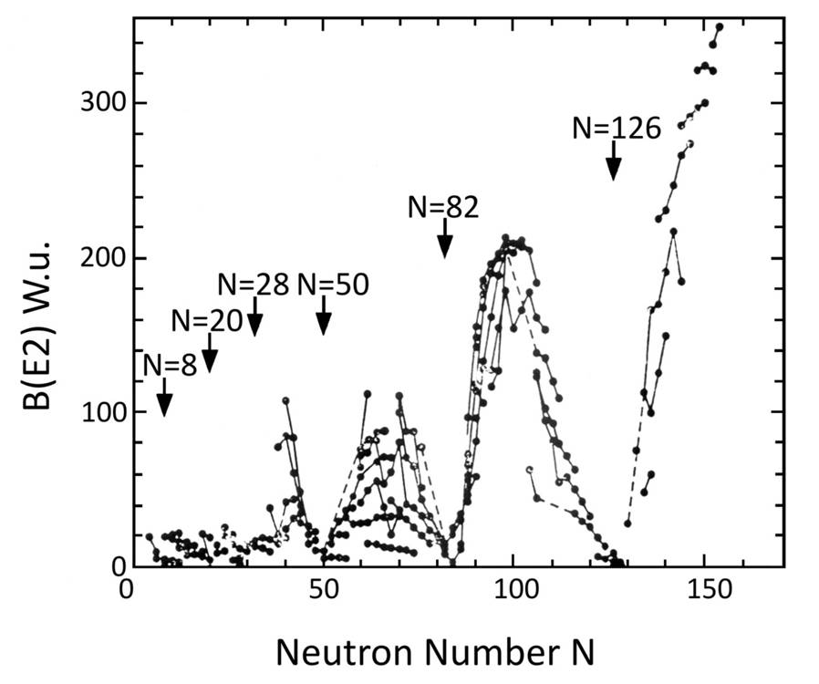

Reduced transition probability
Transition probability:
half-life:
Weisskopf estimate:

Slide 22
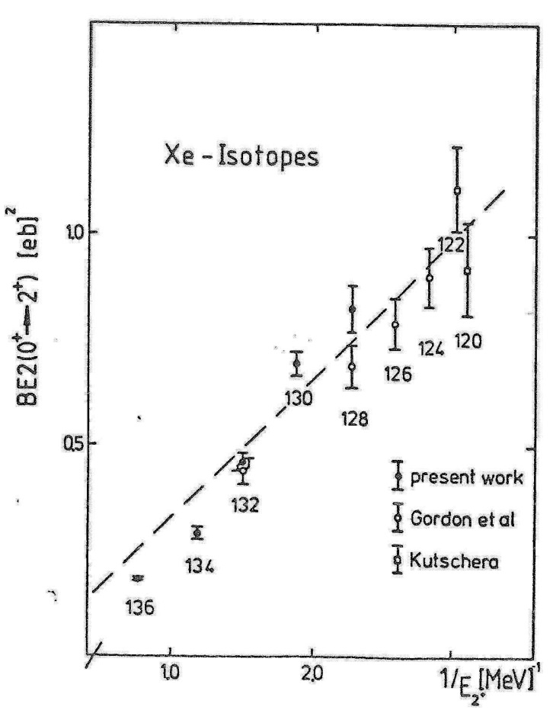

Hydrodynamical model
Reduced transition probability:
Excitation energy:
$$ℏ^{2}$$
Moment of inertia:
L. Grodzins. Phys.Lett. 2,88 (1962)

Slide 23
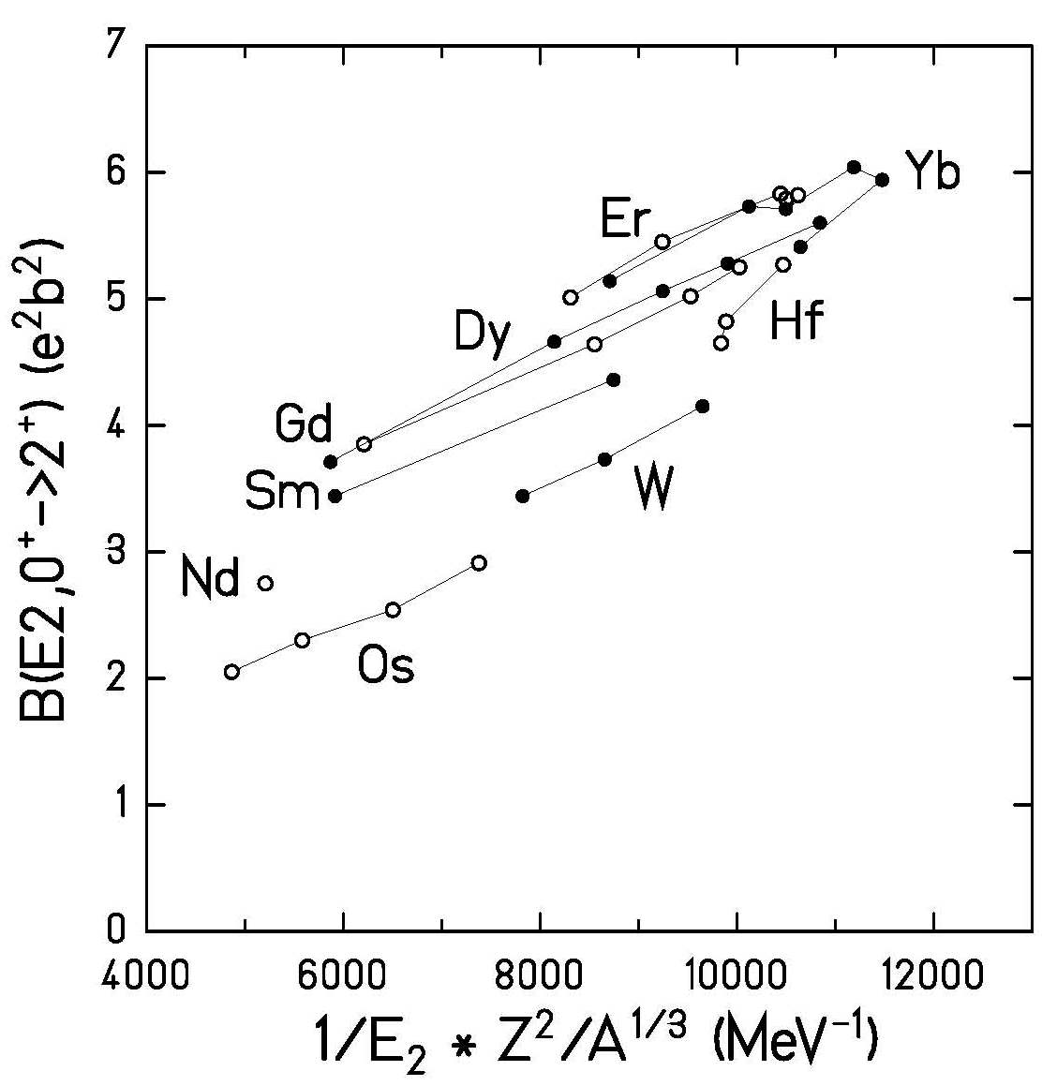
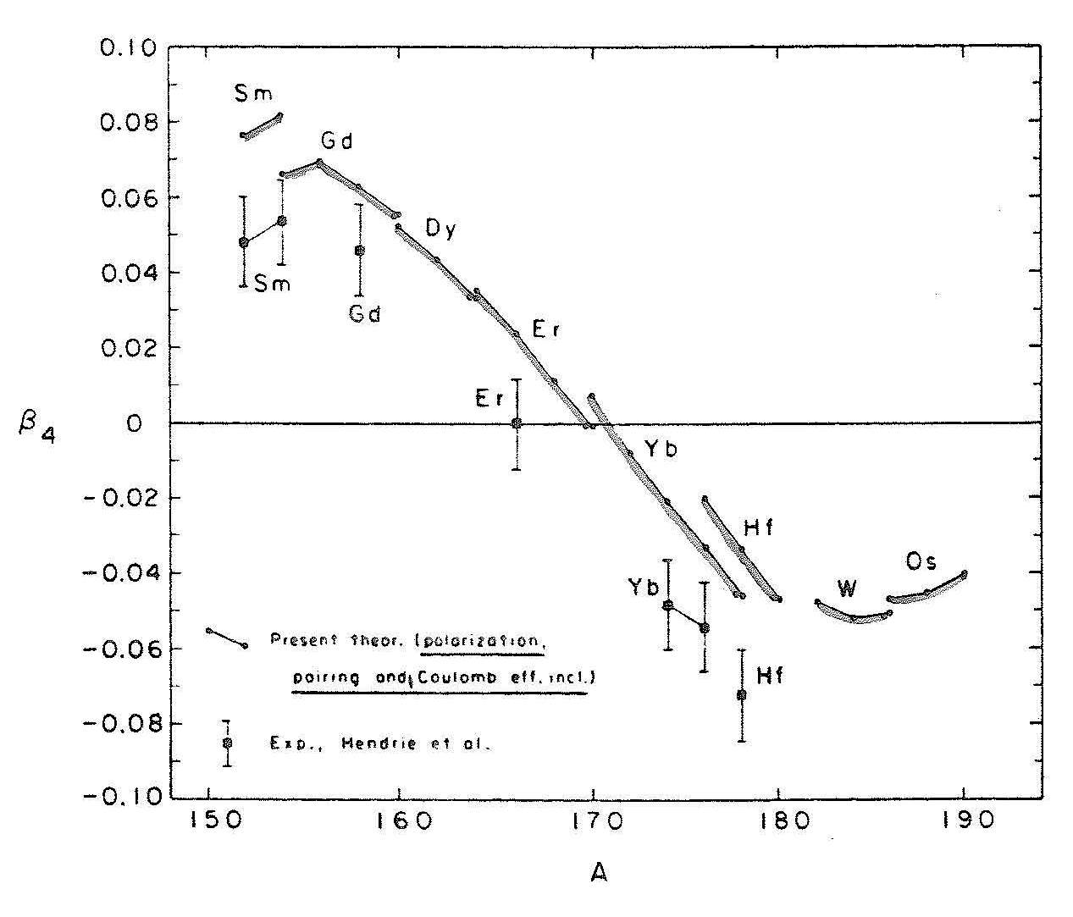

Hydrodynamical model
Reduced transition probability:
Excitation energy:
$$ℏ^{2}$$
first indication of a hexadecapole deformation

Slide 24
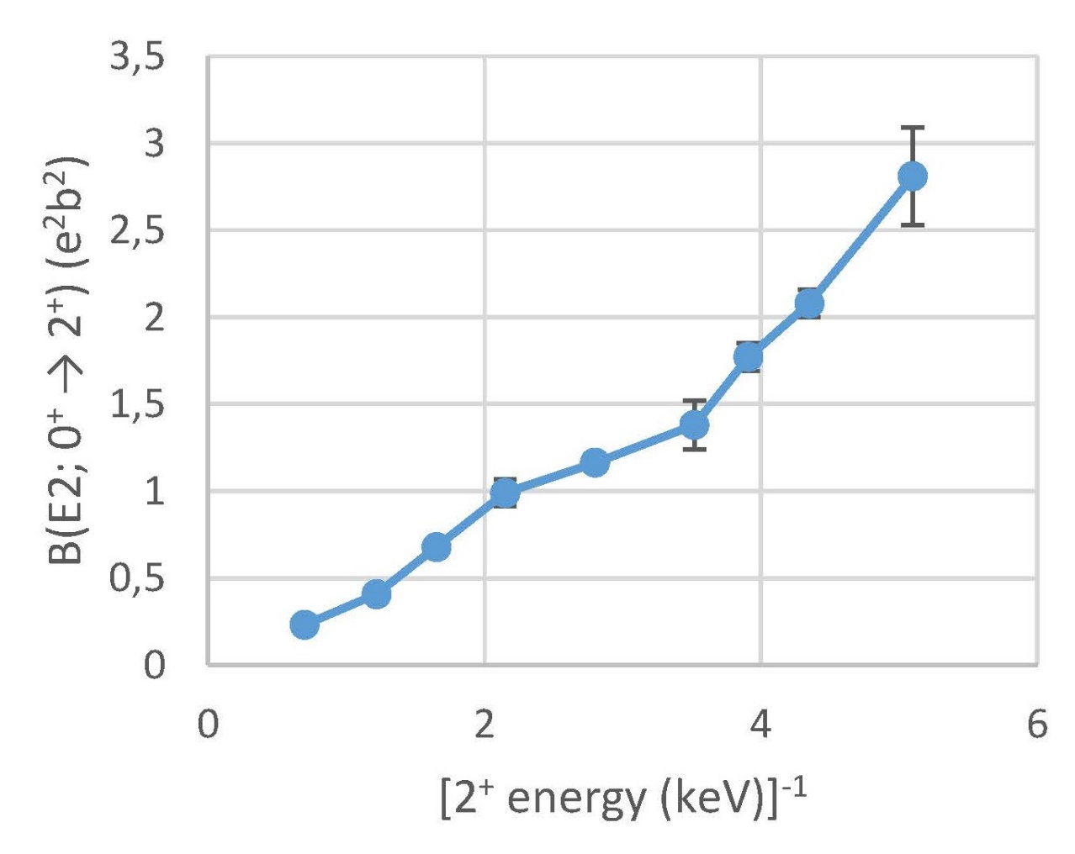
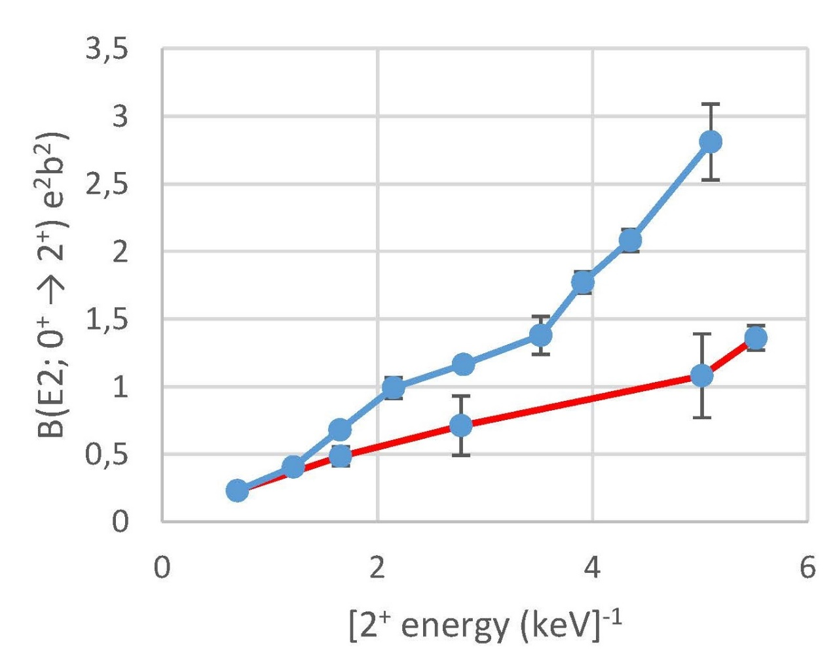
Hydrodynamical model – Barium (Z=56) isotopes
N=66
N=90
N=82

Slide 25
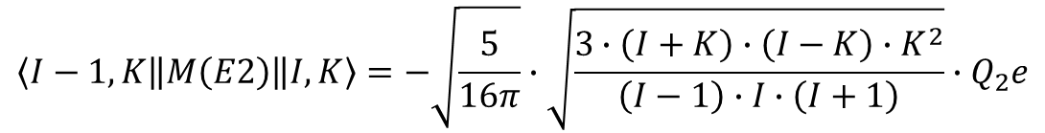
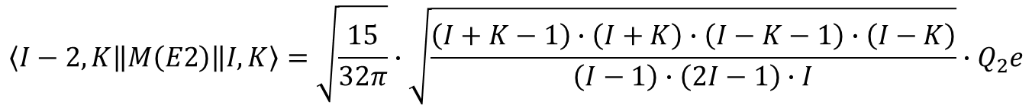
Appendix: Matrixelements
$$\left\langle I−2,K\left\|M\left(E2\right)\right\|I,K\right\rangle =\sqrt{\frac{15}{32π}}∙\sqrt{\frac{\left(I+K−1\right)∙\left(I+K\right)∙\left(I−K−1\right)∙\left(I−K\right)}{\left(I−1\right)∙\left(2I−1\right)∙I}}∙Q_{2}e$$
$$\left\langle I−1,K\left\|M\left(E2\right)\right\|I,K\right\rangle =−\sqrt{\frac{5}{16π}}∙\sqrt{\frac{3∙\left(I+K\right)∙\left(I−K\right)∙K^{2}}{\left(I−1\right)∙I∙\left(I+1\right)}}∙Q_{2}e$$
$$\left\langle I,K\left\|M\left(E2\right)\right\|I,K\right\rangle =−\sqrt{\frac{5}{16π}}∙\sqrt{\frac{2I+1}{\left(2I−1\right)∙I∙\left(I+1\right)∙\left(2I+3\right)}}∙{\left(I^{2}−3K^{2}+I\right)∙Q}_{2}e$$

Slide 26
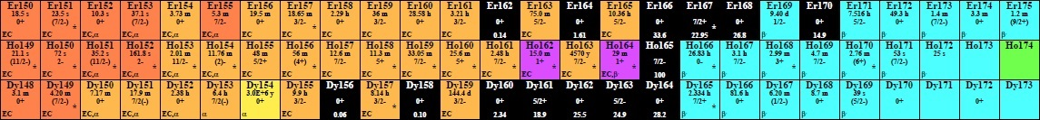
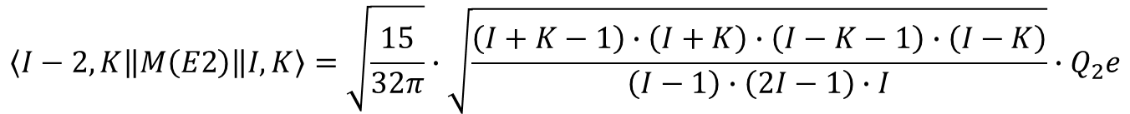
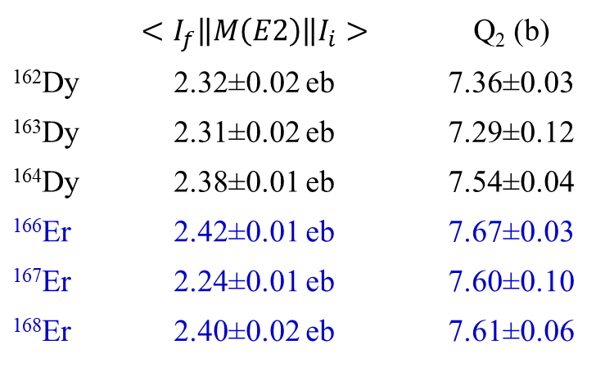
Appendix: Odd-even nuclei
$$\left\langle I−2,K\left\|M\left(E2\right)\right\|I,K\right\rangle =\sqrt{\frac{15}{32π}}∙\sqrt{\frac{\left(I+K−1\right)∙\left(I+K\right)∙\left(I−K−1\right)∙\left(I−K\right)}{\left(I−1\right)∙\left(2I−1\right)∙I}}∙Q_{2}e$$
 | $$<I_{f}\left\|M\left(E2\right)\right\|I_{i}>$$ | Q₂ (b)
¹⁶²Dy | 2.32±0.02 eb | 7.36±0.03
¹⁶³Dy | 2.31±0.02 eb | 7.29±0.12
¹⁶⁴Dy | 2.38±0.01 eb | 7.54±0.04
¹⁶⁶Er | 2.42±0.01 eb | 7.67±0.03
¹⁶⁷Er | 2.24±0.01 eb | 7.60±0.10
¹⁶⁸Er | 2.40±0.02 eb | 7.61±0.06

Slide 27


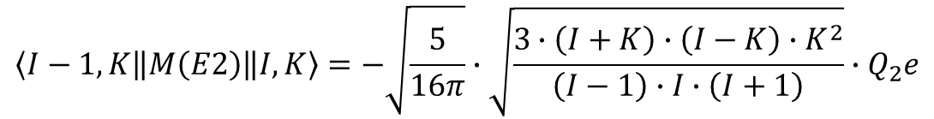
Appendix: Odd-even nuclei
$$\left\langle I−2,K\left\|M\left(E2\right)\right\|I,K\right\rangle =\sqrt{\frac{15}{32π}}∙\sqrt{\frac{\left(I+K−1\right)∙\left(I+K\right)∙\left(I−K−1\right)∙\left(I−K\right)}{\left(I−1\right)∙\left(2I−1\right)∙I}}∙Q_{2}e$$
$$\left\langle I−1,K\left\|M\left(E2\right)\right\|I,K\right\rangle =−\sqrt{\frac{5}{16π}}∙\sqrt{\frac{3∙\left(I+K\right)∙\left(I−K\right)∙K^{2}}{\left(I−1\right)∙I∙\left(I+1\right)}}∙Q_{2}e$$
¹⁶³Dy:
$$\frac{B\left(E2;5/2→7/2\right)}{B\left(E2;5/2→9/2\right)}=2.76±0.14 \left({2.86}_{theo}\right)$$
¹⁶⁷Er:
$$\frac{B\left(E2;7/2→9/2\right)}{B\left(E2;7/2→{11}/2\right)}=3.81±0.15 \left({3.89}_{theo}\right)$$

Slide 28

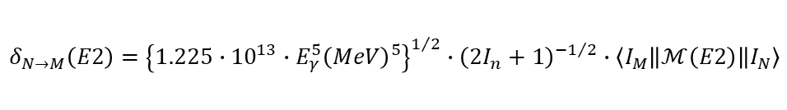
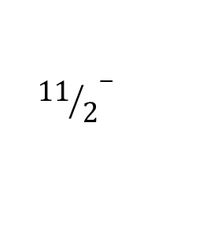

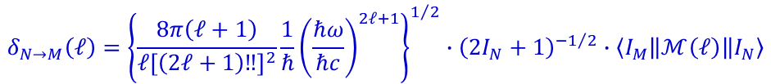
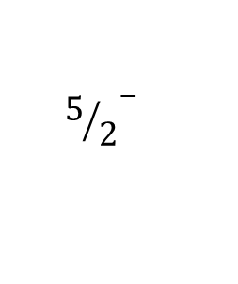

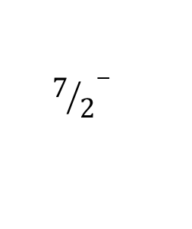
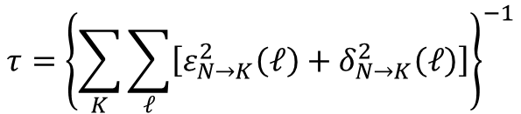
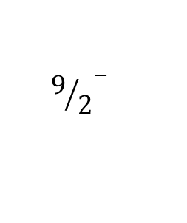

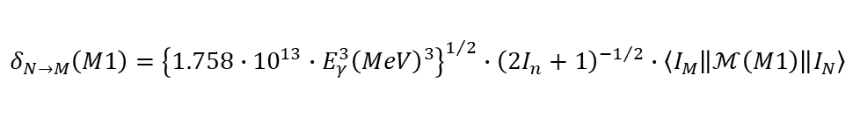
Appendix: Odd-even nuclei
$$τ={\left\{\sum_{K}{\sum_{ℓ}{\left[ε_{N→K}^{2}\left(ℓ\right)+δ_{N→K}^{2}\left(ℓ\right)\right]}}\right\}}^{−1}$$
$${{11}/2}^{−}$$
0.282
$$τ=0.38±0.07 ns$$
$${9/2}^{−}$$
0.167
$$τ=0.49±0.09 ns$$
$${7/2}^{−}$$
0.073
$$τ=2.18±0.07 ns$$
$${5/2}^{−}$$
0.0
¹⁶³Dy
$$δ_{N→M}\left(ℓ\right)={\left\{\frac{8π\left(ℓ+1\right)}{ℓ{\left[\left(2ℓ+1\right)‼\right]}^{2}}\frac{1}{ℏ}{\left(\frac{ℏω}{ℏc}\right)}^{2ℓ+1}\right\}}^{1/2}∙{\left(2I_{N}+1\right)}^{−1/2}∙\left\langle I_{M}\left\|ℳ\left(ℓ\right)\right\|I_{N}\right\rangle$$
$$δ_{N→M}\left(E2\right)={\left\{1.225∙{10}^{13}∙E_{γ}^{5}{\left(MeV\right)}^{5}\right\}}^{1/2}∙{\left(2I_{n}+1\right)}^{−1/2}∙\left\langle I_{M}\left\|ℳ\left(E2\right)\right\|I_{N}\right\rangle$$
$$δ_{N→M}\left(M1\right)={\left\{1.758∙{10}^{13}∙E_{γ}^{3}{\left(MeV\right)}^{3}\right\}}^{1/2}∙{\left(2I_{n}+1\right)}^{−1/2}∙\left\langle I_{M}\left\|ℳ\left(M1\right)\right\|I_{N}\right\rangle$$
$$ε_{N→M}^{2}\left(ℓ\right)=δ_{N→M}^{2}\left(ℓ\right)∙α_{N→M}\left(ℓ\right)$$
conversion coefficient.: bricc.anu.edu.au

Slide 29
Appendix: Odd-even nuclei
$$τ={\left\{\sum_{K}{\sum_{ℓ}{\left[ε_{N→K}^{2}\left(ℓ\right)+δ_{N→K}^{2}\left(ℓ\right)\right]}}\right\}}^{−1}$$
$${{11}/2}^{−}$$
0.282
$$τ=0.38±0.07 ns$$
$${9/2}^{−}$$
0.167
$$τ=0.49±0.09 ns$$
$${7/2}^{−}$$
0.073
$$τ=2.18±0.07 ns$$
$${5/2}^{−}$$
0.0
¹⁶³Dy
Spin I | E_{γ} (MeV) | (2I+1)^{-1/2} | <I-1//M()//I> | delta | α_{T} | ε² | τ (ns)
7/2 | 0.0734 | 0.3536 | -3.886 (E2) | -7019.1 | 8.9 | 4.38·10⁸ | 2.05
 |  |  | 0.108 (M1) | 3183.7 | 5.7 | 5.78·10⁷ | 1.80
9/2 | 0.0939 | 0.3162 | -4.002 (E2) | -11968 | 3.4 | 4.87·10⁸ | 1.59
 |  |  | 0.153 (M1) | 5837.1 | 2.9 | 9.88·10⁷ | 1.31
 | 0.167 | 0.3162 | 2.299 (E2) | 29133 | 0.4 | 3.65·10⁸ | 0.51

Slide 30
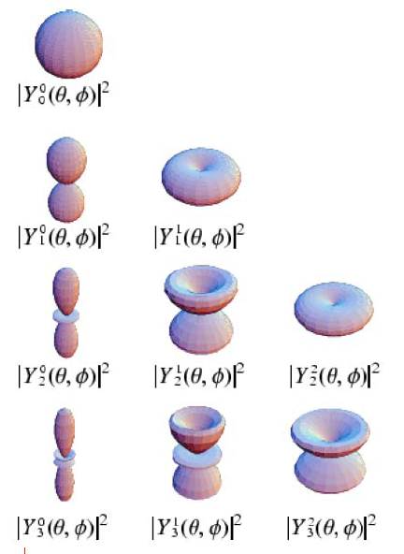
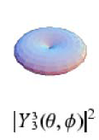
Appendix: Spherical harmonics

Slide 31
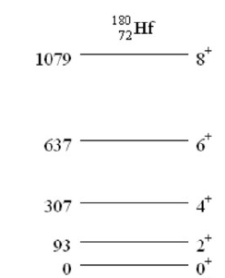
Show that the experimental excitation spectrum of the deformed nucleus ¹⁸⁰Hf follows the rotational band.
Level energy (rotational model):
¹⁸⁰Hf is an even-even nucleus → J=0, 2, 4,…
→ The ratio of the levels should be:
= 2(2+1) : 4(4+1) : 6(6+1) : 8(8+1) = 6 : 20 : 42 : 72
From experiment:
93 : 307 : 637 : 1079 = 6 : 19.8 : 41.1 : 69.6
→ follows the rotational band
E (keV) J^{π}

