Slide 1

Outline: Nuclear Triaxial Shape
Lecturer: Hans-Jürgen Wollersheim
e-mail: h.j.wollersheim@gsi.de
web-page: https://web-docs.gsi.de/~wolle/ and click on
(β,γ) - coordinates
moment of inertia
triaxial rotor model
reduced transition probabilities (W, Os, Pt, Hg)

Slide 2
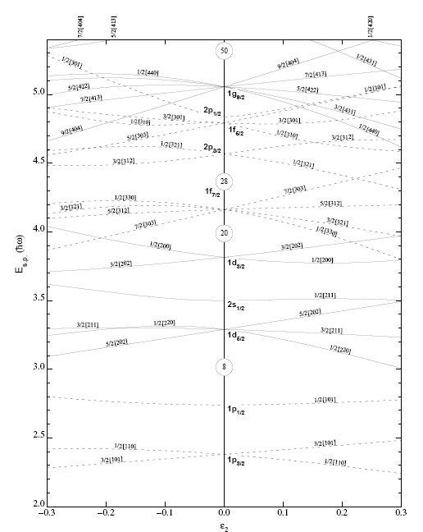
Shape parameterization
Nilsson diagram
50
28
axially symmetric quadrupole
single particle energies
20
oblate
8
prolate
λ=2
α₂₀≠0, α_{2±1}= α_{2±2}= 0
2
elongation

Slide 3
Quadrupole deformation (λ=2)
There are five independent real parameters,
α₂₀ indicates the stretching of the 3-axis with respect to the 1- and 2-axes
α₂₂ determines the difference in length between the 1- and 2-axes
three Euler angles, which determine the orientation of the principle axis system (1,2,3)
with respect to the laboratory frame (x,y,z)
Hill - Wheeler introduced the (β, γ) – parameters:

Slide 4
Quadrupole deformation (λ=2)
Consider the nuclear shapes in the principal axis system (1, 2, 3) ≡ (x´, y´, z´)

Slide 5
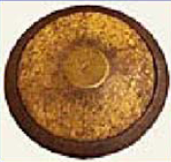
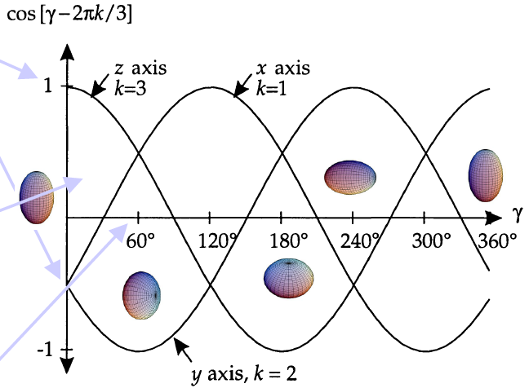
(β,γ) coordinates
At γ = 0⁰ the nucleus is elongated along the z´axis, but the x´and y´axes are equal (prolate shape for x´= y´)
As we increase γ, the x´axis grows at the expense of the y´and z´axes through a region of triaxial shapes with three unequal axis, until axial symmetry is again reached at γ = 60⁰, but now with the z´and x´axis equal in length. These two axes are longer than the y´axis (oblate shape for x´= z´)
This pattern is repeated: every 60⁰ axial symmetry repeated and prolate and oblate shapes alternate.

Slide 6
(β,γ) coordinates
The (β,γ) plane is divided into six equivalent parts by the symmetries:
The sector 0⁰ and 60⁰ contains all shapes uniquely, i.e. triaxial shapes
The types of shapes encountered along the axis: e.g. prolate x´= y´implies prolate shapes with the z´axis as the long axis and the two other axis x´and y´equal.
various nuclear shapes – prolate or oblate – in the (β,γ) plane are repeated every 60⁰. Because the axis orientations are different, the associated Euler angles also differ.
In conclusion, the same physical shape (including ist orientation in space) can be represented by different sets of deformation parameters (β,γ) and Euler angles!

Slide 7
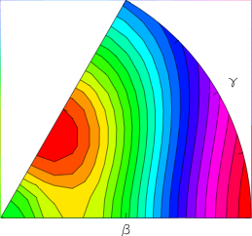
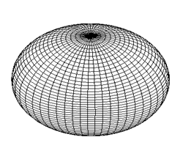


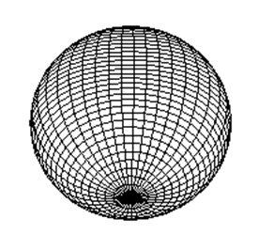
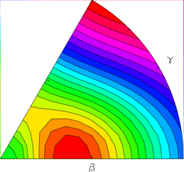
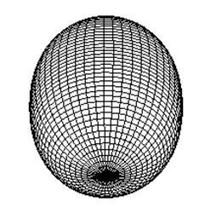
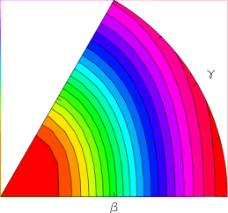
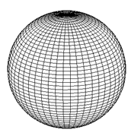
(β,γ) coordinates
V
Spherical
Non collective
oblate
(β, γ = 60⁰)
triaxial
β
Deformed
γ
spherical
β
(0,0)
collective prolate
(β, γ = 0⁰)

Slide 8
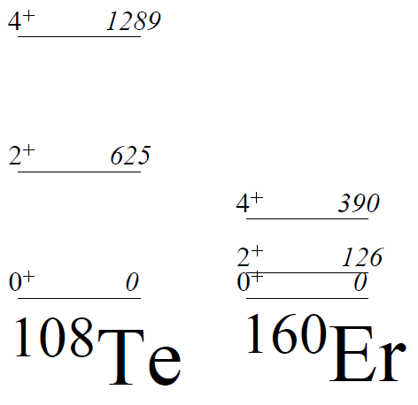


Collective excitation E(4⁺) / E(2⁺): rotational vs vibrational
Rotational (deformed):
  E(4⁺) / E(2⁺) = 10/3
Vibrational (spherical):
  E(4⁺) / E(2⁺) = 2
$$ℏ^{2}$$
$$ℏω_{2}$$
¹⁰⁸Te
¹⁶⁰Er
2.1
3.1

Slide 9


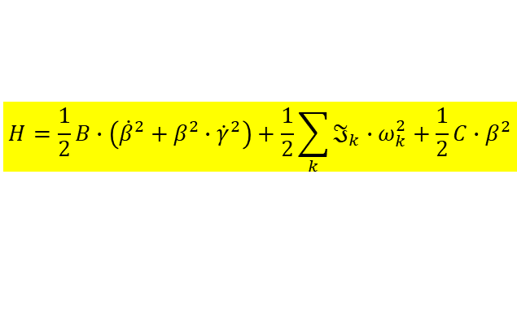
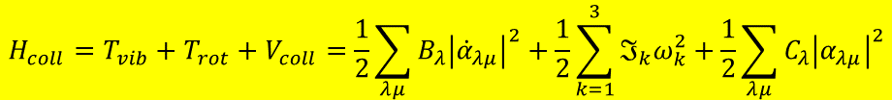
Classical collective Hamiltonian of Bohr-Mottelson for quadrupole deformation
$$H_{coll}=T_{vib}+T_{rot}+V_{coll}=\frac{1}{2}\sum_{λμ}{B_{λ}{\left|{\dot{α}}_{λμ}\right|}^{2}}+\frac{1}{2}\sum_{k=1}^{3}{ℑ_{k}ω_{k}^{2}}+\frac{1}{2}\sum_{λμ}{C_{λ}{\left|α_{λμ}\right|}^{2}}$$
Quadrupole (λ=2) motion
$$H=\frac{1}{2}B∙\left({\dot{β}}^{2}+β^{2}∙{\dot{γ}}^{2}\right)+\frac{1}{2}\sum_{k}{ℑ_{k}∙ω_{k}^{2}}+\frac{1}{2}C∙β^{2}$$
where (β, γ) parameters have been used.
V
Spherical
Potential
β
Deformed

Slide 10
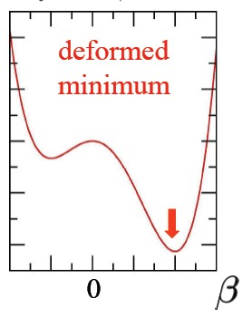
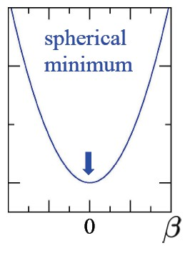
Moment of inertia
z
θ
R(θ)
Rigid body moment of inertia:
Irrotational flow moment of inertia:

Slide 11
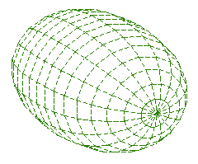
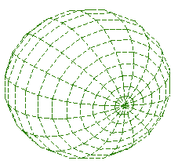
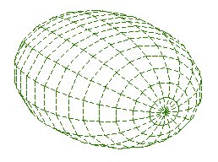
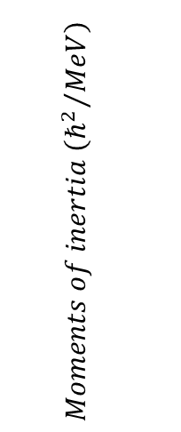
Irrotational flow moment of inertia
$$Moments of inertia \left({ℏ^{2}}/{MeV}\right)$$
$$ℑ_{k}^{Bohr}=4Bβ^{2}\sin^{2}\left(γ−k2π/3\right) k=s,i,l or k=1,2,3$$

Slide 12
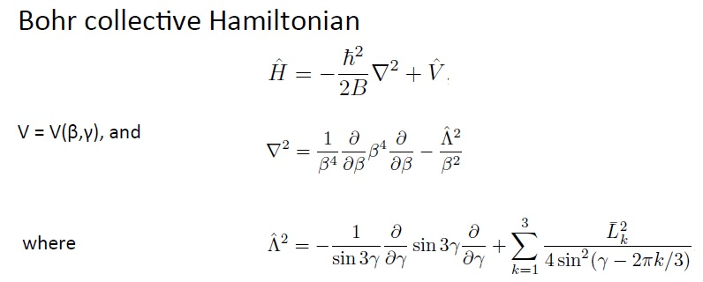
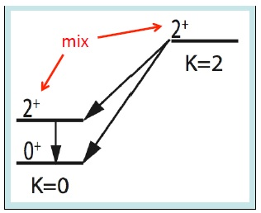
Nuclear Triaxiality Bohr Collective Hamiltonian

Slide 13
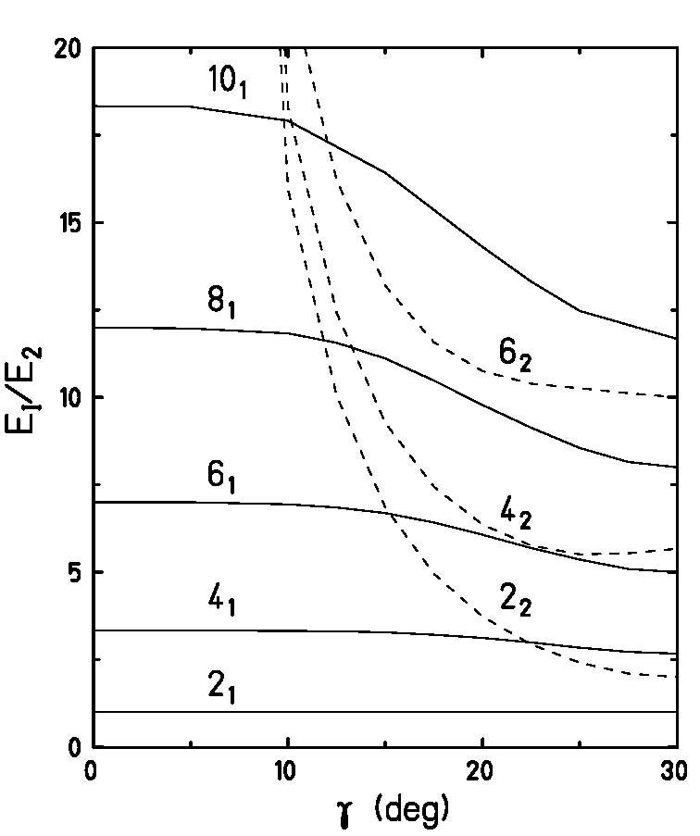
2₂⁺ energy and estimate of γ-deformation parameter
rigid triaxial rotor model
Davydov and Filippov, Nucl. Phys. 8, 237 (1958)
γ | 0⁰ | 5⁰ | 10⁰ | 12.5⁰ | 15⁰ | 17.5⁰ | 20⁰ | 22.5⁰ | 25⁰ | 27.5⁰ | 30⁰
E(4₁)/E(2₁) | 3.33 | 3.33 | 3.32 | 3.31 | 3.28 | 3.21 | 3.12 | 2.99 | 2.84 | 2.72 | 2.67
E(6₁)/E(2₁) | 7.00 | 7.00 | 6.94 | 6.85 | 6.69 | 6.42 | 6.07 | 5.69 | 5.36 | 5.09 | 5.00
E(8₁)/E(2₁) | 12.00 | 11.97 | 11.83 | 11.56 | 11.11 | 10.48 | 9.78 | 9.13 | 8.55 | 8.15 | 8.00
E(10₁)/E(2₁) | 18.33 | 18.31 | 17.91 |  | 16.42 |  | 14.30 | 13.31 | 12.47 |  | 11.67
E(2₂)/E(2₁) | ∞ | 65.16 | 15.94 | 10.04 | 6.85 | 4.95 | 3.73 | 2.93 | 2.41 | 2.10 | 2.00
E(4₂)/E(2₁) | ∞ | 67.50 | 18.28 | 12.41 | 9.27 | 7.44 | 6.36 | 5.76 | 5.51 | 5.54 | 5.67
E(6₂)/E(2₁) | ∞ | 71.17 | 22.00 | 16.20 | 13.19 | 11.57 | 10.75 | 10.39 | 10.26 | 10.12 | 10.00

Slide 14
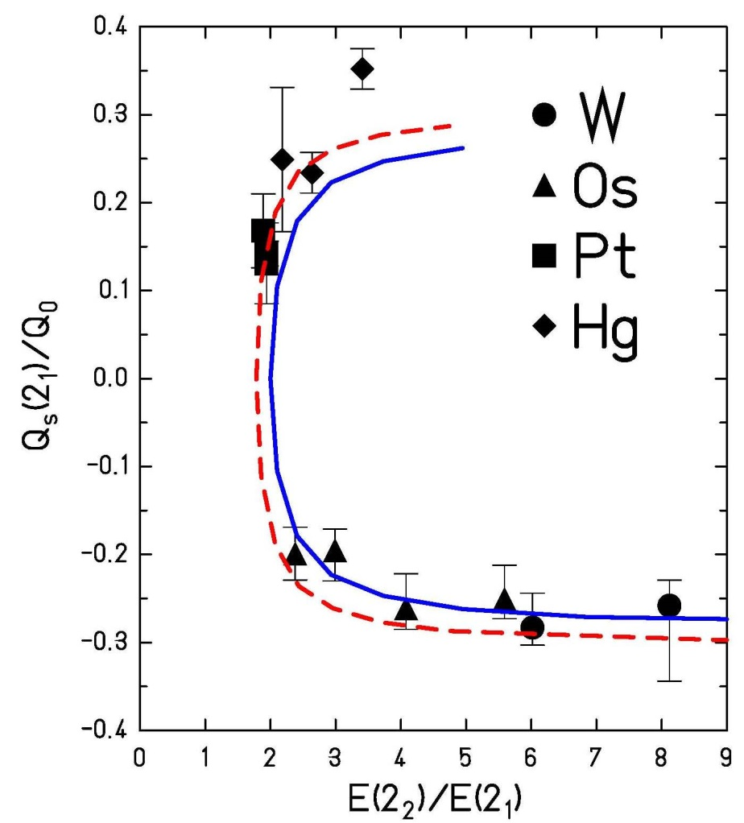
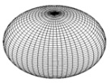
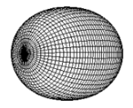
Prolate – oblate shape transition
rigid triaxial rotor model
Z=74
Z=76
Z=78
Davydov and Filippov, Nucl. Phys. 8, 237 (1958)
Z=80
rigid
soft μ=0.5
γ | 0⁰ | 10⁰ | 15⁰ | 20⁰ | 22.5⁰ | 25⁰ | 27.5⁰ | 30⁰
Q_{s}(2₁)/Q₀ | -0.28 | -0.28 | -0.27 | -0.25 | -0.22 | -0.18 | -0.10 | 0.0
soft asymmetric rotor model:
with

Slide 15
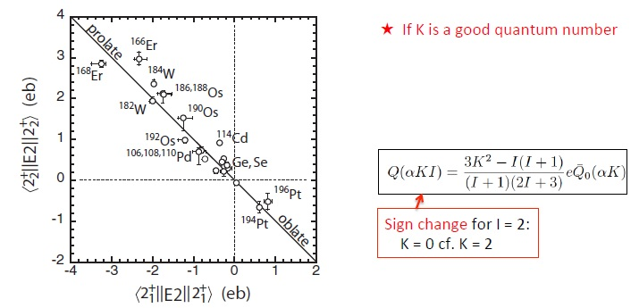
Prolate – oblate shape transition
J.M. Allmond; PRC 88, 041370R (2013)

Slide 16
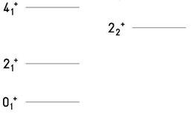
2₂⁺ B(E2)-values and estimate of γ-deformation parameter
rigid triaxial rotor model
¹⁹⁶Pt
γ | 0⁰ | 5⁰ | 10⁰ | 15⁰ | 20⁰ | 25⁰ | 30⁰
B(E2;2₂→0)/B(E2;2₁→0) | 0 | .0075 | .0288 | .0560 | .0718 | .0445 | 0
B(E2;2₂→0)/B(E2;2₁→0) | 0 | .0111 | .0525 | .1510 | .3826 | .9058 | 1.43
B(E2;2₂→2)/B(E2;2₂→0) | 1.43 | 1.49 | 1.70 | 2.70 | 5.35 | 20.6 | ∞

Slide 17
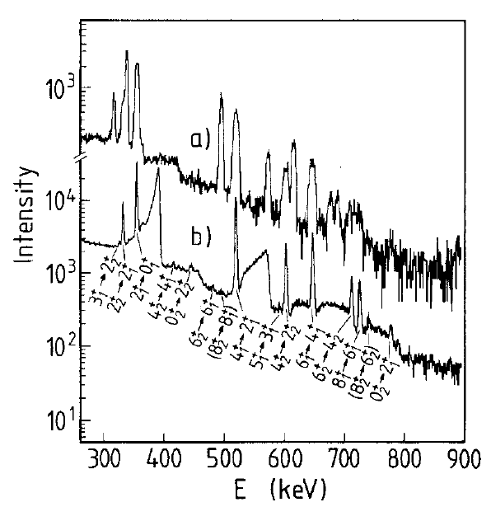
Triaxiality and γ-softness in ¹⁹⁶Pt
²⁰⁸Pb → ¹⁹⁶Pt
4.8 AMeV
position-sensitive
parallel plate counter
(Doppler correction)
87⁰≤θ_{cm}≤93⁰
75⁰≤θ_{cm}≤150⁰
A. Mauthofer et al., Z.Phys. A336, 263 (1990)

Slide 18
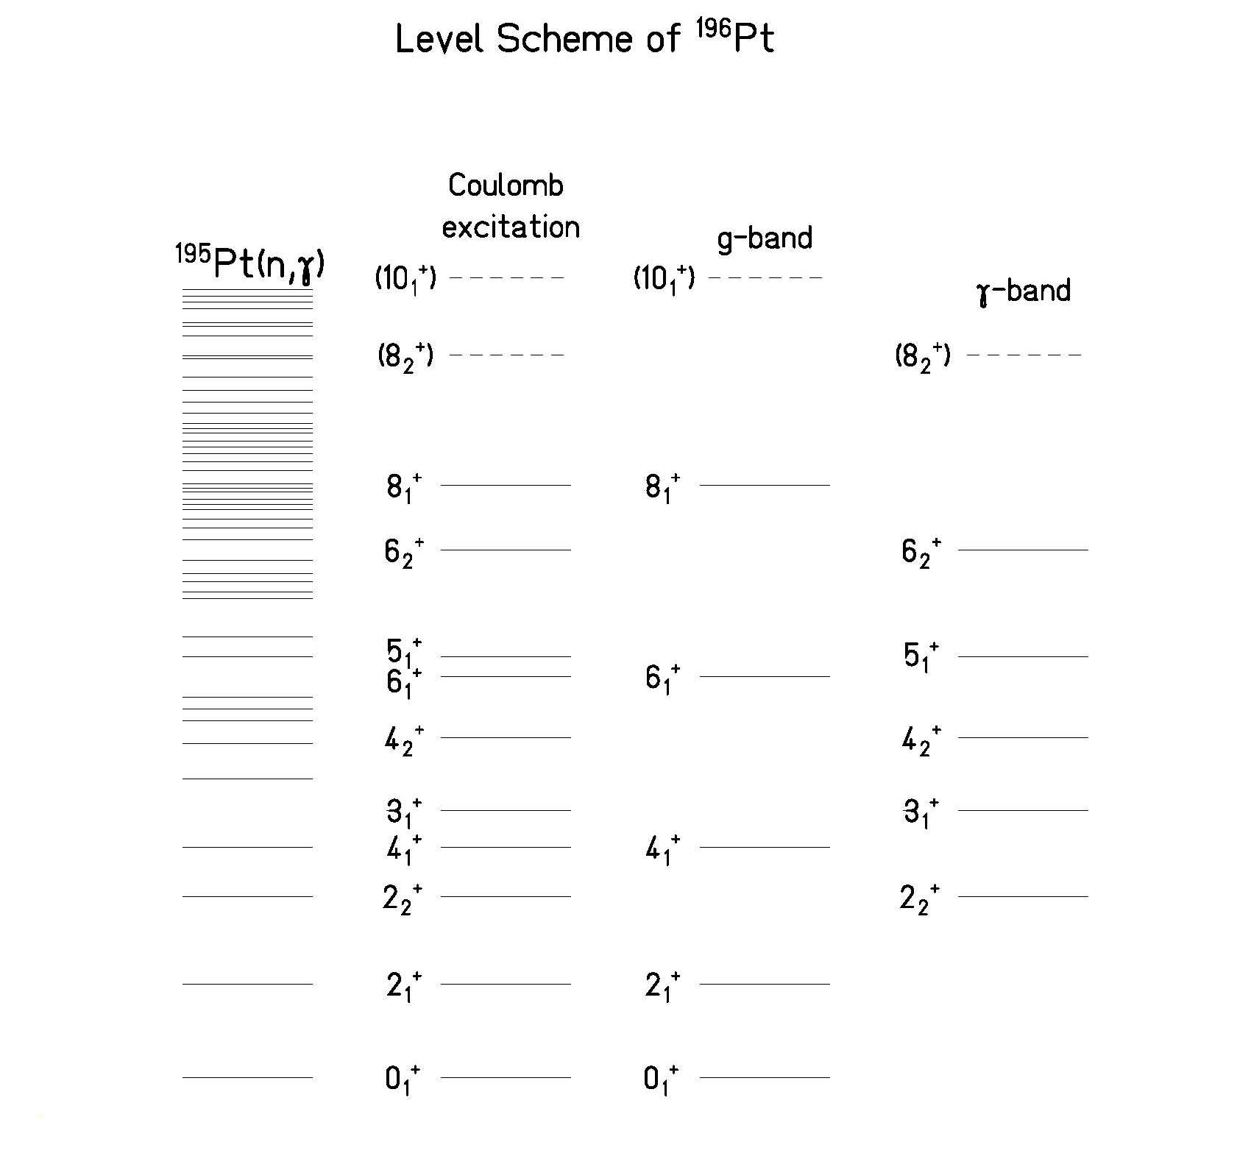
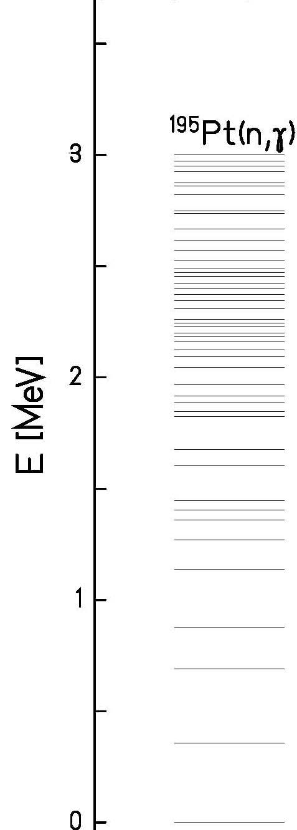
Level scheme of ¹⁹⁶Pt
A. Mauthofer et al., Z.Phys. A336, 263 (1990)

Slide 19
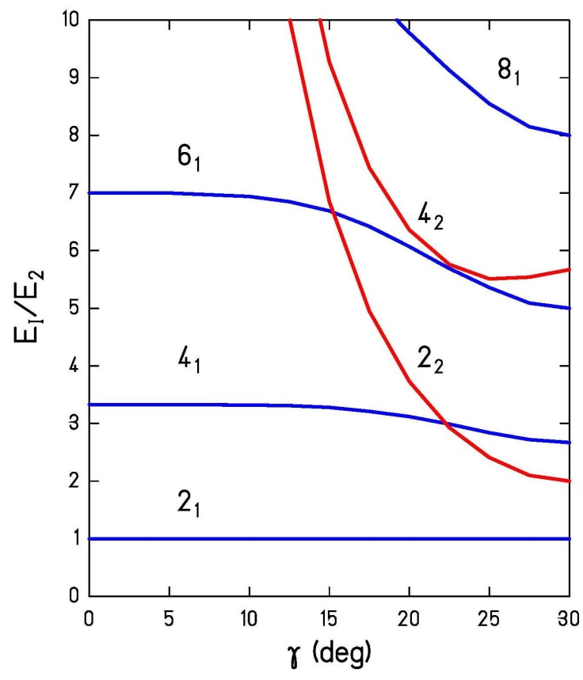
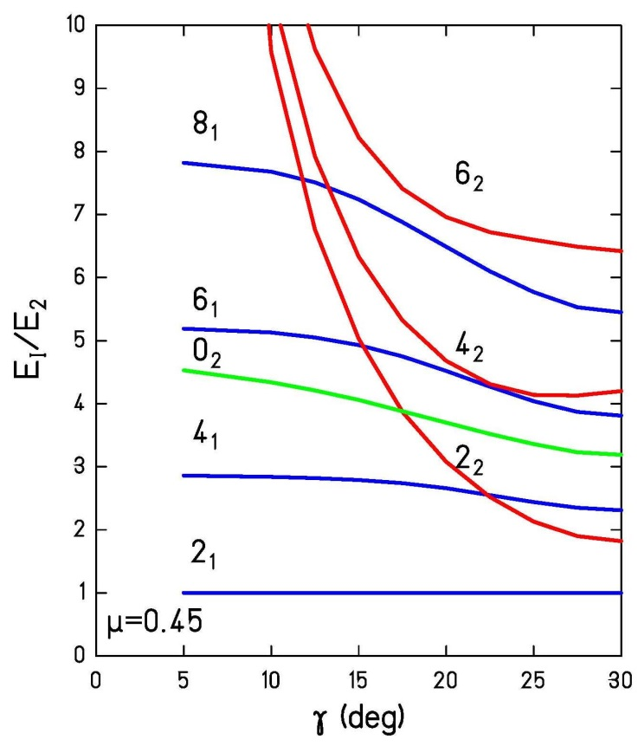
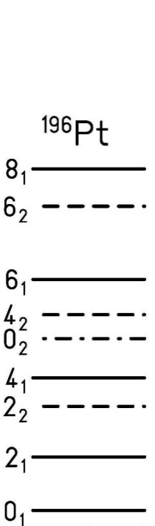
Level scheme of ¹⁹⁶Pt
Comparison with
rigid asymmetric rotor model
Comparison with
soft asymmetric rotor model

Slide 20
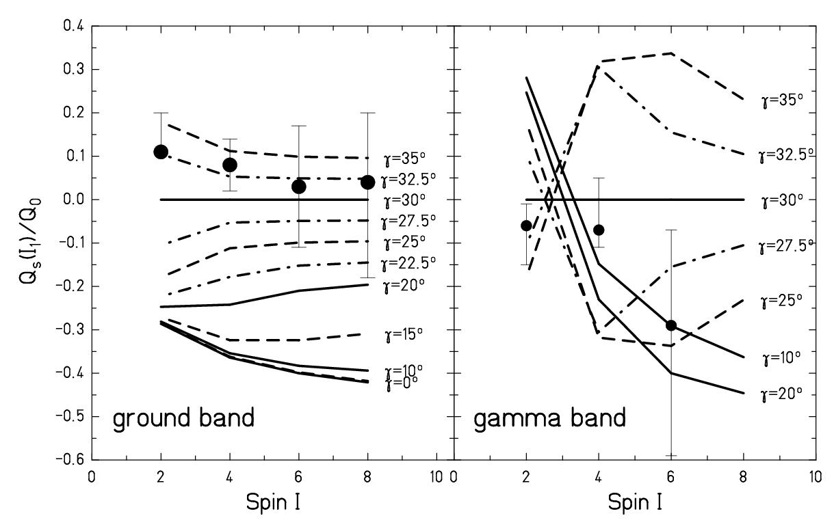
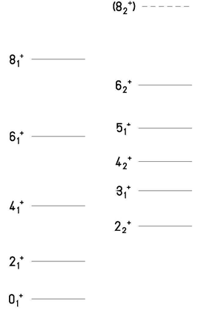
Spin dependence of the spectroscopic quadrupole moment
A. Mauthofer et al., Z.Phys. A336, 263 (1990)

Slide 21
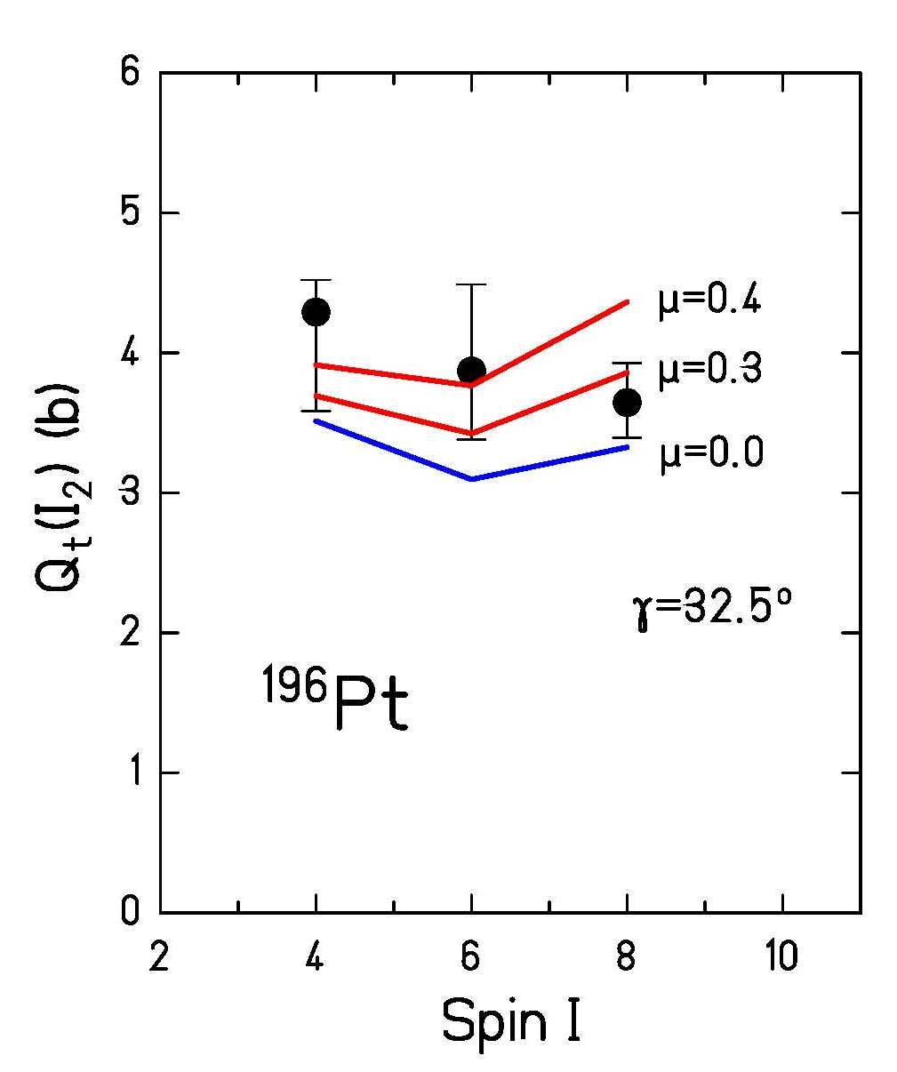
Transition quadrupole moment in the γ-band
soft ARM
rigid ARM
A. Mauthofer et al., Z.Phys. A336, 263 (1990)

Slide 22
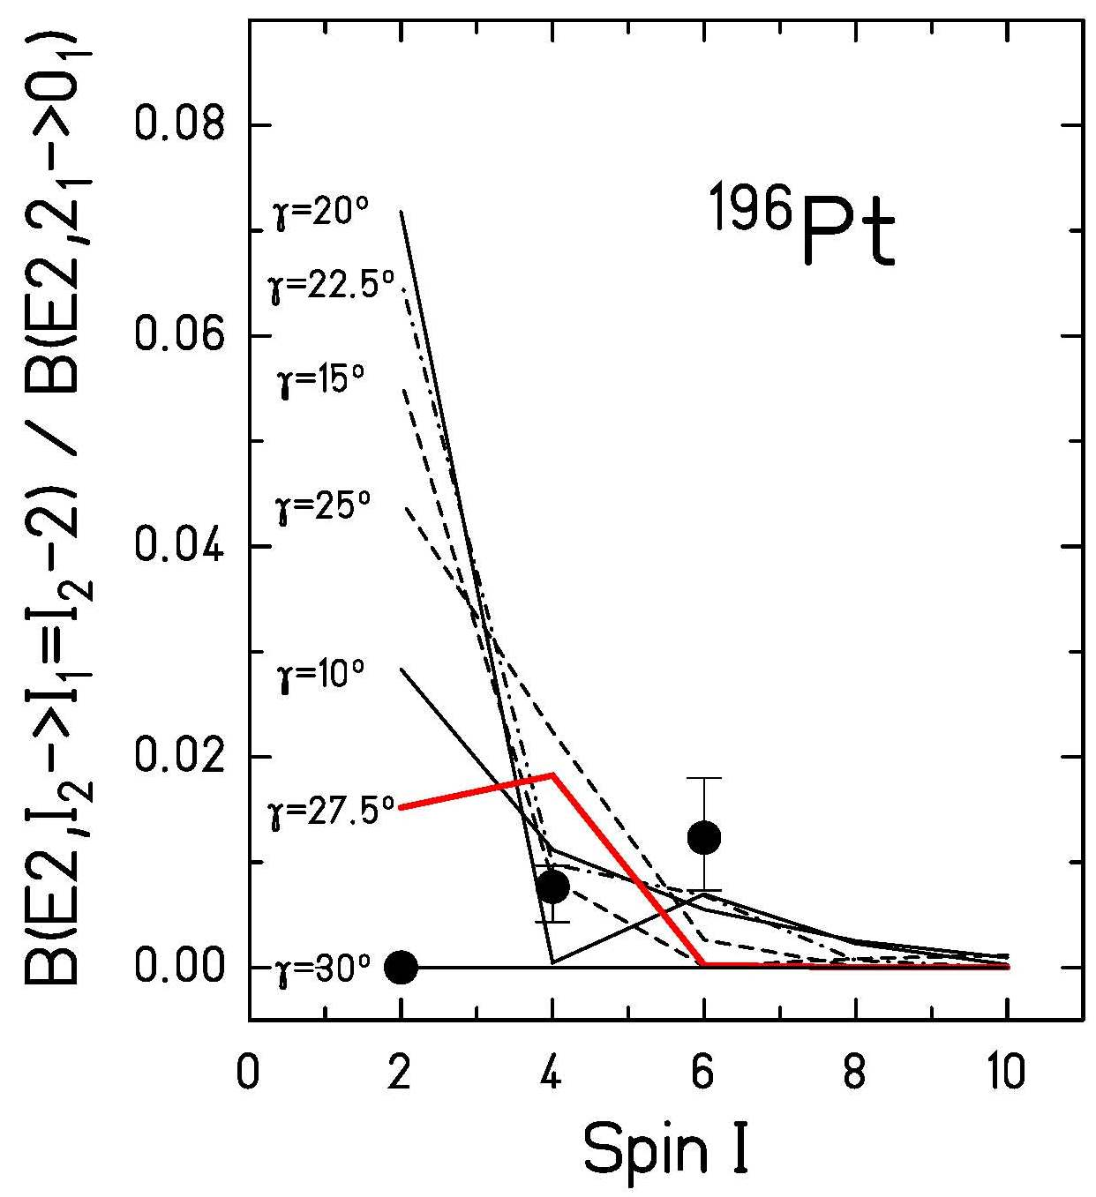
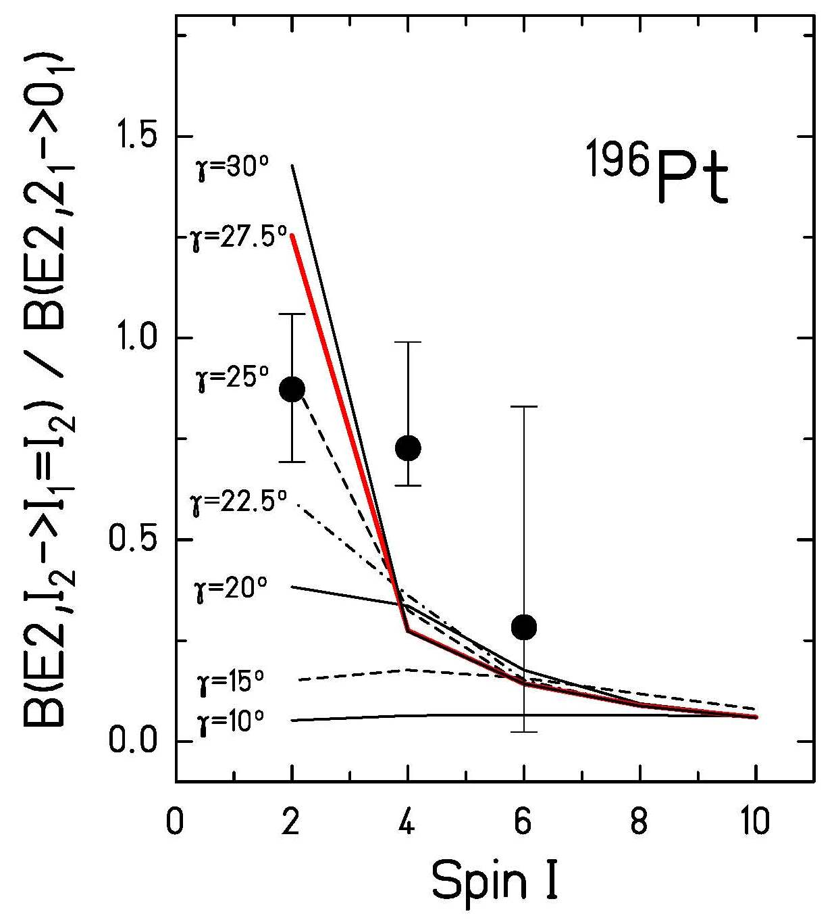
B(E2)-values connecting the γ- and gs-band
I_{γ}→I_{gs}-2
I_{γ}→I_{gs}
A. Mauthofer et al., Z.Phys. A336, 263 (1990)

Slide 23
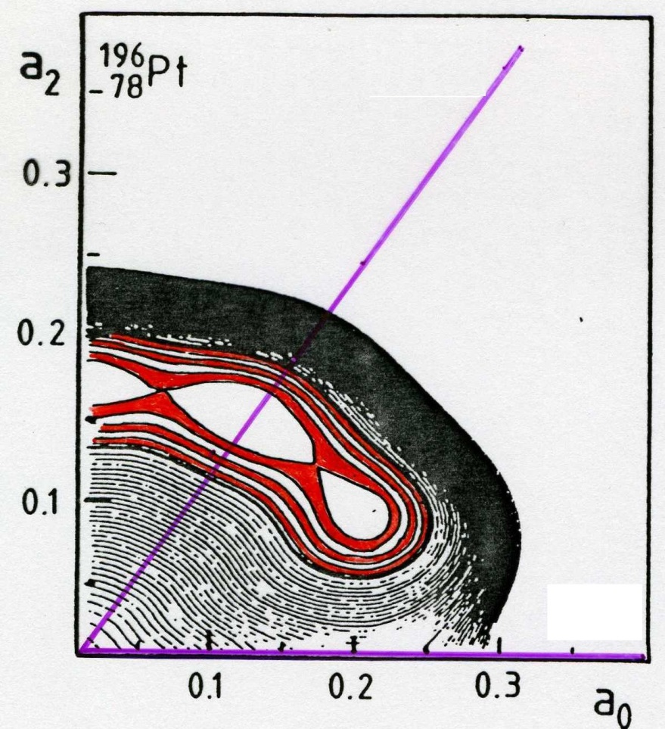
Interpretation of the collective properties in ¹⁹⁶Pt
14 energy levels and 22 E2 matrix elements can be described by the soft asymmetric rotor model assuming the following parameters:
γ=60⁰
γ=0⁰
P.O. Hess et al. J.Phys. G7 (1981), 737

Slide 24
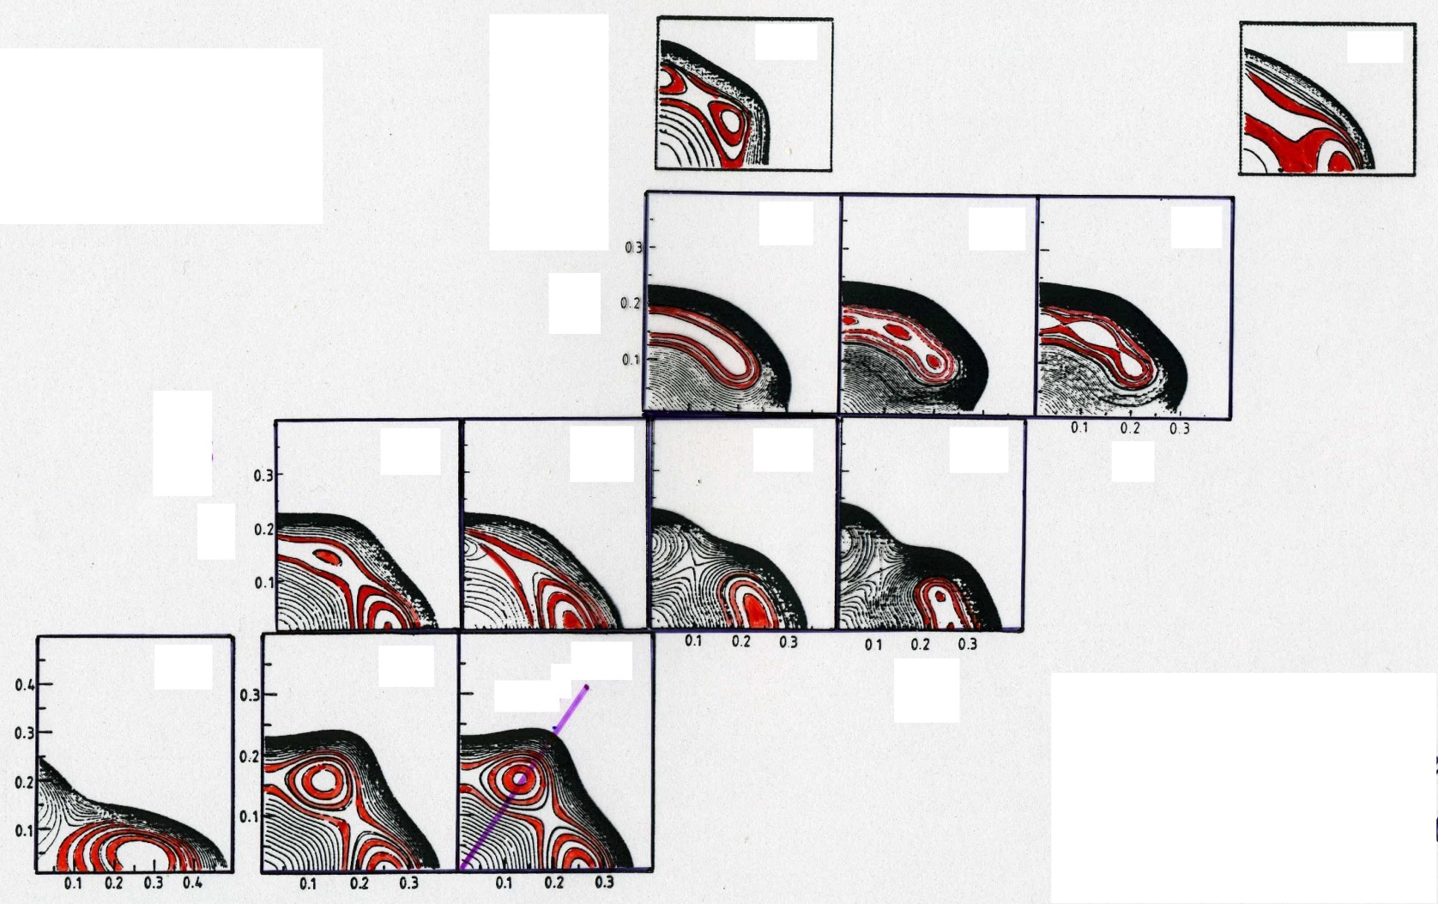

Potential energy surfaces of the W-Os-Pt-Hg chain of isotopes
₈₀Hg
194
200
₇₈Pt
192
194
196
₇₆Os
186
188
190
192
₇₄W
182
184
186
α₂
general collective model
α₀
P.O. Hess et al. J. Phys. G7 (1981), 737

Slide 25
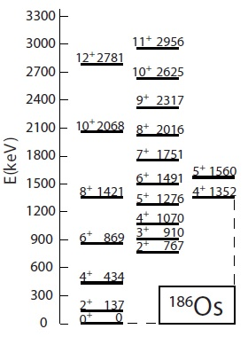

Triaxial Rotor Model ¹⁸⁶Os
NOTE: $4_{3}^{+}$ state appears (sub) vibrational
C.Y. Wu, D. Cline et al.; Ann. Rev. Nucl. Part Sci 36 (1986), 683

Slide 26
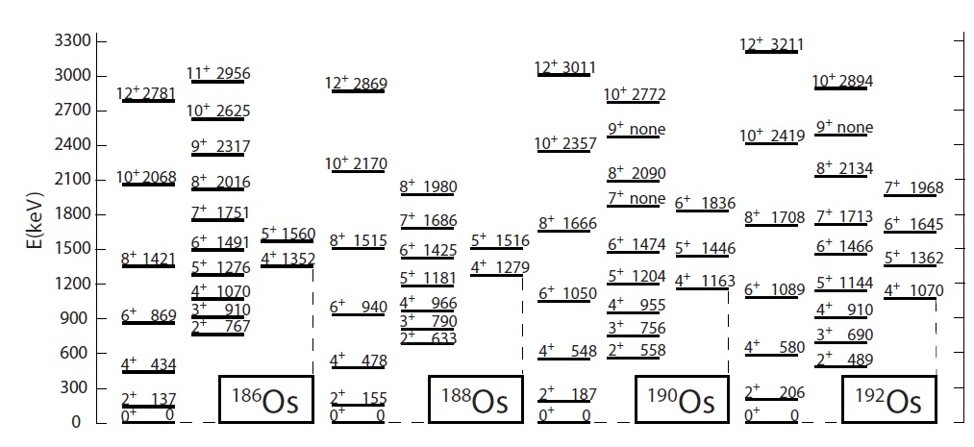
Triaxial Rotor Model Os-isotopes

Slide 27
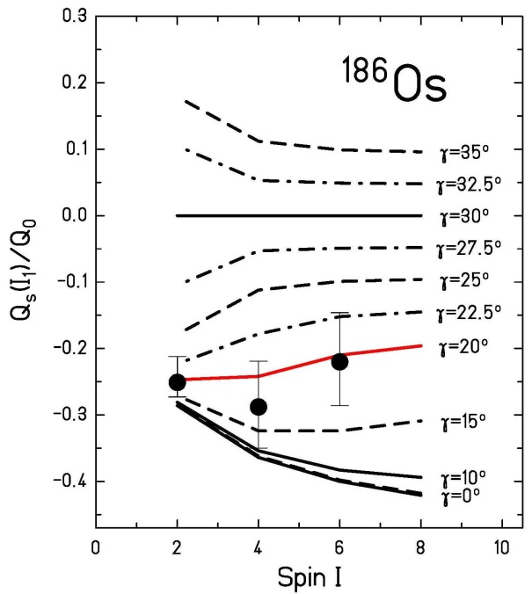
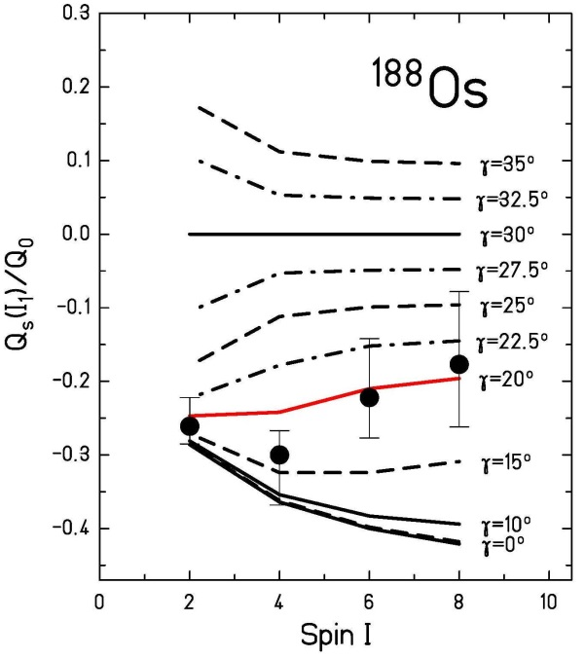
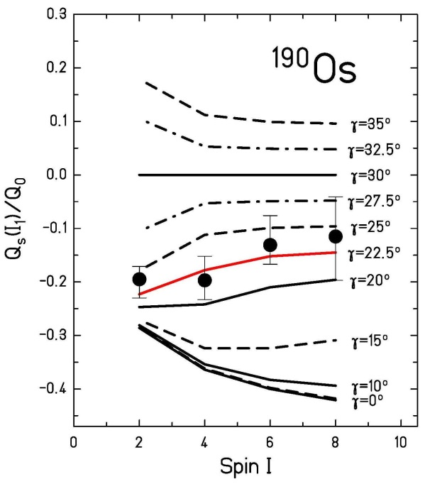
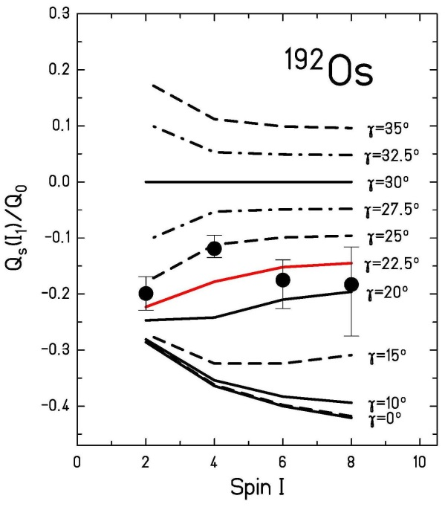
Spectroscopic quadrupole moments in the ground state band of Os-isotopes
C.Y. Wu, D. Cline et al.; Ann. Rev. Nucl. Part Sci 36 (1986), 683

Slide 28
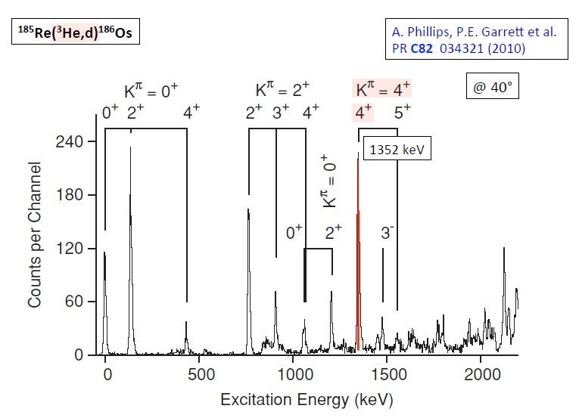
Spectroscopy of Os-isotopes

Slide 29
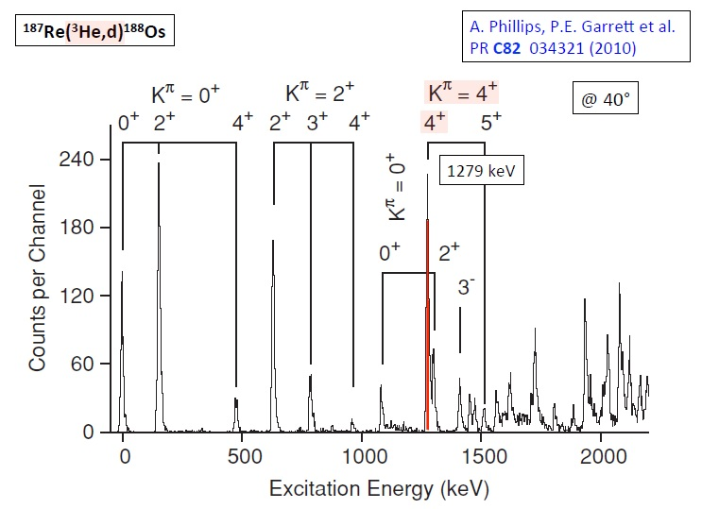
Spectroscopy of Os-isotopes

Slide 30
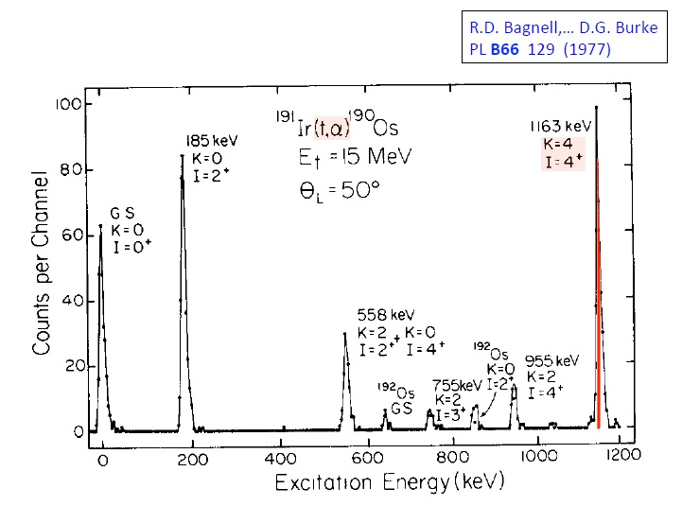
Spectroscopy of Os-isotopes

Slide 31
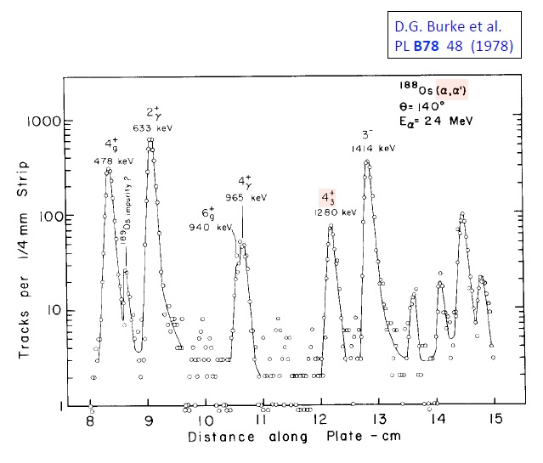
Spectroscopy of Os-isotopes

Slide 32



Spectroscopic quadrupole moments in the ground state band of W-isotopes
Q₀ = 7.10 (38) b
β = 0.274 – 0.193
Q₀ = 6.72 (35) b
β = 0.258
Q₀ = 5.87 (29) b
β = 0.223
R. Kulessa et al.; Phys. Lett B218 (1989), 421

Slide 33



Spectroscopic quadrupole moments in the gamma band of W-isotopes
Q₀ = 5.8 (5) b
β = 0.227
Q₀ = 5.6 (3) b
β = 0.219
Q₀ = 6.3 (4) b
β = 0.239
R. Kulessa et al.; Phys. Lett B218 (1989), 421

Slide 34


Collective properties in ^{198,200,202,204}Hg
A | B(E2;2₁→0₁)
198 | 29 spu
200 | 25 spu
202 | 17 spu
204 | 12 spu
soft (μ=0.3) asymmetric rotor model:
IBM – O(6) limit:
boson number N = 5 to 2
for Hg-isotopes with A=198 to 204
C. Günther et al.; Z. Phys. A301 (1981), 119
Y.K. Agarwal et al.; Z. Phys. A320 (1985), 295

Slide 35

Parameter of the asymmetric rotor model
isotope | β | γ | γ | μ
¹⁸²W | 0.274 | 11.4⁰ | 11.2⁰ | 0.17
¹⁸⁴W | 0.258 | 13.8⁰ | 13.7⁰ | 0.15
¹⁸⁶W | 0.223 | 15.9⁰ | 15.8⁰ | 0.05
¹⁸⁶Os | 0.196 | 16.5⁰ | 16.1⁰ | 0.26
¹⁸⁸Os | 0.185 | 19.2⁰ | 18.8⁰ | 0.26
¹⁹⁰Os | 0.184 | 22.3⁰ | 22.0⁰ | 0.26
¹⁹²Os | 0.168 | 25.2⁰ | 25.2⁰ | 0.10
¹⁹²Pt | 0.146 | - | 32.5⁰ | 0.35
¹⁹⁴Pt | 0.134 | - | 32.5⁰ | 0.35
¹⁹⁶Pt | 0.135 | - | 32.5⁰ | 0.37
¹⁹⁸Hg | 0.106 | 36.3⁰ | 38.0⁰ | 0.44
²⁰⁰Hg | 0.098 | 39.1⁰ | 41.0⁰ | 0.44
²⁰²Hg | 0.082 | 33.4⁰ | 34.4⁰ | 0.35
²⁰⁴Hg | 0.068 | 31.5⁰ | 31.5⁰ | 0.19

Slide 36


Appendix: Spherical harmonics

