Slide 1

Outline: Octupole collectivity
Lecturer: Hans-Jürgen Wollersheim
e-mail: h.j.wollersheim@gsi.de
web-page: https://web-docs.gsi.de/~wolle/ and click on
the double oscillator
Coulomb excitation of ²²⁶Ra
signature of an octupole deformed nucleus
electric moments of ²²⁶Ra

Slide 2
Shape parameterization
axially symmetric quadrupole
axially symmetric octupole
λ=2
α₂₀≠0, α_{2±1}= α_{2±2}= 0
λ=3
α₃₀≠0, α_{3±1,2,3} = 0
α₂₀≠0, α_{2±1,2} = 0

Slide 3
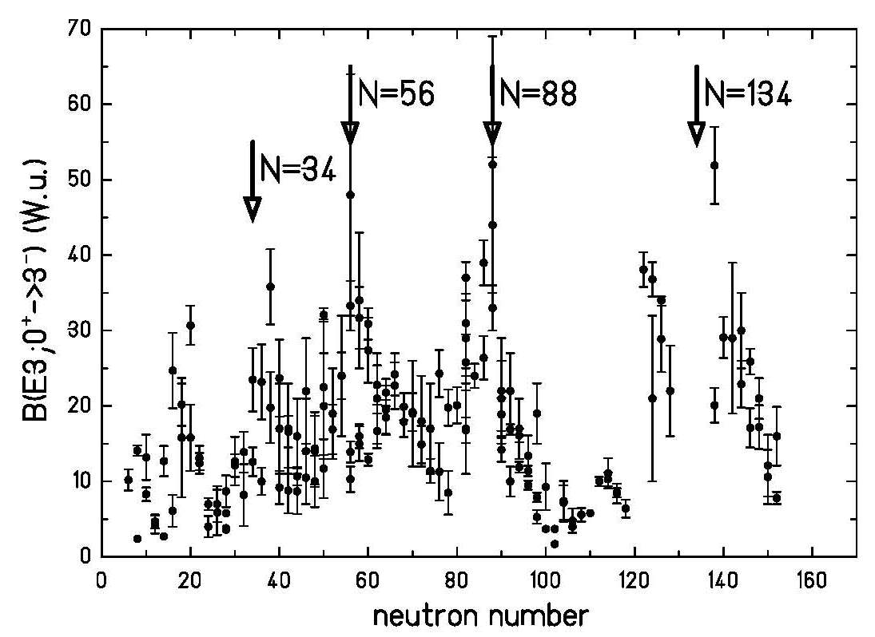
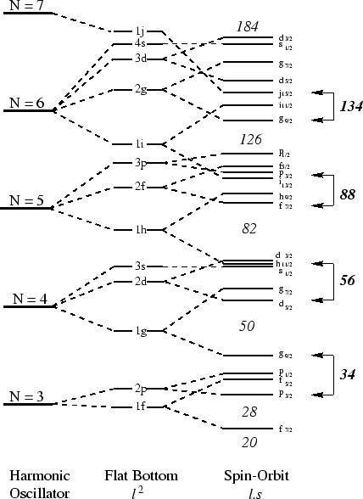
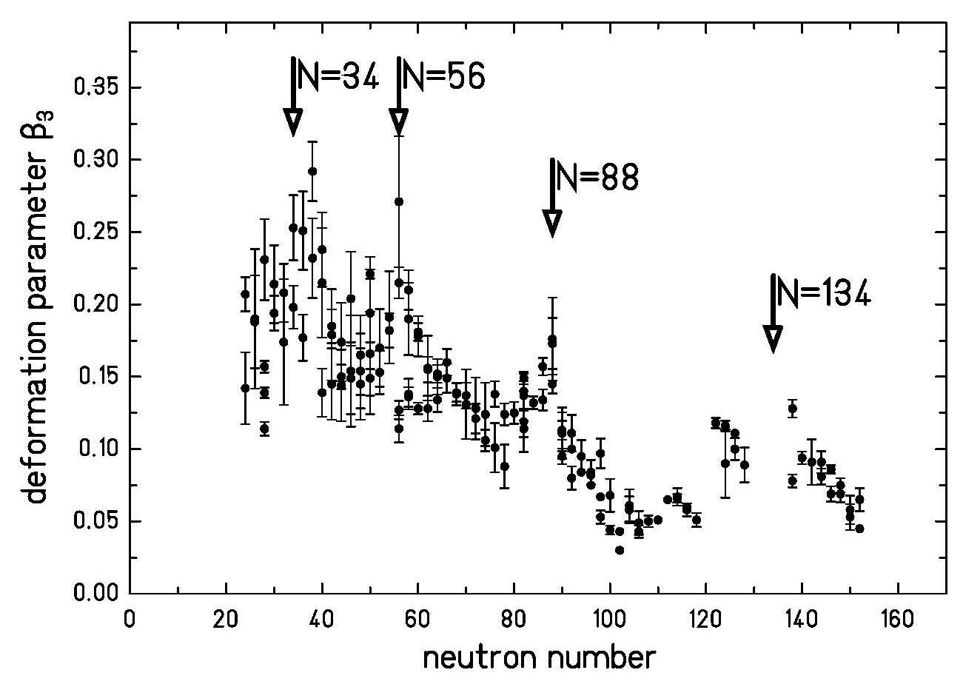
Octupole collectivity
Y₃₀ coupling
Δℓ=3 Δj=3
(W.u.)
some subshells interact via the r³Y₃₀ operator
e.g. in light actinide nuclei one has an interaction between
j_{15/2} and g_{9/2} neutron orbitals
i_{13/2} and f_{7/2} proton orbitals
R.H. Spear At. Data and Nucl. Data Tables 42 (1989), 55

Slide 4
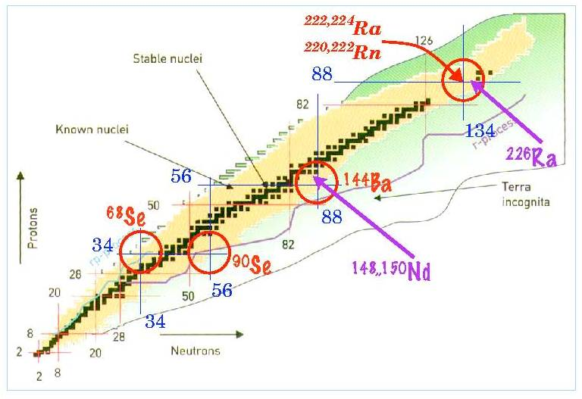
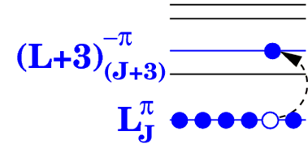
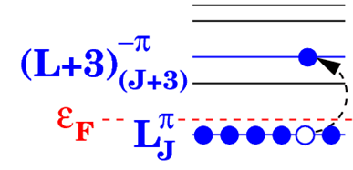
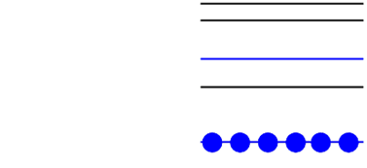
Octupole collectivity
Octupole correlations enhanced at the magic numbers: 34, 56, 88, 134
Microscopically …
Intruder orbitals of opposite parity and ΔJ, ΔL = 3 close to Fermi level
²²⁶Ra close to Z=88 N=134

Slide 5
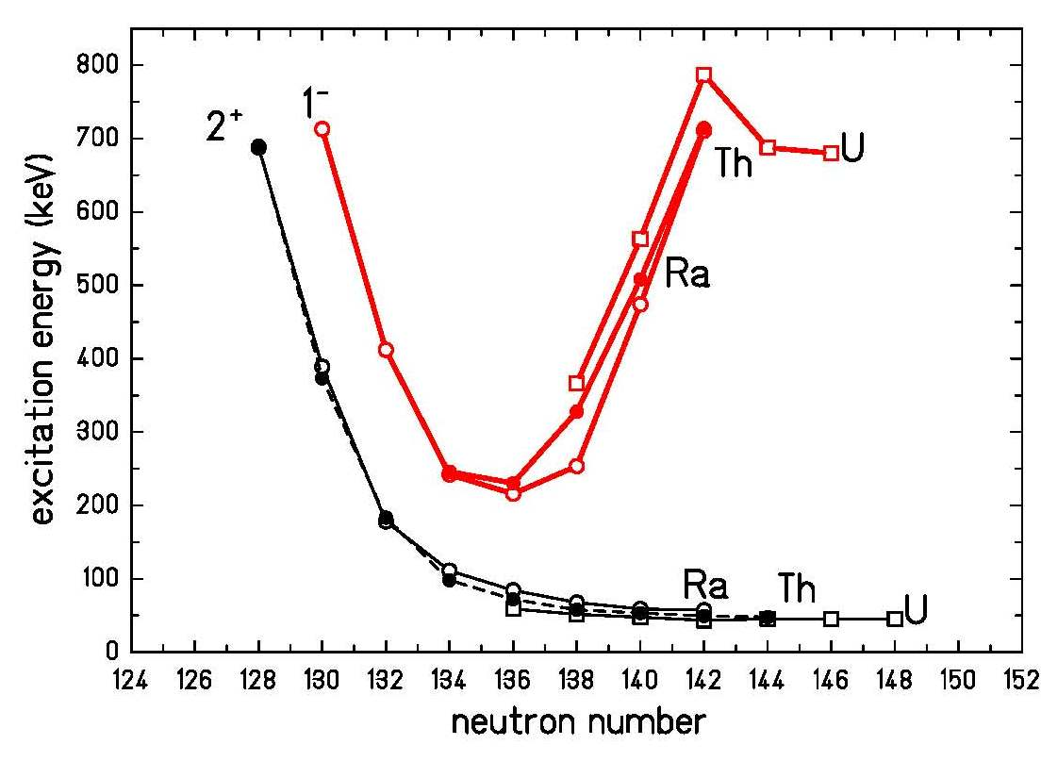
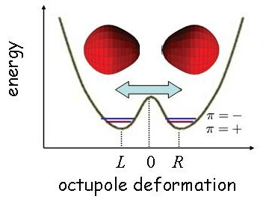
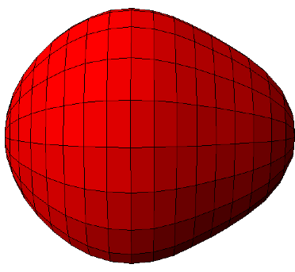
Octupole collectivity
²²⁶Ra
+
-
+
-
+
²²⁶Ra
-
+
-
+
-
In an octupole deformed nucleus the center of mass and center of charge tend to separate,
creating a non-zero electric dipole moment.

Slide 6
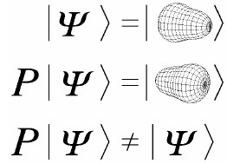
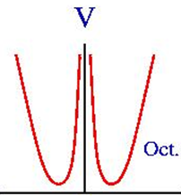
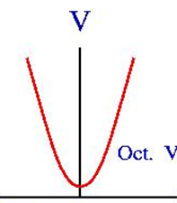
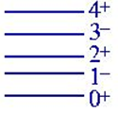
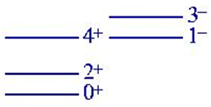



The double oscillator
V
$$H∙Ψ=−\frac{ℏ^{2}}{2∙B}\frac{∂^{2}ψ}{∂β_{3}^{2}}+\frac{V_{0}}{a^{2}}∙{\left(\left|β_{3}\right|−a\right)}^{2}∙Ψ=E∙Ψ$$
V₀
$$E_{even}=ℏω∙\left(ν_{even}+\frac{1}{2}\right)=ℏω∙\left(\frac{1}{2}−\sqrt{\frac{2∙V_{0}}{ℏω∙π}∙e^{−}\frac{2V_{0}}{ℏω}}\right)$$
-a a
$$E_{odd}=ℏω∙\left(ν_{odd}+\frac{1}{2}\right)=ℏω∙\left(\frac{1}{2}+\sqrt{\frac{2∙V_{0}}{ℏω∙π}∙e^{−}\frac{2V_{0}}{ℏω}}\right)$$
β₃
β₃
octupole deformed
octupole vibrational
Merzbacher ‘Quantum Mechanics’

Slide 7
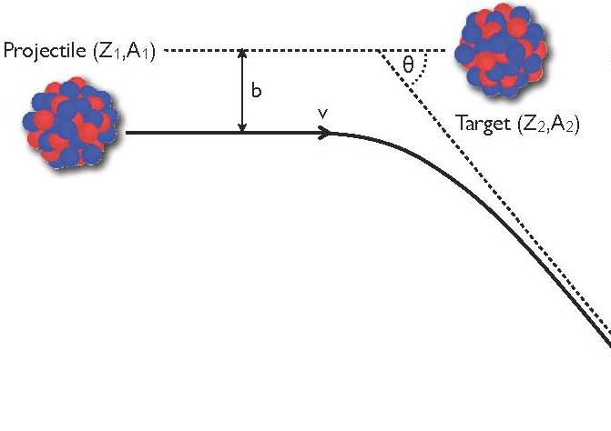
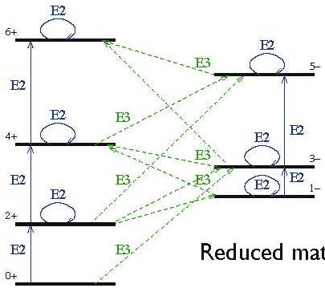
Coulomb excitation
impact parameter
scattering angle

Slide 8
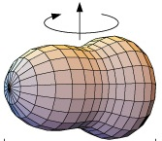
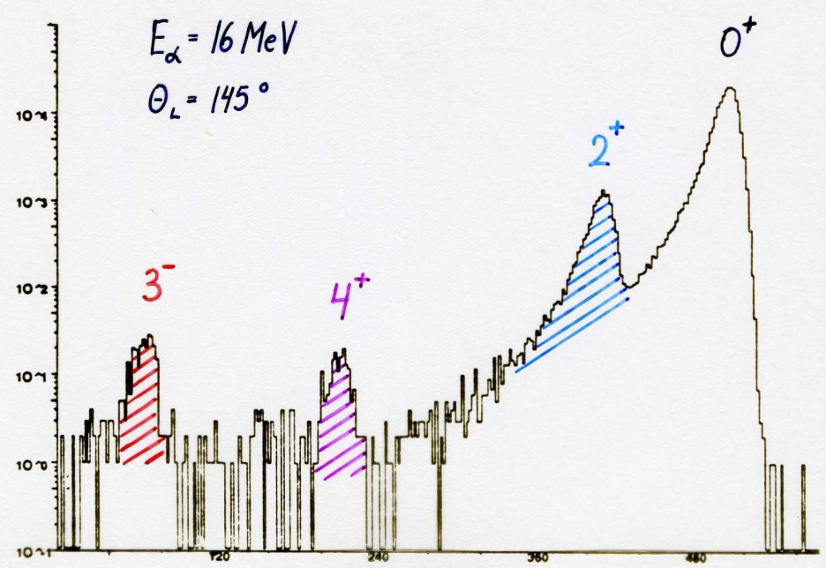
Scattered α-spectrum of ²²⁶Ra
0⁺
⁴He → ²²⁶Ra
E_{α} = 16 MeV
θ_{lab} = 145⁰
2⁺
counts
3⁻
4⁺
²²⁶Ra-target
beam direction
Si-detector
θ
channel number
λ |  | β_{λ} (exp) | β_{λ} (theo)
2 | 2.27 (3) | 0.165 (2) | 0.164
3 | 1.05 (5) | 0.104 (5) | 0.112
4 | 1.04 (7) | 0.123 (8) | 0.096

Slide 9
Scattered α-spectrum of ²²⁶Ra
0⁺
⁴He → ²²⁶Ra
E_{α} = 16 MeV
θ_{lab} = 145⁰
2⁺
counts
3⁻
4⁺
²²⁶Ra-target
beam direction
Si-detector
θ
channel number
λ |  | β_{λ} (exp) | β_{λ} (theo)
2 | 2.27 (3) | 0.165 (2) | 0.164
3 | 1.05 (5) | 0.104 (5) | 0.112
4 | 1.04 (7) | 0.123 (8) | 0.096
I_{f}
4⁺
E2
I_{n}
2⁺
E2
E4
I_{i}
0⁺

Slide 10
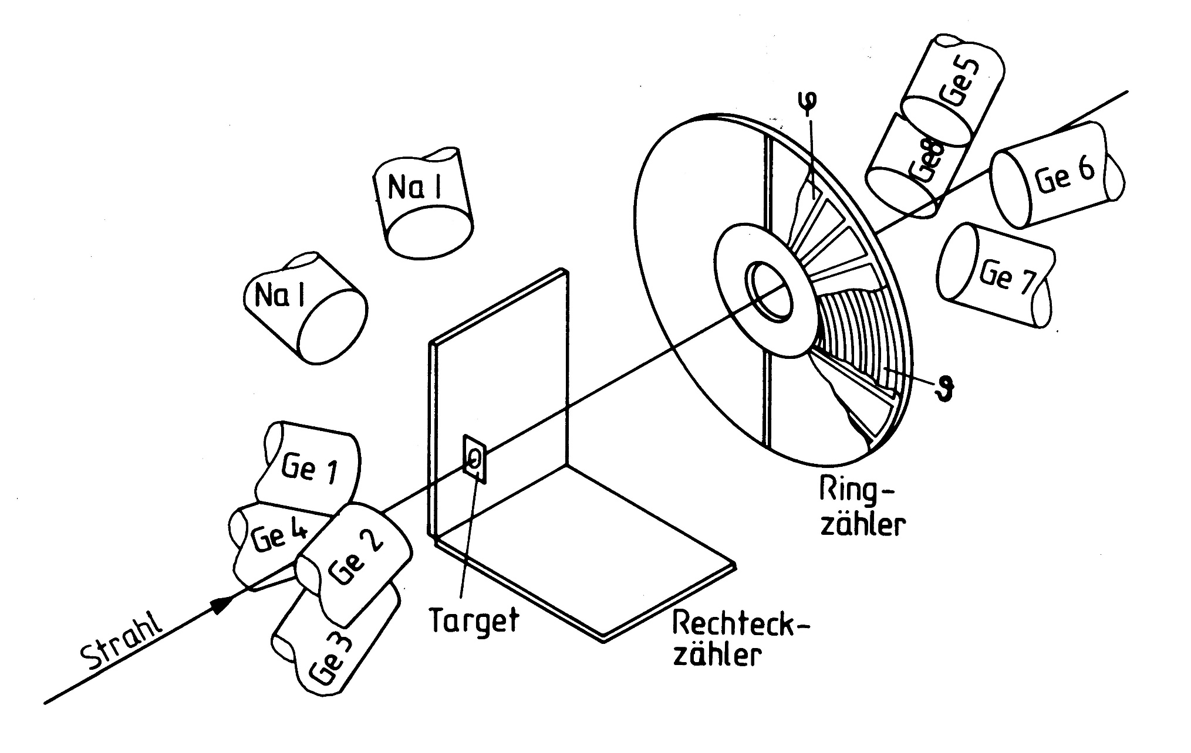
Experimental set-up
Ge 5
Ge8
Ge 6
Ge 7
Ge 1
PPAC ring counter
15⁰≤Θ_{L}≤45⁰, 0⁰≤φ_{L}≤360⁰
Ge 4
Ge 2
²⁰⁸Pb beam
4 PPAC counter
53⁰≤Θ_{L}≤90⁰, 0⁰≤φ_{L}≤84⁰
Ge 3
²²⁶Ra
²²⁶RaBr₂ (400 μg/cm²) on C-backing (50 μg/cm²) and covered by Be (40 μg/cm²)

Slide 11
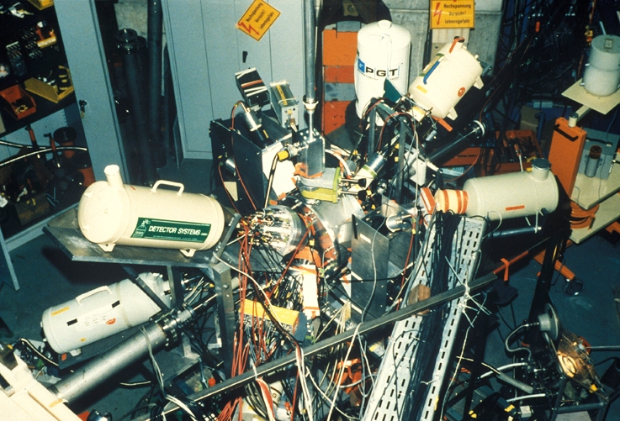
Coulomb excitation of ²²⁶Ra

Slide 12
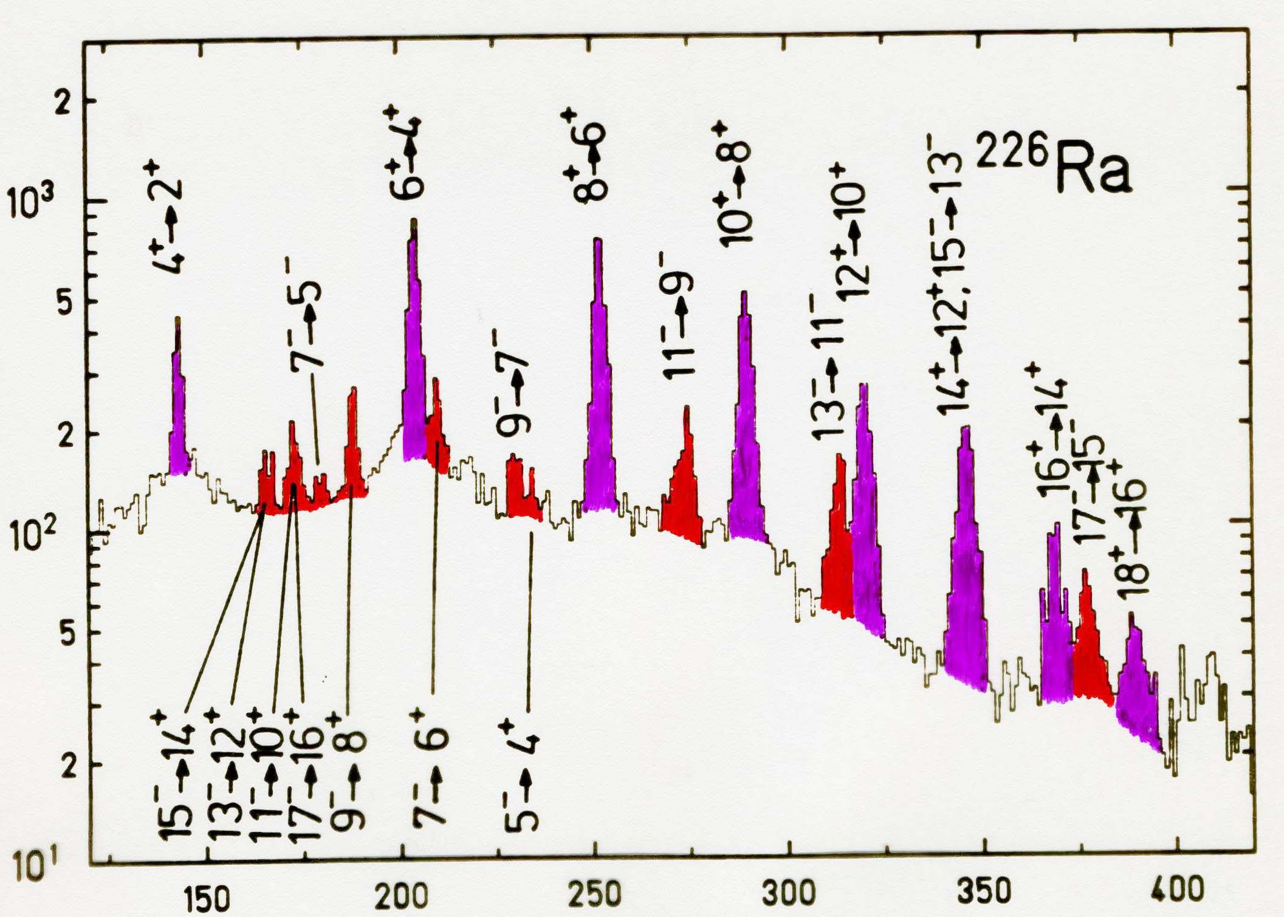
γ-ray spectrum of ²²⁶Ra
²⁰⁸Pb → ²²⁶Ra
E_{lab} = 4.7 AMeV
15⁰ ≤ θ_{lab} ≤ 45⁰
0⁰ ≤ φ_{lab} ≤ 360⁰
counts
energy [keV]

Slide 13
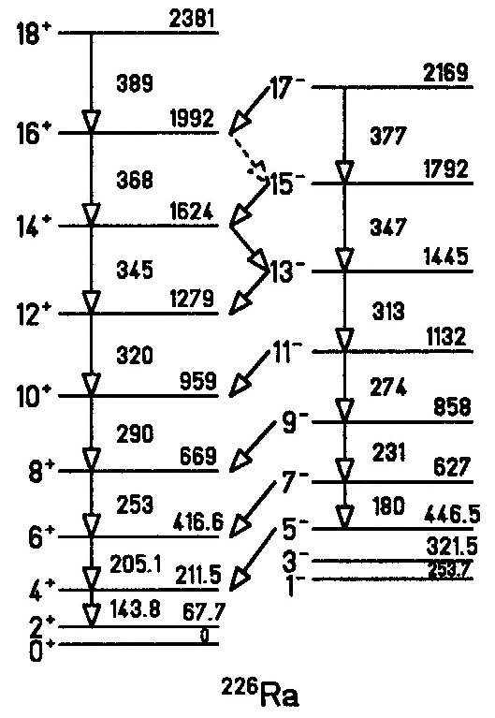
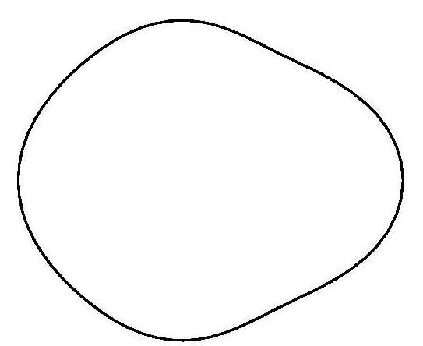
Signature of an octupole deformed nucleus
π: +
π: -
β₂= 0.16
β₃=-0.11
β₄= 0.10
E2
E1
Single rotational band with spin sequence:
I = 0⁺, 1⁻, 2⁺, 3⁻, …
excitation energy E ~ I·(I+1)
competition between intraband E2 and interband E1 transitions
E1 transition strength 10⁻² W.u.

Slide 14
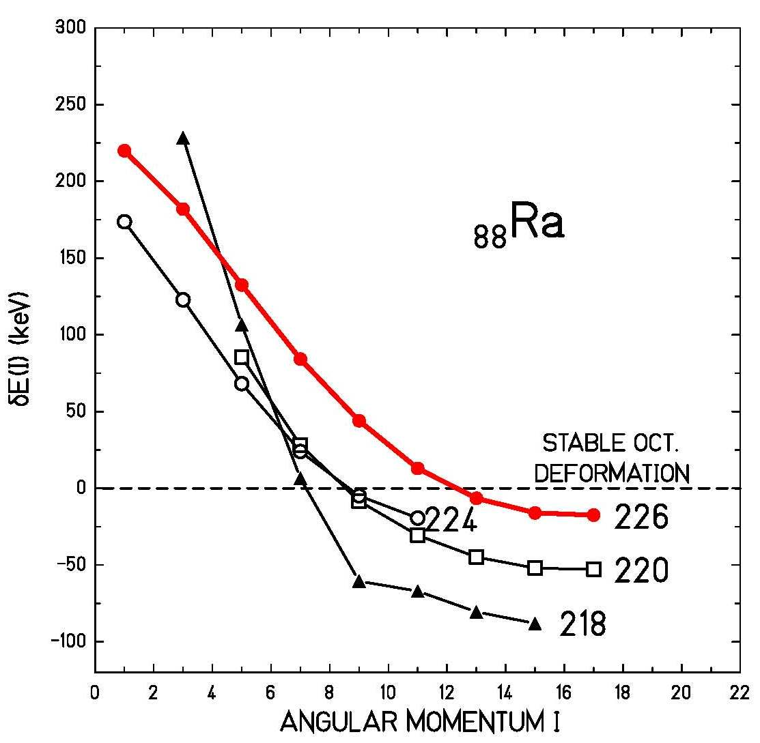

Signature of an octupole deformed nucleus
Energy displacement δE between the positive- and negative-parity states
if they form a single rotational band
$$=−\frac{ℏ^{2}}{2ℑ} for rigid rotor$$
W. Nazarewicz et al.; Nucl. Phys. A441 (1985) 420

Slide 15
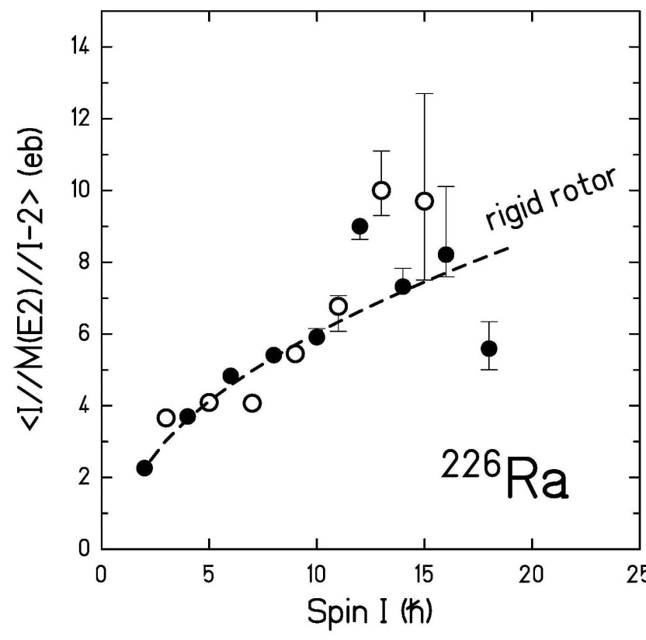
Electric transition quadrupole moments in ²²⁶Ra
negative parity states
positive parity states
rigid rotor model:
liquid drop:
Q₂(exp) = 750 fm²
Q₂(theo) = 680 fm²
β₂ = 0.21
H.J. Wollersheim et al.; Nucl. Phys. A556 (1993) 261
W. Nazarewicz et al.; Nucl. Phys. A467 (1987) 437

Slide 16
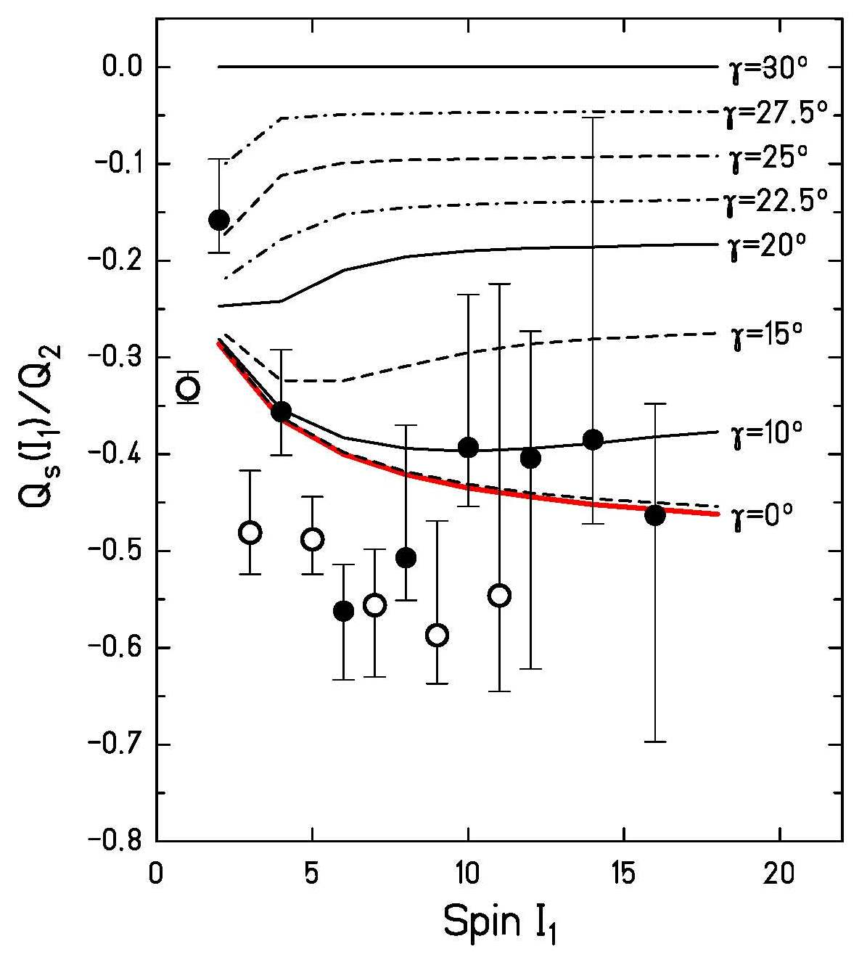
Static quadrupole moments in ²²⁶Ra
negative parity states
positive parity states
rigid rotor model:
rigid triaxial rotor model:
H.J. Wollersheim et al.; Nucl. Phys. A556 (1993) 261
Davydov and Filippov, Nucl. Phys. 8, 237 (1958)

Slide 17
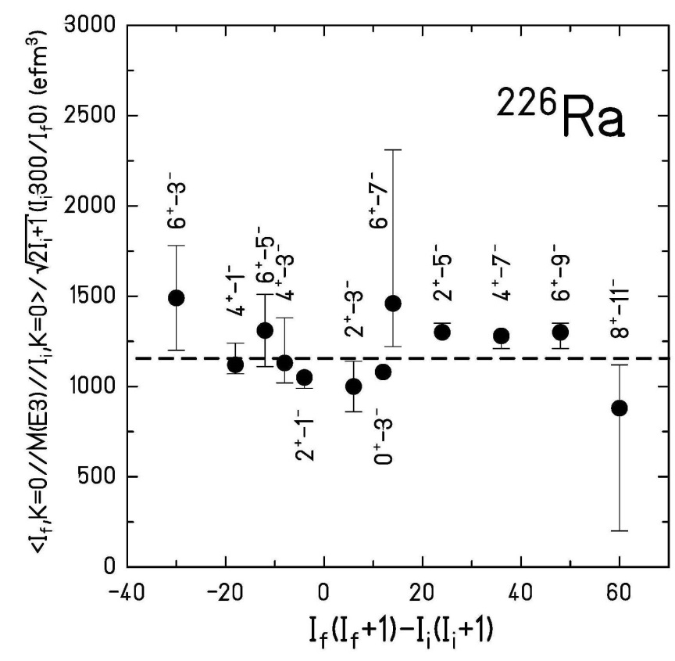
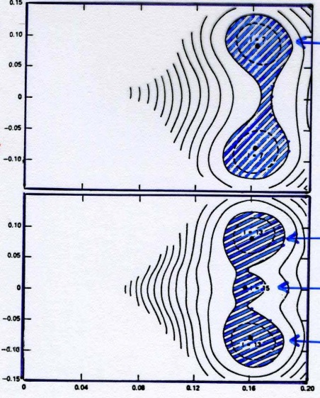






Electric transition octupole moments in ²²⁶Ra
liquid drop:
β₃
0.18
0.12
0.06
$$ℏ$$
0.1
$$ℏ$$
β₃
0
- 0.1
$$ℏ$$
0.1
$$ℏ$$
β₃
0
$$ℏ$$
- 0.1
$$ℏ$$
0.16
β₂
H.J. Wollersheim et al.; Nucl. Phys. A556 (1993) 261
W. Nazarewicz et al.; Nucl. Phys. A467 (1987) 437

Slide 18
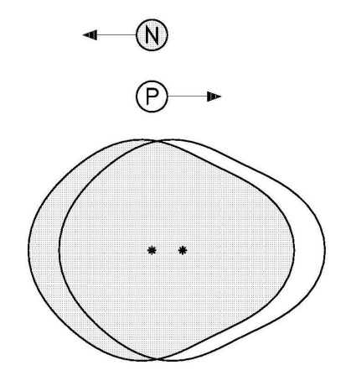
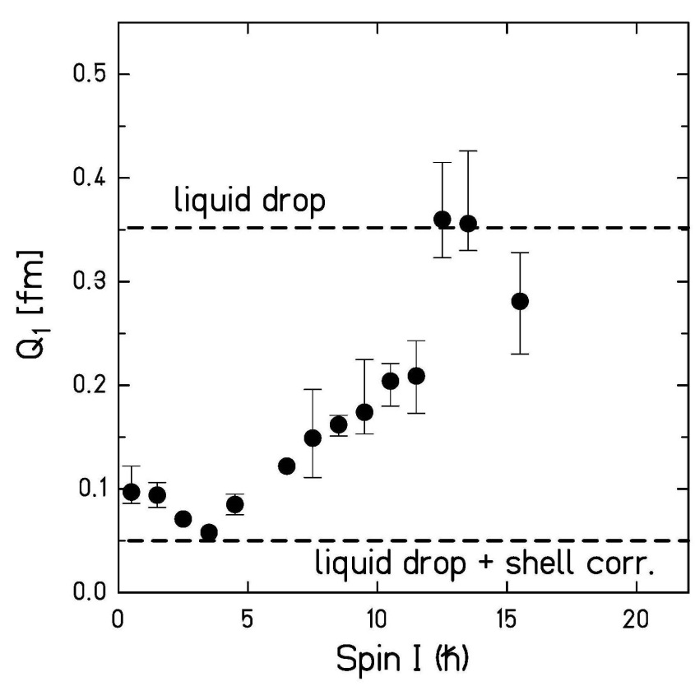
Intrinsic electric dipole moments in ²²⁶Ra
liquid-drop contribution:
rigid rotor model:
H.J. Wollersheim et al.; Nucl. Phys. A556 (1993) 261
G. Leander et al.; Nucl. Phys. A453 (1986) 58

Slide 19
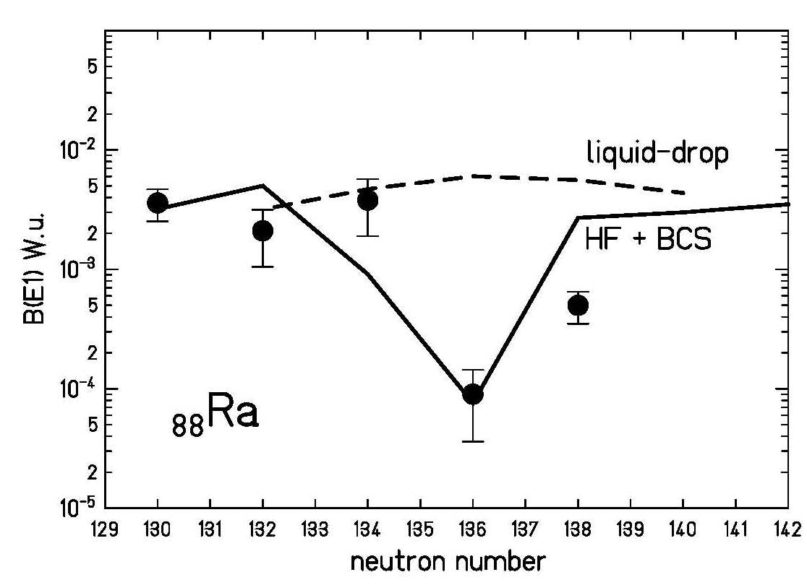
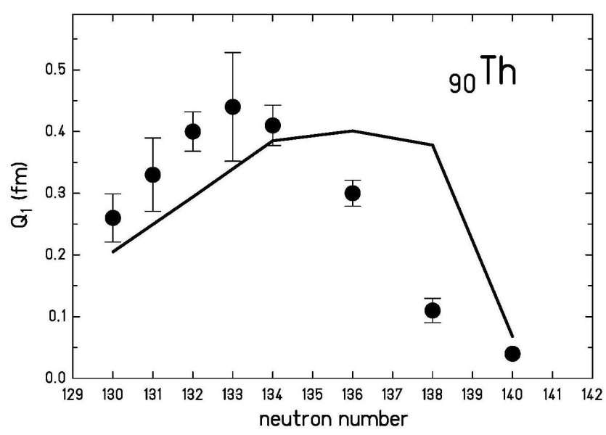
Intrinsic electric dipole moments in Ra / Th
liquid-drop contribution:
G. Leander et al.; Nucl. Phys. A453 (1986) 58

Slide 20


Summary
single rotational band for
no backbending observed
β₂, β₃, β₄ deformation parameters are in excellent agreement
with calculated values
octupole deformation is three times larger than in octupole-
vibrational nuclei
equal transition quadrupole moments for positive- and negative-
parity states
static quadrupole moments are in excellent agreement with an
axially symmetric shape
electric dipole moments are close to liquid-drop value ( )
octupole deformation seems to be stabilized with increasing
rotational frequency
$$ℏ$$
$$ℏ$$

Slide 21
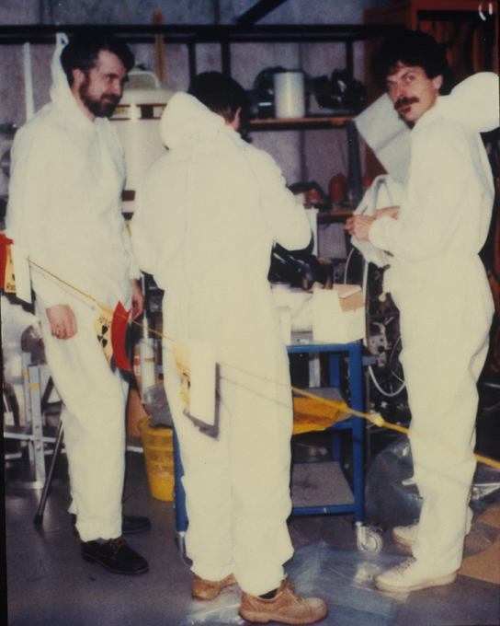

Coulomb excitation of ²²⁶Ra
²²⁶Ra target broken after 8 hours
Christoph Fleischmann

Slide 22

Appendix: Center of mass conservation
The coordinates (x, y, z) can be expressed by
$$⋯$$
The dipole coordinate is not an independent quantity. It is non-zero for nuclear shapes with both quadrupole and octupole degrees of freedom.

Slide 23
Appendix: Intrinsic electric dipole moment
The local volume polarization of electric charge can be derived from the requirement of a minimum in the energy functional. (Myers Ann. of Phys. (1971))
where ρ_{p} and ρ_{n} are the proton and neutron densities, C_{LD} is the volume symmetry energy coefficient of the liquid drop model and V_{C} is the Coulomb potential generated by ρ_{p} inside the nucleus (r < R₀)
Keeping the center of gravity fixed, the integral

Slide 24



Appendix: Intrinsic electric dipole moment
$$⋯$$
$$⋯$$
$$⋯$$
$$⋯$$
$$⋯$$

Slide 25
Appendix: Intrinsic electric dipole moment
C_{LD} ≈ 20 MeV

