Slide 1
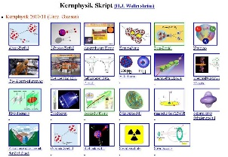
Outline: electron spectroscopy
Lecturer: Hans-Jürgen Wollersheim
e-mail: h.j.wollersheim@gsi.de
web-page: https://web-docs.gsi.de/~wolle/ and click on
Coulomb excitation and fusion reaction
surface oscillations in deformed nuclei
E0/E2 branching ratio
experiments with orange spectrometer

Slide 2
Doppler-corrected e⁻ and γ-ray spectroscopy
Physical Motivation
In-beam conversion electron spectroscopy complements the results obtained from γ-spectroscopy
A method for determining the multipolarity of nuclear transitions
The only method for detecting E0-transitions
Doppler Correction after Inelastic Heavy Ion Scattering
²³⁸U + ¹⁸¹Ta system at the Coulomb barrier
Electron spectroscopy with mini-orange devices
Doppler Correction after (HI,xn)-Reaction
²⁶Mg(¹³⁶Xe,4n)¹⁵⁸Dy reaction
Electron spectroscopy with high transmission orange-β spectrometer
Summary

Slide 3
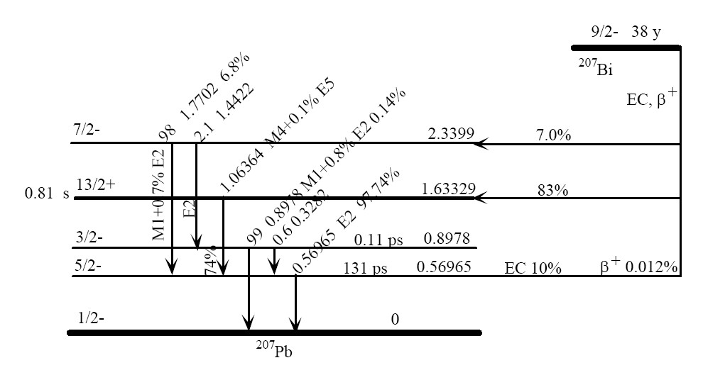
²⁰⁷Bi source
γ-energy [keV] | e—energy [keV]
569.6 | 481.7 [K]
 | 553.8-556.7 [L]
 | 565.8-567.2 [M]
1063.7 | 975.7 [K]
 | 1047.8-1050.6 [L]
 | 1059.8-1061.2 [M]
²⁰⁷Bi emits γ-rays and electrons

Slide 4
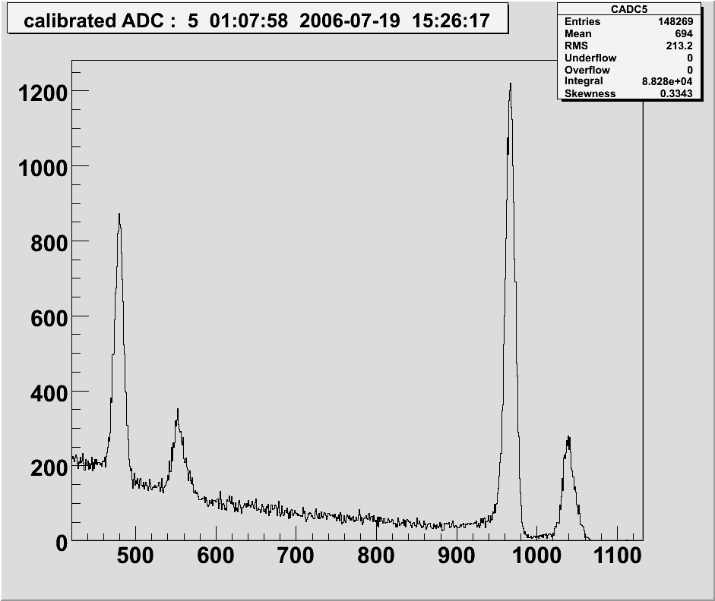
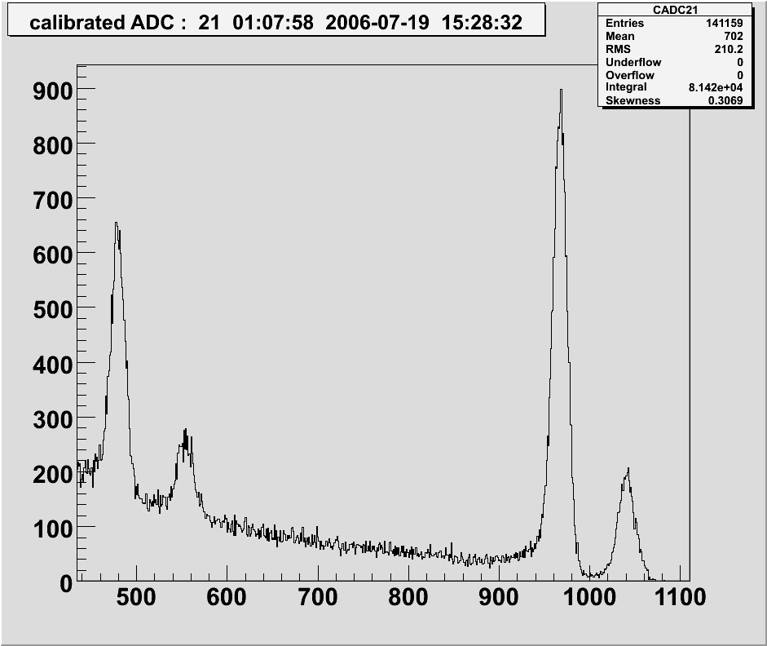
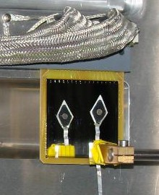
Energy resolution with ²⁰⁷Bi source in vacuum
Front Junction Side
Rear Ohmic Side
MICRON #2512-17
Voltage: 200V
²⁰⁷Bi E=482, 976 keV
range 0.94, 2.31 mm (e⁻e⁻ interaction)
experimental set-up

Slide 5
Conversion electron spectroscopy
lifetime of a nuclear state:
total conversion coefficient:

Slide 6
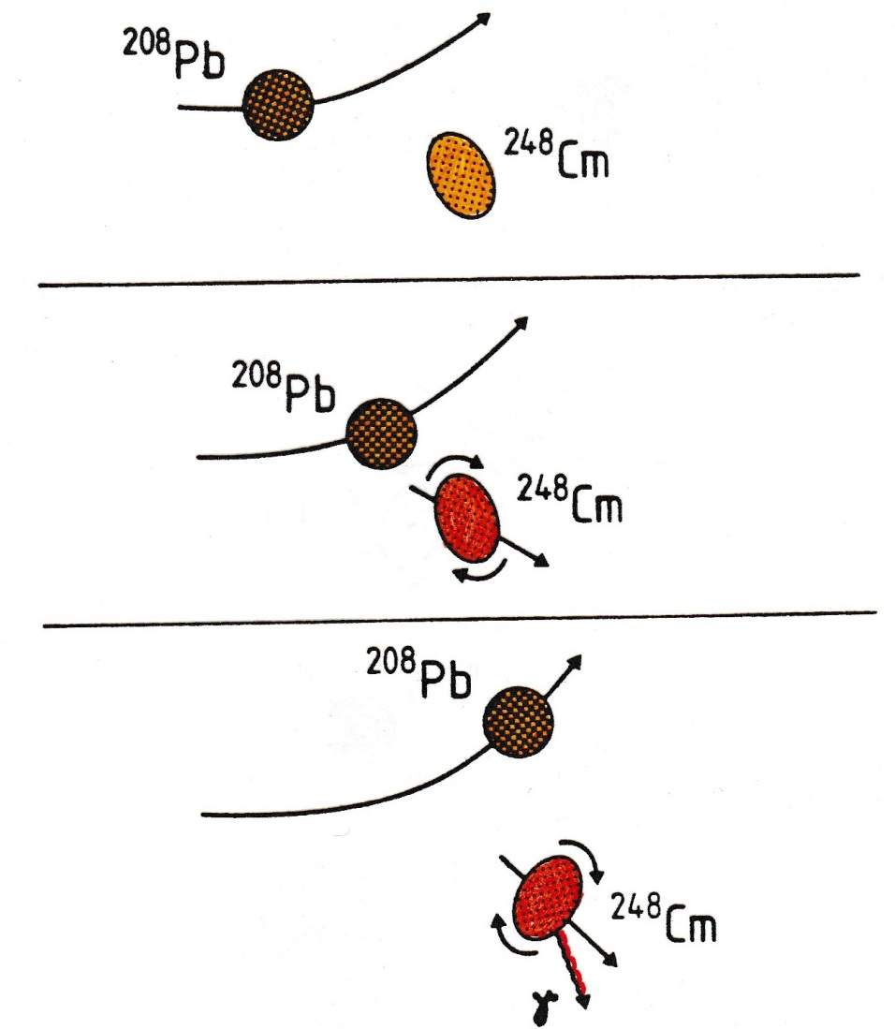
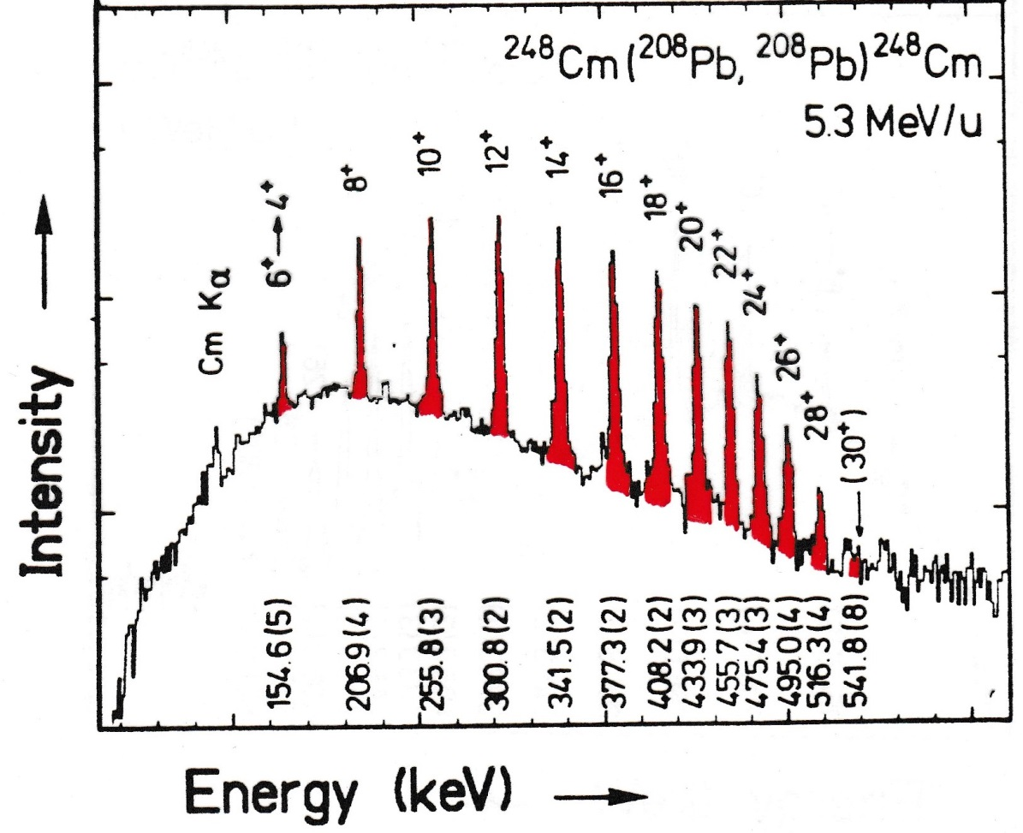
Coulomb excitation

Slide 7
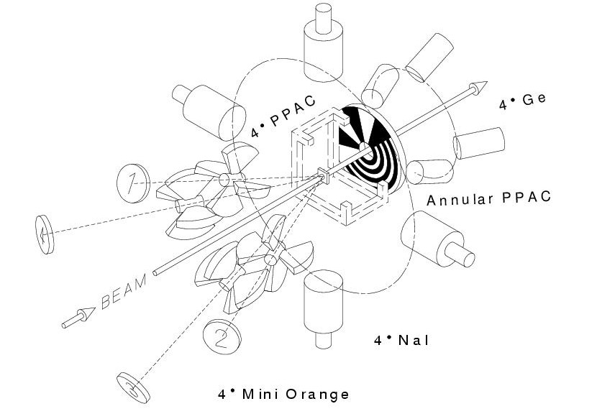
Coulomb excitation experiment

Slide 8
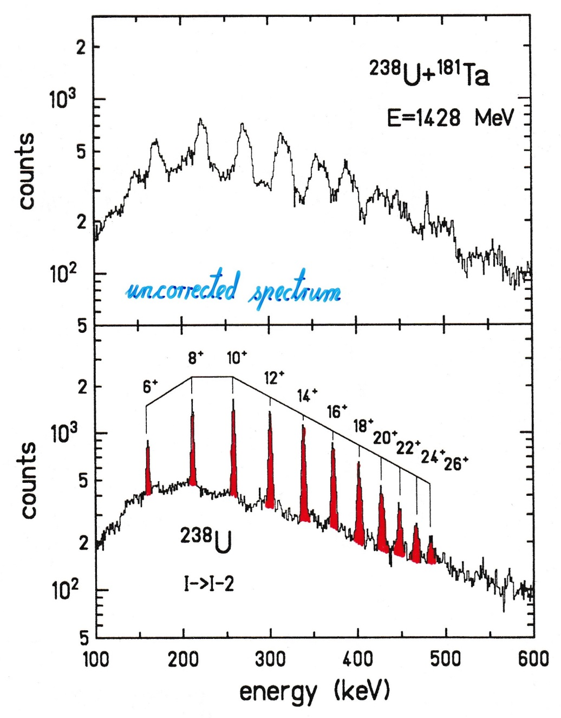
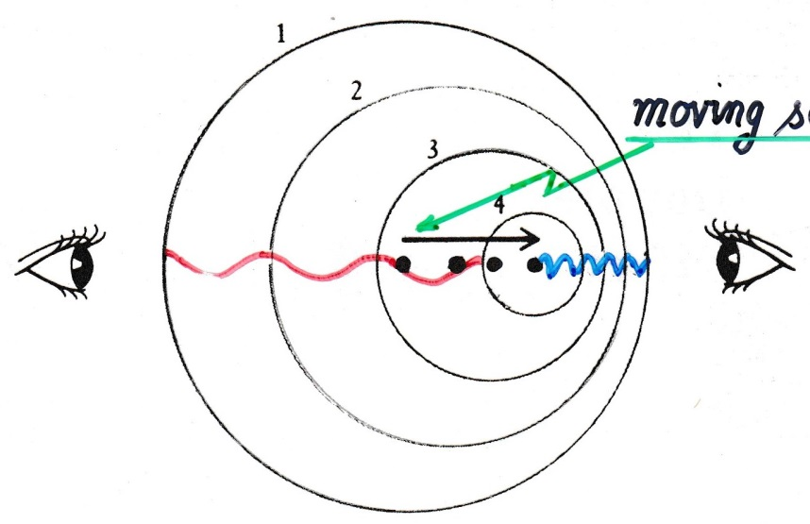
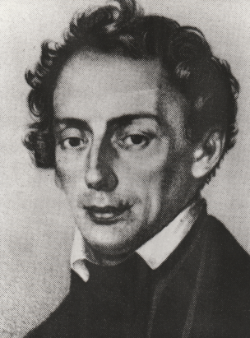
Doppler effect
moving source
uncorrected spectrum
Christian Doppler

Slide 9
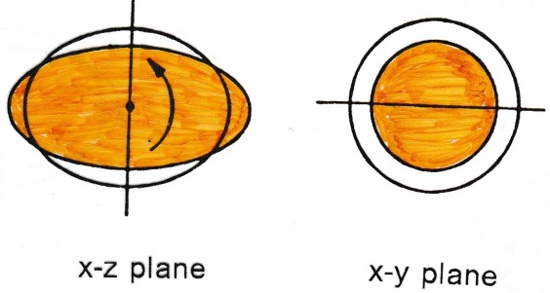
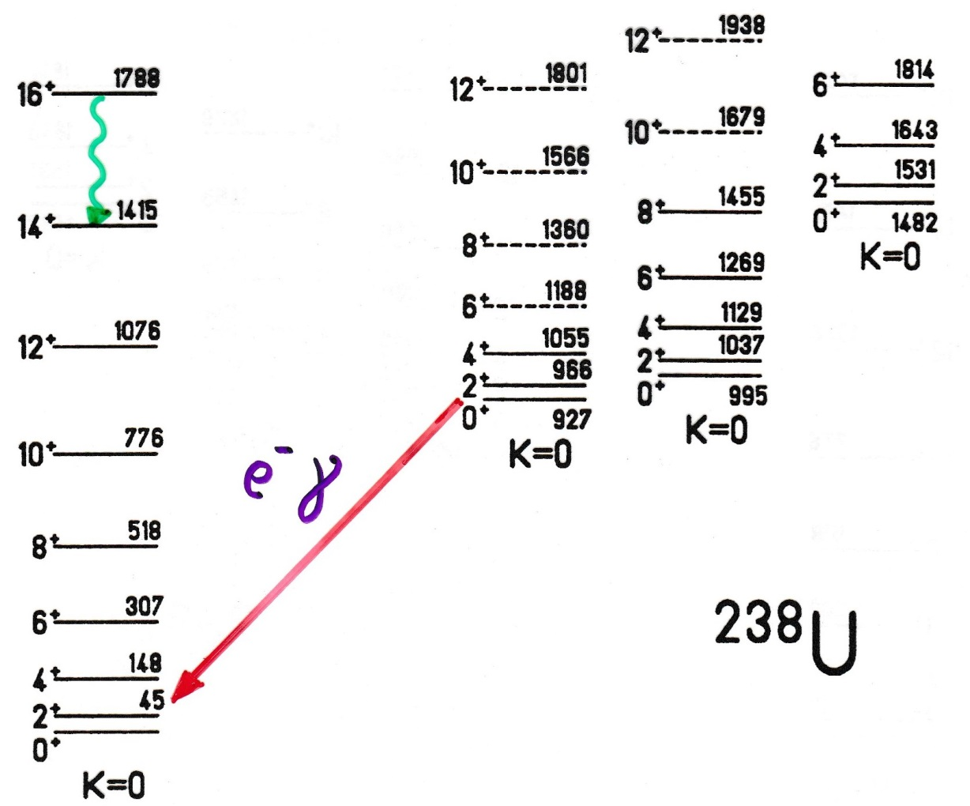
Surface oscillations in deformed nuclei
β - vibration
e⁻ γ
E0 or E2 transition

Slide 10
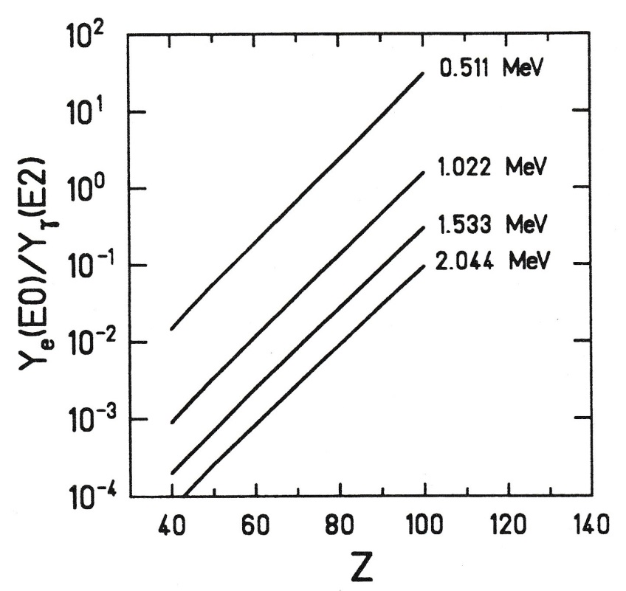
E0/E2 branching ratio
$$\frac{Y_{e}\left(E0\right)}{Y_{γ}\left(E2\right)}=\frac{Ω_{K} \left[s^{−1}\right]}{2.56∙{10}^{9}{∙A}^{4/3}{∙E_{γ}}^{5} \left[MeV\right]}∙\frac{B\left(E0;I→I′\right)}{B\left(E2;I→I′\right)}$$
= 14 β² for 2_{β}→2
~Z^{7.5}
Ω_{K}: conversion probability electronic factor
D.A. Bell et al.; Can. J. of Phys. 48 (1970),2542

Slide 11
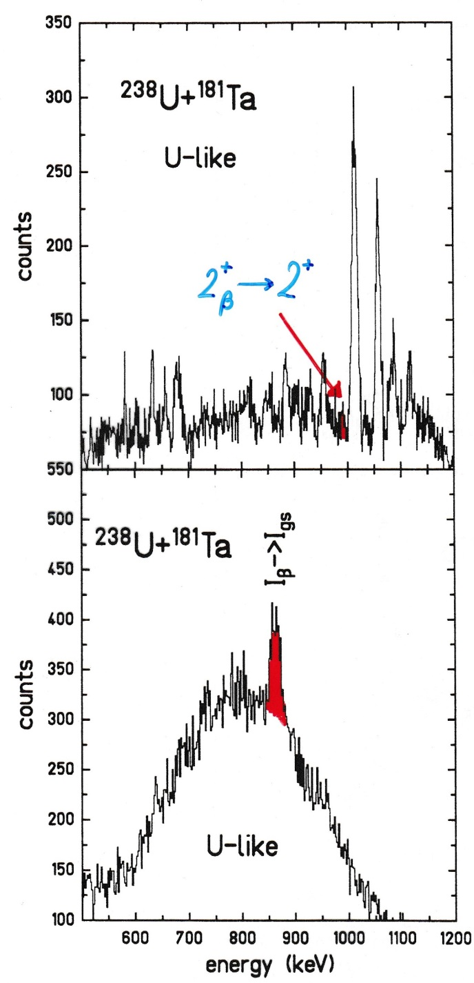
Doppler-corrected e⁻ and γ-ray spectroscopy
$$2_{β}^{+}→2^{+}$$
γ-ray spectrum
e⁻ spectrum

Slide 12
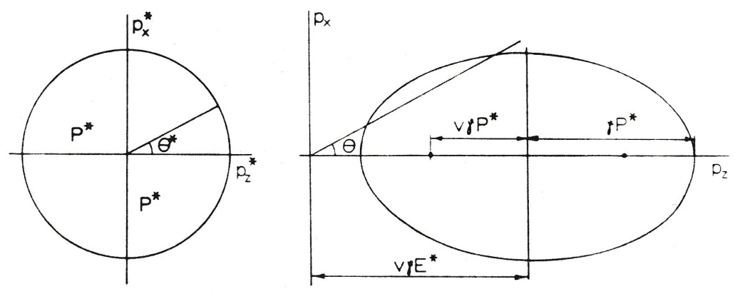
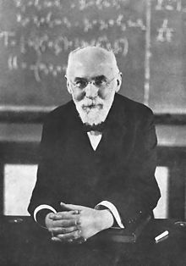
Lorentz transformation
P* = const.
total energy:
$$E^{∗}=−γ∙v∙P∙cosθ+γ∙E$$
with
$$E=\sqrt{{\left(mc^{2}\right)}^{2}+{\left(Pc\right)}^{2}}$$
rest system
laboratory system
E*, P* total energy and momentum in the rest system
E, P total energy and momentum in the laboratory system
Doppler formula for zero-mass particle (photon): E=Pc
$$E^{∗}=−γ∙β∙E∙cosθ+γ∙E$$
$$E^{∗}=γ∙E\left(1−β∙cosθ\right)$$
Hendrik Lorentz
E. Byckling, K. Kajantie J. Wiley & Sons London

Slide 13
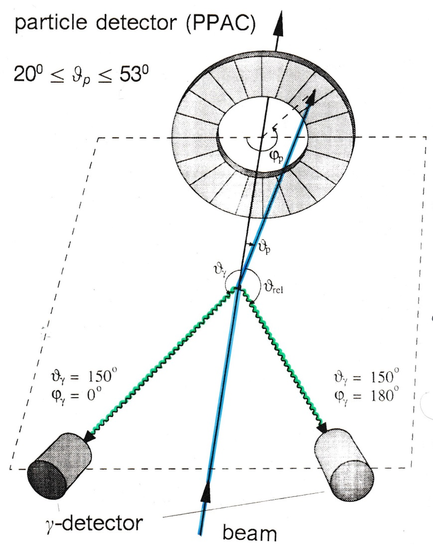
Experimental arrangement
experimental problem:
Doppler broadening due to finite size of Ge-detector
$$\frac{∆E}{E}\sim 1\%$$
for
$$∆θ_{γ}={20}^{0} β_{1}≅10\%$$
For projectile excitation:
$$E^{∗}=γ∙E∙\left(1−β_{1}∙cosθ_{γ1}\right)$$
Doppler shift
with
$$cosθ_{γ1}=cosθ_{1}cosθ_{γ}+sinθ_{1}sinθ_{γ}cos\left(φ_{γ}−φ_{1}\right)$$
$$ΔE≅E^{∗}∙β_{1}∙sinθ_{γ1}∙∆θ_{γ1}$$
Doppler broadening

Slide 14
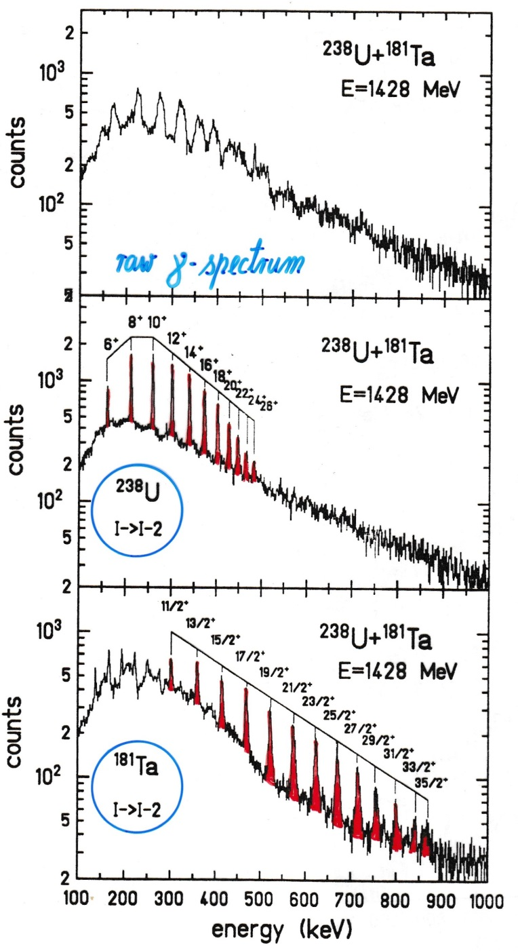
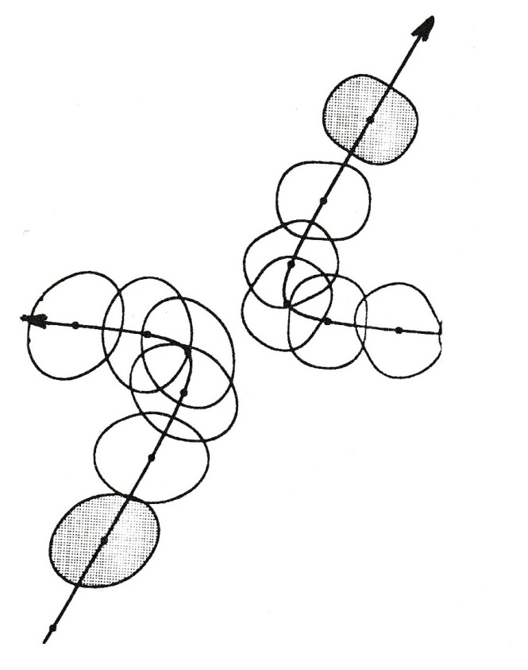
Inelastic heavy-ion scattering
¹⁸¹Ta
raw γ-ray spectrum
²³⁸U

Slide 15
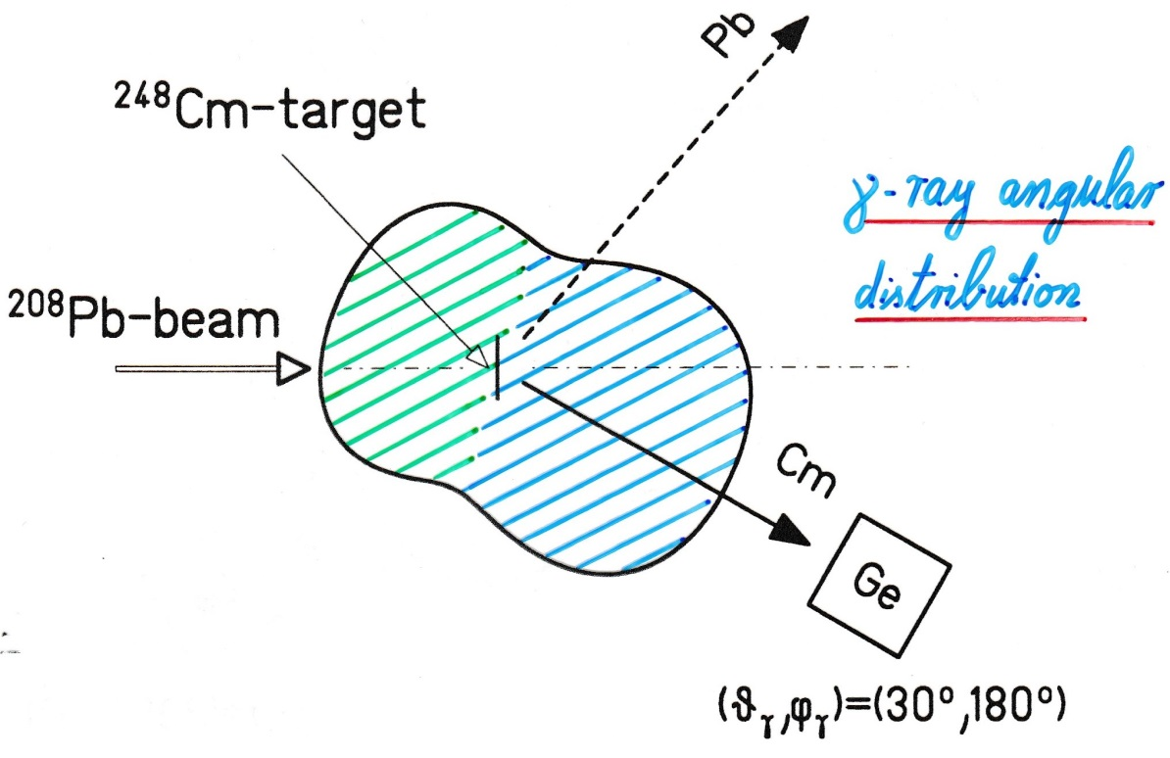
Lorentz transformation
γ-ray angular distribution
Contraction of the solid angle element in the laboratory system
$$\frac{dΩ}{dΩ^{∗}}={\left\{\frac{E^{∗}}{E}\right\}}^{2}$$
with
$$E^{∗}=γ∙E∙\left(1−β∙cosθ\right)$$
Doppler formula

Slide 16
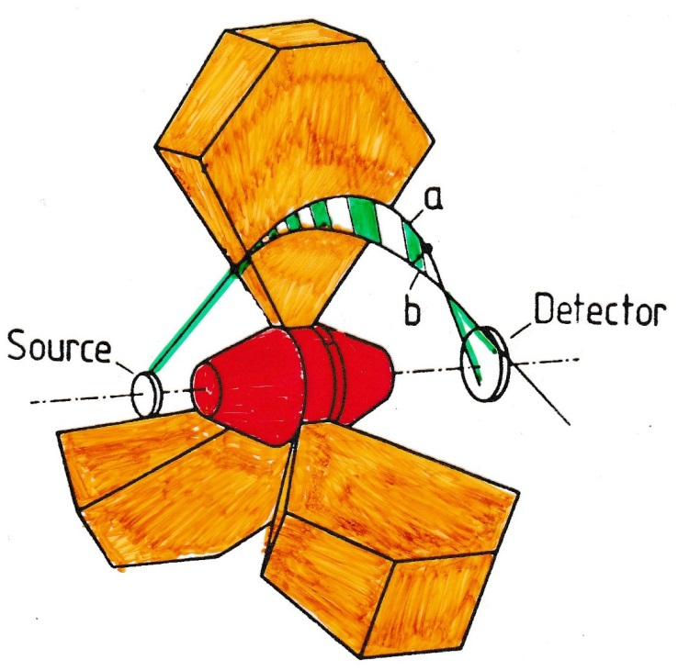
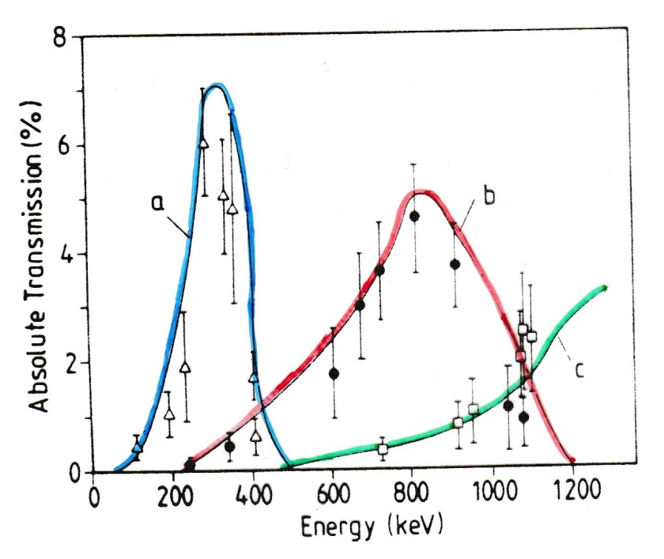
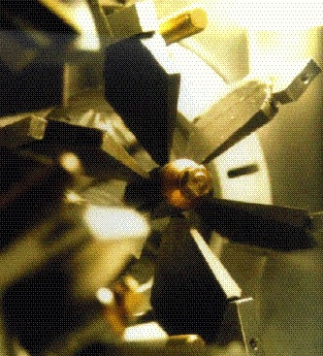
Electron spectroscopy with mini-orange devices
magnetic filters
SmCo₅ magnets
for symmetric configuration 1 – 5 kG
J. v. Klinken et al.; NIM 151 (1978) 433
T. Dresel et al.; NIM A275 (1989) 301

Slide 17
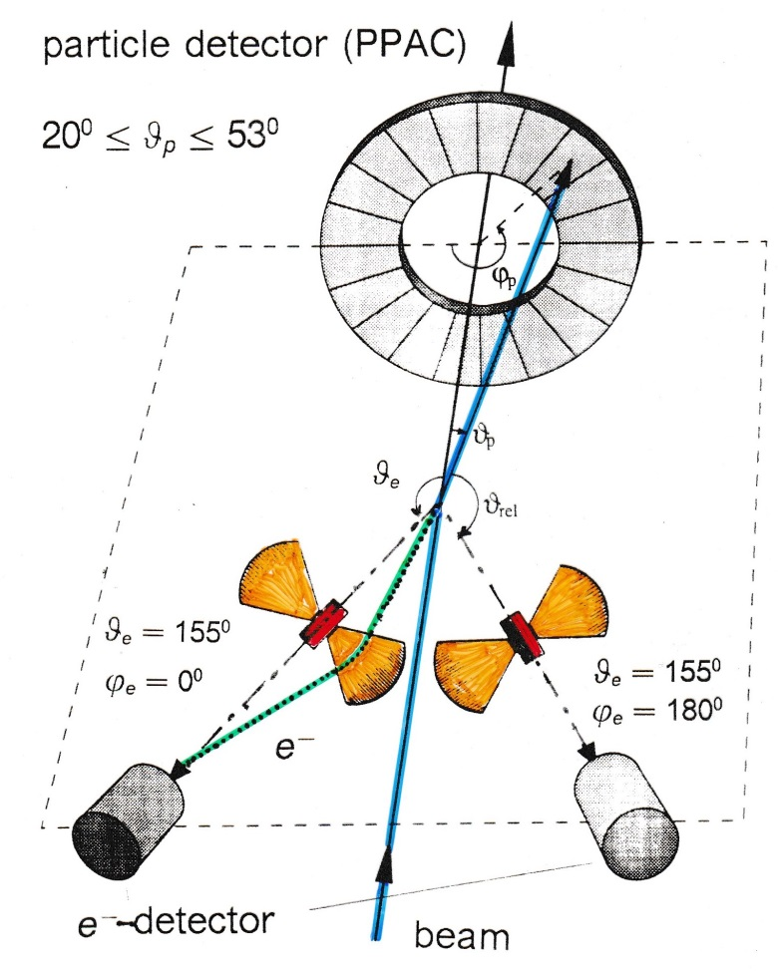
Experimental arrangement
Doppler broadening
Δϑ_{e} = 20⁰
target – Mini-Orange: 19 cm
Mini-Orange – Si detector: 6 cm
For projectile excitation:
$$T_{e}^{∗}=γ∙T_{e}∙\left\{1−β_{1}∙\sqrt{1+2m_{e}{c^{2}}/{T_{e}}}∙cosθ_{e1}\right\}+m_{e}c^{2}∙\left(γ−1\right)$$
with
$$cosθ_{e1}=cosθ_{1}cosθ_{e}+sinθ_{1}sinθ_{e}cos\left(φ_{e}−φ_{1}\right)$$

Slide 18
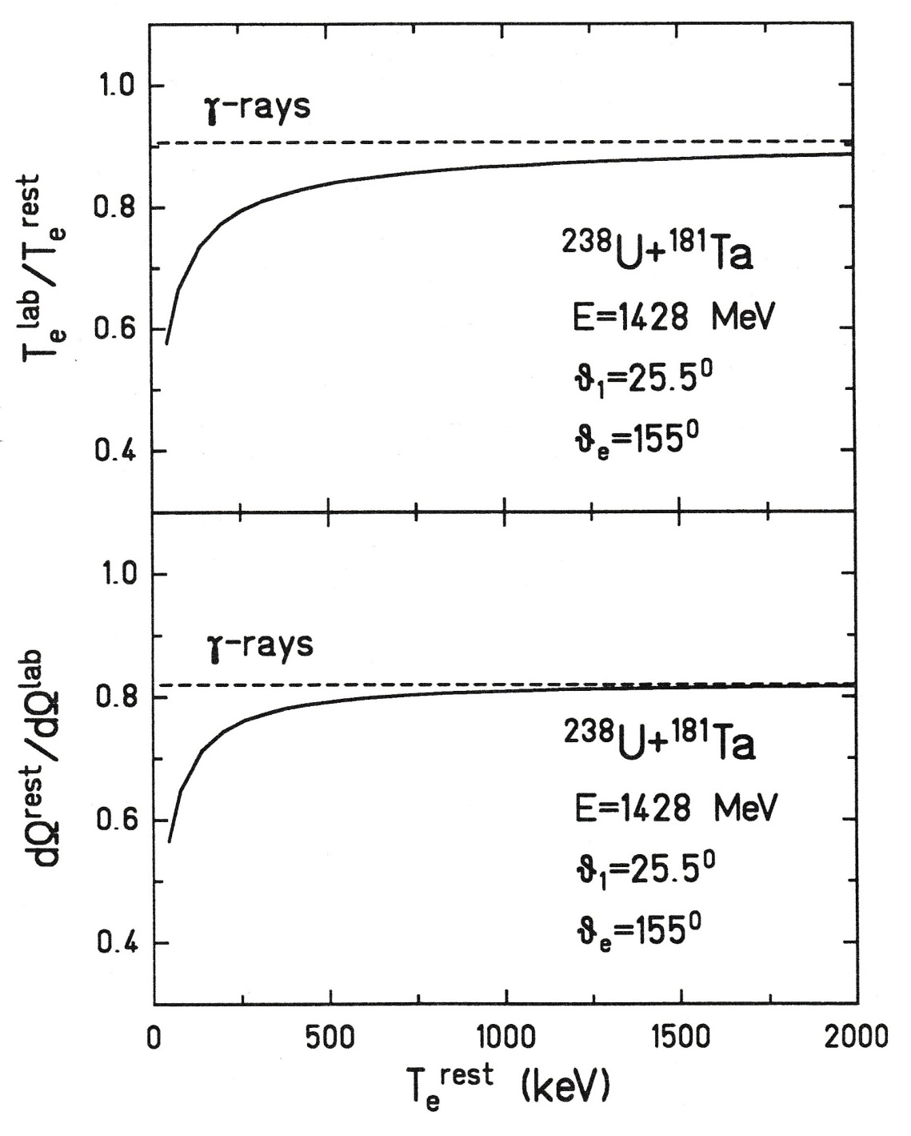
Lorentz transformation
γ-rays
10%
energy shift
The Doppler shift in kinetic energy of electrons is larger than the Doppler shift of massless photons of similar energy.
γ-rays
20%
solid angle contraction
The Lorentz transformation also leads to a contraction of the solid angle in the laboratory system.

Slide 19
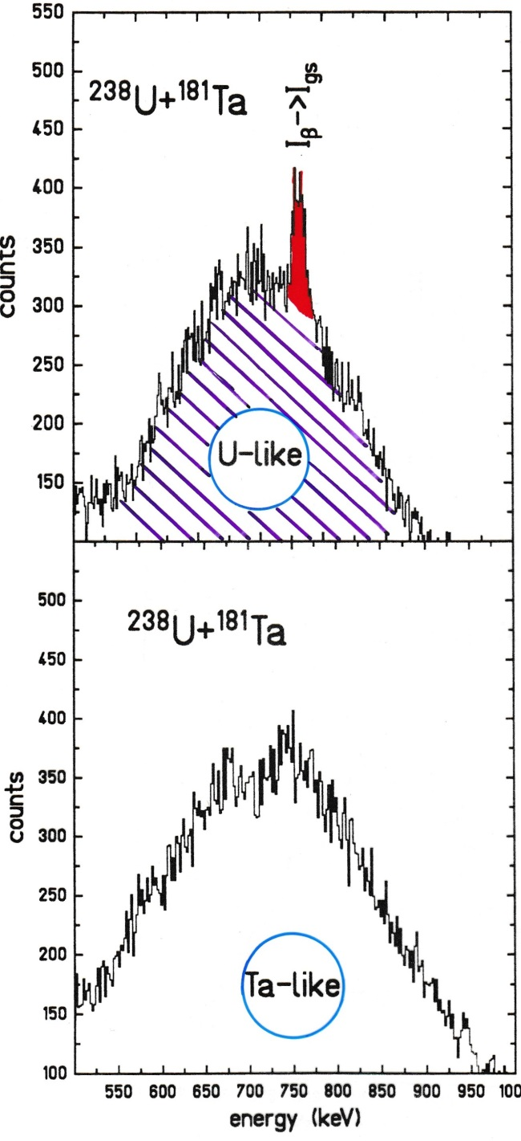
Electron spectroscopy with mini-orange devices
transmission window

Slide 20
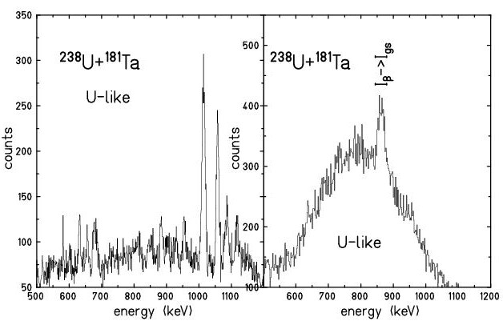
Coulomb excitation experiment

Slide 21
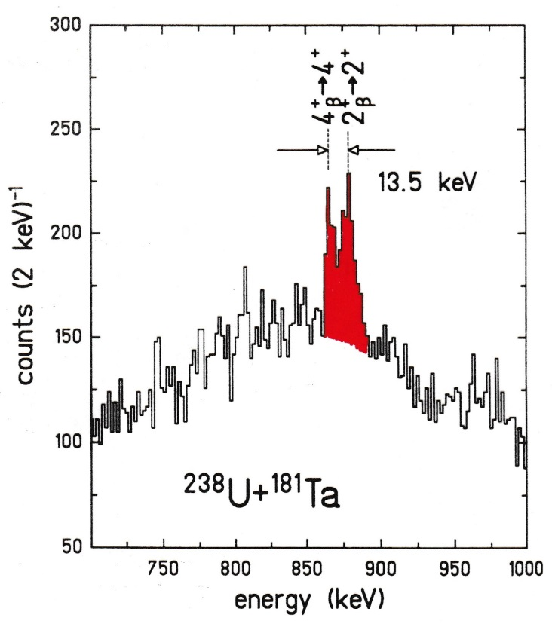
Experimental arrangement
optimal energy resolution:
cos θ_{e1} = ±1

Slide 22
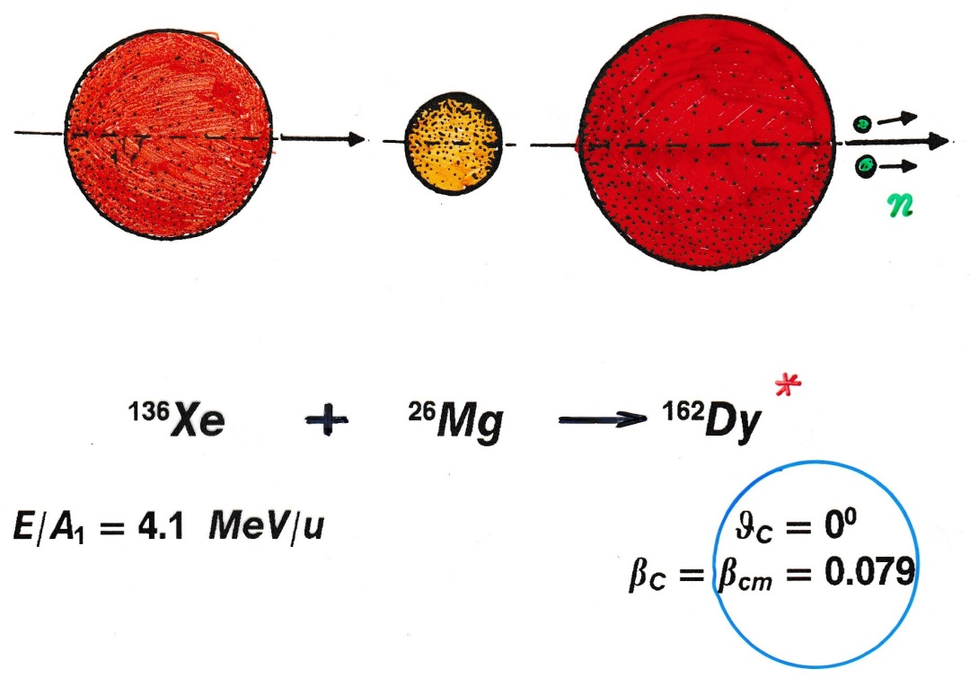
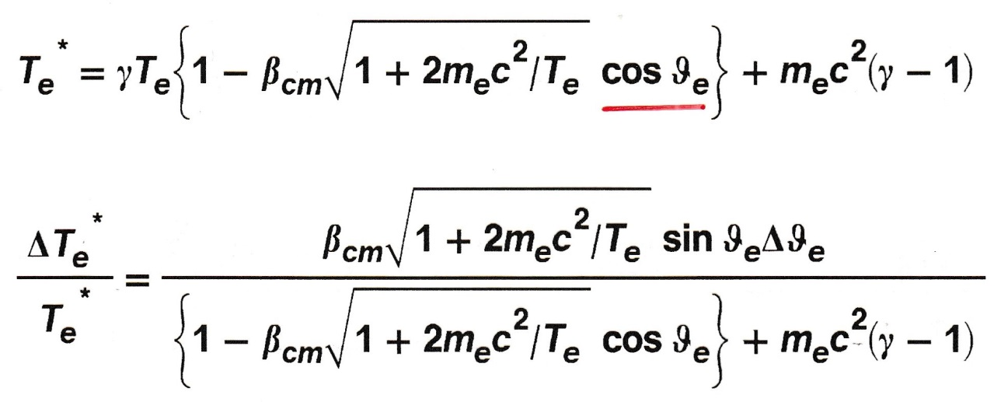
Compound nucleus formation
Lorentz transformation:

Slide 23
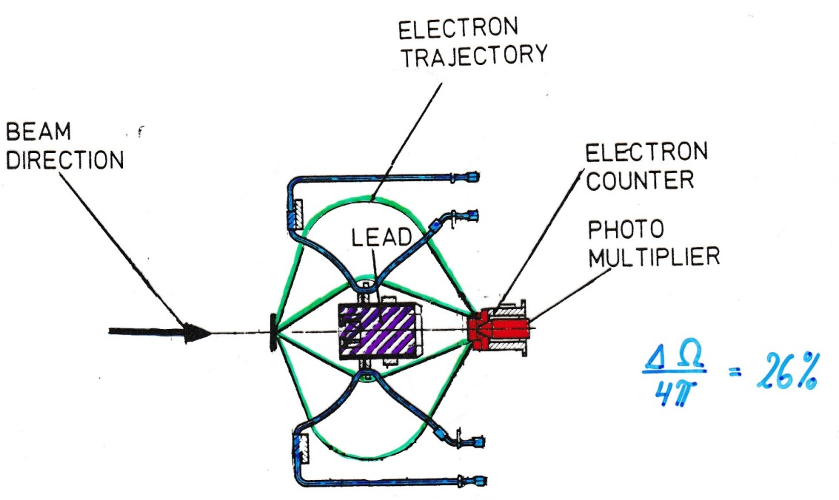
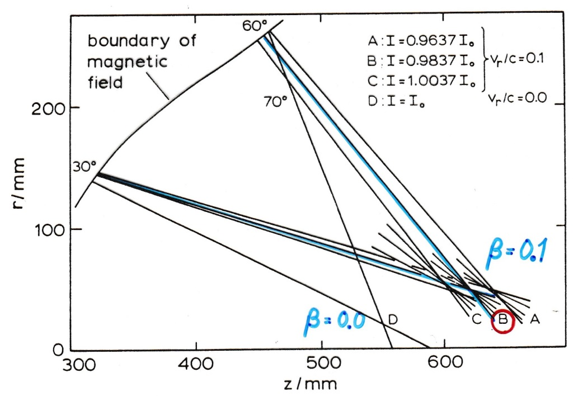
Experimental arrangement with orange spectrometer
$$\frac{ΔΩ}{4π}=26\%$$
optimal focusing: β, $T_{e}^{∗}$
β = 0.1
β = 0.0
L. Handschug et al.; NIM 161 (1979) 117

Slide 24
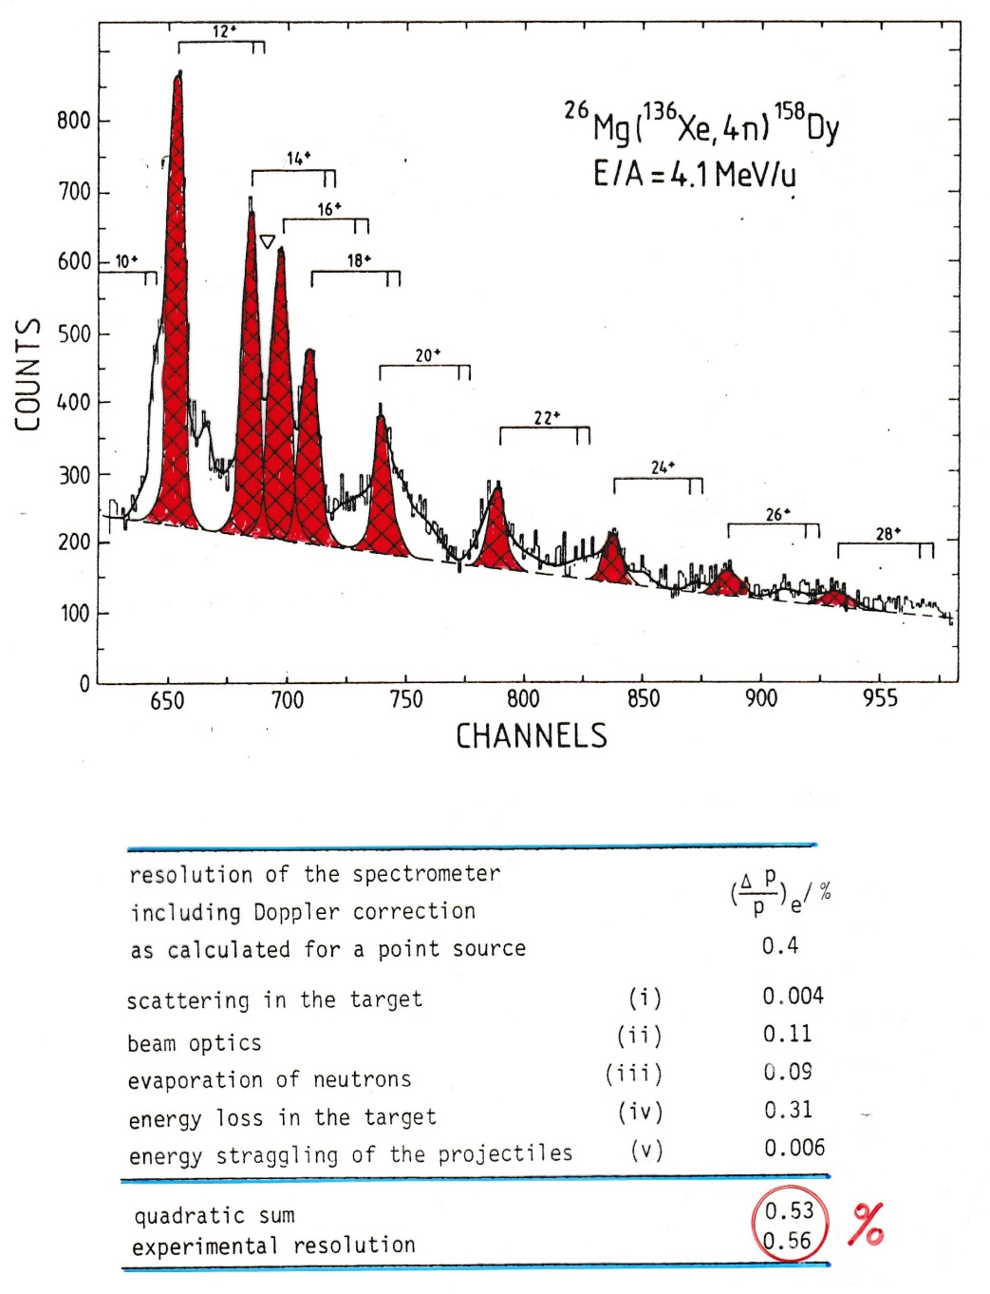
Conversion electron spectroscopy after (HI,xn)-reactions
A. Balanda et al.; GSI 79-11, p.50

Slide 25
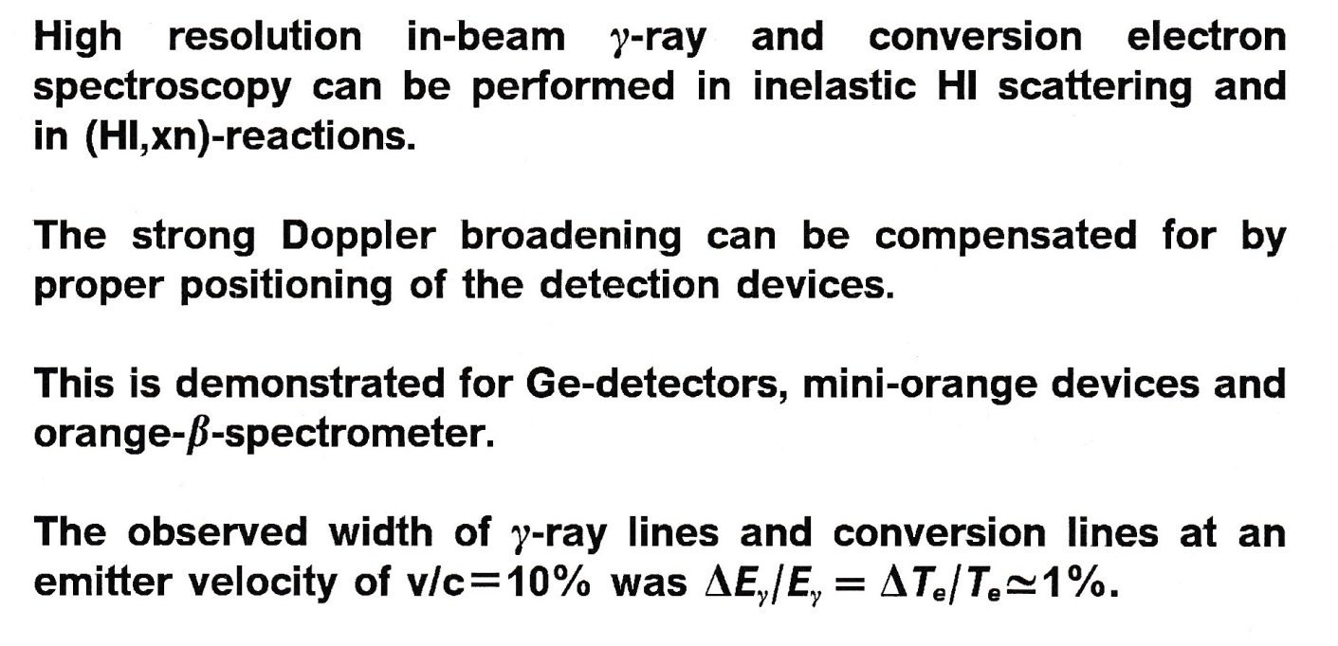
Summary

