Slide 1

Outline: γ-decay
Lecturer: Hans-Jürgen Wollersheim
e-mail: h.j.wollersheim@gsi.de
web-page: https://web-docs.gsi.de/~wolle/ and click on
electromagnetic spectrum
angular momentum in γ-decay
emission of electromagnetic radiation
single particle transition
conversion electrons

Slide 2
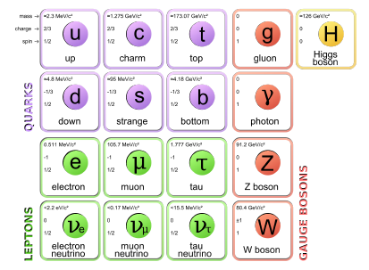
γ-ray spectroscopy
γ-decay is an electromagnetic process where the nucleus decreases in excitation energy, but does not change proton or neutron numbers
This decay process only involves the emission of photons (γ-rays carry spin 1)

Slide 3
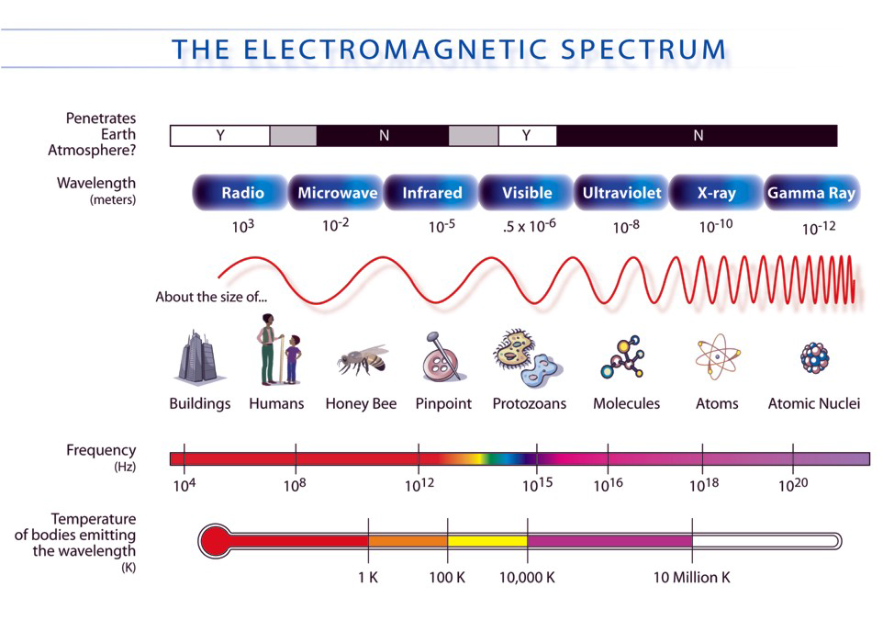
Electromagnetic spectrum

Slide 4
Electromagnetic decay modes
Pair conversion coefficients
E0 transitions: ΔL=0
e⁺ - e⁻ pair
Angular distribution with spin oriented
Angular correlations
Polarization effects
γ-rays
Electron conversion coefficients
E0 transitions: ΔL=0
electron conversion
M
L
K
higher order effects: for example 2 photon emission is very weak

Slide 5
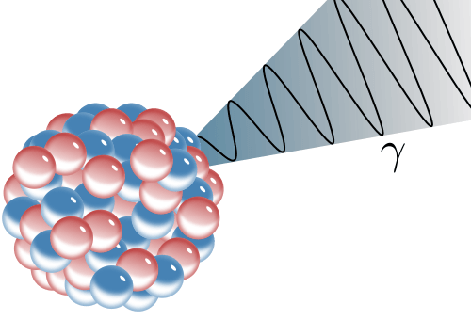
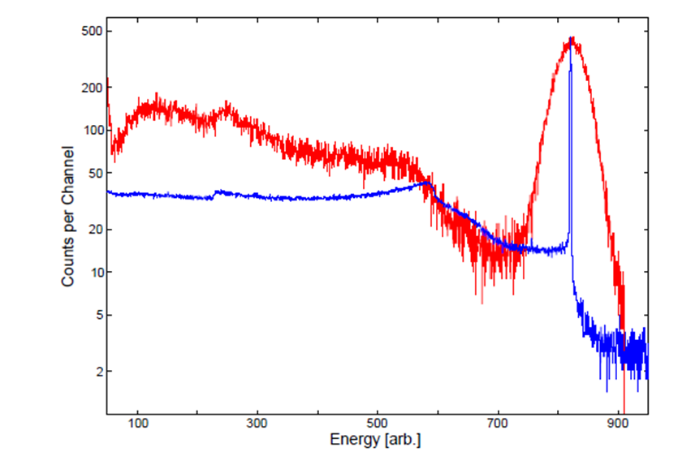
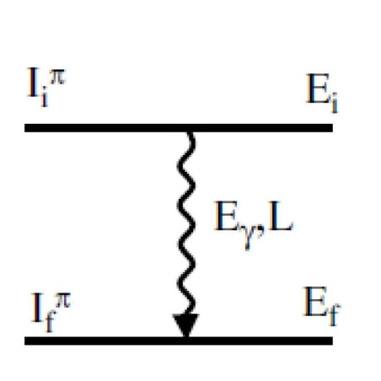

γ-decay
Gamma-ray emission is usually the dominant decay mode
Measurements of γ-rays let us deduce:
energy, spin (angular distr. / correl.), parity (polarization), magnetic moment,
lifetime (recoil distance, Doppler shift), …
of the involved nuclear levels.
¹³⁷Cs detected in red: NaI scintillator
blue: HPGe (high purity Ge semiconductor)
$${}_{Z}^{A}{X_{N}^{∗}}→{}_{Z}^{A}{X_{N}^{\left(∗\right)}}$$

Slide 6
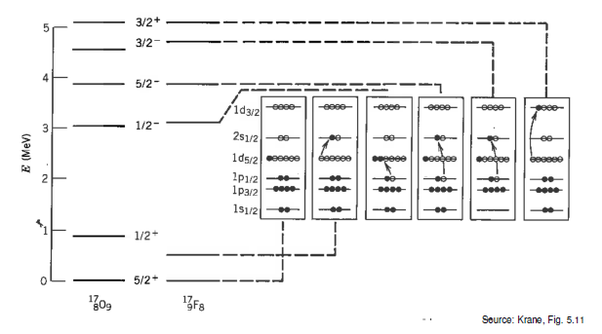
γ-decay in a nutshell
The photon emission of the nucleus essentially results from a re-ordering of nucleons within the shells.
This re-ordering often follows α or β decay, and moves the system into a more energetically favorable state.

Slide 7
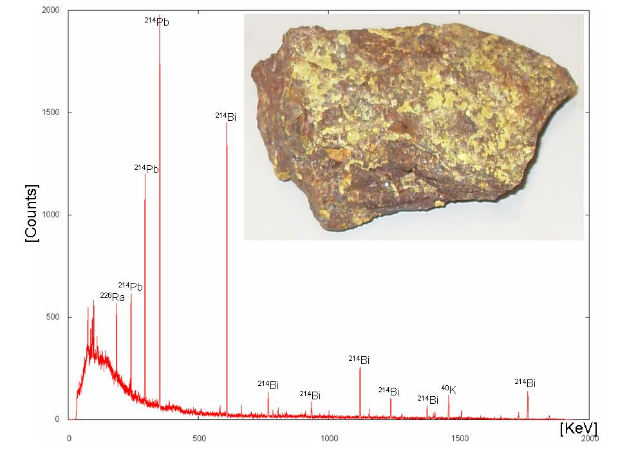
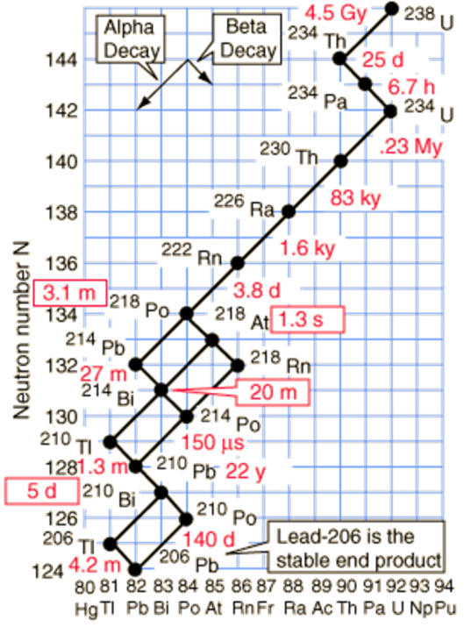
γ-decay
γ-ray spectrum of ^{nat}U

Slide 8
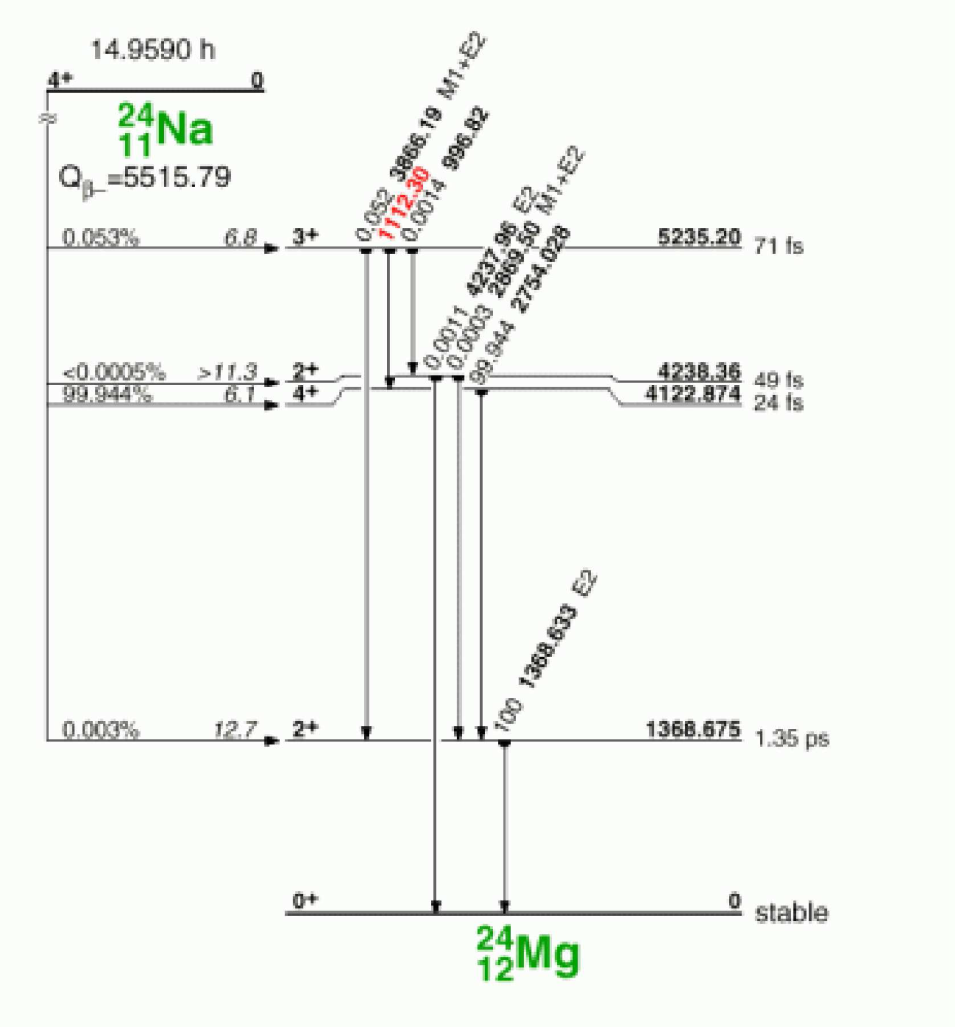
γ-decay
Most β-decay transitions are followed by γ-decay.

Slide 9
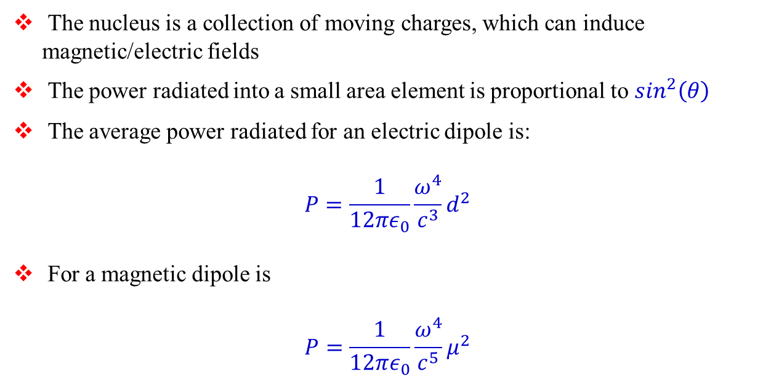
Classical electrodynamics
The nucleus is a collection of moving charges, which can induce magnetic/electric fields
The power radiated into a small area element is proportional to $\sin^{2}\left(θ\right)$
The average power radiated for an electric dipole is:
$$P=\frac{1}{12πε_{0}}\frac{ω^{4}}{c^{3}}d^{2}$$
For a magnetic dipole is
$$P=\frac{1}{12πε_{0}}\frac{ω^{4}}{c^{5}}μ^{2}$$

Slide 10
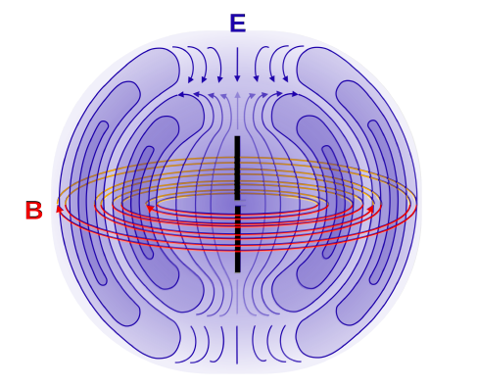
Electric/magnetic dipoles
Electric and magnetic dipole fields have opposite parity:
Magnetic dipoles have even parity and electric dipole fields have odd parity.
$$⇒ π\left(Mℓ\right)={\left(−1\right)}^{ℓ+1} and π\left(Eℓ\right)={\left(−1\right)}^{ℓ}$$

Slide 11
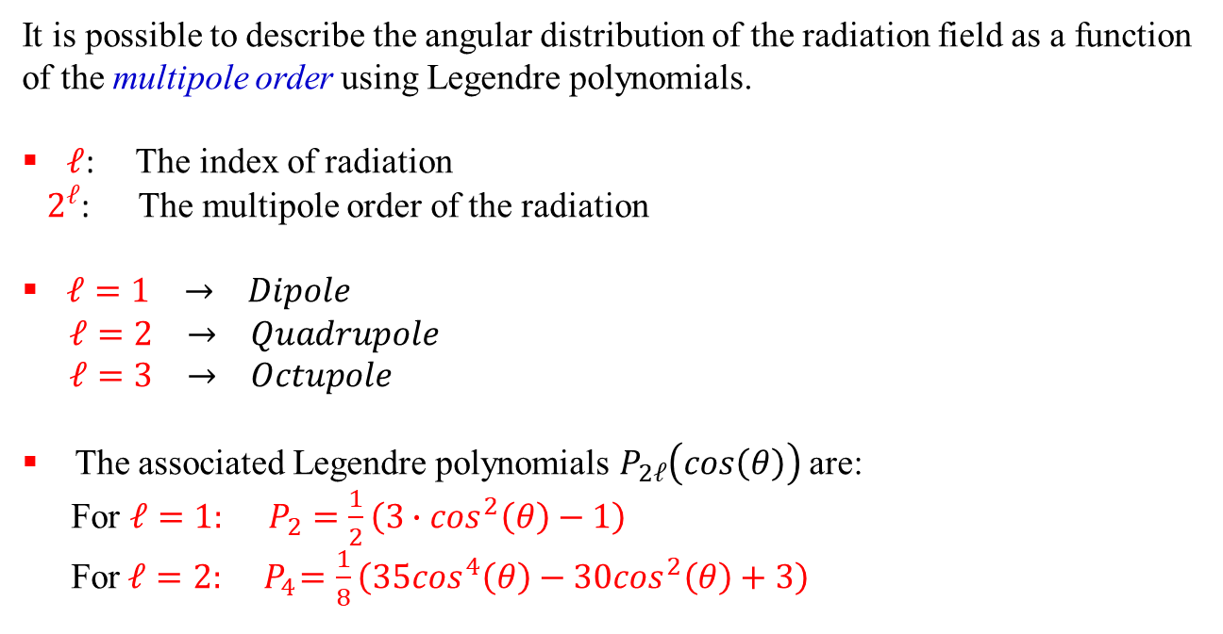
Higher order multipoles
It is possible to describe the angular distribution of the radiation field as a function of the multipole order using Legendre polynomials.
$ℓ$: The index of radiation
$2^{ℓ}$: The multipole order of the radiation
$ℓ=1 → Dipole$
$ℓ=2 → Quadrupole$
$ℓ=3 → Octupole$
The associated Legendre polynomials $P_{2ℓ}\left(cos\left(θ\right)\right)$ are:
For $ℓ=1: P_{2}=\frac{1}{2}\left(3∙\cos^{2}\left(θ\right)−1\right)$
For $ℓ=2: { P}_{4}=\frac{1}{8}\left(35\cos^{4}\left(θ\right)−30\cos^{2}\left(θ\right)+3\right)$

Slide 12
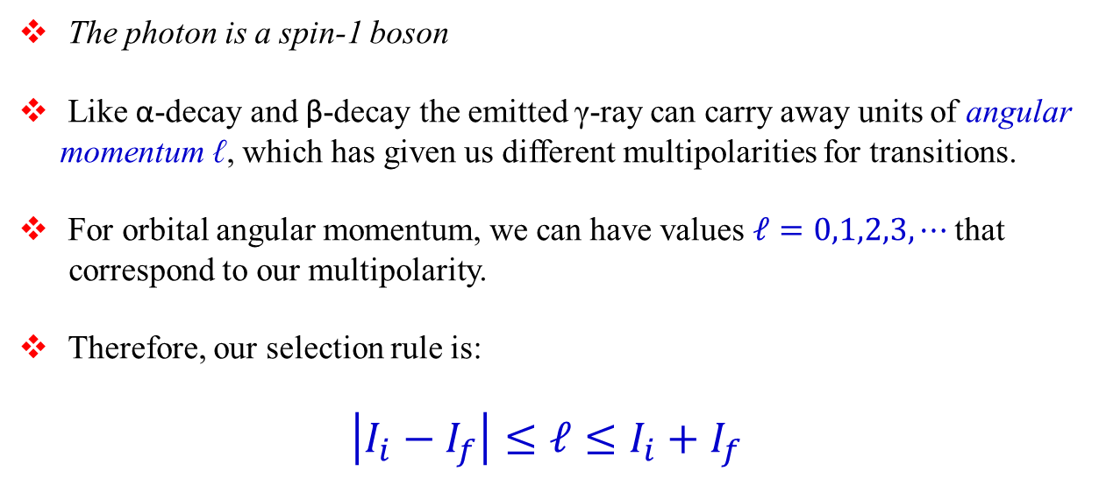
Angular momentum in γ-decay
The photon is a spin-1 boson
Like α-decay and β-decay the emitted γ-ray can carry away units of angular momentum ℓ, which has given us different multipolarities for transitions.
For orbital angular momentum, we can have values $ℓ=0,1,2,3,⋯$ that
correspond to our multipolarity.
Therefore, our selection rule is:
$$\left|I_{i}−I_{f}\right|≤ℓ≤I_{i}+I_{f}$$

Slide 13
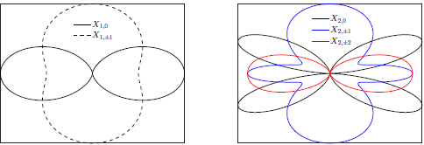




Characteristics of multipolarity
L | multipolarity | π(Eℓ) / π(Mℓ) | angular distribution
1 | dipole | -1 / +1
2 | quadrupole | +1 / -1
3 | octupole | -1 / +1
4 | hexadecapole | +1 / -1
⁞
ℓ = 1
ℓ =2
$$E_{γ}=E_{i}−E_{f}$$
$$\left|I_{i}−I_{f}\right|≤ℓ≤I_{i}+I_{f}$$
$$∆π\left(Eℓ\right)={\left(−1\right)}^{ℓ}$$
$$∆π\left(Mℓ\right)={\left(−1\right)}^{ℓ+1}$$

Slide 14

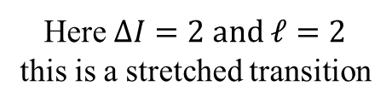
The basics of the situation
2
ℓ
0
$$\left|2−0\right|≤ℓ≤2+0$$
Here $ΔI=2 and ℓ=2$
this is a stretched transition

Slide 15

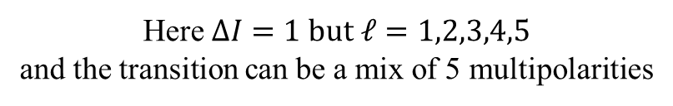
The basics of the situation
3
ℓ
2
$$\left|3−2\right|≤ℓ≤3+2$$
Here $ΔI=1 but ℓ=1,2,3,4,5$
and the transition can be a mix of 5 multipolarities

Slide 16

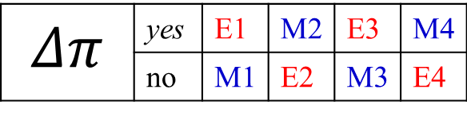


The basics of the situation
$E_{γ}, ℓ, Δπ$
Electromagnetic transitions:
$$Δπ \left(electric\right)= {\left(−1\right)}^{ℓ}$$
$$Δπ \left(magnetic\right)= {\left(−1\right)}^{ℓ+1}$$
$$Δπ$$ | yes | E1 | M2 | E3 | M4
 | no | M1 | E2 | M3 | E4

Slide 17
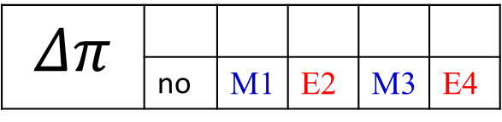

The basics of the situation
2⁺
ℓ
0⁺
$$\left|2−0\right|≤ℓ≤2+0$$
$$ℓ=2 and no change in parity$$
$$Δπ$$ | yes | E1 | M2 | E3 | M4
 | no | M1 | E2 | M3 | E4

Slide 18
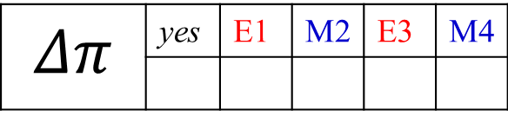

The basics of the situation
3⁺
ℓ
2⁻
$$\left|3−2\right|≤ℓ≤3+2$$
Here $ΔI=1 but ℓ=1,2,3,4,5$
$$Δπ$$ | yes | E1 | M2 | E3 | M4
 | no | M1 | E2 | M3 | E4
mixed E1,M2,E3,M4,E5

Slide 19
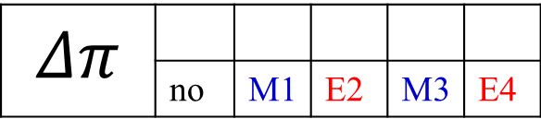

The basics of the situation
3⁺
ℓ
2⁺
$$\left|3−2\right|≤ℓ≤3+2$$
Here $ΔJ=1 but ℓ=1,2,3,4,5$
$$Δπ$$ | yes | E1 | M2 | E3 | M4
 | no | M1 | E2 | M3 | E4
mixed M1,E2,M3,E4,M5

Slide 20



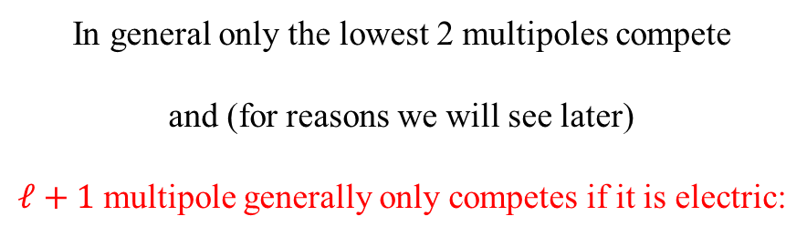
The basics of the situation
$3^{+}→2^{+}:$ mixed M1,E2,M3,E4,M5
$3^{+}→2^{−}:$ mixed E1,M2,E3,M4,E5
In general only the lowest 2 multipoles compete
and (for reasons we will see later)
$ℓ+1$ multipole generally only competes if it is electric:
$3^{+}→2^{+}:$ mixed M1/E2
$3^{+}→2^{−}:$ almost pure E1 (very little M2 admixture)

Slide 21
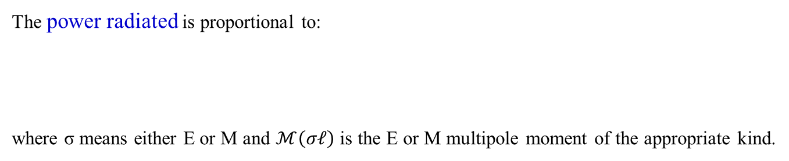
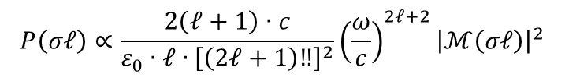
Characteristics of multipolarity
L | multipolarity | π(Eℓ) / π(Mℓ) | angular distribution
1 | dipole | -1 / +1
2 | quadrupole | +1 / -1
3 | octupole | -1 / +1
4 | hexadecapole | +1 / -1
⁞
ℓ = 1
ℓ =2
parity: electric multipoles π(Eℓ) = (-1)^{ℓ}, magnetic multipoles π(Mℓ) = (-1)^{ℓ+1}
The power radiated is proportional to:
where σ means either E or M and $ℳ\left(σℓ\right)$ is the E or M multipole moment of the appropriate kind.
$$P\left(σℓ\right)∝\frac{2\left(ℓ+1\right)∙c}{ε_{0}∙ℓ{∙\left[\left(2ℓ+1\right)‼\right]}^{2}}{\left(\frac{ω}{c}\right)}^{2ℓ+2}{\left|ℳ\left(σℓ\right)\right|}^{2}$$

Slide 22
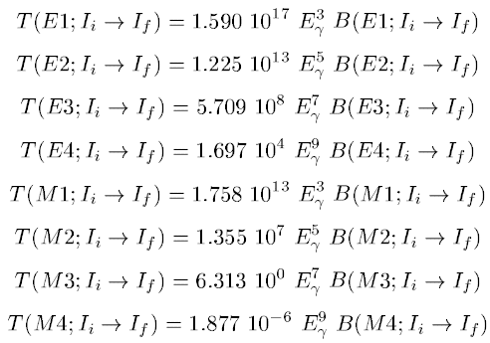
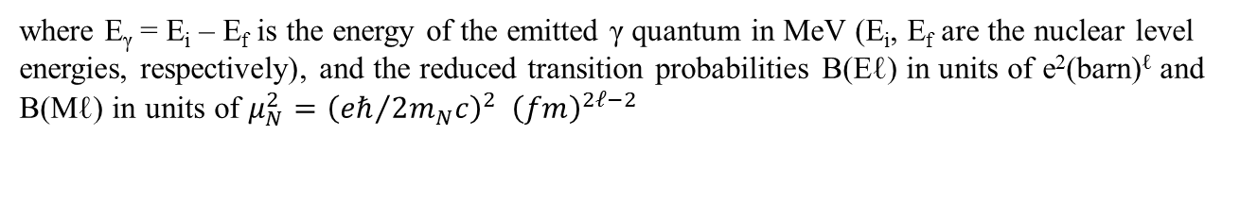
Emission of electromagnetic radiation
where E_{γ} = E_{i} – E_{f} is the energy of the emitted γ quantum in MeV (E_{i}, E_{f} are the nuclear level energies, respectively), and the reduced transition probabilities B(Eℓ) in units of e²(barn)^{ℓ} and B(Mℓ) in units of $μ_{N}^{2}={\left({eℏ}/{2m_{N}c}\right)}^{2} {\left(fm\right)}^{2ℓ−2}$

Slide 23
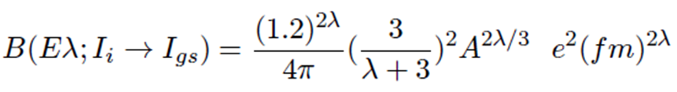
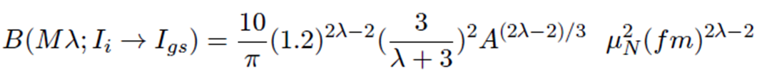
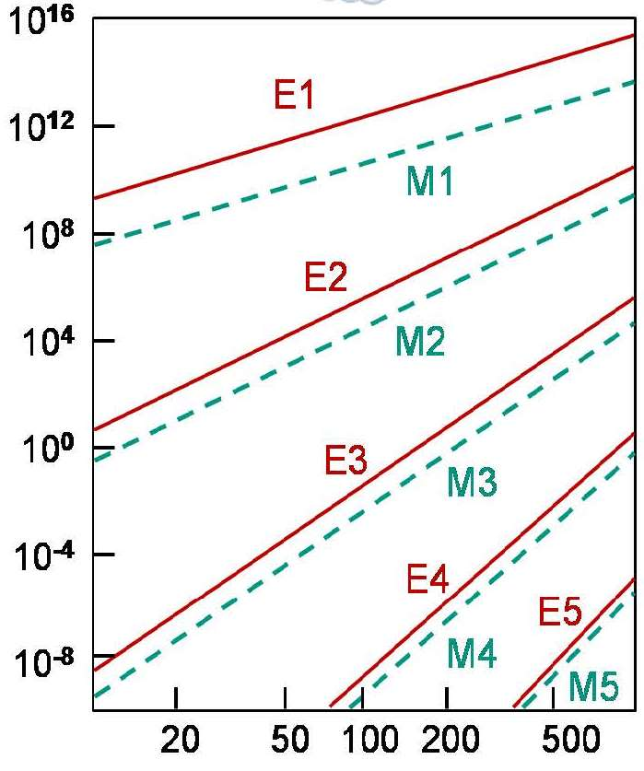
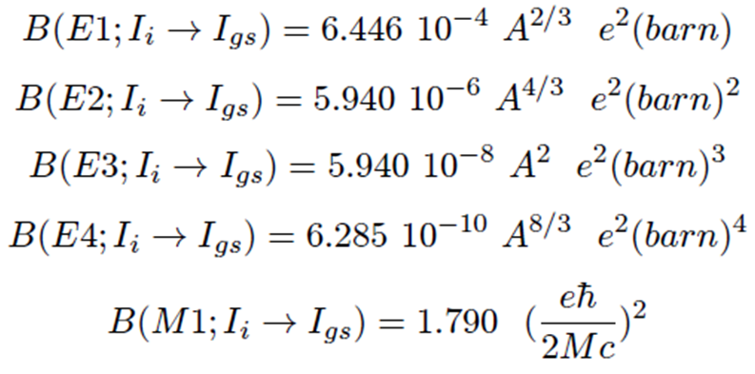
Single particle transition (Weisskopf estimate)
For the first few values of λ, the Weisskopf estimates are
transition probability λ [s⁻¹]
gamma energy E_{γ} [keV]

Slide 24
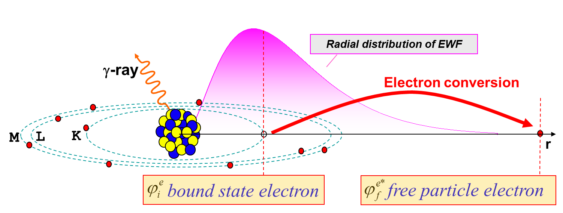
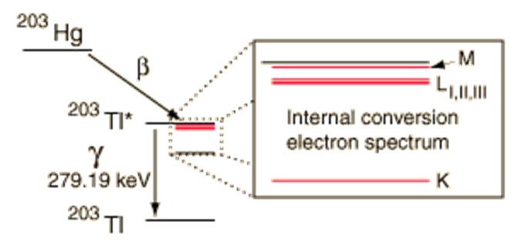
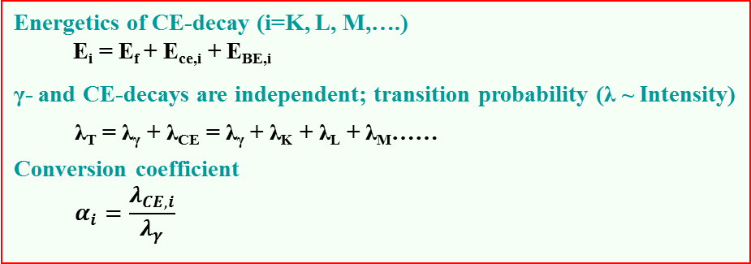
Conversion electrons
Energetics of CE-decay (i=K, L, M,….)
E_{i} = E_{f} + E_{ce,i} + E_{BE,i}
γ- and CE-decays are independent; transition probability (λ ~ Intensity)
  λ_{T} = λ_{γ} + λ_{CE} = λ_{γ} + λ_{K} + λ_{L} + λ_{M}……
Conversion coefficient
  $$α_{i}=\frac{λ_{CE,i}}{λ_{γ}}$$

Slide 25
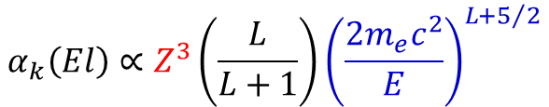
Internal conversion
For an electromagnetic transition internal conversion can occur instead of emission of gamma radiation. In this case the transition energy Q = E_{γ} will be transferred to an electron of the atomic shell.
T_{e} = E_{γ} - B_{e}
T_{e}: kinetic energy of the electron
B_{e}: binding energy of the electron
internal conversion is important for:
heavy nuclei ~ Z³
high multipolarities Eℓ or Mℓ
small transition energies
$$α_{k}\left(El\right)∝Z^{3}\left(\frac{L}{L+1}\right){\left(\frac{2m_{e}c^{2}}{E}\right)}^{L+5/2}$$

Slide 26
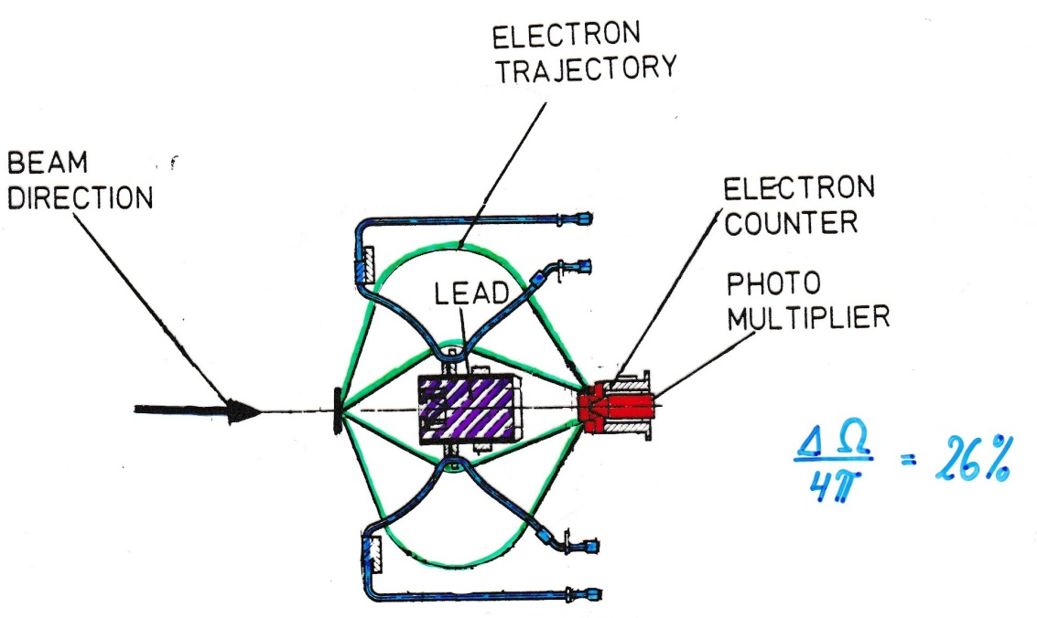
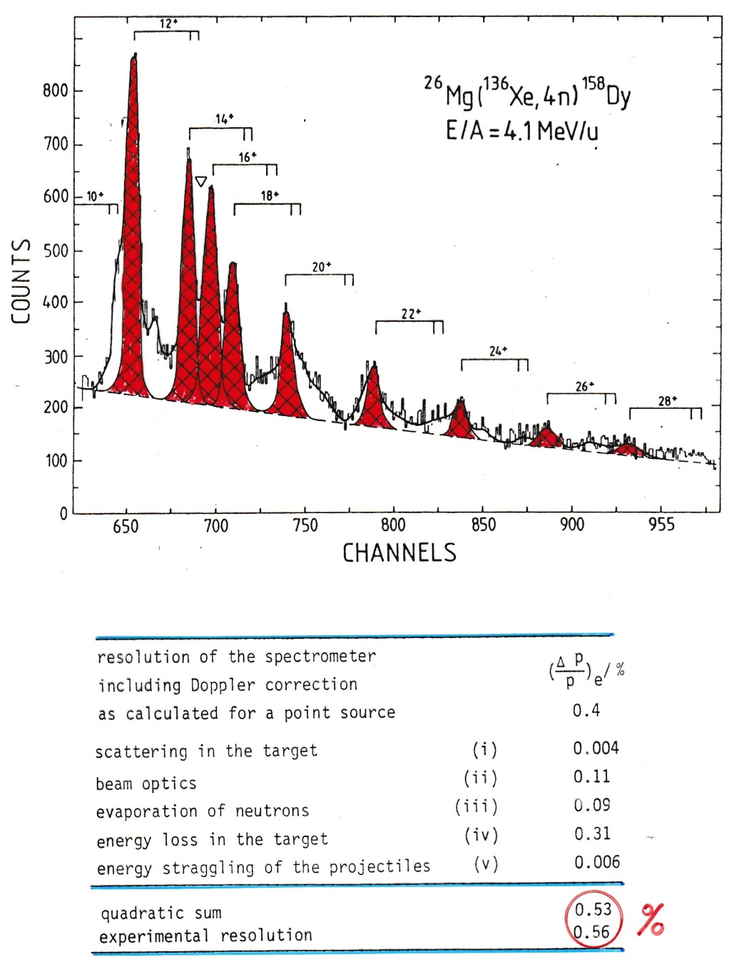

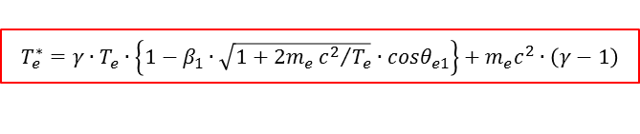
Electron spectroscopy
$$\frac{ΔΩ}{4π}=26\%$$
Doppler shift correction for projectile:
$$T_{e}^{∗}=γ∙T_{e}∙\left\{1−β_{1}∙\sqrt{1+2m_{e}{c^{2}}/{T_{e}}}∙cosθ_{e1}\right\}+m_{e}c^{2}∙\left(γ−1\right)$$
$$cosθ_{e1}=cosθ_{1}cosθ_{e}+sinθ_{1}sinθ_{e}cos\left(φ_{e}−φ_{1}\right)$$

Slide 27
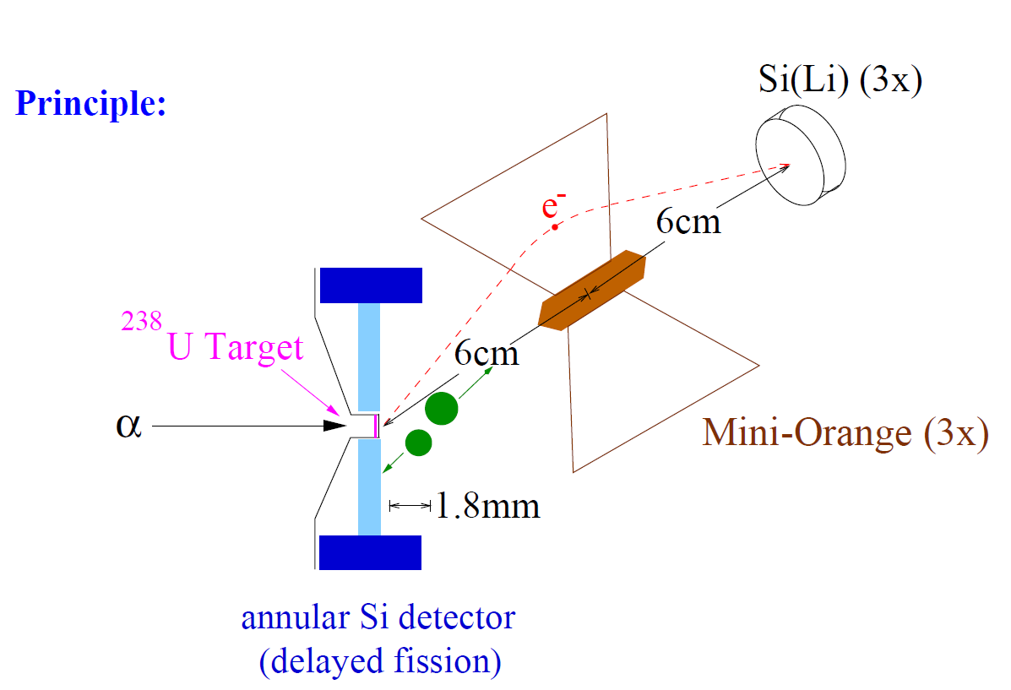
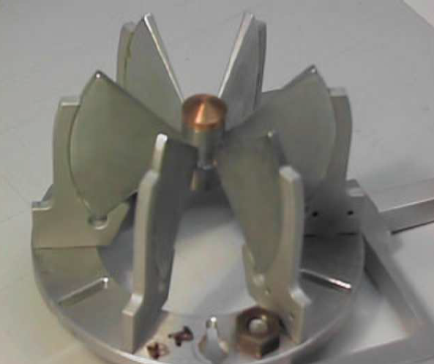
Mini Orange setup for conversion electron spectroscopy

Slide 28
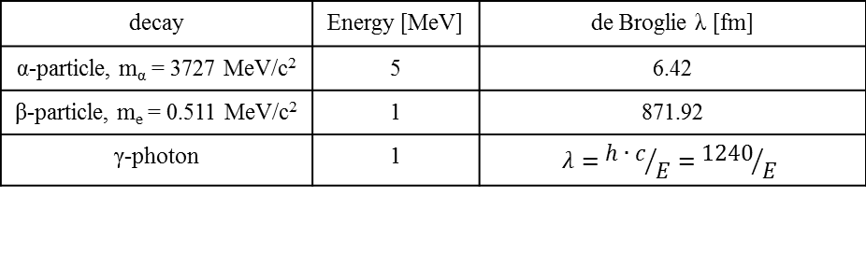

Comparison of α-decay, β-decay and γ-decay
de Broglie wavelength:
$$λ=\frac{h}{p}=\frac{h∙c}{\sqrt{E_{kin}∙\left(E_{kin}+2mc^{2}\right)}}=\frac{1239.84\left[MeV fm\right]}{\sqrt{E_{kin}∙\left(E_{kin}+2mc^{2}\right)}}$$
decay | Energy [MeV] | de Broglie λ [fm]
α-particle, m_{α} = 3727 MeV/c² | 5 | 6.42
β-particle, m_{e} = 0.511 MeV/c² | 1 | 871.92
γ-photon | 1 | $$λ={h∙c}/E={1240}/E$$
For α-particles this dimension is somewhat smaller than the nucleus and this is why a semi-classical treatment of α-decay is successful.
The typical β-particle has a large wavelength λ in comparison to the nuclear size and a quantum mechanical is dictated and wave analysis is called for.
For γ-decay the wavelength λ ranges from 12400 – 1240 fm (0.1 – 1 MeV). Clearly, only a quantum mechanical approach has a chance of success.

Slide 29
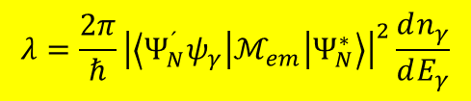
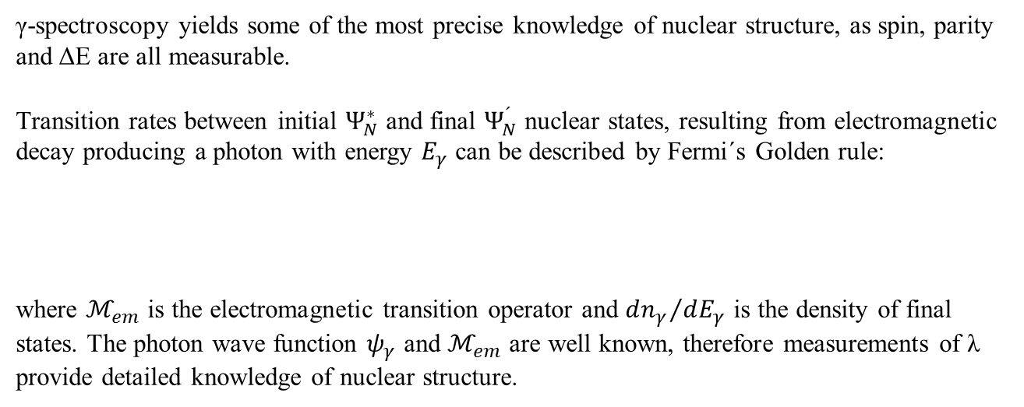
γ-decay
γ-spectroscopy yields some of the most precise knowledge of nuclear structure, as spin, parity and ΔE are all measurable.
Transition rates between initial $Ψ_{N}^{∗}$ and final $Ψ_{N}^{´}$ nuclear states, resulting from electromagnetic decay producing a photon with energy $E_{γ}$ can be described by Fermi´s Golden rule:
where $ℳ_{em}$ is the electromagnetic transition operator and ${dn_{γ}}/{dE_{γ}}$ is the density of final states. The photon wave function $ψ_{γ}$ and $ℳ_{em}$ are well known, therefore measurements of λ provide detailed knowledge of nuclear structure.
$$λ=\frac{2π}{ℏ}{\left|\left\langle Ψ_{N}^{´}ψ_{γ} | ℳ_{em} | Ψ_{N}^{∗}\right\rangle \right|}^{2}\frac{dn_{γ}}{dE_{γ}}$$
A γ-decay lifetime is typically 10⁻¹² [s] and sometimes even as short as 10⁻¹⁹ [s]. However, this time span is an eternity in the life of an excited nucleon. It takes about 4·10 ⁻²² [s] for a nucleon to cross the nucleus.

