Slide 1
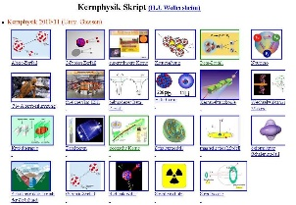
Outline: Doppler effect
Lecturer: Hans-Jürgen Wollersheim
e-mail: h.j.wollersheim@gsi.de
web-page: https://web-docs.gsi.de/~wolle/ and click on
special relativity
Lorentz transformation
Doppler effect and broadening
γ- and electron detection

Slide 2
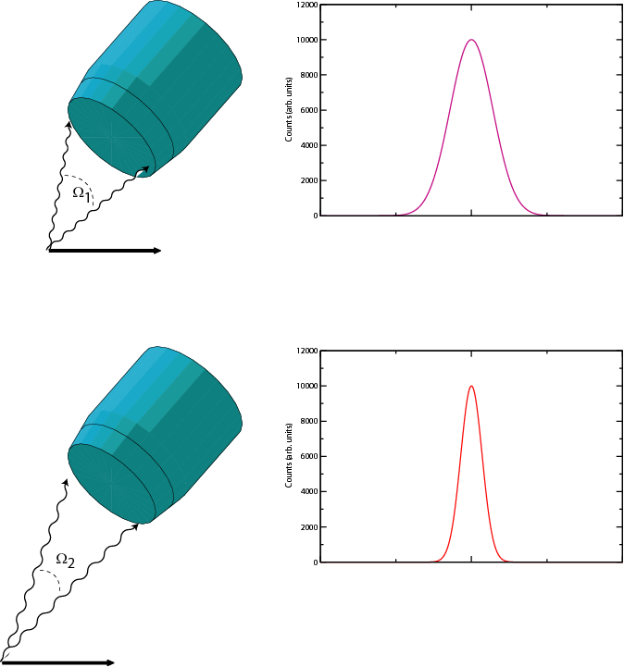
Efficiency versus resolution
With a source at rest, the intrinsic resolution of the detector can be reached;
efficiency decreases with the increasing detector-source distance.
With a moving source also the effective energy resolution depends on the detector-source distance (Doppler effect)
Small d Large d
Large Ω Small Ω
High ε Low ε
Poor FWHM Good FWHM

Slide 3
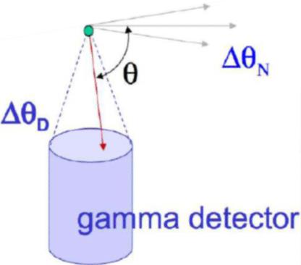
Energy resolution
The major factors affecting the final energy resolution (FWHM) at a particular energy are as follows:
$$ΔE_{γ}^{final}={\left(ΔE_{Int}^{2}+Δθ_{det}^{2}+Δθ_{N}^{2}+Δv^{2}\right)}^{1/2}$$
$$v±∆v$$
$ΔE_{Int} −$The intrinsic resolution of the detector system.
It includes contributions from the detector itself and
the electronic components used to process the signal.
$$Δθ_{N}$$
$$Δθ_{det}$$
$Δθ_{det} −$The Doppler broadening arising from the opening angle of
the detectors
$Δθ_{N} −$The Doppler broadening arising from the angular spread of the
recoils in the target
$Δv −$ The Doppler broadening arising from the velocity (energy)
variation of the excited nucleus

Slide 4
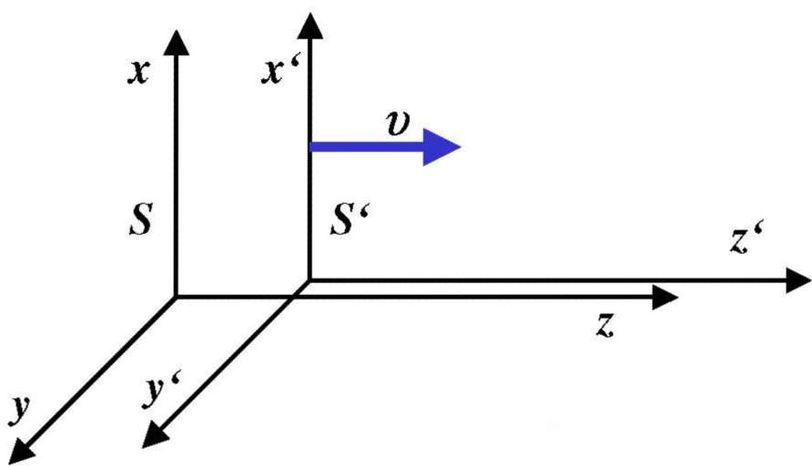
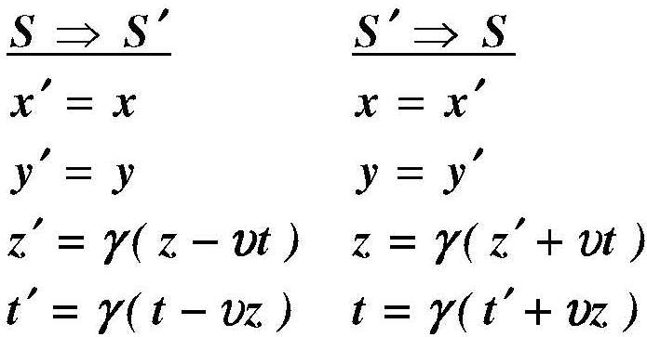
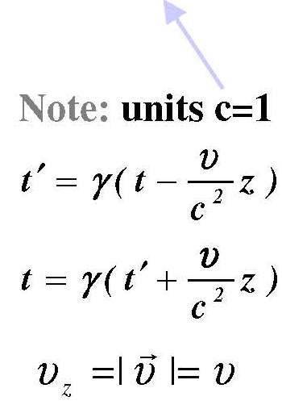
Special relativity
Lorentz transformation:

Slide 5
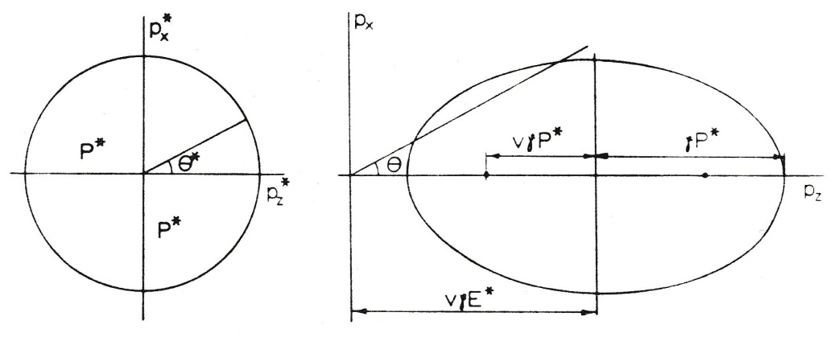
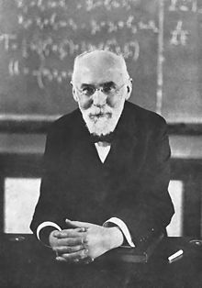
Lorentz transformation
P* = const.
total energy:
$$E^{∗}=γ∙E−γ∙v∙P∙cosθ$$
with
$$E=\sqrt{{\left(mc^{2}\right)}^{2}+{\left(Pc\right)}^{2}}$$
rest system
laboratory system
E*, P* total energy and momentum in the rest system
E, P total energy and momentum in the laboratory system
Doppler formula for zero-mass particle (photon): E=Pc
$$E^{∗}=γ∙E−γ∙β∙E∙cosθ$$
$$E^{∗}=γ∙E\left(1−β∙cosθ\right)$$
Hendrik Lorentz
E. Byckling, K. Kajantie J. Wiley & Sons London

Slide 6
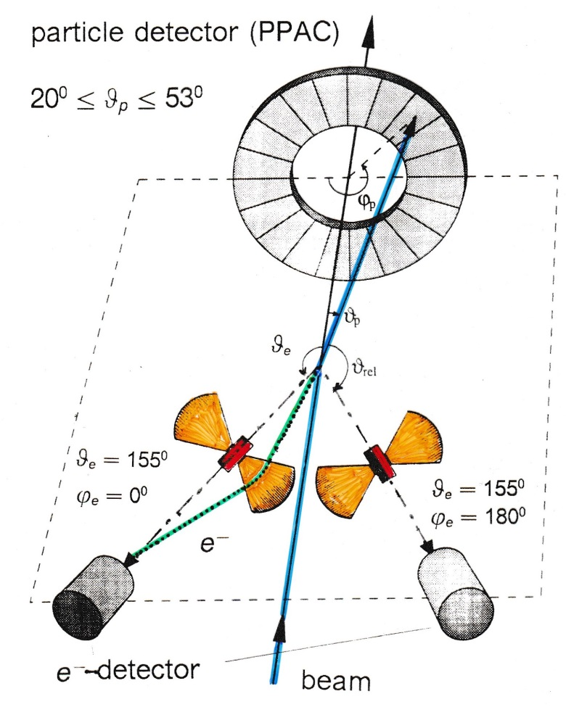
Electron detection
Doppler broadening
Δϑ_{e} = 20⁰
target – Mini-Orange: 19 cm
Mini-Orange – Si detector: 6 cm
For projectile excitation:
$$T_{e}^{∗}=γ∙T_{e}∙\left\{1−β_{1}∙\sqrt{1+2m_{e}{c^{2}}/{T_{e}}}∙cosθ_{e1}\right\}+m_{e}c^{2}∙\left(γ−1\right)$$
with
$$cosθ_{e1}=cosθ_{1}cosθ_{e}+sinθ_{1}sinθ_{e}cos\left(φ_{e}−φ_{1}\right)$$

Slide 7
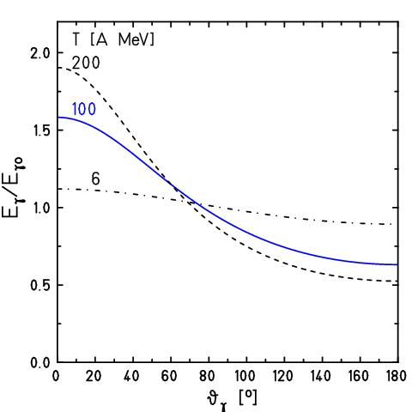
Doppler effect
for

Slide 8
Doppler broadening and position resolution
Position resolution
γ ray
Angular resolution
beam
projectile
Energy resolution

Slide 9
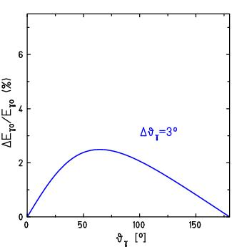
Doppler broadening (opening angle of detector)
for
with

Slide 10
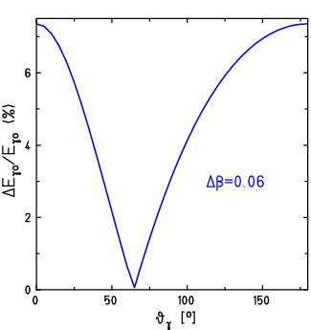
Doppler broadening (velocity variation)
for
with

Slide 11
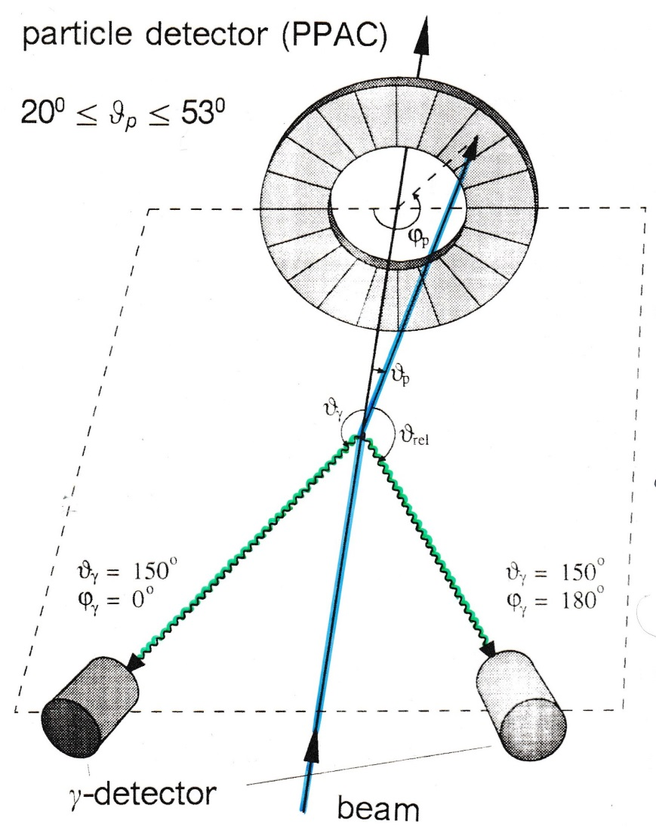
Experimental arrangement
experimental problem:
Doppler broadening due to finite size of Ge-detector
$$\frac{∆E}{E}\sim 1\%$$
for
$$∆θ_{γ}={20}^{0} β_{1}≅10\%$$
For projectile excitation:
$$E^{∗}=γ∙E∙\left(1−β_{1}∙cosθ_{γ1}\right)$$
Doppler shift
with
$$cosθ_{γ1}=cosθ_{1}cosθ_{γ}+sinθ_{1}sinθ_{γ}cos\left(φ_{γ}−φ_{1}\right)$$
$$ΔE≅E^{∗}∙β_{1}∙sinθ_{γ1}∙∆θ_{γ1}$$
Doppler broadening

Slide 12
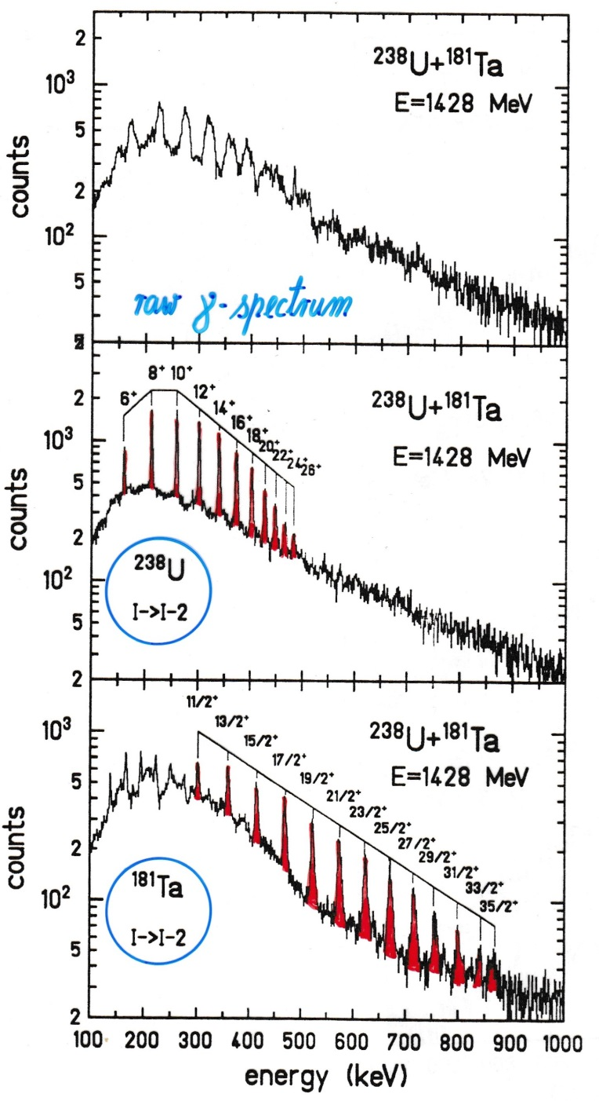
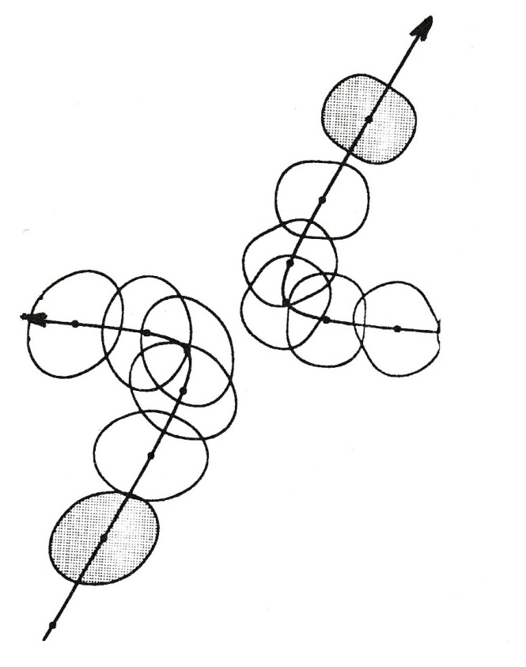
Example: inelastic heavy-ion scattering
¹⁸¹Ta
raw γ-ray spectrum
²³⁸U

Slide 13
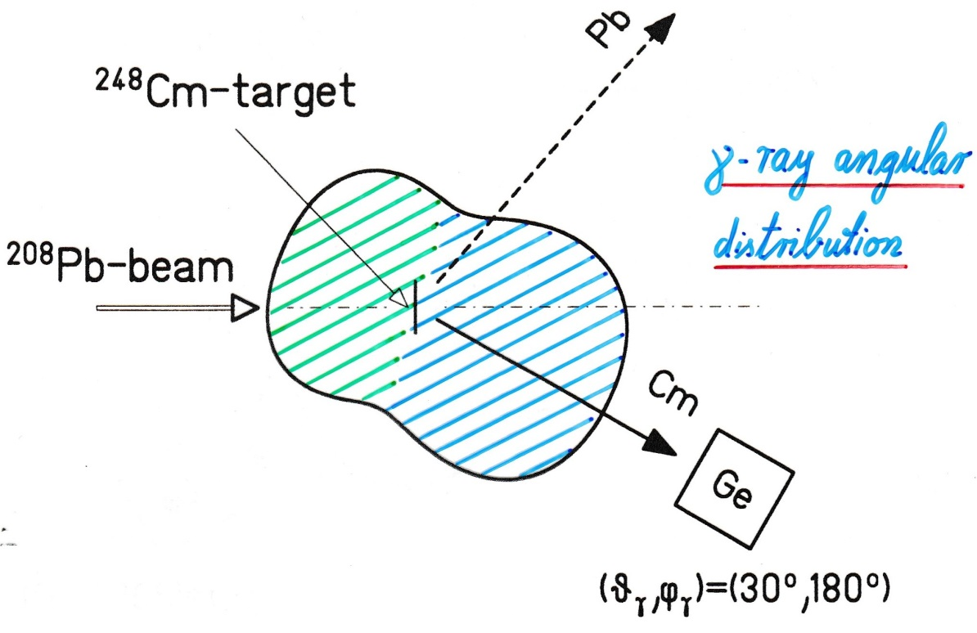
Lorentz transformation
γ-ray angular distribution
Contraction of the solid angle element in the laboratory system
$$\frac{dΩ}{dΩ^{∗}}={\left\{\frac{E^{∗}}{E}\right\}}^{2}$$
with
$$E^{∗}=γ∙E∙\left(1−β∙cosθ\right)$$
Doppler formula

Slide 14
Experimental arrangement (electron detection)
Doppler broadening
Δϑ_{e} = 20⁰
target – Mini-Orange: 19 cm
Mini-Orange – Si detector: 6 cm
For projectile excitation:
$$T_{e}^{∗}=γ∙T_{e}∙\left\{1−β_{1}∙\sqrt{1+2m_{e}{c^{2}}/{T_{e}}}∙cosθ_{e1}\right\}+m_{e}c^{2}∙\left(γ−1\right)$$
with
$$cosθ_{e1}=cosθ_{1}cosθ_{e}+sinθ_{1}sinθ_{e}cos\left(φ_{e}−φ_{1}\right)$$

Slide 15
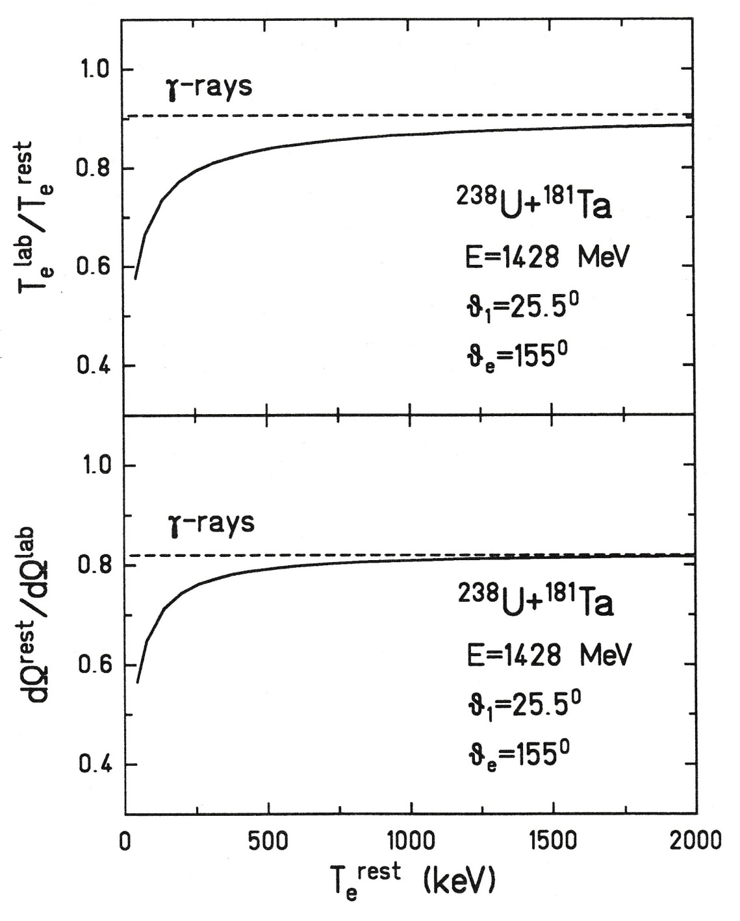
Lorentz transformation
γ-rays
10%
energy shift
γ-rays
20%
solid angle contraction

Slide 16
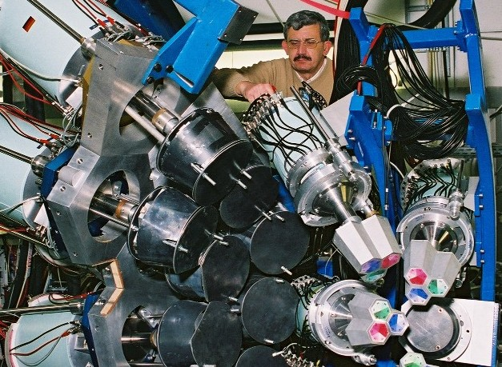
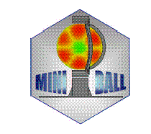
Segmented detectors
70cm
target
beam
20cm

Slide 17
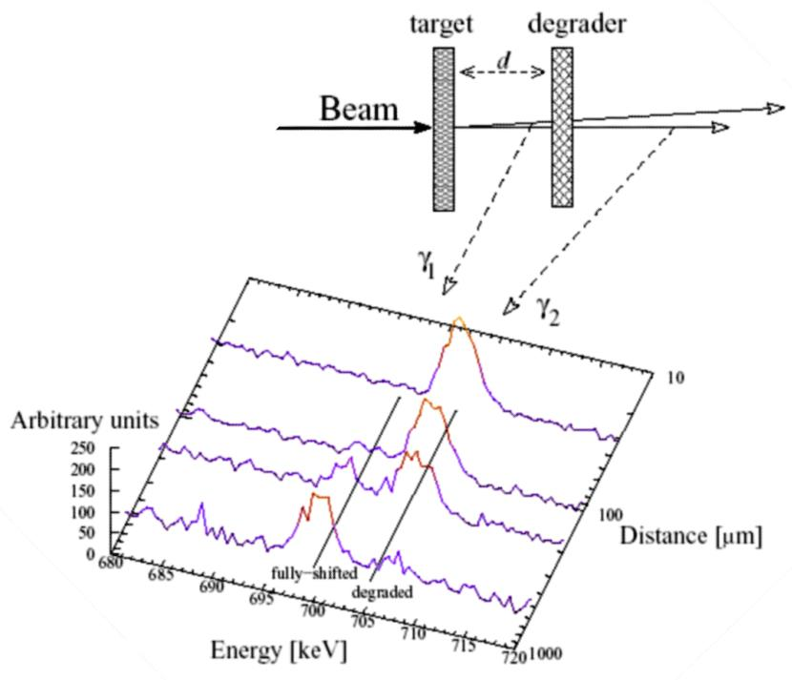
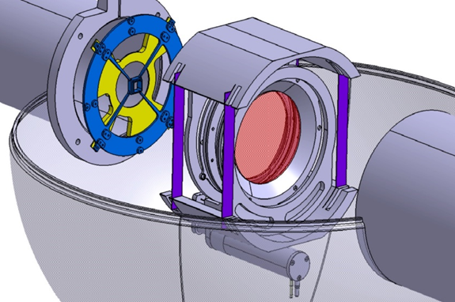
Recoil distance method
$$I_{degraded}=I∙e^{−d/{vτ}}$$
$$I_{shifted}=\left(1−e^{−d/{vτ}}\right)$$
$$\frac{I_{degraded}}{I_{degraded}+I_{shifted}}=e^{−d/{vτ}}$$

Slide 18
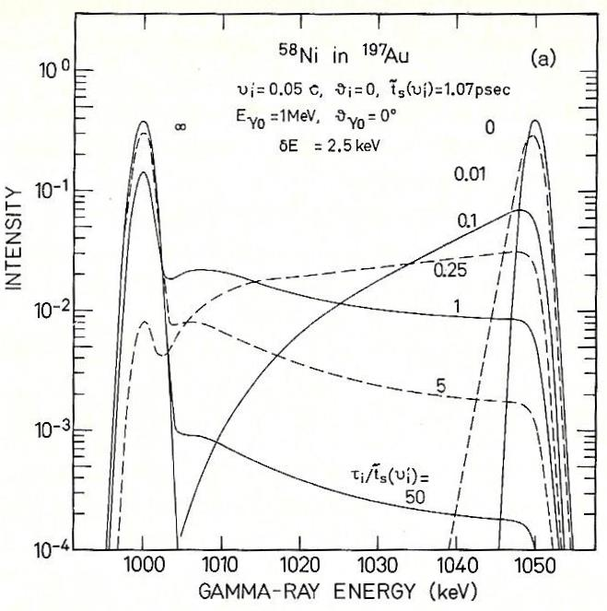
Doppler Shift Attenuation Method
target
stopper
beam
Germanium
detector

Slide 19
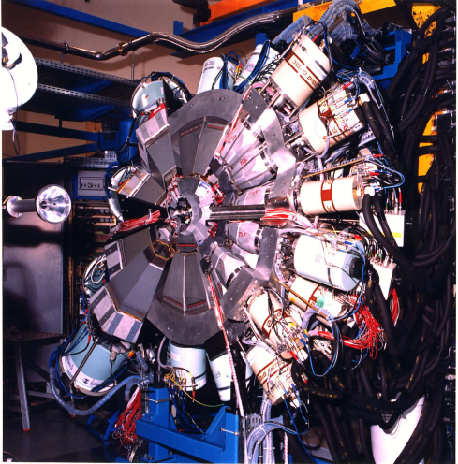
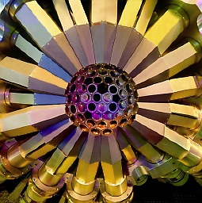
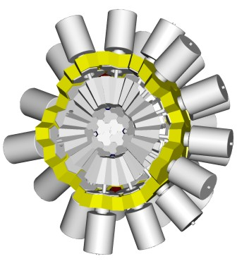
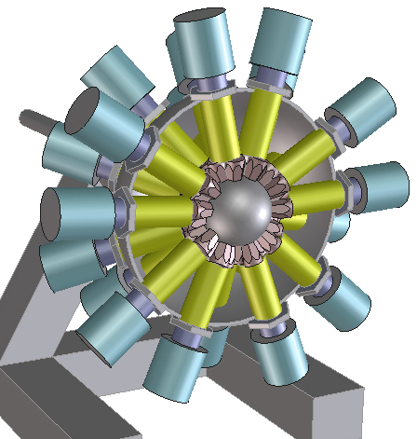
Gamma-ray tracking
Gamma Arrays based on Compton Suppressed Spectrometers
Tracking Arrays based on
Position Sensitive Ge Detectors
EUROBALL
GAMMASPHERE
AGATA
GRETA
ε ~ 10 - 7 %
( M_{γ} = 1 – M_{γ} = 30)
ε ~ 50 - 25 %
( M_{γ} = 1 - M_{γ} = 30)

