Slide 1
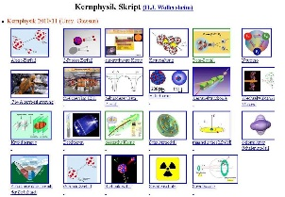
Outline: spin and parity
Lecturer: Hans-Jürgen Wollersheim
e-mail: h.j.wollersheim@gsi.de
web-page: https://web-docs.gsi.de/~wolle/ and click on
basics
angular correlation and distribution
linear polarization

Slide 2
Spins and parities
Two distinct types of measurements:
Angular correlation : can be done with a non-aligned source but need γ-γ coincidence information.
Angular distribution: need an aligned source but can be done with singles data.
...note that these cannot measure parity but you can usually infer something about the transition

Slide 3
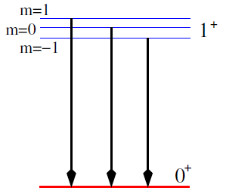
The basics of the situation
Imagine the situation of an M1 decay between two states, the initial one has J^{π} value of 1⁺ and the final one a J^{π} of 0⁺
The initial J^{π}=1⁺ state has 3 degenerate magnetic substates which differ by the magnetic quantum numbers m of $±1$ and 0.
The final J^{π}=0⁺ state has a single magnetic substate with m=0.
When the substates of J^{π}=1⁺ state decay, the γ-rays emitted have different angular patterns.

Slide 4
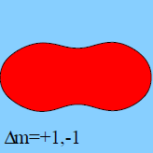
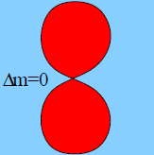
The basics of the situation
For the M1 case the angular distributions W(θ) are:
$$W_{M1, Δm=1}\left(θ\right)=\frac{3}{16π}\left(1+\cos^{2}θ\right)$$
$$W_{M1,Δm=0}\left(θ\right)=\frac{3}{8π}\sin^{2}θ$$
$$W_{M1,Δm=−1}\left(θ\right)=\frac{3}{16π}\left(1+\cos^{2}θ\right)$$
So the total distribution is $W_{M1}=\frac{1}{3}W_{M1,Δm=1}+\frac{1}{3}W_{M1,Δm=0}+\frac{1}{3}W_{M1,Δm=−1}$
$$=\frac{1}{8π}\left(1+\cos^{2}θ+\sin^{2}θ\right)=\frac{1}{4π}$$
no angular dependence

Slide 5
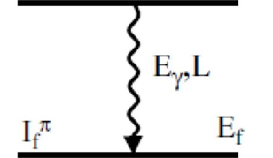
Angular correlation – non-oriented source
Let’s imagine we have two γ-rays which follow immediately after each other in the level scheme.
$$γ_{1}$$
E1
If we measure γ₁ or γ₂ in singles, then the distribution will be isotropic (same intensity at all angles) ... there is no preferred direction of emission
$$γ_{2}$$
Now imagine that we measure γ₁ and γ₂ in coincidence. We say that measuring γ₁ causes the intermediate state to be aligned. We define the z-direction as the direction of γ₁
The angular distribution of the emission of γ₂ then depends on the spin/parities of the states involved and on the multipolarity of the transition.

Slide 6
A simple example:
0⁺
$$J^{π}=0^{+}, m=0$$
$$γ_{1}$$
E1
1⁺
$$J^{π}=1^{+}, m=0, m=±1$$
$$γ_{2}$$
0⁺
$$J^{π}=0^{+}, m=0$$
Hence, for γ₂ we only see the m = ±1 to m = 0 part of the distribution i.e. we see that the intensity measured as a function of angle (relative to γ₁) follows a $1+\cos^{2}θ$ distribution.

Slide 7
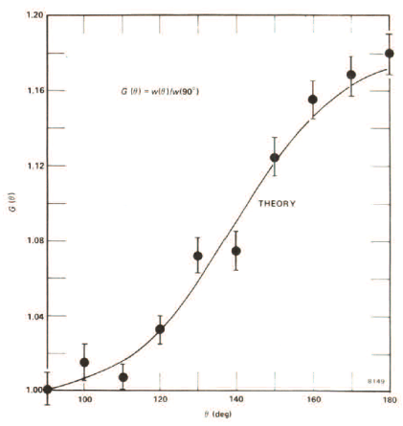
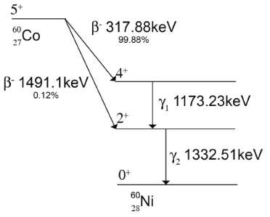
General formula
J₁
In general, the γ-ray intensity varies as:
$$γ_{1}$$
E1
$$W\left(θ\right)=\sum_{k_{even}}{A_{k}\left(γ_{1}\right)A_{k}\left(γ_{2}\right)Q_{k}\left(γ_{1}\right)Q_{k}\left(γ_{2}\right)P_{k}\left(cosθ\right)}$$
J₂
$$γ_{2}$$
where
θ is the relative angle between the two γ-rays
Q_{k} accounts for the fact that we do not have point detectors
A_{k} depends on the details of the transition and the spins of the level
J₃
$$P_{0}=1 P_{2}=\frac{1}{2}\left(3∙\cos^{2}\left(θ\right)−1\right) P_{4}=\frac{1}{8}\left(35\cos^{4}\left(θ\right)−30\cos^{2}\left(θ\right)+3\right)$$
I₁ (ℓ₁) | I₂ (ℓ₂) | I₃ | a₂ | a₄
0 (1) | 1 (1) | 0 | 1 | 0
1 (1) | 1 (1) | 0 | -1/3 | 0
1 (2) | 1 (1) | 0 | -1/3 | 0
2 (1) | 1 (1) | 0 | 1/13 | 0
3 (2) | 1 (1) | 0 | -3/29 | 0
0 (2) | 2 (2) | 0 | -3 | 4
1 (1) | 2 (2) | 0 | -1/3 | 0
2 (1) | 2 (2) | 0 | 3/7 | 0
2 (2) | 2 (2) | 0 | -15/13 | 16/13
3 (2) | 2 (2) | 0 | -3/29 | 0
4 (2) | 2 (2) | 0 | 1/8 | 1/24
$$W\left(θ\right)=1+a_{2}\cos^{2}θ+a_{4}\cos^{4}θ$$
R.D. Evans, The Atomic Nucleus

Slide 8
General formula
J₁
In general, the γ-ray intensity varies as:
$$γ_{1}$$
$$W\left(θ\right)=\sum_{k_{even}}{A_{k}\left(γ_{1}\right)A_{k}\left(γ_{2}\right)Q_{k}\left(γ_{1}\right)Q_{k}\left(γ_{2}\right)P_{k}\left(cosθ\right)}$$
E1
J₂
$$γ_{2}$$
where
θ is the relative angle between the two γ-rays
Q_{k} accounts for the fact that we do not have point detectors
A_{k} depends on the details of the transition and the spins of the level
J₃
$$P_{0}=1 P_{2}=\frac{1}{2}\left(3∙\cos^{2}\left(θ\right)−1\right) P_{4}=\frac{1}{8}\left(35\cos^{4}\left(θ\right)−30\cos^{2}\left(θ\right)+3\right)$$
$$A_{k}\left(γ_{1}\right)=\frac{F_{k}\left(J_{2}J_{1}ℓ,ℓ\right)−2∙δ{∙F}_{k}\left(J_{2}J_{1}ℓ,ℓ+1\right)+δ^{2}{∙F}_{k}\left(J_{2}J_{1}ℓ+1,ℓ+1\right)}{1+δ^{2}}$$
$$A_{k}\left(γ_{2}\right)=\frac{F_{k}\left(J_{2}J_{3}L,L\right)−2∙δ{∙F}_{k}\left(J_{2}J_{3}L,L+1\right)+δ^{2}{∙F}_{k}\left(J_{2}J_{3}L+1,L+1\right)}{1+δ^{2}}$$
Ferentz-Rosenzweig coefficients
$$F_{k}\left(LL′I_{1}I_{2}\right)={\left(−1\right)}^{I_{1}+I_{2}+1}\sqrt{2k+1}\sqrt{2L+1}\sqrt{2L^{′}+1}\sqrt{2I_{2}+1}\left(\begin{matrix}L & L′ & k \\ 1 & −1 & 0\end{matrix}\right)\left\{\begin{matrix}L & L′ & k \\ I_{1} & I_{1} & I_{2}\end{matrix}\right\}$$
https://griffincollaboration.github.io/AngularCorrelationUtility/

Slide 9
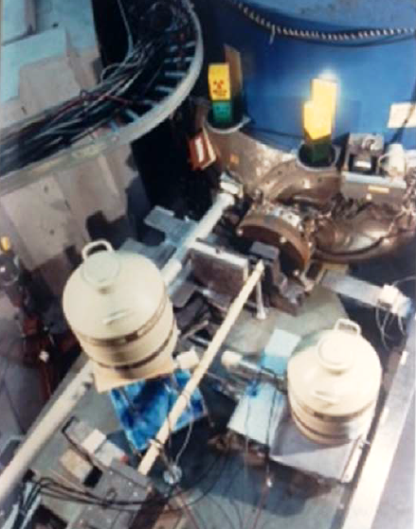
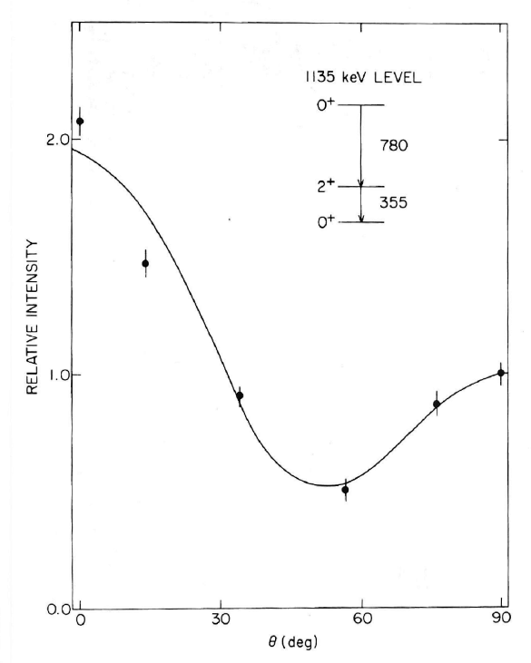
A special case:
$${}_{78}^{195}{Pt}\left(n,γ\right){}_{78}^{196}{Pt}$$

Slide 10
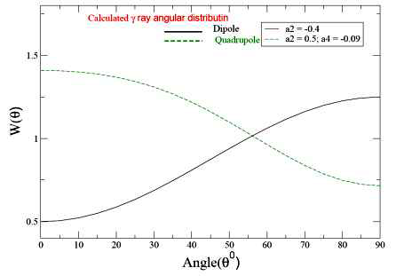
Angular correlations with arrays
Many arrays are designed symmetrically, so the range of possible angles is reduced.
Therefore one measures a Directional Correlation from Oriented Nuclei (DCO ratio)
In the simplest case, if you have an array with detectors at 35⁰ and 90⁰.
Gate on 90⁰ detector, measure coincident intensities in
other 90⁰ detectors
35⁰ detectors
Take the ratio and compare with calculations ... can usually separate quadrupoles from dipoles but cannot measure mixing ratios

Slide 11
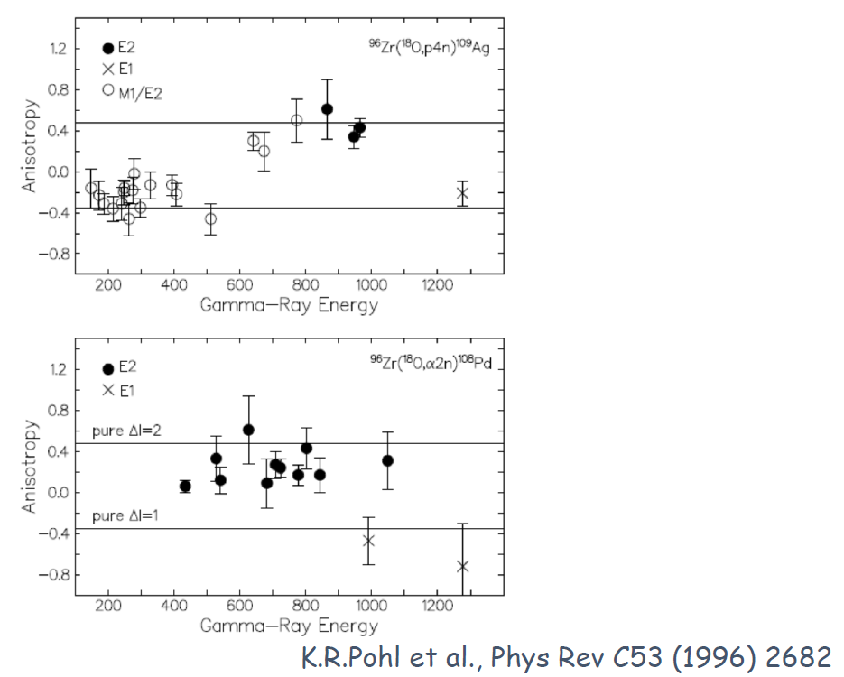
Angular correlations with arrays

Slide 12
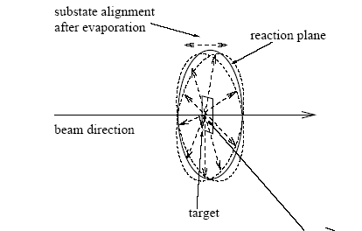
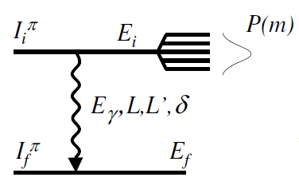
Angular distribution
In heavy-ion fusion-evaporation reactions, the compound nuclei have their spin aligned in a plane perpendicular to the beam axis:
$$\vec{ℓ}=\vec{r}×\vec{p}$$
Depending on the number and type of particles ‘boiled off’ before a γ-ray is emitted, transitions are emitted from oriented nuclei and therefore their intensity shows an angular dependence.
$$W\left(θ\right)=A_{0}\left(1+\frac{A_{2}}{A_{0}}∙B_{2}{∙Q_{2}∙P}_{2}\left(cosθ\right)+\frac{A_{4}}{A_{0}}{∙B}_{4}∙Q_{4}∙P_{4}\left(cosθ\right)\right)$$
where A_{k}, Q_{k} and P_{k} are as before and B_{k} contains information about the alignment of the state
$$P\left(m\right)=\frac{exp\left(−\frac{m^{2}}{2σ^{2}}\right)}{\sum_{m^{′}=−I}^{+I}{exp\left(−\frac{{m′}^{2}}{2σ^{2}}\right)}}$$
$$B_{k}\left(I_{i}\right)=\sqrt{2I_{i}+1}\sum_{m=−I}^{+I}{{\left(−1\right)}^{I_{i}−m}\left\langle I_{i}mI_{i}−m | k0\right\rangle P\left(m\right)}$$

Slide 13
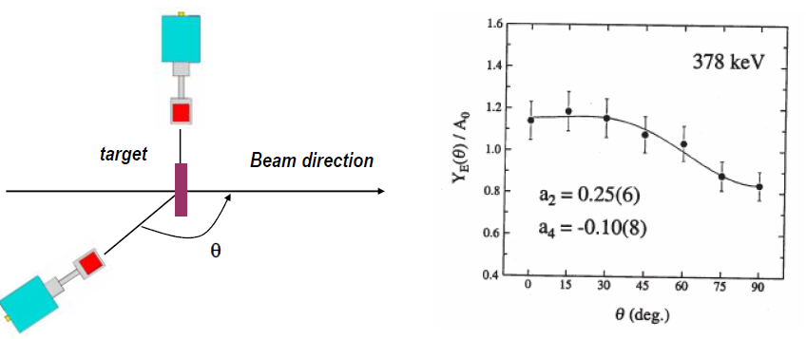
Angular distribution
Measure: the γ-ray yield as a function of θ

Slide 14
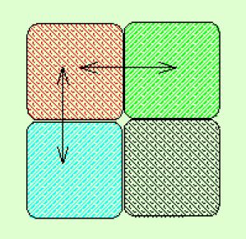
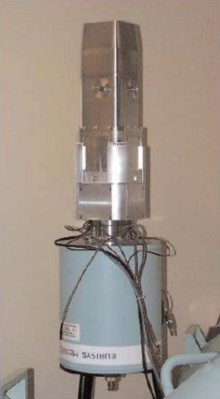
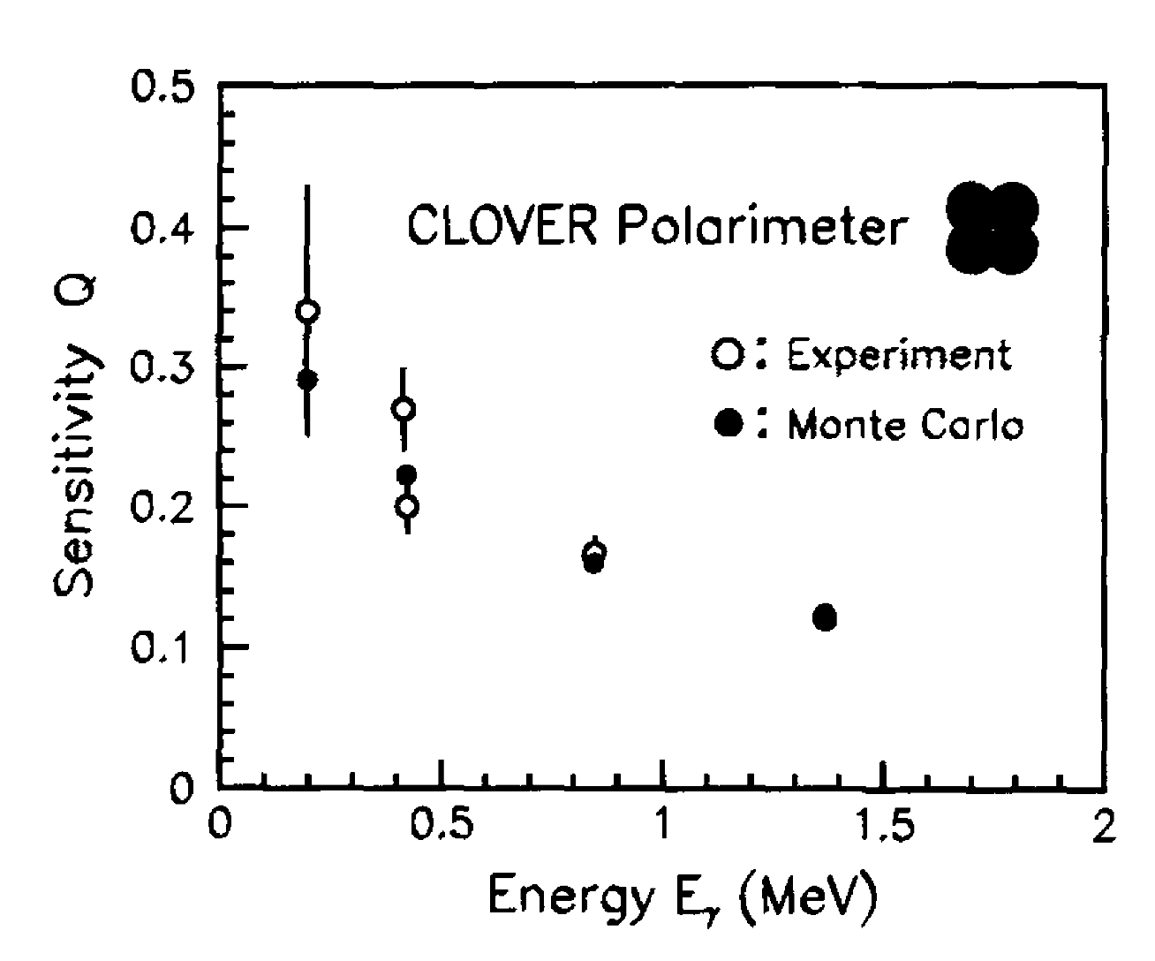
Linear polarization
A segmented detector can be used to measure the linear polarization which can be used to distinguish between magnetic (M) and electric (E) character of radiation of the same multipolarity.
The Compton scattering cross section is larger in the direction perpendicular to the electrical field vector of the radiation.
Define experimental asymmetry as: $A=\frac{N_{90}−N_{0}}{N_{90}+N_{0}}$
where N₉₀ and N₀ are the intensities of scattered photons perpendicular and parallel to the reaction plane.
The experimental linear polarization P=A/Q where Q is the polarization sensitivity of the detector
Q ~ 13% at 1 MeV

Slide 15
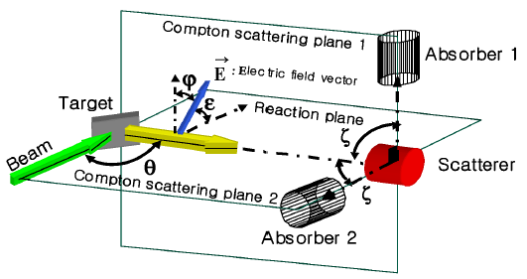
Linear polarization
Klein-Nishina formula:
$$\frac{dσ_{c}}{dΩ}=\frac{r_{0}^{2}}{2}{\left(\frac{E_{γ′}}{E_{γ}}\right)}^{2}∙\left\{\frac{E_{γ}}{E_{γ′}}+\frac{E_{γ′}}{E_{γ}}−2\sin^{2}θ∙\cos^{2}φ\right\}$$
Maximum polarization at θ=90⁰

Slide 16
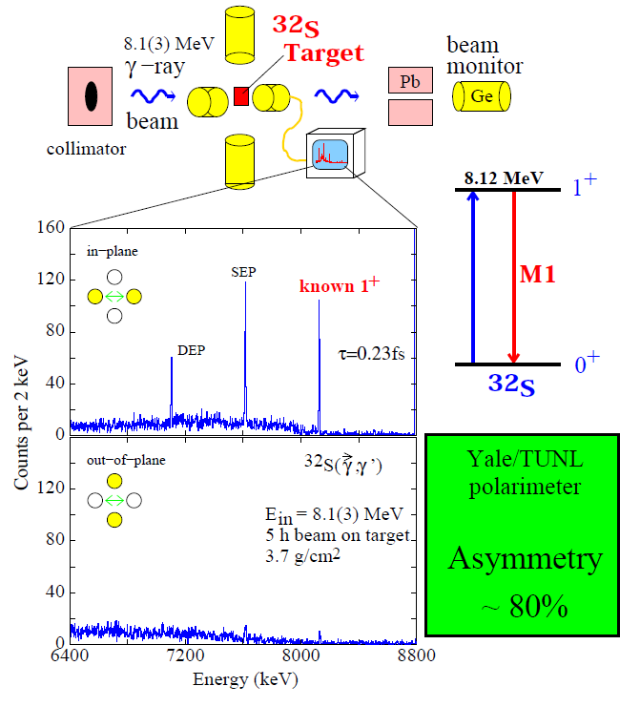
Proof of Principle
N. Pietralla, Nucl. Instr. Meth. A483, 556 (2002)

Slide 17
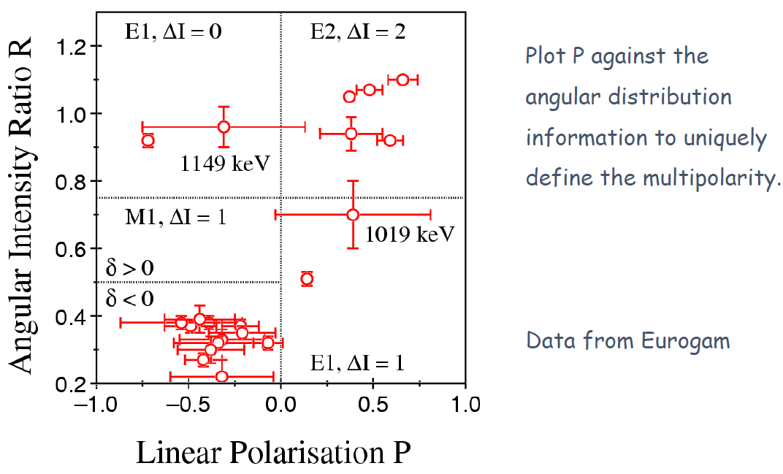
Linear polarization

Slide 18
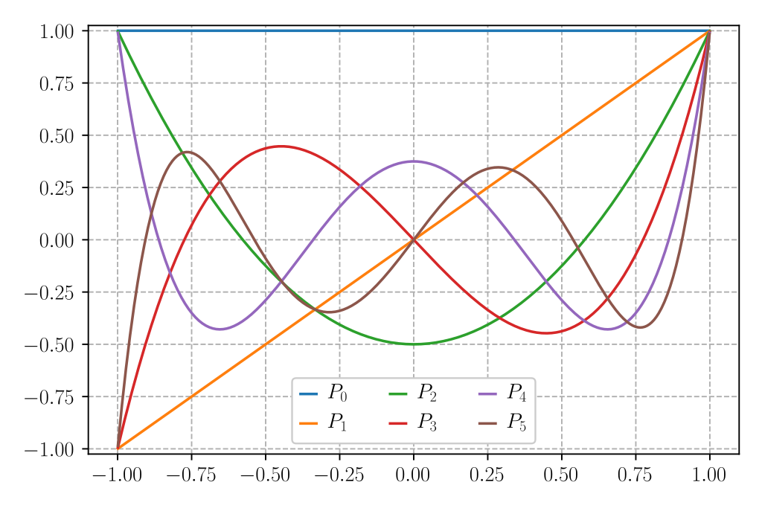
Appendix: Legendre polynomials
$$P_{0}\left(cosθ\right)=1$$
$$P_{1}\left(cosθ\right)=cosθ$$
$$P_{2}\left(cosθ\right)=\frac{1}{2}\left(3\cos^{2}θ−1\right)$$
$$P_{3}\left(cosθ\right)=\frac{1}{2}\left(5\cos^{3}θ−3cosθ\right)$$
$$P_{4}\left(cosθ\right)=\frac{1}{8}\left(35\cos^{4}θ−30\cos^{2}θ+3\right)$$
$$P_{5}\left(cosθ\right)=\frac{1}{8}\left(63\cos^{5}θ−70\cos^{3}θ+15cosθ\right)$$
$$P_{6}\left(cosθ\right)=\frac{1}{16}\left(231\cos^{6}θ−315\cos^{4}θ+105\cos^{2}θ−5\right)$$

