Slide 1

Outline: From Ge(Li) to Germanium detector array
Lecturer: Hans-Jürgen Wollersheim
e-mail: h.j.wollersheim@gsi.de
web-page: https://web-docs.gsi.de/~wolle/ and click on
1960ties and 70ties: Ge(Li) detectors
1980ties: national HPGe detector arrays OSIRIS, HERA, TESSA
1990ties: EUROBALL and GAMMASPHERE
2000ties: position-sensitive Ge-arrays MINIBALL, EXOGAM, SEGA
under development: 4π γ-ray tracking arrays AGATA, GRETA

Slide 2
Phys. Rev. 74 (1948) 100
Invention of the NaI(Tl) detector 1948
(α,xn)
H. Morinaga, P.C. Gugelot Nucl. Phys. 46 (1963) 210
Robert Hofstadter, after hearing about Callmann‘s work, started testing Tl activated alkali halide crystals. Na(Tl) was found to have the largest output

Slide 3
Germanium transistor
1947
by
William Shockley,
John Bardeen and
Walter Brattain
(left to right)

Slide 4
Early semiconductor devices
first transistor (Bell 1947)
hybrid circuits (1960)
first integrated circuit (1959)
Fairchild IC (1962)

Slide 5
E. M. Pell 1960
p-type bulk material layer
Li-drifted n⁺ layer
Li-drift in p-type Si

Slide 6
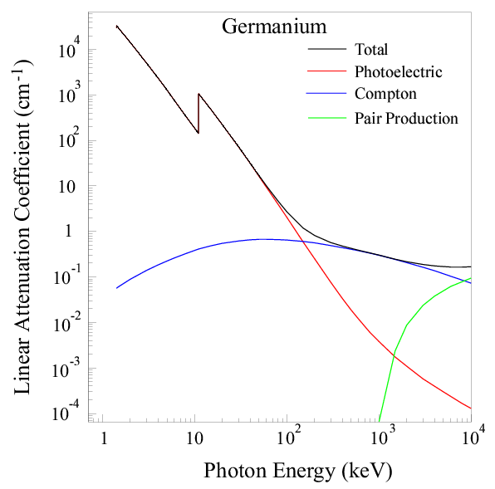
Gamma-ray interaction cross section
100 keV – 2 MeV
is typical γ-ray energy range in nuclear science.
Compton scattering is dominant (in Ge)!
Photo effect: ~Z⁴⁻⁵, E_{γ}^{-3.5}
Compton: ~Z, E_{γ}⁻¹
Pair: ~Z², increases with E_{γ}

Slide 7

First Ge(Li) detector: D.V. Freck and J. Wakefield
Nature 193, 669 (1962)
Milestone 1
Ge(Li) detector, active volume: 0.2 cm³
$$∆E=21 keV$$
661.6 keV

Slide 8
1963 Tavendale and Ewan (Chalk River)
Ge(Li) detector, planar: 2 cm³
ΔE = 6 keV at 1.3 MeV
use of a cooled FET reduced input noise to 0.7 eV (1965)

Slide 9
Li-drift apparatus at IKP Cologne
First coaxial detector 1968 ΔE = 3.5 keV at 1.3 MeV 5.5 cm³

Slide 10
The 1970ties
γ-spectroscopy with Ge(Li) detector
10 – 15 % rel. efficiency (Vol. 50-70 cm³)
resolution 1.9 – 2.3 keV at 1.3 MeV

Slide 11
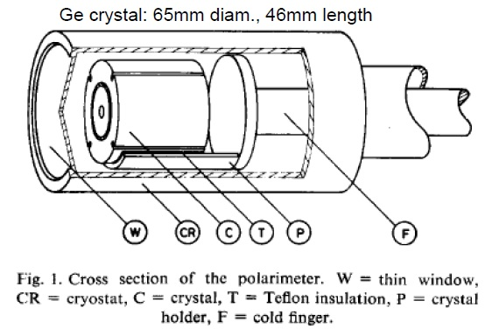
The “five-in-one“ Compton polarimeter (1974)
two concentric coaxial Ge(Li) detectors, outer detector 4-fold segmented
energy resolution 3.5 – 5 keV at 1.3 MeV

Slide 12
Composite Ge-detectors
3(4) Ge(Li) detectors
in a common cryostat
1976
resolution 2.1 keV at 1.3 MeV
for 3 but not for 4 detectors

Slide 13
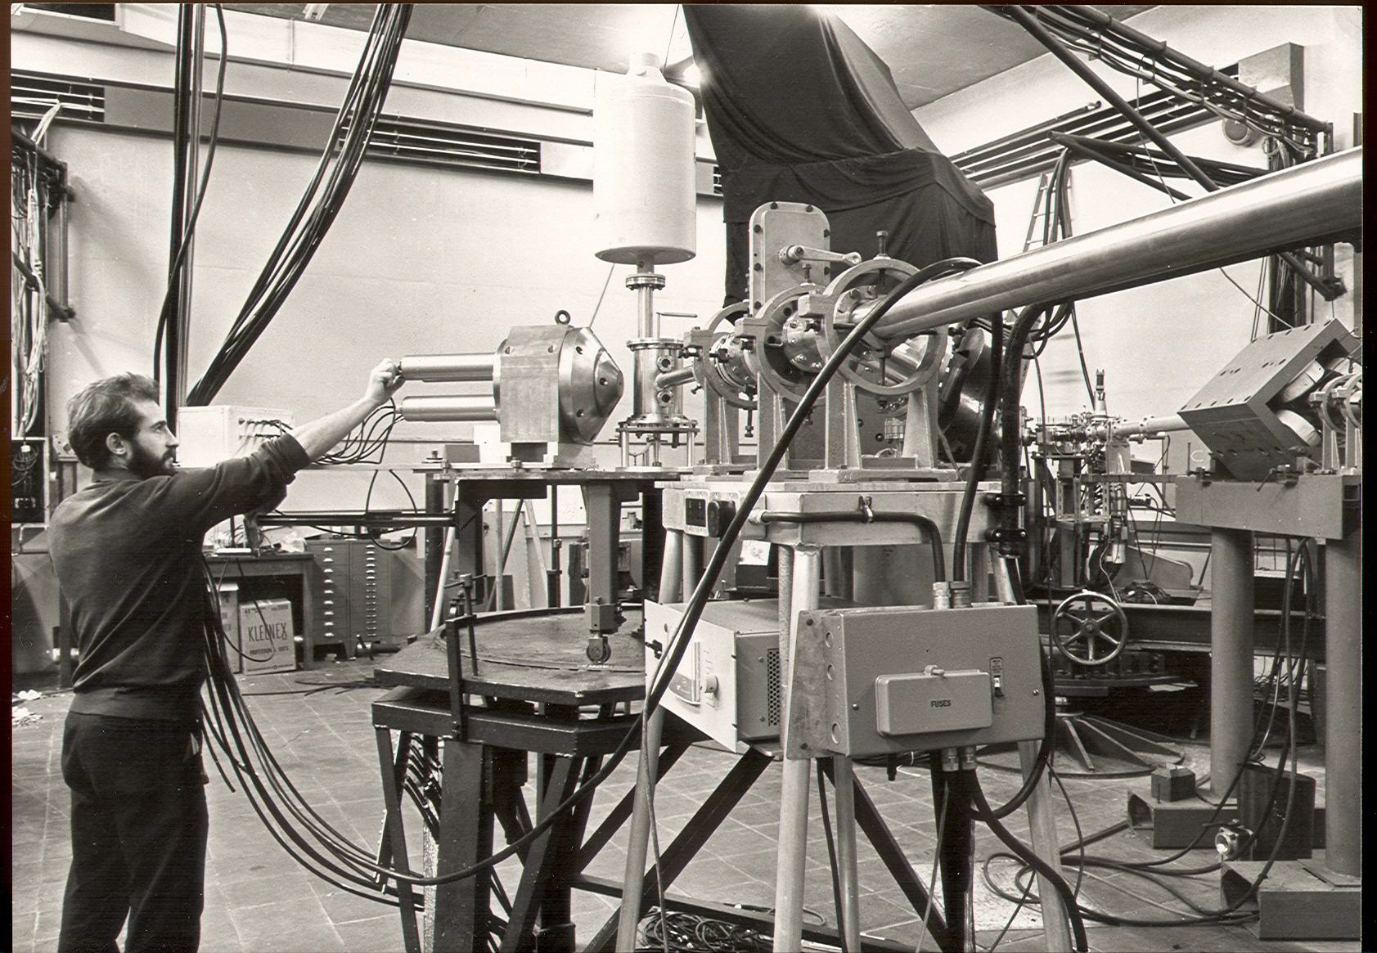
First escape suppression spectrometer at Liverpool
John Francis Sharpey-Schafer

Slide 14
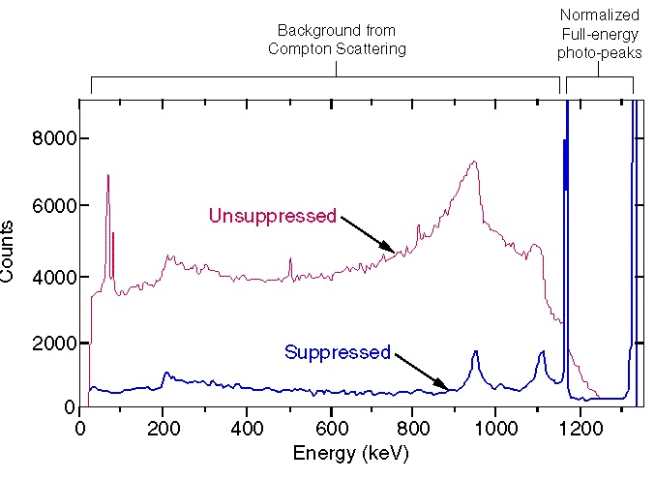
The scattering problem
High background hence suppression shield
High efficiency hence arrays of Escape Suppressed Spectrometer

Slide 15
Arrays of Escape Suppressed Spectrometers
TESSA0 the Escape Suppressed Spectrometer Array
The first one TESSA
Daresbury study weekend 1979
nuclei far from stability
UK Denmark collaboration
Niels Bohr Institute 1980-1982
FN tandem
5 Ge(Li), 5 NaI(Tl) suppression shields
γ² factor of 8 improvement in ph. ph.
coincidences
no channel selection
TESSA1 14 element multiplicity filter

Slide 16
TESSA0 the Escape Suppressed Spectrometer Array

Slide 17
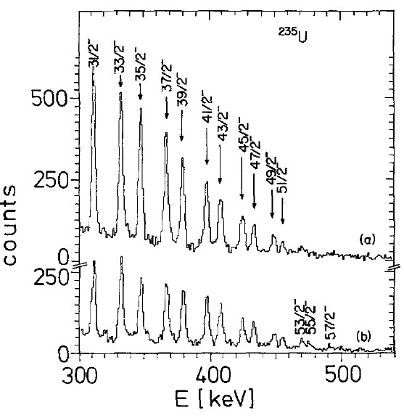
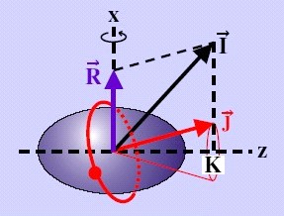
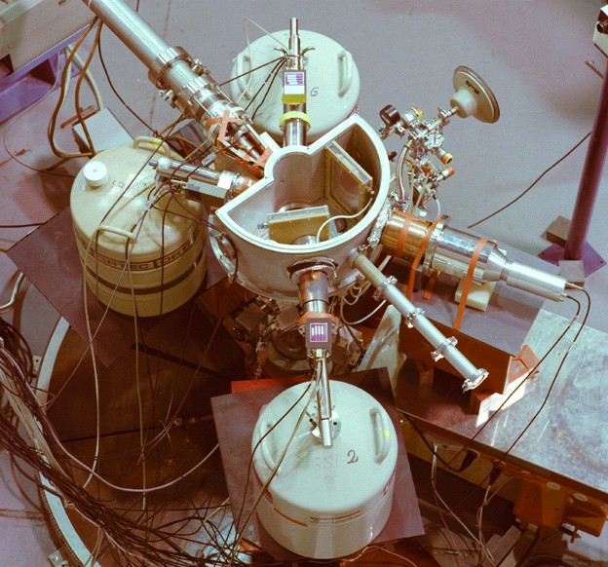
First Coulomb excitation experiments at UNILAC (1980)
²⁰⁸Pb (5.3MeV/u) → ²³⁵U
Doppler-corrected γ-ray spectrum for ²³⁵U
i_{13/2} proton and j_{15/2} neutron alignment in ²³⁵U and ²³⁷Np

Slide 18
TESSA3, NORDBALL, 8π Spectrometer
~ 1987
HERA at LBNL
BGO replaces NaI(Tl)
1 cm ≈ 1 inch
HERA (LBNL)
21 ESS (25% eff.) + BGO ball
γ-γ-γ coincidences

Slide 19
TESSA3

Slide 20
Development of high-purity Ge at LBNL, Ortec, Umicore …
Milestone 2
Production of Ge(li) detectors was abandoned after 1978 when high-purity Ge (HPGe) detectors became commercially available

Slide 21
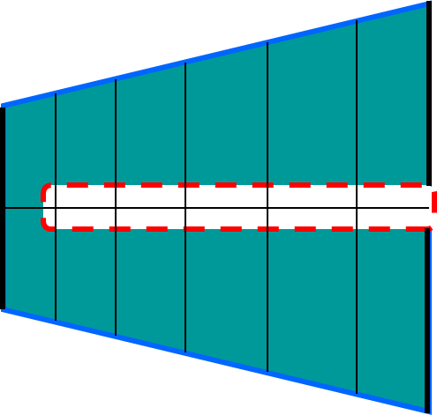
High Purity Germanium detector

Slide 22
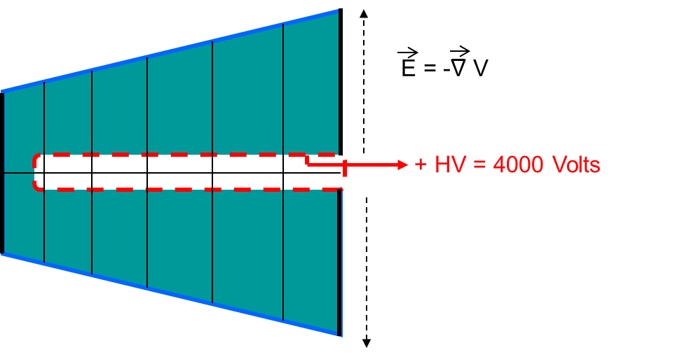
HPGe detector – working principle

Slide 23
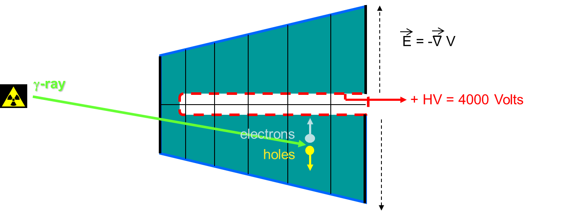
HPGe detector – working principle

Slide 24
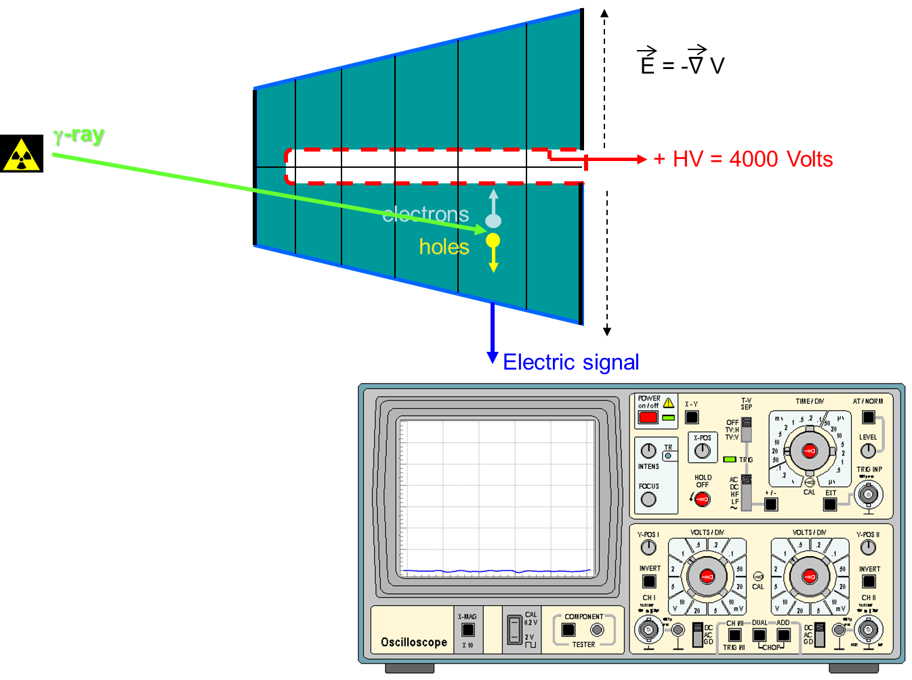
HPGe detector – working principle

Slide 25
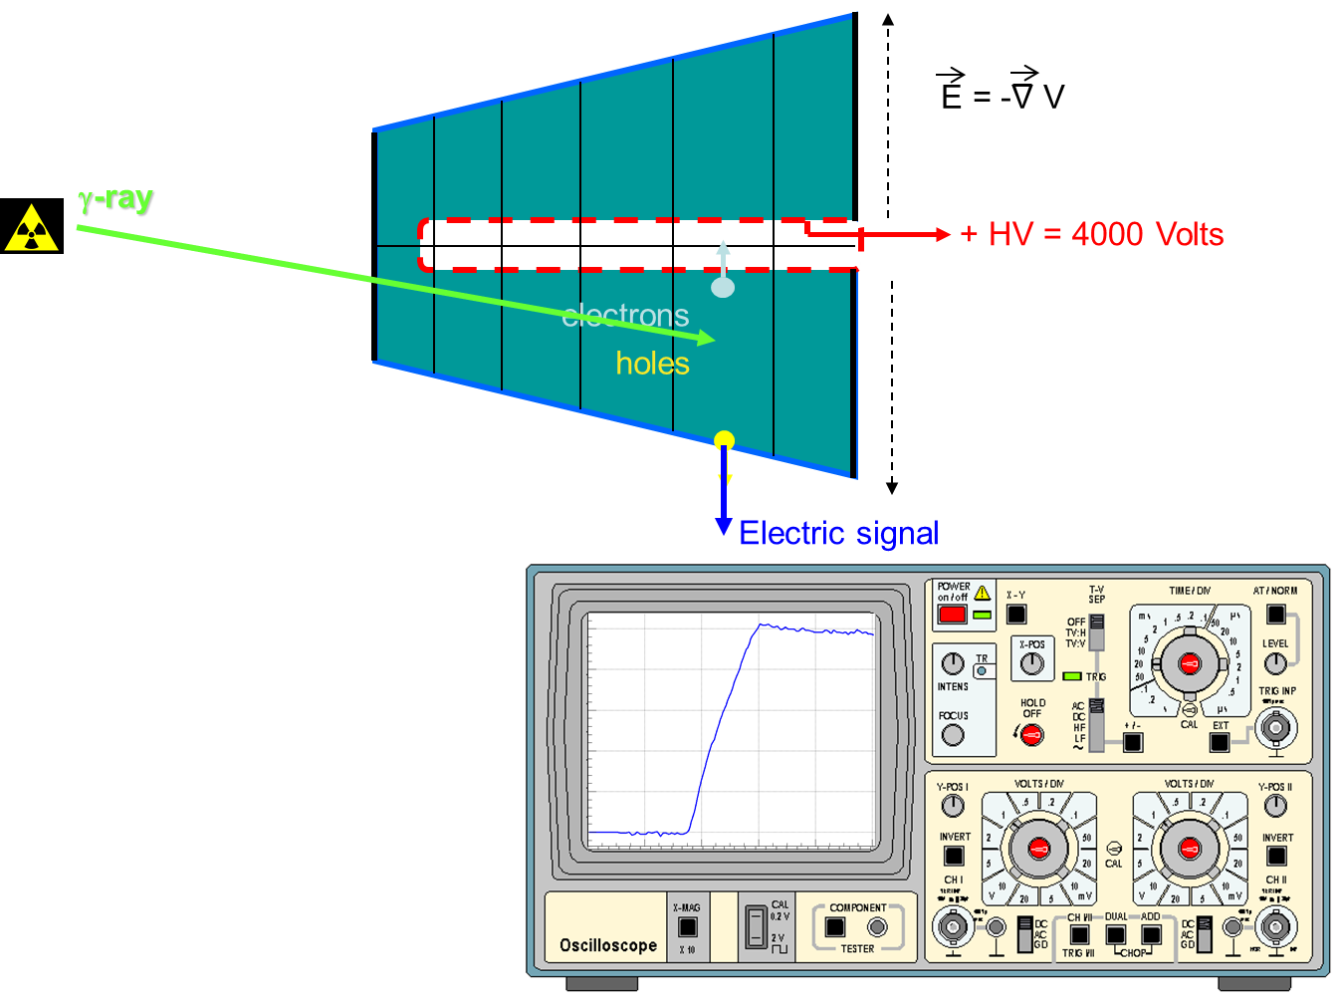
HPGe detector – working principle

Slide 26
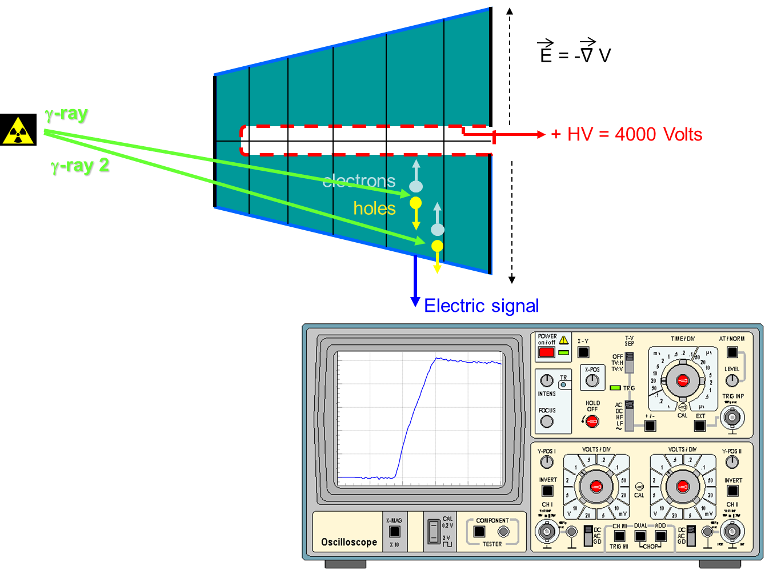
HPGe detector – position sensitivity

Slide 27
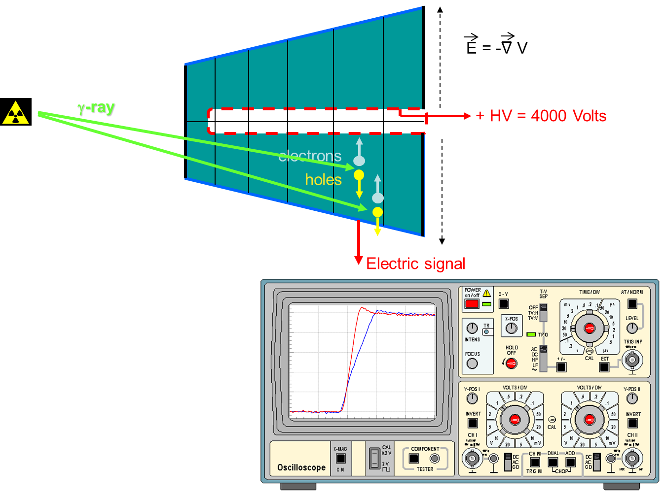
HPGe detector – position sensitivity

Slide 28
The first case of a high spin superdeformed band

Slide 29
GAMMASPERE 1993 Berkeley
110 Ge detectors (70% eff.)
escape suppression shields
70 detectors segmented into two halves to reduce the Doppler broadening
M.A. Deleplanque, R.M. Diamond eds Gammasphere proposal 1987

Slide 30
EUROGAM II
24 CLOVER detectors with increased efficiency (130%) and improved granularity
F. A. Beck et al. Conf. Proc. 1994

Slide 31
From EUROGAM to EUROBALL
γ-ray
Late 1980‘s:
Discussion of a cluster of seven detectors with large efficiency in add-back mode
Conclusion:
seven hexagonal detectors in a common cryostat
Encapsulated!
γ-ray

Slide 32
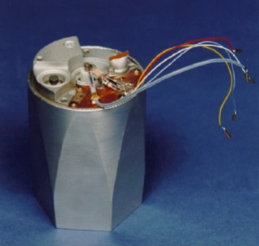
The EUROBALL cluster detector
10 kg HPGE
rel. efficiency 600%

Slide 33
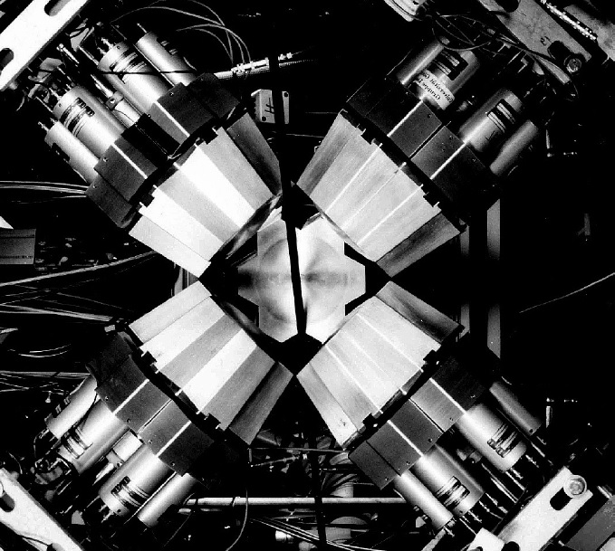
EUROBALL-3 demonstrator at GSI 1993
GSI mass separator
efficiency: 19%

Slide 34
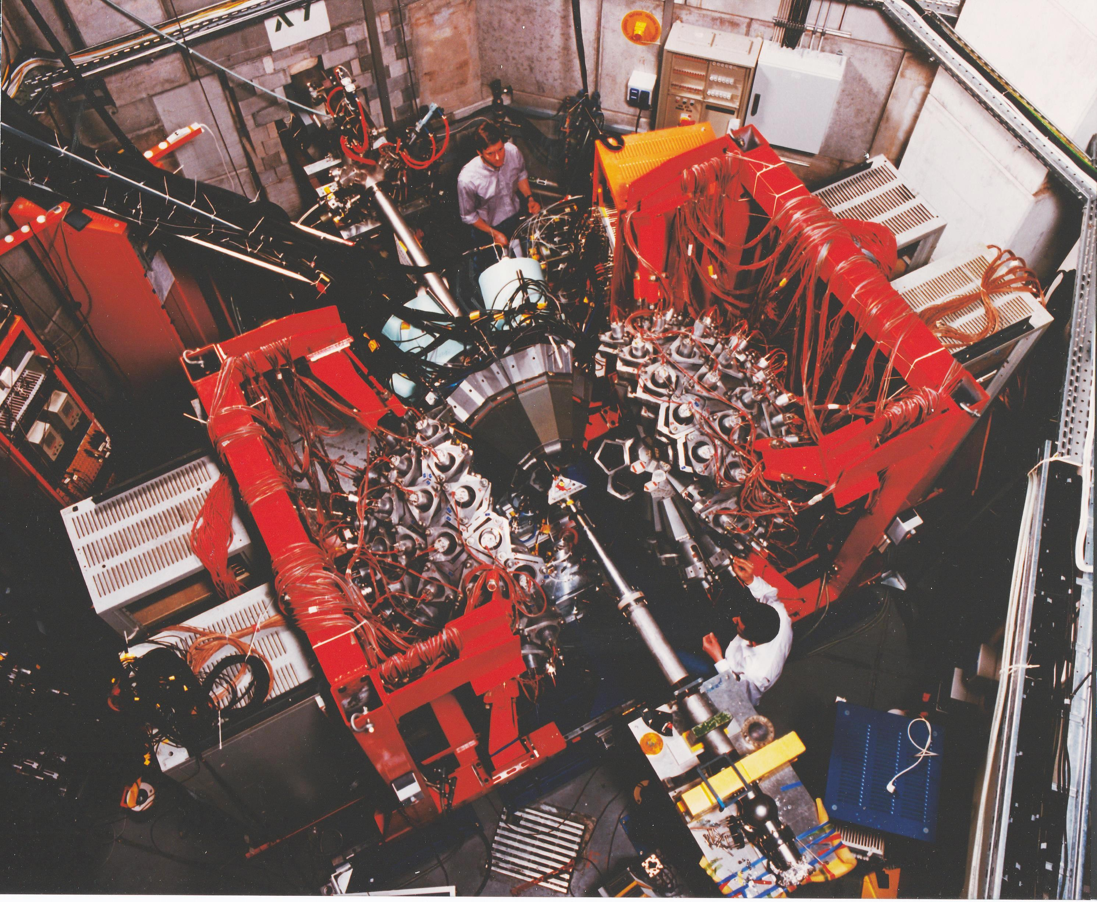
Darmstadt-Heidelberg Crystal Ball and EUROBALL-3 demonstrator 1993

Slide 35
EUROBALL 1997 - 2003

Slide 36
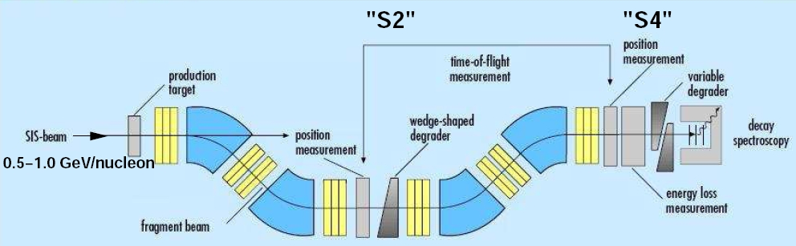
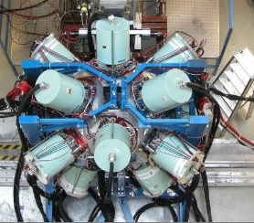
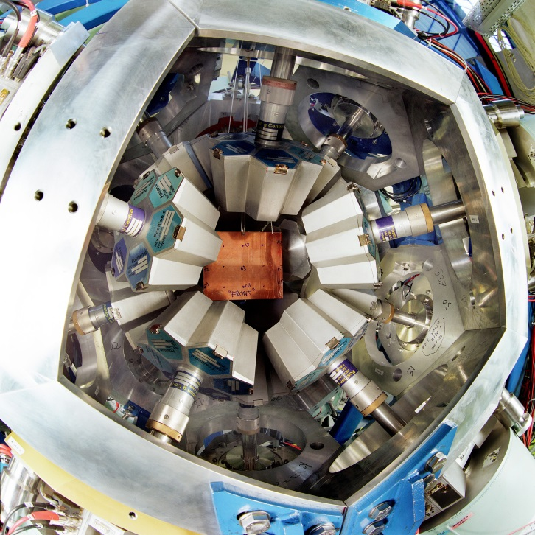
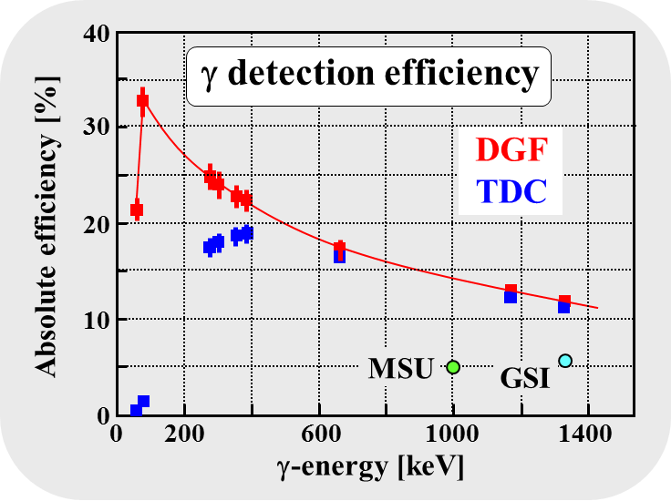
EUROBALL (2003-2009) at RISING Rare ISotope INvestigation at GSI
σ_{exp}(¹³⁰Cd)~150 pb
variable
degrader
4 g/cm² Be
¹³⁶Xe
750 MeV/u
ΔE
15 Cluster detectors with 105 Ge crystals
ε_{γ} = 11% at 1.3 MeV, 20% at 550 keV, 35% at 100 keV
very high γ-ray efficiency
high granularity (prompt flash problem)
implantation in Cu-plate or in 9 DSSSD
S. Pietri et al., NIM B261 (2007), 1079

Slide 37
EUROBALL at RISING stopped beam set-up (2006-2009)

Slide 38
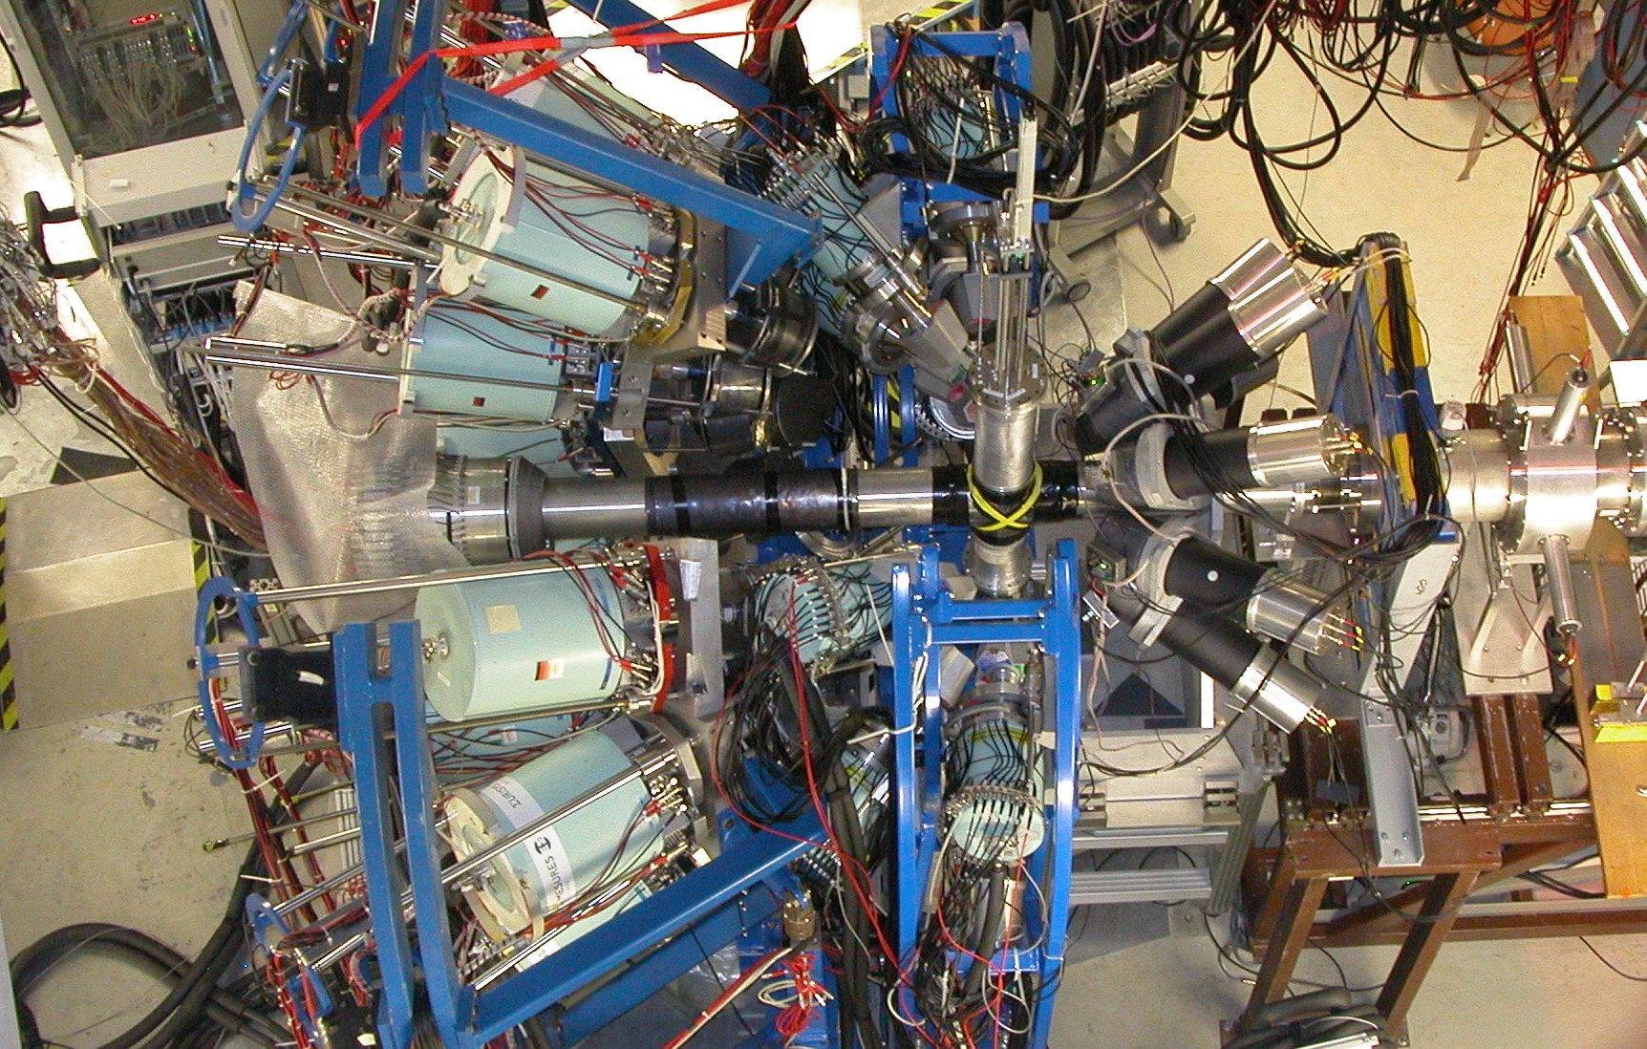
EUROBALL at RISING scattering experiment (2003-2005)

Slide 39
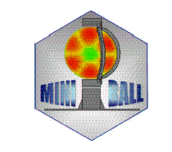
6-fold segmented, encapsulated MINIBALL detector
collaboration: Cologne,Heidelberg,Munich, Leuven

Slide 40
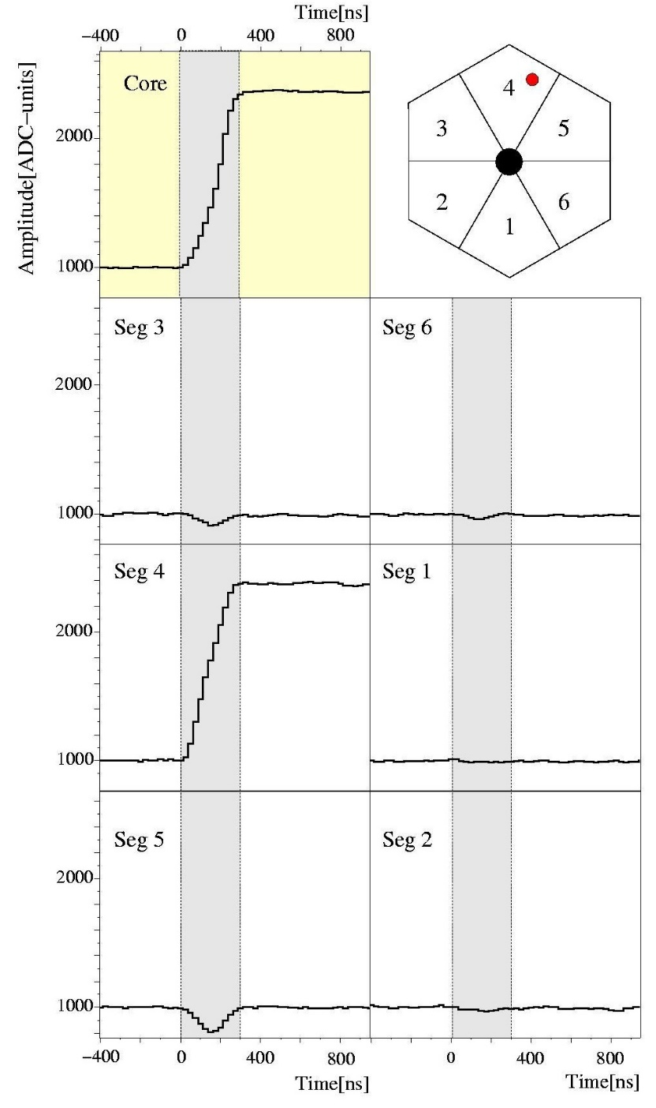
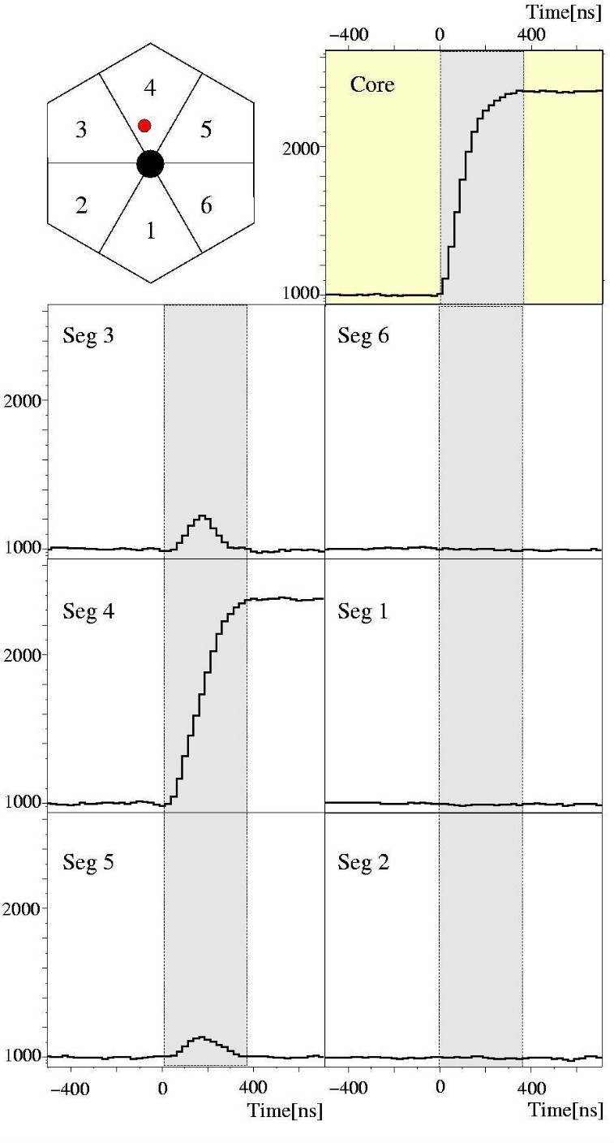
Position-sensitive Ge-detectors (pulse shape analysis)
Milestone 3

Slide 41
Miniball at
REX-ISOLDE, CERN
24 Ge-detectors in 8 cryostates, 6-fold segmented
abs. eff. 8.5%

Slide 42
MINIBALL at REX-ISOLDE
Miniball at
REX-ISOLDE, CERN
24 Ge-detectors in 8 cryostates, 6-fold segmented
abs. eff. 8.5%

Slide 43
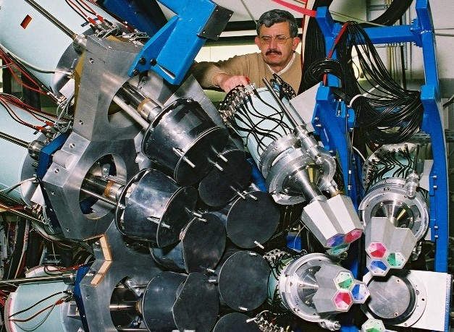

Cluster and MINIBALL detectors at RISING 2005
70cm
target
beam
20cm

Slide 44
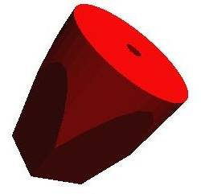
Doppler broadening and position resolution
Position resolution
γ ray
Angular resolution
beam
projectile
Energy resolution

Slide 45
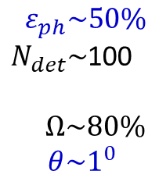
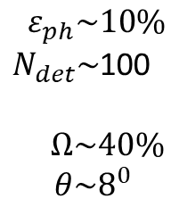
The idea of γ–ray tracking
EUROBALL/
Gammasphere
Compton shielded Ge
$${ ε}_{ph}\sim 10\%$$
$N_{det}\sim$100
$$Ω\sim 40\%$$
$$θ\sim 8^{0}$$
large opening angle
means poor energy
resolution at high
recoil velocity
Previously scattered γ-rays were wasted
Technology is available to track them
Ge tracking array
combination of:
segmented detectors
digital electronics
pulse processing
tracking the -rays
$${ ε}_{ph}\sim 50\%$$
$N_{det}\sim$100
$$Ω\sim 80\%$$
$$θ\sim 1^{0}$$
Milestone 4
AGATA/GRETA

Slide 46

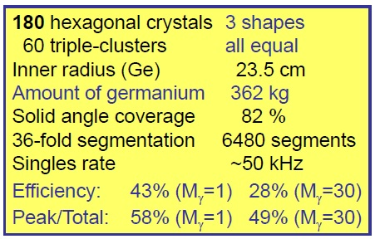
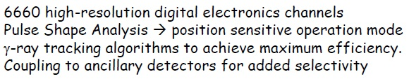
AGATA: Advanced GAmma Tracking Array

Slide 47
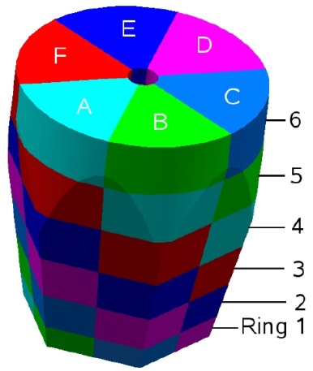
AGATA detectors and AGATA triple-cluster
~2 kg
Signals from 36 segments + core
are measured as a function of time
(γ-ray interaction point)

Slide 48
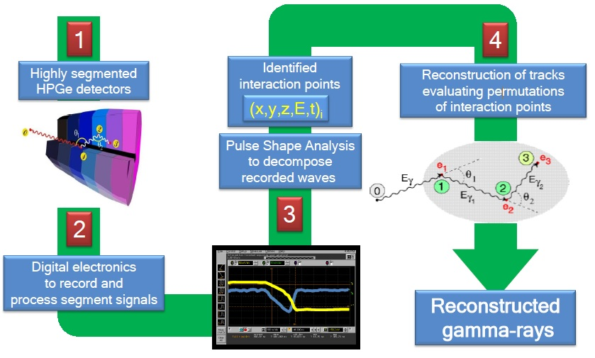
Ingredients of gamma-ray tracking

Slide 49
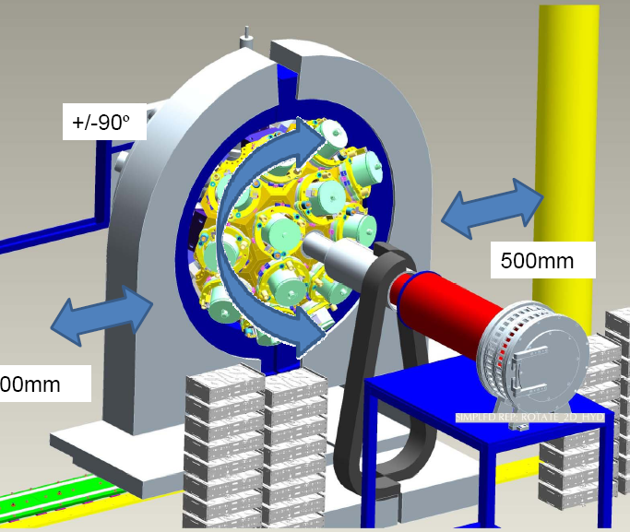

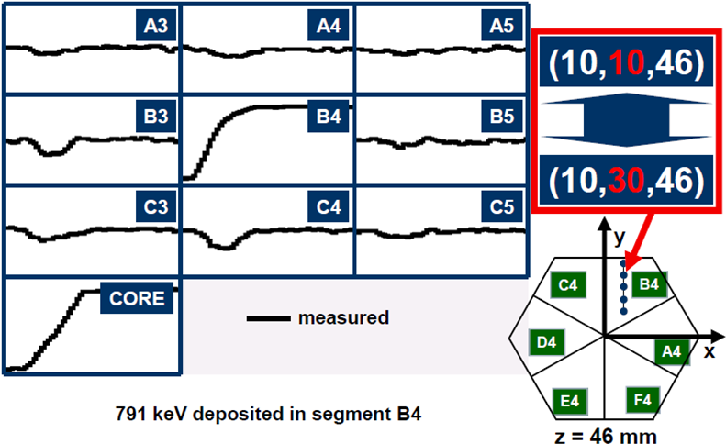
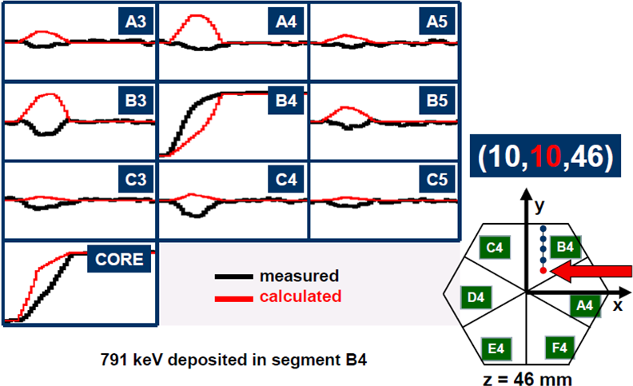

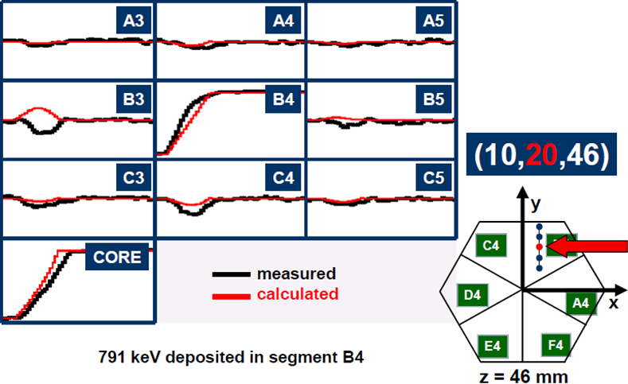

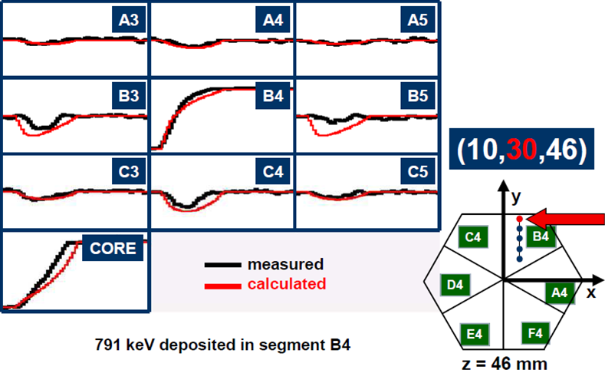
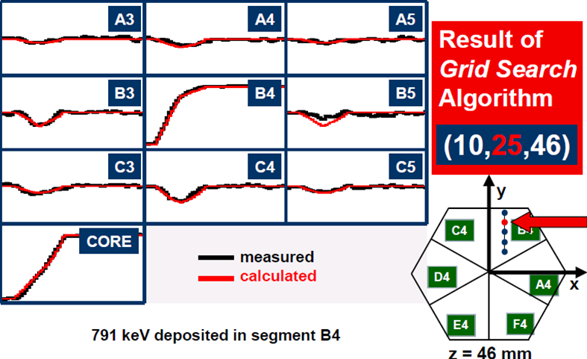
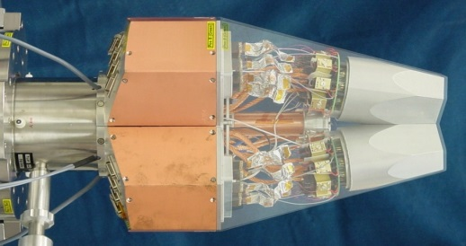
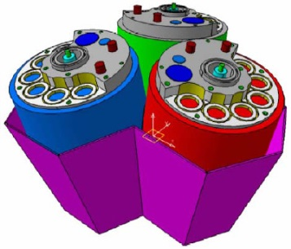
AGATA: pulse shape analysis
Signals from 36 segments + core
are measured as a function of time
(γ-ray interaction point)
John Strachan

Slide 50
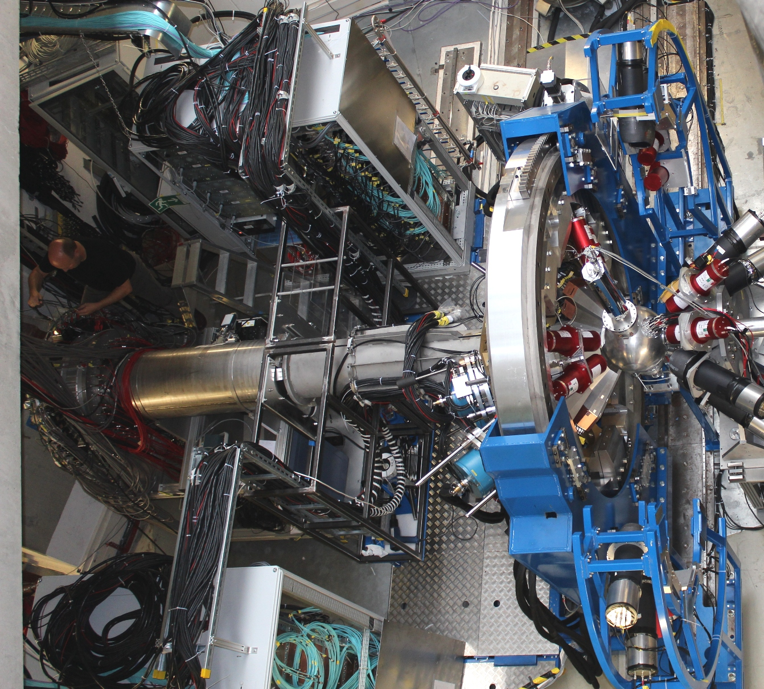
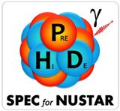

PreSPEC-AGATA campaign (2012)
Au, Be target
LYCCA
AGATA Cluster array
HECTOR BaF₂ array

Slide 51
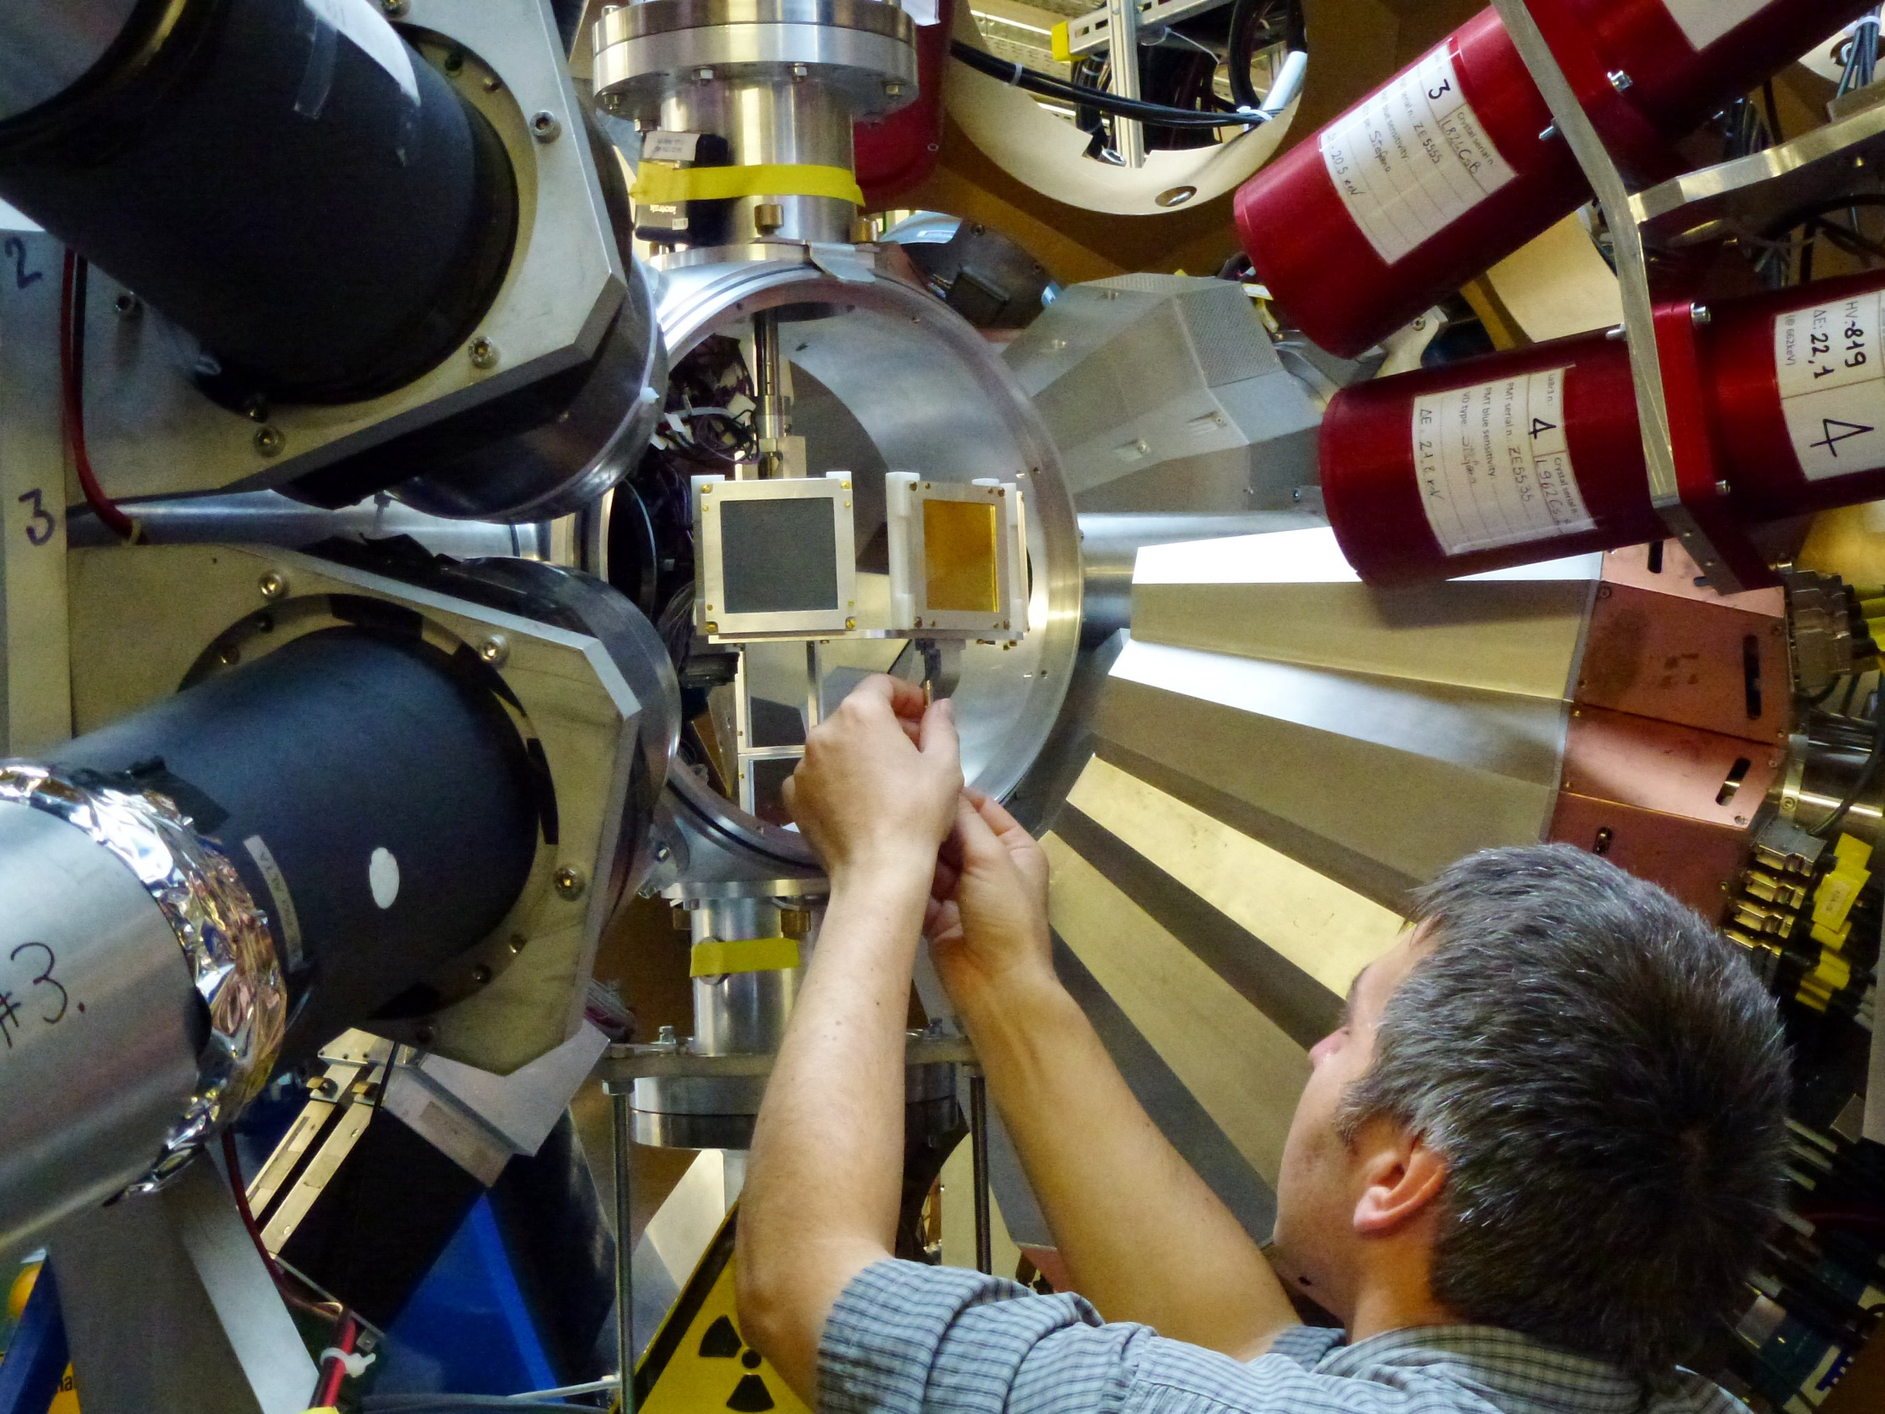
PreSPEC-AGATA campaign (2012)

Slide 52
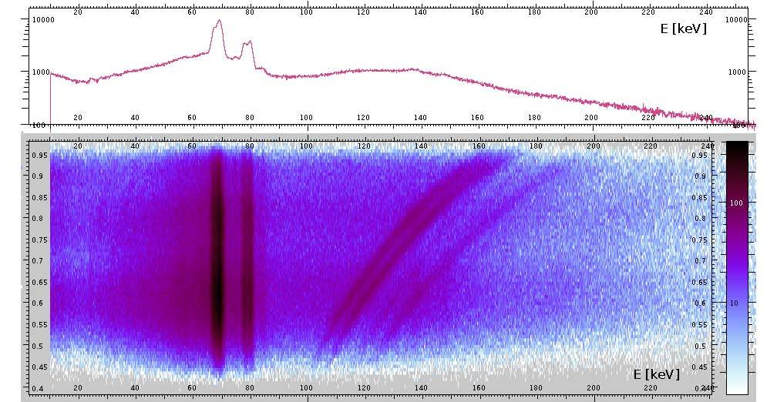
Doppler-shift correction – ²³⁸U on ¹⁹⁷Au (386 mg/cm²) at 183 AMeV
cos θ_{γ}
66.372 | 79 Au | K_{α3} | 0.033
66.991 | 79 Au | K_{α2} | 27.5
68.806 | 79 Au | K_{α1} | 46.4
77.577 | 79 Au | K_{β3} | 5.57
77.982 | 79 Au | K_{β1} | 10.70
80.130 | 79 Au | K_{β2} | 3.84
http://ie.lbl.gov/atomic/x2.pdf
Michael Reese

Slide 53
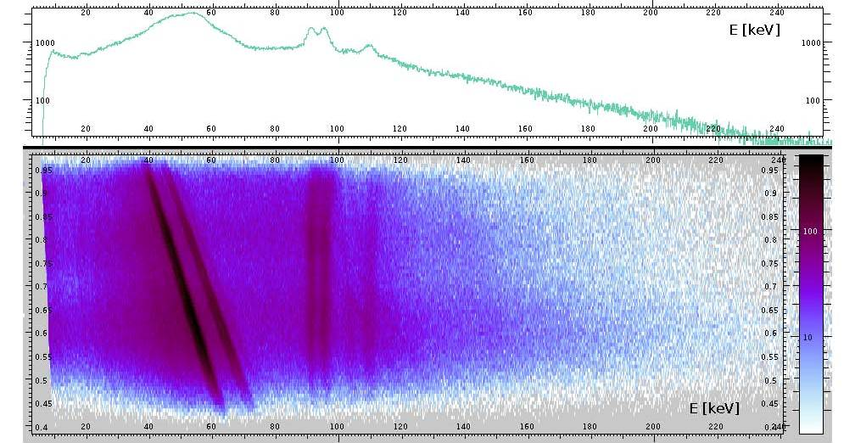
Doppler-shift correction – ²³⁸U on ¹⁹⁷Au (386 mg/cm²) at 183 AMeV
cos θ_{γ}
93.844 | 92 U | K_{α3} | 0.099
94.654 | 92 U | K_{α2} | 28.2
98.434 | 92 U | K_{α1} | 45.1
110.421 | 92 U | K_{β3} | 5.65
111.298 | 92 U | K_{β1} | 10.70
114.445 | 92 U | K_{β2} | 4.15
http://ie.lbl.gov/atomic/x2.pdf
Michael Reese

Slide 54
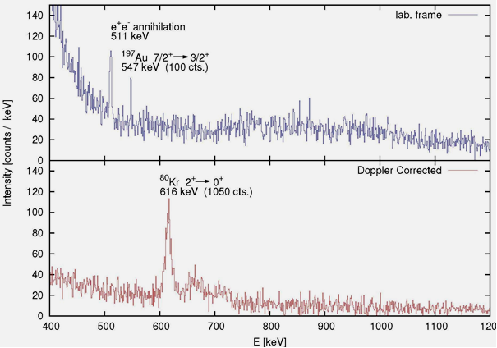

Scattering experiment at relativistic energies
⁸⁰Kr → ¹⁹⁷Au, 150 AMeV
Doppler effect

Slide 55
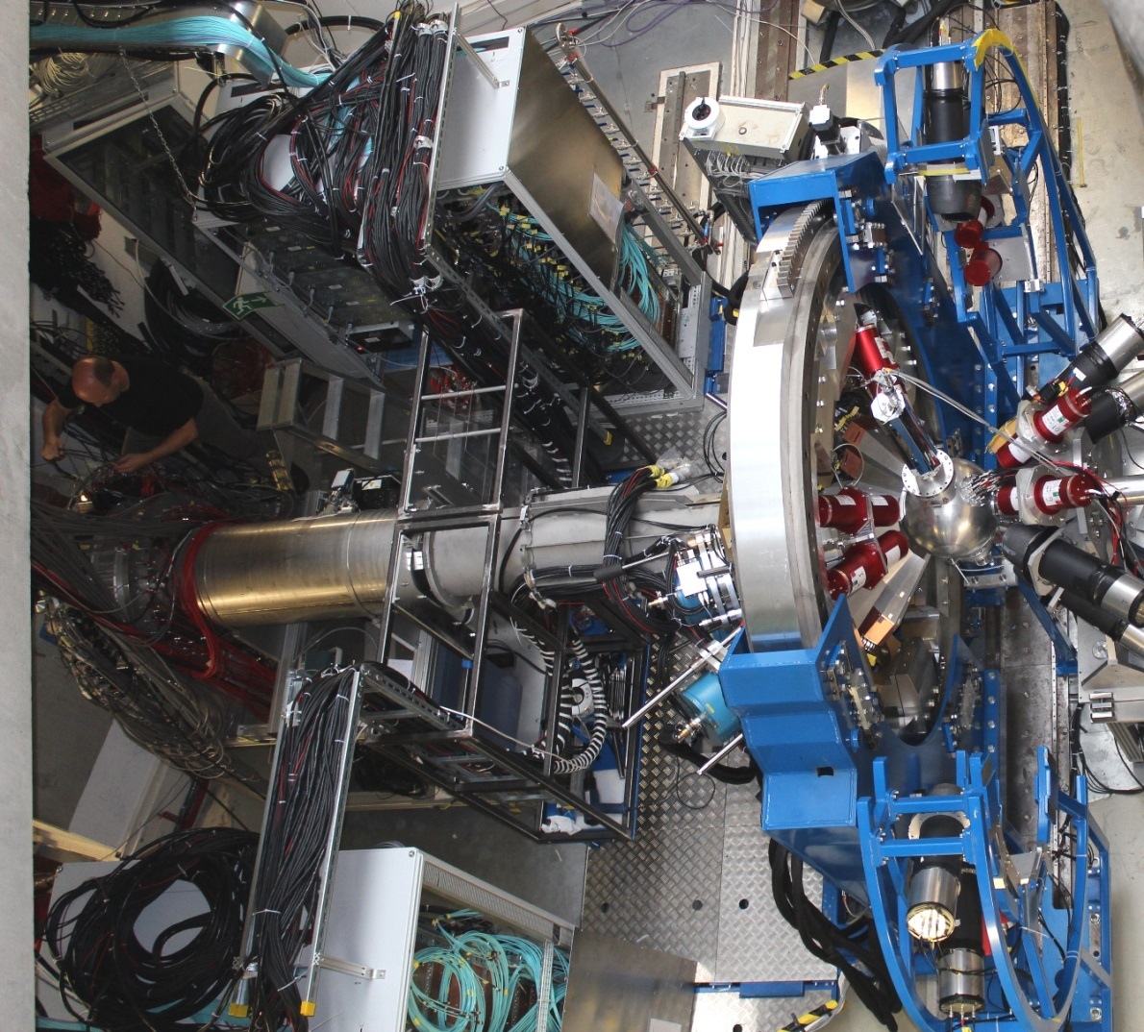
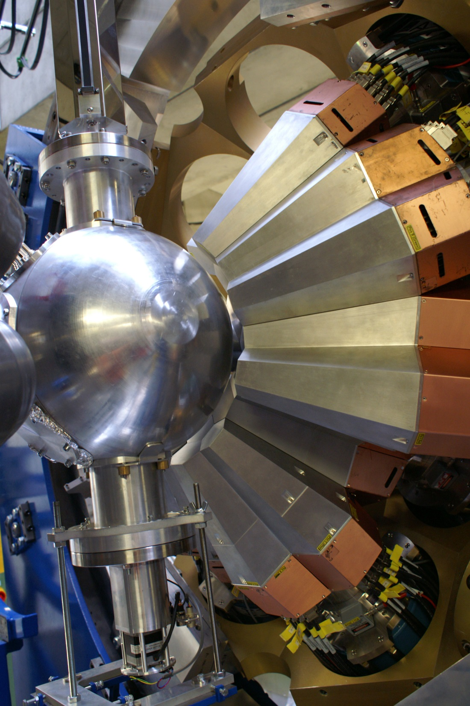

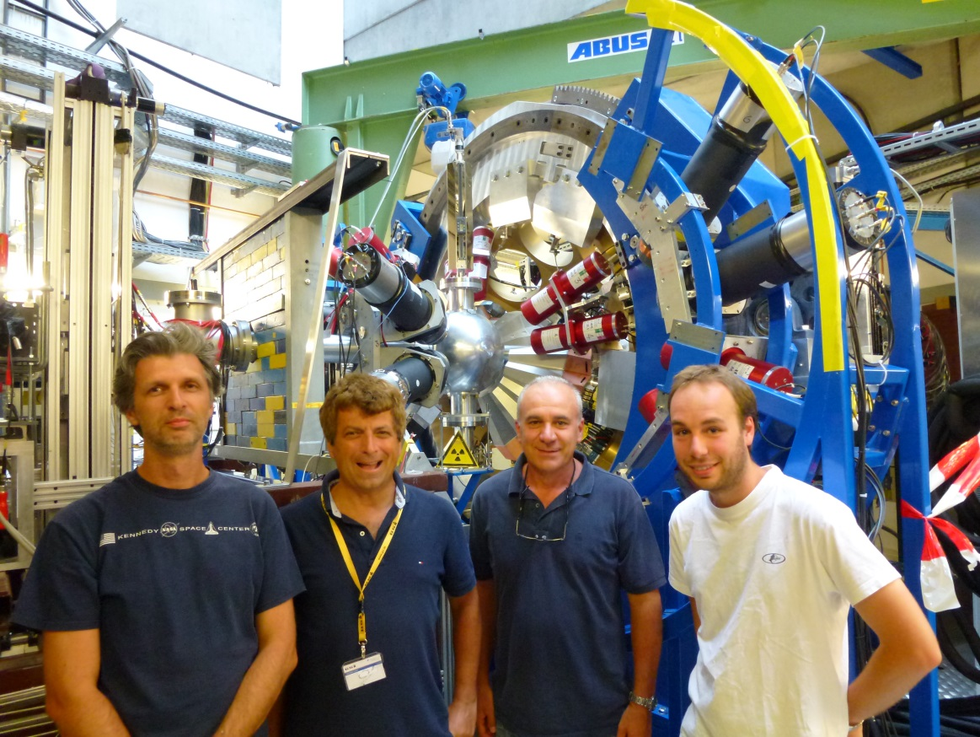

HECTOR team

Slide 57




AGATA at PreSPEC (GSI)
preprocessor
computer farm
AGATA
digitiser
Damian Ralet,
Stephane Pietri

Slide 58
Summary

