Slide 1

Outline: Two-photon decay
Lecturer: Hans-Jürgen Wollersheim
e-mail: h.j.wollersheim@gsi.de
web-page: https://web-docs.gsi.de/~wolle/ and click on
2-photon atomic transitions
double-γ decay in nuclear physics
positronium decay

Slide 2
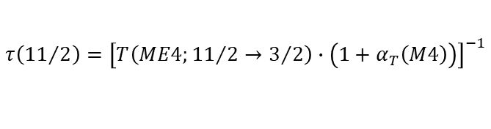
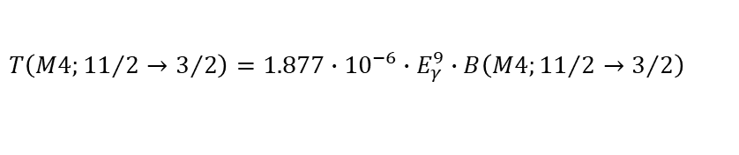
Second order photon emission in nuclei
$$τ\left({11}/2\right)={\left[T\left(ME4;{11}/2→3/2\right)∙\left(1+α_{T}\left(M4\right)\right)\right]}^{−1}$$
$$T\left(M4;{11}/2→3/2\right)=1.877∙{10}^{−6}∙E_{γ}^{9}∙B\left(M4;{11}/2→3/2\right)$$

Slide 3
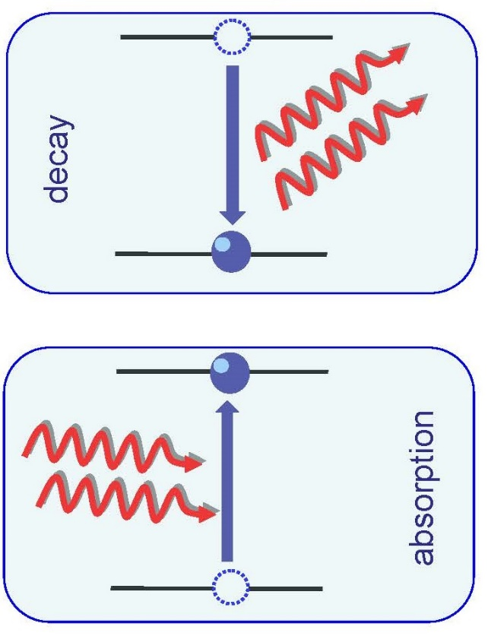
Two-photon atomic transitions
In 1929 in her PhD thesis Maria Göppert-Mayer suggested that bound-bound transitions can undergo under simultaneous absorption/emission of two correlated photons.
For many years two-photon decay/excitation of atoms and ions has attracted much of experimental and theoretical interest.

Slide 4
Two-photon atomic transitions
In 1929 in her PhD thesis Maria Göppert-Mayer suggested that bound-bound transitions can undergo under simultaneous absorption/emission of two correlated photons.
Second order process (10⁻⁶ weaker)
E₀ = E₁ + E₂
E₁, E₂ are continuous
not only two-photon emission, but also absorption and Raman scattering
M. Göppert-Mayer, Ann. Wiss. (1931)

Slide 5
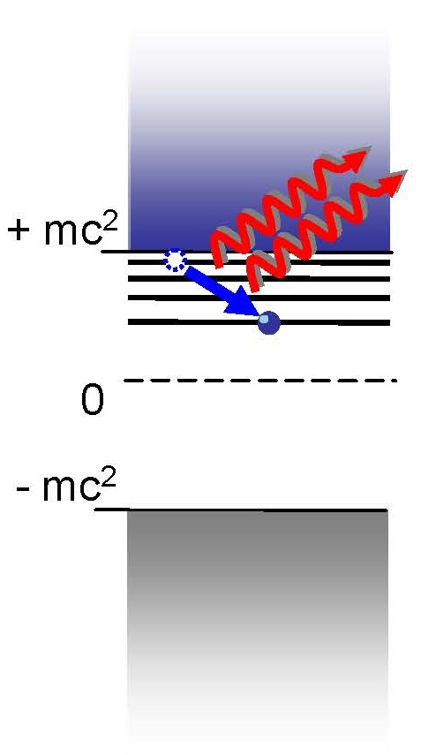
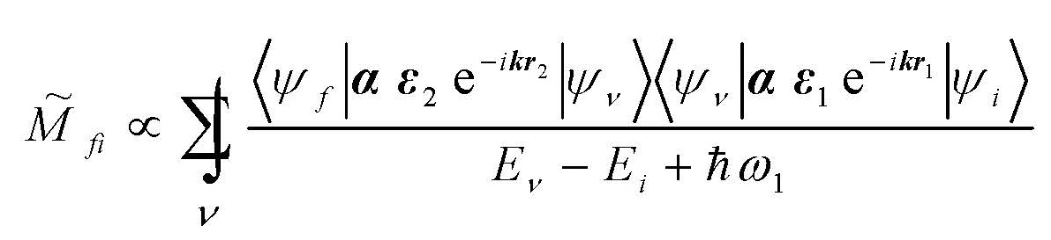
Two-photon atomic transitions
Analysis of the two-photon decay requires knowledge about complete spectrum of the
The summation in the second-order transition amplitude includes a summation over the discrete part of the spectrum as well as an integration over the positive and negative-energy continuum.
A large number of studies have been performed over the last decades to investigate
  Total decay rates
  Energy (spectral) distributions

Slide 6
Two-photon atomic transitions
Analysis of the two-photon decay requires knowledge about complete spectrum of the
The summation in the second-order transition amplitude includes a summation over the discrete part of the spectrum as well as an integration over the positive and negative-energy continuum.
A large number of studies have been performed over the last decades to investigate
  Total decay rates
  Energy (spectral) distributions

Slide 7
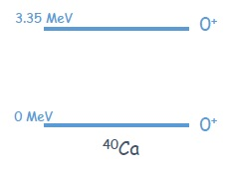
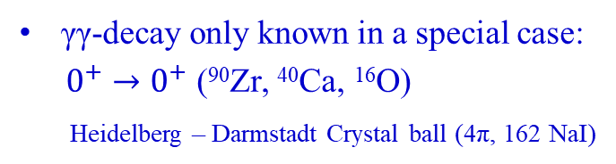
Double-gamma decay in nuclear physics
first unambiguous observation
γγ-decay only known in a special case:
$0^{+}→0^{+}$ (⁹⁰Zr, ⁴⁰Ca, ¹⁶O)
Heidelberg – Darmstadt Crystal ball (4π, 162 NaI)
single photon decay strictly forbidden
Sum-energy spectrum in coincidence with protons populating the states of interest
J. Schirmer et al., PRL 53, 1897 (1984), J. Kramp et al., NPA 474, 412 (1987)

Slide 8
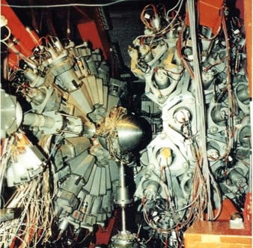
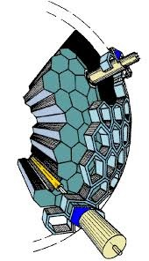
Double-gamma decay in nuclear physics
γ-background: internal pair conversion and subsequent positron annihilation in flight
$$\frac{1}{E_{γ1}}+\frac{1}{E_{γ2}}=\frac{\left(1−cosθ_{12}\right)}{m_{e}c^{2}}$$
Heidelberg – Darmstadt Crystal ball (4π, 162 NaI)
angular resolution ±9⁰
$$E_{γ1}+E_{γ2}=E_{e+}+2m_{e}c^{2}≅E_{0}$$

Slide 9
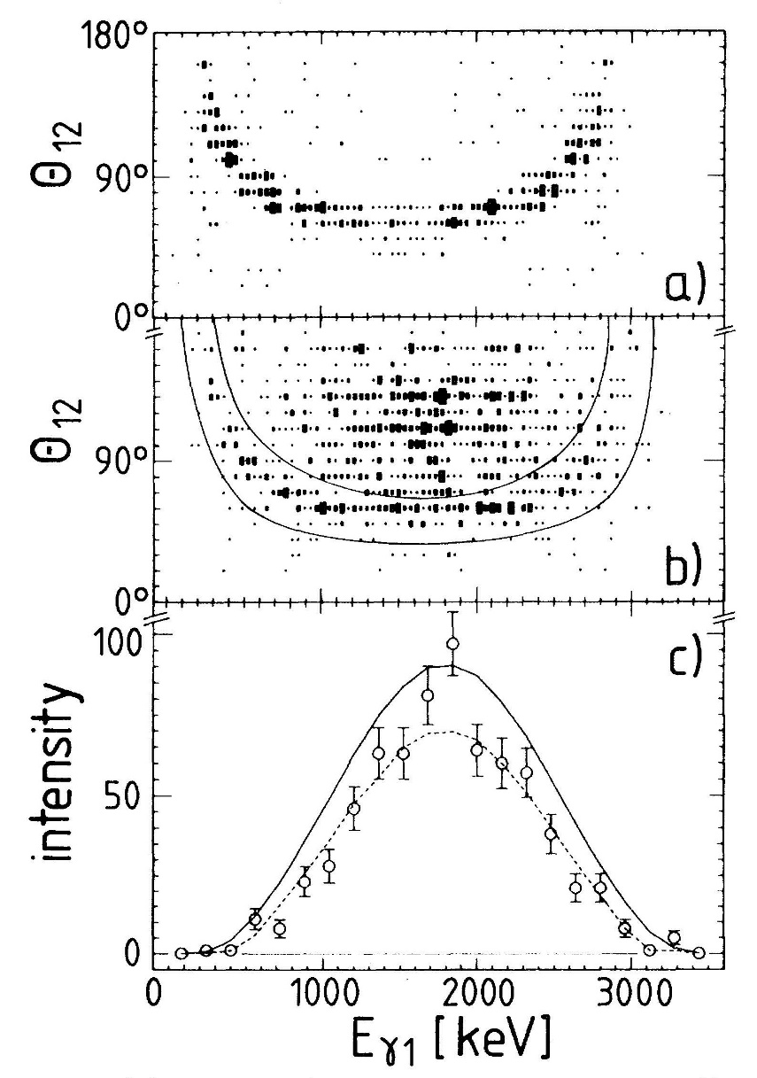
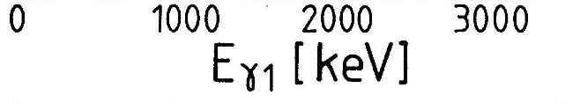
Double-gamma decay in nuclear physics
3.05 MeV ≤ E_{γ1} + E_{γ2} ≤ 3.2 MeV
γ-background: internal pair conversion and subsequent positron annihilation in flight
3.20 MeV ≤ E_{γ1} + E_{γ2} ≤ 3.5 MeV
$$\frac{1}{E_{γ1}}+\frac{1}{E_{γ2}}=\frac{\left(1−cosθ_{12}\right)}{m_{e}c^{2}}$$
$$E_{γ1}+E_{γ2}=E_{e+}+2m_{e}c^{2}≅E_{0}$$

Slide 10
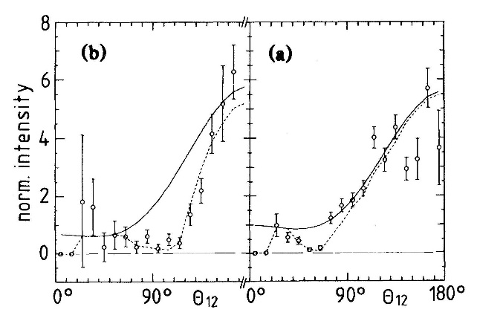
Double-gamma decay in nuclear physics
3.05 MeV ≤ E_{γ1} + E_{γ2} ≤ 3.2 MeV
3.20 MeV ≤ E_{γ1} + E_{γ2} ≤ 3.5 MeV
directional correlation of 2γ-decay
⁹⁰Zr
⁴⁰Ca
ℓ=1
angular correlation not symmetric around 90⁰

Slide 11
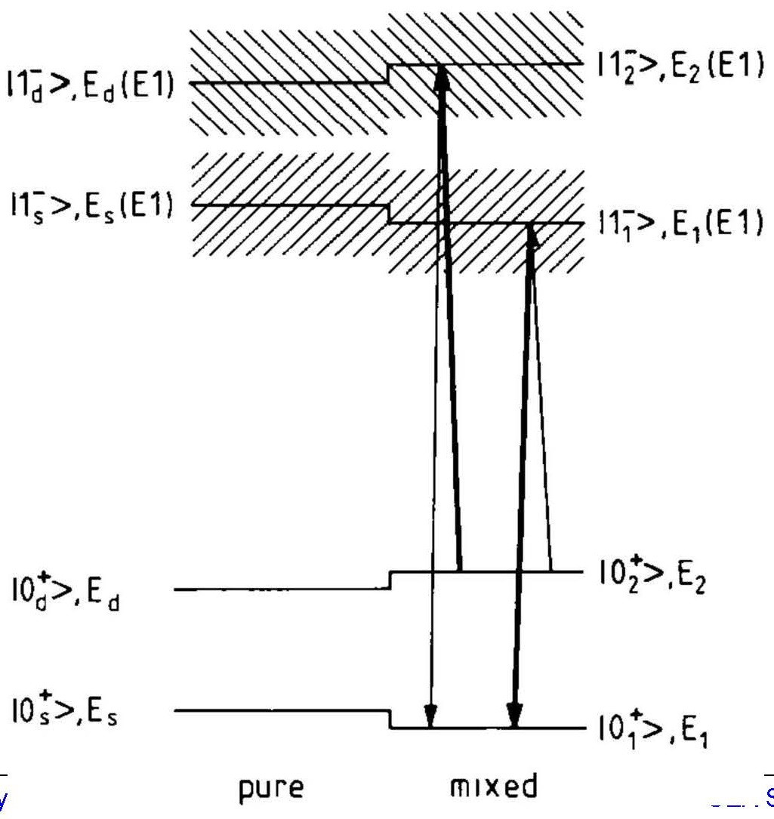
Double-gamma decay in nuclear physics
2-state mixing model for 0⁺ state and 1⁻ GDR states
states couple only via GDR states

Slide 12
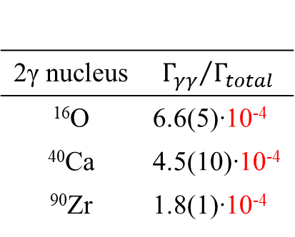

Double-gamma decay in nuclear physics
2γ nucleus | $${Γ_{γγ}}/{Γ_{total}}$$
¹⁶O | 6.6(5)∙10⁻⁴
⁴⁰Ca | 4.5(10)∙10⁻⁴
⁹⁰Zr | 1.8(1)∙10⁻⁴
$0^{+}→0^{+}$ (⁶⁸Ni, ⁷²Ge, ⁸⁰Ge,⁹⁶Zr,⁹⁸Zr,⁹⁸Mo)

Slide 13
Recent experimental advance: LaBr₃(Ce) detectors
so far: NaI(Tl) detectors
  standard detectors, if high efficiency is crucial
  but: poor time and energy resolution
Heidelberg-Darmstadt Crystal-ball
full solid angle 4π 162 NaI(Tl) detectors
large volume LaBr₃(Ce) detectors available:
  better energy resolution by a factor 2-3
  better time resolution by a factor 5-10
  very fast → high rate measurement

Slide 14
GALATEA array: 18 LaBr₃(Ce) detectors (3"x3")

Slide 15
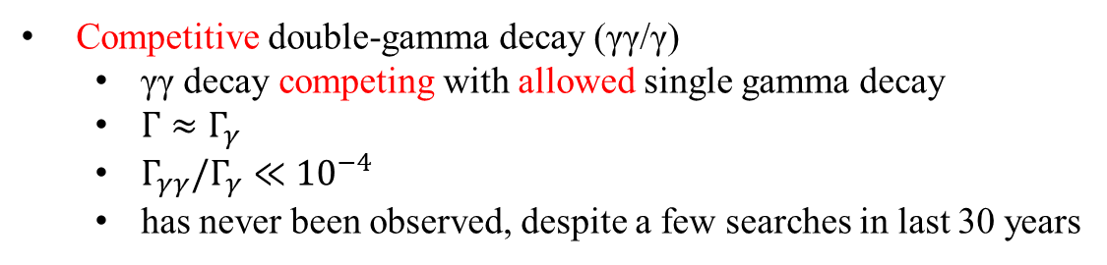
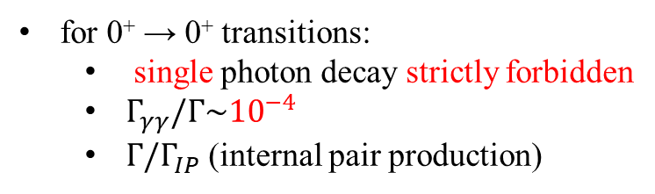
Competitive double-photon decay: γγ/γ
for 0⁺ → 0⁺ transitions:
  single photon decay strictly forbidden
  $Γ_{γγ}/Γ\sim {10}^{−4}$
  $Γ/Γ_{IP}$ (internal pair production)
Competitive double-gamma decay (γγ/γ)
  γγ decay competing with allowed single gamma decay
  $Γ≈Γ_{γ}$
  $Γ_{γγ}/Γ_{γ}≪{10}^{−4}$
  has never been observed, despite a few searches in last 30 years

Slide 16
Basic principle of the experiment
use radioactive ¹³⁷Cs-source: 16.3(5) μCi
background ↔ small decay probability (~ 1 event per day)
  direct Compton scattering
  random coincidences
  cosmic rays, sequential Compton scattering, internal radioactivity

Slide 17
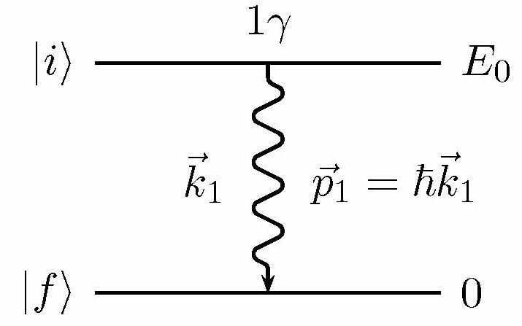
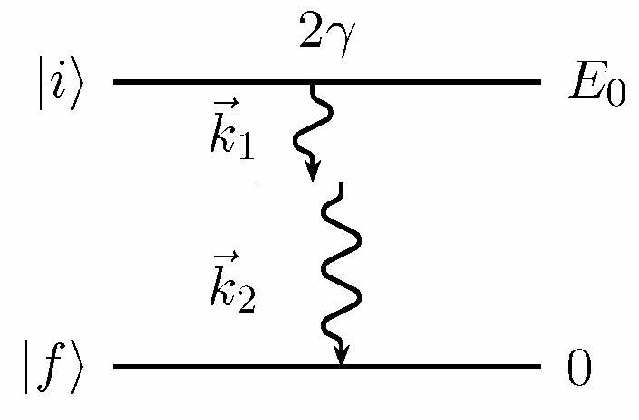


Emission of electromagnetic one and two photon(s)
single photon emission
$$E_{0}=E_{1}=ℏω_{1}$$
double-gamma decay two photons emitted simultaneously
no state
$$E_{0}=E_{1}+E_{2}$$

Slide 18
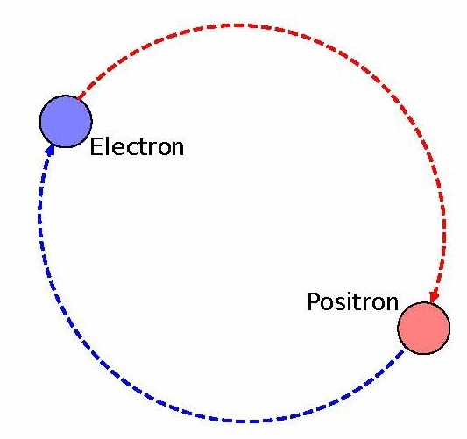
Similar: Positronium – decay into 2, 3, 4 … photons
bound system of an electron and a positron
decay into N_{γ} photons
  due to momentum conservation: N_{γ} = 2
  due to charge conjugation parity
    para-Ps (S = 0): N_{γ} = 2, 4, …
    (for N_{γ} = 2: well known back-to-back 511 keV γ-rays)
    ortho-Ps (S = 1): N_{γ} = 3, 5, …
    (three photons in the lowest order)

Slide 19
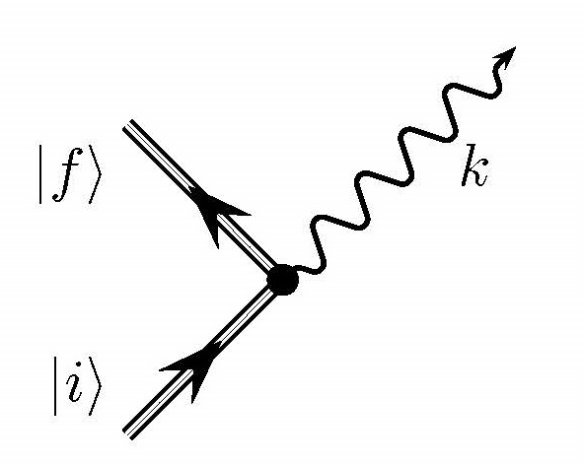
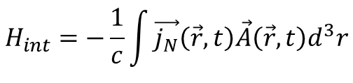

Decay width: first order perturbation theory
Interaction of a nucleus with free EM radiation field:
$$H_{int}=−\frac{1}{c}\int{\vec{j_{N}}\left(\vec{r},t\right)\vec{A}\left(\vec{r},t\right)d^{3}r}$$
Fermi’s Golden Rule
$$Γ_{γ}=2π{\left|\left\langle f | H_{int} | i\right\rangle \right|}^{2}ρ_{f}$$
ρ_{f}: density of final states; H_{int}: interaction Hamiltonian; ${\vec{j}}_{N}\left(\vec{r},t\right)$: nuclear current density; $\vec{A}\left(\vec{r},t\right)$: EM vector potential

Slide 20
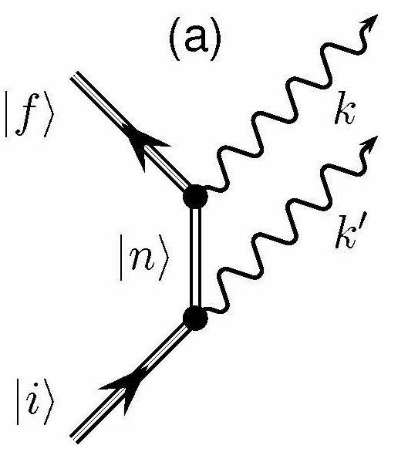
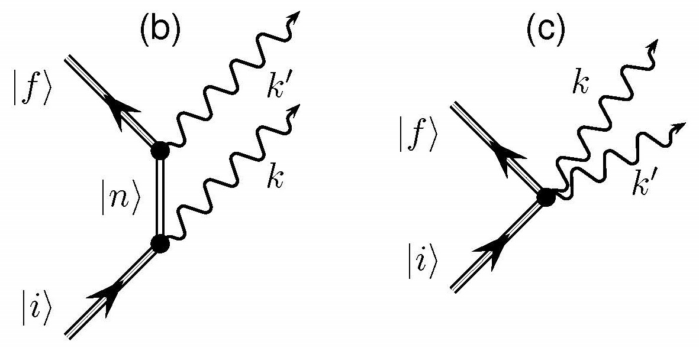
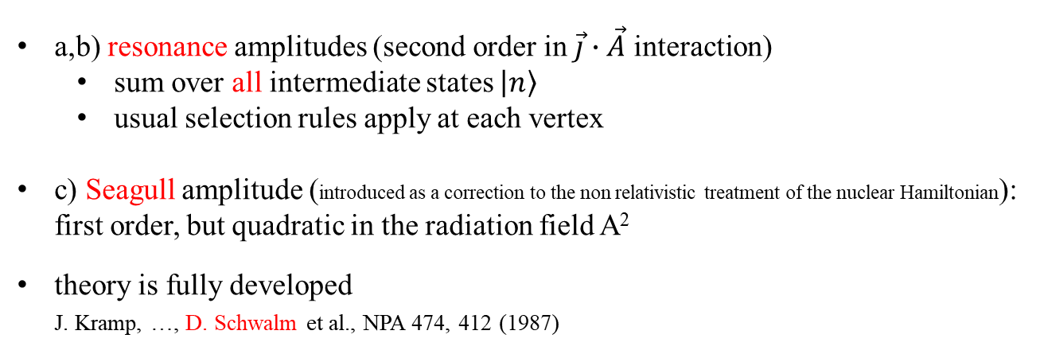
Second order
a,b) resonance amplitudes (second order in $\vec{j}∙\vec{A}$ interaction)
  sum over all intermediate states $\left.\left|n\right.\right\rangle$
  usual selection rules apply at each vertex
c) Seagull amplitude (introduced as a correction to the non relativistic treatment of the nuclear Hamiltonian):
first order, but quadratic in the radiation field A²
theory is fully developed
J. Kramp, …, D. Schwalm et al., NPA 474, 412 (1987)

Slide 21
Matrix element of the double-gamma decay

Slide 22
Matrix element of the double-gamma decay

Slide 23
Matrix element of the double-gamma decay

Slide 24
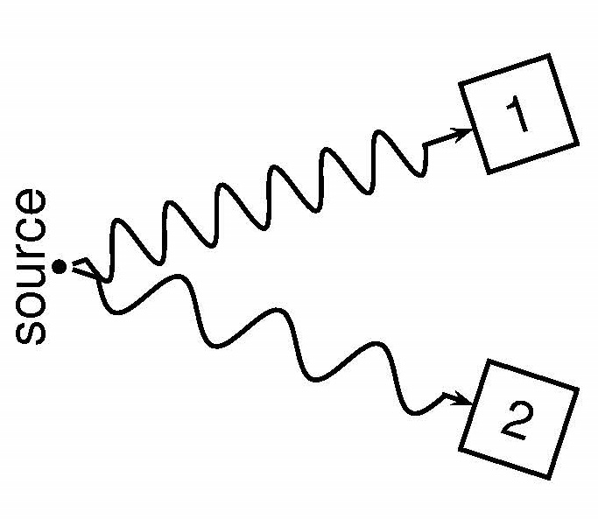
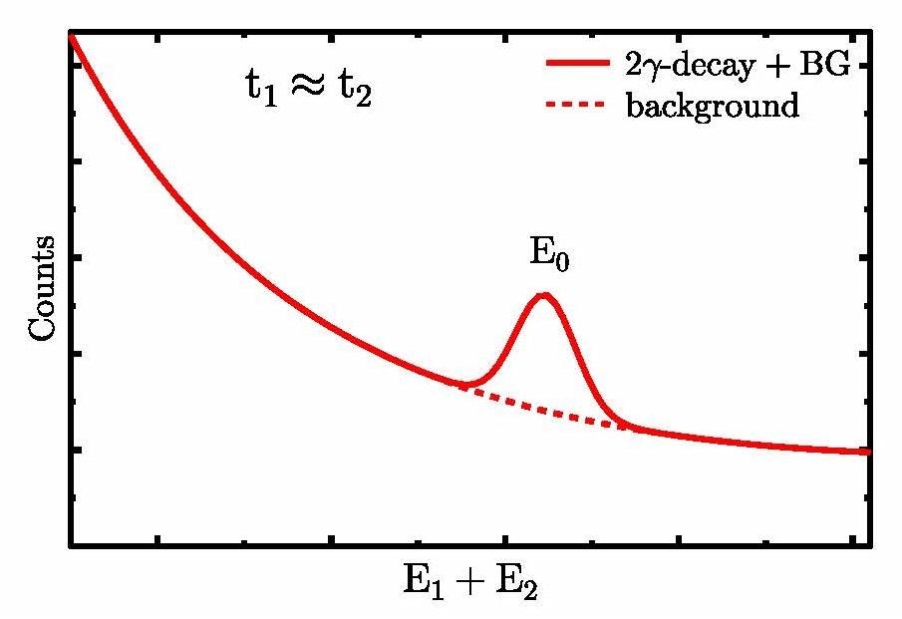

Experimental signature
two photons emitted simultaneously
with continuous energy spectrum
but energy is conserved:
$$E_{0}=E_{1}+E_{2}$$
E₀: transition energy; E_{1,2}: energies of two photons

Slide 25
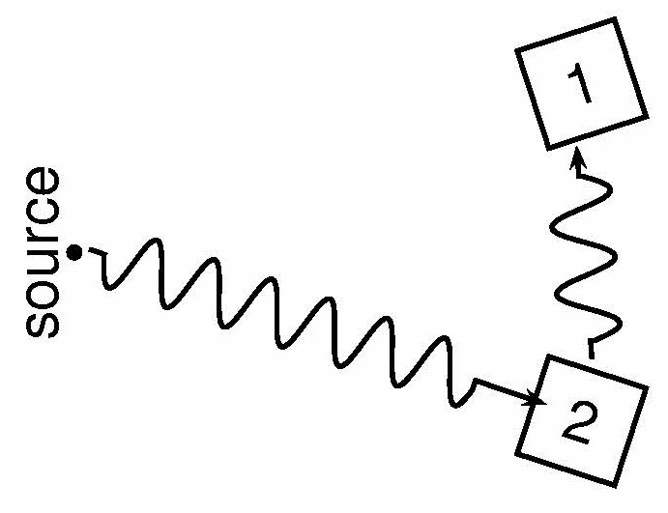

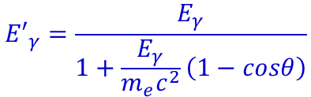

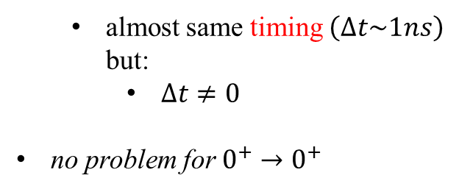
Experimental Obstacle
very small branching ratio $Γ_{γγ}/Γ_{γ}≪{10}^{−4}$
Compton scattering
energy of single γ-ray deposited in two detectors
  exact same signature for energy sum
  but
  different energy distribution
  different path of photons: shielding
$$E_{0}=E_{1}+E_{2}$$
  almost same timing $\left(∆t\sim 1ns\right)$
  but:
    $∆t≠0$
no problem for $0^{+}→0^{+}$
$${E′}_{γ}=\frac{E_{γ}}{1+\frac{E_{γ}}{m_{e}c^{2}}\left(1−cosθ\right)}$$

Slide 26
Experimental setup
72⁰: 5 detector pairs
144⁰: 5 detector pairs
thick Pb blocks
between detectors
ε_{FE}(662 keV) = 1.5 %
ε_{γγ} ≈ 4∙10⁻⁴
ΔE = 3% (FWHM)
Δt = 1 ns (FWHM)
on disk: 53 days
source: ¹³⁷Cs (600 kBq)

Slide 27
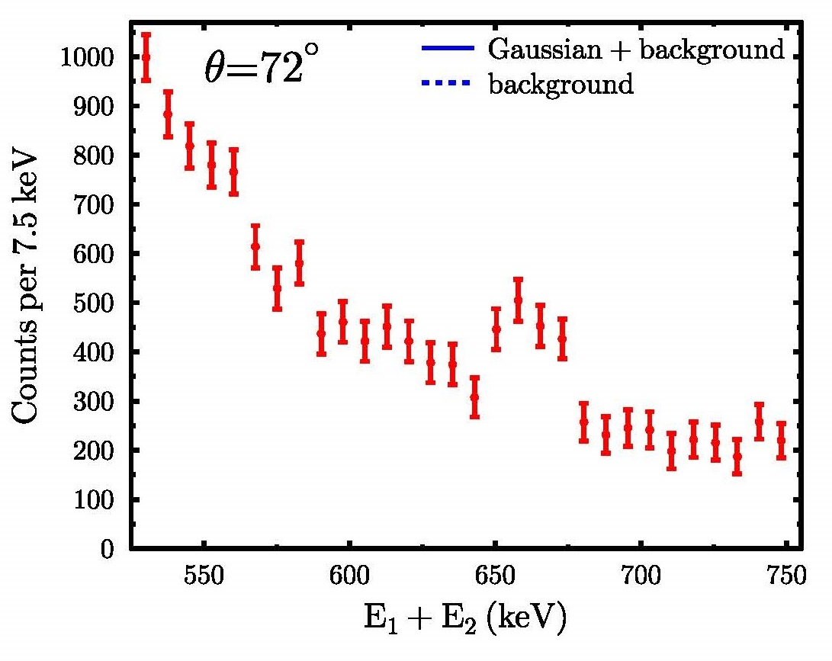
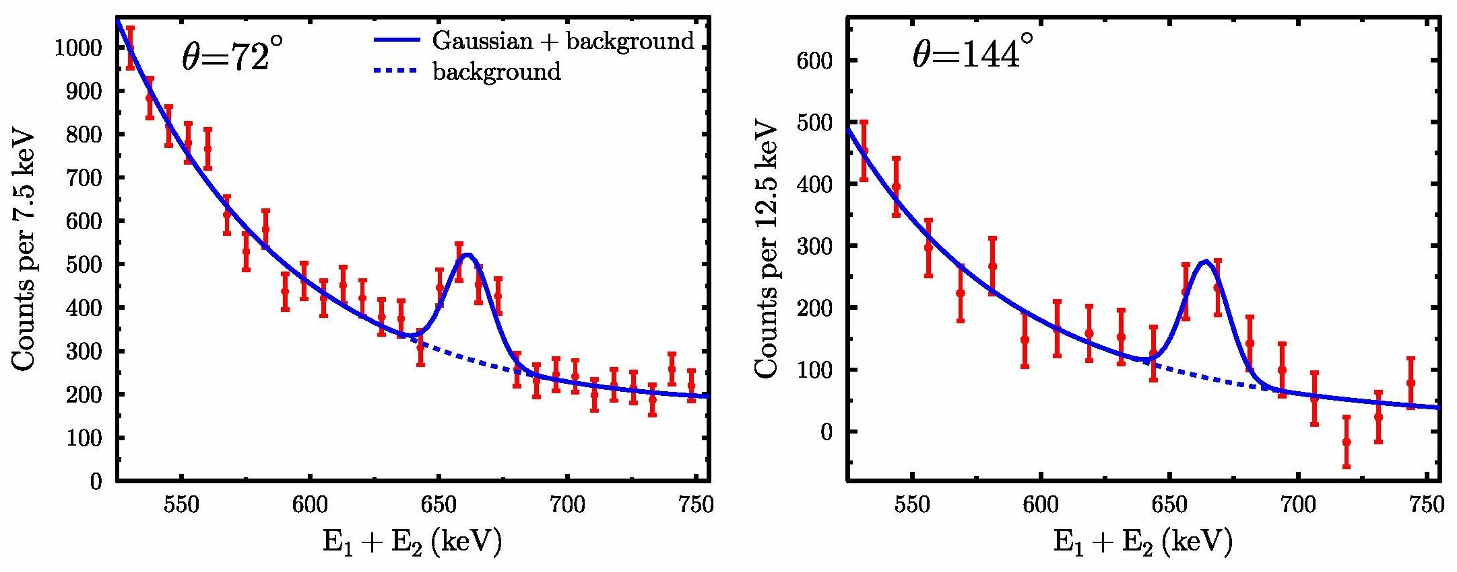
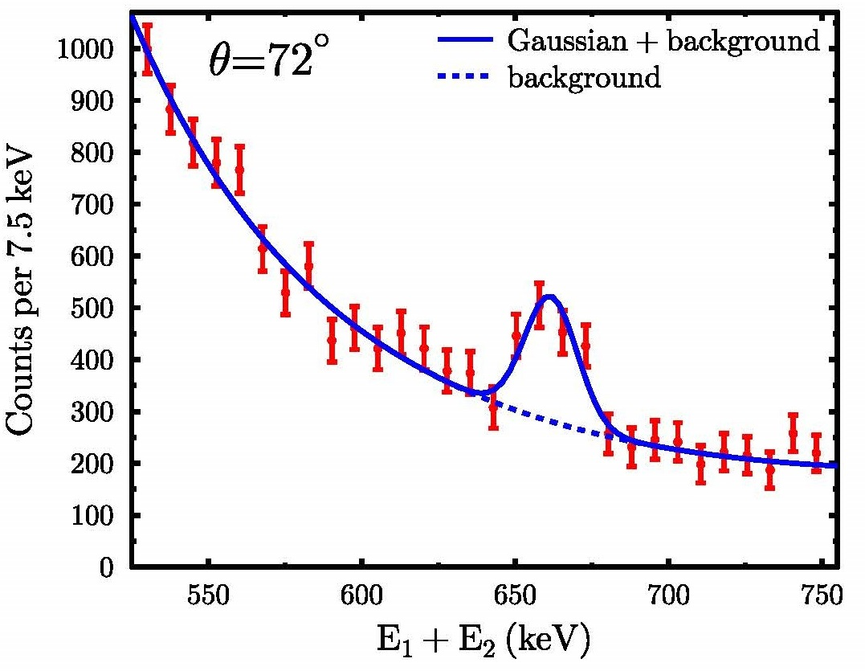
Results – random subtracted energy spectra
693(95) counts (σ = 7.3)
Γ_{γγ}/Γ_{γ} = 1.56(23)∙10⁻⁶
325(76) counts (σ = 4.3)
Γ_{γγ}/Γ_{γ} = 0.70(18)∙10⁻⁶
observation of the competitive double-gamma decay very pronounced angular correlation

Slide 28
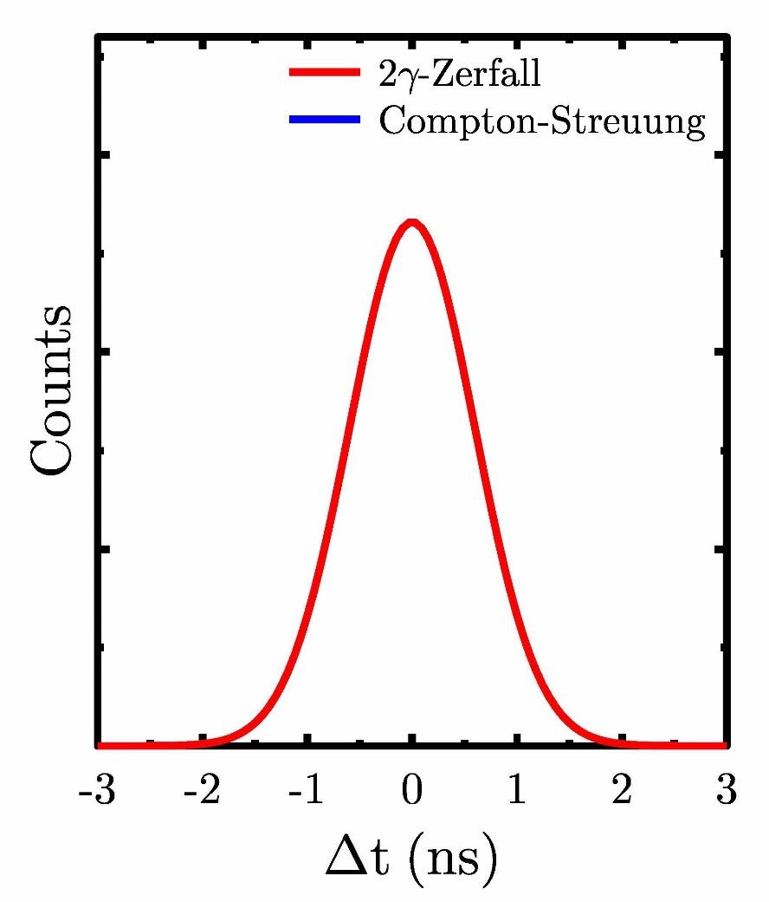
Time analysis

Slide 29
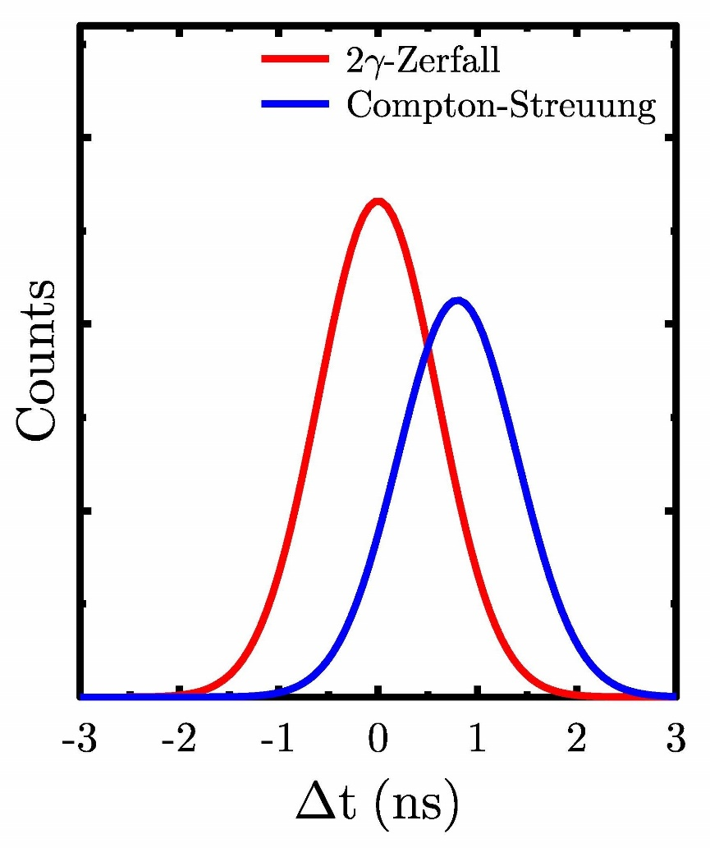
Time analysis

Slide 30
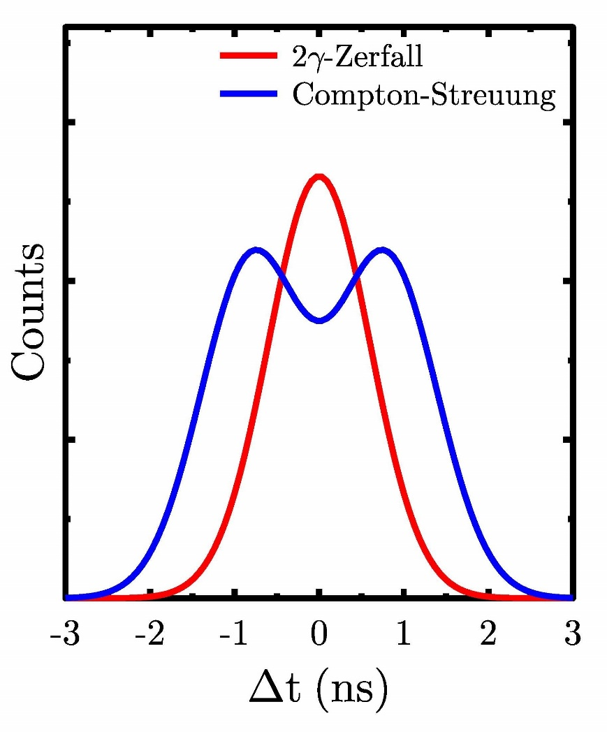
Time analysis
Compton scattering should be visible in time spectrum

Slide 31
Time analysis

Slide 32
Time analysis

Slide 33
Results

Slide 34
Results

Slide 35
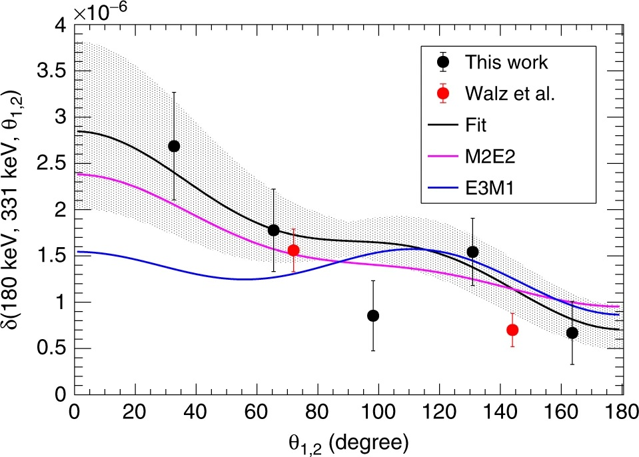

Angular distribution
Söderström
$$W_{ℓ=2,ℓ=2}\left(θ\right)=1+\frac{1}{3}P_{1}\left(cosθ\right)+\frac{5}{49}P_{2}\left(cosθ\right)+\frac{1}{7}P_{3}\left(cosθ\right)+\frac{40}{441}P_{4}\left(cosθ\right)$$
no symmetry axis:
odd Legendre polynomials
$$W_{ℓ=1,ℓ=3}\left(θ\right)=1−\frac{1}{8}P_{1}\left(cosθ\right)+\frac{5}{49}P_{2}\left(cosθ\right)+\frac{3}{8}P_{3}\left(cosθ\right)$$
C. Walz et al.; Nature 406 526 (2015); P.-A. Söderström et al.; Nature Commun. 11, 3242 (2020)

Slide 36
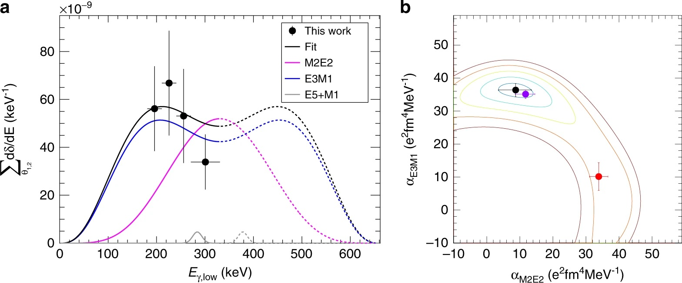
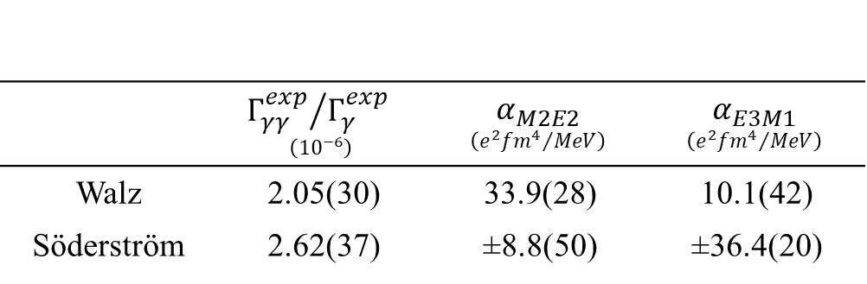
Multipole nature of the γγ/γ decay
 | $${Γ_{γγ}^{exp}}/{Γ_{γ}^{exp}}$$ $$\left({10}^{−6}\right)$$ | $$α_{M2E2}$$ $$\left({e^{2}{fm}^{4}}/{MeV}\right)$$ | $$α_{E3M1}$$ $$\left({e^{2}{fm}^{4}}/{MeV}\right)$$
Walz | 2.05(30) | 33.9(28) | 10.1(42)
Söderström | 2.62(37) | ±8.8(50) | ±36.4(20)

Slide 37
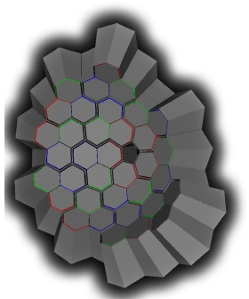
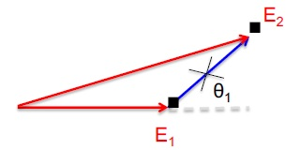
Future: AGATA for the γγ-decay
Position sensitivity and PSA to get spatially a difference between Compton scattered events and real double gamma events

Slide 38
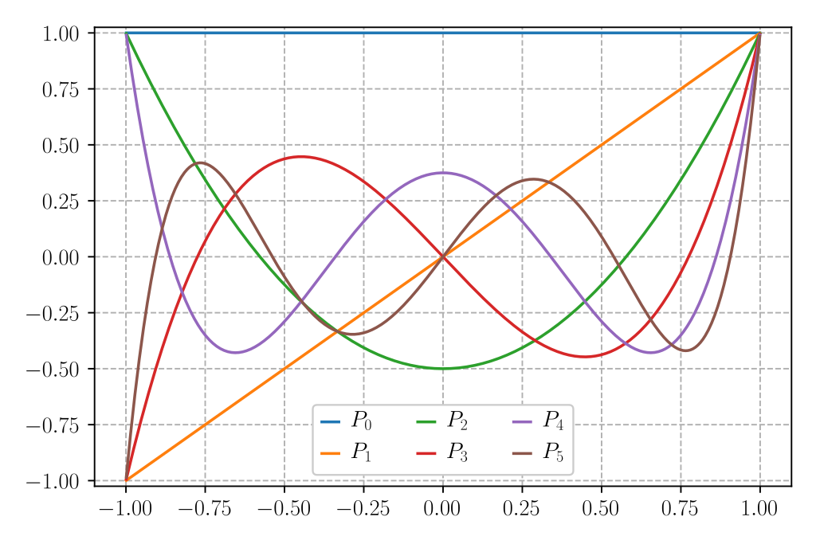






Appendix: Legendre polynomials
$$P_{0}\left(cosθ\right)=1$$
$$P_{1}\left(cosθ\right)=cosθ$$
$$P_{2}\left(cosθ\right)=\frac{1}{2}\left(3\cos^{2}θ−1\right)$$
$$P_{3}\left(cosθ\right)=\frac{1}{2}\left(5\cos^{3}θ−3cosθ\right)$$
$$P_{4}\left(cosθ\right)=\frac{1}{8}\left(35\cos^{4}θ−30\cos^{2}θ+3\right)$$
$$P_{5}\left(cosθ\right)=\frac{1}{8}\left(63\cos^{5}θ−70\cos^{3}θ+15cosθ\right)$$
$$P_{6}\left(cosθ\right)=\frac{1}{16}\left(231\cos^{6}θ−315\cos^{4}θ+105\cos^{2}θ−5\right)$$

