Slide 1

Outline: Spectroscopy of ²⁵²Cf fission
Lecturer: Hans-Jürgen Wollersheim
e-mail: h.j.wollersheim@gsi.de
web-page: https://web-docs.gsi.de/~wolle/ and click on
details of ²⁵²Cf decay
γ-ray angular distribution
fission fragment spectroscopy
ternary spontaneous fission

Slide 2
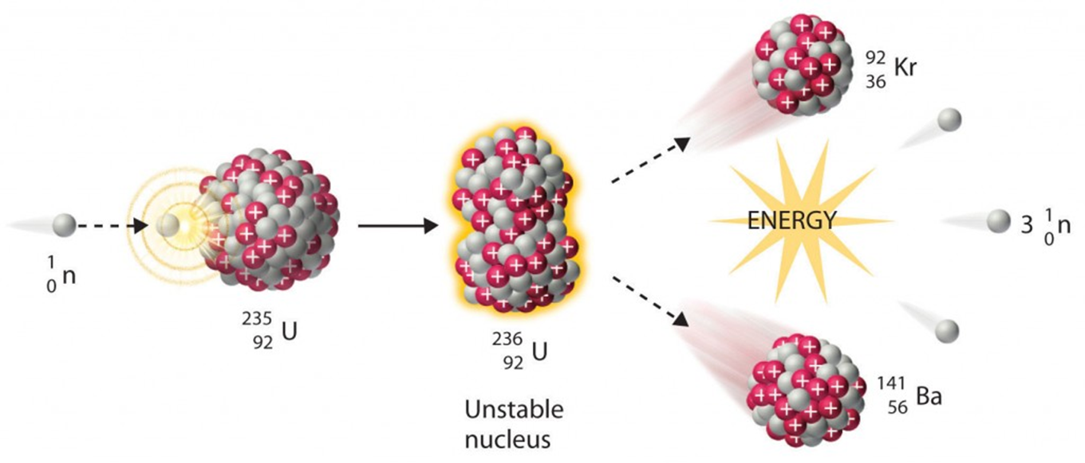
Nuclear fission
Otto Hahn, Lise Meitner

Slide 3
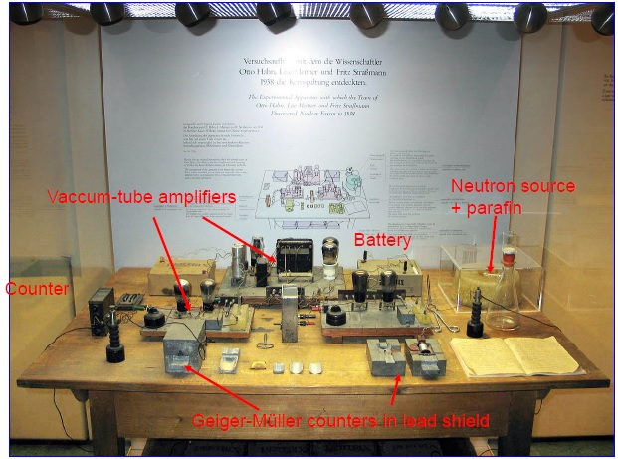
Hahn-Meitner-Strassmann experimental set-up

Slide 4
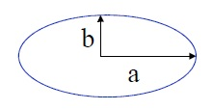



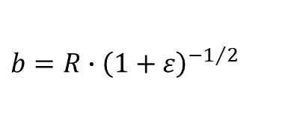


Nuclear fission – spontaneous fission
$$a=R∙\left(1+ε\right)$$
$$b=R∙{\left(1+ε\right)}^{−1/2}$$
saddle point
$$E_{S}=a_{S}∙A^{2/3}∙\left(1+\frac{2}{5}ε^{2}+⋯\right)$$
6 MeV
ground state
potential energy
scission point
$$E_{C}=a_{C}∙Z^{2}∙A^{−1/3}∙\left(1−\frac{1}{5}ε^{2}+⋯\right)$$
$$∆E=\frac{ε^{2}}{5}∙\left(2∙a_{S}∙A^{2/3}−a_{C}∙Z^{2}∙A^{−1/3}\right)$$
$$\frac{Z^{2}}{A}≥\frac{2a_{S}}{a_{C}}≈48$$
deformation
fission barrier ΔE disappears for
This is the case for nuclei with Z>114 and A>270

Slide 5
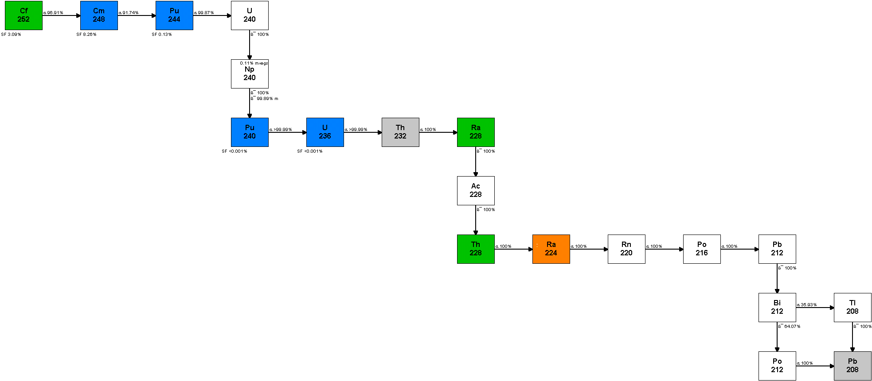
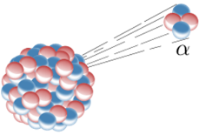
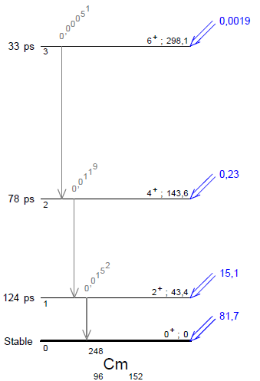
Details of the ²⁵²Cf decay
α´s:
96.9%
SF: 3.1%
T_{1/2} = 2.647 a
Q_{α} = 6.217 MeV
E_{α} = 6.118 MeV
α
α
α
α

Slide 6


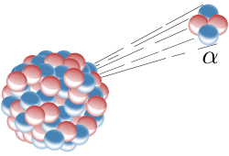


α-decay of ²⁵²Cf
E_{kin}(α)
Mass data: nucleardata.nuclear.lu.se/database/masses/
BE(²⁵²Cf) = 1881.275 MeV
BE(²⁴⁸Cm) = 1859.196 MeV
BE(⁴He) = 28.296 MeV
Q_{α} = 6.217 MeV
E_{kin}(TK)
momentum conservation:
energy conservation:
$${}_{98}^{252}{Cf_{154}→{}_{96}^{248}{Cm_{152}}}+α$$
$${→ E}_{kin}^{α}=Q_{α}∙\frac{m_{k}}{m_{k}+m_{α}}=6.217MeV∙\frac{248}{252}=6.118MeV$$

Slide 7

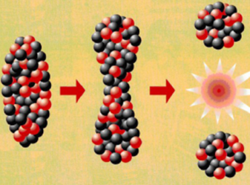
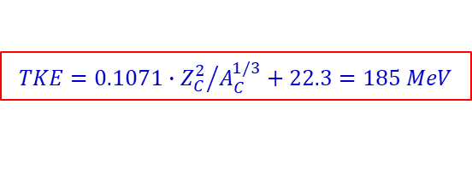

Binary spontaneous fission of ²⁵²Cf
α´s:
96.9%
SF: 3.1%
T_{1/2} = 2.647 a
parameter | experimental value
< A_{L} > | 108.9 ± 0.5 u
<A_{H} > | 143.1 ± 0,5 u
< E_{L} > | 103.5 ± 0.5 MeV
< E_{H} > | 78.3 ± 0.5 MeV
< TKE > | 181.8 ± 0.7 MeV
< A/Z >_{L} | 2.50
< A/Z >_{H} | 2.56
$$V_{C}\left(R_{int}\right)=\frac{1.44∙43∙55}{14}=244 MeV$$
$$TKE=0.1071∙{Z_{C}^{2}}/{A_{C}^{1/3}}+22.3=185 MeV$$

Slide 8
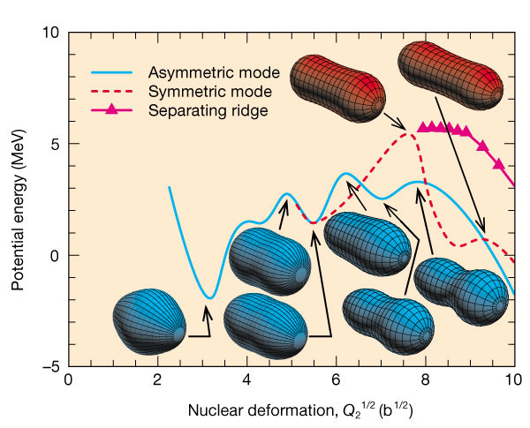
Binary spontaneous fission of ²⁵²Cf

Slide 9
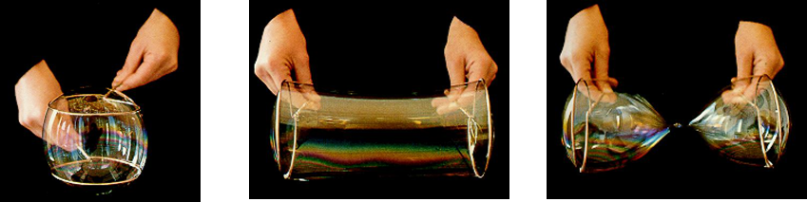
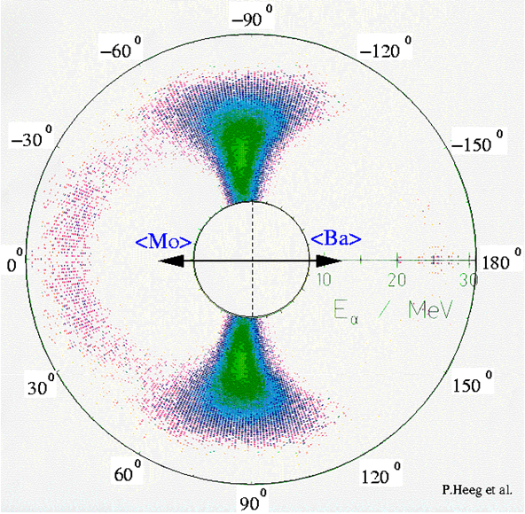
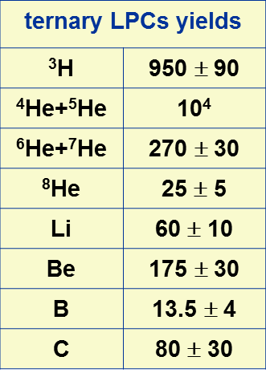
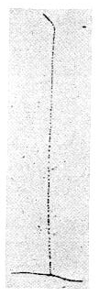
Ternary spontaneous fission of ²⁵²Cf
²⁵²Cf source
T_{1/2} = 2.645 y
bin. fission/α-decay = 1/31
ter. fission/α-decay = 1/8308
photographic emulsion
Tsien San-Tsiang, Phys. Rev. 71 (1947), 128

Slide 10
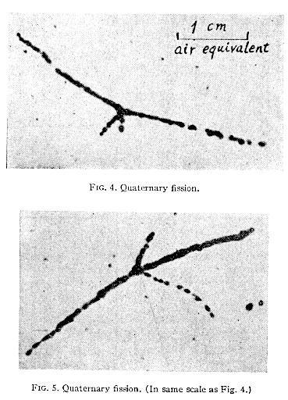
Quaternary spontaneous fission of ²⁵²Cf
Tsien San-Tsiang, Phys. Rev. 71 (1947), 128

Slide 11
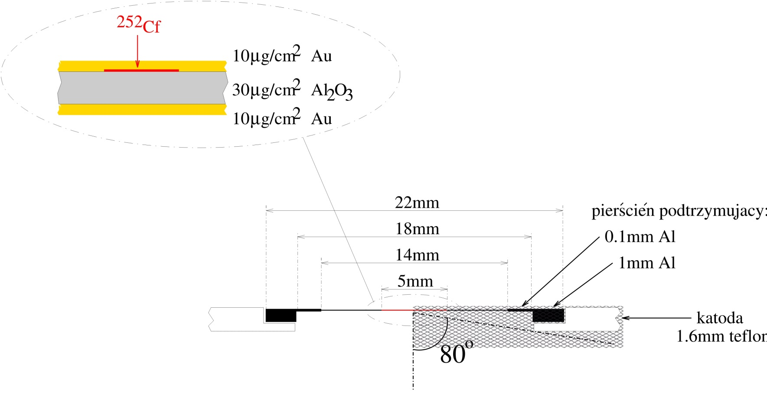
Details of the ²⁵²Cf source

Slide 12
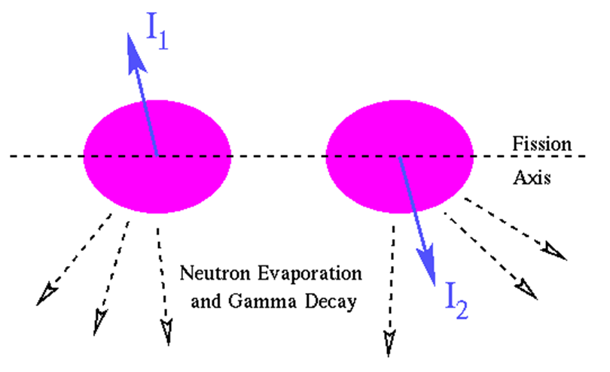
Spontaneous fission of ²⁵²Cf
²⁵²Cf spin J = 0
fragment spin J = < 7-8 >
< N_{γ} > = 9.35
The origin of fragment spins and their alignment:
Collective vibrational modes like bending or wriggling at the saddle-to-scission stage and subsequent Coulomb excitation.
Experimental method:
fragment – γ-ray angular correlation measurement
K. Skarsvag Phys.Rev. C22 (1980) 638

Slide 13
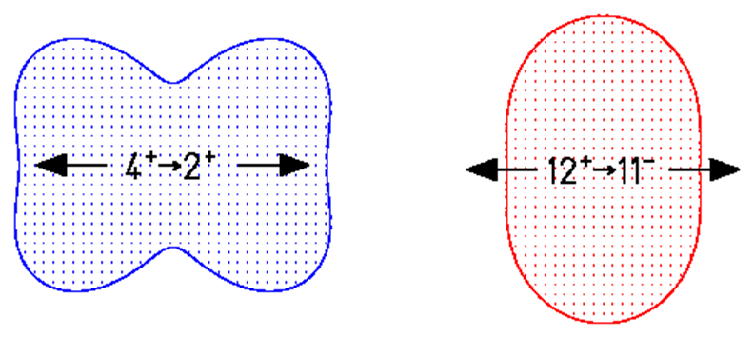
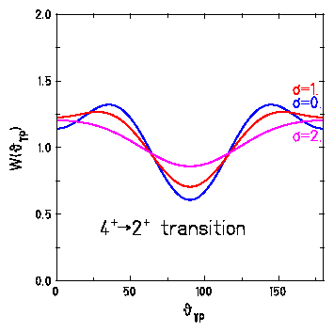
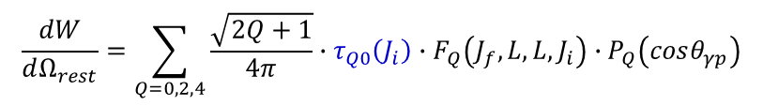
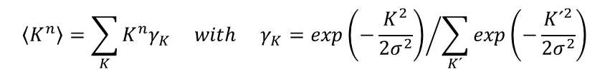
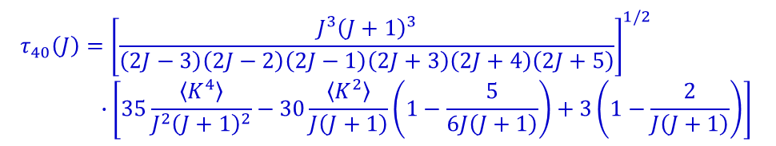
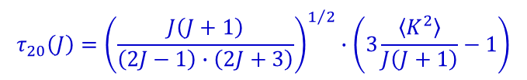
γ-ray emission from aligned nuclei
$$\frac{dW}{dΩ_{rest}}=\sum_{Q=0,2,4}{\frac{\sqrt{2Q+1}}{4π}∙τ_{Q0}\left(J_{i}\right)∙F_{Q}\left(J_{f},L,L,J_{i}\right)∙P_{Q}\left(cosθ_{γp}\right)}$$
Legendre polynomials
γ-γ correlation coefficients
example:
E2
E1
$$τ_{20}\left(J\right)={\left(\frac{J\left(J+1\right)}{\left(2J−1\right)∙\left(2J+3\right)}\right)}^{1/2}∙\left(3\frac{\left\langle K^{2}\right\rangle }{J\left(J+1\right)}−1\right)$$
$$τ_{40}\left(J\right)={\left[\frac{J^{3}{\left(J+1\right)}^{3}}{\left(2J−3\right)\left(2J−2\right)\left(2J−1\right)\left(2J+3\right)\left(2J+4\right)\left(2J+5\right)}\right]}^{1/2}$$
$$∙\left[35\frac{\left\langle K^{4}\right\rangle }{J^{2}{\left(J+1\right)}^{2}}−30\frac{\left\langle K^{2}\right\rangle }{J\left(J+1\right)}\left(1−\frac{5}{6J\left(J+1\right)}\right)+3\left(1−\frac{2}{J\left(J+1\right)}\right)\right]$$
$$\left\langle K^{n}\right\rangle =\sum_{K}{K^{n}γ_{K} with γ_{K}={exp\left(−\frac{K^{2}}{2σ^{2}}\right)}/{\sum_{K´}{exp\left(−\frac{{K´}^{2}}{2σ^{2}}\right)}}}$$
Gaussian distribution
A.L.Barabanov IAE-5670/2 (93)
S.R. de Groot & H.A. Tolhoek, Beta and gamma-ray spectroscopy, ed. K. Siegbahn, p 613 (1955)

Slide 14
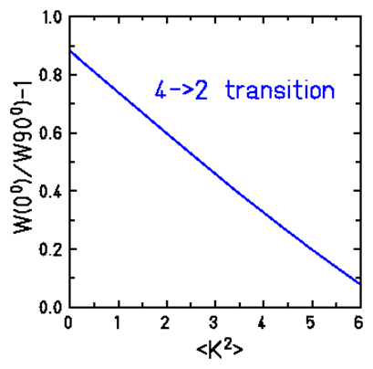
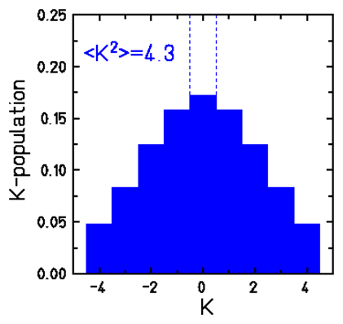
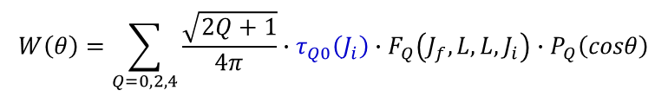
γ-ray emission from aligned nuclei
$$W\left(θ\right)=\sum_{Q=0,2,4}{\frac{\sqrt{2Q+1}}{4π}∙τ_{Q0}\left(J_{i}\right)∙F_{Q}\left(J_{f},L,L,J_{i}\right)∙P_{Q}\left(cosθ\right)}$$
example:
E2
E1
$$τ_{20}\left(J\right)={\left(\frac{J\left(J+1\right)}{\left(2J−1\right)∙\left(2J+3\right)}\right)}^{1/2}∙\left(3\frac{\left\langle K^{2}\right\rangle }{J\left(J+1\right)}−1\right)$$
K-distribution at saddle point
A.L.Barabanov IAE-5670/2 (93)

Slide 15
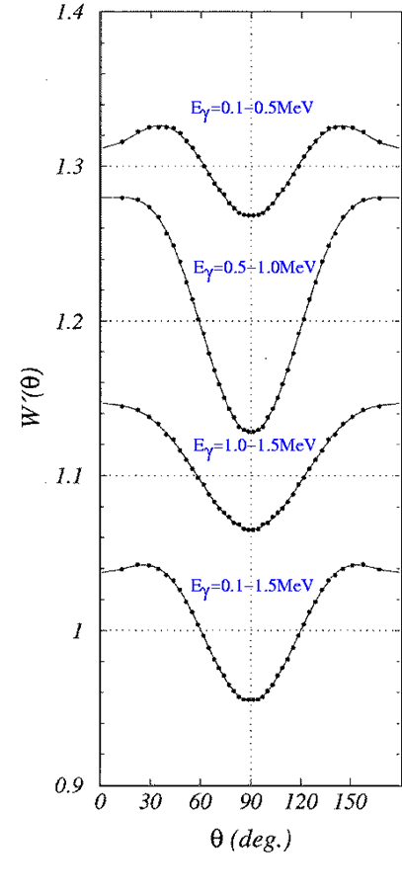
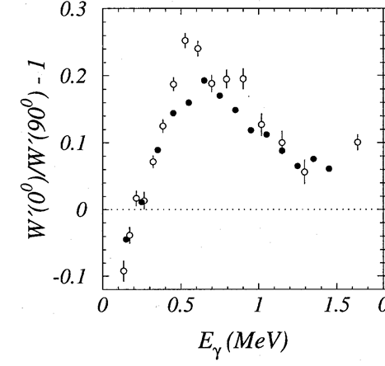
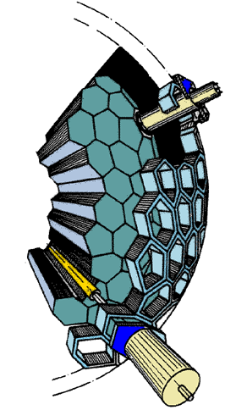
Anisotropy of γ-ray in binary fission of ²⁵²Cf
Darmstadt Heidelberg Crystal Ball
fragment – γ-ray angular correlation measurement
ΔE_{γ} = 90 keV
(no discrimination between different multipole transitions)
Yu.N.Kopatch et al. PRL 82(99),303
K.Skarsvag, PR C22(80),638

Slide 16
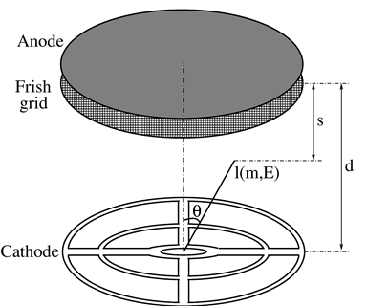
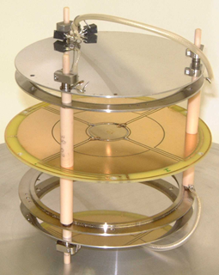
4π twin ionization chamber for fission fragments
measured quantities:
E_{H} A_{H}
E_{L} A_{L}
e⁻ drift-time ϑ
segmented cathode φ
methane at 570 torr
cathode diameter 15cm
²⁵²Cf source (25k f/s)
T_{1/2} = 2.645 y
E_{α} = 6.118 and 6.076 MeV
bin. fission/α-decay = 1/31
ter. fission/α-decay = 1/8308
M.Mutterer et al. Sanibel (97)

Slide 17
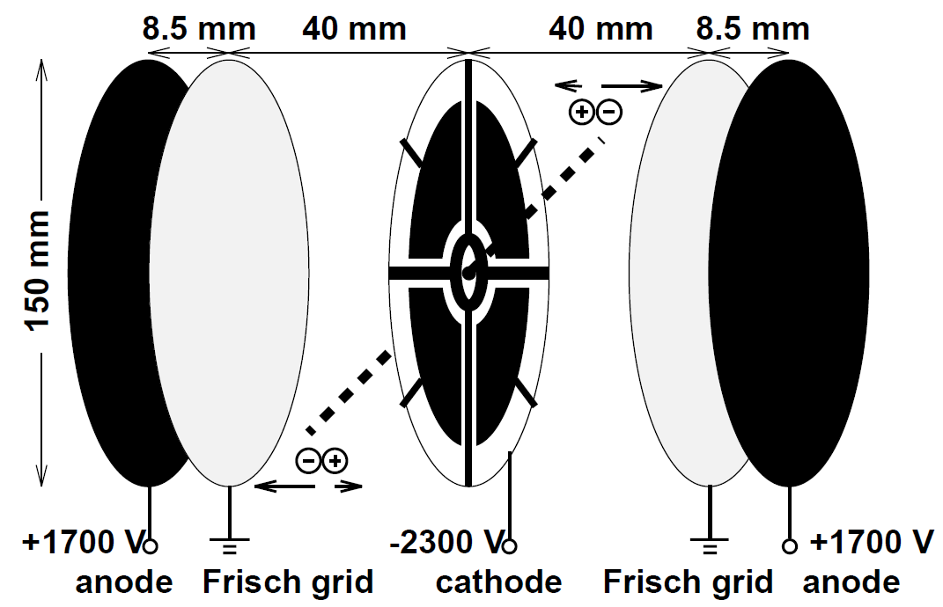
4π twin ionization chamber for fission fragments
measured quantities:
E_{H} A_{H}
E_{L} A_{L}
e⁻ drift-time ϑ
segmented cathode φ
²⁵²Cf source (25k f/s)
T_{1/2} = 2.645 y
E_{α} = 6.118 and 6.076 MeV
bin. fission/α-decay = 1/31
ter. fission/α-decay = 1/8308
M.Mutterer et al. Sanibel (97)

Slide 18
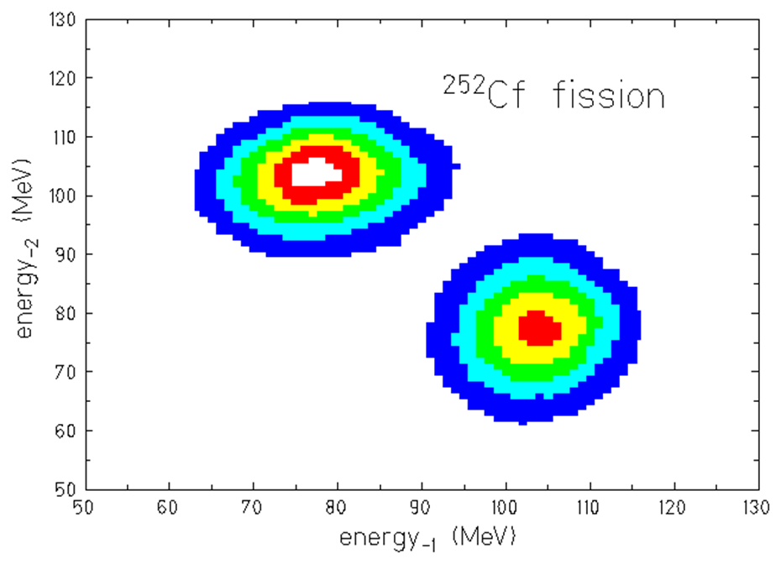
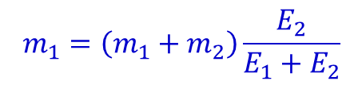
Fission fragment mass measurement
The kinetic energies of the fragments are converted into ionization energy, and the fragments stop before reaching the Frisch grids.
$$m_{1}v_{1}+m_{2}v_{2}=0 → m_{1}E_{1}=m_{2}E_{2}$$
$$m_{1}=\left(m_{1}+m_{2}\right)\frac{E_{2}}{E_{1}+E_{2}}$$
$$\left\langle E_{L}\right\rangle =103.5±0.5 MeV → \left\langle A_{L}\right\rangle =108.9±0.5$$
$$\left\langle E_{H}\right\rangle = 78.3±0.5 MeV → \left\langle A_{H}\right\rangle =143.1±0.5$$
m₁ + m₂ = 252

Slide 19
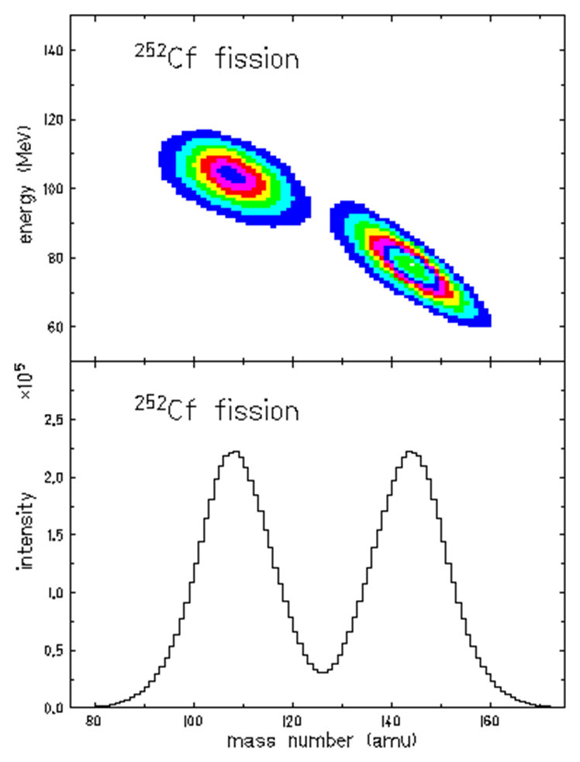
Fission fragment mass measurement
<108.9 u>
<143.1 u>
mass resolution σ = 3 u

Slide 20
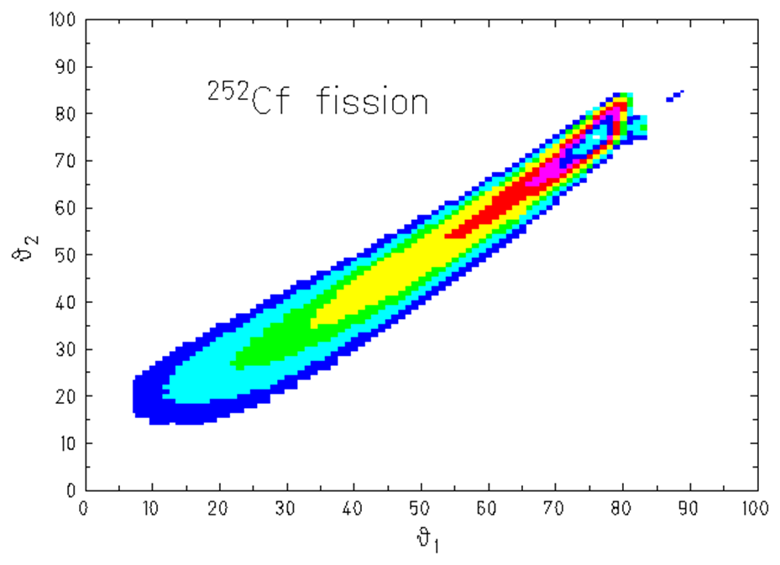
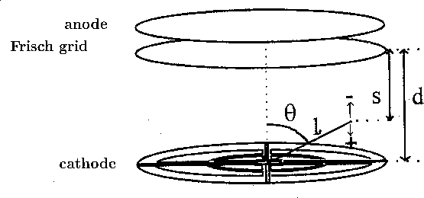


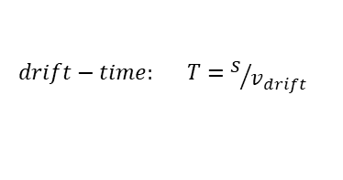
Determination of the polar angles
ϑ
ℓ
The anode time signals are caused by the first electrons which pass the Frisch grids and are thus linear dependent on bot the lengths of the fragment tracks and the cosine of the polar angle θ.
$$drift−time: T=s/{v_{drift}}$$
angular resolution
ϑ | σ
30⁰ | 4.2⁰
50⁰ | 2.5⁰
70⁰ | 2.3⁰
$$s=d−ℓ\left(E,A\right)∙cos\left(θ\right)$$
$$cos\left(θ\right)=\frac{d−T∙v_{drift}}{ℓ\left(E,A\right)}$$
drift velocity: v_{drift} = 10 cm/μs
range of fragments in methan gas: ℓ(E,A)
distance cathode-anode: d = 3.8 cm

Slide 21
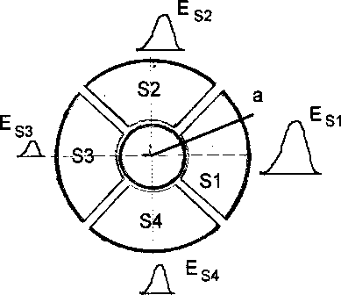


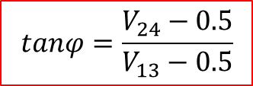
Determination of the azimuthal angle
The energy signal of cathode sections → azimuthal angle φ
energy signals of the four sectors depend on the orientation of the fission axis
$$V_{13}=\frac{E_{S1}}{E_{S1}+E_{S3}}$$
$$V_{24}=\frac{E_{S2}}{E_{S2}+E_{S4}}$$
$$tanφ=\frac{V_{24}−0.5}{V_{13}−0.5}$$

Slide 22
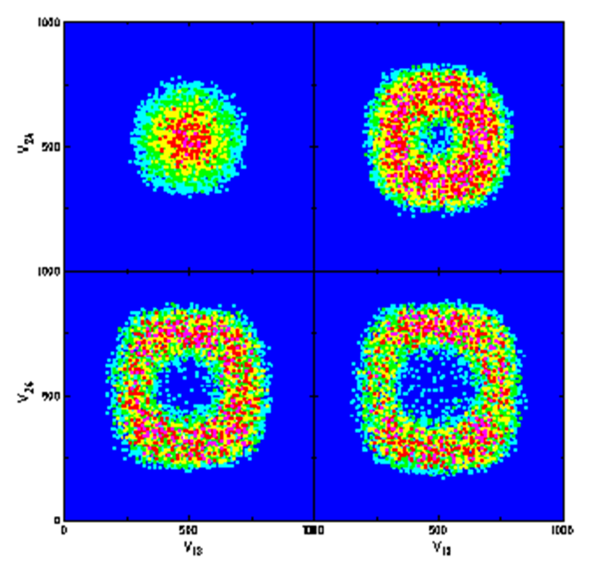

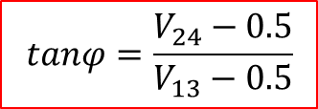

Determination of the azimuthal angle
The energy ratios for different emission angles ϑ
$$V_{13}=\frac{E_{S1}}{E_{S1}+E_{S3}}$$
$$V_{24}=\frac{E_{S2}}{E_{S2}+E_{S4}}$$
$$tanφ=\frac{V_{24}−0.5}{V_{13}−0.5}$$

Slide 23
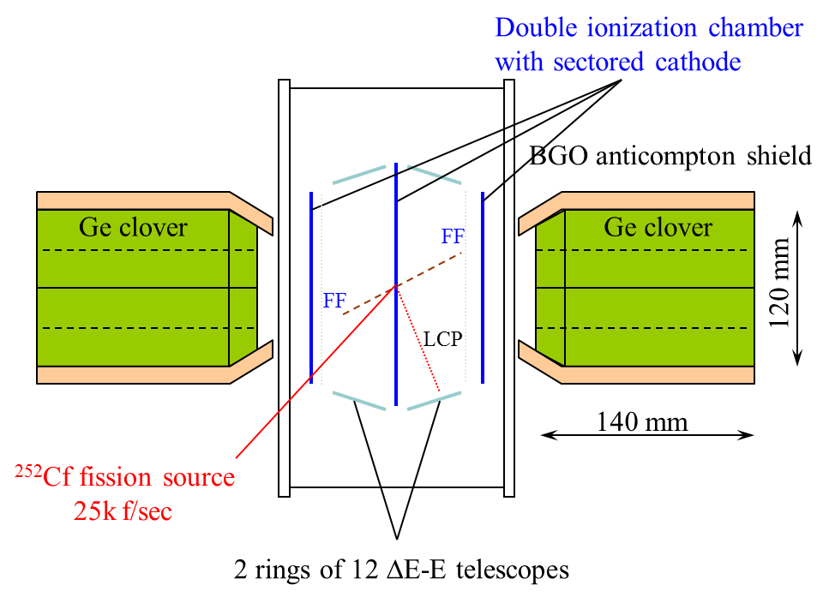
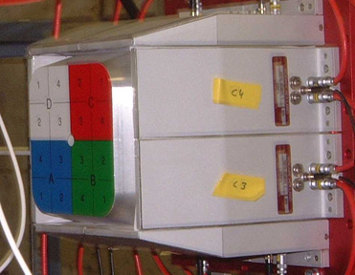
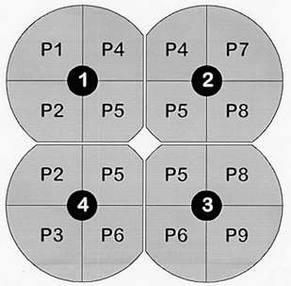
Experimental set-up
4 segmented Clover detector

Slide 24
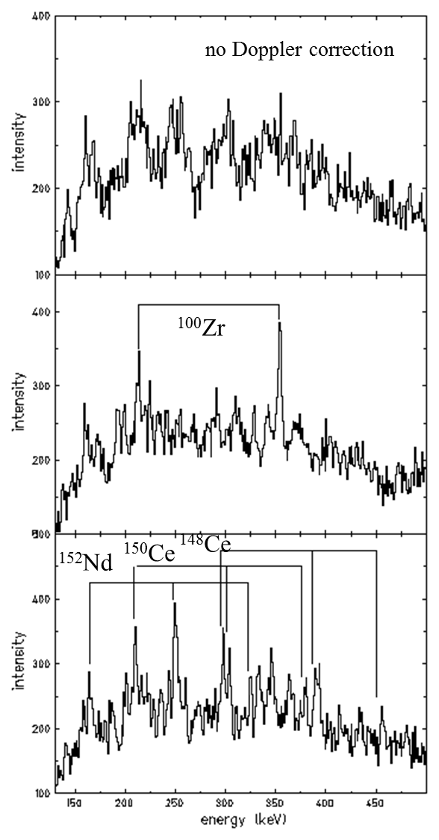

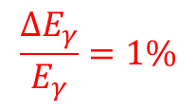
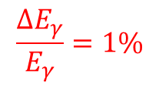

Spectroscopy of binary fission fragments
$$\frac{v}{c}=3.4−4.5 \%$$
$$∆θ_{γ}={18}^{0}$$
$$\frac{ΔE_{γ}}{E_{γ}}=1\%$$
ε_{ph} = 2.5%
$$\frac{ΔE_{γ}}{E_{γ}}=1\%$$

Slide 25
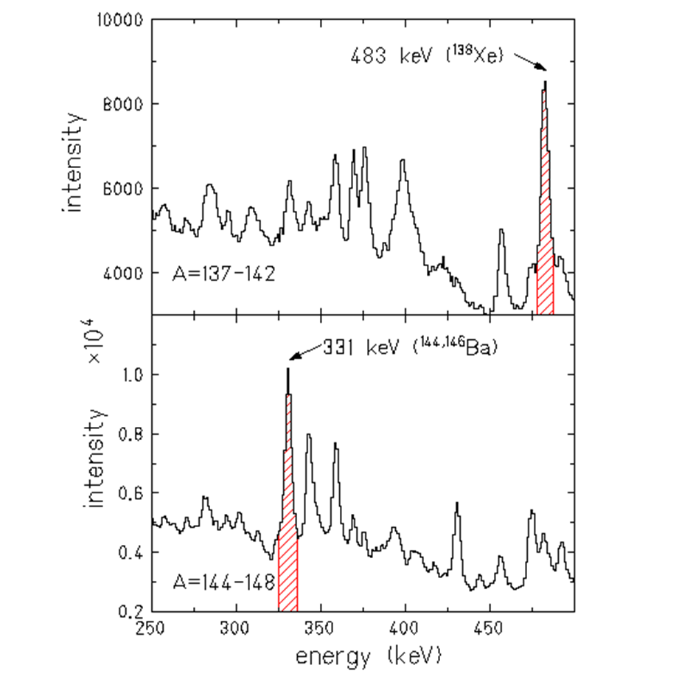


Analysis of the particle-γ angular correlation
$${10}^{0}≤θ_{p}≤{80}^{0}$$
$${−34}^{0}≤θ_{γ}≤{34}^{0}$$

Slide 26


Spontaneous fission process of ²⁵²Cf
excitation energy of fission fragments 35 MeV
evaporation of 3 neutrons

Slide 27



Fission fragment γ-ray angular correlation
$$4^{+}→2^{+} transition$$
crystal ball
no loss of alignment!

Slide 28

Ternary spontaneous fission of ²⁵²Cf

Slide 29

Ternary spontaneous fission of ²⁵²Cf
Fragments → E_{H}, E_{L}, ϑ, φ
LCPs → E, ΔE, ϑ, φ
γ-rays → E, ϑ, φ
2 rings of ΔE-E telescopes

Slide 30



Separation of light charged particles
simulation
data

Slide 31
Summary
γ-ray spectroscopy of fission fragments
open fission source, Doppler-shift correction
access to short-lived γ-ray transitions
angular anisotropy of γ-rays
angular anisotropy of individual γ-ray transitions
spin orientation
changes in the spin population between binary and ternary fission
fragment – LCP correlations
isotope yields of heavier LCPs
formation of LCPs in excited states
quaternary fission (emission of 2 LCPs)
Soap Bubble Experiments (M. Schuyt, Seifenblasen, die Kugeln der Götter, 1988, Köln, Du Mont)

