Slide 1

Outline: Nuclear fission
Lecturer: Hans-Jürgen Wollersheim
e-mail: h.j.wollersheim@gsi.de
web-page: https://web-docs.gsi.de/~wolle/ and click on
history
energy gain
fission barrier
neutron induced nuclear fission
nuclear reactor

Slide 2
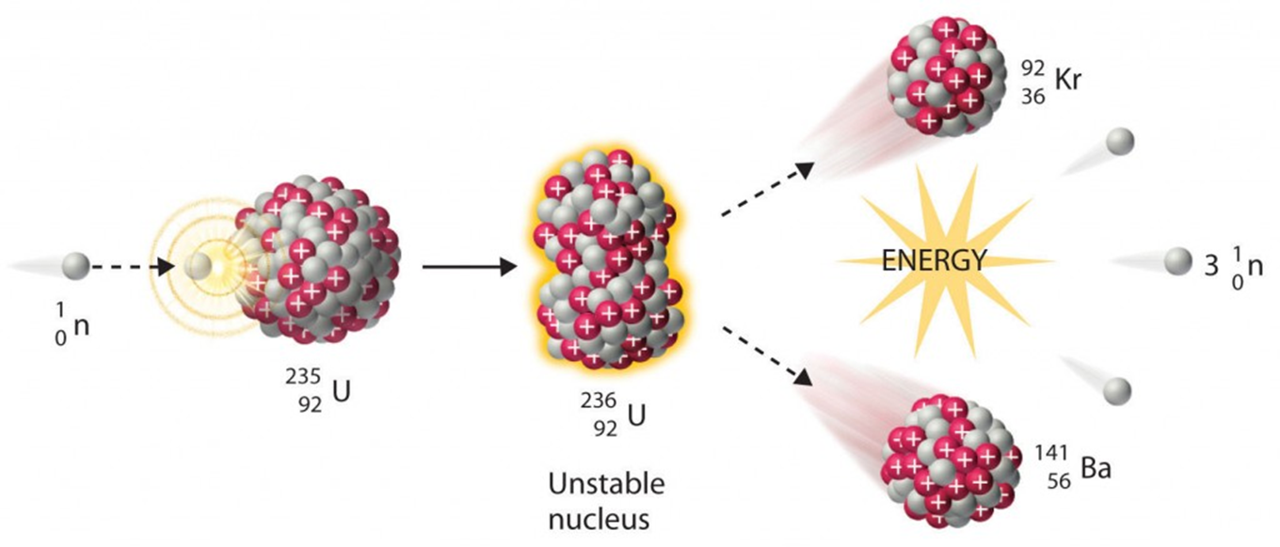
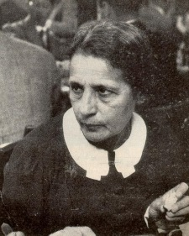
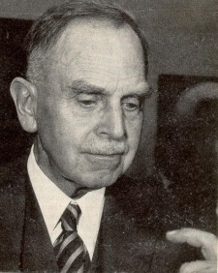
Nuclear fission
Lise Meitner, Otto Hahn

Slide 3
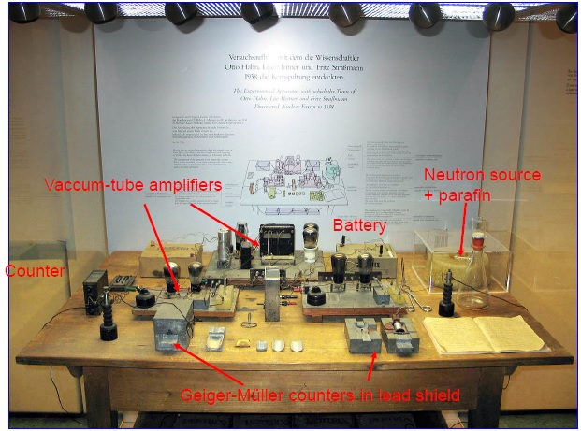
Hahn-Meitner-Strassmann experimental set-up

Slide 4
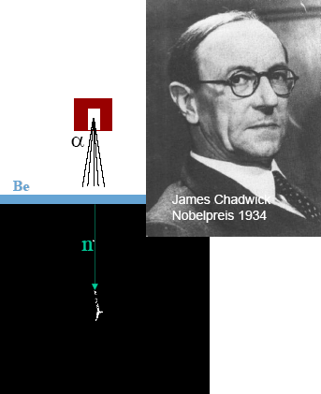
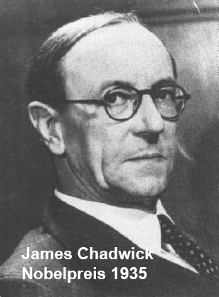
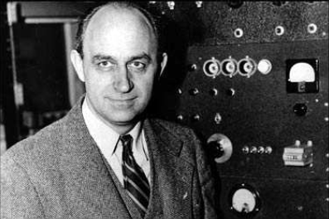
Discovery of fission and the chain reaction
Discovery of the neutron by James Chadwick
( ⁴He + ⁹Be → ¹²C + ¹n + γ)
(Nobel prize 1935)
Fermi bombarded different nuclei with moderated
neutrons and discovered the induced radioactivity
(Nobel prize 1938 und emigration)
Enrico Fermi (1901-1954)
Theoretician and experimentalist;
Fermi statistics, weak interaction,
first nuclear reactor

Slide 5
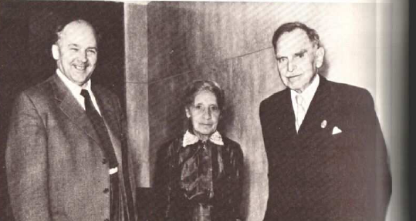
Discovery of fission and the chain reaction
Discovery of nuclear fission by Hahn, Meitner, Strassmann using radiochemical methods
to verify the fission product Barium (Nobel price 1944 without L.M.)
Otto Hahn (1879-1968)
Lise Meitner (1878-1968)
(Emigration 1938)
Fritz Strassmann (1902-1980)
1939 Detection of fission neutrons, with the potential of a chain reaction
(Szilard predicted this in 1933)
Start of the Manhatten projekt, initiator Szilard
(1939 letter from Szilard, Einstein, Wigner to Roosevelt)
Fermi built a nuclear reactor and achieved the first controlled nuclear fission reaction
1945 Atomic bomb (fission of U-235 and Pu-239) dropped on Hiroshima und Nagasaki

Slide 6
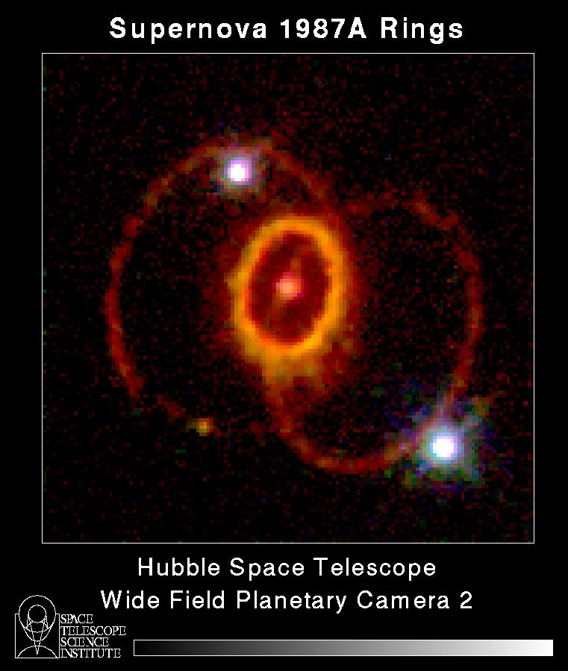
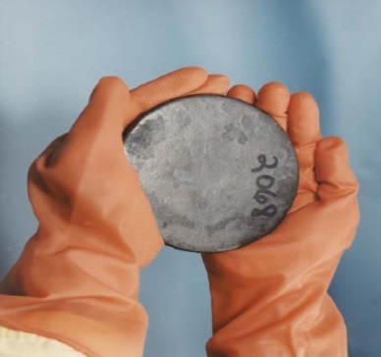
Uranium decay
In a Supernova-explosion, approximately 6 billion years ago, the isotopes Uranium-238 (T_{1/2} =4.5×10⁹ years), Uranium-235 (T_{1/2} =0.7×10⁹ years) and Plutonium-239 (T_{1/2} =24×10³ years) have been produced in equal parts.
Today Pu-239 is completely decayed, while from U-235 and U-238 0.3 % and 40 % are left over, respectively. Uranium fuel elements require a U-235 enrichment of at least 3 %.
Good Uranium mining means a content of 0,3 % Uranium in sedimentary rock and it will be mined for $50/kg Uranium, the world reserve amounts to about 10 Mio tons of natural Uranium. In addition, 100 ×10⁶ tons are estimated in rocks with mining costs of $300/kg. Certain are 4,2 ×10⁹ tons of natural Uranium in sea water which can be extracted for $500/kg.
Alpha-decay:
Spontaneous fission:
- decay of natural Uranium isotopes
Uranium is a silver white shining, soft heavy metal

Slide 7


Energy gain for ²³⁵U
Energy balance of - fission
Mass data: www.nndc.bnl.gov/qcalc http://nrv.jinr.ru/nrv/webnrv/qcalc/
Mass (1u=931.478MeV/c²):
236.045562u → 88.917633u + 143.922940u + 3.025995u
Energy gain: 166.73MeV
Binding energy [M(A,Z) - Z·M(¹H) - N·M(¹n)] :
-1790.415MeV → -766.908MeV - 1190.239MeV
Energy gain: 166.73MeV
1g Uranium → fission products 68 Million kJ
Mass excess [M(A,Z) - A] :
42.441MeV → -76.725MeV – 71.780MeV + 24.214MeV
Energy gain: 166.73MeV

Slide 8
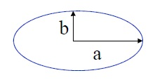



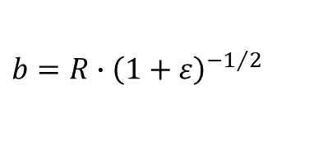


Nuclear fission – spontaneous fission
$$a=R∙\left(1+ε\right)$$
$$b=R∙{\left(1+ε\right)}^{−1/2}$$
saddle point
$$E_{S}=a_{S}∙A^{2/3}∙\left(1+\frac{2}{5}ε^{2}+⋯\right)$$
6 MeV
ground state
potential energy
scission point
$$E_{C}=a_{C}∙Z^{2}∙A^{−1/3}∙\left(1−\frac{1}{5}ε^{2}+⋯\right)$$
$$∆E=\frac{ε^{2}}{5}∙\left(2∙a_{S}∙A^{2/3}−a_{C}∙Z^{2}∙A^{−1/3}\right)$$
$$\frac{Z^{2}}{A}≥\frac{2a_{S}}{a_{C}}≈48$$
deformation
fission barrier ΔE disappears for
This is the case for nuclei with Z>114 and A>270

Slide 9
Spontaneous nuclear fission
Fission is caused in heavy nuclei by the increasing Coulomb force between the protons.
spherical
deformed
saddle
scission
R
R/2^{1/3}
2·R/2^{1/3}
excited
state
fission barrier
ground
state
Fission fragments are deformed
The surface energy and the Coulomb energy is changed due to the ellipsoidal deformation during the fission process.
By exanimating both energy terms one realizes that nuclei with Z²/A ≥ 51 undergo fission spontaneously.
deformation ε

Slide 10
Spontaneous nuclear fission
Fission barrier:
spherical
deformed
saddle
scission
liquid drop model:
excited
state
fission barrier
ground
state
this ratio plays an enormous role
Cohen, Plasil, Swiatecki, Ann. of Phys. 82 (1974), 557
deformation ε
 | Z²/A | E_{S}⁰ [MeV] | E_{C}⁰ [MeV] | X_{S} | ΔE_{F} [MeV]
²³⁵U | 36.02 | 626.0 | 967.4 | 0.773 | 6.1
²³⁸U | 35.56 | 625.9 | 963.3 | 0.770 | 6.4

Slide 11
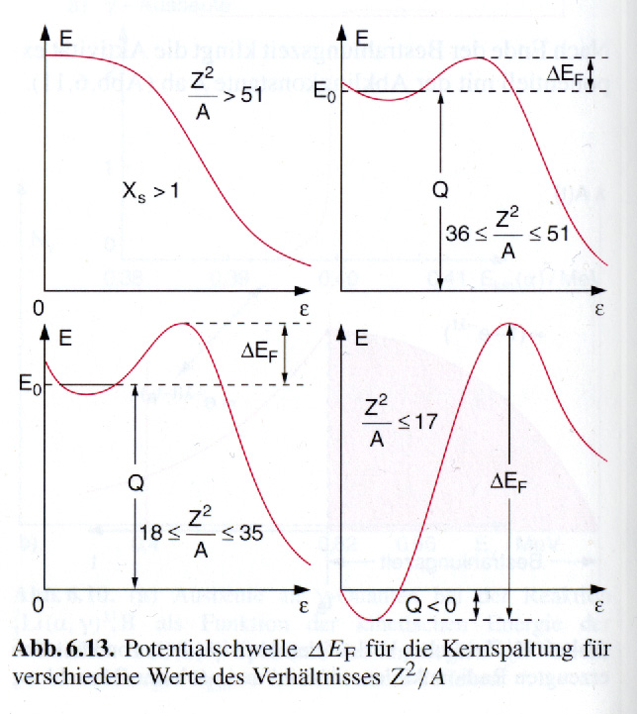
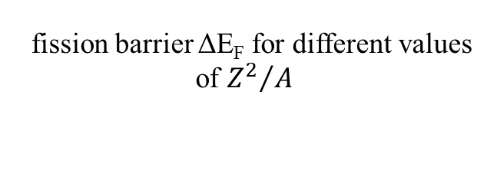
Energy barrier for spontaneous fission
For nuclei with Z²/A < 51 one has to add energy ΔE_{F} in order to observe fission. However, fission is still possible due to the tunneling effect.
The probability for tunneling decrease however very rapidly with decreasing values of Z²/A, since the fragments have comparatively large masses.
fission barrier ΔE_{F} for different values
of ${Z^{2}}/A$

Slide 12
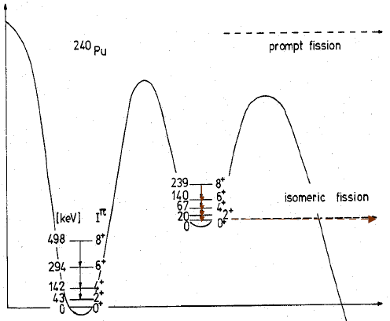
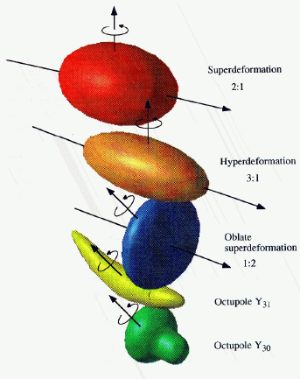

Double humped fission barrier
Energy
²⁴⁰Pu
prompt fission
²³⁸U(α,2n)^{240f}Pu, E_{α}=25 MeV
Measurement of conversion electrons
1.
2.
t_{1/2}=3.8ns
$$\frac{ℏ^{2}}{2∙ℑ}=3.34 keV$$
delayed fission
(axis ratio 2:1)
Superdeformation
2:1
Deformation
Hyperdeformation
3:1
Oblate superdeformation
1:2
Oktupole Y₃₁
Oktupole Y₃₀

Slide 13
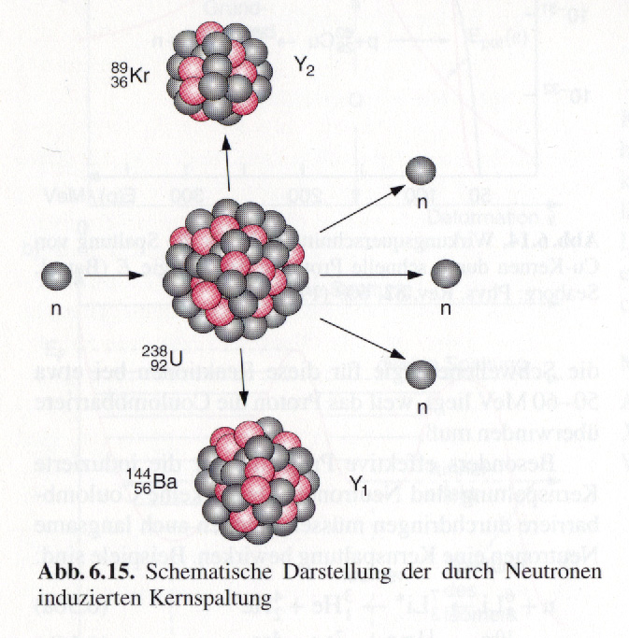
Induced nuclear fission
Neutrons have not to overcome a Coulomb barrier. Therefore, slow neutrons can also induce nuclear fission.
Compound-nucleus: even-odd
Q_{fission}= [M (²³⁸U) + M(¹n) – M(²³⁹U) ]·c² = 4.8 MeV
excitation energy relatively small Q_{fission} < ΔE_{F} = 6.4 MeV
fission is not easily possible
Compound-nucleus: even-even
Q_{fission}= [M (²³⁵U) + M(¹n) – M(²³⁶U) ]·c² = 6.5 MeV
excitation energy relatively large Q_{fission} > ΔE_{F} = 6.1 MeV
fission is easily possible

Slide 14
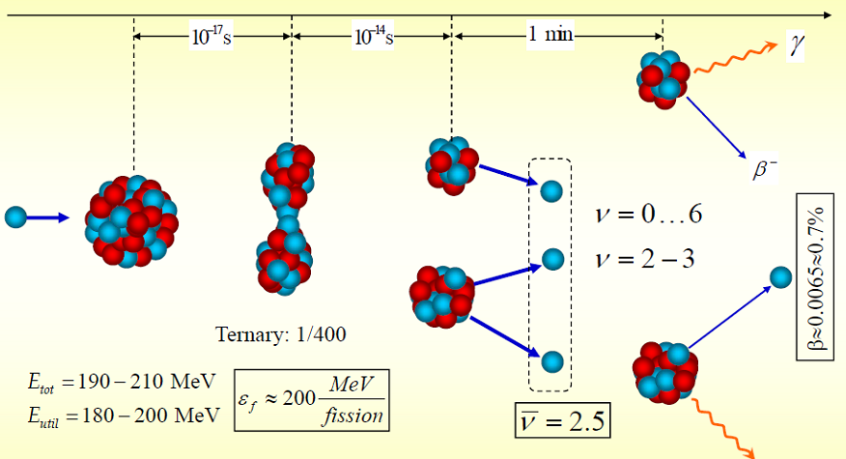
Characteristic properties of nuclear fission

Slide 15
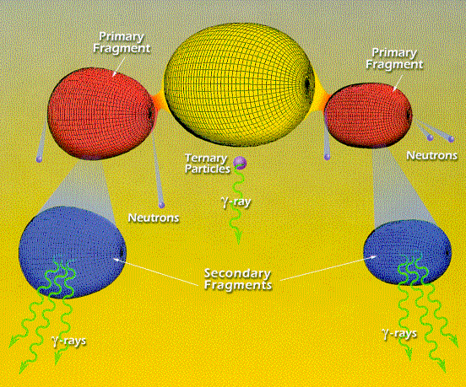
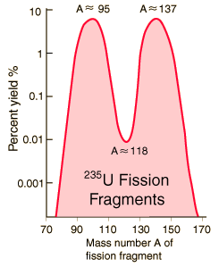

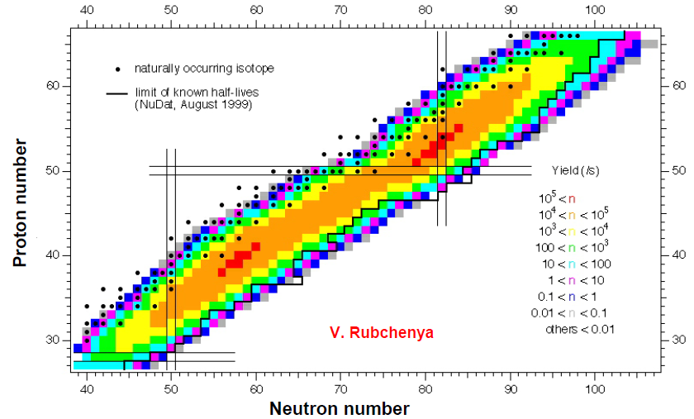
Characteristic properties of nuclear fission
fission asymmetric ⇒ multiple highly excited daughter nuclei

Slide 16
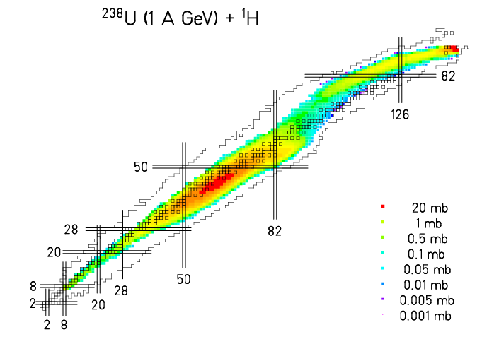
Characteristic properties of nuclear fission
fission asymmetric ⇒ multiple highly excited daughter nuclei

Slide 17
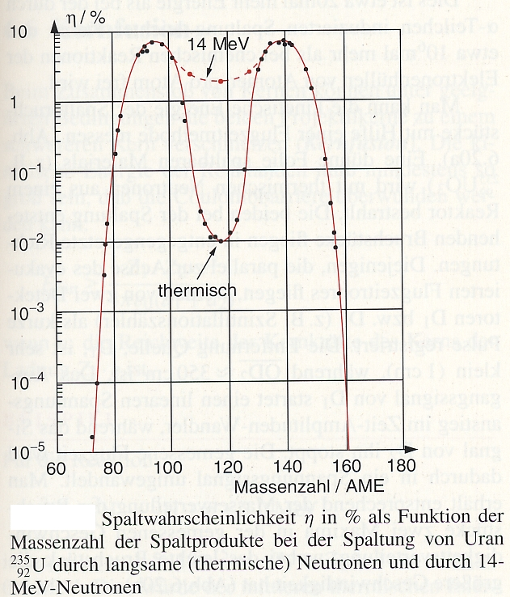
Induced nuclear fission
Fission probability η (in %) for ²³⁵U as a function of the mass number. For different neutron energies (thermal and 14 MeV) one obtains different yields of the fission products.
fission fragment mass [u]

Slide 18
Characteristic properties of nuclear fission
fission asymmetric ⇒ multiple highly excited daughter nuclei
Neutron excess in the daughters:
⇒ many β⁻-instable daughter nuclei (often long living)
examples:
≈1000 different β⁻-instable nuclei after fission
long lived β⁻-emitter together with ²³⁹Pu are called radioactive waste

Slide 19
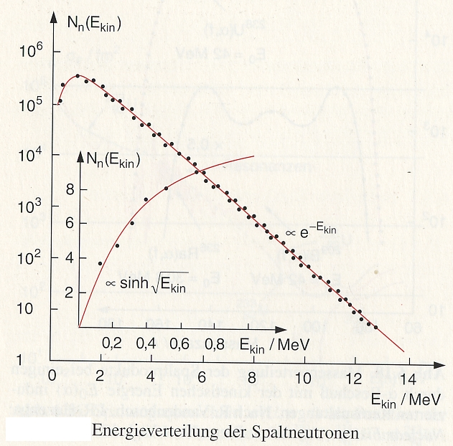
Characteristic properties of nuclear fission
fragments highly excited & neutron excess
⇒ prompt ( Δt < 10⁻¹⁶s ) neutron emission
examples:
thermal
thermal
neutron-energy spectrum ↔ evaporation from a moving source
Maxwell-Boltzmann distribution
k = 8.617·10⁻⁵ eV/⁰K
k·T₀ = 0.0253 eV for T₀=293.61 ⁰K
Important:
Approximately 99% of all neutrons are
immediately released
Only 1% are delayed emitted within a
time window of 0.05s < t < 60s
→ Controlling a nuclear power plant
energy distribution of the fission neutrons

Slide 20
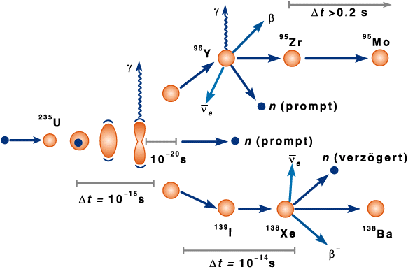
Characteristic properties of nuclear fission
Delayed neutrons ( Δt = 0,2 s … 60 s )
→ ~1% of the neutrons are delayed
β⁻-decay
t_{½} = time delay
delayed

Slide 21
Characteristic properties of nuclear fission
Energy balance of the -fission
Y_{small} 100 MeV β⁻ (fission nuclei) 8 MeV
Y_{large} 70 MeV γ (fission nuclei) 7 MeV
⋅n 5 MeV neutrinos ( ) 12 MeV
γ (prompt) 7 MeV total: 210 MeV

Slide 22
Absorption- and fission cross sections for neutrons
Die bei der Spaltung ausgelösten Neutronen können an einer Reihe unterschiedlicher Reaktionen teilnehmen und für weitere Spaltungen verloren gehen.
Beispiel: (n,γ) Absorptionsreaktion
n + U → U* → U + γ
²³⁵U(n,f)
²³⁵U(n,γ)
²³⁵U(n,f)
Für ²³⁸U ist der WQ für inelastische Stoßprozesse σ(n,n‘γ) größer als der Spaltquerschnitt σ(n,f). In ²³⁸U kann keine Kettenreaktion stattfinden.
Eine Kettenreaktion ist nur mit thermischen Neutronen und Spaltung von ²³⁵U möglich: → Abbremsen (Moderation) der Neutronen.
²³⁵U(n,γ)

Slide 23
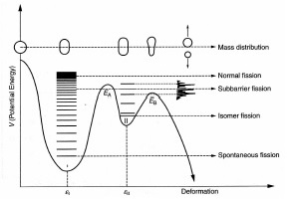
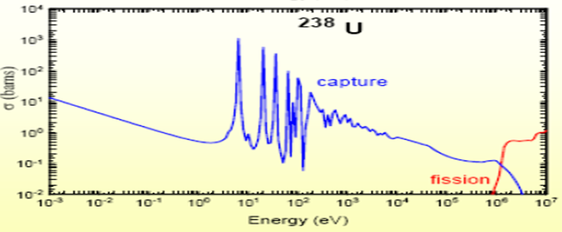
Absorption- and fission cross sections for neutrons
The neutrons, created during fission, can participate in different reactions and are hence lost for future fission processes.
example: (n,γ) absorption reaction
n + U → U* → U + γ
0.0253 eV
thermalized
For ²³⁸U the cross section for inelastic collisions σ(n,n‘γ) is larger than the fission cross section σ(n,f). In ²³⁸U a chain reaction can not occur.
A chain reaction can occur only with thermalized neutrons and fission of ²³⁵U: → slowing down (moderation) of neutrons.

Slide 24
Absorption- and fission cross sections for neutrons
We start with thermalized neutrons,
η is the average number of fission neutrons per thermalized neutron.
0.0253 eV
thermalized
For ²³⁵U: σ_{f} = 584 b and σ_{a} = 97 b, <ν>=2.4
For ²³⁸U: σ_{f} = 0 b and σ_{a} = 2.1 b
Effective value of η = 1.3 for natural Uranium is too small for chain reaction.
→ ²³⁵U has to be enriched to 3% (η=1.8)

Slide 25
Interactions of neutrons with matter
Slowing down of neutrons by elastic nuclear collisions:
M
m
v₀
v₁
v₂
Kinematic of the reaction ⇒
no excitation, no capture, no fission
example:
Average energy loss of the neutrons per collision:

Slide 26
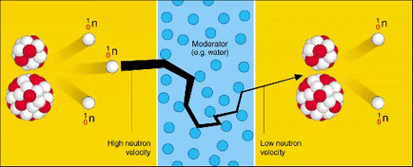
Thermalization of neutrons
Example: water ( H₂O ) as moderator → scattering on protons, A = 1
Rough estimate of the number of collisions k until thermalisation:
Moderator | Average collision number for a slowing down from 1,75 MeV to 0.025 eV | Tendency to capture thermalized neutrons in relative units
Hydrogen | 18 | 650
Deuterium | 25 | 1
Beryllium | 86 | 7
Carbon | 114 | 10

Slide 27
Further neutron losses
²³⁸U-absorption
Reactor poison, e.g. the fission product ¹³⁵Xe: σ_{f} ( ²³⁵U ) ≈ 500 b
σ_{abs} ≈ 3 000 000 b
Control rod material ( Cd, B ) ⇒ controlled neutron-absorption
Reactor fuel: σ_{tot}( ²³⁵U ) > σ_{f}( ²³⁵U )

Slide 28
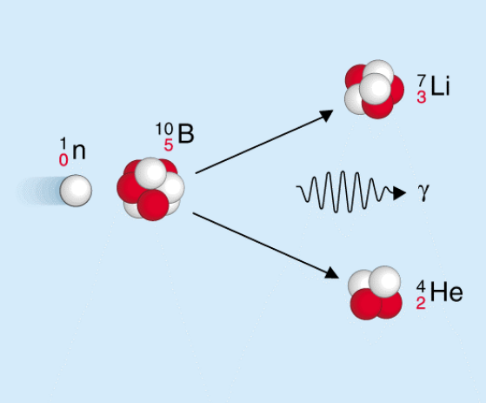
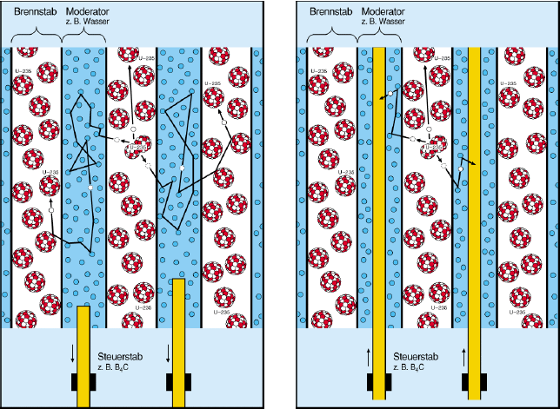
Steering of the chain reaction
Control rods:
Material with large neutron-absorption: B, Cd, In, Ag
fuel rod
moderator
e.g. water
fuel rod
moderator
e.g. water
control rod
e.g. B₄C
controlrod
e.g. B₄C

Slide 29
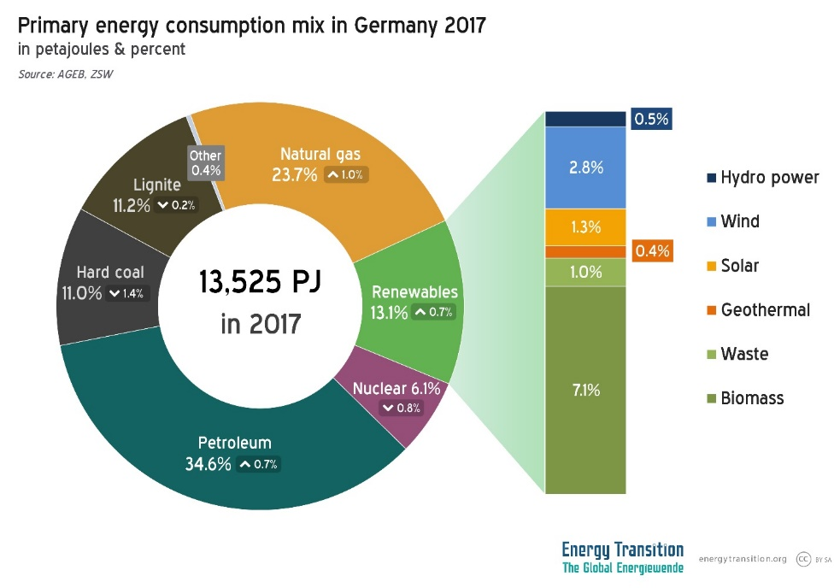
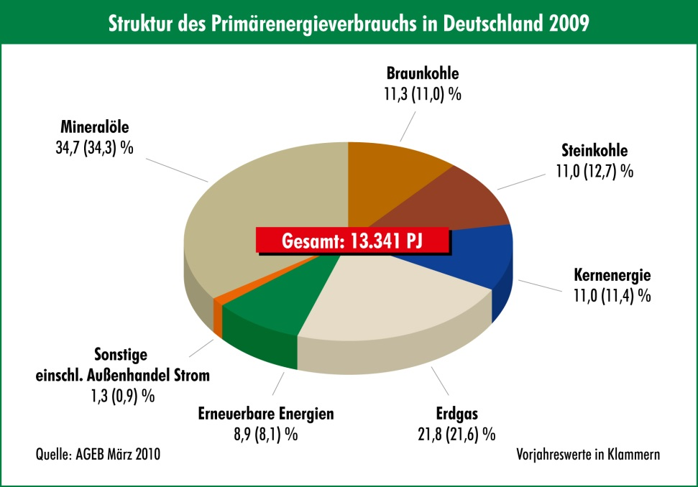
Energy consumption of humans in Germany
Information in power (Watt) = energy / time (Joule/sec) per head, annual mean
turnover of the body (food → heat) 100 Watt
total consumption on primary energy 5000 Watt
(civilization increases consumption by a factor of 50 !!!)
total consumption on final energy (2005) 3700 Watt
electrical power consumption (with industry) 750 Watt
Private households heating and hot water 1000 Watt

Slide 30
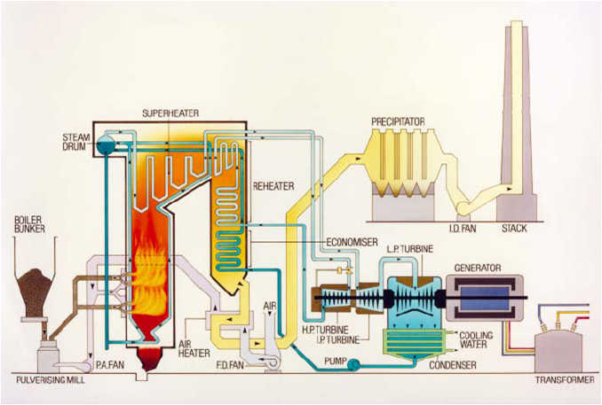
Chemical energy
Chemical energy is atomic energy in the truest sense of the word.
Origin of the chemical energy: Change of the covalent bonds between atoms which are the molecular building blocks.
12g Carbon-burning with 32g Oxygen (O₂) Thermal energy: 393 kJ ~ 30 kJ/gC
reaction C + O₂ → CO₂ + 4.1 eV
Thermal energy (Q = m·c·ΔT, c = 4180 JK⁻¹kg⁻¹) :
30 kJ can heat up 1 liter of water by 7⁰ Celcius .
Electrical energy (W = power times time) :
30 kJ can keep a 100 Watt lamp 5 minutes long switched on.
Mechanical energy (W = mass · earth acceleration · height) :
30 kJ lift a mass of 70kg 43 meter high.

Slide 31
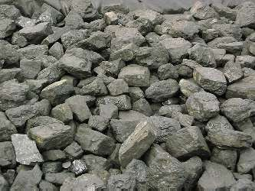
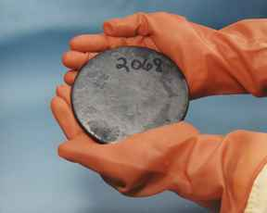
Comparison with coal burning
If one burns 1 kg of hard coal one obtains an available energy of 8.14 kWh.
In nuclear fission of 1 kg Uranium one obtains an available energy of 22 700 000 kWh.
Nuclear bond 200 MeV is significant stronger than molecular bond 4.1 eV.
Uranium is as „fuel“ three million times more effective than hard coal.
In fission of 1 kg Uranium we obtain the same energy as if we would burn 2800000 kg of Carbon to 10.2 millions kg of Carbon dioxyd!!!

Slide 32
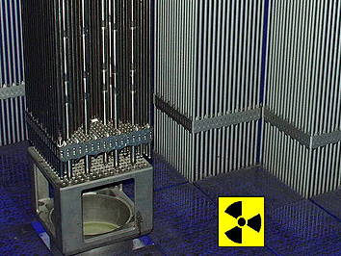
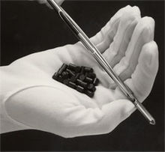
Nuclear reactor (functional principle)
Reactor core contains
→ fuel enriched Uranium with ~3% U-235
(comparison: enrichment of bomb: 80% U-235)
→ moderator water under high pressure (150 bar), to
slow down the neutrons (increase of the
fission probability) and for cooling
(fission energy is turns into kinetic energy of
fission products, which heats up the fuel)
→ absorber movable control rods (B, Cd, Gd) to
adjust the absorption of the neutrona, so that
k=1 (critical) to keep up the chain reaction.
A fuel rod and Uranium-oxide pellets, the fuel of most power reactors.

Slide 33
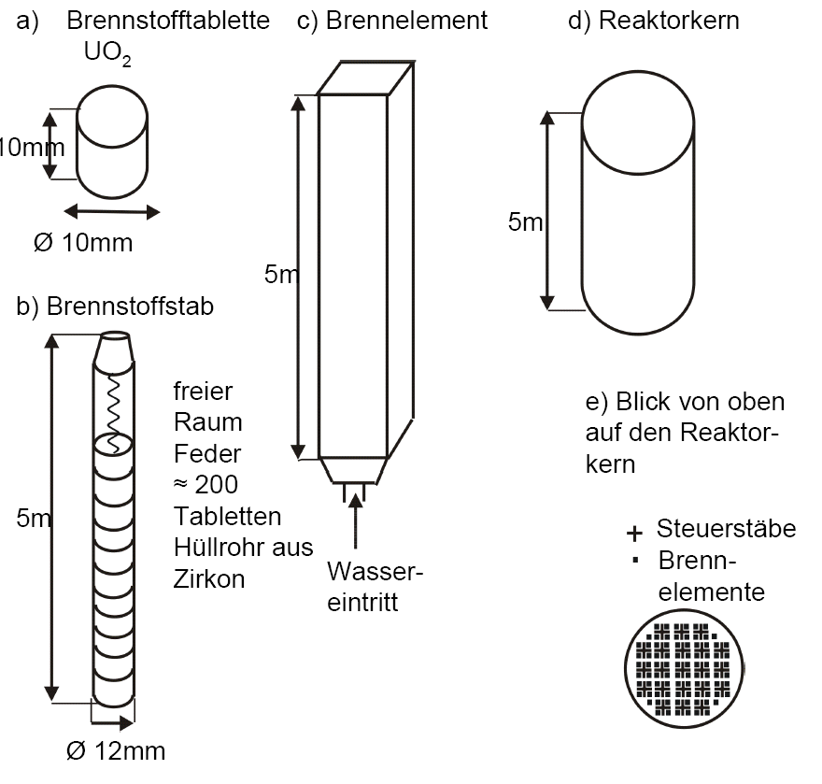
From the fuel pellet to the reactor core
Fuel in form of fuel elements, ~200 of these, each individual water- moderated and cooled. Each element consists of 20-30 fuel rods, each fuel rod consists of 200 Uranium-oxide pellets size of a pellet:
1 cm in height, 1 cm diameter.
fuel pellets
fuel element
reactor core
fuel rod
free space spring
~ 200 pellets tube made out of zirconium
e) view from top
on the reactor core
control rods
fuel elements
water
entry

Slide 34
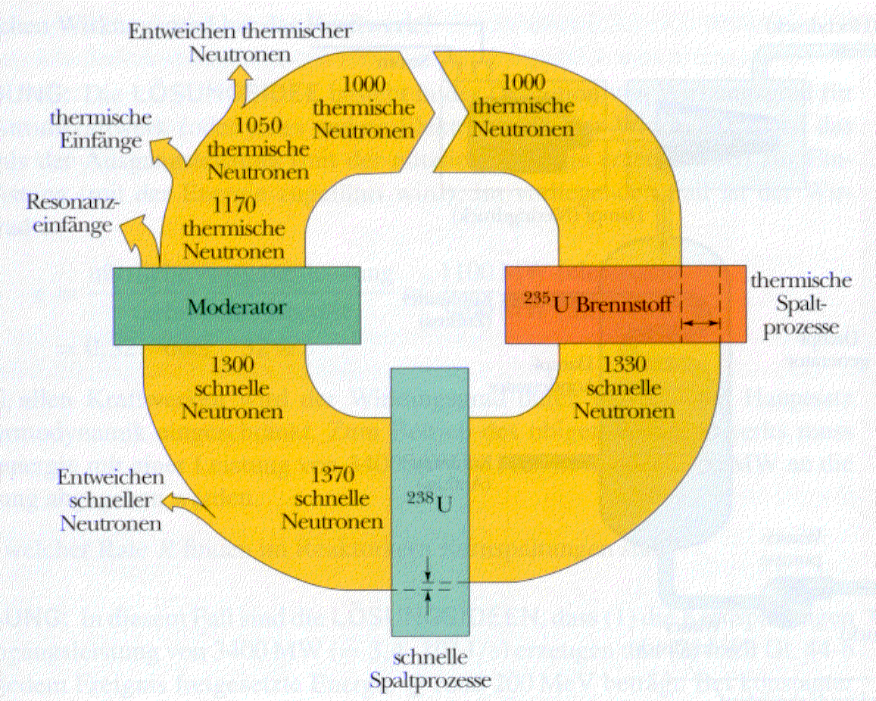
Neutron balance in a reactor
Start:

Slide 35

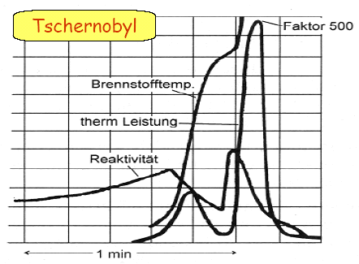
Reactor dynamics
neutron lifetime:
thermal reactor: ~ 20 μs
fast reactor: ~ 0.5 μs
multiplication factor (reactivity):
k<1 reactor runs down (will be stopped)
k=1 constant power
k>1 reactor runs up (getting started)
$$k_{eff}=\frac{neutron production rate}{neutron loss rate}$$
factor 500
How is a reactor running a stable mode?
fuel temperature
assumption: k=1.001
after 1 s: 50000 generations
power multiplication per second:
thermal power
reactivity
Why does a reactor not explode?

Slide 36
Reactor dynamics
How is a reactor running in a stable mode?
Examples for the change of reactivity during operation:
0.5% of the neutrons from 235-U are emitted delayed by about 10 s from the fission fragments
k<1: under critical reactor
1<k<1+β: delayed critical reactor
k>1+β: prompt critical reactor
burn-off of nuclear fuel
conversion (“breeding”) due
to neutron bombardment
decay of fission material
adding neutron poisons
(e.g. Bor in water, control rods)
change in the moderator-fuel ratio
density change of water (temperature)
bubble formation (pos./ neg. reactivity coefficient)
water losses
reactivity losses due to Doppler broadening
of the reaction cross sections at high
temperatures
factor 500
fuel temperature
thermal power
reactivity

Slide 37
Reactor dynamics
Examples for the change of reactivity during operation:
If one reduces the reactor power there will be
an excess of ¹³⁵Xe (neutron poison), which
will reduce the reactivity even more and only
after many hours it will vanish.
Xenon peak: ¹³⁵Xe is a neutron poison
During operation ¹³⁵Xe will be continuously
reduced du to neutron bombardment
factor 500
In Tschnobyl all control rods were removed in order to prevent a complete shut-down of the reactor due to the Xe-peak. Then the power increased so fast that the control rods could not been brought back fast enough. The positive bubble coefficient increased the reactivity in addition. First the explosive ejection of fuel made the reactor under-critical.
fuel temperature
thermal power
reactivity

Slide 39
Energy transfer in a nuclear reactor
release of nuclear binding energy during fission
Transfer into kinetic energy of the fission products
Thermal energy due to slowing down of the fragments (neutrons) in the solid fuel
Use of the thermal energy to heat and evaporate the cooling medium (water)
Water steam will be guided to a turbine
Transformation of the rotational energy of the turbine into electrical energy via a
generator
Supply the electricity into the grid
The waste heat will be given either directly (e.g. into a river) or indirectly (e.g. via a cooling tower to air) to the environment.

Slide 40
Generating electrical energy in a reactor
( im Prinzip wie bei konventionellen Kraftwerken)
Primärkreislauf (Moderator und Kühlwasser) unter hohem Druck von 150 bar, durch Brennelemente auf Temperatur 330⁰ C erhitzt, gibt Wärme über Wärmetauscher an Wasser des Sekundärkreislaufs weiter, zur Verdampfung bei 70 bar.
Dampf treibt Turbine, Turbine treibt Stromgenerator.
Bilanz: Spaltenergie wird in Wärme, Wärme in elektrische Energie verwandelt. Wirkungsgrad umso höher je höher die Temperaturdifferenz (daher Druck hoch). Typisch 35%.

Slide 41
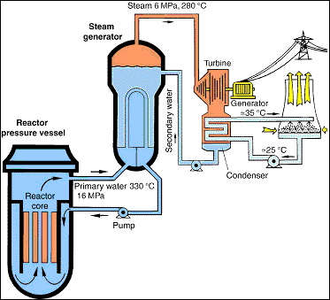
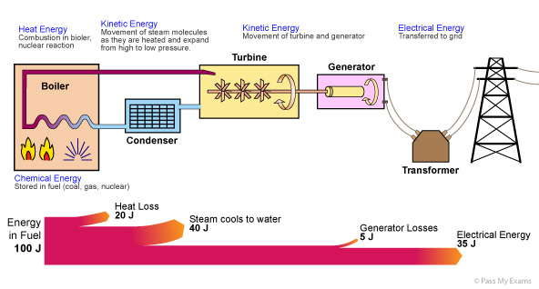
Energy transfer in a hot water reactor

Slide 42
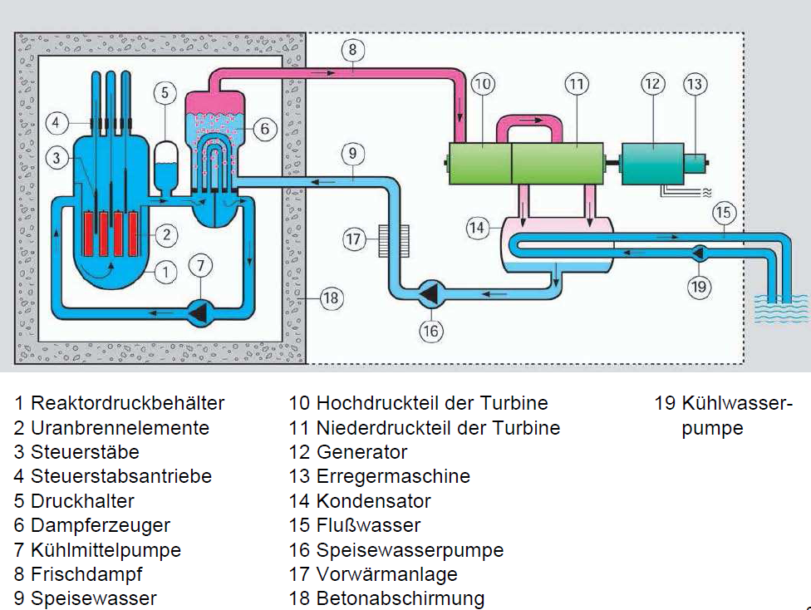
Energy transfer in a pressure water reactor

Slide 43
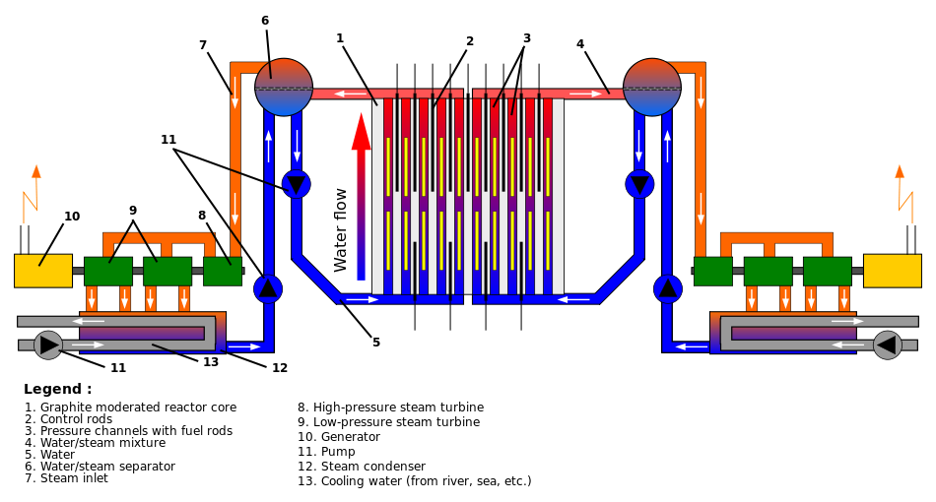
Light water reactor in Chernobyl
The graphite-moderated nuclear power reactor in Chernobyl could use natural Uranium. There are 1661 fuel channels and 211 control rod channels in the graphite blocks.

Slide 44
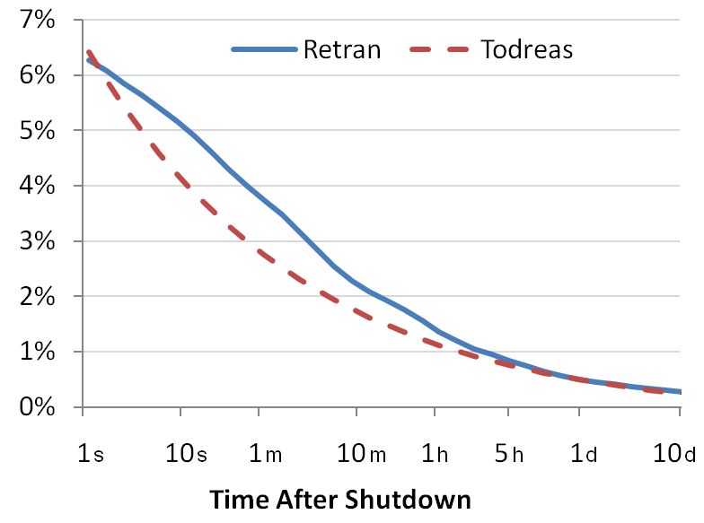
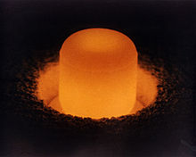
Decay heat
The Plutonium-dioxide pellet is glowing red because of the heat generated by the radioactive decay.
When a nuclear reactor has been shut down and nuclear fission is not occurring at a large scale, the major source of heat production will be due to the delayed beta decay of these fission products (which originated as fission fragments). For this reason, at the moment of reactor shutdown, decay heat will be about 6.5% of the previous core power if the reactor has had a long and steady power history. About 1 hour after shutdown, the decay heat will be about 1.5% of the previous core power. After a day, the decay heat falls to 0.4%, and after a week it will be only 0.2%. (WIKIPEDIA)

Slide 45
Decay heat after 11 month of operation
If a reactor is operated for the time T₀ [s] with a power of P₀, then the decay heat power P at the time t [s] after the shut-down of the reactor
Time after shut-down | Decay heat in percent | Thermal power for 4000 MW before shut-down | Time to heat-up 2500 m³ water from 15 °C to 100 °C
10 Sekunden | 3,72 % | 149 MW | 100 min
1 Minute | 2,54 % | 102 MW | 146 min
1 Stunde | 1,01 % | 40 MW | 6 h
1 Tag | 0,44 % | 18 MW | 14 h
3 Tage | 0,31 % | 13 MW | 20 h
1 Woche | 0,23 % | 9 MW | 26 h
1 Monat | 0,13 % | 5 MW | 49 h
3 Monate | 0,07 % | 3 MW | 89 h

Slide 46
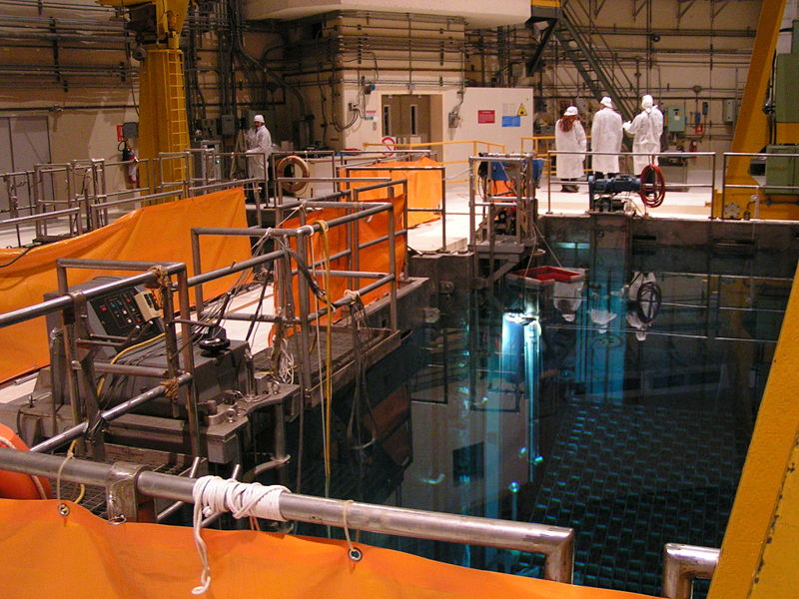
Storage pool
In case of a leakage or failure of the cooling the water can leak out or evaporate. In this case the stored fuel elements can be excessively heated.
Is water still present in the pool, the Zircaloy of the fuel rods can react with the water steam at ~800⁰ C. In an exotherm redox reaction Zirconium-oxide and Hydrogen is produced which will create an explosive Knallgas mixture in a short time.
In case of no cooling at all the fuel rods can start burning which will destroy the fuel elements.

Slide 47
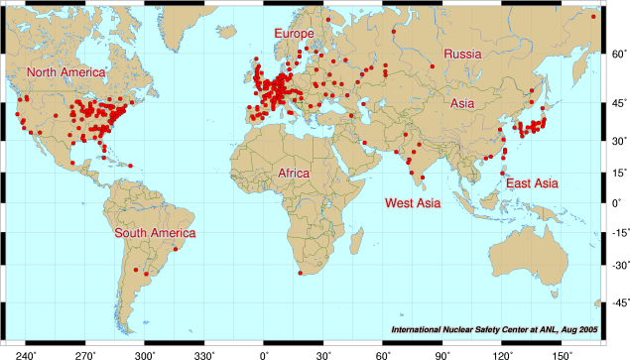
World nuclear energy
440 nuclear power reactors in 50 countries (March 2022)
~10% of the world energy production (2022)
55 more reactors in construction

