Slide 1

Outline: Halo nuclei
Lecturer: Hans-Jürgen Wollersheim
e-mail: h.j.wollersheim@gsi.de
web-page: https://web-docs.gsi.de/~wolle/ and click on
total reaction cross section
energy eigenvalues
radius of the deuteron
momentum distribution

Slide 2

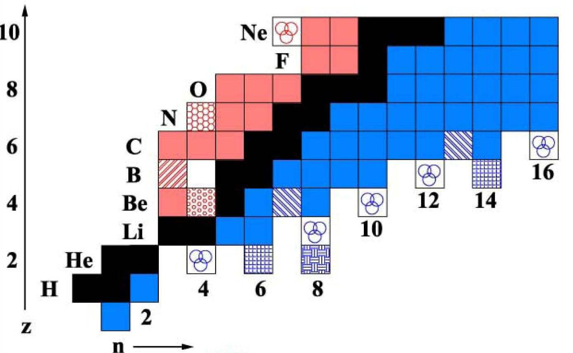
Limits of stability: Halo nuclei
stable nuclei
dripline nuclei
continuum
more neutrons
p
n
p
n

Slide 3
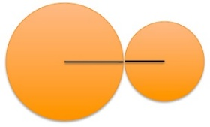
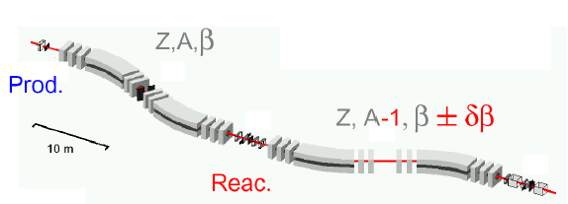
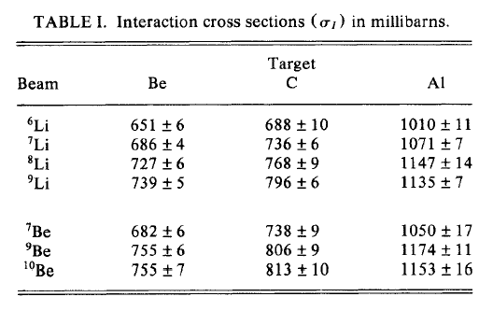
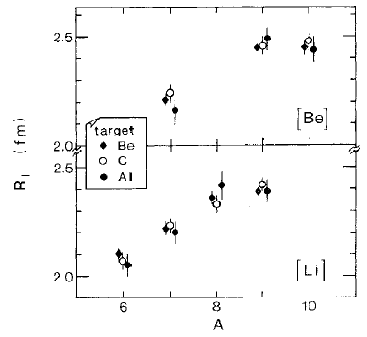

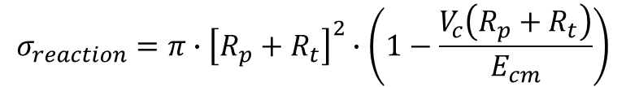
Measurement of the total reaction cross section
P
T
800 MeV/u ¹¹B primary beam
Fragmentation
FRagment Separator FRS
$$σ_{reaction}=π∙{\left[R_{p}+R_{t}\right]}^{2}∙\left(1−\frac{V_{c}\left(R_{p}+R_{t}\right)}{E_{cm}}\right)$$
$$σ_{reaction}=π∙{\left[R_{p}+R_{t}\right]}^{2}$$

Slide 4
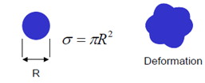
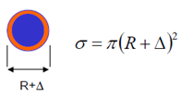
Measurement of the total reaction cross section
P
T
¹¹Li is the heaviest bound Li isotope
¹⁰Li not bound
S_{2n}(¹¹Li) = 295(35) keV
only bound in its ground state
reason for larger radius?
deformation
extended wave function

Slide 5
At the limit of the strong force – halo nuclei
reason for larger radius?
deformation
extended wave function
⇒ measurements of magnetic moment and quadrupole moment
¹¹Li consists in its ground state of paired neutrons and p_{3/2} proton
g-factor of nucleons:
proton: g_{ℓ} = 1; g_{s} = +5.585
neutron: g_{ℓ} = 0; g_{s} = -3.82
proton:
neutron:

Slide 6
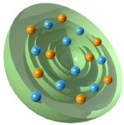
Success of the shell model
Magnetic moments:
g-factor of nucleons:
proton: g_{ℓ} = 1; g_{s} = +5.585
neutron: g_{ℓ} = 0; g_{s} = -3.82
proton:
neutron:

Slide 7
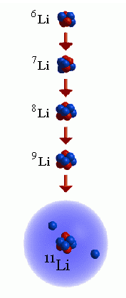

At the limit of the strong force – halo nuclei
reason for larger radius?
deformation
extended wave function
⇒ measurements of magnetic moment and quadrupole moment
¹¹Li consists in its ground state of paired neutrons and a p_{3/2} proton
3 borromean rings
→ spherical and large radius not because of deformation
Exotic nuclei with large neutron excess form nuclei with halo-structure: ¹¹Li nuclei consist of a normal ⁹Li nucleus with a halo of two neutrons. Halo nuclei form borromean states, they are interlocked in such a way that breaking any cycle allows the others to disassociate.
HALO:

Slide 8
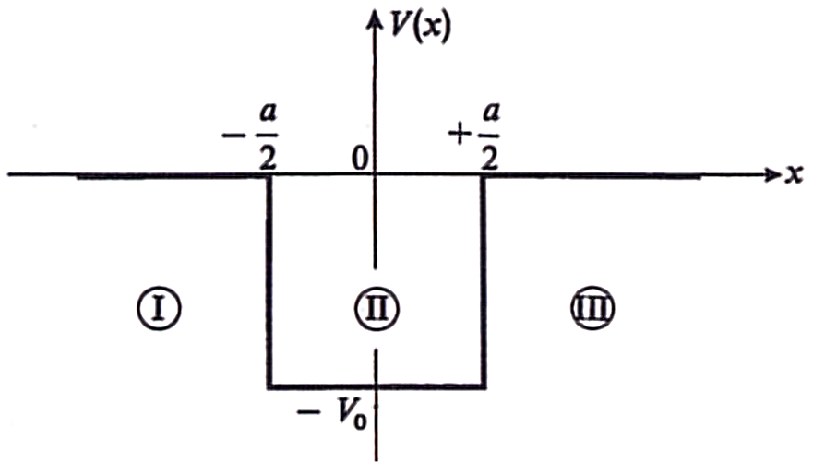
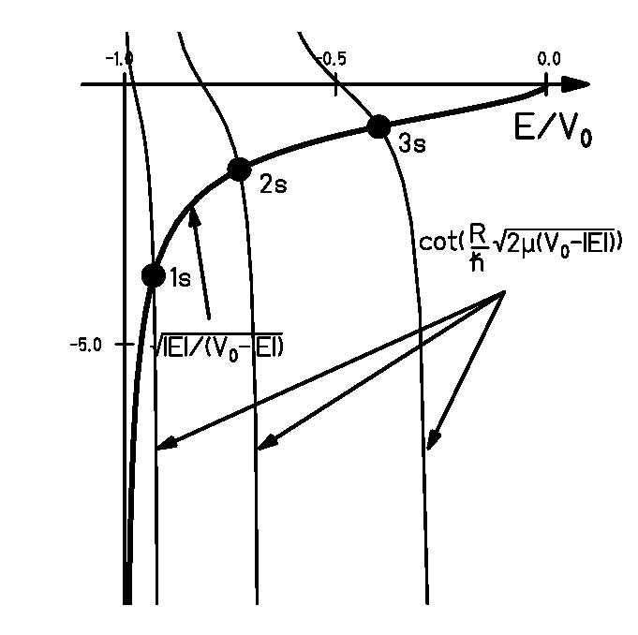




Single particle potential
outside of the square-well potential:
$$\left\{\frac{d^{2}}{dx^{2}}+\frac{2∙m}{ℏ^{2}}∙E\right\}φ\left(x\right)=0$$
$$κ^{2}=−\frac{2∙m}{ℏ^{2}}∙E$$
Lösung:
inside of the square-well potential:
$$\left\{\frac{d^{2}}{dx^{2}}+\frac{2∙m}{ℏ^{2}}∙\left(E+V_{0}\right)\right\}φ\left(x\right)=0$$
$$k^{2}=−\frac{2∙m}{ℏ^{2}}∙\left(E+V_{0}\right)$$
Lösung:
continuity of the wave function:
graphical solution of the eigenvalue problem

Slide 9
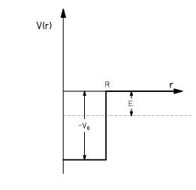


Energy eigenvalues
Schrödinger equation:
$$\left[−\frac{ℏ^{2}}{2∙μ}∇^{2}+V\left(r\right)\right]ψ\left(r\right)=Eψ\left(r\right)$$
$$\frac{d^{2}u}{dr^{2}}+\frac{2}{r}\frac{du}{dr}+\left[\frac{2∙μ}{ℏ^{2}}\left(E−V\left(r\right)\right)−\frac{ℓ∙\left(ℓ+1\right)}{r^{2}}\right]u\left(r\right)=0$$
ℓ=0 energies:
ℓ=1 energies:
ℓ=2 energies:
Orbital nℓ | E_{nℓ} (MeV) ³⁶Ca R=3.96fm | E_{nℓ} (MeV) ³⁶Ca V₀=54.7MeV | E_{nℓ} (MeV) ³⁶S V₀=47.3MeV
1s | 13.16 | 9.75 | 9.55
1p | 26.90 | 19.77 | 19.31
1d | 44.26 | 32.20 | 31.32
2s | 52.61 | 37.55 | 36.25
1f | 65.08

Slide 10
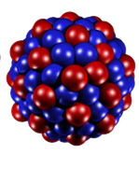
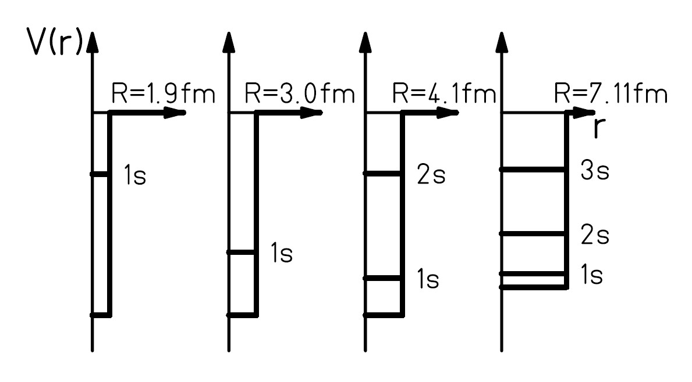
Energy eigenvalues
Energy eigenvalues for ℓ=0 in ⁴He, ¹⁶O, ⁴⁰Ca und ²⁰⁸Pb

Slide 11
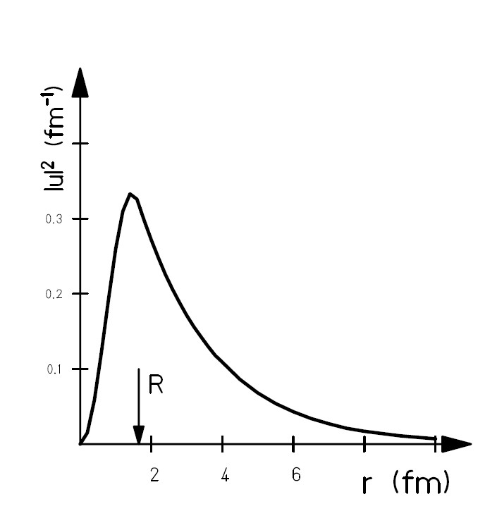


Wave function of the deuteron
$$k=\frac{\sqrt{2∙μ∙\left(V_{0}−\left|E_{n,s}\right|\right)}}{ℏ}$$
$$κ=\frac{\sqrt{2∙μ∙\left|E_{n,s}\right|}}{ℏ}$$
Ι
ΙΙ
normalization:

Slide 12
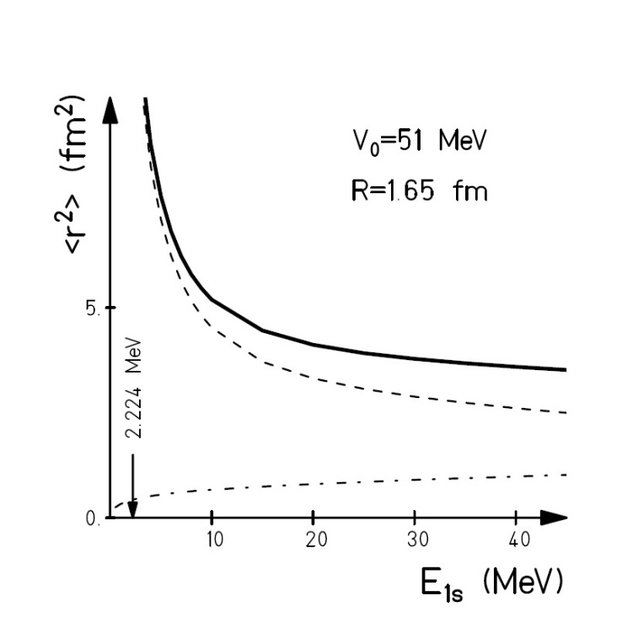
Radius of the deuteron
Ι
ΙΙ
outer region
inner region

Slide 13



Limits of stability: halo nuclei
What can one expect at the neutron-dripline?
wave function outside of the potential
$$κ^{2}=\frac{2∙μ∙E}{ℏ^{2}}≈0.05∙E\left(MeV\right) \left[{fm}^{−2}\right]$$
The smaller the binding energy, the more extended the wave function
$$\left\langle r^{2}\right\rangle =\frac{1}{2∙κ^{2}}∙\left(1+κ∙R\right)≈\frac{ℏ^{2}}{4∙μ∙S_{n}}$$
E | κ² | κ | 1/κ ~ r
7 MeV | 0.35 fm⁻² | 0.6 fm⁻¹ | 1.7 fm
1 MeV | 0.05 fm⁻² | 0.2 fm⁻¹ | 4.5 fm
0.1 MeV | 0.005 fm⁻² | 0.07 fm⁻¹ | 14 fm
Fourier-transform:
$${\left|F\left(p\right)\right|}^{2}=ℏ∙κ∙\frac{1}{π^{2}∙{\left(κ^{2}∙ℏ^{2}+p^{2}\right)}^{2}}$$

Slide 14
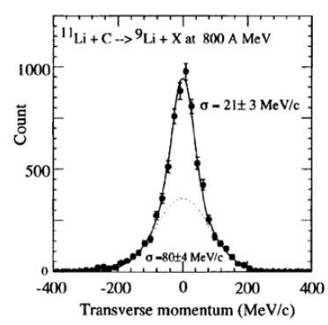
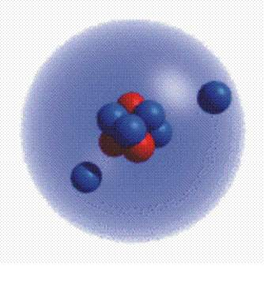


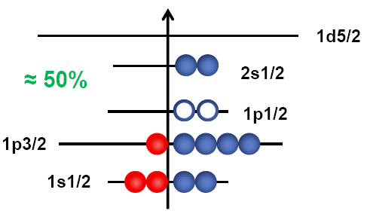
Limits of stability: halo nuclei
test of the extended wave function
momentum distribution:
wider momentum distribution for strongly bound particles
narrow momentum distribution for weakly bound particles
$$∆p∙∆x ≥ ℏ$$
small → large
interpretation:
One can simplify ¹¹Li by describing it as a ⁹Li core plus a di-neutron
One can use the arguments of an extended wave function with an exponential decline:
S_{2n}=250(80) keV
N=8
N=2
$$κ^{2}=\frac{2∙μ_{2n}∙S_{2n}}{ℏ^{2}}$$

Slide 15

Discovery of halo nuclei
2. Momentum distribution of ¹¹Li
⁶He distribution from ⁸He
similar to Goldhaber model
⁹Li distribution from ¹¹Li (very narrow ! )
uncertainty principle
$$∆p∙∆x ≥ ℏ$$
small → large
wider distribution is similar to Goldhaber model

Slide 16

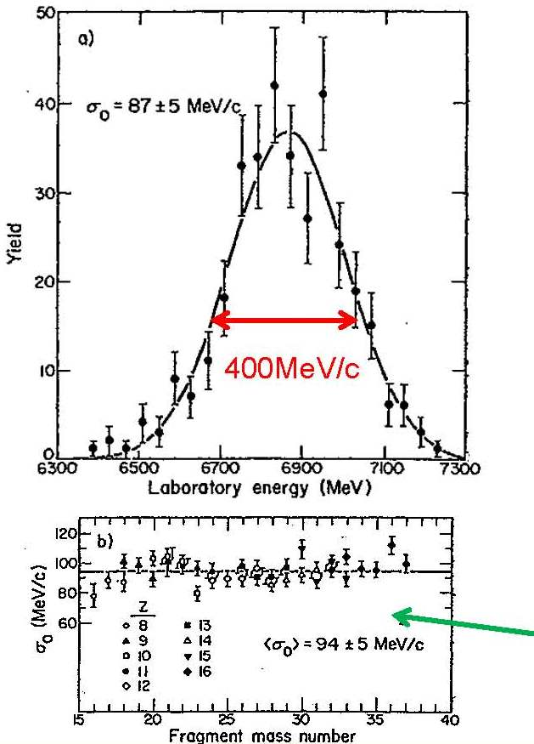
Momentum distribution of fragments
example: ³⁴S fragments from ⁴⁰Ar + C @ 213 AMeV )
³⁴S fragments: 400 MeV/c narrow
⁴⁰Ar beam: 26600 MeV/c
Momentum distribution of fragments are represented by a simple formula based on the Goldhaber model
A: beam mass number
F: fragment mass number
σ₀ = 90 MeV/c

Slide 17
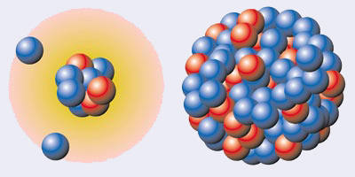
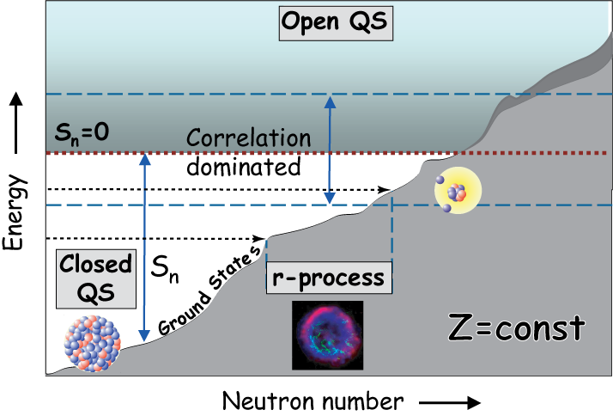
Limits of stability - halo nuclei
Why is the shell structure changing at extreme N/Z ?
radii of lighter nuclei
¹¹Li
²⁰⁸Pb
Prog. Part. Nucl. Phys. 59 (2007), 432

Slide 18
Berechnen sie den Radius der 2-Neutron Wellenfunktion für ¹¹Li
¹⁰Li ist nicht gebunden
Man kann ¹¹Li sehr vereinfacht beschreiben als ⁹Li plus einem Di-Neutron.
S_{2n}(¹¹Li) = 0.295(35) MeV

