Slide 1

Outline: Relativistic Coulomb excitation
Lecturer: Hans-Jürgen Wollersheim
e-mail: h.j.wollersheim@gsi.de
web-page: https://web-docs.gsi.de/~wolle/ and click on
production, separation, identification of RIBs
scattering experiments at relativistic energies
relativistic Coulomb excitation
Doppler shift correction
experimental results with RIBs

Slide 2
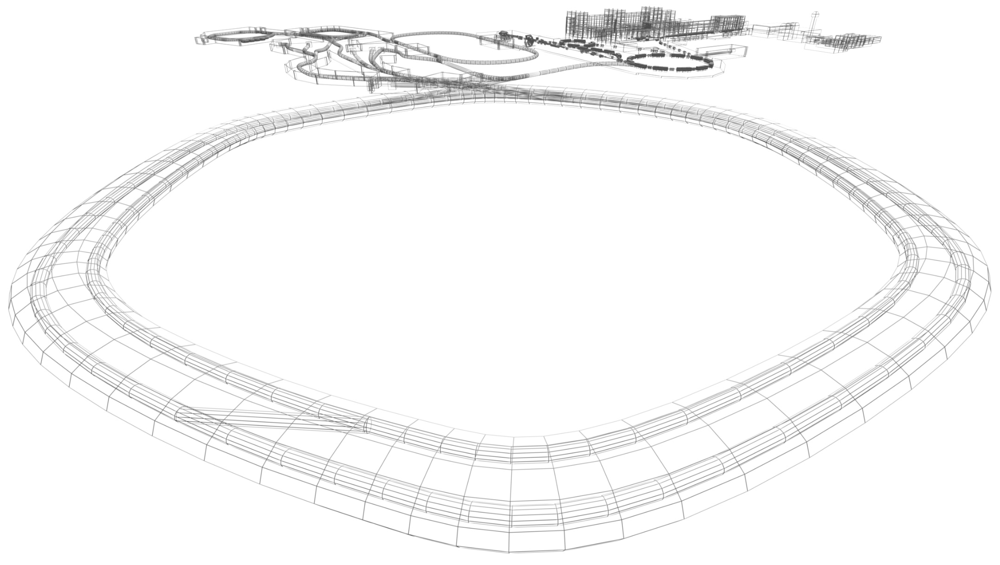

Physics with exotic nuclei
NUclear STructure, Astrophysics and Reactions

Slide 3


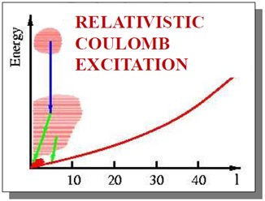
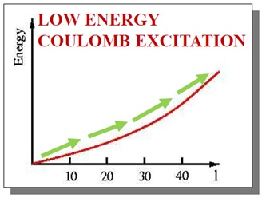
High-energy Coulomb excitation
SIS-18
UNILAC
Christoph Fleischmann

Slide 4
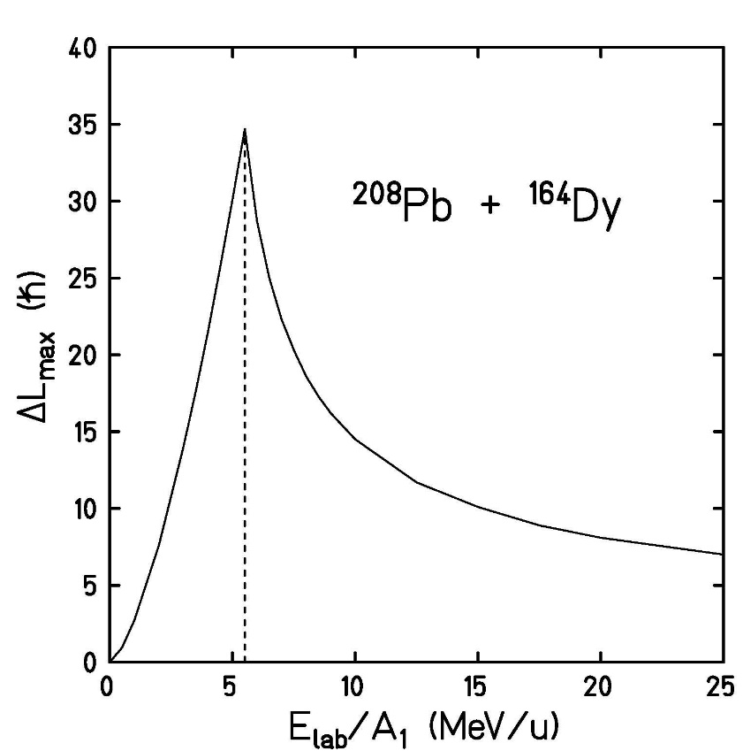

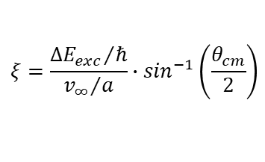


High-energy Coulomb excitation – angular momentum transfer
Excitation occurs only if nuclear (rotational) period is long compared to the collision time:
„sudden approximation“ if >> ~ 10⁻²² s
$$τ_{nucl}=\frac{ℏ}{∆E_{exc}}$$
ξ measures suddenness of interaction
$$ξ=\frac{{∆E_{exc}}/ℏ}{{v_{∞}}/a}∙\sin^{−1}\left(\frac{θ_{cm}}{2}\right)$$
$$ξ=\frac{∆E_{exc}}{ℏ∙c}∙\frac{D−a}{γ∙β}$$
q measures strength
$$q=\frac{Z_{P}∙e^{2}∙Q_{0}}{4∙ℏ∙v∙a^{2}}$$
maximum angular momentum transfer
V_{C}

Slide 5
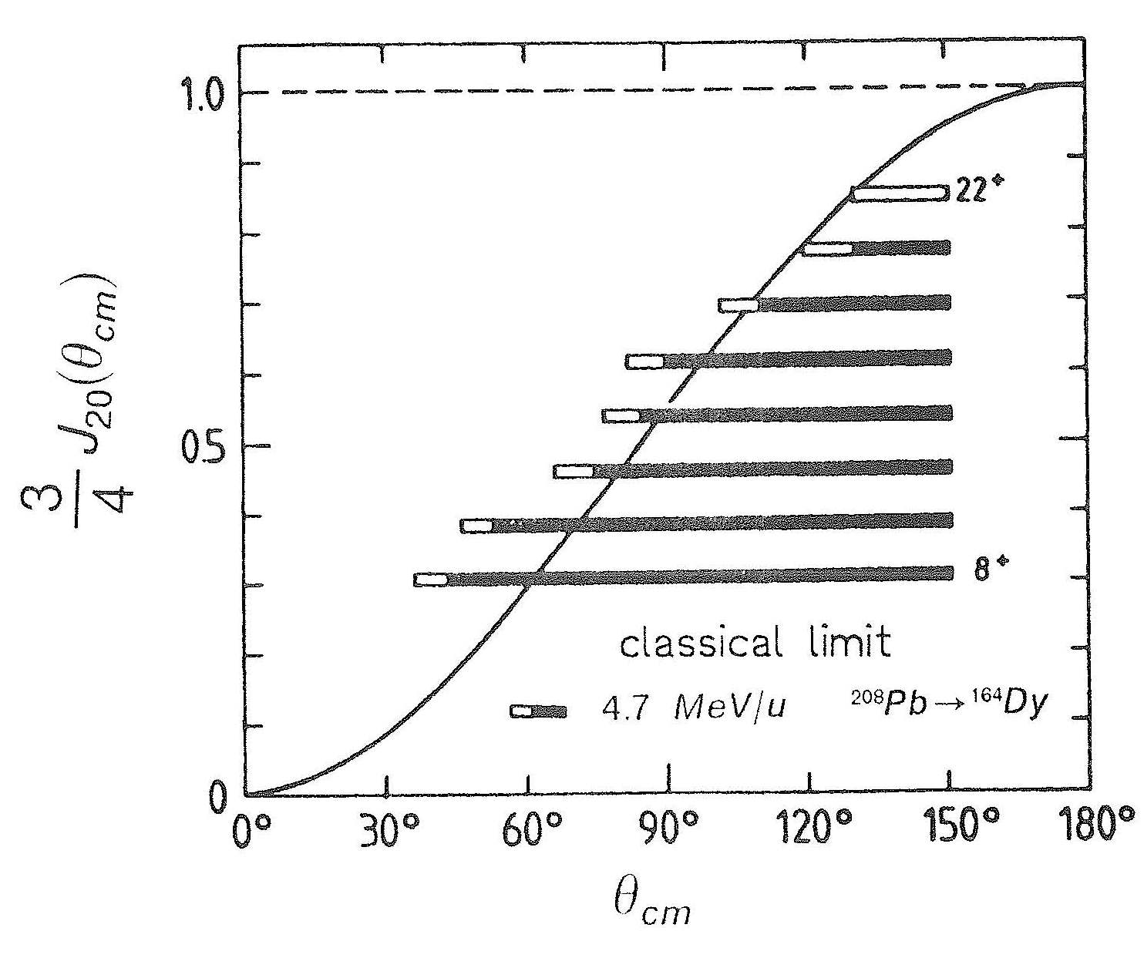

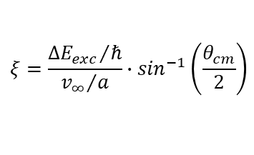
High-energy Coulomb excitation – angular momentum transfer
Excitation occurs only if nuclear (rotational) period is long compared to the collision time:
„sudden approximation“ if >> ~ 10⁻²² s
$$τ_{nucl}=\frac{ℏ}{∆E_{exc}}$$
ξ measures suddenness of interaction
$$ξ=\frac{{∆E_{exc}}/ℏ}{{v_{∞}}/a}∙\sin^{−1}\left(\frac{θ_{cm}}{2}\right)$$
$$ξ=\frac{∆E_{exc}}{ℏ∙c}∙\frac{D−a}{γ∙β}$$
q measures strength
$$q=\frac{Z_{P}∙e^{2}∙Q_{0}}{4∙ℏ∙v∙a^{2}}$$
maximum angular momentum transfer

Slide 6
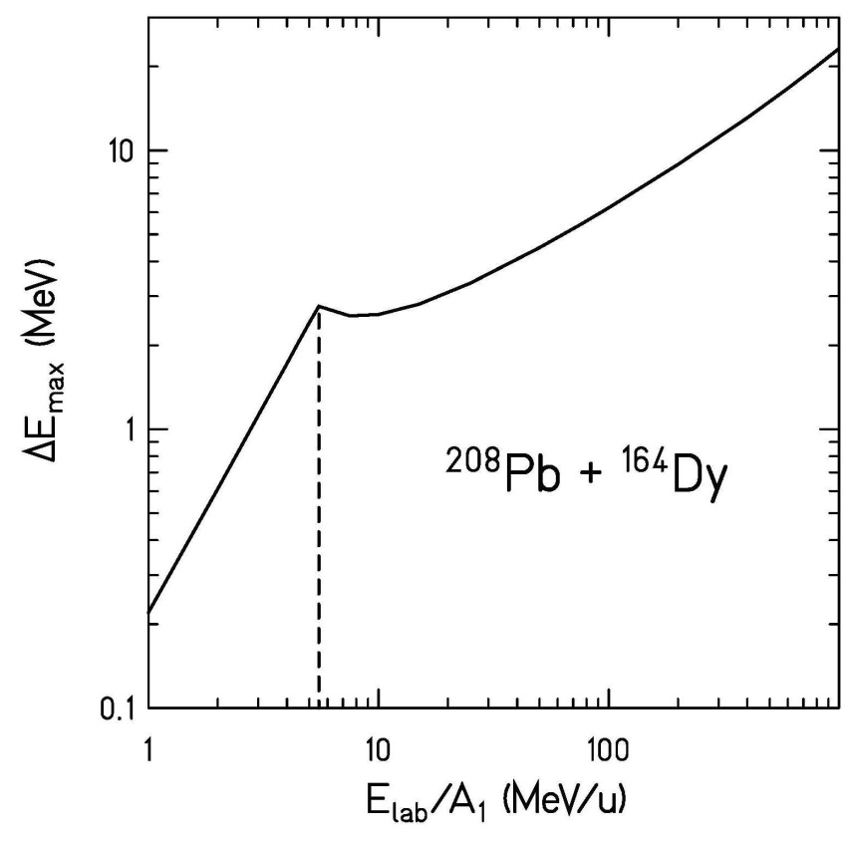



High-energy Coulomb excitation – energy transfer
$$ξ=1$$
ξ measures suddenness of interaction
$$ξ\left(θ_{cm}\right)=\frac{∆E_{exc}}{ℏ∙c}∙\frac{D−a}{γ∙β}$$
“adiabatic limit” for (single step) excitation ξ = 1
V_{C}
$$∆E_{exc}=ℏ∙c∙\frac{β∙γ}{D−a}$$
maximum energy transfer:

Slide 7

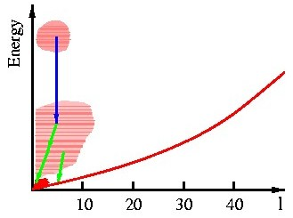


High-energy Coulomb excitation – energy transfer and angular momentum transfer
V_{C}
V_{C}
energy transfer (for single-step excitation):
angular momentum transfer:
$$∆E_{exc}=ℏ∙c∙\frac{β∙γ}{D−a}$$
$$∆L_{max}≅\frac{Z_{P}∙e^{2}∙Q_{0}}{4∙ℏ∙v∙a^{2}}∙\left(1−cosθ_{cm}\right)$$

Slide 8
Outline
Scattering Experiments with RIBs – Nuclear Structure Results
Experimental evidence for closed-shell nuclei
Scattering experiments at relativistic energies
Projectile-like identification (Z, A) and scattering angle θ
Doppler-shift correction of the emitted γ-rays

Slide 9
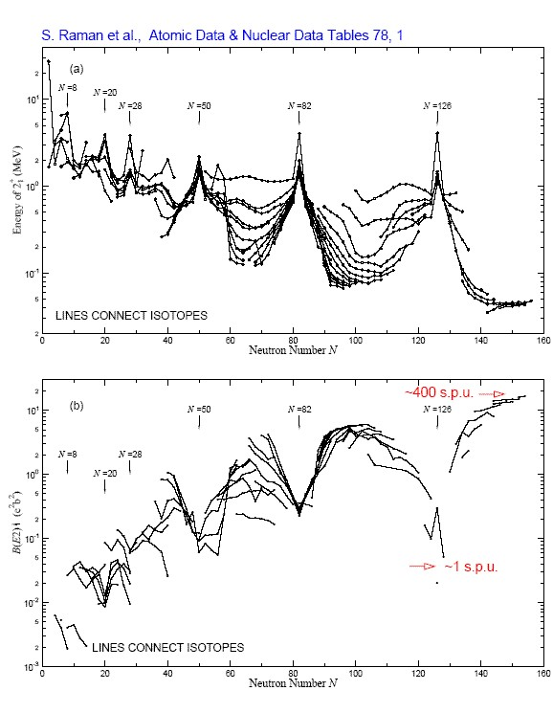
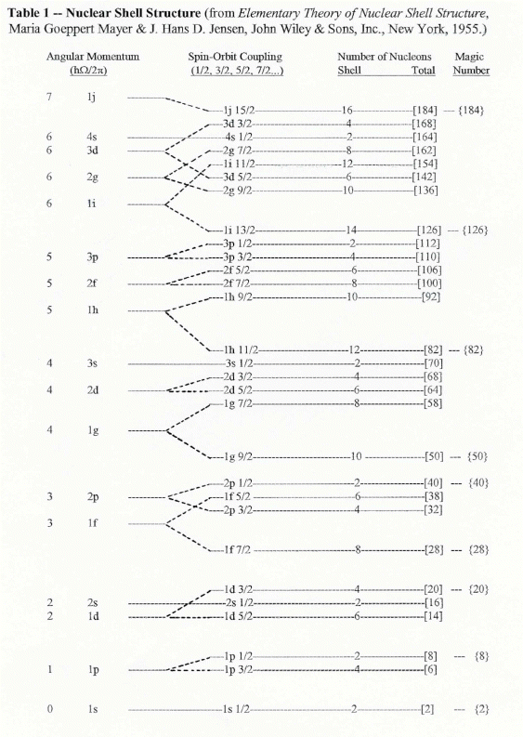

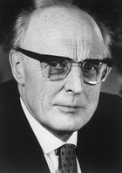
Experimental evidence for magic numbers close to stability
Maria Goeppert-Mayer & J. Hans D. Jensen

Slide 10
Experimental evidence for magic numbers close to stability
Nuclei with magic numbers
of neutrons/protons
high energy of 2₁⁺ state
low B(E2; 2₁⁺→0⁺) values
transition probability measured in
single particle units (spu)
If we move away from stability?

Slide 11
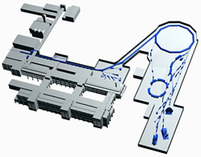
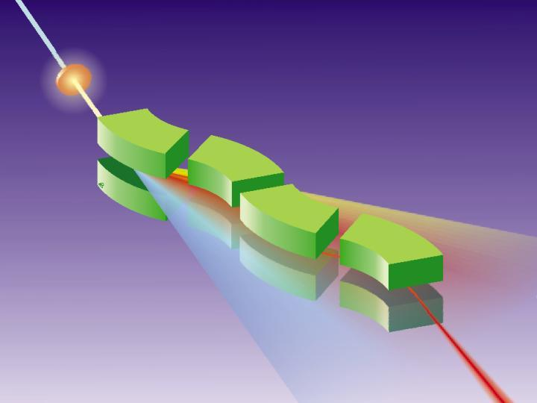
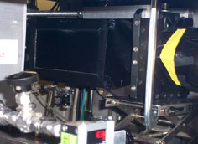
Production, Separation, Identification
UNILAC
SIS
projectile
projectile fragment
FRS
target nucleus
abrasion
ablation
FRagment
Separator
Standard FRS detectors
TPC-x,y position @ S2,S4
Plastic scintillator (TOF)
@ S4
MUSIC (ΔE)
@ S4

Slide 12
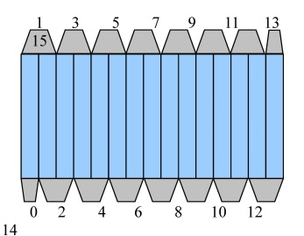
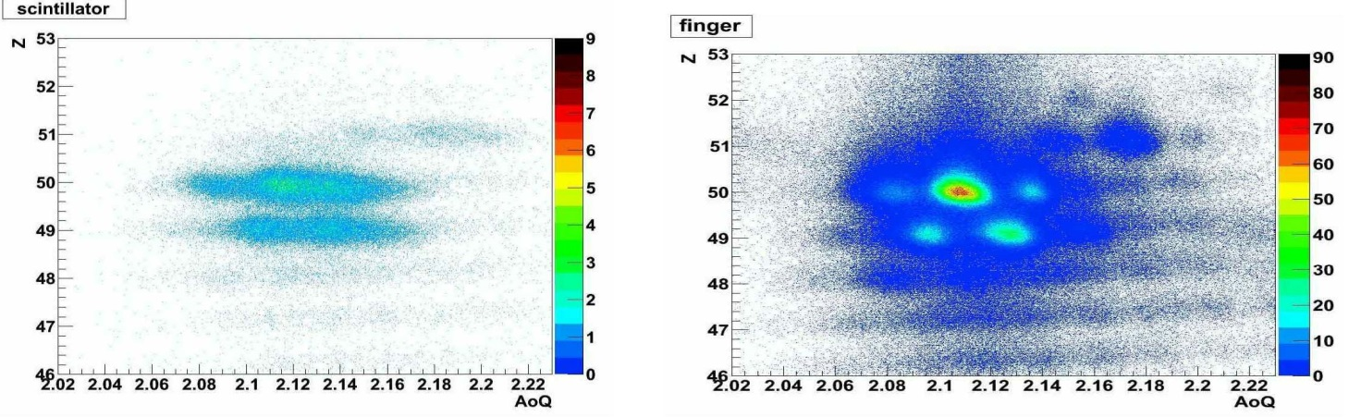
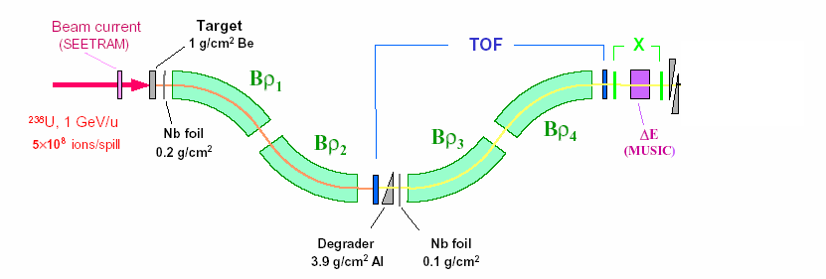
Scattering experiments at relativistic energies
¹⁰⁴Sn, 100 MeV/u
¹²⁴Xe, 793MeV/u
new digital readout
standard scintillator (SC21)
finger segmented detector
¹⁰⁴Sn fragments
using ¹²⁴Xe at 793 MeV/u
high rate at S2 ~10⁶ s⁻¹
~2400 % more tracking efficiency
good A/Q resolving power
Frederic Ameil

Slide 13
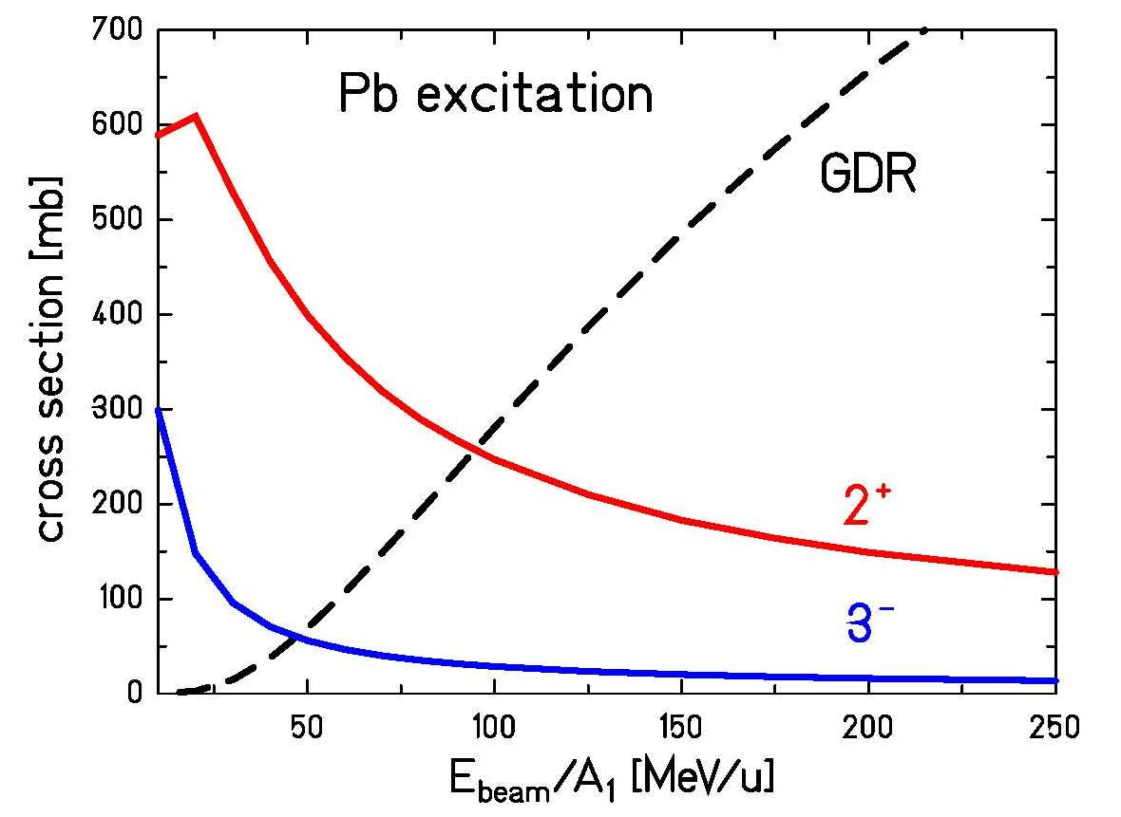
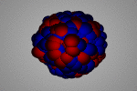
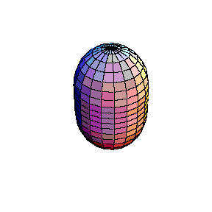
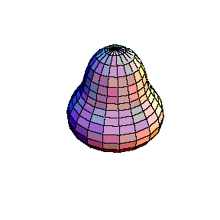
Scattering experiments at relativistic energies
fragment
impact parameter: b
D_{min}
Au
Rutherford scattering only if distance of closest approach D_{min}
is large compared to nuclear radii + surfaces:
C_{P}, C_{T} half-density radii
Notes:
the lower multipolarities are dominant

Slide 14

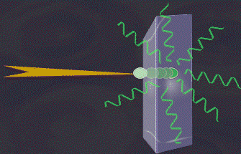
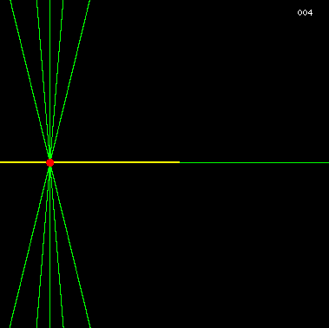
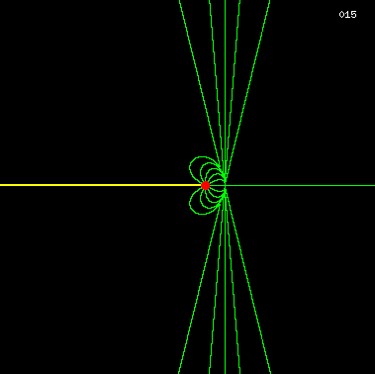
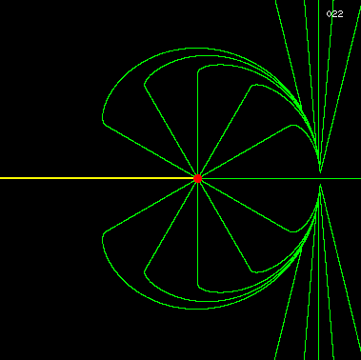
Bremsstrahlung
slowing down of a moving point-charge
electric field lines (v/c=0.99)

Slide 15
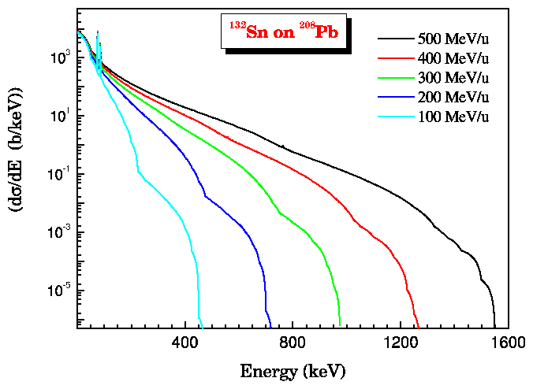
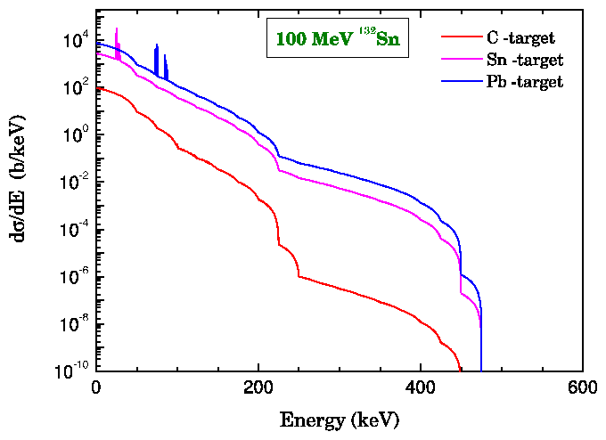
Atomic background radiation
Radiative electron capture (REC) capture of target electrons into bound states of the projectile:
Primary Bremsstrahlung (PB)
capture of target electrons into continuum states of the projectile:
Secondary Bremsstrahlung (SB)
Stopping of high energy electrons in the target:
Bremsstrahlung: slowing down of a moving point-charge

Slide 16
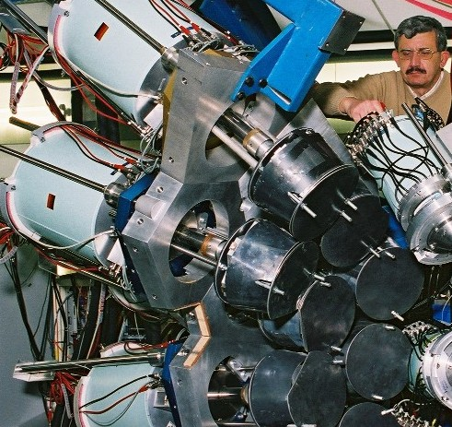
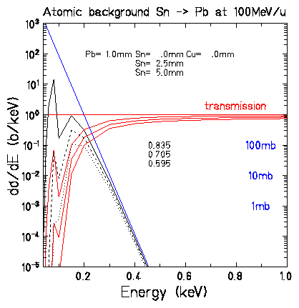
Suppression of atomic background radiation Pb & Sn absorbers

Slide 17


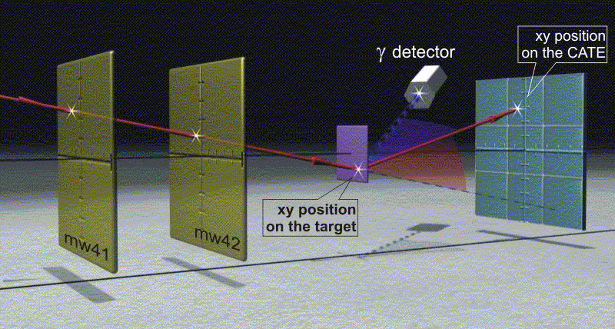

Scattering experiment at relativistic energies
¹⁰⁴Sn
¹⁹⁷Au-target
¹²⁴Xe, 793MeV/u
relativistic Coulomb excitation
xy position
from LYCCA

Slide 18
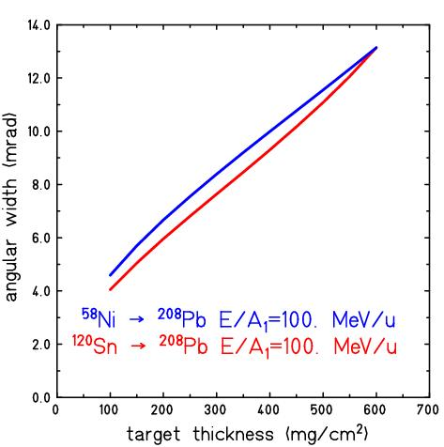
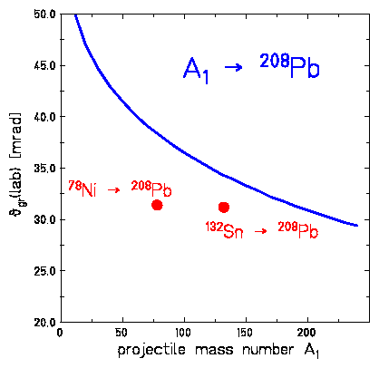
Scattering experiment at relativistic energies
angular width (mrad)
target thickness (mg/cm²)
Coulomb excitation:
grazing angle (mrad)
projectile mass number A₁

Slide 19



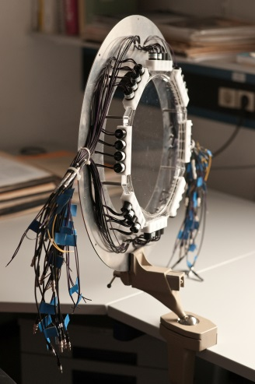
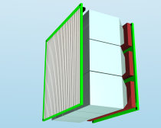
Scattering experiment at relativistic energies
¹⁰⁴Sn
¹⁰⁴Sn, 100 MeV/u
¹²⁴Xe, 793MeV/u
Lund-York-Cologne CAlorimeter
secondary
¹⁹⁷Au target
DSSSD
diamond/plastic
DSSSD
exp. observables:
Z, A, θ
(x,y,ΔE)
(x,y,ΔE)
RIB from FRS
CsI
CsI
time-of-flight

Slide 20
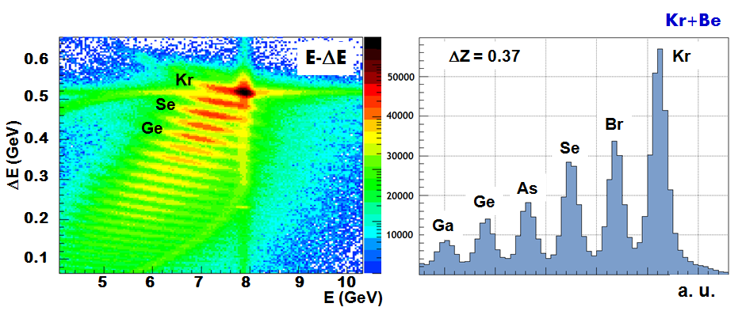
Scattering experiment at relativistic energies
secondary
⁹Be target
DSSSD
diamond/plastic
DSSSD
exp. observables:
Z, A, θ
(x,y,ΔE)
(x,y,ΔE)
RIB from FRS
CsI
CsI
time-of-flight

Slide 21
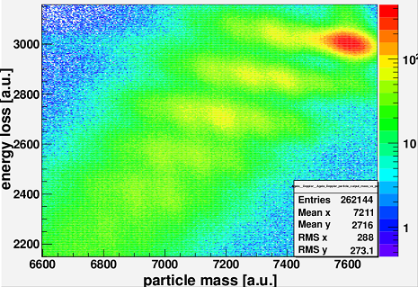
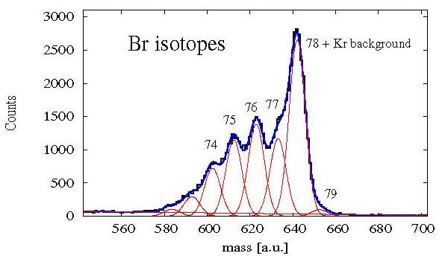
Scattering experiment at relativistic energies
with
and
with v from LYCCA-ToF
secondary
⁹Be target
DSSSD
diamond/plastic
DSSSD
exp. observables:
Z, A, θ
(x,y,ΔE)
(x,y,ΔE)
RIB from FRS
CsI
CsI
time-of-flight

Slide 22
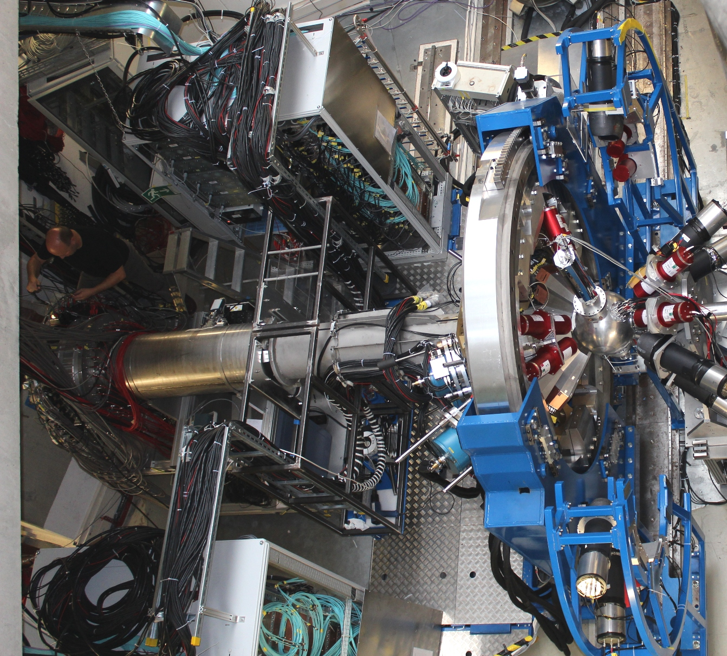


Au, Be target
LYCCA
AGATA Cluster array
HECTOR BaF₂ array

Slide 23
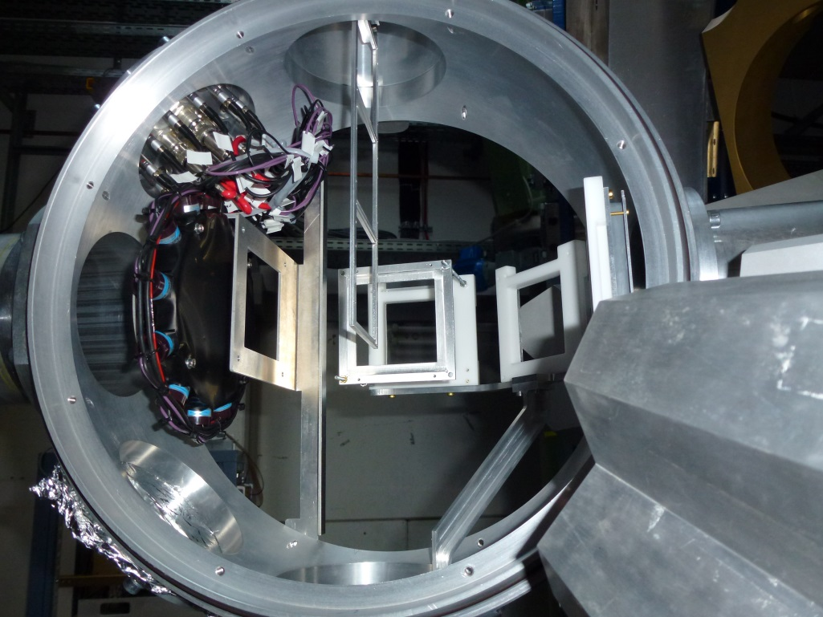
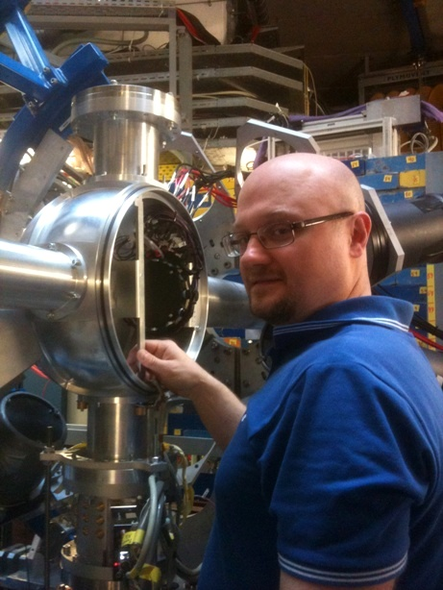
Lund-York-Cologne CAlorimeter
DSSSD
start ToF
Au target
PreSPEC target chamber
variable target position (13cm, 23cm)
Pavel Golubev

Slide 24
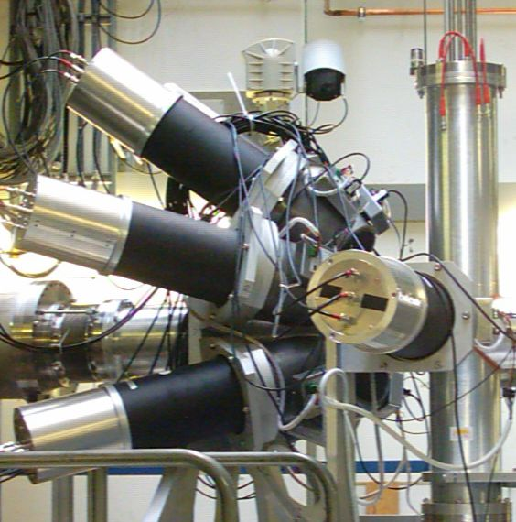
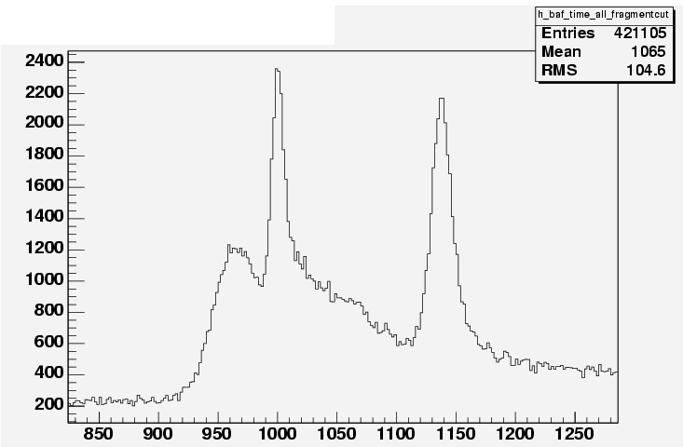
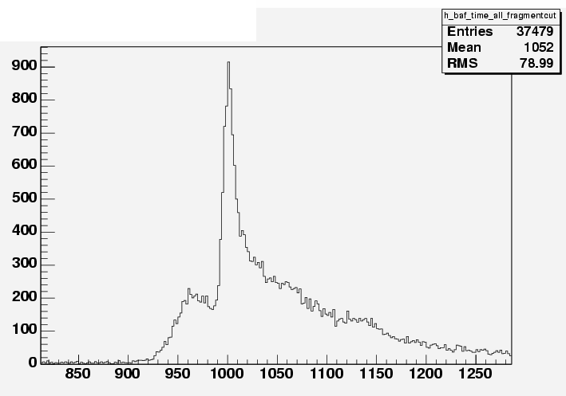
Additional γ–ray background radiation
Coulomb excitation:
A/Q - ³⁷Ca
all Ca detected in ΔE-E
prompt
ΔE-E
1‰ interaction target
most γ-rays from CATE or LYCCA
HECTOR BaF₂
³⁷Ca beam
at 196 MeV/u
time spectrum
Fragmentation:
A/Q - ³⁷Ca
K detected (mainly ³⁶K)
prompt

Slide 25

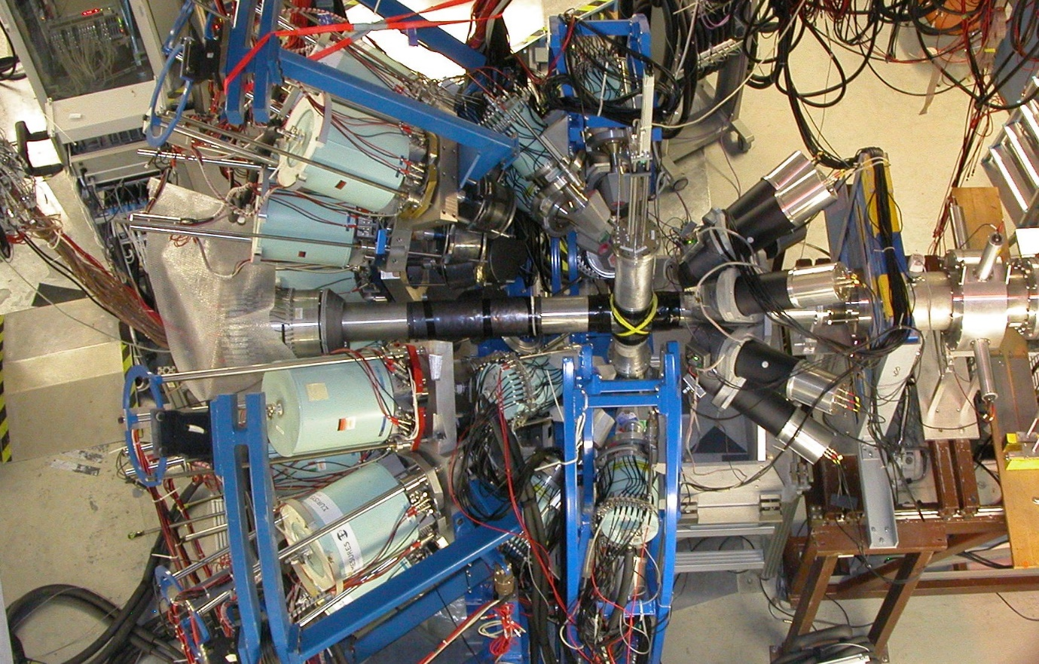
Rare ISotope INvestigation at GSI
EUROBALL Cluster Detectors Miniball: HPGe segmented detectors
HECTOR
Large 14.5 x 17 cm BaF₂ Detectors
CATE : ΔE-E telescope
event by event beam identification
beam
Coulomb Excitation at Relativistic Energy
nucleus | σ (mb)
⁵⁶Cr | 91
¹⁰⁸Sn | 314
¹³⁶Nd | 338 / 2180
New Shell structure at N>>Z
Relativistic Coulomb excitation of nuclei near ¹⁰⁰Sn
Triaxiality in even-even core nuclei of N=75 isotones
E1 Collectivity in neutron rich nuclei ⁶⁸Ni

Slide 26
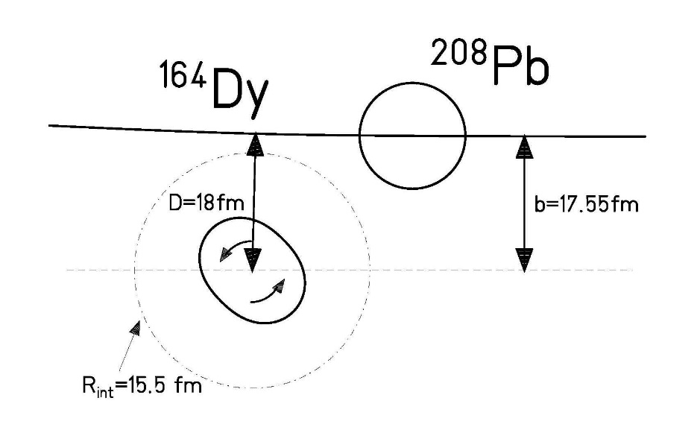
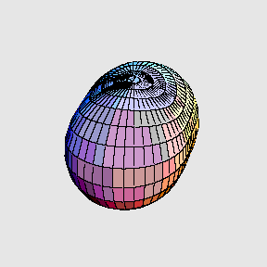
Coulomb excitation of exotic nuclei
Electromagnetic interaction acting between two colliding nuclei.
Inelastic scattering: kinetic energy is transferred
into nuclear excitation energy
Monopole-multipole interaction
Target and projectile excitation possible
100 AMeV
Excitation probability
(or inelastic cross section) is a measure of the collectivity of the nuclear state of interest

Slide 27
Coulomb excitation of exotic nuclei – basic concept
Inter-nuclear potential
Two forces:
Coulomb force (long range, repulsive)
Nuclear force (short range, attractive)
Potential barrier due to the compensation between the two
(Coulomb barrier)
V
100 AMeV
below
Coulomb barrier
r
r
Nuclear half-density radius of a Fermi mass distribution:
with
Mapping energy to radial separation

Slide 28
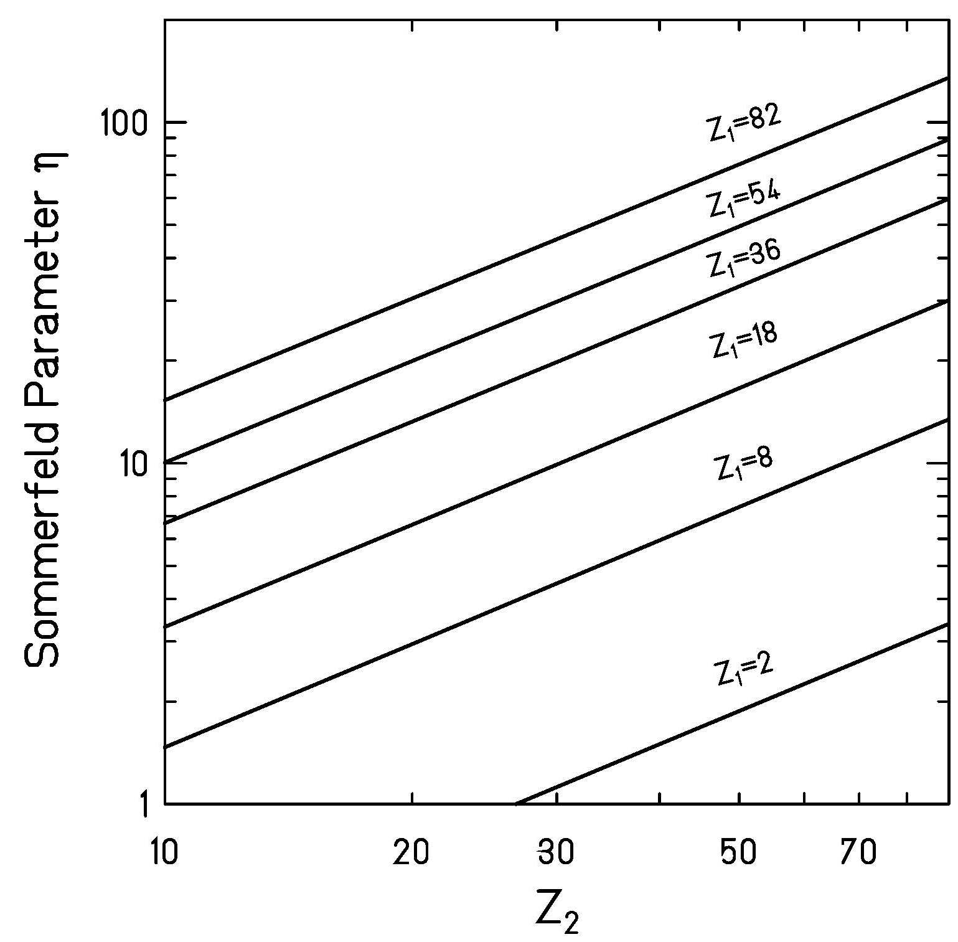

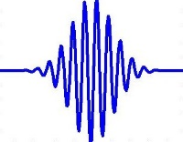

Validity of classical Coulomb trajectories – basic concept
particle
100 AMeV
wave
Sommerfeld parameter:
>> 1 requirement for a (semi-) classical treatment
of equations of motion (hyperbolic trajectories )
$$η=a∙k_{∞}=\frac{Z_{P}∙Z_{T}∙e^{2}}{ℏ∙v_{∞}}≫1$$
η calculated at 100AMeV

Slide 29
Classical Coulomb trajectories – basic concept
distance of closest approach:
impact parameter:
angular momentum :
100 AMeV
Hyperbolic trajectory:
ε = sin⁻¹(θ_{cm}/2) eccentricity of orbit

Slide 30
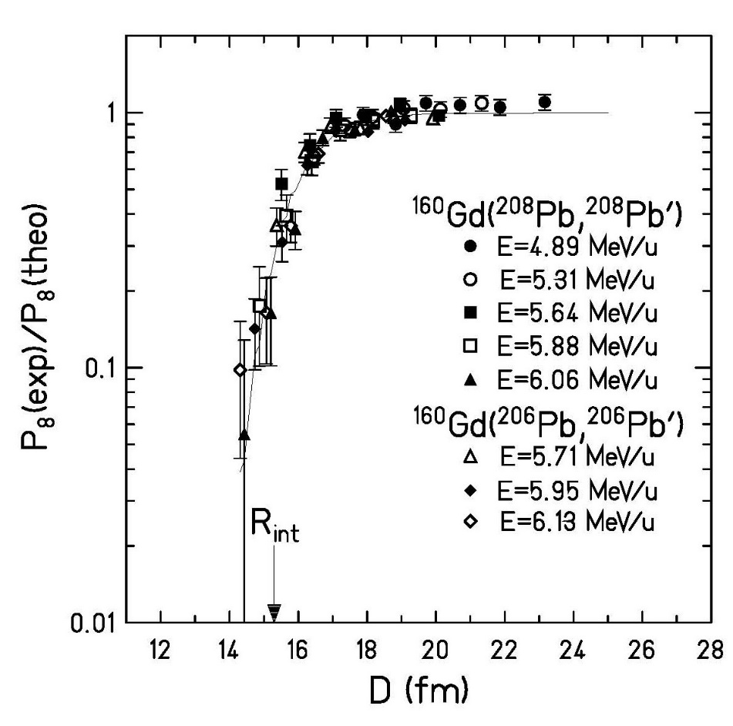



Nuclear interaction radius
100 AMeV
σ_{total} = σ_{el} + σ_{inel} + σ_{reaction}
σ_{total} ≈ σ_{inel} + σ_{reaction}
Nuclear interaction radius:
C_{P}, C_{T} half-density radii
nuclear absorption:
$$\left[1−P_{abs}\left(D\right)\right]=exp\left\{−\frac{2}{ℏ}\int_{−∞}^{+∞}{W\left[r\left(t\right)\right]dt}\right\}$$
$$W\left[r\left(t\right)\right]=W_{0}∙exp\left[−\frac{r\left(t\right)−C_{1}−C_{2}}{a_{I}}\right]$$
$$\left[1−P_{abs}\left(D\right)\right]=exp\left\{−\frac{2}{ℏ}∙W_{0}∙exp\left[−\frac{D−C_{1}−C_{2}}{a_{I}}\right]∙\frac{D}{v}\right\}$$

Slide 31
Safe bombarding energy requirement
100 AMeV
Nuclear interaction radius:
C_{P}, C_{T} half-density radii
Pure Coulomb excitation requires a
much larger distance between the nuclei
➔”safe energy” requirement

Slide 32



Safe bombarding energy requirement – basic concept
D_{min}
< 1% deviation from Coulomb excitation
100 AMeV
Rutherford scattering only if D_{min} is large
compared to nuclear radii + surfaces:
C_{P}, C_{T} half-density radii
➔ choose adequate beam energy (D > D_{min} for all θ)
low-energy Coulomb excitation
➔ limit scattering angle, i.e. select impact parameter b > D_{min}
high-energy Coulomb excitation

Slide 33


High-energy Coulomb excitation – straight line approximation
straight line approximation
distance of closest approach:
impact parameter:
100 AMeV
straight line for large E_{cm}: b = D
zero degree detector
LYCCA
TOF
s = 3.1 m
ΔE
E
Lund York Cologne CAlorimeter

Slide 34


High-energy Coulomb excitation – grazing angle and angular coverage of LYCCA
distance of closest approach:
For nonrelativistic projectiles:
at 100 MeV/u
grazing angle (mrad)
D
b=5.2 fm
For relativistic projectiles ( ):
Coulomb excitation:
projectile mass number A₁

Slide 35



High-energy Coulomb excitation – grazing angle
¹³⁶Xe on ²⁰⁸Pb at 700 MeV/u
excitation of giant dipole resonance
Coulomb ex.
Protons
Neutrons
For relativistic projectiles ( ):
π
ν
A.Grünschloß et al., Phys. Rev. C60 051601 (1999)

Slide 36

Scattering experiments at relativistic energies
fragment
impact parameter: b
D_{min}
Au
Rutherford scattering only if distance of closest approach D_{min}
is large compared to nuclear radii + surfaces:
C_{P}, C_{T} half-density radii
$$ℏc$$
Notes:
the lower multipolarities are dominant

Slide 37




High-energy Coulomb excitation – M1 and E2 excitations, full analytical description
$$ℏv$$
$$ℏc$$
Conclusion:
The lower multipolarities are dominant
For a given multipole order, electric transitions
are more likely than magnetic transitions
K. Alder et al., RMP 28 (56) 432

Slide 38

High-energy Coulomb excitation – M1 and E2 excitations
πp_{1/2} ???
N=50
⁸⁹Y
⁸⁷Rb
⁸⁵Br
⁸³As
1p_{1/2}
j< = ℓ-½
Unique signature!!!
1p (ℓ=1)
B(M1;j>→j<) ≈ 1 μ_{N}²
⁸⁵Br → ¹⁹⁷Au at 100 MeV/u
j> = ℓ+½
1p_{3/2}
rate = 10⁵ s⁻¹ · 10²¹ cm⁻² · 0.5·10⁻²⁷ cm² · 10% = 22 h⁻¹

Slide 39




Scattering experiments at relativistic energies
Doppler effect:
$$\frac{E_{γ0}}{E_{γ}}=\frac{1−β∙{cosθ}_{γ}^{lab}}{\sqrt{1−β^{2}}}$$
for
Lorentz boost:
beam

Slide 40

Doppler-shift correction – ²³⁸U on ¹⁹⁷Au (386 mg/cm²) at 183 AMeV
cos θ_{γ}
66.372 | 79 Au | K_{α3} | 0.033
66.991 | 79 Au | K_{α2} | 27.5
68.806 | 79 Au | K_{α1} | 46.4
77.577 | 79 Au | K_{β3} | 5.57
77.982 | 79 Au | K_{β1} | 10.70
80.130 | 79 Au | K_{β2} | 3.84
http://ie.lbl.gov/atomic/x2.pdf
Michael Reese

Slide 41

Doppler-shift correction – ²³⁸U on ¹⁹⁷Au (386 mg/cm²) at 183 AMeV
cos θ_{γ}
93.844 | 92 U | K_{α3} | 0.099
94.654 | 92 U | K_{α2} | 28.2
98.434 | 92 U | K_{α1} | 45.1
110.421 | 92 U | K_{β3} | 5.65
111.298 | 92 U | K_{β1} | 10.70
114.445 | 92 U | K_{β2} | 4.15
http://ie.lbl.gov/atomic/x2.pdf
Michael Reese

Slide 42

Doppler broadening and position resolution
Position resolution
γ ray
Angular resolution
beam
projectile
Energy resolution

Slide 43








Doppler broadening
opening angle: slowing down in target:

Slide 44



Segmented detectors
70cm
target
beam
20cm

Slide 45












Advanced GAmma Tracking Array
Signals from 36 segments + core
are measured as a function of time
(γ-ray interaction point)
John Strachan

Slide 46

Scattering experiment at relativistic energies
⁸⁰Kr → ¹⁹⁷Au, 150 AMeV
Doppler effect

Slide 47


High-energy Coulomb excitation – triaxiality in even-even nuclei (N=76)
2₁⁺→0⁺
2₂⁺→2₁⁺
2₂⁺→0⁺
2₂⁺→2₁⁺
2₂⁺→0⁺
First observation of a second excited 2⁺ state populated in a Coulomb experiment at 100 AMeV using EUROBALL and MINIBALL Ge-detectors.
shape symmetry
collective strength
T.R. Saito et al. Phys.Lett. B669 (2008), 19

Slide 48
Au, Be target
LYCCA
AGATA Cluster array
HECTOR BaF₂ array

Slide 49





HECTOR team

Slide 50





AGATA at PreSPEC
preprocessor
computer farm
AGATA
digitiser
Damian Ralet,
Stephane Pietri

Slide 51

Commissioning of LH₂ target
⁵²Cr
4⁺ ➔2⁺
932 (15)
2⁺ ➔0⁺
1436 (27)

Slide 52

Ivan Kojouharov, Michael Reese, Namita Goel, Liliana Cortes, Frederic Ameil, Bogdan Szczepanczyk
H.-J. W., Damian Ralet, Pushpendra Singh, Stephane Pietri, Tobias Habermann, Edana Merchan, Giulia Guastalla, Plamen Boutachkov, Adolf Brünle,
Ian Burrows, Jonathan Strachan, (Paul Morral), Jürgen Gerl, (Henning Schaffner, Magda Gorska)

Slide 53



Reactions with relativistic radioactive beams – R³B
Excitation energy E* from kinematically complete measurement of all outgoing particles
$$E^{∗}=\left(\sqrt{\sum_{i}{{m_{i}}^{2}}+\sum_{i≠j}{m_{i}m_{j}γ_{i}γ_{j}\left(1−β_{i}β_{j}cosθ_{ij}\right)}}−m_{proj}\right)c^{2}+E_{γ,sum}$$
Notes:
invariant-mass technique, Rossi

Slide 54


Large Area Neutron Detector
Large Area Neutron Detector (2m x 2m x 1m)
neutron energy T_{n} ≤ 1 GeV
ΔT_{n}/T_{n} = 5.3%
efficiency ~1
passive Fe-converter

Slide 55










Invariant mass analysis
$$M_{proj}^{inv}=m_{proj}+E^{∗}$$
$$M_{proj}^{inv}=\sqrt{{\left\{\begin{matrix}\sum_{i}{E_{i}} \\ \sum_{i}{\overset{→}{p_{i}}}\end{matrix}\right\}}^{2}}$$
$${\left(\sum_{i}{E_{i}}\right)}^{2}=\sum_{i}{{\left(γ_{i}m_{i}\right)}^{2}}+\sum_{i≠j}{γ_{i}γ_{j}m_{i}m_{j}}$$
$${\left(\sum_{i}{\overset{→}{p_{i}}}\right)}^{2}=\sum_{i}{{\left(γ_{i}β_{i}m_{i}\right)}^{2}}+\sum_{i≠j}{γ_{i}γ_{j}β_{i}β_{j}m_{i}m_{j}cosθ_{ij}}$$
$$M_{proj}^{inv}=\sqrt{\sum_{i}{{m_{i}}^{2}}+\sum_{i≠j}{m_{i}m_{j}γ_{i}γ_{j}\left(1−β_{i}β_{j}cosθ_{ij}\right)}}+E_{γ}$$
Momentum reconstruction: (ħ=c=1)
four-momenta:
$$\hat{P}=\left(E,\vec{p}\right)$$
$$E^{∗}=\sqrt{\sum_{i}{{m_{i}}^{2}}+\sum_{i≠j}{m_{i}m_{j}γ_{i}γ_{j}\left(1−β_{i}β_{j}cosθ_{ij}\right)}}−m_{proj}+E_{γ}$$
$$\left\{\begin{matrix}p_{x}=p_{0}sinθcosφ \\ p_{y}=p_{0}sinθsinφ \\ p_{z}=p_{0}cosθ \end{matrix}\right\}$$
$$p_{0}=m_{0}βγ$$
$$γ^{2}\left(1−β^{2}\right)=1$$

Slide 56





Dipole strength distribution of ⁶⁸Ni
mean field calculation
Pygmy resonance
neutron decay data
direct γ-decay
branching ratio:
Γ₀/Γ = 7(2)%
E.Litvinova et al.; PRC 79, (2009) 054312
γ-ray decay data
O. Wieland et al.; Phys. Rev. Lett 102, 092502 (2009)
D. Rossi et al.; Phys. Rev. Lett 111, 242503 (2013)

Slide 57




Slow down beams – new experimental perspectives
collective strength
nuclear shape
angular momentum transfer:
$$∆L_{max}≅\frac{Z_{P}∙e^{2}∙Q_{0}}{4∙ℏ∙v∙a^{2}}∙\left(1−cosθ_{cm}\right)$$
V_{C}

Slide 58


Slowed down beams – beam characteristics
10⁹ pps 10⁷ pps 3∙10⁶ pps 10⁵ pps
⁶⁴Ni
700 AMeV
⁶²Co
~ 13 AMeV
ΔEnergy
5.2 AMeV
Δθ
35 mrad

Slide 59


Slowed down beams – experimental set-up
degrader
target
TPC-1 TPC-2 SC41
(x₁ y₁ t₁) (x₂ y₂ t₂)
(x₃ y₃ t₃)
experimental results:
velocity β
beam energy E/A₁
scattering angle θ_{cm}
electrostatic mirror + MCP detector
position resolution ~ 1 mm
time resolution ~ 100 ps
MCP ≡ micro channel plate

Slide 60


Slowed down beams – experimental set-up
degrader
target
TPC-1 TPC-2 SC41
(x₁ y₁ t₁) (x₂ y₂ t₂)
(x₃ y₃ t₃)
TOF between MCP and DSSSD
MCP DSSSD
Time resolution 200 ps for one of the 256 detector pixels
Akhil Jhingan (IUAC)

Slide 61

FAIR accelerator facility
GSI
p - LINAC
FAIR
SIS18
Synchrotrons
SIS100 and SIS300
UNILAC
Rare Isotope
Production Target
Antiproton
Production Target
High-Energy Storage Ring
HESR
Superconducting
large-acceptance Fragment Separator
Super-FRS
Collector Ring
CR
New Experimental Storage Ring
NESR
Recycled Exp. Storage Ring RESR
100 m

Slide 62


