Slide 1
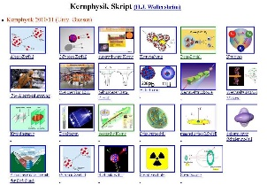
Outline: Peripheral collisions
Lecturer: Hans-Jürgen Wollersheim
e-mail: h.j.wollersheim@gsi.de
web-page: https://web-docs.gsi.de/~wolle/ and click on
reaction Q-value
sub-barrier transfer reactions
transfer probabilities for multi-nucleon transfer
PRISMA and HIRA spectrometers
transfer reactions with weakly bound nuclei

Slide 2
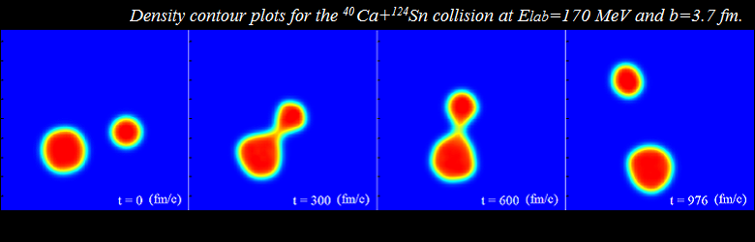
Peripheral collisions
probing single particle aspects and nucleon-nucleon correlations
transition from quasi elastic to deep inelastic processes
connection with other reaction channels (near and sub-barrier fusion)
population of neutron-rich nuclei
time-dependent density functional theory

Slide 3
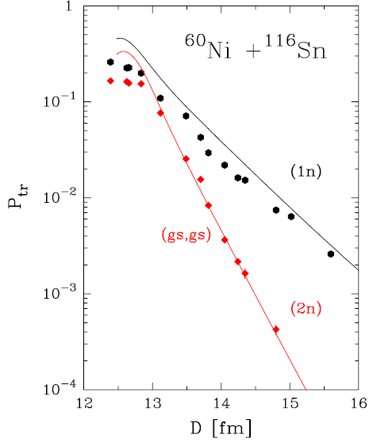
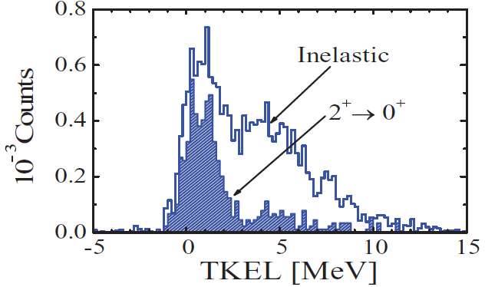
Peripheral collisions
Sub-barrier transfer reactions
study of nucleon-nucleon correlations
Multi-nucleon transfer
study of secondary processes
C_{p} = 4.2 fm, C_{t} = 5.5 fm, R_{int} = 12.7 fm

Slide 4
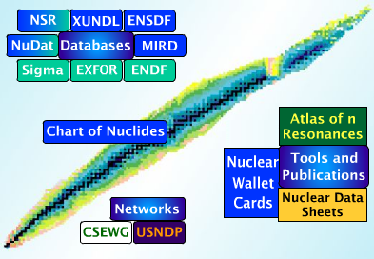

Reaction Q-value
Consider the T(p,x)R reaction:
The Q-value of the reaction is defined as the difference in mass energies of the products and reactants, i.e.
if Q is positive, the reaction is exoergic while if Q is negative, the reaction is endoergic.
x
m_{t}
ϑ
P
$$Q_{gg}=\left[m_{p}+m_{t}−\left(m_{x}+m_{R}\right)\right]∙c^{2}$$
T
m_{p}, v_{p}
Ψ
R
before after
https://www.nndc.bnl.gov/qcalc/
$$m_{p}c^{2}+T_{p}+m_{t}c^{2}=m_{x}c^{2}+T_{x}+m_{R}c^{2}+T_{R}$$
$$Q_{gg}=\left[m_{p}+m_{t}−m_{x}−m_{R}\right]c^{2}=T_{x}+T_{R}−T_{p}$$

Slide 5
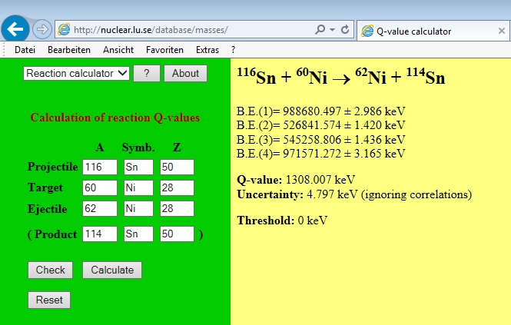
Reaction Q-value
Consider the T(p,x)R reaction:
The Q-value of the reaction is defined as the difference in mass energies of the products and reactants, i.e.
if Q is positive, the reaction is exoergic while is Q is negative, the reaction is endoergic.
x
m_{t}
ϑ
P
$$Q_{gg}=\left[m_{p}+m_{t}−\left(m_{x}+m_{R}\right)\right]∙c^{2}$$
T
m_{p}, v_{p}
Ψ
R
before after

Slide 6
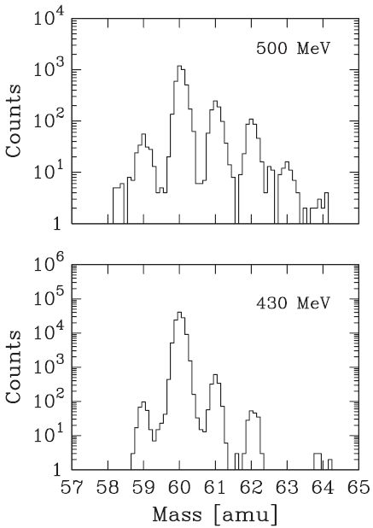

Reaction Q-value neutron transfer
Consider the T(p,x)R reaction:
The Q-value of the reaction is defined as the difference in mass energies of the products and reactants, i.e.
if Q is positive, the reaction is exoergic while is Q is negative, the reaction is endoergic.
$$Q_{gg}=\left[m_{p}+m_{t}−\left(m_{x}+m_{R}\right)\right]∙c^{2}$$
¹¹⁶Sn → ⁶⁰Ni @ E_{lab} = 430, 460, 500 MeV
E_{cm} = 147, 156, 170 MeV
V_{C}(R_{int}) = 159 MeV
(⁶⁰Ni,⁵⁸Ni) -2n | (⁶⁰Ni,⁵⁹Ni) -1n | (⁶⁰Ni,⁶⁰Ni) 0n | (⁶⁰Ni,⁶¹Ni) +1n | (⁶⁰Ni,⁶²Ni) +2n | (⁶⁰Ni,⁶³Ni) +3n | (⁶⁰Ni,⁶⁴Ni) +4n
-4,12 MeV | -4.44 MeV | 0 MeV | -1.74 MeV | +1.31 MeV | -2.15 MeV | -0.24 MeV

Slide 7


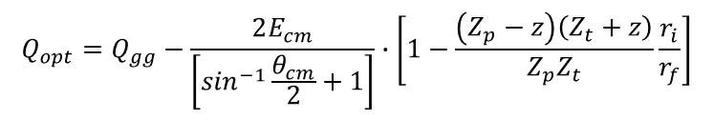


Reaction Q-value proton transfer
Consider the T(p,x)R reaction:
The Q-value of the reaction is defined as the difference in mass energies of the products and reactants, i.e.
if Q is positive, the reaction is exoergic while is Q is negative, the reaction is endoergic.
x
m_{t}
ϑ
P
$$Q_{gg}=\left[m_{p}+m_{t}−\left(m_{x}+m_{R}\right)\right]∙c^{2}$$
T
m_{p}, v_{p}
Ψ
R
before after
The Q-value of the reaction will change for proton transfer due to the rearrangement of nuclear charge.
$$Q_{opt}=Q_{gg}−E^{∗}=Q_{gg}−e^{2}\left[\frac{Z_{p}Z_{t}}{r_{i}}−\frac{\left(Z_{p}−z\right)\left(Z_{t}+z\right)}{r_{f}}\right]$$
$$Q_{opt}=Q_{gg}−\frac{Z_{p}Z_{t}e^{2}}{r_{i}}∙\left[1−\frac{\left(Z_{p}−z\right)\left(Z_{t}+z\right)}{Z_{p}Z_{t}}\frac{r_{i}}{r_{f}}\right]$$
$$r_{i}=D=\frac{0.72∙Z_{1}Z_{2}}{E_{cm}}\left[\sin^{−1}\frac{θ_{cm}}{2}+1\right]$$
$$Q_{opt}=Q_{gg}−\frac{2E_{cm}}{\left[\sin^{−1}\frac{θ_{cm}}{2}+1\right]}∙\left[1−\frac{\left(Z_{p}−z\right)\left(Z_{t}+z\right)}{Z_{p}Z_{t}}\frac{r_{i}}{r_{f}}\right]$$
$$Q_{opt}≈Q_{gg}−E_{cm}∙\left[1−\frac{\left(Z_{p}−z\right)\left(Z_{t}+z\right)}{Z_{p}Z_{t}}\right]$$

Slide 8
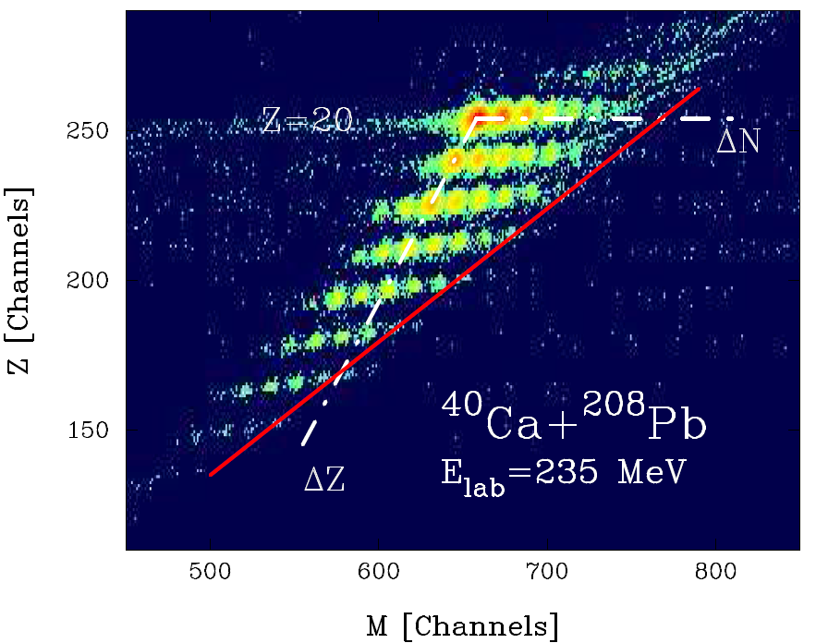
Reaction Q-value
The population in the (N,Z) plane is governed by Q_{opt}
E_{cm} = 197 MeV V_{C}(R_{int}) = 178 MeV

Slide 9

Reaction Q-value
The population in the (N,Z) plane is governed by Q_{opt}
 | E* | -2n | -1n | 0n | 1n | 2n | 3n | 4n | 5n | 6n | 7n | 8n
₂₂Ti | -14.4 | -34.7 -13.0 | -24.7 -12.7 | -10.5 -12.5 | -5.0 -12.2 | +5.6 -11.9 | +7.7 -11.6 | +14.9 -11.4 | +16.0 -11.1 | +21.4 -10.9 | +21.5 -10.7 | +25.8 -10.4
₂₁Sc | -7.3 | -6.9 -6.9 | -19.3 -6.6 | -6.9 -6.3 | -2.2 -6.1 | +3.4 -5.8 | +5.6 -5.5 | +10.2 -5.3 | +11.1 -5.0 | +14.9 -4.8 | +14.9 -4.6 | +18.1 -4.3
₂₀Ca | 0 | -19.8 -0.6 | -11.7 -0.3 | 0 0 | +1.0 +0.3 | +5.7 +0.5 | +5.6 +0.8 | +10.0 +1.1 | +9.0 +1.3 | +12.5 +1.5 | +11.0 +1.8 | +13.9 +2.0
₁₉K | +7.6 | -19.9 +6.0 | -13.0 +6.3 | -4.5 +6.6 | -4.2 +6.8 | -1.0 +7.1 | -1.5 +7.4 | +1.1 +7.6 | -0.1 +7.9 | +1.5 +8.1 | -0.4 +8.3 | +0.5 +8.5
₁₈Ar | +15.4 | -16.0 +12.8 | -13.2 +13.1 | -5.9 +13.4 | -7.0 +13.6 | -4.1 +13.9 | -6.4 +14.2 | -4.0 +14.4 | -7.1 +14.6 | -6.0 +14.9 | -9.6 +15.1 | -8.9 +15.3
₁₇Cl | +23.4 | -21.0 +19.9 | -18.5 +20.1 | -13.2 +20.4 | -14.8 +20.7 | -13.9 +20.9 | -16.6 +21.2 | -16.0 +21.4 | -19.1 +21.7 | -19.6 +21.9 | -24.8 +22.1 | -25.4 +22.3
₁₆S | +31.7 | -22.3 +27.1 | -22.1 +27.4 | -17.3 +27.7 | -20.9 +27.9 | -20.1 +28.2 | -24.5 +28.4 | -24.1 +28.7 | -29.4 +28.9 | -30.2 +29.1 | -36.4 +29.4 | -37.7 +29.6
₁₅P | +40.3 | -30.6 +34.7 | -31.1 +34.9 | -28.2 +35.2 | -32.8 +35.4 | -33.5 +35.7 | -38.8 +35.9 | -40.2 +36.2 | -45.6 +36.4 | -48.8 +36.6 | -55.3 +36.8 | -58.4 +37.0
₁₄Si | +49.0 | -35.8 +42.4 | -38.6 +42.7 | -36.7 +42.9 | -42.6 +43.2 | -44.0 +43.4 | -50.9 +43.7 | -53.3 +43.9 | -60.6 +44.1 | -63.7 +44.3 | -71.9 +44.5 | -75.1 +44.7
E_{cm}·[1-V_{C}(f)/V_{C}(i)] (MeV)
Q_{gg} (MeV)
[V_{C}(i)-V_{C}(f)] (MeV)

Slide 10
Reaction Q-value
The population in the (N,Z) plane is governed by Q_{opt}
 | E* | -2n | -1n | 0n | 1n | 2n | 3n | 4n | 5n | 6n | 7n | 8n
₂₂Ti | -14.4 | -47.7 | -37.4 | -23.0 | -17.2 | -6.3 | -3.9 | +3.5 | +4.9 | +10.5 | +10.8 | +15.4
₂₁Sc | -7.3 | 0.0 | -25.9 | -13.2 | -8.3 | -2.4 | +0.1 | +4.9 | +6.1 | +10.1 | +10.3 | +13.8
₂₀Ca | 0 | -20.4 | -12.0 | 0 | +1.3 | +6.2 | +6.4 | +11.1 | +10.3 | +14.0 | +12.8 | +15.9
₁₉K | +7.6 | -13.9 | -6.7 | +2.1 | +2.6 | +6.1 | +5.9 | +8.7 | +7.8 | +9.6 | +7.9 | +9.0
₁₈Ar | +15.4 | -3.2 | -0.1 | +7.5 | +6.6 | +9.8 | +7.8 | +10.4 | +7.5 | +8.9 | +5.5 | +6.4
₁₇Cl | +23.4 | -1.1 | +1.6 | +7.2 | +5.9 | +7.0 | +4.6 | +5.4 | +2.6 | +2.3 | -2.7 | -3.1
₁₆S | +31.7 | +4.8 | +5.3 | +10.4 | +7.0 | +8.1 | +3.9 | +4.6 | -0.5 | -1.1 | -7.0 | -8.1
₁₅P | +40.3 | +4.1 | +3.8 | +7.0 | +2.6 | +2.2 | -2.9 | -4.0 | -9.2 | -12.2 | -18.5 | -21.4
₁₄Si | +49.0 | +6.6 | +4.1 | +6.2 | +0.6 | -0.6 | -7.2 | -9.4 | -16.5 | -19.4 | -27.4 | -30.4
E_{cm}·[1-V_{C}(f)/V_{C}(i)] (MeV)
Q_{gg} - [V_{C}(i)-V_{C}(f)] (MeV)

Slide 11
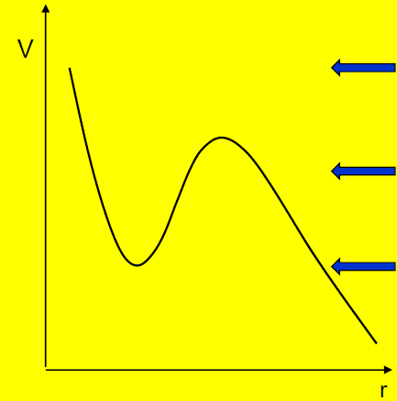
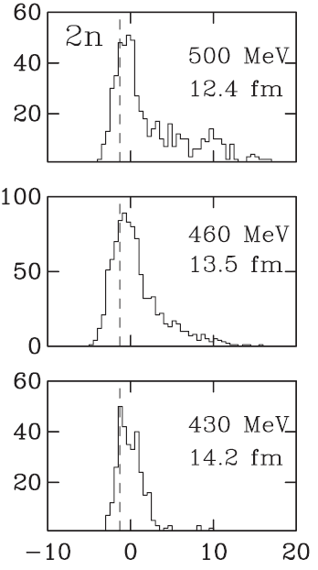
Sub-barrier transfer reactions
A smooth transition between quasi-elastic and deep inelastic processes
⁶⁰Ni(¹¹⁶Sn,¹¹⁴Sn)⁶²Ni Q_{gg} = +1.3 MeV
170 MeV
E > E_{B}
159 MeV
156 MeV
E ~ E_{B}
147 MeV
E < E_{B}
TKEL [MeV] = -Q
Below the barrier Q-values gets very narrow and without deep inelastic components

Slide 12
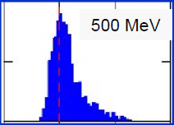
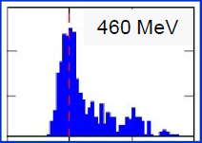
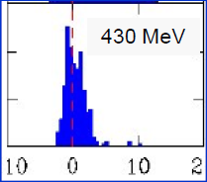
Sub-barrier transfer reactions
A smooth transition between quasi-elastic and deep inelastic processes
¹¹⁶Sn(⁶⁰Ni,⁶²Ni) Q_{gg} = +1.3 MeV
E > E_{B}
E ~ E_{B}
E < E_{B}
Below the barrier Q-values gets very narrow and without deep inelastic components

Slide 13
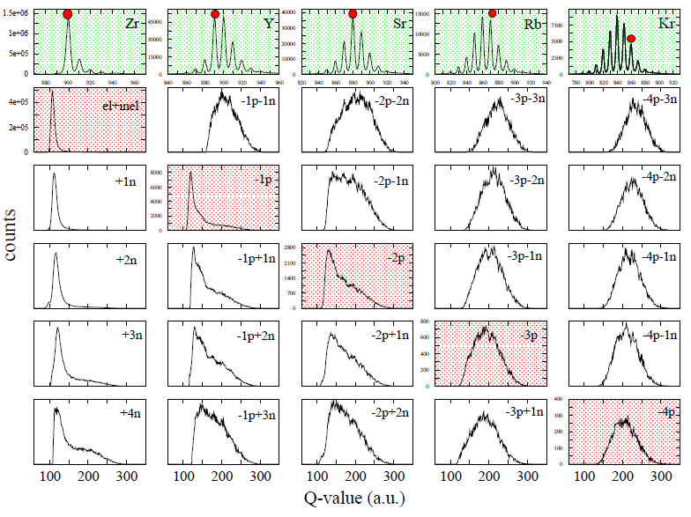
From quasi-elastic to deep-inelastic regime ⁹⁰Zr + ²⁰⁸Pb at E=560 MeV (PRISMA)
E_{cm}/V_{C}(R_{int}) = 1.19

Slide 14
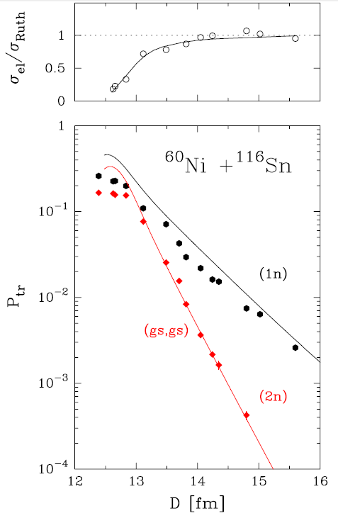
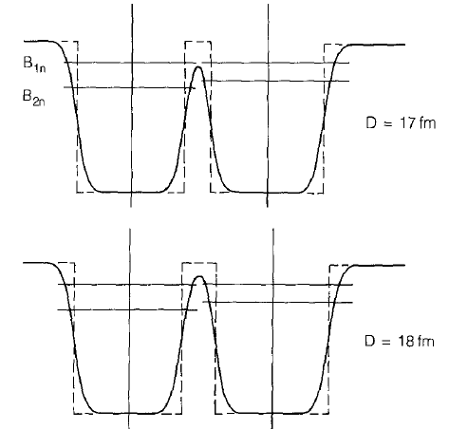

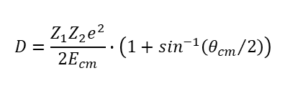

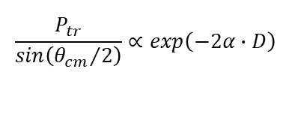
Sub-barrier transfer reactions
⁶⁰Ni(¹¹⁶Sn,¹¹⁴Sn)⁶²Ni Q_{gg} = +1.3 MeV
slopes of P_{tr} versus D are expected from the binding energy
B → binding energy
$$α=\sqrt{\frac{2μB}{ℏ^{2}}}$$
$$\frac{P_{tr}}{sin\left({θ_{cm}}/2\right)}∝exp\left(−2α∙D\right)$$
$$αxn\left[{fm}^{−1}\right]=0.21874\sqrt{{x∙B}_{MeV}}$$
²⁰⁶Pb
²³²Th
B_{1n}
B_{2n}
D = 17 fm
one probes tunneling effects between interacting nuclei, which enter into contact through the tail of their density distributions
D = 18 fm
$$D=\frac{Z_{1}Z_{2}e^{2}}{2E_{cm}}∙\left(1+\sin^{−1}\left({θ_{cm}}/2\right)\right)$$
D. Montanari et al.; Phys. Rev. Lett 113, 052501 (2014)

Slide 15
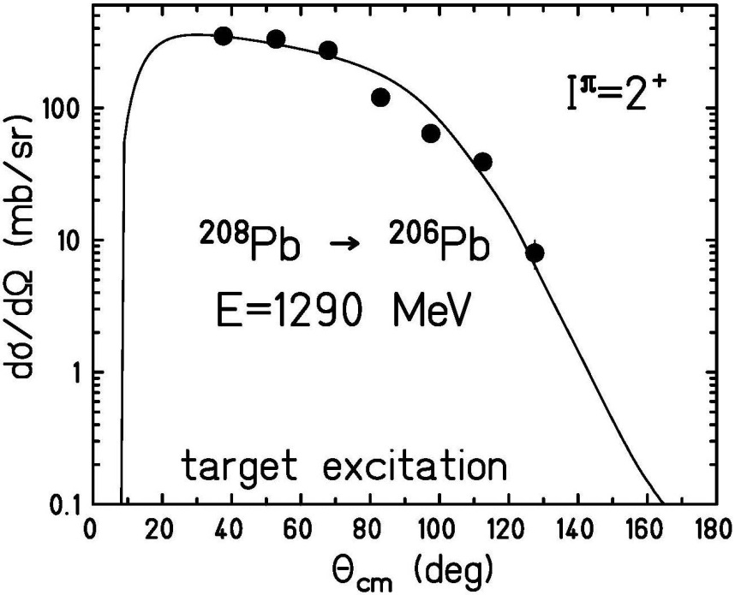

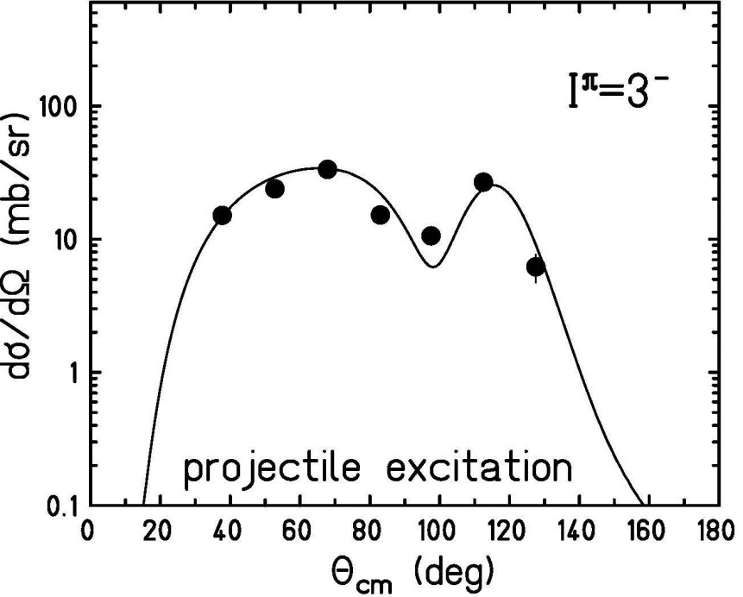



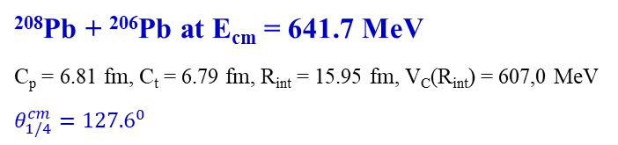

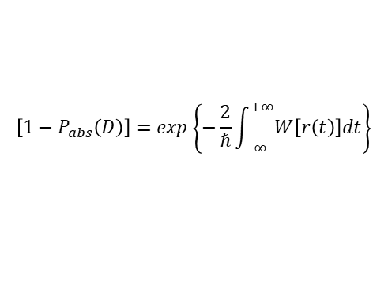

Inelastic scattering close to the Coulomb barrier
electromagnetic and nuclear excitation
Coulex
²⁰⁸Pb + ²⁰⁶Pb at E_{cm} = 641.7 MeV
C_{p} = 6.81 fm, C_{t} = 6.79 fm, R_{int} = 15.95 fm, V_{C}(R_{int}) = 607,0 MeV
$$θ_{1/4}^{cm}={127.6}^{0}$$
$$\frac{dσ_{inel}}{dΩ_{cm}}=\left\{1−P_{abs}\left(D,θ_{cm}\right)\right\}∙\frac{dσ_{coul}}{dΩ_{cm}}$$
$$θ_{1/4}^{cm}$$
$$σ_{reac}=P_{abs}\left(D,θ_{cm}\right)∙σ_{Ruth}$$
$$\left[1−P_{abs}\left(D\right)\right]=exp\left\{−\frac{2}{ℏ}\int_{−∞}^{+∞}{W\left[r\left(t\right)\right]dt}\right\}$$
$$W\left[r\left(t\right)\right]=W_{0}∙exp\left[−\frac{r\left(t\right)−C_{1}−C_{2}}{a_{I}}\right]$$
$$\left[1−P_{abs}\left(D\right)\right]=exp\left\{−\frac{2}{ℏ}∙W_{0}∙exp\left[−\frac{D−C_{1}−C_{2}}{a_{I}}\right]∙\frac{D}{v}\right\}$$

Slide 16
Transfer studies at energies below the Coulomb barrier
only a few reaction channels are open
one reduces uncertainties with nuclear potentials
Q-value distributions get much narrower
one can probe nucleon correlations close to the ground state
but
angular distributions are backward peaked
projectile-like particles have low kinetic energy
a complete identification of final reaction products in A,Z and Q-values becomes difficult
cross sections get very small (need for high efficiency)
solutions:
- use Recoil Mass Separator
- use Magnetic Spectrometers with inverse kinematics

Slide 17
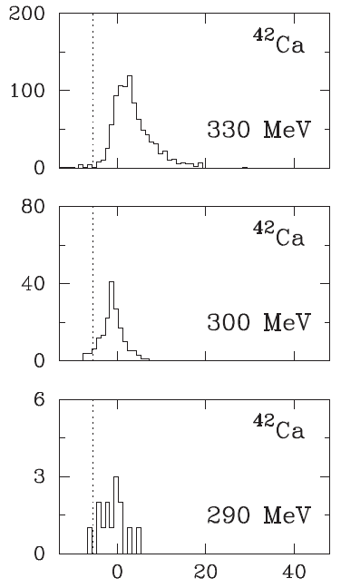
Sub-barrier transfer reactions
A smooth transition between quasi-elastic and deep inelastic processes
⁴⁰Ca(⁹⁶Zr,⁹⁴Zr)⁴²Ca Q_{gg} = +5.5 MeV
97 MeV
E > E_{B}
98 MeV
88 MeV
E ~ E_{B}
85 MeV
E < E_{B}
TKEL [MeV] = -Q

Slide 18
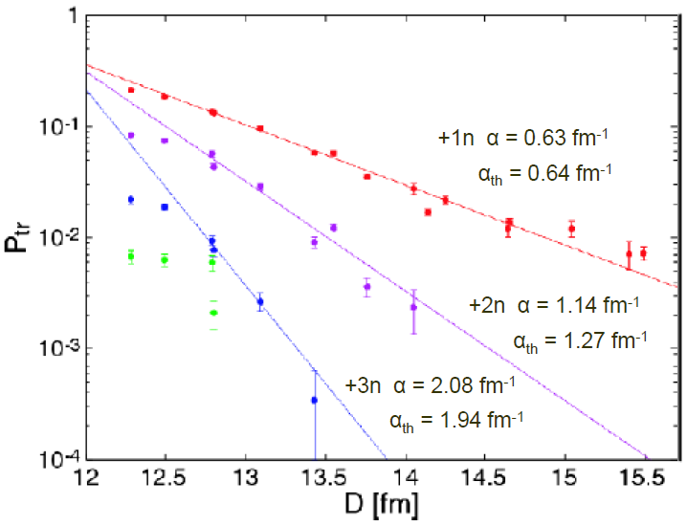
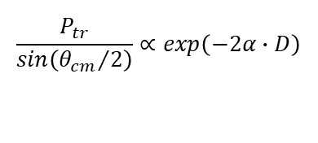
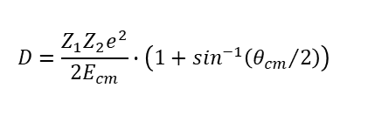

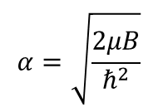
Transfer probabilities for multi-neutron transfer
⁹⁶Zr + ⁴⁰Ca
$$\frac{P_{tr}}{sin\left({θ_{cm}}/2\right)}∝exp\left(−2α∙D\right)$$
$$α=\sqrt{\frac{2μB}{ℏ^{2}}}$$
xn | S_{xn} (MeV) | α_{xn} (fm⁻¹)
1n | 7.854 | 0.61
2n | 14.317 | 1.17
3n | 22.537 | 1.80
$$2αxn\left[{fm}^{−1}\right]=0.43747\sqrt{{x∙B}_{MeV}}$$
$$D=\frac{Z_{1}Z_{2}e^{2}}{2E_{cm}}∙\left(1+\sin^{−1}\left({θ_{cm}}/2\right)\right)$$
C_{p} = 5.1 fm, C_{t} = 3.6 fm, R_{int} = 11.8 fm

Slide 19
Transfer probabilities for multi-neutron transfer
⁹⁶Zr + ⁴⁰Ca
P_{2n} ~ 3·(P_{1n})²
P_{4n} ~ (P_{2n})²
P_{3n} ~ P_{2n}·P_{1n}
$$D=\frac{Z_{1}Z_{2}e^{2}}{2E_{cm}}∙\left(1+\sin^{−1}\left({θ_{cm}}/2\right)\right)$$
C_{p} = 5.1 fm, C_{t} = 3.6 fm, R_{int} = 11.8 fm

Slide 20
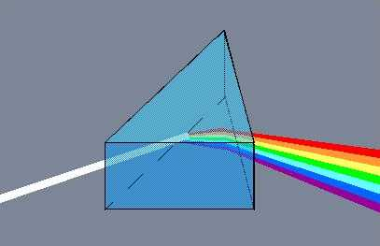
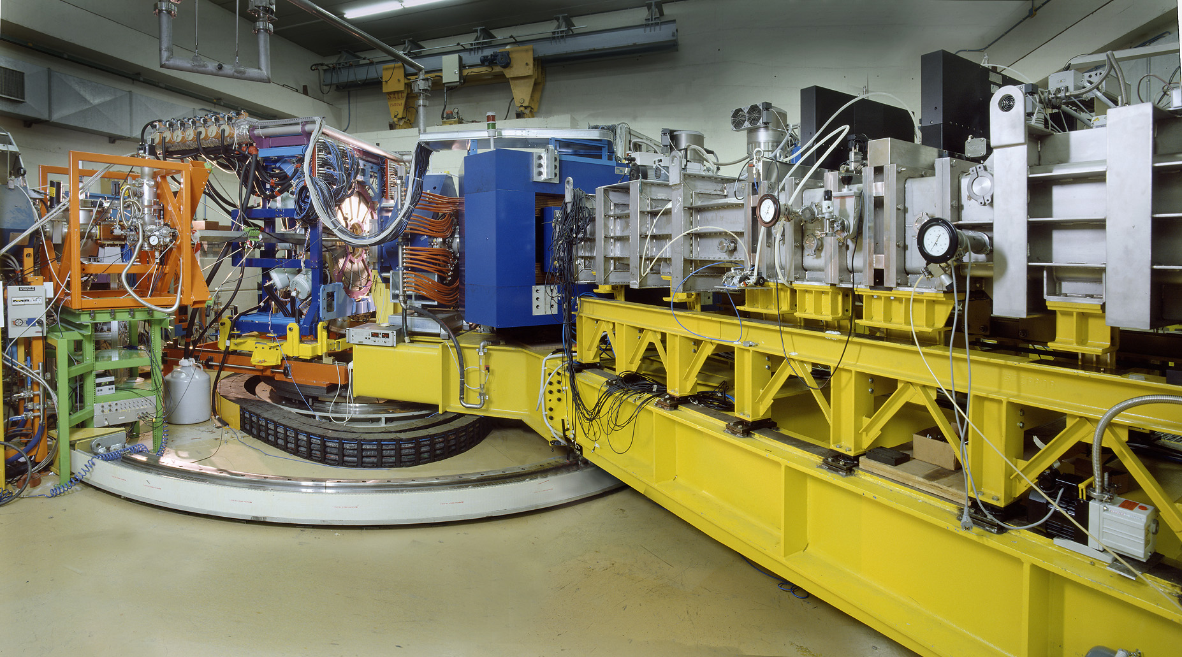
Prisma spectrometer
PRISMA: a large acceptance
magnetic spectrometer
Ω ≈ 80 msr; Bρ_{max} = 1.2 Tm
ΔA/A ~ 1/200
Energy acceptance ~ ±20%

Slide 21
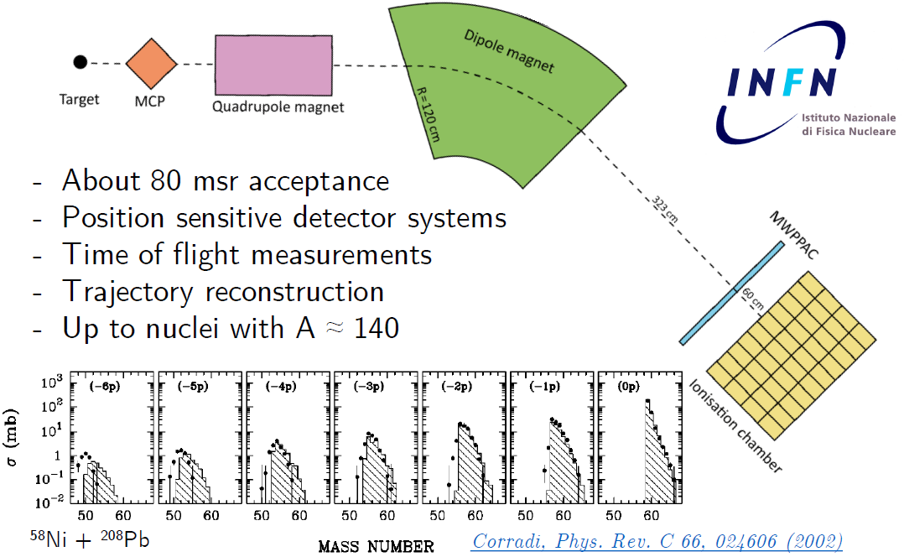
Prisma spectrometer
MCP = micro channel plate

Slide 22
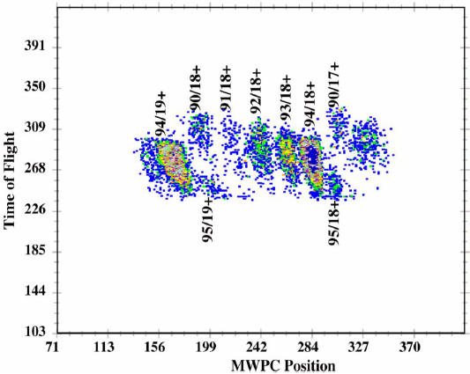
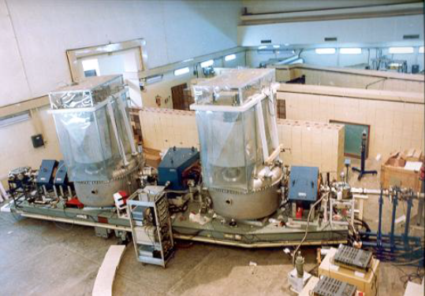
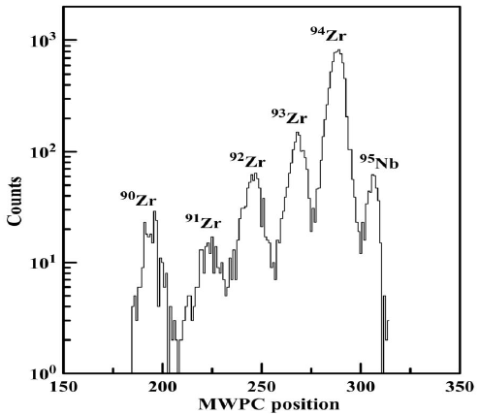
Heavy Ion Reaction Analyzer (HIRA)
focal plane
²⁸Si → ⁹⁴Zr @ 97 MeV
target chamber
²⁸Si → ^{90,94}Zr @ E_{lab} = 83.3, 86.4, 89.5, 92.5, 95.5 MeV
²⁸Si → ⁹⁰Zr @ E_{cm} = 63.5, 65.9, 68.3, 70.6, 72.8 MeV V_{C} = 71.5 MeV
²⁸Si → ⁹⁴Zr @ E_{cm} = 64.2, 66.6, 69.0, 71.3, 73.6 MeV V_{C} = 71.1 MeV
S. Kalkal et al., Phys. Rev. C83 (2011) 054607

Slide 23
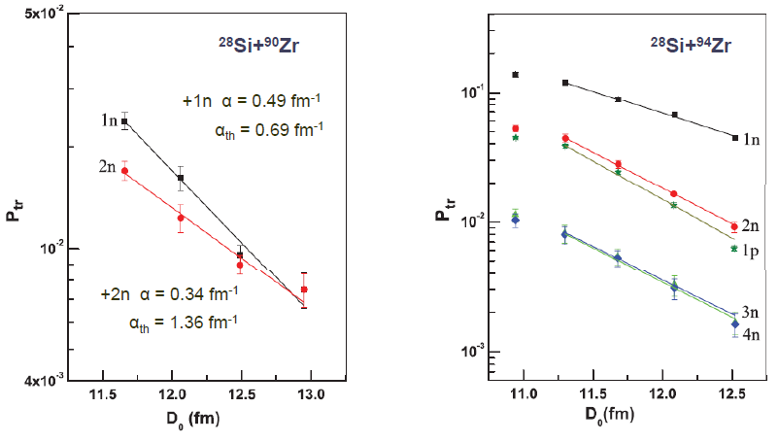
One and two nucleon transfer reactions ²⁸Si + ^{90,94}Zr
²⁸Si → ^{90,94}Zr @ E_{lab} = 83.3, 86.4, 89.5, 92.5, 95.5 MeV
²⁸Si → ⁹⁰Zr @ E_{cm} = 63.5, 65.9, 68.3, 70.6, 72.8 MeV V_{C} = 71.5 MeV
²⁸Si → ⁹⁴Zr @ E_{cm} = 64.2, 66.6, 69.0, 71.3, 73.6 MeV V_{C} = 71.1 MeV
S. Kalkal et al., Phys. Rev. C83 (2011) 054607
C_{p} = 3.1 fm, C_{t} = 5.0 fm, R_{int} = 11.3 fm

Slide 24
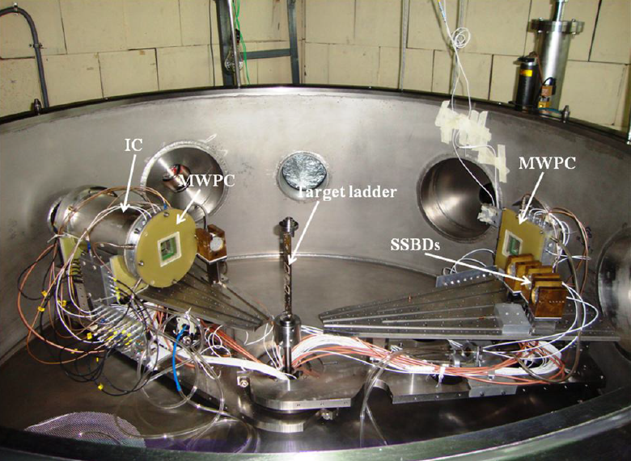
General Purpose Scattering Chamber (GPSC)
²⁸Si → ^{90,94}Zr @ E_{lab} = 120 MeV

Slide 25
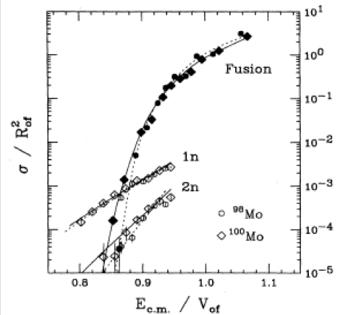
Why should we measure sub-barrier transfer?
one probes transfer and fusion in an overlapping region of energies and angular momenta

Slide 26
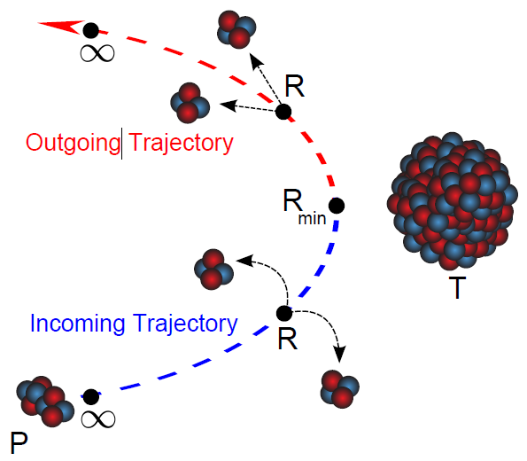
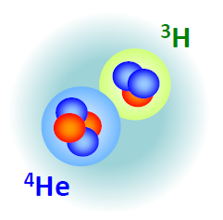
Transfer reactions with weakly bound nuclei ⁷Li +²⁰⁹Bi
⁷Li
breakup threshold energy:
Q_{breakup} = -2.467 MeV
(⁷Li,⁵Li) -2n | (⁷Li,⁶Li) -1n | (⁷Li,⁸Li) +1n | (⁷Li,⁹Li) +2n | (⁷Li,⁶He) -1p | (⁷Li,⁸Be) +1p
-3.18 MeV | -2.65 MeV | -5.43 MeV | -8.25 MeV | -4.99 MeV | +13.46 MeV
⁵Li→⁴He+¹H | ⁶Li→⁴He+²H |  |  |  | ⁸Be→⁴He+⁴He
+1.965 MeV | -1.474 MeV |  |  |  | +0.092 MeV

Slide 27
Transfer triggered breakup reactions ⁶Li + ²⁰⁹Bi
⁷Li
breakup threshold energy:
Q_{breakup} = -1.474 MeV
(⁶Li,⁴Li) -2n | (⁶Li,⁵Li) -1n | (⁶Li,⁷Li) +1n | (⁶Li,⁸Li) +2n | (⁶Li,⁵He) -1p | (⁶Li,⁷Be) +1p
-17.6 MeV | -1.06 MeV | -0.21 MeV | -5.06 MeV | +0.40 MeV | +1.81 MeV
⁵Li→⁴He+¹H | ⁶Li→⁴He+²H |  |  |  | ⁸Be→⁴He+⁴He
+1.965 MeV | -1.474 MeV |  |  |  | +0.092 MeV

Slide 28
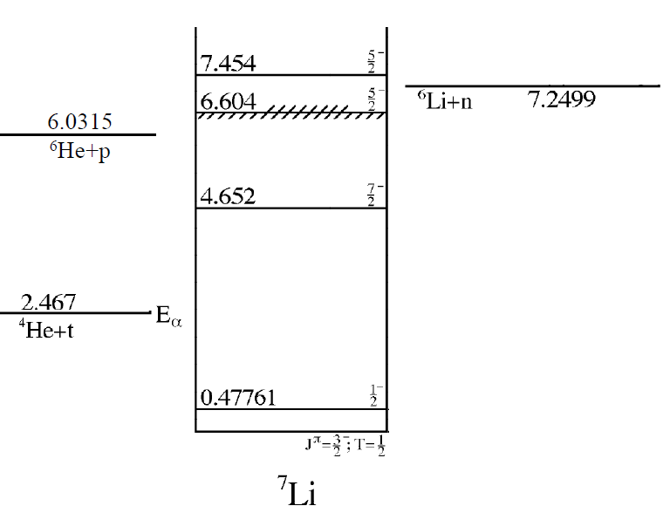
Structure and thresholds
D. R. Tilley et al., Nucl. Phys. A490, 3 (1988)

Slide 29
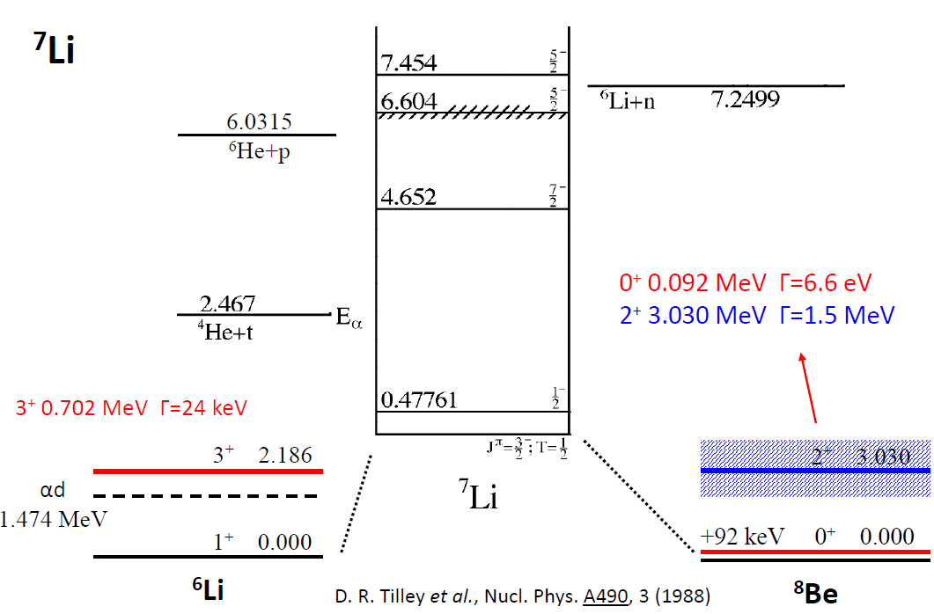
Structure and thresholds

Slide 30
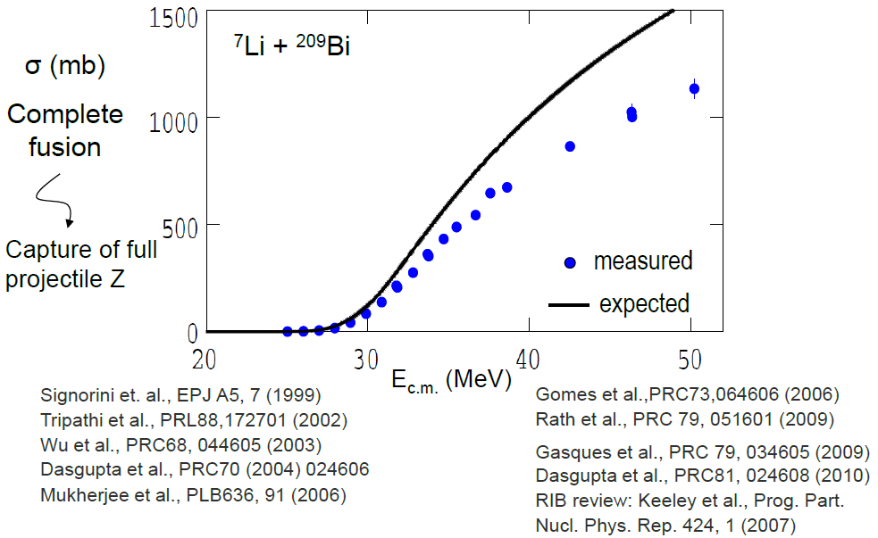
What causes the reduction in fusion?
⁷Li
breakup threshold energy:
Q_{breakup} = -2.467 MeV
Dasgupta et al., Phys. Rev. Lett. 82 (1999) 1395

Slide 31
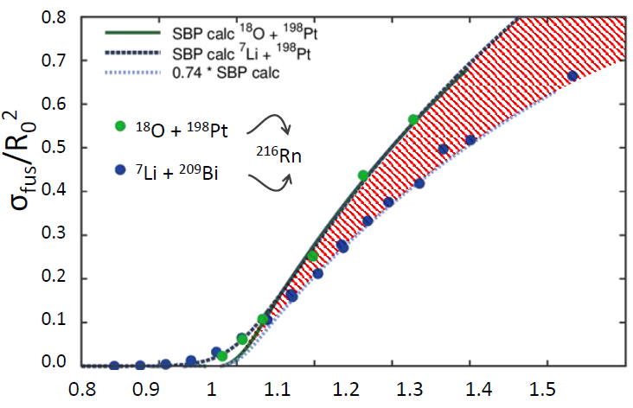
What causes the reduction in fusion?
⁷Li
breakup threshold energy:
Q_{breakup} = -2.467 MeV
E_{cm}/V_{C}(R_{fu})
Fusion of weakly bound ⁷Li + ²⁰⁹Bi suppressed relative to single-barrier calculation in contrast to ¹⁸O + ¹⁹⁸Pt
Dasgupta et al., Phys. Rev. C70, 024606 (2004)

Slide 32
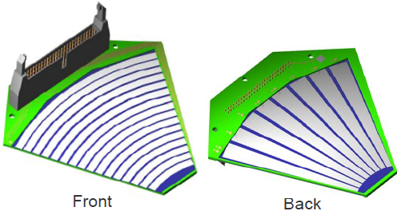
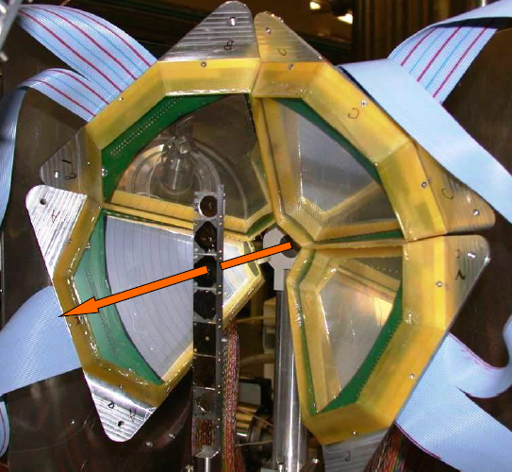
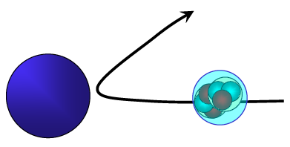
Experimental set-up at ANU
60⁰ wedge detectors
Micron semiconductor Ltd
Large angular coverage (0.83 π sr)
Detectors with high pixellation
(512 pixels)

Slide 33
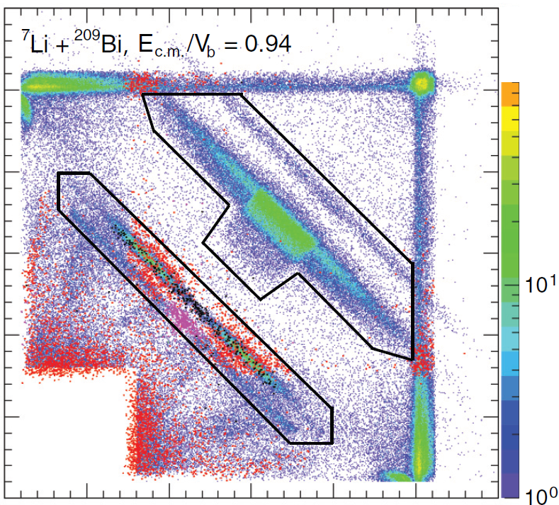

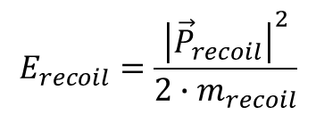

Reconstruction of Q-value non-relativistic implementation
energy conservation:
momentum conservation (3-body breakup)
$$Q=\left(E_{1}+E_{2}+E_{recoil}\right)−E_{beam}$$
measured
from momentum
conservation
known
⁴He + ⁴He
$${\vec{P}}_{beam}={\vec{P}}_{1}+{\vec{P}}_{2}+{\vec{P}}_{recoil}$$
$$E_{recoil}=\frac{{\left|{\vec{P}}_{recoil}\right|}^{2}}{2∙m_{recoil}}$$
⁴He + ³H
⁴He + ²H

Slide 34
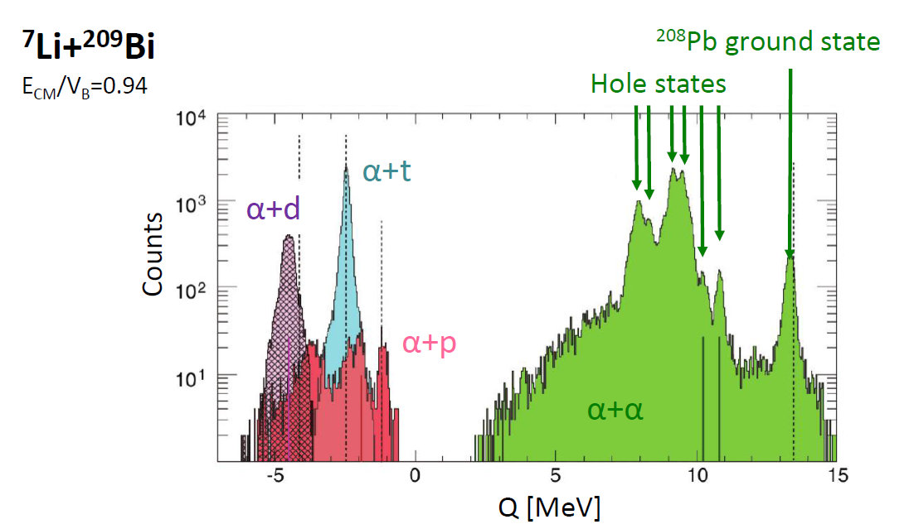
Q-value spectrum (target states)
⁷Li + ²⁰⁹Bi → ⁸Be + ²⁰⁸Pb Q_{gg} = 13.457 MeV
→ ⁵Li + ²¹¹Bi Q_{gg} = -3.175 MeV
→ ⁶Li + ²¹⁰Bi Q_{gg} = -2.645 MeV
⁸Be→⁴He+⁴He Q_{gg} = +0.092 MeV
⁵Li→⁴He+¹H Q_{gg} = +1.965 MeV
⁶Li→⁴He+²H Q_{gg} = -1.474 MeV

Slide 35


Q-value spectrum (target states)
⁷Li+²⁰⁸Pb
E_{CM}/V_{B}=0.95
⁷Li + ²⁰⁸Pb → ⁸Be + ²⁰⁷Tl Q_{gg} = 9.246 MeV
→ ⁵Li + ²¹⁰Pb Q_{gg} = -3.792 MeV
→ ⁶Li + ²⁰⁹Pb Q_{gg} = -3.313 MeV
⁸Be→⁴He+⁴He Q_{gg} = +0.092 MeV
⁵Li→⁴He+¹H Q_{gg} = +1.965 MeV
⁶Li→⁴He+²H Q_{gg} = -1.474 MeV

Slide 36

Q-value spectrum (target states)
⁷Li+²⁰⁷Pb
E_{CM}/V_{B}=0.95
⁷Li + ²⁰⁷Pb → ⁸Be + ²⁰⁶Tl Q_{gg} = 9.766 MeV
→ ⁵Li + ²⁰⁹Pb Q_{gg} = -1.610 MeV
→ ⁶Li + ²⁰⁸Pb Q_{gg} = 0.118 MeV
⁸Be→⁴He+⁴He Q_{gg} = +0.092 MeV
⁵Li→⁴He+¹H Q_{gg} = +1.965 MeV
⁶Li→⁴He+²H Q_{gg} = -1.474 MeV

