Slide 1

Outline: Deep-inelastic heavy-ion collisions
Lecturer: Hans-Jürgen Wollersheim
e-mail: h.j.wollersheim@gsi.de
web-page: https://web-docs.gsi.de/~wolle/ and click on
elastic scattering
deep-inelastic heavy-ion collisions
correlations of experimental observables

Slide 2
Deep-inelastic or strongly damped heavy-ion collisions
N/Z equilibration
1
2
3

Slide 3
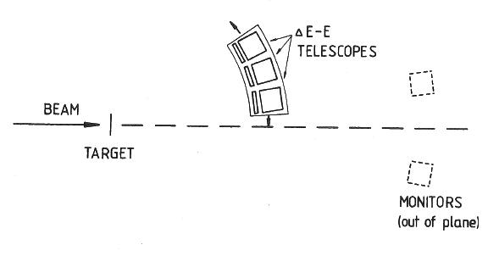
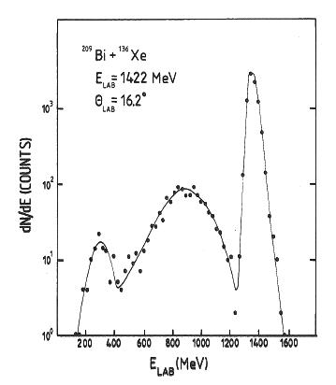
Deep-inelastic or strongly damped heavy-ion collisions
¹³⁶Xe
²⁰⁹Bi
´elastic´
measured angular range: θ_{lab}=11⁰-30⁰
energy resolution 4.5% FWHM for elastic scattering
SD
SF
H.J. Wollersheim; Phys.Rev.C 24 (1981), 2114

Slide 4
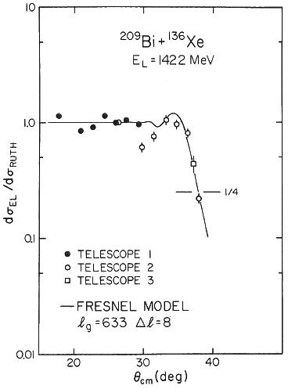
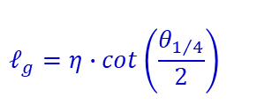
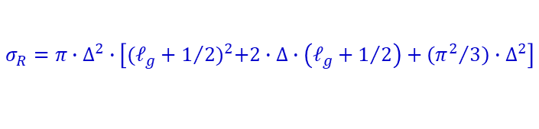
Elastic scattering
electromagnetic interaction:
= 15.2 fm
$$ℓ_{g}=η∙cot\left(\frac{θ_{1/4}}{2}\right)$$
= 633 ħ
²⁰⁹Bi (¹³⁶Xe, HI); E_{lab}= 940, 1130, 1422 MeV
reaction parameters:
= 15.14 fm
$$σ_{R}=π∙∆^{2}∙\left[{(ℓ_{g}+1/2)}^{2}+2∙∆∙\left(ℓ_{g}+1/2\right)+\left({π^{2}}/3\right)∙∆^{2}\right]$$
²⁰⁹Bi (¹³⁶Xe, HI); E_{lab}= 1422 MeV
H.J. Wollersheim; Phys.Rev.C 24 (1981), 2114
W.W. Wilcke; At. Data & Nucl. Data Tables 25 (1980), 389

Slide 5
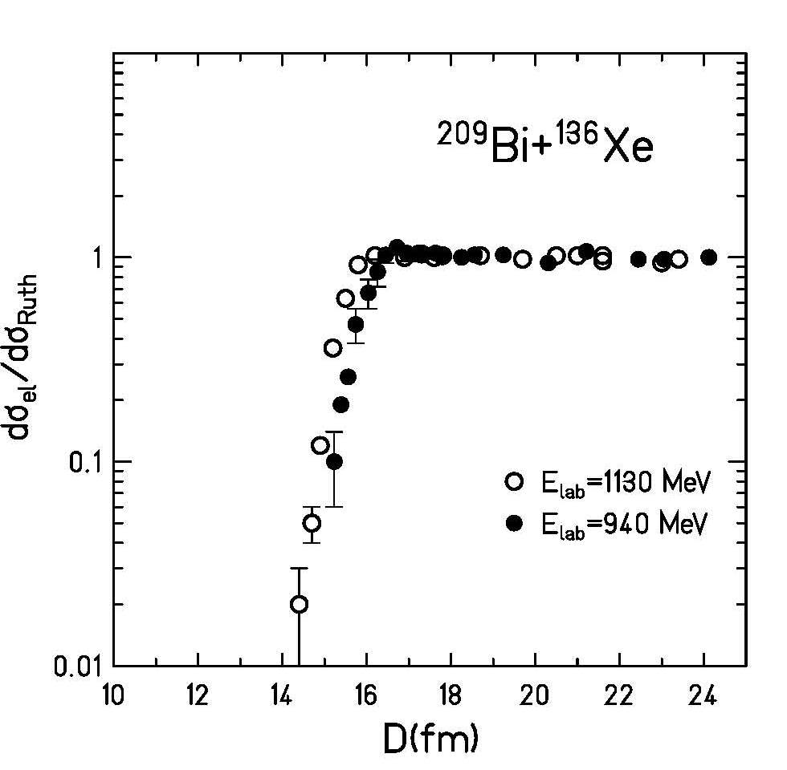

Elastic scattering
electromagnetic interaction:
= 15.2 fm
$$ℓ_{g}=η∙cot\left(\frac{θ_{1/4}}{2}\right)$$
= 633 ħ
²⁰⁹Bi (¹³⁶Xe, HI); E_{lab}= 940, 1130, 1422 MeV
reaction parameters:
= 15.14 fm
$$σ_{R}=π∙R_{int}^{2}∙\left[1−\frac{V_{C}\left(R_{int}\right)}{E_{cm}}\right]$$
²⁰⁹Bi (¹³⁶Xe, HI); E_{lab}= 1422 MeV
H.J. Wollersheim; Phys.Rev.C 24 (1981), 2114
W.W. Wilcke; At. Data & Nucl. Data Tables 25 (1980), 389

Slide 6
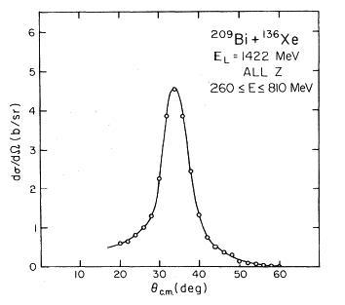
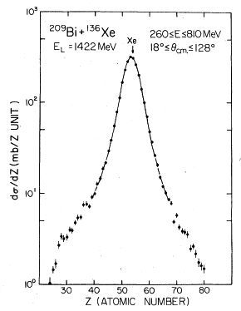
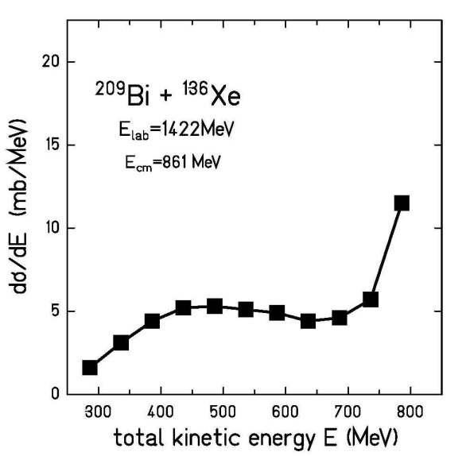
Deep-inelastic or strongly damped heavy-ion collisions
dσ / dΩ (b/sr)
dσ / dZ (mb/Z unit)
V_{C} (spheres)
Θ_{cm} (deg)
Xe
Z (atomic number)
cross section focused into a
narrow angular region close to
the grazing angle (θ_{gr}=38⁰)
(similar to peripheral collision)
σ_{SD} = (3.1±0.4) b ~ σ_{R}
maximum of Z-distribution
remains centered at Z of the
projectile (Z=54)
But a large amount of kinetic
energy is dissipated
(V_{C} (R_{int}) = 426 MeV is the initially
available energy)
E_{min}= (270±30) MeV
(nuclei in the exit channel can be deformed)
H.J. Wollersheim; Phys.Rev.C 24 (1981), 2114

Slide 7
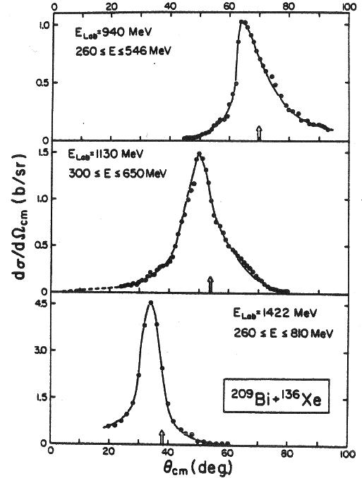
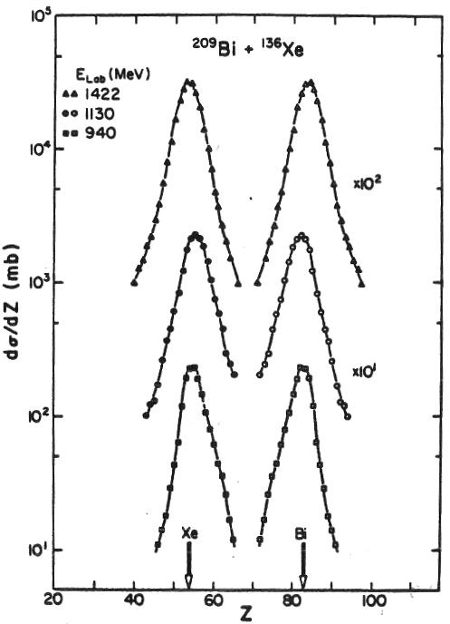
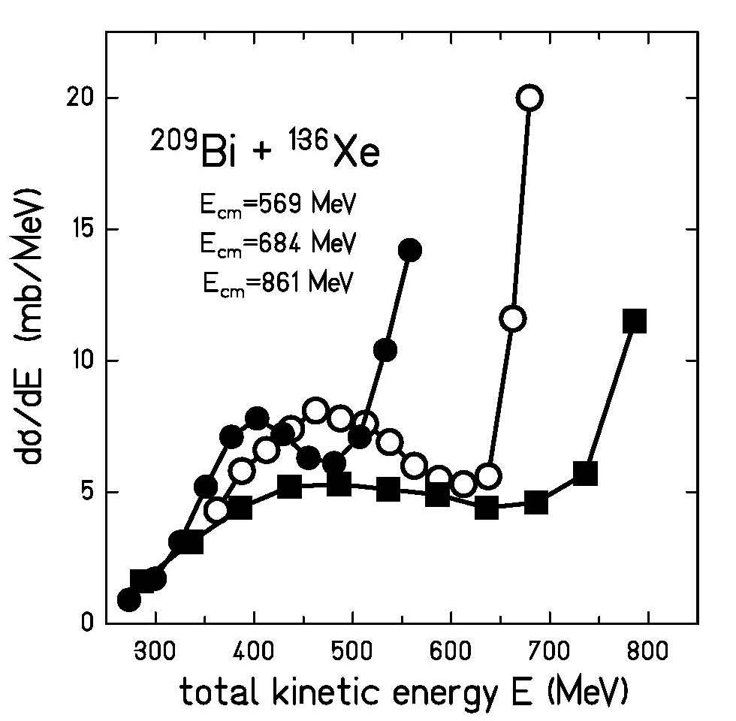
Deep-inelastic or strongly damped heavy-ion collisions
Xe
Bi
V_{C} (spheres)
a large amount of kinetic
energy is dissipated
(V_{C} (R_{int}) = 426 MeV is the initially
available energy)
E_{min}= (270±30) MeV
(nuclei in the exit channel can be deformed)
cross section focused into a
narrow angular region close to
the grazing angle
(similar to peripheral collision)
maximum of Z-distribution
remains centered at Z of the
projectile (Z=54)
H.J. Wollersheim; Phys.Rev.C 24 (1981), 2114
W.W. Wilcke; Phys.Rev.C 22 (1980), 128
W.U. Schröder; Phys.Rep.45 (1978), 301

Slide 8
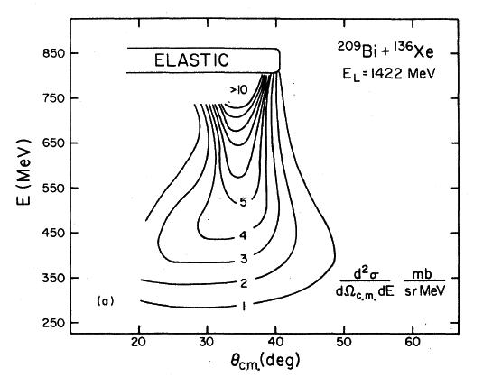
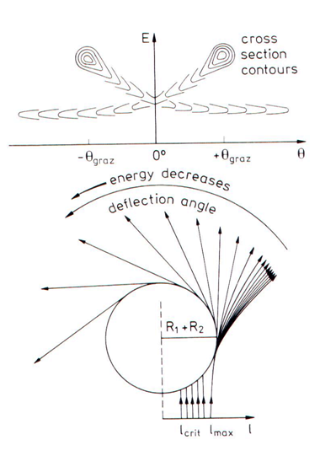

Correlations of experimental observables
modified Coulomb parameter:
$$ℏ$$
0 < η´< 150 orbiting trajectory (see left)
250 < η´< 400 strong focussing effect
500 < η´ Coulomb-like trajectory
Wilczynski plot (0 < η´< 150)
(Phys. Lett. 47B (1973) 484)
η´= 306 for ²⁰⁹Bi (¹³⁶Xe, HI); E_{lab}= 1422 MeV
H.J. Wollersheim; Phys.Rev.C 24 (1981), 2114
W.W. Wilcke; At. Data & Nucl. Data Tables 25 (1980), 389

Slide 9
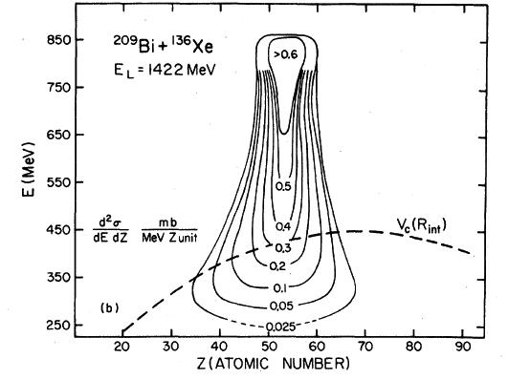
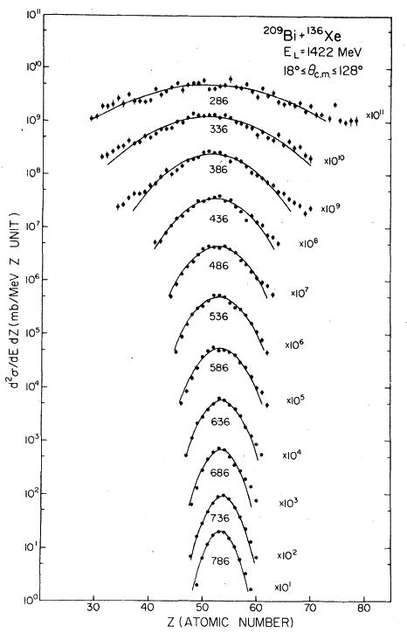
Correlations of experimental observables
Gaussian Z-distribution:
H.J. Wollersheim; Phys.Rev.C 24 (1981), 2114

Slide 10
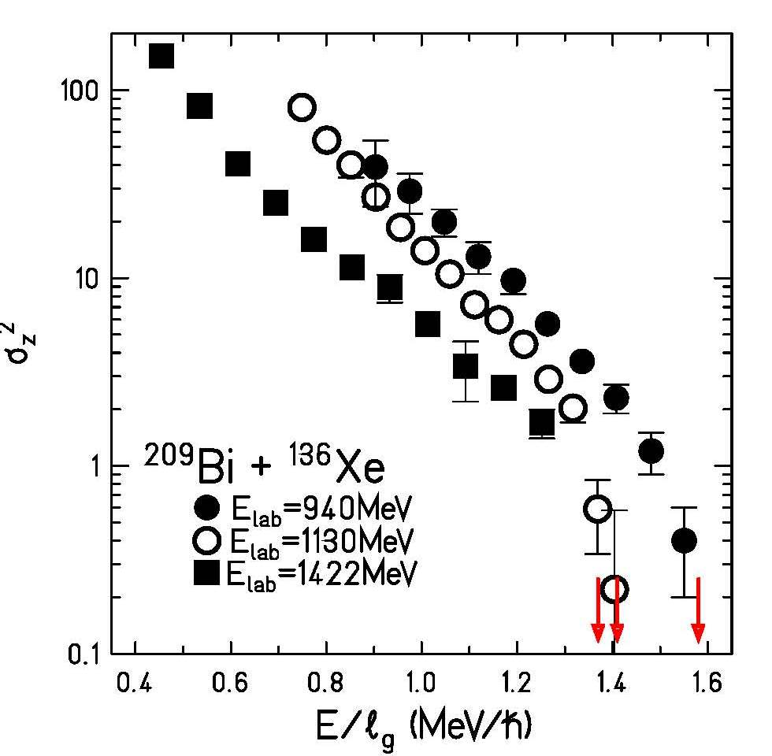
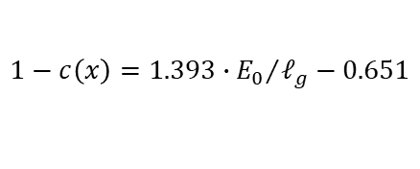
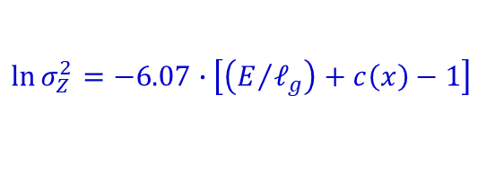
Correlations of experimental observables
common slope dependence:
$$\ln{σ_{Z}^{2}=−6.07∙\left[\left(E/{ℓ_{g}}\right)+c\left(x\right)−1\right]}$$
with
$$1−c\left(x\right)=1.393∙{E_{0}}/{ℓ_{g}}−0.651$$
H.J. Wollersheim; Phys.Rev.C 24 (1981), 2114
H.J. Wollersheim; Phys.RevC25 (1982), 338

Slide 11
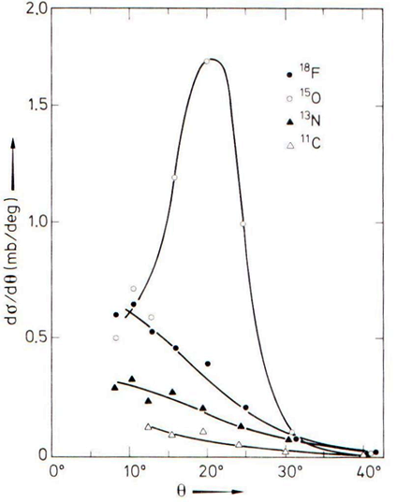
Angular distributions (¹⁶O + Rh @ 160MeV)
R. Kaufmann and R. Wolfgang Phys. Rev. 121 (1961) 192
From the deep-inelastic studies of Kaufmann and Wolfgang around 1960’s:
Transfers of several nucleons, in particular (pn), (p2n) and (2p3n) transfers, occur with large cross sections, which amount typically to 10-20% of one nucleon transfer cross sections. The ratios of these cross sections are approximately equal for different target nuclei – the underlying mechanisms appears to be insensitive to Q values or nuclear structure effects.
Angular distributions of multi-nucleon transfer reactions are strongly forward peaked.

Slide 12
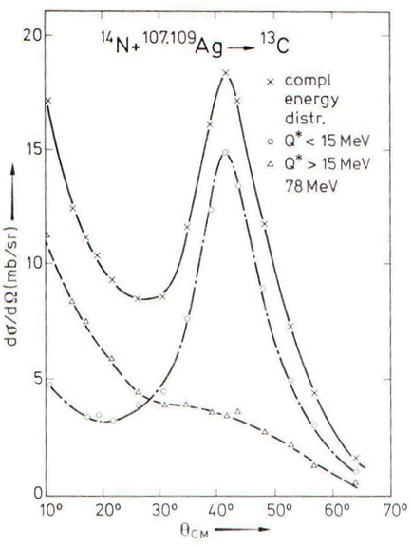
Angular distributions for quasi-elastic and deep-inelastic processes
Quasi-elastic
Deep-inelastic

Slide 13
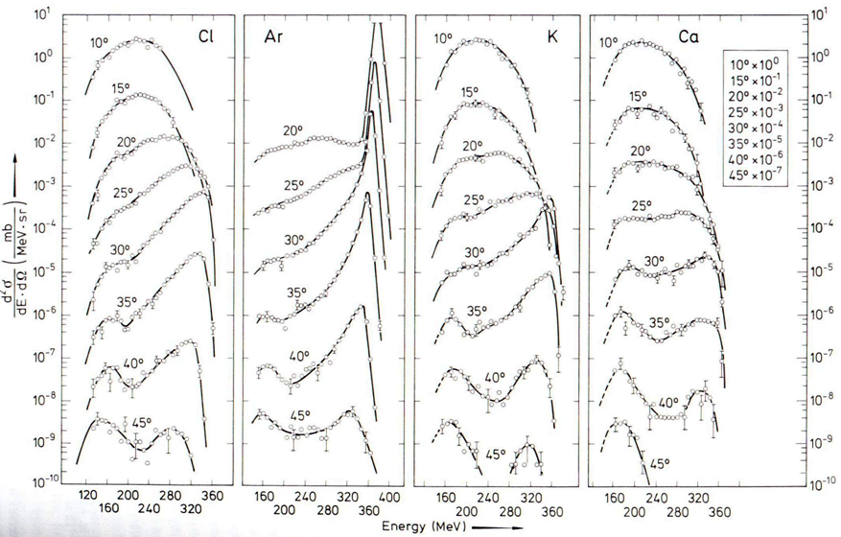
Energy spectra of different elements emitted in the interaction of 40Ar with 232Th @ 9.48 MeV/A
A.G. Artukh et. al. Nucl. Phys A215 (1973) 91

Slide 14
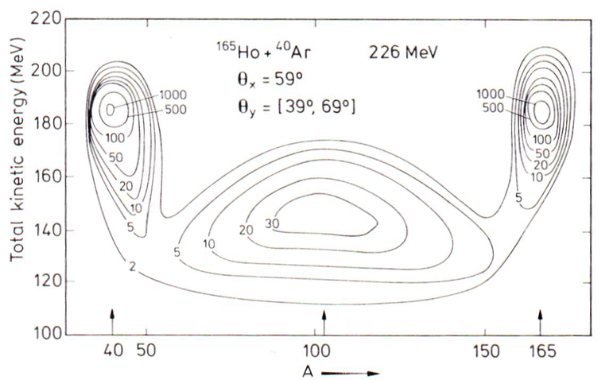
Contour plot of the yield. 40Ar+165Ho @5.65 MeV/A
B. Tamain et. al. Nucl. Phys. A252 (1975) 187

Slide 15
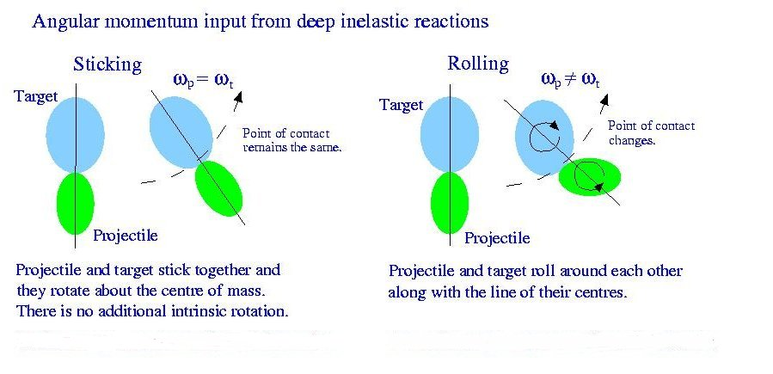
Deep-inelastic models
Taken from C. Wheldon PhD Thesis
Taken from C. Wheldon PhD Thesis

Slide 17
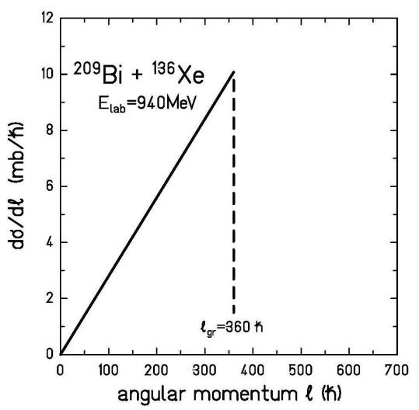
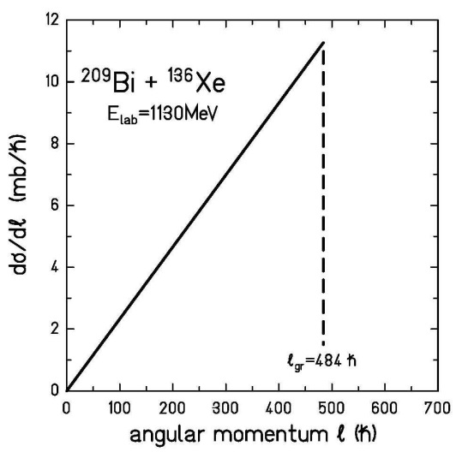
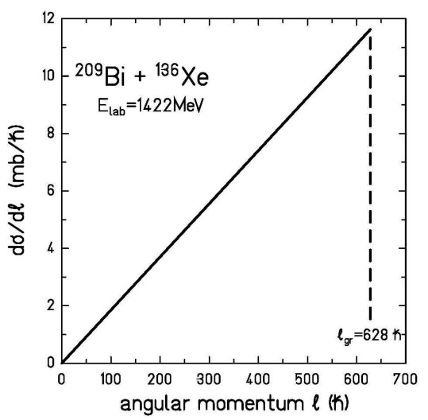
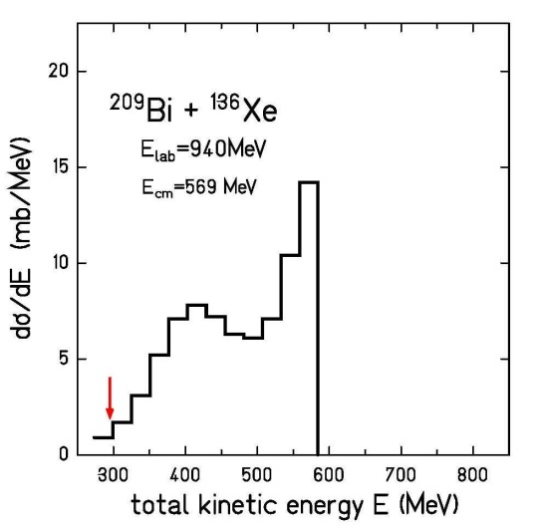
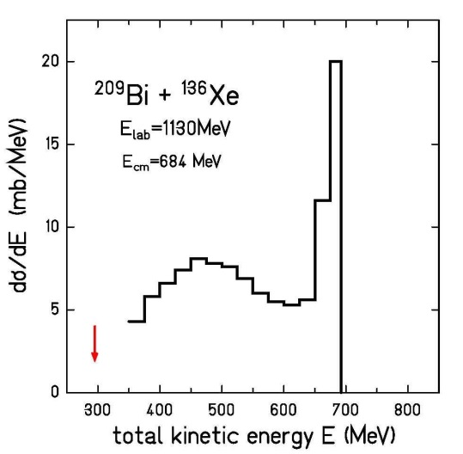
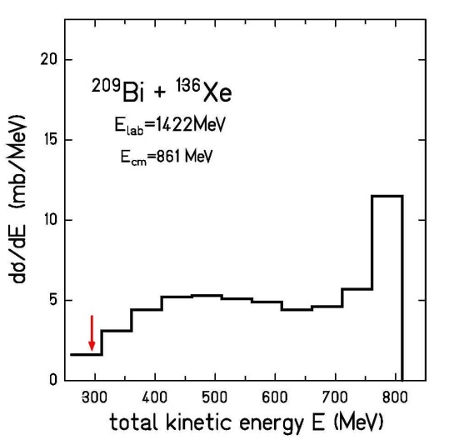

Slide 18
