Slide 1

Outline: Fusion reactions
Lecturer: Hans-Jürgen Wollersheim
e-mail: h.j.wollersheim@gsi.de
web-page: https://web-docs.gsi.de/~wolle/ and click on
fusion cross section
de-excitation of a hot compound nucleus
nuclear temperature, level density, evaporation particles
limiting nuclear angular momentum
production of super heavy elements SHE

Slide 2
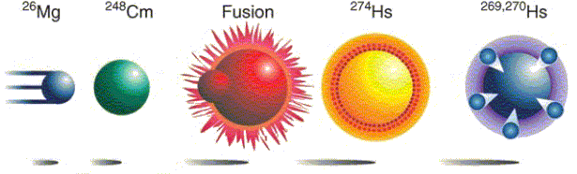
Fusion reactions
“Hot Fusion”
$$5∙{10}^{15} 5∙{10}^{8}$$
projectiles on target compound nuclei 1 atom

Slide 3
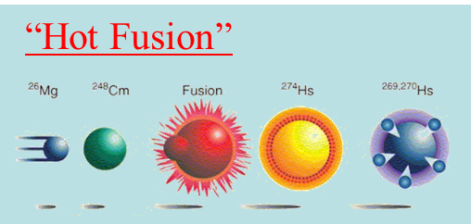
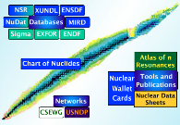


Hot fusion (~1952) successful up to element 106 (Seaborgium)
Coulomb barrier V_{C} between projectile and target nucleus
has to be exceeded
$$V_{C}=\frac{Z_{p}∙Z_{t}∙e^{2}}{R_{int}}$$
$$=126.2 MeV \left({}_{}^{26}{Mg}+{}_{}^{248}{Cm}\right)$$
reaction: a + A → C* → B + b
Δm = m_{a} + m_{A} - m_{CN}
https://www.nndc.bnl.gov/qcalc/
Δm = (25.983 + 248.072 – 274.143) * 931.478 MeV/c²
= -82.153 MeV/c²
excitation energy of compound nucleus
E* = E_{kin} + Δm·c²
= 126.2 MeV – 82.2 MeV
r
= 44.0 MeV
approximate 4 neutrons will be evaporated to avoid fission

Slide 4
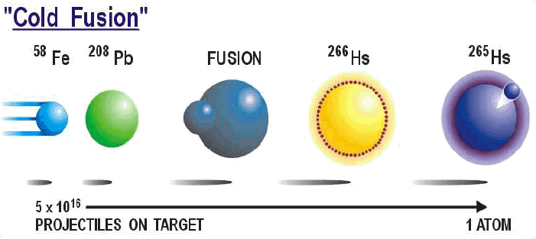


Cold fusion (1981-1996)
Coulomb barrier V_{C} between projectile and target nucleus
has to be exceeded
$$V_{C}=\frac{Z_{p}∙Z_{t}∙e^{2}}{R_{int}}$$
$$=223.3 MeV \left({}_{}^{58}{Fe}+{}_{}^{208}{Pb}\right)$$
reaction: a + A → C* → B + b
Δm = m_{a} + m_{A} - m_{CN}
https://www.nndc.bnl.gov/qcalc/
Δm = (57.933 + 207.977 – 266.130) * 931.478 MeV/c²
= -205.092 MeV/c²
excitation energy of compound nucleus
E* = E_{kin} + Δm·c²
= 223.3 MeV – 205.1 MeV
r
= 18.2 MeV
approximate 1-2 neutrons will be evaporated to avoid fission

Slide 5
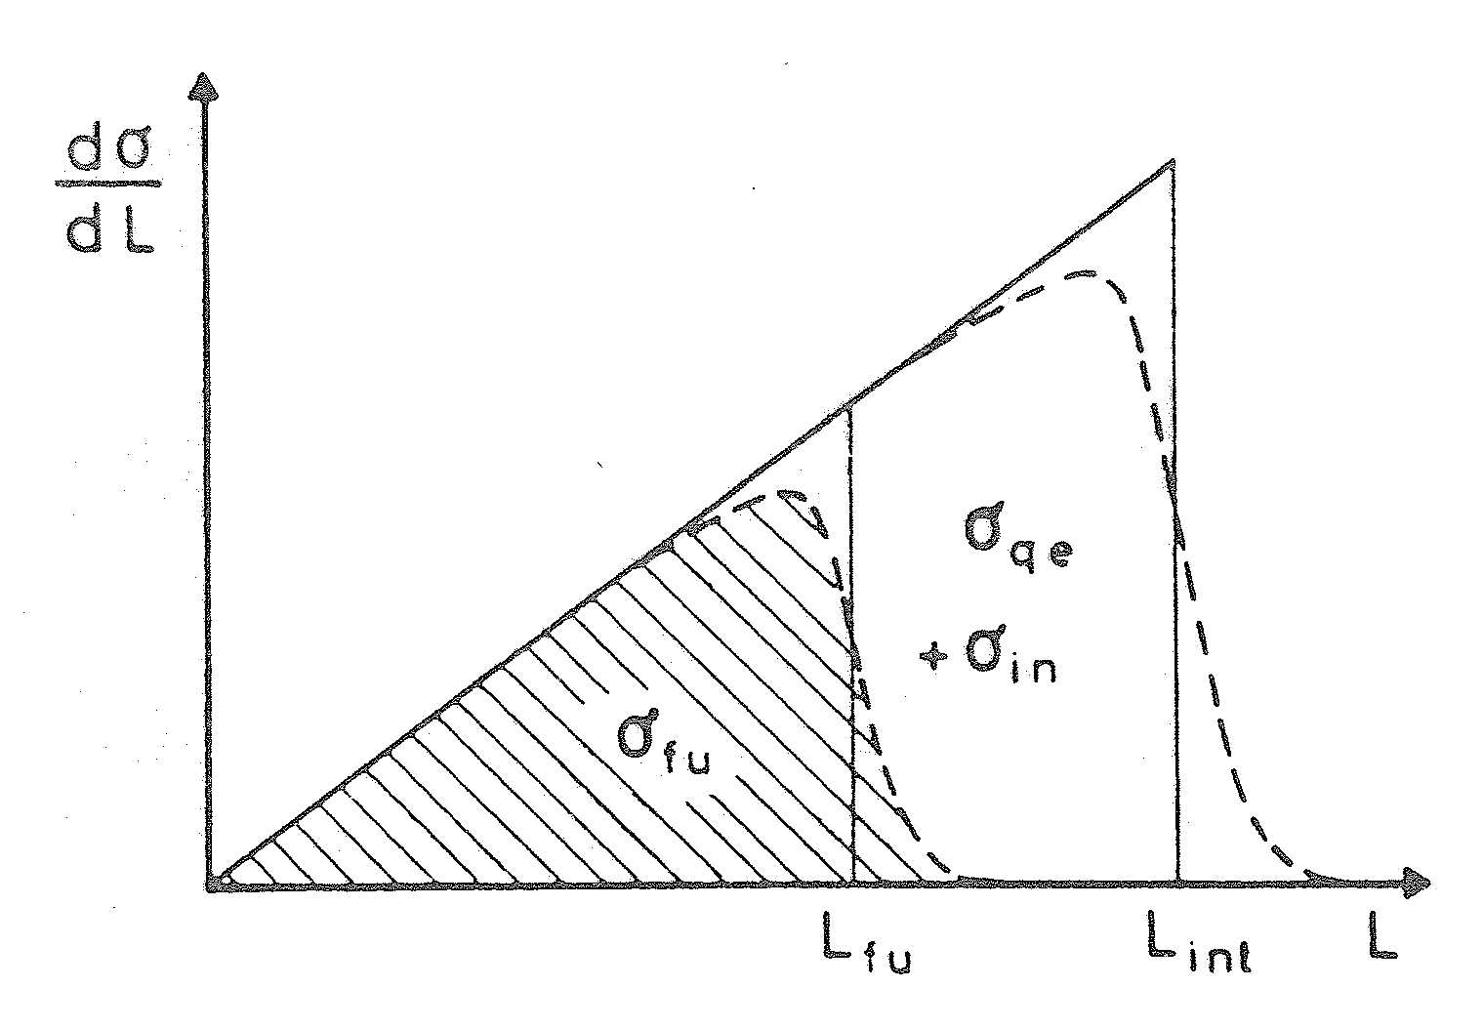

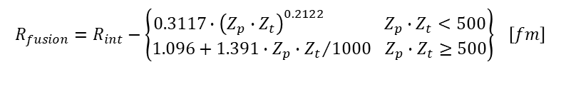




Fusion cross section
Radius for fusion barrier:
$$\frac{dσ}{dℓ}$$
$$R_{fusion}=R_{int}−\left\{\begin{matrix}0.3117∙{\left(Z_{p}∙Z_{t}\right)}^{0.2122} Z_{p}∙Z_{t}<500 \\ 1.096+1.391∙Z_{p}∙{Z_{t}}/{1000} Z_{p}∙Z_{t}≥500\end{matrix}\right\} \left[fm\right]$$
 | R_{i} [fm] | C_{i} [fm] | R_{int} [fm] | V_{C}(R_{int}) [MeV] | R_{fusion} [fm] | V_{C}(R_{fusion}) [MeV]
⁵⁸Fe | 4.40 | 4.17 | 13.75 | 223.3 | 12.36 | 248.4
²⁰⁸Pb | 6.96 | 6.82
ℓ_{fusion} ℓ_{int} ℓ
Total cross section for fusion:
$$σ_{fusion}=πR_{fusion}^{2}∙\left[1−\frac{V_{C}\left(R_{fusion}\right)}{E_{cm}}\right]$$
$$with E_{cm}=\frac{A_{t}}{A_{t}+A_{p}}∙E_{lab}$$
$$σ_{fusion}=\frac{π}{k_{∞}^{2}}∙ℓ_{fusion}∙\left(ℓ_{fusion}+1\right)$$
$$with k_{∞}=0.2187∙\frac{A_{t}}{A_{t}+A_{p}}∙\sqrt{A_{p}∙E_{lab}} \left[{fm}^{−1}\right]$$

Slide 6
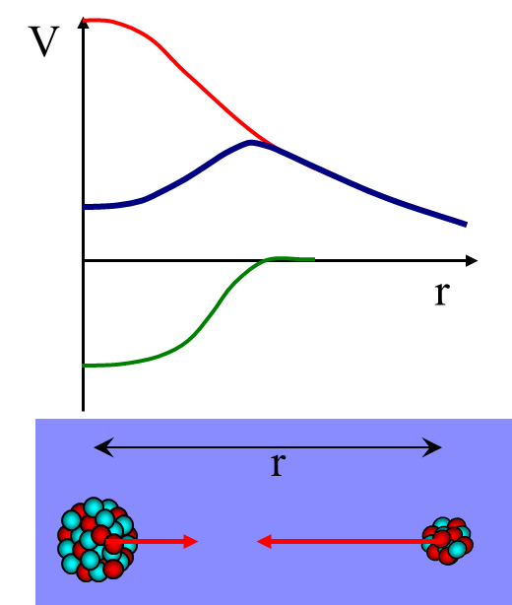

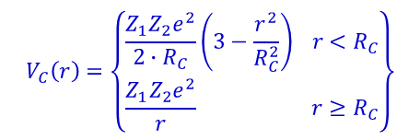


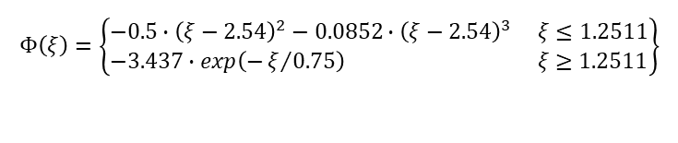




Interaction potential
The potential between projectile and target nucleus is given by a function of the relative distance between them
$$V\left(r\right)=V_{N}\left(r\right)+V_{C}\left(r\right)$$
nuclear potential + Coulomb potential
$$V_{C}\left(r\right)=\left\{\begin{matrix}\frac{Z_{1}Z_{2}e^{2}}{2∙R_{C}}\left(3−\frac{r^{2}}{R_{C}^{2}}\right) r<R_{C} \\ \frac{Z_{1}Z_{2}e^{2}}{r} r≥R_{C}\end{matrix}\right\}$$
nuclear proximity potential:
$$V_{N}\left(r\right)=4π∙γ∙\frac{C_{p}∙C_{t}}{C_{p}+C_{t}}∙b∙Φ\left(ξ\right)$$
$$Φ\left(ξ\right)=\left\{\begin{matrix}−0.5∙{\left(ξ−2.54\right)}^{2}−0.0852∙{\left(ξ−2.54\right)}^{3} ξ≤1.2511 \\ −3.437∙exp\left(−ξ/{0.75}\right) ξ≥1.2511\end{matrix}\right\}$$
$$ξ=\left(r−C_{p}−C_{t}\right)/b$$
$$b=\frac{π}{\sqrt{3}}∙a≅1 fm with a=0.55 fm$$
$$γ=0.9517∙\left\{1−1.7826∙{\left(\frac{N_{c}−Z_{c}}{A_{c}}\right)}^{2}\right\} \frac{MeV}{{fm}^{2}}$$
$$C_{i}=R_{i}∙\left(1−R_{i}^{−2}\right) \left[fm\right]$$
$$R_{i}=1.28∙A_{i}^{1/3}−0.76+0.8∙A_{i}^{−1/3} \left[fm\right]$$

Slide 7



The statistical model de-excitation of the hot compound system
σ_{ℓ}
E*
n
n
Yrast line
n
no states
$$E^{∗}=E_{kin}+∆m∙c^{2}$$
ℓ
$$E_{kin}>V_{C}=\frac{Z_{a}∙Z_{A}∙e^{2}}{R_{int}}$$
$$∆m=m_{a}+m_{A}−m_{CN}$$
https://www.nndc.bnl.gov/qcalc/
Notes:
The decay of the compound system does not depend on the way the compound was formed but only on the excitation energy and angular momentum of the compound. The decay of the highly excited compound system proceeds first by emission of the nucleons or alpha particles on the time scale of 10-19s
defined by the strong interactions involved. When the energy is not sufficient to continue particle emission the decay proceed via the gamma-ray emission with the timescale 10-15 to 10-9 s defined by the electromagnetic interactions involved.

Slide 8
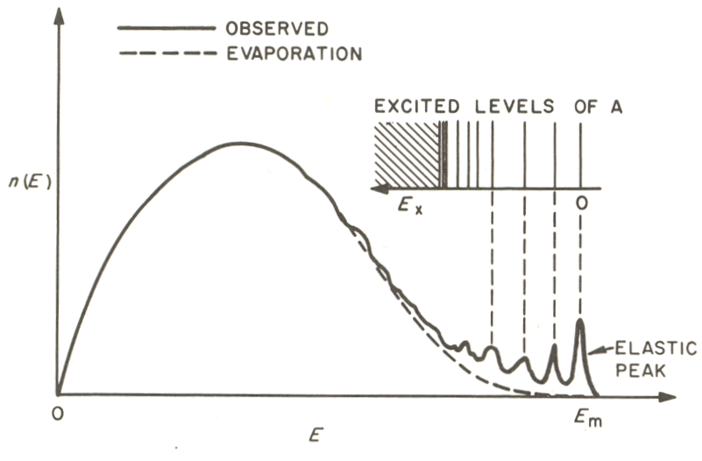
Evaporation particles
cm-spectra of particles statistically emitted from CN (evaporation) are of Maxwell Boltzmann type
neutrons
protons
E_{B} = Coulomb barrier
T = effective nuclear temperature
E_{B}
compound nucleus reactions
direct reactions
Typical energy spectrum of nucleons emitted at a fixed angle
in inelastic nucleon-nucleon reactions.

Slide 9
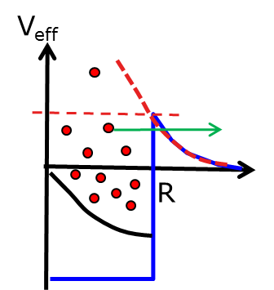
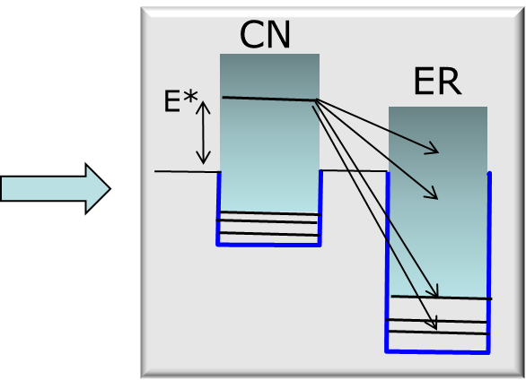
Evaporation particles
cm-spectra of particles statistically emitted from CN (evaporation) are of Maxwell Boltzmann type
neutrons
protons
E_{B} = Coulomb barrier
T = effective nuclear temperature
E_{B}
Even for fixed E* the particle spectrum is continuous (Maxwell Boltzmann), except for transitions to discrete spectrum at low E_{ER}*

Slide 10
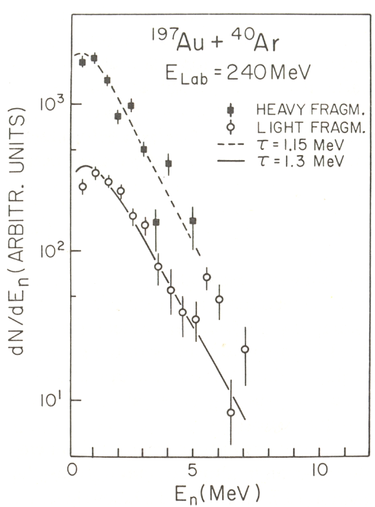
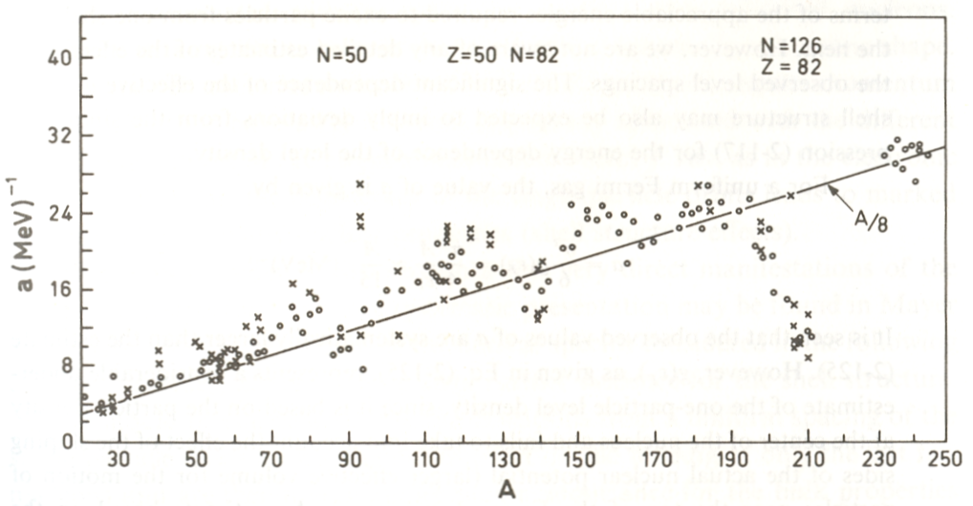
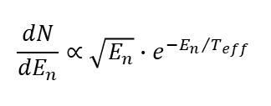

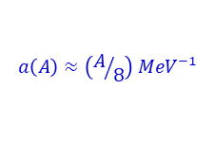
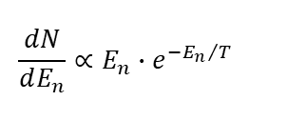
Nuclear temperatures and level densities
de-excitation of the hot compound system
$$\frac{dN}{dE_{n}}∝E_{n}∙e^{−{E_{n}}/T}$$
spectrum of single neutron
excitation energy
$$\left\langle E_{n}\right\rangle =2T \max{ }\frac{dN}{dE_{n}} @ E_{n}=T$$
$$\frac{dN}{dE_{n}}∝\sqrt{E_{n}}∙e^{−{E_{n}}/{T_{eff}}}$$
spectrum of cascade of neutrons
$$\left\langle E_{n}\right\rangle =1.5T T_{eff}≈0.92∙T \left(1^{st} daughter\right)$$
deviations at shell closures
Fermi gas relations:
collective states
$$a\left(A\right)≈\left(A/8\right) {MeV}^{−1}$$
ground state

Slide 11
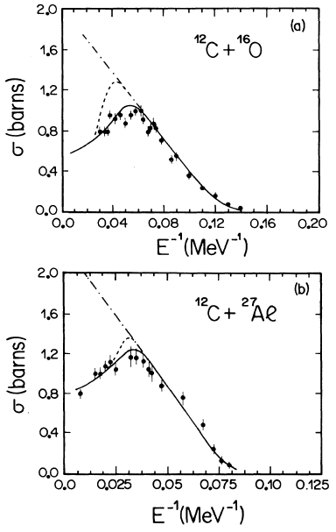
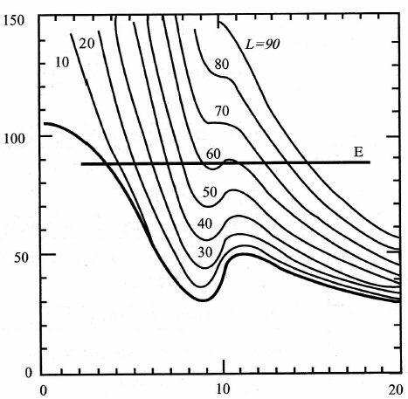
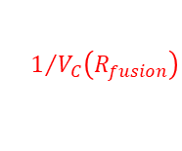





Fusion excitation functions
$$πR_{fusion}^{2}$$
maximum ℓ_{fusion} due to nuclear centrifugal stability
V_{nucl} + V_{coul} + V_{L}
$$1/{V_{C}\left(R_{fusion}\right)}$$
r
Elastic/quasi-elastic scattering
multi-
nucleon transfer
FusionFission
Fusion
-ER
0 _{ER} _{F} _{R} 
$$ℓ_{ER}$$
$$ℓ_{F}$$
$$ℓ_{R}$$
$$ℓ$$
P. Sperr et al., PRL37, 321(1976)

Slide 12
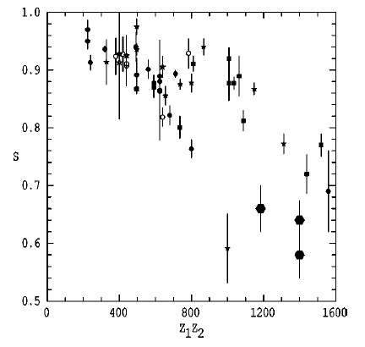
Reduction in fusion at above barrier energies
increased reduction of fusion with Z₁Z₂
Above-barrier suppression
V_{nucl} + V_{coul} + V_{L}
Reported deep inelastic probability close to V_{B}
r
Elastic/quasi-elastic scattering
multi-
nucleon transfer
FusionFission
Fusion
-ER
0 _{ER} _{F} _{R} 
$$ℓ_{ER}$$
$$ℓ_{F}$$
$$ℓ_{R}$$
$$ℓ$$
P. Sperr et al., PRL37, 321(1976)

Slide 13
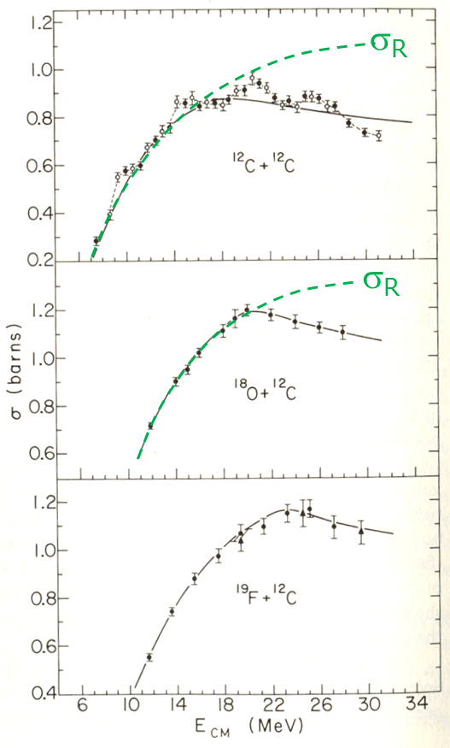
Fusion excitation functions
maximum ℓ_{fusion} due to yrast limitation (nuclear centrifugal stability)
Elastic/quasi-elastic scattering
multi-
nucleon transfer
FusionFission
Fusion
-ER
0 _{ER} _{F} _{R} 
P. Sperr et al., PRL37, 321(1976)

Slide 14
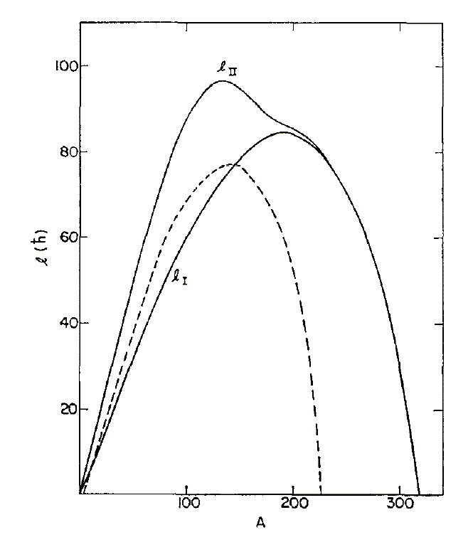
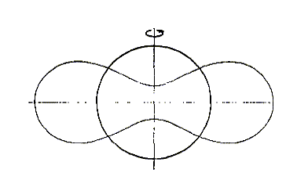
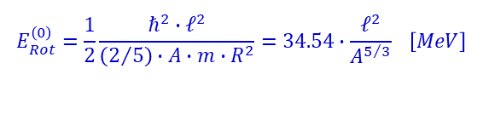

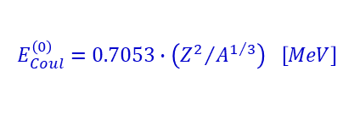
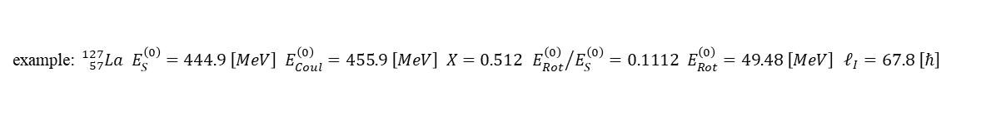
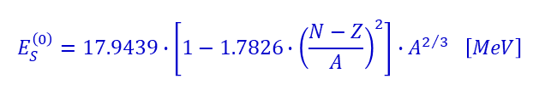


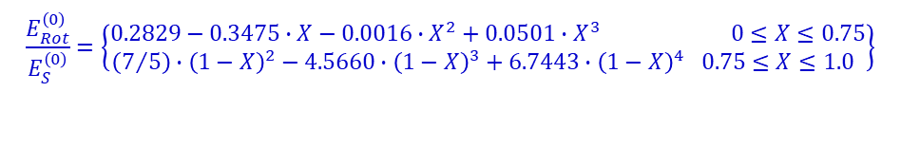

A limiting nuclear angular momentum rotating charged liquid drop
surface energy:
$$E_{S}^{\left(0\right)}=17.9439∙\left[1−1.7826∙{\left(\frac{N−Z}{A}\right)}^{2}\right]∙A^{2/3} \left[MeV\right]$$
$$ℓ_{II}$$
Coulomb energy:
$$E_{Coul}^{\left(0\right)}=0.7053∙\left({Z^{2}}/{A^{1/3}}\right) \left[MeV\right]$$
rotational energy:
ℓ(ħ)
$$E_{Rot}^{\left(0\right)}=\frac{1}{2}\frac{ℏ^{2}∙ℓ^{2}}{\left(2/5\right)∙A∙m∙R^{2}}=34.54∙\frac{ℓ^{2}}{A^{5/3}} \left[MeV\right]$$
$$ℓ_{I}$$
$$Γ_{n}=Γ_{fission}$$
change of the nuclear shape
mass number
$$\frac{E_{Rot}^{\left(0\right)}}{E_{S}^{\left(0\right)}}=\left\{\begin{matrix}0.2829−0.3475∙X−0.0016∙X^{2}+0.0501∙X^{3} 0≤X≤0.75 \\ \left(7/5\right)∙{\left(1−X\right)}^{2}−4.5660∙{\left(1−X\right)}^{3}+6.7443∙{\left(1−X\right)}^{4} 0.75≤X≤1.0 \end{matrix}\right\}$$
$$X=\frac{E_{Coul}^{\left(0\right)}}{2∙E_{S}^{\left(0\right)}}$$
with “fissility parameter”
example: ${}_{57}^{127}{La E_{S}^{\left(0\right)}=444.9 \left[MeV\right] E_{Coul}^{\left(0\right)}=455.9 \left[MeV\right] X=0.512 {E_{Rot}^{\left(0\right)}}/{E_{S}^{\left(0\right)}=0.1112 E_{Rot}^{\left(0\right)}=49.48 \left[MeV\right]} ℓ_{I}=67.8 \left[ℏ\right]}$
Cohen, Plasil, Swiatecki; Ann. Phys. 82, 557 (1974)

Slide 15
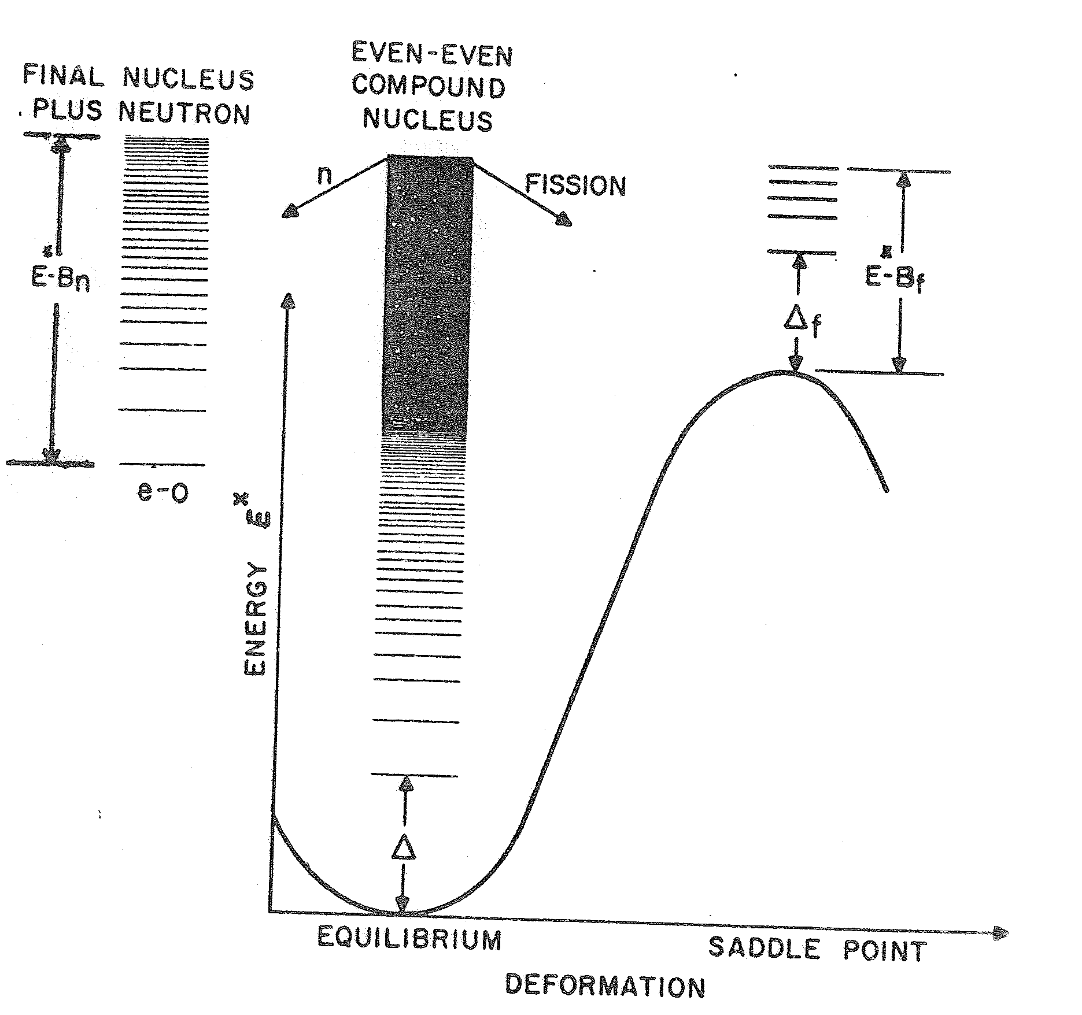
Fusion and evaporation cold fusion
final nucleus
plus neutron
even-even
compound
nucleus
n
fission
⁵⁰Ti + ²⁰⁸Pb ⇒ ²⁵⁸Rf*
(HIVAP calculations)
Fusion
Fission
σ [mbarn]
≈5-7 orders of magnitude
Both decay processes are determined by the level density, either from the residual nucleus or at the saddle point.
level density:
1n
2n
3n
evaporation residues (ER)
E_{lab} [MeV]

Slide 16
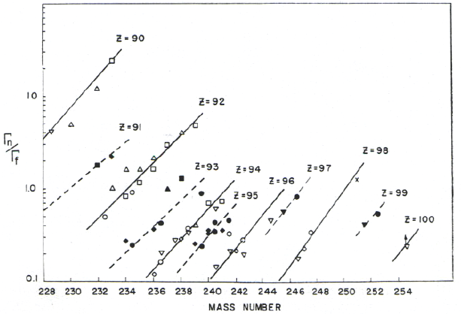

Slide 17
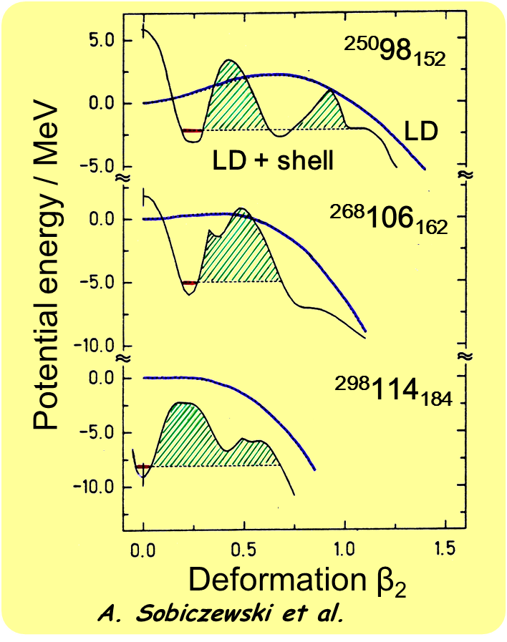
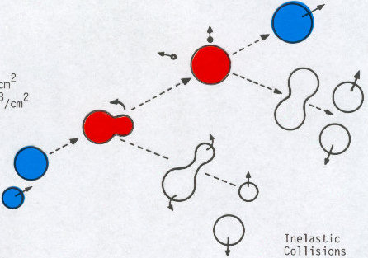


Fusion/Fission competition for SHE liquid drop + shell corrections
$${}_{98}^{250}{Cf}$$
evaporation residue survival
$${}_{106}^{268}{Rf}$$
compound
fission
fast (quasi-)
fission

Slide 18
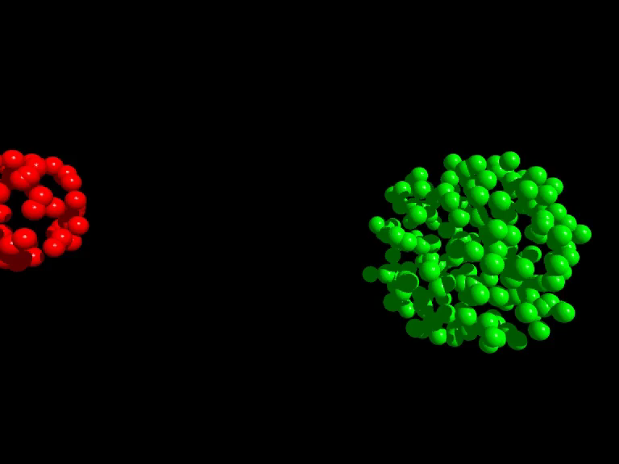
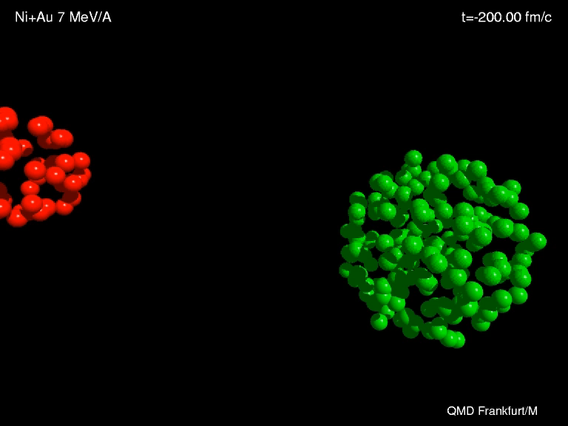
Synthesis of heavy elements
n
⁷⁰Zn
²⁰⁸Pb
²⁷⁷112
Fusion
_1_
10¹²
Compound Fission

Slide 19
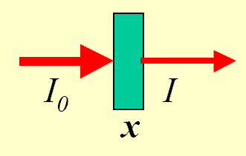
Event rate for SHE production
2·10¹²/s projectiles → ²⁰⁸Pb target (0.5 mg/cm²)
$$N_{p}\left(x\right)=N_{p}\left(0\right)∙\left(1−e^{N_{t}∙σ∙x}\right)≅N_{p}\left(0\right)∙N_{t}∙σ∙x$$
N_{p}
N_{p}(x)
208g ≡ 6.02·10²³ atoms
0.5mg ≡ 1.45·10¹⁸ atoms
luminosity: N_{p}·N_{t} = 2.9·10³⁰ [s⁻¹cm⁻²]
SHIP transmission: ε = 40%
cross section: σ = 1 [pb] = 10⁻³⁶ [cm²]
event rate: N_{p}·N_{t}·ε·σ = 1·10⁻⁶ [s⁻¹] = 0.1 [d⁻¹]

Slide 20
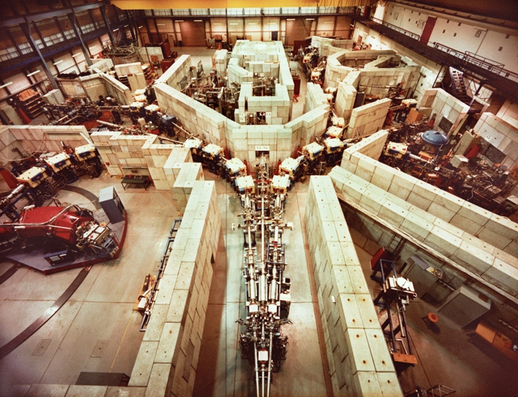
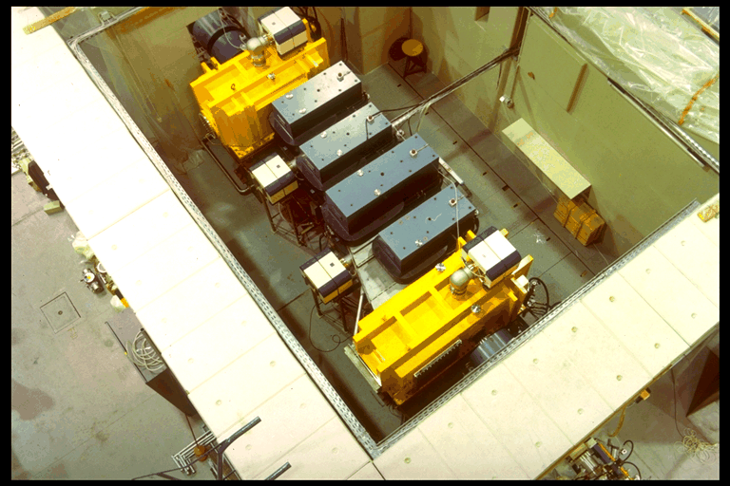
Separator for Heavy Ion Productions (SHIP)

Slide 21
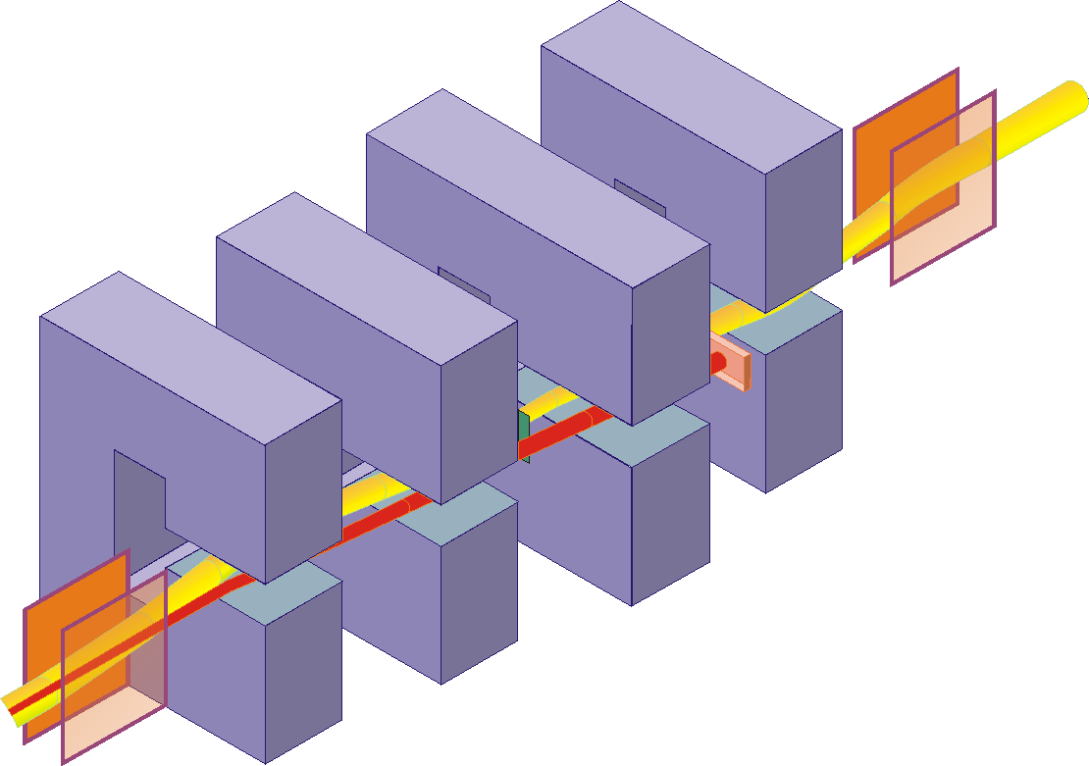
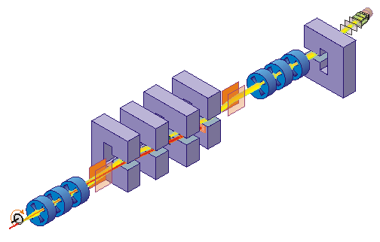




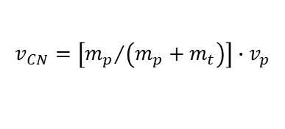
Separator for Heavy Ion Productions (SHIP)
Fusion products are slower than scattered or transfer particles
E- and B-field are perpendicular to each other
$$v_{CN}=\left[{m_{p}}/{\left(m_{p}+m_{t}\right)}\right]∙v_{p}$$
$$e.q. v_{p}≈10.3\% → v_{CN}≈2.2\%$$
$$B∙ρ=\frac{m∙v}{e∙q}$$
$$E∙ρ=\frac{m∙v^{2}}{e∙q}$$
$$F_{mag}=F_{el}⇒F_{tot}=0$$
electric deflectors: ±330 kV dipole magnets: 0.7 T max

Slide 22

Separator for Heavy Ion Productions (SHIP)
The choice of E and B determines the transmitted velocity
The rejected beam will be stopped on a cooled Cu plate
$$v=\frac{E}{B}$$

Slide 23
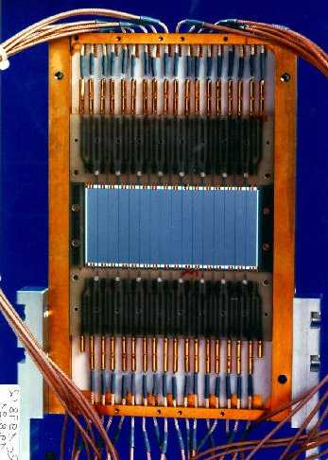
SHIP – stop detector
γ
α (ΔE signal)
SHE will be measured in a pixel
position sensitive Silicon detector determines the position an energy of SHE and α, β, ...
area: 27*87mm², thickness: 0.3mm, 16 strips
energy resolution ΔE=18-20 keV @ E_{α}> 6MeV (cooling 260K)
position resolution Δx=0.3mm (FWHM)
Wait for the emission of an α-particle
(or β-particle)
correlation method: implantation and decay event in the same pixel

Slide 24
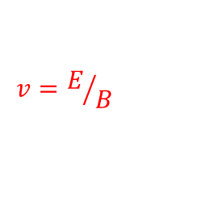
Synthesis and identification of heavy elements with SHIP
n
⁷⁰Zn
²⁰⁸Pb
²⁷⁷112
²⁷⁷112
²⁷⁷112
ER
²⁷³110
11.45 MeV
280 μs
12 m
²⁶⁹Hs
11.08 MeV
110 μ s
²⁶⁵Sg
9.23 MeV
19.7 s
²⁶¹Rf
4.60 MeV (escape)
7.4 s
known
kinematical separation (in flight)
using electric deflectors
and dipole magnets
→ velocity filter
8.52 MeV
4.7 s
²⁵⁷No
²⁵³Fm
8.34 MeV
15.0 s
$$v=E/B$$
Date: 09-Feb-1996
Time: 22:37 h

Slide 25
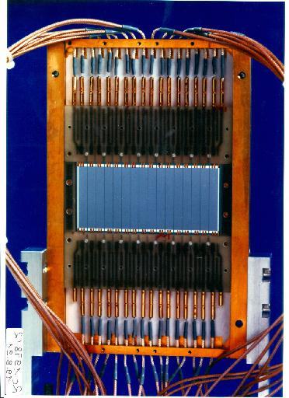
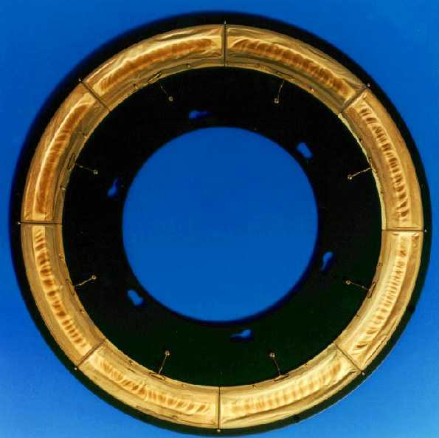
Synthesis and identification of heavy elements with SHIP
n
⁷⁰Zn
²⁰⁸Pb
²⁷⁷112
²⁷⁷112
8 cm
²⁷⁷112
ER
²⁷³110
11.45 MeV
280 μs
12 m
²⁶⁹Hs
11.08 MeV
110 μ s
31 cm
9.23 MeV
19.7 s
²⁶⁵Sg
Identification by
α-α correlations
down to known
isotopes
²⁶¹Rf
4.60 MeV (escape)
7.4 s
known
kinematical separation (in flight)
using electric deflectors
and dipole magnets
→ velocity filter
8.52 MeV
4.7 s
²⁵⁷No
²⁵³Fm
8.34 MeV
15.0 s
$$v=E/B$$
Date: 09-Feb-1996
Time: 22:37 h

Slide 26
Trans Actinide Separator and Chemistry Apparatus
New gas-filled Separator for SHE
Actinide targets (U, Pu, Am, …)
Highest UNILAC beam intensities
high transmission
~60%
small image size
~40%
5 cm x 12 cm
3 cm
The gas-filled recoil-separator comprises a dipole magnet for spatial separation of ions according to their magnetic rigidity, followed by a quadrupole duplet for focusing the separated superheavy elements into the focal plane.

Slide 27
Vacuum of gas-filled separator
vacuum
gas (He: 0.5 – 2 mbar)
Fused nuclei leave the target in different charge states. In a gas-filled separator one obtains very fast an average charge state. (B·ρ is independent of v), so that the transmission is increased substantially.
Bohr velocity v₀=c/137

Slide 28
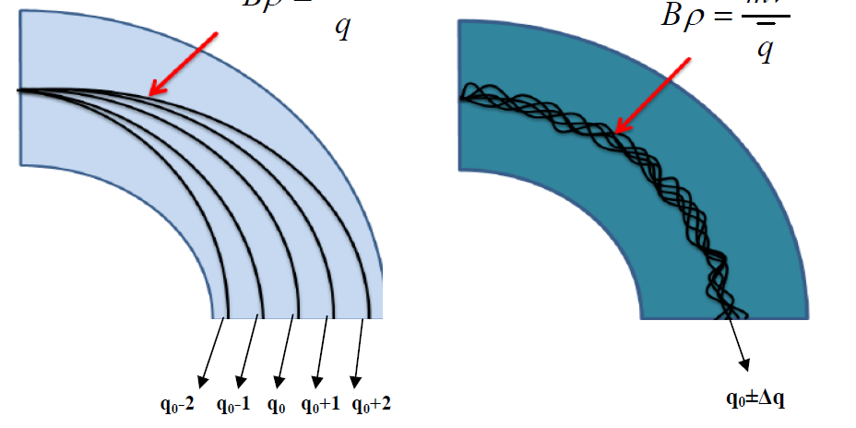
Vacuum of gas-filled separator
Heavy ions leave the target in a charge distribution
Vacuum systems accept only a few charge states
excellent resolution
Ion scattering with the gas (velocity of ions and electrons are almost equal)
magnetic rigidity Bρ is independent of the velocity, since also the average charge state depends on the velocity
large acceptance
but: problems with resolution, background suppression

Slide 29
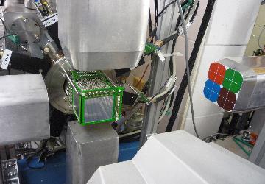
TASISPEC – TASCA Small Image Spectrometer
DSSSD: 0.5mm, 32x32 strips
4 SSSD: 1.0mm, 4x32 strips
Efficiency: ~80% (alpha)
~50-100 keV energy threshold
Ge-cube:
4 Clover, 1 Cluster: 23 Ge crystals
Efficiency: ~40% at 250 keV
Multi-coincidence options

Slide 30
The JUROGAM array + RITU + GREAT spectrometer

Slide 31
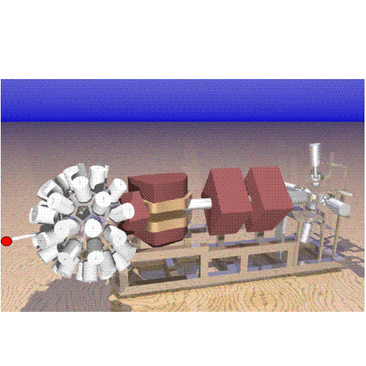



The JUROGAM array + RITU + GREAT spectrometer

Slide 32

The JUROGAM array + RITU + GREAT spectrometer
rotational energy:
gamma-ray energy:
J
3
S. Eeckhaudt et al., Eur. Phys. J. A 26, 227 (2005)

Slide 33

Comparison between potential model and experimental data
Fusion cross sections calculated with a static, energy independent potential
works well for relatively light systems
underpredicts σ_{fus} for heavy systems at low energies
¹⁶O + ²⁷Al
¹⁴N + ¹²C
⁴⁰Ar + ¹⁴⁴Sm
L.C. Vaz, J.M. Alexander and G.R. Satchler, Phys.Rep. 69 (1981) 373

Slide 34

Comparison between potential model and exp. data
Fusion cross sections calculated with a static, energy independent potential
Potential model:
reproduces the data reasonably well
for E > V_{B}
underpredicts σ_{fus}
for E < V_{B}
L.C. Vaz, J.M. Alexander and G.R. Satchler, Phys.Rep. 69 (1981) 373

Slide 35




Comparison between potential model and exp. data
Fusion cross sections calculated with a static, energy independent potential
Effect of collective excitation
$$β_{2}≅\frac{4π}{3∙Z_{t}∙R_{t}^{2}}∙\sqrt{\frac{B\left(E2↑\right)}{e^{2}}}$$
$$β_{4}≅\frac{4π}{3∙Z_{t}∙R_{t}^{4}}∙\sqrt{\frac{B\left(E4↑\right)}{e^{2}}}$$
L.C. Vaz, J.M. Alexander and G.R. Satchler, Phys.Rep. 69 (1981) 373

Slide 36




Fusion for a deformed nucleus
$$σ_{fus}\left(E\right)=\int_{0}^{1}{σ_{fus}\left(E,θ\right)d\left(cosθ\right)}$$
θ = π/2
θ = 0
spherical
θ = 0 deg.
θ = 90 deg.
The barrier is lower for θ = 0
The barrier is higher for θ = π/2
Deformation enhances σ_{fus} by a factor of 10 - 100

Slide 37
Fusion below and above the barrier inconsistent
¹⁶O + ²⁰⁸Pb
a = 0.66 fm
a = 1.18 fm
a = 1.65 fm
¹⁶O + ²⁰⁴Pb
(mb)
a = 0.66 fm
a = 1.18 fm
a = 1.65 fm
E_{c.m.} – V_{B} (MeV)
E_{c.m.} – V_{B} (MeV)
M. Dasgupta et al., Phys Rev Lett 99 (2007) 192701

