Slide 1

Outline: Photo nuclear reaction
Lecturer: Hans-Jürgen Wollersheim
e-mail: h.j.wollersheim@gsi.de
web-page: https://web-docs.gsi.de/~wolle/ and click on
photons in the universe
nuclear resonance fluorescence
inverse Compton scattering
laser Compton backscattering (ELI)
Thomson scattering

Slide 2
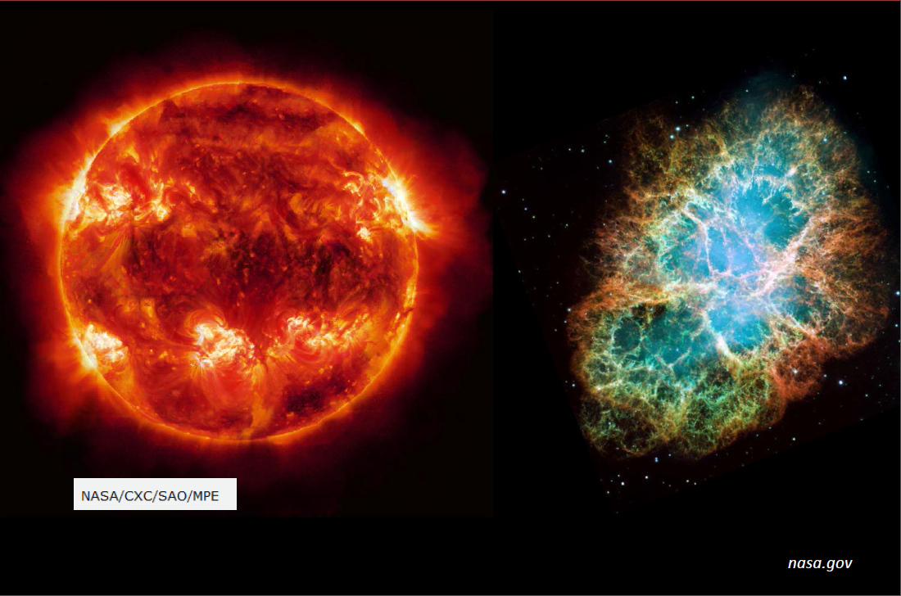
Photons in the universe

Slide 3
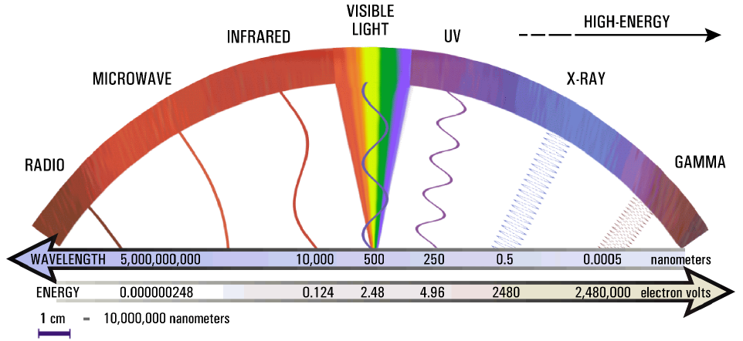
Photons in the universe

Slide 4
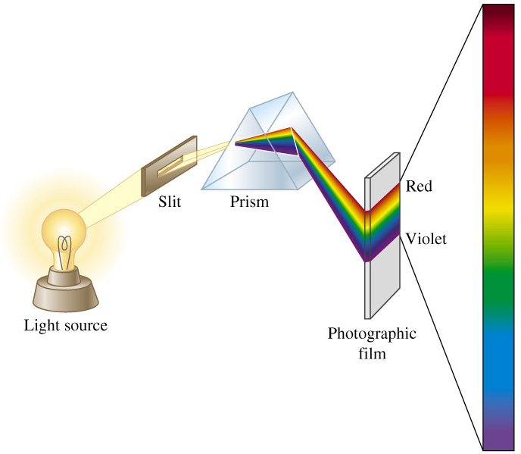
Element production on the sun

Slide 5

Spectral lines of hydrogen
absorption spectrum
absorption
hydrogen gas

Slide 6
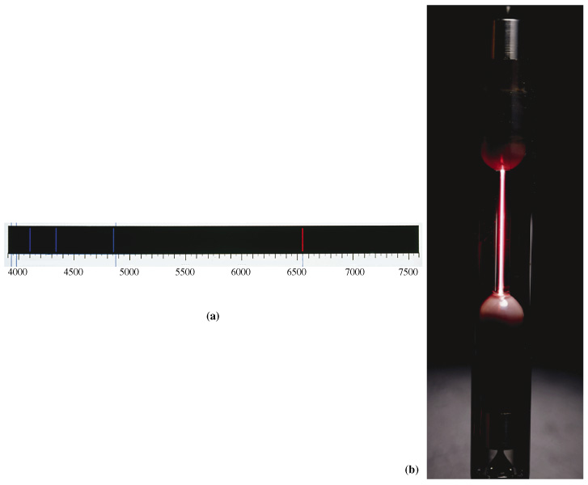
Element production on the sun
Hydrogen emission spectrum
wave length nm
6

Slide 7
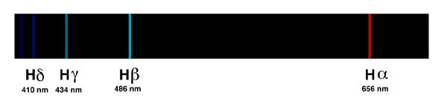
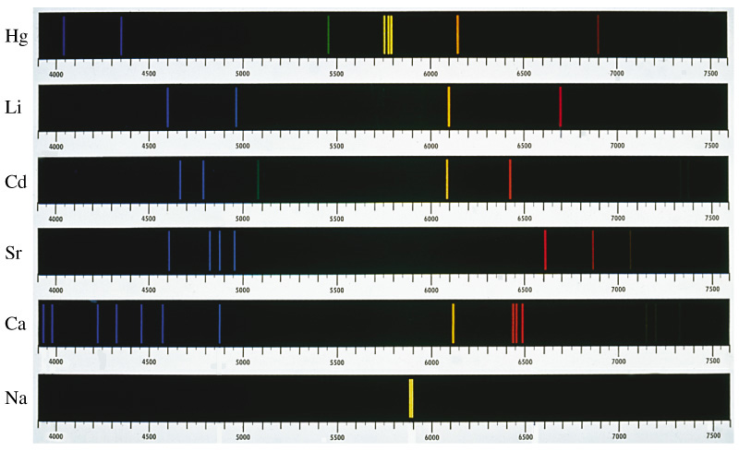
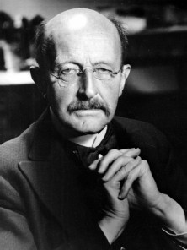
Spectral analysis
H
Spectral analysis
Kirchhoff und Bunsen:
Every element has a characteristic emission band
Max Planck
7

Slide 8
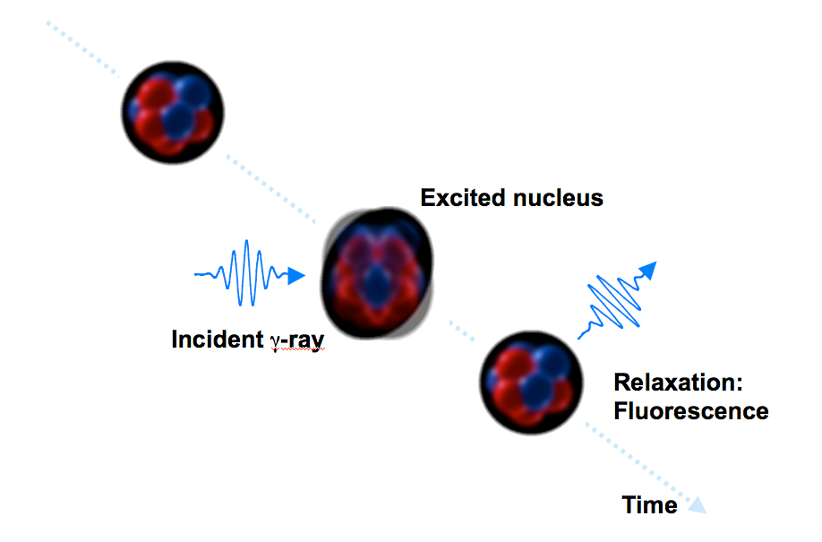
Nuclear Resonance Fluorescence
Nuclear Resonance Fluorescence (NRF) is analogous to atomic resonance fluorescence but depends upon the number of protons AND the number of neutrons in the nucleus

Slide 9
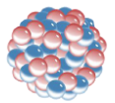

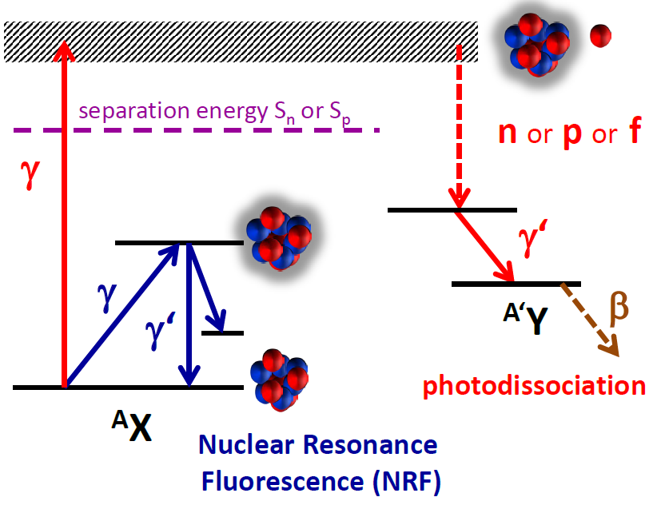
Photon-nuclear reactions with MeV γ-rays
pure electromagnetic interaction
spin selectivity (mainly E1, M1, E2 transitions)
γ-ray
What happens?
~ 8 MeV
1^{π}

Slide 10
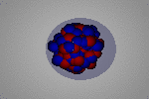
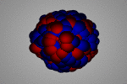
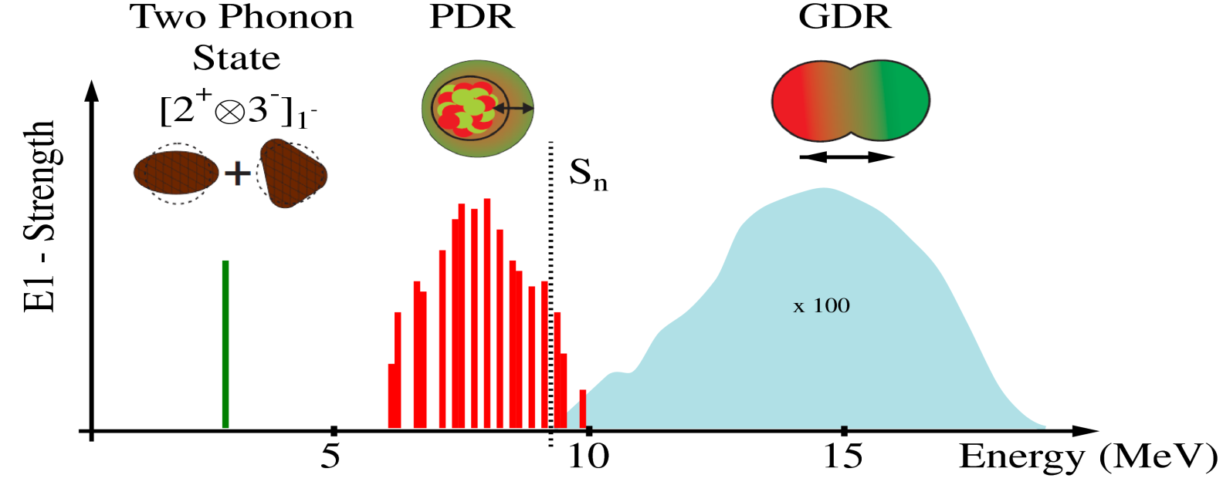
Photon-nuclear reactions with MeV γ-rays
pure electromagnetic interaction
spin selectivity (mainly E1, M1, E2 transitions)
γ-ray
pygmy dipole resonance
neutron skin nuclei
giant dipole resonance

Slide 11
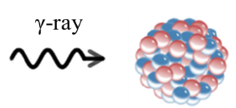
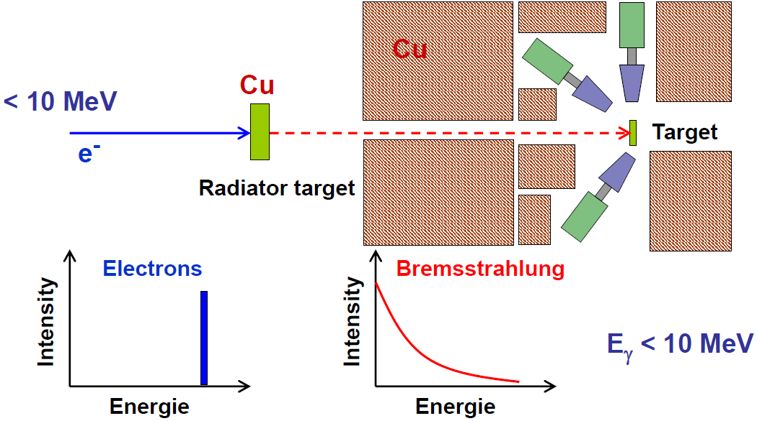
Low energy photon scattering at S-DALINAC
“white“ photon spectrum
wide energy region examined

Slide 12
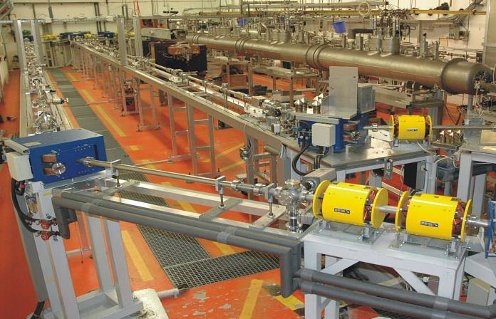
S-DALINAC at TU Darmstadt
Recirculating superconducting LINAC
Niobium cavities
liquid He cooled @ 2 K
3 GHz cw e-beams
<130 MeV, ≤60 μA

Slide 13
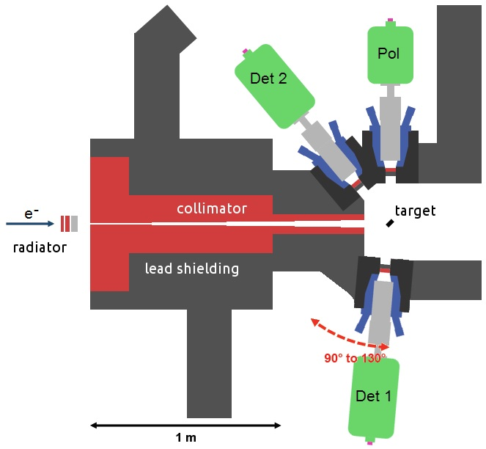
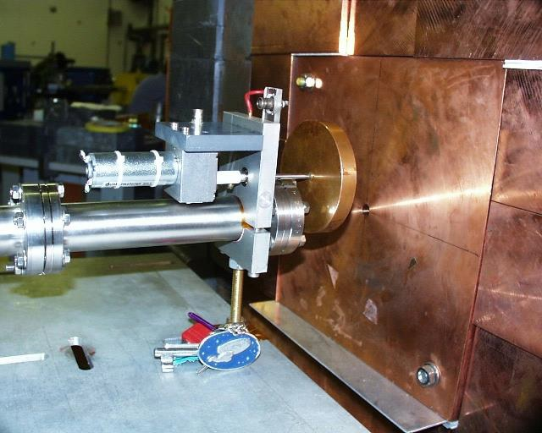
Darmstadt high intensity photon set-up
Bremsstrahlung γ-ray spectrum
provided by S-DALINAC
photon energies up to 11 MeV available
multipole order from
angular distribution

Slide 14
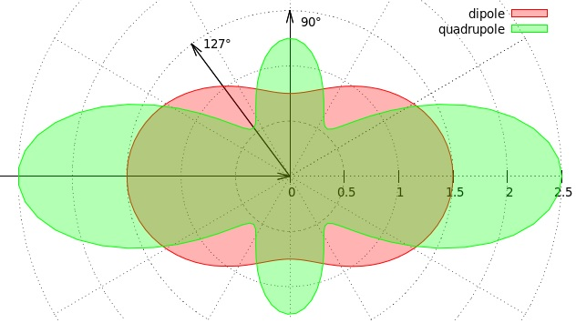
Darmstadt high intensity photon set-up
Bremsstrahlung γ-ray spectrum
provided by S-DALINAC
multipole order from
angular distribution

Slide 15
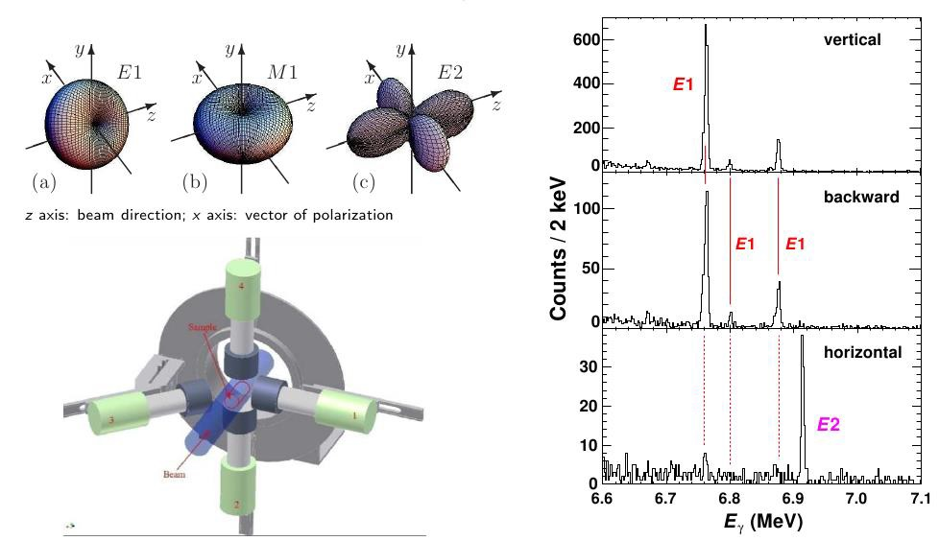
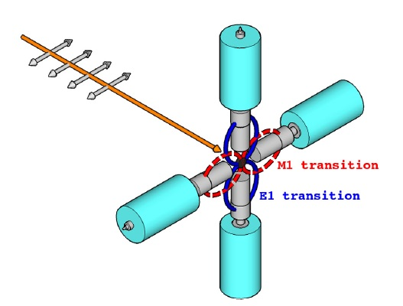
Spin and Parity determination using monoenergetic photons
out-of-plane
E1
E1
E1
linearly polarized photon beam

Slide 16
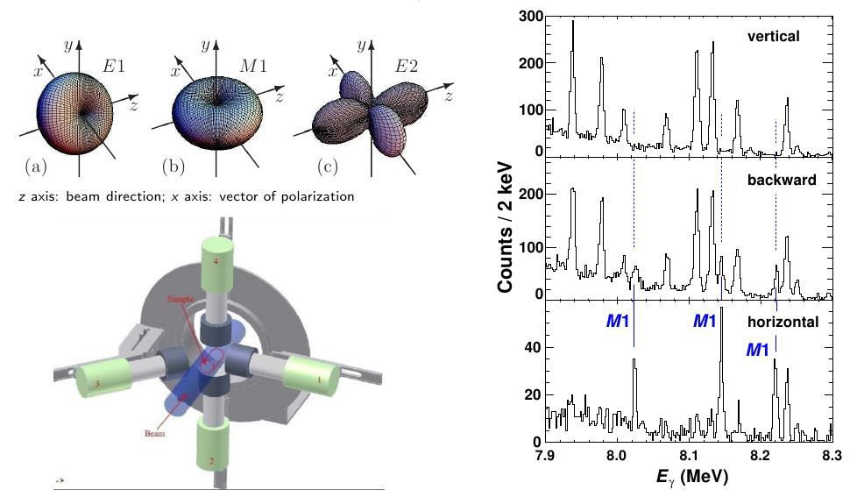
Spin and Parity determination using monoenergetic photons
in-plane
M1
M1
M1
linearly polarized photon beam

Slide 17

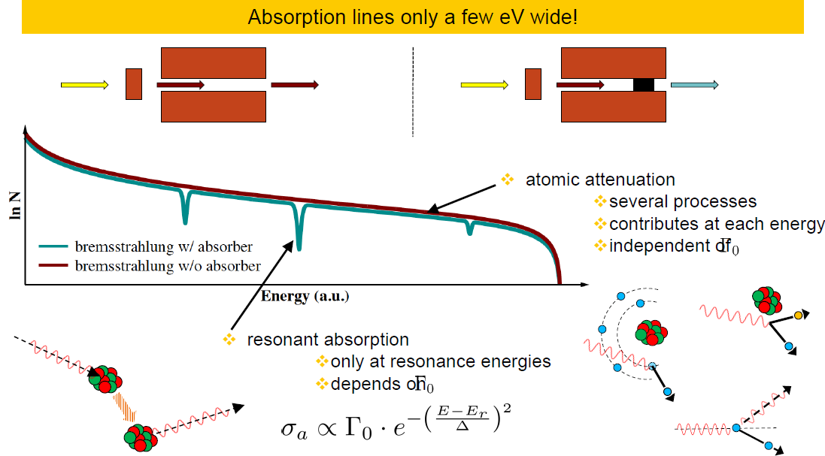
Absorption processes

Slide 18
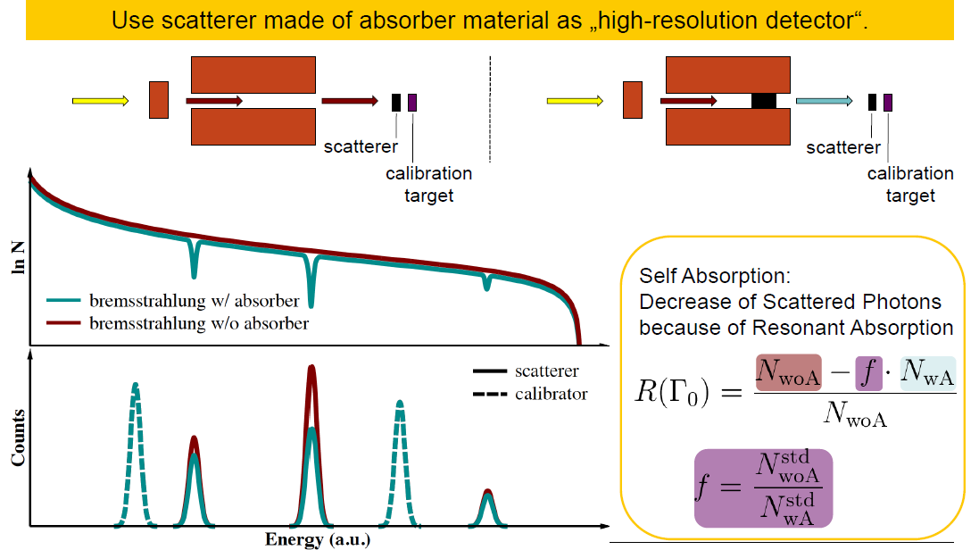
Principle of measurement and self absorption

Slide 19
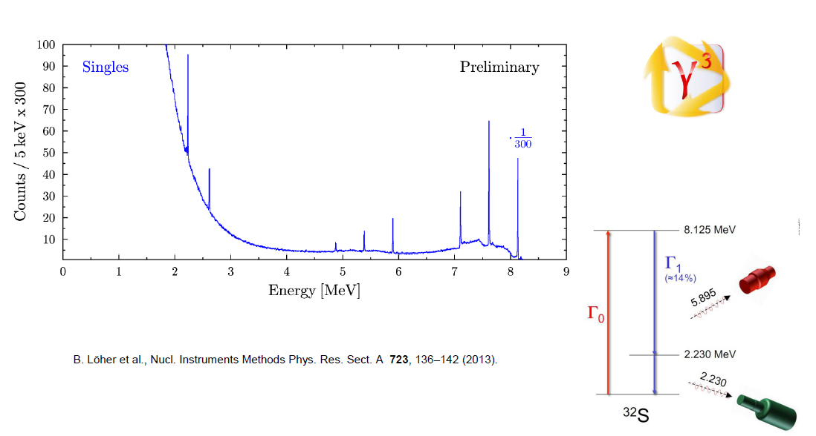
First γγ-coincidences in a γ-beam

Slide 20
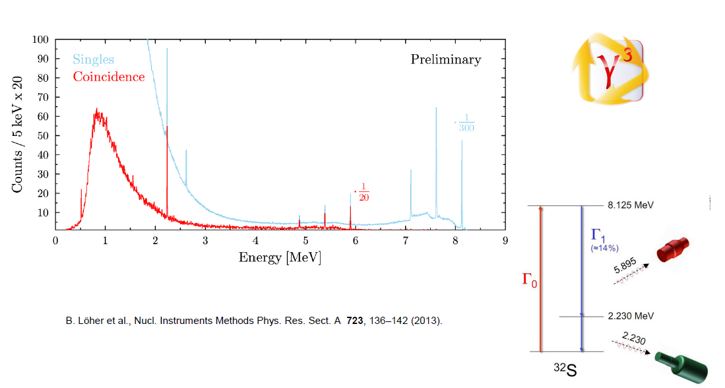
First γγ-coincidences in a γ-beam

Slide 21
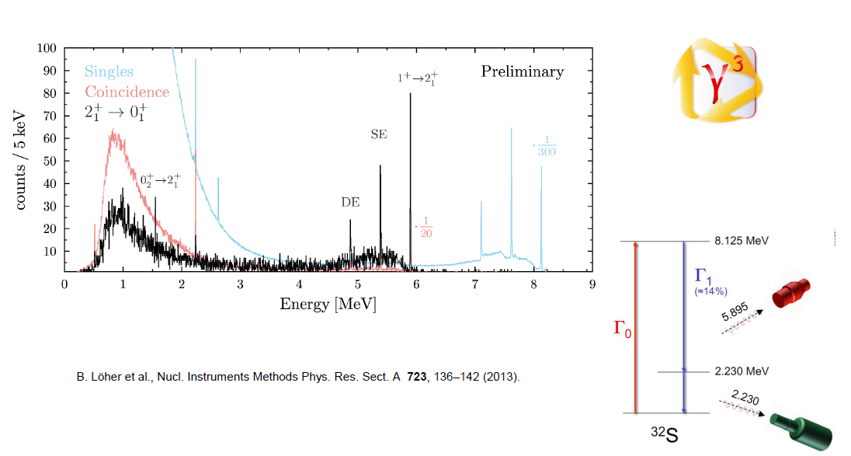
First γγ-coincidences in a γ-beam

Slide 22
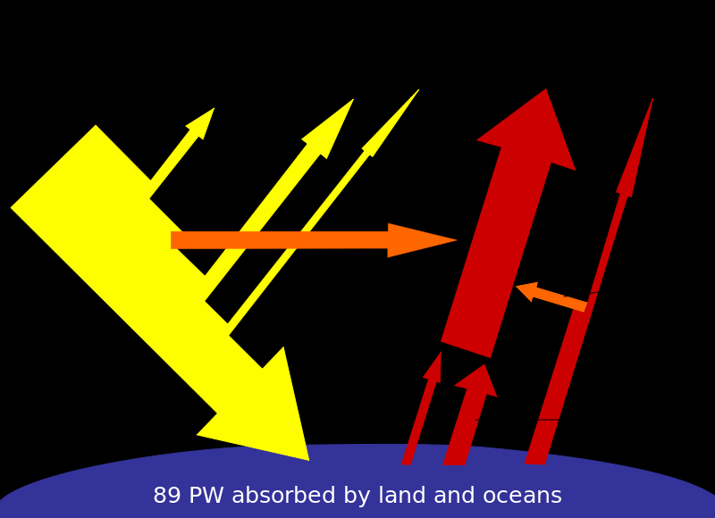


Total power received by Earth from the Sun
174 Peta (10¹⁵) Watt
@
extreme light infrastructure, Europe

Slide 23
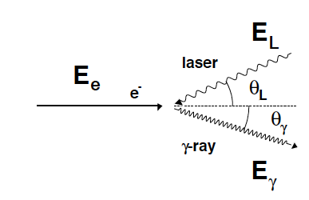


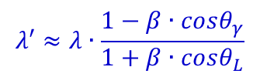
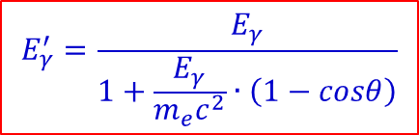
Compton scattering and inverse Compton scattering
Compton scattering:
Elastic scattering of a high-energy γ-ray on a free electron.
A fraction of the γ-ray energy is transferred to the electron.
The wave length of the scattered γ-ray is increased: λ‘ > λ.
$$hν≥m_{e}c^{2}$$
$$λ^{′}−λ=\frac{h}{m_{e}c}∙\left(1−cosθ_{γ}\right)$$
$$E_{γ}^{′}=\frac{E_{γ}}{1+\frac{E_{γ}}{m_{e}c^{2}}∙\left(1−cosθ\right)}$$
Inverse Compton scattering:
Scattering of low energy photons on ultra-relativistic electrons.
Kinetic energy is transferred from the electron to the photon.
The wave length of the scattered γ-ray is decreased: λ‘ < λ.
$$λ′≈λ∙\frac{1−β∙cosθ_{γ}}{1+β∙cosθ_{L}}$$

Slide 24
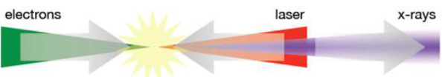







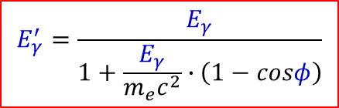

Inverse Compton scattering
Electron is moving at relativistic velocity
Transformation from laboratory frame to reference frame of e⁻ (rest frame): in order to repeat the derivation for Compton scattering
$$E_{γ}=γ∙E_{γ}\left(1−\frac{v}{c}cosθ_{e^{−}γ}\right)$$
Lorentz factor: $γ={\left(1−β^{2}\right)}^{−1/2}=1+\frac{T_{e}^{MeV}}{931.5∙0.00055}$
Doppler shift
$$E_{γ}^{′}=\frac{E_{γ}}{1+\frac{E_{γ}}{m_{e}c^{2}}∙\left(1−cosφ\right)}$$
Compton scattering in rest frame
$$E_{γ}^{′}=γ∙E_{γ}^{′}\left(1+\frac{v}{c}cosθ_{e^{−}γ^{′}}\right)$$
transformation into the laboratory frame
Limit $E_{γ}≪m_{e}c^{2}$
$$E_{γ}^{′}≈γ^{2}∙E_{γ}\left(1−\frac{v}{c}cosθ_{e^{−}γ}\right)\left(1+\frac{v}{c}cosθ_{e^{−}γ^{′}}\right)$$
$$E_{γ}^{′}≈{4γ}^{2}∙E_{γ}$$
electron and γ interaction $θ_{e^{−}γ}\sim {180}^{0}$
γ‘ emission relative to electron $θ_{e^{−}γ^{′}}\sim 0^{0}$

Slide 25
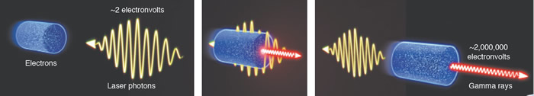
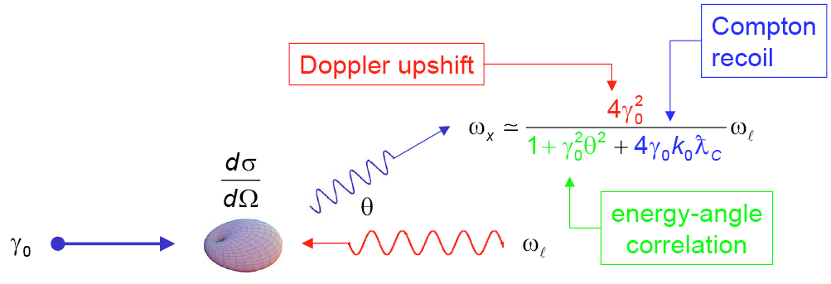
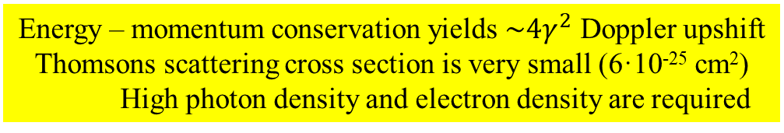
Laser Compton backscattering
Energy – momentum conservation yields $\sim 4γ^{2}$ Doppler upshift
Thomsons scattering cross section is very small (6·10⁻²⁵ cm²)
High photon density and electron density are required

Slide 26
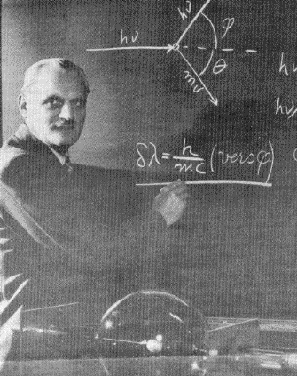


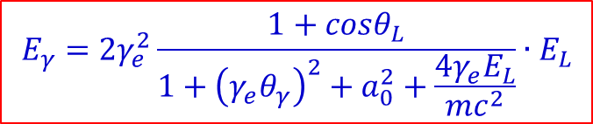





Gamma rays resulting after inverse Compton scattering
photon scattering on relativistic electrons (γ >> 1)
$$hν=2.3 eV \left(≡515 nm\right)$$
$$T_{e}^{lab}=720 MeV → γ_{e}=1+\frac{T_{e}^{lab}\left[MeV\right]}{931.5∙A_{e}\left[u\right]}=1410$$
$$E_{γ}=2γ_{e}^{2}\frac{1+cosθ_{L}}{1+{\left(γ_{e}θ_{γ}\right)}^{2}+a_{0}^{2}+\frac{4γ_{e}E_{L}}{mc^{2}}}∙E_{L}$$
$\frac{4γ_{e}E_{L}}{mc^{2}}=$ recoil parameter
$a_{L}=\frac{eE}{mω_{L}c}=$ normalized potential vector of the laser field
E = laser electric field strength $E_{L}=ℏω_{L}$
$γ_{e}=\frac{E_{e}}{mc^{2}}=\frac{1}{\sqrt{1−β^{2}}}=$ Lorentz factor
maximum frequency amplification:
head-on collision (θ_{L} = 0⁰) & backscattering (θ_{γ} = 0⁰)
A. H. Compton
Nobel Prize 1927
$$E_{γ}\sim 4γ_{e}^{2}∙E_{L}$$
$$≅18.3 MeV$$

Slide 27
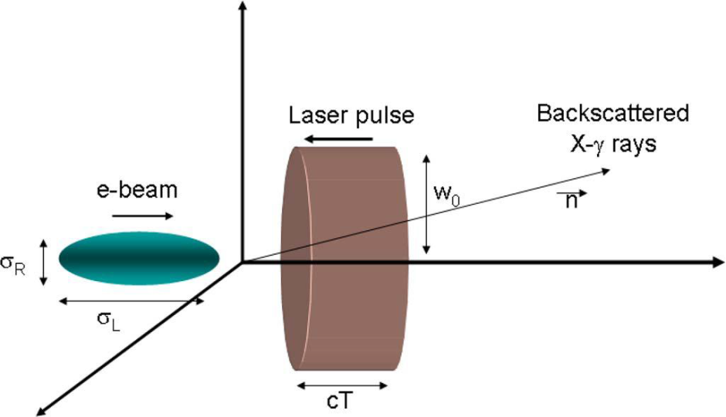











Scattered photons in collision
Yb: Yag J-class laser
10 Peta (10¹⁵) Watt
$$Q=1\left[nC\right]$$
$$U_{L}=0.5\left[J\right] hν_{L}=2.4\left[eV\right]=3.86∙{10}^{−19}\left[J\right]≡515\left[nm\right]$$
$${→ N}_{e}={6.25∙10}^{9}$$
$${→ N}_{L}={1.3∙10}^{18}$$
Luminosity: $L=\frac{N_{L}∙N_{e}}{4π∙σ_{R}^{2}}$
$$∙f$$
$$≅{2.9∙10}^{32}∙f \left[{cm}^{−2}s^{−1}\right]$$
$$σ_{R}=15\left[μm\right]$$
γ-ray rate: $N_{γ}=L∙σ_{Thomson}$
$$≅2∙{10}^{8}∙f \left[s^{−1}\right]$$
$$σ_{T}=0.67∙{10}^{−24}\left[{cm}^{2}\right]$$
(full spectrum)
repetition rate:
$f=3.2 kHz$

Slide 28
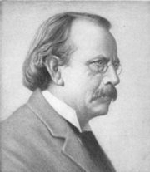
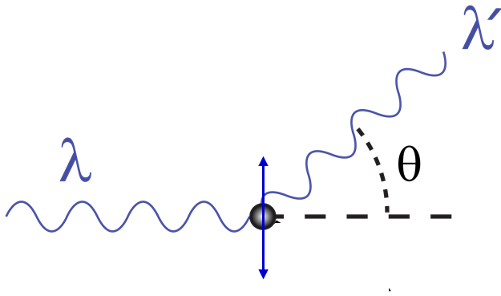
Thomson scattering
J. J. Thomson
Nobel prize 1906
Thomson scattering = elastic scattering of electromagnetic radiation by an electron at rest
the electric and magnetic components of the incident wave act on the electron
the electron acceleration is mainly due to the electric field
→ the electron will move in the direction of the oscillating electric field
→ the moving electron will radiate electromagnetic dipole radiation
→ the radiation is emitted mostly in a direction perpendicular to the motion of
the electron
→ the radiation will be polarized in a direction along the electron motion

Slide 29
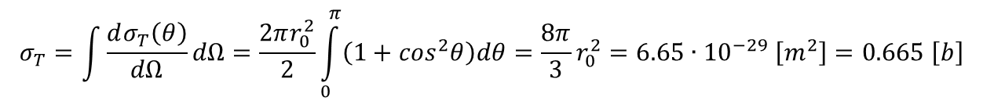
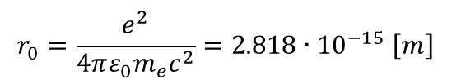

Thomson scattering
J. J. Thomson
Nobel prize 1906
$$\frac{dσ_{T}\left(θ\right)}{dΩ}=\frac{1}{2}r_{0}^{2}∙\left(1+\cos^{2}θ\right)$$
differential cross section
$$r_{0}=\frac{e^{2}}{4πε_{0}m_{e}c^{2}}=2.818∙{10}^{−15} \left[m\right]$$
classical electron radius
$$σ_{T}=\int{\frac{dσ_{T}\left(θ\right)}{dΩ}dΩ}=\frac{2πr_{0}^{2}}{2}\int_{0}^{π}{\left(1+\cos^{2}θ\right)dθ}=\frac{8π}{3}r_{0}^{2}=6.65∙{10}^{−29} \left[m^{2}\right]=0.665 \left[b\right]$$

Slide 30
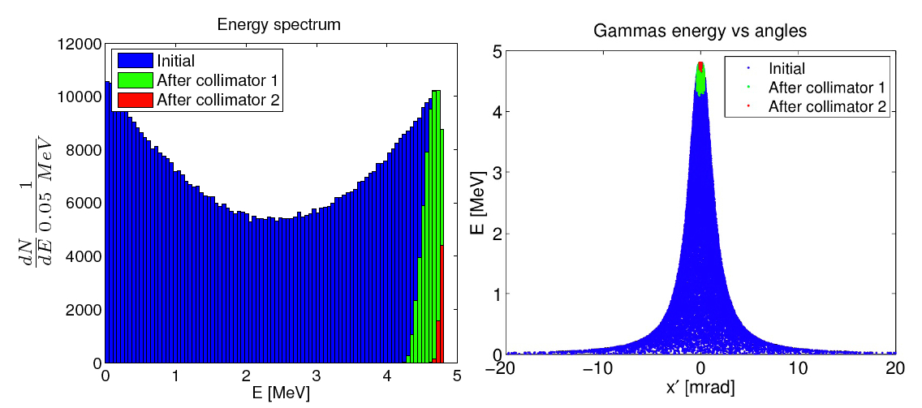
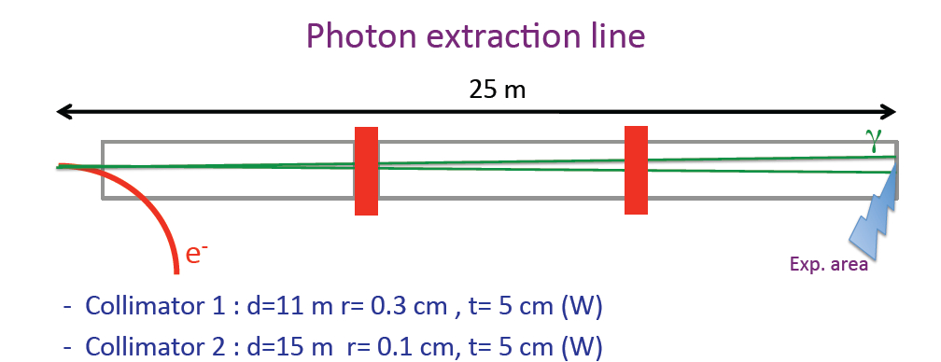

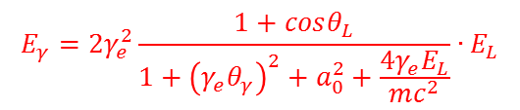
Scattered photons in collision
$$E_{γ}=2γ_{e}^{2}\frac{1+cosθ_{L}}{1+{\left(γ_{e}θ_{γ}\right)}^{2}+a_{0}^{2}+\frac{4γ_{e}E_{L}}{mc^{2}}}∙E_{L}$$
θ = π
θ = 0
Compton edge
$$sinθ=1/γ$$

Slide 31
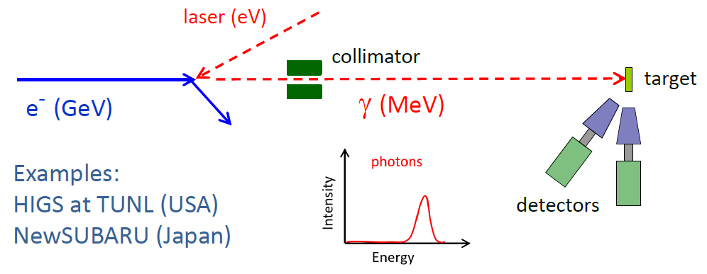
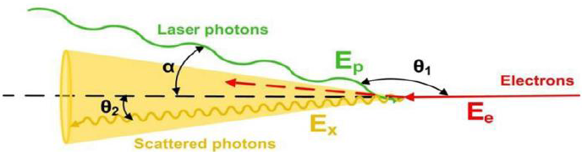
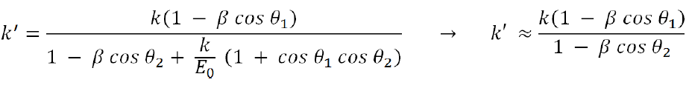
Laser Compton backscattering

Slide 32
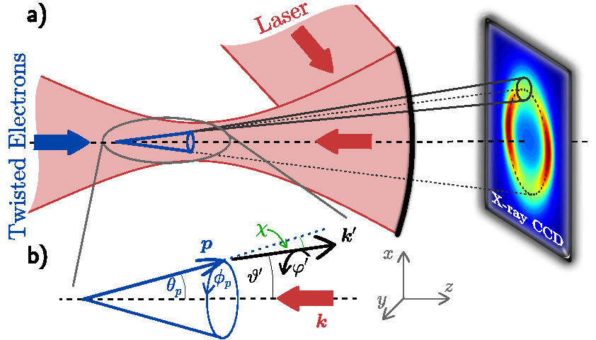

Inverse Compton scattering of laser light

Slide 33



Gamma rays resulting after inverse Compton scattering

Slide 34

Extreme Light Infrastructure – Nuclear Physics

Slide 35



Nuclear Resonance Fluorescence
Widths of particle-bound states: $Γ≤10eV$
Breit-Wigner absorption resonance curve for isolated resonance:
$$σ_{a}\left(E\right)=π{\overline{λ}}^{2}\frac{2J+1}{2}\frac{Γ_{0}Γ}{{\left(E−E_{r}\right)}^{2}+{\left(Γ/2\right)}^{2}}\sim {Γ_{0}}/Γ$$
Resonance cross section can be very large: $σ_{0}≅200 \left[b\right]$ (for Γ₀ = Γ, 5 MeV)
Example: 10 mg, A~200 → N_{target} = 3·10¹⁹, N_{γ} = 100, event rate = 0.6 [s⁻¹]

Slide 36


Nuclear Resonance Fluorescence
Count rate estimate
10⁴ γ/(s eV) in 100 macro pulses
100 γ/(s eV) per macro pulse
example: 10 mg, A ~ 200 target
resonance width Γ = 1 eV
2 excitations per macro pulse
0.6 photons per macro pulse in detector
pp-count rate 6 Hz
1000 counts per 3 min
narrow band width 0.5%
8 HPGe detectors
2 rings at 90⁰ and 127⁰
ε_{rel}(HPGe) = 100%
solid angle ~ 1%
photopeak ε_{pp} ~ 3%

Slide 37

Nuclear Resonance Fluorescence
narrow bandwidth allows selective excitation and detection of decay channels

Slide 38

Deformation and scissors mode
Decay to intrinsic excitations

