Slide 1

Outline: Projectile fragmentation
Lecturer: Hans-Jürgen Wollersheim
e-mail: h.j.wollersheim@gsi.de
web-page: https://web-docs.gsi.de/~wolle/ and click on
fragmentation cross section
nuclear reaction rates
in-flight separation of Radioactive Ion Beams
fragment separator at GSI and FAIR
identification of RIBs

Slide 2
Outline
Projectile Fragmentation – A Route to Exotic Nuclei
Fragmentation Cross Sections
Nuclear Reaction Rates
In-Flight Separation of Radioactive Ion Beams
FRagment Separator at GSI
Comparison FRS – Super-FRS
Identification of RIBs
Excited Fragments – Gateway to Nuclear Structure
Scattering Experiments with RIBs
projectile
projectile fragment
target nucleus
abrasion
ablation

Slide 3
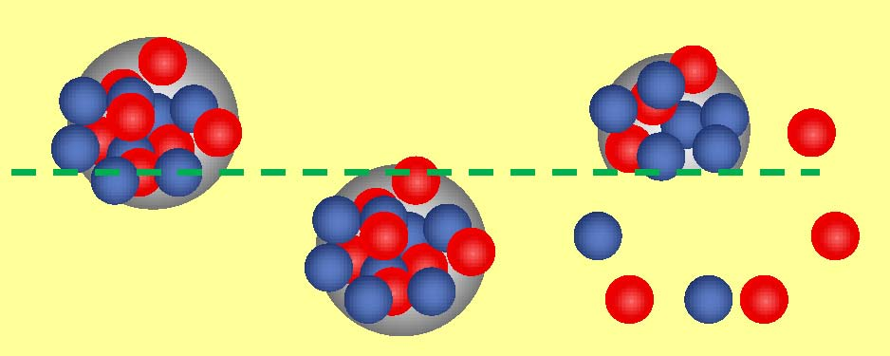
Projectile fragmentation reaction
Discovery
at Bevalac @ LBL (Lawrence Berkeley Laboratory)
D.E. Greiner et al., Phys.Rev. Lett. 35 (1975) 152
¹²C, ¹⁶O (2.1 AGeV) + Target (Be, C, Al, Cu, Ag, Pb)
Several fragments are produced in reactions
Velocity of fragments is almost the same as that of the beam
Momentum distribution is narrow, and has no significant correlation
with target mass and beam energies

Slide 4
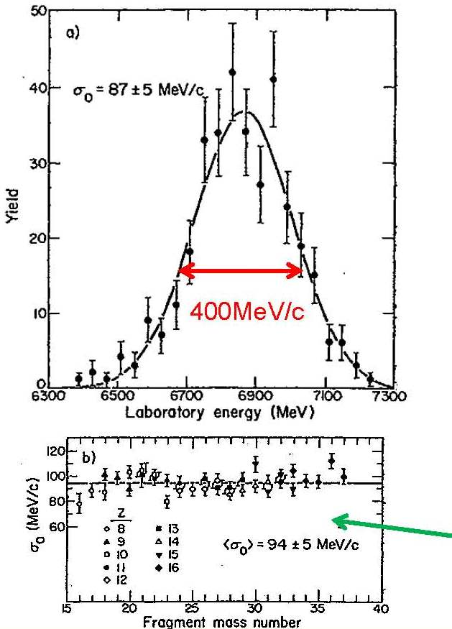
Projectile fragmentation reaction
Momentum distribution of fragments (example ³⁴S fragments from ⁴⁰Ar + C @ 213 AMeV )
³⁴S fragments: 400 MeV/c narrow
⁴⁰Ar beam: 26600 MeV/c
Momentum distribution of fragments are represented by a simple formula based on the Goldhaber model
A: beam mass number
F: fragment mass number
σ₀ = 90 MeV/c

Slide 5
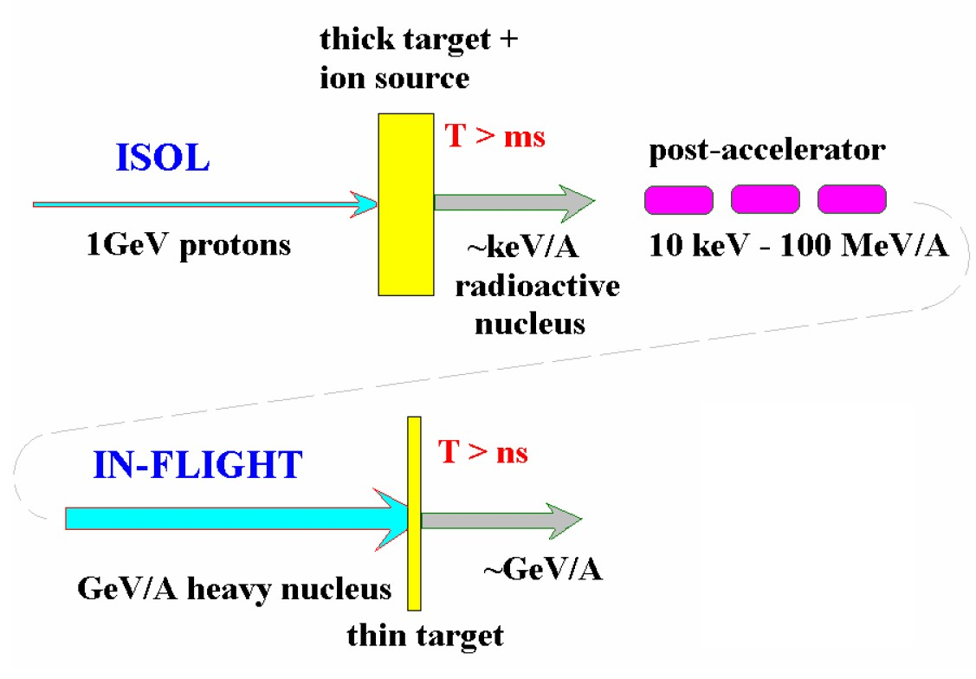
Spallation & projectile fragmentation reactions route to exotic nuclei
Spallation
Fragmentation
ISOL = Isotope Separator On Line

Slide 6
High-energy proton-induced nuclear reactions
Some early high-energy proton accelerators:
Facility | Energy | from year
Bevatron (Berkeley) | 6 GeV | 1954.....
AGS (Brookhaven) | 11 GeV | 1960.....
Fermilab (Chicago) | >300 GeV | 1967.....
They were also used to bombard various stable target materials.
These targets were analyzed with radiochemical methods,
i.e. γ-spectroscopy with or without chemical separators
Production cross sections and (some) kinematics for suitable radioactive isotopes

Slide 7
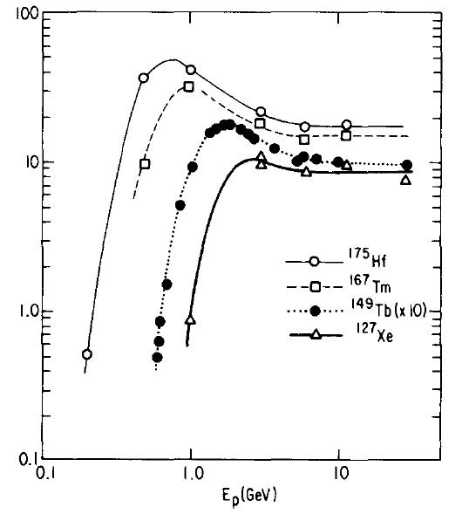
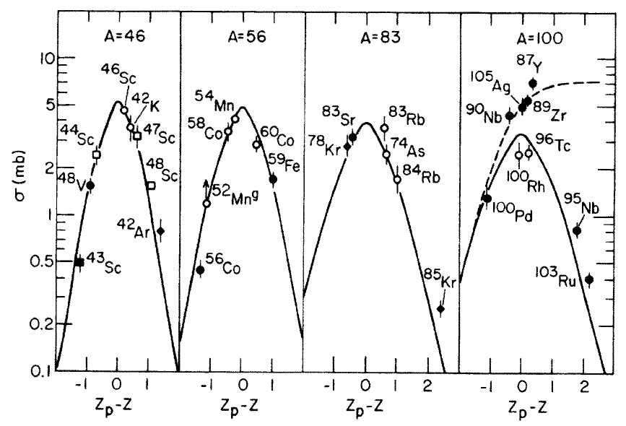
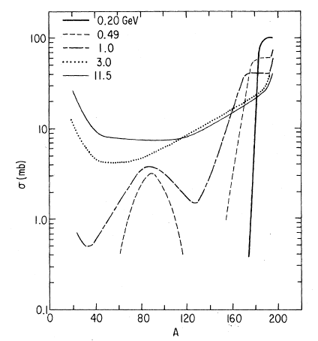
High-energy proton-induced nuclear reactions
Important findings:
Energy-independence of cross sections
Bell-shaped Z-distribution for constant A
E_{p} [GeV]
σ [mb]
σ [mb]
p+Au
Mass yields: exponential slope
A

Slide 8
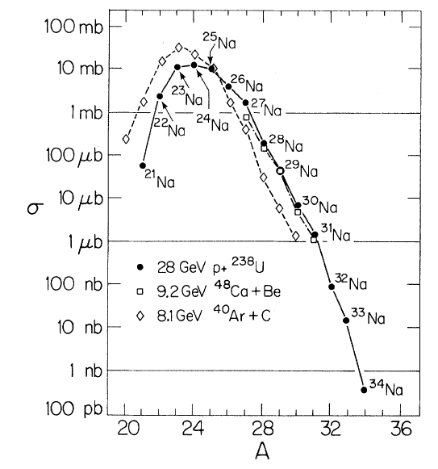
Proton- versus heavy-ion induced reactions
Proton- and heavy-ion induced reactions give very similar isotope distribution:
Na
8 GeV ⁴⁸Ca+Be
Target fragmentation: GeV p + A_{target} → A
Projectile fragmentation: GeV/u A_{proj} + p → A
are equivalent
28 GeV p + ²³⁸U

Slide 9
Projectile fragmentation reactions
projectile
projectile fragment
target nucleus
abrasion
ablation
At GeV energies nucleons can be regarded as a classical particles
Nucleon-nucleon collisions can be treated classically using measured free nucleon-nucleon cross sections (intra-nuclear cascade).
In these collisions very little transfer momentum is exchanged.
After the cascade the residual nucleus is highly excited.
Heavy-ion projectiles can be treated as a bag of individual nucleons.
Physical models: Two-step approach
Step 1: Abrasion models or Intranuclear-cascade models (10⁻²³ s)
Step 2: Ablation: nucleons evaporated (final fragment 10⁻¹⁹ s)

Slide 10
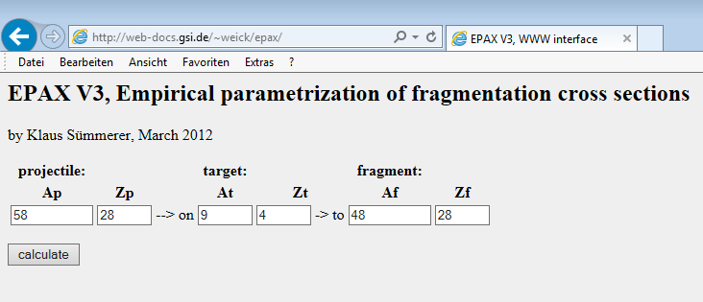
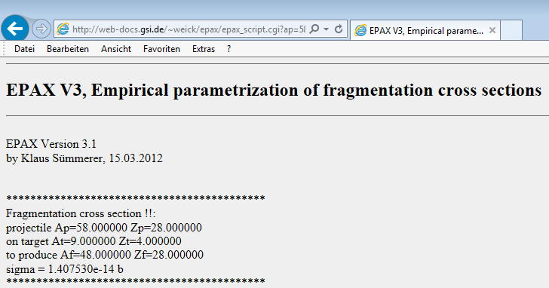
Projectile fragmentation reactions abrasion-ablation model
projectile
projectile fragment
target nucleus
abrasion
ablation
Empirical parameterization of fragmentation cross section:
EPAX v.3 K. Sümmerer, Phys. Rev. C86 (2012) 014601
http://web-docs.gsi.de/~weick/epax/

Slide 11
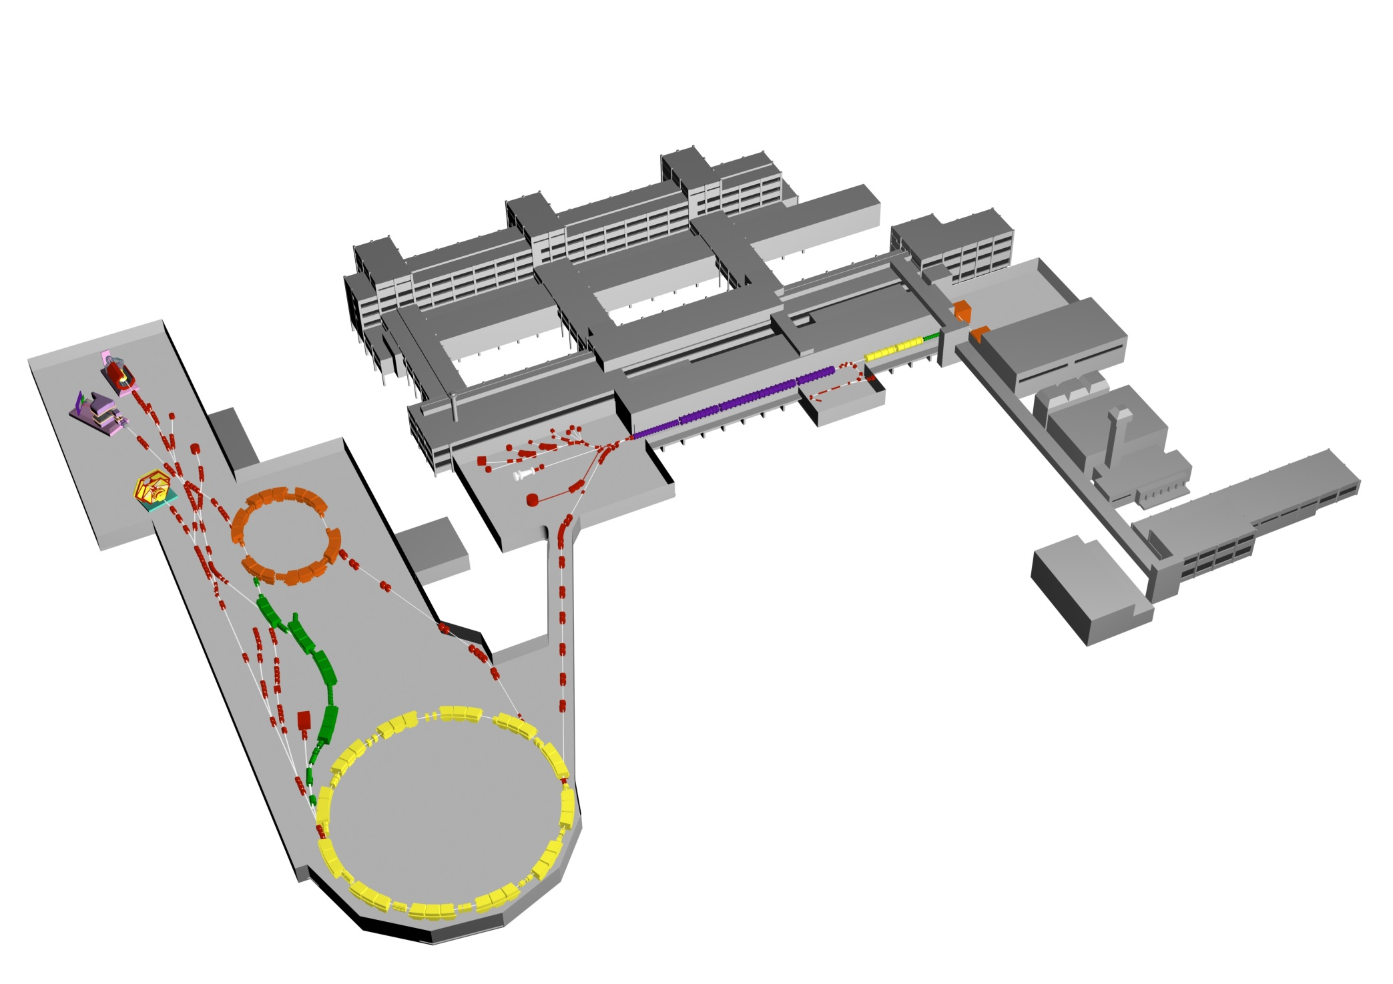

The accelerator facility at GSI
Experimental Areas
Ion Sources
all elements: p…U
UNILAC
ESR
Linear-Accelerator
20% speed of light
(20 AMeV)
Fragment
Separator
FRS
N
Synchrotron SIS-18
SIS
90% speed of light
(2 AGeV)

Slide 12
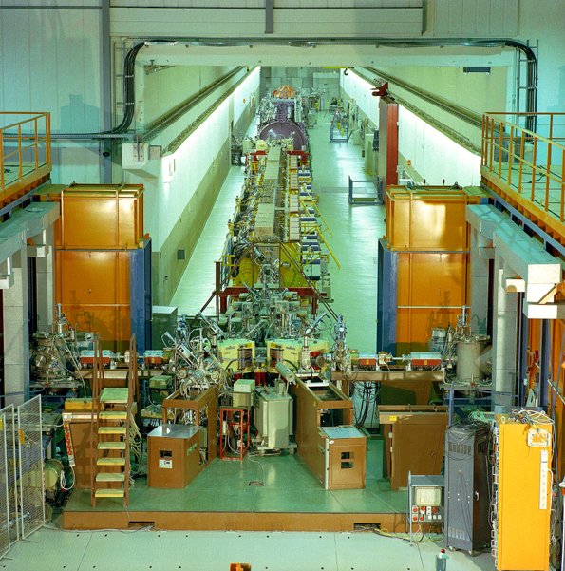
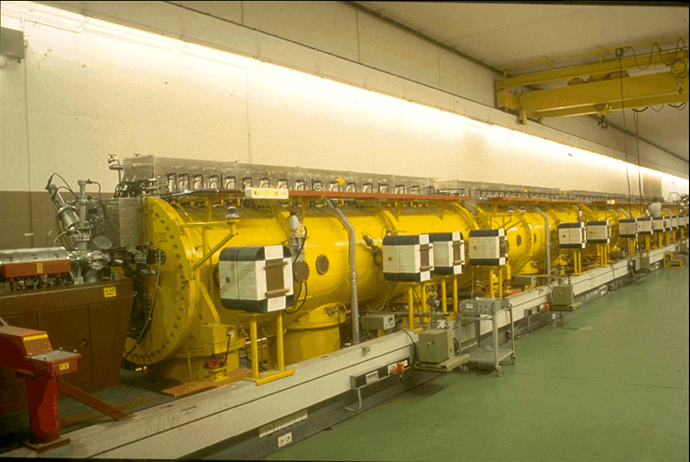
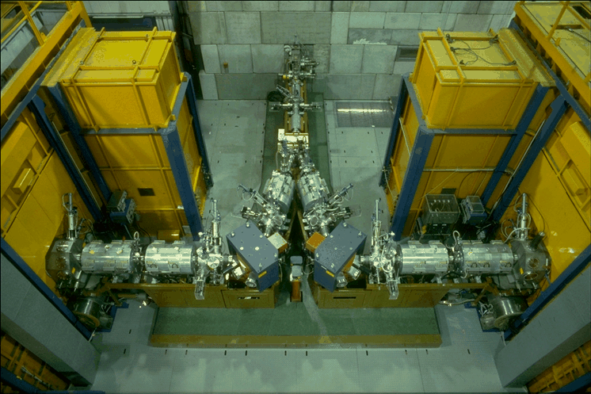
UNILAC accelerator

Slide 13
The accelerator facility at GSI
Experimental Areas
Ion Sources
all elements: p…U
UNILAC
ESR
Linear-Accelerator
20% speed of light
(20 AMeV)
Fragment
Separator
FRS
N
Synchrotron SIS-18
SIS
90% speed of light
(2 AGeV)

Slide 14
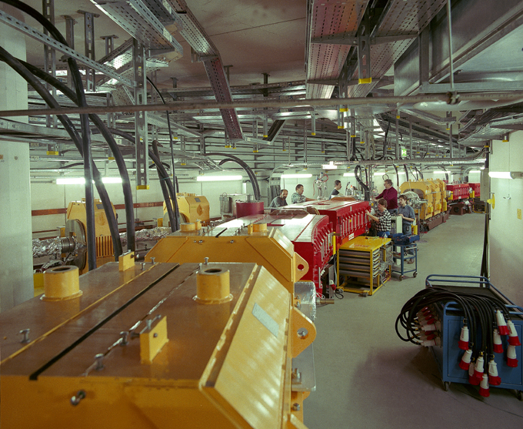

Slide 15
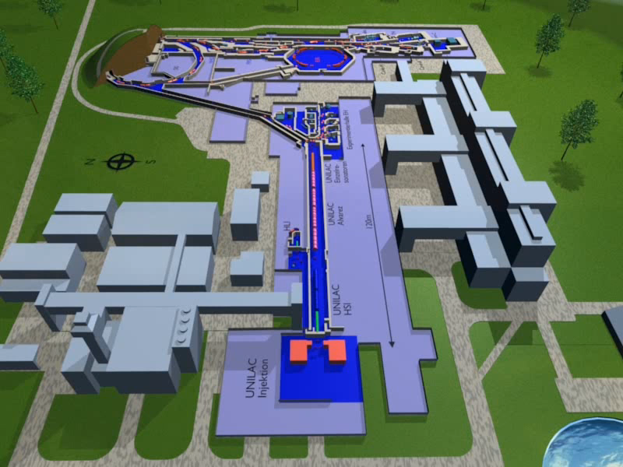
Where do we do the experiments?

Slide 16
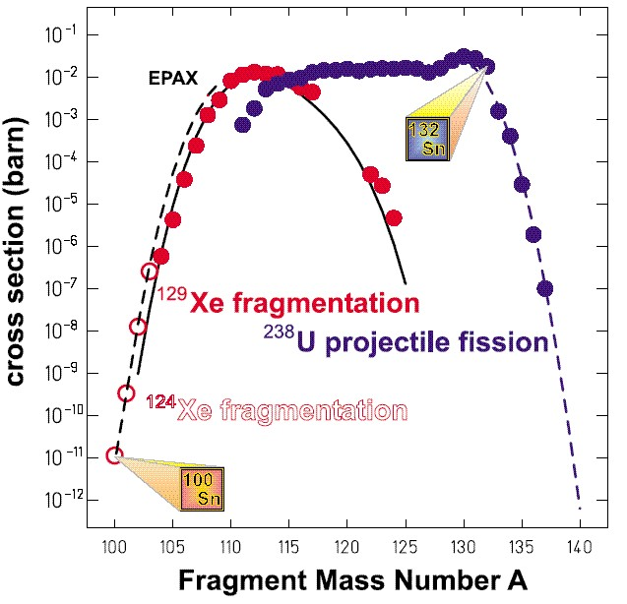
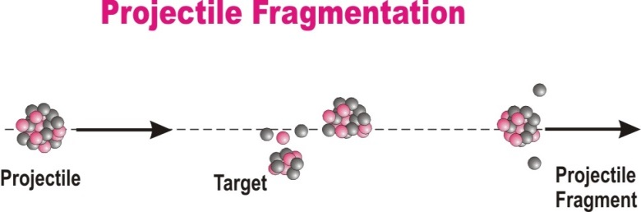
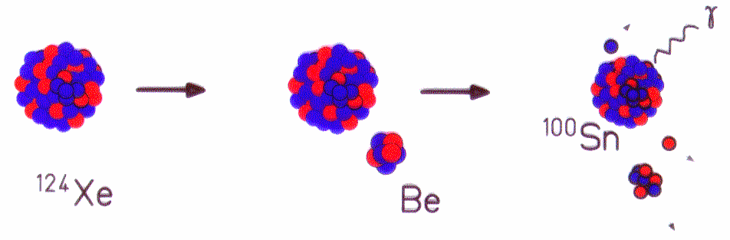
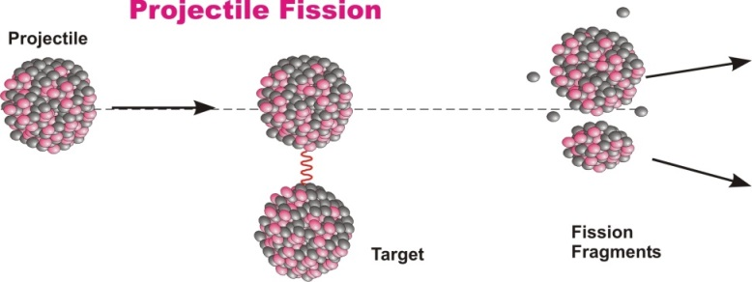
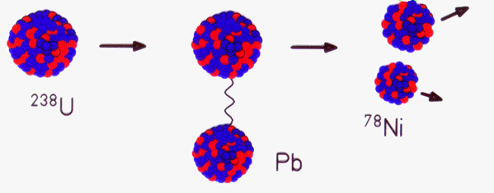
Projectile fragmentation reactions
Projectile Fragmentation
Projectile
Target
Projectile
Fragment
Projectile Fission
Projectile
Projectile
Fragments
Target

Slide 17
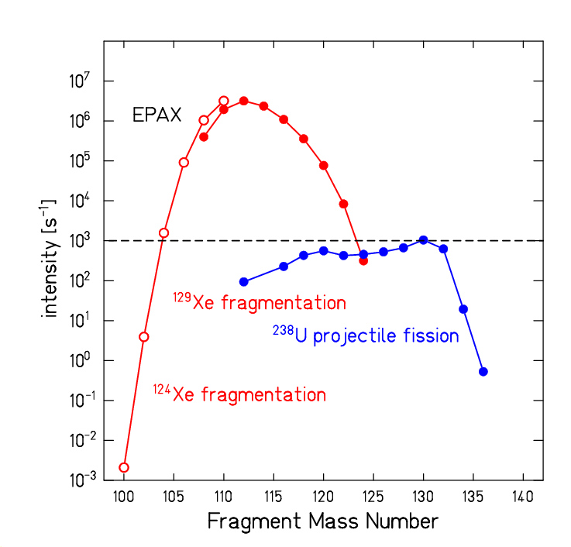
Secondary beam intensities at S4
Projectile Fragmentation
Projectile
Target
Projectile
Fragment
Projectile Fission
Projectile
Projectile
Fragments
Target
transmission SIS-FRS: 70%
primary Xe-beam intensity: 2.5·10⁹[s⁻¹]
Be-target thickness: 4g/cm²
transmission through FRS: 60%
primary U-beam intensity: 10⁹[s⁻¹]
Pb-target thickness: 1g/cm²
transmission through FRS: 2%

Slide 18
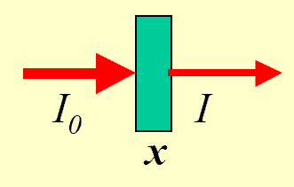
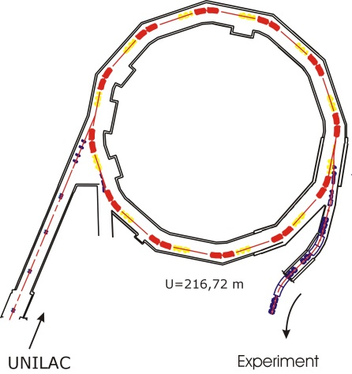

Nuclear reaction rate
nuclear reaction rate [s⁻¹] = luminosity [atoms cm⁻² s⁻¹] * σ_{f} [cm²]
abrasion
ablation
σ_{f} [cm²] for projectile fragmentation + fission
luminosity [atoms cm⁻² s⁻¹] = projectiles [s⁻¹] * target nuclei [cm⁻²]
Ion | SIS-18 (2008) | SIS-100 (expected)
²⁰Ne¹⁰⁺ | 2·10¹¹ | ²⁰Ne⁷⁺ | 1.6·10¹²
⁴⁰Ar¹⁸⁺ | 1·10¹¹ | ⁴⁰Ar¹⁰⁺ | 1.4·10¹²
⁵⁸Ni²⁶⁺ | 9·10¹⁰ | ⁵⁸Ni¹⁴⁺ | 1.3·10¹²
⁸⁴Kr³⁴⁺ | 8·10¹⁰ | ⁸⁴Kr¹⁷⁺ | 1.2·10¹²
¹³²Xe⁴⁸⁺ | 7·10¹⁰ | ¹³²Xe²²⁺ | 1.3·10¹²
¹⁹⁷Au⁶⁵⁺ | 5·10¹⁰ | ¹⁹⁷Au²⁵⁺ | 1.2·10¹²
²³⁸U⁷³⁺ | 1.6·10¹⁰ | ²³⁸U⁹²⁺ | 1.4·10¹⁰
²³⁸U²⁸⁺ | 1.4·10¹⁰ | ²³⁸U²⁸⁺ | 5.0·10¹¹
$$extraction$$
$$≥70\%$$
experiment

Slide 19
Nuclear reaction rate
Primary reaction rate:
(thin target)
density ρ
Example: ²³⁸U (10⁹s⁻¹) on ²⁰⁸Pb (x=1g/cm²) → ¹³²Sn (σ_{f}=15.4mb) reaction rate: 44571 [s⁻¹]
Example: ¹²⁴Xe (10⁹s⁻¹) on ⁹Be (x=1g/cm²) → ¹⁰⁴Sn (σ_{f}=5.6μb) reaction rate: 375 [s⁻¹]
The optimum thickness of the production target is limited by the loss of fragments due to secondary reactions
Primary + secondary reaction rate:
Example:
max
$$φ_{f}\left[s^{−1}\right]=φ_{p}\left[s^{−1}\right]−φ\left[s^{−1}\right]=φ_{p}\left[s^{−1}\right]∙\left\{1−e^{−N_{t}\left[{cm}^{−2}\right]∙σ_{f}\left[{cm}^{2}\right]}\right\}$$
(thick target)
x [g/cm²]

Slide 20
Nuclear reaction rate
Reaction rate (thick target):
Reaction rate (thin target):
Example:
Reaction rate: 57941[s⁻¹] transmission (SIS/FRS)=70%, transmission (FRS) 1.9%

Slide 21
Optimization of the target thickness
Primary reaction rate:
Primary + secondary reaction rate:
1 | 0.79
2 | 1.25
3 | 1.48
4 | 1.56
5 | 1.54
6 | 1.46
Example:

Slide 22
Reaction Parameters for Heavy-Ion Collisions
The relevant formulae are calculated if A₁, Z₁ and A₂, Z₂ are the mass (in amu) and charge number of the projectile and target nucleus, respectively.
Nuclear radius for homogeneous (sharp) mass distribution:
Nuclear radius for diffuse (Fermi) mass distribution:
Nuclear interaction radius:
Nuclear reaction cross section at relativistic energies:

Slide 23

In-flight separation of Radioactive Ion Beams
Primary (production) target
Peripheral nuclear reactions
Forward focused products
Secondary (reaction) target
Experimental area
Electromagnetic separator
Stable HI projectile source
E ~ 1000 AMeV
Selected radioactive beam
E >> 20 AMeV

Slide 24
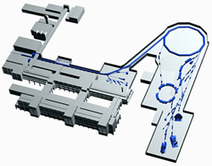
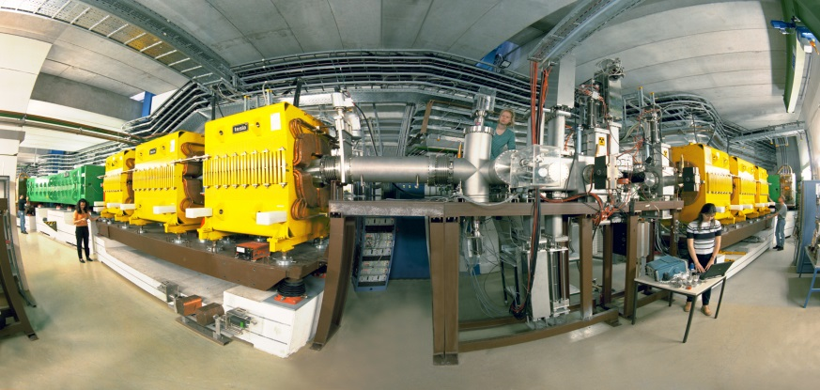
Fragmentation at relativistic energies
projectile
projectile fragment
target nucleus
abrasion
ablation
FRS
FRS
FRagment Separator

Slide 25
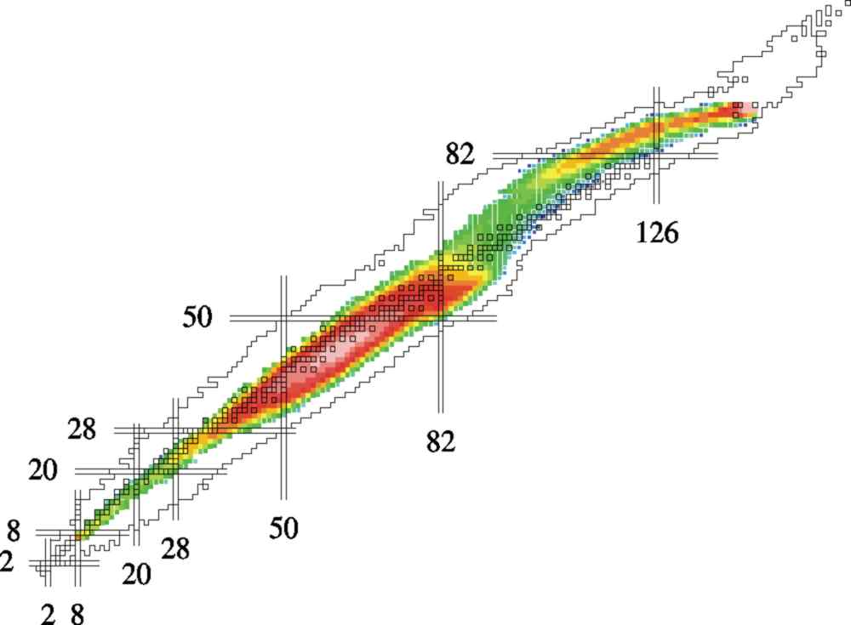
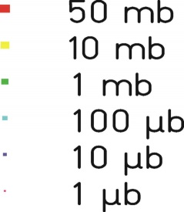
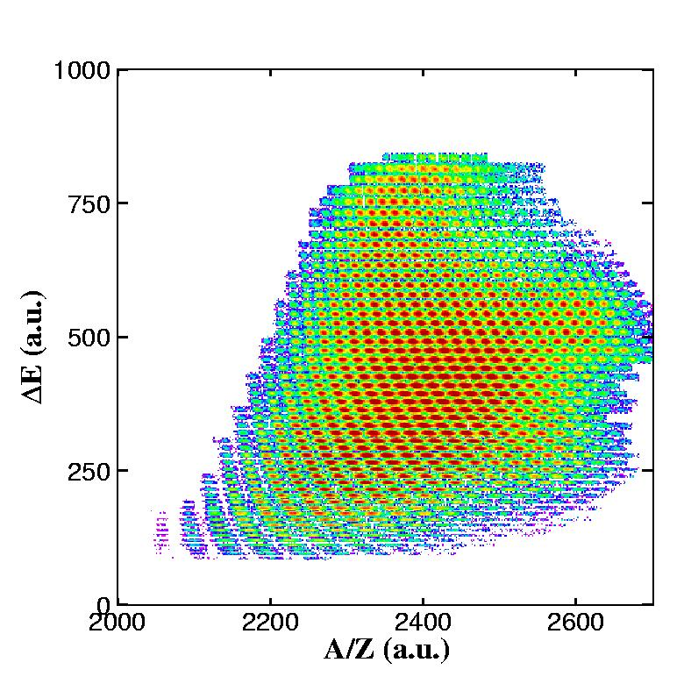
Radioactive Ion Beams at GSI
1GeV/u U + H
About 1000 nuclear residues identified
A/Z-resolution ~10⁻³

Slide 26

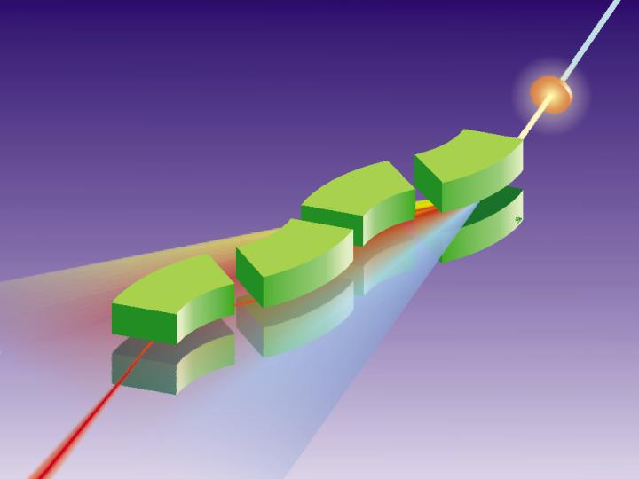
FRagment Separator at GSI
¹³¹Sn
¹³²Sn
in-flight A and Z selection
energy resolution: ~ 1 GeV

Slide 27
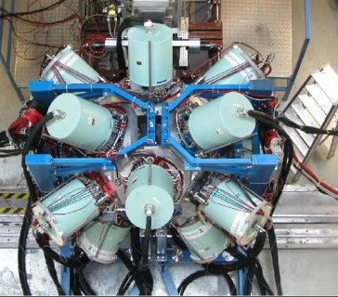

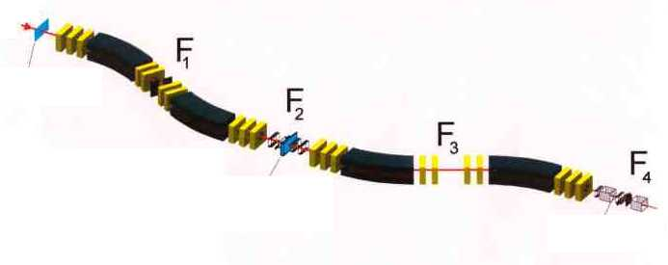
Rare isotope selection at FRS: Bρ-ΔE-Bρ selection
fully striped fragments
primary beam
⁸⁶Kr ~700 AMeV
20m
secondary beam
⁷⁸Ni ~ 100 AMeV
production target
⁹Be

Slide 28
Rare isotope selection at FRS: Bρ-ΔE-Bρ selection
Transmission :
20-70 % for fragmentation
< 2 % for fission
primary beam
⁸⁶Kr ~700 AMeV
20m
secondary beam
⁷⁸Ni ~ 100 AMeV
production target
⁹Be
magnetic dipoles
degrader
magnetic dipoles
Βρ ∝ βγ Α/Ζ
ΔΕ ∝ Ζ²f(β)
Βρ ∝ βγ Α/Ζ

Slide 29
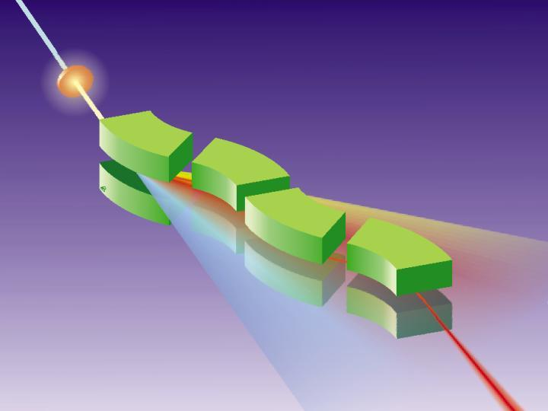
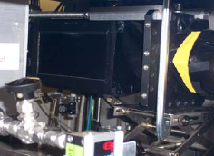
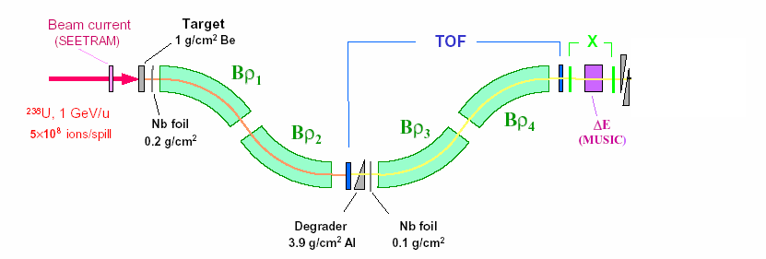
Production, separation, identification
UNILAC
SIS
fragment
FRS
abrasion
ablation
FRagment Separator
⁵⁶Cr, 100MeV/u
⁸⁶Kr, 480MeV/u
Standard FRS detectors
TPC-x,y position @ S2,S4
Plastic scintillator (TOF)
@ S4
MUSIC (ΔE)
@ S4

Slide 30
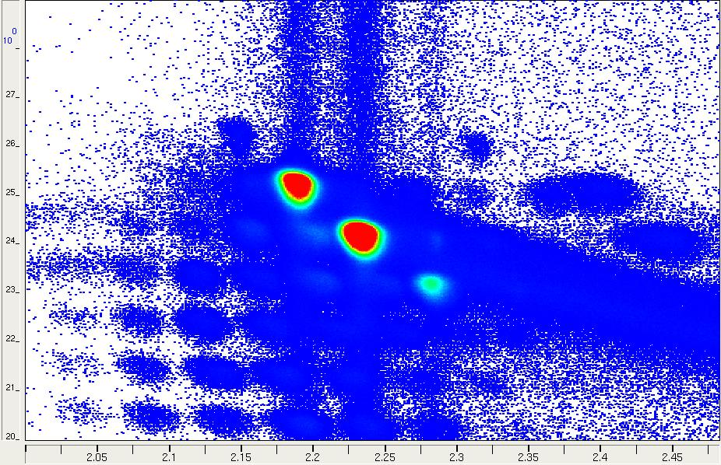
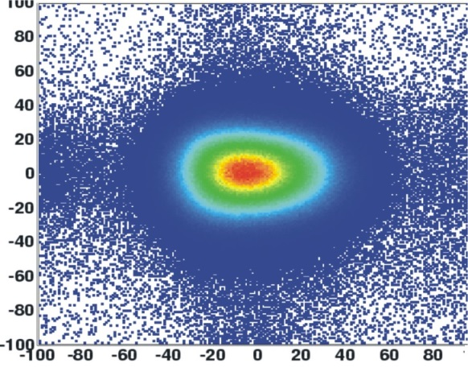
Production, separation, identification
multiwire chamber;
beam position
MUSIC
ionization chamber;
Z
scintillator
scintillator
β
Z
Y
X
A/Q

Slide 31
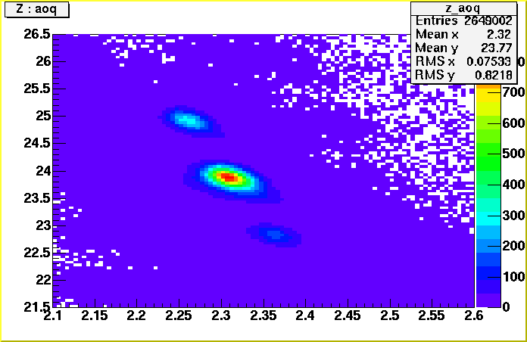
Production, separation, identification
multiwire chamber or TPC;
beam position
⁵⁶Cr, 100MeV/u
⁸⁶Kr, 480MeV/u
MUSIC
ionization chamber;
Z
scintillator
scintillator
β
⁵⁶Cr
Y
Z
X
A/Q

Slide 32
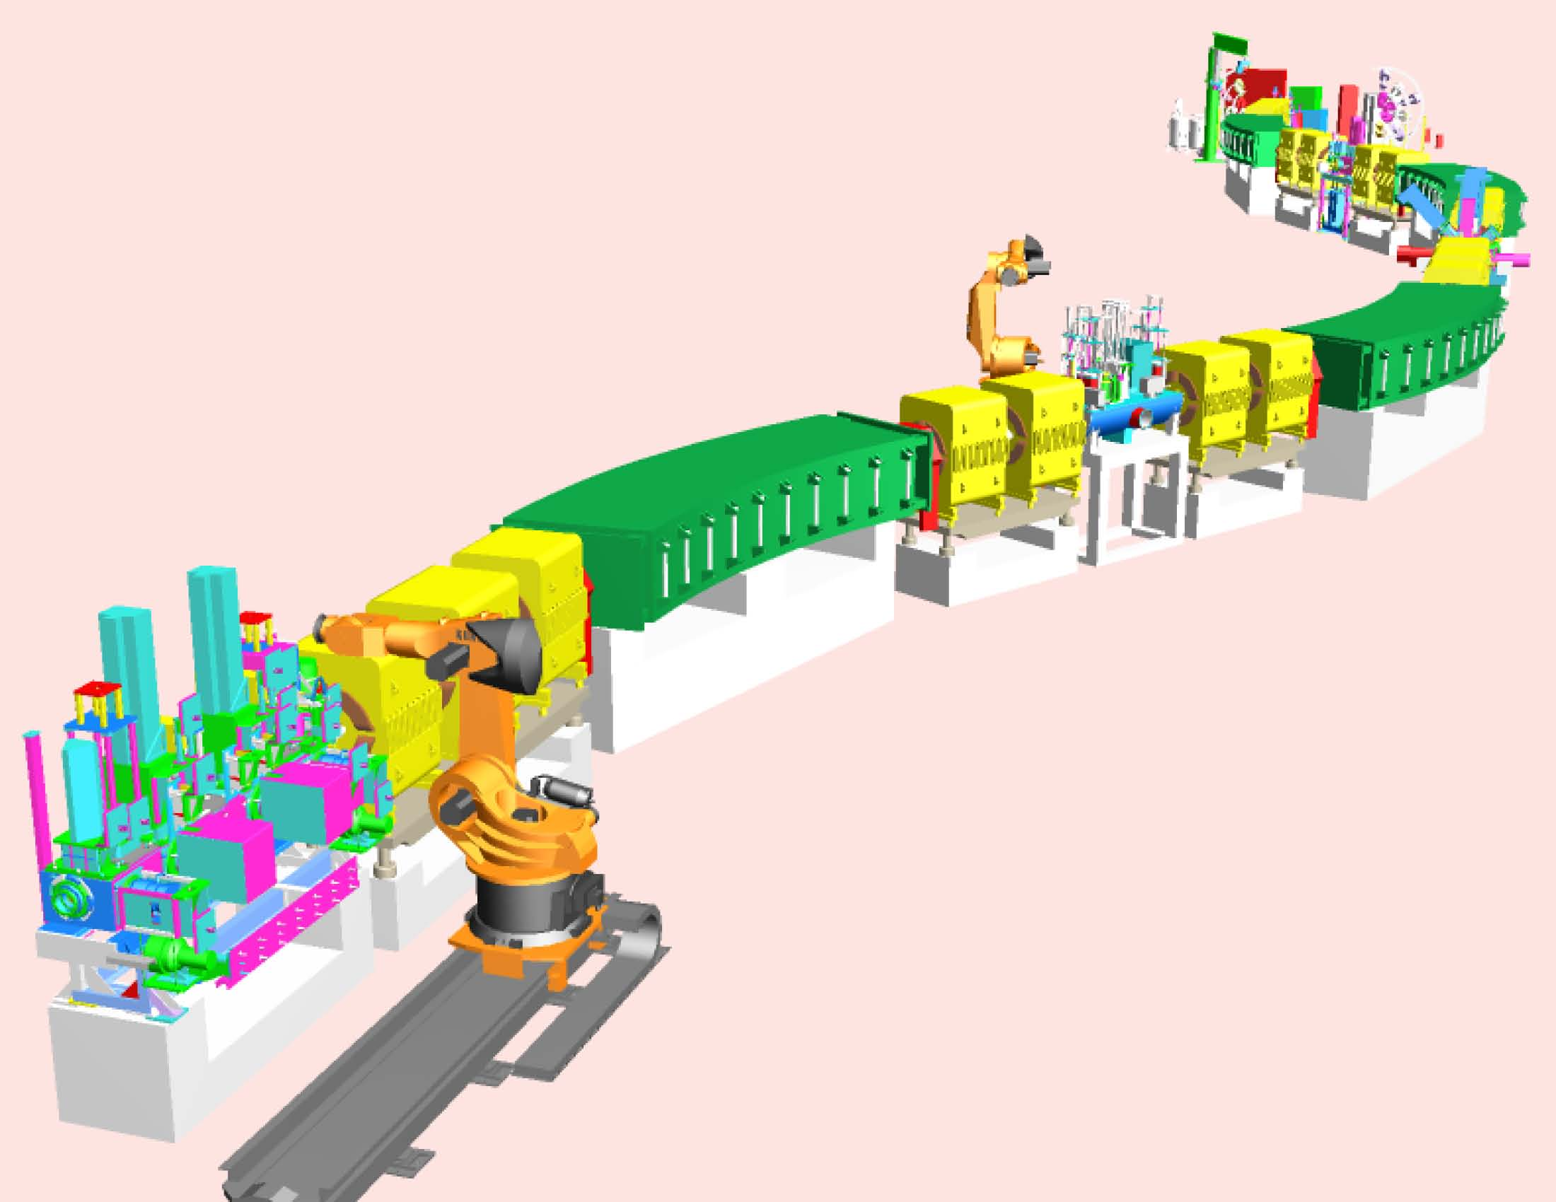
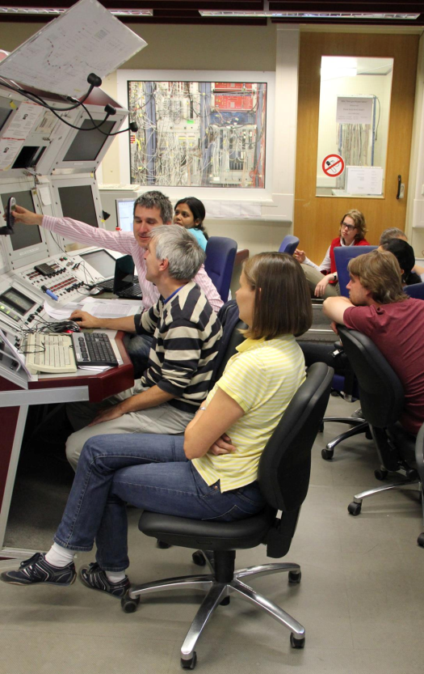
Production, separation, identification
UNILAC
SIS
fragment
FRS
abrasion
ablation
FRagment Separator

Slide 33
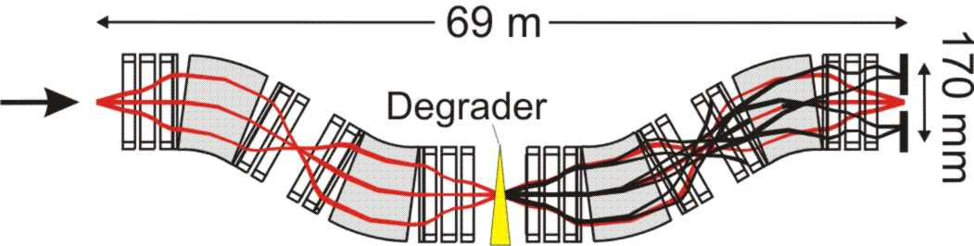
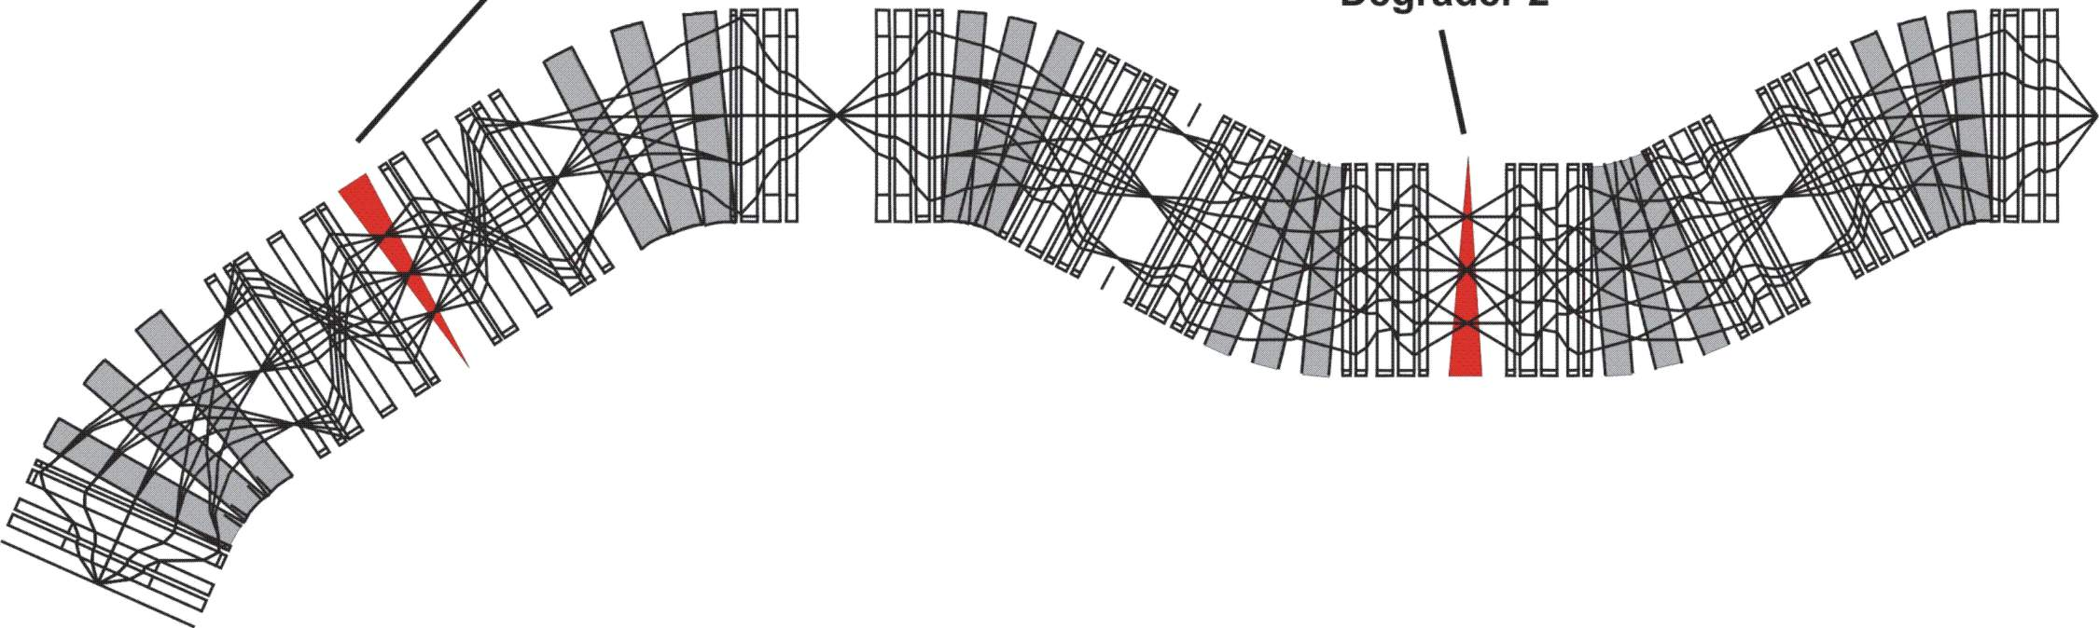
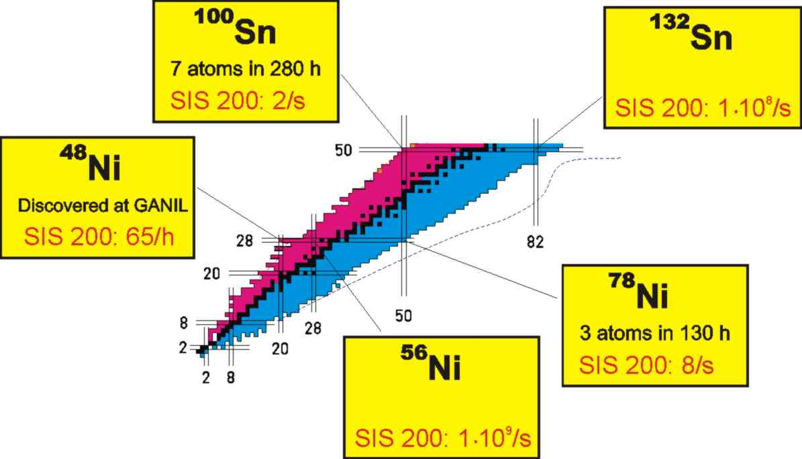
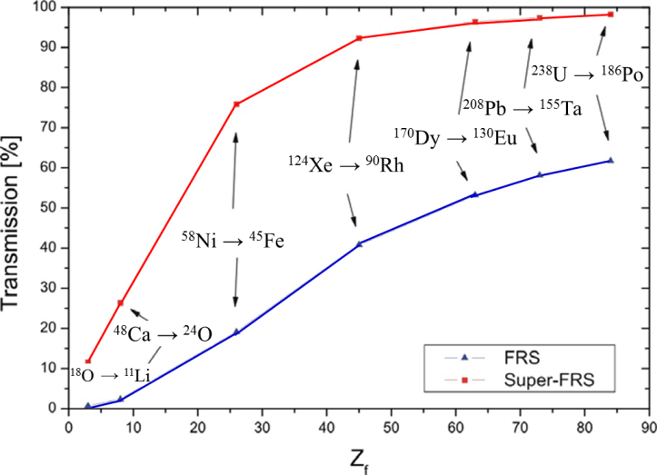
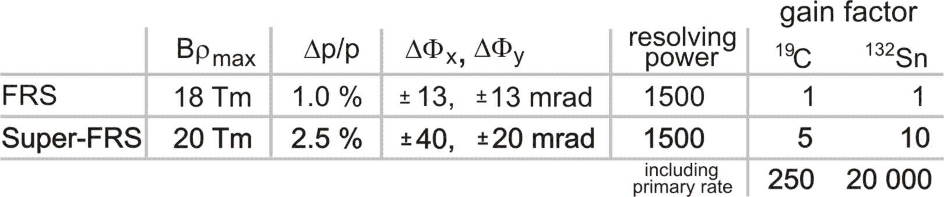
Comparison of FRS with Super-FRS
FRS
Super-FRS
150m

Slide 34
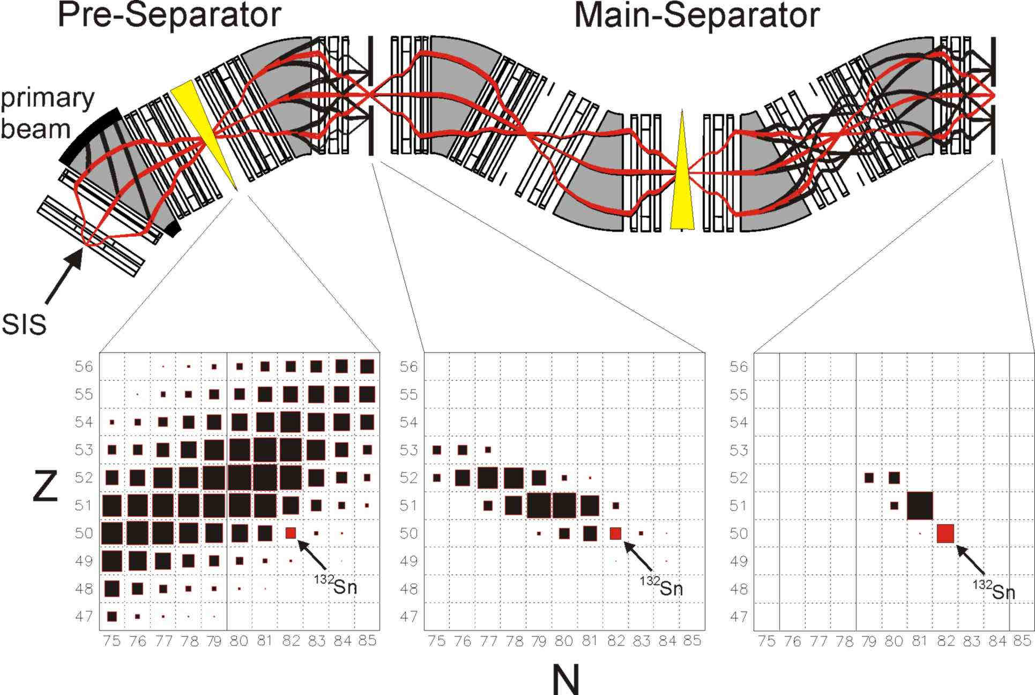
Layout and separation properties

Slide 35
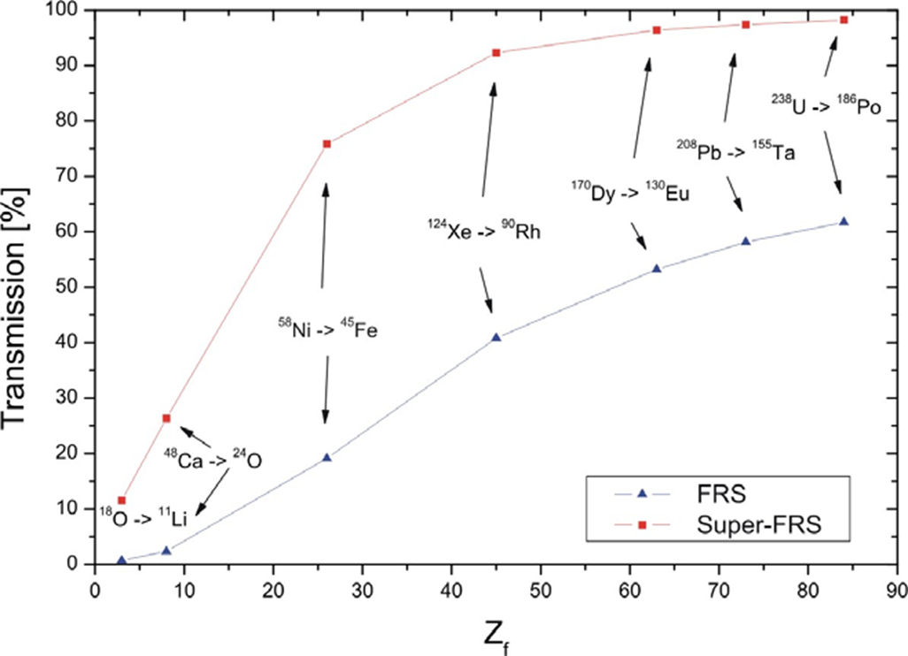
²³⁸U → ¹⁸⁶Po
²⁰⁸Pb → ¹⁵⁵Ta
¹⁷⁰Dy → ¹³⁰Eu
¹²⁴Xe → ⁹⁰Rh
⁵⁸Ni → ⁴⁵Fe
⁴⁸Ca → ²⁴O
¹⁸O → ¹¹Li

Slide 36
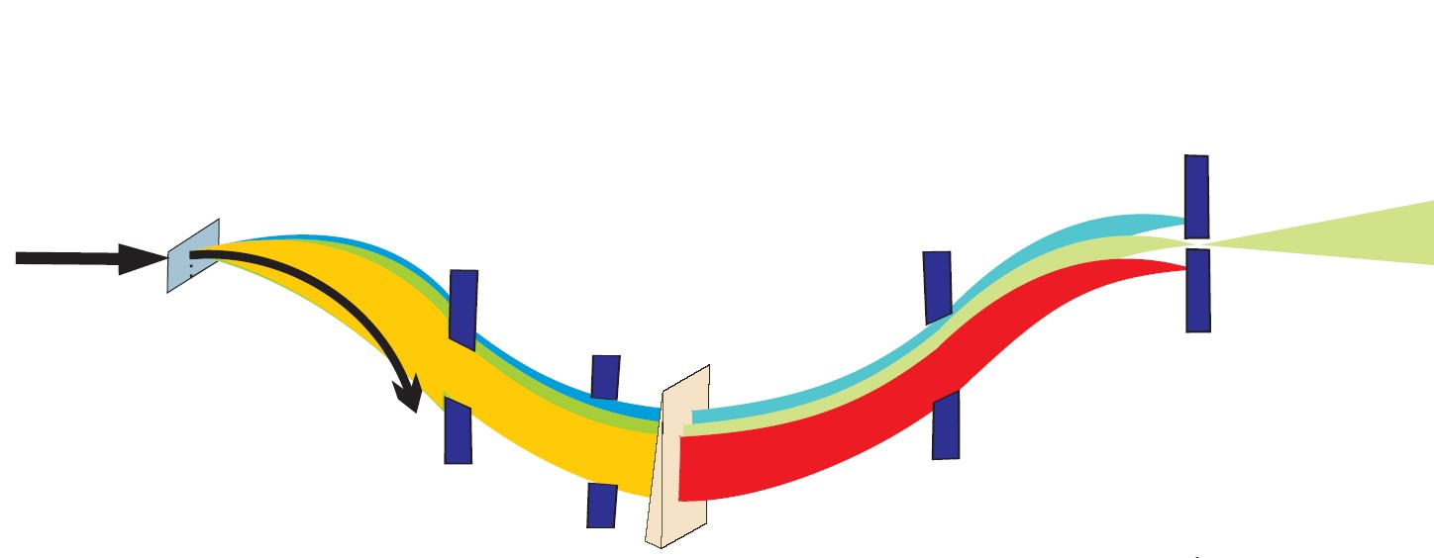
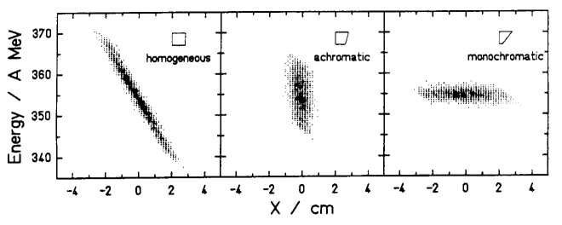
FRagment Separator
Beam & All
Fragmentation
Products
Primary
Beam
Spacial
Dispersion
Secondary
Beam
Momentum
Selection
Isotope
Selection
Wedge-shaped
Degrader
¹⁹Ne at 600AMeV:
Phase-space imaging of differently shaped degraders within the achromatic ion-optical system. The results for a homogeneous, an achromatic, and a monoenergetic degrader are given. All degraders have the same thickness on the optical axis (d/r=0.5)

Slide 37
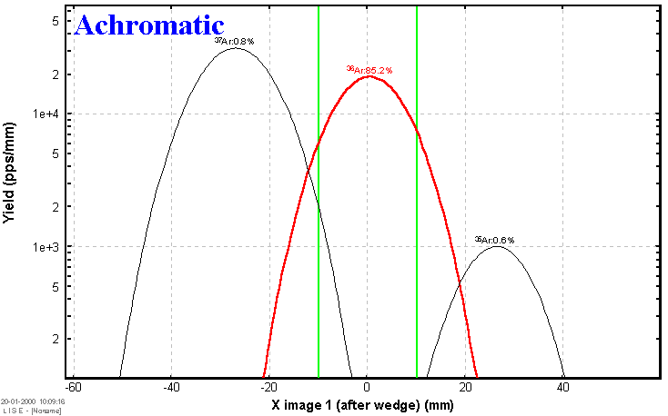
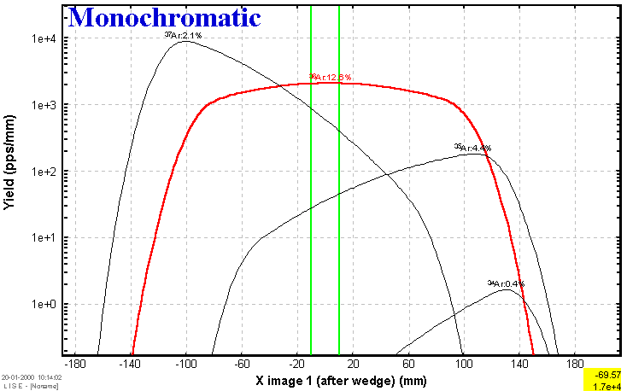


Fragment separation settings
⁴⁰Ar 50MeV/u + Ta (100μm), wedge shaped Al (200μm) degrader
0.39 mrad
1.66 mrad

Slide 38


Optics: chromatic aberration
When different colors of light propagate at different speeds in a medium, the refractive index is wavelength dependent. This phenomenon is known as dispersion.
Longitudinal (axial) chromatic aberration: Transverse (lateral) chromatic aberration:
The focal planes of the various colors do The size of the image varies from one
not coincide. color to the next.

