Slide 1

Outline: GSI accelerator facility
Lecturer: Hans-Jürgen Wollersheim
e-mail: h.j.wollersheim@gsi.de
web-page: https://web-docs.gsi.de/~wolle/ and click on
heavy ion source
universal linear accelerator UNILAC
synchrotron SIS-18
nuclear reaction rate

Slide 2
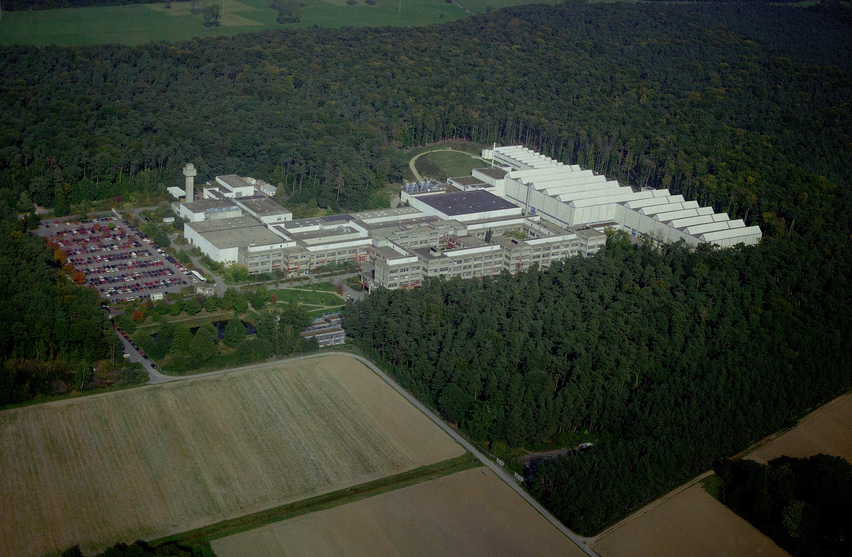
GSI Helmholtz Centre for Heavy Ion Research

Slide 3
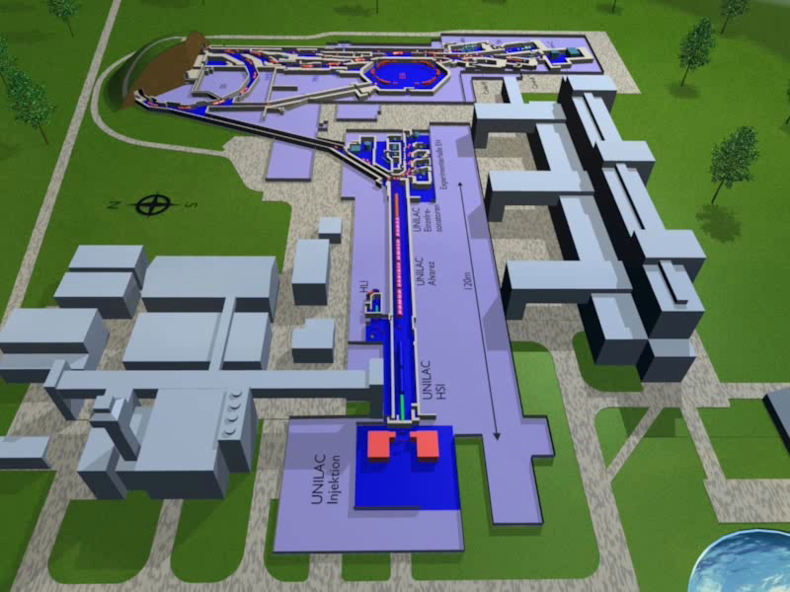
Accelerator facility

Slide 4
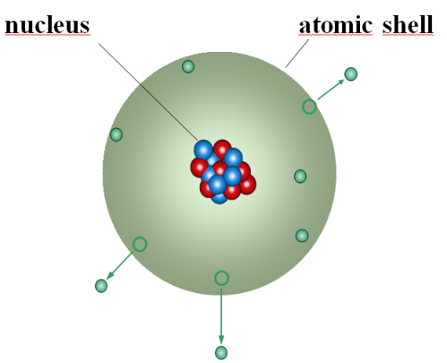
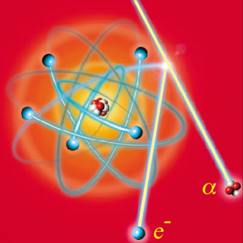
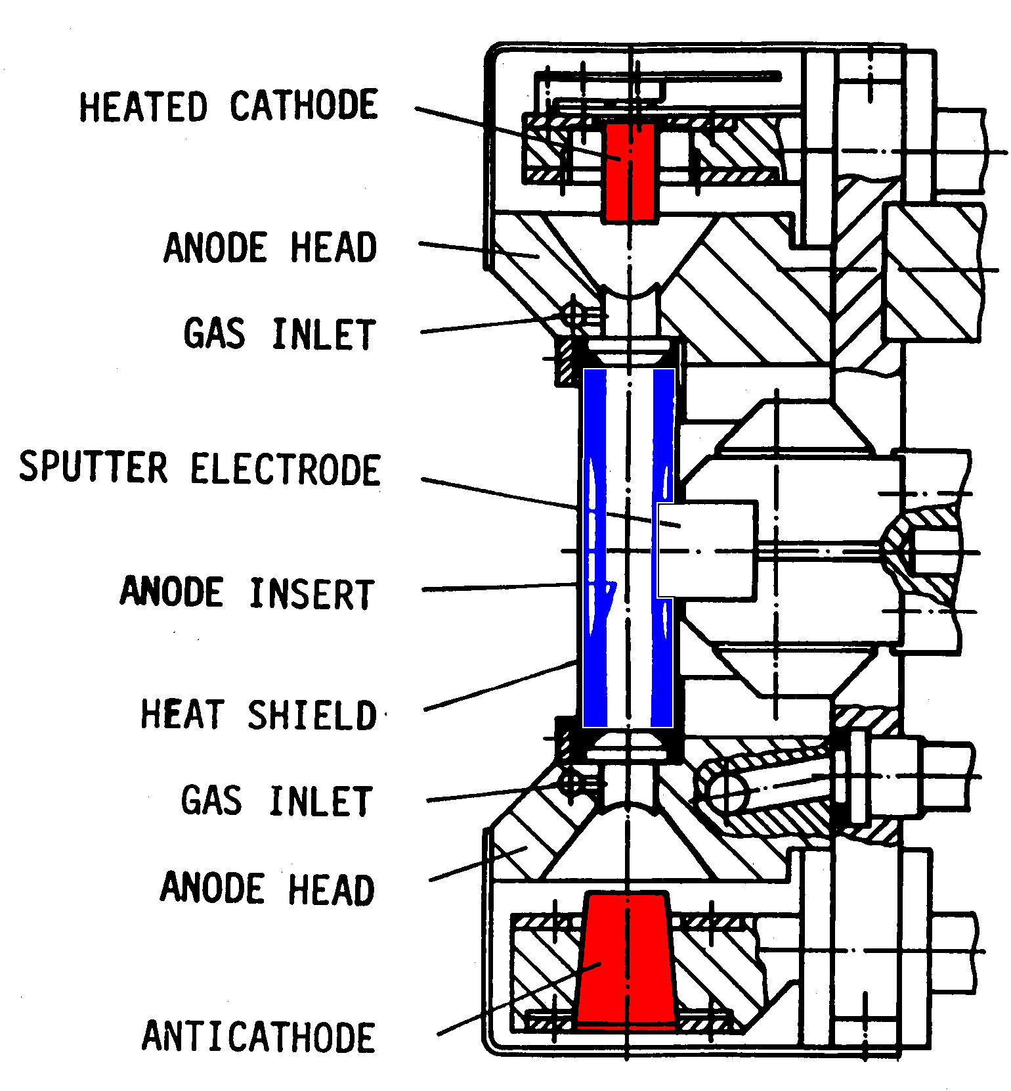
Ion source
To create ions one needs:
electrons
noble gases
element material (e.g. Fe, Sn, Pb, U)
Ionization
Discharge voltage 0.3...1.3 kV
Discharge current 5...20 A
Magnetic flux 0,2...2 T
Filament heating 0.5 kW
Power consumption up to 20 kW
T_{e} in the order of 1 eV
Current density 10 mA/cm²
Penning ion source

Slide 5
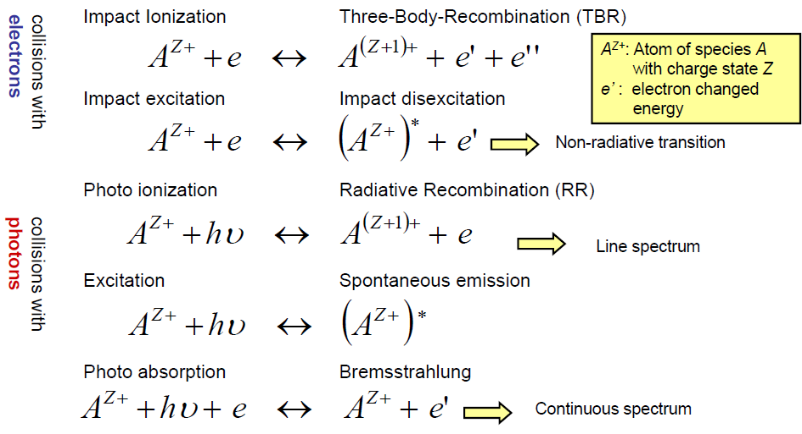
Ionization for positive ions

Slide 6
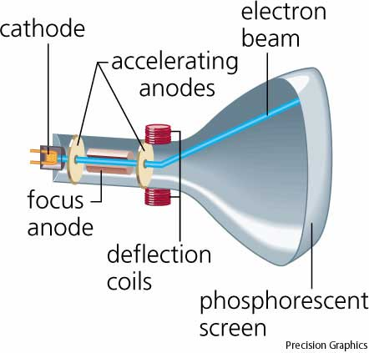
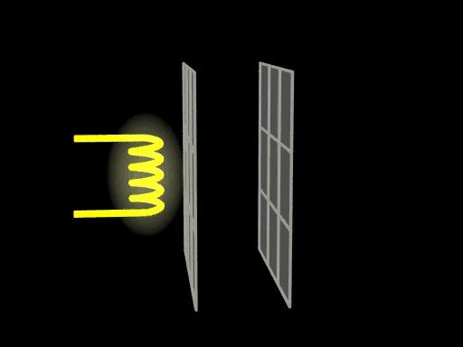
Cathode Ray Tube

Slide 7

Cathode Ray Tube

Slide 8
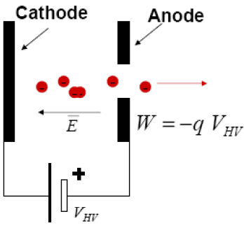
Electron Gun – simplest electrostatic accelerator

Slide 9
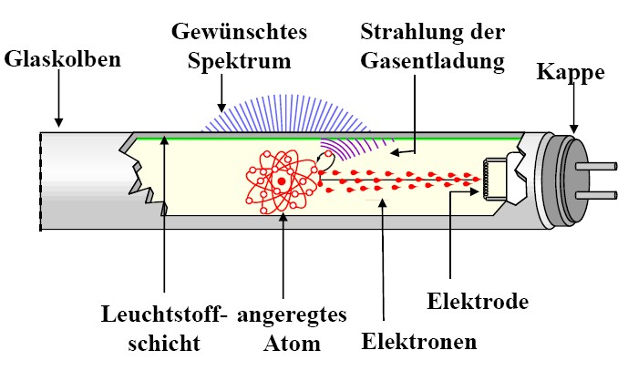
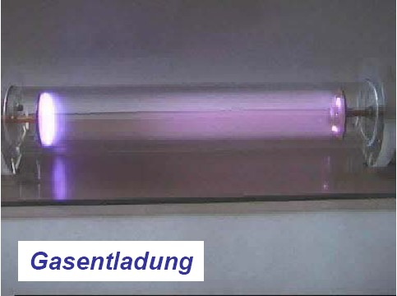
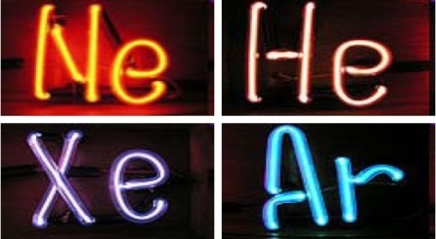
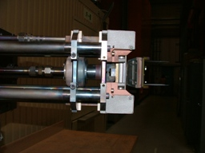
How to create ions?
desired
spectrum
radiation of
gas discharge
glass bulb
end-cap
gas discharge
luminescent
substrate
electrode
excited
atom
electrons
Discharge voltage 0.3...1.3 kV
Discharge current 5...20 A
Magnetic flux 0,2...2 T
Filament heating 0.5 kW
Power consumption up to 20 kW
T_{e} in the order of 1 eV
Current density 10 mA/cm²
To create ions one needs:
electrons
noble gases
element material (e.g. Fe, Sn, Pb, U)

Slide 10
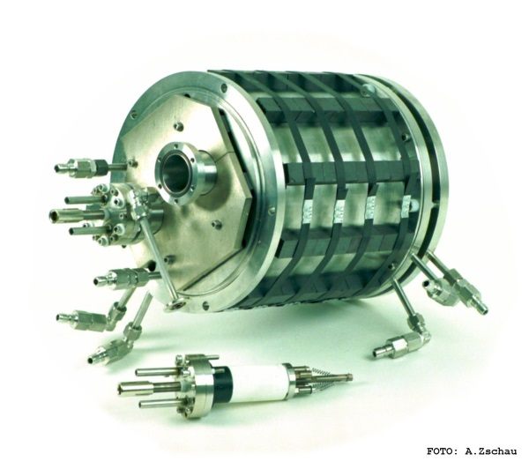
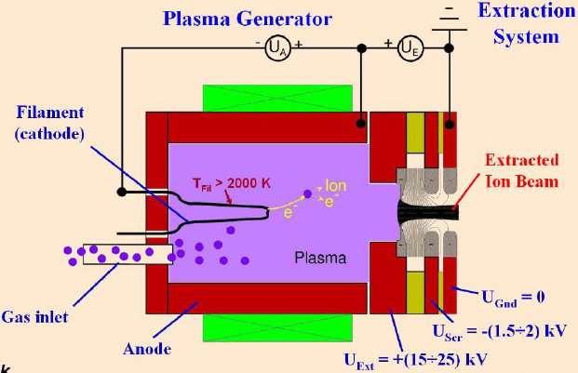
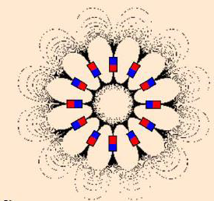
Volume ion source with filament
Multi Cusp Ion Source
with permanent magnets
Electrons generated from a filament and used for ionization within a gas volume. Magnetic field guides electrons towards the plasma chamber.

Slide 11
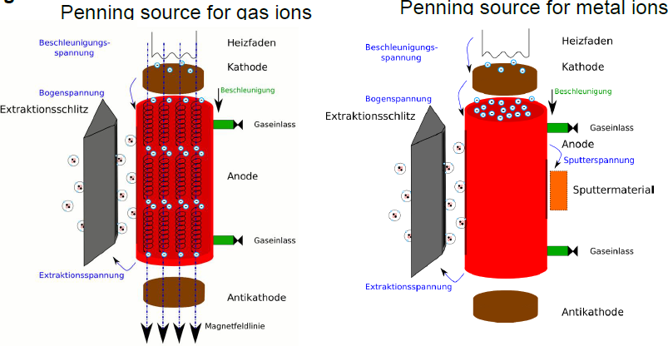
Penning ion source for gases and metals

Slide 12
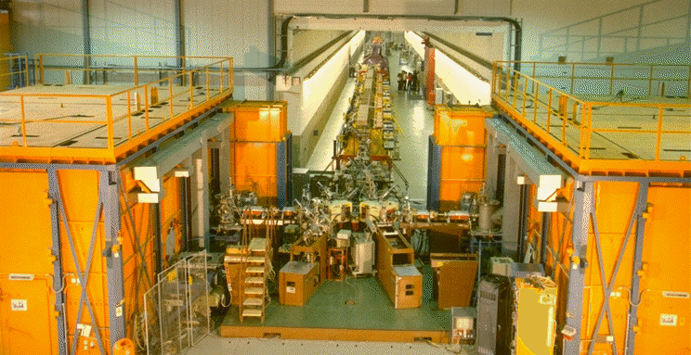

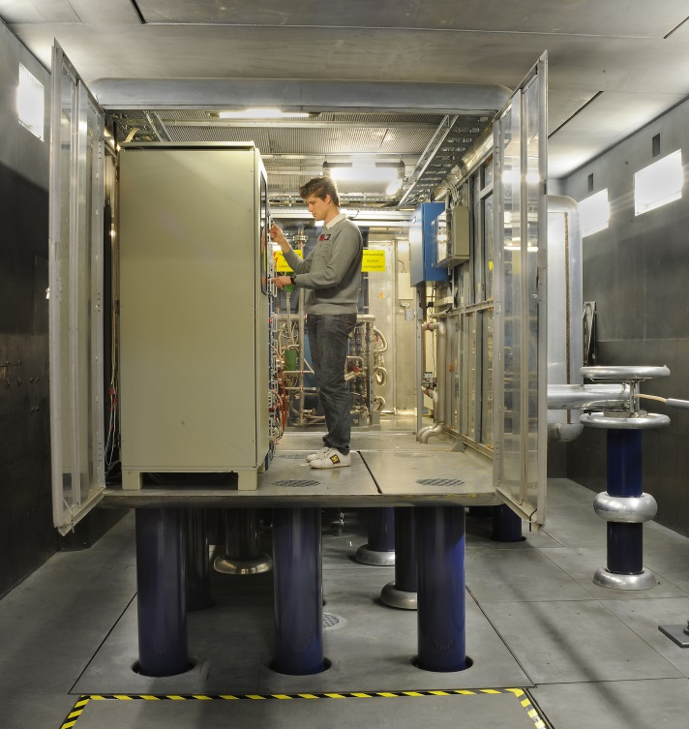
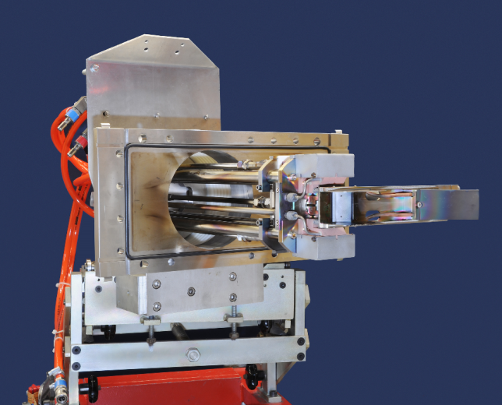
UNIversal Linear ACcelerator
From zero to 2,000,000 km/h
with a voltage of 20,000 V to 130,000 V
ions will be accelerated to v/c = 0.002

Slide 13
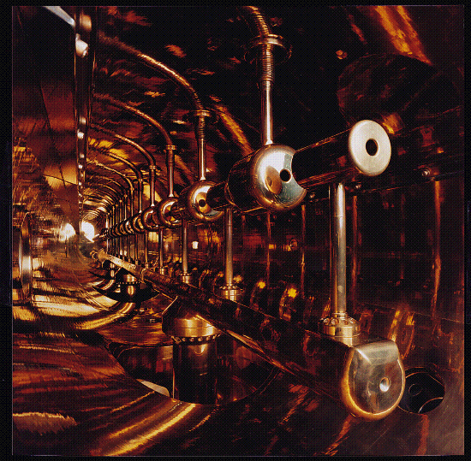
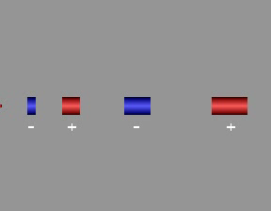
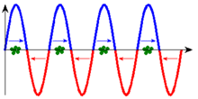
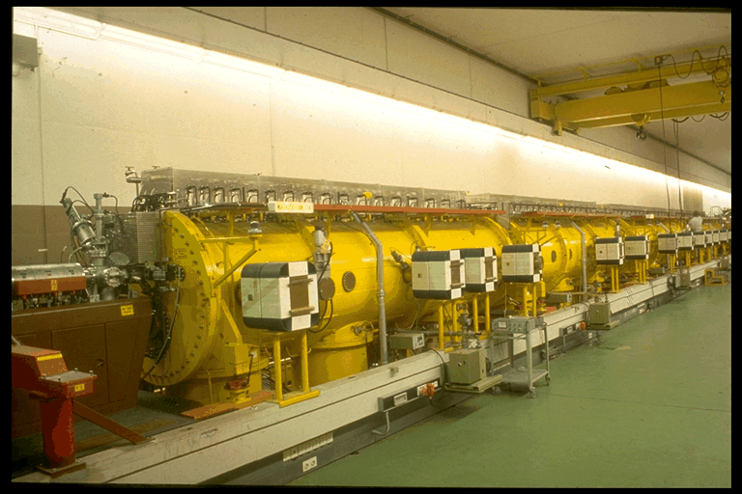
UNILAC Wideroe - Accelerator
27 MHz high frequency

Slide 14
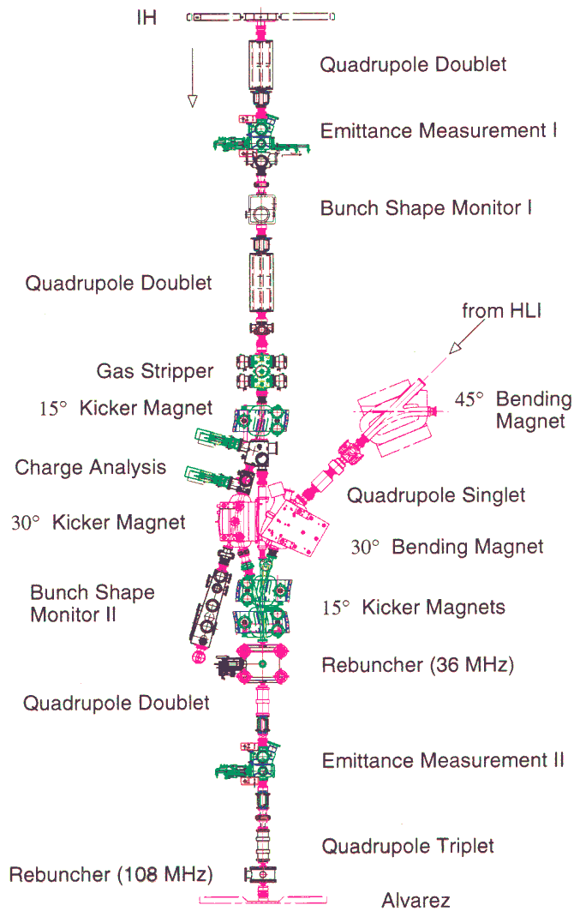
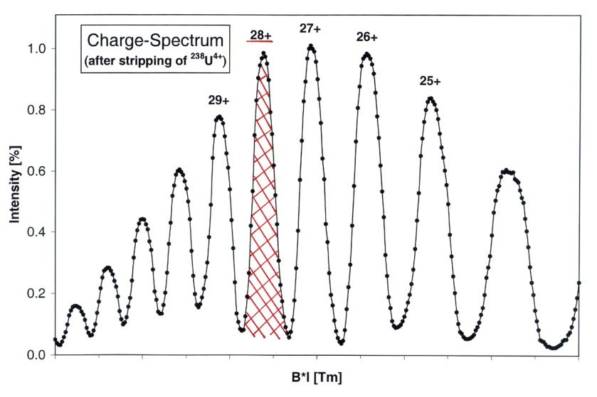
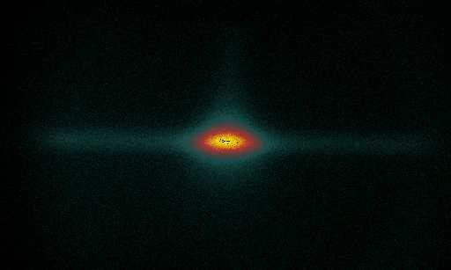
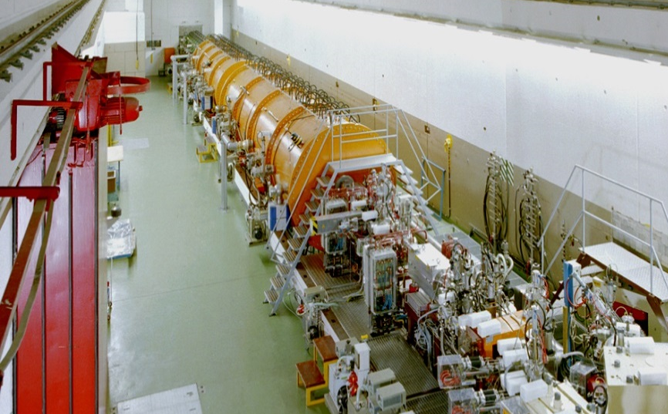
Gas-stripper to increase acceleration efficiency
N·²³⁸U⁴⁺
increase of accel. efficiency by a factor of 28/4 = 7
but ≈ 87% of ions get lost (q ≠ 28)
noble gas (Xe)
0.13·N·²³⁸U²⁸⁺
v/c = 5.4% or 1.4 MeV/u

Slide 15
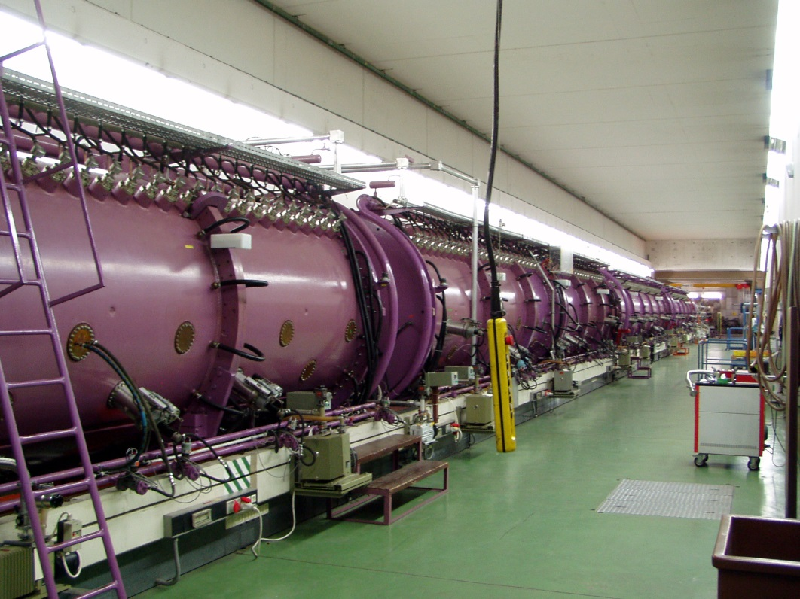
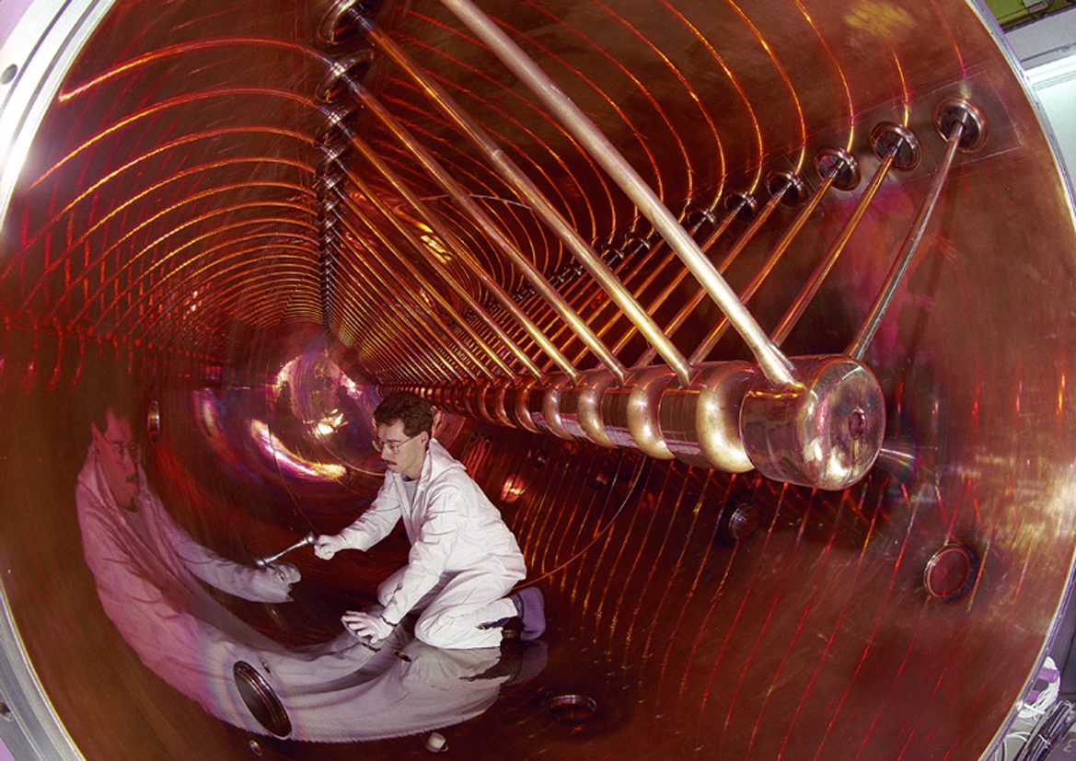
UNILAC Alvarez Accelerator
108 MHz high frequency
standing wave
v/c = 16% or 11.4 MeV/u

Slide 16
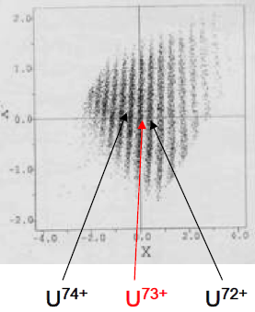
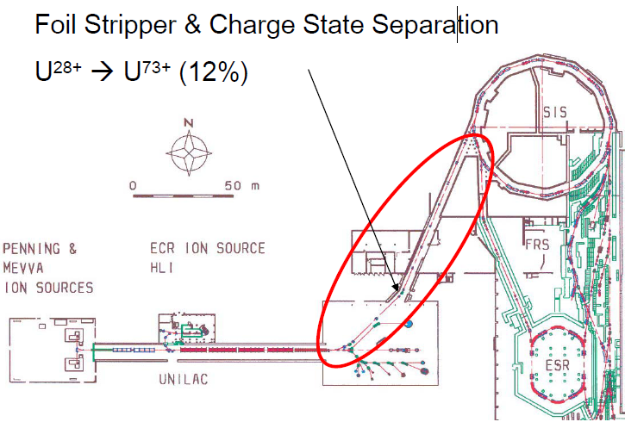
UNILAC: Beam transfer to synchrotron SIS-18
Foil Stripper and Charge State Separation

Slide 17
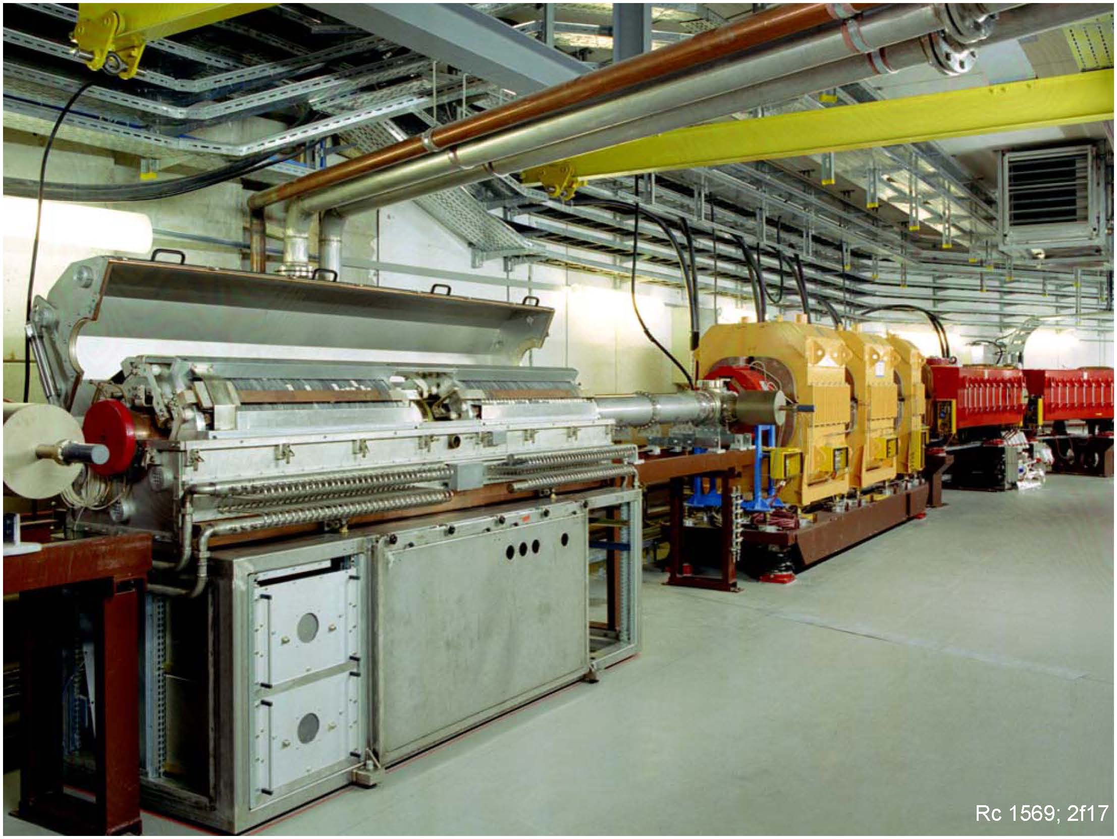
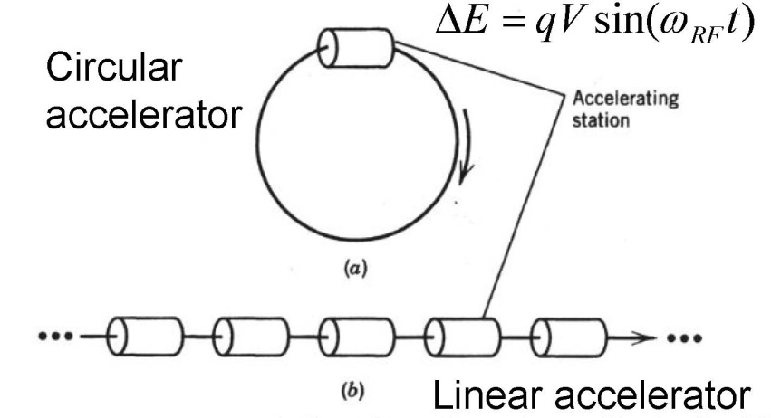
GSI Synchrotron SIS-18
As linacs are dominated by cavities, circular maschines are dominated by magnets
SIS-18 accelerating cavity

Slide 18
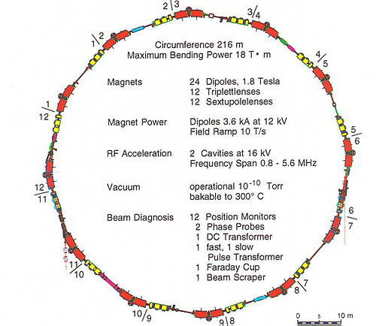
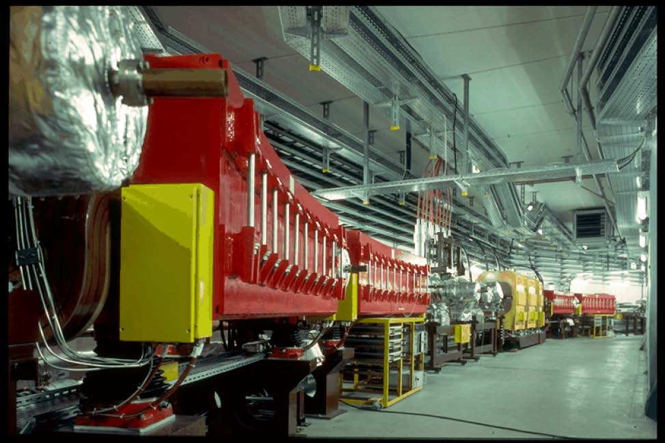
GSI Synchrotron SIS-18
SIS: Schwere Ionen Synchrotron
Heavy Ion Synchrotron
accelerates ions from p to U
energy: 4 GeV (p), 2 GeV/u (Ne), 1 GeV/u (U)
β = 0.98 (p), 0.95 (Ne), 0.88 (U)
bending radius: 10 m
max mag. field 18 T
rf frequency: 0.85 – 6 MHz

Slide 19
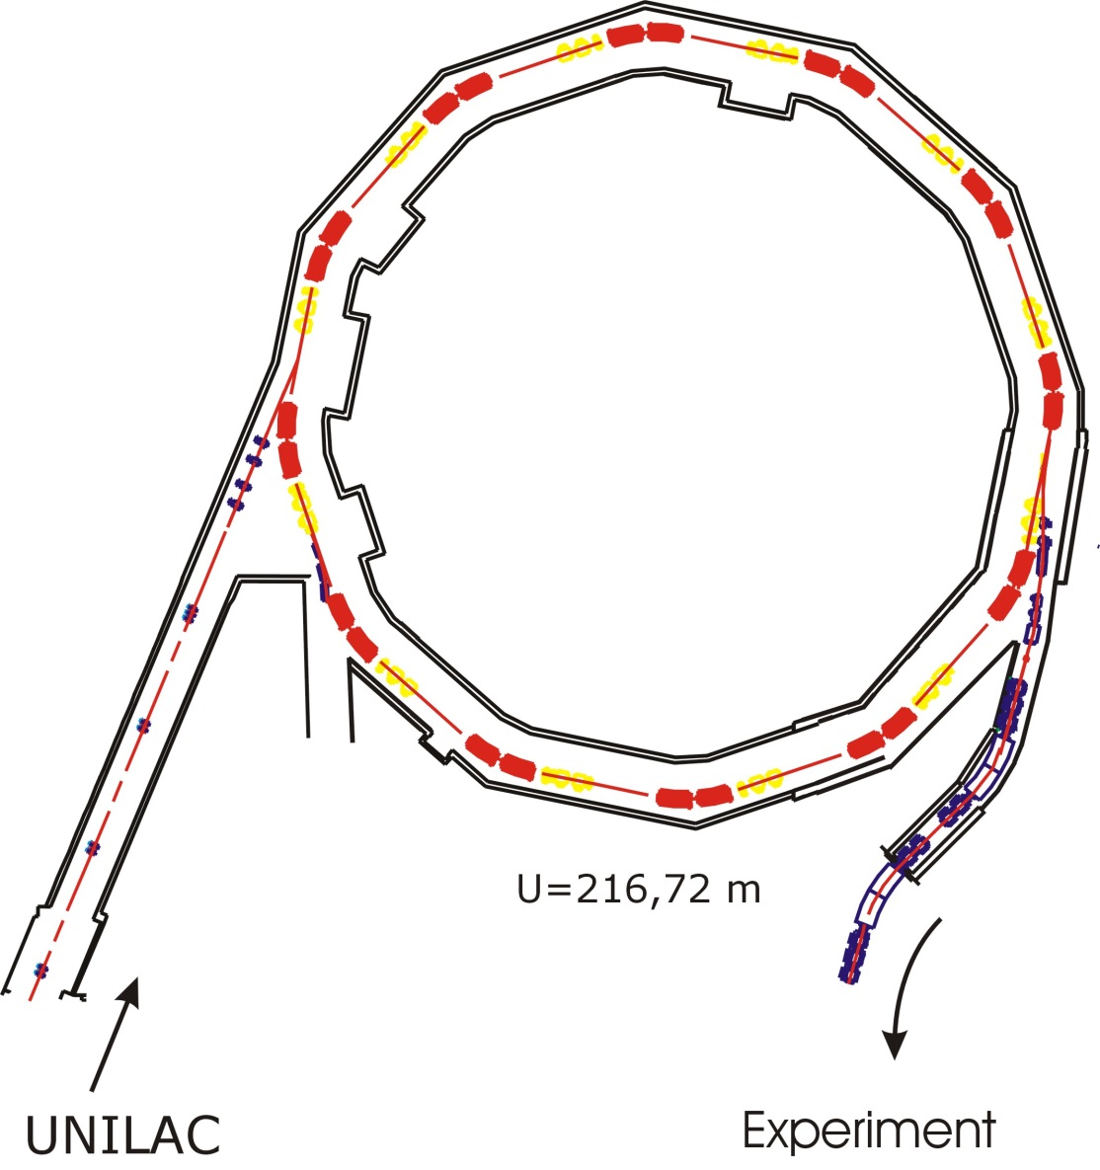
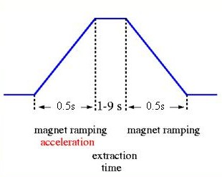

SIS – Schwere Ionen Synchrotron
acceleration
> 100 000 turns/s
eff. puls width
for injection: 47μs
36.2% efficiency
deflecting magnets
( < 1.8 T )
focussing magnets
$1.0∙{10}^{10}∙\frac{0.362}{2}=1.8∙{10}^{9}$ particles/s
Ion | Number of injections | Intensity [spill⁻¹] at FRS | Ion source | Date
⁵⁸Ni | 1 | 6*10⁹ | MEVVA | 3.2006
¹⁰⁷Ag | 1 | 3*10⁹ | MEVVA | 2.2006
¹²⁴Xe | 1 | 5*10⁹ | MUCIS | 3.2008
¹³⁶Xe | 4 | 5*10⁹ | MEVVA | 7.2006
²⁰⁸Pb | 30 | 1.3*10⁹ | PIG | 3.2006
²³⁸U | 1 | 2.0*10⁹ | PIG | 9.2009
20% speed of light
Max. 90%
speed of light
15.5% speed of light
period of one revolution 4.7μs
10 turns will be accepted for injection
UNILAC
experiment
$$900μA=\frac{900∙{10}^{−6}\left[A\right]∙130∙{10}^{−6}}{73\left[U−charge\right]∙1.6∙{10}^{−19}\left[C\right]}=1.0∙{10}^{10} particles/s$$
intensity[s⁻¹]=0.5*intensity[spill⁻¹]

Slide 20
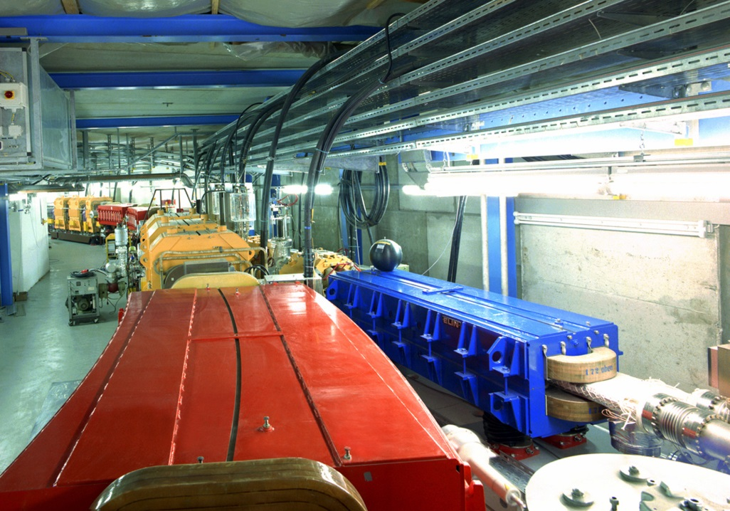
GSI Synchrotron SIS-18
SIS: Schwere Ionen Synchrotron
Heavy Ion Synchrotron
SIS 18 has a circumference of 216 m
92 elements will be accelerated from p to U
max. ion velocity up to 270 000 km/s (β = 90%)
ions are accelerated by 80 000 V in the accelerator structures during every circulation
ions are accelerated in one second cover a distance of 90 000 km, that corresponds to 416 000 cycles in the ring
32 billion medium-charged uranium ions can be accelerated at SIS 18
one billionth Pascal: an ultra-high vacuum is a prerequisite for acceleration.

Slide 21
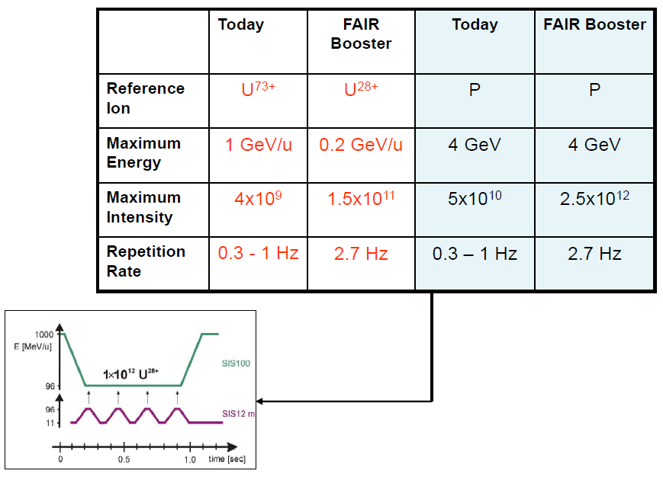
Requirements for SIS-18

Slide 22
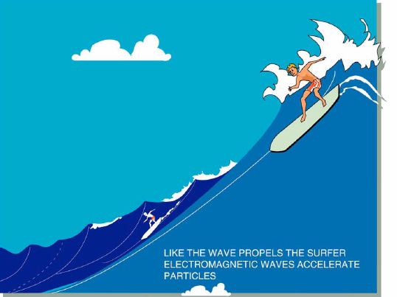
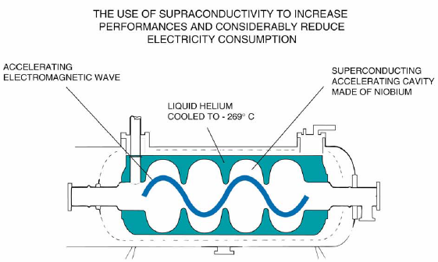

Slide 23
Nuclear reaction rate
Reaction rate (thick target):
Reaction rate (thin target):
Example:
Reaction rate: 57941[s⁻¹] transmission (SIS/FRS)=70%, transmission (FRS) 1.9%

Slide 24
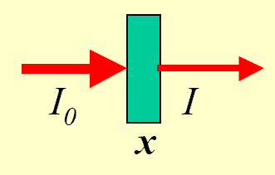
Nuclear reaction rate
Primary reaction rate:
Example: ²³⁸U (10⁹s⁻¹) on ²⁰⁸Pb (x=1g/cm²) → ¹³²Sn (σ_{f}=15.4mb) reaction rate: 44571[s⁻¹]
Example: ¹²⁴Xe (10⁹s⁻¹) on ⁹Be (x=1g/cm²) → ¹⁰⁴Sn (σ_{f}=5.6μb) reaction rate: 375[s⁻¹]
The optimum thickness of the production target is limited by the loss of fragments due to secondary reactions
Primary + secondary reaction rate:
1 | 0.79
2 | 1.25
3 | 1.47
4 | 1.55
5 | 1.53
6 | 1.45
Example:

Slide 25
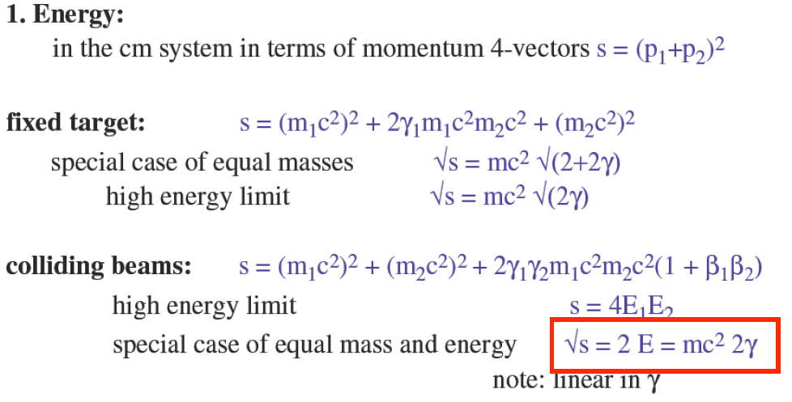

Slide 26
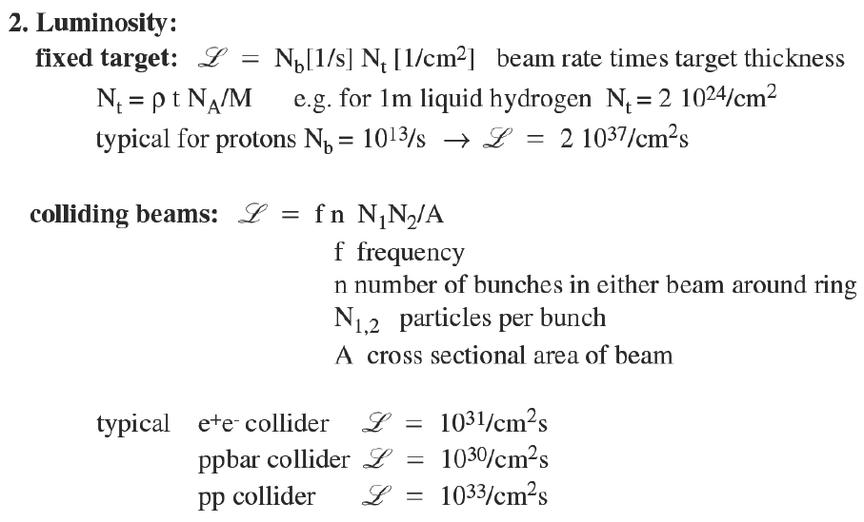
Luminosity

