Slide 1
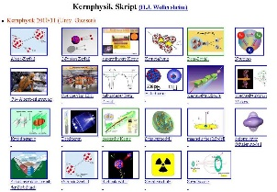
Outline: RISING – active stopper 2006
Lecturer: Hans-Jürgen Wollersheim
e-mail: h.j.wollersheim@gsi.de
web-page: https://web-docs.gsi.de/~wolle/ and click on
measurements with double-sided Si-strip detector
mesytec and multichannel systems electronics
²⁴¹Am and ²⁰⁷Bi source
implantation detector for RISING
experimental results

Slide 2
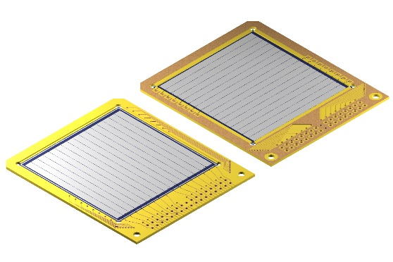
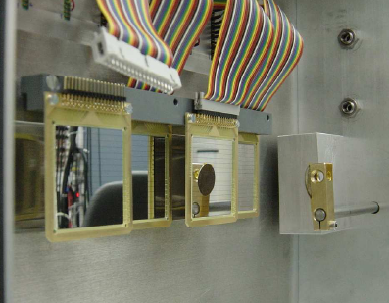
Implantation detector as active stopper 2006
Active catcher for implantation-decay correlations
Implantation-decay correlations with large background
(half lifes similar to the implantation rate):
implantation-decay time correlation: active catcher
implantation-decay position correlation: granularity
implantation of several ions: thickness and area
energy of the implanted ion and the emitted β
3 double-sided silicon-strip detectors
- surface 5x5 cm²
- thickness 1 mm
- 2 x 16 3.125 mm strips
- manufactured by MICRON
Rakesh Kumar, P. Doornenbal, I. Kojouharov, W. Prokopowicz, H. Schaffner, H.J. Wollersheim NIM A 598 (2009) 754

Slide 3
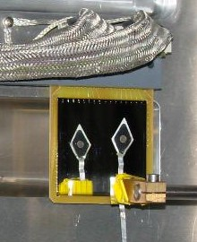
Implantation detector as active stopper 2006
Active catcher for implantation-decay correlations
Implantation-decay correlations with large background
(half lifes similar to the implantation rate):
implantation-decay time correlation: active catcher
implantation-decay position correlation: granularity
implantation of several ions: thickness and area
energy of the implanted ion and the emitted β
grounding
3 double-sided silicon-strip detectors
- surface 5x5 cm²
- thickness 1 mm
- 2 x 16 3.125 mm strips
- manufactured by MICRON
experimental set-up
Rakesh Kumar, P. Doornenbal, I. Kojouharov, W. Prokopowicz, H. Schaffner, H.J. Wollersheim NIM A 598 (2009) 754

Slide 4
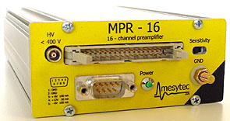
Measurements with a double-sided Si-strip detector 2006
Rear Ohmic Side
Front Junction Side
CAEN
32
Micron Semiconductor
Nº Junction Elements: 16
Nº Junction Elements: 16
Element Length: 49.5 mm
Element Pitch: 3.1 mm
Element width: 3.0 mm
Active Area: 50x50 mm²
Thickness: 1000 µm
Price: 5600 €
MPR-32
Charge Sensitive Preamplifier
32 channel compact module
Sensitivity switch, factor 5
Bias voltage up to ±400V
Price: 2790 €
STM-16
16 fold shaper
16 channel NIM module
shaper amplifier
timing filter amplifier
leading edge discriminator
Price: 2x 3415 €
ADC V785AF
32 channel
Price: 5094 €
MRC-1
rc master controller
for STM-16
Price: 2200 €
Total cost 22,514.- €

Slide 5
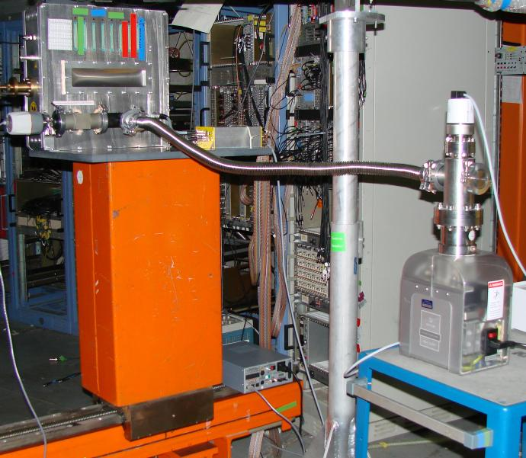
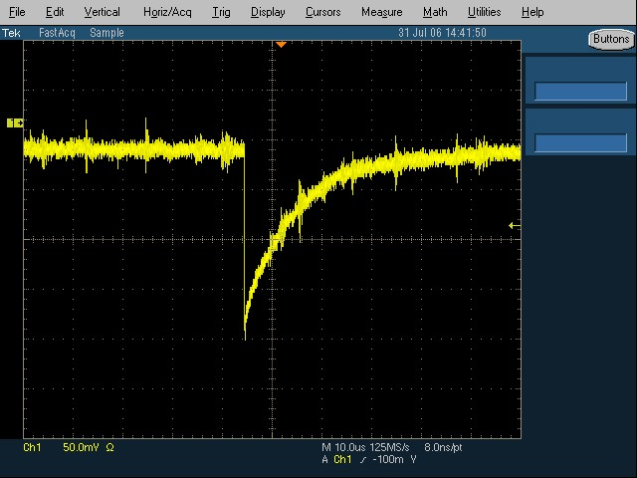
Measurements with a double-sided Si-strip detector 2006
grounding
Output signal of the MPR-32 preamplifier for a ²⁰⁷Bi β-source
(pulse-height 200mV, decay time 30μs)

Slide 6
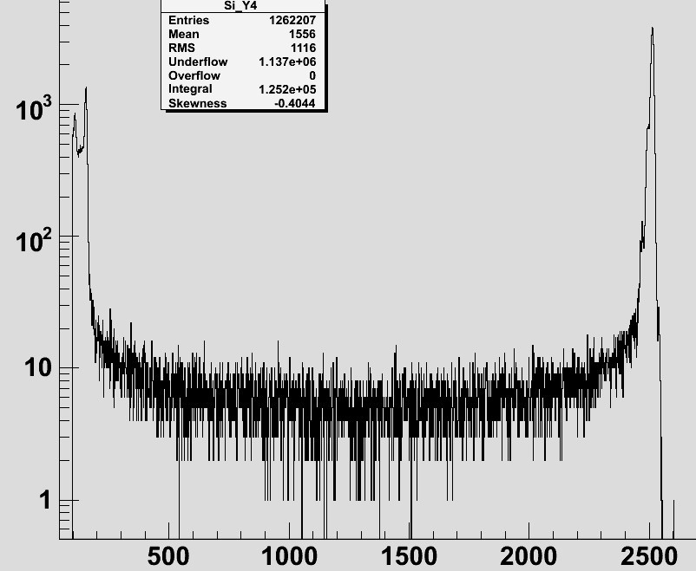
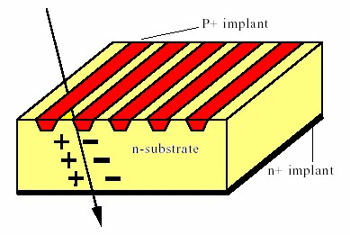
Energy resolution with ²⁴¹Am source measurement in vacuum
Front Junction Side
Rear Ohmic Side
Low energy peak from gap events at about ½ the full pulse height
C.Wrede et al. NIM B204 (2003), 619
MICRON #2215-17
Voltage: 200V
²⁴¹Am E_{α}=5.486 MeV
range ~28 µm

Slide 7
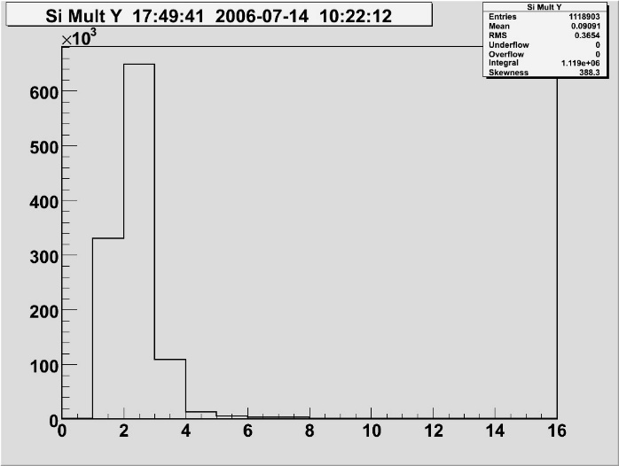
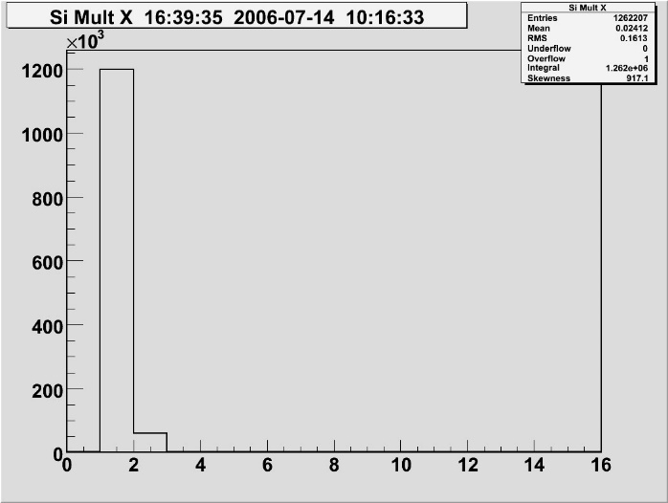
Strip multiplicity with ²⁴¹Am source
Front Junction Side
Rear Ohmic Side
MICRON #2215-17
Voltage: 40V
below full depletion
measurement in vacuum
MICRON #2215-17
Voltage: 200V
full depletion voltage
measurement in vacuum
²⁴¹Am E_{α}=5.486 MeV
range ~28 µm
Front Junction Side
Rear Ohmic Side

Slide 8
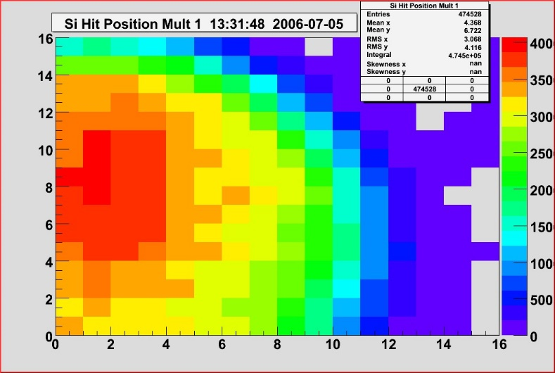
Two dimensional position spectra
²⁴¹Am source centered
²⁴¹Am source centered, strip-multiplicity=1
²⁴¹Am source left
²⁴¹Am source left, strip-multiplicity=1
MICRON #2243-5 Voltage: 40V, measurement in vacuum

Slide 9
Energy resolution with ²⁰⁷Bi source measurement in vacuum
Front Junction Side
Rear Ohmic Side
MICRON #2512-17
Voltage: 200V
²⁰⁷Bi E=482, 976 keV
range 0.94, 2.31 mm (e⁻e⁻ interaction)
experimental set-up

Slide 10
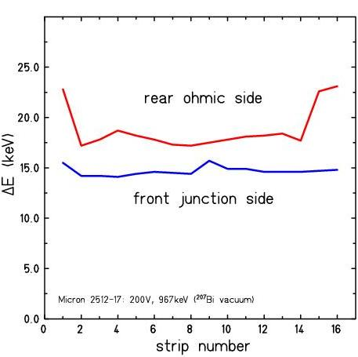
Energy resolution with ²⁰⁷Bi source measurement in vacuum
Front Junction Side
Rear Ohmic Side
MICRON #2512-17
Voltage: 200V
²⁰⁷Bi E=482, 976 keV
range 0.94, 2.31 mm (e⁻e⁻ interaction)
experimental set-up

Slide 11
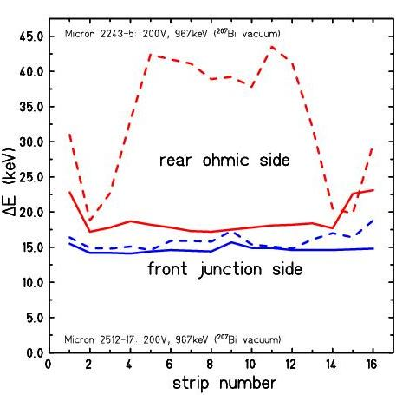
Energy resolution with ²⁰⁷Bi source measurement in vacuum
Front Junction Side
Rear Ohmic Side
MICRON #2512-17 (full lines)
#2243-5 (dashed lines)
Voltage: 200V
²⁰⁷Bi E=482, 976 keV
range 0.94, 2.31 mm (e⁻e⁻ interaction)
experimental set-up

Slide 12
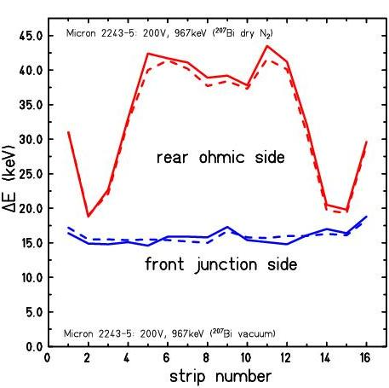
Energy resolution with ²⁰⁷Bi source measurement in vacuum and dry N₂
Front Junction Side
Rear Ohmic Side
MICRON #2243-5
Voltage: 200V
conclusion: measurement in dry N₂
²⁰⁷Bi E=482, 976 keV
range 0.94, 2.31 mm (e⁻e⁻ interaction)
experimental set-up

Slide 13
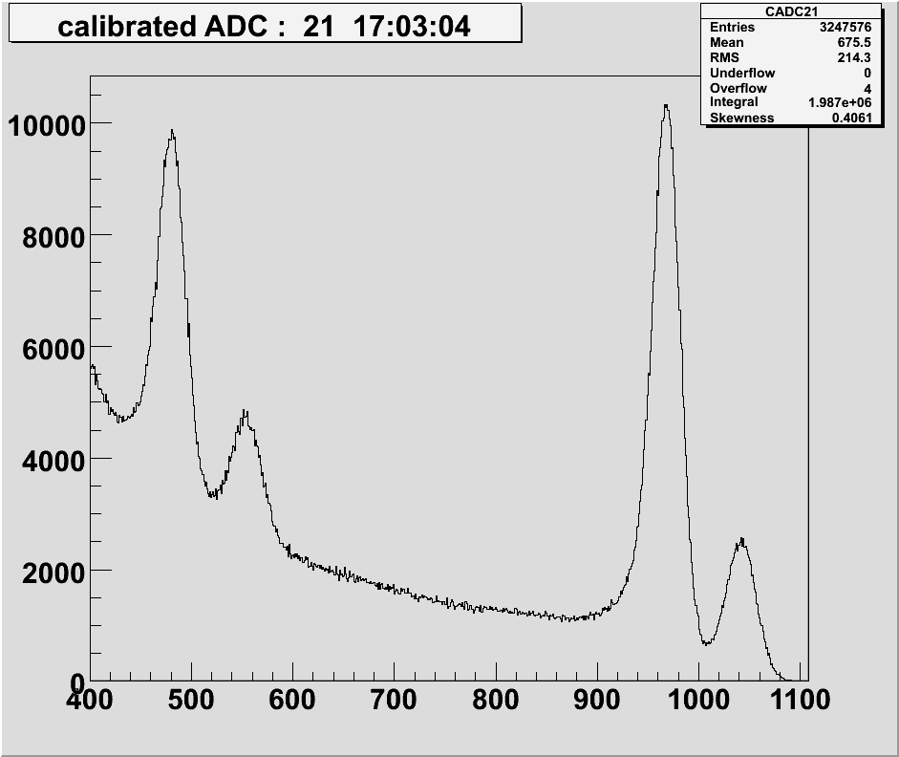
Energy resolution of the DSSSD
MICRON | ∆E (²⁴¹Am) vacuum | ∆E(²⁰⁷Bi) vacuum | ∆E(²⁰⁷Bi) dry nitrogen
#2243-5 | N: 31.3 keV | N: 16.2 keV P: 33.3 keV | N: 16.0 keV P: 32.5 keV
#2243-4 | N: 30.2 keV | N: 18.5 keV
#2243-3 | N: 34.0 keV | N: 18.2 keV
#2243-2 | N: 35.7 keV | N: 14.5 keV P: 27.0 keV
#2512-17 | N: 27.4 keV P: 29.7 keV | N: 14.8 keV P: 18.8 keV
Front Junction Side
∆E=15.4 keV
Rear Ohmic Side
∆E=32.5 keV
experimental set-up
²⁰⁷Bi E_{e}=976 keV ; ²⁴¹Am E_{α}=5.486 MeV

Slide 14
RISING: Test of the active stopper
γ-energy [keV] | e⁻-energy
569.6 | 481.7 [K]
 | 553.8-556.7 [L]
 | 565.8-567.2 [M]
1063.7 | 975.7 [K]
 | 1047.8-1050.6 [L]
 | 1059.8-1061.2 [M]
²⁰⁷Bi emits gamma rays and electrons

Slide 15
Energy threshold of the DSSSD
experimental set-up
²⁰⁷Bi E_{e}=482, 976 keV

Slide 16
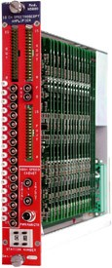
Measurements with a double-sided Si-strip detector 2006
Rear Ohmic Side
CAEN
Front Junction Side
CAEN
32
Micron Semiconductor
Nº Junction Elements: 16
Nº Junction Elements: 16
Element Length: 49.5 mm
Element Pitch: 3.1 mm
Element width: 3.0 mm
Active Area: 50x50 mm²
Thickness: 1000 µm
Price: 5600 €
CPA-16
Charge Sensitive Preamplifier
16 channel compact module
2 output stages with different gains
Bias voltage up to ±500V
Price: 2x 2250 €
Amplifier N 568BC
16 fold shaper
Price: 2x 3481 €
ADC V785AF
32 channel
Price: 2x 5094 €
Total cost 27,250.- € (discriminator not included)

Slide 17
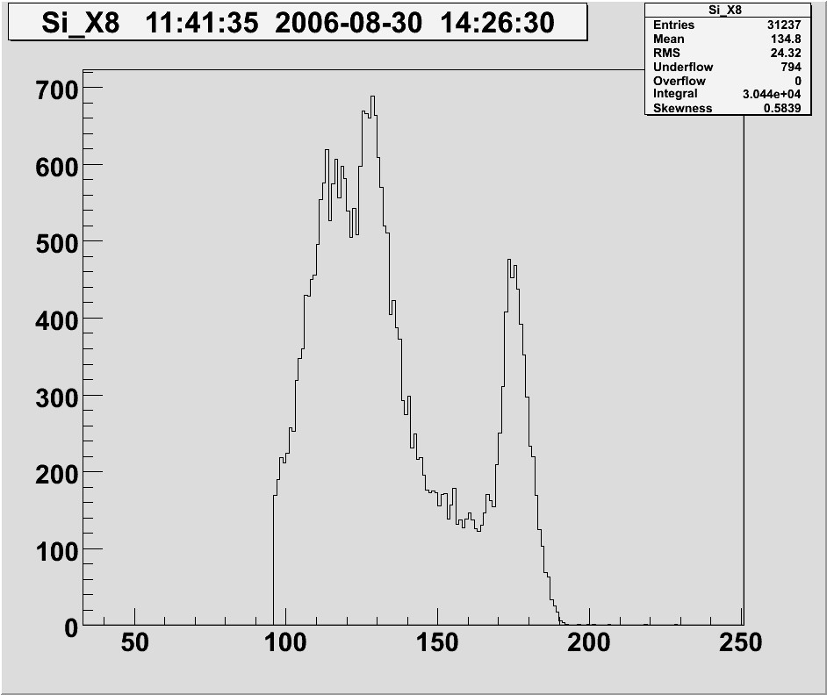
Energy resolution with ²⁰⁷Bi source measurement with Mesytec and Multichannel Systems
Front Junction Side
MICRON #2243-5
Voltage: 200V
measurement in vacuum
ORTEC 572
shaping time 0.5 μs ∆E=122 keV
1.0 μs ∆E=112 keV
2.0 μs ∆E=103 keV
experimental set-up

Slide 18
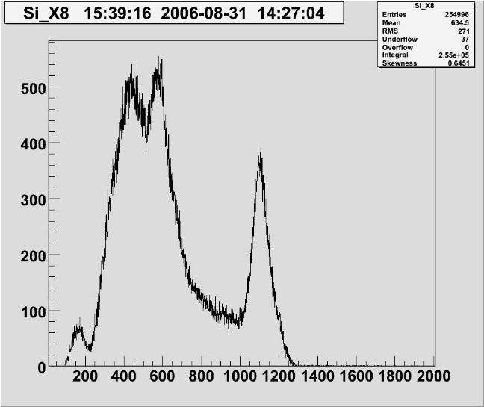
Energy resolution with ²⁰⁷Bi source measurement with Multichannel Systems
ORTEC 573
MICRON #2243-5
Voltage: 200V
measurement in vacuum
CAEN N568BC
experimental set-up

Slide 19
Implantation detector as active stopper 2006
Active catcher for implantation-decay correlations
Implantation-decay correlations with large background
(half lifes similar to the implantation rate):
implantation-decay time correlation: active catcher
implantation-decay position correlation: granularity
implantation of several ions: thickness and area
energy of the implanted ion and the emitted β
grounding
3 double-sided silicon-strip detectors
- surface 5x5 cm²
- thickness 1 mm
- 2 x 16 3.125 mm strips
- manufactured by MICRON
experimental set-up
Rakesh Kumar, P. Doornenbal, I. Kojouharov, W. Prokopowicz, H. Schaffner, H.J. Wollersheim NIM A 598 (2009) 754

Slide 20
Double-sided silicon-strip detector DSSSD
- surface 5x5 cm²
- thickness 1 mm
- 2 x 16 3.125 mm strips
- manufactured by MICRON
thickness sufficient for HI-implantation
but range of β-particles larger than 1mm
therefore part of the kinetic energy is measured
Monte-Carlo Simulation with GEANT4

Slide 21
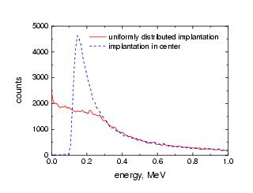
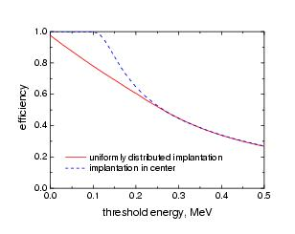
Monte-Carlo simulation with GEANT4
Simulated energy spectrum of β-particles emitted from fragments implanted uniformly (solid line) and exactly in the centre (dashed line) in the middle of a DSSSD.
Calculated β-detection efficiency as a function of the DSSSD threshold for the two considered implantation scenarios
Detection threshold should be less than 100 keV

Slide 22
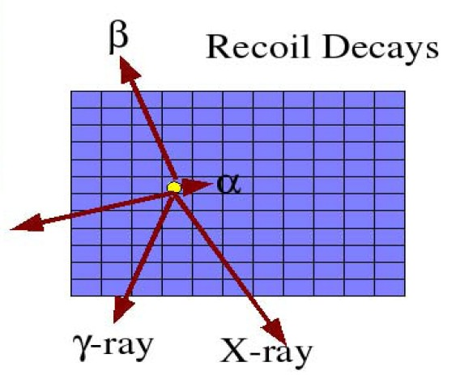
Rare ISotope INvestigation at GSI spectroscopy of stopped beams
n - det.
γ - det.
identified projectile fragments
γ - det.
DSSSD for HI and β
projectile decays
implantation ↔ range focusing
position correlation ↔ high granularity
time correlation ↔ dedicated electronics
projectile implants

Slide 23
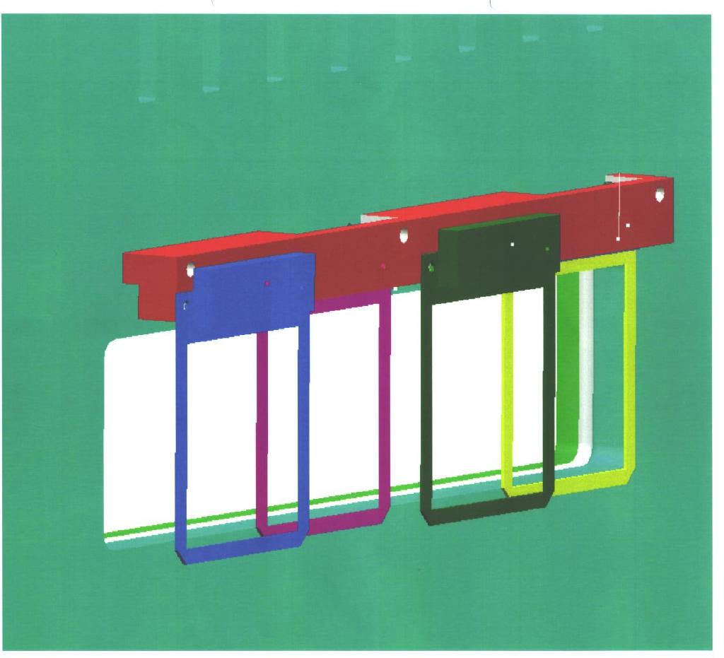
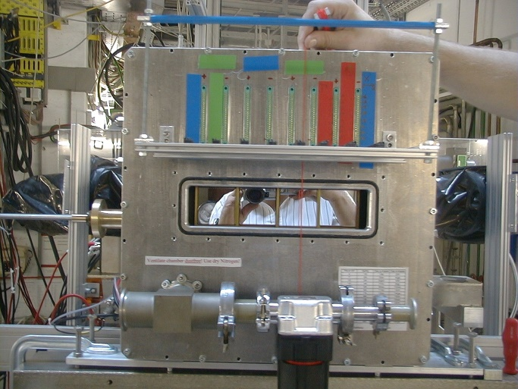
Implantation detector
double sided silicon strip detector
active area 50x50 mm²
thickness 1.0 mm
16 strips in x- and y-direction

Slide 24
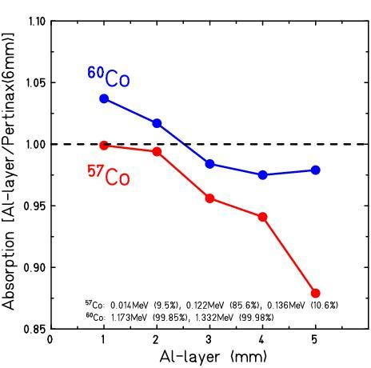
Chamber for active stopper measurement with dry N₂
Pertinax
phenolic-formaldehyd cellulose-paper
PF CP 2061
result:
6mm Pertinax ≈ 2mm Al
2mm Pertinax for active stopper chamber

Slide 25
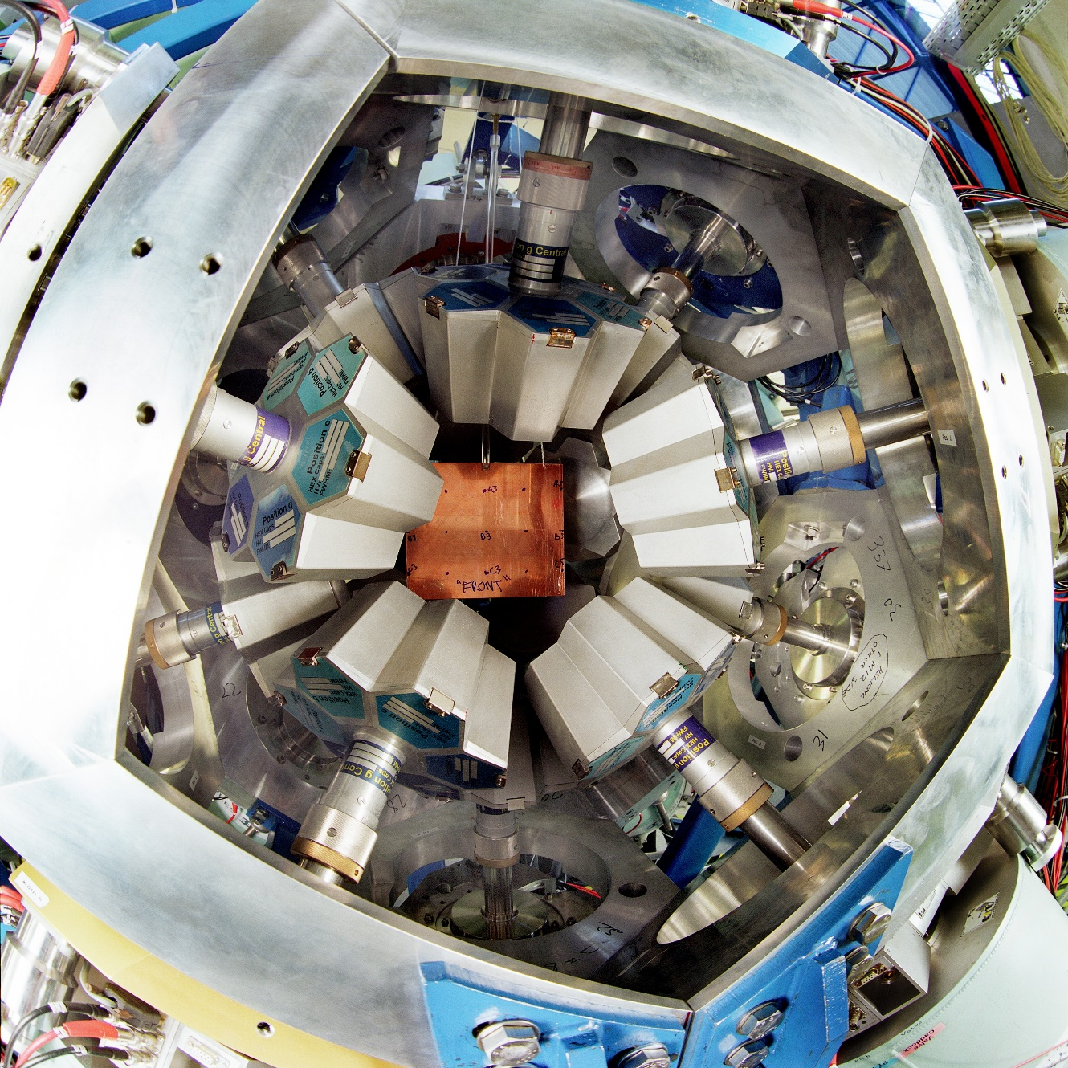
Stopped RISING array @ GSI: 15x7 element Cluster with passive Cu stopper

Slide 26
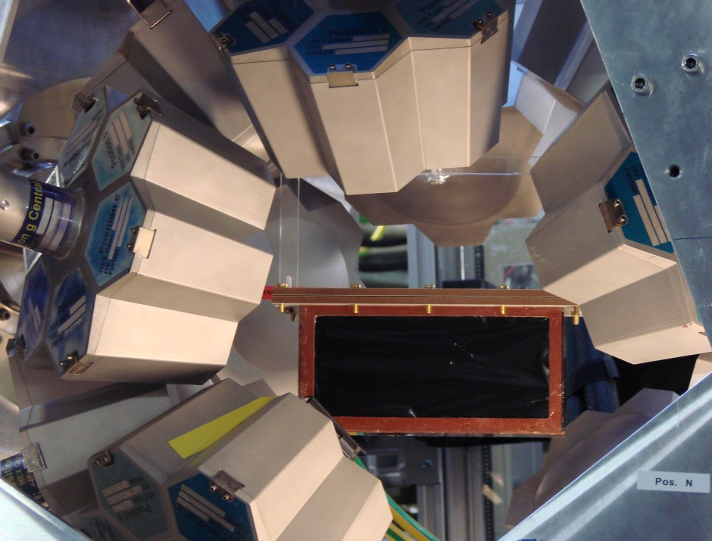
Stopped RISING array @ GSI: 15x7 element Cluster with DSSD

Slide 27
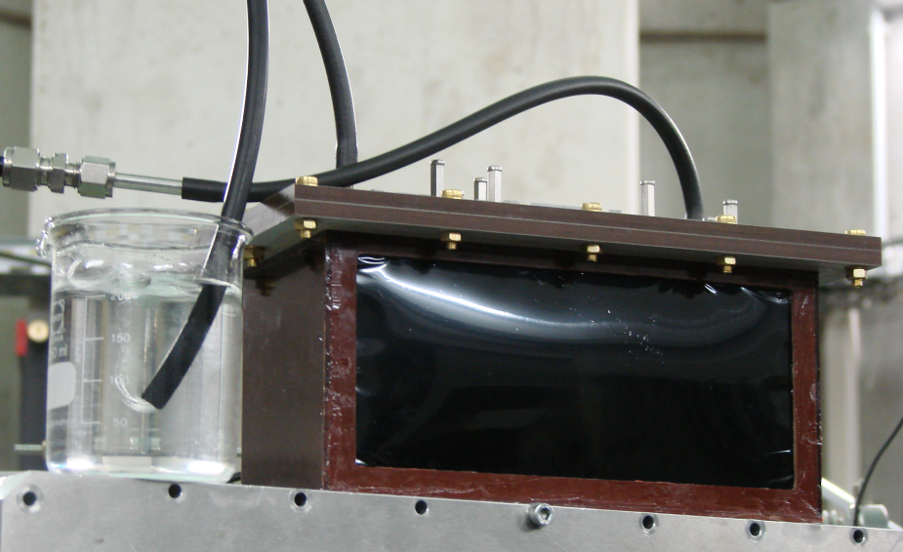
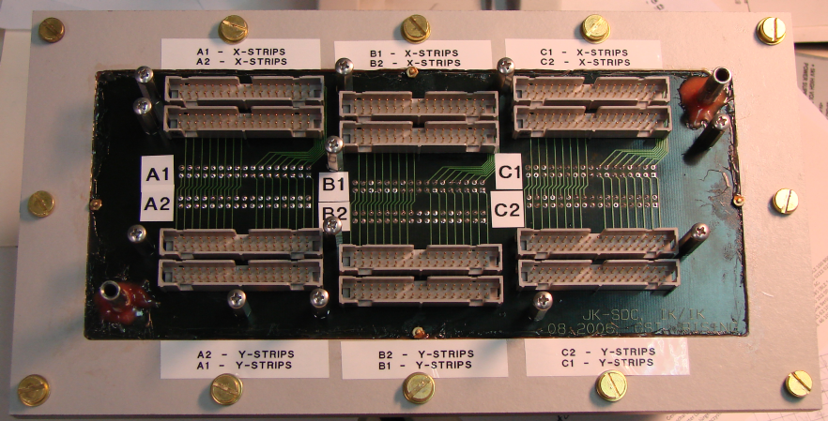
Chamber for active stopper measurement with dry N₂
Thin black Pocalon C foil 20μm

Slide 28
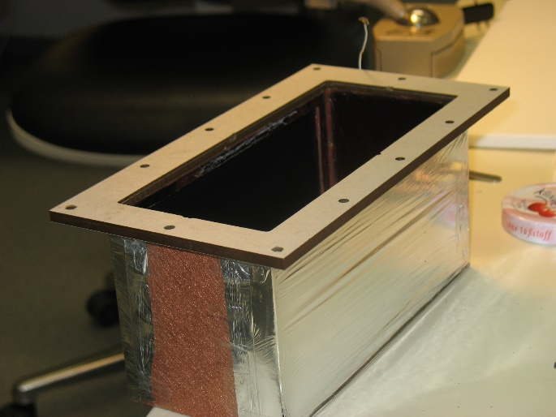
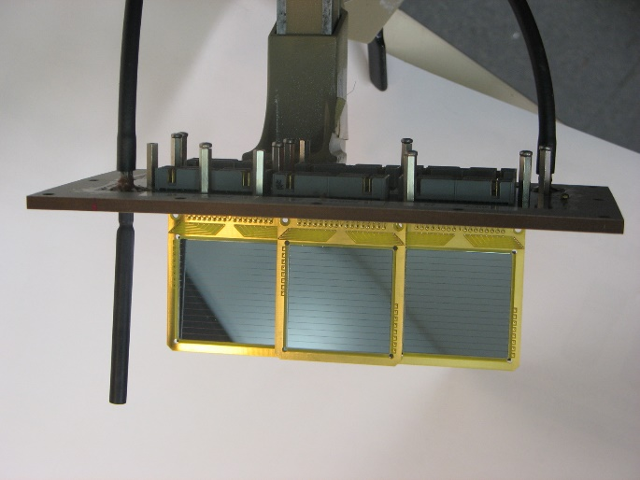
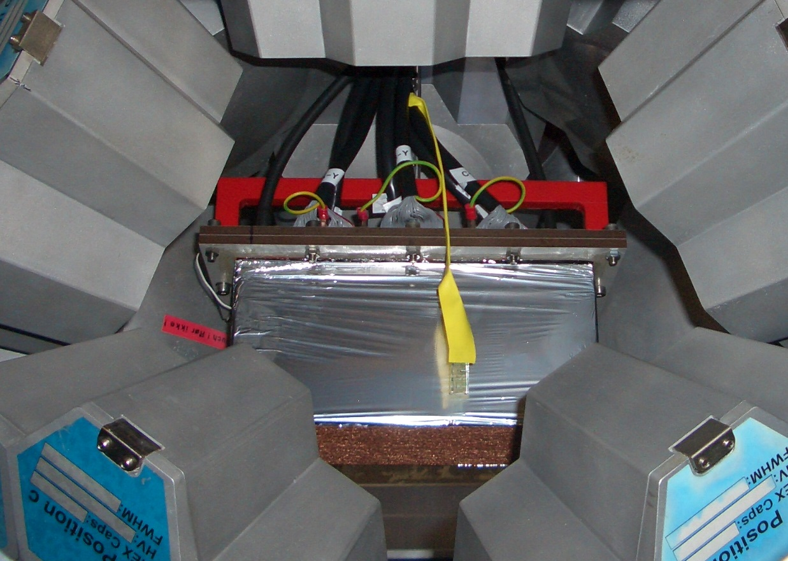
Chamber for active stopper

Slide 29
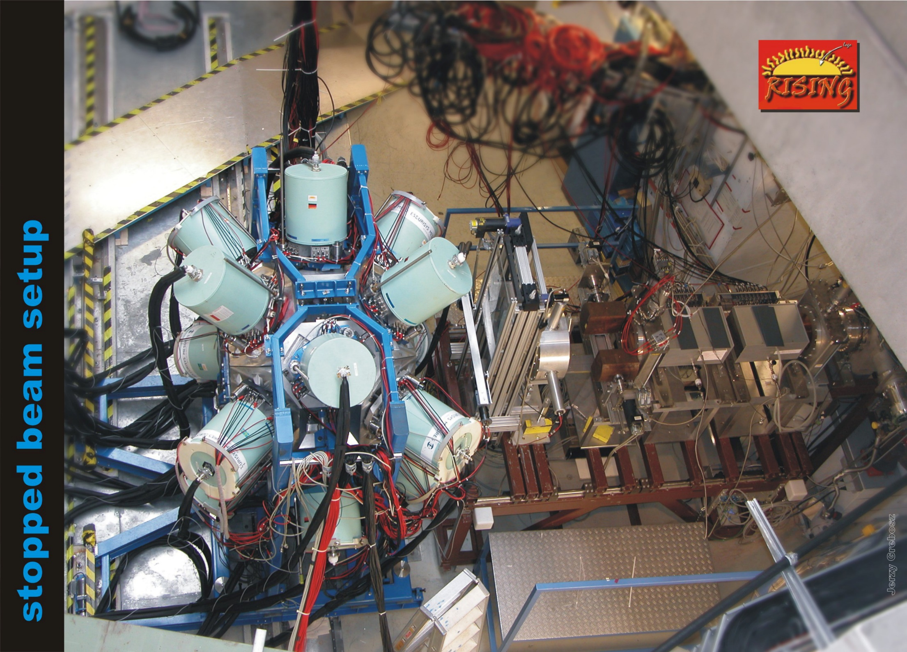
Stopped RISING array @ GSI: 15x7 element Cluster with DSSD

Slide 30
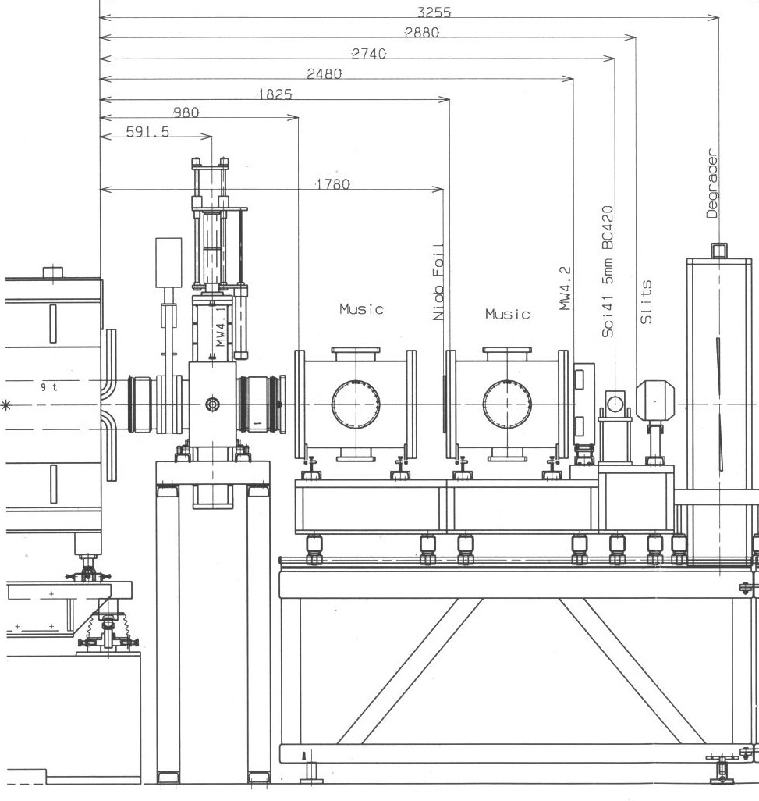
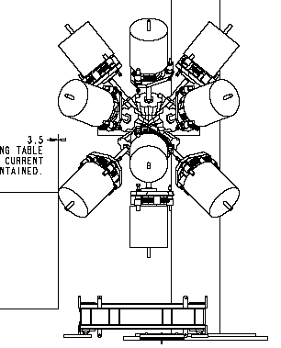
RISING set-up with stopped beams
RISING Ge
Cluster Array
degrader
MW42
beam
MW41
MUSIC
MUSIC
Sci41

Slide 31
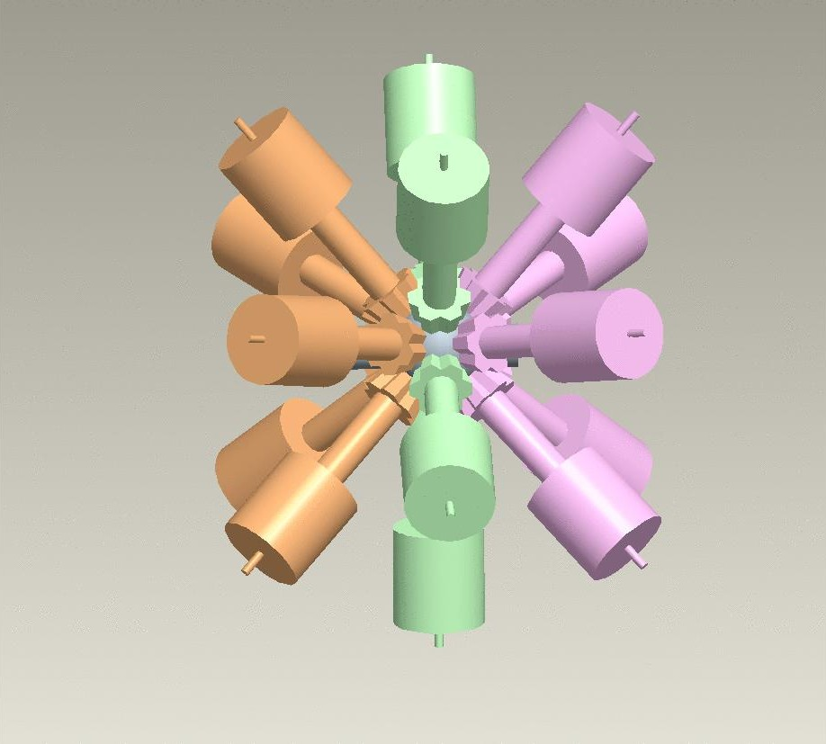
RISING with stopped beams
no. of Clusters | angle | distance to target
5 | 50⁰ | 210+10mm
5 | 90⁰ | 210+20mm
5 | 130⁰ | 210+10mm
beam
photopeak efficiency:
18.2%
J. Simpson CCLRC Daresbury

Slide 32
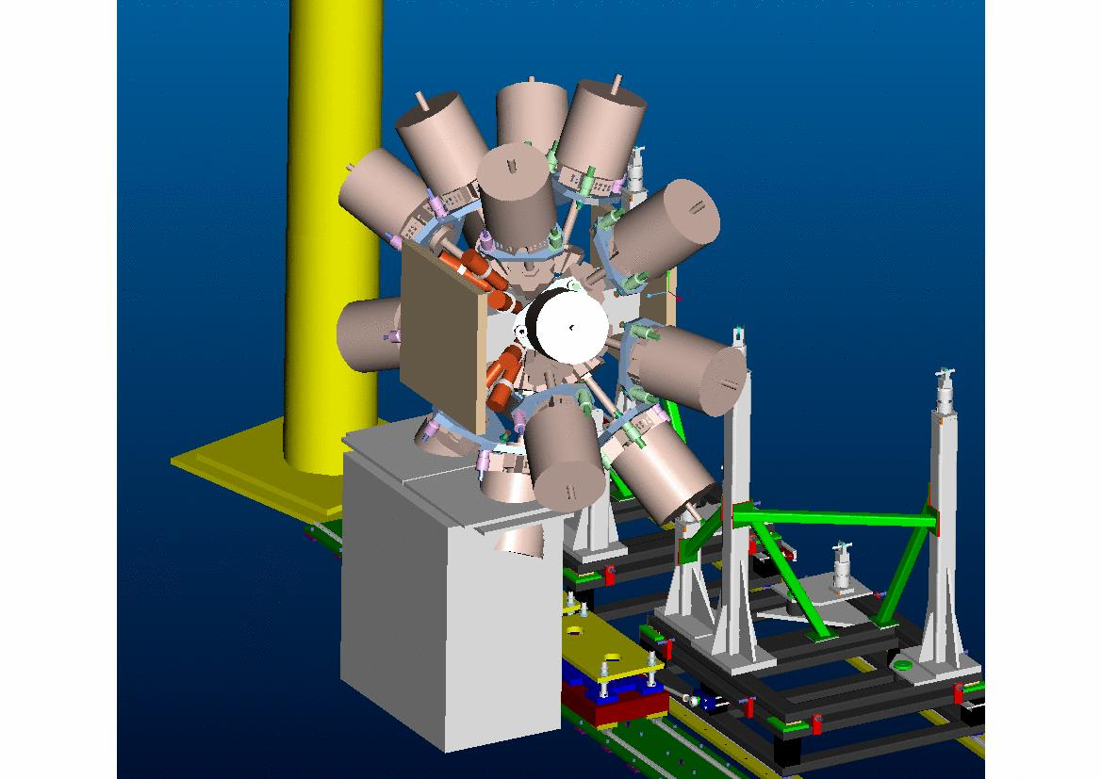
RISING set-up with stopped beams

Slide 33
Count rate limitations with active stopper
3 x 16 x 16 = 3 x 256 = 768 total pixels.
Assume upper limit for β-half-life of ~30 seconds
Each pixel hit every 5 half-lives (150 s)
Max. rate of ~768/150 = 5 per sec ( = 50 per 10s spill).
Rate increases directly with decreasing half-life
(e.g., T_{1/2} = 10 seconds → 150 per 10 s spill cycle)
Dual gain pre-amps on DSSSD to get energies of
implanted ion and β-particle
All events time stamped with MHz clock.

Slide 34
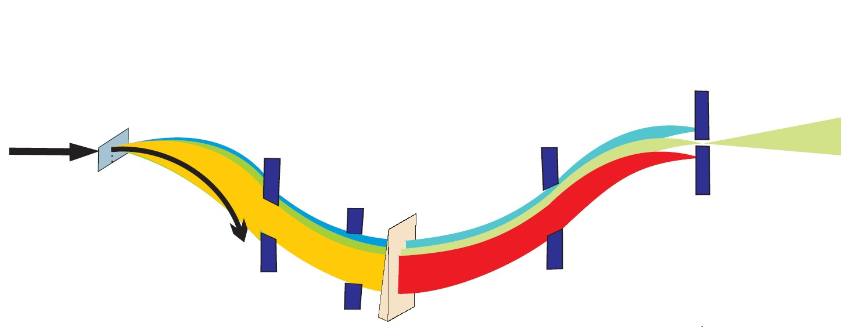
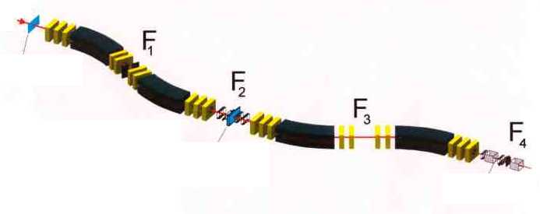
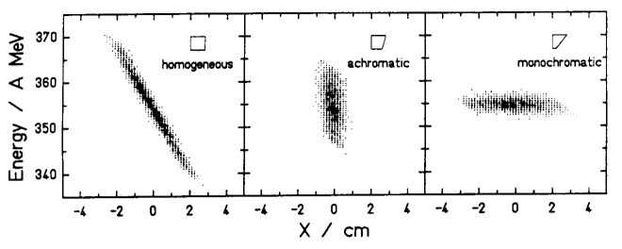
Fragment separator FRS
Beam & All
Fragmentation
Products
Primary
Beam
Spacial
Dispersion
Secondary
Beam
Momentum
Selection
Isotope
Selection
Wedge-shaped
Degrader
¹⁹Ne at 600AMeV:
Phase-space imaging of differently shaped degraders within the achromatic ion-optical system. The results for a homogeneous, an achromatic, and a monoenergetic degrader are given. All degraders have the same thickness on the optical axis (d/r=0.5)

Slide 35
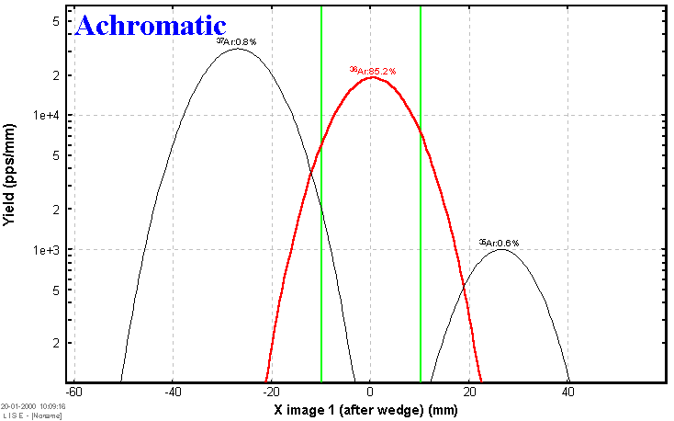
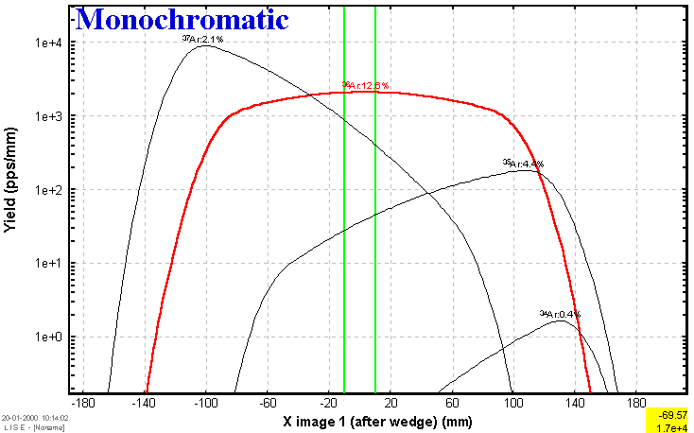
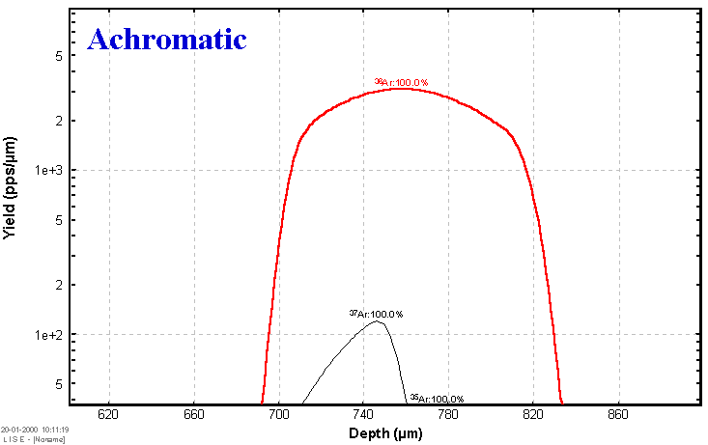
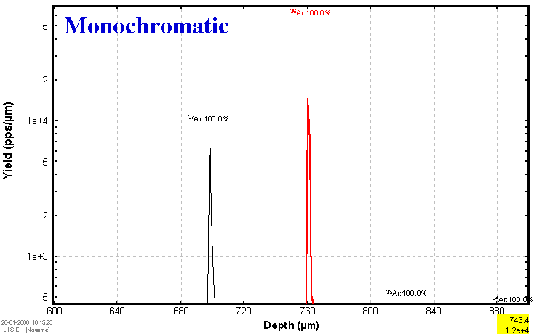
Fragment separator FRS ⁴⁰Ar 50 MeV/u + Ta (100 μm), wedge shaped Al (200 μm) degrader
0.39 mrad
1.66mrad

Slide 36
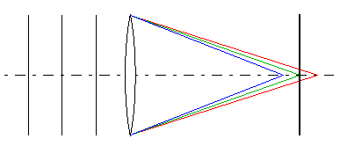
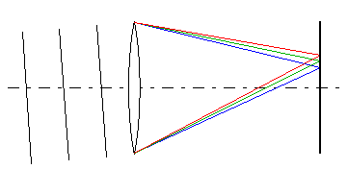
Chromatic aberration
When different colors of light propagate at different speeds in a medium, the refractive index is wavelength dependent. This phenomenon is known as dispersion.
Longitudinal (axial) chromatic aberration: Transverse (lateral) chromatic aberration:
The focal planes of the various colors do The size of the image varies from one
not coincide. color to the next.

Slide 37
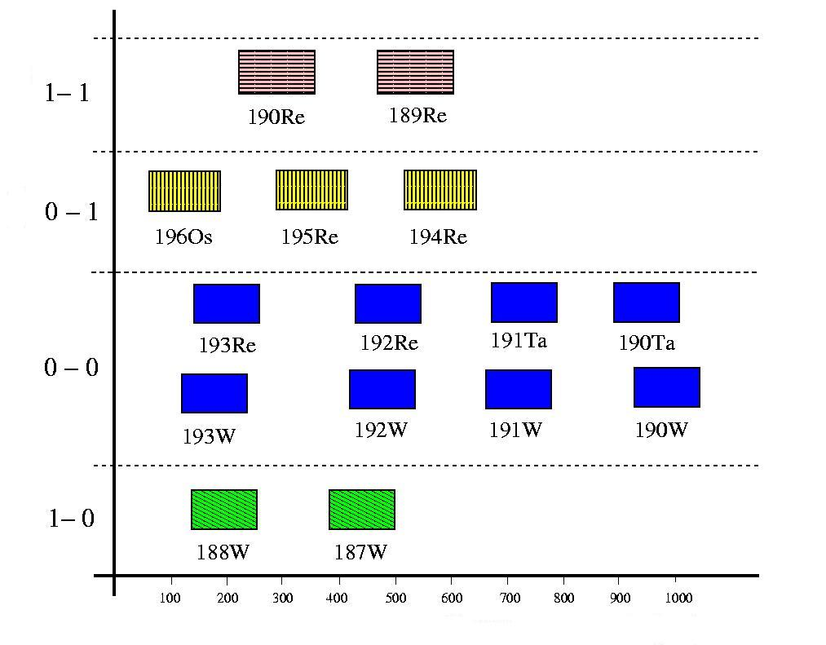
Implantation range
Estimated implanted isotopes for a setting centered on ¹⁹²W
in 1 mm thickness silicon with a monoenergetic degrader at S2
charge states
Silicium thickness (μm)

Slide 38
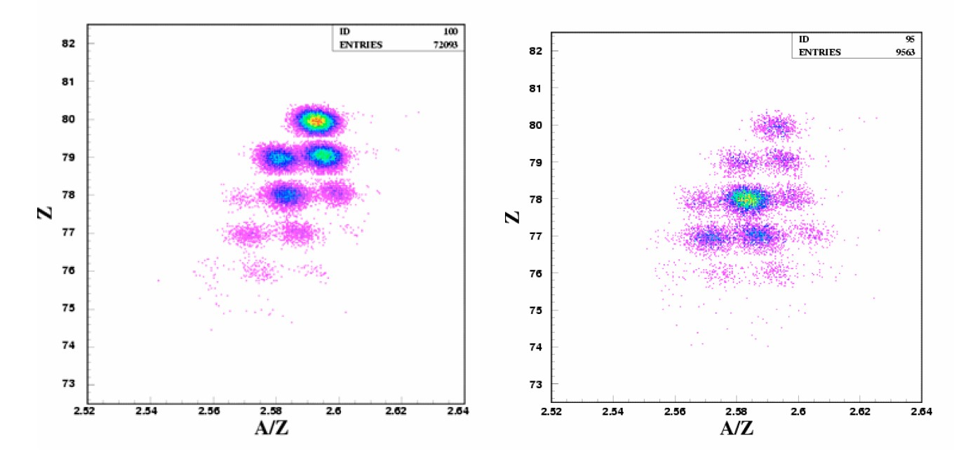
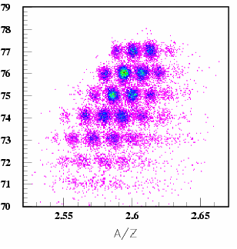
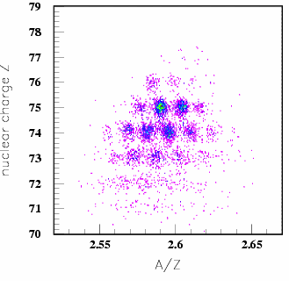
Estimated implanted isotopes for a setting centered on ¹⁹²W in 1mm thickness silicon with a monoenergetic degrader at S2
Setting centered on ¹⁹⁸Ir
produced implanted
charge states
Silicium thickness (μm)

Slide 39
Experimental results conversion electrons
Zs. Podolyak, Phys. Lett B672 (2009), 116
proton-hole excitation in the closed shell nucleus ²⁰⁵Au

Slide 40
Experimental results beta decay
T_{z}-1 → T_{z}=0 GT transition (β-decay)
F. Molina, Phys. Rev. C91 (2015) 014301

