Slide 1

Outline: K-isomers in ¹⁷⁸Hf
Lecturer: Hans-Jürgen Wollersheim
e-mail: h.j.wollersheim@gsi.de
web-page: https://web-docs.gsi.de/~wolle/ and click on
magnetic moments
K-selection rule
Coulomb excitation of the 8⁻ isomer in ¹⁷⁸Hf
investigation of the K=16 isomer in ¹⁷⁸Hf
deuteron and ²⁰⁸Pb inelastic scattering, laser spectroscopy

Slide 2
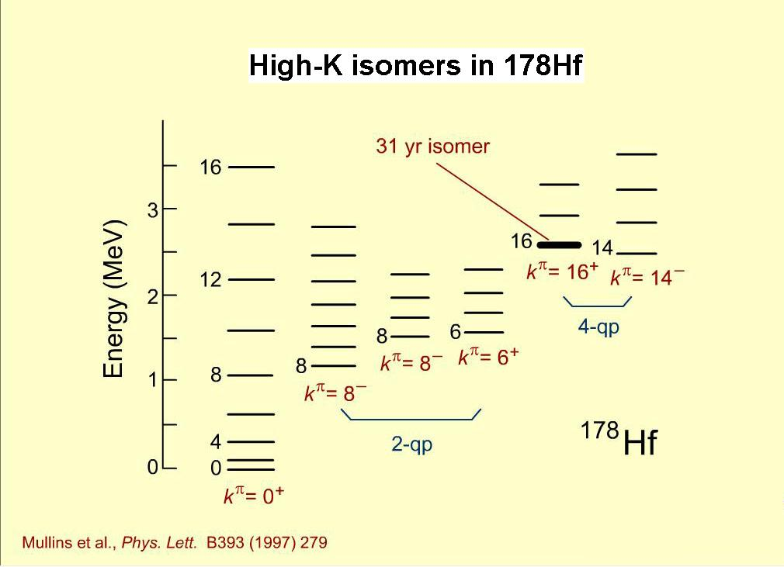
Investigation of ¹⁷⁸Hf – K-isomers
A well-known example:
K=0
9/2[624]
9/2[514]
Fermi Surface
7/2[514]
7/2[404]
neutron
proton

Slide 3
Investigation of ¹⁷⁸Hf – K-isomers
j₂
A well-known example:
j₁
j
K>0
9/2[624]
9/2[514]
Fermi Surface
7/2[514]
7/2[404]
neutron
proton

Slide 4
Investigation of ¹⁷⁸Hf – K-isomers
j₂
A well-known example:
j₁
j
K>0
9/2[624]
9/2[514]
Fermi Surface
7/2[514]
7/2[404]
neutron
proton

Slide 5
Investigation of ¹⁷⁸Hf – K-isomers
A well-known example:
9/2[624]
9/2[514]
Fermi Surface
7/2[514]
7/2[404]
neutron
proton

Slide 6


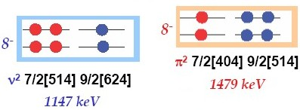



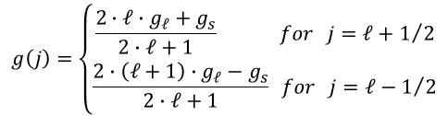
Magnetic moments in ¹⁷⁸Hf
$$g\left(j\right)=\left\{\begin{matrix}\frac{2∙ℓ∙g_{ℓ}+g_{s}}{2∙ℓ+1} for j=ℓ+1/2 \\ \frac{2∙\left(ℓ+1\right)∙g_{ℓ}−g_{s}}{2∙ℓ+1} for j=ℓ−1/2\end{matrix}\right.$$
proton
neutron
$$g_{ℓ}=1 g_{s}=5.59$$
$$g_{ℓ}=0 g_{s}=−3.83$$
g(h_{11/2}) = 1.42 g(g_{7/2}) = 0.49 g(f_{7/2}) = -0.55 g(i_{13/2})=-0.29
g(h_{11/2} x g_{7/2}; 8⁻) = 1.08 g(f_{7/2} x i_{13/2}) = -0.36
g(8⁻ x 8⁻; 16⁺) = 0.36 → μ = g·I = 5.76 nm
E_{x}~2Δ_{p}
E_{x}~2Δ_{n}
7.26±0.16 nm
Helmer & Reich; Nucl. Phys. A114 (1968), 649

Slide 7
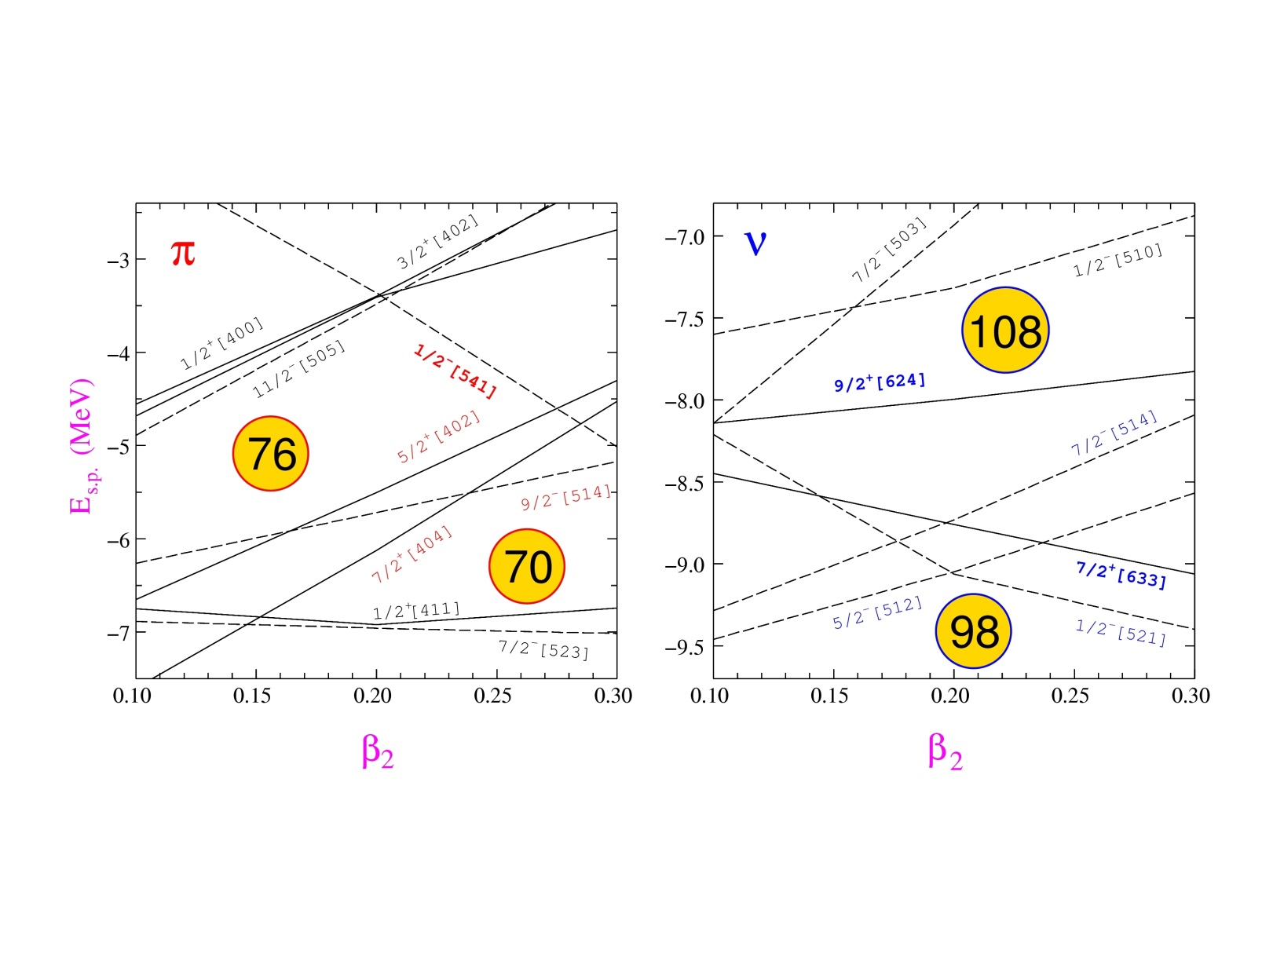
K-isomers: Where to find them?
Deformed nuclei with axially-symmetric shape
Mass 180 region : Yb (Z=70) - Ir (Z=77)
ω
j₂
j₁
j
K
High-K orbitals near the Fermi surface
: 7/2[404], 9/2[514], 5/2[402]
ν: 7/2[514], 9/2[624], 5/2[512], 7/2[633]

Slide 8
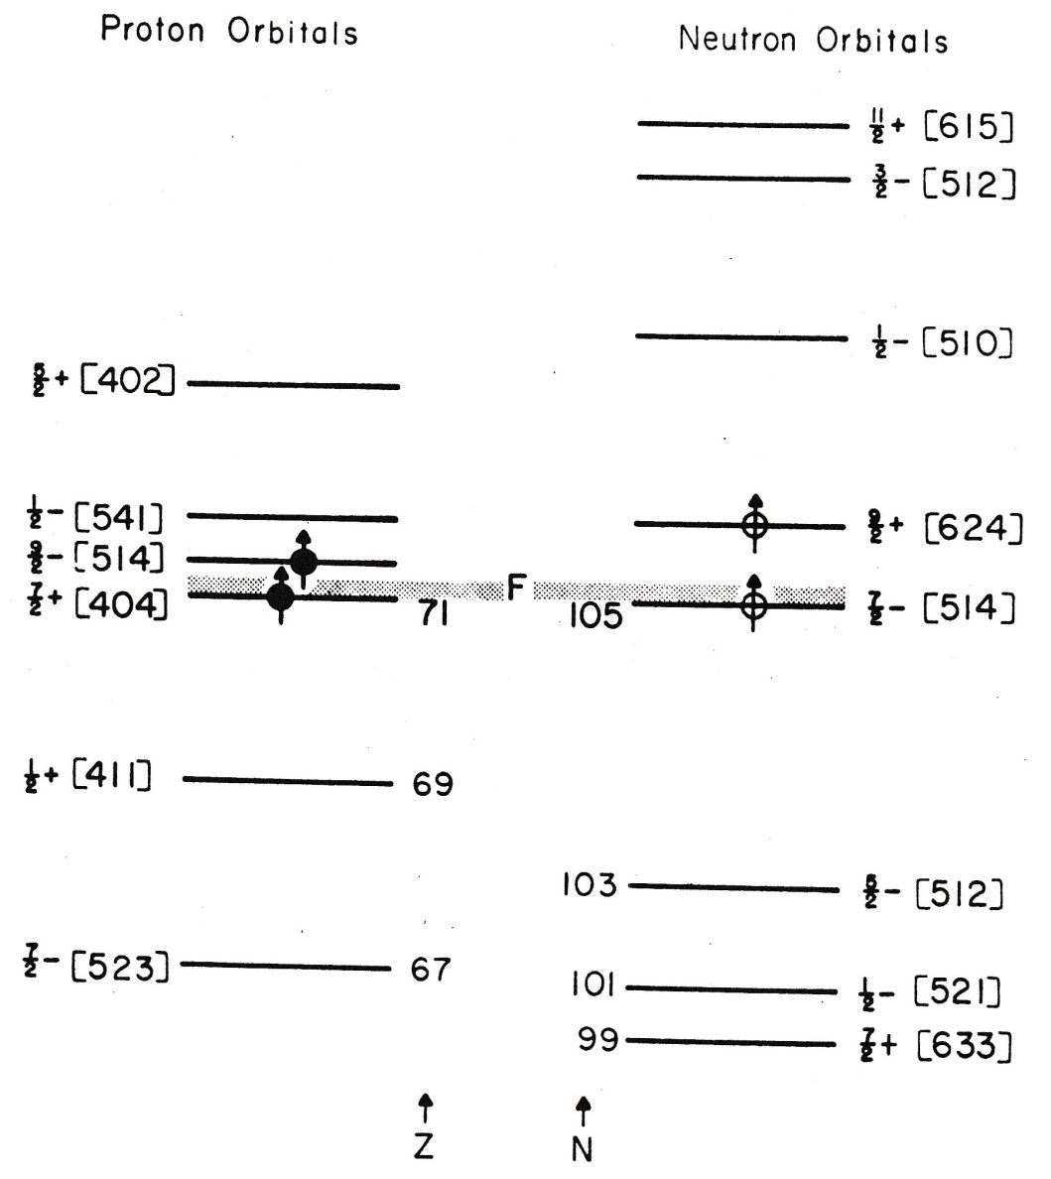
Proton Neutron orbitals

Slide 9
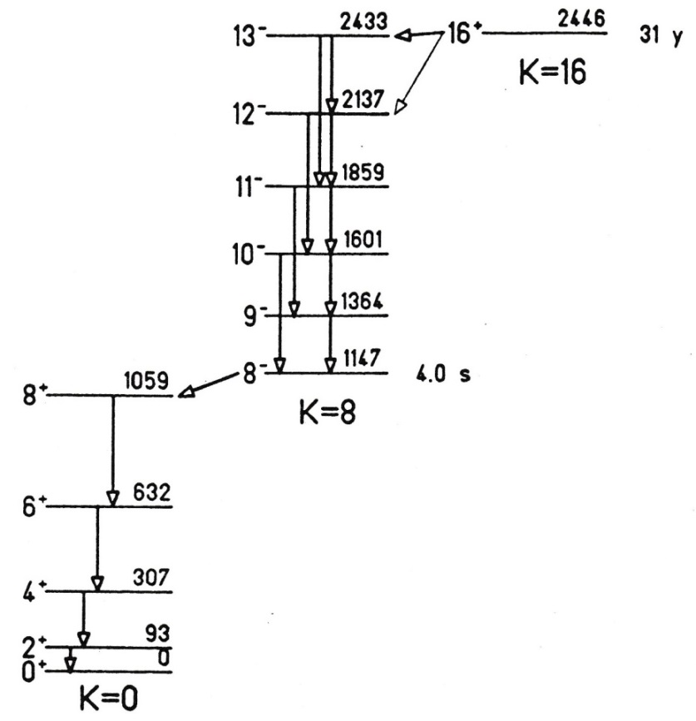

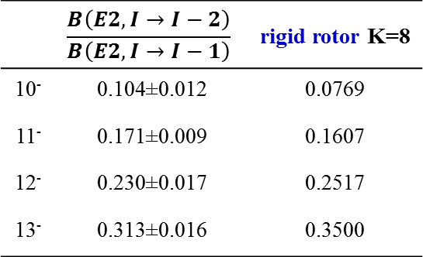
Decay study of the K = 16 isomeric state
 | $$\frac{B\left(E2,I→I−2\right)}{B\left(E2,I→I−1\right)}$$ | rigid rotor K=8
10⁻ | 0.104±0.012 | 0.0769
11⁻ | 0.171±0.009 | 0.1607
12⁻ | 0.230±0.017 | 0.2517
13⁻ | 0.313±0.016 | 0.3500
E2/M1 mixing ratios are related to $\frac{g_{K}−g_{R}}{Q_{20}}$
mixed 2-quasiparticle configuration: g_{K} = 0.36(2) > 0
{π[514]9/2 + π[404]7/2}8⁻ and {ν[514]7/2 + ν[624]9/2}8⁻

Slide 10


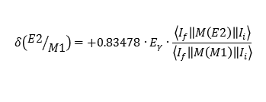


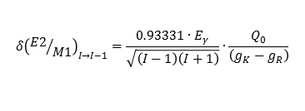
Decay study of the K = 16 isomeric state
 | $$\frac{B\left(E2,I→I−2\right)}{B\left(E2,I→I−1\right)}$$ | rigid rotor K=8
10⁻ | 0.104±0.012 | 0.0769
11⁻ | 0.171±0.009 | 0.1607
12⁻ | 0.230±0.017 | 0.2517
13⁻ | 0.313±0.016 | 0.3500
$$δ{\left({E2}/{M1}\right)}_{I→I−1}=\frac{0.93331∙E_{γ}}{\sqrt{\left(I−1\right)\left(I+1\right)}}∙\frac{Q_{0}}{\left(g_{K}−g_{R}\right)}$$
$$δ\left({E2}/{M1}\right)=+0.83478∙E_{γ}∙\frac{\left\langle I_{f}\left\|M\left(E2\right)\right\|I_{i}\right\rangle }{\left\langle I_{f}\left\|M\left(M1\right)\right\|I_{i}\right\rangle }$$
E2/M1 mixing ratios are related to $\frac{g_{K}−g_{R}}{Q_{20}}$
$$\left\langle I_{f}\left\|M\left(E2\right)\right\|I_{i}\right\rangle =\sqrt{\frac{5}{16π}}\sqrt{2I_{i}+1}\left(I_{i}2K0|I_{f}K\right)Q_{0}$$
mixed 2-quasiparticle configuration: g_{K} = 0.36(2) > 0
$$\left\langle I−1\left\|M\left(E2\right)\right\|I\right\rangle =−\sqrt{\frac{5}{16π}}\sqrt{\frac{3\left(I+K\right)\left(I−K\right)K^{2}}{\left(I−1\right)I\left(I+1\right)}}Q_{0}$$
{π[514]9/2 + π[404]7/2}8⁻ and {ν[514]7/2 + ν[624]9/2}8⁻
$$\left\langle I_{f}\left\|M\left(M1\right)\right\|I_{i}\right\rangle =\sqrt{\frac{3}{4π}}\sqrt{2I_{i}+1}\left(I_{i}1K0|I_{f}K\right)∙\left(g_{K}−g_{R}\right)∙K$$
$$\left\langle I−1\left\|M\left(M1\right)\right\|I\right\rangle =−\sqrt{\frac{3}{4π}}\sqrt{\frac{\left(I+K\right)\left(I−K\right)}{I}}∙\left(g_{K}−g_{R}\right)∙K$$

Slide 11
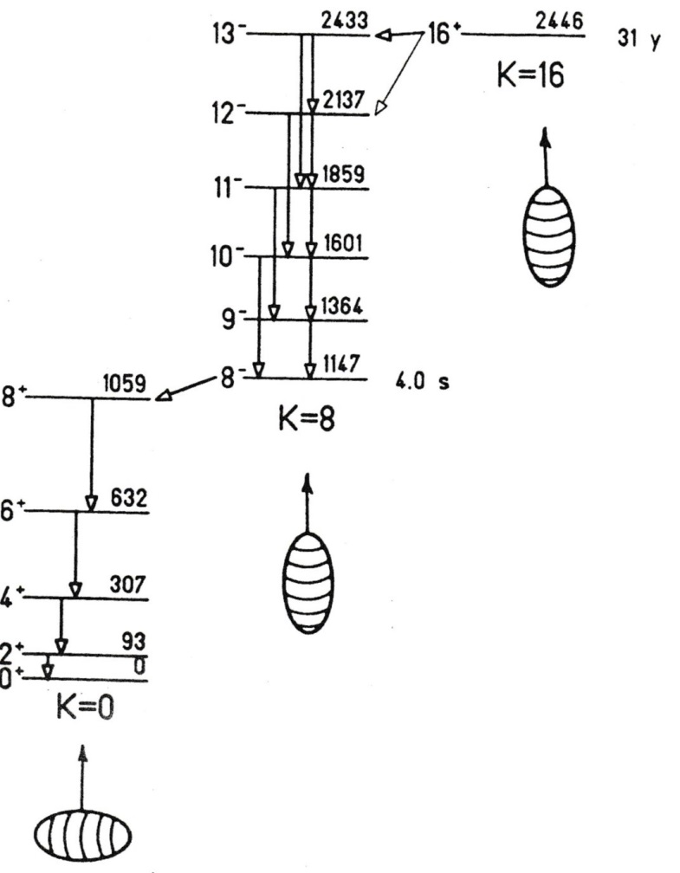
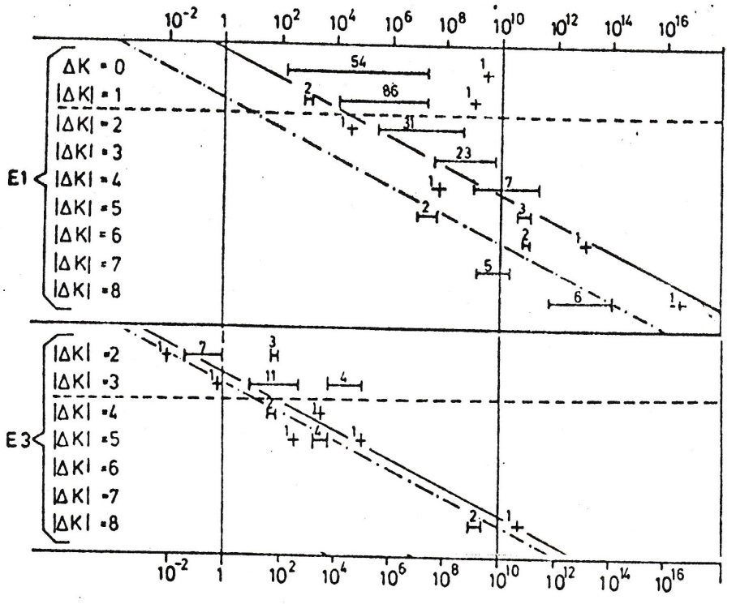
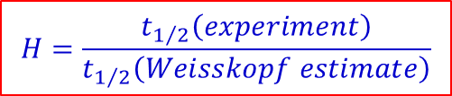
K - isomerism
H = 10⁹
H = 2·10¹³
$$H=\frac{t_{1/2}\left(experiment\right)}{t_{1/2}\left(Weisskopf estimate\right)}$$
K-selection rule
Helmer & Reich; Nucl. Phys. A114 (1968), 649
K.E.G. Löbner; Phys. Lett 26B (1968), 369

Slide 12
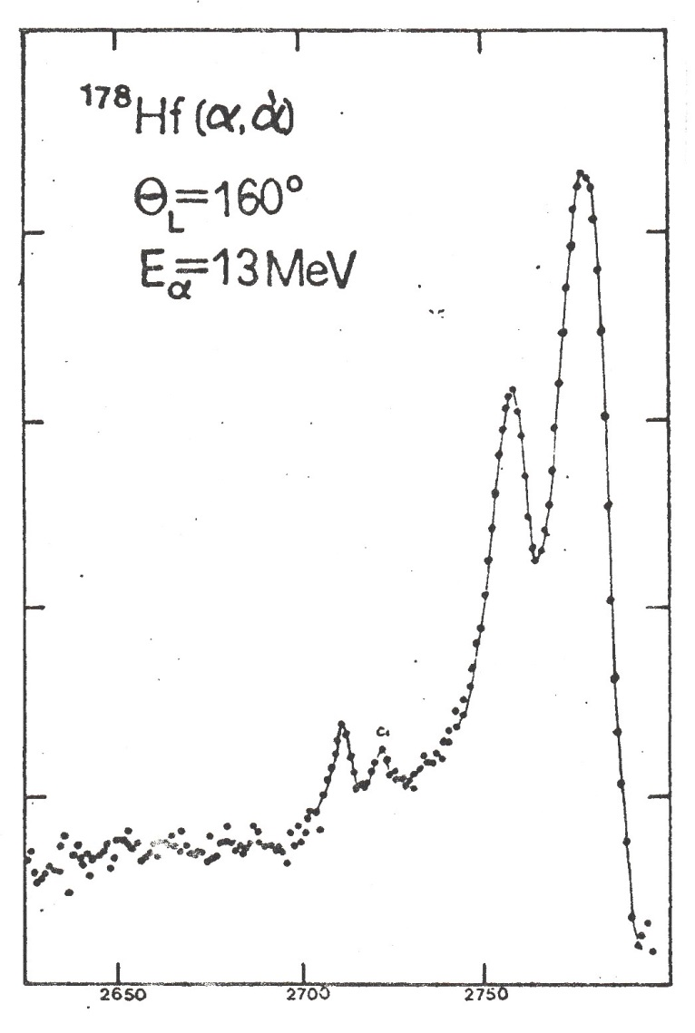
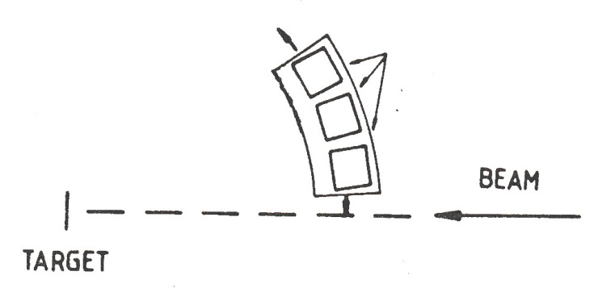
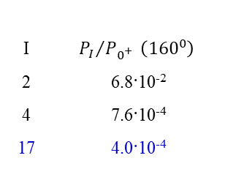

¹⁷⁸Hf: particle spectroscopy
Si counter
0⁺
α-beam
10⁵
2⁺
¹⁷⁸Hf-target
10⁴
counts
$$dσ_{C.E.}\left(E,θ_{cm}\right)=P_{I}\left(E,θ_{cm}\right)∙dσ_{Ruth}\left(E,θ_{cm}\right)$$
$$=4.82{\left(1+\frac{A_{p}}{A_{t}}\right)}^{−2}\frac{A_{p}}{Z_{t}^{2}}\left(E_{lab}−ΔE′\right)∙B\left(E2,0^{+}→2^{+}\right)∙{df}_{E2}\left(ξ,θ_{cm}\right)$$
10³
4⁺
10²
I | $${P_{I}}/{P_{0^{+}}} \left({160}^{0}\right)$$
2 | 6.8·10⁻²
4 | 7.6·10⁻⁴
17 | 4.0·10⁻⁴
10¹
α-energy
σ_{m2}/σ_{gs} = 0.05
G. Ebel, diploma thesis

Slide 13
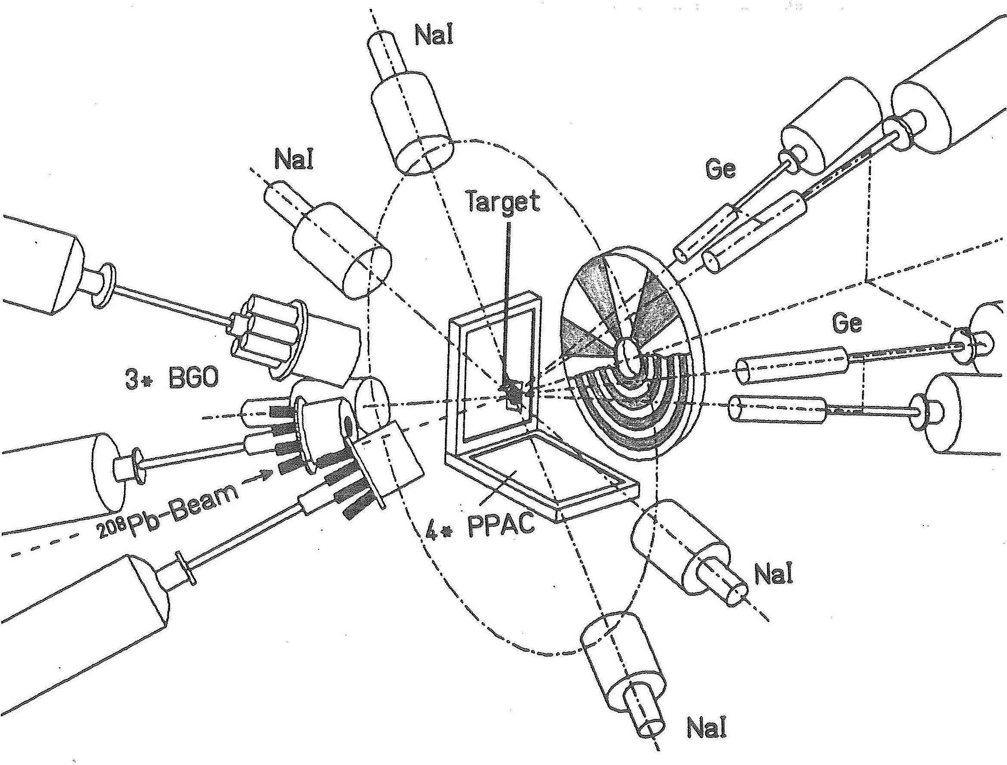
Coulomb excitation of ¹⁷⁸Hf with ²⁰⁸Pb ions

Slide 14
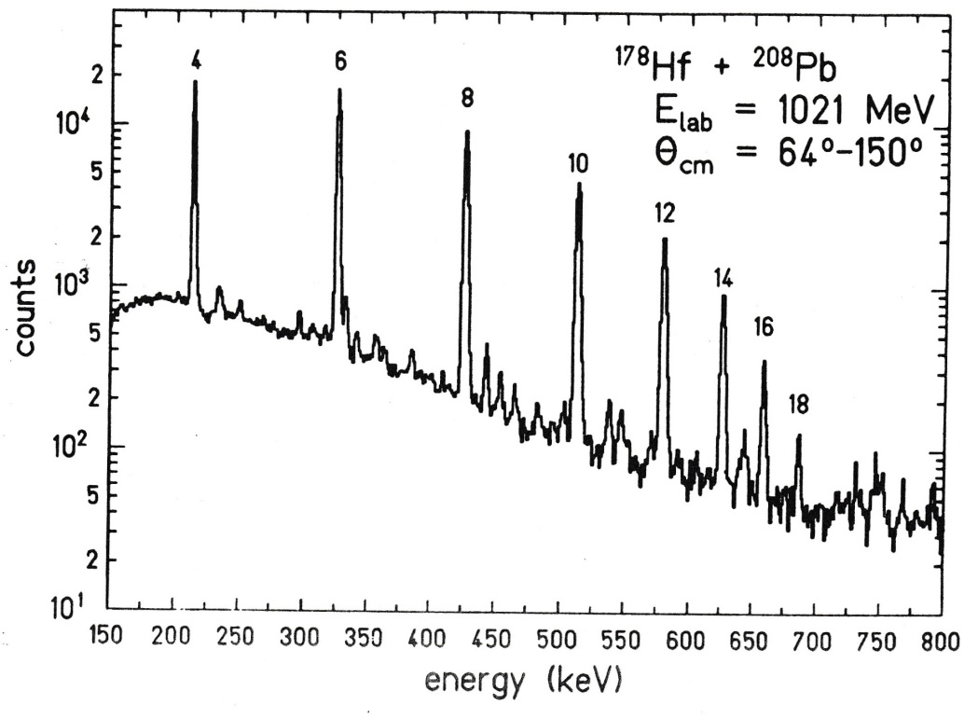


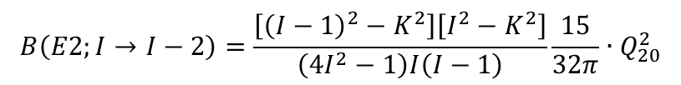
Coulomb excitation of ¹⁷⁸Hf with ²⁰⁸Pb ions
E2, E3 excitation of collective states:
ground state band K = 0
γ-vibrational band K = 2
H. Bohn et al.
determination of K-quantum number:
$$B\left(E2;I→I−2\right)=\frac{\left[{\left(I−1\right)}^{2}−K^{2}\right]\left[I^{2}−K^{2}\right]}{\left(4I^{2}−1\right)I\left(I−1\right)}\frac{15}{32π}∙Q_{20}^{2}$$
$$Q_{20}=6.99\left(4\right) b$$
$$Q_{40}=0.54\left(\begin{matrix}26 \\ 47\end{matrix}\right) b^{2} or −1.58\left(48\right) b^{2}$$
β₂ = 0.29(1) β₄ = -0.20(4)
J.H. Hamilton et al.; Phys. Lett. 112B (1982), 327: lifetime measurement
R.M. Ronningen et al.; Phys. Rev C16 (1977), 2218; Phys. Rev. Lett. 40 (1978), 364

Slide 15
Coulomb excitation of ¹⁷⁸Hf with ²⁰⁸Pb ions
E2, E3 excitation of collective states:
ground state band K = 0
γ-vibrational band K = 2
H. Bohn et al.
excitation of the K = 8 isomeric state !
observation of delayed γ-rays in the K = 0 ground state band
¹⁷⁸Hf + ⁸⁶Kr, ¹⁷⁸Hf + ¹³⁶Xe
J.H. Hamilton et al.; Phys. Lett. 112B (1982), 327: lifetime measurement

Slide 16
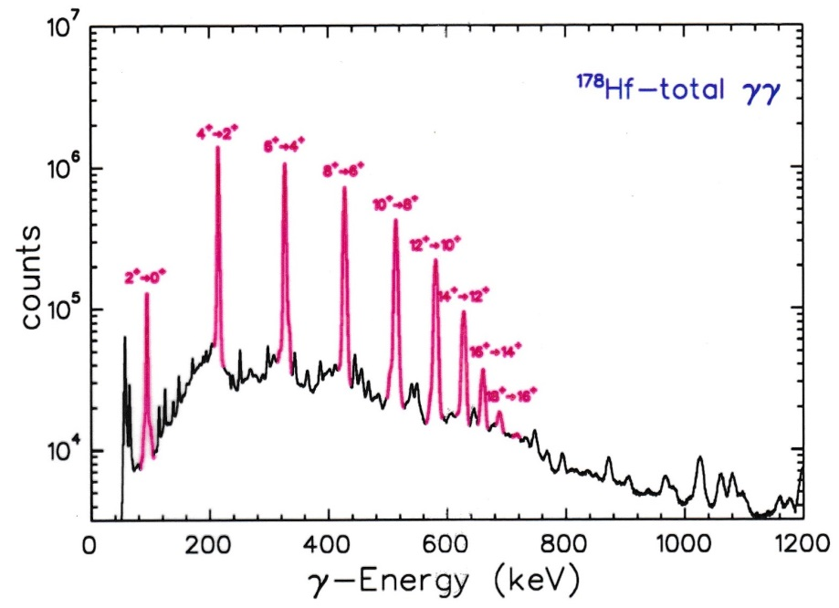
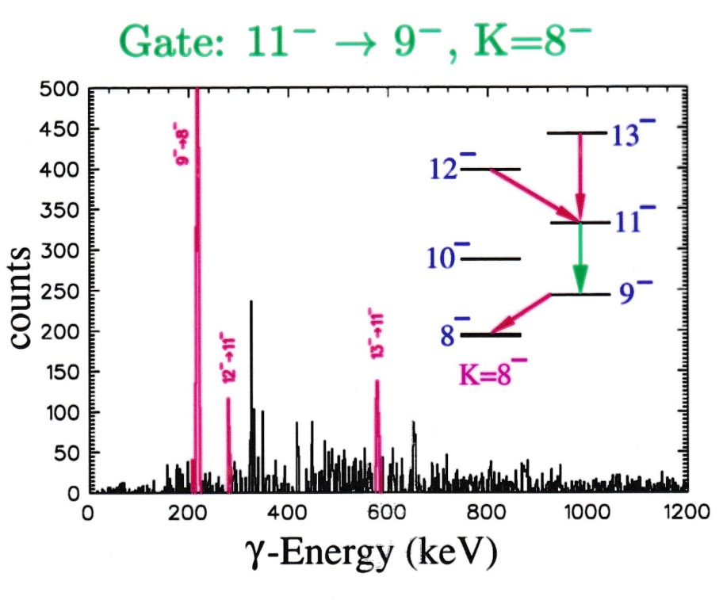
Coulomb excitation of ¹⁷⁸Hf

Slide 17
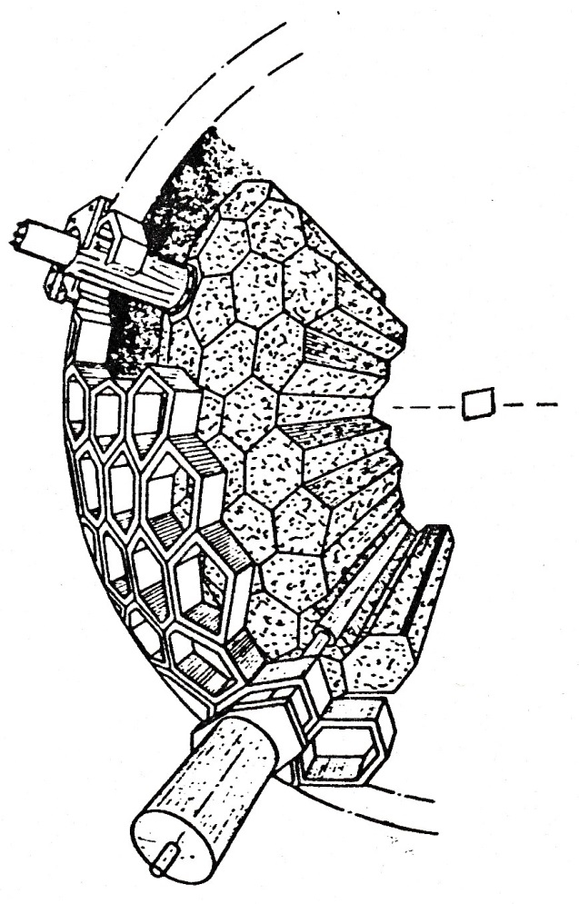
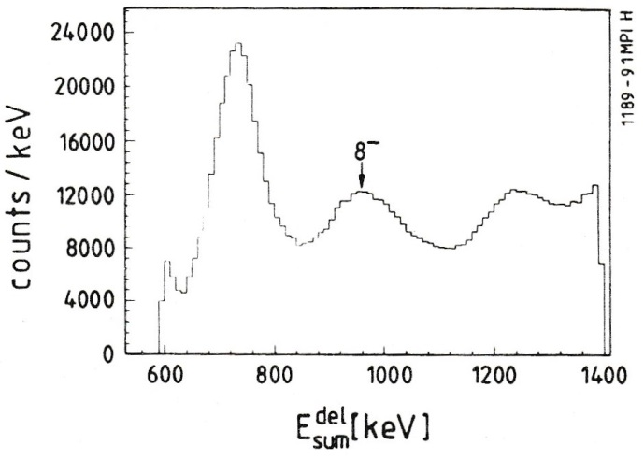
Coulomb excitation of the K = 8 isomer in ¹⁷⁸Hf
parameters and resolutions FWHM
E_{i} 5.5% at 1332 keV
t_{i} 2.8 ns
W(θ) 14⁰
E_{total} 18-22% for M_{γ}=20
M_{γ} 25-30% for M_{γ}=20
The two basic observables which can be measured for the resulting γ-ray shower are the total energy emitted as γ-radiation and the number of γ-rays.
¹⁷⁸Hf + ¹³⁰Te at 560, 590, 620 MeV
particle detection at ~180⁰, Pb catcher (0.5 mm thickness) was positioned
1cm downstream to stop the recoiling ¹⁷⁸Hf ions.
8⁻
162 NaI detectors
6 Ge detector
Delayed sum-energy spectrum taken at 590 MeV. (delayed time window 20-65ns with respect to beam pulse) A peak associated to the K^{π}=8⁻ shows up.
The other peaks correspond to isomers of fusion products from target contaminants and β-decay.
H. Xie et al.; Phys. Rev. C48 (1993), 2517

Slide 18
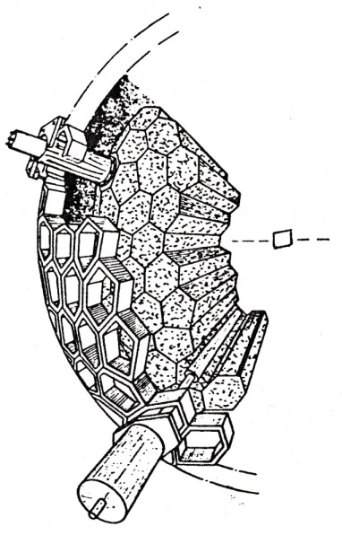
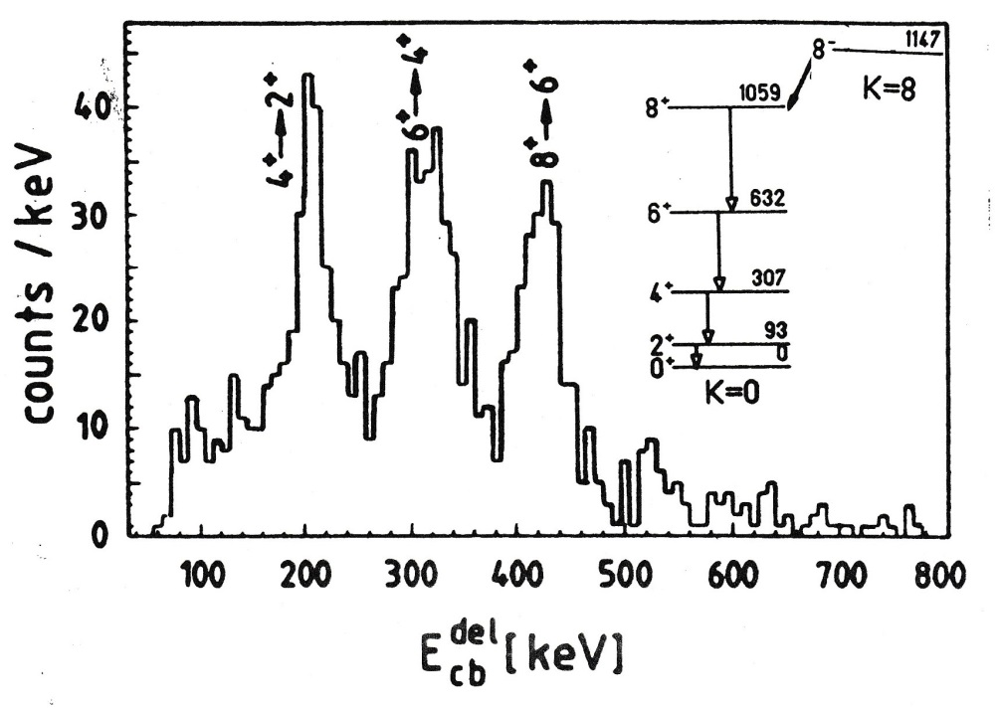
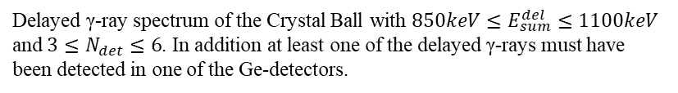

Coulomb excitation of the K = 8 isomer in ¹⁷⁸Hf
¹⁷⁸Hf + ¹³⁰Te at 560, 590, 620 MeV
4 s
$${→M}_{30}\left(E3\right)≤0.01$$
delayed γ-spectrum
Delayed γ-ray spectrum of the Crystal Ball with $850keV≤E_{sum}^{del}≤1100keV$
and $3≤N_{det}≤6$. In addition at least one of the delayed γ-rays must have been detected in one of the Ge-detectors.
H. Xie et al.; Phys. Rev. C48 (1993), 2517

Slide 19
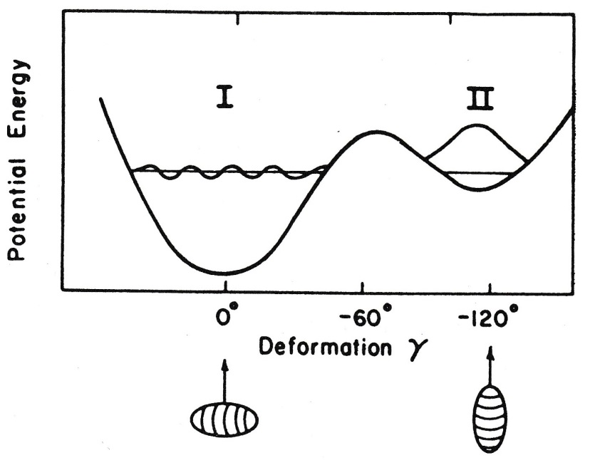
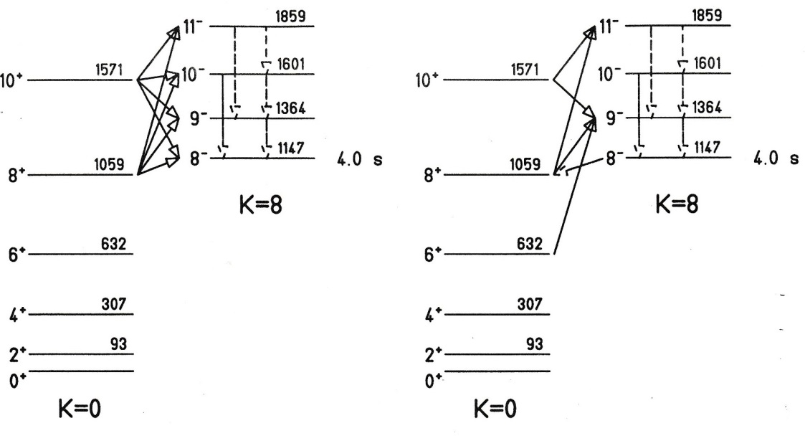
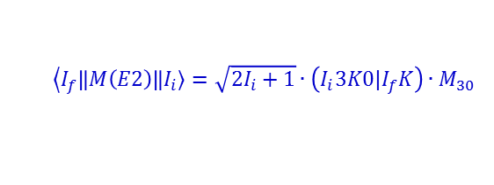
Decay of the isomer by barrier penetration
+ small K=8 admixture
+ small K=0 admixture
rigid rotor model:
$$\left\langle I_{f}\right.\left\|M\left(E2\right)\right\|\left.I_{i}\right\rangle =\sqrt{2I_{i}+1}∙\left(I_{i}3K0|I_{f}K\right)∙M_{30}$$
8⁻ lifetime is independent from excitation

Slide 20
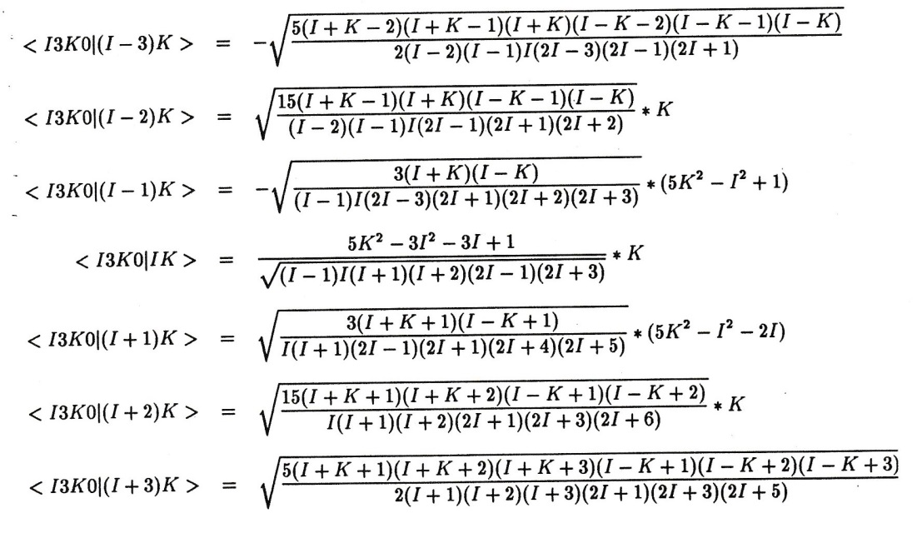

2-band K-mixing model
+ small K=8 admixture
+ small K=0 admixture
8⁻ lifetime is independent from excitation
Clebsch Gordan coefficient:
rigid rotor model:
$$\left\langle I_{f}\right.\left\|M\left(E3\right)\right\|\left.I_{i}\right\rangle =\sqrt{2I_{i}+1}∙\left(I_{i}3K0|I_{f}K\right)∙M_{30}$$

Slide 21
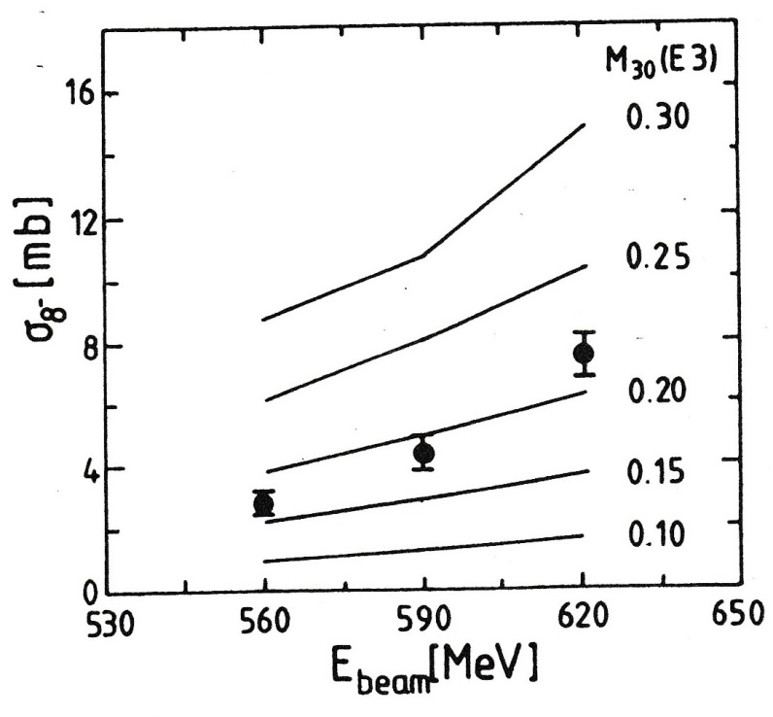
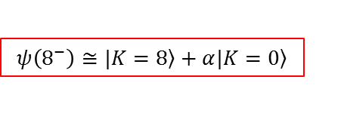

Coulomb excitation of the K = 8 isomer in ¹⁷⁸Hf
¹⁷⁸Hf + ¹³⁰Te at 560, 590, 620 MeV
4 s
$${→M}_{30}\left(E3\right)≤0.01$$
delayed γ-spectrum
$$M_{30}\left(E3\right)$$
coupling between rotational motion and single particle excitation
$$ψ\left(8^{−}\right)≅\left.|K=8\right\rangle +α\left.|K=0\right\rangle$$
H. Xie et al.; Phys. Rev. C48 (1993), 2517

Slide 22

Investigation of the K=16 isomer in ¹⁷⁸Hf
decay scheme of ^{178m2}Hf
4 quasi-particle state
Production of ^{178m2}Hf in the past
reaction | projectile energy (MeV) | σ_{m}/σ_{gs} | reference
¹⁷⁷Hf(n,γ) | thermal | 10⁻⁹ | R.G. Helmer et al.; Nucl. Phys. A211, 1 (1973)
¹⁸¹Ta(γ,p2n) | ≤85 | low | F.W.N. de Boer et al.; Nucl. Phys. A263,1 (1976)
¹⁸¹Ta(α,αp2n) | 120 | - | J. Van Klinken et al.; Nucl. Phys. A339, 189 (1980)
¹⁸¹Ta(p,α) | 92.5 | 10⁻³ | W. Kutschera et al.; Radio. Beam Conf., 345 (1989)
¹⁷⁶Yb(α,2n) | 26 | 0.01 | T. Khoo et al.; Phys. Lett. 67B, 271 (1977)
 | 27 | 0.005 | A. Kugler et al.; priv. communication
 | 32 | 0.05 | NUPECC News 1991
 | 40 | 0.08
2 quasi-particle state
Helmer & Reich; Nucl. Phys. A114 (1968), 649

Slide 23
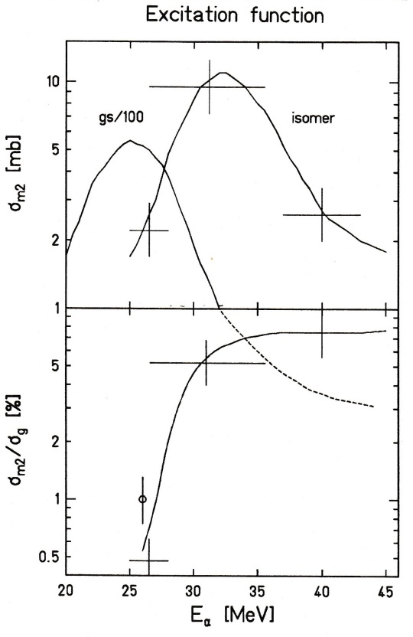
Investigation of the K=16 isomer in ¹⁷⁸Hf
decay scheme of ^{178m2}Hf
4 quasi-particle state
Production of ^{178m2}Hf using ¹⁷⁶Yb(α,2n)
2 quasi-particle state
Helmer & Reich; Nucl. Phys. A114 (1968), 649

Slide 24
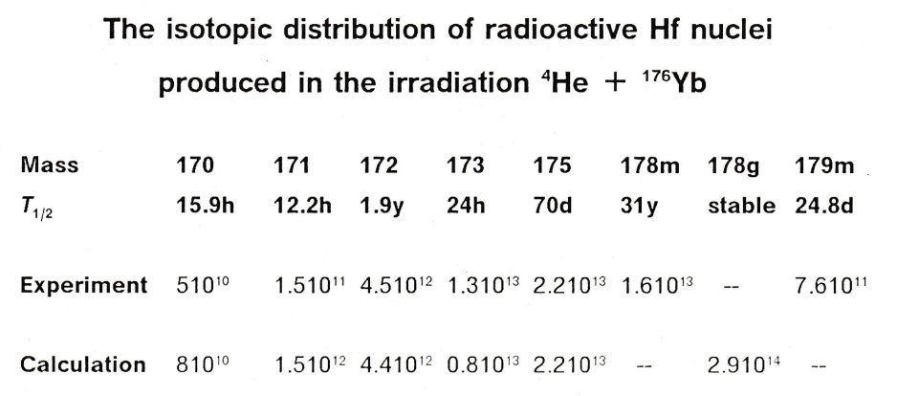
Investigation of the K=16 isomer in ¹⁷⁸Hf
decay scheme of ^{178m2}Hf
4 quasi-particle state
2 quasi-particle state
Helmer & Reich; Nucl. Phys. A114 (1968), 649

Slide 25
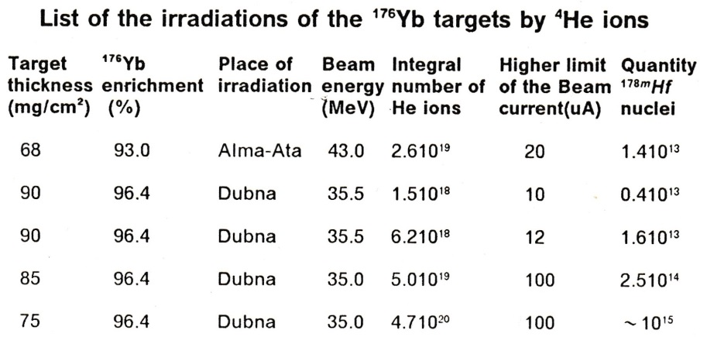
Investigation of the K=16 isomer in ¹⁷⁸Hf
decay scheme of ^{178m2}Hf
4 quasi-particle state
Production of ^{178m2}Hf using ¹⁷⁶Yb(α,2n)
2 quasi-particle state
Helmer & Reich; Nucl. Phys. A114 (1968), 649

Slide 26
Investigation of the K=16 isomer in ¹⁷⁸Hf
decay scheme of ^{178m2}Hf
4 quasi-particle state
magnet moment µ(16⁺) = 7.3±0.2 nm
4-qp state: π[514]9/2+π[404]7/2 + ν[514]7/2+ν[624]9/2
production: ¹⁷⁶Yb(α,2n)¹⁷⁸Hf Dubna
chemical separation Orsay, Dubna
mass separation Orsay
target preparation Orsay
chemistry by M. Hussonnois (IN2P3-CNRS Orsay, France)
Yu. Ts. Oganessian; J. Phys. G: Nucl. Part. Phys. 18 (1992),393
2 quasi-particle state
Helmer & Reich; Nucl. Phys. A114 (1968), 649

Slide 27
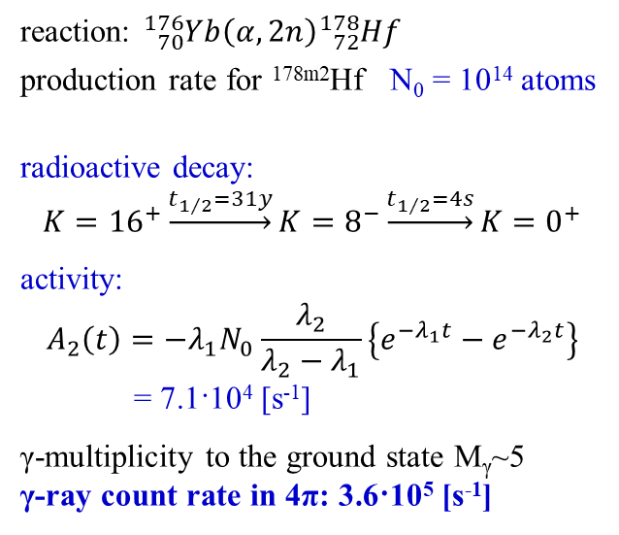
γ-background from the decay of the K=16 isomer in ¹⁷⁸Hf
decay scheme of ^{178m2}Hf
4 quasi-particle state
reaction: ${}_{70}^{176}{Yb}\left(α,2n\right){}_{72}^{178}{Hf}$
production rate for ^{178m2}Hf N₀ = 10¹⁴ atoms
radioactive decay:
$$K={16}^{+}\underset{→}{t_{1/2}=31y}K=8^{−}\underset{→}{t_{1/2}=4s}K=0^{+}$$
activity:
$$A_{2}\left(t\right)=−λ_{1}N_{0}\frac{λ_{2}}{λ_{2}−λ_{1}}\left\{e^{−λ_{1}t}−e^{−λ_{2}t}\right\}$$
= 7.1·10⁴ [s⁻¹]
γ-multiplicity to the ground state M_{γ}~5
γ-ray count rate in 4π: 3.6·10⁵ [s⁻¹]
2 quasi-particle state
Helmer & Reich; Nucl. Phys. A114 (1968), 649

Slide 28
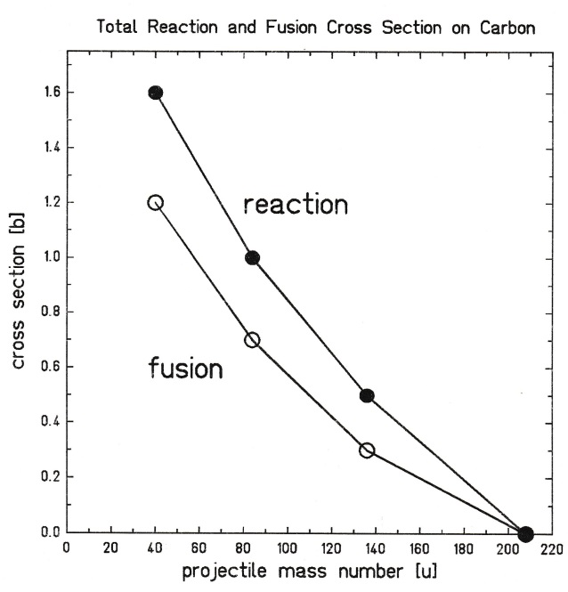
γ-background from the decay of the K=16 isomer in ¹⁷⁸Hf
decay scheme of ^{178m2}Hf
4 quasi-particle state
Hf - Targets
C-backing | 40 μg/cm² | 2.0·10¹⁸ atoms/cm²
O | 0.9 μg/cm² | 3.2·10¹⁶ atoms/cm²
¹⁷⁸Hf | 4.7 μg/cm² | 1.6·10¹⁶ atoms/cm²
^{178m2}Hf | 0.24 μg/cm² | 8.0·10¹⁴ atoms/cm²
C-cover | 11 μg/cm² | 5.5·10¹⁷ atoms/cm²
2 quasi-particle state
Helmer & Reich; Nucl. Phys. A114 (1968), 649

Slide 29
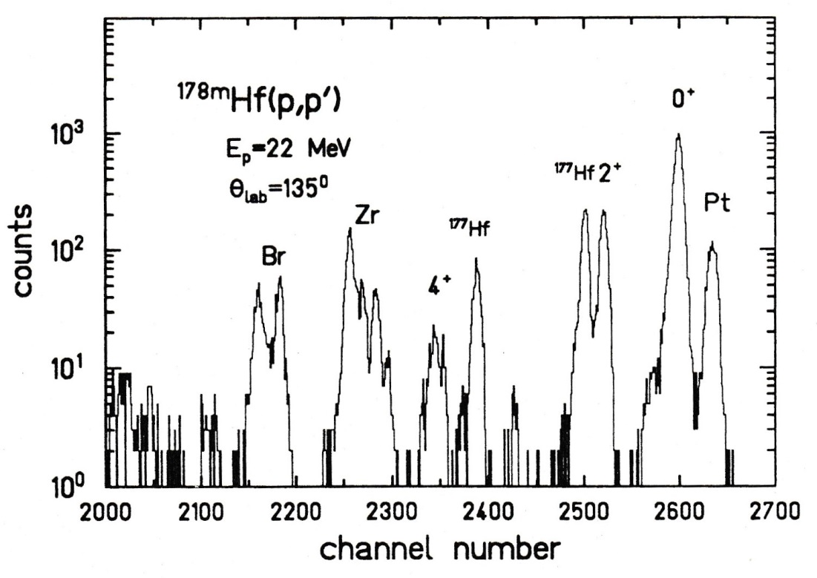
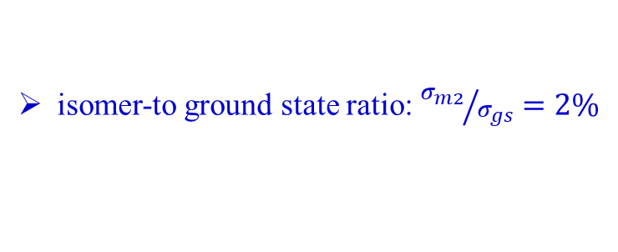
Target analysis
inelastic p-scattering experiment
X-ray analysis
 |  | Br | Zr | Hf | Pt
^{178m2}Hf | 15μg | 107 | 320 | 1278 | 33 | counts/s
^{nat}Hf | 40μg | - | 223 | 3645 | - | counts/s
isomer-to ground state ratio: ${σ_{m2}}/{σ_{gs}}=2\%$

Slide 30
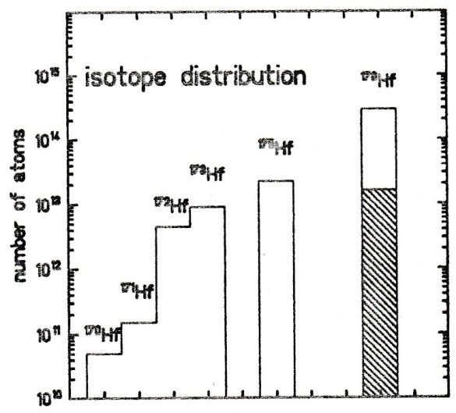
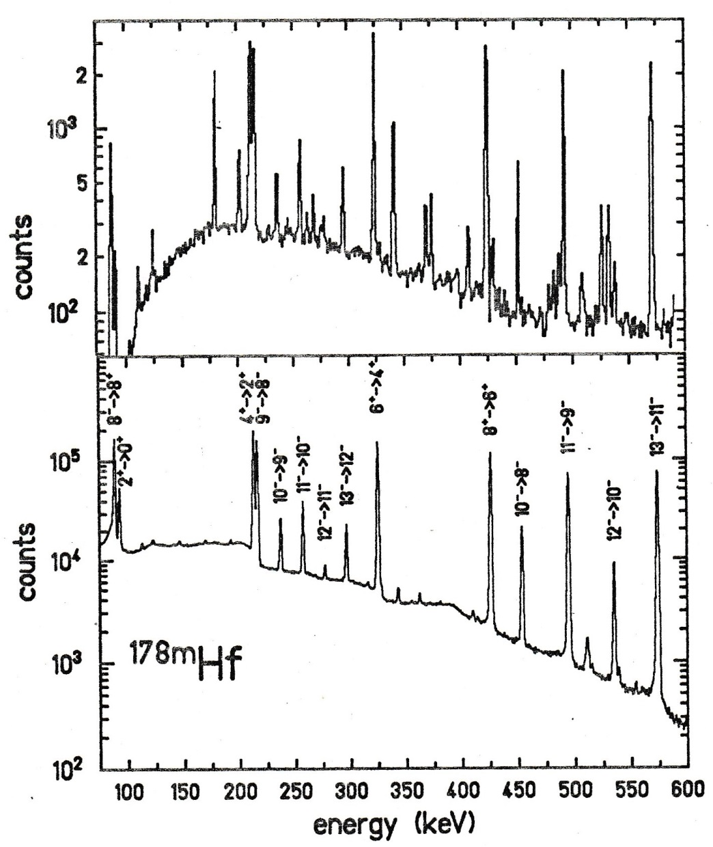
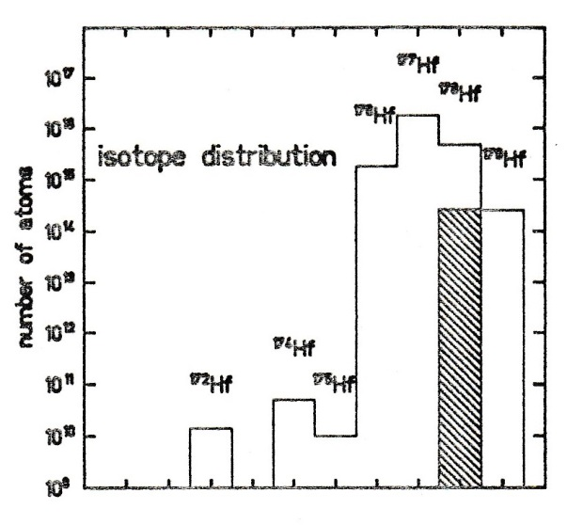
The ¹⁷⁶Yb(α,2n) reaction
¹⁷⁸Hf
96%
enriched ¹⁷⁶Yb
¹⁷⁵Hf
¹⁷³Hf
¹⁷²Hf
¹⁷¹Hf
¹⁷⁰Hf
96% enriched ¹⁷⁶Yb
99.998%
enriched ¹⁷⁶Yb
¹⁷⁷Hf
¹⁷⁶Hf
¹⁷⁸Hf
¹⁷⁹Hf
¹⁷⁴Hf
¹⁷²Hf
¹⁷⁵Hf
99.998% enriched ¹⁷⁶Yb

Slide 31
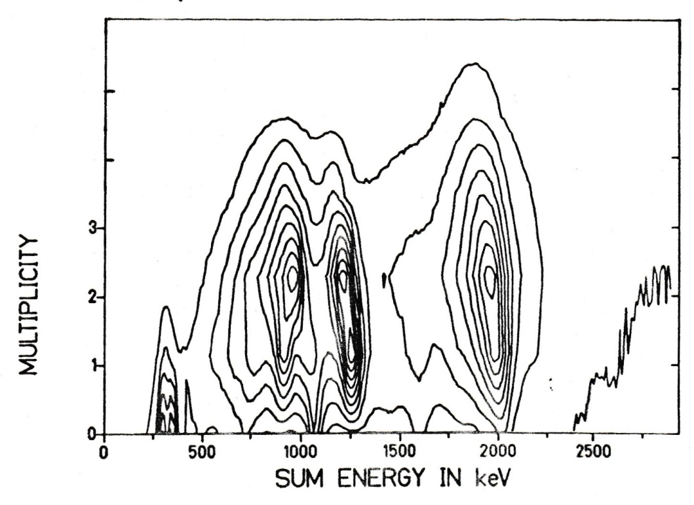
Decay study with the GSI-MPI Crystal Ball
parameters and resolutions FWHM
E_{i} 5.5% at 1332 keV
t_{i} 2.8 ns
W(θ) 14⁰
E_{total} 18-22% for M_{γ}=20
M_{γ} 25-30% for M_{γ}=20
The two basic observables which can be measured for the resulting γ-ray shower are the total energy emitted as γ-radiation and the number of γ-rays.
¹⁷²Lu
^{178m2}Hf
¹⁷⁵Hf
162 NaI detectors
1 Ge detector
H. Xie et al.; Phys. Rev. C48 (1993), 2517

Slide 32
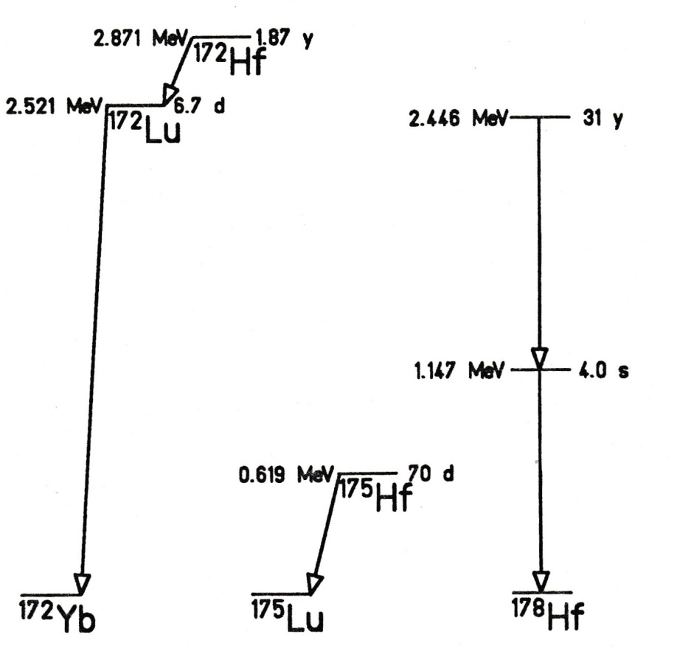
Decay scheme of ^{175,178m2}Hf, ¹⁷²Lu
¹⁷²Lu
^{178m2}Hf
¹⁷⁵Hf
H. Xie et al.; Phys. Rev. C48 (1993), 2517

Slide 33
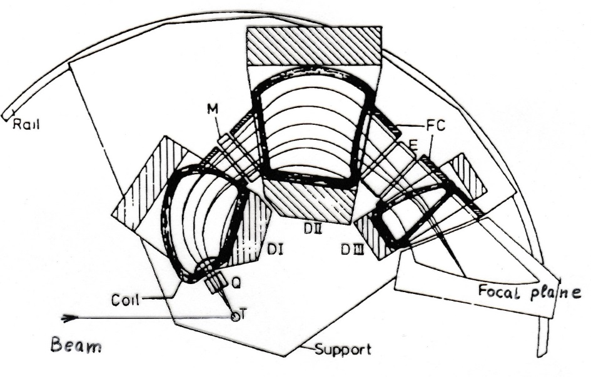
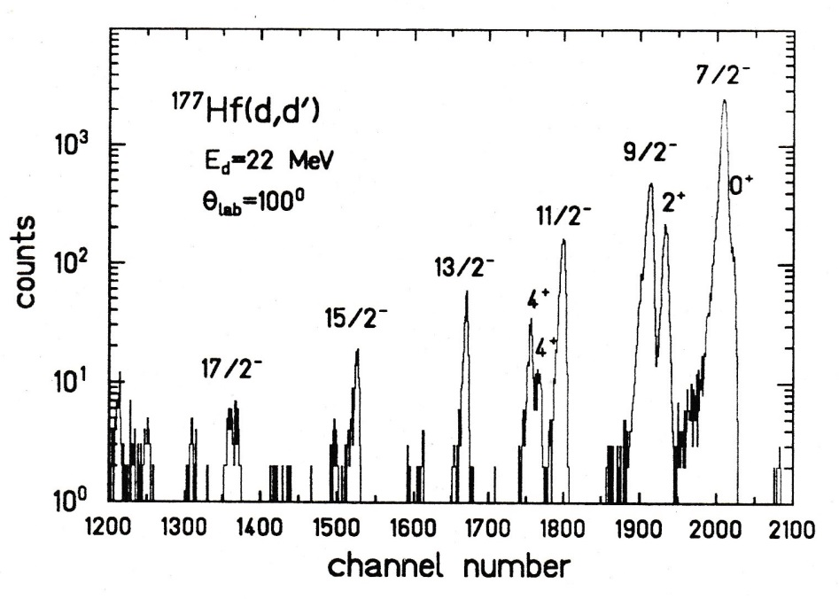
Inelastic Deuteron scattering experiment
Q3D measurement at the Munich tandem
energy resolution: 12 keV
S. Deylitz et al. Phys. Rev. C53 (1996), 1266

Slide 34
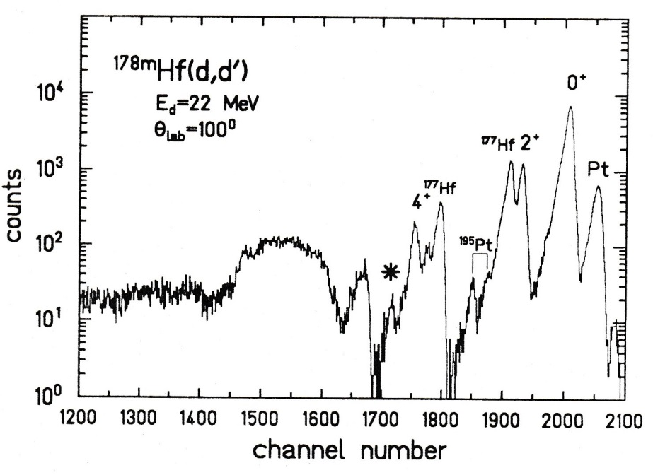
Inelastic Deuteron scattering experiment
isomeric ¹⁷⁸Hf target
Q3D measurement at the Munich tandem
energy resolution: 12 keV
S. Deylitz et al. Phys. Rev. C53 (1996), 1266

Slide 35
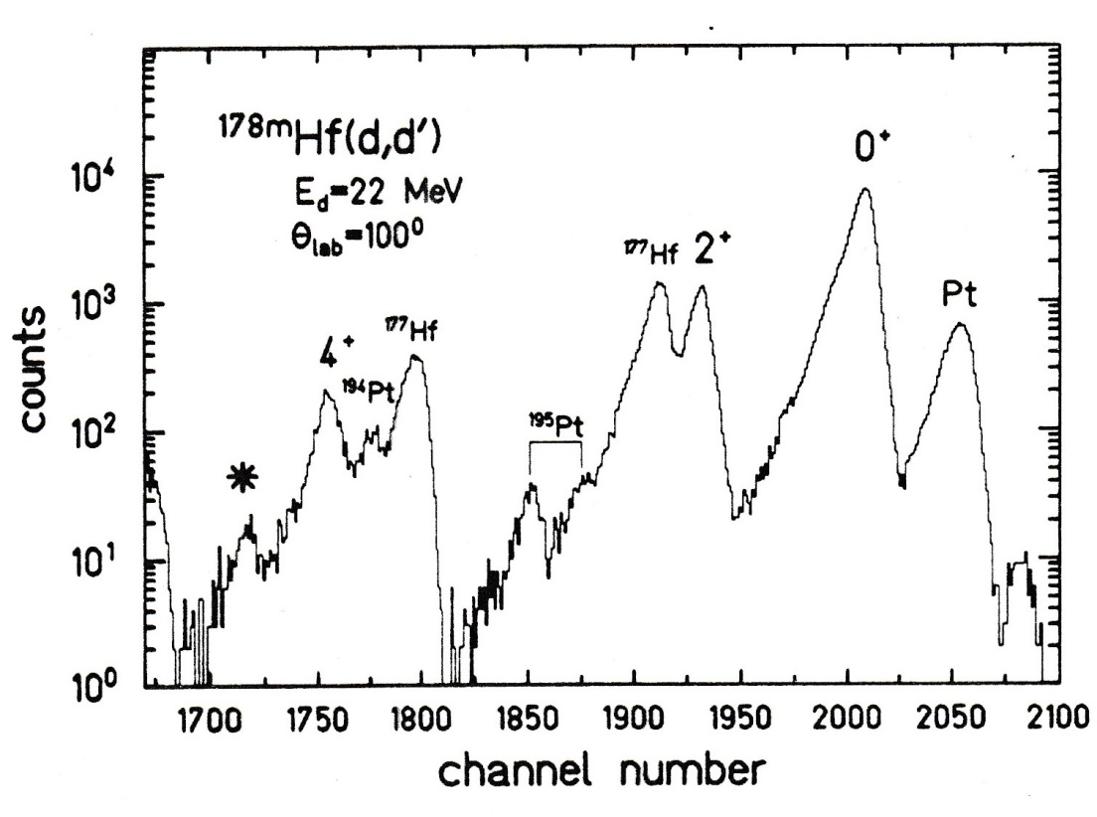
Inelastic Deuteron scattering experiment
Q3D measurement at the Munich tandem
energy resolution: 12 keV
S. Deylitz et al. Phys. Rev. C53 (1996), 1266

Slide 36
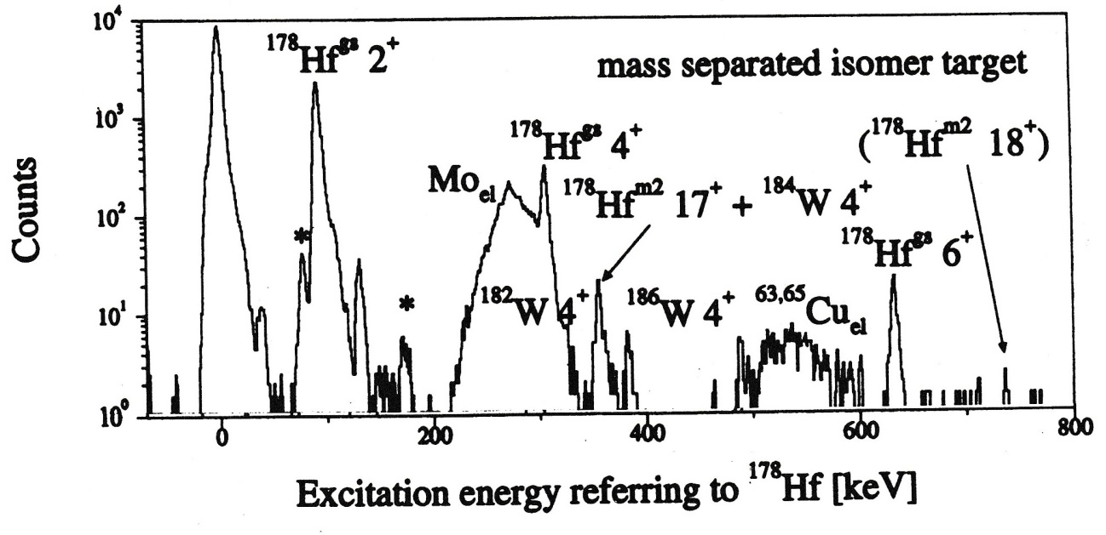


Inelastic Deuteron scattering from K=16 isomer
$$\frac{{}_{}^{178m2}{Hf}}{{}_{}^{178}{Hf}}≅3\%$$
experiment performed at Munich tandem accelerator with Q3D spectrograph (45⁰ – 100⁰)
W, Ta, Mo, Cu result from sputtering and migration process in the mass-separator facility
E_{x} = 356.5±0.4 keV 17⁺ member of rotational band
$$\frac{ℑ\left({}_{}^{178m2}{Hf}\right)}{ℑ\left({}_{}^{178}{Hf}\right)}=1.48$$
S. Deylitz et al. Phys. Rev. C53 (1996), 1266

Slide 37
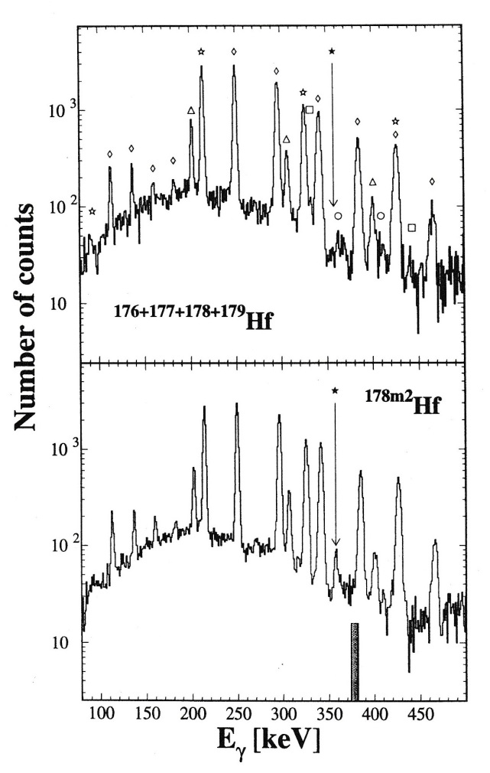
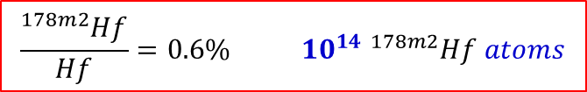
Coulomb excitation of the K=16 isomer
²⁰⁸Pb → Hf; 4.8 MeV/u
“artificial” γ-spectrum
γ-spectrum with isomeric target
$$\frac{{}_{}^{178m2}{Hf}}{Hf}=0.6\% {10}^{14} {}_{}^{178m2}{Hf} atoms$$
experiment performed at UNILAC accelerator
E_{γ} = 357.4±0.3 keV 17⁺ → 16⁺ transition
Q₀ (K=16) = 8.2±1.1 b rigid rotor model
E. Lubkiewicz et al.; Z. Phys. A355 (1996), 377

Slide 38


Coulomb excitation of the K=16 isomer
²⁰⁸Pb → Hf; 4.8 MeV/u
“artificial” γ-spectrum
357 keV
722 keV
γ-spectrum with isomeric target
$$\frac{{}_{}^{178m2}{Hf}}{Hf}=0.6\% {10}^{14} {}_{}^{178m2}{Hf} atoms$$
experiment performed at UNILAC accelerator
E_{γ} = 357.4±0.3 keV 17⁺ → 16⁺ transition
Q₀ (K=16) = 8.2±1.1 b rigid rotor model
E. Lubkiewicz et al.; Z. Phys. A355 (1996), 377

Slide 39
Determination of the beam current due to a limitation in particle detection
target thickness: ¹⁷⁸Hf 10¹⁶ particles/cm²
^{178m2}Hf 10¹⁴ particles/cm²
beam current (100 pnA): 6.25·10¹¹ particles/s
max. luminosity 6.25·10²⁷ [cm⁻²s⁻¹]
Rutherford cross section 50 [b]
count rate in particle counter 3·10⁵ [s⁻¹]

Slide 40
γ-background from the decay of the K=16 isomer in ¹⁷⁸Hf
decay scheme of ^{178m2}Hf
4 quasi-particle state
reaction: ${}_{70}^{176}{Yb}\left(α,2n\right){}_{72}^{178}{Hf}$
production rate for ^{178m2}Hf N₀ = 10¹⁴ atoms
radioactive decay:
$$K={16}^{+}\underset{→}{t_{1/2}=31y}K=8^{−}\underset{→}{t_{1/2}=4s}K=0^{+}$$
activity:
$$A_{2}\left(t\right)=−λ_{1}N_{0}\frac{λ_{2}}{λ_{2}−λ_{1}}\left\{e^{−λ_{1}t}−e^{−λ_{2}t}\right\}$$
= 7.1·10⁴ [s⁻¹]
γ-multiplicity to the ground state M_{γ}~5
γ-ray count rate in 4π: 3.6·10⁵ [s⁻¹]
2 quasi-particle state
Helmer & Reich; Nucl. Phys. A114 (1968), 649

Slide 41

Influence of the γ-background on the solid angle of the Ge-detector
γ-count rate in 4π due to the decay of the K=16 isomer: 6.4·10⁵ [s⁻¹]
total efficiency of a Ge-detector (ε_{rel} = 30%) for a 500 keV γ-ray 80%
accepted γ-ray count rate in a Ge-detector 5100 [s⁻¹]
solid angle of a Ge-detector $ε_{Ω}=\frac{πr^{2}}{4πR^{2}}≅{10}^{−2}$
radius of Ge-crystal: r = 3 cm
distance to the target: R = 15 cm
intrinsic photopeak efficiency for a 500 keV γ-ray $ε_{i}≅0.2$
$ε_{i}∙ε_{Ω}≅0.002$

Slide 42

Estimate of count rates
beam current (100 pnA) 6.25·10¹¹ [s⁻¹]
target thickness (^{178m2}Hf) 10¹⁴ [cm⁻²]
luminosity 6.25·10²⁵ [s⁻¹cm⁻²]
solid angle and photopeak efficiency of Ge-detector $ε_{i}∙ε_{Ω}=0.002$
projectile | σ₁₈₋₁₆ [b] | available beam current [pnA] | γ-count rate [h⁻¹]
²⁰⁸Pb | 0.573 | 11.5 | 30
¹³⁶Xe | 0.481 | 95 | 216
⁸⁴Kr | 0.377 | 188 (100) | 170
⁴⁰Ar | 0.118 | 700 (100) | 53

Slide 43

Rotational band on the K=16 isomer in ¹⁷⁸Hf
ΔI=1
ΔI=2
Summed coincidence spectrum from projections made on transitions in the rotational band assigned to ^{178m2}Hf.
¹⁷⁶Yb(⁹Be,α3n) ¹⁷⁸Hf 55, 60 MeV
incomplete fusion reaction
14 charged-particle detectors cover 85% of 4π
E2/M1 mixing ratios g_{K}=0.52(6) ν²π² – qp band
S.M. Mullins et al. Phys. Lett. B393 (1997), 279

Slide 44




Partial level scheme of ¹⁷⁸Hf
Q₂₀ = 8.2±1.1 b
4 quasi-particle state
Q₂₀ = 7.0 b
$$I_{x}={\left\{{\left(I+1/2\right)}^{2}−K^{2}\right\}}^{1/2}$$
$$ℏω=\frac{E\left(I+1\right)−E\left(I−1\right)}{I_{x}\left(I+1\right)−I_{x}\left(I−1\right)}$$

Slide 45







Collinear laser spectroscopy
kinetic energy spread in ion source: $ΔE=mv∙∆v=few eV$
residual Doppler width after acceleration: $∆ν=\frac{ν_{0}ΔE}{\sqrt{2eU∙mc^{2}}}$ Δν=60 MHz for 60 kV
0⁺
$$∆W_{HFS}=\frac{A}{2}K+B\frac{\frac{3}{4}K\left(K+1\right)−I\left(I+1\right)J\left(J+1\right)}{2I\left(2I−1\right)∙J\left(2J−1\right)}$$
$$K=F\left(F+1\right)−I\left(I+1\right)−J\left(J+1\right)$$
$$A=\frac{μ_{I}∙\left\langle H\left(0\right)\right\rangle }{I∙J}$$
$$B=eQ_{s}∙\left\langle V_{zz}\left(0\right)\right\rangle$$
The single peak at 0 MHz corresponds to the ground state ¹⁷⁸Hf. The nine hyperfine resonances 0f 178m2Hf are marked by arrows.

Slide 46











Collinear laser spectroscopy
0⁺
$$∆W_{HFS}=\frac{A}{2}K+B\frac{\frac{3}{4}K\left(K+1\right)−I\left(I+1\right)J\left(J+1\right)}{2I\left(2I−1\right)∙J\left(2J−1\right)}$$
$$K=F\left(F+1\right)−I\left(I+1\right)−J\left(J+1\right)$$
$$A=\frac{μ_{I}∙\left\langle H\left(0\right)\right\rangle }{I∙J}$$
$$B=eQ_{s}∙\left\langle V_{zz}\left(0\right)\right\rangle$$
The single peak at 0 MHz corresponds to the ground state ¹⁷⁸Hf. The nine hyperfine resonances 0f 178m2Hf are marked by arrows.
$$μ_{I}^{178m2}=+8.16\left(4\right) nm$$
strong coupling scheme:
$$Q_{s}^{178m2}=+6.00\left(7\right) b$$
$${→ Q}_{0}=7.2\left(1\right) b$$
$$Q_{s}=\frac{3K^{2}−I\left(I+1\right)}{\left(I+1\right)\left(2I+3\right)}∙Q_{0}$$
$${→ Q}_{s}\left(K=I\right)=\frac{I∙\left(2I−1\right)}{\left(I+1\right)\left(2I+3\right)}∙Q_{0}$$
$$δ{\left\langle r^{2}\right\rangle }^{178,178m2}=−0.059\left(9\right) {fm}^{2}$$
$$δ\left\langle r^{2}\right\rangle =δ{\left\langle r^{2}\right\rangle }_{0}+\frac{5}{4π}{\left\langle r^{2}\right\rangle }_{0}\sum_{λ}{δ\left\langle β_{λ}^{2}\right\rangle }$$

Slide 47
Partial level scheme of ¹⁷⁸Hf
Q₂₀ = 7.2±0.1 b
Q₂₀ = 8.2±1.1 b (Coulomb excitation)
µ_{I} = +8.16(4) n.m.
4 quasi-particle state
Q₂₀ = 7.0 b
$$I_{x}={\left\{{\left(I+1/2\right)}^{2}−K^{2}\right\}}^{1/2}$$
$$ℏω=\frac{E\left(I+1\right)−E\left(I−1\right)}{I_{x}\left(I+1\right)−I_{x}\left(I−1\right)}$$

