Slide 1

Outline: Nuclear isomers
Lecturer: Hans-Jürgen Wollersheim
e-mail: h.j.wollersheim@gsi.de
web-page: https://web-docs.gsi.de/~wolle/ and click on
nuclear isomers (shape-, spin-, K-traps)
In-flight separation of excited Radioactive Ion Beams
nuclear shell closure in ⁹⁸Cd and ¹³⁰Cd
T=1 isospin symmetry – mirror nuclei

Slide 2

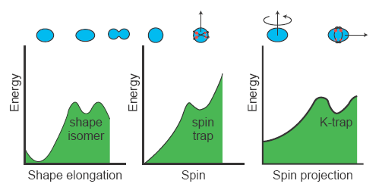
What is a nuclear isomer?
Nuclear Isomer – a long-lived excited nuclear state (T_{1/2} > 1 ns)
decays by emission of α, β, γ, p, fission, cluster
The first one discovered by O. Hahn in Berlin in 1921 – decay of ²³⁴Pa (70 s)
von Weizsacker, A. Bohr & B. Mottelson
1/τ ~ E_{γ} ^{2λ+1} |< ψ_{f} | T | ψ_{i} >|
J_{max}
J
J=0
J
K=0
K_{max}

Slide 3
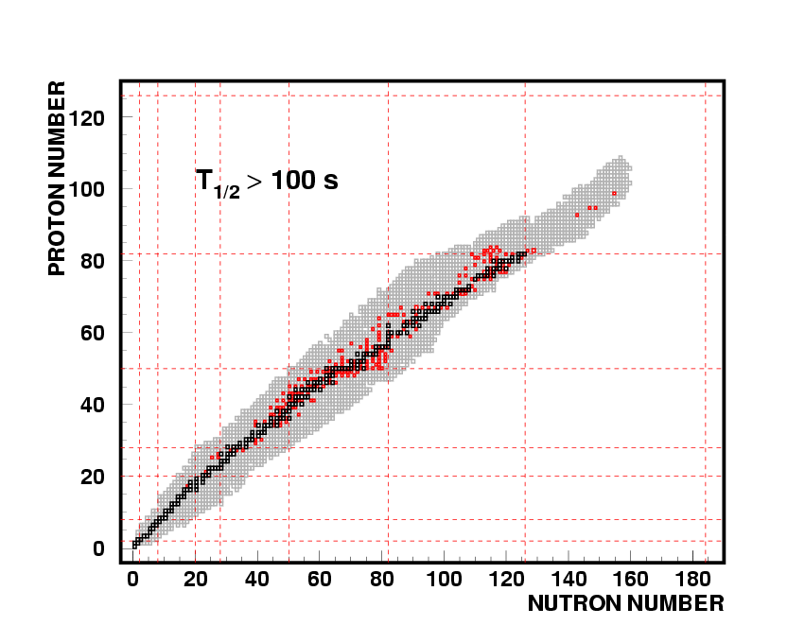
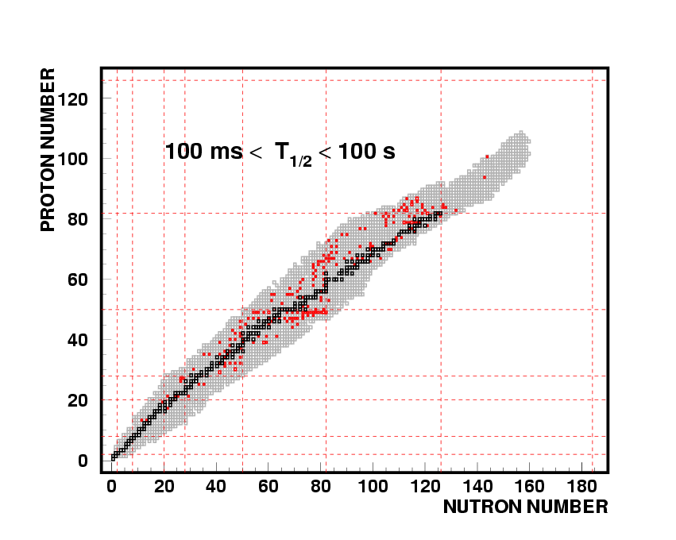
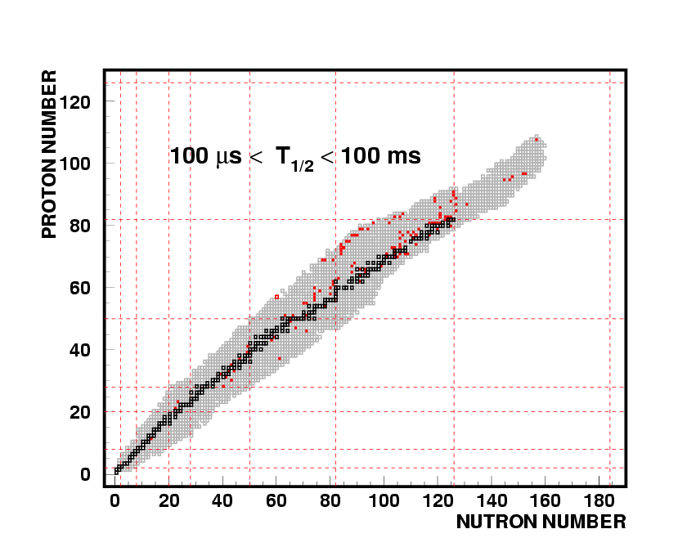
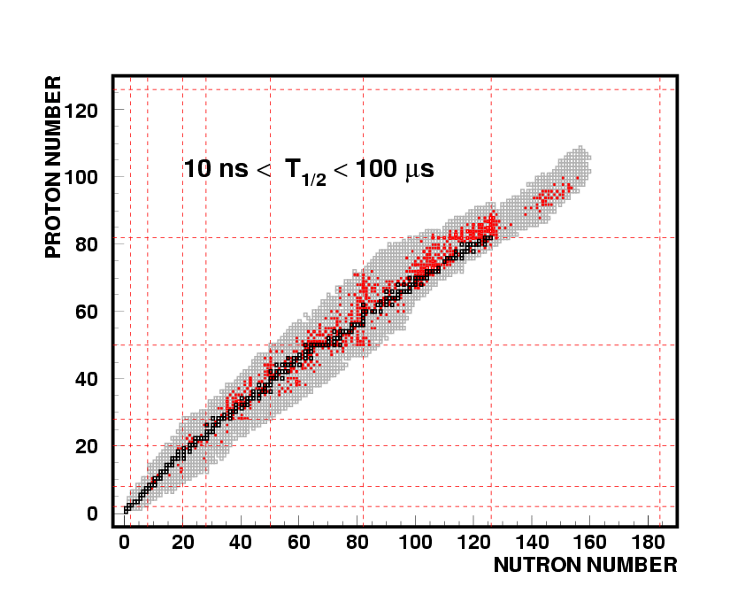
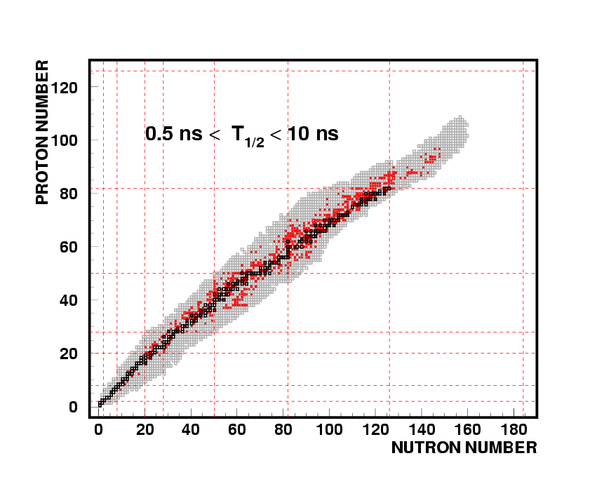
The variety of known nuclear isomers
Excited nuclear states with long half-lives > 1 ns
~2800 known nuclei
~2600 known isomers
(predicted ~6000 bound nuclei)
isomeric state
τ_{m}
fission
α β
p
ground state
τ_{g}
fission
α β
p
www.nndc.bnl.gov
NEUTRON NUMBER

Slide 4
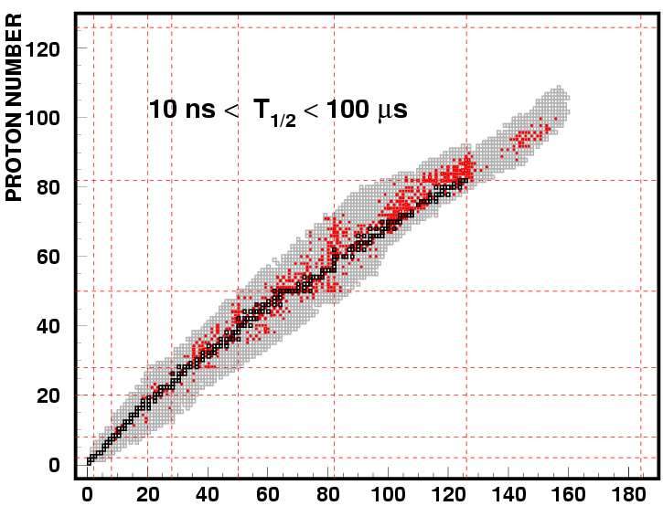
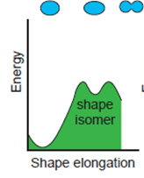
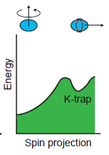
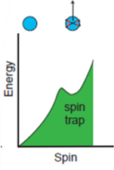
Three types of isomers
www.nndc.bnl.gov
NEUTRON NUMBER

Slide 5
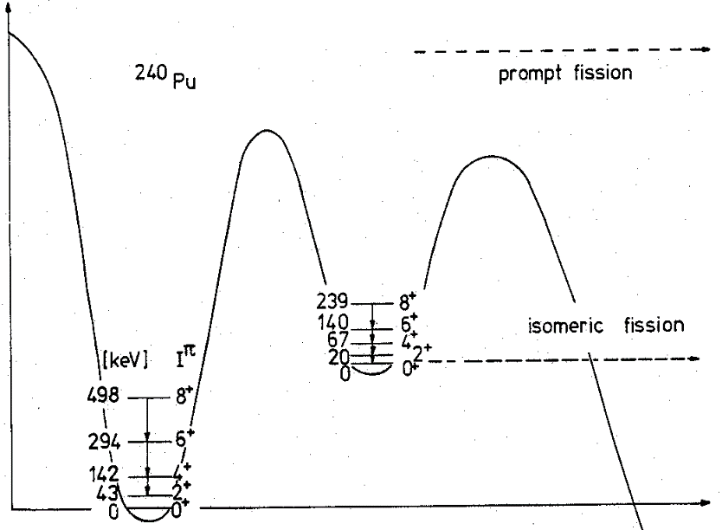
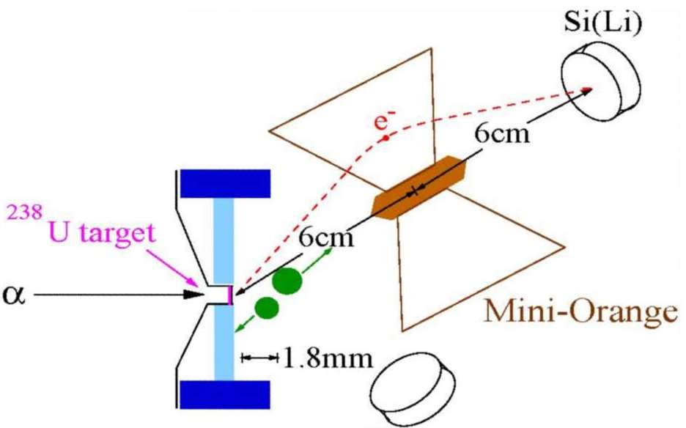
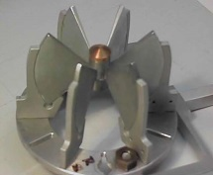
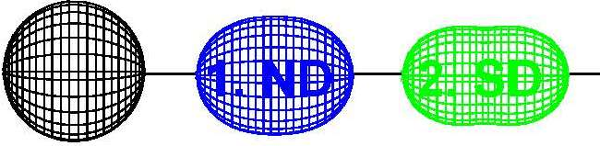

1. Shape isomers
fission isomer (discovered by S.M. Polikanov Sov. Phys. JEPT 15 (1962) 105)
energy
²⁴⁰Pu
²³⁸U(α,2n)^{240f}Pu, E_{α}=25 MeV
E_{A}
E_{B}
T_{1/2}=3.8 ns
deformation
monitor
(prompt fission)
Si-ring counter
(delayed fission)
$$\frac{ℏ^{2}}{2ℑ}=3.34 keV$$
E_{A}=5.8±0.3 MeV
E_{B}=5.45±0.3 MeV
D. Pansegrau et al., Phys. Lett. B484 (2000) 1
D. Gassmann et al., Phys. Lett. B497 (2001) 181
axis ratio 2:1
H. Specht et al. Phys. Lett. B41 (1972) 43

Slide 6
1. Shape isomers
D. Gassmann et al., Phys. Lett. B497 (2001) 181

Slide 7
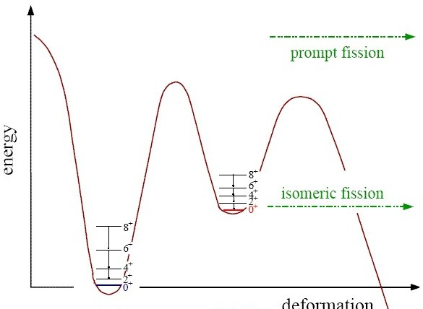
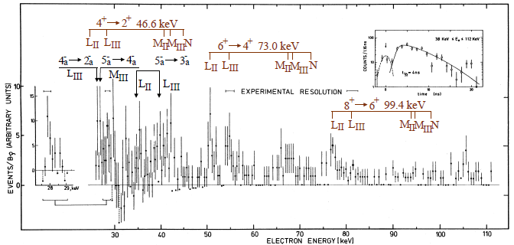

1. Shape isomers
²⁴⁰Pu
1. minimum 2. minimum
fission isomer t_{1/2}=3.8 ns
5.8±0.3 MeV
5.5±0.3 MeV
²³⁸U(α, 2n)^{240f}Pu, E_{α} = 25 MeV
conversion electrons in coincidence with delayed fission
deformation
$$\frac{ℏ^{2}}{2ℑ}=3.34 keV$$
axis ratio: 2:1
H. Specht et al. Phys. Lett. B41 (1972) 43

Slide 8
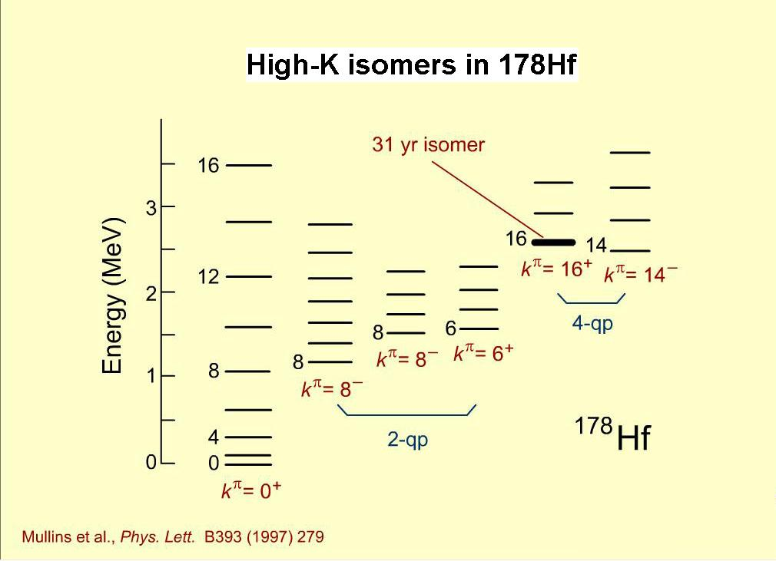
2. K-isomers
ω
A well-known example:
K=0
9/2[624]
9/2[514]
Fermi Surface
7/2[514]
7/2[404]
neutron
proton

Slide 9
2. K-isomers
j₂
A well-known example:
j₁
j
K>0
9/2[624]
9/2[514]
Fermi Surface
7/2[514]
7/2[404]
neutron
proton

Slide 10
2. K-isomers
j₂
A well-known example:
j₁
j
K>0
9/2[624]
9/2[514]
Fermi Surface
7/2[514]
7/2[404]
neutron
proton

Slide 11
2. K-isomers
A well-known example:
9/2[624]
9/2[514]
Fermi Surface
7/2[514]
7/2[404]
neutron
proton

Slide 12



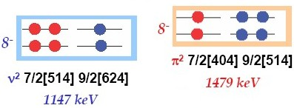



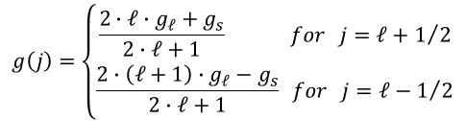
Magnetic moments in ¹⁷⁸Hf
$$g\left(j\right)=\left\{\begin{matrix}\frac{2∙ℓ∙g_{ℓ}+g_{s}}{2∙ℓ+1} for j=ℓ+1/2 \\ \frac{2∙\left(ℓ+1\right)∙g_{ℓ}−g_{s}}{2∙ℓ+1} for j=ℓ−1/2\end{matrix}\right.$$
proton
neutron
$$g_{ℓ}=1 g_{s}=5.59$$
$$g_{ℓ}=0 g_{s}=−3.83$$
g(h_{11/2}) = 1.42 g(g_{7/2}) = 0.49 g(f_{7/2}) = -0.55 g(i_{13/2})=-0.29
g(h_{11/2} x g_{7/2}; 8⁻) = 1.08 g(f_{7/2} x i_{13/2}) = -0.36
g(8⁻ x 8⁻; 16⁺) = 0.36 → μ = g·I = 5.76 nm
E_{x}~2Δ_{p}
E_{x}~2Δ_{n}
7.26±0.16 nm
Helmer & Reich; Nucl. Phys. A114 (1968), 649

Slide 13
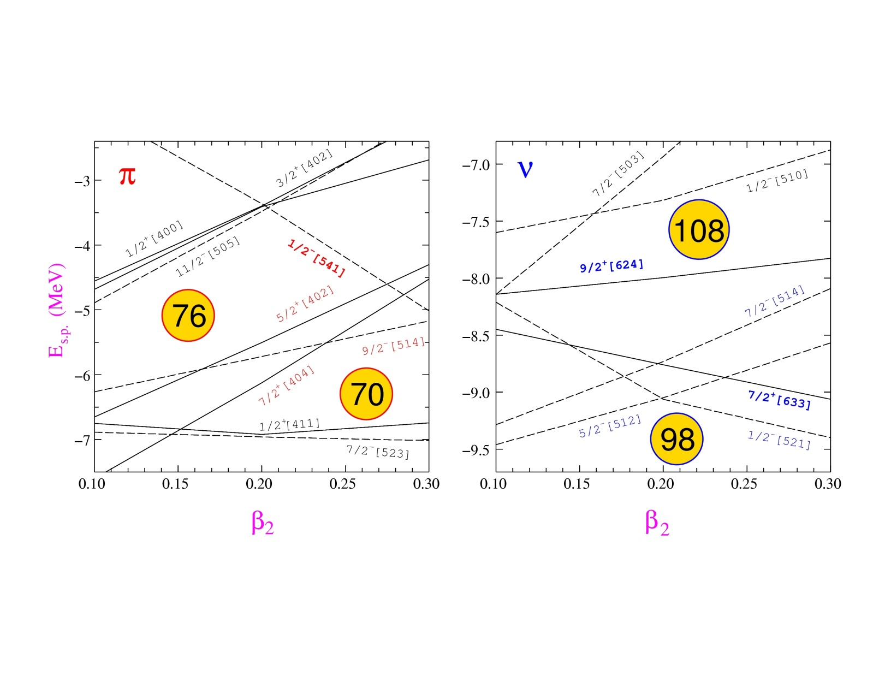
K-isomers: where to find them?
Deformed nuclei with axially-symmetric shape
Mass 180 region : Yb (Z=70) - Ir (Z=77)
ω
j₂
j₁
j
K
High-K orbitals near the Fermi surface
: 7/2[404], 9/2[514], 5/2[402]
ν: 7/2[514], 9/2[624], 5/2[512], 7/2[633]

Slide 14
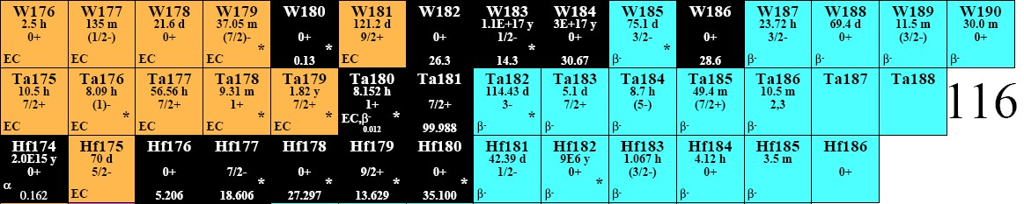
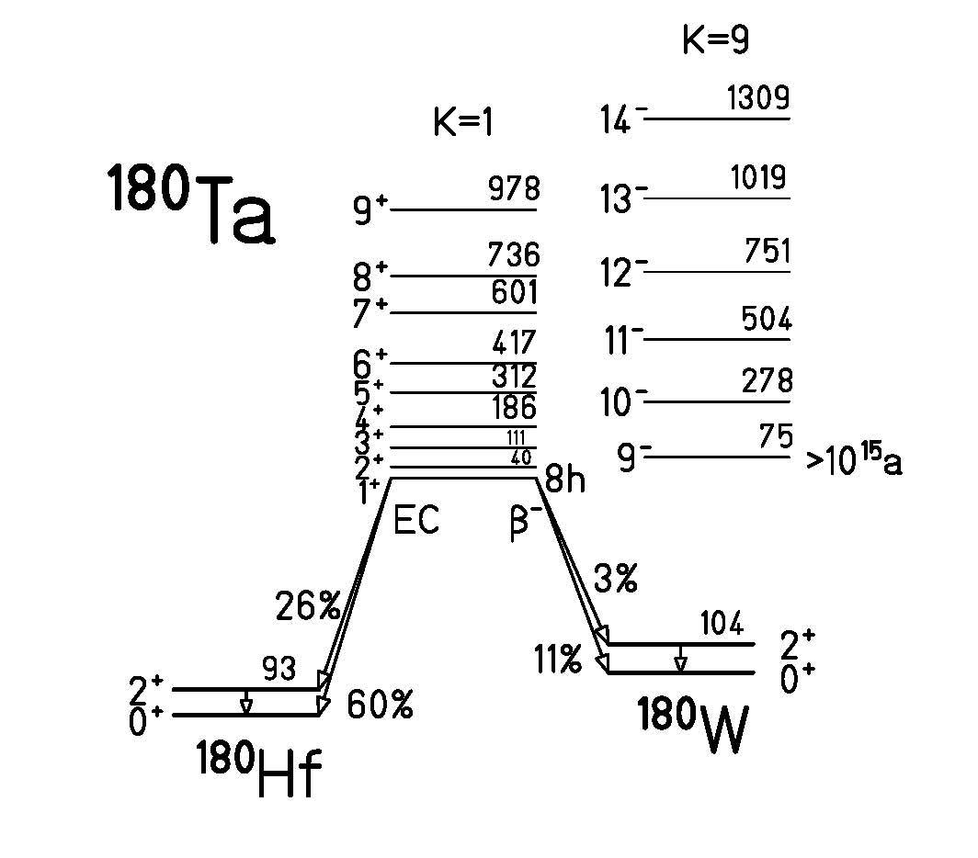
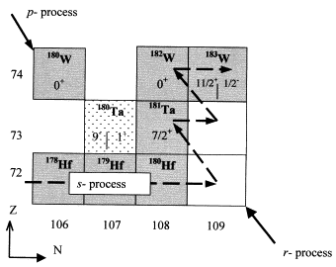
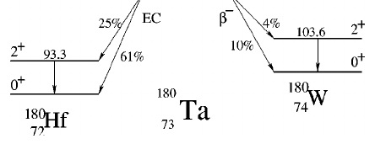
K-isomers in ¹⁸⁰Ta
75 keV
>10¹⁵ a !!!
0
8h
The rarest natural isotope: abundance of 0.012%

Slide 15
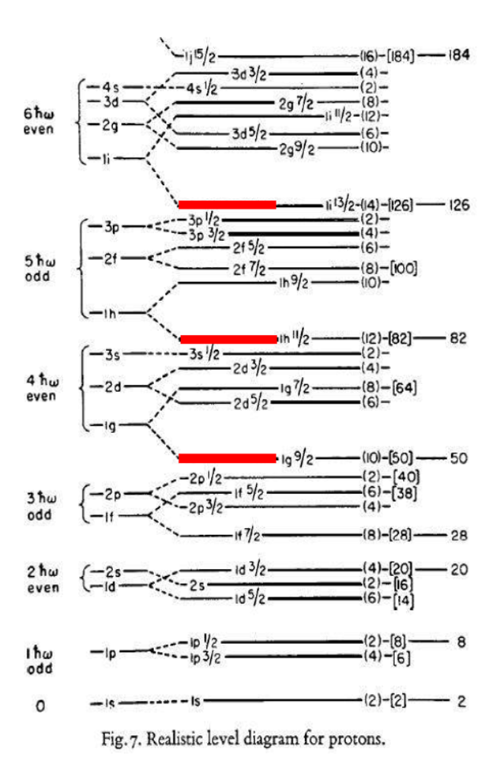
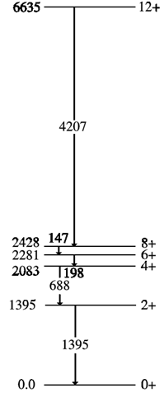

3. Spin isomers
~230 ns
E4
$${}_{48}^{98}{{Cd}_{50}}$$
~170 ns
A. Blazhev et al., Phys.Rev.C69 (2004) 064304

Slide 16

3. Spin isomers
~230 ns
E4
$${}_{48}^{98}{{Cd}_{50}}$$
~170 ns
A. Blazhev et al., Phys.Rev.C69 (2004) 064304

Slide 17
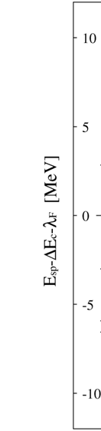
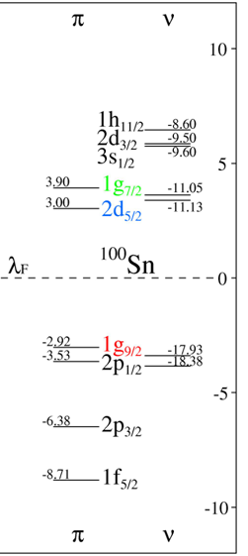
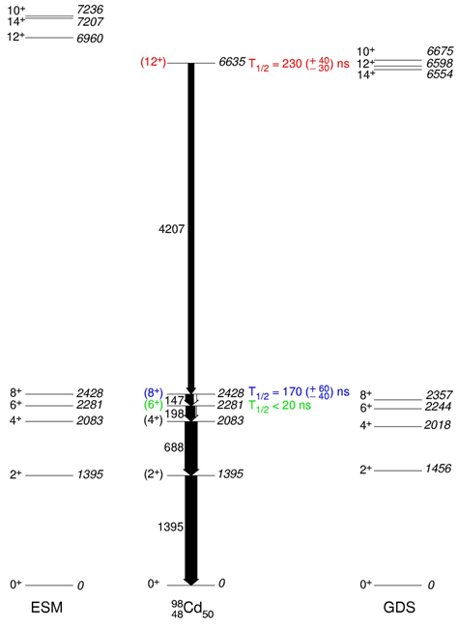
Core-excited states in ⁹⁸Cd
e_{π} = 1.3(2)
e_{π} = 1.1
ESM: H. Grawe et al., NS98 AIP CP 481 (1999) 177
GDS: F.Nowacki, Nuc. Phys. A 704 (2002) 223c
A. Blazhev et al., Phys.Rev.C69 (2004) 064304

Slide 18
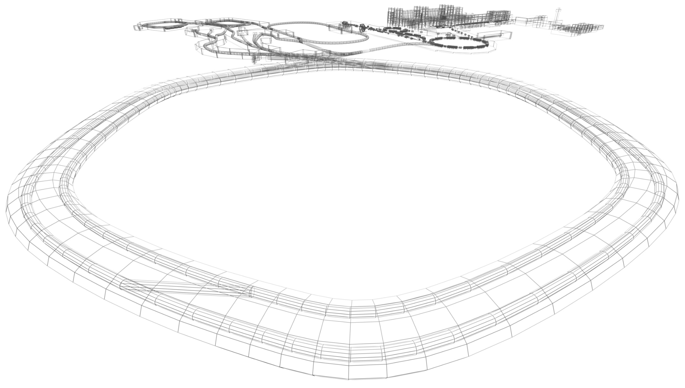

Physics with exotic nuclei

Slide 19

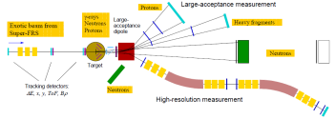
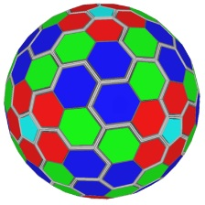
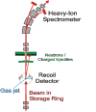
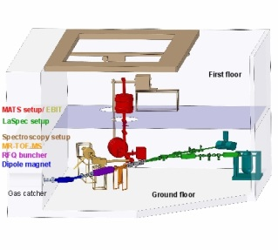
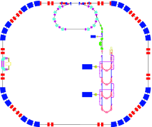

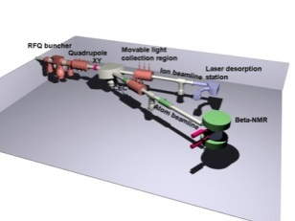
NUclear STructure, Astrophysics and Reactions
Super-FRagment Separator
HIgh resolution SPECtroscopy / DEcay SPECtroscopy
Precision Measurements of very short-lived nuclei with Advanced Trapping System
LAser SPECtroscopy
Reaction with Relativistic Radioactive Beams (R³B)
EXotic nuclei studied in Light-ion induced reactions at the NESR storage ring
ELectron-Ion Scattering in a Storage Ring
Isomeric Beams, LIfetimes and MAsses
Super-FRS
R³B
HISPEC/DESPEC
EXL
MATS
ELISe
LASPEC
ILIMA

Slide 20
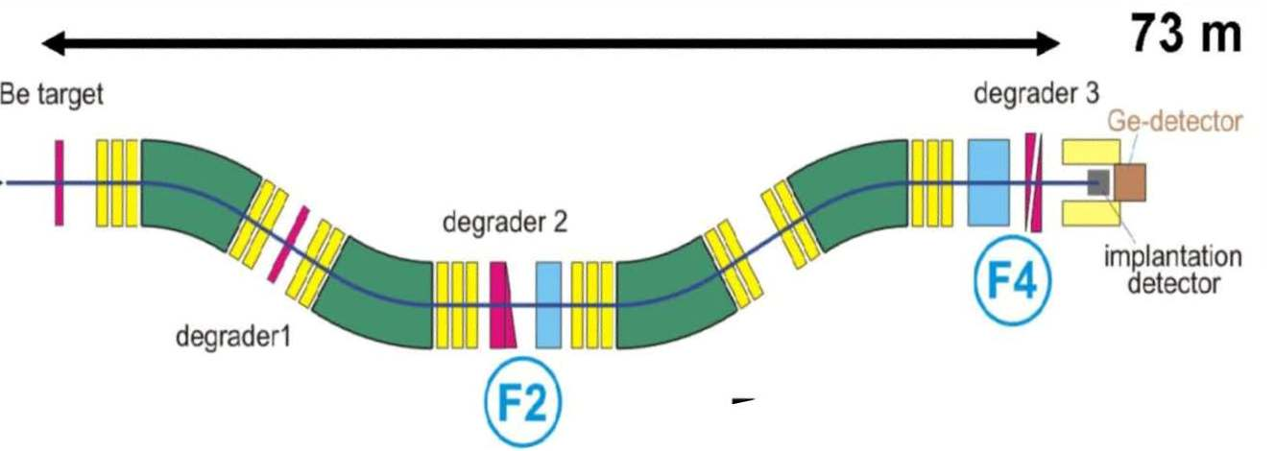
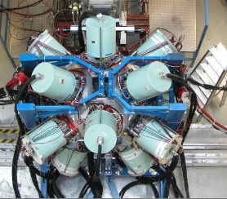
Production of Radioactive Ion Beams
Fragmentation
in ~20% of all cases the fragment is excited
primary beam
time-of-flight through the fragment separator FRS ~300 ns
Isomeric states can be investigated!

Slide 21
Outline
Excited Fragments – Gateway to Nuclear Structure
Nuclear Isomers (shape-, spin-, K-traps)
In-Flight Separation of excited Radioactive Ion Beams
Stopped Beam Experiments and Limitations to Decay Spectroscopy
Nuclear Shell Closure in ⁹⁸Cd and ¹³⁰Cd
Seniority Isomers in ²¹⁰Pb, ²¹²Pb, ²¹⁴Pb, ²¹⁶Pb
T=1 Isospin Symmetry – Mirror Nuclei
Silicon Implantation Detector – β-Decay of ¹⁰⁰Sn
Scattering Experiments with RIBs – Nuclear Structure Results

Slide 22
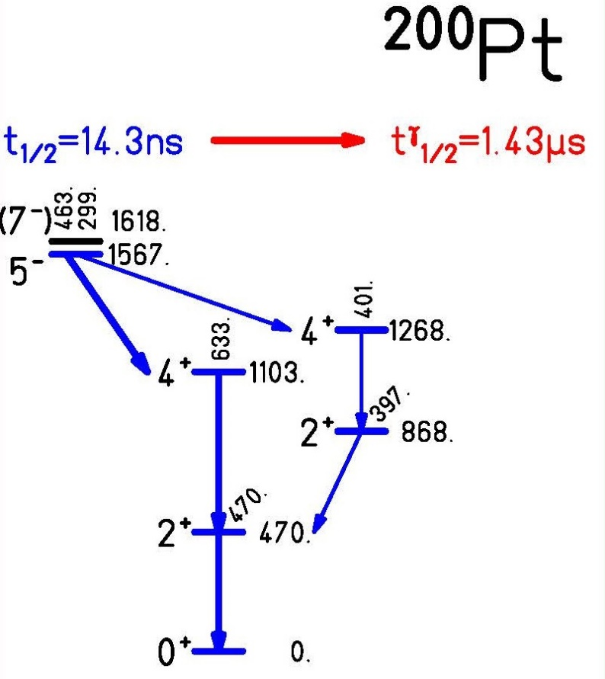
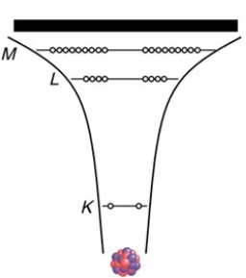
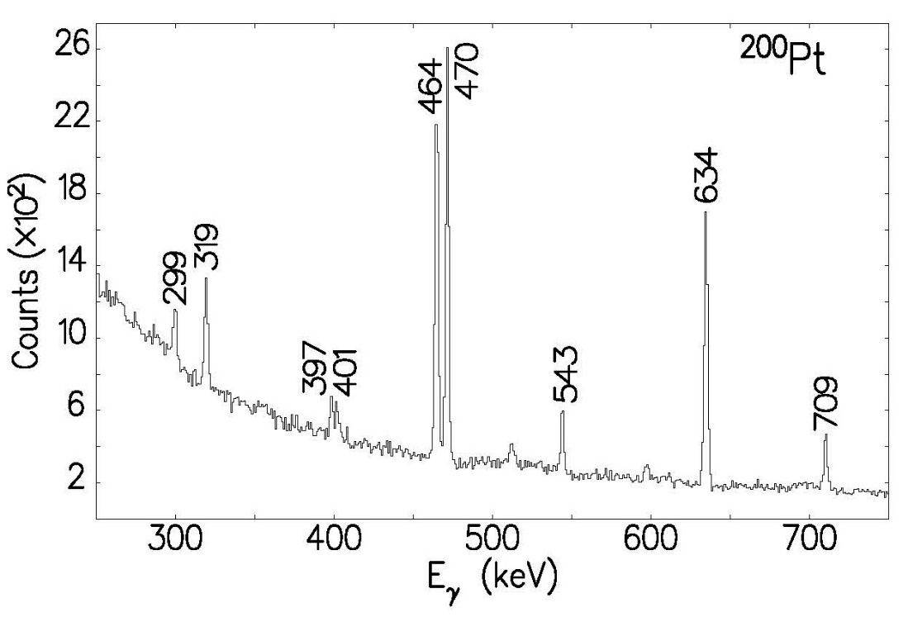
Longer lifetime for bare atoms
no conversion electrons
γ-spectrum after ~300 ns ToF

Slide 23
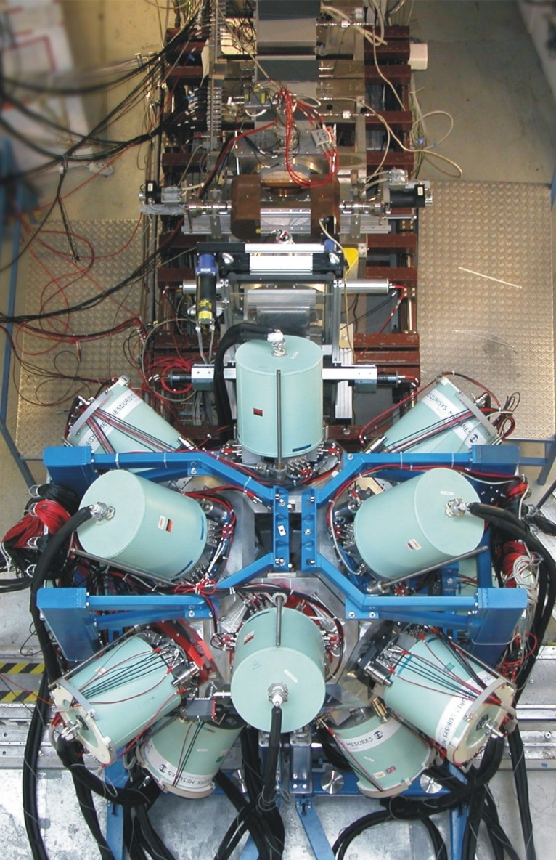
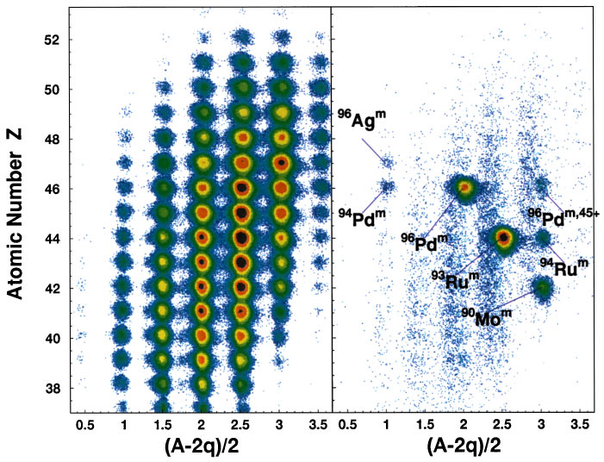
Experimental set-up for isomer decay gateway to nuclear structure
R. Grzywacz et al., Phys. Rev C55 ,1126 (1997)

Slide 24
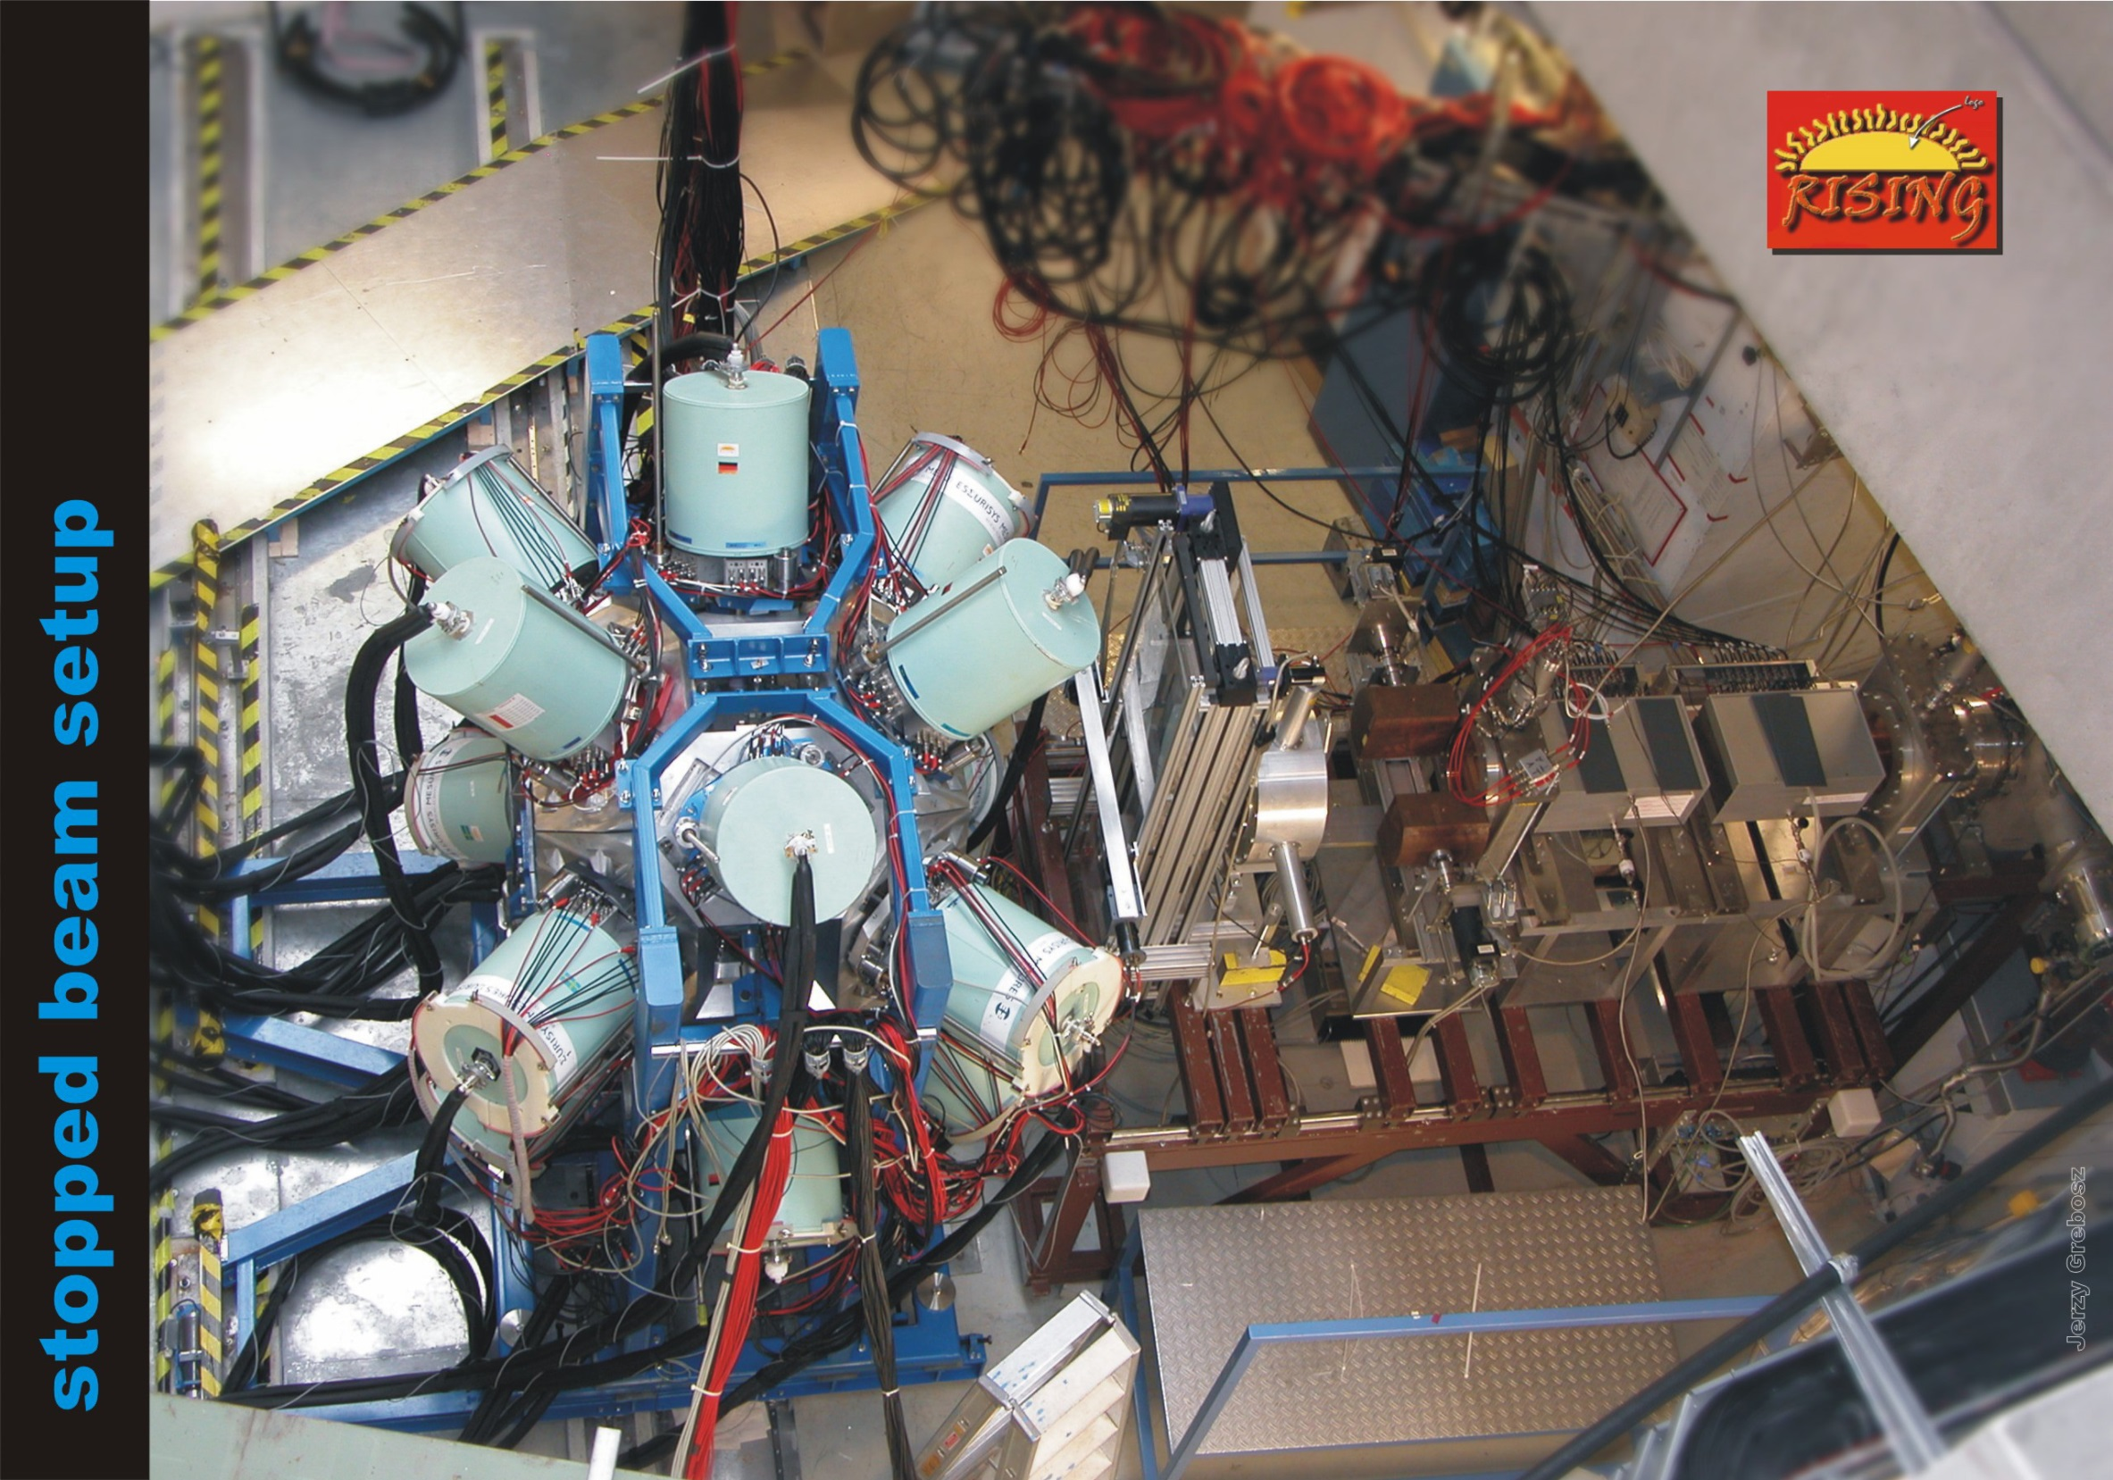
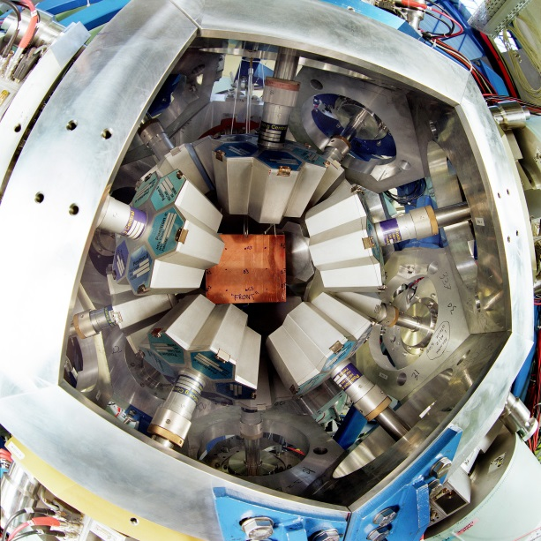
ionization
chambers
(MUSIC41,42)
scintillator
(SC41)
beam
multiwire
chambers
(MW41,MW42)
degrader

Slide 25
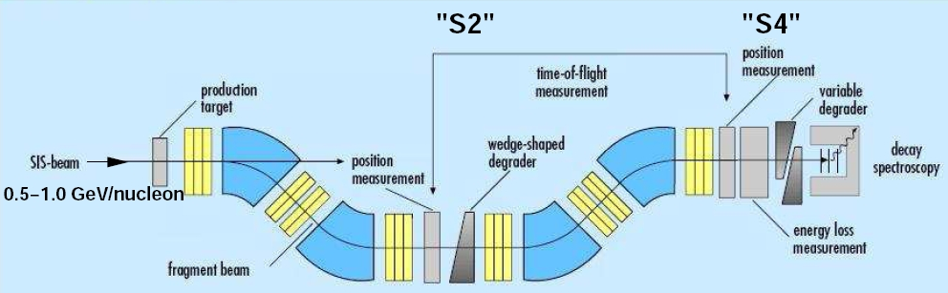

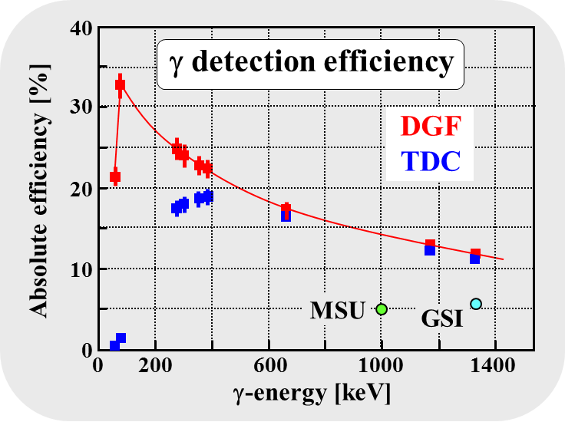
Experimental set-up with passive target
σ_{exp}(¹³⁰Cd)~150 pb
variable
degrader
4 g/cm² Be
¹³⁶Xe
750 MeV/u
ΔE
15 Cluster detectors with 105 Ge crystals
ε_{γ} = 11% at 1.3 MeV, 20% at 550 keV, 35% at 100 keV
very high γ-ray efficiency
high granularity (prompt flash problem)
implantation in Cu-plate
S. Pietri et al., NIM B261 (2007), 1079

Slide 26

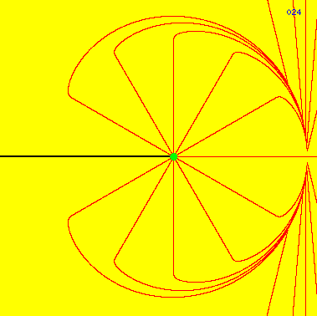
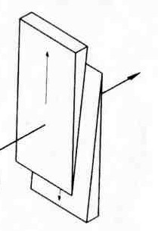
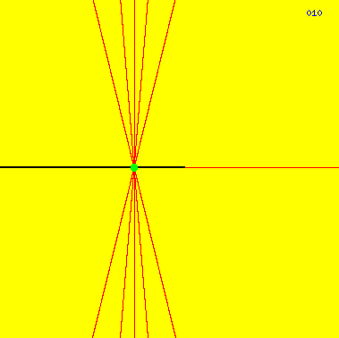

Limitations in isomeric spectroscopy
degrader
electrical field lines

Slide 27

Identification of ${}_{48}^{130}{{Cd}_{82}}$
production
selection & identification
stopping
variable
degrader
σ_{exp}(¹³⁰Cd) ~ 150 pb
4 g/cm² Be
¹³⁶Xe
750 MeV/u
ΔE
spectroscopy
130Cd
4000 identified ¹³⁰Cd ions
in fragmentation
Notes:
EPAX = 175 pb

Slide 28




Limitations in isomer spectroscopy
¹³⁰Cd: DGF-timing
0
1.5
1.0
0.5
0.0
slowing down of a moving point-charge
Energy ( MeV )
DGF time ( arbt. units )
Prompt γ-flash
Decay time range: 20 ns ... 20 μs
A. Jungclaus et al., Phys. Rev. Lett 99, 132501 (2007)
Notes:
dgf = digital gamma finder

Slide 29

Decay spectroscopy probes shell closures
¹³⁰Cd: DGF-timing
0
1.5
1.0
0.5
0.0
Energy ( MeV )
DGF time ( arbt. units )
Prompt γ-flash
Decay time range: 20 ns ... 20 μs
A. Jungclaus et al., Phys. Rev. Lett 99, 132501 (2007)

Slide 30

Decay spectroscopy probes shell closures
No Shell quenching observed
A. Jungclaus et al., Phys. Rev. Lett 99, 132501 (2007)

Slide 31


Decay spectroscopy probes shell closures
¹²⁸Cd: DGF-timing
1.5
1.0
5.0
0.0
Energy ( MeV )
DGF time ( arbt. units )
L. Caceres et al., Phys. Rev. C79, 011301(R) (2009)

Slide 32

Decay spectroscopy probes shell closures

Slide 33
8⁺(g_{9/2})⁻² seniority isomers in ⁹⁸Cd and ¹³⁰Cd
h_{11/2}
N=82
MeV
(8⁺)
2428
2.6
(6⁺)
d_{3/2}
2.2
(4⁺)
2281
s_{1/2}
1.6
(8⁺)
2128
N=50
Z=48
2083
d_{5/2}
0.5
(6⁺)
N=82
Z=48
(4⁺)
2002
g_{7/2}
0
1864
N=50
(2⁺)
participating neutron-orbitals
(2⁺)
1395
1325
two proton holes in the g_{9/2} orbit
No dramatic shell quenching!
0⁺
0⁺
A. Blazhev et al., Phys. Rev. C69 (2004) 064304 A. Jungclaus et al., Phys. Rev. Lett. 99 (2007), 132501

Slide 34

The astrophysical r-process ´path´
r-process abundances
exp.
pronounced shell gap
shell structure quenched
mass number A
r-process waiting point
Assumption of a N=82 shell quenching leads to a considerable
improvement in the global abundance fit in r-process calculations !

Slide 35








Level scheme of ²¹⁰Pb
2846 keV
2202 keV
1558 keV
exp. single particle energies
1423 keV
779 keV
0.0 keV
-1304 keV (pairing energy)
residual interaction !
M. Rejmund Z.Phys. A359 (1997), 243

Slide 36

Level schemes of neutron-rich Pb-isotopes
Pb216
Pb217
Pb218
g_{9/2}

Slide 37

Nuclei populated in fragmentation
1 GeV·A ²³⁸U beam with 10⁹ pps on 2.5 g/cm² ⁹Be

Slide 38

γ-ray spectra and decay curves for ^{212,214,216}Pb

Slide 39




T=1 isospin symmetry in pf-shell nuclei search for isospin breaking effects
28
218(4) ns
525(10) ns
mirror nuclei
28
N=Z
decay of the excited 10⁺-state by proton emission and γ-radiation
N=Z
28
26
26
28
⁵⁴Fe / ⁵⁴Ni: π / ν (f_{7/2})⁻²
D. Rudolph, R. Hoischen et al., Phys.Rev.C78 (2008), 021301

Slide 40




Identification of ⁵⁴Ni
γγ coincidence spectra
gate on ⁵⁴Ni
50 ns < t < 1 μs

Slide 41

The big surprise …
Delayed γ-spectrum for ⁵⁴Ni (50ns-1μs)
Where does the 1327 keV line come from ???

Slide 42

Time spectra (long range TDC)

Slide 43




Active target SIlicon IMplantation detector and Beta Absorber
¹⁰⁰Sn
β-calorimeter
10 mm Si
β-calorimeter
10 mm Si
implantation
2.1 mm Si
x-y position
0.6 mm Si
Notes:
10 mm Si stop 4-5 MeV beta particles

Slide 44

Spectroscopy of the doubly magic nucleus ¹⁰⁰Sn and its decay
Z
N=Z-1
N=Z
N=Z+1
N=Z+2
259 ¹⁰⁰Sn
Te
¹⁰³Sb?
Sb
⁹⁹Sn
Sn
⁹⁷In
In
⁹⁵Cd
Cd
⁹³Ag
Ag
A/Q

Slide 45


Spectroscopy of the doubly magic nucleus 100Sn and its decay
Theoretical predictions for the ¹⁰⁰Sn level schemes
~ 100 ns
6⁺
4⁺
p?
1.6MeV
5 ns
2⁺
3⁻
0⁺
¹⁰⁰Sn

Slide 46



Gamow-Teller Strength and Q_{EC} value in the β-decay of ¹⁰⁰Sn
Single particle energies for shell model orbitals in ¹⁰⁰Sn
¹⁰⁰Sn is an ideal testing ground to investigate GT-strength:
ℓs-coupling ~6 MeV
pure GT spin-flip transition: 0⁺ (πg_{9/2}⁻¹ νg_{7/2}) 1⁺
Almost the whole strength of the GT resonance is covered by the energy window of the β⁺-decay
Theoretical calculation of the distribution of the GT-strength:
97% of the whole strength is concentrated in a single state, which is accessible in the β⁺-decay
β⁺: Q=M(Z+1)c²-M(Z)c²-2m_{e}c²
EC: Q=M(Z+1)c²-M(Z)c²-BE(K-electron)
β⁺ decay
$$B_{GT}\left(ESM\right)=\frac{4ℓ}{2ℓ+1}∙\left(1−\frac{N_{νg_{7/2}}}{8}\right)∙N_{πg_{9/2}}$$
= 17.78
EC-decay
Gamow-Teller-Strength B_{GT}
with ℓ=4 N_{νg7/2}=0 N_{πg9/2}=10
excitation energy in ¹⁰⁰In [MeV]
Notes:
Fermi decay: neutrino and electron are emitted with antiparallel spins. (no change of isospin, population of isobaric analogue states, β⁺ decay in lighter nuclei Z>N, to 0⁺ state in daughter nucleus, ¹⁰⁰Sn ~13 MeV. Gamow-Teller decay: neutrino and electron are emitted with parallel spins. In GT-β⁺ decay a proton is converted to a neutron with opposite spin direction, Q_{EC} ~ 7-8 MeV

Slide 47





Gamow-Teller strength and Q_{EC} value in the β-decay of ¹⁰⁰Sn
T_{1/2} = 1.16 ± 0.20 s
The Gamow-Teller Strength B_{GT} (only one final state populated) can be calculated from the half life T_{1/2} and the Fermi Phasespace Integral f(Z,E₀):
$$f\left(Z,E_{0}\right)∙T_{1/2}=\frac{2π^{3}ℏ^{7}}{{m_{e}}^{5}c^{4}{G_{F}}^{2}}∙\frac{ln2}{{g_{v}}^{2}∙{\left|M_{F}\right|}^{2}+{g_{A}}^{2}∙{\left|M_{GT}\right|}^{2}}$$
G_{F}/(ħc)³ = 1.16637(1)·10⁻⁵ GeV⁻², g_{A}/g$V$ = 1.2695 ± 0.0029
$$f\left(Z,E_{0}\right)∙T_{1/2}=\frac{6142.8s}{B_{F}+{\left(g_{A}/g_{V}\right)}^{2}∙B_{GT}}$$
In the case of a pure Gamow-Teller decay the transition strength can be calculated in the following way:
$$B_{GT}=\frac{3811.5s}{f\left(Z,E_{0}\right)∙T_{1/2}}$$
= 9.1
+4.8
-2.3
E₀ = 3.29 ± 0.20 MeV
Fermi-integral with LOGFT program NNDC
Notes:
MLH =maximum likelihood analysis, weak coupling constants g_{A} and g_{V} axial vector current (decay of free neutron)

Slide 48



Gamow-Teller strength and Q_{EC} value in the β-decay of ¹⁰⁰Sn
$$B_{GT}\left(ESM\right)=\frac{4ℓ}{2ℓ+1}∙\left(1−\frac{N_{νg_{7/2}}}{8}\right)∙N_{πg_{9/2}}$$
= 17.78
with ℓ=4 N_{νg7/2}=0 N_{πg9/2}=10
$$B_{GT}=\frac{3811.5s}{f\left(Z,E_{0}\right)∙T_{1/2}}$$
= 9.1
+4.8
-2.3
The main condition for the existence of isolated Super Gamow-Teller transition is that the spin-orbit gap between the ℓ+1/2 and ℓ-1/2 orbits (in ¹⁰⁰Sn ℓ=4 orbitals πg_{9/2},υg_{7/2}) be sufficiently small compared to the shell gap for protons and neutrons (6 MeV), so that the 1-particle-1-hole states are isolated below the 2-particle-2-hole states.

Slide 49

Gamow-Teller strength and Q_{EC} value in the β-decay of ¹⁰⁰Sn
Q_{EC}=E_{β} + E(1⁺) + 2m_{e}c²

