Slide 1
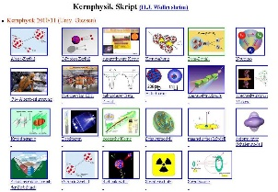
Outline: K-isomers in ¹⁸⁰Ta
Lecturer: Hans-Jürgen Wollersheim
e-mail: h.j.wollersheim@gsi.de
web-page: https://web-docs.gsi.de/~wolle/ and click on
K-selection rule
Coulomb activation of ¹⁸⁰Ta
excitation and decay of K=1 band in ¹⁸⁰Ta
investigation of the K=16 isomer in ¹⁷⁸Hf
deuteron and ²⁰⁸Pb inelastic scattering, laser spectroscopy

Slide 2
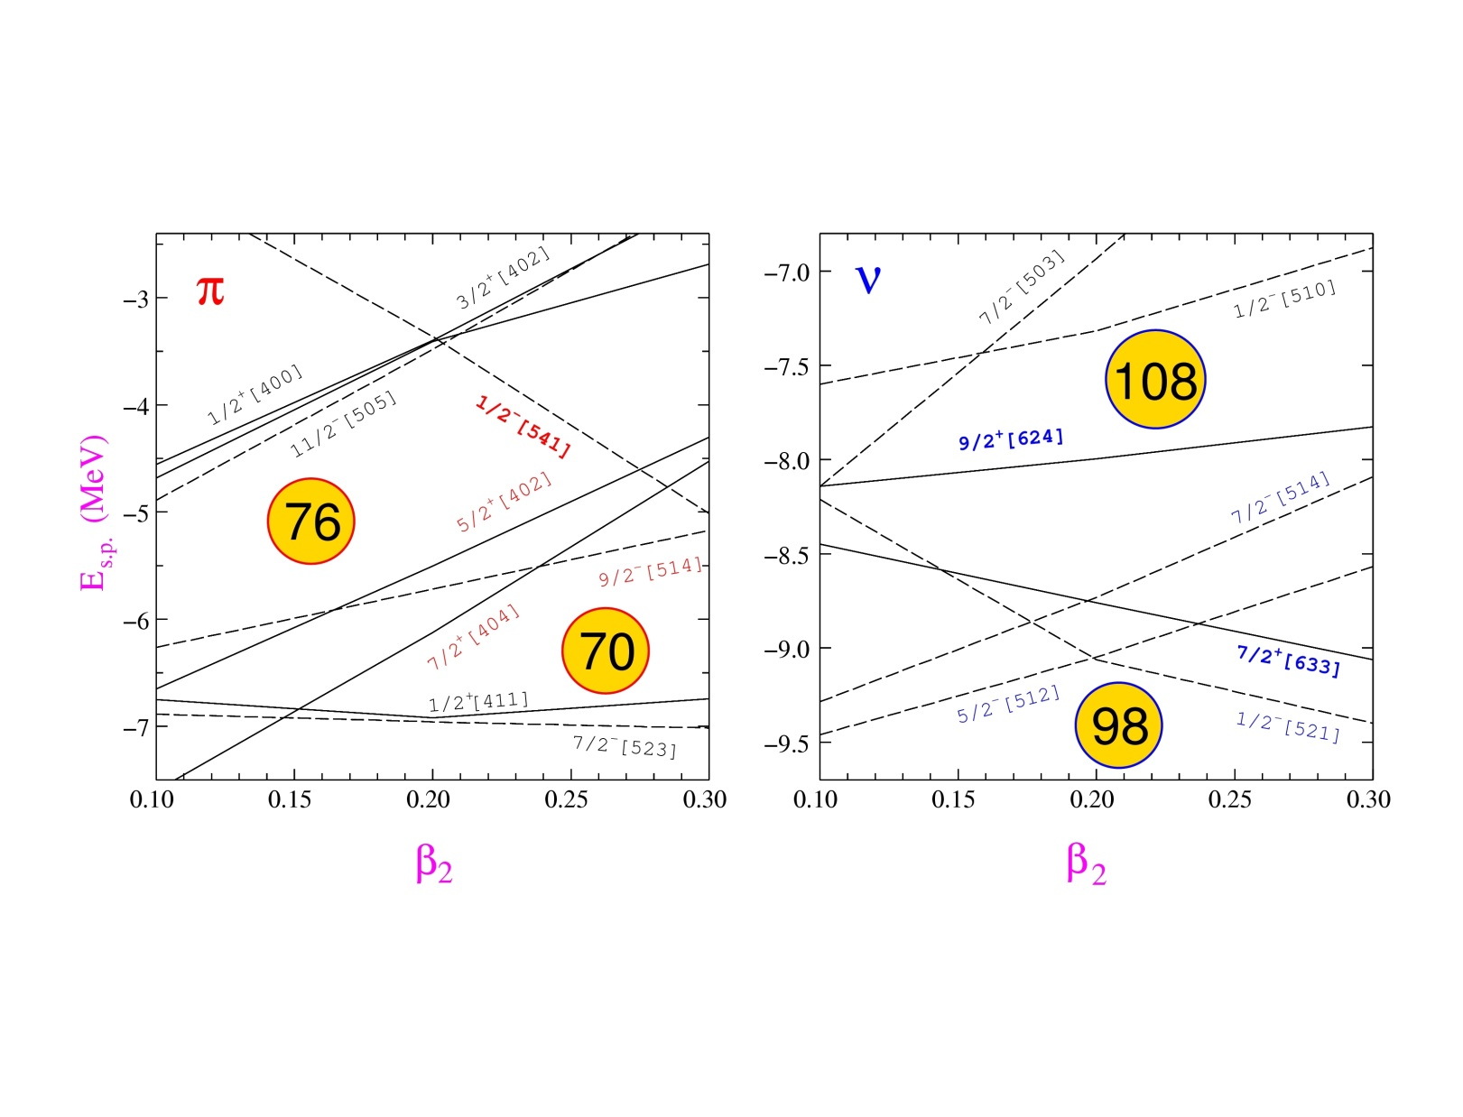
K-isomers: Where to find them?
Deformed nuclei with axially-symmetric shape
Mass 180 region : Yb (Z=70) - Ir (Z=77)
ω
j₂
j₁
j
K
High-K orbitals near the Fermi surface
: 7/2[404], 9/2[514], 5/2[402]
ν: 7/2[514], 9/2[624], 5/2[512], 7/2[633]

Slide 3
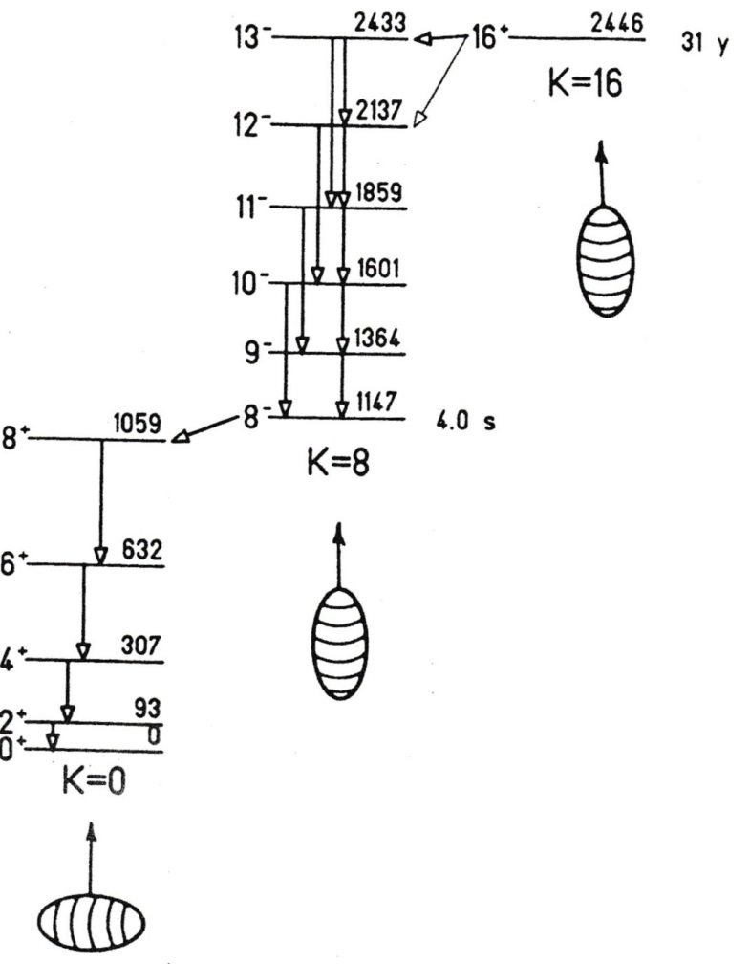
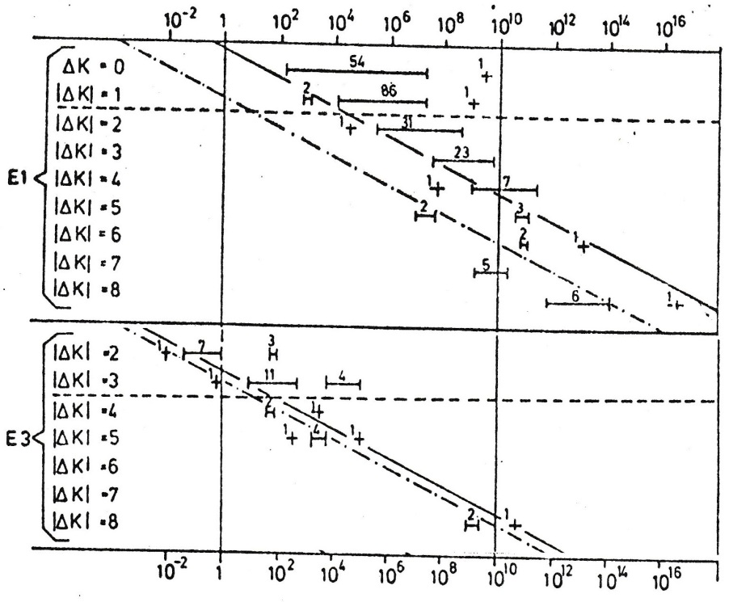
Isomerism
H = 10⁹
H = 2·10¹³
$$H=\frac{t_{1/2}\left(experiment\right)}{t_{1/2}\left(Weisskopf estimate\right)}$$
K-selection rule
Helmer & Reich; Nucl. Phys. A114 (1968), 649

Slide 4
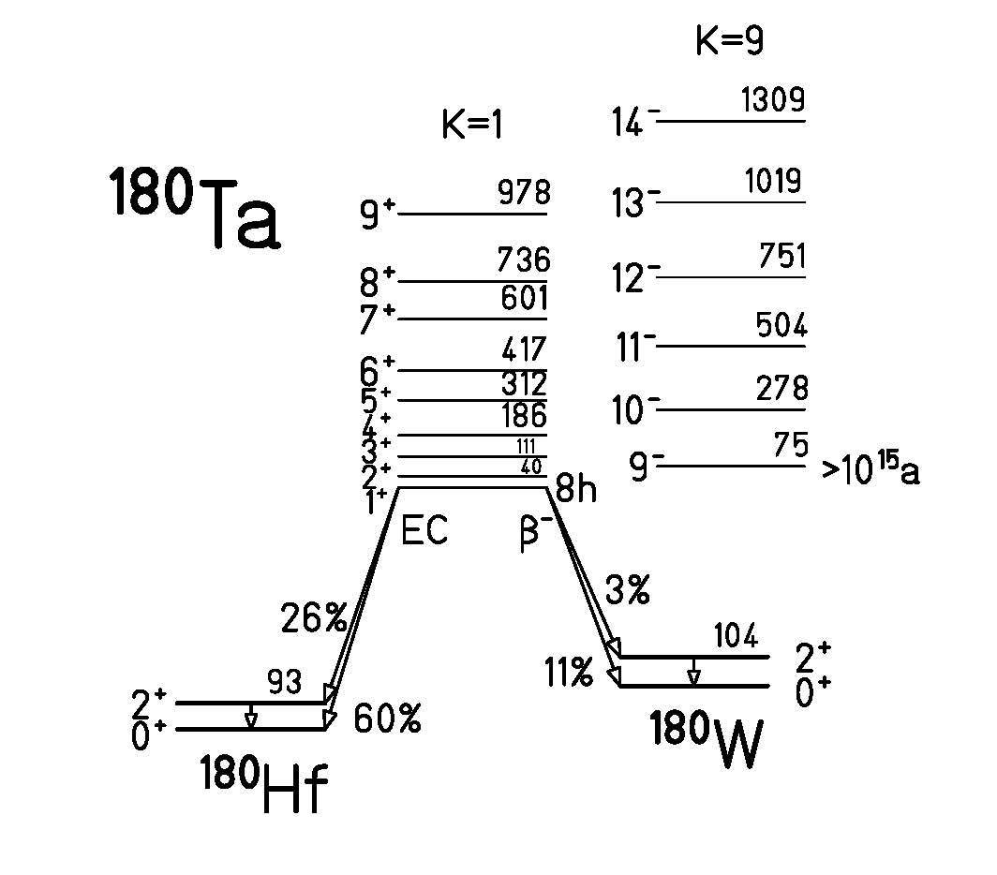
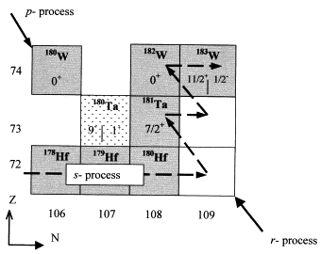
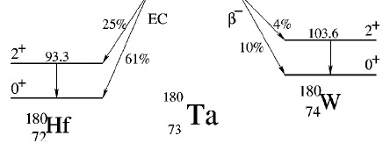
K-isomers in ¹⁸⁰Ta
75 keV
>10¹⁵ a !!!
0
8h
The rarest natural isotope: abundance of 0.012%

Slide 5
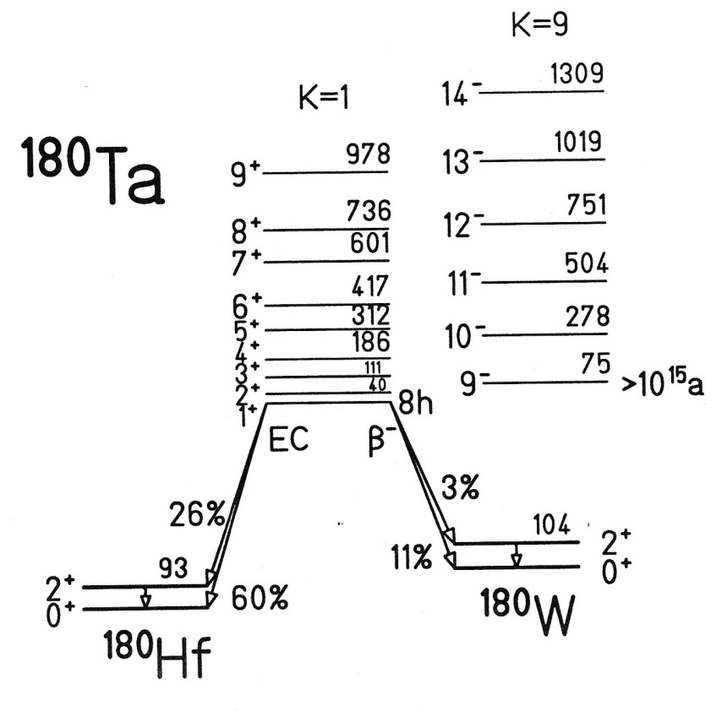
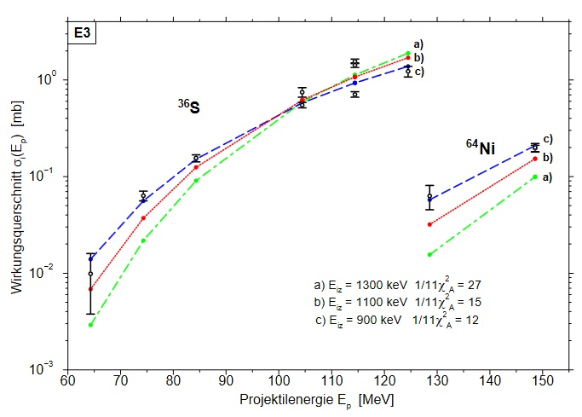
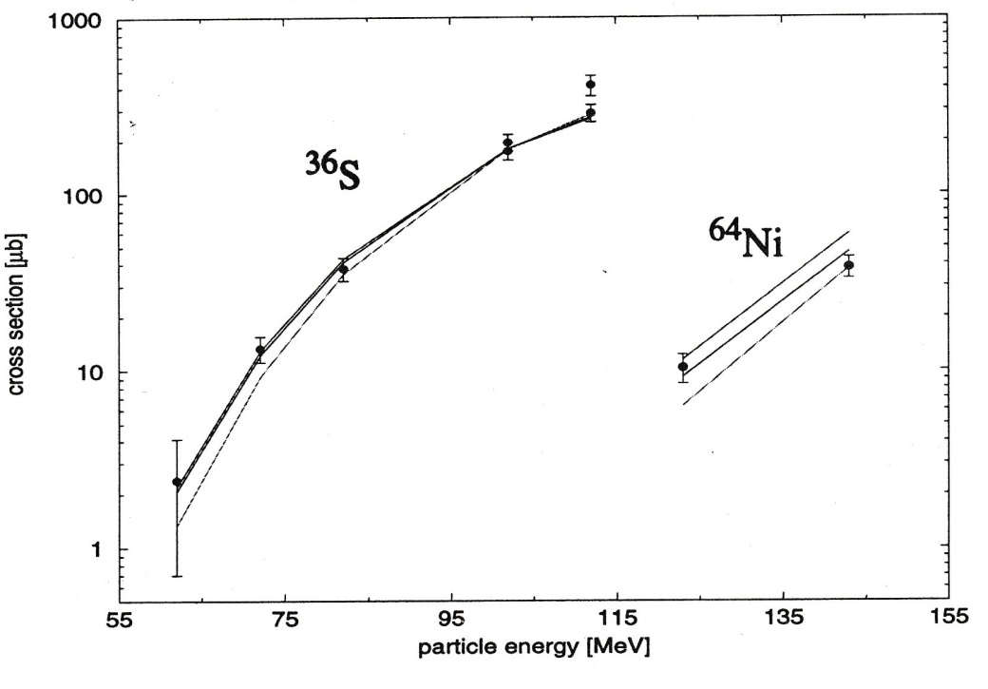
Coulomb activation of ¹⁸⁰Ta
excitation function
The curves are calculated with the Coulomb excitation code COULEX
red curve: single step E2 E* = 1.1 MeV B(E2) = 0.3 W.u. final spin 9⁻
blue curve: single step E3 E* = 1.1 MeV B(E3) = 3.3 W.u. final spin 9⁺
green curve: single step E3 E* = 1.2 MeV B(E3) = 4.0 W.u. final spin 9⁺

Slide 6
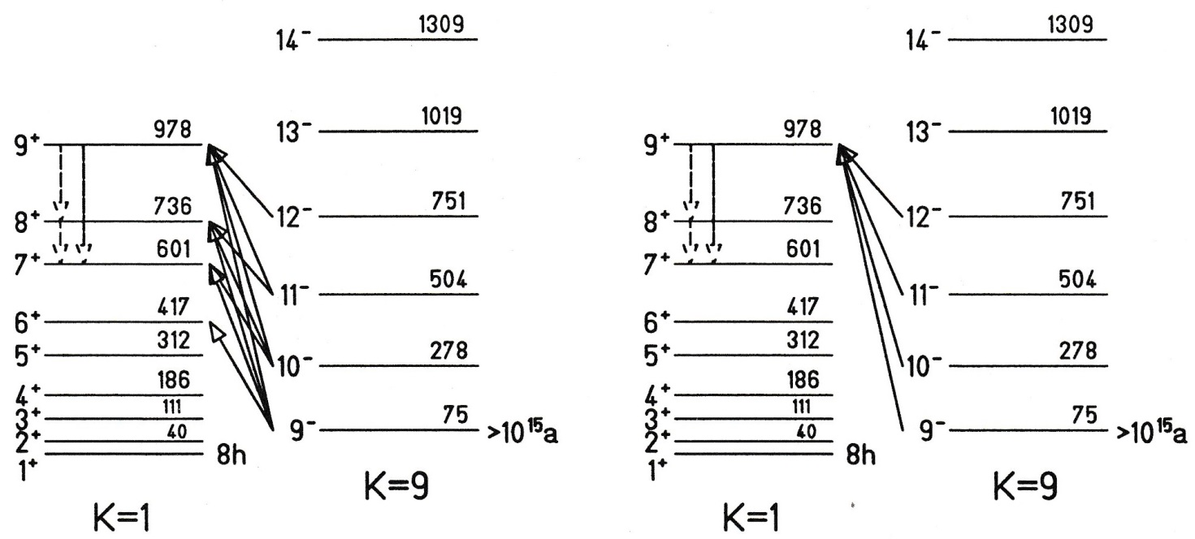
2-band K-mixing model
+ small K=1 admixture
+ small K=9 admixture
rigid rotor model:
$$\left\langle I_{f}\right.\left\|M\left(E3\right)\right\|\left.I_{i}\right\rangle =\sqrt{2I_{i}+1}∙\left(I_{i}3K0|I_{f}K\right)∙M_{30}$$

Slide 7
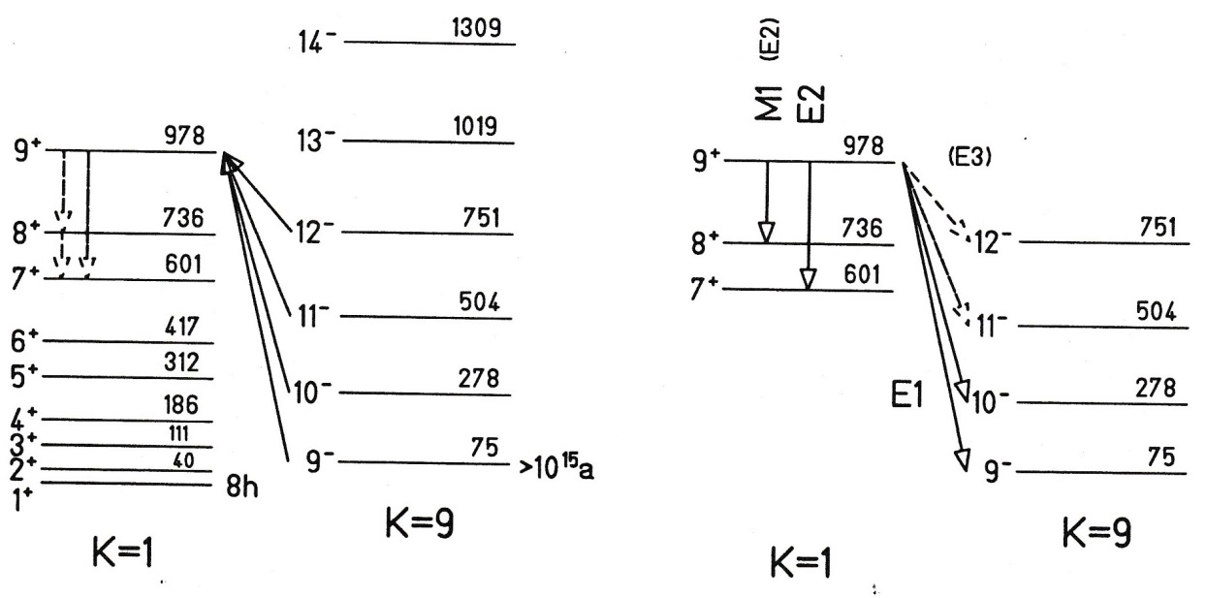
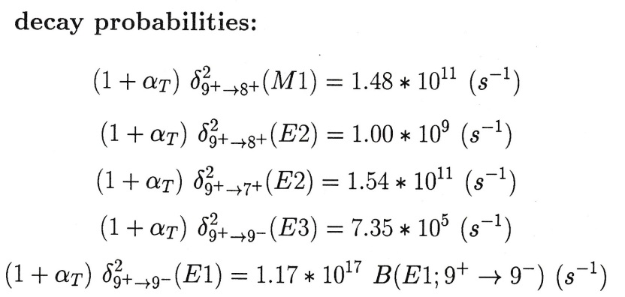
Excitation and decay of the K=1 band
1.3·10⁻⁴ W.u.

Slide 8
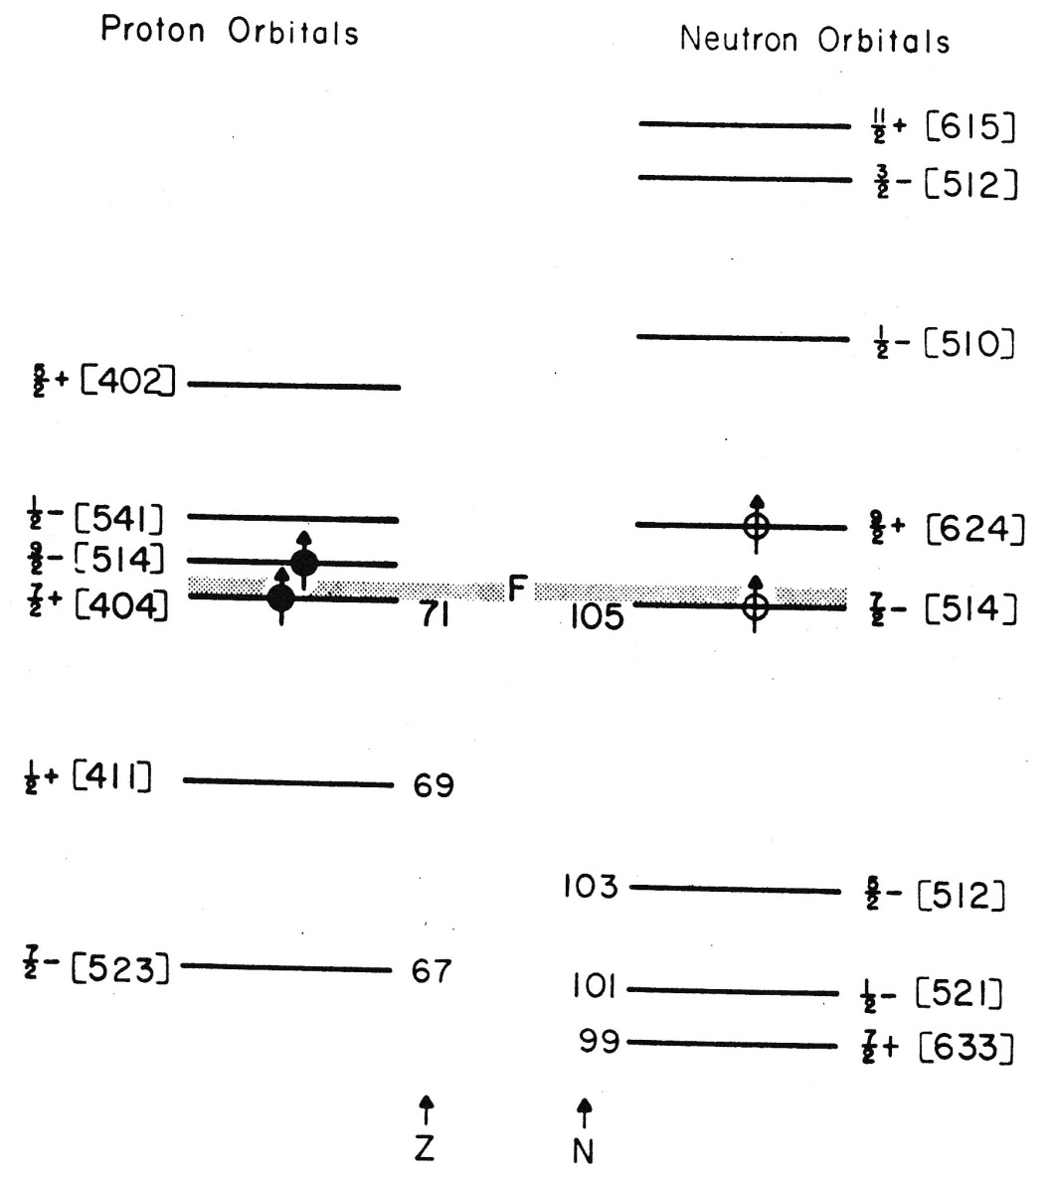
Proton Neutron orbitals

Slide 9
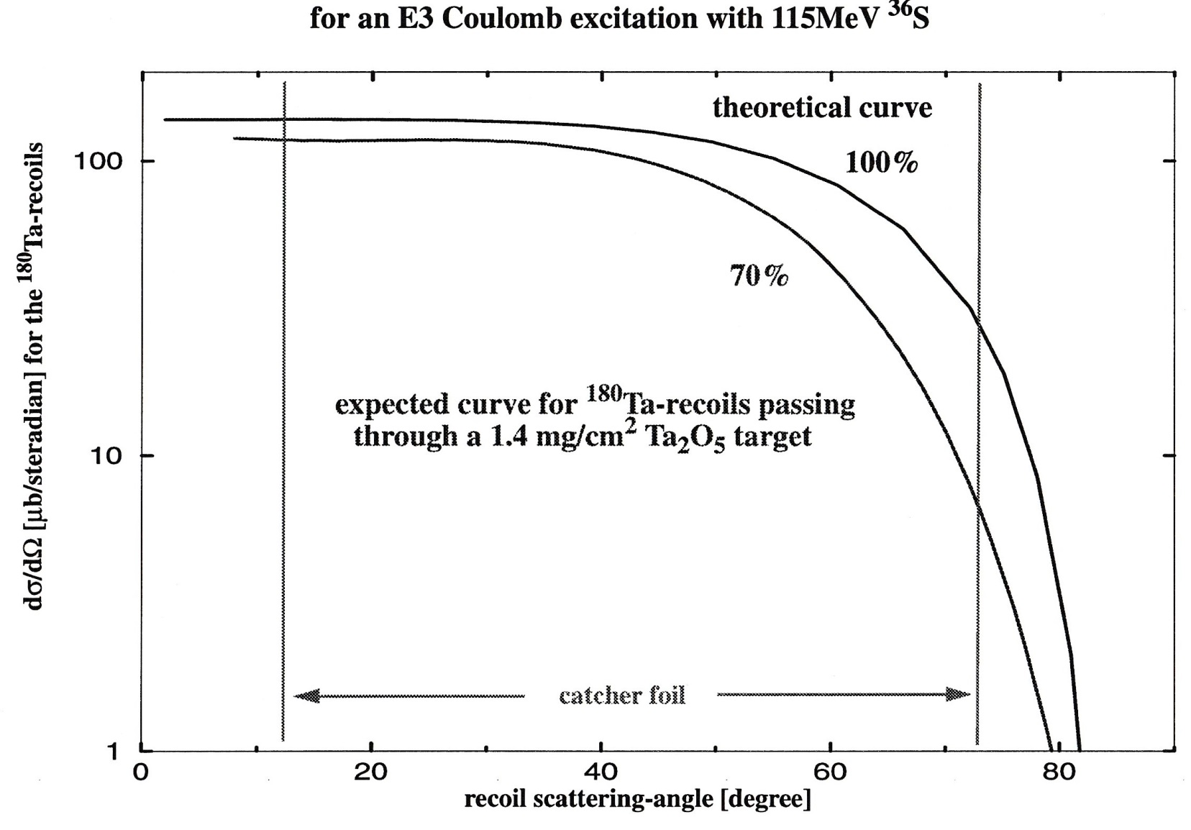
Influence of the target on the differential cross section

Slide 10
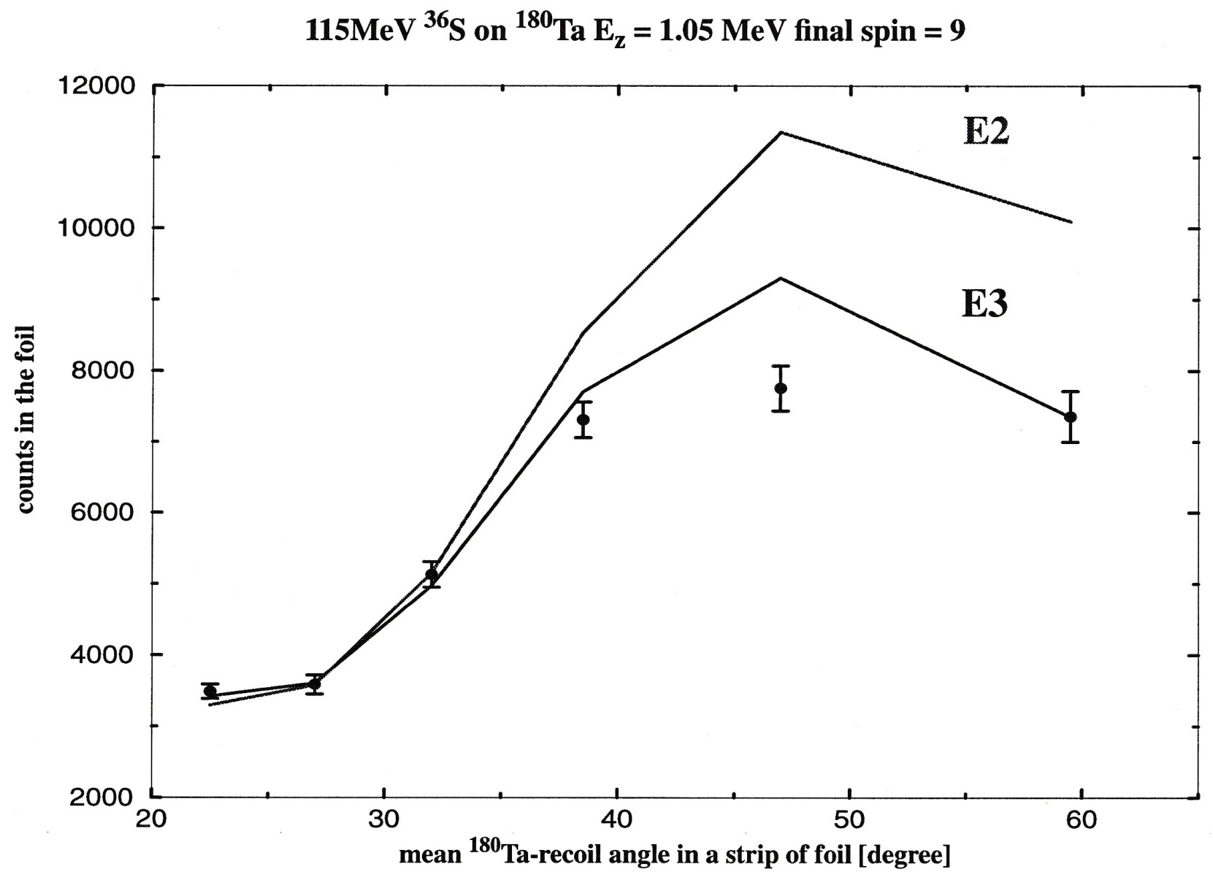
Dependence of the angular distribution on the multipolarity of the excitation

