Slide 1

Outline: Symmetries
Lecturer: Hans-Jürgen Wollersheim
e-mail: h.j.wollersheim@gsi.de
web-page: https://web-docs.gsi.de/~wolle/ and click on
definition and consequences
isospin symmetry (mirror nuclei: ⁵⁴Ni, ⁵⁴Fe)
seniority-pairing: ⁹⁸Cd, ¹³⁰Cd
rotational nuclei SU(3): ²⁵⁴No, ¹⁵²Dy
octupole deformation: ²²⁶Ra

Slide 2
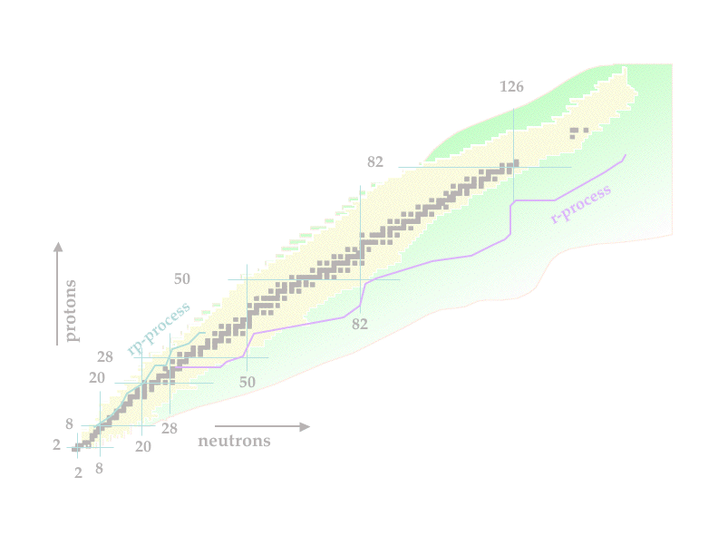
Structure of exotic nuclei – basic symmetries
Introduction
Symmetries
  Isospin Symmetry (mirror nuclei: ⁵⁴Ni, ⁵⁴Fe)
  Seniority-pairing: ⁹⁸Cd, ¹³⁰Cd
  Rotational nuclei SU(3): ²⁵⁴No
  Superdeformed nuclei: ¹⁵²Dy
  Octupole deformation: ²²⁶Ra
Summary and outlook

Slide 3
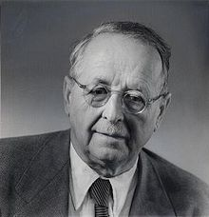
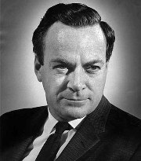
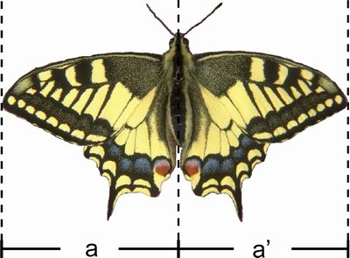
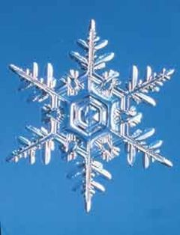
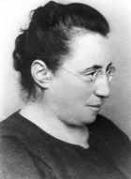
Symmetry: definition
by Hermann Weyl, Richard P. Feynman:
object, natural law
transformation
„… a thing is symmetrical, if you can do something to it
and after you have done it, it looks the same as before …“
invariance
why symmetries ?
Symmetry: ordering principle
predictions
connection to unobserved quantities
conservation laws
structure of interactions
Noether-theorem (1918)
Emmy Amalie Noether (1882-1935)
The symmetry properties of a physical system are intimately related to conservation laws!

Slide 4
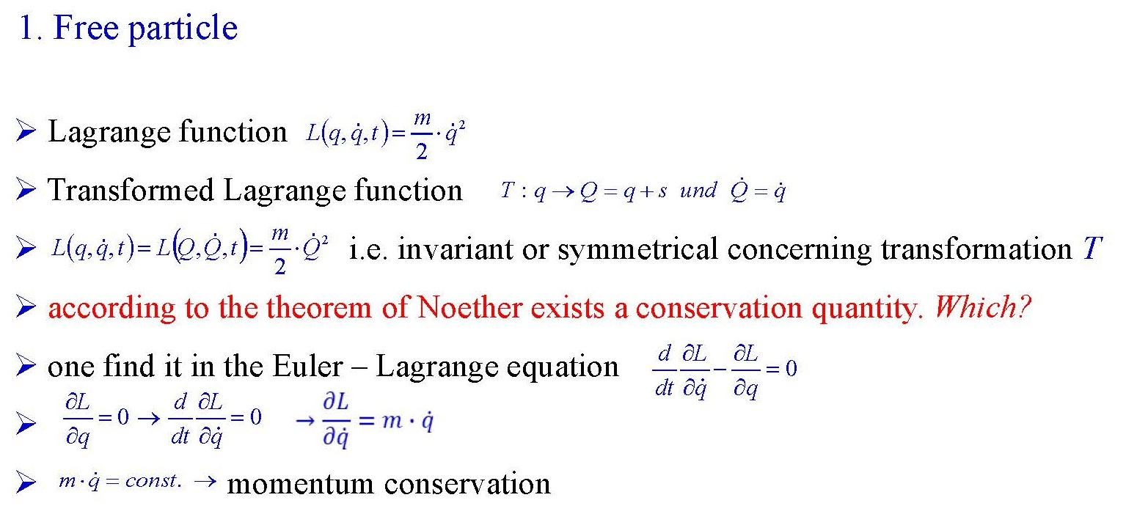
Example
Example

Slide 5
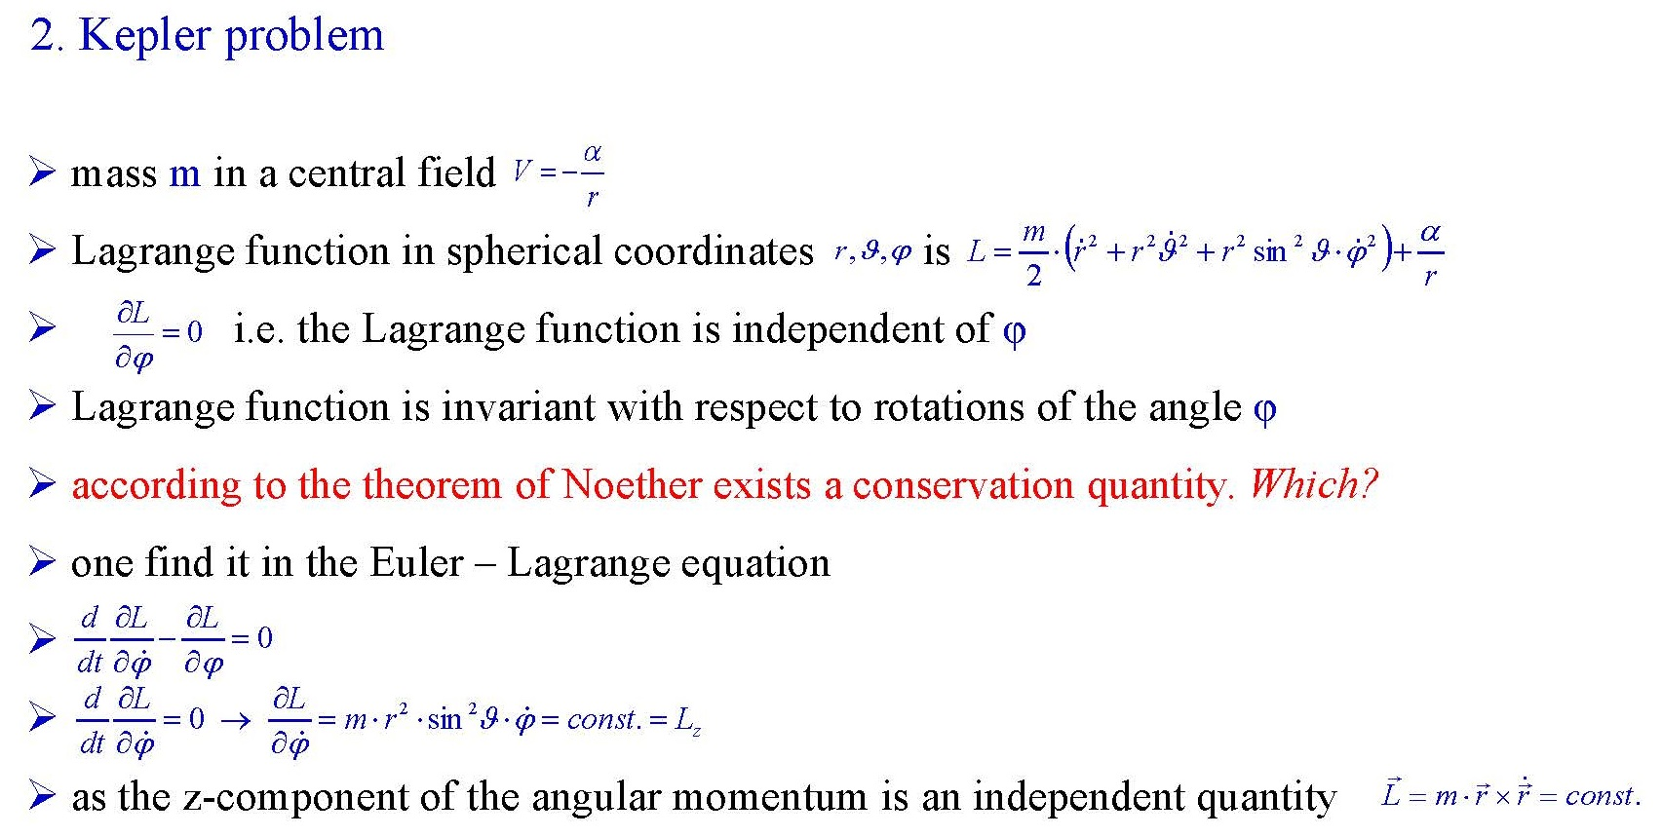
Example
Example

Slide 6
Conservation quantities in space-time symmetries
Homogeneity of space
momentum conservation
Isotropy of space
angular momentum
conservation
Homogeneity of time
energy conservation
solar system
energy - and angular momentum conservation

Slide 7
Particle physics: particle zoo
How can we bring order in the particle zoo ?
new symmetry ? new conservation quantities ? new order !

Slide 8
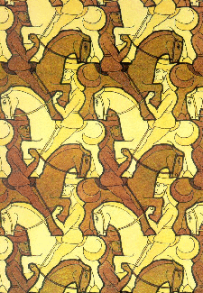
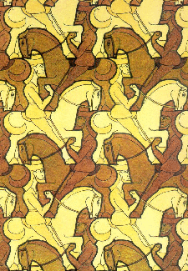
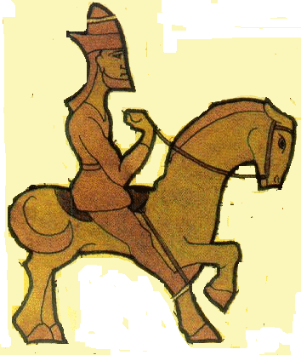
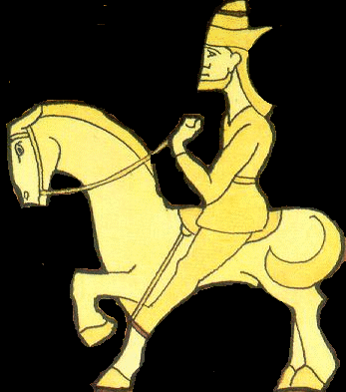
The world according to Escher/Pauli
The world according to Escher/Pauli
H.W. Wilschut
P
C
T
identical
to start
start
matter
antimatter
start
matter
antimatter
identical to start
mirror
time → ← time
mirror
time →
← time
Holds on very general grounds:
Nature is local, causal & Lorentz invariant.
True for gauge theories!
Matter antimatter asymmetry not explained
antiparticle particle
P ≡ space inversion, C ≡ charge, T ≡ time reversal invariance

Slide 9
C.S. Wu: Experimental test of parity conservation in beta-decay
before parity operation
after parity operation
spin polarized
β-decay in
nuclear spin aligned
in a mag. field at T=10 mK
The different yields of the detected electrons at θ and 180-θ is a unique proof of the parity
violation in the β⁻ - decay.

Slide 10


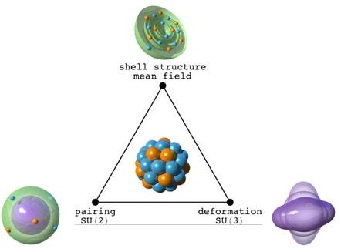
Chart of nuclei
properties of nuclear matter

Slide 11
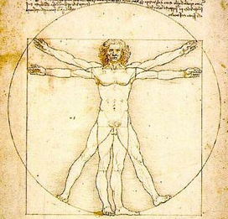

Symmetries
Symmetries help to understand nature
Investigation of fundamental symmetries:
a key-question in physics
conservation laws
good quantum numbers
chirality - if an image in a plane mirror cannot be brought to coincide with itself
In nuclear physics, conserved quantities imply underlying symmetries of the interactions and help to interpret nuclear structure features

Slide 12
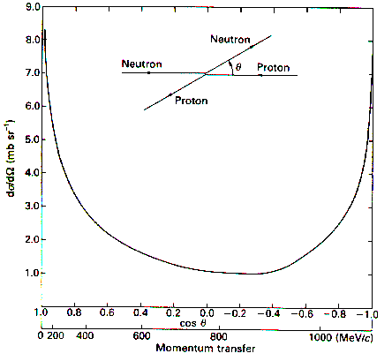
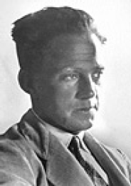
Symmetries in nuclear physics
Isospin symmetry: 1932 Heisenberg SU(2)
) θ
n
p
1901-1976
Nobel prize 1932
) θ
n
p
exchange forces
m_{p} = 938.3 MeV m_{n} = 939.5 MeV
Strong interaction can not distinguish between protons and neutrons
Proton and neutron are for strong interaction states of one particle (nucleon) → Isospin

Slide 13
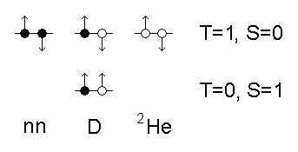
Isospin
T_{z}=1/2(Z-N)
T=|T_{z}|
proton: T_{z}(p) = +1/2
neutron: T_{z}(n) = -1/2
Proton and neutron are 2 states of the same particle.
Pauli principle forbids T=0 states for nn und ²He
Deuteron (T=0,S=1) is the only A=2 bound system
²He
nn

Slide 14
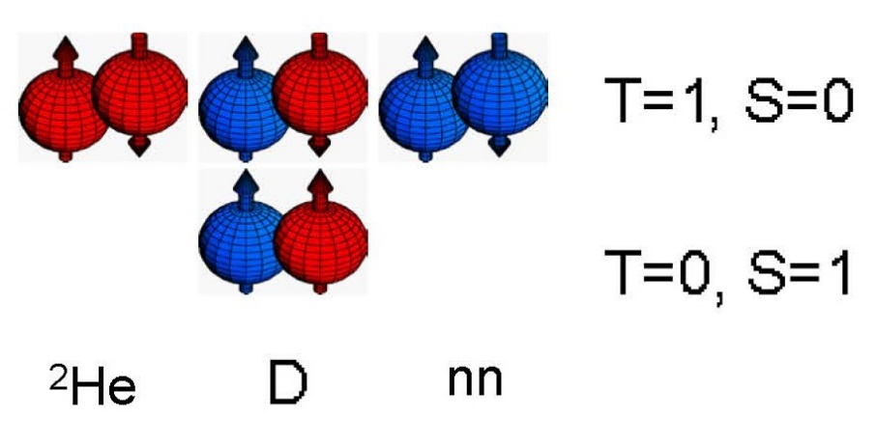
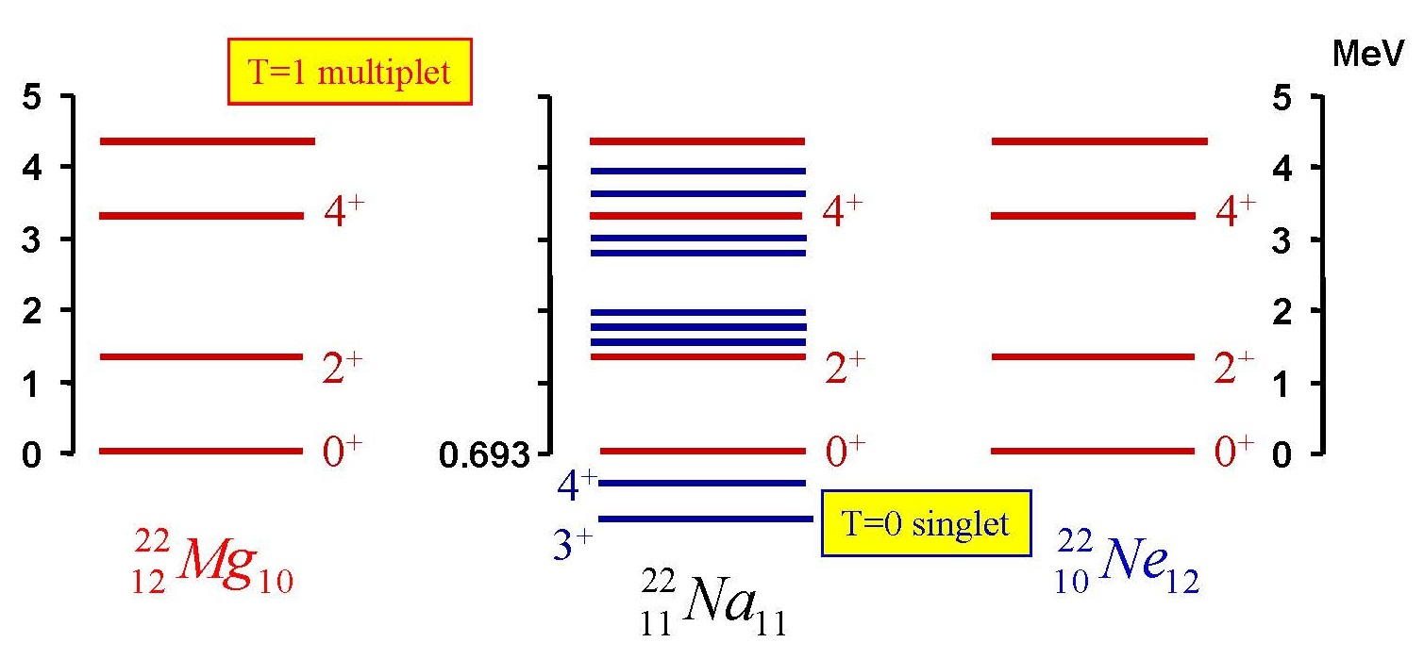
Isospin
Is V_{np} interaction equal to the V_{nn} and V_{pp}?
Compare the energy levels for nuclei with constant A.
Equal spin / parity states have the same energy.
V_{np}=V_{nn}=V_{pp}

Slide 15
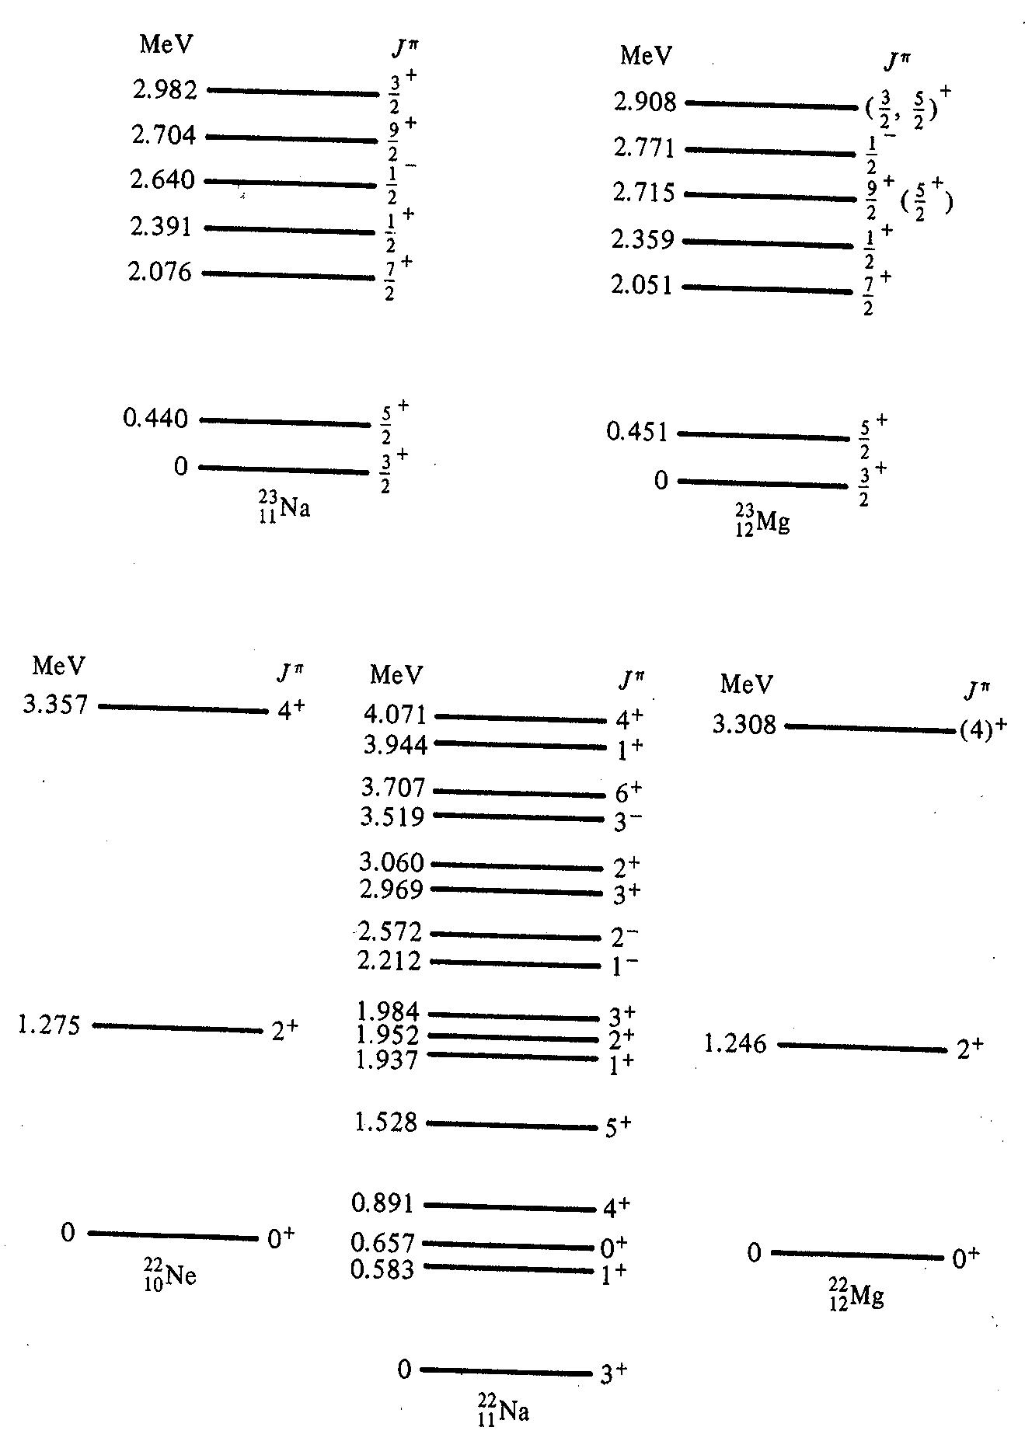

Isospin
Is V_{np} interaction equal to the V_{nn} and V_{pp}?
Compare the energy levels for nuclei with constant A.
Equal spin / parity states have the same energy.
V_{np}=V_{nn}=V_{pp}

Slide 16
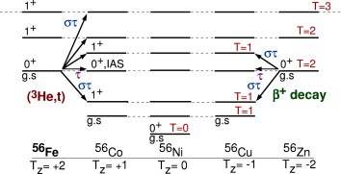
Isospin independence in nuclei
Nuclei with the same isospin, T, show nearly identical structure
Total energy is changed by the Coulomb force (+ other small differences)
Nuclei with varying T_{z} are called members of a multiplet

Slide 17

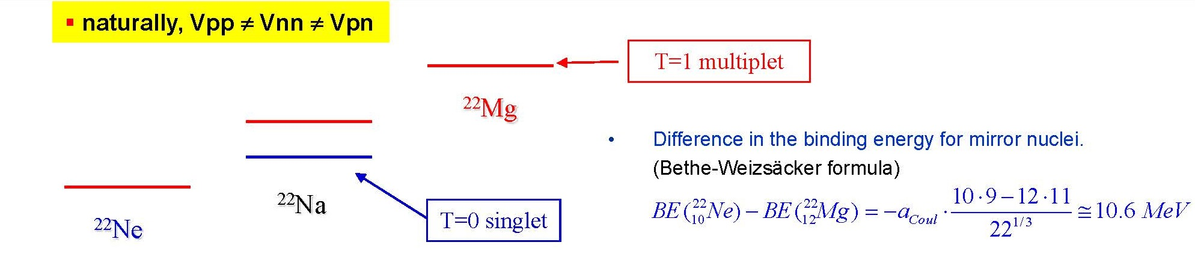
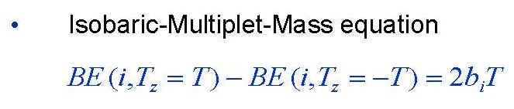
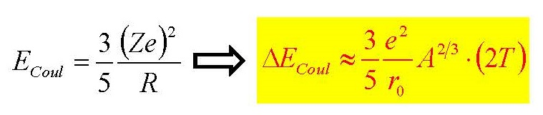
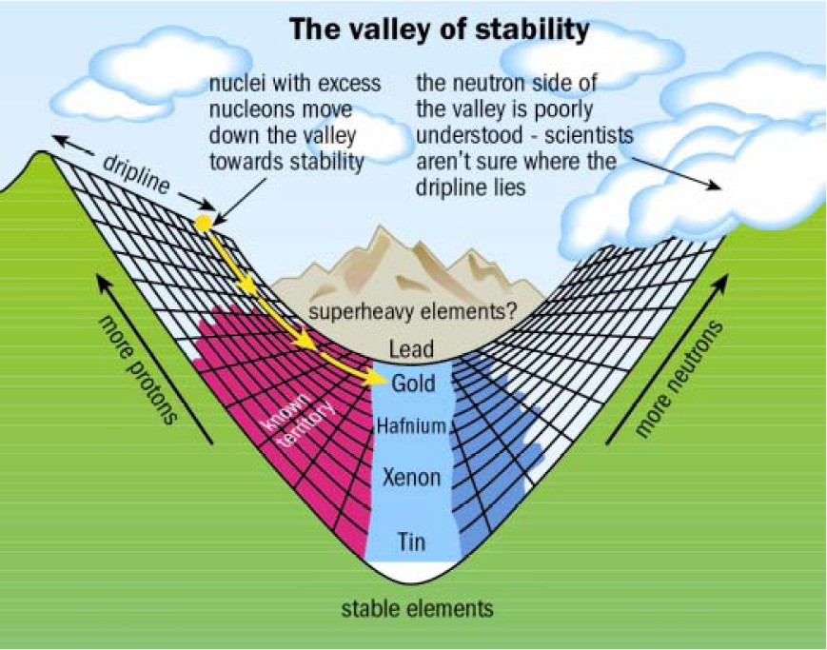
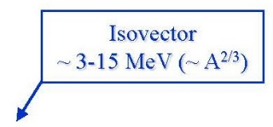

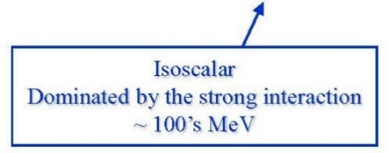
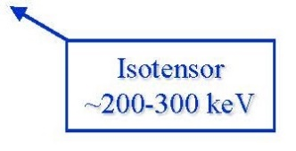
Isospin symmetry in T=1 nuclei
(apart from the Coulomb energy)

Slide 18
Isospin
naturally, Vpp ≠ Vnn ≠ Vpn
T=1 multiplet
²²Mg
²²Na
T=0 singlet
²²Ne
NN - interaction has scalar-, vector-, and tensor- components in the isospin space
isoscalar
isovector
isotensor
Isovector
~ 3-15 MeV (~ A^{2/3})
The Isobaric-Multiplet-Mass equation (IMME)
Isoscalar
Dominated by the strong interaction
~ 100’s MeV
Isotensor
~200-300 keV

Slide 19

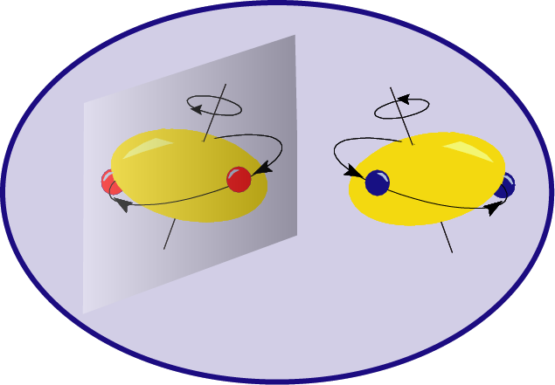
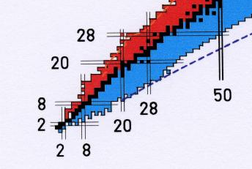
T=1 Isospin symmetry in pf-shell nuclei
Search for deviations from isospin symmetry
mirror nuclei
N=Z
⁵⁴Ni
⁵⁰Fe
⁵⁴Fe
⁴⁶Cr
⁵⁰Cr
T_{z}=-1
⁴⁶Ti
T_{z}=0
T_{z}=1

Slide 20
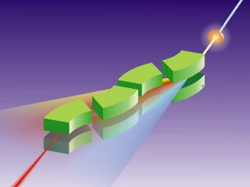
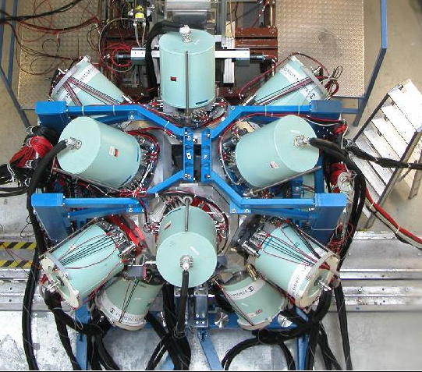
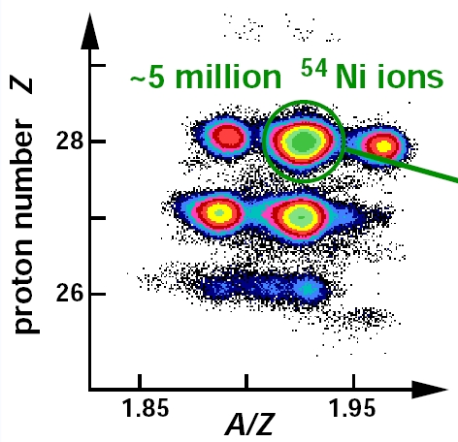
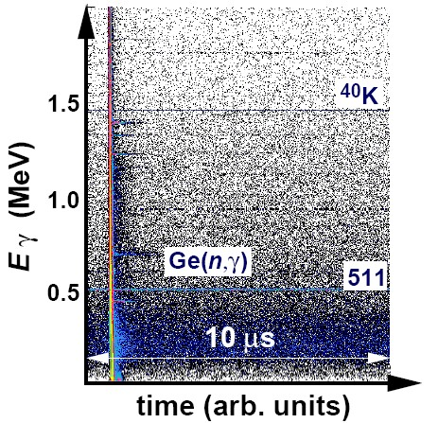
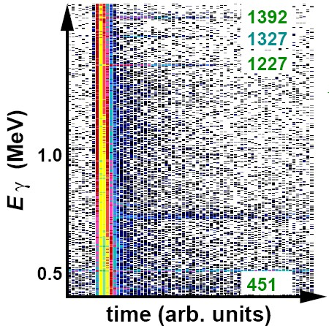
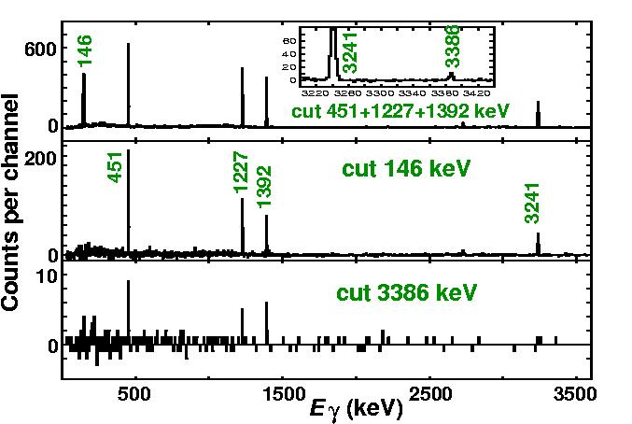
Identification of ⁵⁴Ni
γγ coincidence spectra
gate on ⁵⁴Ni
50 ns < t < 1 μs

Slide 21
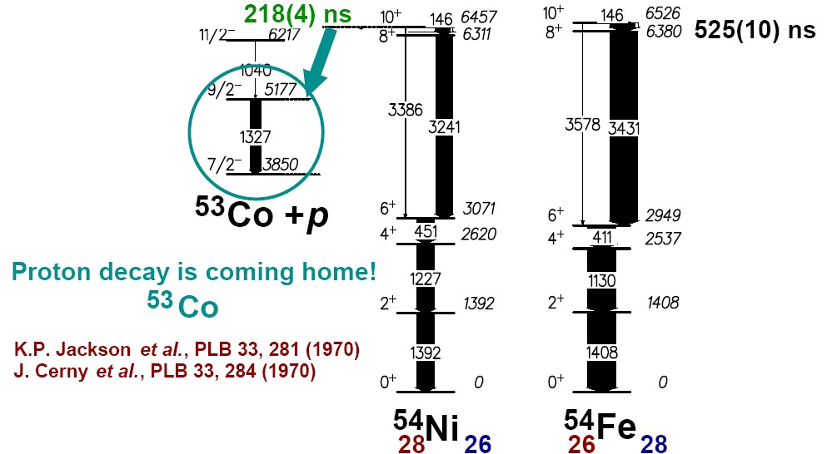
Proton radioactivity – decay of the I^{π}=10⁺ isomer in ⁵⁴Ni
decay of the excited 10⁺-state by proton emission and γ-radiation
D. Rudolph, R. Hoischen et al., Phys.Rev.C78 (2008), 021301

Slide 22
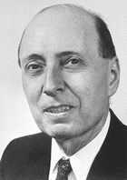
Symmetries in nuclear physics
Isospin Symmetry: 1932 Heisenberg SU(2)
Spin-Isospin Symmetry: 1936 Wigner SU(4)
Seniority-Pairing: 1943 Racah

Slide 23
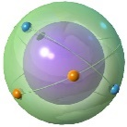
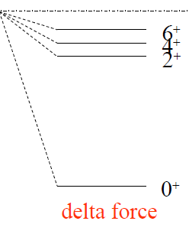
Pairing force: Seniority
Seniority ν is a number of unpaired nucleons. (pairs are usually coupled to J=0)
A large spin-orbit splitting (magic nuclei) leads to a jj-coupling scheme.
The pairing interaction between two nucleons in a j-subshell is only for ν=0 and J=0
different from zero.
ν=2
ν=2
ν=0
The δ-interaction explains the resulting seniority-spectra in a simple geometrical picture.

Slide 24
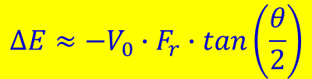
Paarungskraft: Seniorität
Seniorität ν ist die Zahl der Nukleonen, die nicht zu Paaren mit J=0 verknüpft sind.
Eine große Spin-Bahn Aufspaltung (magische Kerne) bedeutet ein jj-Kopplungsschema.
Die Paarwechselwirkung zwischen zwei Nukleonen in der j-Unterschale ist nur für
ν=0 und J=0 verschieden von Null.
energy axis
Seniority scheme:
θ_{min}
6⁺
ν=2
θ
θ
4⁺
ν=2
$$∆E≈−V_{0}∙F_{r}∙tan\left(\frac{θ}{2}\right)$$
j
j
j
J
2⁺
ν=2
j
j
j
j
J
j
J
0⁺
ν=0
Die δ-Wechselwirkung liefert eine einfache geometrische Begründung für die
Senioritäts-Spektren.

Slide 25
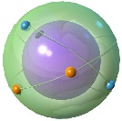
8⁺(g_{9/2})⁻² seniority isomers in ⁹⁸Cd and ¹³⁰Cd
h_{11/2}
N=82
MeV
2.6
d_{3/2}
2.2
s_{1/2}
1.6
(8⁺)
2428
N=50
Z=48
(6⁺)
d_{5/2}
0.5
N=82
Z=48
2281
g_{7/2}
0
(8⁺)
2128
(4⁺)
N=50
(6⁺)
2083
2002
participating N-orbitals
(4⁺)
1864
(2⁺)
(2⁺)
1395
1325
two proton holes in the g_{9/2} orbit
No dramatic shell quenching!
0⁺
0⁺

Slide 26

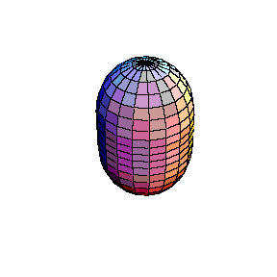
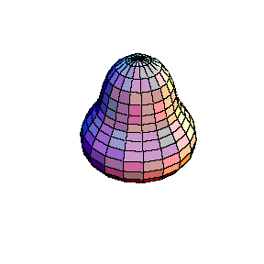

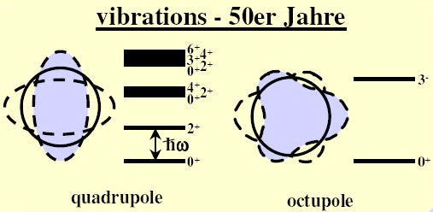
Symmetries in nuclear physics
Isospin Symmetry: 1932 Heisenberg SU(2)
Spin-Isospin Symmetry: 1936 Wigner SU(4)
Seniority-Pairing: 1943 Racah
$$\vec{j}$$
Spherical Symmetry: 1949 Mayer
s

Slide 27
Symmetries in nuclear physics
Isospin Symmetry: 1932 Heisenberg SU(2)
Spin-Isospin Symmetry: 1936 Wigner SU(4)
Seniority-Pairing: 1943 Racah
Spherical Symmetry: 1949 Mayer
Deformed nuclear field (spontaneous symmetry breaking)
symmetry restoration → rotational spectra:
1952 Bohr-Mottelson
SU(3) dynamical Symmetry: 1958 Elliott
bridge between the spherical shell model and the liquid drop model

Slide 28
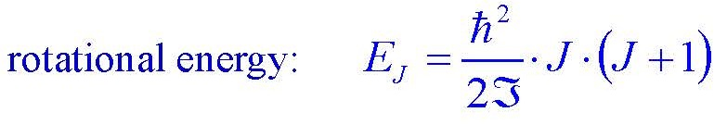
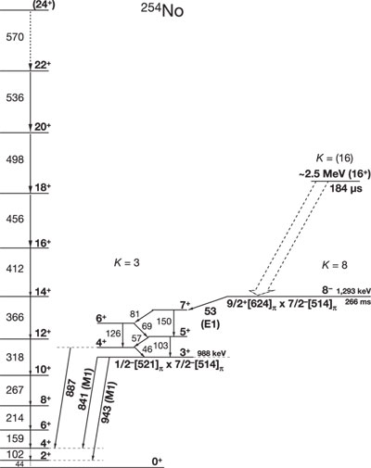
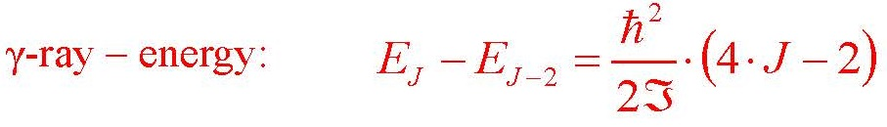
Rotational spectrum of ²⁵⁴No
J
3
states with projections
K and –K are degenerated
S. Eeckhaudt et al., Eur. Phys. J. A 26, 227 (2005)

Slide 29

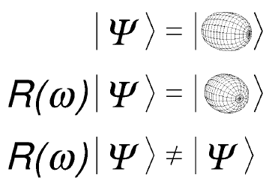
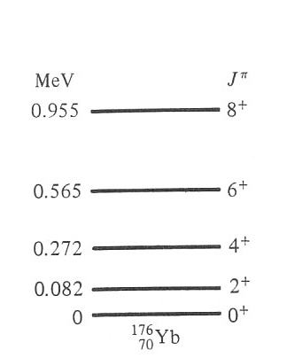

Rotational invariance
MeV
0.519
0.305
0.146
0.044
0
γ-decay
Broken symmetries are restored for the wave function in the laboratory frame.
J
3
Notice – larger means smaller distances
between the energy levels!
Notice - rotations around the symmetry axis 3
are indistinguishable;
the angular momentum has to be perpendicular to
the symmetry axis 3.
$$ℑ$$

Slide 30




Rotational bands in deformed nuclei
$$E_{J}=\frac{ℏ^{2}}{2ℑ}∙J∙\left(J+1\right)$$
MeV
0.519
0.305
0.146
0.044
0
γ-decay
$E_{J}−E_{J−2}=\frac{ℏ^{2}}{2ℑ}∙\left(4∙J−2\right)$2
J
3
$${}_{102}^{254}{No}$$
Notice - rotations around the symmetry axis 3
are indistinguishable;
the angular momentum has to be perpendicular to
the symmetry axis 3.
Notice – larger means smaller distances
between the energy levels!
$$ℑ=\int{r^{2}dm}$$

Slide 31


Rotational spectra in ²⁵⁴No
Yrast plot
R.-D. Herzberg et al., Nature 442, 896 (2006)

Slide 32


Superdeformation of ¹⁵²Dy
moment of inertia → deformation β=0.6
axis ratio 2:1

Slide 33

Nuclear deformation and rotations

Slide 34



Space inversion invariance: octupole deformed nuclei
Rotation

Slide 35





Space inversion invariance: octupole deformed nuclei
Search of electric dipole moments
(violation of the time reversal)
Y₃₀ coupling
$$Q_{1}=C_{LD}∙A∙Ze∙β_{2}∙$$
$$β_{3}$$
static octupole deformation exists only in special regions of the chart of nuclei.
+
-
+
-
+
²²⁶Ra
-
+
88
-
+
-
In octupole deformed nuclei the center of mass and charge are separated which yields a non-vanishing electric dipole moment.

Slide 36

Rotations in the universe

Slide 37

Creation of angular momenta in nuclei

Slide 38



Creation of angular momenta in nuclei
SU(3)
SU(2)
U(5)

Slide 39

Symmetries in nuclear physics
Spherical Symmetry: 1949 Mayer
Deformed nuclear field (spontaneous symmetry breaking)
symmetry restoration → rotational spektra:
1952 Bohr-Mottelson
SU(3) dynamical Symmetry: 1958 Elliott
Interacting Boson Model (IBM dynamical symmetry):
1974 Arima and Iachello
Critical point symmetry E(5), X(5) ….
2000… F. Iachello

Slide 40






Symmetries in nuclear physics
no residual interaction ⇒ independent particle shell model
residual interaction:
pairing interaction (jj coupling) ⇒ Racah´s SU(2)
quadrupole interaction (LS coupling) ⇒ Elliott´s SU(3)

Slide 41





Nuclear shapes and symmetries
Vibrator
Soft
Rotor
nuclei with X(5) symmetry:
Spherical
Transitional
Deformed
Energy
p-dripline
stable
Deformation
n-dripline
prolate
oblate
Transitional nuclei
R. F. Casten Nature Physics 2 (2006) 811

Slide 42


Dynamical symmetries in nuclear physics
Gamma-soft-O(6)
Spherical
Transitional
Deformed
Energy
Vibrator-SU(5)
Rotor-SU(3)
Deformation

Slide 43


Chart of the Nuclei mirror nuclei and the nuclear shell model
126
82
r-process
50
protons
rp-process
82
28
70
20
50
8
28
40
2
20
neutrons
2
8

