Slide 1

Outline: Nuclear mass
Lecturer: Hans-Jürgen Wollersheim
e-mail: h.j.wollersheim@gsi.de
web-page: https://web-docs.gsi.de/~wolle/ and click on
chemical and nuclear reactions
binding energy
mass excess
characteristics of nuclear binding
penning trap measurement
Schottky mass spectroscopy

Slide 2
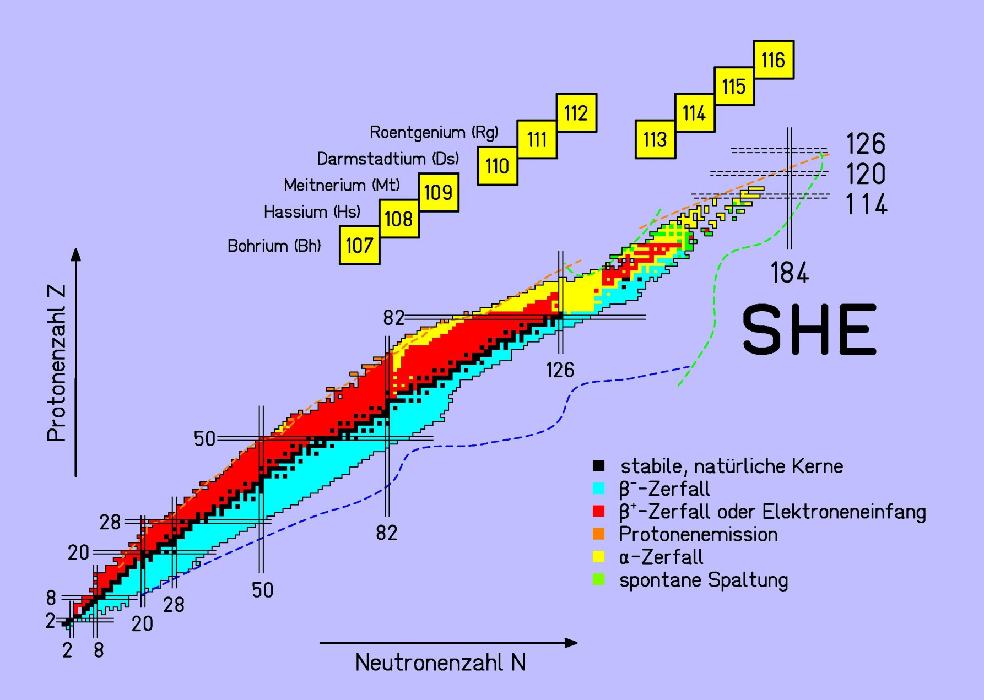
Nuclear masses
Gross Properties of Nuclei
proton number Z
Nuclear Masses
and Binding Energies
neutron number N

Slide 3
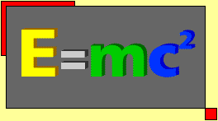
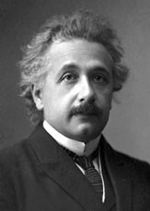
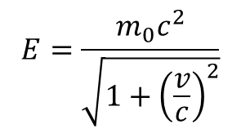
Nuclear masses
In 1905 Albert Einstein following his derivation of the Special Theory of Relativity identifies relation between mass and energy of an object at rest:
The corresponding relation for moving object is
$$E=\frac{m_{0}c^{2}}{\sqrt{1+{\left(\frac{v}{c}\right)}^{2}}}$$
Albert Einstein
(1879 - 1955)
This discovery explains the energy powering nuclear decay. The question of energy release in nuclear decay was a major scientific puzzle from the time of the discovery of natural radioactivity by Henry Becquerel (1896) until Einstein’s postulate of mass-energy equivalence.

Slide 4
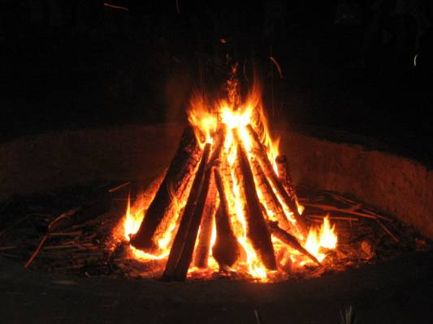
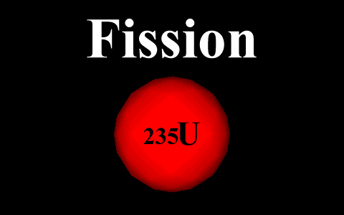



Chemical and nuclear reactions
Heat is evolved in the chemical reaction in which hydrogen and oxygen are combined to be water and generates 3.0 eV energy emission:
$$H_{2}+\frac{1}{2}O_{2}=H_{2}O+3.0 eV$$
Such chemical reaction in which heat is evolved is called exothermic reaction.
Another example is where one mol of carbon is oxidized to be carbon dioxide with producing 4.1 eV energy:
C$+O_{2}=CO_{2}+4.1 eV$
The nuclear reaction in which two deuterons bind with each other is an example of nuclear fusion. This exoergic reaction is written as
$${}_{1}^{2}H+{}_{1}^{2}H→{}_{2}^{3}{He}+n+3.27 MeV$$
If a neutron is absorbed in the uranium-235 nucleus, it would split into two fragments of almost equal masses and evolves some number of neutrons and energy. One of the equations for the processes is written
$${}_{92}^{235}U+n→{}_{56}^{137}{Ba}+{}_{36}^{97}{Kr}+2n+215 MeV$$

Slide 5
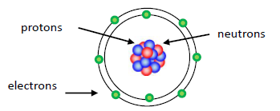



Nuclear masses
 | mass (kg) | mass (MeV/c²) | mass (u)
electron | 9.109·10⁻³¹ | 0.511 | 0.000549
proton | 1.673·10⁻²⁷ | 938.2794 | 1.007276
neutron | 1.675·10⁻²⁷ | 939.5728 | 1.008665
¹H atom | 1.674·10⁻²⁷ | 938.7904 | 1.007825
nuclear and atomic masses are expressed in ATOMIC MASS UNITS (u)
definition: 1/12 of mass of neutral ¹²C → M(¹²C) = 12 u
1 u = 1.6605·10⁻²⁷ kg or 931.494 MeV/c² (E = mc²)
Expect:
$$M\left({{}_{Z}^{A}X}_{N}\right)=Z∙m_{p}+N∙m_{n}+Z∙m_{e}$$
$$∆m∙c^{2}=BE$$
Find:
$$M\left({{}_{Z}^{A}X}_{N}\right)<Z∙m_{p}+N∙m_{n}+Z∙m_{e}$$
mass defect
We typically use ATOMIC and not NUCLEAR masses → mass of electrons also included

Slide 6
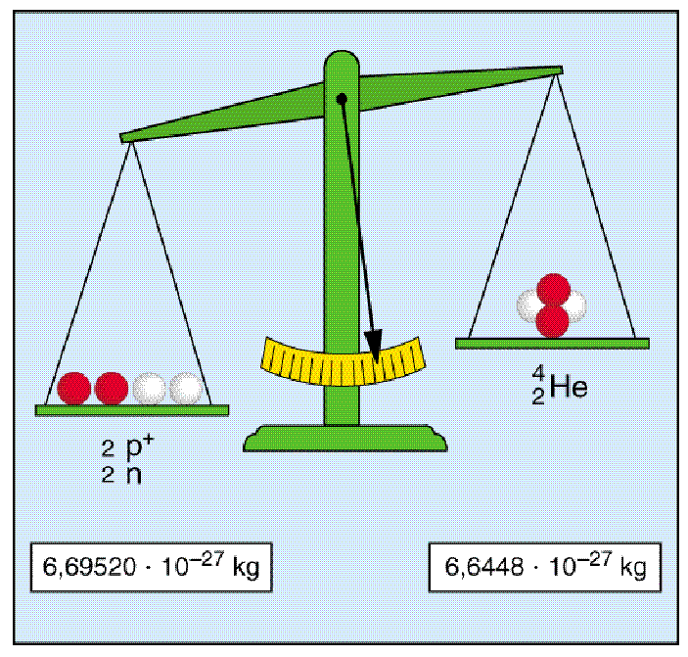
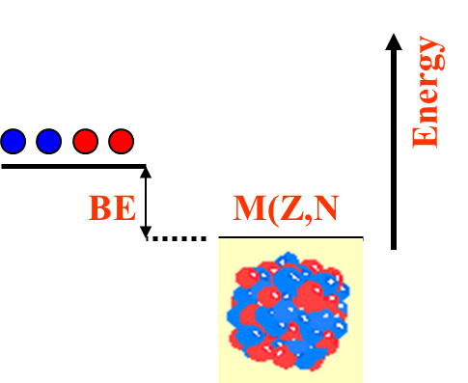
Nuclear masses and binding energy
 | mass (kg) | mass (MeV/c²) | mass (u)
electron | 9.109·10⁻³¹ | 0.511 | 0.000549
proton | 1.673·10⁻²⁷ | 938.2794 | 1.007276
neutron | 1.675·10⁻²⁷ | 939.5728 | 1.008665
¹H atom | 1.674·10⁻²⁷ | 938.7904 | 1.007825
1 u = 1.6605·10⁻²⁷ kg or 931.494 MeV/c²
A bound system has a lower potential energy than its constituents !
Binding energy:
$$BE=\left\{\left[Z∙m_{H}+N∙m_{n}\right]−M\left({{}_{Z}^{A}X}_{N}\right)\right\}∙c^{2}$$
> 0
BE $\left({}_{2}^{4}{He}\right)$ = [2·1.007825 + 2·1.008665] – 4.002603 = 0.030377 u (= 28.296 MeV)

Slide 7

Binding energy and mass excess
 | mass (kg) | mass (MeV/c²) | mass (u)
electron | 9.109·10⁻³¹ | 0.511 | 0.000549
proton | 1.673·10⁻²⁷ | 938.2794 | 1.007276
neutron | 1.675·10⁻²⁷ | 939.5728 | 1.008665
¹H atom | 1.674·10⁻²⁷ | 938.7904 | 1.007825
1 u = 1.6605·10⁻²⁷ kg or 931.494 MeV/c²
Binding energy:
$$BE=\left\{\left[Z∙m_{H}+N∙m_{n}\right]−M\left({{}_{Z}^{A}X}_{N}\right)\right\}∙c^{2}$$
Mass excess:
$$∆M=M\left(A,Z\right)−A∙M\left(u\right)$$
Example:
mass of ⁵⁶Fe: M(56,26) = 55.934942 [u]
mass excess: ΔM = M(A,Z) - A·M(u) = 55.934942 – 56 = -0.06506 [u]
= -0.06506·931.494 = -60.601 [MeV/c²]
binding energy: BE(Z,A) = [Z·M(¹H) + N·M_{n} – M(Z,A)]·c²
= [26·1.007825 + 30·1.008665 – 55.934942]·931.494 = 492.25 [MeV]

Slide 8
Binding energy
 | mass (kg) | mass (MeV/c²) | mass (u)
electron | 9.109·10⁻³¹ | 0.511 | 0.000549
proton | 1.673·10⁻²⁷ | 938.2794 | 1.007276
neutron | 1.675·10⁻²⁷ | 939.5728 | 1.008665
¹H atom | 1.674·10⁻²⁷ | 938.7904 | 1.007825
1 u = 1.6605·10⁻²⁷ kg or 931.494 MeV/c²
$$BE=\left\{\left[Z∙m_{H}+N∙m_{n}\right]−M\left({{}_{Z}^{A}X}_{N}\right)\right\}∙c^{2}$$
element | mass of nucleons [u] | nuclear mass [u] | binding energy [MeV] | BE/A [MeV/u]
²H | 2.01594 | 2.01355 | 2.23 | 1.12
⁴He | 4.03188 | 4.00151 | 28.29 | 7.07
⁷Li | 7.05649 | 7.01336 | 40.15 | 5.74
⁹Be | 9.07243 | 9.00999 | 58.13 | 6.46
⁵⁶Fe | 56.44913 | 55.92069 | 492.24 | 8.79
¹⁰⁷Ag | 107.86187 | 106.87934 | 915.23 | 8.55
¹²⁷I | 128.02684 | 126.87544 | 1072.53 | 8.45
²⁰⁶Pb | 207.67109 | 205.92952 | 1622.27 | 7.88
²¹⁰Po | 211.70297 | 209.93683 | 1645.16 | 7.73
²³⁸U | 239.93448 | 238.00037 | 1801.63 | 7.57

Slide 9
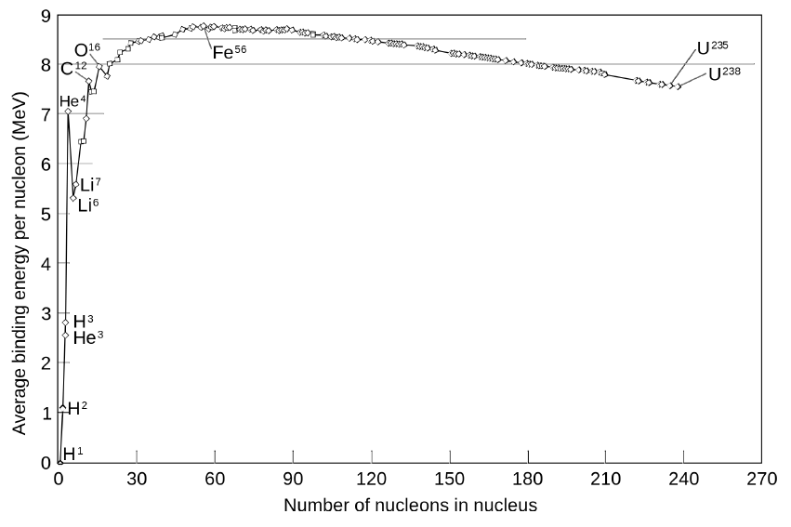
Characteristics of nuclear binding
Binding energy per nucleon (BE/A)
Most nuclei have almost exactly the same B/A, which is roughly 8 MeV/A. This means the nuclear force saturates such that only each nucleon can interact with a few of its neighbors.
The most bound nuclei are in the region of A ~ 56 – 62.
Nuclei on the left of the maximum can release energy by joining together
(nuclear fusion)
Nuclei on the right of the maximum can release energy by breaking apart
(nuclear fission)
Some structure in this curve also exists (particularly for ⁴He) that results from quantum effects of the nucleus.

Slide 10
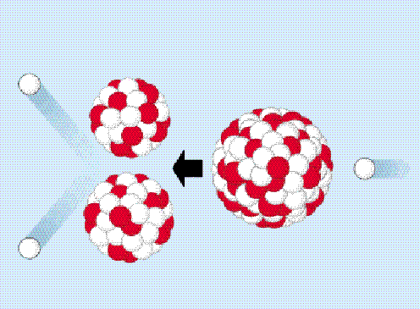
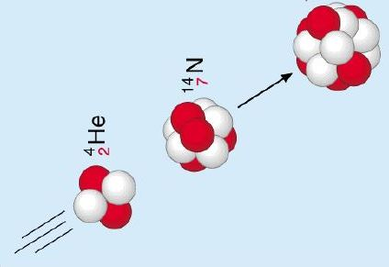






Characteristics of nuclear binding
Binding energy per nucleon (BE/A)
fusion
fission
$${}_{9}^{18}F$$
$${}_{36}^{89}{Kr}$$
$${}_{92}^{235}U$$
$${}_{7}^{14}N$$
$${}_{2}^{4}{He}$$
$${}_{56}^{144}{Ba}$$
fusion
fission

Slide 11
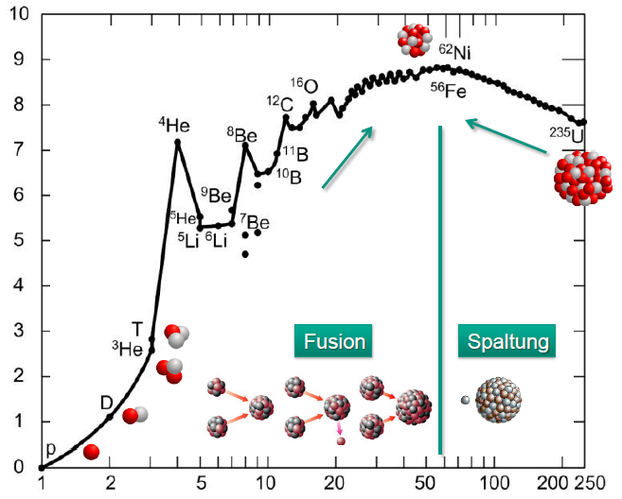
Characteristics of nuclear binding
Binding energy per nucleon: B/A ~ 8 MeV/u, approximately constant for A > 20
< B/A > ~ 7 – 8 MeV
nuclear interaction only with the next nucleons!
short range nuclear forces
average binding energy per nucleon (MeV/u)
range ~ 1 fm
fusion
fission
maximum B/A for
A = 56-58 (56Fe, 56Ni)
A < 56: nuclear fusion
A > 56: fission
number of nucleons in nucleus A

Slide 12
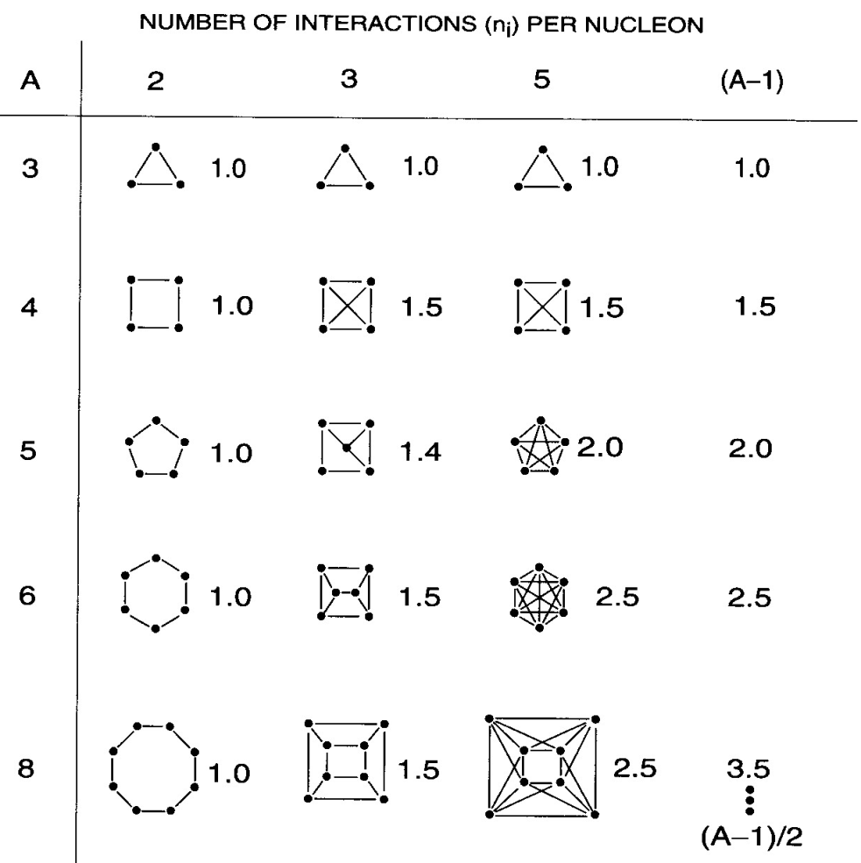
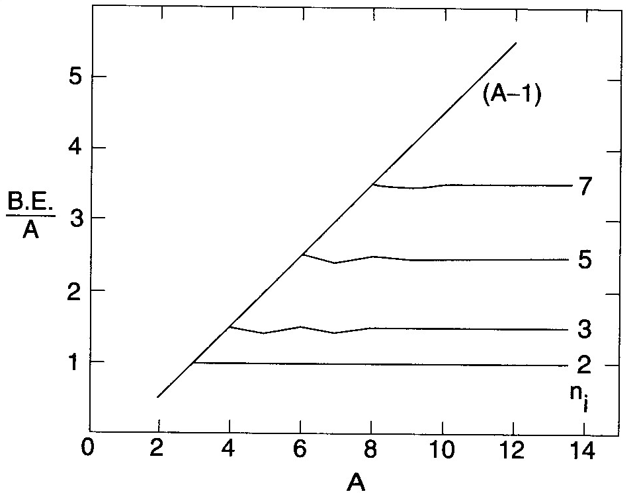
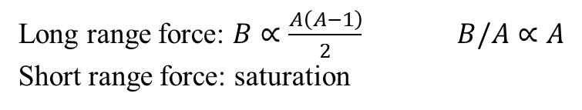
Long vs short range interaction
Long range force: $B∝\frac{A\left(A−1\right)}{2} B/A∝A$
Short range force: saturation

Slide 13
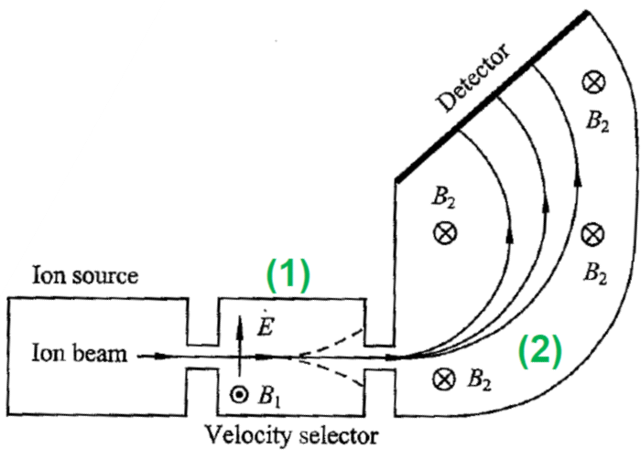
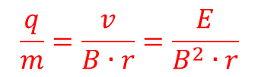
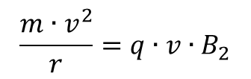
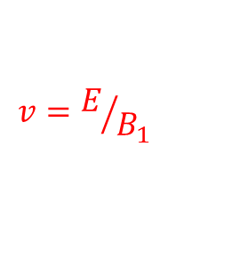

Mass spectroscopy
Mass of nuclei are measured by passing ion beams through magnetic and electric field (2 steps)
deflection spectrometer
select a constant velocity with a velocity (Wien) filter
E and B₁ are at right angles
$$q∙E=q∙v∙B_{1}$$
$$v=E/{B_{1}}$$
Measure a trajectory of ions in a uniform magnetic B₂ field
$$\frac{m∙v^{2}}{r}=q∙v∙B_{2}$$
If B₁ = B₂ = B
$$\frac{q}{m}=\frac{v}{B∙r}=\frac{E}{B^{2}∙r}$$

Slide 14
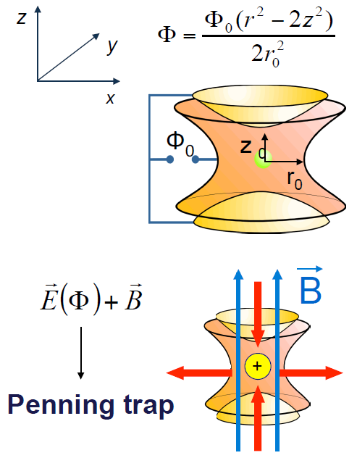
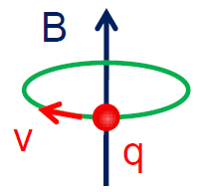
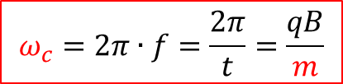



Penning trap measurement
The most precise measurements come from storage devices that confine ions in three dimensions by means of well-controlled electromagnetic fields.
Examples: storage rings, Penning trap, Paul trap
In a Penning trap,
Ions are confined in 2D with a strong magnetic field B
A weak electrostatic field is used to trap ions in 3D (along the Z-axis)
Cyclotron oscillations (ω_{c})
$$\frac{m∙v^{2}}{r}=q∙v∙B$$
$$v=\frac{q∙B∙r}{m}$$
$$t=\frac{2π∙r}{v}=\frac{2π∙m}{q∙B}$$
$$ω_{c}=2π∙f=\frac{2π}{t}=\frac{qB}{m}$$

Slide 15
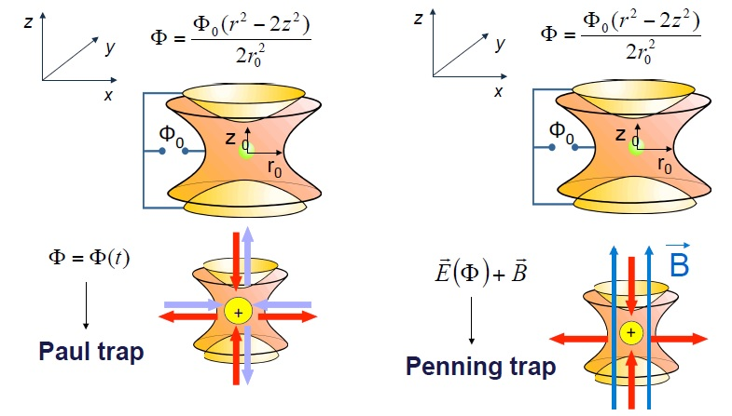
Confinement of charged particles
Wolfgang Paul
Frans Michel Penning

Slide 16
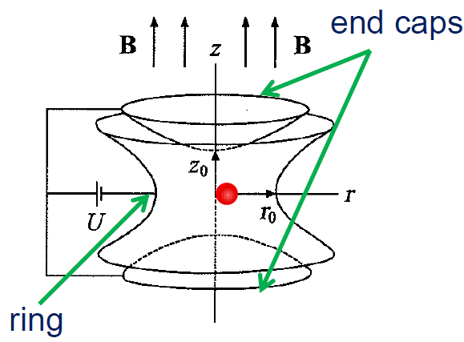
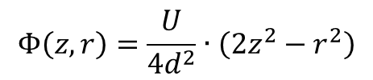
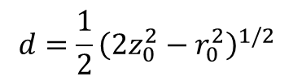
Penning trap measurement
A weak axially symmetric electrostatic potential is superimposed to produce a saddle point at the center.
This requires the quadrupole potential:
$$Φ\left(z,r\right)=\frac{U}{4d^{2}}∙\left(2z^{2}−r^{2}\right)$$
$$d=\frac{1}{2}{\left(2z_{0}^{2}−r_{0}^{2}\right)}^{1/2}$$
(so that U is the potential difference between the endcap and the ring electrodes)

Slide 17
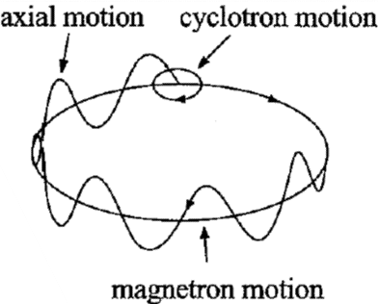


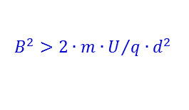
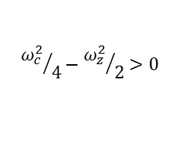
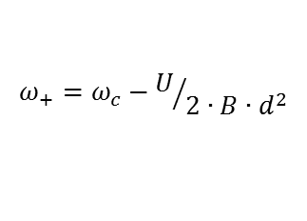

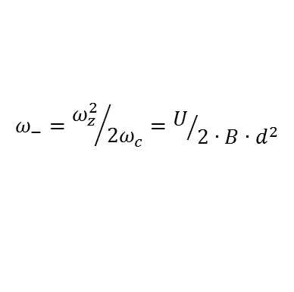

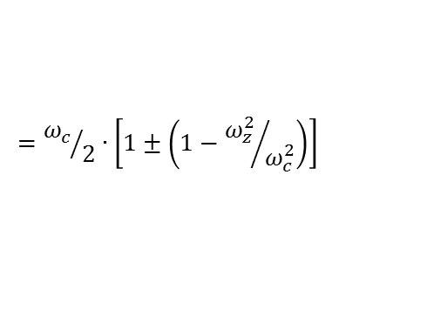
Penning trap measurement
Solving the equations of motions result in three independent motional modes with frequencies;
$$ω_{z}=\sqrt{{q∙U}/{m∙d^{2}}}$$
(axial motion)
$$ω_{+}={ω_{c}}/2+\sqrt{{ω_{c}^{2}}/4−{ω_{z}^{2}}/2}$$
(cyclotron motion)
$$ω_{−}={ω_{c}}/2−\sqrt{{ω_{c}^{2}}/4−{ω_{z}^{2}}/2}$$
(magnetron motion)
The condition on the magnetic field,
$${ω_{c}^{2}}/4−{ω_{z}^{2}}/2>0$$
$$B^{2}>{2∙m∙U}/{q∙d^{2}}$$
$$ω_{±}={ω_{c}}/2∙\left[1±{\left(1−{2∙ω_{z}^{2}}/{ω_{c}^{2}}\right)}^{1/2}\right]$$
In the experiment one needs to measure the sum
ω₊ + ω₋
(not cyclotron frequency from ω₊ only)
$$={ω_{c}}/2∙\left[1±\left(1−{ω_{z}^{2}}/{ω_{c}^{2}}\right)\right]$$
$$ω_{−}={ω_{z}^{2}}/{2ω_{c}}=U/{2∙B∙d^{2}}$$
$$ω_{+}=ω_{c}−U/{2∙B∙d^{2}}$$
$$→ ω_{c}=ω_{+}+ω_{−} ω_{c}^{2}=ω_{+}^{2}+ω_{−}^{2}+ω_{z}^{2} \left(ω_{+}∙ω_{−}=ω_{z}^{2}/2\right)$$

Slide 18
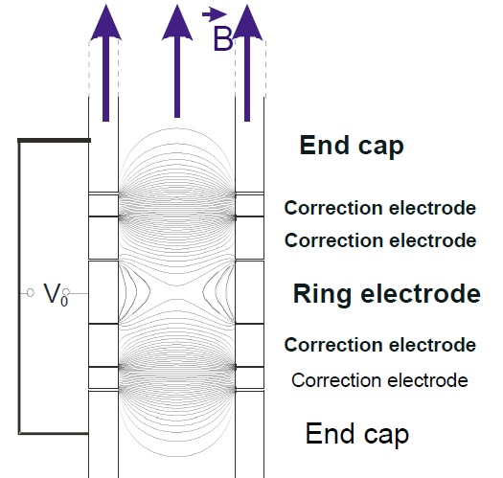
Cylindrical Penning trap
GSI-Darmstadt

Slide 19
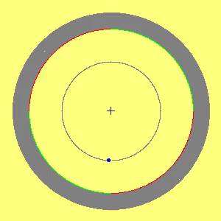
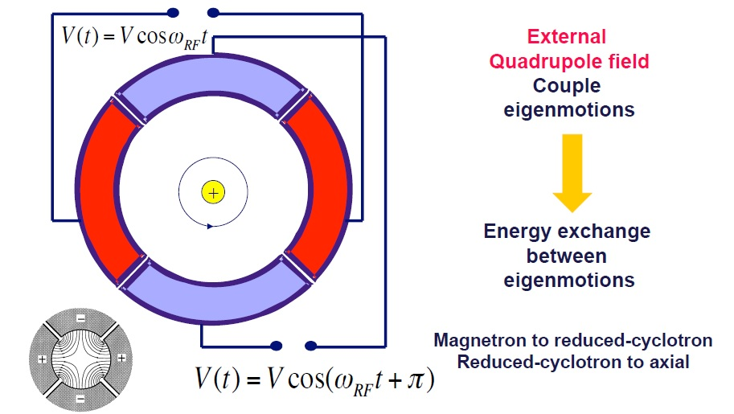
Ion manipulation

Slide 20
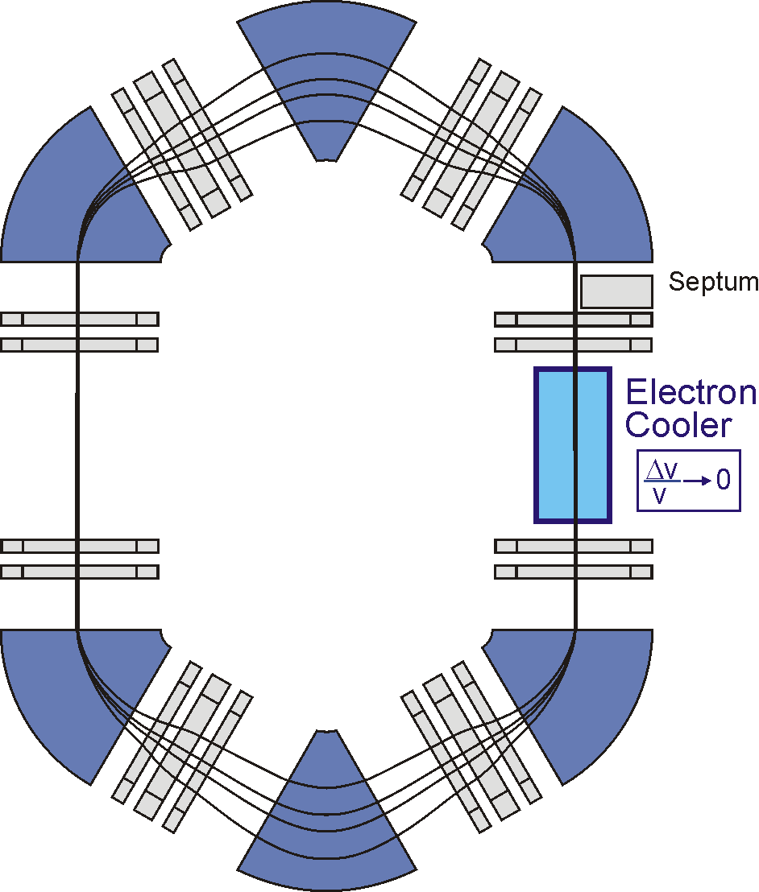
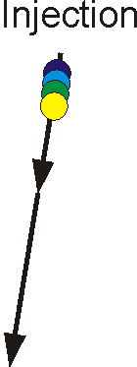





Schottky-mass-spectroscopy
4 particles with different m/q
time

Slide 21


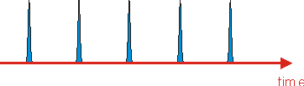
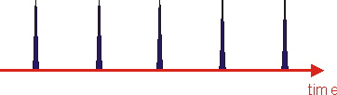
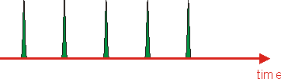


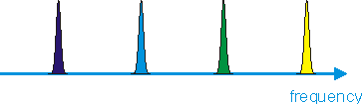

Schottky-mass-spectroscopy
Sin(ω₁)
Sin(ω₂)
fast Fourier transform
ω₄
ω₃
ω₂
ω₁
Sin(ω₃)
time
Sin(ω₄)

Slide 22
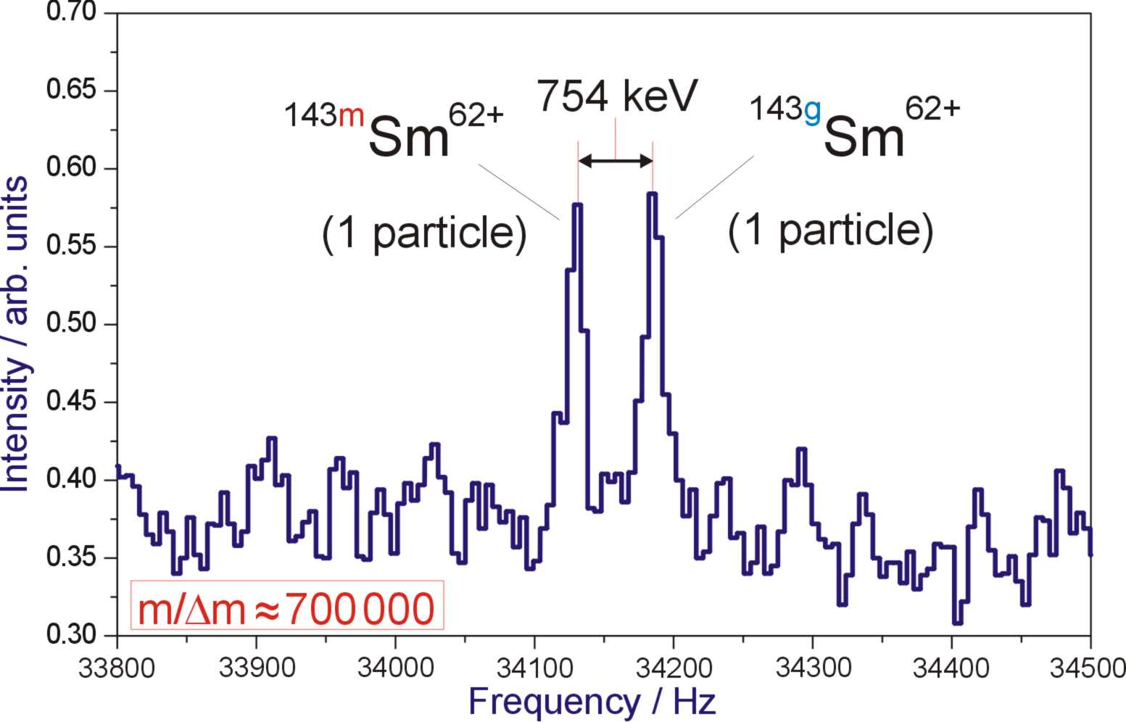
Small-band Schottky frequency spectra

Slide 23
Exercise: Nuclear Masses
Using the R=1.2·A^{1/3} observation, estimate the average mass density of a nucleus.
Estimate the rest energy of 1 Å³ of nuclear matter.
Calculate the binding energy per nucleon of ⁷Li and ⁵⁶Fe.
Calculate the mass excess of ²³⁸U.

