Slide 1
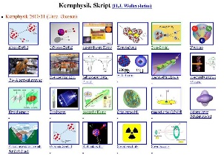
Outline: Transient magnetic field
Lecturer: Hans-Jürgen Wollersheim
e-mail: h.j.wollersheim@gsi.de
web-page: https://web-docs.gsi.de/~wolle/ and click on
how to measure magnetic moments?
optimal beam energy
precision of γ–angular correlation
g-factor measurements using α-transfer reaction

Slide 2



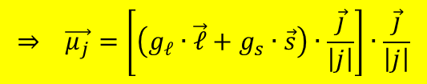



Success of the extreme single-particle shell model
Magnetic moments:
The g-factor g_{j} is given by:
with
Simple relation for the g-factor
of single-particle states
$$⇒ \vec{μ_{j}}=\left[\left(g_{ℓ}∙\vec{ℓ}+g_{s}∙\vec{s}\right)∙\frac{\vec{j}}{\left|j\right|}\right]∙\frac{\vec{j}}{\left|j\right|}$$
$$\vec{μ_{j}}=g_{ℓ}∙\vec{ℓ}+g_{s}∙\vec{s}=g_{j}∙\vec{j}$$
$${\vec{ℓ}}^{2}={\left(\vec{j}−\vec{s}\right)}^{2}={\vec{j}}^{2}−2∙\vec{j}∙\vec{s}+{\vec{s}}^{2}$$
$${\vec{s}}^{2}={\left(\vec{j}−\vec{ℓ}\right)}^{2}={\vec{j}}^{2}−2∙\vec{j}∙\vec{ℓ}+{\vec{ℓ}}^{2}$$
$${\vec{μ}}_{j}=\frac{g_{ℓ}∙\left\{j\left(j+1\right)+ℓ\left(ℓ+1\right)−3/4\right\}+g_{s}∙\left\{j\left(j+1\right)−ℓ\left(ℓ+1\right)+3/4\right\}}{2∙j\left(j+1\right)}∙\vec{j}$$
$$g_{j}=\frac{1}{2}∙\left(g_{ℓ}+g_{s}\right)+\frac{1}{2}∙\frac{ℓ\left(ℓ+1\right)−s\left(s+1\right)}{2j\left(j+1\right)}∙\left(g_{ℓ}−g_{s}\right)$$
μ/μ_{N}
nucleus state J^{π} model experiment
$$\frac{μ}{μ_{N}}=g_{nucleus}=g_{ℓ}±\frac{\left(g_{s}−g_{ℓ}\right)}{2ℓ+1} for j=ℓ±1$$

Slide 3
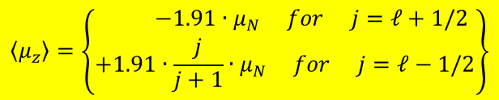
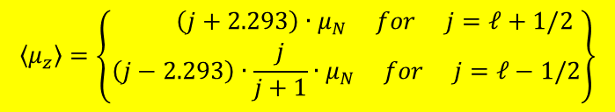
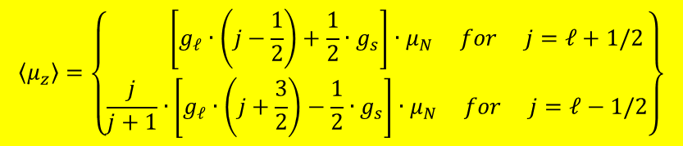
Success of the extreme single-particle shell model
$$\left\langle μ_{z}\right\rangle =\left\{\begin{matrix} \left[g_{ℓ}∙\left(j−\frac{1}{2}\right)+\frac{1}{2}∙g_{s}\right]∙μ_{N} for j=ℓ+1/2 \\ \frac{j}{j+1}∙\left[g_{ℓ}∙\left(j+\frac{3}{2}\right)−\frac{1}{2}∙g_{s}\right]∙μ_{N} for j=ℓ−1/2\end{matrix}\right\}$$
magnetic moments:
g-factor of nukleons:
proton: g_{ℓ} = 1; g_{s} = +5.585
neutron: g_{ℓ} = 0; g_{s} = -3.82
proton:
neutron:
$$\left\langle μ_{z}\right\rangle =\left\{\begin{matrix} \left(j+2.293\right)∙μ_{N} for j=ℓ+1/2 \\ \left(j−2.293\right)∙\frac{j}{j+1}∙μ_{N} for j=ℓ−1/2\end{matrix}\right\}$$
$$\left\langle μ_{z}\right\rangle =\left\{\begin{matrix} −1.91∙μ_{N} for j=ℓ+1/2 \\ +1.91∙\frac{j}{j+1}∙μ_{N} for j=ℓ−1/2\end{matrix}\right\}$$

Slide 4
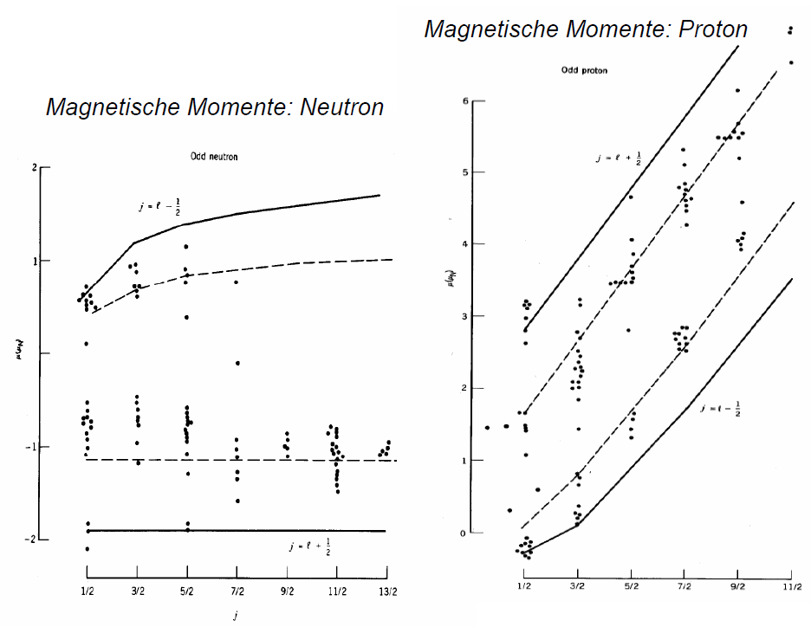
Magnetic moments: Schmidt lines
magnetic moments: proton
magnetic moments: neutron

Slide 5










Magnetic moment classical description
$$\vec{L}$$
e⁻-movement ⇒ magnetic moment $\vec{μ_{e}}$
$$\vec{n}$$
$$\vec{μ_{e}}=\frac{I}{c}∙A∙\vec{n}$$
A
I
$$I=−e∙ν=−e∙\frac{v}{2πr}$$
$$⇒ \vec{μ_{e}}=−\frac{1}{2}∙\frac{e∙v∙r∙\vec{n}}{c}$$
$$\vec{r}$$
$$A=π∙r^{2}$$
e⁻
angular momentum:
$$\vec{L}=\vec{r}×\vec{p}=r∙m_{e}∙v∙\vec{n} ⇒ \vec{μ_{e}}=−\frac{e}{2∙m_{e}∙c}\vec{L}$$
Quantum mechanical description: angular momentum will be quantized, in units of ħ.
$$μ_{B}=\frac{e∙ℏ}{2∙m_{e}∙c}=5.788∙{10}^{−11} \frac{MeV}{Tesla}$$
$$μ_{K}=\frac{e∙ℏ}{2∙m_{P}∙c}=3.152∙{10}^{−14} \frac{MeV}{Tesla}$$

Slide 6
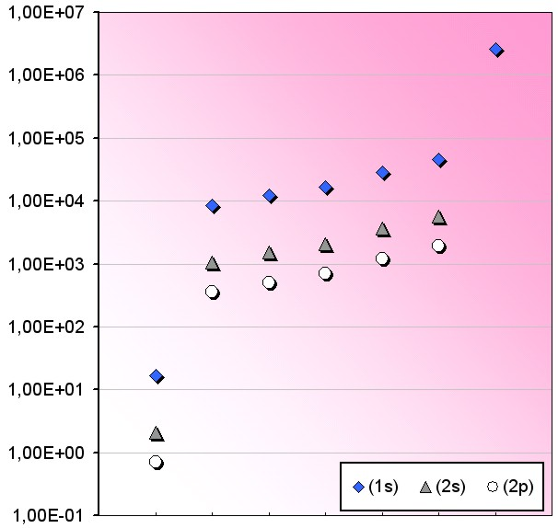
How to measure magnetic moments?
Larmor frequency
ω_{L} = g · μ_{N}/ħ · B
Time integral measurement of the
precession angle
MTesla !
Δφ/g = μ_{N}/ħ·B·t_{eff}
kTesla fields required for short t_{eff} (<τ) !
Fermi contact field [Tesla]
kTesla !
Magnetic fields of this strength in general available at the
nucleus ONLY due to its own electrons !
Fermi contact field at the nucleus:
B_{1s} = 16.7 Z³ R(Z) [T]
for 1s electrons
H
O
F
Ne
Mg
Si
Xe
R(Z) ≅ 1+(Z/84)^{2.5} relativistic correction factor
randomly oriented electron spins:
attenuation of γ-ray angular distribution
“nuclear deorientation”
oriented electron spins (polarization):
precession of γ-ray angular distribution
“transient fields”

Slide 7
Three different techniques to measure g-factors of short-lived states using radioactive beams
low-velocity transient field
high-velocity transient field
¹³²Te @ Oak Ridge 3.0 MeV/u
N. Benczer-Koller et al., PLB 664(2008)241
^{38,40}S @ MSU 40 MeV/u
A.D. Davies et al., PRL 96 (2006) 112503
A.E. Stuchbery et al., PRC 74 (2006) 054307
¹³⁸Xe @ REX-ISOLDE 2.8 MeV/u
2006/2009 SP: A. Jungclaus
⁷²Zn @ GANIL 60 MeV/u
April 2008 SP: G. Georgiev, A. Jungclaus
nuclear deorientation
^{42,44,46}Ar @ MSU & N=40 Fe @ MSU
October 2008 SP: A.E. Stuchbery
¹³²Te @ Oak Ridge 3.0 MeV/u
N.J. Stone, A.E. Stuchbery et al.,
Phys. Rev. Lett. 94 (2005) 192501
Nothing yet at relativistic energies !
Only very few experiments so far advantages and disadvantages
of the different techniques still need to be explored !

Slide 8
Transient fields: From the low- to the high-velocity regime
B_{tf} (v, Z) = ξ_{1s}(v, Z) · F¹_{1s}(v, Z) · B_{1s}(Z)
ξ_{1s}: degree of polarization of
1s electrons
F¹_{1s}: ion fraction with unpaired
1s electrons
B_{1s}: Fermi contact field of
1s electrons
Transient field strength in Fe host
v/c∼20-50%
Z∙v₀: 1s electron velocity
(v₀=c/137 Bohr velocity)
intermediate-energy
& relativistic Coulex
maximum around v=Z∙v₀
strength scales with Z³ (Z² in Gd)
v/c∼3-7%
Problem:
Transient field strength para-
metrized only up to Z ~ 16.
What happens for higher Z ?
low-energy
Coulex
A.E. Stuchbery et al.,
Phys. Rev. C74 (2006) 054307
Phys. Lett. B611 (2005) 81

Slide 9
Ion kinetic energy (beam energy) at the 1s electron velocity Z_{v0}
No information
for Z>30 !
⁷²Zn@GANIL: 40 MeV/u
prim. 60 MeV/u ⁷⁶Ge - 2008
Fe@MSU: 50 MeV/u
prim. 130 MeV/u ⁷⁶Ge
2008
calibrated
range
¹³²Sn region
energy (MeV/u)
^{38,40}S@MSU: 40 MeV/u
prim. 140 MeV/u ⁴⁰Ar,⁴⁸Ca
Davies et al., PRL 96 (2006) 112503
Stuchbery et al., PRC 74 (2006) 054307
only GSI !
⁵²Cr@UNILAC: 14.5 MeV/u
Grabowy, Speidel et al., ZPA359 (1997) 377
proton number Z

Slide 10
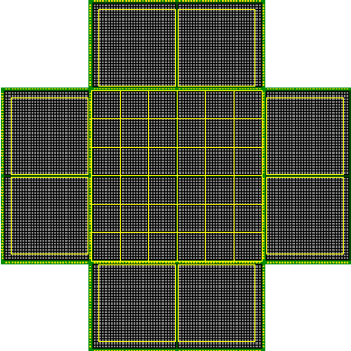
How to measure the precession of a γ-ray angular correlation with PreSPEC?
¹³⁴Te
¹³⁶Xe primary beam @ 500 MeV/u
2.5 g/cm² Be target
¹³⁴Xe
4.1 ps
62 MeV/u
W_{lab}(Θ)
LYCCA-0
¹³⁴Xe
1.5º
400 mg/cm² Gd
2.1º
100 MeV/u
83.5 MeV/u
2.3 ps
τ = 3.0(2) ps
0.1º-1.7º
figure of merit
Including decay:
t_{eff} = 1.4 ps, v/Zv₀ = 1.07-0.93
S_{nuc}(Θ), S²N
Δφ/g = 129 mrad, B_{ave} = 1.9 kTesla
N=7500 photopeak counts per field per day in
Clusters A, D and E
Only angular range Θ<40º and Θ>120º
useful for precession measurement !
Full simulation performed using the
code GKINT by A. Stuchbery
angle Θ (deg)

Slide 11
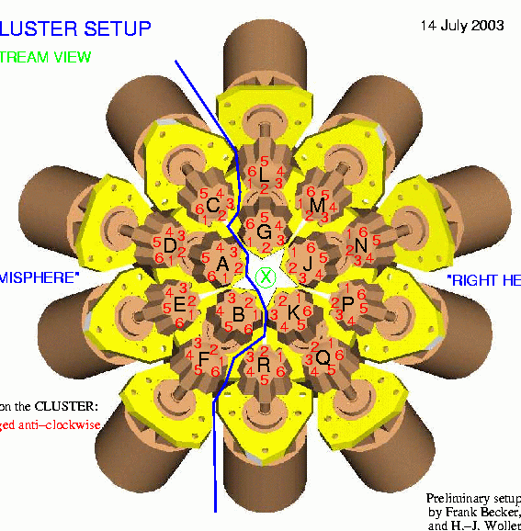
Geometry of the PreSPEC Ge-array
PRESPEC
→
B
P
10º < Θ < 40º !
¹³⁴Te
E
A
D
J
N
The RISING array is very well suited
for such a precession measurement !
All Ge crystals in the range Θ<40º and three pairs
of Cluster detectors close to the horizontal plane !

Slide 12
Relative uncertainty of the TF strength as a function of statistics/time
ξ_{1s} = 0.2%
Large uncertainties in this
estimate due to:
unknown field strength
unclear rate limitations
ξ_{1s} = 0.1%
ξ_{1s} = 0.05%
2 days or 60 shifts
of parasitic beam
8 %
Best guess !
1 day
2 days
,
It is most important to see an
effect at all for the first time !
Then we can do proper estimates
for real g(2⁺) measurements …

Slide 13
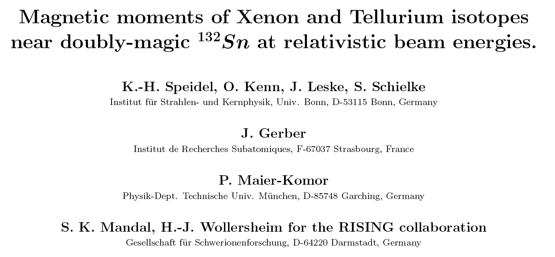
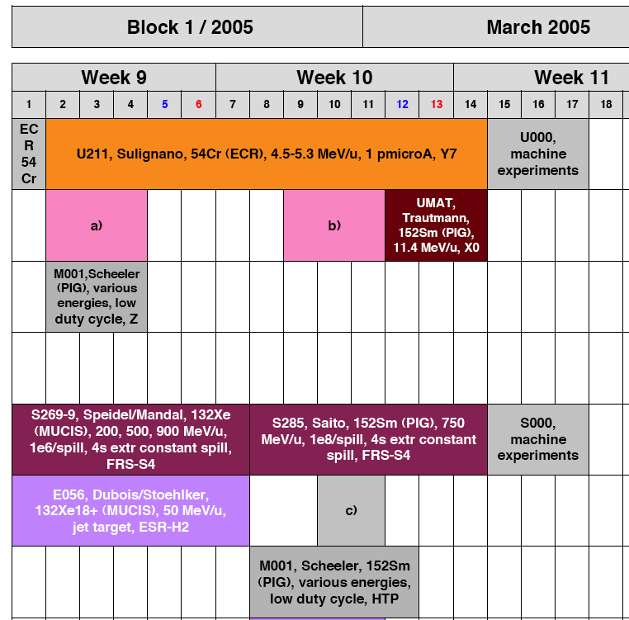
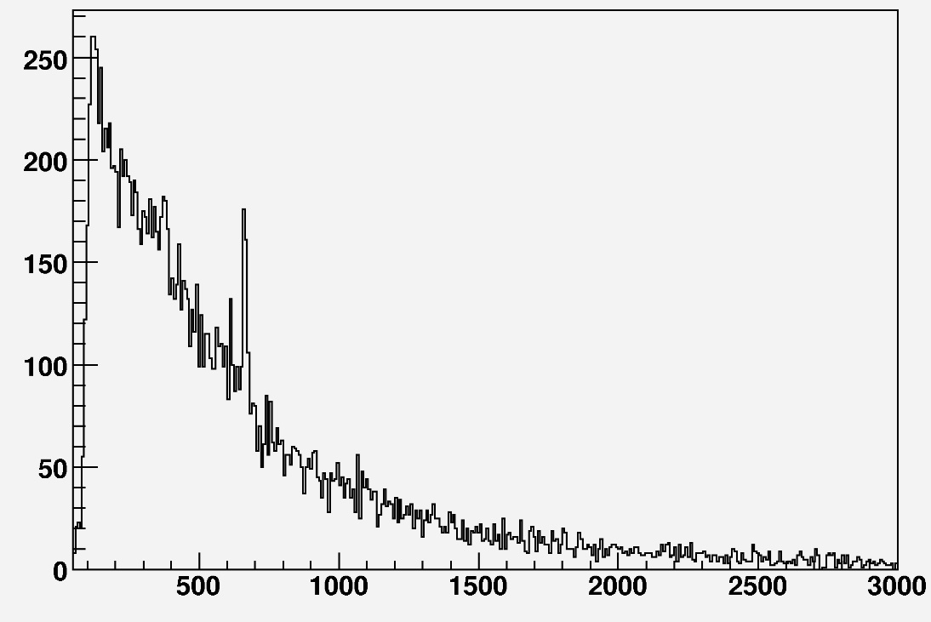
RISING fast-beam proposal in 2002
proposed and approved in 2002
comissioning run scheduled
in 2005
2⁺ 0⁺
667 keV
¹³²Xe
counts
Doppler corrected
β = 0.386
Stopped in 2005 after
only a few hours !
energy [keV]
Courtesy: J. Leske

Slide 14
Summary & Conclusions
Magnetic moment information is
important (sometime E(2⁺) and
B(E2) is not sufficient) !
Transient fields (TF) largest
around 1s electron velocity
Relativistic heavy ions “in principle”
well suited for g(2⁺) measurements !
TF strength only known up to Z=16 (30)
We need at least one calibration point
to tackle the ¹³²Sn region !
GSI only !
60 shifts of parasitic Xe beam sounds a lot, but:
can run in parallel to long proton beamtimes
(HADES or FOPI)
Xe beams often requested by material science
community (¹³²Xe would be fine for us, too)
allows for additional LYCCA
tests in the mass 130 region

Slide 15
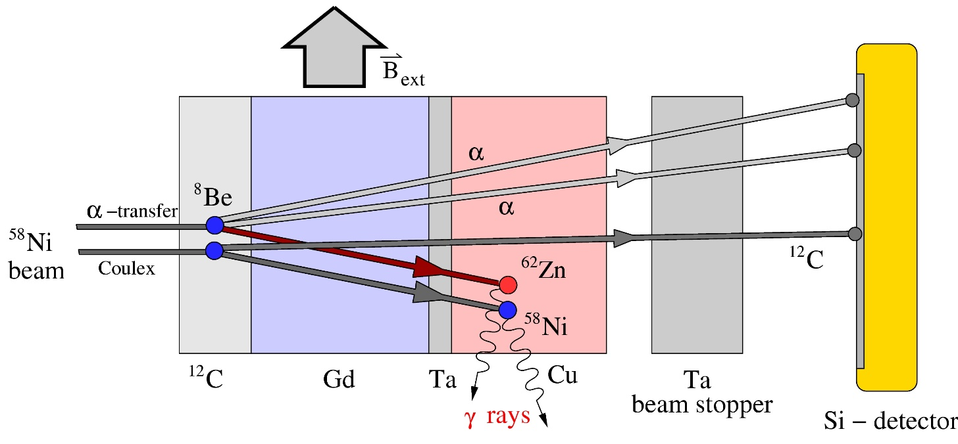
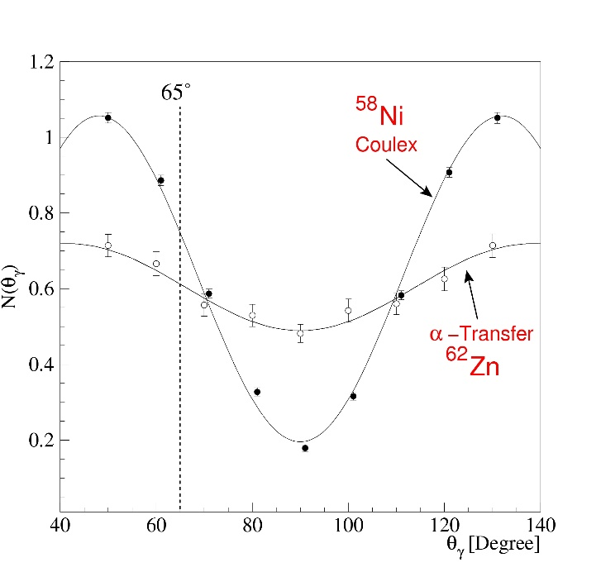
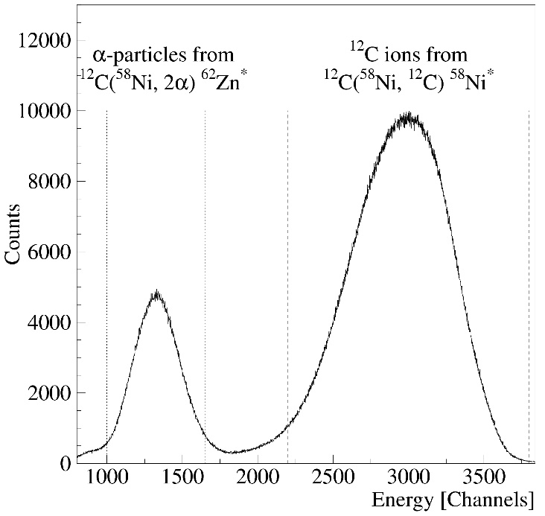
g-factor measurements using α transfer at UNILAC
Particle coincidence
spectrum
Particle-γ- angular correlation

Slide 16
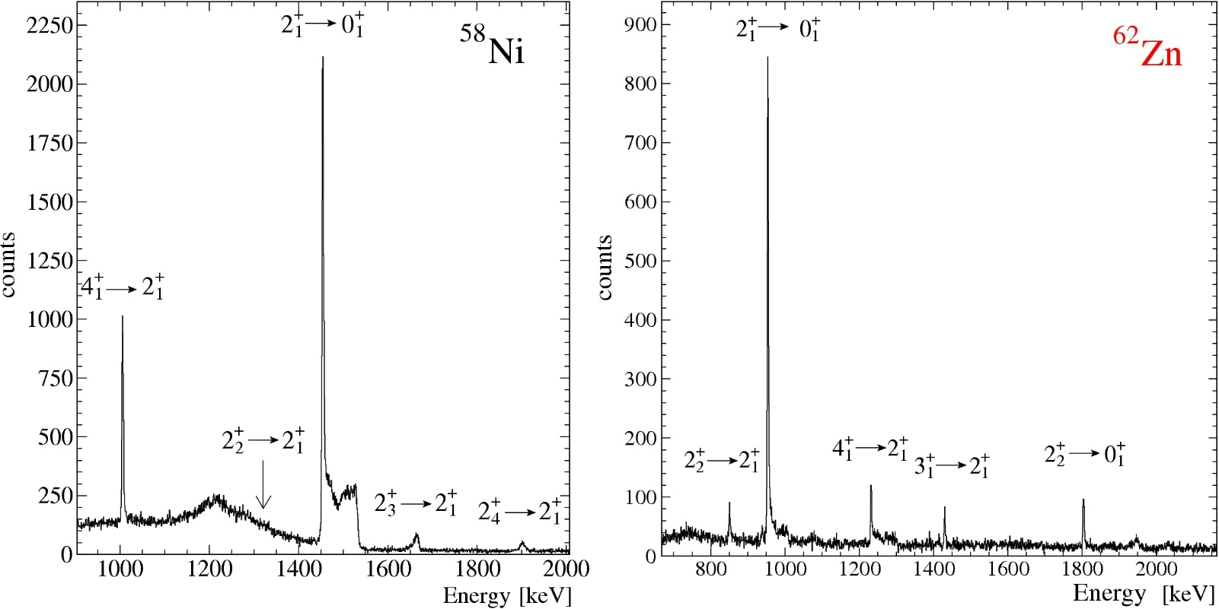
Particle gated γ–coincidence spectra
two different nuclei studied simultaneously
rates comparable those of Coulex experiments
α transfer selective to low spin states

Slide 17
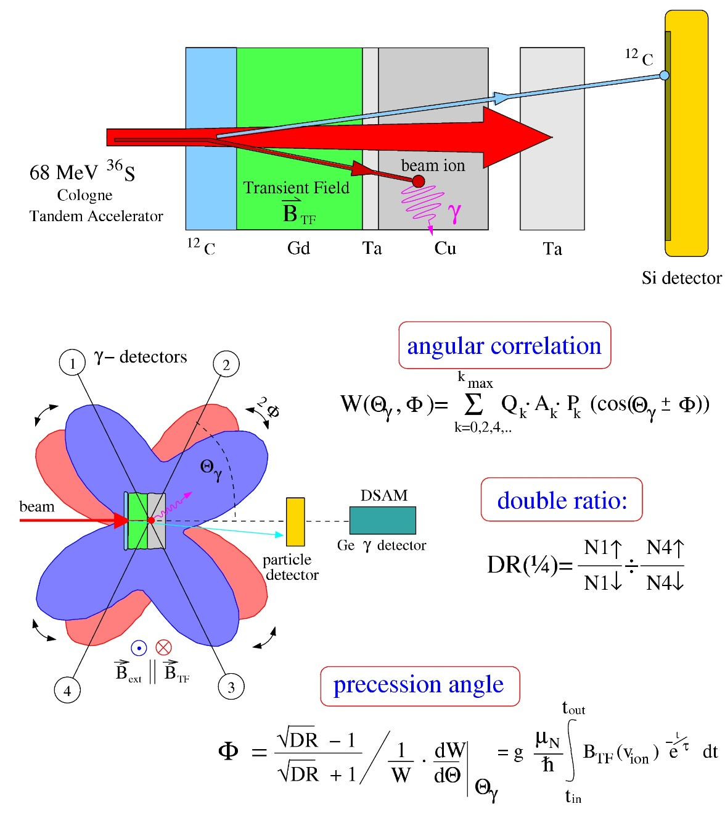
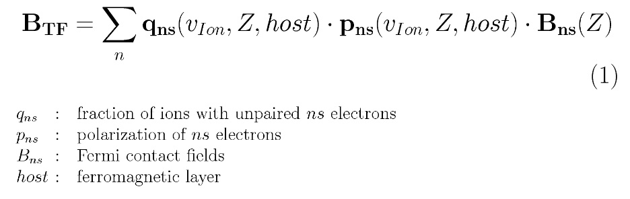
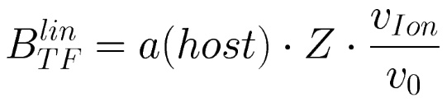
Transient magnetic fields
stable beam
excited ion with aligned nuclear spin
travels through polarized
ferromagnetic environment
polarized electrons and aligned nuclear spin
empirical parametrization required !
linear parametrisation with
ion beam induced attenuation
Φ ^{exp} = G_{beam} Φ ^{lin}
g

Slide 18
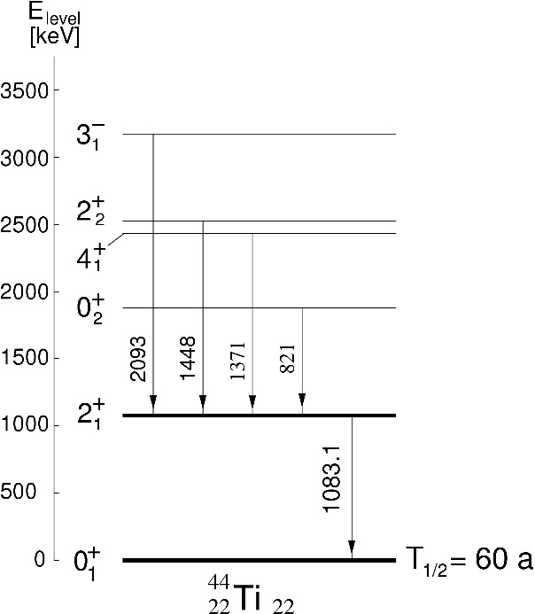
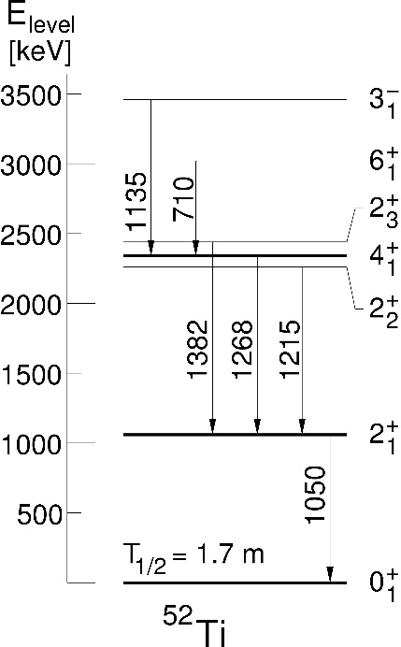
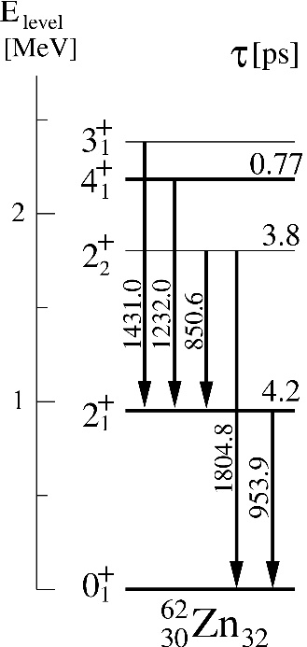
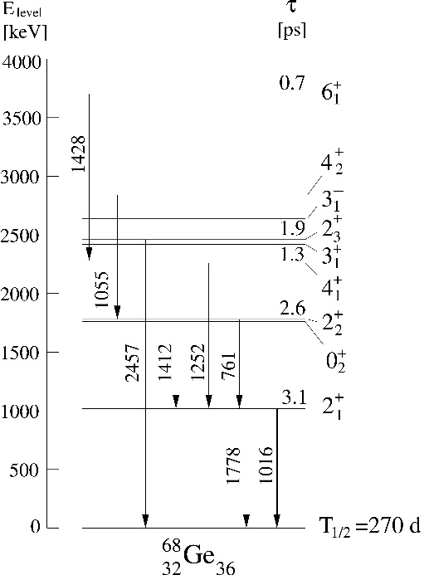
g-factors and B(E2)‘s from α–transfer experiment
44
Ti
52
Ti
62
Zn
68
Ge
22
22
22
30
30
32
32
36
T_{1/2} = 60 y
T_{1/2} = 1.7 m
T_{1/2} = 9.2 h
T_{1/2} = 271 d
S. Schielke et al., Phys. Lett. B 567 (2003) 153
K.-H. Speidel et al., Phys. Lett. B 633 (2006) 219
O. Kenn et al., Phys. Rev. C65 (2002) 034308
J. Leske et al., Phys. Rev. C71 (2005) 044316
Is α transfer also applicable for isotopes heavier than A = 68 ?

Slide 19
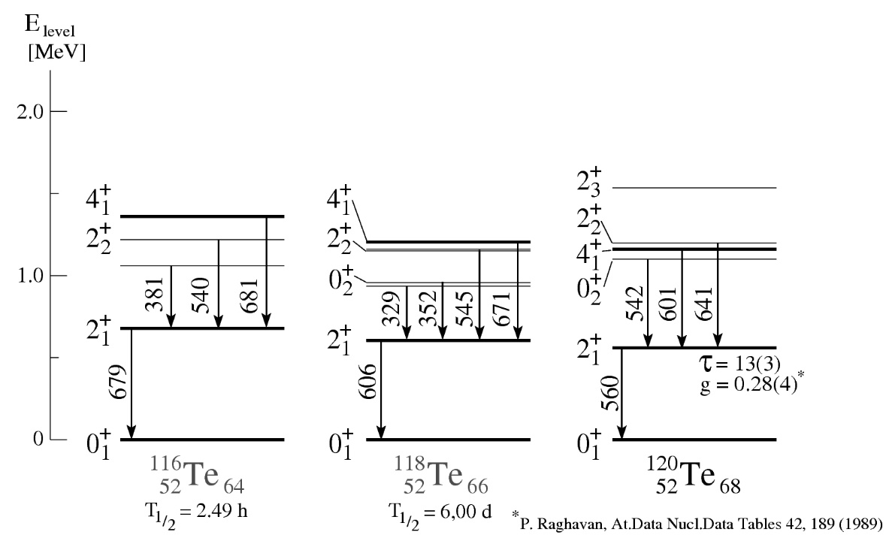
UNILAC experiment U234 (see also HK 48.7 from J. Walker)
“Measurement of the g-factors of 2⁺ states in stable A=112,114,116 Sn isotopes using the transient field technique”
4 Euroball Cluster at ±65°
^{nat}C
excitation layer natural carbon
Gd
Cu
^{112,114,116}Sn*
^{112,114,116}Sn + ¹²C
0.7
10.8
4.9
^{116,118,120}Te*
mg/cm²
recoil detection
20° ≤ Θ ≤ 45°
^{112,114,116}Sn
@ 4 MeV/u

Slide 20
UNILAC experiment U234
Prompt particle gated γ-ray spectra
¹¹⁴Sn
4⁺ → 2⁺
2⁺ → 0⁺
51º
65º
5⁻ → 4⁺
79º
3⁻ → 2⁺
e⁻e⁺
counts
¹¹⁸Te
2⁺ → 0⁺
4⁺ → 2⁺
Si spectrum
¹²C
2₂⁺ → 2⁺
e⁻e⁺
6⁺ → 4⁺
counts
α
E_{γ} (keV)
channel

Slide 21
γ-ray spectra
¹¹²Sn/¹¹⁶Te
e⁻e⁺
e⁻e⁺
¹¹⁴Sn/¹¹⁸Te
counts
e⁻e⁺
¹¹⁶Sn/¹²⁰Te
E_{γ} (keV)

Slide 22
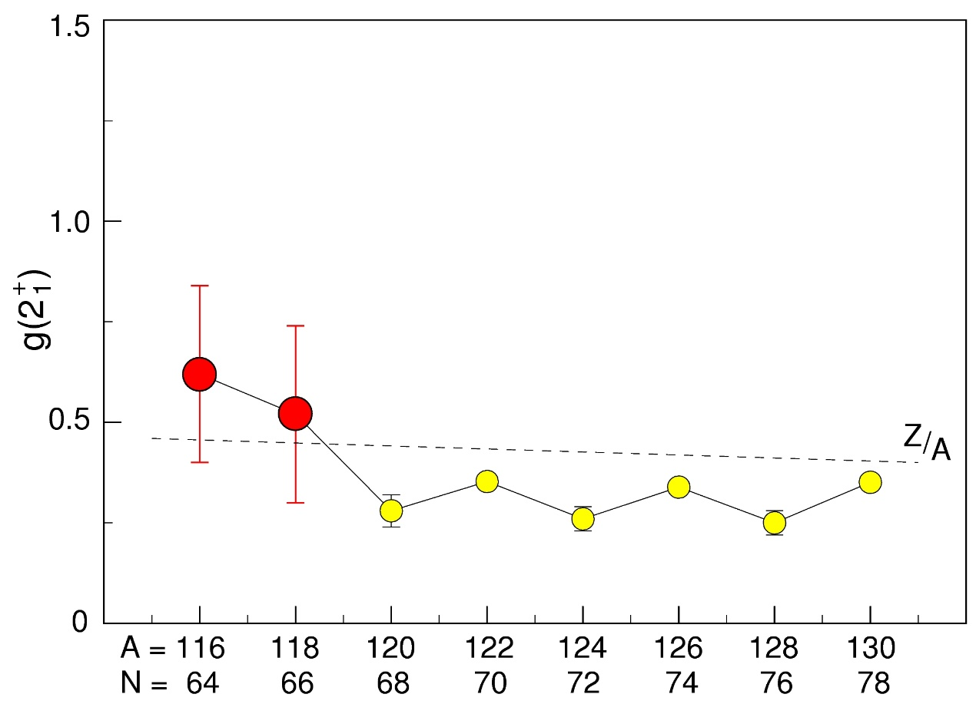
Experimental results
+
lifetimes from DSAM analysis in ^{116,118,120}Te
g(2 ) factors in ^{116,118,120}Te
1
PRELIMINARY
P. Raghavan, At. Data Tables 42, 189 (1989)
Institut für Kernphysik, TU Darmstadt

Slide 23
Summary
α Transfer observed in nuclei beyond A ~ 110
Proof of principle for g-factor and DSAM experiments using α transfer to stable nuclei in a mass region between 32 < A < 116
α Transfer to stable Ion Beams (examples)
Beam :
⁷⁸Kr
⁸⁶Kr
⁸⁴Sr
⁹⁶Ru
¹²⁴Xe
¹³⁶Xe
Isotope :
⁸²Sr₄₄
⁹⁰Sr₅₂
⁸⁸Zr₄₈
¹⁰⁰Pd₅₄
¹²⁸Ba₇₂
¹⁴⁰Ba₈₄
T_{1/2} :
25.5 d
28.5 y
83.4 d
3.6 d
2.4 d
12.8 d
More exotic nuclei by
α Transfer to radioactive Ion Beams !

Slide 25
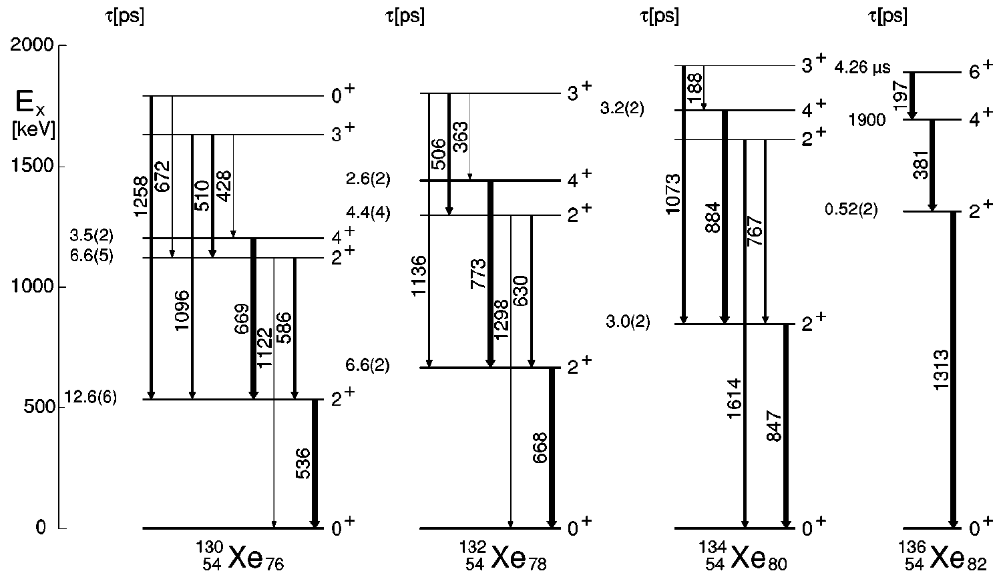
Appendix: The chain of Xe isotopes
 | ¹³⁰Xe | ¹³²Xe | ¹³⁴Xe | ¹³⁶Xe
E(2⁺) (keV) | 536 | 668 | 847 | 1313
τ(2⁺) (ps) | 12.6(6) | 6.6(2) | 3.0(2) | 0.52(2)
g(2⁺) | +0.334(11) | +0.314(12) | +0.354(7) | +0.766(45)
alignment

Slide 26
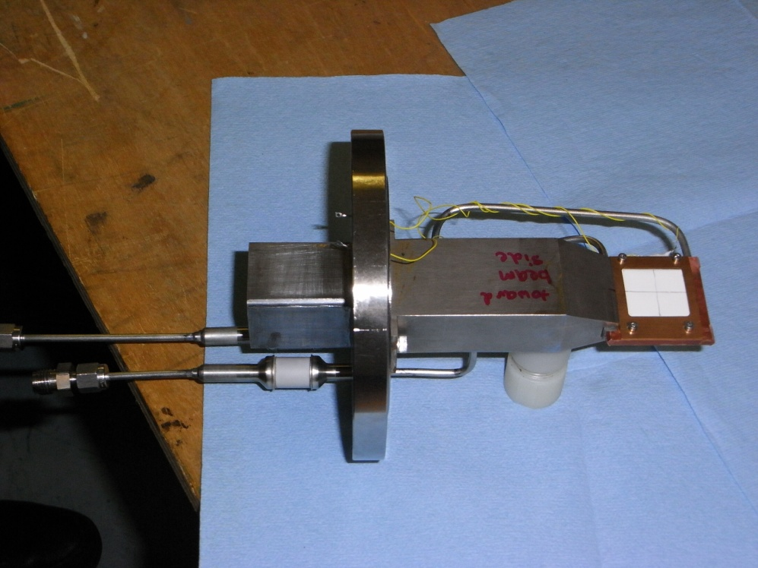
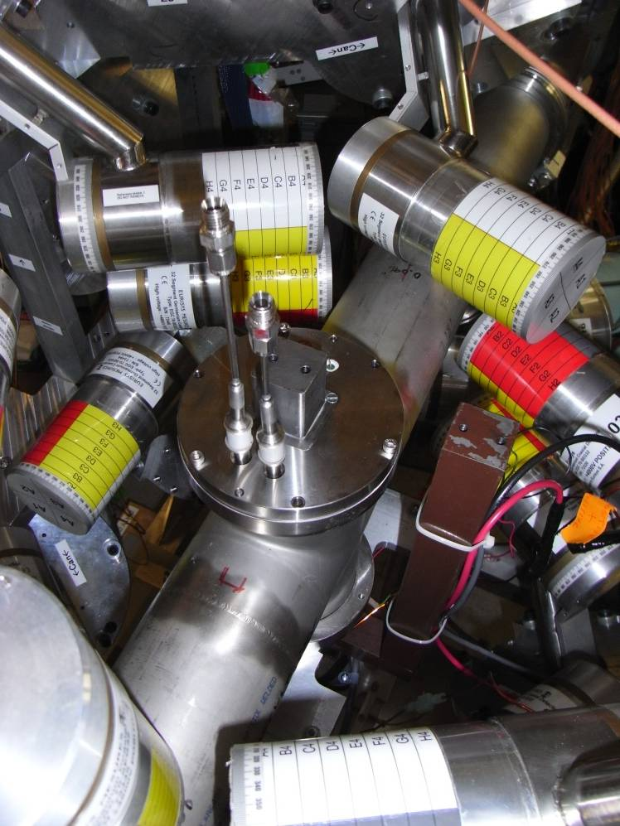
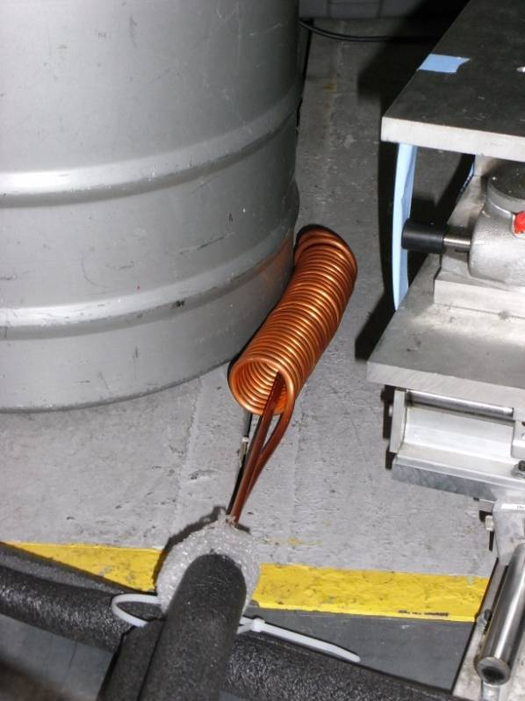
Appendix: The target chamber used at MSU

Slide 27
Relative uncertainty of the TF strength as a function of statistics/time
ξ_{1s} = 0.2%
Large uncertainties in this
estimate due to:
unknown field strength
unclear rate limitations
ξ_{1s} = 0.1%
ξ_{1s} = 0.05%
2 days or 60 shifts
of parasitic beam
8 %
Best guess !
1 day
2 days
,
It is most important to see an effect for the first time !
Then we can do proper estimates for real g(2⁺) measurements …

