Slide 1

Outline: Deformed (Nilsson) shell model
Lecturer: Hans-Jürgen Wollersheim
e-mail: h.j.wollersheim@gsi.de
web-page: https://web-docs.gsi.de/~wolle/ and click on
deformed shell model
Nilsson model for small deformation
shell closure for large deformation
K-isomers e.g. ¹⁷⁸Hf
structure of super heavy elements

Slide 2

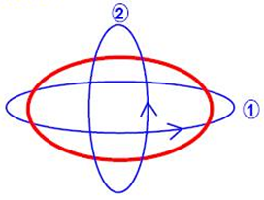
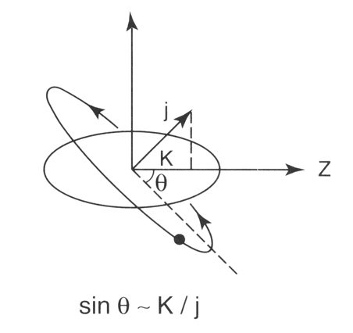
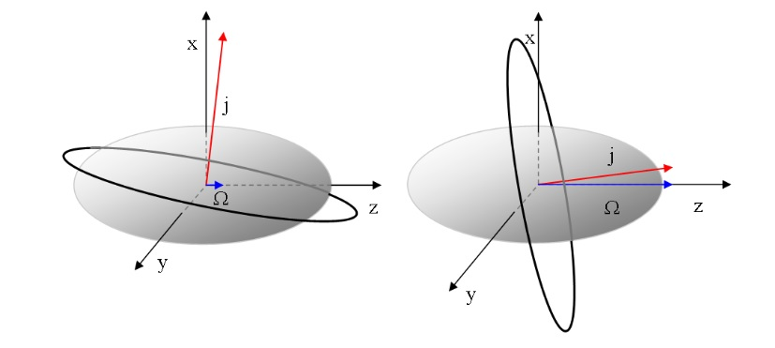
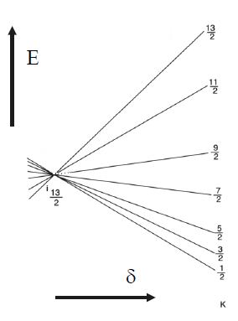

Deformed (Nilsson) shell model
spherical nucleus:
deformed nucleus:
→ can rotate
orbit 1 is closer to the center of gravity than orbit 2.
The energy of orbit 1 is the lowest.
z
3
Separation of laboratory system and
body-fixed (intrinsic) system
Ω = K projection of the single-particle
angular momentum onto the symmetry axis
Rotation perpendicular to the symmetry axis
will not change the Ω-quantum number
$$Ω=K$$

Slide 3
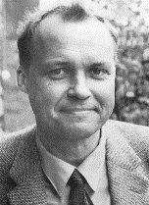


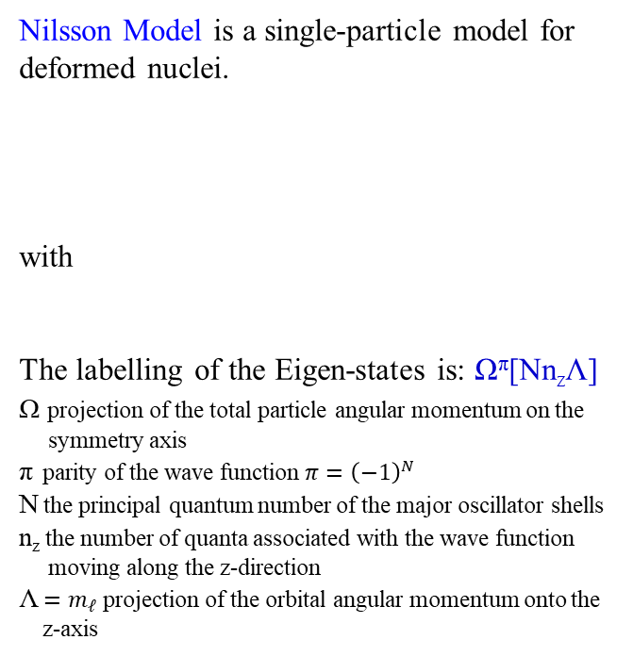
Nilsson model (quadrupole interaction)
Sven Gösta Nilsson
Nilsson Model is a single-particle model for deformed nuclei.
with
The labelling of the Eigen-states is: Ω^{π}[Nn_{z}Λ]
Ω projection of the total particle angular momentum on the
symmetry axis
π parity of the wave function $π={\left(−1\right)}^{N}$
N the principal quantum number of the major oscillator shells
n_{z} the number of quanta associated with the wave function
moving along the z-direction
Λ $=m_{ℓ}$ projection of the orbital angular momentum onto the
z-axis
$$ω_{x}^{2}=ω_{0}^{2}∙\left(1+\frac{2}{3}∙δ\right)$$
$$ω_{z}^{2}=ω_{0}^{2}∙\left(1−\frac{4}{3}∙δ\right)$$

Slide 4



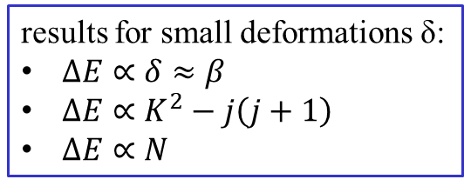
Nilsson model for small deformations
shell model with H.O. potential
H_{def}
results for small deformations δ:
$ΔE∝δ≈β$
$ΔE∝K^{2}−j\left(j+1\right)$
$ΔE∝N$

Slide 5
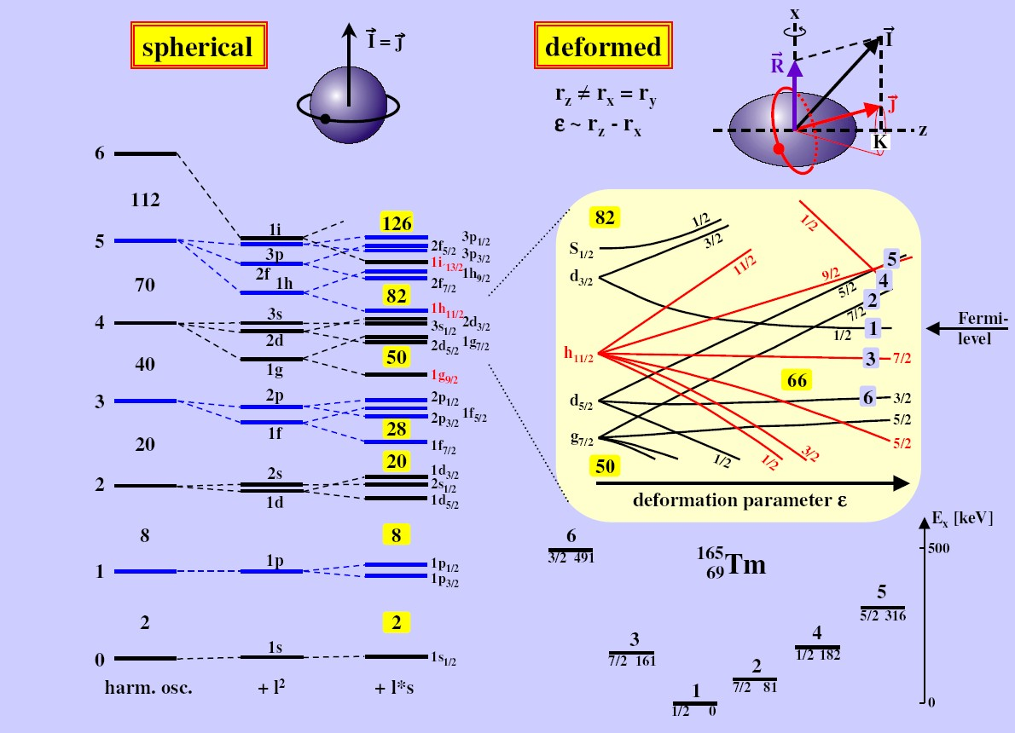
Spherical shell model → Nilsson model
z
3
The lower K, the more attraction
the orbit feels (for prolate shape)

Slide 6

Shell closures for large deformations
For large deformation the $\vec{ℓ}∙\vec{s}$ and ${\vec{ℓ}}^{2}$ terms can be neglected.
spectrum of a prolate deformed harmonic oscillator as a function of the deformation parameter ε

Slide 7
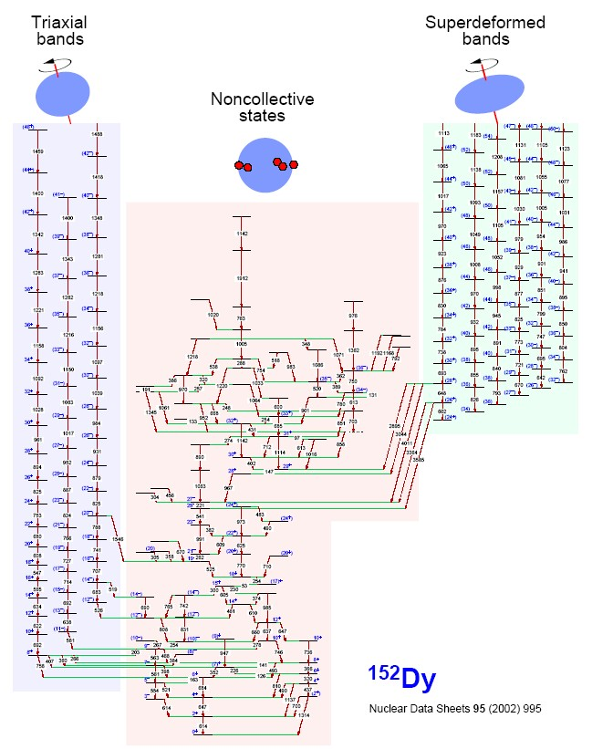
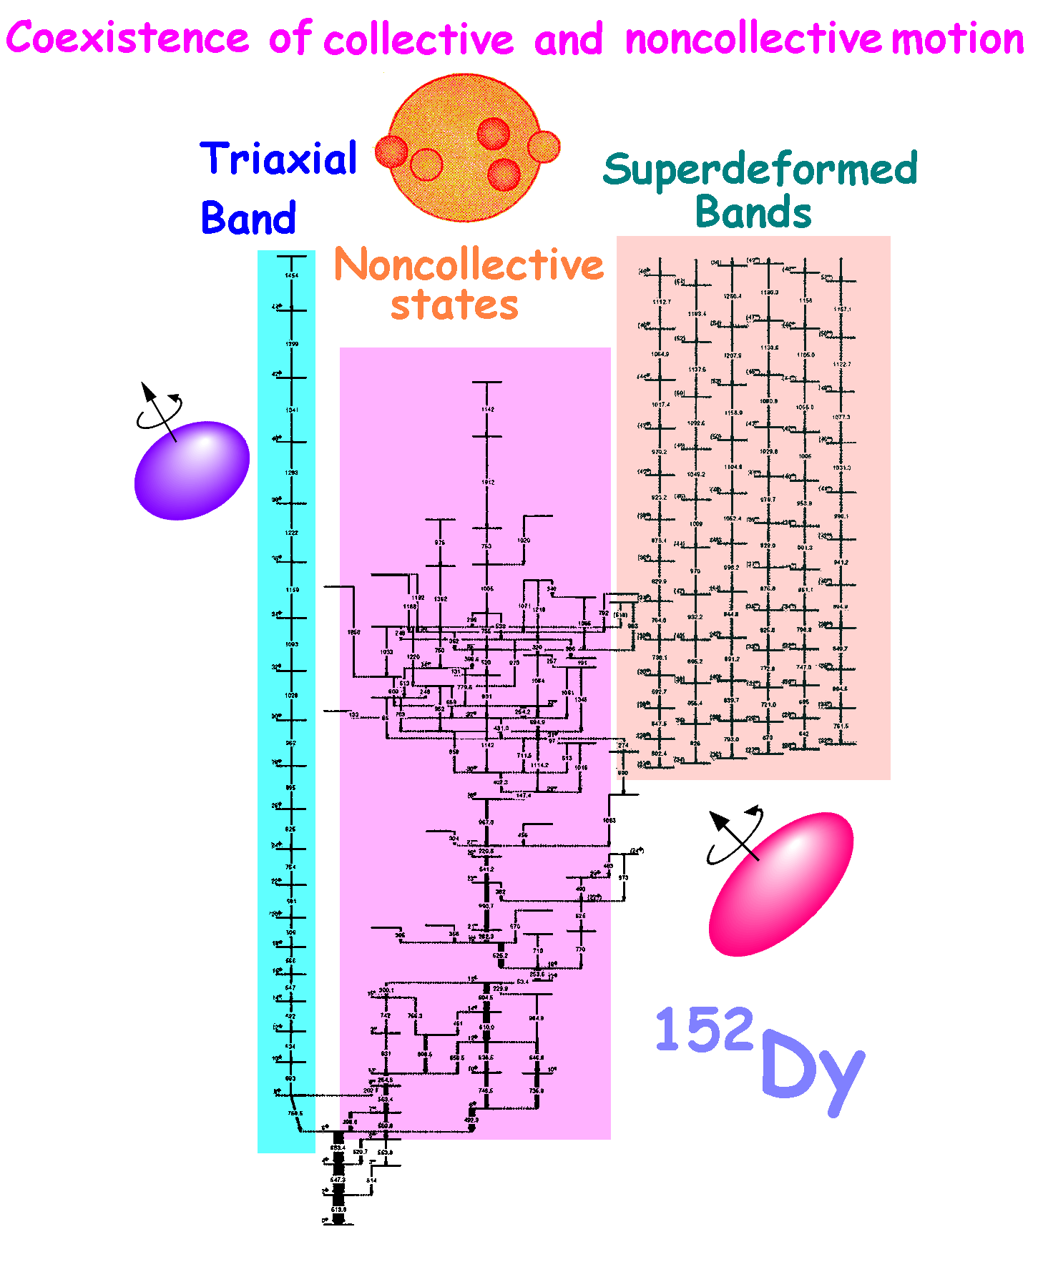
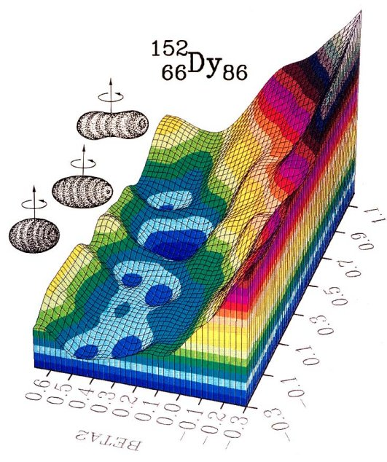
Nuclear structure of ¹⁵²Dy: hadronic field theory in nuclei

Slide 8
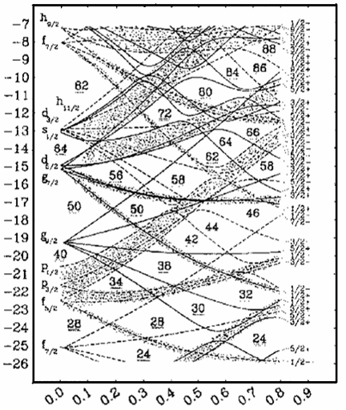
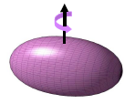
Nuclear structure and intruder states
π i_{13/2}
²³⁵U
¹⁵²Dy
¹⁰⁸Cd
N+3 shell
N+2 shell
N+1 shell
N shell
single-particle energy (Woods-Saxon)
Fermi level
Z=48
Energy
Deformation
ND
SD
HD
(N+1) intruder
⇒ normal deformed, e.g. ²³⁵U
quadrupole deformation
(N+2) super-intruder
⇒ super deformation, e.g. ¹⁵²Dy, ⁸⁰Zr
(N+3) hyper-intruder
⇒ hyper deformation in ¹⁰⁸Cd, ?

Slide 9
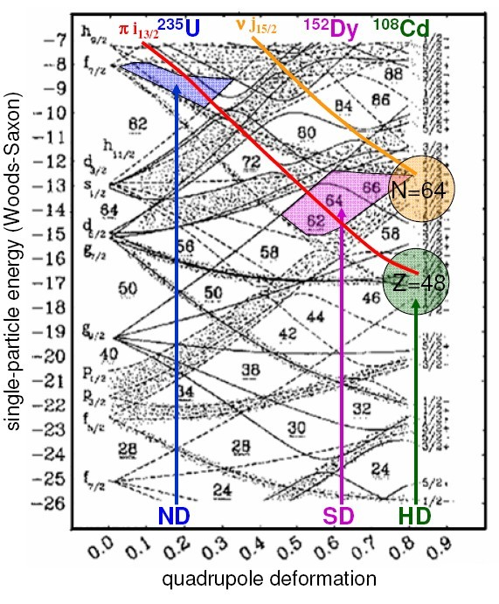
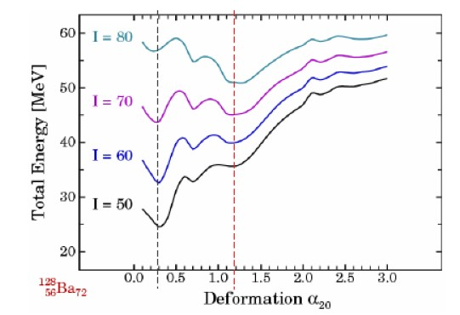
Nuclear deformation
For large spins: interaction between
macroscopic effects: liquid drop
microscopic effects: shell structure
The different slopes of the single-particle states create different minima for the same number of nucleons

Slide 10
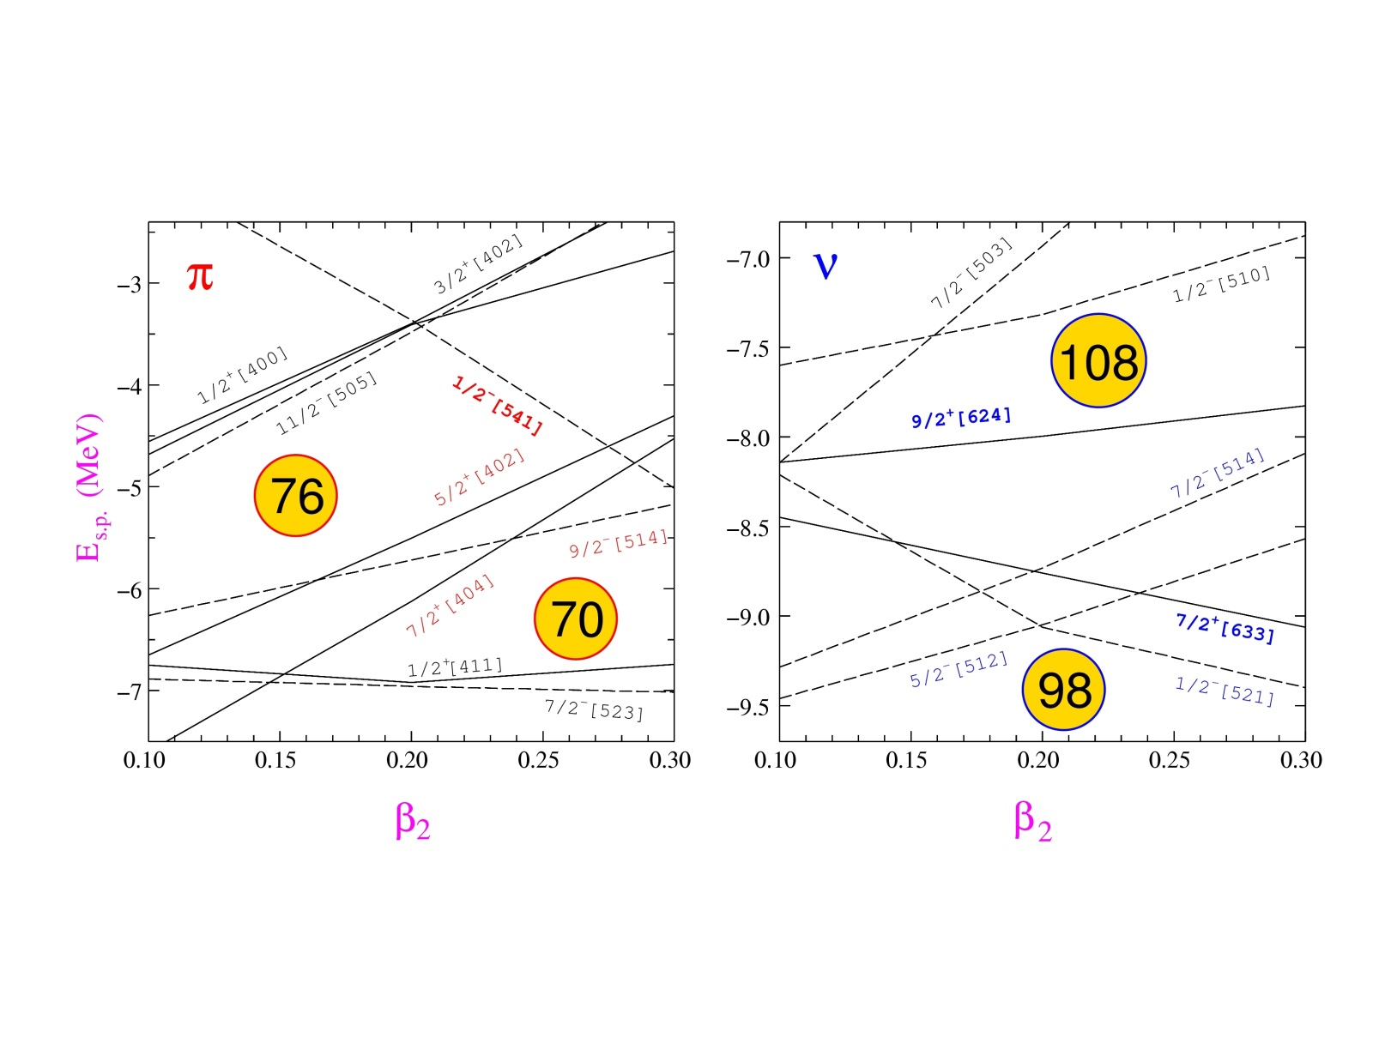
K-Isomers
Deformed nuclei with axially-symmetric shape
Mass 180 region : Yb (Z=70) - Ir (Z=77)
ω
j₂
j₁
j
K
High-K orbitals near the Fermi surface
: 7/2[404], 9/2[514], 5/2[402]
ν: 7/2[514], 9/2[624], 5/2[512], 7/2[633]

Slide 11
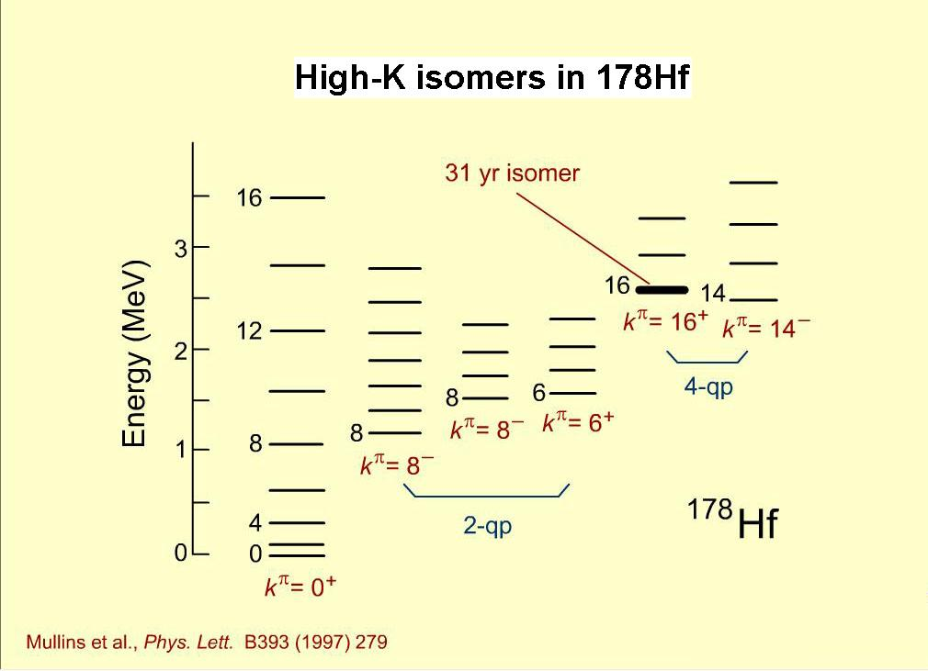
K-Isomers
ω
A well-known example:
K=0
9/2[624]
9/2[514]
Fermi Surface
7/2[514]
7/2[404]
neutron
proton

Slide 12
K-Isomers
j₂
A well-known example:
j₁
j
K>0
9/2[624]
9/2[514]
Fermi Surface
7/2[514]
7/2[404]
neutron
proton

Slide 13
K-Isomer
j₂
A well-known example:
j₁
j
K>0
9/2[624]
9/2[514]
Fermi Surface
7/2[514]
7/2[404]
neutron
proton

Slide 14
K-Isomer
A well-known example:
9/2[624]
9/2[514]
Fermi Surface
7/2[514]
7/2[404]
neutron
proton

Slide 15


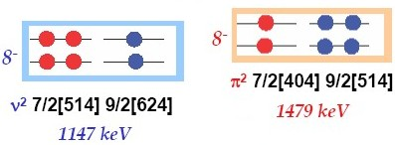

Magnetic moments in ¹⁷⁸Hf
proton
neutron
g(h_{11/2}) = 1.42 g(g_{7/2}) = 0.49 g(f_{7/2}) = -0.55 g(i_{13/2})=-0.29
g(h_{11/2} x g_{7/2}; 8⁻) = 1.08 g(f_{7/2} x i_{13/2}) = -0.36
g(8⁻ x 8⁻; 16⁺) = 0.36 → μ = g·I = 5.76 nm
E_{x}~2Δ_{p}
E_{x}~2Δ_{n}
7.26±0.16 nm

Slide 16
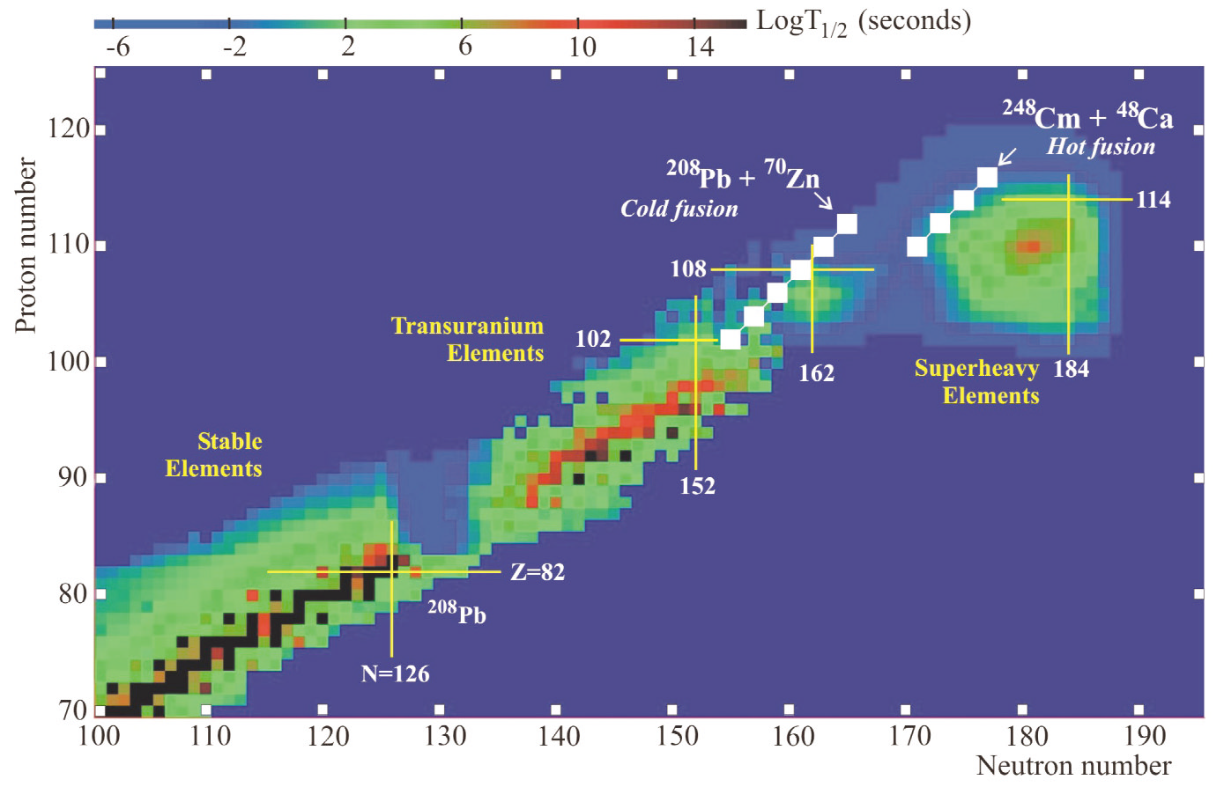
Chart of nuclides: the domain of heavy and super-heavy elements

Slide 17
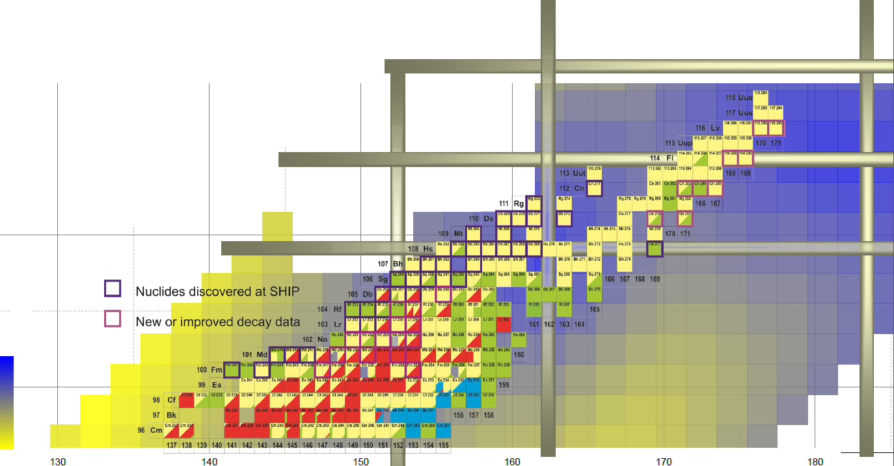
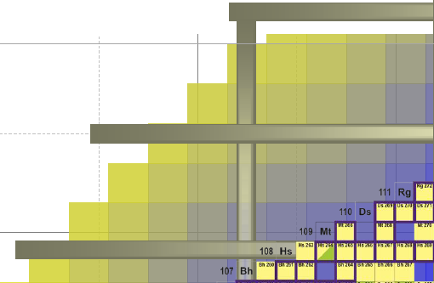

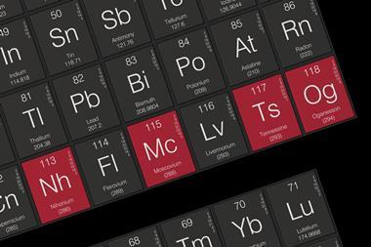
Chart of nuclides: the domain of heavy and superheavy elements
162
184
120
152
Og
Ts
Mc
114
Nh
sperical shell-stabilised
superheavy nuclei
108
E_{shell}
-8.3
-7.4
-6.4
-5.4
-4.4
-3.4
-2.4
-1.4
-0.4
deformed shell-stabilised
superheavy nuclei
Calc.: A. Sobiczewski

Slide 18
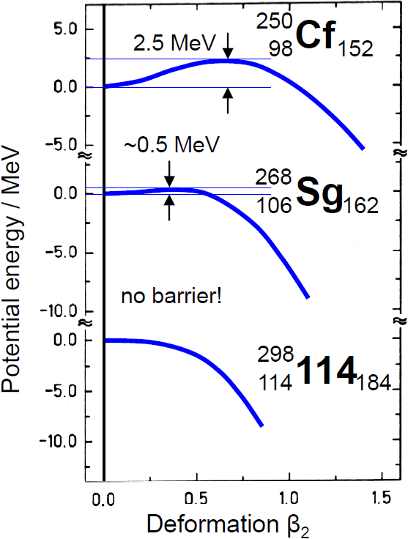
Influence of shell effects on fission barrier
macroscopic barrier:
disappears at Z ~ 104!

Slide 19
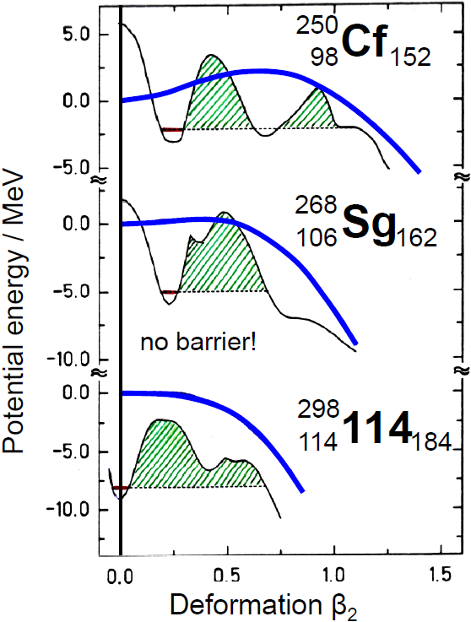
Influence of shell effects on fission barrier
macroscopic barrier:
disappears at Z ~ 104!
with shell structure:
spherical ↔ deformed ground state
fission barrier is also > 0 for Z ≥ 104
some fission barriers have complicated shapes,
multi-humped structure
elements exist only due to shell effects:
superheavy elements

Slide 20
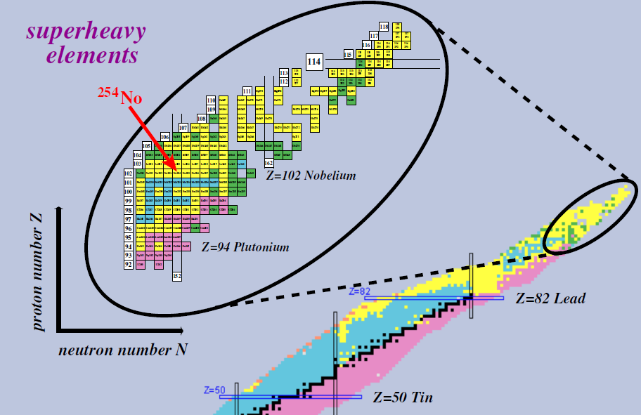
What is the structure of SHE?

Slide 21

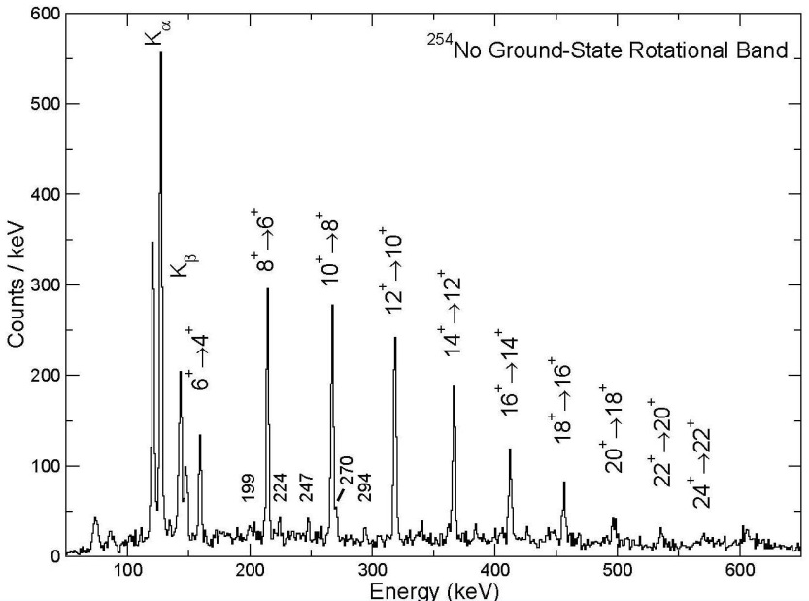
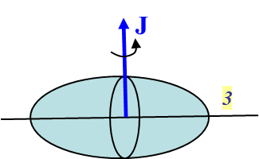
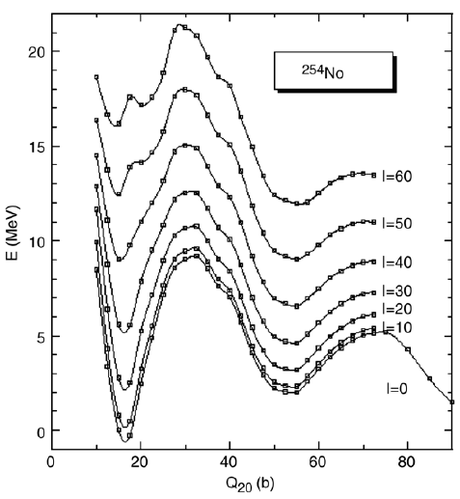


Spinning the heaviest elements
rotational energy: $E_{I}=\frac{ℏ^{2}}{2ℑ}∙I\left(I+1\right)$
γ-ray energy: $E_{I}−E_{I−2}=\frac{ℏ^{2}}{2ℑ}∙\left(4I−2\right)$
dependence of the fission barrier on spin I
S. Eeckhaupt et al.; EPJA 26 (2005), 227

Slide 22
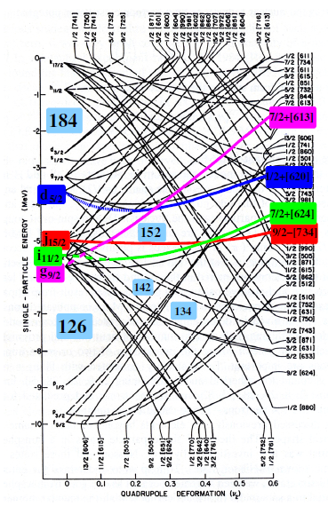
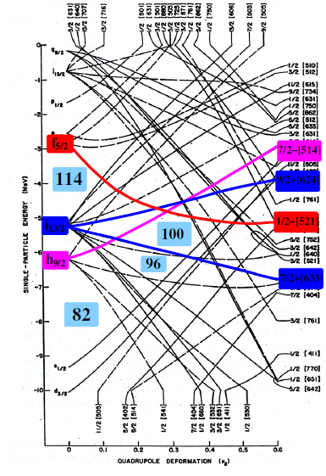
What is the structure of SHE

Slide 23
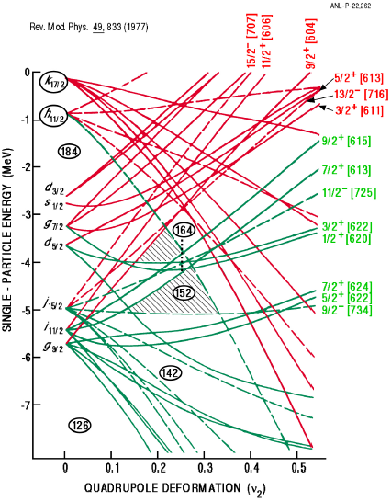
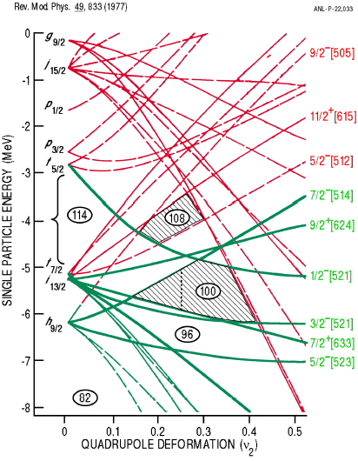

Single particle orbitals
R. Chasman et al. Rev. Mod. Phys. 49 (1977), 833
oblate
$${}_{102}^{254}{{No}_{152}} β_{2}\sim 0.28$$
prolate

Slide 24
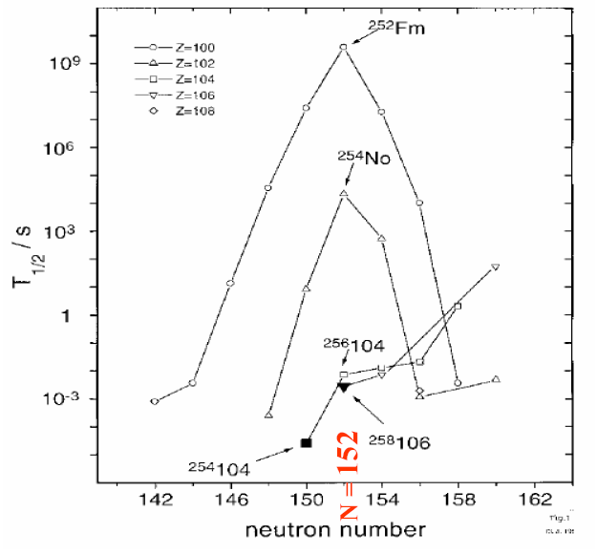
Stability of heavy elements – Nilsson level energy
N = 152
²⁵⁴No (Z=102), ²⁵²Fm (Z=100) and ²⁵⁰Cf (Z=98) with N=152
seem to be more stable than their neighbors

Slide 25
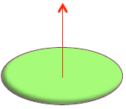
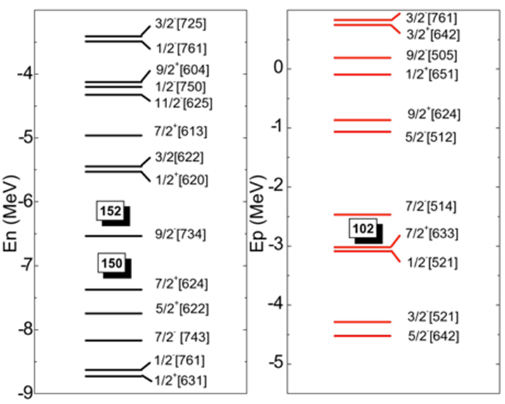
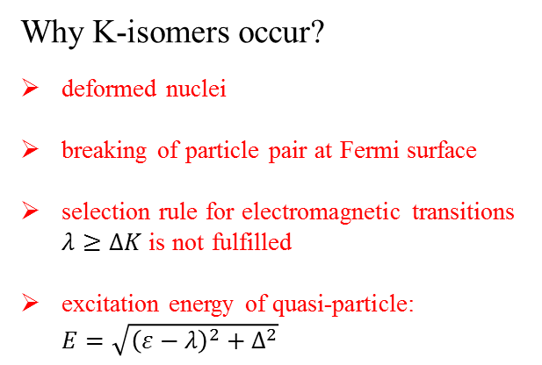
Isomeric states in even-even nuclei
Why K-isomers occur?
deformed nuclei
breaking of particle pair at Fermi surface
selection rule for electromagnetic transitions $λ≥ΔK$ is not fulfilled
excitation energy of quasi-particle: $E=\sqrt{{\left(ε−λ\right)}^{2}+Δ^{2}}$
I=R
K=0
What we can learn?
information about Nilsson level energy gaps
influence on stability of superheavy elements
pairing interaction

Slide 26
Isomeric states in even-even nuclei
Why K-isomers occur?
deformed nuclei
breaking of particle pair at Fermi surface
selection rule for electromagnetic transitions $λ≥ΔK$ is not fulfilled
excitation energy of quasi-particle: $E=\sqrt{{\left(ε−λ\right)}^{2}+Δ^{2}}$
I=R
I=R+j
K=0
Ω₁+Ω₂=K
K=8⁻
K=8⁻
What we can learn?
information about Nilsson level energy gaps
influence on stability of superheavy elements
pairing interaction

Slide 27
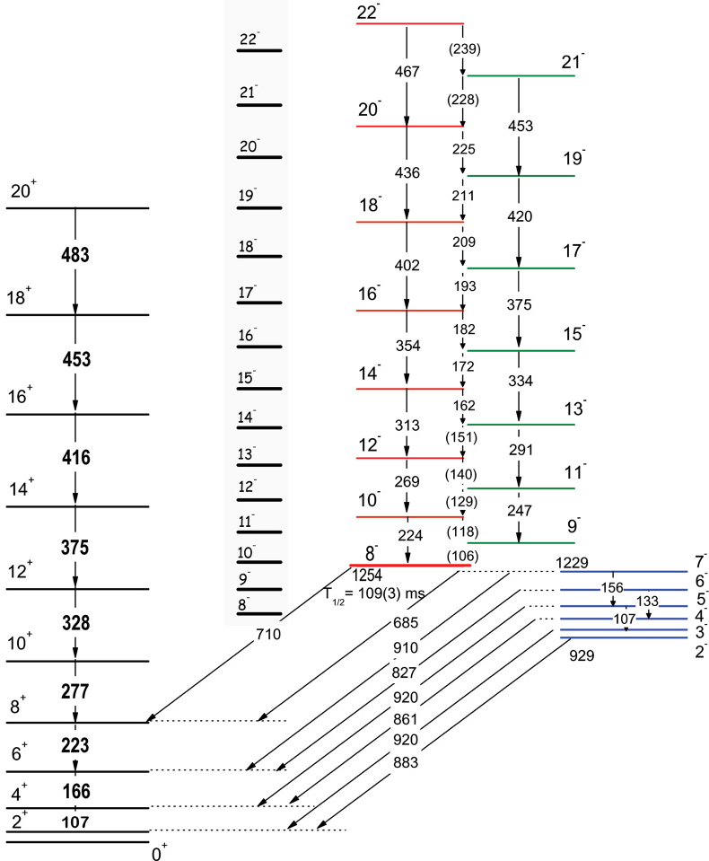
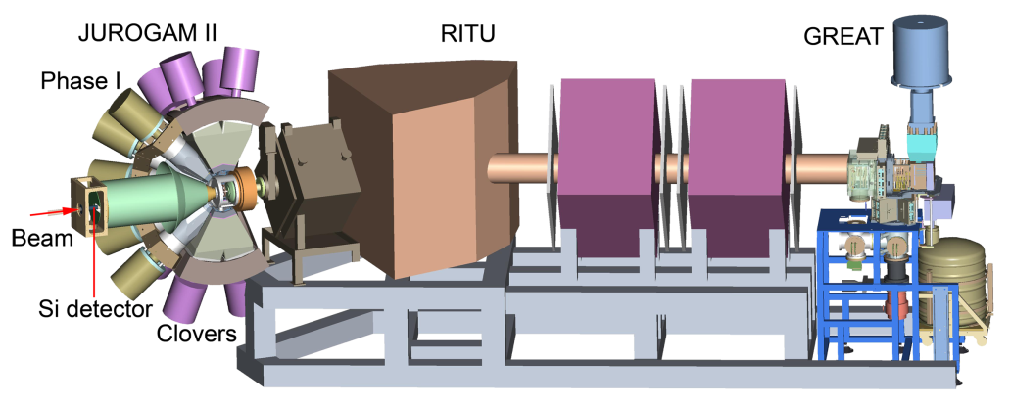
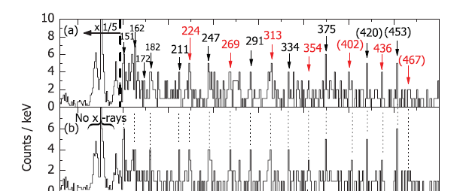

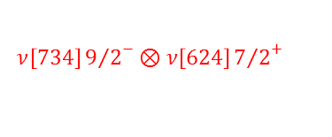
K-Isomers in ²⁵²No
K=8⁻
$$ν\left[734\right]{9/2}^{−}⊗ν\left[624\right]{7/2}^{+}$$
K=8⁻
K=2⁻
B. Sulignano st al; Phys. Rev. C 86, 044318 (2012)

Slide 28
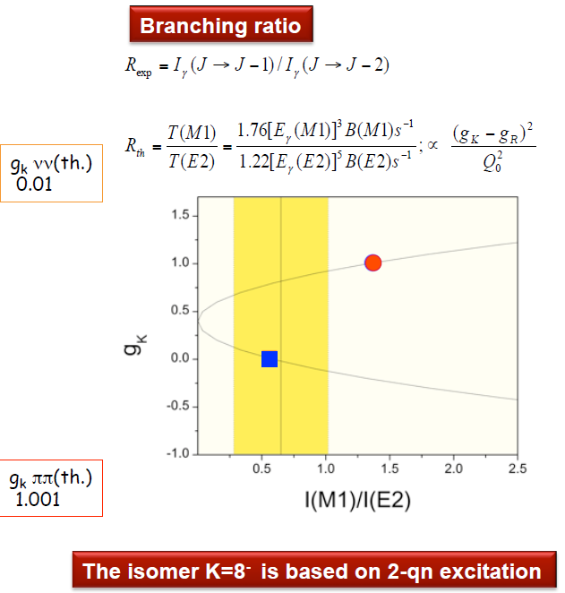


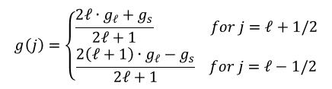

Neutron single particle states in ²⁵²No
7/2⁺[624] Nilsson configuration i_{11/2}
9/2⁻[734] Nilsson configuration j_{15/2}
$$g\left(j\right)=\left\{\begin{aligned}\frac{2ℓ∙g_{ℓ}+g_{s}}{2ℓ+1} for j=ℓ+1/2 \\ \frac{2\left(ℓ+1\right)∙g_{ℓ}−g_{s}}{2ℓ+1} for j=ℓ−1/2\end{aligned}\right.$$
proton: g_{ℓ} = 1 g_{s} = 5.59
neutron: g_{ℓ} = 0 g_{s} = -3.83
g(i_{11/2}) = +0.295 g(j_{15/2}) = -0.255
$$g\left(j_{1}×j_{1};J\right)=\frac{1}{2}∙\left(g_{1}+g_{2}\right)+\frac{j_{1}\left(j_{1}+1\right)−j_{2}\left(j_{2}+1\right)}{2J\left(J+1\right)}∙\left(g_{1}−g_{2}\right)$$
g(i_{11/2} x j_{15/2}; 8) = 0.09
$$B\left(M1;I→I−1\right)=\frac{3}{4π}{\left[g_{K}−g_{R}\right]}^{2}∙K^{2}{\left|\left\langle IK10 | \left(I−1\right)K\right\rangle \right|}^{2}$$
$$B\left(E2;I→I−2\right)=\frac{5}{16π}Q_{0}^{2}{\left|\left\langle IK20 | \left(I−2\right)K\right\rangle \right|}^{2}$$
g_{R} = Z/A = 0.40

Slide 29
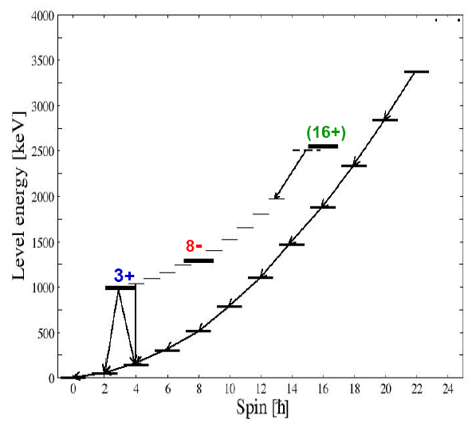
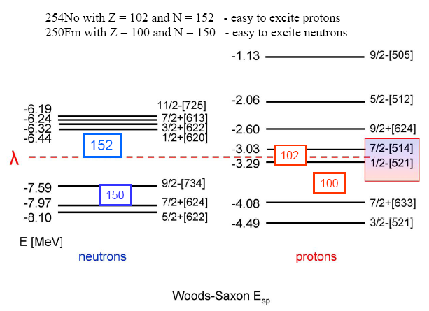
K-Isomeric states
Exp. results: excitation of isomeric states
Yrast – plot ( ²⁵⁴No)
²⁵⁴No with Z=102 and N=152 – protons will be excited easily
²⁵⁰Fm with Z=100 and N=150 – neutrons will be excited easily

Slide 30
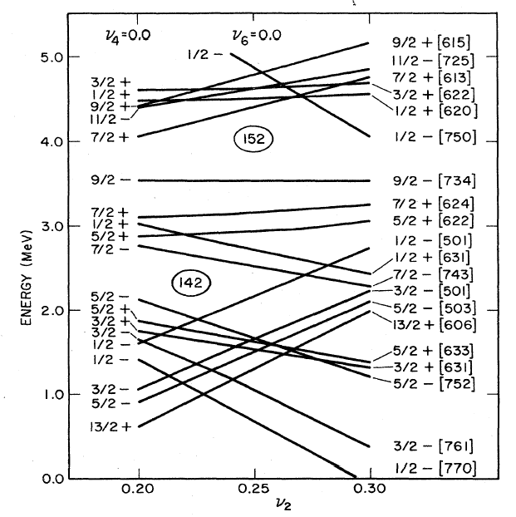
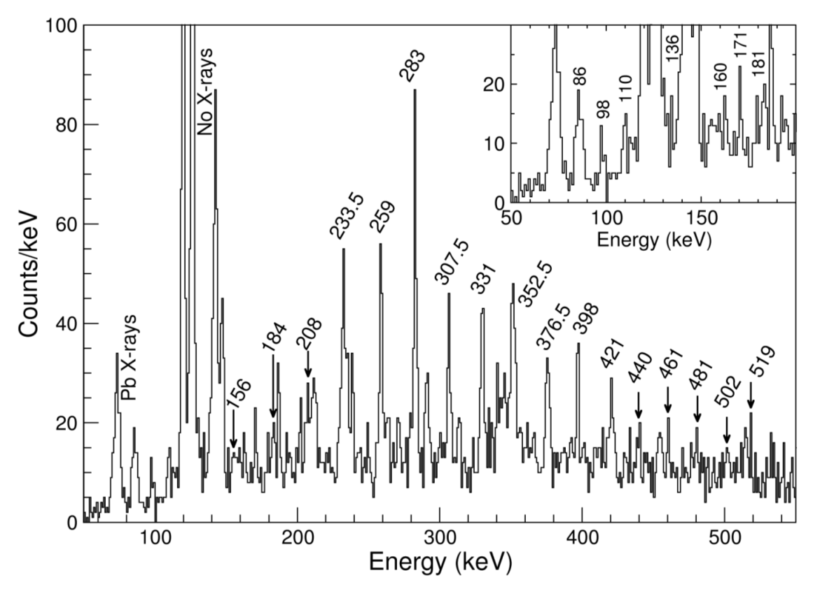
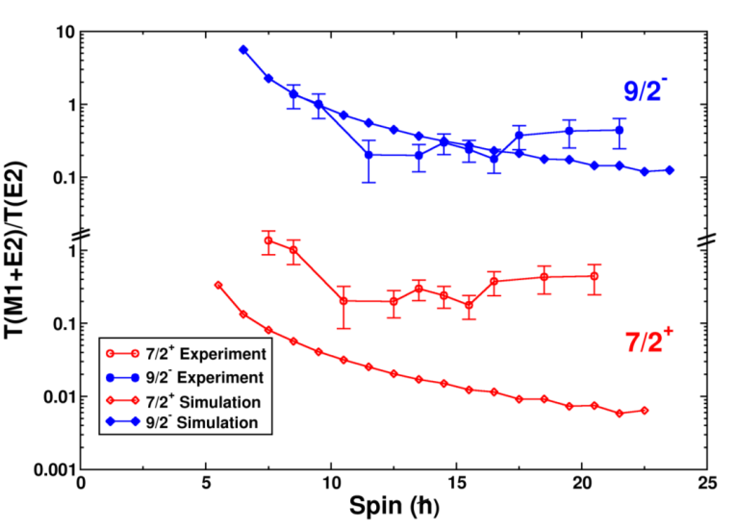
Level scheme of ²⁵³No (151 neutrons)
ground state 9/2⁻
excited state 7/2⁺
rotational band observed at Gammasphere & JUROGAM
9/2⁻ [734]
7/2⁺ [624]
M1
R. Chasman et al.; Rev. Mod. Phys. 49 (1977) 833

Slide 31
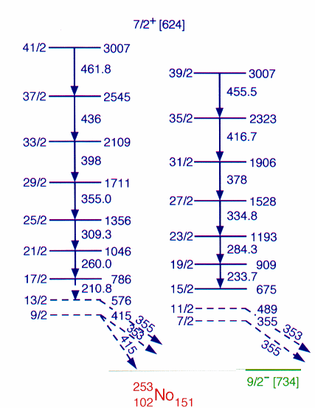
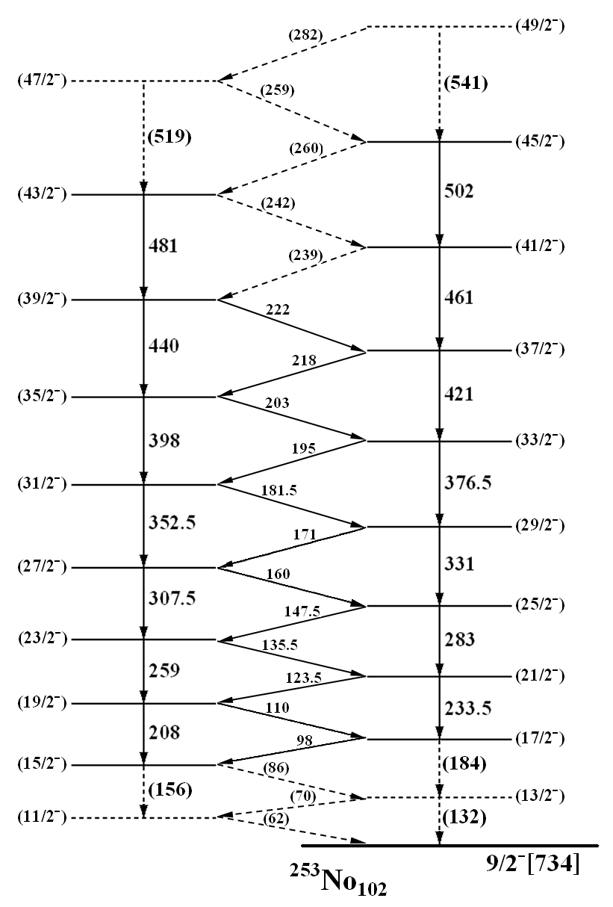
Level scheme of ²⁵³No (151 neutrons)
9/2⁻ [734]
7/2⁺ [624]
R. Chasman et al.; Rev. Mod. Phys. 49 (1977) 833

