Slide 1

Outline: Solar Abundances
Lecturer: Hans-Jürgen Wollersheim
e-mail: h.j.wollersheim@gsi.de
web-page: https://web-docs.gsi.de/~wolle/ and click on
mass fraction and abundance
solar abundances
outside the solar neighborhood
galactic radioactivity

Slide 2
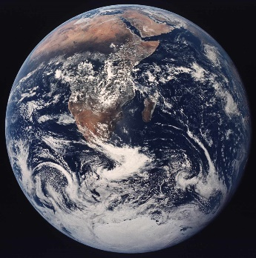
Abundances – the composition of the universe
Before answering the question of the origin of the elements we want to see
what elements are actually there - in other words
What is the Universe made of ? Answer: We have no clue ….
60% Dark Energy (don’t know what it is)
35% Cold dark matter (don’t know what it is)
5% Nuclei and electrons (visible as stars ~ 0.5%)
Topic of this course
Why bother with 5% ???
Important things are made of it:
Questions to be answered:
What kind of nuclei (nuclides) is the universe made of ?
How abundant is each element ? Each nuclide ?

Slide 3
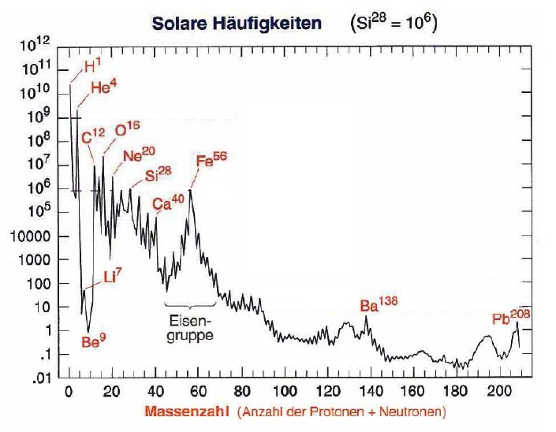
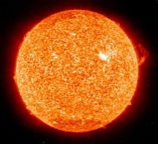
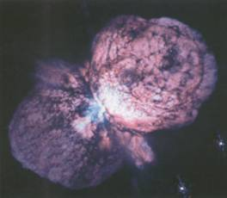
Open questions
solar abundances (Si²⁸ = 10⁶)
big bang
fusion reaction
neutron reaction
Why is iron more abundant
than gold?
Why are the heavy elements
existing and how are they
produced?
How can we explain the
abundances in the universe?
mass number (sum of protons + neutrons)

Slide 4

1. The nucleus
The atomic nucleus consists of protons and neutrons
Protons and Neutrons are therefore called nucleons
A nucleus is characterized by:
A: Mass Number = number of nucleons
Z: Charge Number = number of protons
N: Neutron Number
Determines the Element
Determines the Isotope
Of course A=Z+N
Usual notation:
Mass number A
¹²C
Element symbol – defined by charge number
C is Carbon and Z=6
So this nucleus is made of 6 protons and 6 neutrons

Slide 5
2. Abundance of a nucleus
How can we describe the relative abundances of nuclei of different species and
their evolution in a given sample (say, a star, or the Universe) ?
2.1. Number density
We could use the number density = number of nuclei of species i per cm³
Disadvantage: tracks not only nuclear processes that create or destroy nuclei,
but also density changes, for example due to compression
or expansion of the material.

Slide 6
2.2 Mass fraction and abundance
Mass fraction X_{i} is fraction of total mass of sample that is made up by nucleus of species i
ρ : mass density (g/cm³)
m_{i} mass of nucleus of species i
(CGS only !!!)
with
and
as atomic mass unit (amu)
note: we neglect here nuclear binding energy and electrons (mixing atomic and nuclear masses) - therefore strictly speaking our ρ is slightly different from the real ρ, but differences are negligible in terms of the accuracy needed for densities in astrophysics
call this abundance Y_{i}
so
with
note: abundance has no units
only valid in CGS
The abundance Y is proportional to number density but changes only if the
nuclear species gets destroyed or produced. Changes in density are factored out.

Slide 7
2.3 Some useful quantities and relations
of course
but, as Y=X/A < X
Mean molecular weight μ_{i}
= average mass number =
or
Electron Abundance Y_{e}
As matter is electrically neutral, for each nucleus with charge number Z there
are Z electrons:
and as with nuclei, electron density
prop. to number of protons
can also write:
prop. to number of nucleons
So Y_{e} is ratio of protons to nucleons in sample
(counting all protons including the ones contained in nuclei
- not just free protons as described by the “proton abundance”)

Slide 8
2.3 Some useful quantities and relations
some special cases:
For 100% hydrogen: Y_{e} = 1
For equal number of protons and neutrons (N=Z nuclei): Y_{e} = 0.5
For pure neutron gas: Y_{e} = 0

Slide 9
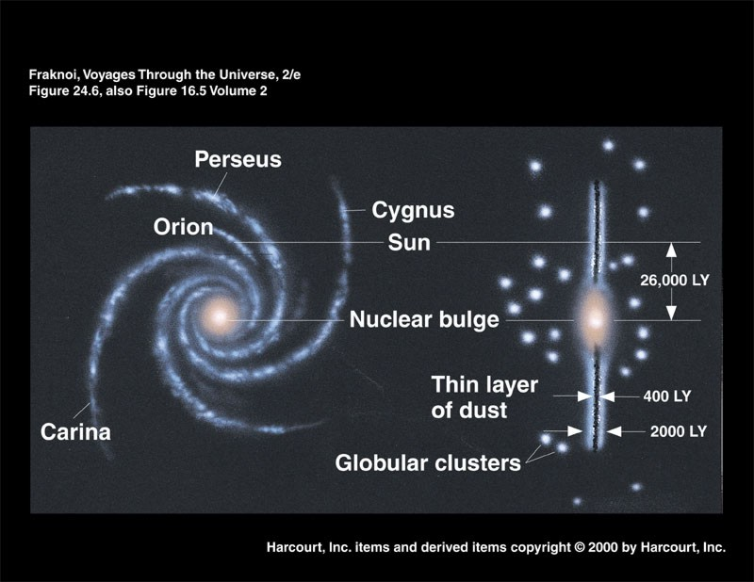
3. The solar abundance distribution
Disk
solar abundances:
Elemental
(and isotopic)
composition
of Galaxy at
location of solar
system at the time
of it’s formation
Halo
+
+
Sun
Bulge

Slide 10
How can solar abundances be determined?
1. Earth material
Problem: chemical fractionation modified the local composition
strongly compared to pre solar nebula and overall solar system.
for example: Quarz is 1/3 Si and 2/3 Oxygen and not much else.
This is not the composition of the solar system.
But: Isotopic compositions mostly unaffected (as chemistry is determined
by number of electrons (protons), not the number of neutrons).
main source for isotopic composition of elements
2. Solar spectra
Sun formed directly from pre solar nebula - (largely) unmodified outer layers
create spectral features
3. Unfractionated meteorites
Certain classes of meteorites formed from material that never experienced
high pressure or temperatures and therefore was never fractionated.
These meteorites directly sample the pre solar nebula

Slide 11
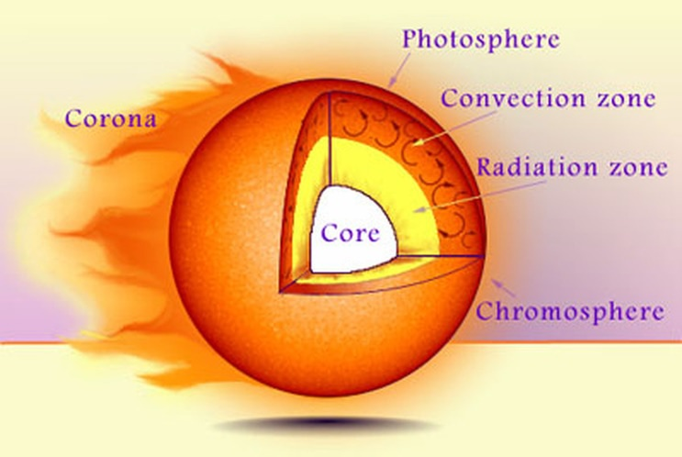
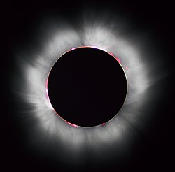
The sun
sun´s chromosphere (red rim) during a solar eclipse

Slide 12
3.1 Abundances from stellar spectra (for example the sun):
corona (nanoflares)
hot thin gas
up to 2 Mio K
emission lines
chromosphere
hot thin gas
~ 10,000 km
up to 10,000 K
emission lines
photosphere (sphere of light)
photons escape
freely
still dense enough for
photons to excite atoms
when frequency matches
~ 500 km
~ 6000 K
absorption lines
convective zone
radiation
transport
(short photon
mean free path)
continuous spectrum
Emission lines from atomic deexcitations
Wavelength → Atomic Species
Absorption lines from atomic excitations
Intensity → Abundance

Slide 13
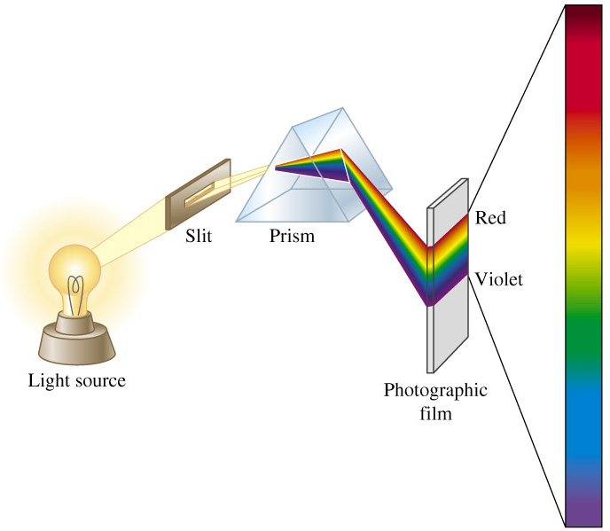

Spectral analysis absorption
H-absorption spectrum
absorption
Hydrogen gas

Slide 14
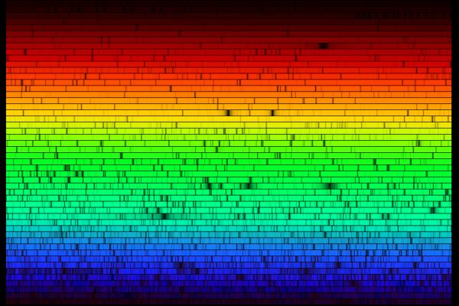
3.1.1 Absorption spectra:
provide majority of data because:
by far the largest number of elements can be observed
least fractionation as right at end of convection zone - still well mixed
well understood - good models available
solar spectrum (Nigel Sharp, NOAO)

Slide 15
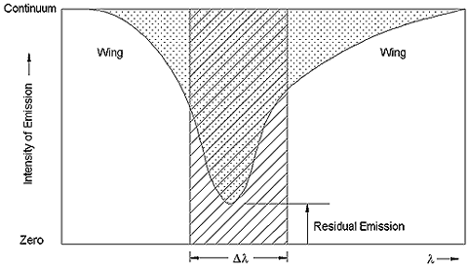
Analysis of absorption spectra
effective line width ~ total absorbed intensity
Simple model consideration for absorption in a slab of thickness Δx:
Ι, Ι₀ = observed and initial intensity
σ = absorption cross section
n = number density of absorbing atom
So if one knows σ one can determine n and get the abundances
There are 2 complications:

Slide 16

Complication (1) Determine σ
The cross section is a measure of how likely a photon gets absorbed when
an atom is bombarded with a flux of photons (more on cross section later …)
It depends on:
Oscillator strength: a quantum mechanical property of the atomic transition
Needs to be measured in the laboratory - not done with sufficient accuracy
for a number of elements.
Line width
the wider the line in wavelength, the more likely a photon is absorbed
(as in a classical oscillator).
E
ΔE
excited state has an energy width ΔE.
This leads to a range of photon energies
that can be absorbed and to a line width
Heisenberg’s uncertainty principle relates that
to the lifetime τ of the excited state
Atom
photon
energy
range
$$∆E∙τ=h$$
need lifetime of final state

Slide 17
The lifetime of an atomic level in the stellar environment depends on:
The natural lifetime (natural width)
lifetime that level would have if atom is left undisturbed
Frequency of interactions of atom with other atoms or electrons
Collisions with other atoms or electrons lead to deexcitation, and therefore to
a shortening of the lifetime and a broadening of the line
Varying electric fields from neighboring ions vary level energies
through Stark Effect
depends on pressure
need local gravity, or mass/radius of star
Doppler broadening through variations in atom velocity
thermal motion
depends on temperature
micro turbulence
Need detailed and accurate model of stellar atmosphere !

Slide 18
Complication (2)
Atomic transitions depend on the state of ionization !
The number density n determined through absorption lines is therefore
the number density of ions in the ionization state that corresponds to the
respective transition.
to determine the total abundance of an atomic species one needs the fraction
of atoms in the specific state of ionization.
Notation: I = neutral atom, II = one electron removed, III = two electrons removed …..
Example: a CaII line originates from singly ionized Calcium

Slide 19
Example: determine abundance of single ionized atom through lines.
need n₊/n₀
to determine total abundance n₊+ n₀
n₊: number density of atoms in specific state of ionization
n₀: number density of neutral atoms
We assume local thermodynamic equilibrium LTE, which means
that the ionization and recombination reactions are in thermal equilibrium:
A
A⁺ + e⁻
Then the Saha ionization equation yields:
n_{e} = electron number density
m_{e} = electron mass
B = electron binding energy
g = statistical factors (2J+1)
need pressure and temperature
strong temperature dependence !
with higher and higher temperature more ionized nuclei - of course eventually
a second, third, … ionization will happen.
again: one needs a detailed and accurate stellar atmosphere model

Slide 20
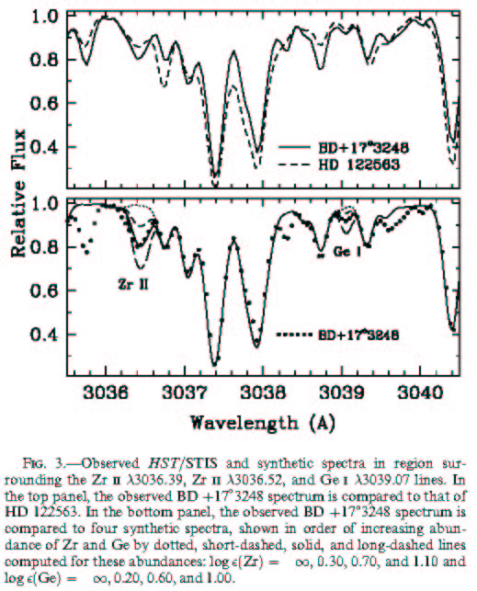
Practically, one sets up a stellar atmosphere model, based on star type, effective
temperature etc. Then the parameters (including all abundances) of the model are fitted
to best reproduce all spectral features, incl. all absorption lines (can be 100’s or more) .
Example for a r-process star (Sneden et al. ApJ 572 (2002) 861)
varied ZrII
abundance

Slide 21
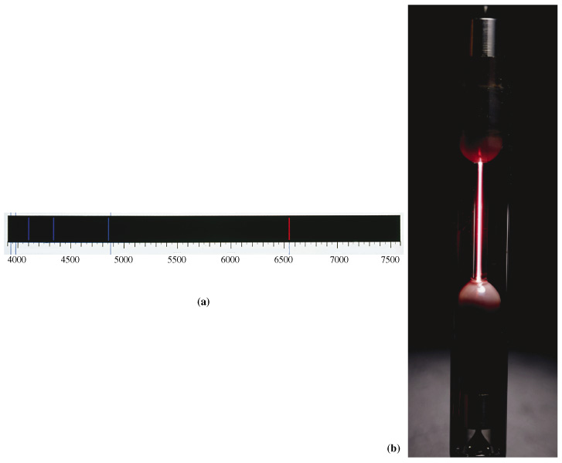
3.1.2 Emission spectra Hydrogen spectral lines
Hydrogen emission spectrum
wave length nm
21

Slide 22
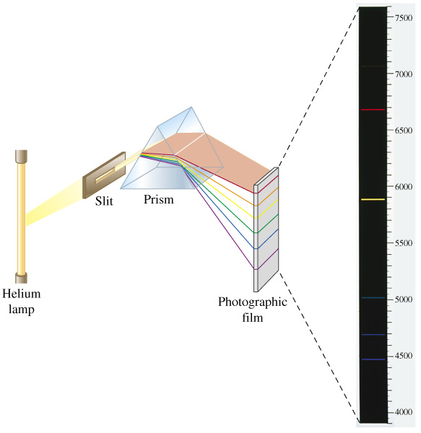
3.1.2 Emission spectra Helium spectral lines
Emission spectrum

Slide 23
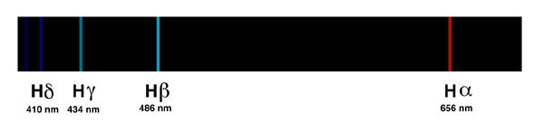
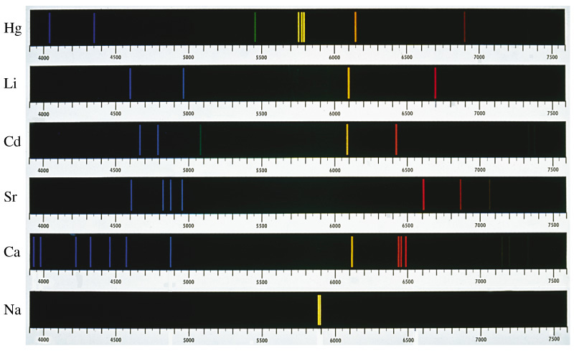
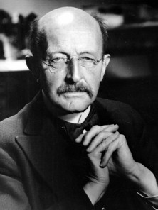
3.1.2 Emission spectra
H
Spectral analysis
Kirchhoff und Bunsen:
Every element has its characteristic emission band
Max Planck

Slide 24
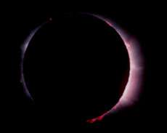
3.1.2 Emission spectra
Disadvantages:
less understood, more complicated solar regions
(it is still not clear how exactly these layers are heated)
some fractionation/migration effects
for example FIP (first ionization potential): species with low first ionization potential
are enhanced in respect to photosphere possibly because of fractionation
between ions and neutral atoms
Therefore abundances less accurate
But there are elements that cannot be observed in the photosphere
(for example Helium is only seen in emission lines)
Solar Chromosphere
red from Hα emission
lines
this is how Helium
was discovered by
Sir Joseph Lockyer
England in October 20, 1868

Slide 25
3.2 Meteorites
Meteorites can provide accurate information on elemental abundances
in the pre solar nebula. More precise than solar spectra if data are available …
But some gases escape and cannot be determined this way
(for example hydrogen, or noble gases)
Not all meteorites are suitable - most of them are fractionated
and do not provide representative solar abundance information.
One needs primitive meteorites that underwent little modification after forming.
Classification of meteorites:
Group | Subgroup | Frequency
Stones | Chondrites | 86%
 | Achondrites | 7%
Stony Irons |  | 1.5%
Irons |  | 5.5%

Slide 26
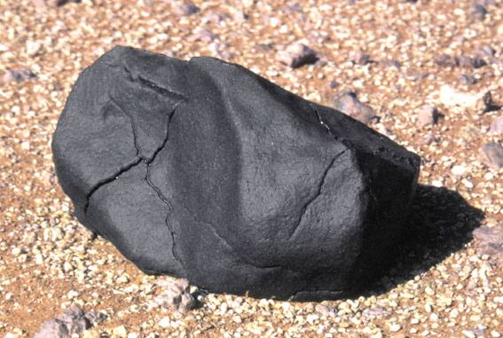
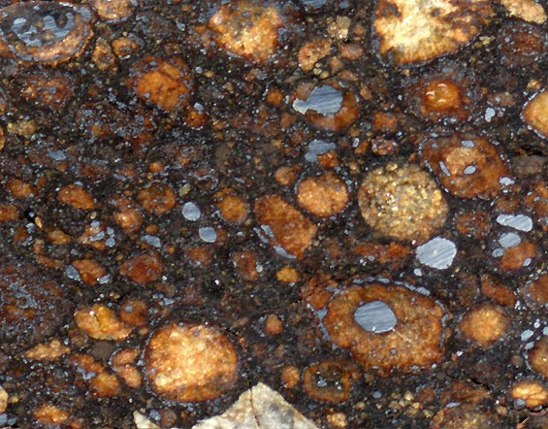
Use carbonaceous chondrites (~ 6% of falls)
Chondrites: Have Chondrules - small ~1mm size spherical inclusions in matrix
believed to have formed very early in the pre solar nebula
accreted together and remained largely unchanged since then
Carbonaceous Chondrites have lots of organic compounds that indicate
very little heating (some were never heated above 50 degrees)
Chondrule
How find them ?

Slide 27

http://www.saharamet.com
http://www.meteorite.fr
more on meteorites

Slide 28
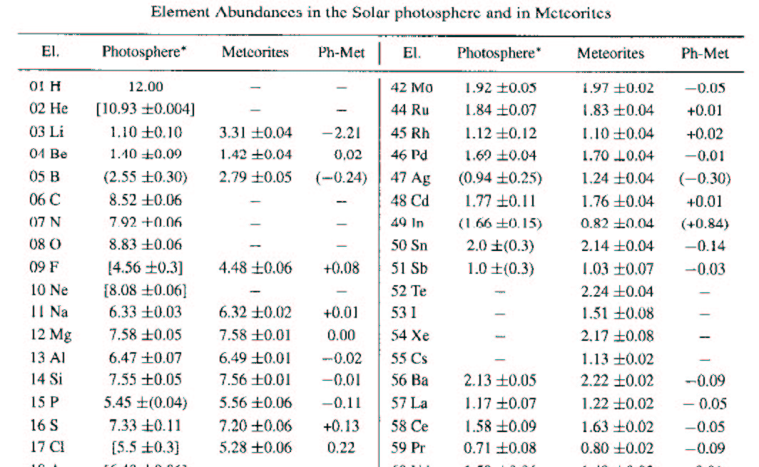
3.3 Results for solar abundance distribution
Part of Tab. 1, Grevesse & Sauval, Space Sci. Rev. 85 (1998) 161
units: given is A = log(n/n_{H}) + 12 (log of number of atoms per 10¹² H atoms)
(often also used: number of atoms per 10⁶ Si atoms)

Slide 29
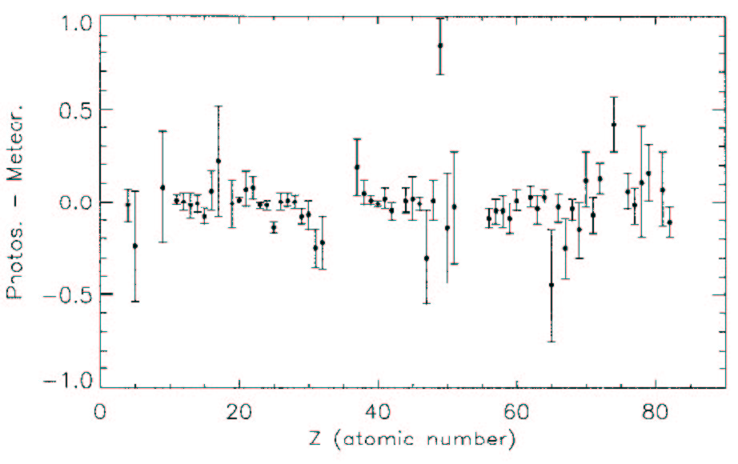
log of photosphere abundance/ meteoritic abundance
generally good agreement

Slide 30
Solar abundance distribution
Hydrogen mass fraction | X = 0.71
Helium mass fraction | Y = 0.28
Metallicity (mass fraction of everything else) | Z = 0.019
Heavy Elements (beyond Nickel) mass fraction | 4E-6
Gap
B,Be,Li
α-nuclei
¹²C,¹⁶O,²⁰Ne,²⁴Mg, …. ⁴⁰Ca
general trend; less heavy elements
r-process peaks (nuclear shell closures)
s-process peaks (nuclear shell closures)
Fe peak
(width !)
U,Th
Fe
Au
Pb

Slide 31
4. Abundances outside the solar neighborhood?
Abundances outside the solar system can be determined through:
Stellar absorption spectra of other stars than the sun
Interstellar absorption spectra
Emission lines from Nebulae (Supernova remnants, Planetary nebulae, …)
γ-ray detection from the decay of radioactive nuclei
Cosmic Rays
What do we expect ?

Slide 32
Nucleosynthesis is a gradual, still ongoing process:
H, He, Li
Star
Formation
Big Bang
Nucleosynthesis !
Ejection of
envelope into
ISM
continuous
enrichment,
increasing
metallicity
Life of a
star
Death of a star
(Supernova,
planetary nebula)
Remnants
(WD,NS,BH)
Nucleosynthesis !
BH: Black Hole
NS: Neutron Star
WD: White Dwarf Star
ISM Interstellar Medium

Slide 33
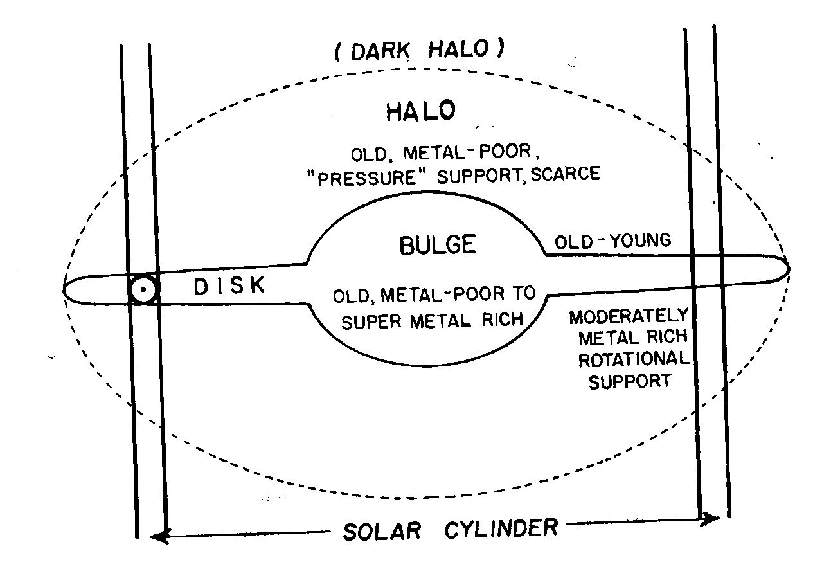
Therefore the composition of the universe is NOT homogeneous !
Efficiency of nucleosynthesis cycle depends on local environment
For example star formation requires gas and dust - therefore extremely
different metallicities in different parts of the Galaxy
Pagel, Fig 3.31

Slide 34
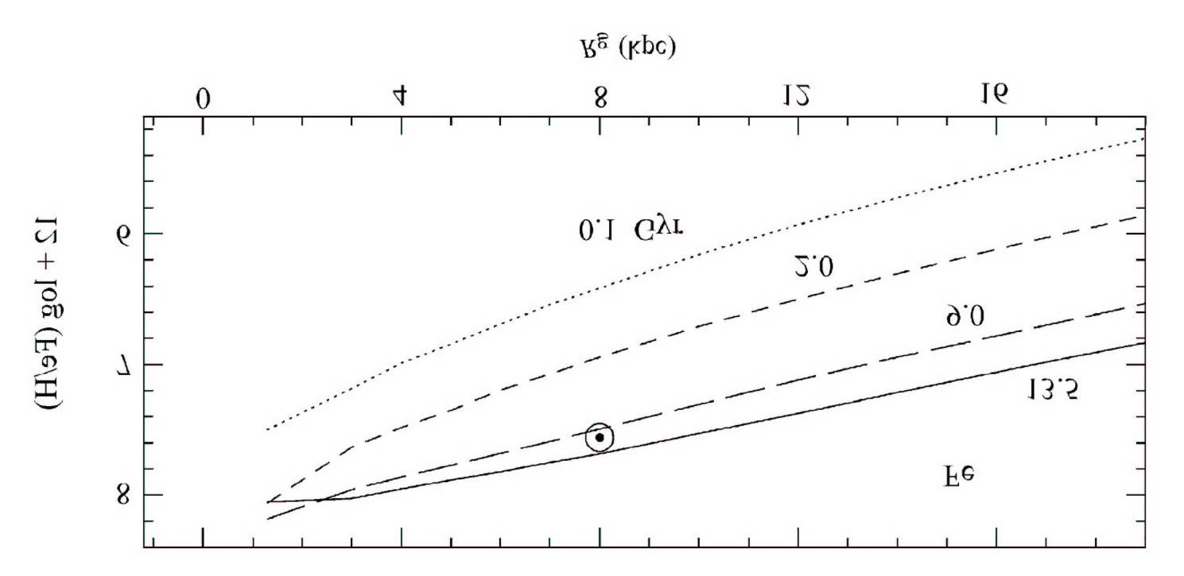
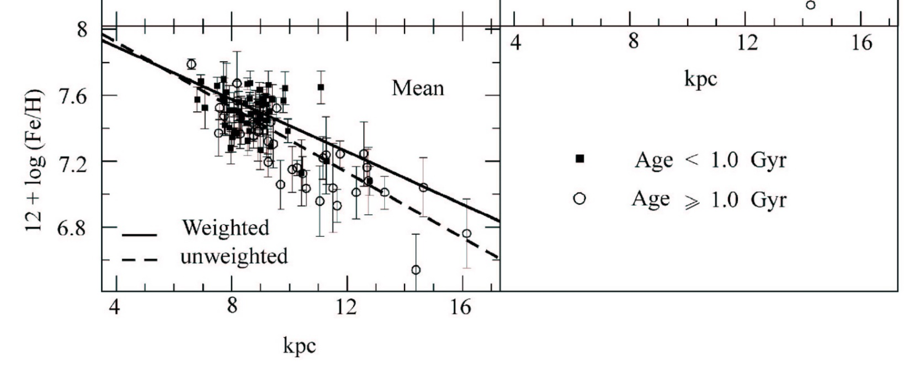
Also, metallicity gradient in Galactic disk:
model calculation:
Observation:
Hou et al. Chin. J. Astron. Astrophys. 2 (2002) 17

Slide 35
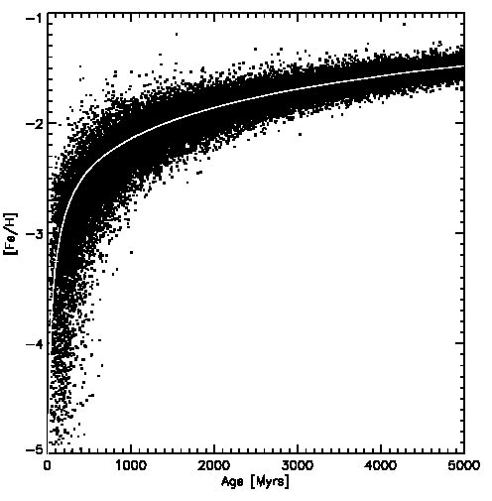
“population effect” - enrichment contineous over time (see prev. slide)
so metallicity of a star depends on when it was born
(Fe/H)
[Fe/H] =
log
(Fe/H)_{solar}
Classical picture:
Pop I: metal rich like sun
Pop II: metal poor [Fe/H] < -2
Pop III: first stars (not seen)
but today situation is much
more complicated - many
mixed case …
model calculation:
Argast et al. A&A 356 (2000) 873
finally found
metallicity - age relation: old stars are metal poor BUT: large scatter !!!

Slide 36
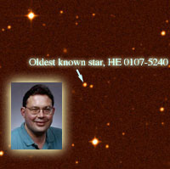
From MSU Physics and Astronomy Department Website:
[Fe/H]=-5.1
found in halo (little star formation, lots of old, metal poor stars)

Slide 37
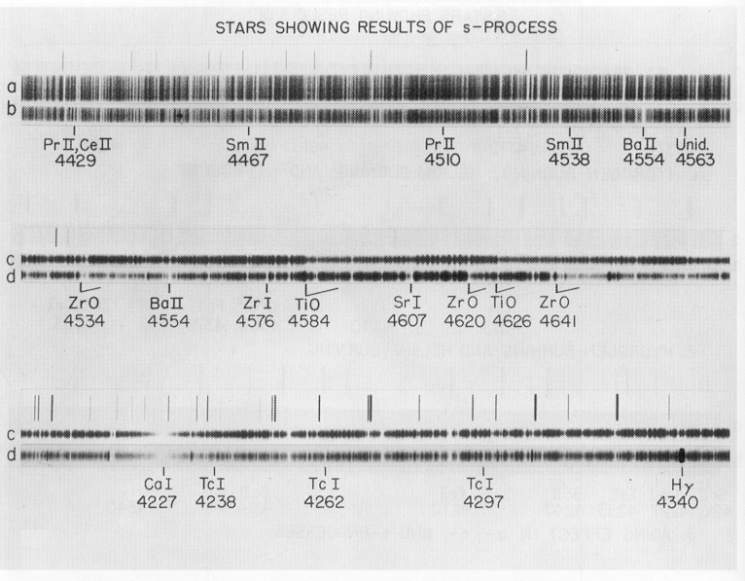
very different abundance distribution when one looks directly at or near
nucleosynthesis sites (before mixing with ISM)
Examples:
(a) Stars where, unlike in the sun, nucleosynthesis products from the interior
are mixed into the photosphere
for example discovery of Tc in stars. Tc has no stable isotope and
decays with a half-life of 4 Mio years (Merrill 1952)
Pagel Fig 1.8
proof for ongoing nucleosynthesis in stars !

Slide 38
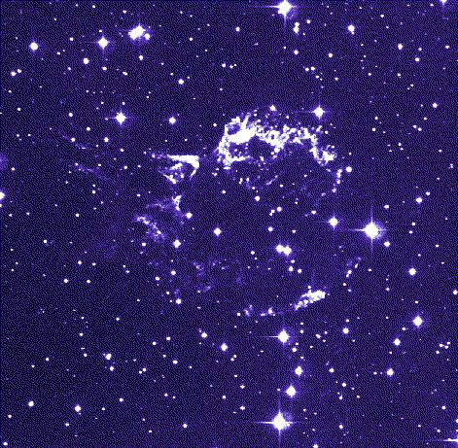
(b) Supernova remnants - where freshly synthesized elements got ejected
Cas A:

Slide 39
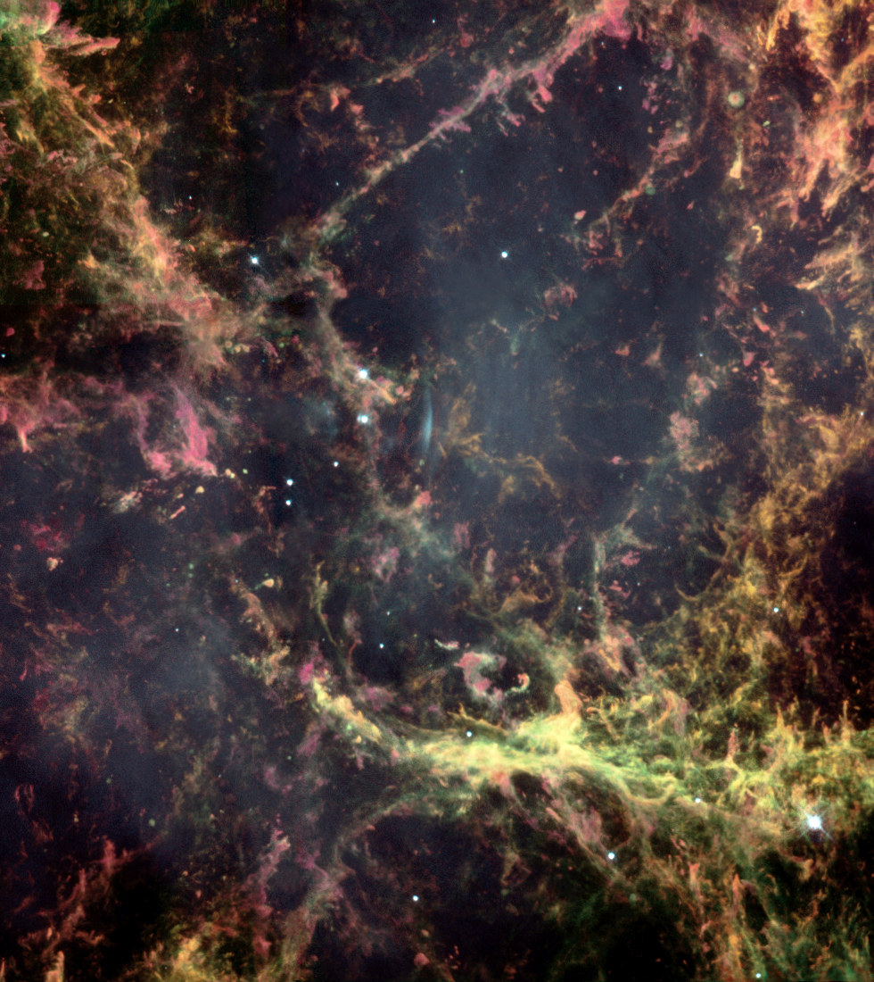
Cas A Supernova Remnant
Hydrogen (orange),
Nitrogen(red),
Sulfur(pink),
Oxygen(green)
by Hubble Space Telescope

Slide 40
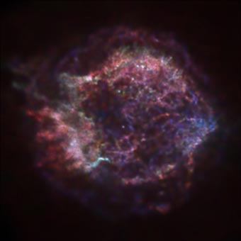
Cas A with
Chandra X-ray observatory:
red: iron rich
blue: silicon/sulfur rich

Slide 41
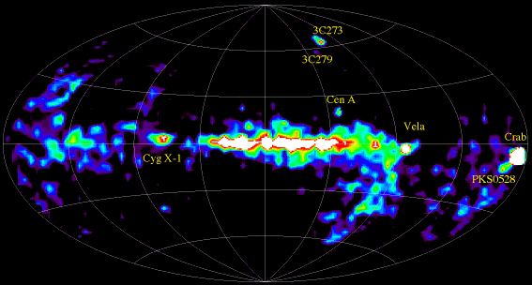
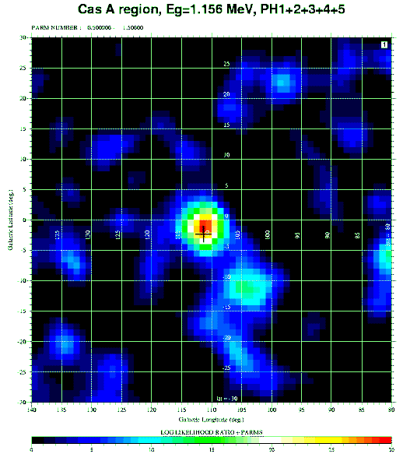
Galactic radioactivity – detected by γ-radiation
1 MeV-30 MeV
γ-Radiation in Galactic Survey
(²⁶Al Half life: 700,0000 years)
⁴⁴Ti in Supernova Cas-A Location
(Half life: 60 years)

