Slide 1

Outline: Big Bang Nucleosynthesis
Lecturer: Hans-Jürgen Wollersheim
e-mail: h.j.wollersheim@gsi.de
web-page: https://web-docs.gsi.de/~wolle/ and click on
the first 3 minutes
neutron / proton ratio
deuteron bottleneck
Helium abundance

Slide 2
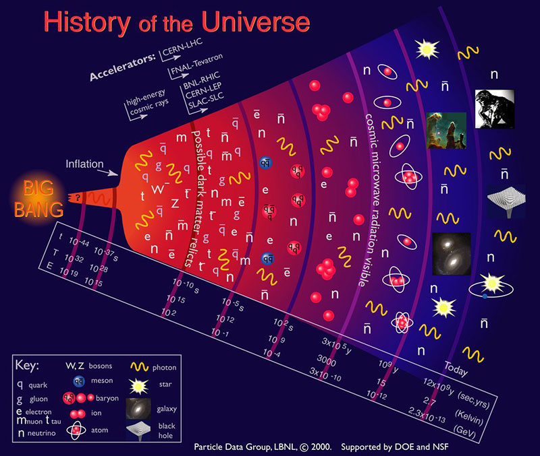

Slide 3
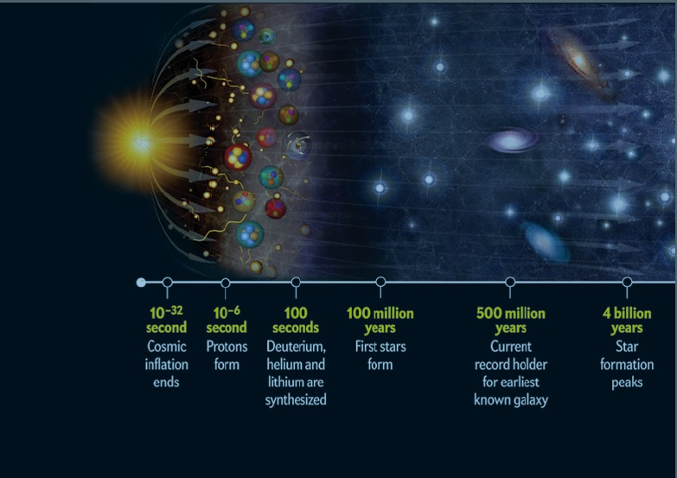
The first 3 minutes Steven Weinberg

Slide 4
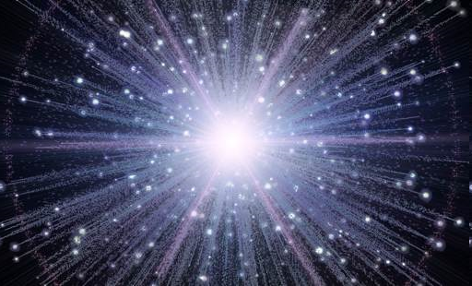
Big Bang: Main steps
Universe started ~15 Ga, the size of an atom, at temperatures (or energy) too hot for normal matter > 10²⁷ K – it start expanding extremely rapidly
Within 10⁻³² seconds, it cools enough to form a quark soup + electrons and other particles
At about 1 second, the universe was a hot and dense mixture of free electrons, protons, neutrons, neutrinos and photons.
At about 13.8 seconds, temperature has decreased to 3 x 10⁹ K and atomic nuclei began to form, but not beyond H and He. The universe was a rapidly expanding fireball!
700 000 years later electrons became attached to nuclei of H and He – formation of true atoms. Matter became organized into stars, galaxies and clusters

Slide 5



The early universe
The energy density in the early universe is dominated by radiation.
$$T\left(t\right)≅{10}^{10}K{\left(\frac{t}{1s}\right)}^{−1/2}$$
$$kT\left(t\right)≅1MeV{\left(\frac{t}{1s}\right)}^{−1/2}$$
$$E_{mean}=2.7∙kT\left(t\right)≅3MeV{\left(\frac{t}{1s}\right)}^{−1/2}$$
Hadron area (t < 10⁻⁵ s): all matter, including electrons, protons, neutrons, neutrinos and their associated anti-particles are in thermal equilibrium with the photon radiation field.
Lepton area (t < 10 s): The temperature decreases such that kT is significantly lower than the rest mass energy of the proton (m_{p} = 938 MeV/c²). The lepton era begins with photons in thermal equilibrium with electrons and positrons, muons, neutrinos and anti-neutrinos. The lepton era ends when the radiation temperature drops significantly below T~5·10⁹ K
(i.e. kT~ m_{e}c² = 511 keV) leaving a small excess of electrons.
The radiation temperature/energy as a function of cosmic time

Slide 6


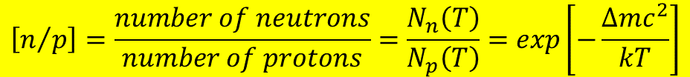

Time ~ 0.01 s
At t ~ 0.01 s, the temperature is T ~ 10¹¹ K, and kT ~ 10 MeV, which is much larger than the electron mass. Neutrinos, electrons and positrons are easily produced and destroyed by means of weak interactions (i.e., interactions involving neutrinos)
$$i) n+ν_{e}↔p+e^{−}$$
$$ii) n+e^{+}↔p+{\overline{ν}}_{e}$$
$$iii) n↔p+e^{−}+{\overline{ν}}_{e}$$
As long as the weak reactions are fast enough, the neutron-to-proton ratio is given by
$$\left[n/p\right]=\frac{number of neutrons}{number of protons}=\frac{N_{n}\left(T\right)}{N_{p}\left(T\right)}=exp\left[−\frac{Δmc^{2}}{kT}\right]$$
where m(n) = 939.5 MeV/c², m(p) = 938.3 MeV/c², and Δm = 1.294 MeV/c².
At T = 10¹¹ K, kT = 8.62 MeV yielding n/p = 0.86
This temperature is far above the temperature of nucleosynthesis,
but the n/p ratio already begins to drop

Slide 7
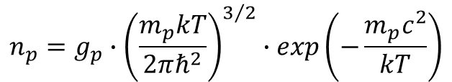
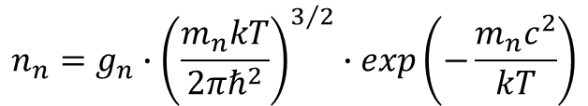
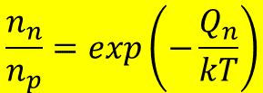
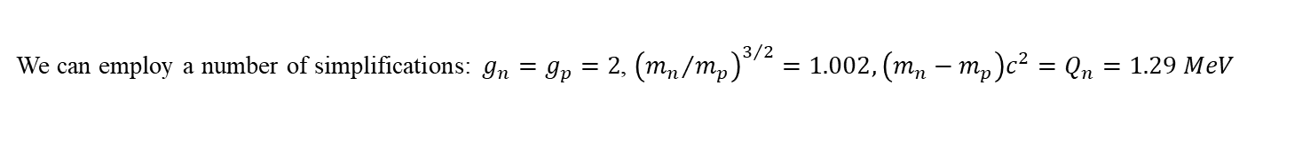
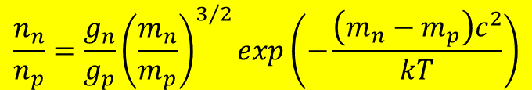
Neutron production
In thermal equilibrium, the number of neutrons and protons are given by Maxwell-Boltzmann distribution
$$n_{n}=g_{n}∙{\left(\frac{m_{n}kT}{2πℏ^{2}}\right)}^{3/2}∙exp\left(−\frac{m_{n}c^{2}}{kT}\right)$$
$$n_{p}=g_{p}∙{\left(\frac{m_{p}kT}{2πℏ^{2}}\right)}^{3/2}∙exp\left(−\frac{m_{p}c^{2}}{kT}\right)$$
$$\frac{n_{n}}{n_{p}}=\frac{g_{n}}{g_{p}}{\left(\frac{m_{n}}{m_{p}}\right)}^{3/2}exp\left(−\frac{\left(m_{n}−m_{p}\right)c^{2}}{kT}\right)$$
We can employ a number of simplifications: $g_{n}=g_{p}=2$, ${\left({m_{n}}/{m_{p}}\right)}^{3/2}=1.002, \left(m_{n}−m_{p}\right)c^{2}=Q_{n}=1.29 MeV$
Therefore, in equilibrium the neutron to proton ratio is
$$\frac{n_{n}}{n_{p}}=exp\left(−\frac{Q_{n}}{kT}\right)$$
As Q_{n} = 1.29 MeV, this implies a corresponding value of kT ~ 1.5·10¹⁰ K. Therefore, at T >> 1.5·10¹⁰ K we expect n_{n} ~ n_{p} and at T << 1.5·10¹⁰ K we expect n_{n} << n_{p}

Slide 8
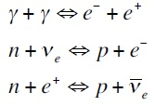
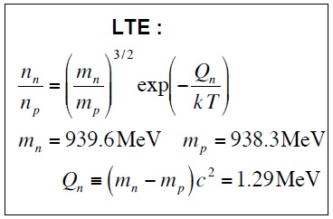
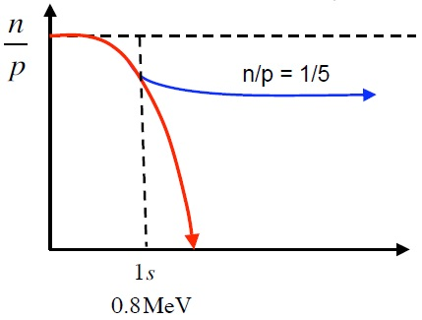
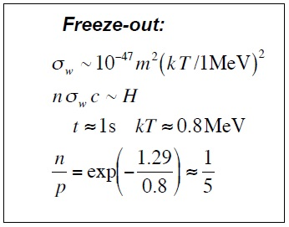
Neutron / Proton ratio
0.1% mass difference is critical!

Slide 9
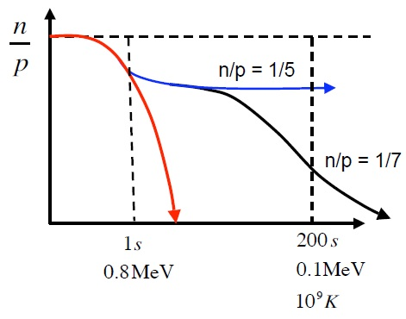
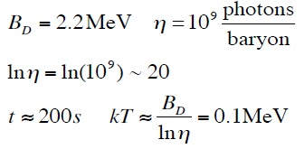
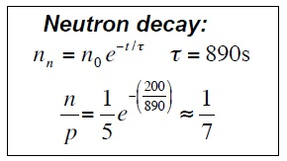

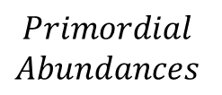

Neutron / Proton → He / H
Deuterium production: $n+p→D+γ$
$$Primordial$$
$$Abundances$$
$$X_{p}≡\frac{mass in H}{total mass}=0.75 Y_{p}≡\frac{mass in He}{total mass}=0.25$$

Slide 10
Big Bang Nucleosynthesis (BBN)
A summary of the BBN when the temperature of the universe allowed deuteron to be formed without being immediately destroyed by photons is:
The light elements (deuterium, helium, and lithium) were produced in the first few minutes after the Big Bang.
Elements heavier than ⁴He were produced in the stars and supernovae explosions.
Helium and deuterium produced in stars do not to match observation because stars destroy deuterium in their cores.
Therefore, all the observed deuterium was produced around three minutes after the big bang, when T ~ 10⁹ K
A simple calculation based on the n/p ratio shows that BBN predicts that 25% of the matter in the Universe should be helium
More detailed BBN calculations predict that about 0.001% should be deuterium

Slide 11


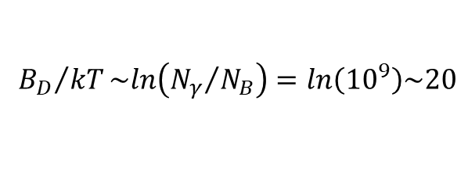

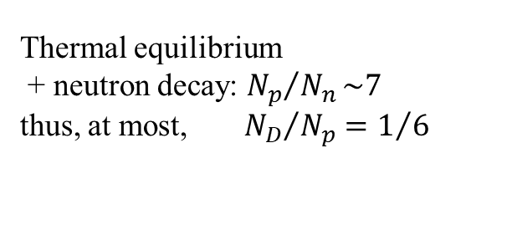
Onset of Big Bang nucleosynthesis (BBN)
Deuterium production: $n+p→D+γ$
delayed until the high energy tail of blackbody photons can no longer break up D. Binding energy: B_{D} = 2.2 MeV.
$${B_{D}}/{kT}\sim ln\left({N_{γ}}/{N_{B}}\right)=ln\left({10}^{9}\right)\sim 20$$
$$kT\sim 0.1 MeV \left(T\sim {10}^{9} K t\sim 200 s\right)$$
Thermal equilibrium
+ neutron decay: ${N_{p}}/{N_{n}}\sim 7$
thus, at most,${{ N}_{D}}/{N_{p}}=1/6$
Deuterium readily assembles into heavier nuclei

Slide 12
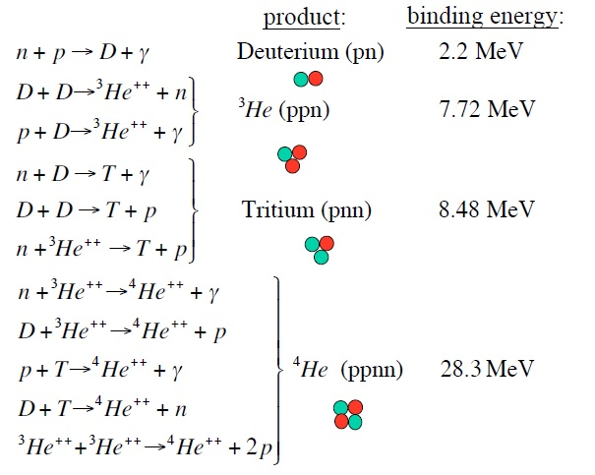
Key fusion reactions

Slide 13
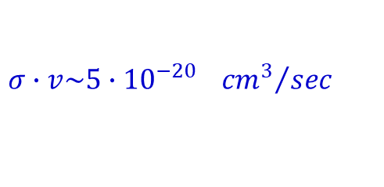

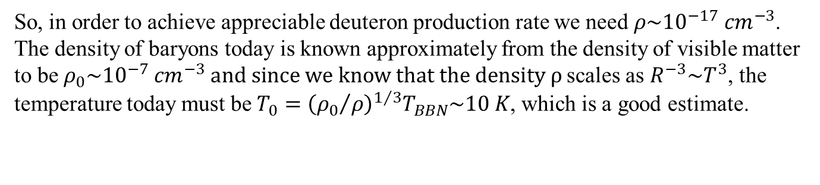
Deuterium bottleneck
As the temperature of the universe decreased, neutrons and protons started to interact and fuse to a deuteron
$$n+p →d+γ$$
The binding energy of deuterons are small (E_{B} = 2.23 MeV). The baryon-to-photon ratio, called η, at this time is also very small (< 10⁻⁹). As a consequence, there are many high-energy photons to dissociate the formed deuterons, as soon as they are produced.
The temperature for nucleosynthesis at the start is about 100 keV, when we would have expected ~ 2 MeV, the binding energy of deuterium. The reason is the very small value of η. The BBN temperature, ~ 100 keV, corresponds to timescales less than about 200 sec. The cross-section and reaction rate for the reaction is
$$σ∙v\sim 5∙{10}^{−20} {{cm}^{3}}/{sec}$$
So, in order to achieve appreciable deuteron production rate we need $ρ\sim {10}^{−17} {cm}^{−3}$. The density of baryons today is known approximately from the density of visible matter to be $ρ_{0}\sim {10}^{−7} {cm}^{−3} and since we know that the density ρ$scales as $R^{−3}\sim T^{3}$, the temperature today must be $T_{0}={\left({ρ_{0}}/ρ\right)}^{1/3}T_{BBN}\sim 10 K$, which is a good estimate.

Slide 14
Deuterium bottleneck
The bottleneck implies that there would be no significant abundance of deuterons before the universe cooled to about 10⁹ K.
Other important facts are:
The nucleon composition during BBN was proton-rich
The most tightly bound light nucleus is ⁴He
There is no stable nucleus with mass numbers A = 5 and A = 8
The early universe was too cold and not dense enough to overcome the Coulomb barriers to produce heavier nuclides
The BBN network is active until all neutrons are bound in ⁴He. As the BBN mass fraction of neutrons was X_{n} = N_{n} / (N_{n} + N_{p}) = 1/8, it follows that the mass fraction of ⁴He after BBN is about X_{4He} = 2·X_{n} = 25%

Slide 15
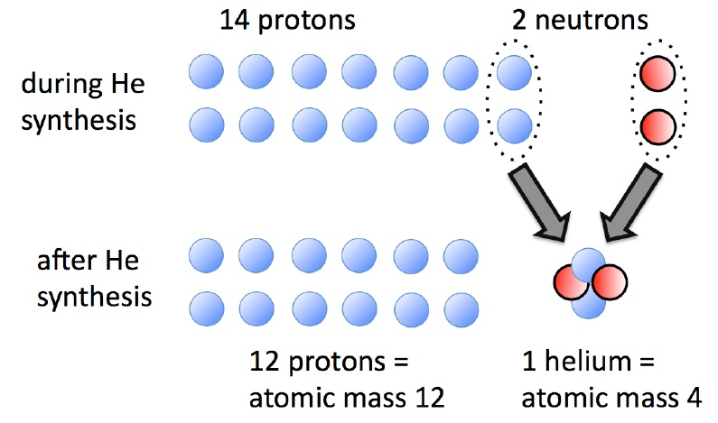
BBN prediction – the Helium abundance
BBN predicts that when the universe had T = 10⁹ K (1 minute old), protons outnumbered neutrons by 7:1. When ²H and He nuclei formed, most of the neutrons formed He nuclei. That is, one expects 1 He nucleus for every 12 H nuclei, or 75% H and 25% He. This is the fraction of He and ²H we observe today.

Slide 16

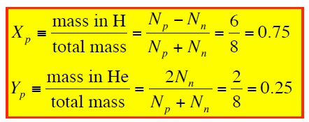

Primordial abundances
Because ⁴He is so stable, all fusion pathways lead to ⁴He, and further fusion is rare.
Thus almost all neutrons end up in ⁴He, and residual protons remain free. (p + p → ²He does not occur)
To first order, with N_{p}/N_{n} ~ 7
Primordial abundances of H and He (by mass, not number)

Slide 17
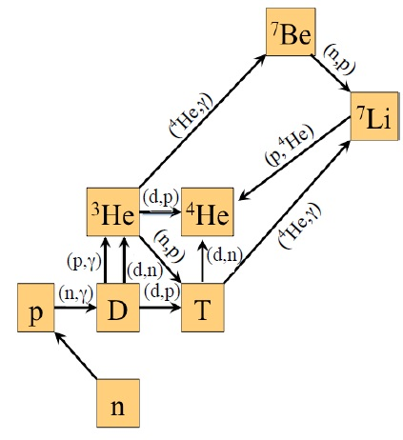
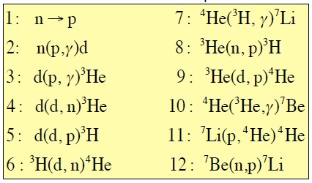
The BBN reaction network
After deuterons are produced at T ~ 10⁹ K, a successive chain of nuclear reactions occur.
The most important are
Except for ⁷Be electron capture, all reactions are fast. The binding energies of ³He, ³H, ⁴He are significantly larger than the one of deuterons.
Thus these nuclei are not dissociated again.
At T ~ 10⁸ K BBN terminates because
the temperature and density are too low
the Coulomb barriers are too high

Slide 18
BBN nuclei in stars
Deuteron
In stellar processes deuteron is quickly converted to ³He.
Astronomers look at quasar: bright atomic nuclei of active galaxies, ten billion light years away
³He
star account for only 0.1% of all He.
The ³He abundance in stars is difficult to deduce. Its abundance is increasing in stellar fusion.
Scientists look to our own galaxy.
⁷Li
⁷Li can form when “cosmic rays” collide with stellar gas.
Observations can be made on old, cool stars in our own galaxy.
⁷Li is destroyed more that it is created inside stars.
Very old stars have low oxygen content, and their outermost layers still contain mostly primordial ⁷Li

Slide 19
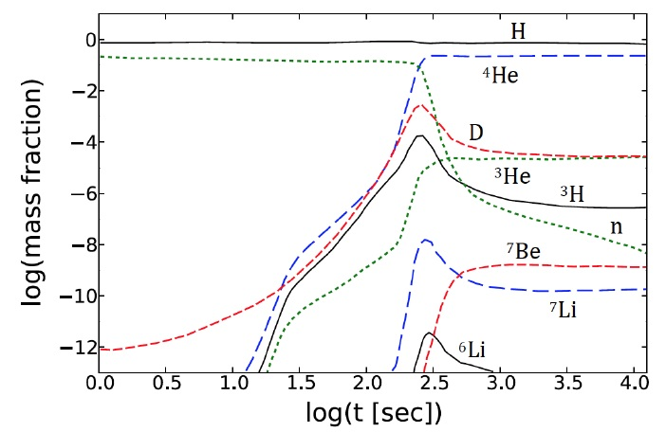

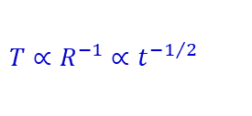
Time evolution of BBN – mass fractions
thermal equilibrium
reactions “freeze out” due to expansion
$$\frac{n_{n}}{n_{p}}≈exp\left(−\frac{\left(m_{n}−m_{p}\right)c^{2}}{kT}\right)$$
$$T∝R^{−1}∝t^{−1/2}$$
Mass fractions of light nuclei as a function of time during the BBN

Slide 20
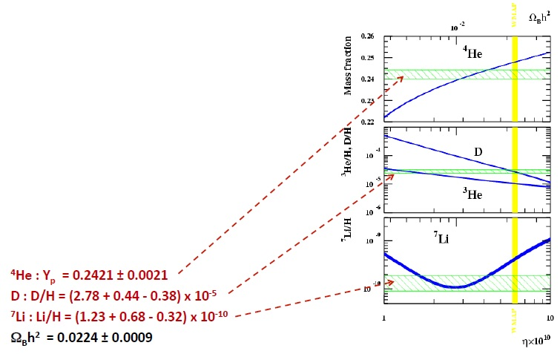
Primordial abundances
Note: Light elements have been made and destroyed since the Big Bang
Some are made in stars:
  stars (³He, ⁴He)
  spallation (scattering) (^{6,7}Li, Be, B)
  supernova explosions (⁷Li, ¹¹B)
Some are destroyed
  d, Li, Be, B are very fragile
  they are destroyed in the center of stars
→ observed abundances (at surface of stars)
do not reflect the destruction side

