Slide 1

Outline: Evidence for Big Bang theory
Lecturer: Hans-Jürgen Wollersheim
e-mail: h.j.wollersheim@gsi.de
web-page: https://web-docs.gsi.de/~wolle/ and click on
3 pillars of Big Bang theory
Hubble expansion
nucleosynthesis
cosmic microwave background radiation

Slide 2
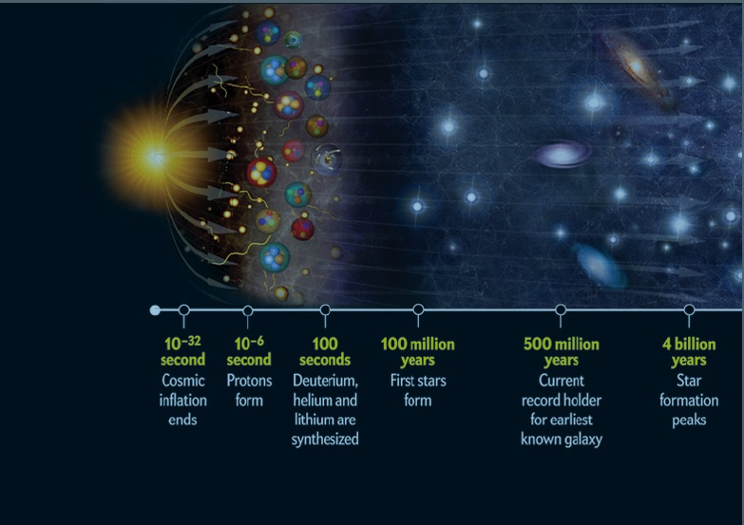
The first 3 minutes Steven Weinberg

Slide 3
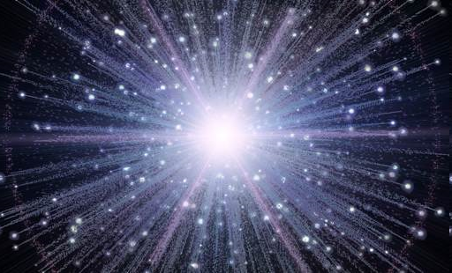
Big Bang: Main steps
Universe started ~15 Ga, the size of an atom, at temperatures (or energy) too hot for normal matter > 10²⁷ K – it start expanding extremely rapidly
Within 10⁻³² seconds, it cools enough to form a quark soup + electrons and other particles
At about 1 second, the universe was a hot and dense mixture of free electrons, protons, neutrons, neutrinos and photons.
At about 13.8 seconds, temperature has decreased to 3 x 10⁹ K and atomic nuclei began to form, but not beyond H and He. The universe was a rapidly expanding fireball!
700 000 years later electrons became attached to nuclei of H and He – formation of true atoms. Matter became organized into stars, galaxies and clusters

Slide 4
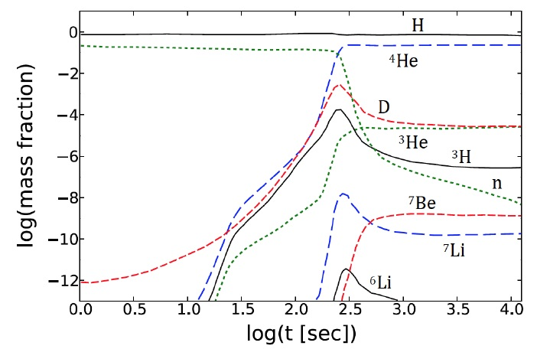
“Three Pillars” of Big Bang Theory
Hubble Expansion – Nucleosynthesis – 3 K Background Radiation

Slide 5
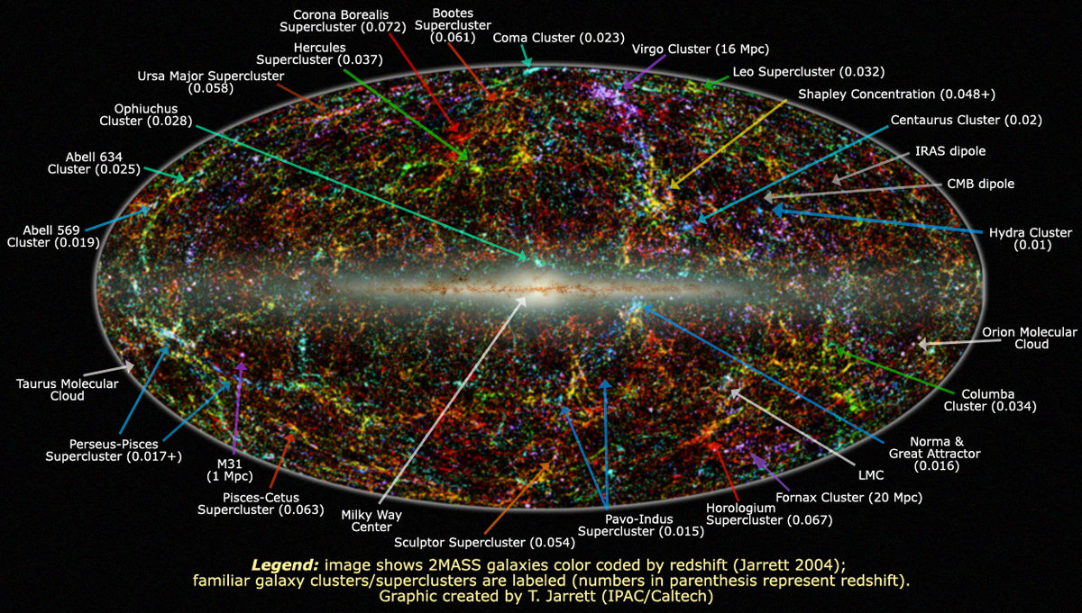
Cosmological redshift

Slide 6
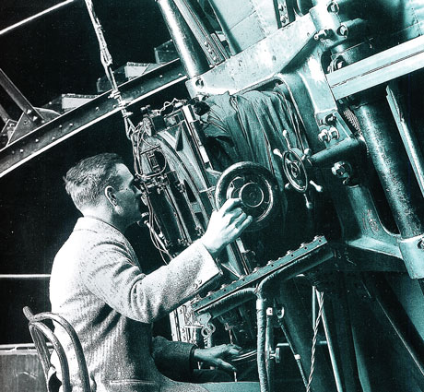
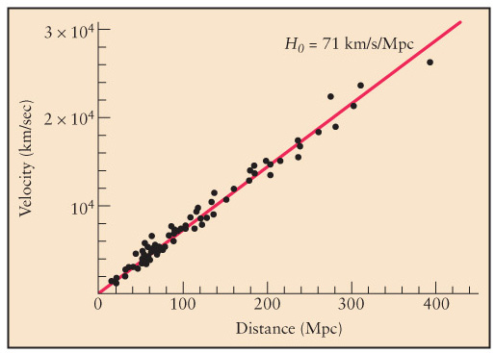
1. Edwin Hubble (1920): “Universe is expanding in all directions”

Slide 7
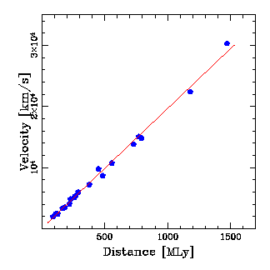
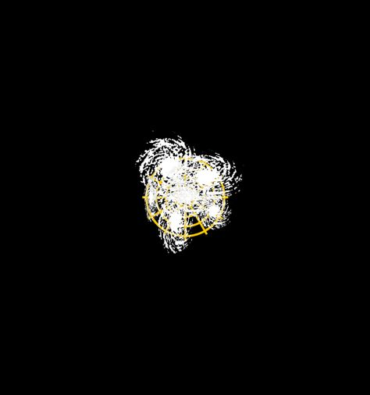

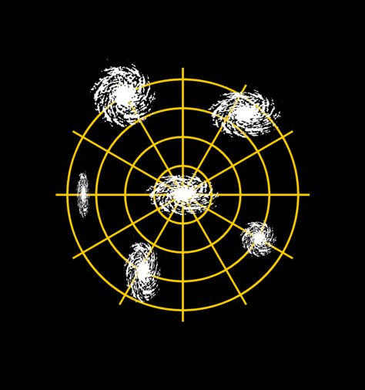
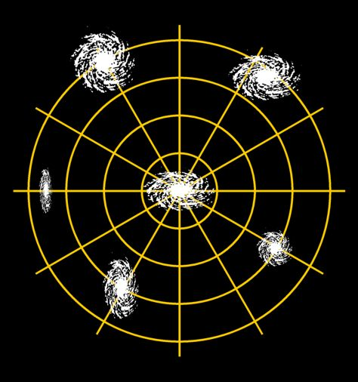
Expanding Universe and the Big Bang
Age of the universe:
SNe Ia Hubble Diagram
Reiss, Press & Kirshner, ApJ 1996
Hubble Law
H_{o}~20 km/s/MLyr

Slide 8
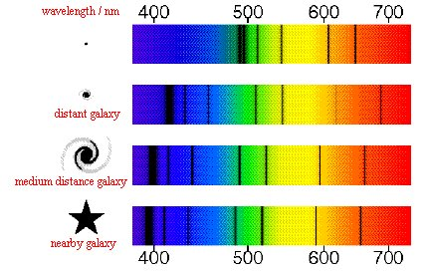
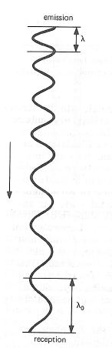
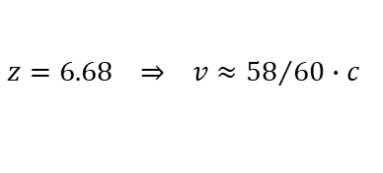
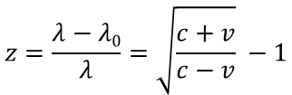
Speed of stars or galaxies - Redshift
Doppler effect:
if stars are approaching
shorter wave length
if stars are receding
large wave length
Cosmological redshift measures the expansion of space
$$z=\frac{λ−λ0}{λ}=\sqrt{\frac{c+v}{c−v}} −1$$
λ₀
λ
$$z=6.68 ⇒ v≈{58}/{60}∙c$$

Slide 9
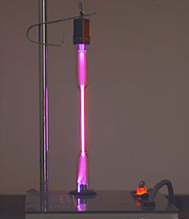
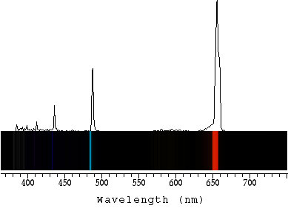
Expanding Universe
Spectrum of Hydrogen gas is a unique finger print of the element
Hydrogen lamp

Slide 10
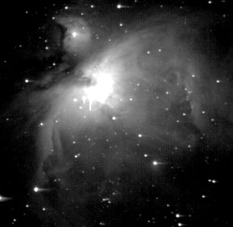
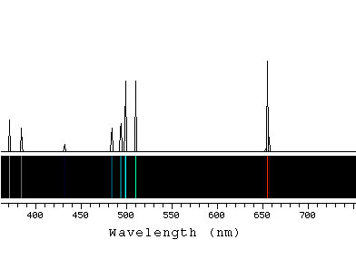
Expanding Universe
If one observes the same spectrum as in the laboratory, Hydrogen should be present.
Orion Nebula

Slide 11
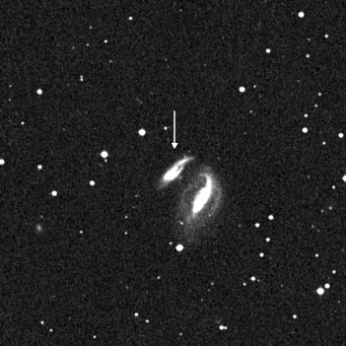
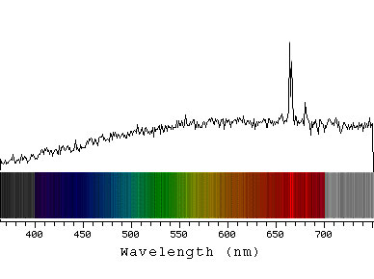
Expanding Universe
We see the same lines in the galaxy, but they are shifted to larger wave length (redshift)
Galaxy UGC 12915

Slide 12
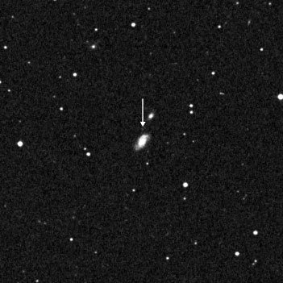
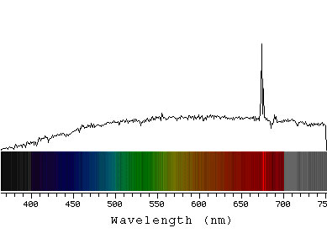
Expanding Universe
The further the galaxy is, the larger the redshift of the lines occur
Galaxy UGC 12508

Slide 13
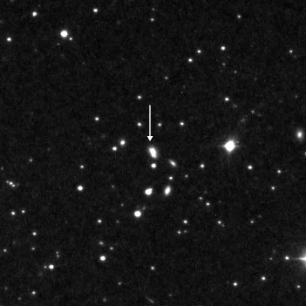
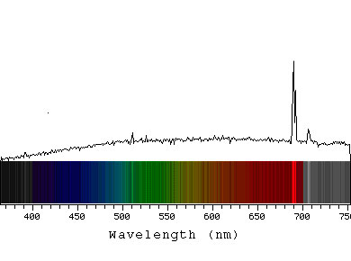
Expanding Universe
The larger the redshift, the further away is the galaxy
Galaxy KUG 1750

Slide 14
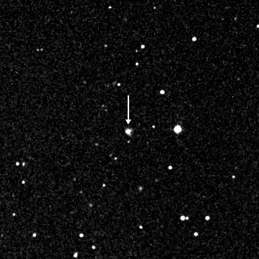
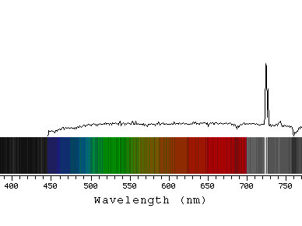
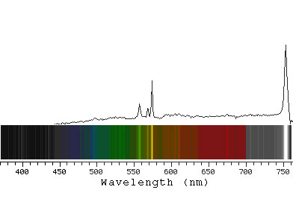
Expanding Universe
The redshift is caused by the expansion of space
Galaxy KUG 1217

Slide 15
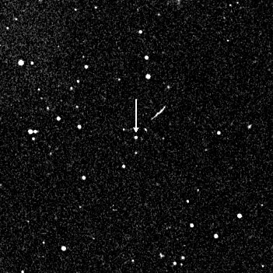
Expanding Universe
The redshift is the proof for the expanding universe
Galaxy IRAS F09159

Slide 16


Determination of distances - paralax

Slide 17
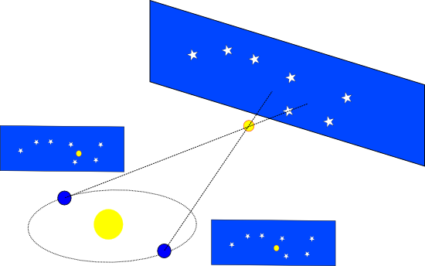
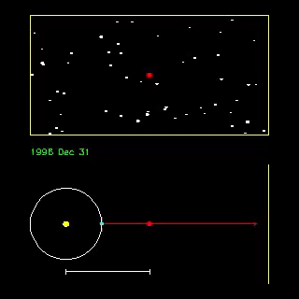
Determination of distances - parallax
Trigonometry:
Limited to stars no more than 100pc distance
1AE
1AU
1parsec (pc) = unit of length, measures the distance of a star with a parallax of 1arc-second

Slide 18
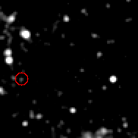
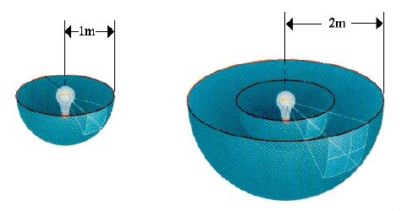
Cepheid – intrinsic stellar pulsation
Cepheids are stars, that undergo pulsations.
(imbalance between ionization and gravitation)
1912: H. Leavitt, H.Shapley:
There is a linear relationship between luminosity and
pulsation period.
This method allows distance measurements up to 50 Mpc.
If one measures the pulsation period of a Cepheid,
one knows its true luminosity.
One compares this with the observed brightness
on Earth and obtains the cosmic distance to the star.

Slide 19
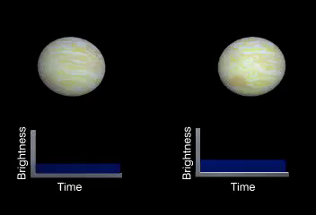
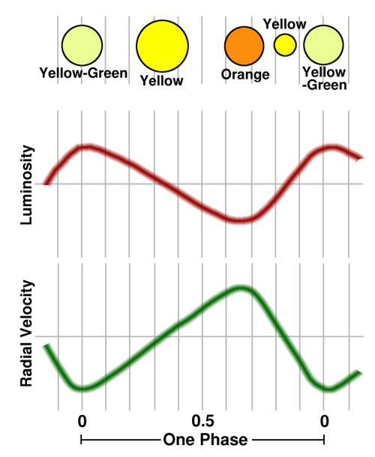

Cepheids – intrinsic stellar pulsation
Luminosity:
small but hot bright
big but cool dim

Slide 20
Cepheids – intrinsic stellar pulsation
50 Mpc – 3 Gpc
L = c · t
time t
Supernovae Ia
1 astronomical unit (AU) =
1.496 · 10¹¹ m
1 AU
1 light year (ly) =
9.461 · 10¹⁵ m
= 63.240 AU = 0.3066 pc
distance L
1 Parsec (pc) =
3.086 · 10¹⁶ m
=2.06 ·105 AU = 3.262 ly

Slide 21
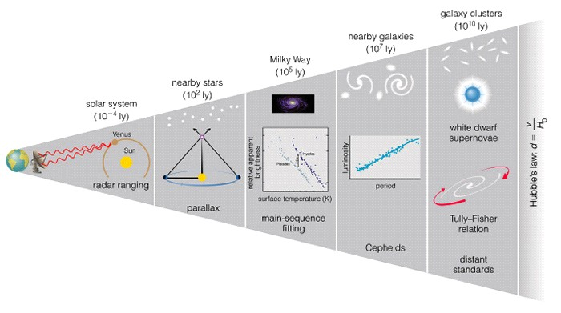
cosmic distance ladder
“standard candle”

Slide 22
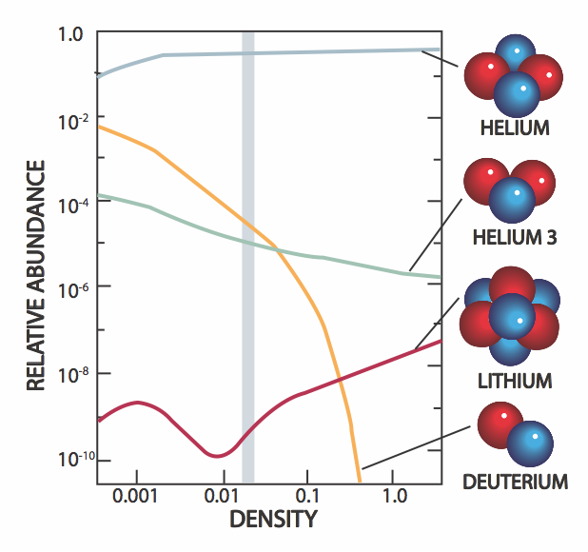
2. Nucleosynthesis
Big Bang theory explains that protons and neutrons fused together to form deuterium and helium in the first few minutes of the Universe.
The process where protons and neutrons combine to produce atomic nuclei is called nucleosynthesis.

Slide 23
3. Cosmic microwave background radiation
WMAP 2002
Penzias, Wilson 1965
COBE satellite 1992

Slide 24
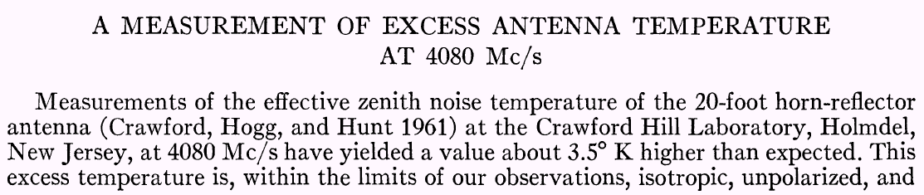

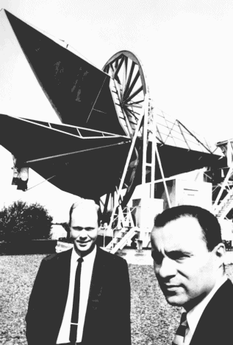
A. Penzias & R. Wilson 1965

Slide 25
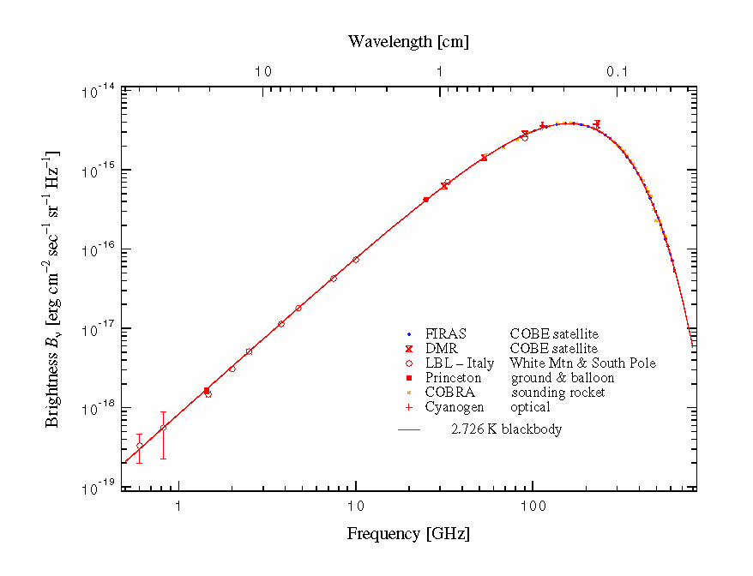
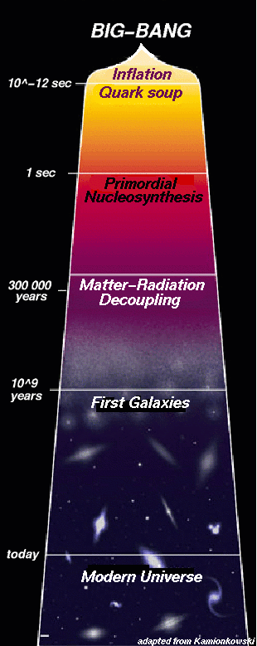
Interpretation of cosmic microwave background radiation
Cosmic microwave background radiation is exactly thermal
(black-body radiation)
When the temperature dropped enough to allow electrons and protons to form hydrogen atoms – this occurred some 380 000 years after the Big Bang.
This event made the universe nearly transparent to radiation, because light was no longer being scattered of free electrons.
 | 380 000 y | today
size of universe | 1 | 1100
frequency of light | 1100 | 1
temperature | 3000 K (0.26 eV) | 2.725 K (0.2348 meV)

Slide 26
Photon-Matter interaction
+
-
-
-
-
+
+
+
-
+
-
-
Opaque (a fog)
+
Photons of light interact strongly with free (ionized)electrons and protons
+
+
-
+
-
-
+
+
Transparent
-
-
Photons of light rarely interact with stable atoms (paired electrons & protons)

Slide 27
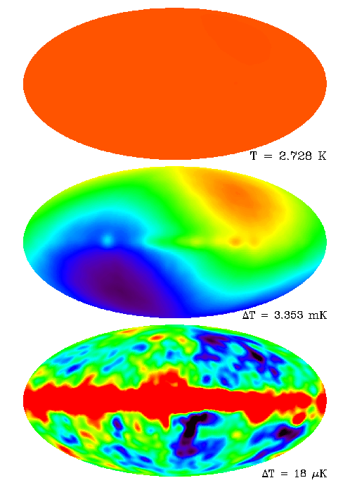
COBE sky maps the most distant light
T = 2.7 K isotropy T(z) = T₀·(1+z)
scale
ΔT = 3.4 mK
(after subtraction of constant emission,
dipole anisotropy due to the motion of the Earth)
ΔT = 18 μK
(after subtraction of dipole, fluctuations,
the Milky Way has some emission in microwaves)

Slide 28
Measurement of cosmic microwave background radiation
very small temperature variations
red: T=2.725 K + 0,00002 K
blue: T=2.725 K – 0.00002 K
Isotropic?
CMB is anisotropic!
(at the 1/100,000 level)

Slide 29
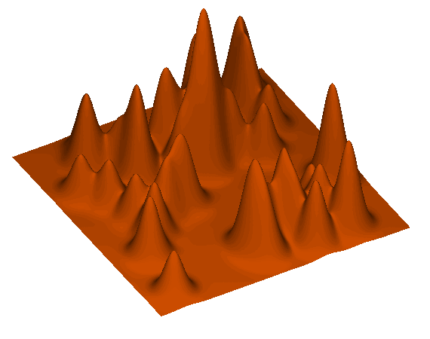
Where do the spots come from?
Quantum mechanical energy fluctuations during inflationary period.
These fluctuations pulse through the universe as sound waves.
When the universe become transparent sound waves are frozen in (light and matter are decoupled)

Slide 30
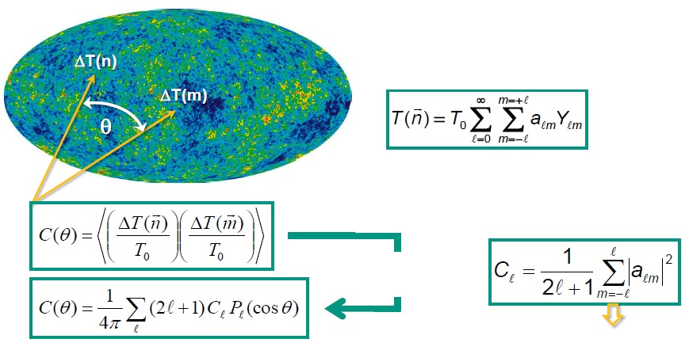
Multipole expansion
statistical analysis of the temperature fluctuations ΔT with respect to the average temperature T₀ using the correlation function C(θ)
expansion with respect to spherical harmonics using the coefficients α_{ℓm}
for Gauss fluctuations:
coefficient C_{ℓ}
expansion of Legendre polynomes
cosmic variance
correlation function C(θ)

Slide 31
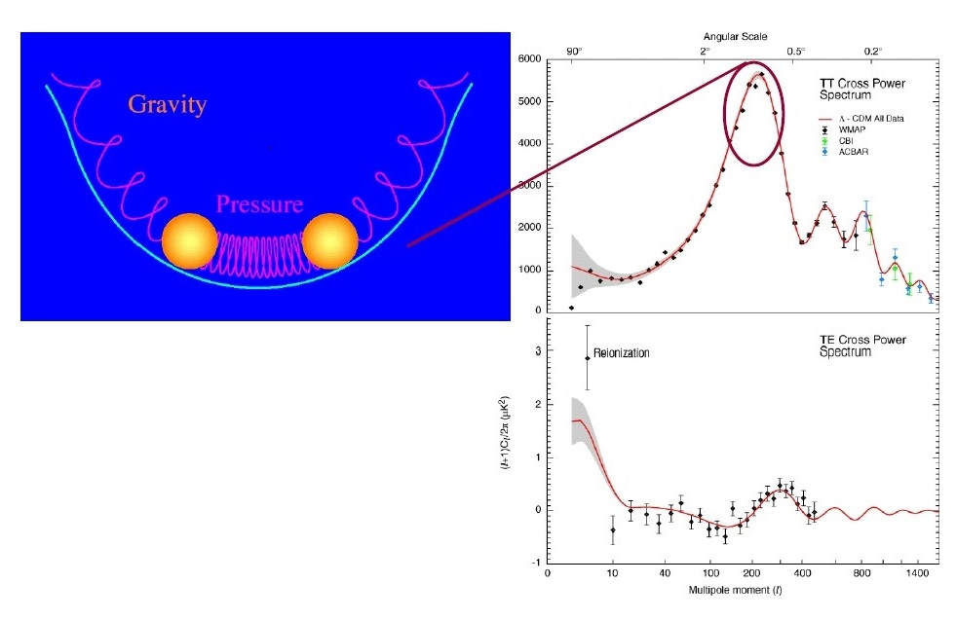
Acoustic oscillation Cosmic microwave background radiation
radiation pressure causes expansion
gravitation causes compression
matter as plasma in equilibrium
Basic idea: Hit it and listen to the cosmic sound
multipole expansion

Slide 32
What is still uncertain?
Why did inflation occur?
Standard model doesn’t predict fundamental constants (masses, charges, speed of light, etc.
  Anthropic principle: If constants were even a little different, we wouldn’t be here to puzzle about them!
Why is energy density of the vacuum so close to the energy density of matter.
  Particle physics predicts ratio should be ~10¹²⁰!
Is there only one Universe or are there ‘many Universe bubbles?’
  Inflation allow for such disconnected space-time ‘bubbles’
What was before the Big Bang?
  String theory avoids singularity at t=0 (in 10-dimensional space-time)

