Slide 1

Outline: Evidence for Big Bang theory
Lecturer: Hans-Jürgen Wollersheim
e-mail: h.j.wollersheim@gsi.de
web-page: https://web-docs.gsi.de/~wolle/ and click on
3 pillars of Big Bang theory
Hubble expansion
nucleosynthesis
cosmic microwave background radiation

Slide 2
Question:
Is the mass in the universe all observable through
emission or absorption of electromagnetic radiation ?
Dark Matter
...is matter that does not shine or absorb light, and has
therefore escaped direct detection by electromagnetic
transducers like telescopes, radio antennas, x-ray satellites...
It turns out that there is strong experimental evidence that there is more than 4 times as much dark matter as luminous matter in the observable universe

Slide 3
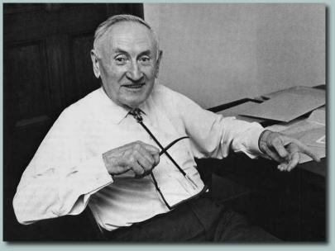
The father of Dark Matter
In 1933, Fritz Zwicky checked out the Coma Cluster.
The galaxies were flying around too fast (*160! as measured by the
Doppler effect) for their visible mass to keep them together, so
he proposed dark matter was present.

Slide 4
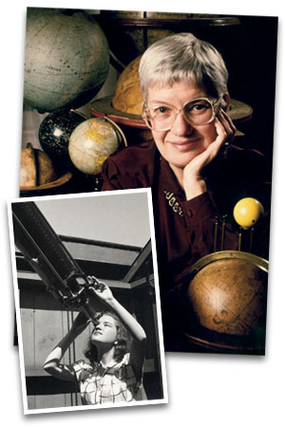
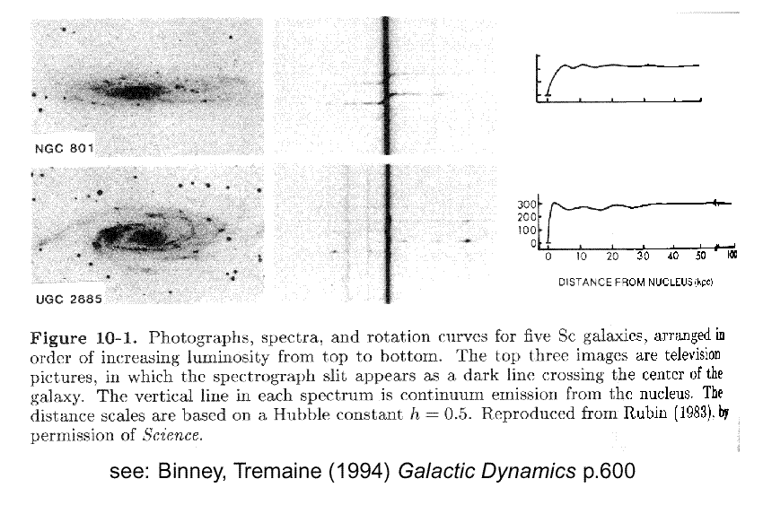
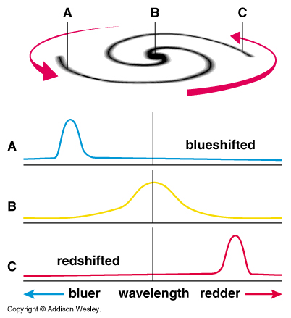
The mother of Dark Matter
A few decades later, Vera Rubin started to notice FLAT rotation curves in spiral galaxies.

Slide 5



Evidence for Dark Matter
Use the fact that massive objects, even if they emit no light,
exert gravitational forces on other massive objects.
m₁
r₁₂
m₂
Study the motions (dynamics) of visible objects like stars
in galaxies, and look for effects that are not explicable by
the mass of the other light emitting or absorbing objects
around them.

Slide 6
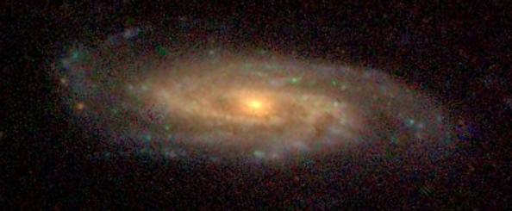

Rotation of stars around Galactic centres
We can measure how fast stars rotate around galactic
centres by looking at the frequency shift of known spectral
lines originating in the stars due to the Doppler effect.
Star’s motion towards you, relative to the
galactic centre alters wavelength of light

Slide 7
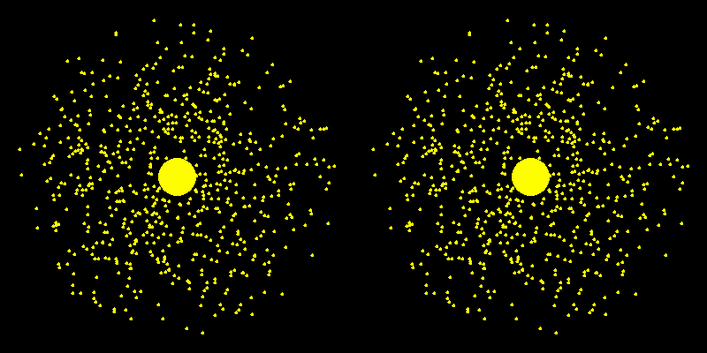
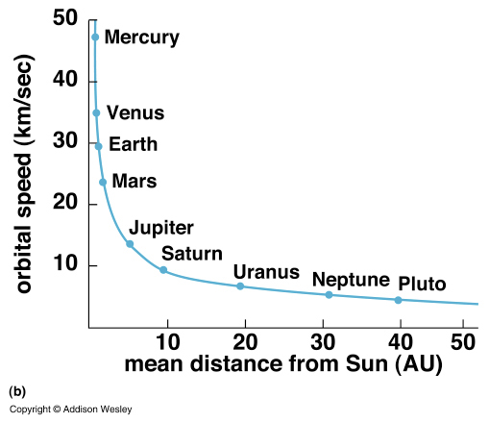
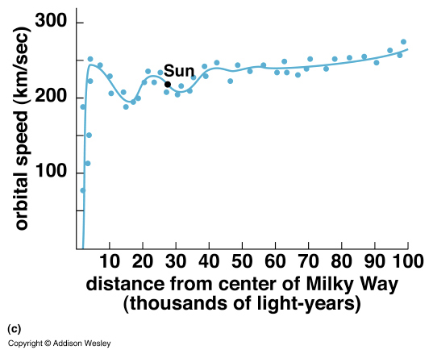
Flat rotation curves
v ≈ √G M(r) / r
following Rieke, images from Bennett and Pryke

Slide 8
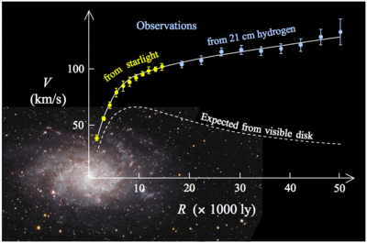
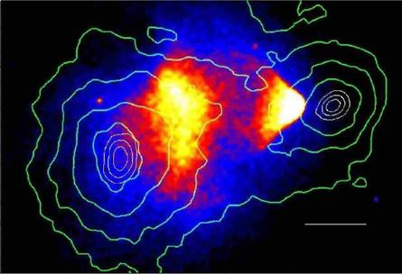
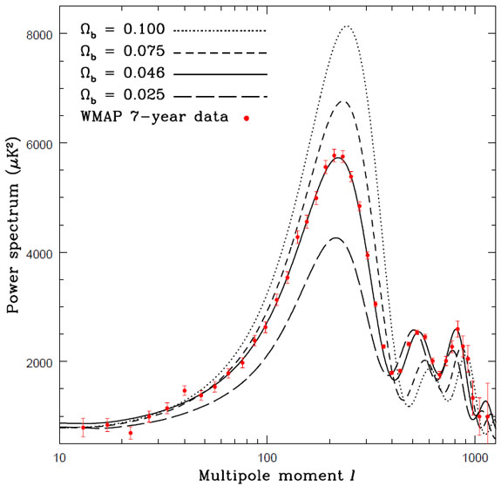
Dark matter overview
Why do we need DM?
• Galaxy rotation curve (Wikipedia)
• Bullet Cluster (Deep Chandra)
• The CMB Anisotropy Power Spectrum
(WMAP year 5 data)

Slide 9
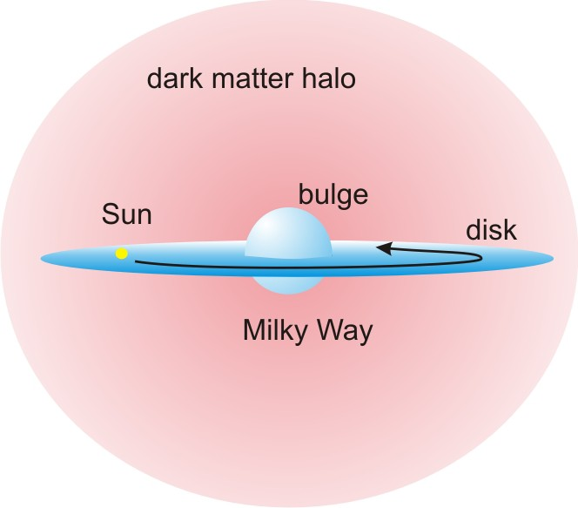
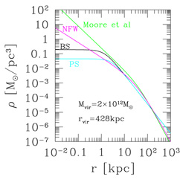


Dark matter overview
Some basic facts we roughly know so far:
8.5 kpc
Local DM energy density:
Local DM velocity:

Slide 10
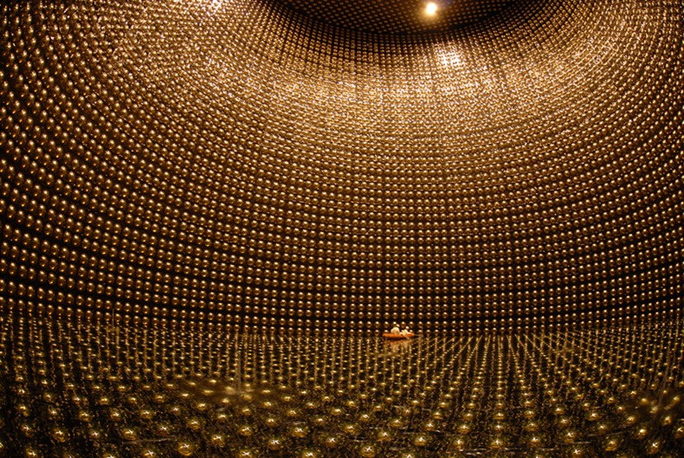
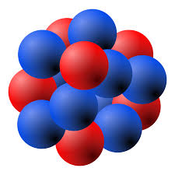

Boosted dark matter channels
Boosted DM detection:
DM particle is energetic enough to knock a nucleon out!
v ~ O(1) c
p/n
Looking for proton/neutron
knocked out of a nucleus.
Similar to neutrino neutral current interaction!
DM-nucleon scattering cross section
can be less constrained!
Large Volume Neutrino Experiments
Super-K ~ 50K ton! DUNE ~ 68K ton!

Slide 11
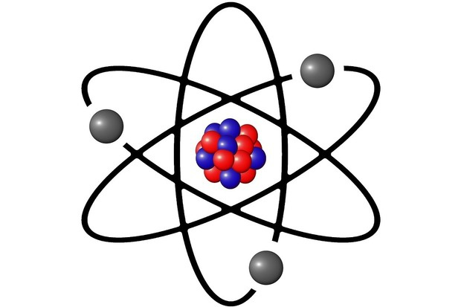

Boosted dark matter channels
Boosted DM detection:
DM particle is energetic enough to knock a nucleon out!
v ~ O(1) c
electron
Looking for electron
knocked out of an atom.
Similar to neutrino neutral current interaction!
DM-nucleon scattering cross section
can be less constrained!
Large Volume Neutrino Experiments
Super-K ~ 50K ton! DUNE ~ 68K ton!

Slide 12
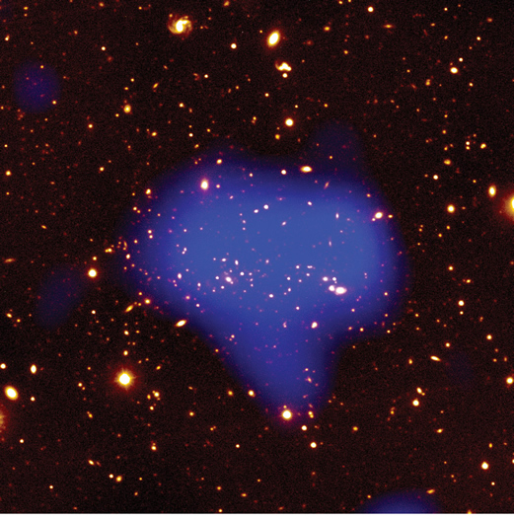
Clusters contain large amounts hot gas: emits x-rays
Temperature of hot gas tells us cluster mass:
85% dark matter
13% hot gas
2% stars

Slide 13
Gravitational lensing of light
Bending of light in gravitational fields can make lenses out of massive objects
NO
LENS
LENS
SOURCE
US
LENSING OBJECT
Strong or close lens, expect a ring of light, or a ring of images in the presence of the lens. When not resolved, expect increased intensity.

Slide 14
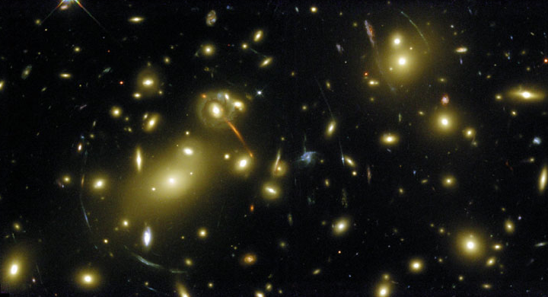
Gravitational lensing of light
Gravitational lensing of background galaxies also tells us the mass

Slide 15
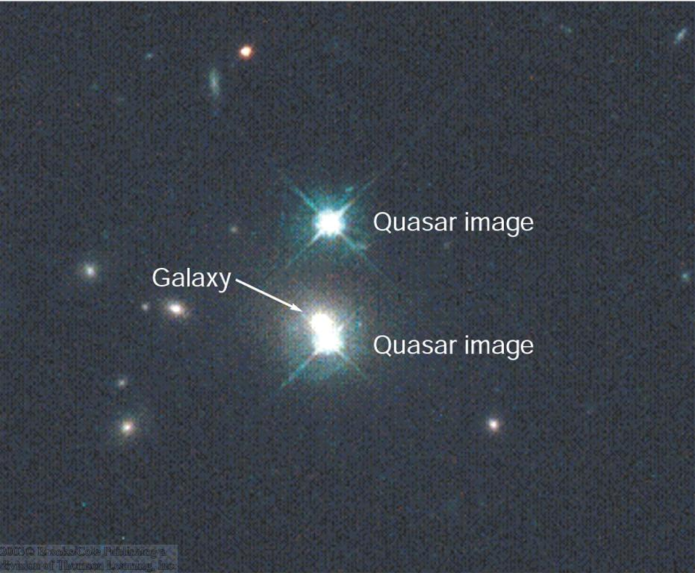
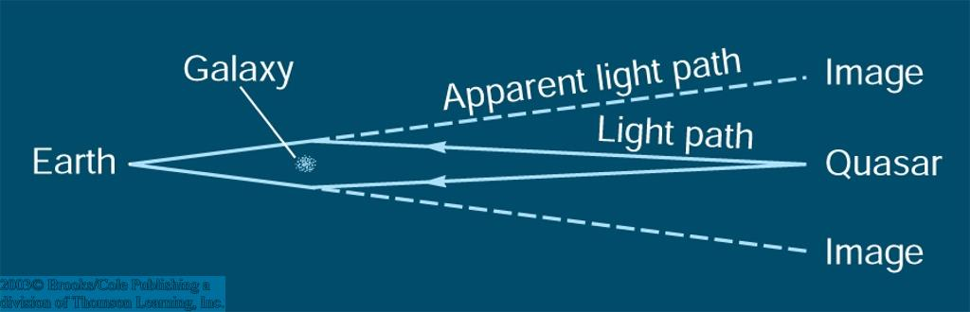
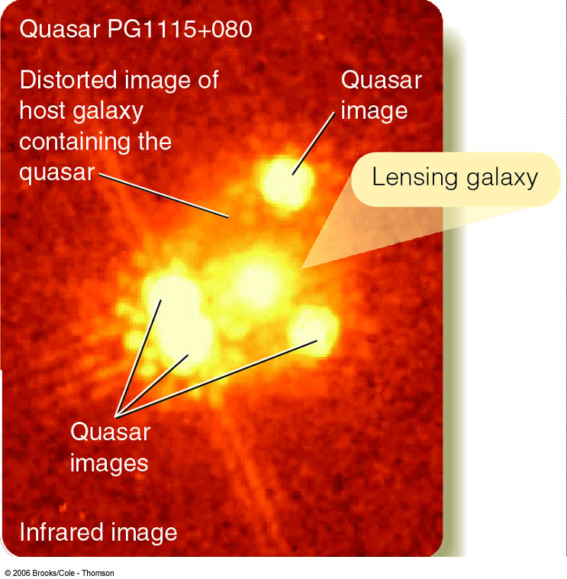
Probing Dark Matter with distant Quasars
Light from a distant quasar is bent around a foreground galaxy
→ two images of the same quasar!
Light from a quasar behind a galaxy cluster is bent by the mass in the cluster.
Use to probe the distribution of matter in the cluster.

Slide 16
Gravitational lensing of light

Slide 17
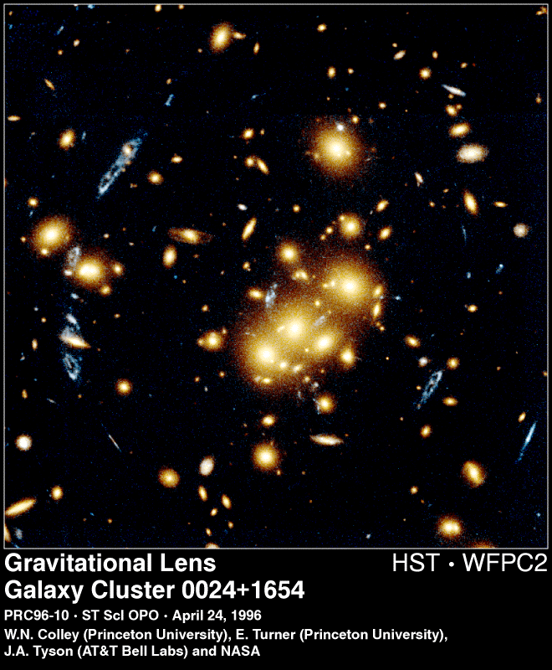
Galaxy Cluster 0024-1654 Hubble Deep Field
1.4 million light years

Slide 18
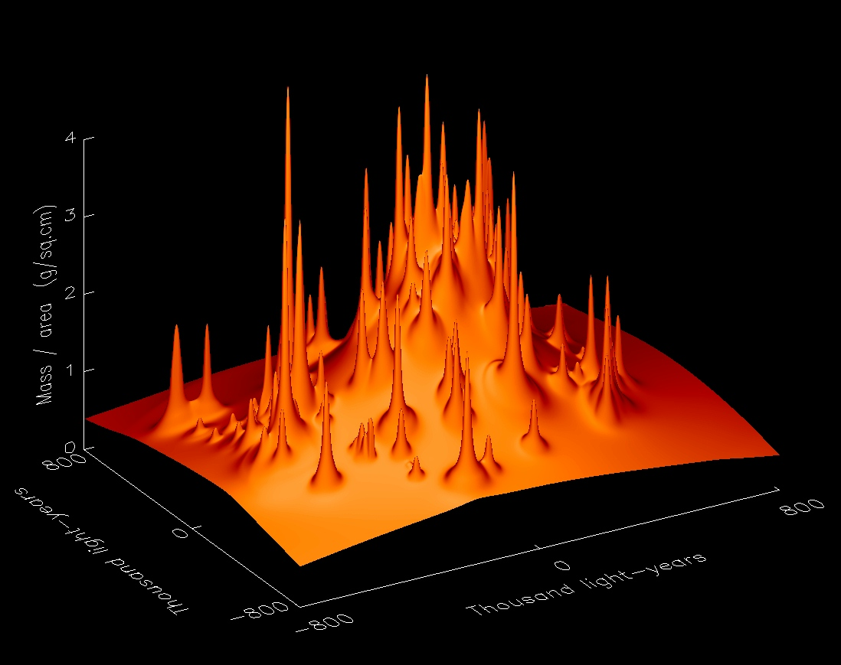
Reconstructed Matter Distribution Galaxy Cluster 0024-1654
[Tyson et al., Ap. J. 498 L107-110, 1998]

Slide 19
What could constitute the Dark Matter (1)?
IDEA 1 : Rocks
from pebbles to giant planets like Jupiter.
If there are enough of them, they could make up the dark matter.
Jupiter-size and above planets are a serious contender,
and are called MACHOs by the community - MAssive
Compact Halo Objects.
IDEA 2: Neutrinos
Light, neutral particles of which at least some have a small mass. Produced in enormous numbers in stars and possibly at the big bang. If there are enough of them, they could (maybe) be the dark matter.

Slide 20
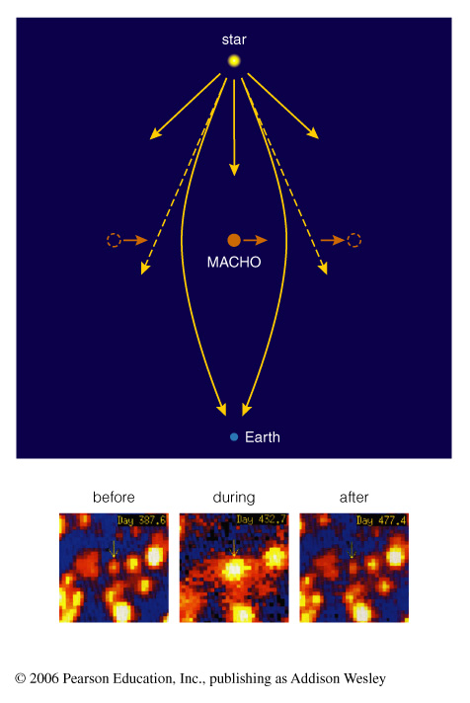
MAssive Compact Halo Objects
MACHOs do not cause enough lensing events to explain all the dark matter

Slide 21
What could constitute the Dark Matter (2)?
IDEA 3: Black Holes
Don’t emit significant amounts of light, can be very massive. Would need lots of them.
IDEA 4: Cosmic Strings
Dense filamentary structures that some theorists think could thread the universe, giving rise to its present-day lumpiness. Currently disfavored by cosmological data, but may come back into vogue sometime.

Slide 22
What could constitute the Dark Matter (3)?
IDEA 5: Axions
Very light particles, mass around 1/1,000,000,000,000 of an electron. Needed for building most realistic models of the neutron from standard model particle physics. Not detected. To be the dark matter, there should be around 10,000,000,000,000 per cubic centimeter here on Earth.
IDEA 6: WIMPS (Weakly Interacting Massive Particles)
Particles having mass roughly that of an atomic nucleus, could be as light as carbon or as heavy as 7 nuclei of xenon. Need a few per liter to constitute dark matter. Unlike nucleus, only interact WEAKLY with other matter, through the same
mechanism that is responsible for nuclear beta-decay.
Could be left over from Big Bang

Slide 23
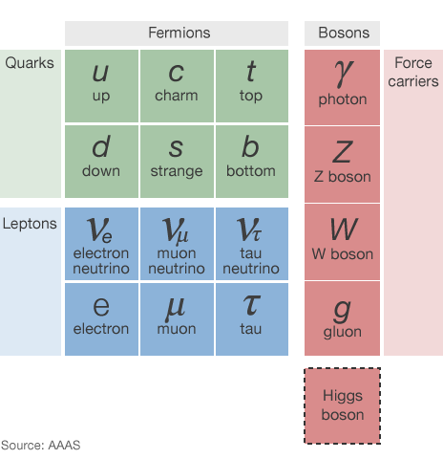
Dark matter
  Known DM properties
  Gravitationally interacting
  Not short-lived
  Not hot
  Not baryonic

Slide 24
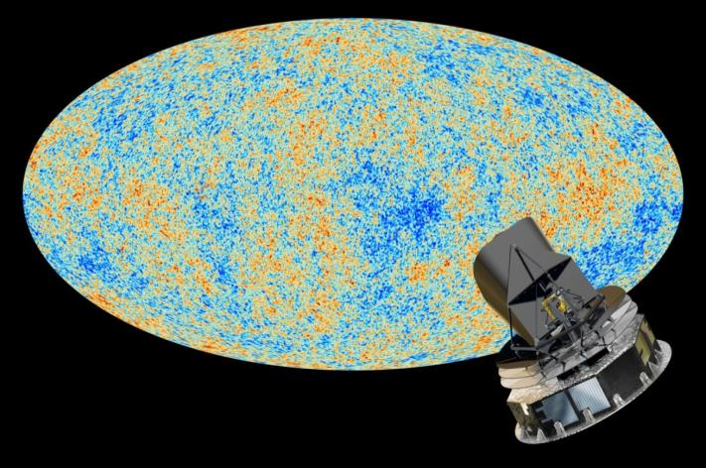
Dark Matter
26.8%
Normal Matter
4.9%
Dark Energy
68.3%

