Slide 1

Outline: Experimental Nuclear Astrophysics
Lecturer: Hans-Jürgen Wollersheim
e-mail: h.j.wollersheim@gsi.de
web-page: https://web-docs.gsi.de/~wolle/ and click on
LUNA – Gran Sasso
reaction yields
reactions in solar pp-chain

Slide 2
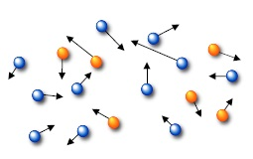
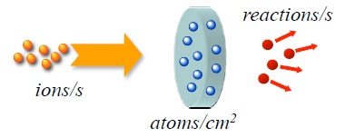
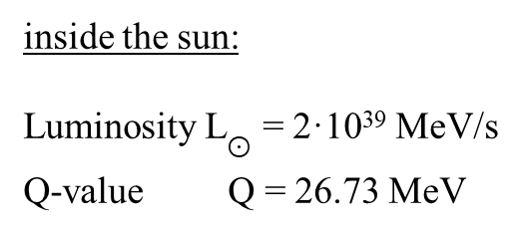
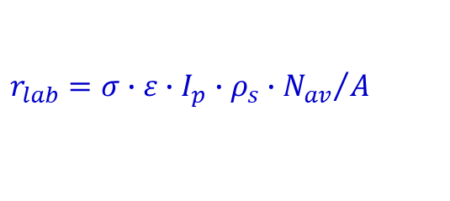

Reaction rates
inside the sun:
Luminosity L$⊙$ = 2·10³⁹ MeV/s
Q-value Q = 26.73 MeV
$$r_{⨀}=\frac{L_{⨀}}{Q}={10}^{38} s^{−1}$$
luminosity is the total amount of energy produced in a star and radiated into space in form of E-M radiation per time
in the lab:
ε ~ 10%
I_{p} ~ mA
ρ_{s} ~ mg/cm²
pb < s < nb
$$r_{lab}=σ∙ε∙I_{p}∙ρ_{s}∙{N_{av}}/A$$
even / month < r_{lab} < event / day
signal rate ≥ background rate
cosmic ray flux at the sea level ~ 2·10⁻² cm⁻² s⁻¹
on a 10 cm² detector ~ 2000 events / day !!!

Slide 3
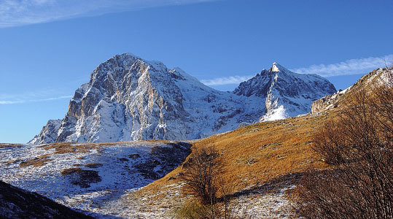
LUNA @ Laboratori Nazionali Gran Sasso
Rock as passive shielding
cosmic ray background reduction ~ 10⁻⁴
4-50 keV accelerator
p-, α-beams ≤ 1 mA
study of pp-chains
e.g. ³He + ³He

Slide 4
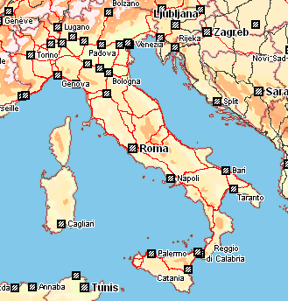
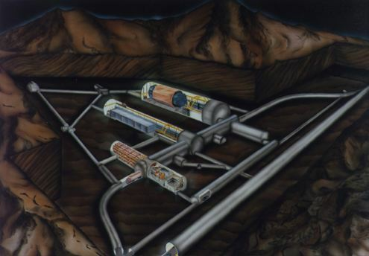
The LUNA facility
Gran Sasso - Italy
Laboratori Nazionali del Gran Sasso
(1400 m rock → 10⁶ shielding factor)
Radiation | LNGS/surface
muons neutrons photons | 10⁻⁶ 10⁻³ 10⁻¹
LUNA 400kV
The (present) LUNA Collaboration
Italy (INFN Gran Sasso, Napoli, Genova, Padova, Milano, Torino)
Germany (Bochum, Dresden)
Hungary (Debrecen)
UK (Edinburgh)

Slide 5
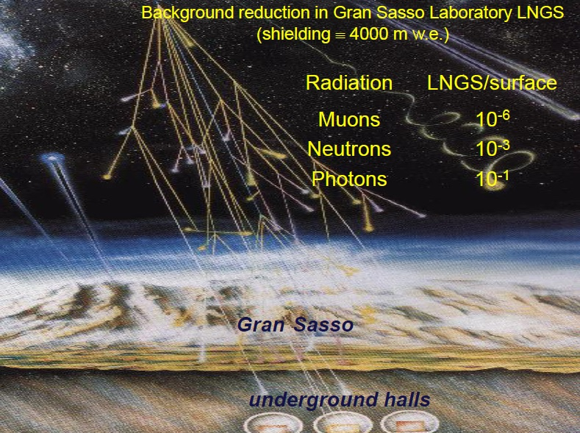

Slide 6
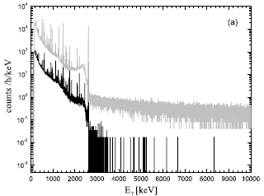
γ-ray background at Gran Sasso
surface
LUNA
unshielded
LUNA
shielded
with lead shielding
much higher suppression factor
than with shielding at surface lab
NB shielding becomes even more efficient underground

Slide 7
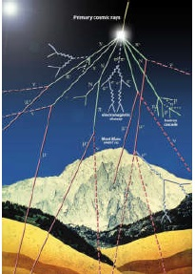
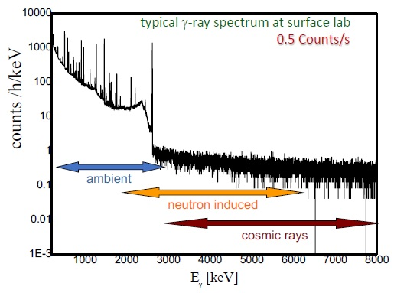
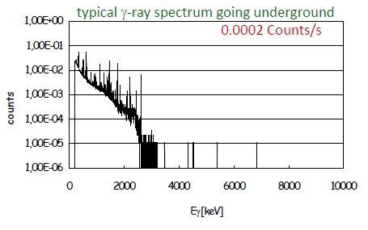
γ-ray background at Gran Sasso
Main source of background:
natural radioactivity (mainly from U and Th chains and from Rn)
cosmic rays (muons, ^{1,3}H, ⁷Be, ¹⁴C, …)
neutrons from (α,n) reactions and fission
Ideal location: underground + low concentration of U and Th
The advantage is evident for high Q-value capture reactions, less evident for low Q-value reactions

Slide 8
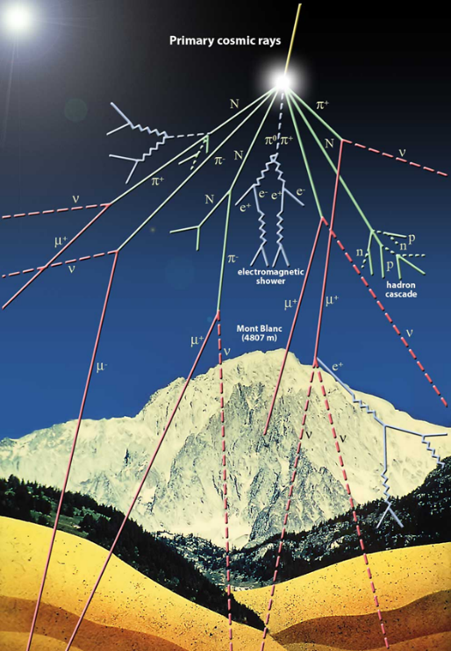
underground location
+ low U and Th environment
major advantages:
in all cases where background is dominated by cosmic rays
poor signal-to-noise ratio at surface level (e.g. neutron-induced background)
limited, though not negligible, advantages:
in all cases where background is mostly beam-induced
background arising from laboratory environment

Slide 9
LUNA’s accelerators
Energy spread
20 eV
50 kV: LUNA I
³He(³He,2p)⁴He
d(p,γ)³He
d(³He,p)⁴He
keV/h

Slide 10
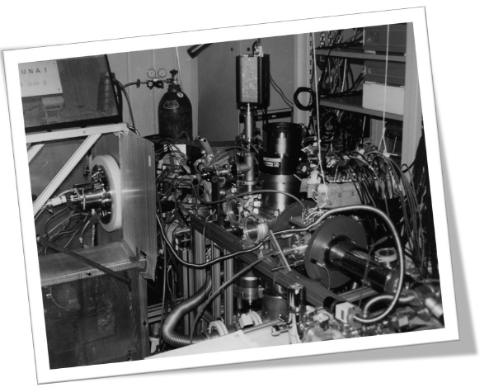
Nuclear reactions of astrophysical interest at LUNA
LUNA 50 kV
energy range: 10-50 kV
current: 1 mA
beam spread: 20 eV

Slide 11
LUNA’s accelerators
400 kV: LUNA II
U = 50 – 400 kV
I ~ 500 μA for protons
I ~ 250 μA for alphas
Energy spread ~ 70 eV
long term stability: 5 eV/h
¹⁴N(p,γ)¹⁵O ³He(⁴He,γ)⁷Be

Slide 12
LUNA’s accelerators
400 kV: LUNA II

Slide 13
Nuclear reactions of astrophysical interest at LUNA
LUNA 400 kV
energy range: 50-400 kV
current: 1 mA
beam spread: < 100 eV
stability: 5 eV/h

Slide 14
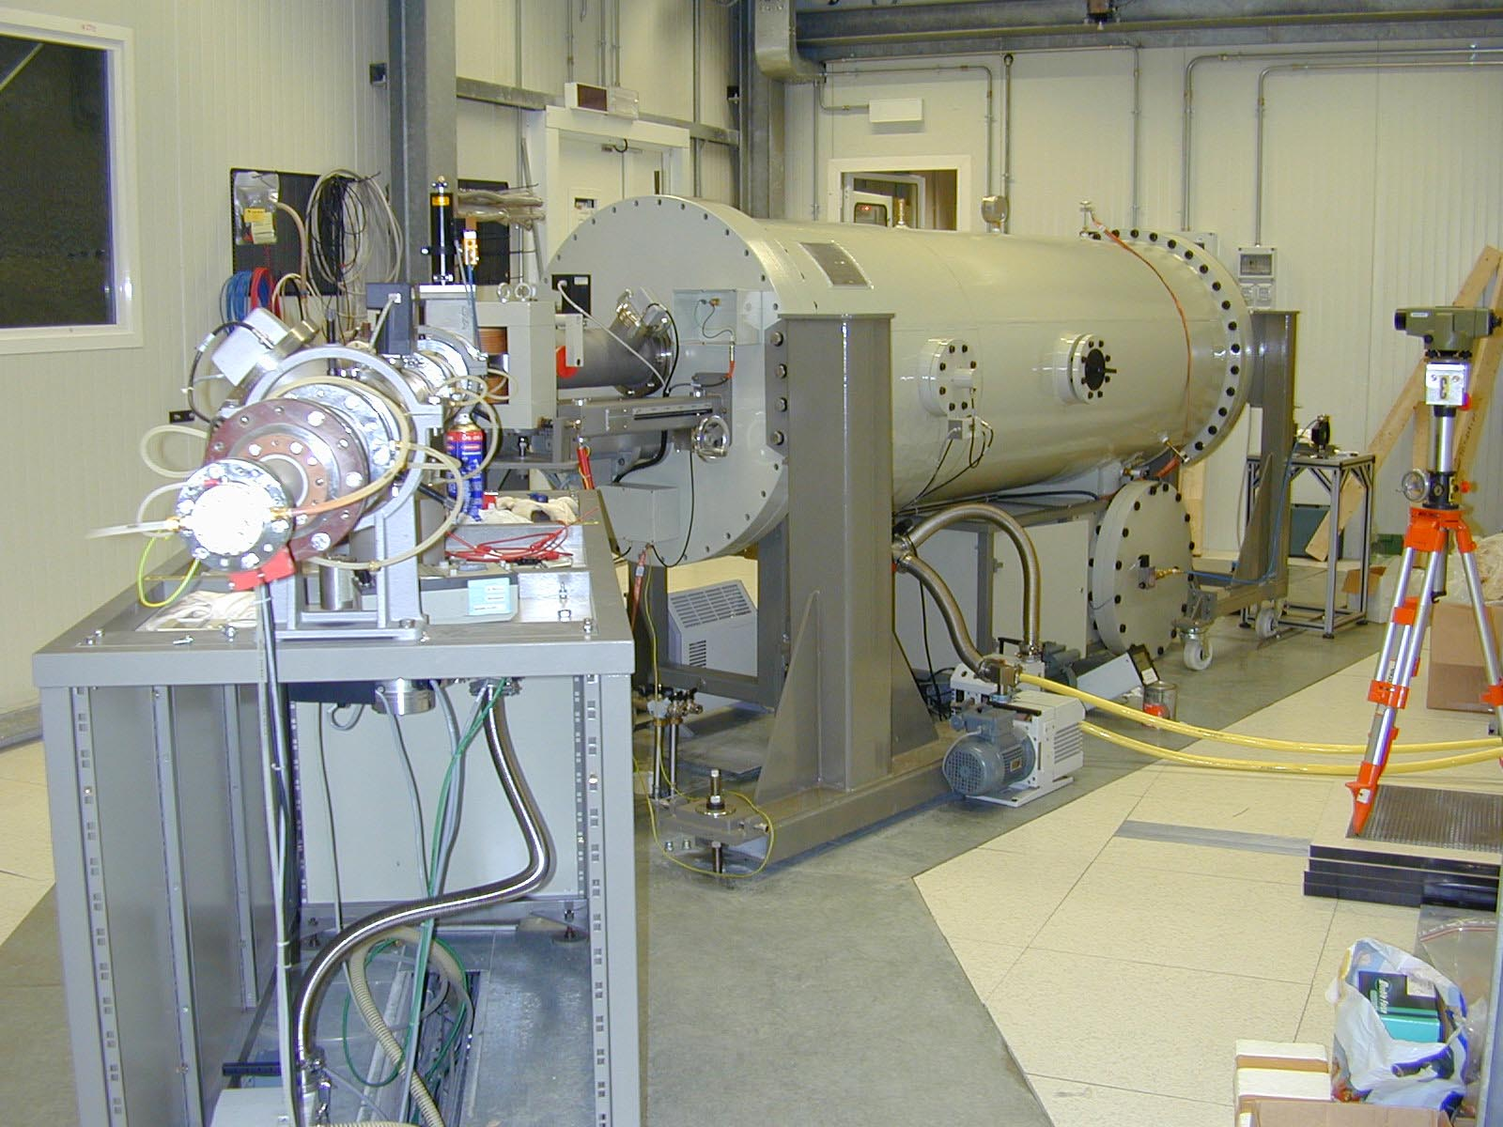
LUNA aims, tools
1. Direct experiment in Gamow window
2. Reach lower energies with competitive accuracy
3. Improve accuracy at already reached energies
Preserve excellent background conditions → beam induced bg control
U = 50 – 400 kV
I ∼ 500 μA for p ∼ 250 μA for α
Energy spread ≈ 70eV
Long term stability ≈ 5 eV/h

Slide 15
A unique approach: LUNA @ LNGS
Neutrino detection: shield+detector
Nuclear physics: shield+detector+source
Laboratory for Underground Nuclear Astrophysics
³He(³He,2p)⁴He
50 kV :
(1992-2001)
d(p,γ)³He
400 kV:
(2000→…)
¹⁴N(p,γ)¹⁵O

Slide 16
Nuclear reactions of astrophysical interest at LUNA
LUNA MV
energy range: 200-3500 kV
current: < 1 mA
beam spread: 350 eV
stability: 35 eV/h
This machine will provide not only proton and helium (3/4) but also ¹²C⁺ and ¹²C⁺⁺

Slide 17
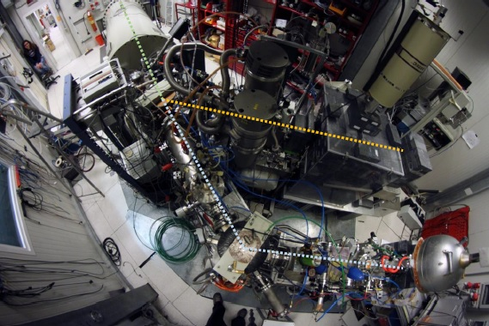
Nuclear reactions of astrophysical interest at LUNA
The LUNA experiment
LUNA 50 kV (1992-2001) - solar phase
LUNA 400 kV (2000-2018) – CNO, Mg-Al and Ne-Na cycles, BBN
LUNA MV (since 2018) – Helium burning
LUNA accelerator
high current
long term stability
high energy accuracy
targets
windowless gas target
solid target
detectors
137% HPGe
BGO
Silicon
NaI

Slide 18
Two approaches to stellar energies
Extrapolations:
• Measure level gamma widths
• Measure asymptotic normalization constants (ANCs)
• Measure cross sections at high energies
• R-matrix fit for each transition
Extrapolations for each transition are summed to give the total extrapolated cross section at astrophysical energies
Direct Measurement:
• Low laboratory background
• Low ion beam induced background
• High beam intensity
• High detection efficiency
Direct data for the total cross section at astrophysical energies

Slide 19
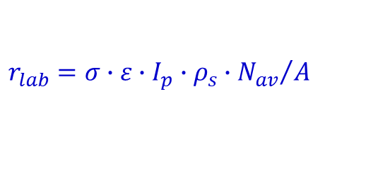

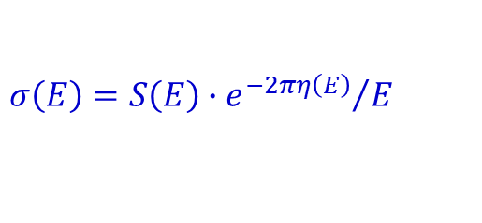
Underground accelerator – main features
$$σ\left(E\right)=S\left(E\right)∙{e^{−2πη\left(E\right)}}/E$$
Low cross section
$$r_{lab}=σ∙ε∙I_{p}∙ρ_{s}∙{N_{av}}/A$$
$$σ\left(E\right)=S\left(E\right)∙{e^{−2πη\left(E\right)}}/E$$
high beam current to increase reaction rate
long measurements to collect statistics
small energy spread
energy stability during measurement

Slide 20
Experimental approach
measure σ(E) over as wide a range as possible, then extrapolate down to E₀!
CROSS SECTION
S-FACTOR
σ (E) = exp(-2πη) S(E)
S(E) = Eσ (E) exp(2πη)
S(E)
σ(E)
resonance
extrapolation
LINEAR
SCALE
direct measurement
LOG
SCALE
low-energy tail
of broad
resonance
non-resonant
non resonant
process
direct measurements
sub-threshold
resonance
⇓
E₀
E_{coul}
-E_{r}
0
E_{r}
interaction energy E
extrapolation
needed !
Coulomb
barrier
DANGER OF EXTRAPOLATION !

Slide 21
Targets
☺ ☹
H targets
solid CH₂ target (plastic material)
simple to handle hydrogen depletion
dx ~ 50 - 1000 μg cm⁻² non uniformity
melting problems
deuterium contamination
He targets
solid implanted target
simple to handle low concentration
(n ~ 10¹⁵ - 10¹⁷ atoms cm⁻²)
window-confined gas target
higher concentration background reactions
(depending on pressure) (e.g. on window materials)
windowless gas target
higher concentration differential-pumping system
almost background free high pumping speeds
no physical degradation

Slide 22
What is measured in the laboratory
reaction yield:
Y = N_{p} N_{t} σ ε
N_{p} = number of projectile ions
typically, stable beam intensities 10¹⁴ pps (~100 μA q=1+)
N_{t} = number of target atoms
typically, 10¹⁹ atoms/cm²
σ = reaction cross section (given by nature)
typically, 10⁻¹⁵ barn (1 barn = 10⁻²⁴ cm²)
ε = detection efficiency
typically, 100% for charged particles
~1% for gamma rays
Y = 0.3-30 counts/year

Slide 23


Challenges
low cross sections → low yields → poor signal-to-noise ratio
Sources of background:
Beam induced:
- reactions with impurities in the target
- reactions on beam collimators/apertures
non beam-induced:
- interaction of cosmic muons with detection setup
- charged particles from natural background
- neutron-induced reactions

Slide 24
maximising the yield requires:
improving “signal”
- high beam currents
BUT limitations: charge confinement
heating effects on target
- thicker, purer targets
BUT limitations: exponential drop of cross section
high purities difficult + expensive
reducing “noise” (i.e. background)
combination of both

Slide 25
Main source of background
natural radioactivity (mainly from U and Th chains and from Rn)
cosmic rays (muons, ^{1,3}H, ⁷Be, ¹⁴C, …)
neutrons from (α,n) reactions and fission
typical γ-ray spectrum at surface lab
ambient
neutron induced
cosmic rays

Slide 26
γ-ray background at Gran Sasso
surface
LUNA
unshielded
LUNA
shielded
with lead shielding
much higher suppression factor
than with shielding at surface lab
NB shielding becomes even more efficient underground

Slide 27
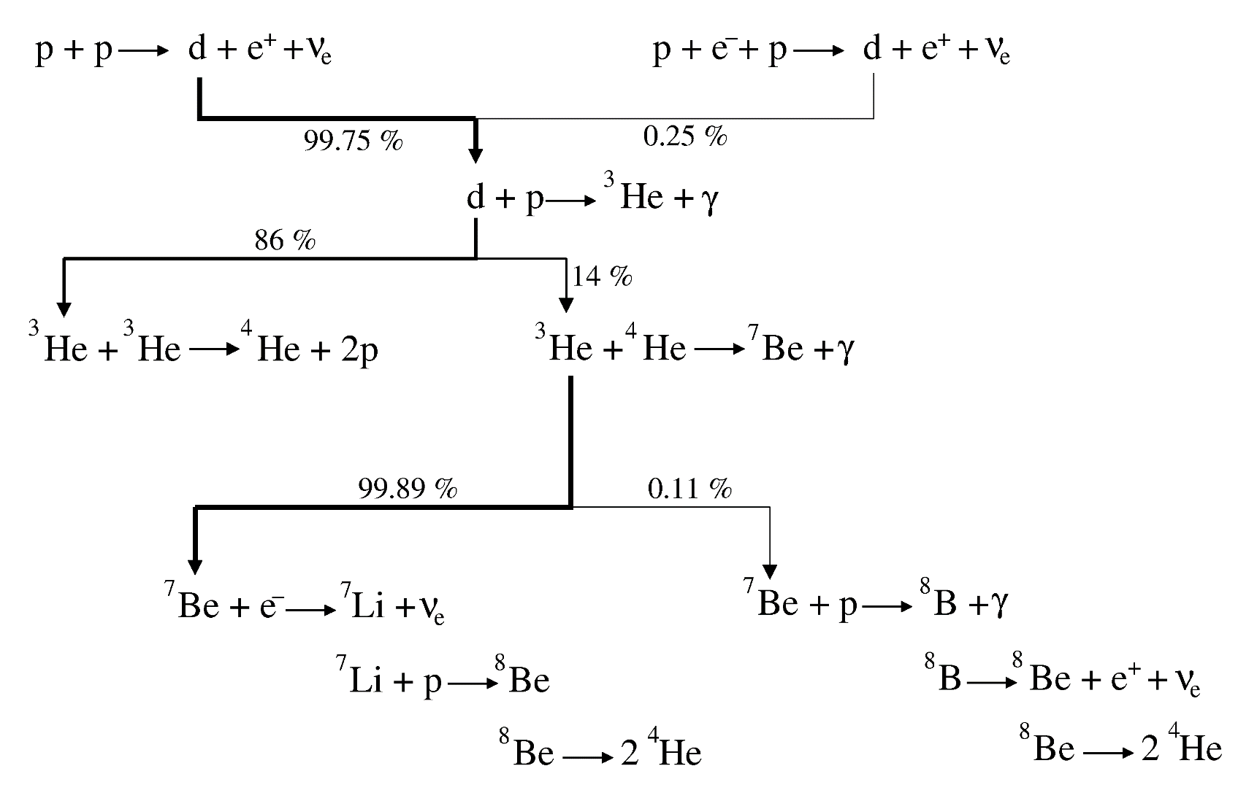
Precision data for solar models
+ CNO
E₀ = 21 keV, σ = 7 ·10⁻¹³ barn
E₀ = 22 keV, σ = 9 ·10⁻¹⁸ barn
Charged particle reaction cross sections are difficult to measure at astrophysical energies

Slide 28
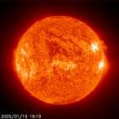
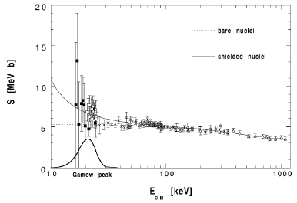
Laboratory for Underground Nuclear Astrophysics
LUNA – Phase I: 50 kV accelerator (1992-2001)
investigate reactions in solar pp-chain
R. Bonetti et al.: Phys. Rev. Lett. 82 (1999) 5205
³He(³He,2p)⁴He
d(p,γ)³He
The ²H(p,γ)³He reaction controls the equilibrium abundance of solar deuterium
@ lowest energy:
σ ~ 20 fb → 1 count/month
@ lowest energy:
σ ~ 9 pb → 50 counts/day
only two reactions studied directly at Gamow peak

Slide 29
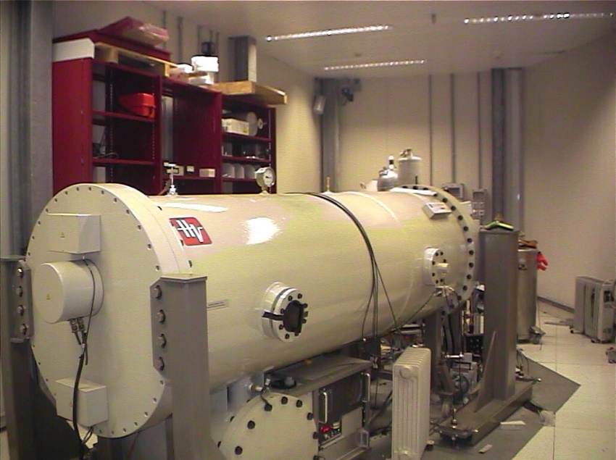
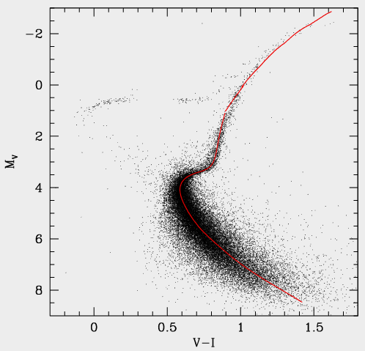
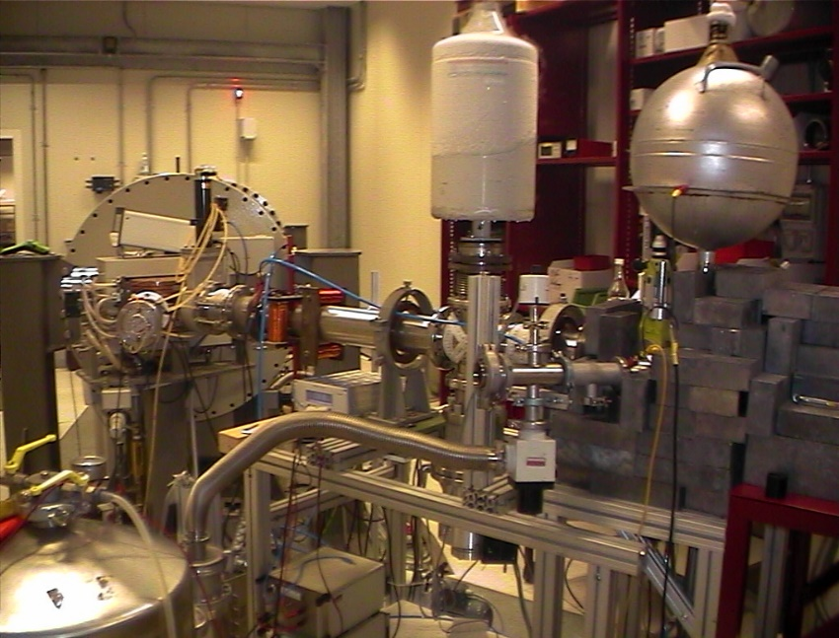
LUNA – Phase II: 400 kV accelerator (2002-2006)
CNO cycle
¹⁴N(p,γ)¹⁵O
slowest reaction
in CNO cycle
O
15
N
13
14
15
C
12
13
6
7
8
A. Formicola et al. PL B591 (2004) 61-68
G. Imbriani et al. A&A 420 (2004) 625
CNO
pp-chain
solar neutrino flux from CNO reduced by factor 2
age of globular cluster increased by 1Gy !!

Slide 30
Example of nuclear reaction rates in stars
CNO cycle
O
15
(p,γ)
13
14
15
N
(e⁺ν)
C
12
13
(p,α)
6
7
8
¹²C(p,γ)¹³N(e⁺ν)¹³C(p,γ)¹⁴N(p,γ)¹⁵O(e⁺ν)¹⁵N(p,α)¹²C
cycle limited by β-decay of ¹³N (t ~ 10 min) and ¹⁵O (t ~ 2 min)
CNO isotopes act as catalysts
net result: 4p → ⁴He + 2e⁺ + 2ν + Q_{eff} Q_{eff} = 26.73 MeV
nucleosynthesis
energy production
changes in stellar conditions ⇒ changes in energy production and nucleosynthesis
need to know REACTION RATE at all temperatures to determine
ENERGY PRODUCTION and NUCLEOSYNTESIS

Slide 31
LUNA
Reactions measured so far at or near Gamow region:
³He(³He,2p)⁴He ¹H(p,γ)³He ^{14,15}N(p,γ)¹⁵O ³He(⁴He,γ)⁷Be ²⁵Mg(p,γ)²⁶Al
²H(⁴He,γ)⁶Li ¹⁷O(p,γ)¹⁸F ¹⁷O(p,α)¹⁴N …
Limitations
produces & accelerates H and He beams
no deuteron beams allowed
reactions producing neutrons not allowed
only direct kinematics studies are possible
many critical reactions for astrophysics BEYOND current capabilities
!! new underground facilities are very much needed !!

Slide 32
Trojan Horse Method Bauer, Typel, Wolter
⁷Li
α
α
Principle
  Obtain 2-body σ from 3-body reaction
  Example: ⁷Li ( p α)α from ²Η(⁷Li, αα)n
Results (Lattuada et al., Ap.J. tbp)
•
p
•
²H (n+p)
n
(spectator)
Comments
Large rates, no screening correction
Norm to 2-body, extend to low-E
Compare to direct ⇒ screening correction near 250 eV. Larger than usual theory.
Direct 2-body
Troj. Hor.-3 body

Slide 33
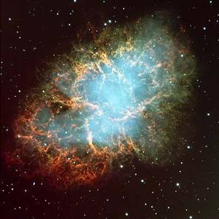
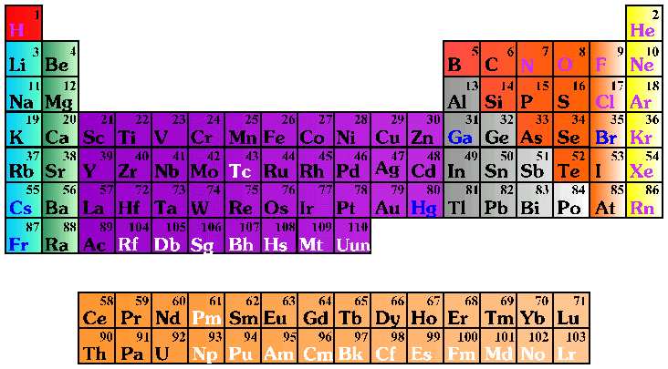
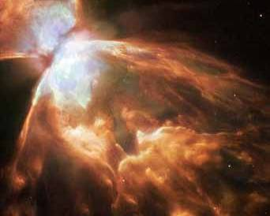
Key open questions
fate of massive stars (supernovae explosions)?
carbon burning [¹²C+¹²C] in advanced stages of stellar evolution
where and how are heavy elements produced?
neutron sources [¹³C(α,n)¹⁶O and ²²Ne(α,n)²⁶Mg] for s-process
AGB stars nucleosynthesis, Novae ejecta, Galaxy composition?
Ne, Na, Mg and Al nucleosynthesis [(p,γ) and (p,α) reactions]
Crab Nebula SN 1054

Slide 34
projects in Europe
Boulby (UK)
Gran Sasso (Italy)
Canfranc (Spain)
Felsenkeller (Germany)
projects elsewhere
DIANA (US)
Andes (Chile/Argentina)
China
India

Slide 35
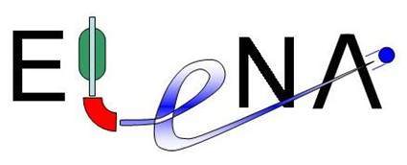
Boulby mine
commercial potash and salt mine
Cleveland Potash Ltd
deepest mine in Britain
(850m to 1.3km deep)
European Laboratory for
Experimental Nuclear Astrophysics
Middlesborough
Staithes
Whitby
York

Slide 36
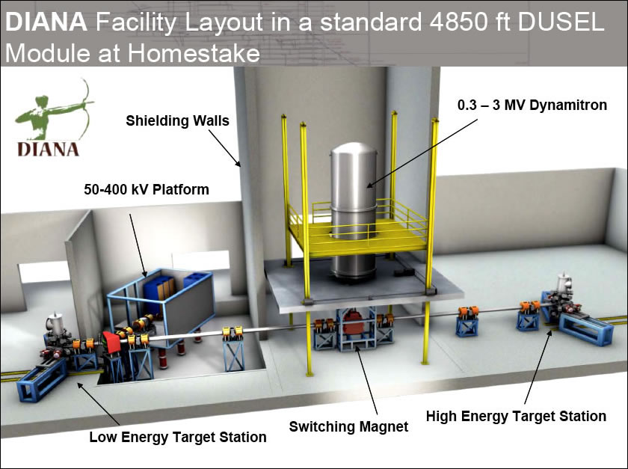
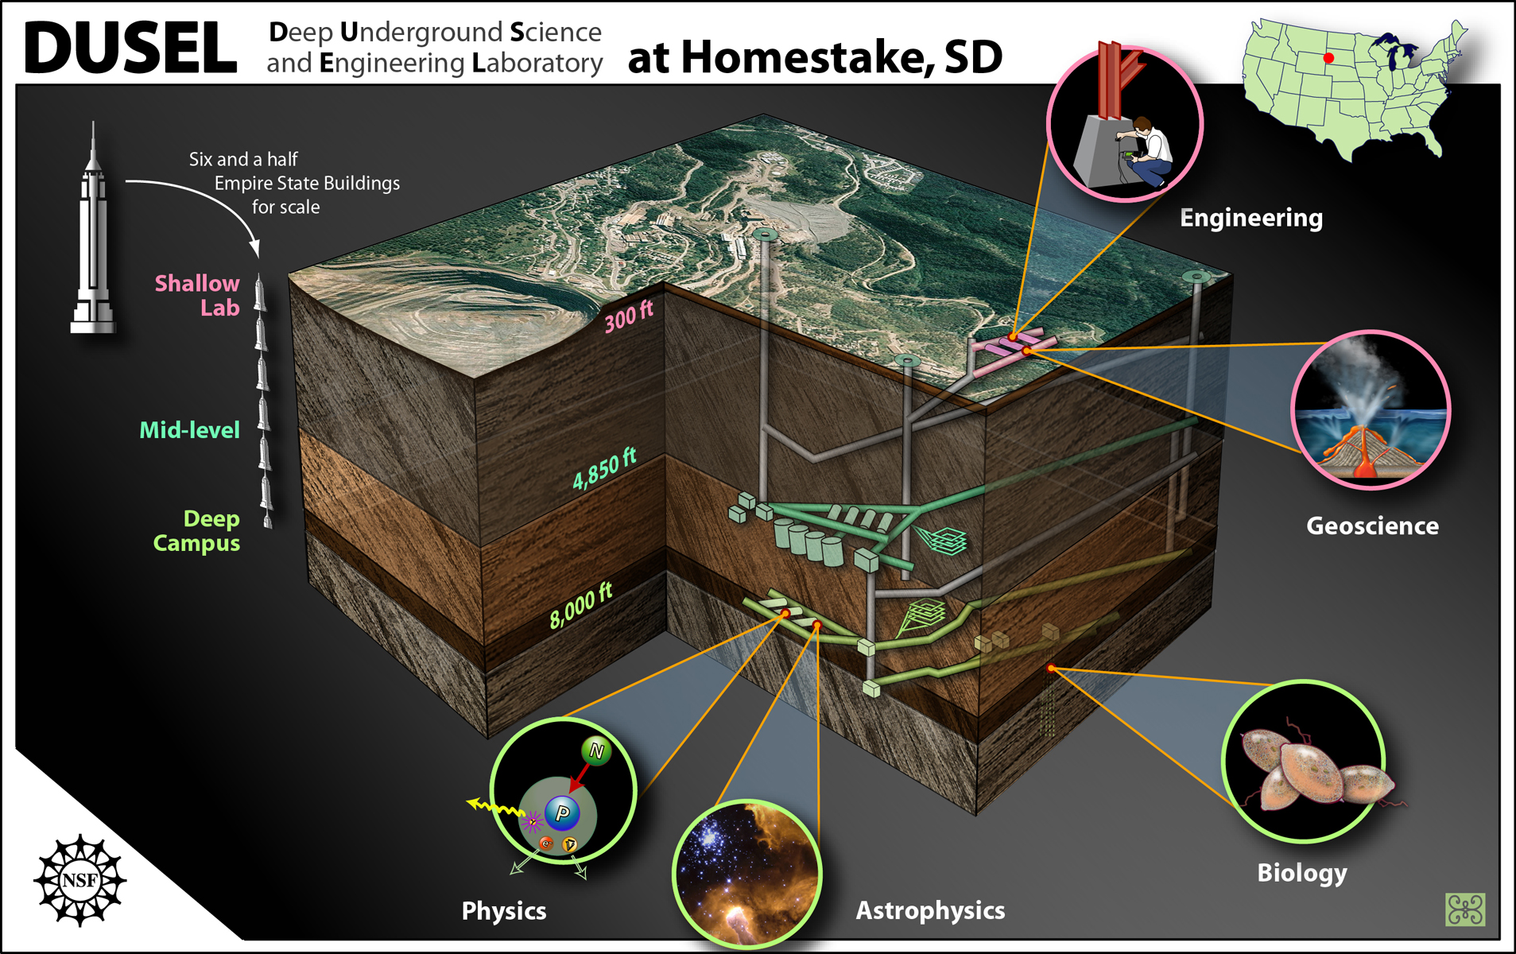
DIANA
Dual/Dakota/DUSEL Ion Accelerator for Nuclear Astrophysics

Slide 37
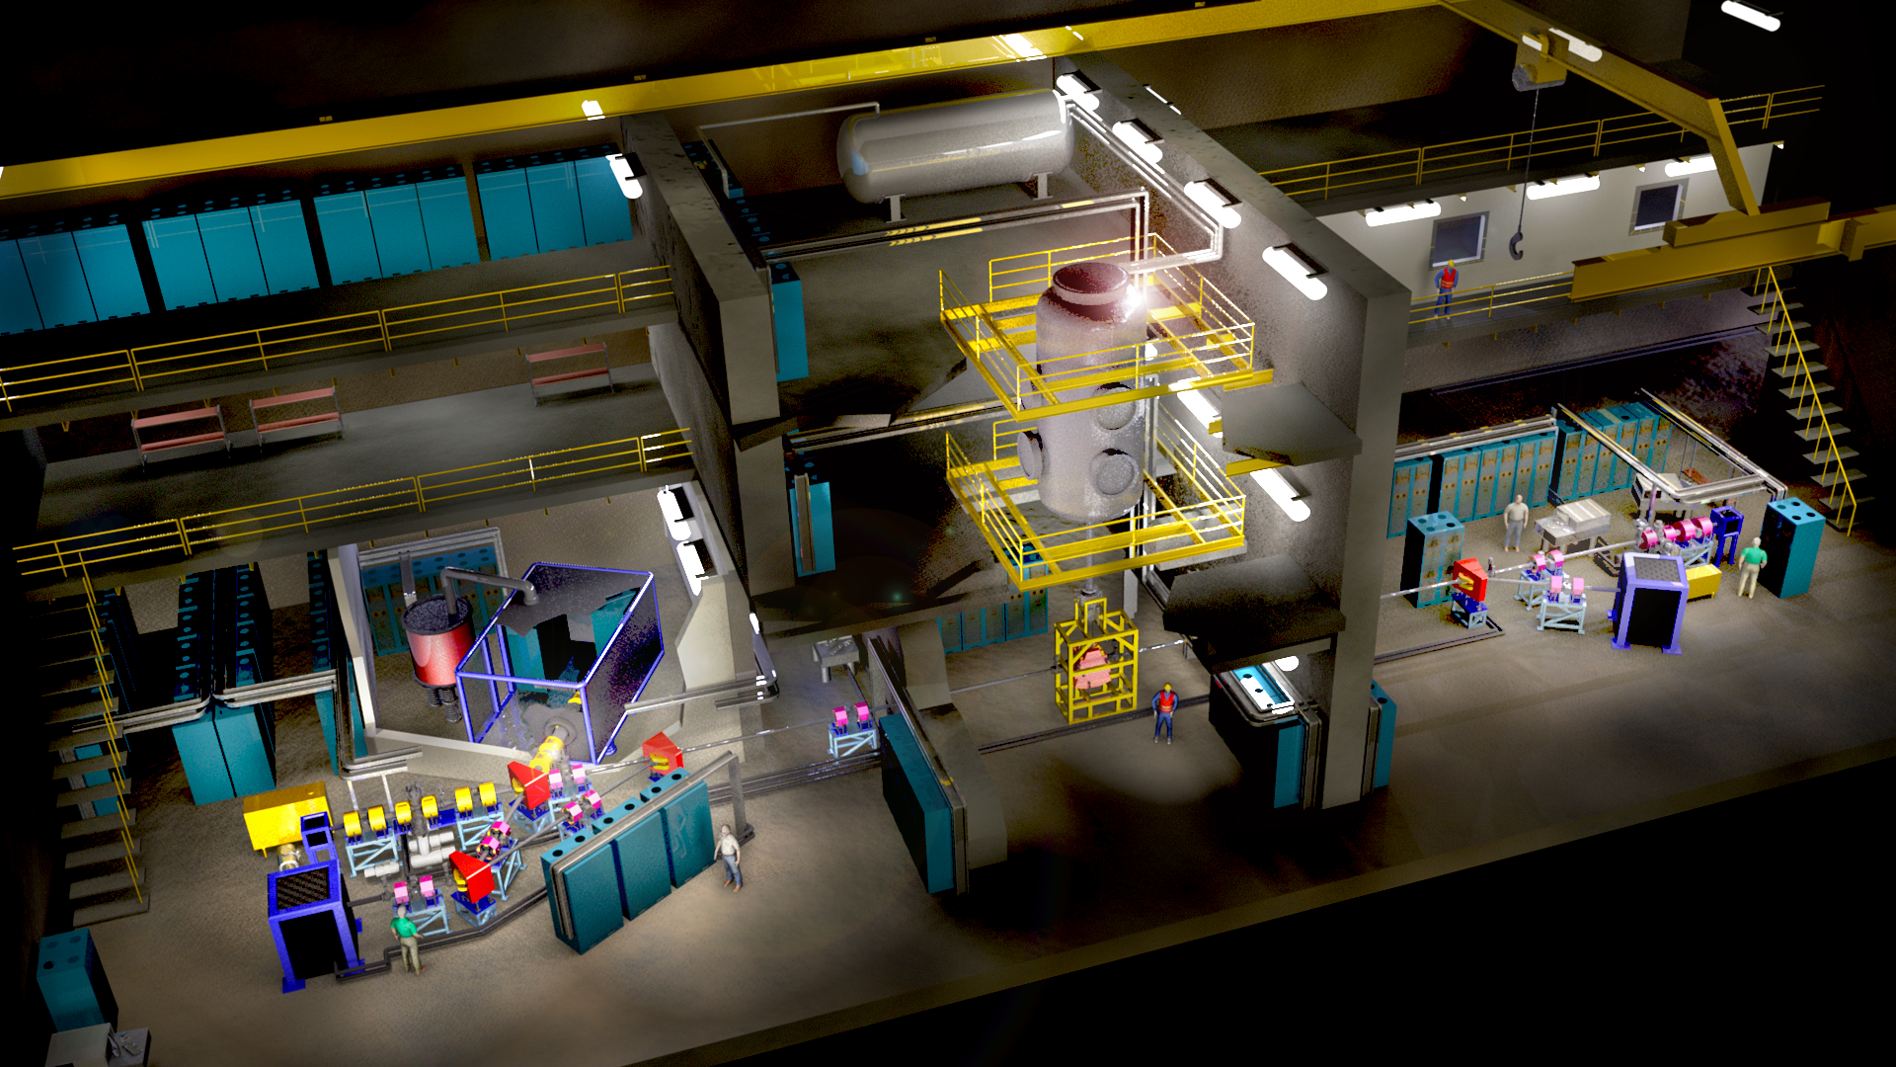
DIANA design
courtesy: M Wiescher
E=10 keV-3.0 MeV
I=0.5 mA to 10 mA
ρ=10¹⁹ prt/cm²
p, α, HI beams
100 x LUNA luminosity

Slide 38
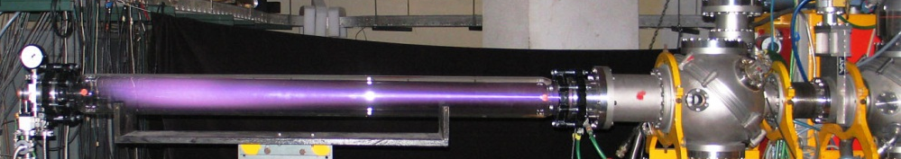
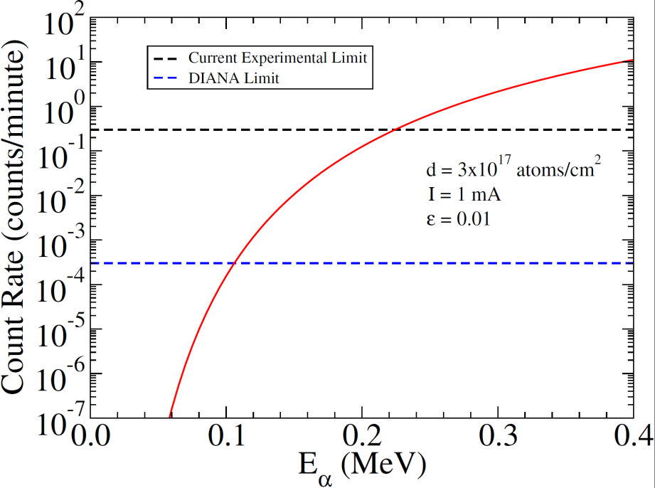
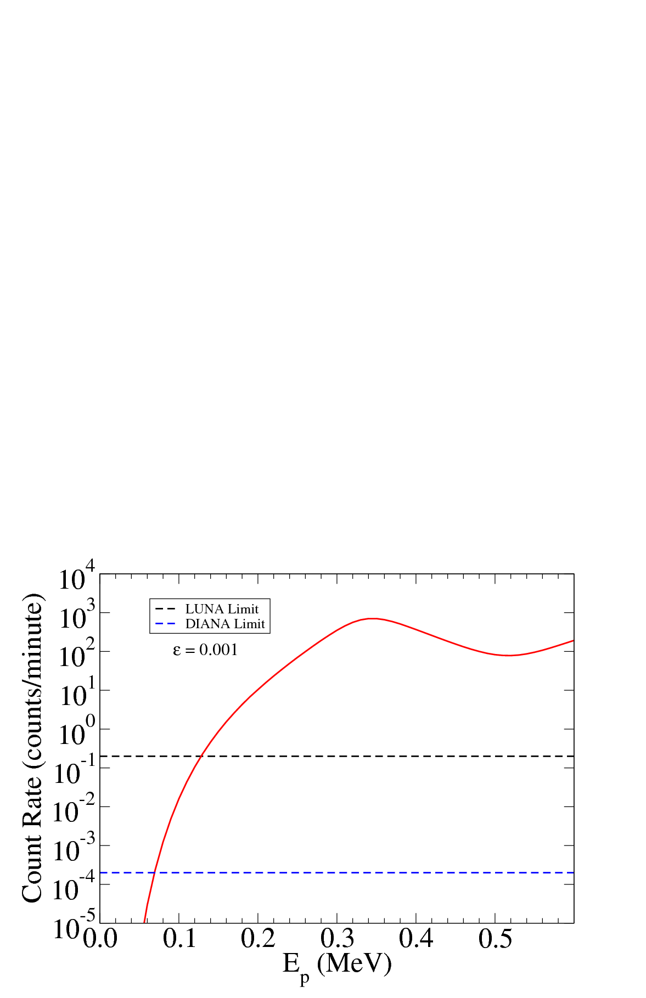
Yield and count rate estimate
Beam intensity: 10mA, target density 10¹⁸ g/cm² gas jet
³He(α,γ)⁷Be
¹⁵N(p,γ)¹⁶O
increase in luminosity → up to 3 orders of magnitude improvement compared to LUNA
courtesy: M Wiescher

Slide 39
Improve the figure of merit
Minimum detection limit:
Increase the number of counts in the peak:
  Increase the beam current
  Increase the target thickness
  Increase the detector efficiency
Reduce the background:
  Use Compton reduction
  Use coincidence technique
  Use shielding
N

Slide 40
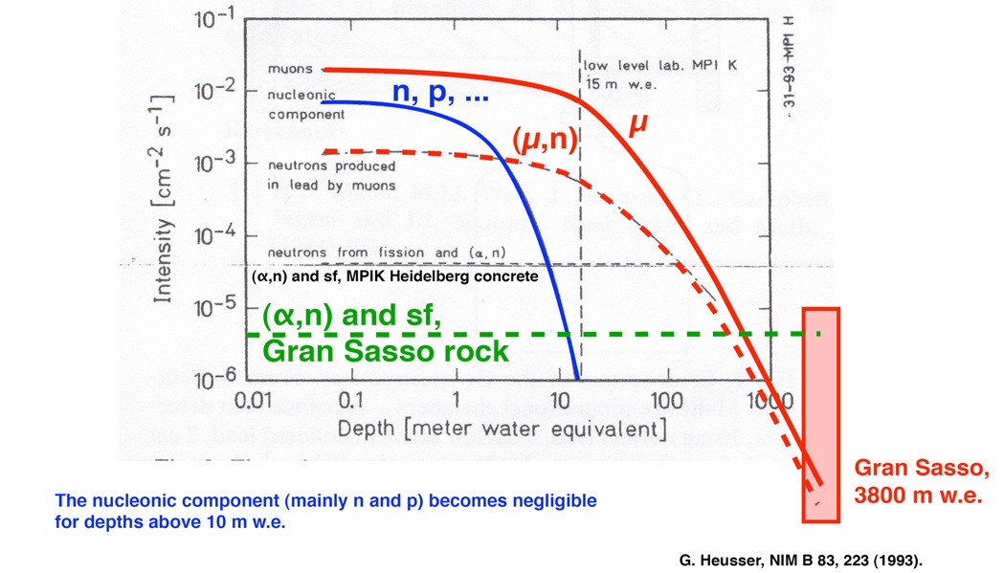
Secondary $\left[μ,n,p,⋯\right]$and tertiary $\left[\left(μ,n\right)\right]$cosmic rays underground

Slide 41
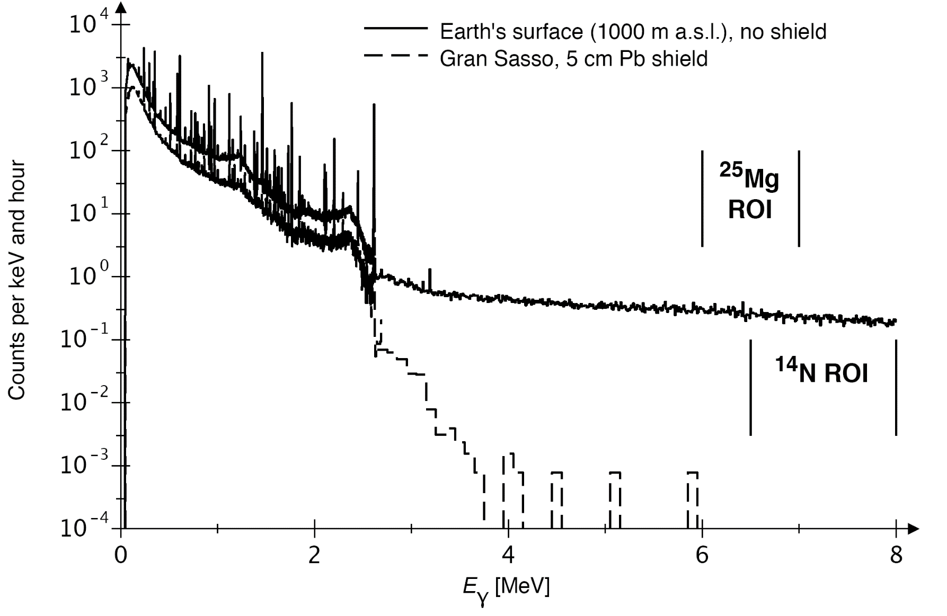
HPGe detector underground

Slide 42
Thermonuclear reactions in stars
Consider reaction: 1 + 2 → 3 + 4 Q₁₂ > 0
( ⇐ known from
atomic mass tables)
Reaction cross section σ ⇒ probability for a reaction to occur
Dimension: area Unit: barn (b) = 10⁻²⁴ cm²
In general: not possible to determine reaction cross section from first principles
However:
cross sections depend on nature of force involved
cross sections are energy (i.e. velocity) dependent
Reaction | Force | σ (barn) | E_{proj} (MeV)
¹⁵N(p,α)¹²C | strong | 0.5 | 2.0
³He(α,γ)⁷Be | electromagnetic | 10⁻⁶ | 2.0
p(p,e⁺ν)d | weak | 10⁻²⁰ | 2.0
Reaction rate:
r = N₁N₂
vσ(v)

