Slide 1

Outline: Helium burning
Lecturer: Hans-Jürgen Wollersheim
e-mail: h.j.wollersheim@gsi.de
web-page: https://web-docs.gsi.de/~wolle/ and click on
critical reactions in He-burning
the 3α reaction as two step process
¹²C(α,γ)¹⁶O reaction

Slide 2
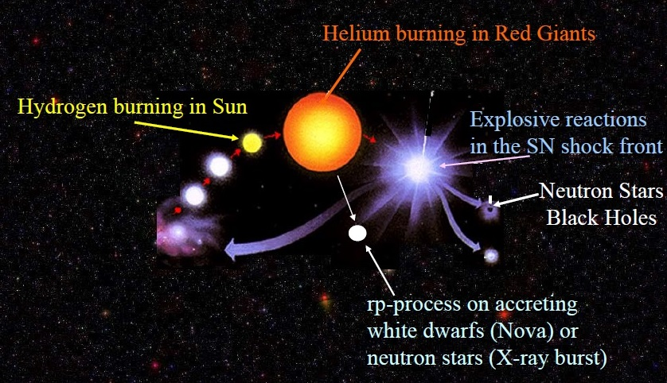

Slide 3
The star-gas-star cycle
atomic hydrogen
clouds
molecular clouds
hot bubbles
star-gas-star
cycle
star formation
supernovae and stellar winds
stellar burning
heavy element formation

Slide 4
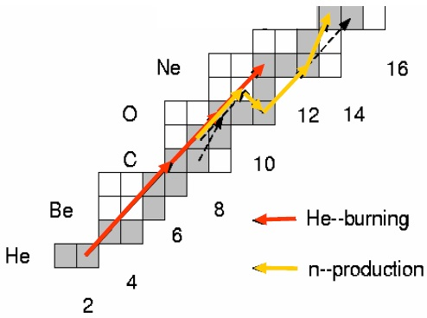

He-burning in massive stars
He-burning is ignited on the ⁴He and ¹⁴N ashes of the preceding hydrogen burning phase!
Most important reaction – triple alpha process - $3α→12C+7.96 MeV$

Slide 5
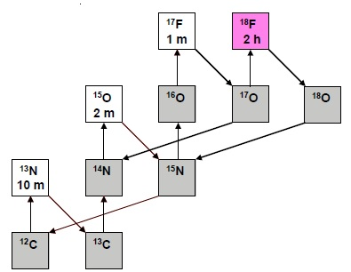
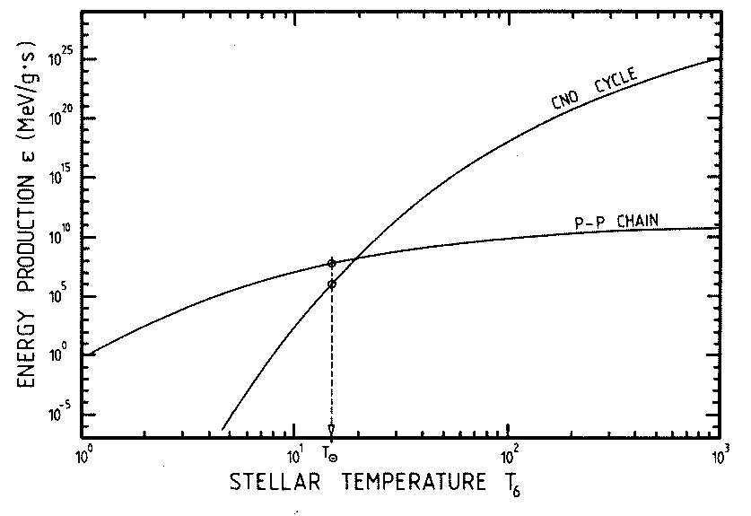


CNO-cycle
Dominant source of energy generation in stars heavier than the sun
What is CNO contribution to energy production in the sun? few %?
CNO abundances in sun certain
Stellar photospheric metallicity disagrees with helioseismology
$$ε≅T^{17}$$
CNO
$$ε≈T^{4}$$
sun
P-P

Slide 6
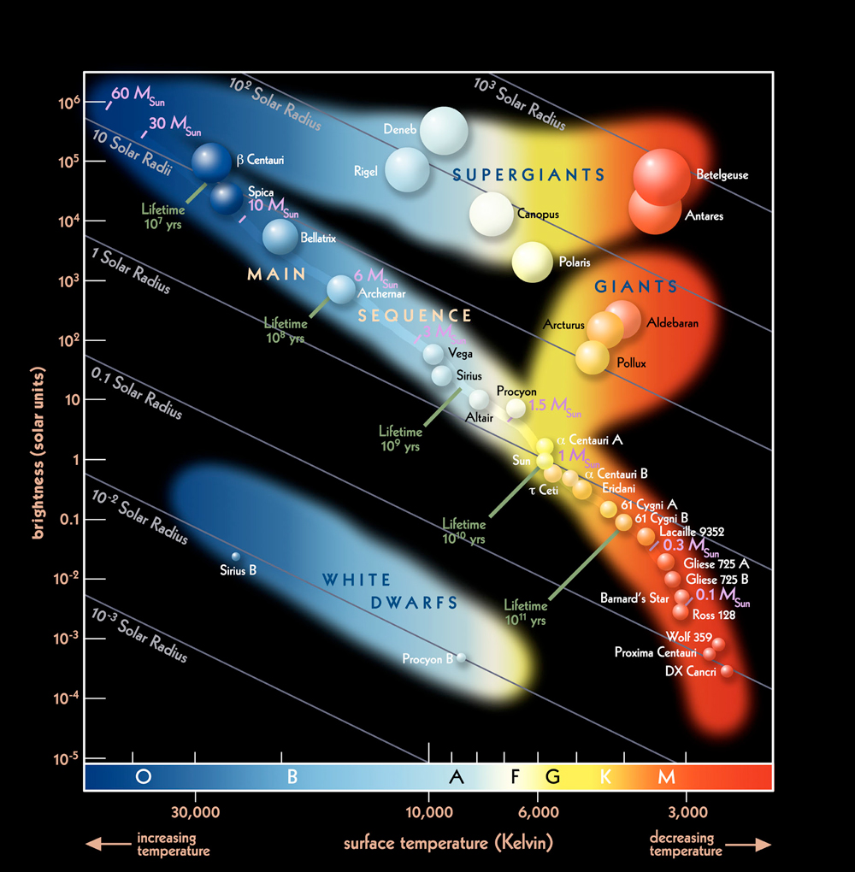
Hertzsprung Russell Diagram
Main Sequence Stars are identified as stars in their hydrogen burning stage. As more massive the star is as larger its size, its energy production (temperature) and its luminosity

Slide 7
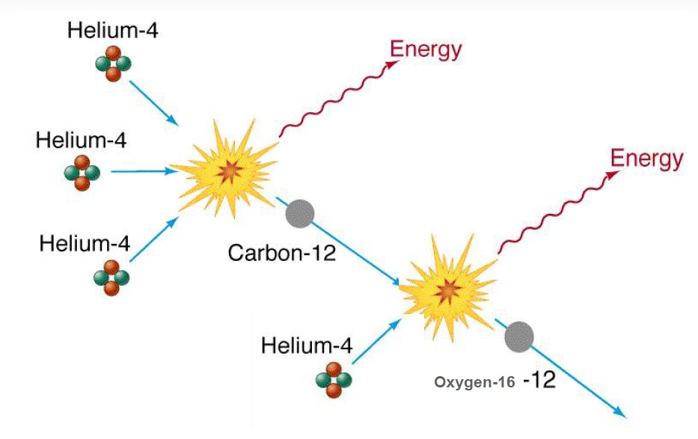
Critical reactions in He-burning
Energy source in stellar He burning
Energy release determined by associated reaction

Slide 8
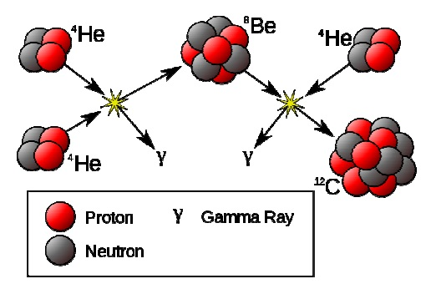
Critical reactions in He-burning
Resonance in Gamow window
- C is made !

Slide 9
He burning
• Typical conditions:
  • Temperature: (1-2) 10⁸ K
  • Density: a few 10² – 10⁴ g/cm³
• Net reaction: ⁴He (2α,γ) ¹²C
• fuel: helium
• main products: carbon, oxygen
• ⁴He + ⁴He ↔ ⁸Be + γ
⁸Be + ⁴He ↔ ¹²C + γ
• and ¹²C + ⁴He → ¹⁶O + γ
• difficulty: lifetime of ⁸Be ~ 10⁻¹⁶ s
→ Hoyle state (resonance in ¹²C at E=7.68 MeV)
• Other products: ^{21,22}Ne, ^{25,26}Mg, ³⁶S, ³⁷Cl, ⁴⁰K, ⁴⁰Ar
• ¹⁴N (α,γ) ¹⁸F (e⁺,ν) ¹⁸O (α,γ) ²²Ne (α,n) ²⁵Mg
kT ~ 8.6 x 10⁻⁸ T[K] keV

Slide 10
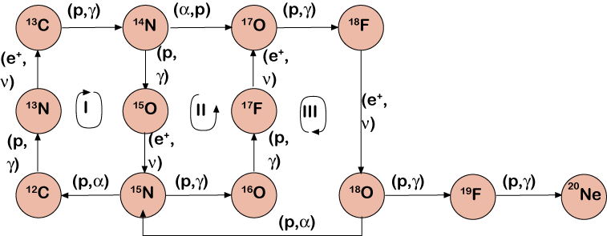
CNO-cycle

Slide 11
CNO-cycle
CNO cycle
O
15
(p,γ)
N
13
14
15
(e⁺ν)
C
(p,α)
12
13
6
7
8
¹²C(p,γ)¹³N(e⁺ν)¹³C(p,γ)¹⁴N(p,γ)¹⁵O(e⁺ν)¹⁵N(p,α)¹²C
Cycle limited by β-decay of ¹³N (t ~ 10 min) and ¹⁵O (t ~ 2 min)
CNO isotopes act as catalysts
α+α ⁸Be ⁸Be + α ¹²C*(7.7 MeV)
nucleosynthesis
energy production
changes in stellar conditions ⇒ changes in energy production and nucleosynthesis
need to know REACTION RATE at all temperatures to determine ENERGY PRODUCTION

Slide 12
Abundance change and lifetimes
consider reaction 1+2 → 3
where 1 is destroyed through capture of 2 and 3 is produced
example
3 is produced
O
15
13
14
15
N
C
12
13
1 is destroyed
6
7
8
define:
lifetime of 1 against destruction by with 2:
need to know REACTION RATE at all temperatures to determine NUCLEOSYNTHESIS

Slide 13
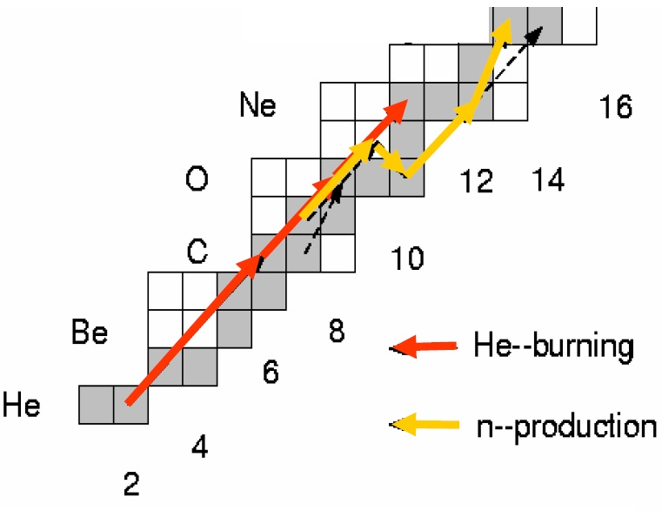
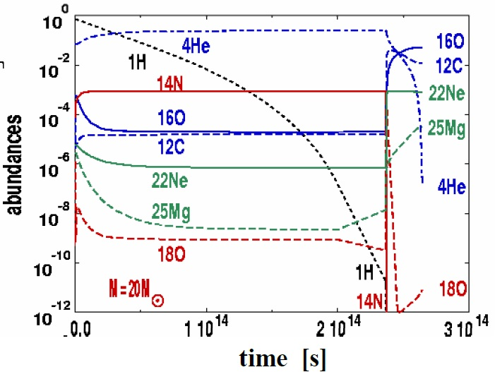
Abundance evolution in stellar core
Decline of ⁴He (time scale)
increase in ¹²C, ¹⁶O
→ equilibrium ¹²C/¹⁶O
rapid decline in ¹⁴N

Slide 14
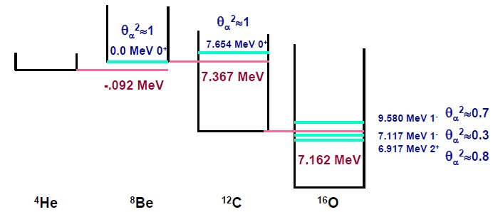
The case of 3α and ¹²C(α,γ)¹⁶O
Reaction rates determined by
α cluster state configurations
providing strong resonances!

Slide 15
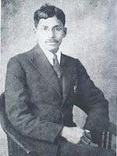
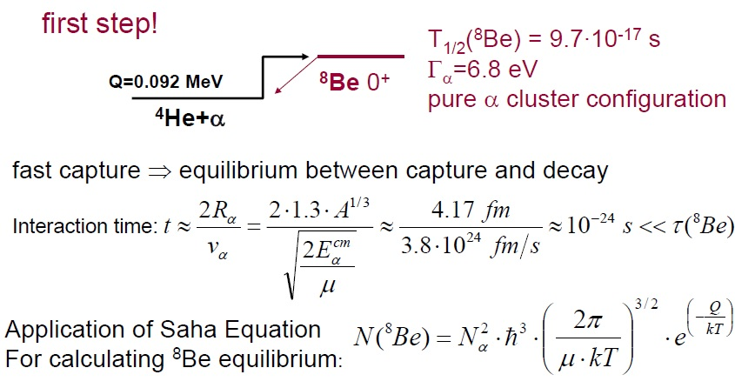
The (ααα) reaction as two step process
Meghnad Saha
with

Slide 16
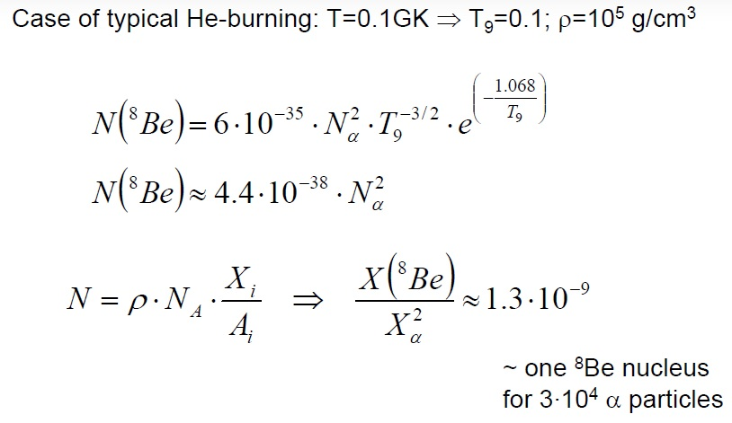
Example for ⁸Be equilibrium abundance:

Slide 17
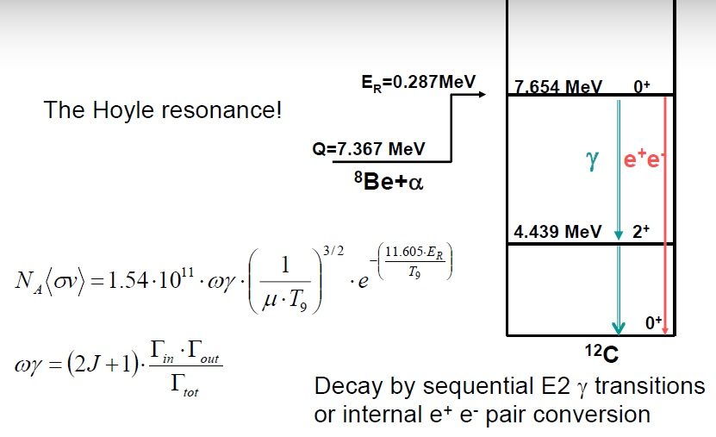
Resonant capture on ⁸Be

Slide 18
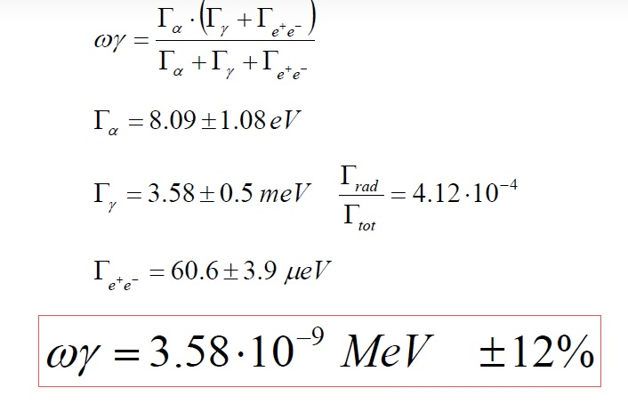
The resonance strength

Slide 19
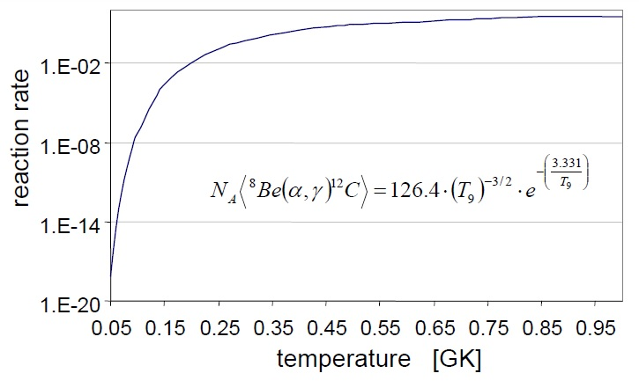
The ⁸Be+α reaction rate

Slide 20
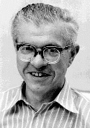
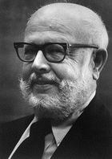
How did they do the experiment?
Used a deuterium beam on a ¹¹B target to produce ¹²B via a (d,p) reaction.
¹²B β-decays within 20 ms into the second excited state in ¹²C
This state then immediately decays under alpha emission into ⁸Be
Which immediately decays into 2 alpha particles
So they saw after the delay of the β-decay 3 alpha particles coming from their
target after a few ms of irradiation
This proved that the state can also be formed by the 3 alpha process …
removed the major roadblock for the theory that elements are made in stars
Nobel Prize in Physics 1983 for Willy Fowler (alone !)

Slide 21
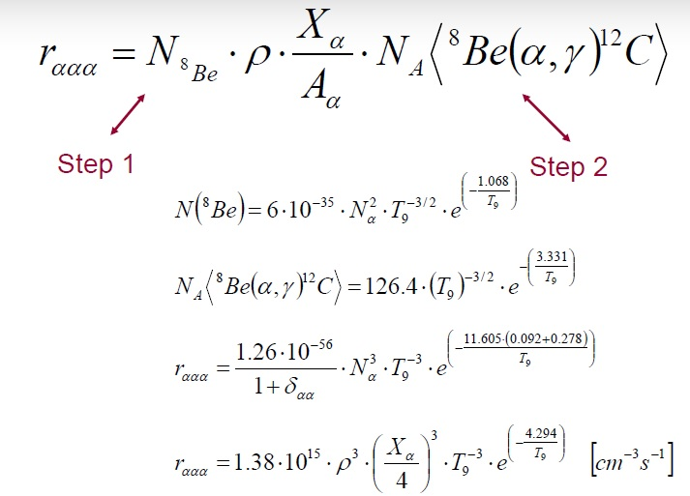
The total <ααα> rate

Slide 22
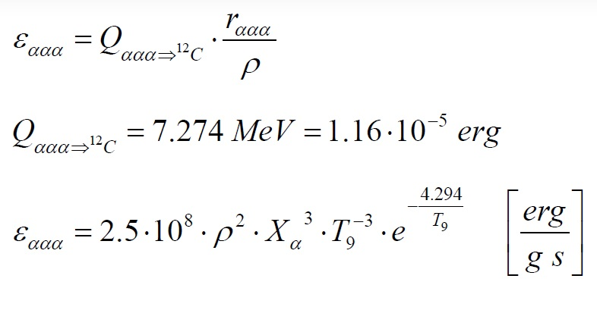
Energy production in He burning

Slide 23
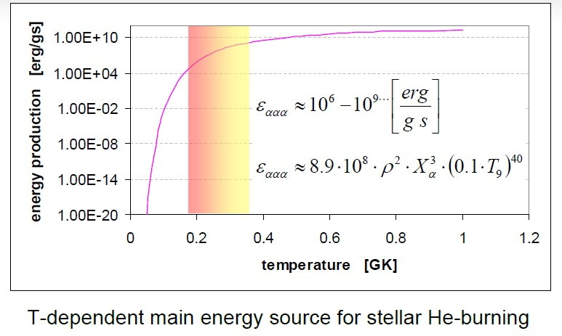
Example: ρ=10⁵ g/cm³

Slide 24
C-burning
• Typical conditions:
  • Temperature: (6-8) 10⁸ K
  • Density: 10⁵ g/cm³
• Net reaction: ¹²C + ¹²C
• fuel: carbon
• main products: neon, magnesium, oxygen
• ¹²C + ¹²C → α + ²⁰Ne (Q = 4.62 MeV)
• ¹²C + ¹²C → p + ²³Na (Q = 2.24 MeV)
• other reactions: ²³Na + p → α + ²⁰Ne
²⁰Ne + α → ²⁴Mg
• ¹²C + α → ¹⁶O + γ
conversion of ⁴He into ¹²C and ¹⁶O
kT ~ 8.6 x 10⁻⁸ T[K] keV

Slide 25
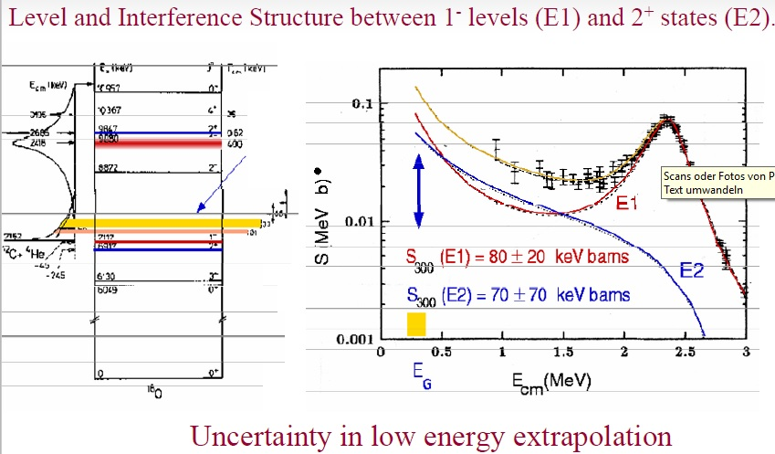
¹²C(α,γ)¹⁶O, the Holy Grail
E1
E1
E2

Slide 26
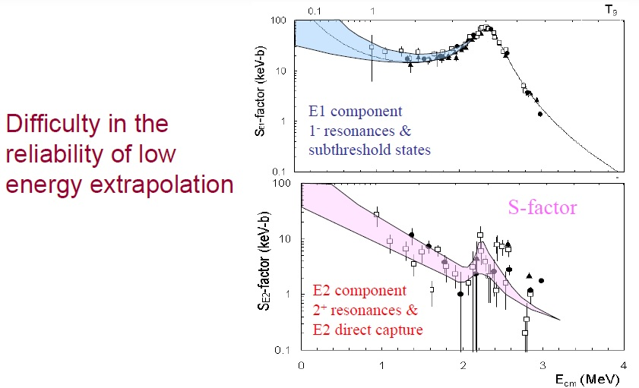
Reaction contributions in ¹²C(α,γ)¹⁶O

Slide 27
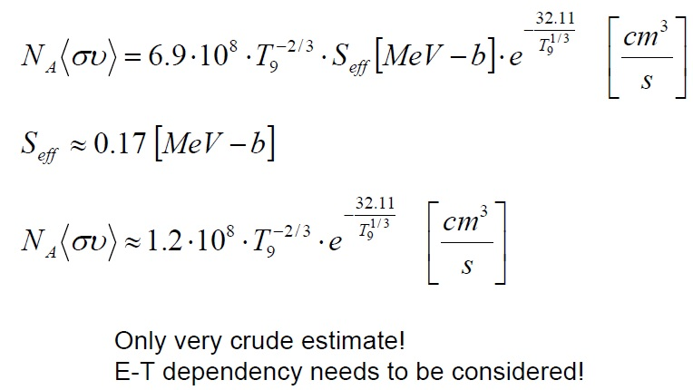
¹²C(α,γ)¹⁶O reaction rate

Slide 28
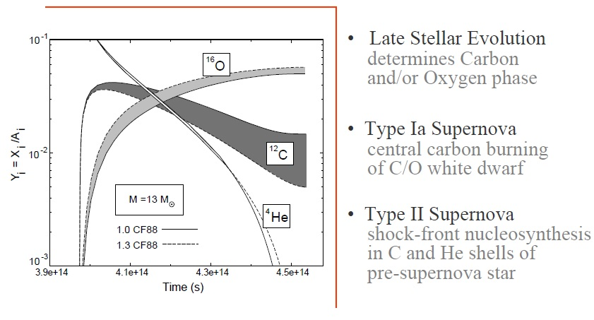
Consequences of ¹²C(α,γ)¹⁶O

Slide 29
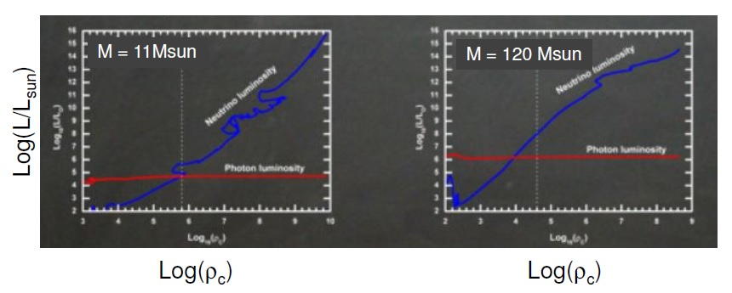

The role of neutrino-losses
• At temperatures above ~10⁹ K: pair-production
• Luminosity of photons and neutrinos
$$γ↔e^{+}+e^{−}↔ν_{e}+{\overline{ν}}_{e}$$

Slide 30
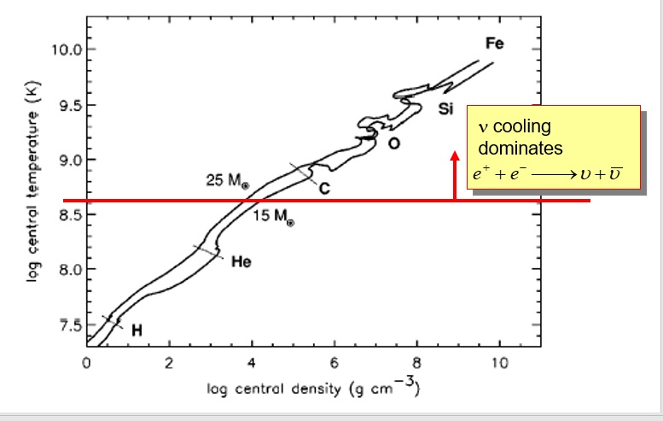
The role of neutrino-losses
• At temperatures above ~10⁹ K: pair-production
• Luminosity of photons and neutrinos
$$γ↔e^{+}+e^{−}↔ν_{e}+{\overline{ν}}_{e}$$

Slide 31
Ne-burning
• Typical conditions:
  • Temperature: (1-2) 10⁹ K
  • Density: 10⁶ g/cm³
• Reactions: ²⁰Ne + ²⁰Ne → ¹⁶O + ²⁴Mg +4.59 MeV
• fuel: neon
• main products: oxygen, silicon
• ²⁰Ne (γ,α) ¹⁶O
• other reactions:
²⁰Ne (α,γ) ²⁴Mg (α,γ) ²⁸Si (α,γ) ³²S
²¹Ne (α,n) ²⁴Mg (n,γ) ²⁵Mg (α,n) ²⁸Si
²³Na (α,p) ²⁵Mg (α,n) ²⁸Si
²⁵Mg (p,γ) ²⁵Al
²³Na (p,α) ²⁰Ne
Why would neon burn before oxygen?
Temperatures are sufficiently high to initiate photodisintegration of ²⁰Ne
$$\left.\begin{matrix}20Ne+γ→16O+α \\ 16O+α→20Ne+γ\end{matrix}\right\} equilibrium is established$$
kT ~ 8.6 x 10⁻⁸ T[K] keV

Slide 32
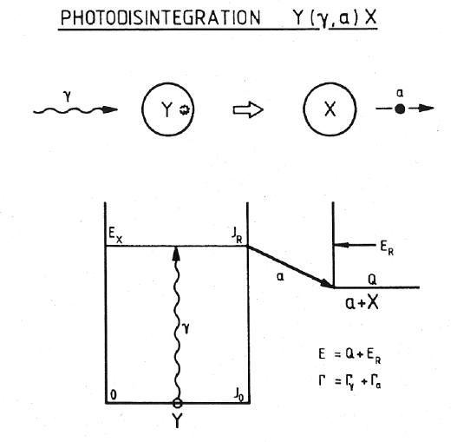
Photodisintegration

Slide 33
O-burning
• Typical conditions:
  • Temperature: (1.5-2.2) 10⁹ K
  • Density: 10⁷ g/cm³
• Reactions:
• fuel: oxygen
• main products: silicon, sulfur (90%)
• ¹⁶O + ¹⁶O → ³²S* → p + ³¹P (56%, Q = 7.676 MeV)
• ¹⁶O + ¹⁶O → ³²S* → α + ²⁸Si (34%, Q = 9.593 MeV)
• ¹⁶O + ¹⁶O → ³²S* → n + ³¹S (5%, Q = 1.459 MeV)
• other reactions:
³¹P (p,α) ²⁸Si
³³S (e⁻,ν) ³³P
³⁵Cl (e⁻,ν) ³⁵P ²⁵Mg (p,γ) ²⁵Al
²³Na (p,α) ²⁰Ne
kT ~ 8.6 x 10⁻⁸ T[K] keV

Slide 34
Si-burning
• Typical conditions:
  • Temperature: (3-4) 10⁹ K
  • Density: 10⁹ g/cm³
• Net reaction: ²⁸Si + ²⁸Si
• fuel: silicon
• main products: Fe-group elements (A = 50-60 nuclei)
• other reactions: ²⁸Si + γ → p + ²⁷Al
²⁸Si + γ → α + ²⁴Mg
²⁸Si + γ → n + ²⁷Si
• Balance between forward and reverse reactions
for increasing number of processes: a + b ↔ c + d
→ Nuclear Statistical Equilibrium (NSE)
kT ~ 8.6 x 10⁻⁸ T[K] keV

Slide 35
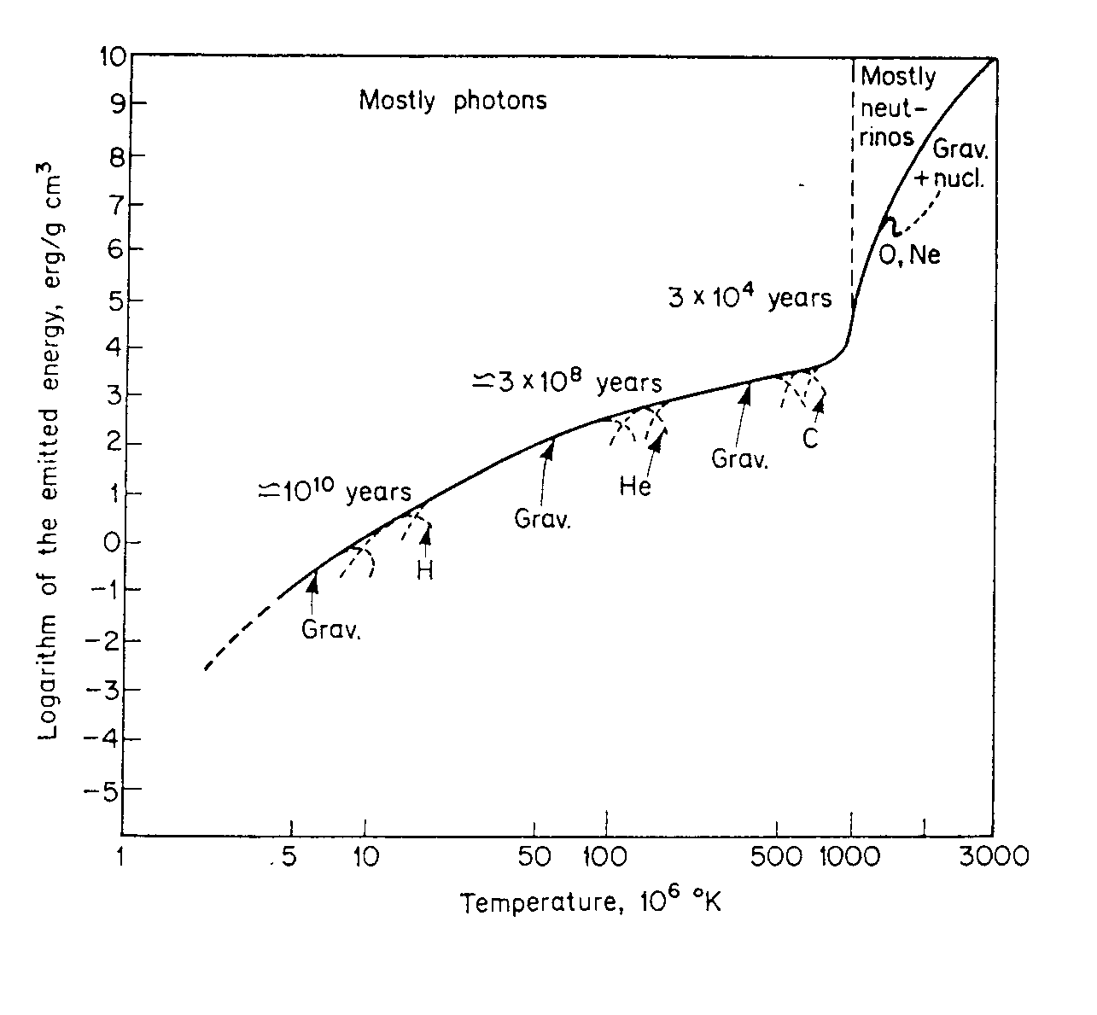
Stellar evolution
Main parameters governing evolution: initial mass & initial chemical composition
Example: evolution stages of a 25 M star
Quiescent burning
Energy generation rate
ε ~ T^{n}
n ~ 4 (H-burning)
n ~ 30 (C-burning)
Pre-Supernova
~ days - seconds
Super Giant
~ 3x10⁴ y
Red Giant
~ 3x10⁸ y
O, Ne…
innermost regions only
contribute to nuclear burning
Main
Sequence
~ 10¹⁰ y
C
He
e.g. 1/10 M for H-burning
less for subsequent stages
H
Gravitational
Contraction
H-burning ≡ MAIN SEQUENCE
longest stage of star’s lifetime

Slide 36
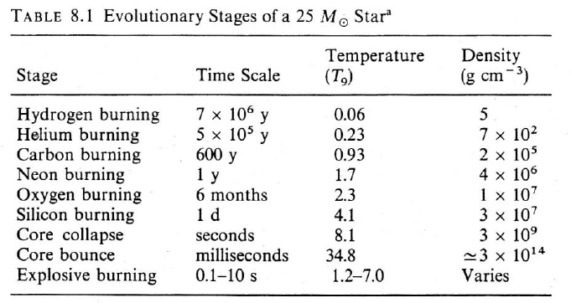
Summary stellar burning
>0.8M₀
>8M₀
>12M₀
Why do timescales get smaller ?
Note: Kelvin-Helmholtz timescale for red supergiant ~10,000 years,
so for massive stars, no surface temperature - luminosity change for C-burning and beyond

Slide 37
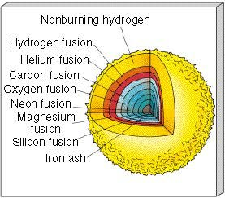
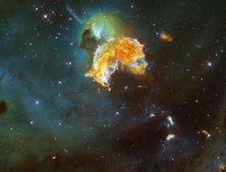
… and nucleosynthesis
nucleosynthesis
energy
HYDROGEN BURNING (1st equilibrium)
4p → ⁴He + 2β⁺ + 2ν + 26 MeV
HELIUM BURNING (2nd equilibrium)
3α → ¹²C
¹²C(α,γ)¹⁶O
+ 8 MeV
¹²C/¹⁶O BURNING
The Stellar Onion
… ¹²C ashes = Ne, Na, Mg
… ¹⁶O ashes = Al, … Si
T, ρ
²⁸Si MELTING
major ash = ⁵⁶Fe
… A = 40-65
further reactions endothermic gravitational collapse
SUPERNOVA EXPLOSION
neutron star
black hole

Slide 38
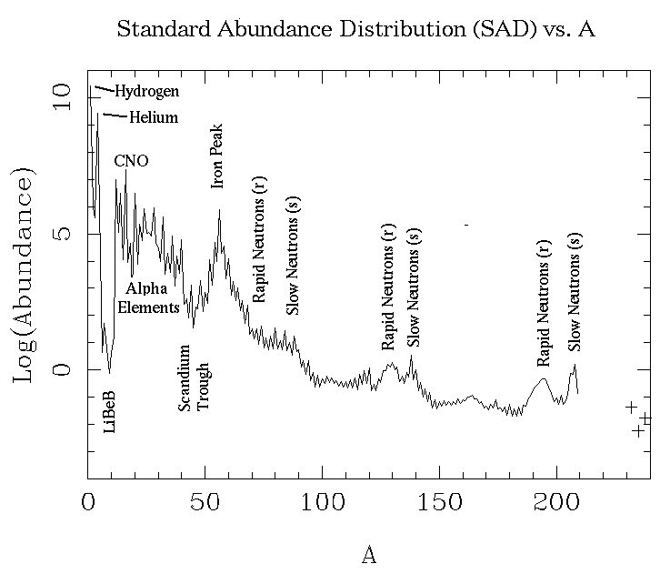
Nuclear processes in stars
charged-particle
induced reaction
mainly neutron
capture reaction
during quiescent stages
of stellar evolution
mainly during explosive
stages of stellar evolution
involve mainly STABLE NUCLEI
involve mainly UNSTABLE NUCLEI

Slide 39
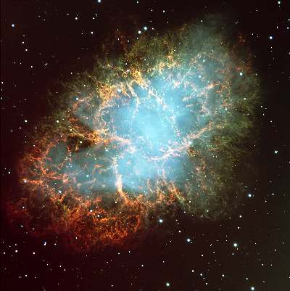
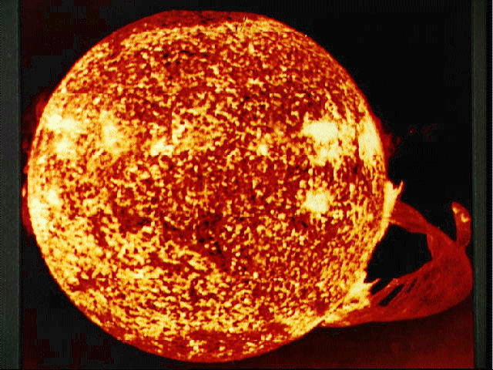
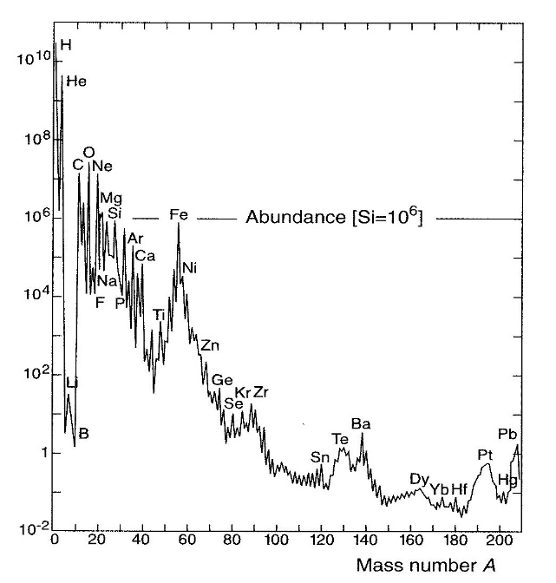
Interstellar gas
BIRTH
gravitational
contraction
Stars
explosion
ejection
DEATH
mixing of
interstellar gas
thermonuclear
reactions
abundance distribution
energy production
stability against collapse
synthesis of “metals”

