Slide 1

Outline: Experimental Nuclear Astrophysics M. Aliotta
Lecturer: Hans-Jürgen Wollersheim
e-mail: h.j.wollersheim@gsi.de
web-page: https://web-docs.gsi.de/~wolle/ and click on
neutron capture processes
mechanism of s-process
mechanism of r-process
shell closures

Slide 2
Abundances beyond Fe
α-nuclei
¹²C,¹⁶O,²⁰Ne,²⁴Mg, …. ⁴⁰Ca
Gap
B,Be,Li
Elements heavier than Fe are the result of neutron capture processes
NEUTRONS
H 30 000
C 10
Fe 1
Au 2 10⁻⁷
r-process peaks (nuclear shell closures)
s-process peaks (nuclear shell closures)
Fe peak
Th, U
Sr-Zr
Ba-La
Au
Pb

Slide 3
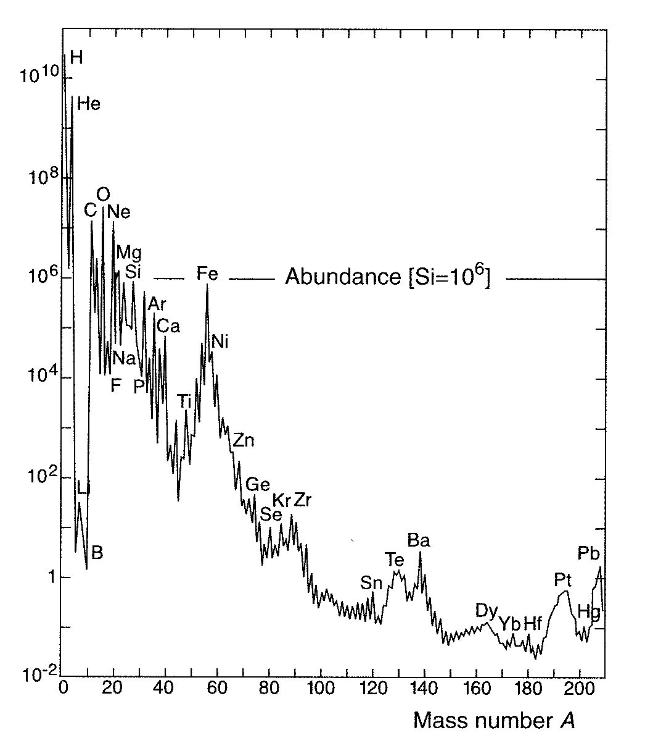
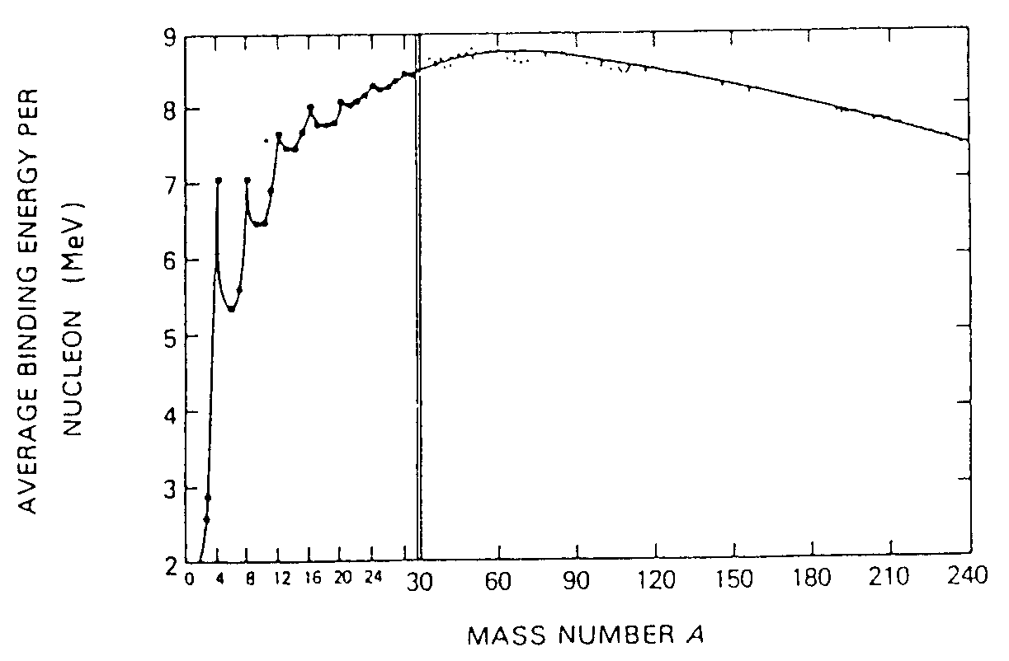
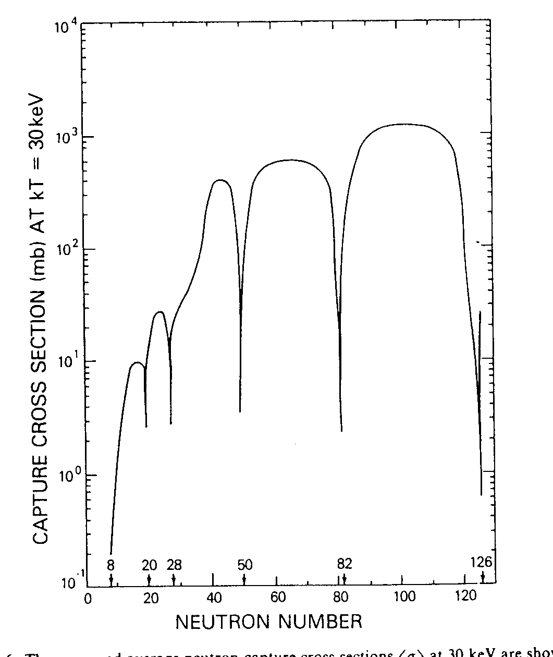
Why neutron capture processes for the synthesis of heavy elements?
exponential abundance decrease up to Fe
⇔ exponential decrease in tunnelling
probability for charged-particle reactions
almost constant abundances beyond Fe
⇔ non-charged-particle reactions
binding energy curve ⇔ fusion reactions
beyond iron are endothermic
characteristic abundance peaks at magic
neutron numbers
neutron capture cross sections for heavy
elements increasingly larger
large neutron fluxes can be made available
during certain stellar stages
Q < 0
Q > 0

Slide 4
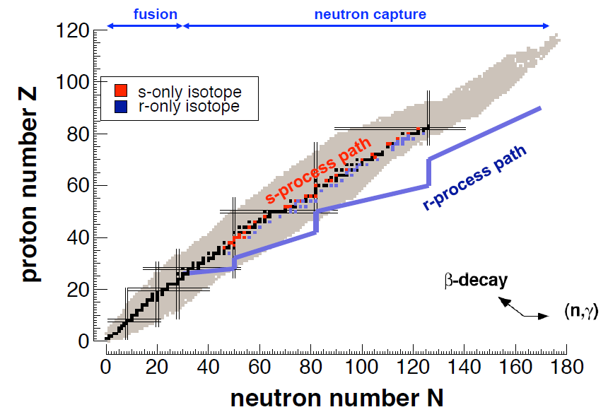
The stellar nucleosynthesis
Neutron beams
s-process (Red Giants)
radioactive beam facilities
r-process (Supernovae)
s-process (slow process):
  Capture times long relative to decay time
  Involves mostly stable isotopes
  N_{n} = 10⁶⁻¹² n/cm³ , kT = 8 – 90 keV
r-process (rapid process):
  Capture times short relative to decay times
  Produces unstable isotopes (neutron-rich)
  N_{n} = 10²⁰⁻³⁰ n/cm³

Slide 5
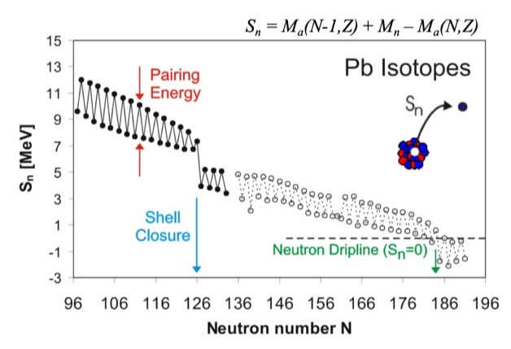
How many neutrons can a proton bind?
The limit of nuclear existence is characterized by the nucleon driplines
B. Jonson: “The driplines are the limits of the nuclear landscape where additional protons or neutrons can no longer be kept in the nucleus – they literally drip out.”
P.G. Hansen & J.A. Tostevin: “(the dripline is) where the nucleon separation energy goes to zero.”

Slide 6
How many neutrons can a proton bind?
The limit of nuclear existence is characterized by the nucleon driplines
B. Jonson: “The driplines are the limits of the nuclear landscape where additional protons or neutrons can no longer be kept in the nucleus – they literally drip out.”
P.G. Hansen & J.A. Tostevin: “(the dripline is) where the nucleon separation energy goes to zero.”
Zr isotopes (Z=40, N varies)

Slide 7

2-neutron binding energies = 2-neutrons separation energies
$$S_{2n}=BE\left(N,Z\right)−BE\left(N−2,Z\right)$$
N = 82
25
23
21
N = 126
19
17
S(2n) MeV
15
13
11
Sm
Hf
9
N = 84
Ba
Pb
7
Sn
5
52
56
60
64
68
72
76
80
84
88
92
96
100
104
108
112
116
120
124
128
132
Neutron Number

Slide 8
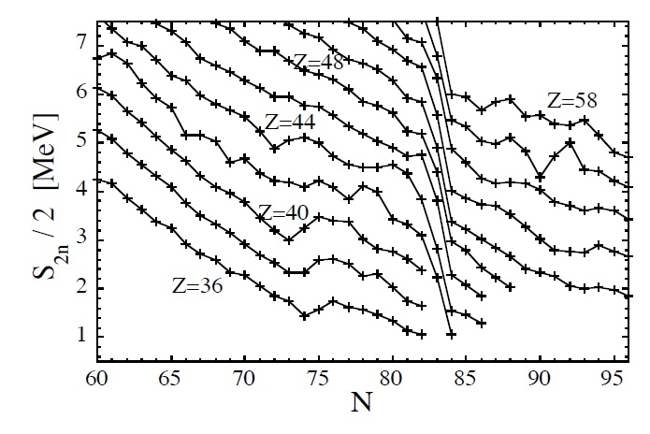
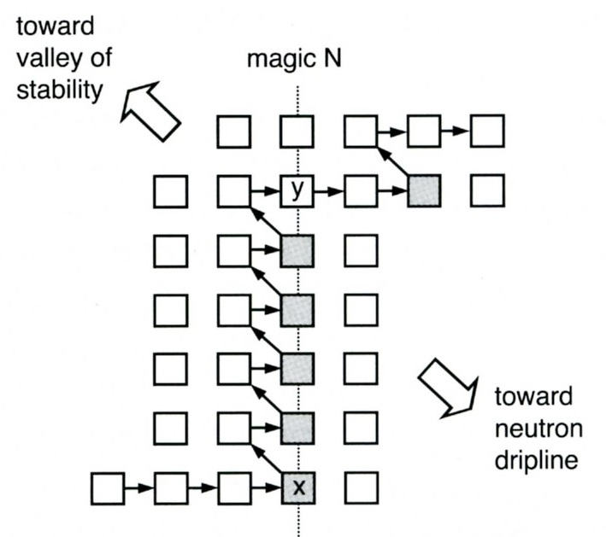
2-neutron binding energies = 2-neutrons separation energies

Slide 9
Where is the neutron dripline?

Slide 10
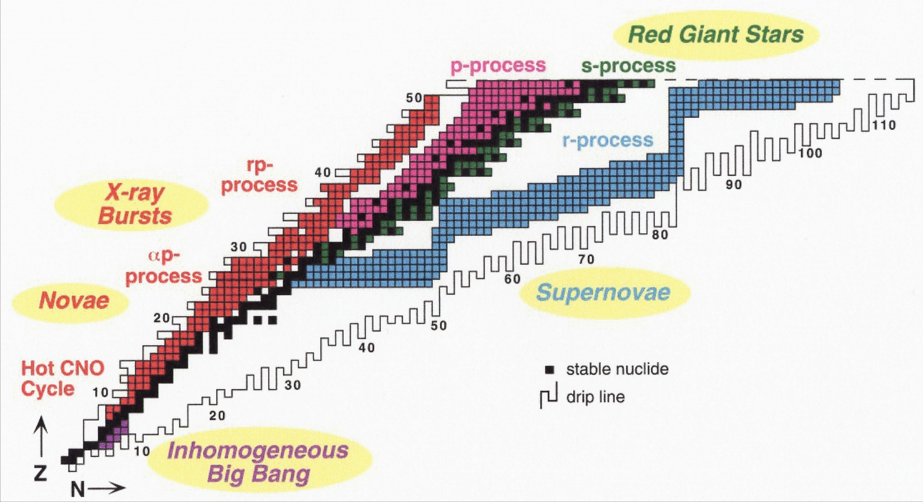
Overview of main nuclear processes and astrophysical sites
M.S. Smith and K.E. Rehm,
Ann. Rev. Nucl. Part. Sci, 51 (2001) 91-130
vast majority of chemical elements produced during explosive phenomena
nuclear reaction paths involve UNSTABLE species ⇒ Radioactive Ion Beams
key reactions identified by sensitivity of astrophysical models to nuclear inputs

Slide 11
The reaction processes R.Reifarth
s-only
Zr
⁸⁰Br, t_{1/2}=17 min, 92% (β⁻), 8% (β⁺)
Y
p-process
Sr
(n,γ)
Rb
p-only
Kr
Br
(β⁻)
proton number
Se
(β⁺)
As
⁸⁵Kr, t_{1/2}=11 y
Ge
Ga
⁷⁹Se, t_{1/2}=65 ky
Zn
r-only
r-process
Cu
Ni
⁶⁴Cu, t_{1/2}=12 h, 40% (β⁻), 60% (β⁺)
Co
⁶³Ni, t_{1/2}=100 y
Fe
neutron number

Slide 12
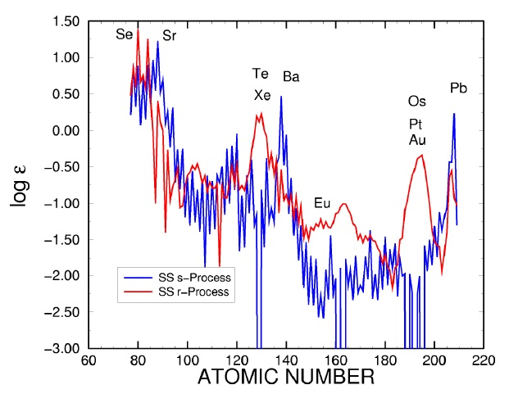
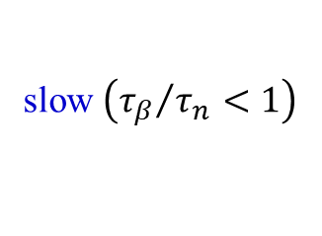

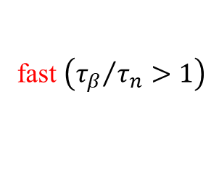
Neutron-capture processes
heavy elements are made by
slow $\left({τ_{β}}/{τ_{n}}<1\right)$
and
fast $\left({τ_{β}}/{τ_{n}}>1\right)$
neutron capture events
$$τ_{n}=lifetime against neutron capture$$
$τ_{β}=lifetime against β^{−}−decay$
Sequences of (n,γ) reactions and β⁻ decays
$$A\left(Z,N\right)+n↔A+1\left(Z,N+1\right)+γ$$
$$A\left(Z,N\right)→A\left(Z+1,N−1\right)+e^{−}+{\overline{ν}}_{e}$$
Closed neutron-shells give rise to the peaks at
Te, Xe / Ba and at Os, Pt, Au / Pb

Slide 13
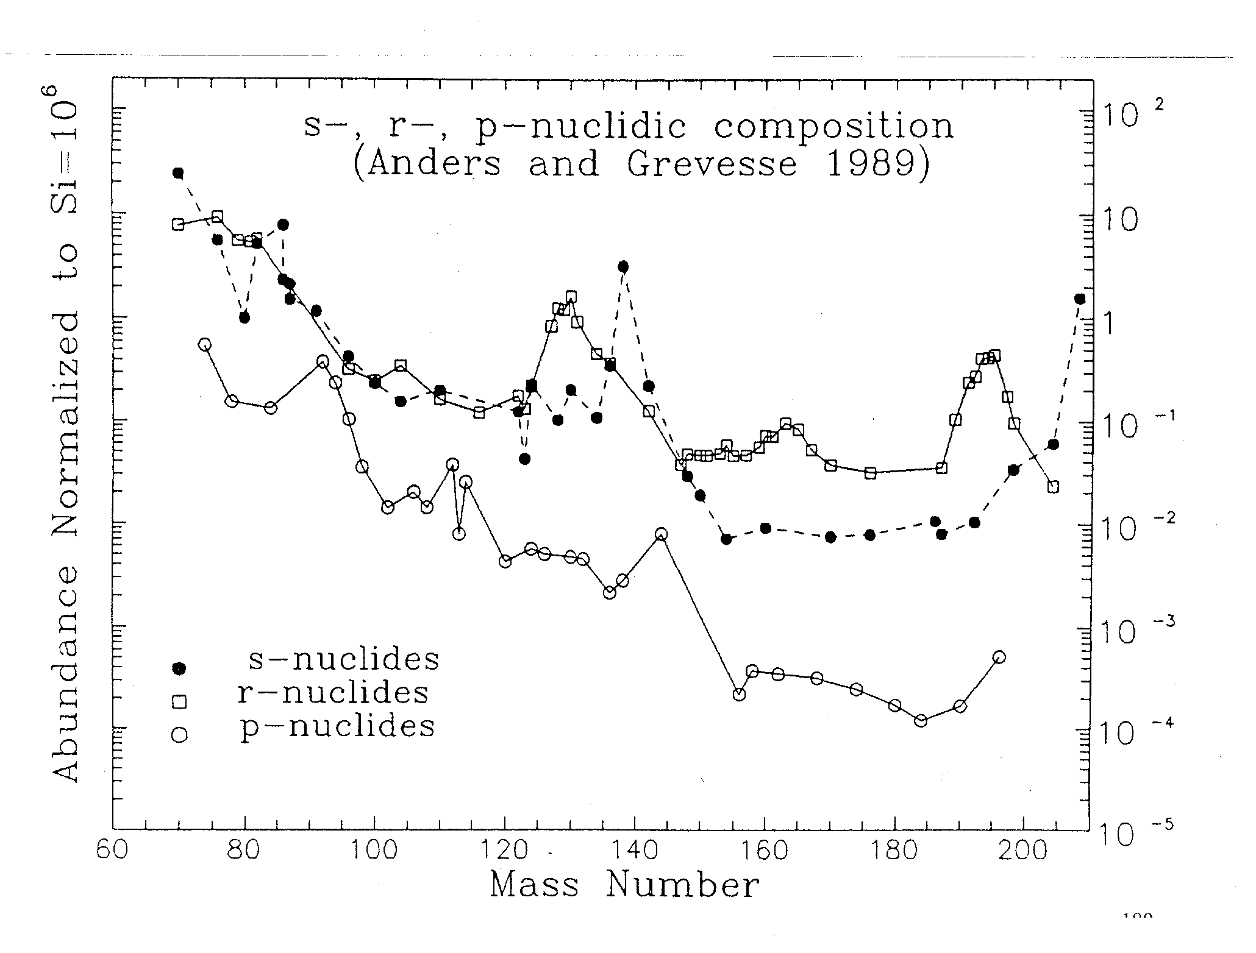
s-only, r-only and p-only isotopes help to disentangle the individual contributions
A=85
A=140
A=208
s-process abundances
abundance peaks at A = 85, 140, and 208
how to explain abundance curve with the s process?

Slide 14
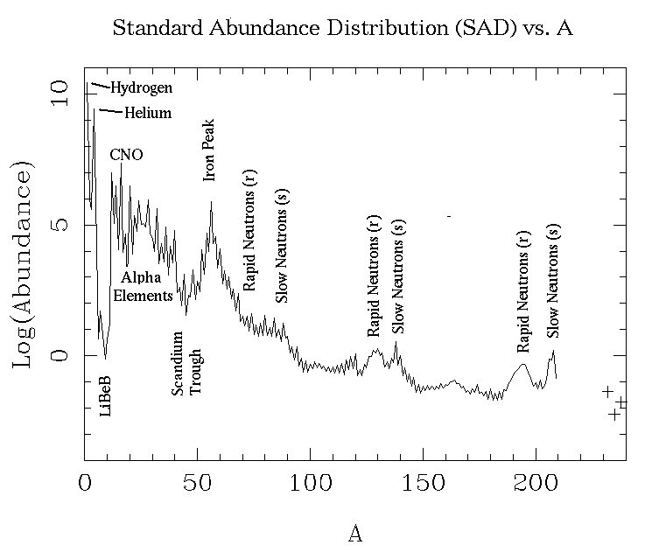
The synthesis of the trans-iron elements
charged-particle
induced reaction
mainly neutron
capture reaction
during quiescent stages
of stellar evolution
mainly during explosive
stages of stellar evolution
involve mainly STABLE NUCLEI
involve mainly UNSTABLE NUCLEI

Slide 15
Nucleosynthesis beyond iron
start with Fe seeds for neutron capture
whenever an unstable species is produced one of the following can happen:
  the unstable nucleus decays (before reacting)
  the unstable nucleus reacts (before decaying)
  the two above processes have comparable probabilities
if τ_{n} >> τ_{β} ⇒ unstable nucleus decays
if τ_{n} << τ_{β} ⇒ unstable reacts
if τ_{n} ~ τ_{β} ⇒ branchings occur
with:
mean lifetime of nucleus X against destruction by neutron capture
mean lifetime of nucleus X against β decay
NOTE: τ_{n} varies depending upon stellar conditions (T, ρ)
⇒ different processes dominate in different environments
ALSO: τ_{β} can be affected too by physical conditions of stellar plasma!

Slide 16
factors influencing the β-decay lifetime of an unstable nucleus
both β⁻ and β⁺ decay are hampered in the presence of electron or positron degeneracy
β⁻ and β⁺ decays may occur from excited isomeric states maintained in equilibrium
with ground state by radiative transitions
electron-capture rates are affected by temperature and density through population of
the K electronic shell
example: ⁷Be
⁷Be nucleus can only decay by electron capture with a lifetime: τ_{EC} ~ 77 d
in the Sun, T ~ 15x10⁶ K ⇒ kT ~ 1.3 keV ⇒ low-Z nuclei almost completely ionized
e.g. binding energy of innermost K-shell electrons in ⁷Be: E_{b} = 0.22 keV
⇒ if no electrons available ⁷Be becomes essentially STABLE!
in fact free electrons present in the plasma can be captured
for solar conditions τ_{EC} ~ 120 d ⇒ factor 1.6 larger than in terrestrial laboratory

Slide 17
The s-process
the process
its astrophysical site(s)
nuclear data needs
(experimental equipment and techniques)

Slide 18
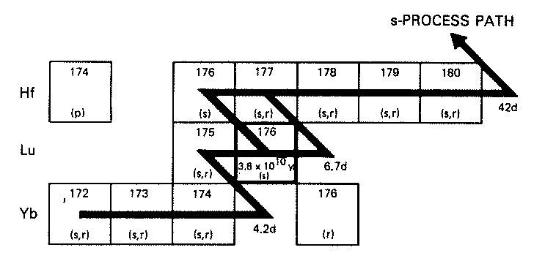
The s-process slow neutron capture process
unstable nucleus decays before capturing another neutron
⇔
τ_{β} << τ_{n}
how many neutrons are needed?
typical lifetimes for unstable nuclei close to the valley of β stability: seconds → years
assuming: σ ~ 0.1 b @ E = 30 keV → v = 3x10⁸ cm/s
⇔
requiring:
τ_{n} ~ 10 y ⇔ N_{n} ~ 10⁸ n/cm³

Slide 19
Classical approach of the s-process
time dependence of abundance N_{A} given by:
Z
A
production
destruction
N
assuming:
T ~ const
τ_{n} >> τ_{β}
with:
Maxwellian averaged cross section
neutron exposure
in steady state condition (so-called local equilibrium approximation):

Slide 20
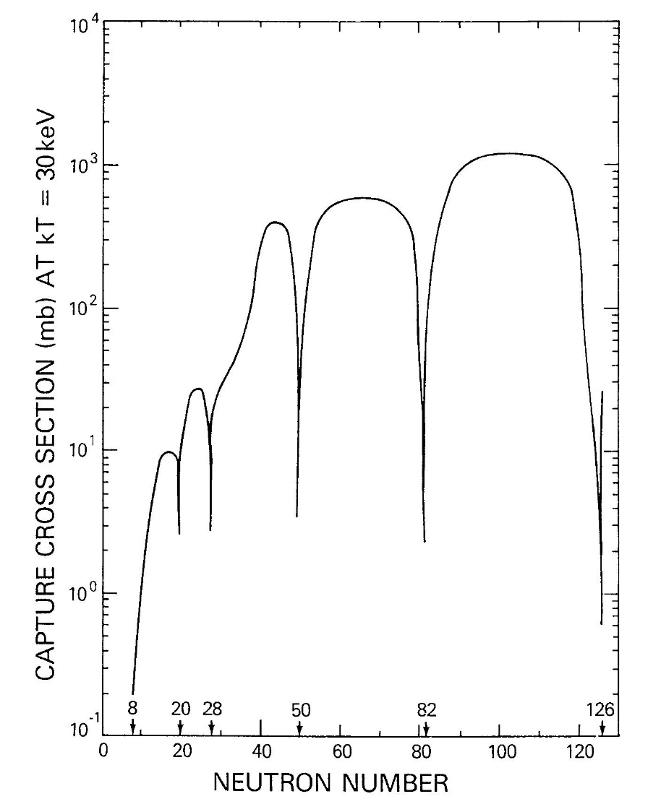
small capture cross sections at neutron magic numbers
⇔ pronounced abundance peaks
A=85
A=140
A=208
A=85
A=140
A=208
Rolfs & Rodney: Cauldrons in the Cosmos, 1988

Slide 21
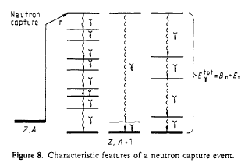
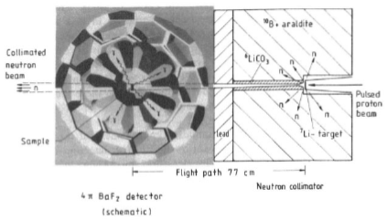
Capture cross section measurements
Time-of-Flight technique
applicable to all stable nuclei
need pulsed neutron source for E_{n} determination via TOF
signature for neutron capture events
total energy of γ cascade to ground state
need 4π detector of high efficiency,
good time and energy resolution
⇔
Karlsruhe: 42 individual BaF₂ crystals
F. Kaeppeler: Rep. Prog. Phys. 52 (1989) 945 – 1013

Slide 22
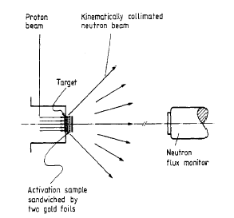
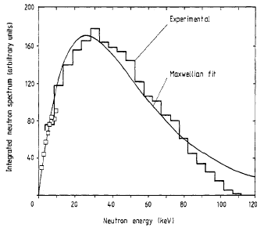
Capture cross section measurements
activation technique
⁷Li(p,n)⁷Be (or ³H(p,n)³He)
angle-integrated spectrum closely resembles
a MB distribution at kT = 25 keV (52 keV)
reaction rate measured in such spectrum
gives proper stellar cross section
advantages:
high sensitivity ⇒ tiny samples are enough
for (n,γ) mesurements
good for RIBs
high selectivity ⇒ samples of natural composition
can be used
limitations: (n,γ) capture must produce
unstable species
cross section measurements
at E= 25 (and 52) keV only
applications with RIA type facilities: R. Reifarth et al.: NIMA 524 (2004) 215-226

Slide 23
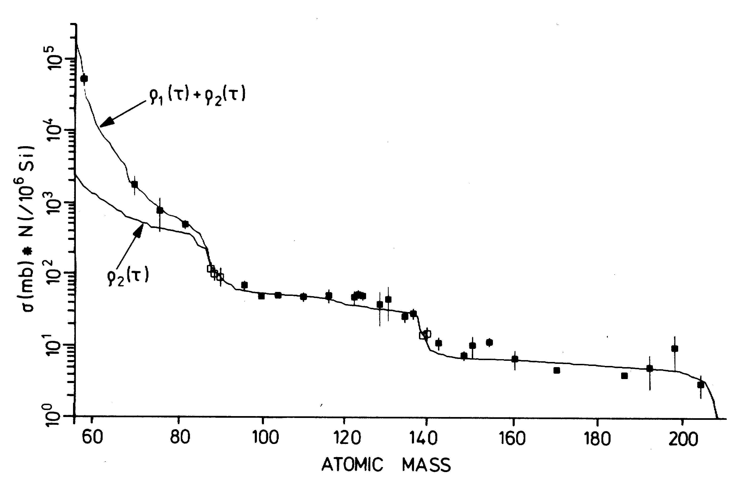
condition fulfilled between
magic numbers of neutrons
A~140
A~208
sudden drops observed at
neutron magic numbers
A~85
NOTE
a superposition of many neutron irradiations is needed to correctly reproduce the abundance curve
main component (A=88-209)
weak component (A<90)
s-process: best understood nucleosynthesis process from nuclear point of view
what about the astrophysical site?

Slide 24
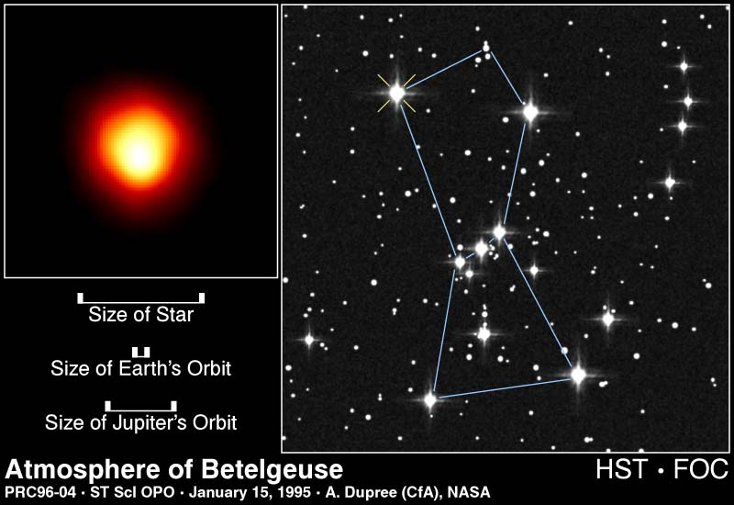
Where does the s-process happen?
there !
in red giants – and it takes several million years !
(or, more correctly, low mass TP-Asymmetric Giant Branch stars)

Slide 25
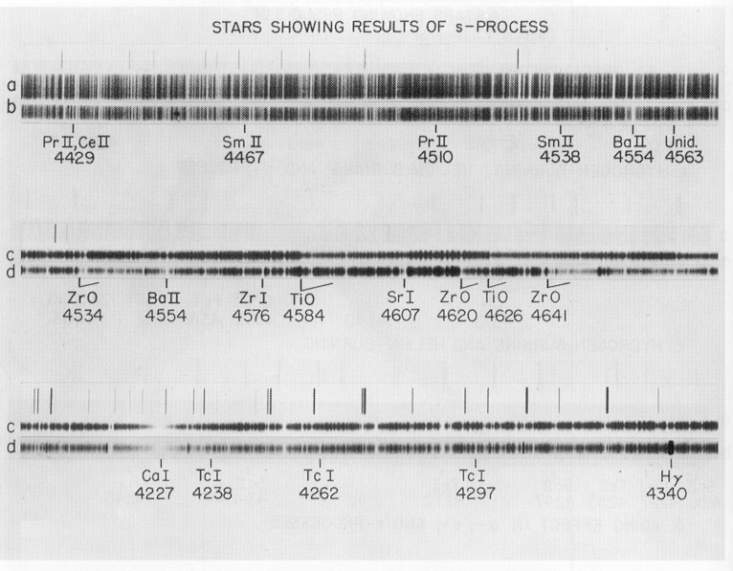
How can we tell?
Analyze light from a red giant:
Star contains Technetium (Tc) !!!
(heavy element Z=43, T_{1/2} 4 Mio years, Merrill 1952)

Slide 26
s-process site(s) and conditions
free neutrons are unstable ⇒ they must be produced in situ
in principle many (α,n) reactions can contribute
in practice, one needs suitable reaction rate & abundant nuclear species
most likely candidates as neutron source are:
²²Ne(α,n)²⁵Mg
²⁵Mg
¹³C(α,n)¹⁶O
(α,n)
¹⁶O
²²Ne
¹³N
(p,γ)
(β⁺)
(α,n)
¹⁸F
(β⁺)
(α,γ)
¹²C
¹³C
(α,γ)
¹⁸O
¹⁴N
astrophysical site:
He-flashes followed by H mixing
into ¹²C enriched zones
low-mass (1.5 - 3 M_{sun}) TP-AGB stars
T₈ ~ 0.9 – 2.7
astrophysical site:
core He burning (and shell C-burning)
in massive stars (e.g. 25 solar masses)
T₈ ~ 2.2 – 3.5
contribution to weak s-process
contribution to main s-process

Slide 27
in some cases: τ_{β} ~ τ_{n} ⇒ a branching occurs in nucleosynthesis path
example:
¹⁷⁶Lu^{gs} → ¹⁷⁶Hf τ_{β} ~ 5x10¹⁰ y
¹⁷⁶Lu^{m} → ¹⁷⁶Hf τ_{β} ~ 5.3 h
for N_{n} ~ 10⁸ cm⁻³ ⇒ τ_{n} ~ 1 y
¹⁷⁶Lu^{gs} essentially STABLE
¹⁷⁶Lu^{m} quickly decays into ¹⁷⁶Hf
from abundance determinations:
(note: ¹⁷⁴Hf = p-only nucleus, i.e. not affected by s-process)
⇒ significant amount of s-process branching from ¹⁷⁶Lu^{m} β-decay is required
⇒ need temperatures T₈ > 1 to guarantee that isomeric state is significantly populated
branching points can be used to determine
neutron flux
temperature
density
about 15-20 branchings
relevant to s process
in the star during the s process

Slide 28
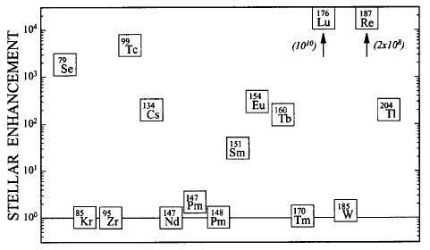
stellar enhancement of decay (stellar decay rate/terrestrial rate)
for some important branching-point nuclei in s-process path @ kT = 30 keV
F. Kaeppeler: Prog. Part. Nucl. Phys. 43 (1999) 419 – 483

Slide 29
Experimental requirements
nuclear data needs
neutron capture cross sections on unstable isotopes
12 ≤ A ≤ 210 and 10 ≤ kT ≤ 100 keV
about 1/10 of σ(n,γ) on radioactive isotopes measured so far
(n,γ) rates on long-lived branching point nuclei
mass region: 79 ≤ A ≤ 204
motivations
improved stellar models for s-process
temperature, density and neutron flux conditions
galactic nucleosynthesis
cosmo-chronometry
neutron production
techniques
nuclear reactions: ⁷Li(p,n)⁷Be, ³H(p,n)³He
(Karlsruhe, Tokyo)
(γ,n) reactions from energetic electrons on heavy metal targets
(ORELA @ Oak Ridge, Tennessee and GELINA @ Geel, Belgium)
spallation reactions by energetic particle beams
(LANSCE @ Los Alamos, n-TOF @ CERN)
(n,γ) measurements
prompt γ detection from (n,γ) reaction (TOF)
activation technique (t_{½} < 0.5 y)

Slide 30
The s-process in a nutshell
Weak component
Main component
temperature 2.2 – 3.5x10⁸ K 0.9x10⁸ K
neutron density 7x10⁵ cm⁻³ 4x10⁸ cm⁻³
neutron source ²²Ne(α,n) ¹³C(α,n) & ²²Ne(α,n)
stellar site core helium burning TP-AGB stars
in massive stars
synthesis path along valley of β-stability up to ²⁰⁹Bi
n-source: ¹³C(α,n)¹⁶O and/or ²²Ne(α,n)²⁵Mg
quiescent scenarios: e.g. He burning (T₈ ~ 1 – 4; E₀ ~ 30 keV)
branching points: if τ_{β} ~ τ_{n} ⇒ several paths possible
data needs: (n,γ) cross sections on unstable nuclei along stability valley
capture data at branching points
motivation: s-process stellar models; physical conditions of astrophysical site
review: F. Kaeppeler: Prog. Part. Nucl. Phys. 43 (1999) 419 – 483

Slide 31
The r-process
the process
its astrophysical site(s)
nuclear data needs

Slide 32
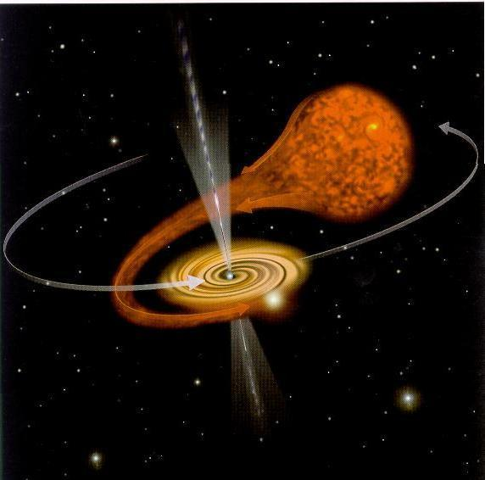
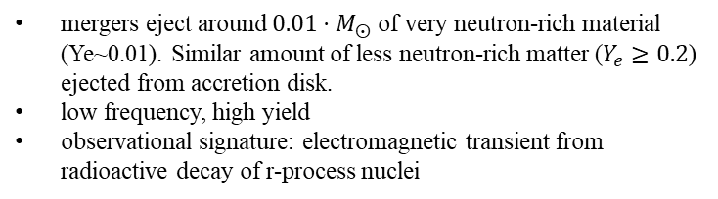
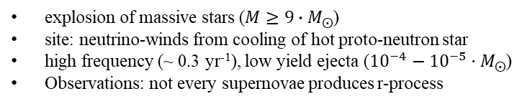
What is the r-process?
Rapid neutron-capture
The dominant process through which elements heavier than iron are formed (also s-process or slow neutron capture)
The exact site of r-process is still unconfirmed however due to the conditions necessary (high neutron density, high temperature) core collapse supernovae and neutron stars mergers are the most likely candidates.
core-collapse supernovae
neutron star mergers
explosion of massive stars ($M≥9∙M_{⨀}$)
site: neutrino-winds from cooling of hot proto-neutron star
high frequency (~ 0.3 yr⁻¹), low yield ejecta (${10}^{−4}−{10}^{−5}⋅M_{⨀}$)
Observations: not every supernovae produces r-process
mergers eject around $0.01⋅M_{⨀}$ of very neutron-rich material (Ye~0.01). Similar amount of less neutron-rich matter ($Y_{e}≥0.2$) ejected from accretion disk.
low frequency, high yield
observational signature: electromagnetic transient from radioactive decay of r-process nuclei
supernovae I: no hydrogen lines in spectrum, supernovae II: hydrogen lines in spectrum

Slide 33
Supernova classification
observational:
Type I: no hydrogen lines in spectrum
Type II: hydrogen lines in spectrum
SN Ia
theoretical:
thermonuclear explosion of degenerate core
core collapse → neutron star/black hole
relation no longer 1 to 1 → confusion
Type Ia (Si lines): thermonuclear explosion of white dwarf
\Type Ib/Ic (no Si; He or no He): core collapse of He star
Type II-P: classical" core collapse of a massive star with hydrogen envelope
Type II-L: supernova with linear light curve
(thermonuclear explosion of intermediate-mass star?
probably not!)
SN II
SN Ic
SN Ib
complications
special supernovae like SN 1987A
Type IIb: supernovae that change type, SN 1993J
(Type II → Type Ib)
some supernova "types" (e.g., IIn) occur for both explosion types ("phenomenon", not type; also see SNe Ic)
new types: thermonuclear explosion of He star (Type Iab?)

Slide 34
The r-process
r-process abundances N_{r} can be obtained as the difference between
solar abundances N_{solar} and calculated s-process abundances N_{s}
A=80
A=130
A=195

Slide 35
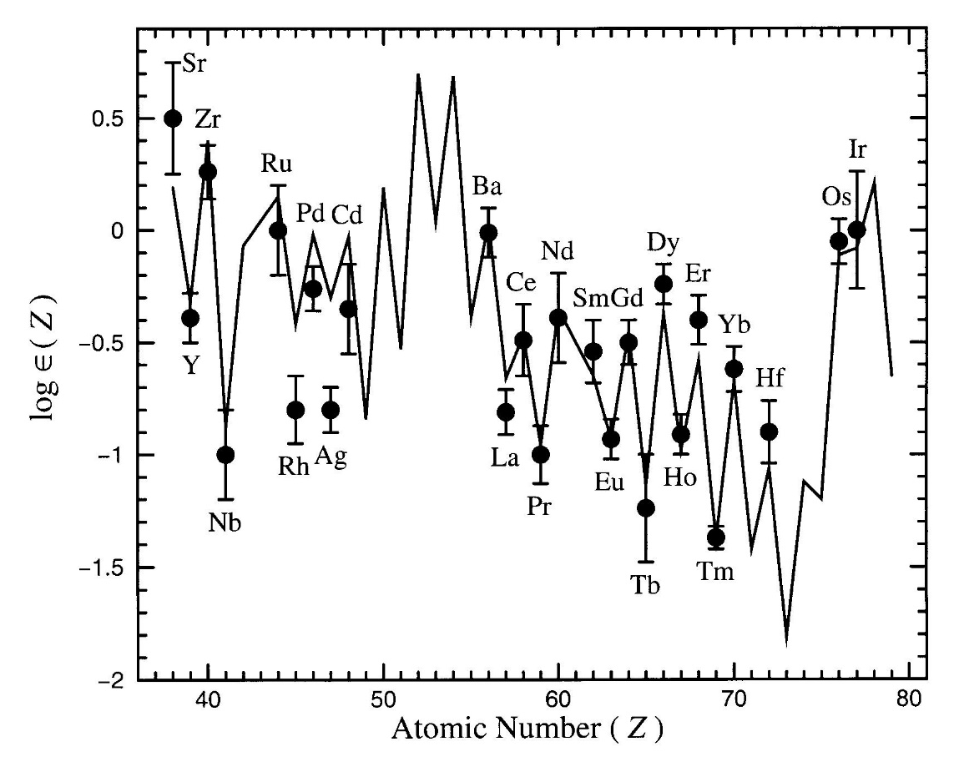
Constraints from elemental abundances
Ultra Metal Poor giant halo stars give info on early nucleosynthesis in Galaxy
example:
CS22892-052
red giant located in galactic halo
[Fe/H]= -3.0
[Dy/Fe]= +1.7
recall:
[X/Y]=log(X/Y)-log(X/Y)_{solar}
weak r-process
main r-process
for A ≥ 130 solar-like abundances even for stars originating from very different
regions of Galactic halo
⇒ main r-process independent of astrophysical site
for A ≤ 130 under-abundances ⇒ weak r-process

Slide 36
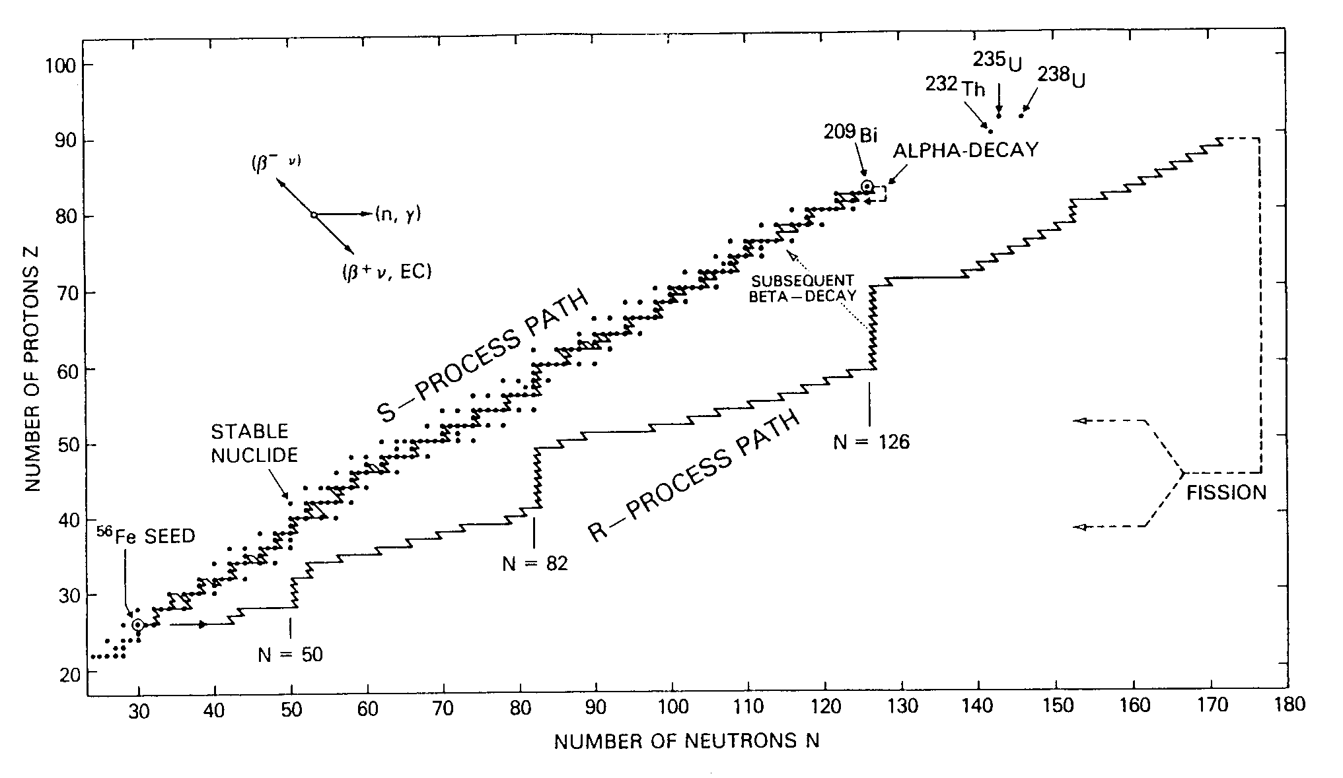
The r-process rapid neutron capture process
unstable nucleus reacts before capturing decay
⇔
τ_{n} << τ_{β}
termination point:
fission of very heavy nuclei
waiting points
Rolfs & Rodney:
Cauldrons in the Cosmos, 1988
typical lifetimes for unstable nuclei far from the valley of β stability: 10⁻⁶ – 10⁻² s
requiring:
τ_{n} ~ 10⁻⁴ s ⇔ N_{n} ~ 10²⁰ n/cm³
explosive scenarios needed to account for such high neutron fluxes

Slide 37
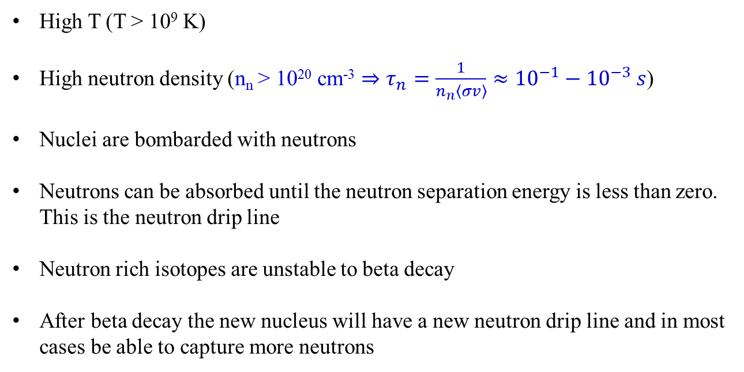
Mechanisms of r-process
High T (T > 10⁹ K)
High neutron density (n_{n} > 10²⁰ cm⁻³ $⇒τ_{n}=\frac{1}{n_{n}\left\langle σv\right\rangle }≈{10}^{−1}−{10}^{−3} s$)
Nuclei are bombarded with neutrons
Neutrons can be absorbed until the neutron separation energy is less than zero. This is the neutron drip line
Neutron rich isotopes are unstable to beta decay
After beta decay the new nucleus will have a new neutron drip line and in most cases be able to capture more neutrons

Slide 38
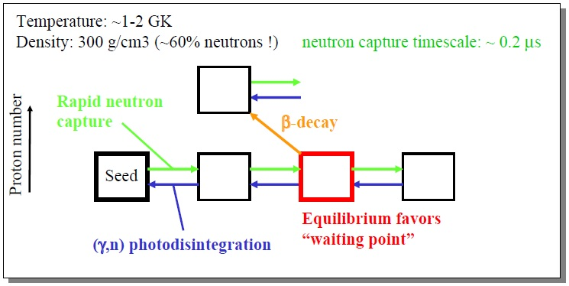
(n,γ) and (γ,n) equilibrium
Photodisintegration can play an important role in the r-process path. In very these hot environments there will be high energy photons.
The location of “waiting points” in r-process are points where an equilibrium between neutron capture rates and photodisintegration has been reached

Slide 39
Classical approach of the r-process
waiting point approximation
assume
(n,γ) ↔ (γ,n) equilibrium within isotopic chain, and
β-flow equilibrium
β-decay of nuclei from each Z-chain to (Z+1) is equal to the flow from (Z+1) to (Z+2)
rapid neutron
capture
β-decay
seed
Z
equilibrium favors
“waiting point”
N
(γ,n) photo-
disintegration
the nucleus with maximum abundance in each isotopic chain must wait for the longer
β-decay time scales
good approximation for parameter studies, BUT steady-flow approximation is not always valid

Slide 40
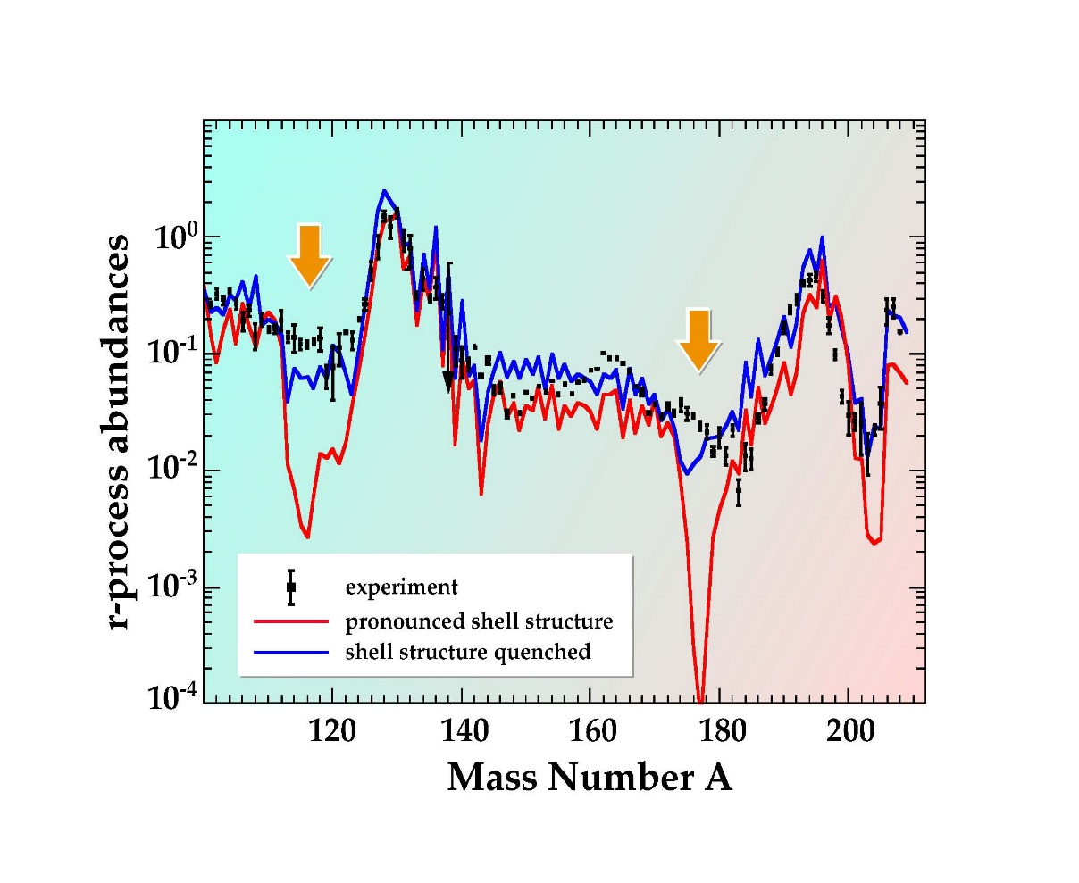
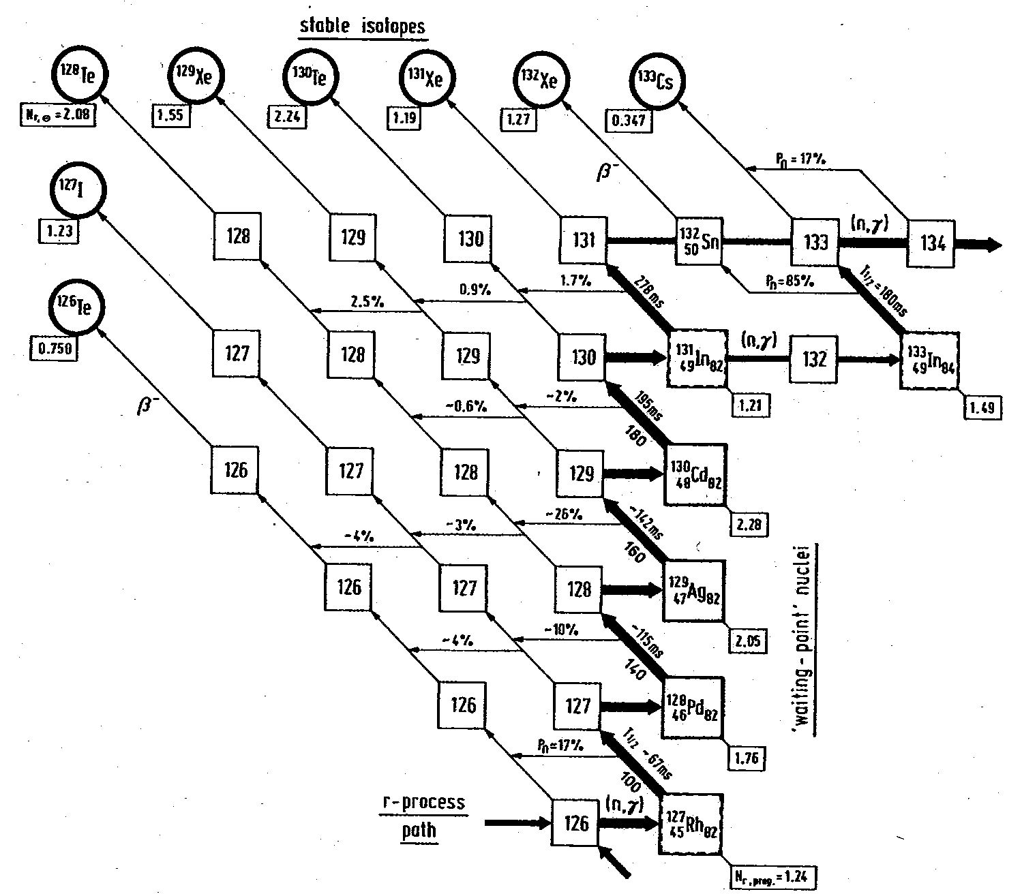
Imprints of shell effects in r-process?
R - abundances
Details of nuclear properties
¹³⁰Cd
⁴⁸ ⁸²
“..the calculated r-abundance ‘hole‘ in the A ≅ 120 region reflects ... the weakening of the shell strength ... below ¹³²Sn “ K-L Kratz
bottleneck at N=82 waiting point near stability?

Slide 41
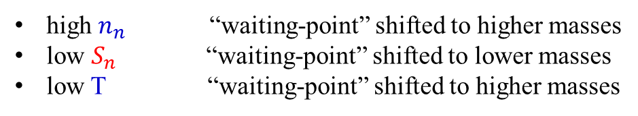
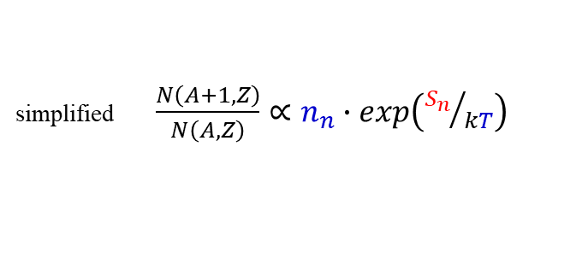

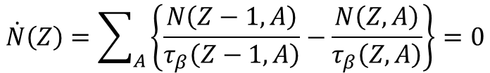
The „waiting-point“ concept in astrophysics
Nuclear Saha equation:
simplified $\frac{N\left(A+1,Z\right)}{N\left(A,Z\right)}∝n_{n}∙exp\left({S_{n}}/{kT}\right)$
high $n_{n}$ “waiting-point” shifted to higher masses
low $S_{n}$ “waiting-point” shifted to lower masses
low T “waiting-point” shifted to higher masses
Equilibrium-flow along r-process path:
$$\dot{N}\left(Z\right)=\sum_{A}{\left\{\frac{N\left(Z−1,A\right)}{τ_{β}\left(Z−1,A\right)}−\frac{N\left(Z,A\right)}{τ_{β}\left(Z,A\right)}\right\}}=0$$
- governed by β–decays from isotopic chain Z to (Z+1)
β-decay flow equilibrium implies (n,γ) – (γ,n) equilibrium
$$τ_{β}>τ_{n,γ},τ_{γ,n}$$
T_{1/2} (“waiting-point“) ↔N_{r-process}

Slide 42
Classical approach of the r-process
abundance ratios of neighbouring isotopes only depends on N_{n}, T and S_{n}
A
A+1
Z
N
note:
neutron capture rates do not play relevant role in most of r-process
abundance flow from neighbouring isotopic chains is governed by β decays
define:
total abundance in each isotopic chain
Z+1
Z
A
N
need nuclear masses (S_{n}) and lifetimes (τ_{β}) together with environment conditions (N_{n}, T)
late neutron captures can modify final abundance distribution mainly in region A > 140

Slide 43
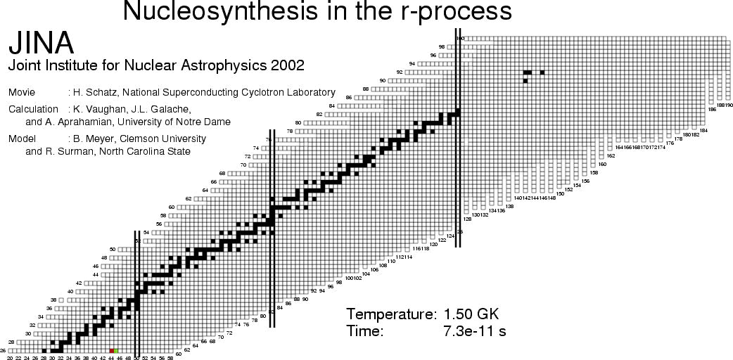
Timescale of the r-process
summing up time spent at waiting points: t ~ 0.5 – 10 s

Slide 44
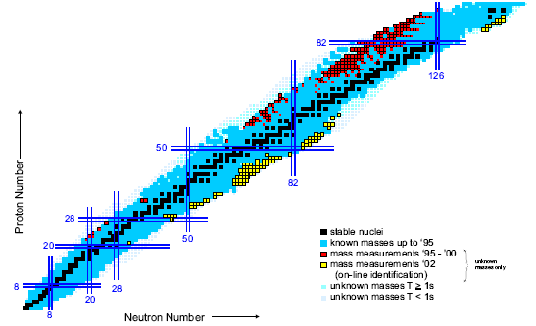
at present very little is known for neutron-rich nuclei very far away from β stability
⇒ must rely on theoretical calculations
NuPECC
Long Range Plan 2004
@ ISOLDE β-decays for ~ 30 neutron-rich nuclei have been determined
including N=82 waiting points ¹³⁰Cd & ¹²⁹Ag
GSI ~ 70 new masses determined recently in region N=50 & 82

Slide 45
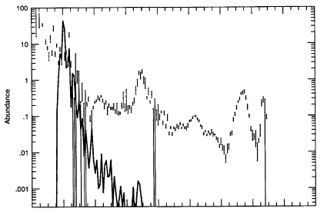
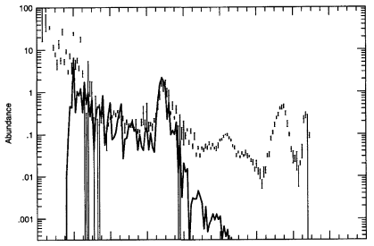
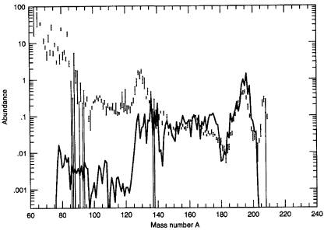
Time-dependent r-process calculations
N_{n} = 10²⁰ gcm⁻³
N_{n} = 10²² gcm⁻³
t = 1.2 s
t = 1.7 s
T = 1.35x10⁹ K
N_{n} = 10²⁴ gcm⁻³
a full fit to the solar r-process abundances
requires a superposition of different stellar
conditions (not necessarily different sites)
t = 2.1 s
Pfeiffer et al.: Nucl. Phys. A 693 (2001) 282 – 324

Slide 46
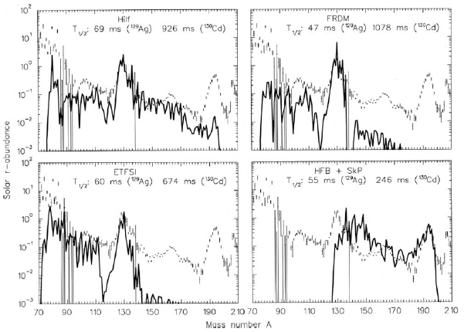
Time-dependent r-process calculations
S_{n} values from four different mass models; constant astrophysical parameters;
t_{½} for ¹²⁹Ag and ¹³⁰Cd calculated according to respective mass values

Slide 47
The end of r-process: fission
eventually it is possible to make a bigger nucleus. Trying to pack too many protons in a nucleus results in instability to spontaneous fission as well as neutron induced fission
nuclei in the N = 175 region typically fission and terminate the r-process
the fission fragments from the heavy nucleus will re-seed the r-process
r-process path
H | 30,000
C | 10
Fe | 1
Au | 2·10⁻⁷

Slide 48
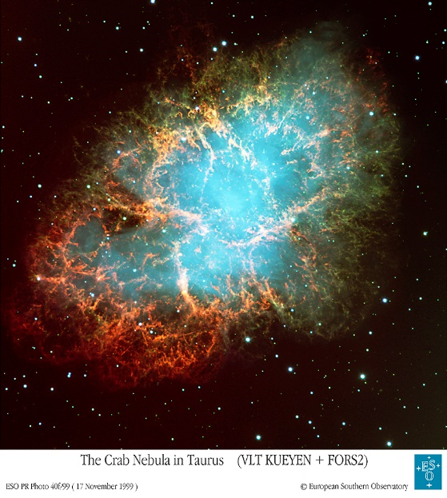
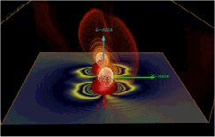
Astrophysical site(s) for the r-process
actual site(s) still unknown
however, possible candidates for r-process site:
type II supernovae
merging neutron stars
neutrino driven wind of proto-neutron star
He shell of exploding massive star merging neutron stars
others?...
type II supernova
merging neutron stars

Slide 49


Astrophysical site(s) for the r-process
actual site(s) still unknown
R-process related to environments with
high-neutron density and high temperature.
Type II supernovae prime suspects…
Neutron star mergers and accretion disks in g-ray bursts promising alternatives.
Not enough is known at present about the physics to create realistic models

Slide 50
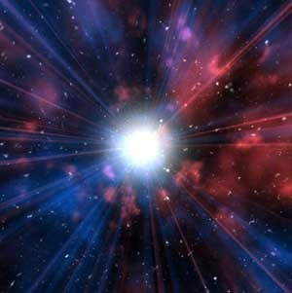
Supernovae
When the evolved star can burn no more, it collapses
The core compresses until it becomes the most dense substance known: a neutron star
The rest of the star violently explodes, including even more nuclear burning and spreading all the elements into space
The material can then form a new solar system, like ours!
Energy released = 10⁴⁶ Joules (in a matter of seconds) (cup of tea ~600 Joules)
= 30,000 trillion, trillion * Annual U.S. Energy Consumption
Can outshine the entire Galaxy it occurs in!
More energy than our sun will generate in its lifetime

Slide 51
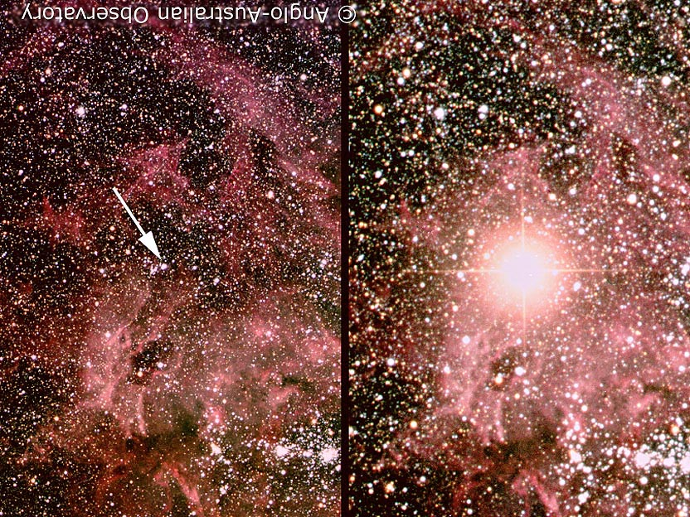
Supernovae

Slide 52
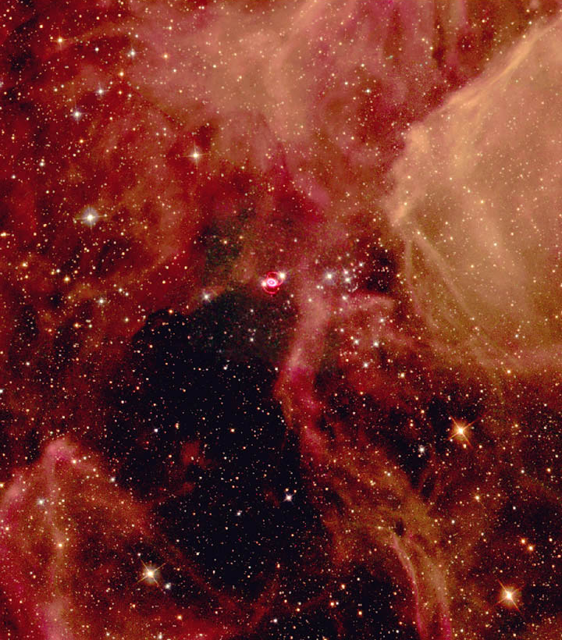
Supernovae

Slide 53
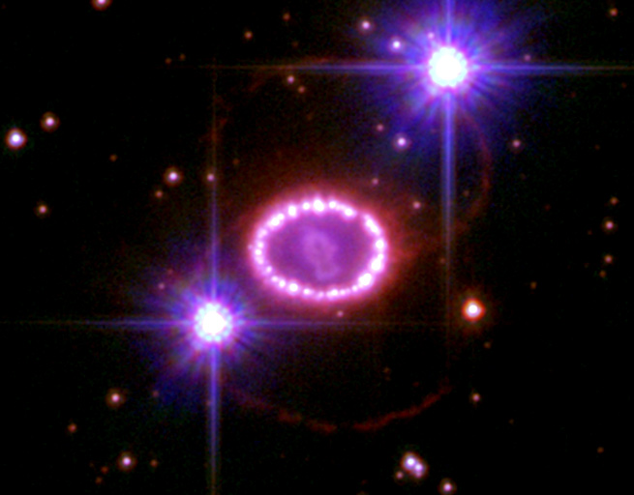
Supernovae SN1987A in 2004

Slide 54
The r-process in a nutshell
temperature 1-2x10⁹ K
timescale ~ seconds
neutron density 10²⁰-10²⁴ cm⁻³
neutron source unknown
stellar site type II supernovae?
neutron star mergers?
synthesis path far from valley of β-stability
synthesis of n-rich nuclei
waiting points: τ_{β} << τ_{n} at closed shells ⇒ abundance peaks (after φ_{n} → 0)
data needs: neutron separation energies S_{n}
(model dependent) nuclear masses far away from stability
β-decay lifetimes for neutron rich nuclei
neutron capture cross sections on key isotopes
motivation: synthesis of heavy elements up to Th, U, Pu
r-process path(s)
abundance pattern
conditions for waiting point approximation
review: Pfeiffer et al.: Nucl. Phys. A 693 (2001) 282 – 324

Slide 55
A schematic representation of the s- and r-process
If the neutron capture rates are low enough then nuclei have time to beta decay before being hit by another neutron (s-process)
If the neutron capture rates are high then once an equilibrium between neutron capture and photodisintegration has been reached beta decay will occur (r-process)

Slide 56
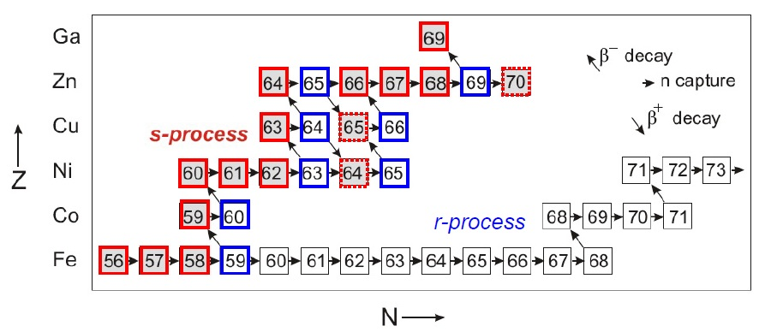
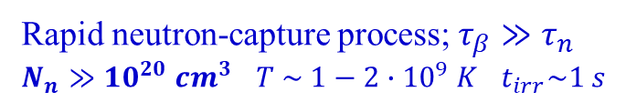
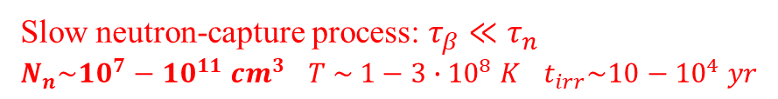
A schematic representation of the s- and r-process
Slow neutron-capture process: $τ_{β}≪τ_{n}$
$N_{n}\sim {10}^{7}−{10}^{11} {cm}^{3}$ $T \sim 1−3∙{10}^{8} K$ $t_{irr}\sim 10−{10}^{4} yr$
$$τ_{n}=lifetime against neutron capture$$
$τ_{β}=lifetime against β^{−}−decay$
Rapid neutron-capture process; $τ_{β}≫τ_{n}$
$N_{n}≫{10}^{20} {cm}^{3}$ $T \sim 1−2∙{10}^{9} K$ $t_{irr}\sim 1 s$

Slide 57



A schematic representation of the s- and r-process
Slow neutron-capture process: $τ_{β}≪τ_{n}$
$N_{n}\sim {10}^{7}−{10}^{11} {cm}^{3}$ $T\sim 1−3∙{10}^{8} K$ $t_{irr}\sim 10−{10}^{4} yr$
$$τ_{n}=lifetime against neutron capture$$
$τ_{β}=lifetime against β^{−}−decay$
Rapid neutron-capture process; $τ_{β}≫τ_{n}$
$N_{n}≫{10}^{20} {cm}^{3}$ $T\sim 1−2∙{10}^{9} K$ $t_{irr}\sim 1 s$

Slide 58

A schematic representation of the s- and r-process
Closed shells at magic numbers N = 50, 82, 126 → slow n-capture

Slide 59
Explosive hydrogen burning
novae and X-ray bursts
the rp- and αp-processes

Slide 60


Cosmic X-rays: discovered end of 1960´s
0.5 – 5 keV (T = E/k = 6 – 60 *10⁶ K
Nobel Price 2002
Riccardo Giacconi

Slide 61



X-ray burst
neutron star has very strong gravitational field
temperatures and densities reach much higher than novae
different set of nuclear reactions occur in thermonuclear runaway
material cannot escape!
Neutron stars in binary system
X-ray bursts are very interesting: the observations don’t quite agree with the theory yet; they are extremely regular; no-one quite knows what the composition of the neutron star is!

Slide 62

Possible structure of neutron stars
Open questions:
Compressibility of nuclear matter?
How strange is dense matter ?
F. Weber J.Phys. G27 (2001) 465

Slide 63
The fate of matter in the neutron star crust
neutron star surface
atmosphere
(rp-process)
density
ocean
(e⁻ capture)
border of
known masses
Future
facility
reach
crust
(pycnonuclear
reactions)
⁵⁶Ni
Ni (28)
Fe (26)
Electron capture
Cr (24)
Ti (22)
(1.5 x 10⁹ g/cm³)
⁶⁸Ca
Ca (20)
Ar (18)
S (16)
⁵⁶Ar
Si (14)
(2.5 x 10¹¹ g/cm³)
Mg (12)
Ne
Electron capture
and n-emission
³⁴Ne
(1.5 x 10¹² g/cm³)
Pycnonuclear fusion

Slide 64
Pycnonuclear reactions
At densities > ρ=10¹²g/cm³ nuclei are densely frozen in lattice position.
Pycnonuclear reactions occur when nuclei vibrate around their frozen lattice position penetrating the Coulomb barrier of the neighbor nucleus.
(Salpeter at al, 1956)
(Koonin, Schramm 1992)
S [MeV-b]
large Z⇨ small rate

Slide 65
Hydrogen burning
COLD τ_{β} << τ_{part}
mainly, quiescent stages of stellar evolution
pp-chain, CNO, NeNa, MgAl cycles
HOT τ_{β} >> τ_{part}
mainly, explosive stages of stellar evolution
Hot pp-chain super-massive low-metallicity stars
novae
HCNO
Hot NeNa (novae), X-ray bursts
Hot MgAl cycles
rp(αp) process X-ray bursts & some SNI

Slide 66
proton-proton chain
p + p → d + e⁺ + ν
p + d → ³He + γ
86%
14%
³He + ³He → ⁴He + 2p
³He + ⁴He → ⁷Be + γ
PP-I
Q_{eff}= 26.20 MeV
99.7%
0.3%
⁷Be + e⁻ → ⁷Li + ν
⁷Be + p → ⁸B + γ
⁷Li + p → 2 ⁴He
⁸B → ⁸Be + e⁺ + ν
PP-II
Q_{eff}= 25.66 MeV
2 ⁴He
PP-III
Q_{eff}= 19.17 MeV
net result: 4p → ⁴He + 2e⁺ + 2ν + Q_{eff}

Slide 67
CNO cycle
cold CNO
T₈ < 0.8
O
15
¹²C(p,γ)¹³N(e⁺ν)¹³C(p,γ)¹⁴N(p,γ)¹⁵O(e⁺ν)¹⁵N(p,α)¹²C
13
14
15
N
cycle limited by β decay of ¹³N (t ~ 10 min) and ¹⁵O (t ~ 2 min)
C
energy production rate:
12
13
6
7
8
hot CNO
T₈ ~ 0.8 – 1
O
14
15
¹²C(p,γ)¹³N(p,γ)¹⁴O(e+,ν)¹⁴N(p,γ)¹⁵O(e⁺ν)¹⁵N(p,α)¹²C
N
13
14
15
cycle limited by β decay of ¹⁴O (t ~ 70.6 s) and ¹⁵O (t ~ 2 min)
C
12
13
6
7
8
CNO isotopes act as catalysts and accumulate at largest τ
net result: 4p → ⁴He + 2e⁺ + 2ν + Q_{eff} Q_{eff} = 26.73 MeV

Slide 68
very hot CNO-cycle
T₈ ~ 3
still “beta limited”
T_{1/2}=1.7s
3α flow
breakout
processing beyond CNO cycle
after breakout via:
T₈ ≥ 3
¹⁵O(α,γ)¹⁹Ne
T₈ ≥ 6
¹⁸Ne(α,p)²¹Na
3α flow

Slide 69
Explosive hydrogen burning
hydrogen burning under extreme conditions
H burning at temperatures and densities far in excess of those attained in the interiors
of ordinary stars is expected to occur on a variety of astrophysical sites:
hot burning in massive AGB stars (> 4 M_{sun}) (T₉ ~ 0.08)
nova explosions on accreting white dwarfs (T₉ ~ 0.4)
X-ray bursts on accreting neutron stars (T₉ ~ 2)
accretion disks around low mass black holes
neutrino driven wind in core collapse supernovae
explosive scenarios in binary systems
luminosity, time scales & periodicity properties depend on:
    nature of accreting object
    accretion rate

Slide 70

Observational features of a novae explosions
main features of novae explosions
sudden increase in luminosity
by factor 10⁴ – 10⁶
mass ejection (10⁻³ M_{initial})
energy release (10⁴⁵ erg)
characteristic spectral lines
very common phenomenon
(about 10 y⁻¹ in our Galaxy)
what causes these outbursts?
how to account for observational features?

Slide 71


The model
NOVAE
semi-detached binary system:
n.b. about 50% of all stars
are in binary systems
White Dwarf and less evolved star (e.g. Red Giant)
“dead” star (mainly CO or ONe)
radiating away gravitational energy
maintained by electron degeneracy
H-shell burning
core contraction (possibly He burning)
envelope expansion
assume:
RG completely fills its Roche Lobe while still undergoing expansion;
since no further expansion possible beyond Roche Lobe, matter transfer
occurs through Lagrange point

Slide 72
The model
H-rich matter transfer from RG to WD
accretion process - artist’s impression
temperature and density increase on WD’s surface
H-burning ignition at basis of accreted layer
temperature increase due to energy release
no expansion on degenerate matter
no cooling
further temperature/energy increase
thermonuclear runaway
cataclysmic explosion
http://hubblesite.org/newscenter/newsdesk/
archive/releases/2000/24/video/a
T ≤ 3x10⁸ K
ρ ~ 10³ g cm⁻³
(p,γ) and (α,p) reactions on proton-rich nuclei
nucleosynthesis up to A ~ 40 mass region
nucleosynthesis path: Hot CNO, NeNa & MgAl cycles
(see later for details)
matter ejected ⇒ observations put important constraints on models

Slide 73
Reaction network for explosive hydrogen burning
(exact path depends on given stellar conditions)
²⁷Si
²⁸Si
²⁴Al
²⁵Al
²⁶Al
²⁷Al
rp-process
onset
²¹Mg
²²Mg
²³Mg
²⁴Mg
²⁵Mg
²⁶Mg
²⁰Na
²¹Na
²²Na
²³Na
NeNa
cycle
breakout
from HCNO
¹⁸Ne
¹⁹Ne
²⁰Ne
²¹Ne
²²Ne
¹⁷F
¹⁸F
¹⁹F
(p,γ)
(α,γ)
¹⁴O
¹⁵O
¹⁶O
¹⁷O
¹⁸O
(α,p)
(p,α)
(β⁺)
HCNO
¹³N
¹⁴N
¹⁵N
stable
¹²C
¹³C
unstable

Slide 74
Considerations
overall mechanism well understood, however open questions still remain:
  how and when does mixing at bottom of accreted layer occur?
  missing-mass problem (models under-predict mass of ejecta)
  do reactions produce more energy than expected?
  what contribution to Galactic nucleosynthesis? (¹³C, ¹⁵N, ¹⁷O & ²⁷Al)
  does a break-out from HCNO cycle (e.g. ¹⁵O(α,γ)¹⁹Ne) take place?
  (models seem to indicate limited leakage out of HCNO)
  how to explain observed overproduction (vs. solar) of elements in Ne to Ca region?
nuclear data needs
p-capture reactions on short-lived proton-rich nuclei e.g. ²⁵Al(p,γ)²⁶Mg and ³⁰P(p,γ)³¹S
synthesis of e.g. ¹⁸F, ²²Na, (²⁶Al) very important for their characteristic γ-ray emissions
INTEGRAL satellite ⇒ γ-ray detection ⇒ constraint on models
reactions on P and S isotopes for possible flow out of MgAl cycle

Slide 75

Observational features of X-ray bursts
regular recurrent bursts
main features of X-ray bursts
10³⁶-10³⁸ erg/s
(stars: 10³³ - 10³⁵ erg/s)
duration 10 s – 100s
recurrence: hours-days
regular or irregular
irregular bursts
frequent and very bright
phenomenon!
total ~230 X-ray binaries known

Slide 76


Observational features of X-ray bursts
type I X-ray bursts
10³⁸ - 10³⁹ erg/s
fast rise time (1-10 s)
duration (~10-100 s)
some show double peak at max
spectral softening
recurrence intervals (several hours)
type II X-ray bursts
rapid successions of bursts
(few minutes interval)
sudden flux drop without gradual
decay from peak values
no spectral softening in decay
figures from Lewin, W.H.G., van Paradijs, J. & Taam, R.E., 1993, Sp Sci Rev, 62, 223

Slide 77
X-ray bursters
frequent outbursts of 10-100s duration
with lower, persistent X-ray flux in between
X-ray binaries
(bursting pulsar:
GRO J1744-28)
type I bursts
burst energy proportional
to duration of preceeding
inactivity period
most common type
type II bursts
burst energy proportional
to duration of following
inactivity period
“rapid burster”
and GRO J1744-28 ?
X-ray pulsars
regular pulses with
periods of 1- 1000 s

Slide 78

The model
X-RAY BURSTERS & X-RAY PULSARS
semi-detached binary system: Neutron star + less evolved star
explosive ignition of H and/or He (via 3α → ¹²C)
sudden increase surface temperature
emission of strong X-rays
cooling down of surface after explosion
decay of burst profile
if matter transfer continues process may repeat
T ~ 10⁹ K
ρ ~ 10⁶ g cm⁻³
(α,p) and (p,γ) reactions on proton-rich nuclei
nucleosynthesis up to A ~ 80-100 mass region
nucleosynthesis path: breakout from Hot CNO, onset of rp-process

Slide 79
burst ignition
T₉ ~ 0.8 ⇒ breakout 2: ¹⁸Ne(α,p)
(~50 ms after breakout 1)
leads to rp process and
main energy production
T₉ ~ 0.7 ⇒ breakout 1: ¹⁵O(α,γ)
Hot CNO cycle II
prior to ignition ⇒ hot CNO cycle
T₉ ~ 0.2 ⇒ ignition 3α → ¹²C
courtesy: H. Schatz

Slide 80
the αp process
αp process: ¹⁴O(α,p)¹⁷F
¹⁷F(p,γ)¹⁸Ne
¹⁸Ne(α,p)²¹Na
²¹Na(p,γ)…
…
alternating (α,p) and (p,γ) reactions:
for each proton capture there is an
(α,p) reaction releasing a proton
net effect: pure He burning
3α reaction
α+α+α → ¹²C
courtesy: H. Schatz

Slide 81

the rp process
rp-process end point:
the Sn-Sb-Te cycle
known ground state α emitters
rp process: ⁴¹Sc(p,γ)⁴²Ti
⁴²Ti(p,γ)⁴³V
⁴³V(p,γ)⁴⁴Cr
⁴⁴Cr(β⁺)⁴⁴V
⁴⁴V(p,γ)…
rapid proton capture
on proton-rich nuclei
αp process: ¹⁴O(α,p)¹⁷F
¹⁷F(p,γ)¹⁸Ne
¹⁸Ne(α,p)²¹Na
²¹Na(p,γ)…
…
endpoint varies with conditions:
amount of H available at ignition
peak temperature
3α reaction
α+α+α → ¹²C
Schatz et al.: Phys Rev Lett 86 (2001) 3471(4)

Slide 82


Slide 83

type I X-ray burst
luminosity
nuclear energy
generation
abundances of
waiting points
H, He abundance
H. Schatz et al.: Phys Rev Lett 86 (2001) 3471(4)

Slide 84
Considerations
overall mechanism seems well understood, however open questions still remain:
  why are there bursters and pulsars?
  why do burst timescales vary from ~10 s to ~100 s?
  what is the origin of superbursts (10³ times stronger and longer, t ~ 10⁴-10⁵ s)?
  what crust composition of neutron star?
  what contribution of X-ray bursts to galactic nucleosynthesis?
observational signatures for X-ray outbursts?
some Type I X-ray bursts show double peak in luminosity separated by a few seconds
possible cause: waiting points in thermonuclear reaction flow ?
waiting points: ²⁶Mg, ²⁶Si, ³⁰S, and ³⁴Ar ?
(α,p) reactions too weak because of Coulomb barrier and
(p,γ)-reaction quenched by photo-disintegration
conclusion: effects of the experimentally unknown ³⁰S(α,p)³³Cl and ³⁴Ar(α,p)³⁷K
directly visible in the observation of X-ray burst light curves?
Fisker and Thielemann: arXiv:astro-ph/0312361 v1 13 Dec 2003

Slide 85
nuclear data needs
thermonuclear runway driven by αp-process and rp-process
breakout reactions ⇒ critical constraints on ignition conditions + runaway timescale
proton-capture reactions on short-lived proton-rich nuclei up to proton-drip line
⇒ influence on temperature and luminosity
β-decay studies of isomeric and/or excited states
masses, lifetimes, level structure, proton-separation energies

Slide 86
from: H. Schatz
nuclear data need & present status
β-decay rates
masses (proton separation energies)
(p,γ) and (α,p) reaction rates
some recent mass measurenents
β-endpoint at ISOLDE and ANL
Ion trap (ISOLTRAP)
many lifetime measurements at
radioactive beam facilities
(LBL, GANIL, GSI, ISOLDE, MSU,
ORNL)
separation energies
experimentally
known up to here
know all β-decay rates (earth)
location of drip line known (odd Z)
indirect information about rates
from radioactive and stable beam experiments
(transfer reactions, Coulomb breakup, …)
direct reaction rate measurements
with radioactive beams have begun
(ANL, LLN, ORNL, ISAC)

