Slide 1

Outline: A brief history of Nuclear Astrophysics N. Prantzos
Lecturer: Hans-Jürgen Wollersheim
e-mail: h.j.wollersheim@gsi.de
web-page: https://web-docs.gsi.de/~wolle/ and click on
solar abundances of the elements
nuclear reactions with Hydrogen
expanding Universe
formation of ¹²C
explosive nucleosynthesis (supernovae)

Slide 2
The origin of the elements table of the elements
Dmitri
Ivanovitch
Mendeleiev

Slide 4
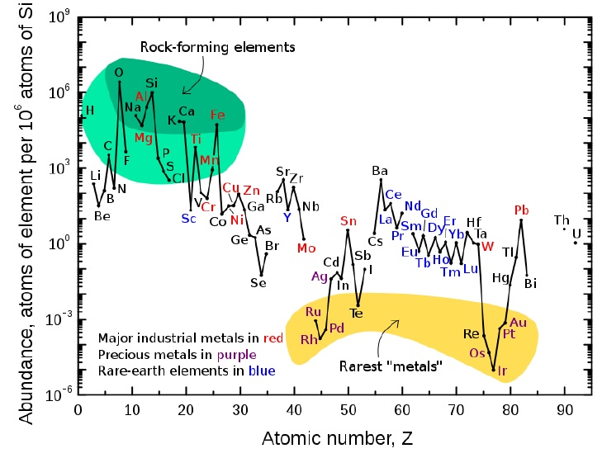
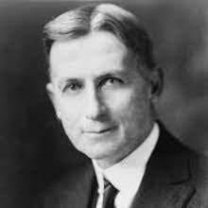
Composition of Earth´s crust
William Draper Harkins
Harkins rule (1915)
elements with specific properties are more abundant than others:
even vs odd charge
It should be related to the structure of their nuclei, and not to their position
in the Periodic Table

Slide 5
Stellar spectroscopy reveals the presence of chemical elements in stellar surfaces
Cecilia Payne
1925: H and He are the most abundant elements in stellar atmospheres

Slide 6
On the composition of the Sun´s atmosphere
H
O
Fe
Sr
Henry Norris Russell
1929:
Harkins rule (1915)
elements with specific properties are more abundant than others:
even vs odd charge

Slide 7
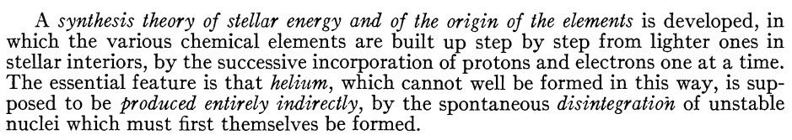
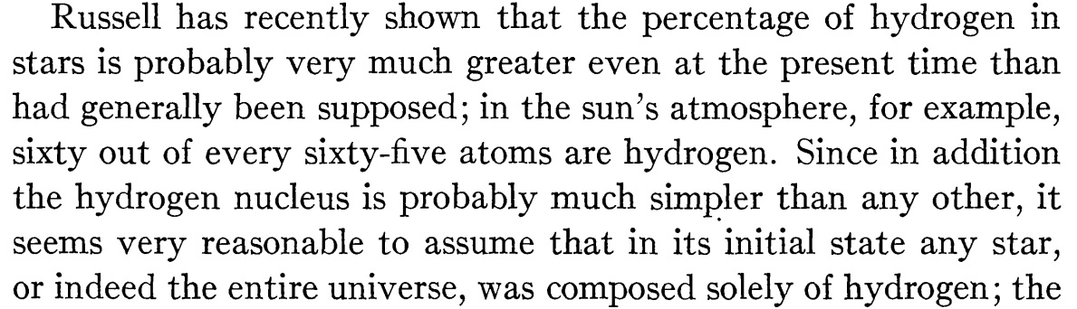
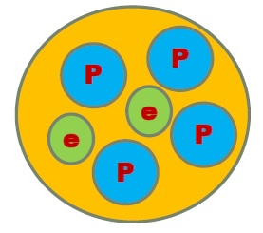

Atomic synthesis and stellar energy
1931:
Robert D. Atkinson
$$4p^{+}+2e^{−}⟹He$$

Slide 8
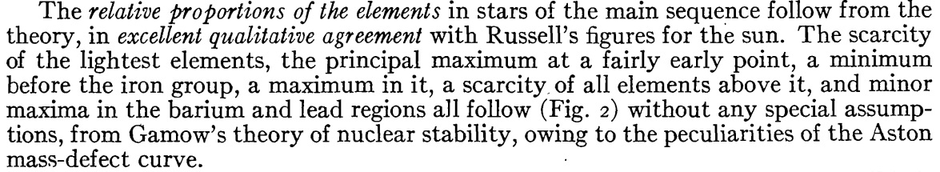
O
Fe
Sr
Ba
Pb

Slide 9
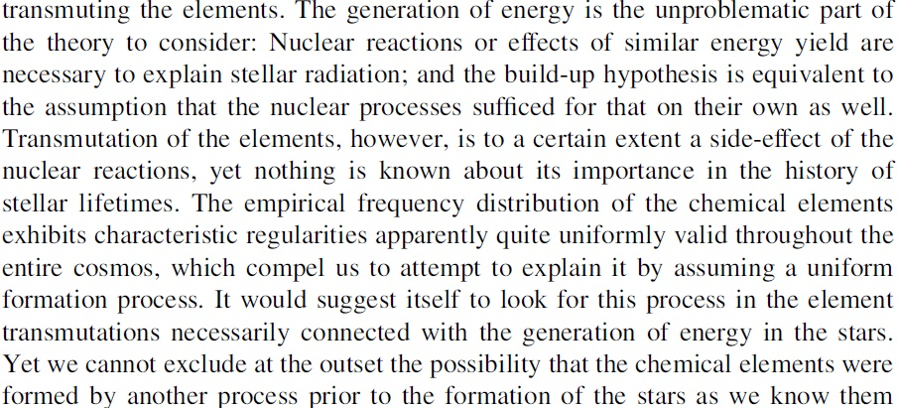
On elementary transmutations in the interior of stars
Are stars making their own elements or is it something else preceding them?
Carl Friedrich
von Weizäcker

Slide 10
The Weizsäcker family
Ernst Heinrich von W.
Richard Karl von W.
Carl Friedrich von W.
diplomat, politician
War criminal
after Nürnberg 2 trial
politician
President of German republic
(1984-1993)
physicist, philosopher
German research team on nuclear weapons in World War 2
1945: Operation Alsos and the Farm Hall transcripts (released 1993)
Weizsäcker: „I believe the reason we didn´t do it was because all the physicists didn´t want to do it, on principle. If we had wanted Germany to win the war we would have succeeded!
Heisenberg: *Well, that´s not quite right. I would say that I was absolutely convinced of the possibility of our making a uranium engine, but I never thought we would make a bomb and I am glad we did not“
Max von Laue called this agreement „die Lesart“ (the vision): „The leader in all these discussions was Weizsäcker. I did not hear and mention of any ethical point of view“

Slide 11
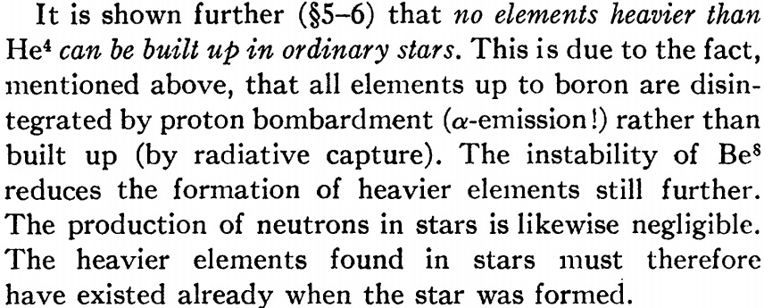
Energy production in stars
H. A. Bethe

Slide 12
Early studies and ideas about the origin of the elements up to 1940
1915: William Harkins
Even elements on Earth´s crust are more abundant than odd ones to the structure of their nuclei
1925: Cecilia Payne
stars are made mostly of Hydrogen
1931: Robert Atkinson
stars build up their elements in their interiors by pre-existing Hydrogen (except for He)
1929: Henri Norris Russell
stellar abundances display specific regularities similar to those on Earth
1937: Carl F. von Weizsäcker
may be; but perhaps the elements were made by another process, prior to their formation
1939: Hans Bethe
normal stars cannot built in their interiors elements heavier than Helium

Slide 13
Solar (Cosmic) Abundances of the elements

Slide 14
Cosmic abundances of nuclides are locally correlated with
nuclear stability
(binding energy per nucleon)
α-nuclei (A = mult of 4), „magic“ nuclei, Fe peak nuclei
or nuclei with even A or Z
are more abundant than their neighbors
Nuclear processes have shaped the cosmic abundances of the chemical elements
where? how?

Slide 15
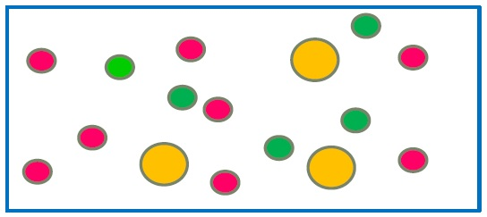
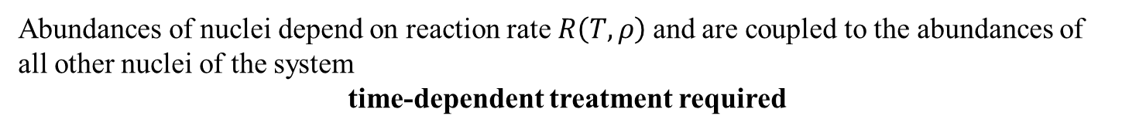

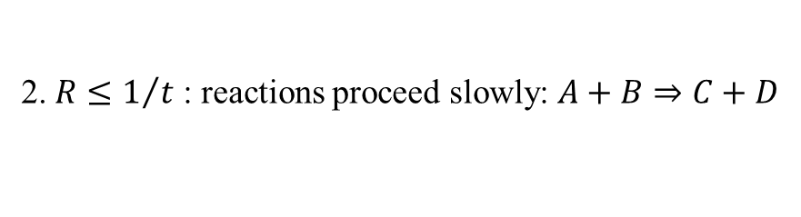
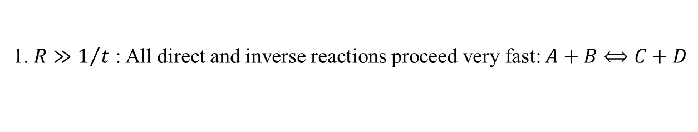
Nuclear reactions
System of interacting nuclei at temperature T and density ρ evolving for lapse of time t
Nuclear reactions proceeding at rate R
$$A+B⟹C+D$$
1. $R≫1/t$ : All direct and inverse reactions proceed very fast:$A+B⟺C+D$
nuclear statistical equilibrium
$$X_{i}\left(A_{i},Z_{i},T,ρ\right)=\frac{A}{N_{A}∙ρ}∙ω\left(T\right)∙{\left(\frac{2π∙k∙T∙M\left(A_{i},Z_{i}\right)}{h^{2}}\right)}^{3/2}∙exp\left[\frac{μ\left(A_{i},Z_{i}\right)+B\left(A_{i},Z_{i}\right)}{k∙T}\right]$$
Abundances of nuclei depend on T, ρ and their binding energies $B\left(A_{i},Z_{i}\right)$
2. $R≤1/t$ : reactions proceed slowly: $A+B⇒C+D$
Abundances of nuclei depend on reaction rate $R\left(T, ρ\right)$and are coupled to the abundances of all other nuclei of the system
time-dependent treatment required

Slide 16
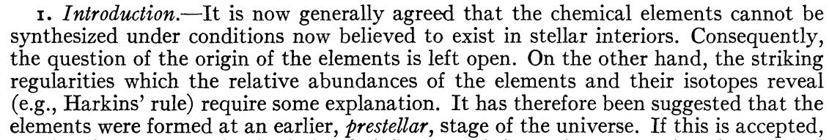
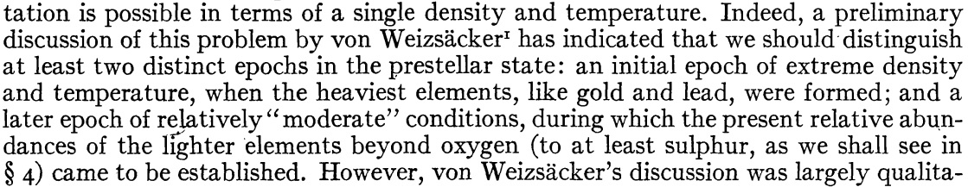
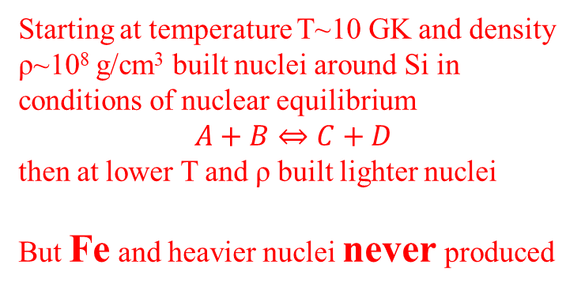
An attempt to interpret the relative abundances of the elements 1942
Subrahmanyan
Chandrasekhar
Starting at temperature T~10 GK and density ρ~10⁸ g/cm³ built nuclei around Si in conditions of nuclear equilibrium
$$A+B⇔C+D$$
then at lower T and ρ built lighter nuclei
But Fe and heavier nuclei never produced
Temperature (GK)

Slide 17
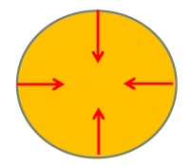
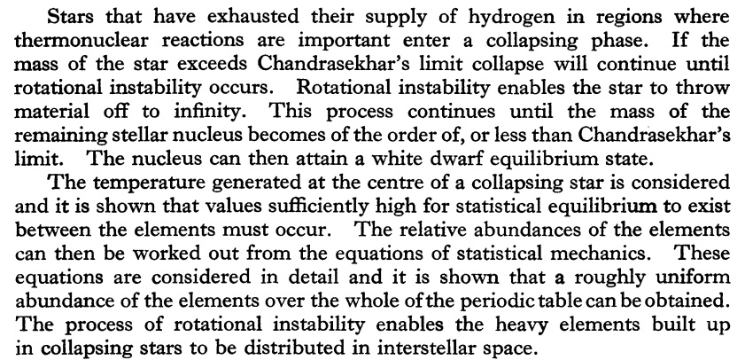
The synthesis of the elements from Hydrogen 1946
F. Hoyle
But HOW to get material out of the stars?

Slide 18
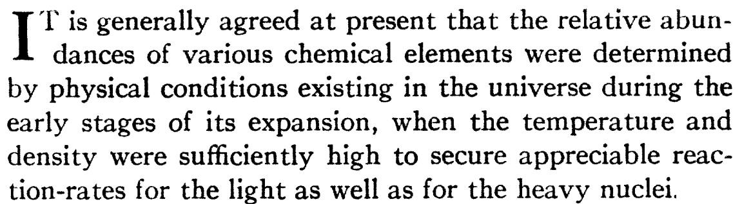
Expanding Universe and the origin of elements G. Gamow 1946
Georges
Lemaitre
Albert
Einstein
Lemaitre 1927:
Recession of galaxies explained as due to expansion of the Universe
Einstein to Lemaitre:
your calculations are correct, but your physics is atrocious
1931:
Explosion of the primeval atom

Slide 19
The origin of chemical elements R. A. Alpher, H. Bethe, G. Gamow 1948
log (abundances)
n-capture cross sections for nuclei with A>20 from declassified data of the atomic bomb teste (Hughes 1946)

Slide 20
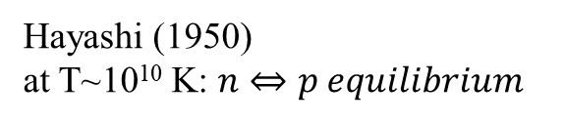
Washington Post 16.4.1948: World began in 5 minutes, new theory
At the beginning of everything, the Universe had infinite density concentrated in a single point. Then just 300 seconds – 5 minutes – after the start of everything, there was a rapid expansion and cooling of the primordial matter. The neutrons – those are the particles that trigger the atomic bomb – started decaying into protons and building up heavier chemical elements … This act of creation of the chemical elements took the surprising short time of an hour. (the Bible story said something about 6 days for the act of creation)
Fermi and Turkevich (1949)
no elements beyond He, (Li) because of A=5 (8) gap
Hayashi (1950)
at T~10¹⁰ K: $n⇔p equilibrium$
after the discovery of 3 K microwave
background (Penzias and Wilson 1965)
Peebles 1966, Wagoner, Fowler, Hoyle 1967
first calculation of realistic Big Bang nucleosyntheses

Slide 21
Address to the Pontifical Academy of Sciences 1951
Pius XII
The proof for the existence of God in the light of modern natural science
Present day science, with one sweeping step back across millions of centuries, has succeeded in bearing witness to that primordial “Fiat lux” uttered at the moment when, along with matter, there burst forth from nothing a sea of light and radiation, while the particles of chemical elements split and formed into millions of galaxies …
Hence, creation took place in time. Therefore, there is a Creator. Therefore,, God exists! Although it is neither explicit nor complete, this is the reply we were awaiting from science, and which the present human generation is awaiting from it
We may speak of this event as of a beginning. I do not say a creation. Physically it is a beginning in the sense that if something happened before, it has no observable influence on the behavior of our universe, as any feature of matter before this beginning has been completely lost by the extreme contraction at the theoretical zero. The question if it was really a beginning or rather a creation, something started from nothing, is a philosophical question which cannot be settled by physical or astronomical considerations
G. Lemaitre

Slide 22
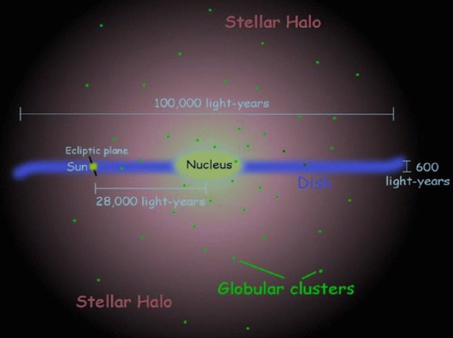
G. Gamow:
all elements were produced in the hot primordial Universe (Big Bang) by successive neutron captures
Early 1950s
F. Hoyle:
all elements produced inside stars during their collapsing stage. by thermonuclear reactions
Old stars of galactic halo (population II) contain less heavy elements (metals) than younger stellar population (population I) of the galactic disc
Chamberlain and Aller 1951
The chemical composition of the Milky Way was substantially different in the past

Slide 23
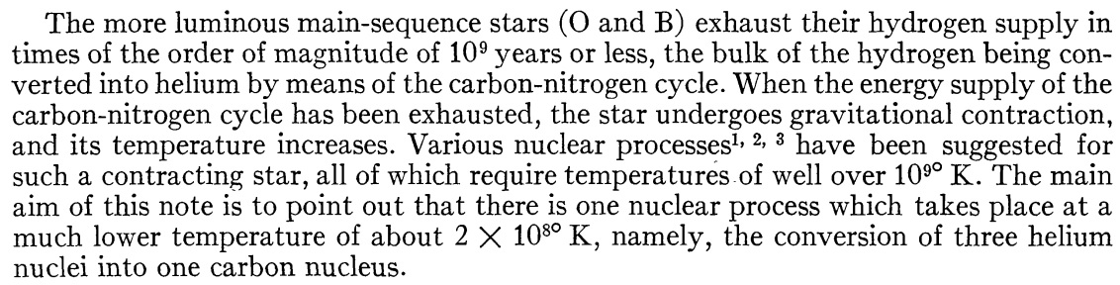
Nuclear reactions in stars without Hydrogen
E. E. Salpeter
1st step
OK
2nd step
Not OK!

Slide 24
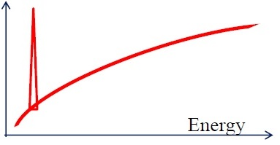
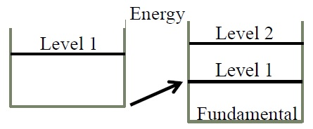
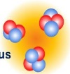
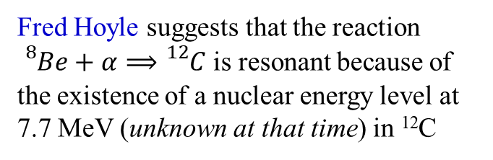
Formation and survival of ¹²C in He-burning
Probability of nuclear reaction
it becomes very high when the reaction is resonant
E. E. Salpeter
formation of ⁸Be
Fred Hoyle suggests that the reaction ${}_{}^{8}{Be}+α⟹{}_{}^{12}C$ is resonant because of the existence of a nuclear energy level at 7.7 MeV (unknown at that time) in ¹²C
formation of ¹²C
The level is found in W. Fowler´s Kellog laboratory in 1953
survival of ¹²C
First quantitative prediction of a microscopic property of matter (structure of ¹²C nucleus) from a macroscopic one (abundance of ¹²C and ¹⁶O)
1st and only ´prediction´ of the Anthropic Principle

Slide 25
Formation of ¹²C

Slide 26
The synthesis of elements from Carbon to Nickel F. Hoyle 1954

Slide 27
Elements and Isotopes
“very” n-rich
“moderately” n-rich
Hoyle 1954

Slide 28
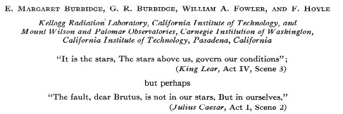
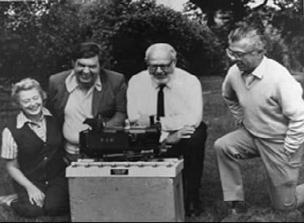
Synthesis of the elements in stars 1957
Margaret Geoffrey
Burbidge
William
Fowler
Fred
Hoyle

Slide 29

$$n from \left(α,n\right) on 4N+1 nuclei$$
Data on neutron capture cross sections and yields from the first H-bomb test in Bikini island (1952)

Slide 30
Method of formation
1957:
Alastair G.W. Cameron
Nuclear reactions
in stars and nucleogenesis
(Chalk River report)

Slide 31
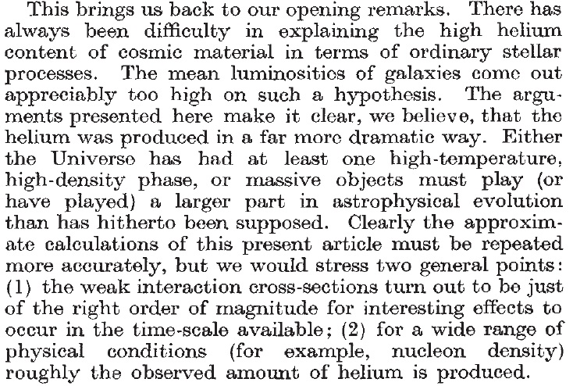
The mystery of the cosmic Helium abundance 1964
1 nucleus of He for 10 nuclei of H
25% of the mass of the Universe is He

Slide 32
Discovery of the Cosmic microwave background 1965
Robert
Wilson
Arno
Penzias

Slide 33
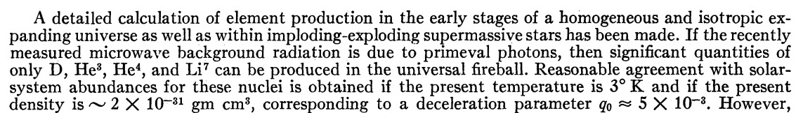




On the synthesis of elements at very high temperatures 1966
R. V. Wagoner, W. A. Fowler, F. Hoyle
Hayashi (1950): n – p equilibrium
$$p$$
X(n)/X(p) ~ 0.13 at freeze-out
$$n$$
$${}_{}^{4}{He}$$
X(⁴He) ~ 2·X(n) ~ 0.25
$$D$$
only way to produce so much ⁴He ~ (25% by mass)
only way to produce Deuterium ~ (destroyed in stellar interiors)
in excellent agreement with observation

Slide 34
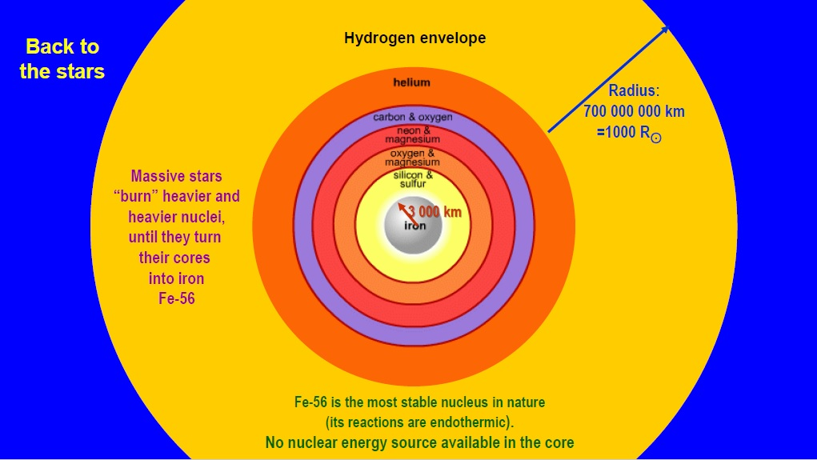

Back to the stars

Slide 35
Advanced nucleosynthesis phases in massive stars
Because of the increased sensitivity of nuclear reactions to temperature heavier nuclei are produced closer to the center of the stars
The “onion skin” model (Hoyle 1955)
The outer layers keep (partially) the products of previous phases of stellar nucleosynthesis
This material synthesized by nuclear reactions in stellar interiors must come out through the final event of a supernova explosion
Crab nebula
The explosion produces also new elements
(explosive nucleosynthesis)
including short-lived radioactive ones

Slide 36
What powers the exponentially decreasing lightcurve of supernovae?
luminosity
Radioactivity
of lifetime ~ 2 months
⁷Be: Borst 1950
²⁵⁴Cf: Baade, B2FH 1956
⁵⁶Ni → ⁵⁶Co → ⁵⁶Fe
7 days 2 months
B²FH
⁵⁶Fe, the most stable nucleus in nature is produced as unstable ⁵⁶Ni
Hoyle´s greatest regret
Hoyle and Fowler 1960: Explosive nucleosynthesis

Slide 37
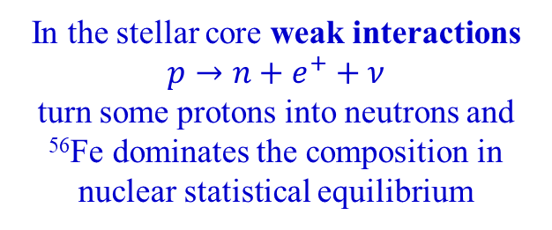
The way towards the Fe-peak: hydrostatic versus explosive
⁴⁰Ca is the last stable nucleus with N=Z on the way of Si-melting towards the Fe-peak
In the stellar core weak interactions
$p→n+e^{+}+ν$
turn some protons into neutrons and ⁵⁶Fe dominates the composition in nuclear statistical equilibrium
In explosive nucleosynthesis, weak (= slow) interactions have no time to operate and the nuclear flow goes through N = Z up to ⁵⁶Ni (N=Z=28)
Hoyle´s greatest regret: missing the origin of ⁵⁶Fe, the most stable nucleus in nature
It is produced as unstable ⁵⁶Ni in supernova explosions

Slide 38
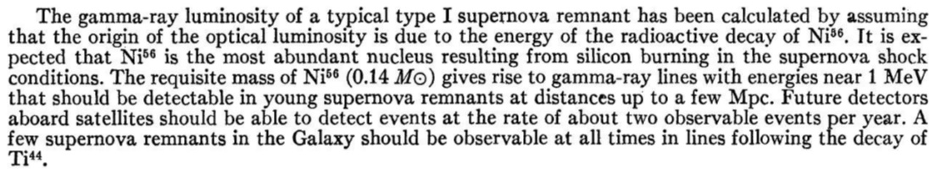
Gamma-ray lines from young supernova remnants
D. D. Clayton, S. A. Colgate, G. J. Fishman (1968)

Slide 39
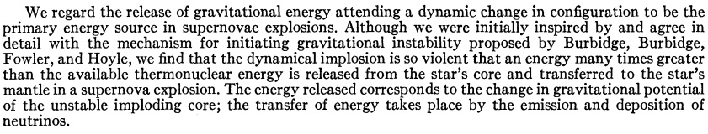
The hydrodynamic behavior of supernovae explosion
1959: suggests satellites for search of γ – rays from supernovae. In fact to cover monitoring of soviet test explosions
Stirling Colgate
99% of the enormous amount of gravitational energy from the dynamical collapse of the Fe core is released in the form of neutrinos
Some of them interact with the stellar mantle and expel it, making a supernova

Slide 40
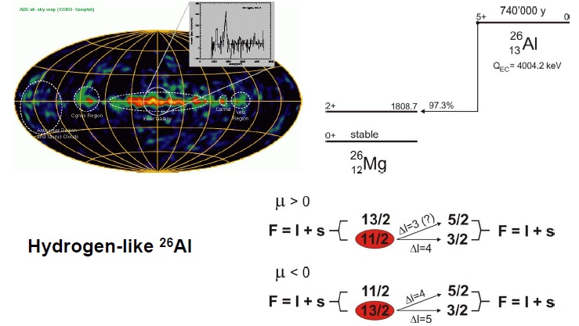
Stellar gamma-ray emitters

Slide 41
SN 1987A in the
Large Magellanic Cloud
150 000 light years from Earth
detection of the gamma-ray line in ⁵⁶Co
detection of two dozens of neutrinos in 3 detectors

Slide 42
Primordial nucleosynthesis T~1000-100 MK
Galactic Cosmic Rays T~10 K
Hydrogen burning T~15 – 30 MK
Helium burning T~100 – 300 MK
Carbon-Neon burning T~1 – 1.5 GK
Oxygen burning T~2.5 GK
Explosive nucleosynthesis (NSE) T ~ 4 GK
Neutron captures
s-process T~100-300 MK
r-process T~2 GK

Slide 43
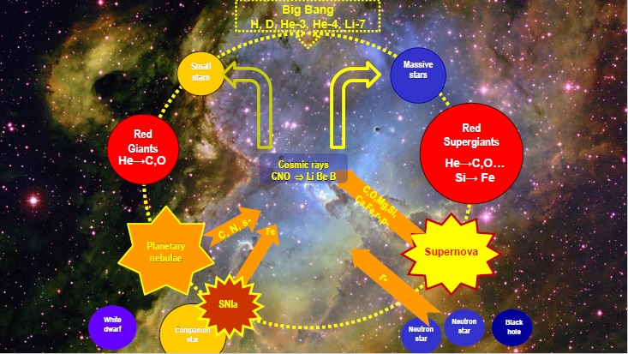

Slide 44
abundances at solar system
formation 4.5 Gy ago
observed
calculated
Fred Hoyle
William A. Fowler

Slide 45
